Slide 1

Notes:
The Role of a Youth Pastor

Slide 2

Notes:
The youth pastor is responsible to shepherd a segment of the wider congregation – in some congregations this would be an age-based breakdown of people from 13 to 18 or it could be focused on High Schoolers. Youth ministry is generally viewed as a department within the local church rather than a separate congregation – this ensures that the youth ministry operates in a way that balances the age-specific needs of the age group with the need for inter-generational connectivity and smooth transition into the wider congregation when they graduate from high school.

Slide 3

Notes:
As a youth pastor I (Mark Tittley) have the following general responsibilities:

Slide 4

Notes:
1. Shape the Direction – ensure the youth ministry operates with the same vision, mission and strategy of the wider congregation with adaptation for the high school age group.

Slide 5

Notes:
The church has this mission statement: We see lives, communities and society transformed through discipleship in the Word, the presence and power of God.

Slide 6

Notes:
Here is our mission statement at His People Church: We see lives, communities and society transformed through discipleship in the Word, the presence and the power of God.

Slide 7

Notes:
As His Youth we are a part of His People Christian Church and our global movement is Every Nation Ministries. and as such has embraced a common approach to disciplemaking with the following four phases: Engage – Establish – Equip – Empower.

Slide 8

Notes:
As a youth ministry, His Youth, we believe it is critical to embrace the same approach for disciplemaking as the wider church so have built out youth ministry around the same four phases of ministry.

Slide 9

Notes:
2. Administrate the Vision – ensure all aspects of the ministry are run with excellence and dependence on the power of the Holy Spirit.

Slide 10


Slide 11


Slide 12

Notes:
3. Implement the Strategies – design and implement a disciplemaking ministry that engages, establishes, equips and empower high schoolers.

Slide 13

Notes:
So, in summary, here are some of the key components of our Engage event that takes place on a Friday night: Setup, Prayer. Hang Time, Welcome, Announcements, Main Event, Small Groups and Refreshments.

Slide 14


Slide 15


Slide 16


Slide 17

Notes:
4. Cover the Services – be a presence at youth events to provide oversight and ensure that discipline is maintained and an environment is created in which God moves.

Slide 18

Notes:
5. Build the Team – create an effective system to identify and equip adult and teen leaders to fulfill leadership roles within the youth ministry.

Slide 19
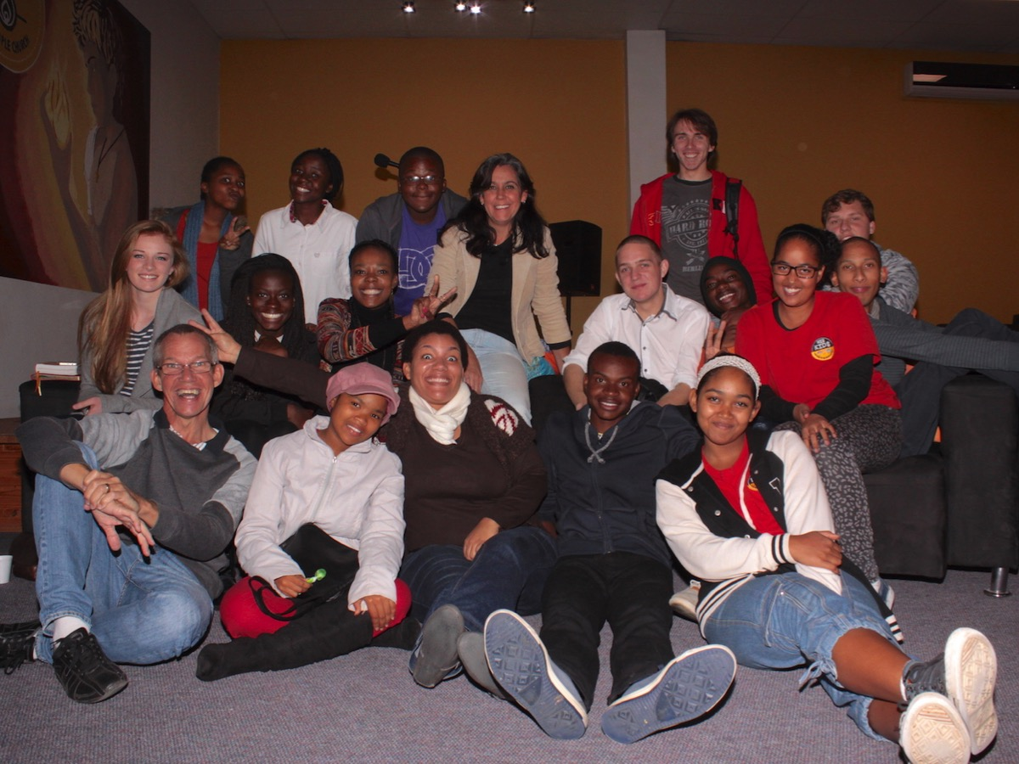

Slide 20

Notes:
6. Shepherd the Flock – ensure that members of that age group are provided with the pastoral care they need at they enter their high school years, navigate through various issues they encounter in their personal lives and families, and prepare to transition into adulthood.

Slide 21
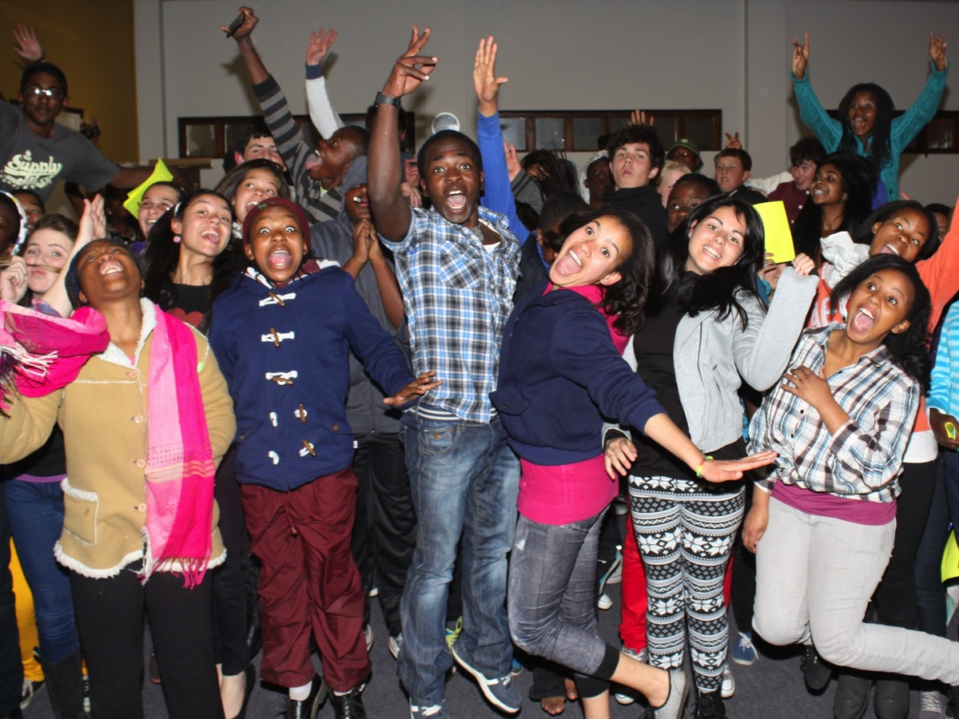
Notes:
Teens may look fine on the outside, but you will soon discover that they have needs that must be addressed - and often this can only take place on one one!

Slide 22
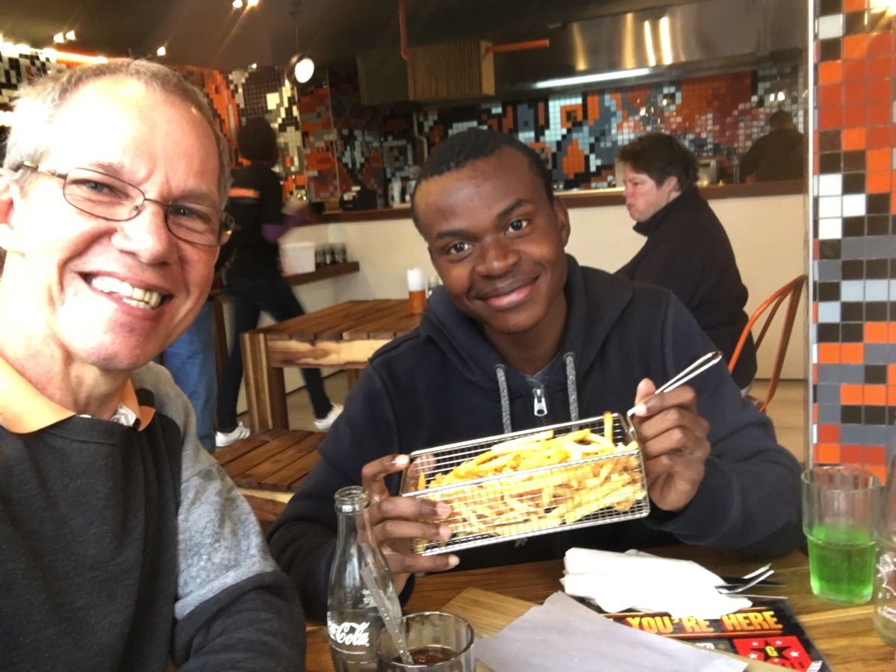
Notes:
A youth pastor will spend many hours engaged in conversations with teens at coffee shops!

Slide 23

Notes:
7. Impact the Schools – find a way to minister in high schools on a regular weekly basis to engage and establish learners and encourage teens to find a local church to call home.

Slide 24


Slide 25
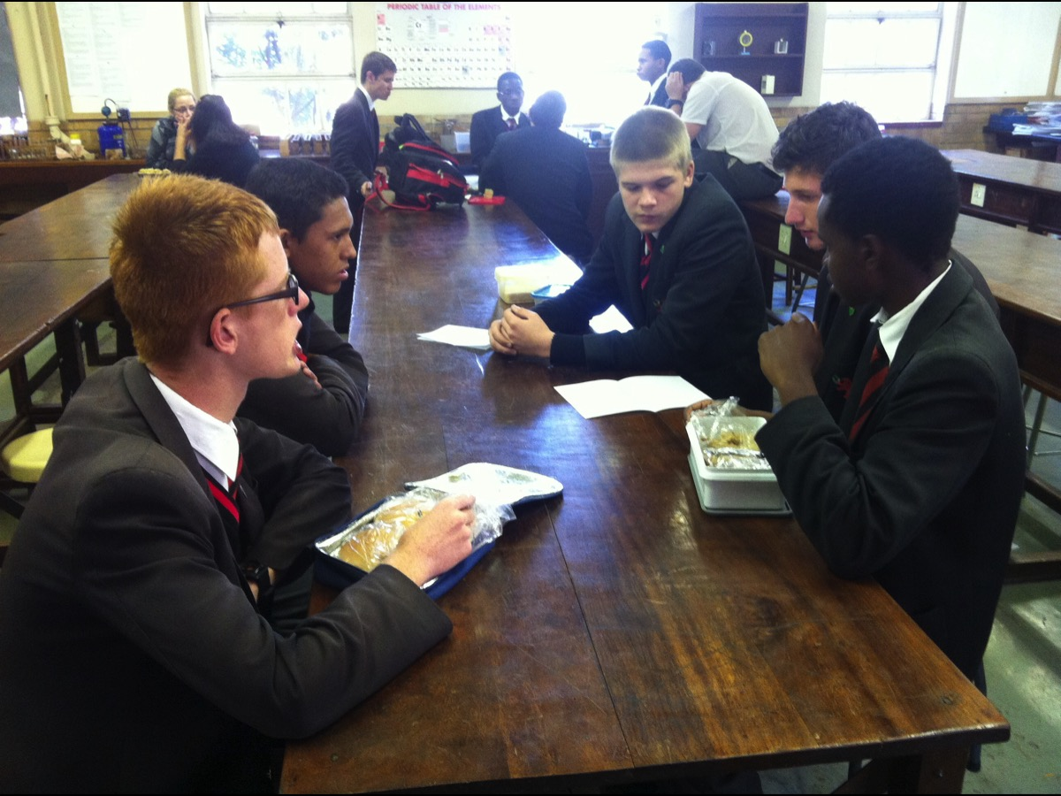

Slide 26
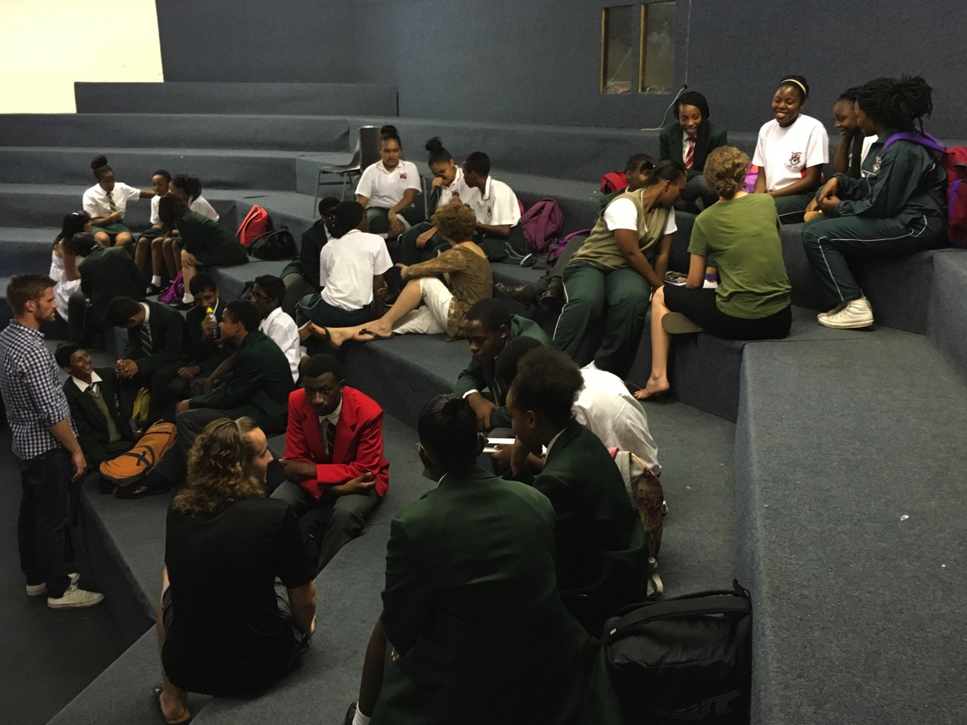

Slide 27

Notes:
8. Represent the Ministry – play a key role in connecting the youth ministry into the wider congregation through attending and participating in meetings and events in the wider congregation – especially at a leadership level.

Slide 28
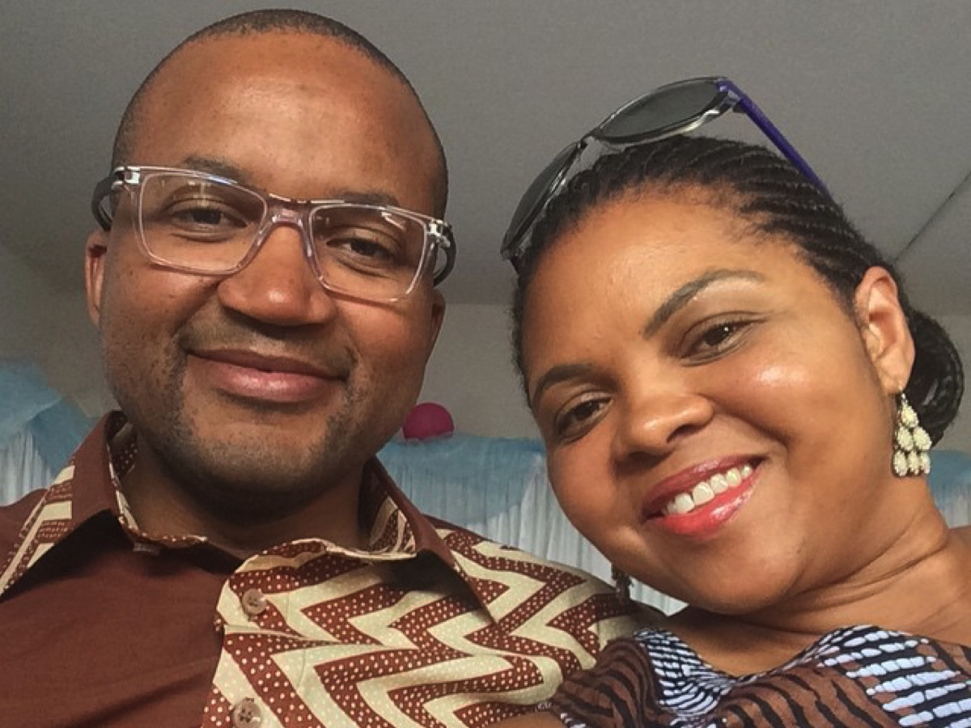
Notes:
Simon and Lindi Lerefolo, who provide the covering for youth ministry from an elder level.

Slide 29
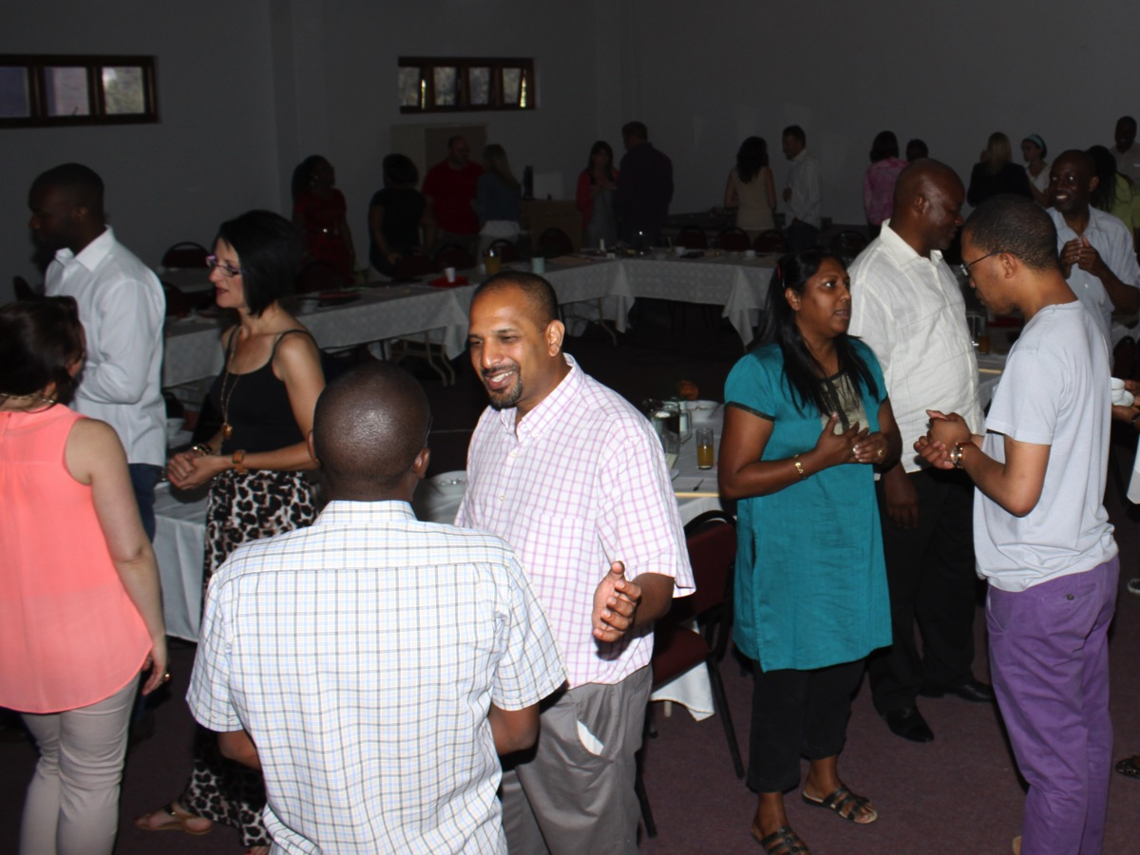
Notes:
Simon and Lindi Lerefolo, who provide the covering for youth ministry from an elder level.

Slide 30
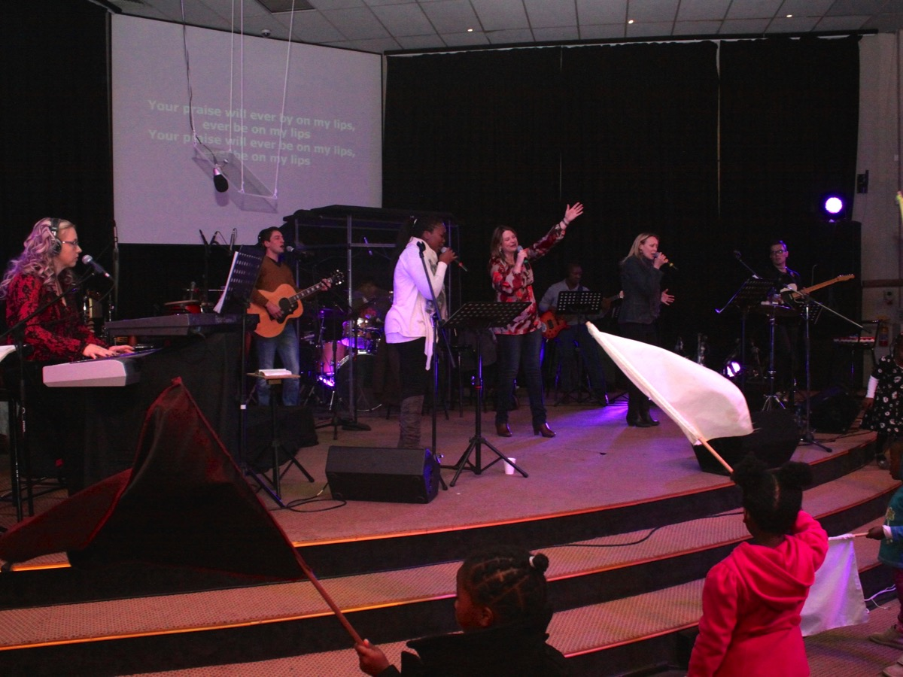

Slide 31

Notes:
Summary

Slide 32

Notes:
Summary

Slide 33

Notes:
1. Manila Youth Pastor Job Description
Position Title: Youth Pastor
Accountable To: Senior Pastor
Work Details:
General Responsibilities
1. Prays for the youth congregation
2. Preaches and teaches the Word through the services, discipleship programs, and the various events of the youth
3. Represents Victory Santa Rosa in all LifeBox and Victory Metro Manila Youth meetings and projects
4. Ensures that the overall youth direction will help the students to Honor God in their lives
5. Ensures that the overall youth direction will help the students to be Disciples of Christ and Make Disciples for Christ
Youth Ministry Administration
1. Regularly encourages, ministers, and prays for the Youth Ministry volunteers
2. Sets the yearly direction of the ministry
3. Develops goals, strategies, and programs to achieve the ministry direction
4. Monitors the development of the various strategies and programs being implemented
5. Analyzes and evaluates the effectivity and efficiency of all strategies and programs implemented
6. Manages the Youth Ministry budget responsibly
7. Regularly dialogues with the Senior Pastor for ministry updates and development

Slide 34

Notes:
2. Youth Pastor Job Description
Reports to: Next Generation Pastor
Measurable Criteria:
Agreement with our church’s vision, goals and statement of faith
At least three years youth ministry experience in a growing youth ministry
Experience managing others, especially volunteers
Observable Qualifications:
A strong walk with God through a growing personal relationship with Jesus Christ
Teachable, with a desire to grow in both faith and abilities
A self starter—highly motivated
Has organizational and leadership ability
Has a passion for youth ministry
An understanding of contemporary youth culture
Strong verbal and written communication skills
A good role model
Team player with effective relational skills (works well with others)
Job Description:
In conjunction with the Next Generation Pastor, set the vision for the youth ministry with a plan to carry it out
Ensure that the vision of the youth ministry adds to the general vision of the church
Develop and implement a clear strategy to achieve the vision
Clearly communicate the vision and strategy to all volunteers, staff, and student leaders
Develop and lead programs according to the vision and purpose of the youth ministry
Primarily be responsible for the church based aspect of the ministry (see attached vision document for clarity)
Oversee the running of regular church based programs and events
Recruit and train volunteer leaders to help you with your purpose
Meet regularly with volunteers and staff
Build into the youth ministry team with consistent training, equipping and mentoring
Encourage attendance at training events or conferences that would help leaders grow in the ministry
Build and maintain relationships with kids both churched and unchurched
Meet regularly with kids from the youth group
As time allows, develop relationships with un-churched youth
Build and maintain quality relationships with parents
Clearly share your vision with parents so they understand the purpose of the youth ministry
Create avenues of consistent contact with parents
Contribute meaningfully to the parent focused aspect of the ministry vision
Network with other youth workers in the community
Initiate contact with other youth workers in the area
Meet regularly with other youth workers, encouraging each other, sharing ideas and experiences
Program or attend area events with other youth ministries
Set and oversee the youth ministry budget
Set a budget that reflects the values in your vision and purpose
Manage the budget and the finances responsibly
Involve students in the ministry of the church as a whole, supporting and participating in the church’s vision, worship services, and activities
Attend weekly church staff meeting

Slide 35

Notes:
3. The Youth Pastor’s Profile (By Graeme Codrington)
The various roles that the youth pastor fulfills are listed and then the character, knowledge, and skills required for each role are identified. The profile is a detailed description of what a youth pastor must be (character); what he must know (knowledge); and what he must do (skills).
In determining the profile, eight aspects of the youth pastor’s role are explored: minister, leader, specialist, evangelist, worker, discipler, counselor, and presenter.
Before each aspect is explored a few overriding principles must be stressed: (1) the youth pastor must be a disciple of Christ who cultivates a disciplined devotional life; practices spiritual disciplines; takes advantage of corporate contexts in which spiritual growth is fostered; and discovers and develop their spiritual gifts. (2) The youth pastor must be called of God to work among young people and should see his calling as life-long, until the Lord leads him into a different ministry. (3) The youth pastor should be dependent on God through prayer for effectiveness and success in ministry. (4) The youth pastor should be a student of theology as it is only as he grows in his understanding of God that he will be effective in leading people to Him.
1. Youth Minister
The youth pastor as a youth minister is responsible to be a servant who shepherds young people by their love and godly example.
Character:
Humble – James 4:6, James 4:10
Caring - 1 Peter 5:2, John 21:15-18, Ephesians 4:2
Love - Matthew 22:37-39, 1 Corinthians 13:4-8
Godly - 1 Timothy 4:7, Titus 2:12 It
Accountable - Romans 3:19, Romans 14:11-12
Sense of need – a team player – vulnerable - Matthew 10:24, 1 Corinthians 12:24-25
Teachable – Psalms 94:12, Proverbs 10:17
Accessible to youth - Proverbs 14:26, Matthew 19:14
Loyal - Titus 3:1
Positive attitude, courage - Romans 15:4
Balancing Priorities - Philippians 4:8
Initiative
Endurance - Hebrews 12:1, James 1:2-4
Knowledge:
Jesus ministry as the example for ministry – Matthew, Mark, Luke, and John.
Values of Christian ministry – 2 Timothy 4:1-5 1
Power of example - Matthew 5:16, Titus 2:7-8
Value of accountability structures - James 5:16
Need for support of others – John 13:34-35, Ephesians 5:21
Value of on going training - 1 John 2:28
Skills:
Develop spirituality and godliness – 1 Timothy 4:7
Set an example to be followed – 1 Thessalonians 4:11-12
Serve people – Ephesians 5:21
Develop accountability structures – James 5:16
Develop a personal support system – John 13:34-35
Involvement in ongoing education – Proverbs 2:1-5
Balance being an adult and a friend to youth
2. Youth Leader
The youth pastor as a youth leader is responsible for being the kind of leader who can effectively oversee ministry in the local church. These are various aspects to this leadership: (a) personal: vision, excellence, time management, stress management; (b) ministry: plan, organize, direct, supervise; and (c) relational: conflict management, change management, marketing.
Character:
Purpose-driven – Matthew 22:37, Deuteronomy 6:13, Joshua 22:5
Pursue excellence – 1 Peter 1:16, Titus 1:7-8
Proactive and disciplined – Proverbs 12:1, 2 Timothy 2:15
Balance of work and rest – Genesis 2:2
Oriented towards the future – Jeremiah 29:11-13, James 4:14-15, Ephesians 5:15-16
Organized – 1 Corinthians 14:40
Leader and follower – Proverbs 10:8, Matthew 28:19-20, Romans 2:21
People developer – 1 Thessalonians 3:12-13
Open to change – Luke 2:52
Committed to peace – Proverbs 12:20, 1 Thessalonians 5:12-13
Positive and communicating – Galatians 6:10, Colossians 4:5, 1 Thessalonians 4:11-12
Worshipper – Psalm 90:14, John 9:31, 1 Chronicles 16:29
Relational – Philippians 2:1-4
Knowledge:
Create vision for life and ministry – Hebrews 12:1-2
Importance of excellence in ministry – 1 Peter 1:16, Titus 1:7-8
Time management – Ephesians 5:16-17
Reality and effects of stress – Matthew 26:41, Hebrews 12:3,12
Importance and practice of planning
Organization of youth ministry – structure, delegation, budgeting – 1 Corinthians 4:2
Leadership styles, motivation, communication, equipping, problem solving, decision making – Proverbs 10:17-18, John 8:31-32
Importance and practice of supervision – Luke 16:1-12, Matthew 25:14-30
Effects and process of change.
Conflict management – Proverbs 12:16, 1 Thessalonians 5:12-13, Hebrews 3:13
Marketing process
Understanding worship – Hebrews 10:25
Life changes in small groups – Proverbs 9:9-10, Philippians 2:1-10
Skills:
Develop a personal mission statement – 1 Timothy 6:12-16
Write a life plan to achieve excellence – Ephesians 5:16-17
Use a weekly time management planner – Ephesians 5:16-17
Ways to order ministry – John 15:8
Using an action plan
Creating relational organizational structures – lead meetings, budgeting, delegating
How to lead, motivate, communicate, equip, solve problems, and make decisions – John 8:31-32
Supervise people for ministry – 1 Thessalonians 5:12-13
Coping with change, preparing a group for change
Conflict resolution – Matthew 5:24, Matthew 18:15
Promote ministry and events.
Leading worship – Psalm 149:1, Genesis 35:2-3, Psalm 95:6, 1 Peter 4:11
Leading small groups – Proverbs 11:30,
Motivate and cast vision for adult and student leaders – Matthew 28:19-20
3. Youth Specialist
The youth pastor as a youth specialist must understand youth development and youth culture in such a way that they are effectively able to minister among young people. 1Timothy 4:12 Don’t let anyone look down on you because you are young, but set an example for the believers in speech, in life, in love, in faith, and in purity.
Character:
Secure in own personality development – Philippians 4:11-13, Job 11:13-18, 1 Timothy 6:6
Open to learn from youth – Galatians 6:6, Matthew 10:24
Positive about family – Ephesians 5:22-6:4
Incarnational – 1 Timothy 3:16, John 1:14
Knowledge:
Personality development – characteristics and developmental tasks
Trends in society (What’s in/ what’s out) – 1 Corinthians 9:22-23.
Family ministry
Incarnation as a model for ministry – John 1:14
Skills:
Age-appropriate ministry – Titus 2
Identify trends in society - 1 Corinthians 9:22-23
Ministry among youth sub-cultures – Matthew 5:13-16
Minister to parents and families
Involvement in the life of the community – 1 Corinthians 22-23
Ministering incarnationally in youth culture – John 1:14
4. Youth Evangelist
The youth pastor as a youth evangelist must be able to lead young people to Christ through the local church and youth group.
Character:
Attractive, Christ-like nature – Ephesians 4:29, Matthew 5:14
Passion for evangelizing the lost – Matthew 28:19-20a
Life-style evangelism – Matthew 5:16, Philippians 2:14-16a
Knowledge:
Understand youth: non-Christian, unchurched, seekers, etc. – John 10:14, 1 Corinthians 9:22
Know and understand the Gospel - Philippians 3:10, 1 Corinthians 9:22-23
Evangelize youth in the youth group – Colossians 2:2-3
Involve Christian youth in evangelism – 1 Timothy 4:12, Matthew 28:19-20a
Skills:
Lead youth to Christ through personal evangelism – Colossians 4:5
Discover strategies for reaching lost youth.
Motivate and train Christian youth to evangelize – 2 Corinthians 5:11-21
Teach methods of presenting the Gospel – 1 Corinthians 9:19-23
Involve Christian youth in service projects and mission trips- 1 Timothy 4:12
5. Youth Worker
The youth pastor as a youth worker is responsible for working among young people who are outside the local church context. They should be skilled in working outside-in with youth in the community who will not enter the church. This role also involves caring for the social dimensions of the life of youth by addressing their concerns and intervening in their lives where necessary. Mark 16:20, Acts 8:4.
Character:
Trustworthy – keeping confidences – Proverbs 11:12-13
Love and care for youth – Mark 10:13-16
Respectability – 1 Thessalonians 4:11-12, 1 Timothy 3:2
Knowledge:
World view of unchurched youth – 1 Corinthians 9:19-23
Dynamics of life in society and the family – John 4:7-9, Luke 19:5-7
Ways to develop leadership qualities in youth – 1 Timothy 4:9-16, Philippians 4:9.
The Gospel and culture – John 4:7-9
Ministry in schools, malls, homes, sports fields, etc. – John 4:7-9, Luke 19:5-7, Mark 16:15, Matthew 5:14-16
Skills:
Nurture healthy relationships between youth and their parents and other adults
Help youth deal with problems – John 17:15-16
Develop leadership skills in young people
Support and educate parents
Help youth develop social skills
Creative hanging with unchurched youth
Express the Gospel in youth culture
Ability to minister in school, malls, homes, etc. – John 4:7-9, Luke 19:5-7
6. Youth Discipler
The youth pastor as a youth discipler is responsible to establish new converts in the faith and grow Christian youth to maturity. – Ephesians 4:11-15, Titus 2:6-8.
Character:
Passion for discipling others – 2 Timothy 2:8-10
Personal spiritual growth – Hebrews 5:13-14
Involvement in mentoring relationships with student and adult leaders – 2 Timothy 2:2
Knowledge:
Understanding discipleship – 2 Timothy 2:15
Faith and commitment development – 2 Peter 1:5-10
Contexts that facilitate spiritual growth – John 15:2,5, 2 Corinthians 9:10, 2 Peter 1:5-10
Skills:
Identify commitment levels in youth – 1 Peter 2:2
Ways to increase commitment in youth – 1 Corinthians 15:58
Develop youth for leadership – 1 Timothy 4:11-13
Involve youth in ministry – 1 Timothy 4:11-13
Lead a small group – Scriptures concerning Christ and the 12.
Develop a cell ministry including cell leaders and adult cell coaches – Matthew 28:18-20
Integrate youth into the life of the church – Ephesians 4:11-12
Disciple adult leaders – Ephesians 4:12
7. Youth Counselor
The youth pastor as a youth counselor is responsible to help young people help themselves reach maturity, experience healing or move through crises or personal problems. 1 Peter 5:2-3, Titus 2:1, Titus 2:6-8, Proverbs 19:20, 1 Thessalonians 5:14.
Character:
Warm and caring – 1 Peter 5:2, John 21:15-18, Ephesians 4:2
Positive view of self – aware of strengths and weaknesses – Romans 12:3-8
Biblical and positive handling of personal problems – Proverbs 13:10
Open to personal growth – Psalm 141:5
Positive view of people – believe in their ability to change – Philemon 11
Genuine interest in people –1 Peter 5:2
Knowledge:
Principles and practices of Christian counseling – Psalm 37:30-31, 1 Kings 22:5
Hazards and limits in counseling – Proverbs 11:12-13
Models for counseling – 1 Thessalonians 5:14
Techniques for the counseling process – Proverbs 16:23, 1 Kings 22:5
Crisis situations youth face – James 1:14-15, 1 Peter 5:7, 2 Timothy 2:22, Proverbs 3:5-6, Proverbs 19:20
Defense mechanisms youth use – Psalm 95:8, Proverbs 14:12, Proverbs 15:12, Ephesians 4:31
Issues youth face – 1 Corinthians 10:13, James 3:14-15, John 14:27, Proverbs 29:11, Luke 21:34, Psalm 147:3, 1 John 2:16
Knowing when to refer youth for professional help – Proverbs 11:14b, Proverbs 20:18
Skills:
Respond to youth with warmth and concern – Romans 12:10, 2 Timothy 4:2
Set guards against dangers in counseling – Proverbs 20:19, Proverbs 3:5-6, James 1:19, Proverbs 11:13
Work with personalized model for counseling – 1 Thessalonians 5:14, Proverbs 27:9
Use skills for the counseling process – Proverbs 8:14, Proverbs 23:23, 26:4, Psalm 78:72
Intervention strategies for crises – James 5:19-20, Romans 15:7
Deal with defense mechanisms – 2 Corinthians 10:4-5
Counsel youth through issues they face – Psalm 1:1, 2 Corinthians 1:3-4, 1 Peter 5:9, Romans 15:7
Practicing referral when necessary –Proverbs 15:22, Proverbs 20:18
Provide pastoral counseling to youth and/or parents – Proverbs 13:14, Proverbs 2:9, Psalm 78:71-72, 2 Timothy 4:2
8. Youth Presenter
The youth pastor as a youth presenter is responsible to communicate Christian truth to youth in various contexts such as Bible studies, messages, devotions, programs, etc. – 1 Corinthians 9:16.
Character:
Relational – Mark 4:33
Integrity – Titus 2:7
Confidence – Romans 1:16
Knowledge: Titus 2:7-8
Programming for different age groups; commitment levels – 1 Kings 8:61
Principles of effective programming
Structure and methods of programming
Christian education – 2 Timothy 3:16
Communication theory – Isaiah 28:9-10, 2 Timothy 2:24-26
Commitment level programming - Hebrews 10:24
Youth group management – discipline, building unity – Ephesians 4:11-13
Skills:
Communicate truth to youth – 2 Timothy 2:15-16, 2 Timothy 4:2
Evaluate presentations and programs – Philippians 1:10
Presentation techniques – Philippians 1:10
Handle audience behavior – Nehemiah 8:3
Building unity in a youth group – Ephesians 4:3

Slide 36

Notes:
What is your role as a youth worker or youth pastor?

