Slide 1

Notes:
This session is all about running awesome events. We will first take a look at the context in which we run events, namely a disciplemaking ministry, then explore some general guidelines for creating awesome events and finally look at specific ways in which we can run Wow events!

Slide 2

Notes:
Can I assume that most of you have seen this movie? Here is the trailer:

Slide 3
Notes:
Video: Guardians of the Galaxy Trailer. Get it on YouTube at: https://www.youtube.com/watch?v=2LIQ2-PZBC8
Guardians of the Galaxy Trailer.mp4

Slide 4

Notes:
1. Events in a Disciplemaking Ministry
Before we jump into the specifics of how to run event in a youth ministry it would be helpful to set the context in which events take place.

Slide 5

Notes:
As His Youth we are a part of His People Christian Church and our global movement is Every Nation Ministries. and as such has embraced a common approach to disciplemaking with the following four phases: Engage – Establish – Equip – Empower.

Slide 6
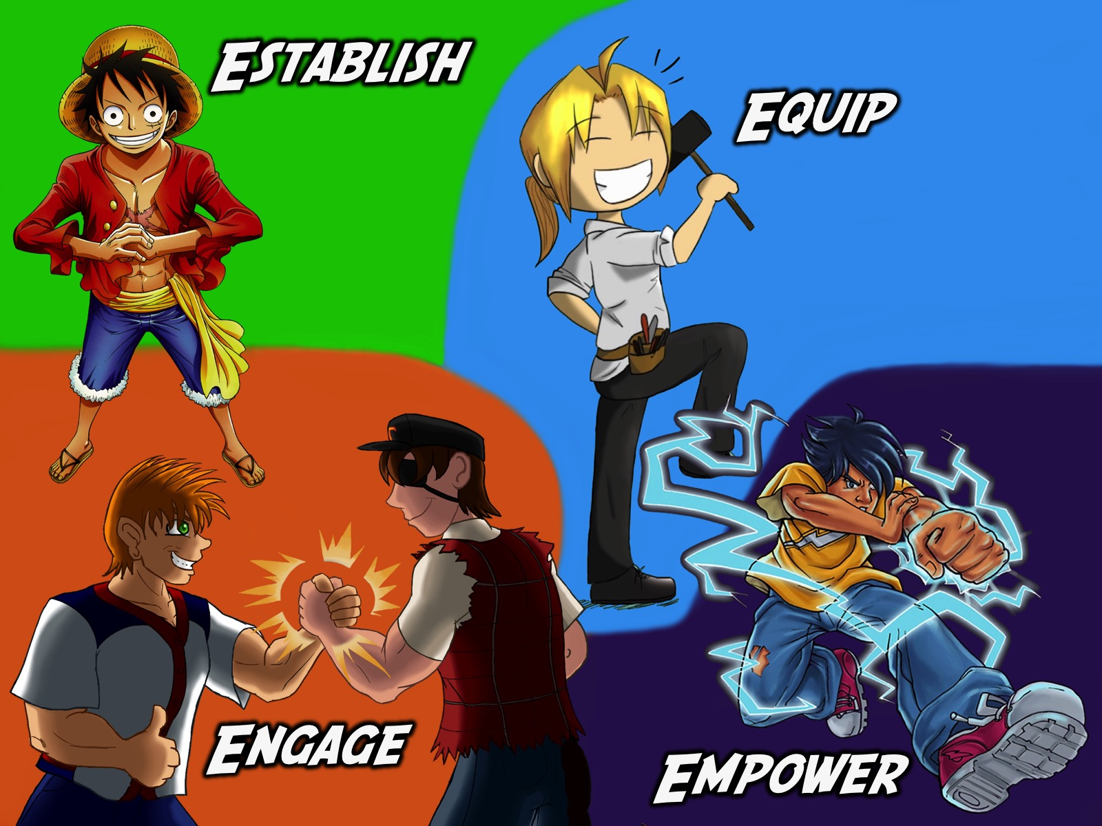
Notes:
As a youth ministry, His Youth, we believe it is critical to embrace the same approach for disciplemaking as the wider church so have built out youth ministry around the same four phases of ministry.

Slide 7
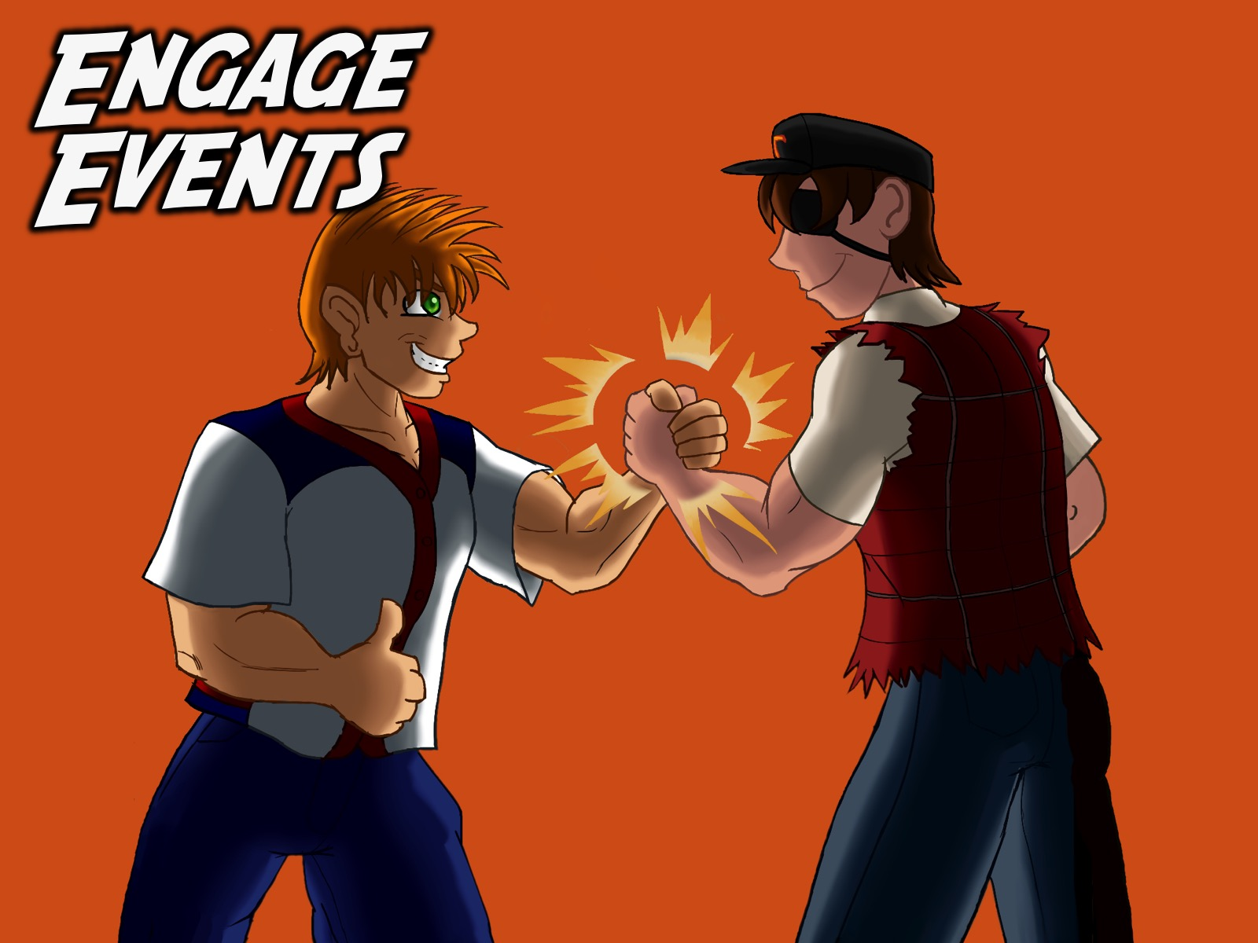
Notes:
Engage. The first phase in our disciplemaking strategy is to Engage teens by connecting with them and bringing them to faith in Christ. Our Friday night weekly ministry focuses primarily on this phase. Here is a detailed outline of our current Friday night youth group event at His Youth in Rosebank. This event is an opportunity for believers to bring teens that they are building relationships with into an event in which they can engage with others believers and with God.

Slide 8

Notes:
I will show some slides along the way and photos so you can see what the various part of the night look like. Most of these images have been taken from the My Health Night program we presented recently.

Slide 9
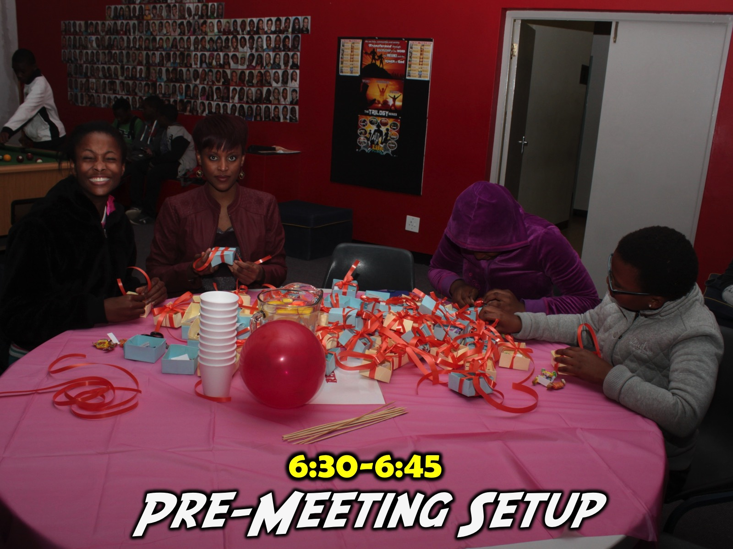
Notes:
6:30-6:45 Pre-Meeting Setup. Those responsible for the night meet to walk through the night - set up any decor and get all the materials for the night on order. Those presenting the night are walked through the PowerPoint Presentation that drives the whole Friday night event. They would have seen most of the presentation during the week as I sent images of each slide in a facebook message to those presenting the night - but this is usually the first proper run through with all the media and videos in the right place and order. A teen runs the PowerPoint and it is critical that they are there at 6:30 as well. Those responsible for sound engineering on the night also need to be there at 6:30.

Slide 10
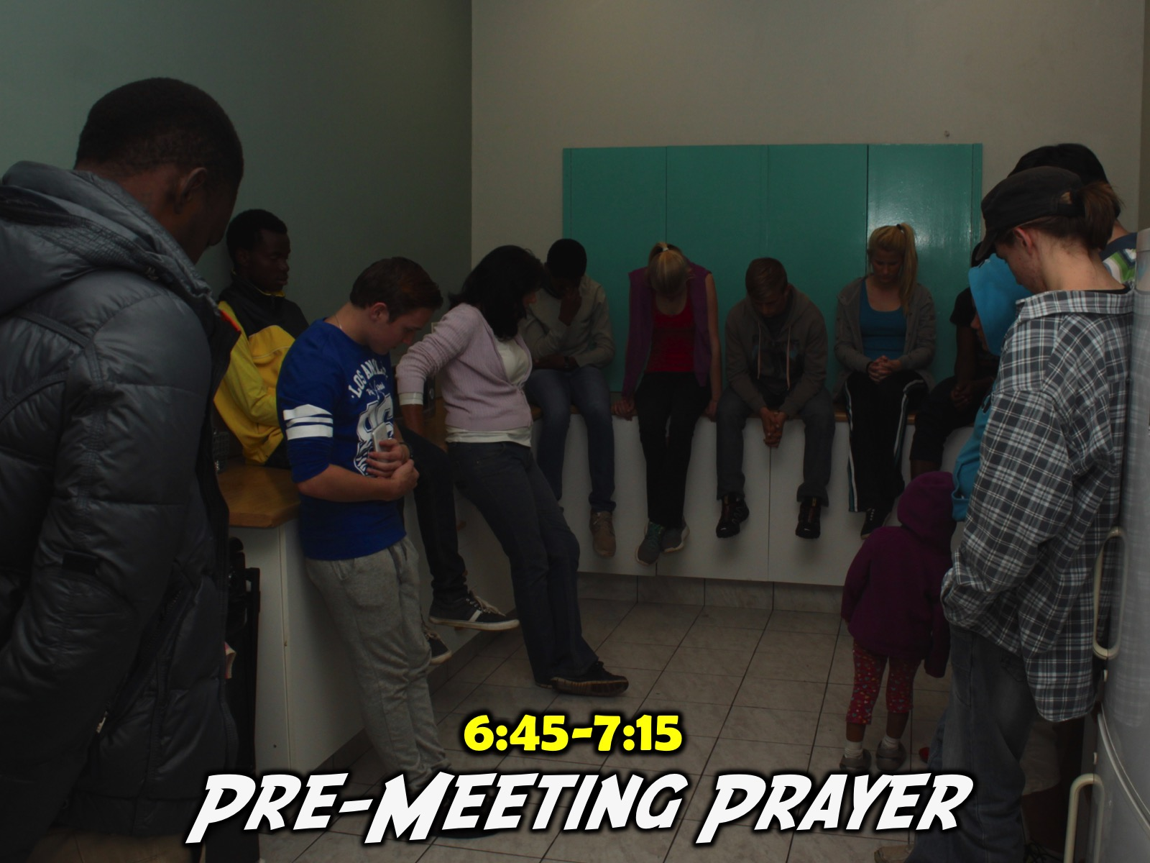
Notes:
6:45-7:15 Pre-Meeting Prayer. Our large group of leaders meets once a week for prayer - and it also allows us to brief our leaders - who are our small group leaders on the night - about anything they need to do to make the night work well. We urge them to connect with newcomers and give them a feel of what we are trying to accomplish on the night - especially in terms of the small groups. I email the small group questions out via WhatsApp to all the small group leaders on Wednesday night so this is the not first time they are seeing the questions.

Slide 11
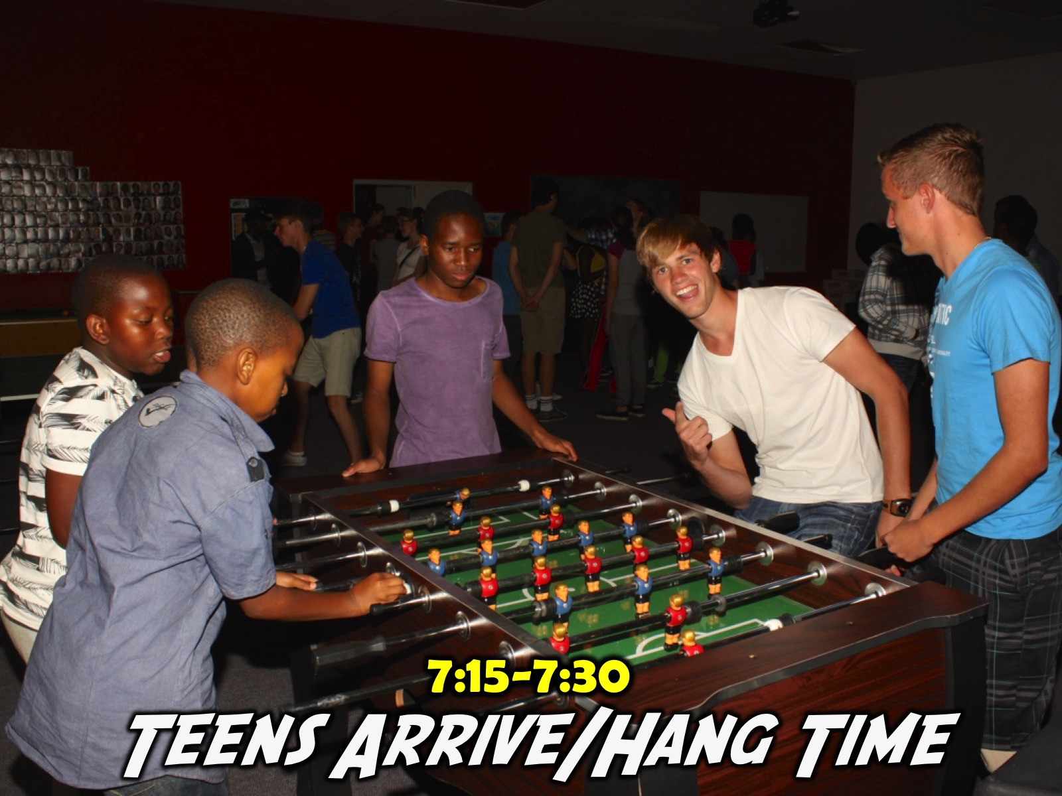
Notes:
7:15-7:30 Teens Arrive. This is our hang time - some teens arrive as early at 7pm (some even are the by 6:30 when I get there playing games in the room like Pool, Table Tennis, Foosball and Darts or just chilling) - so our prayer time happens in the kitchen. The teen and adult leaders are encouraged to spend this time connecting with teens while those few running the program do last minute checks that everything is ready.

Slide 12
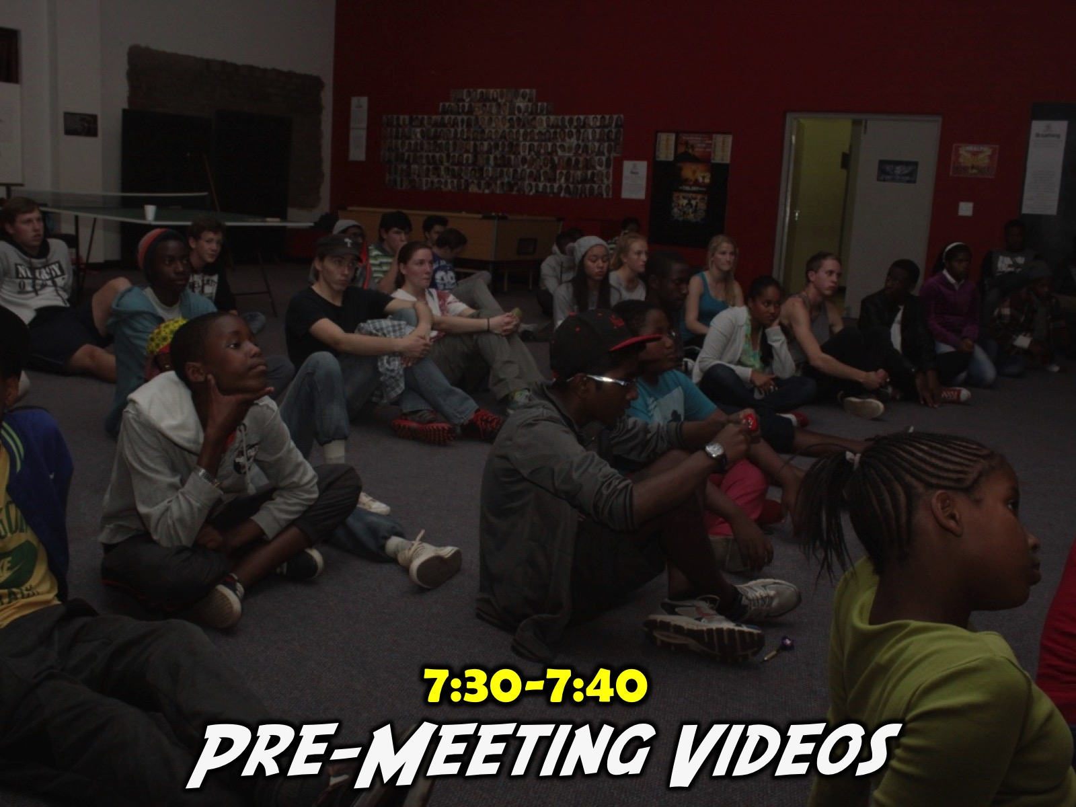
Notes:
7:30-7:40 Pre-Meeting Videos
We show either 10 or 15 minutes worth of videos on the screen during this time. This Friday night is our Steam Night (we are busy with a media series called Online Fridays where we are bringing various online worlds to life in the youth room - we have done iTunes, Snapchat and Google so far and this Friday night it is Steam Night). These videos help set up the media app that we are exploring on the night. Some teens actually stand and watch the videos while other carry on playing games. So the event has not actually started as yet.

Slide 13
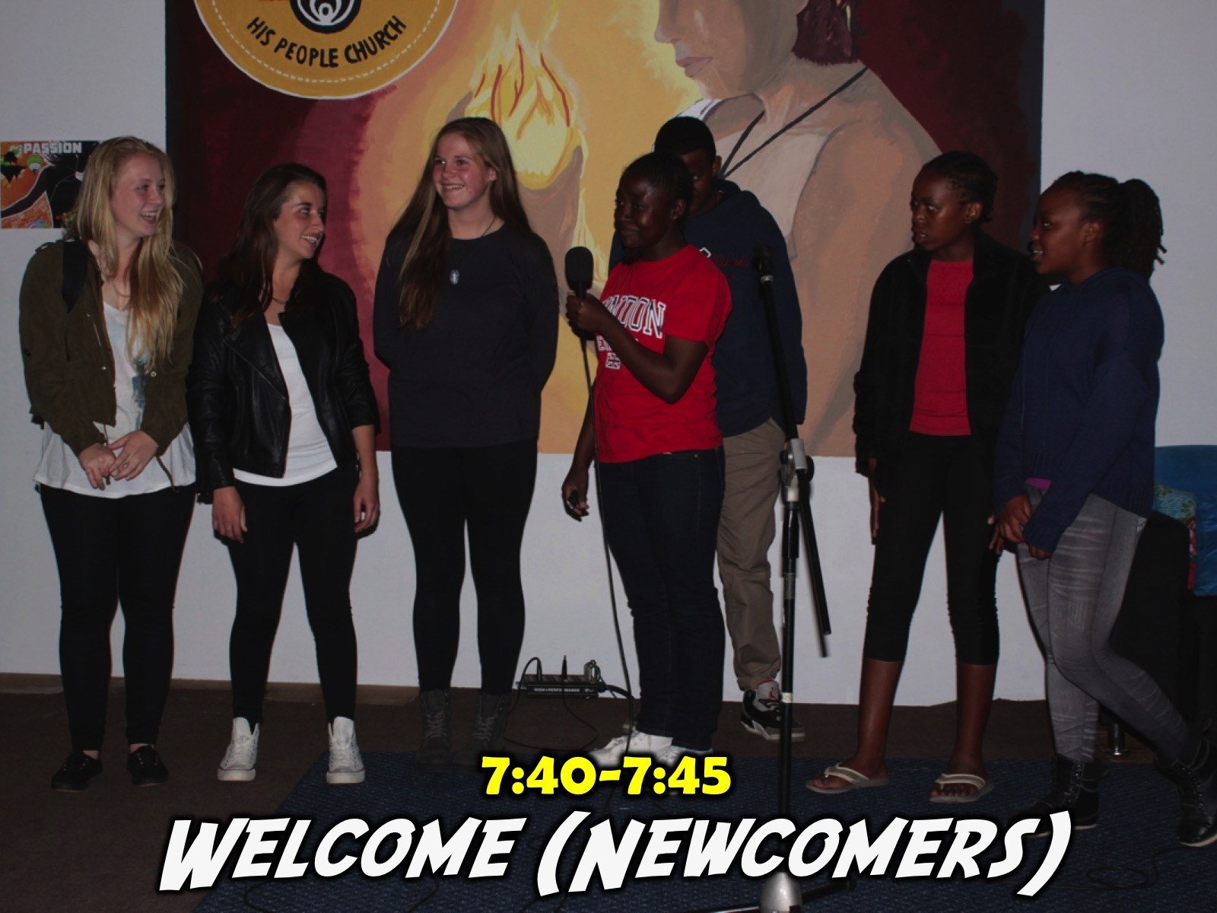
Notes:
7:40-7:45 Welcome and Introduction of Newcomers
We welcome teens to the night and ask any newcomers to come forward to be introduced. We ask them their name, what school they are from and sometime a silly question like the colour of their toothbrush or something like that.

Slide 14
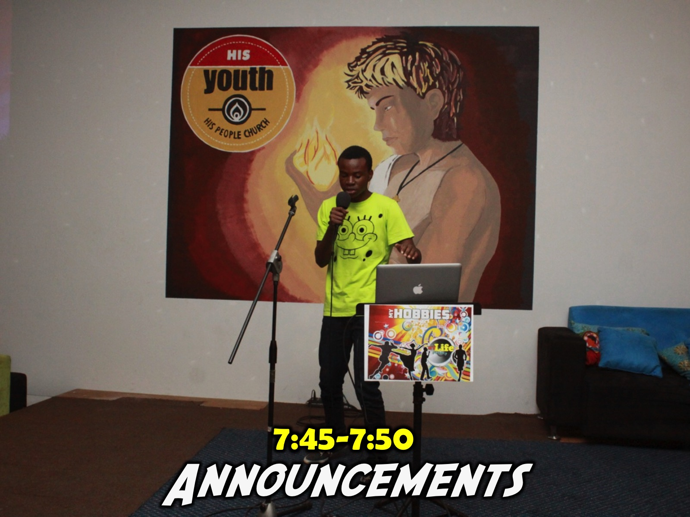
Notes:
7:45-7:50 Announcements
This is a very important part of the night as it helps to connect newcomers and regulars into the rest of our ministry. We advertise what we are going to be doing on Sunday morning (mentioning the series title and the theme for that morning) in our teaching series and also mention the theme for Next Friday night's event.

Slide 15

Notes:
Here is an example of a slide to advertise our Sunday and Friday events.

Slide 16
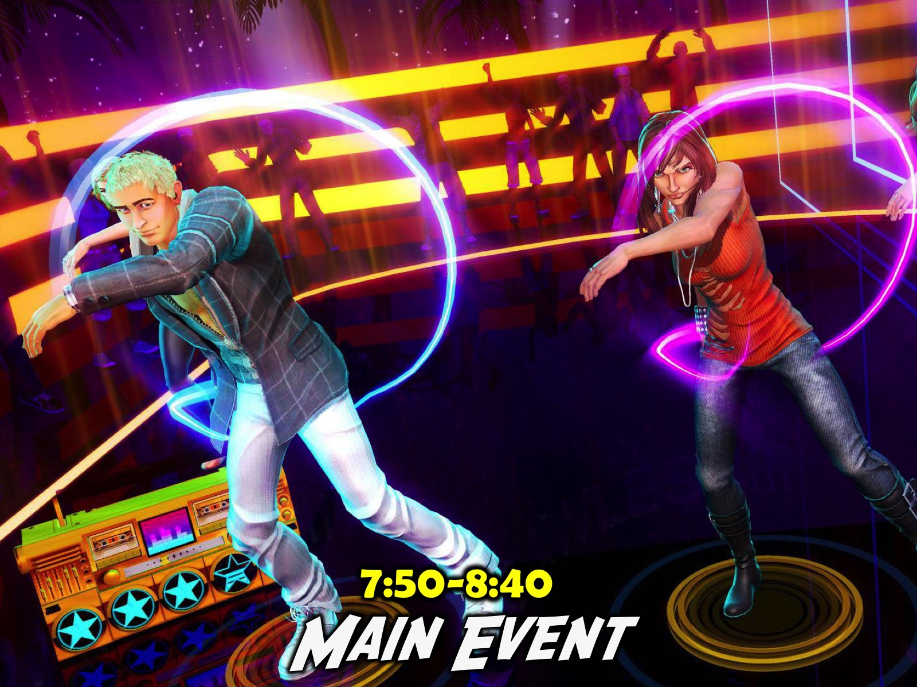
Notes:
7:50-8:40 Main Event Time. Now starts the real program part of our night where we introduce the theme for the night - normally with a video clip and then we launch into the event. The theme for the term and the night will determine what is involved in this time - but for example, on the My Health Night the group we divided into two groups. They split up and each spent 10 minutes at 2 fitness stations and then joined together to visit a spiritual fitness station.

Slide 17

Notes:
Station #1: Crossfit Workout. An instructor led a 10 minute Crossfit workout session.

Slide 18
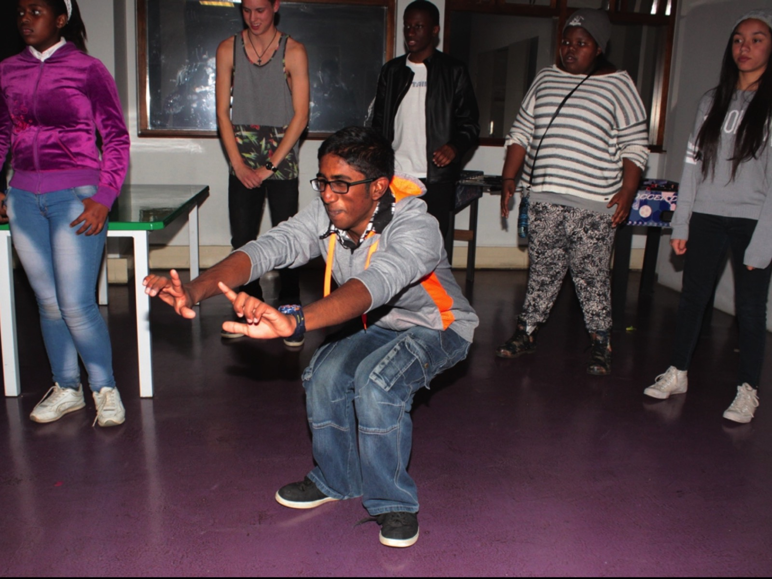
Notes:
Here are some teens at the Crossfit station.

Slide 19
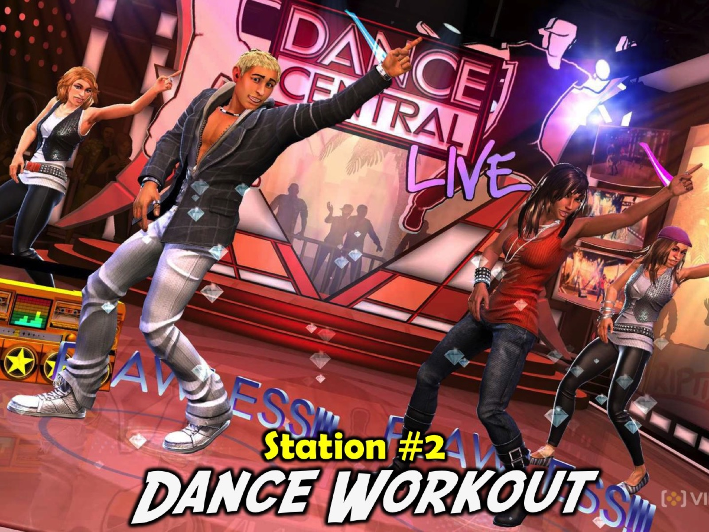
Notes:
Station #2: Dance Workout. The group had 2 instructional Zumba videos to dance to.

Slide 20
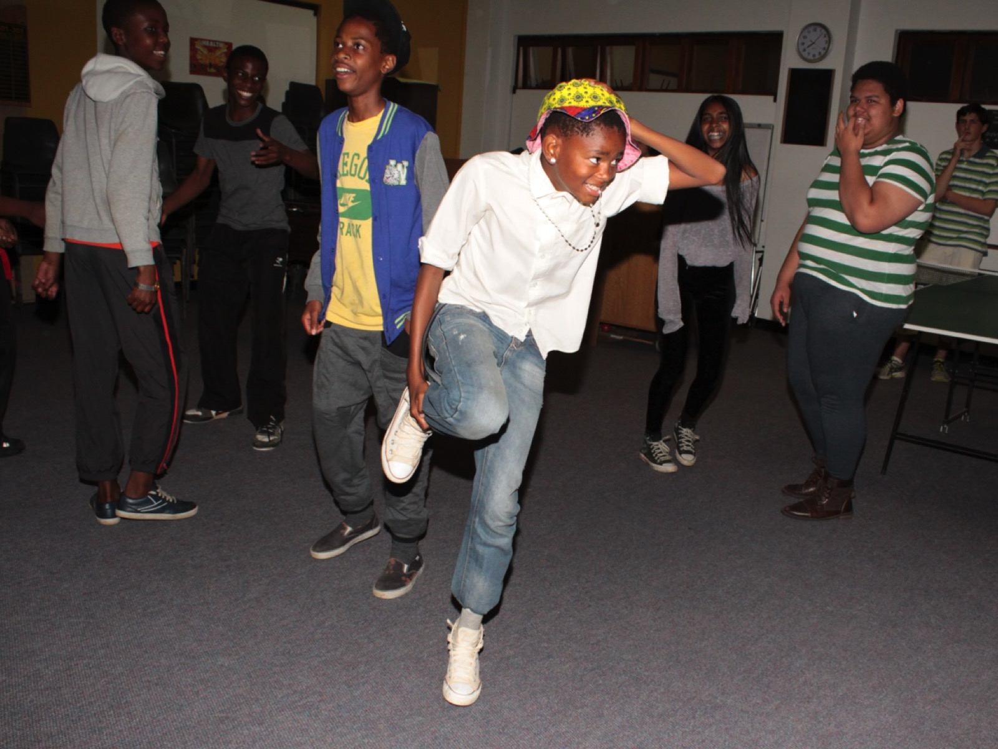
Notes:
Here are some teens at the Zumba dance station.

Slide 21
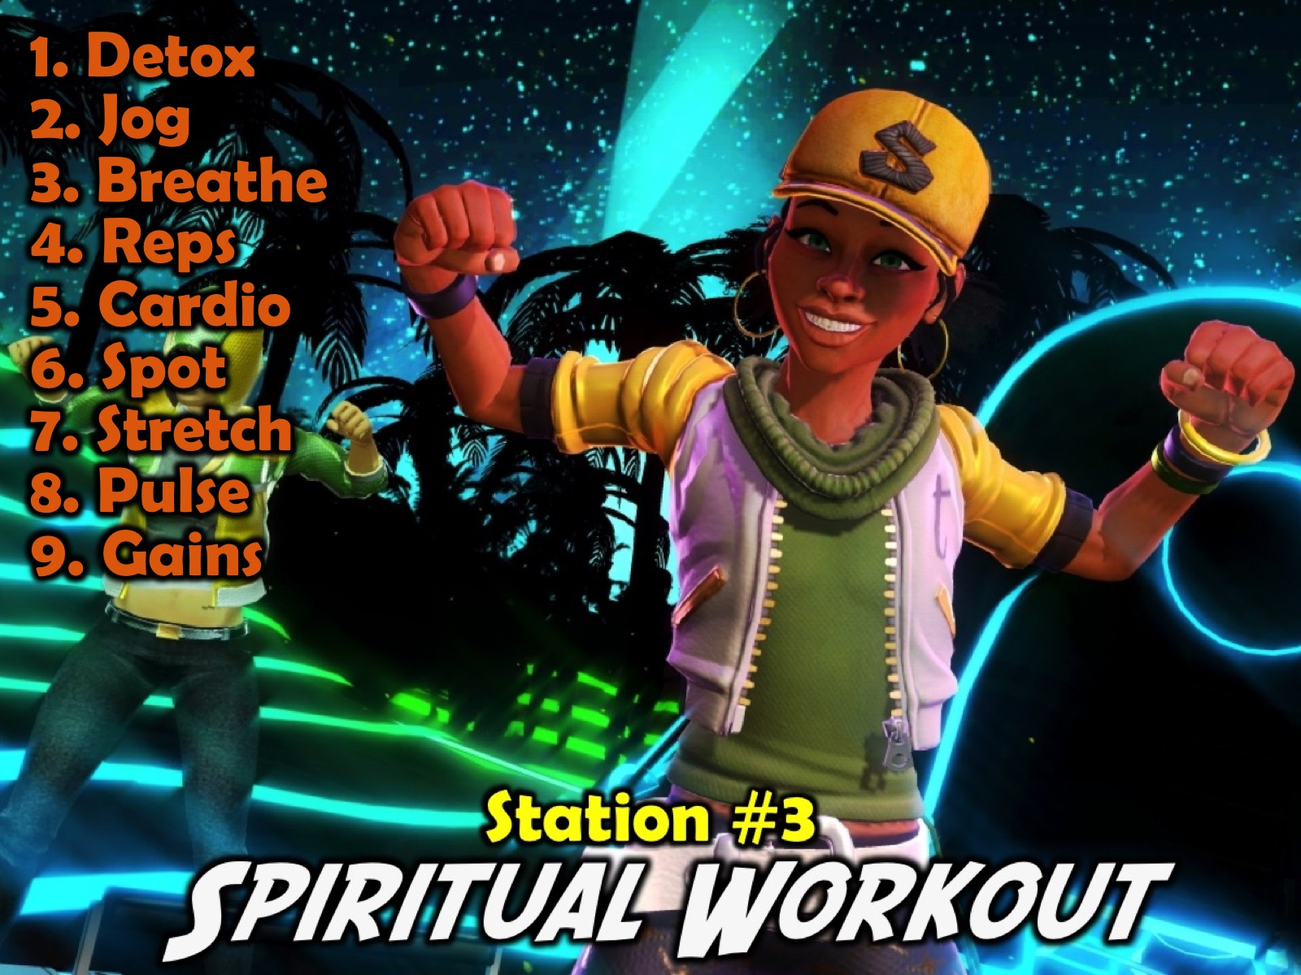
Notes:
Station #3: Spiritual Workout. We created 9 mini-9 stations around the room for teens to visit in any order to engage in spiritual exercise. The Stations:
1. Detox. Confess anything to God that you have done in the past week that he is not please about.
2. Jog. Jog your memory about God’s love by saying this verse 5 times: “For God so loved the world that he gave his one and only Son, that if I believe in him I will not perish but have eternal life.” Thank God for loving you!
3. Breathing. Say the Lord’s Prayer out loud - slowly line by line - actually say it as a prayer to God. “Our Father in heaven, hallowed be your name, your kingdom come, your will be done, on earth as it is in heaven. Give us today our daily bread. And forgive us our debts, as we also have forgiven our debtors. And lead us not into temptation, but deliver us from the evil one. For yours is the kingdom and the power and the glory forever. Amen.”
4. Reps. Say this verse over a few times until you can say it without looking: "This is how God showed his love among us: He sent his one and only Son into the world that we might live through him.” (1 John 4:9)
5. Cardio. Ask God to speak to you as you meditate on His Word. Say the verse over slowly at least 7 times - pausing between each time you repeat it. Pause and ask God what he wants to say to you. Thank God for having spoken to you. Verse: “Love the Lord your God with all your heart, and all your soul and all your mind, and love your neighbour as you love yourself.” (Luke 10:27)
6. Spot. Ask God to show you one person that you need to speak to about how much he loves them. Write their name down on the wall. (Use the heart shape on the wall)
7. Stretch. Which of these Fruit of the Spirit do you need to work on in your life? “But the fruit of the Spirit is love, joy, peace, patience, kindness, goodness, faith, gentleness, self-control.” (Galatians 5:22-23). What can you do to develop it in your life?
8. Pulse. Take your spiritual pulse by asking yourself whether you are more in love with God now than you were 6 months ago. If your answer is YES, then think of 3 reasons why you are in a better place. If your answer is NO, then ask God to show you what you need to do or stop doing to get into a better place in the next 6 months.
9. Gains. Think about something that you have learnt in the last month about God and write it on the page. God is…

Slide 22
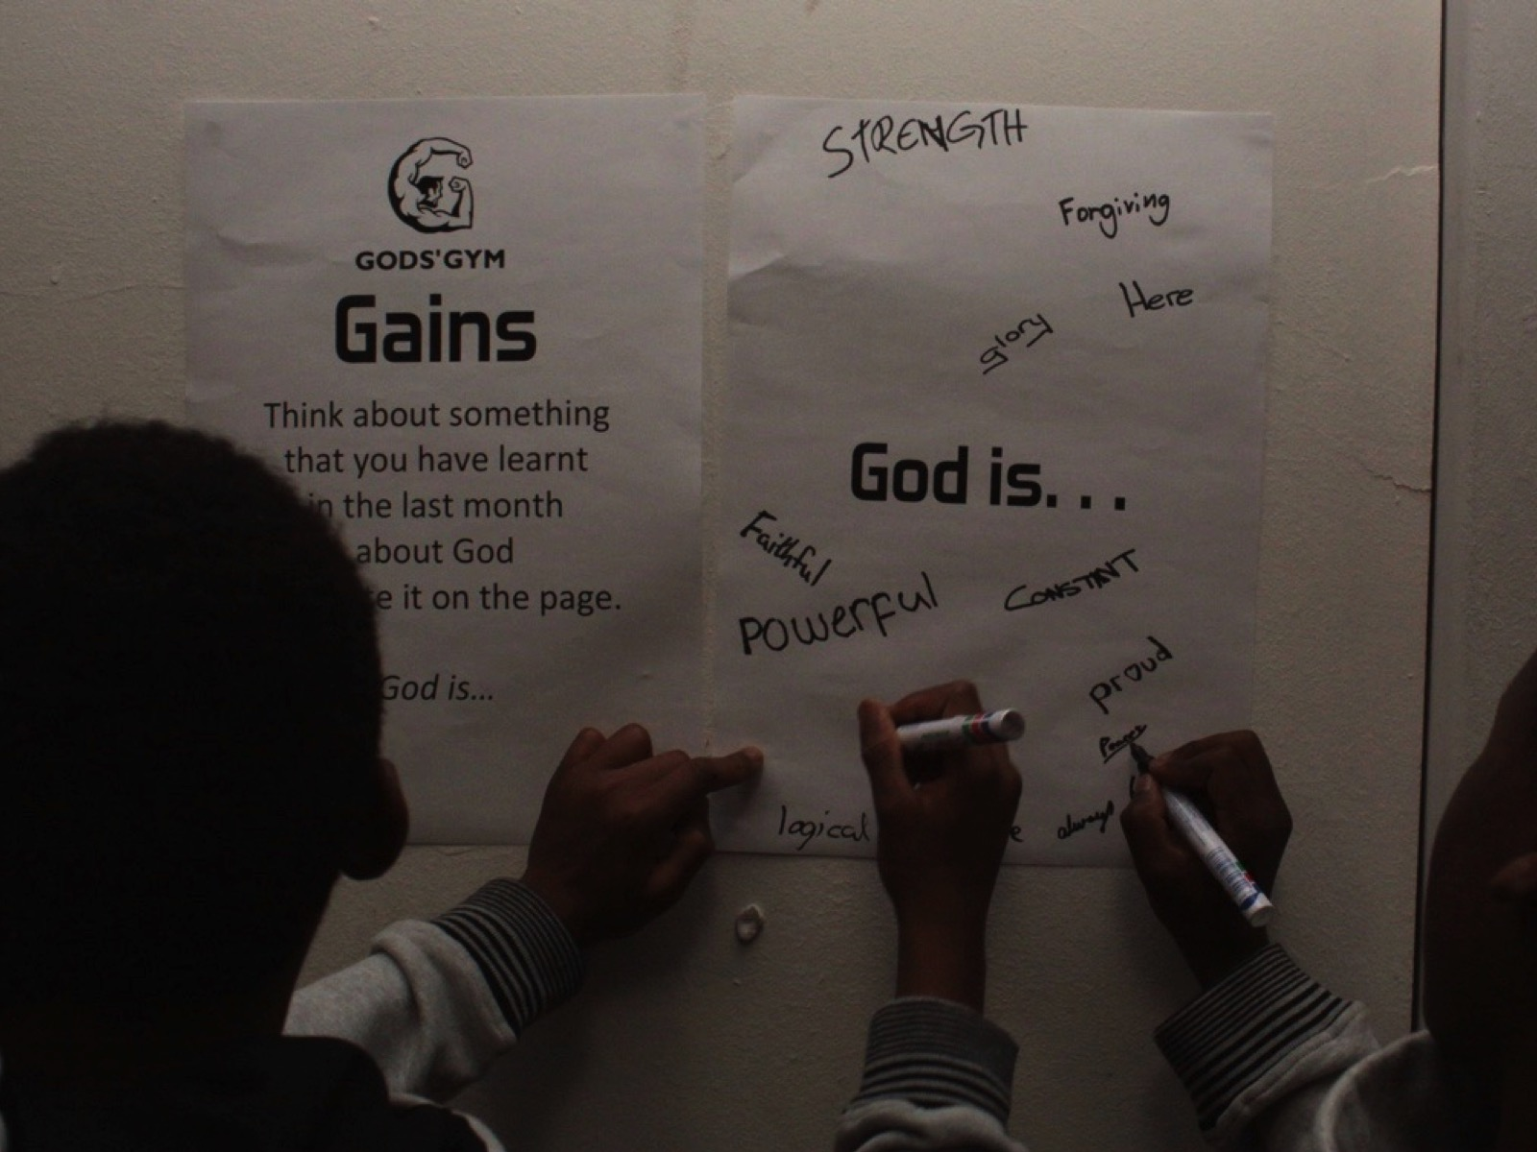
Notes:
Here are some teens at the Gains station where they had to think about something they had learnt in the last month about God and write it on the page.

Slide 23
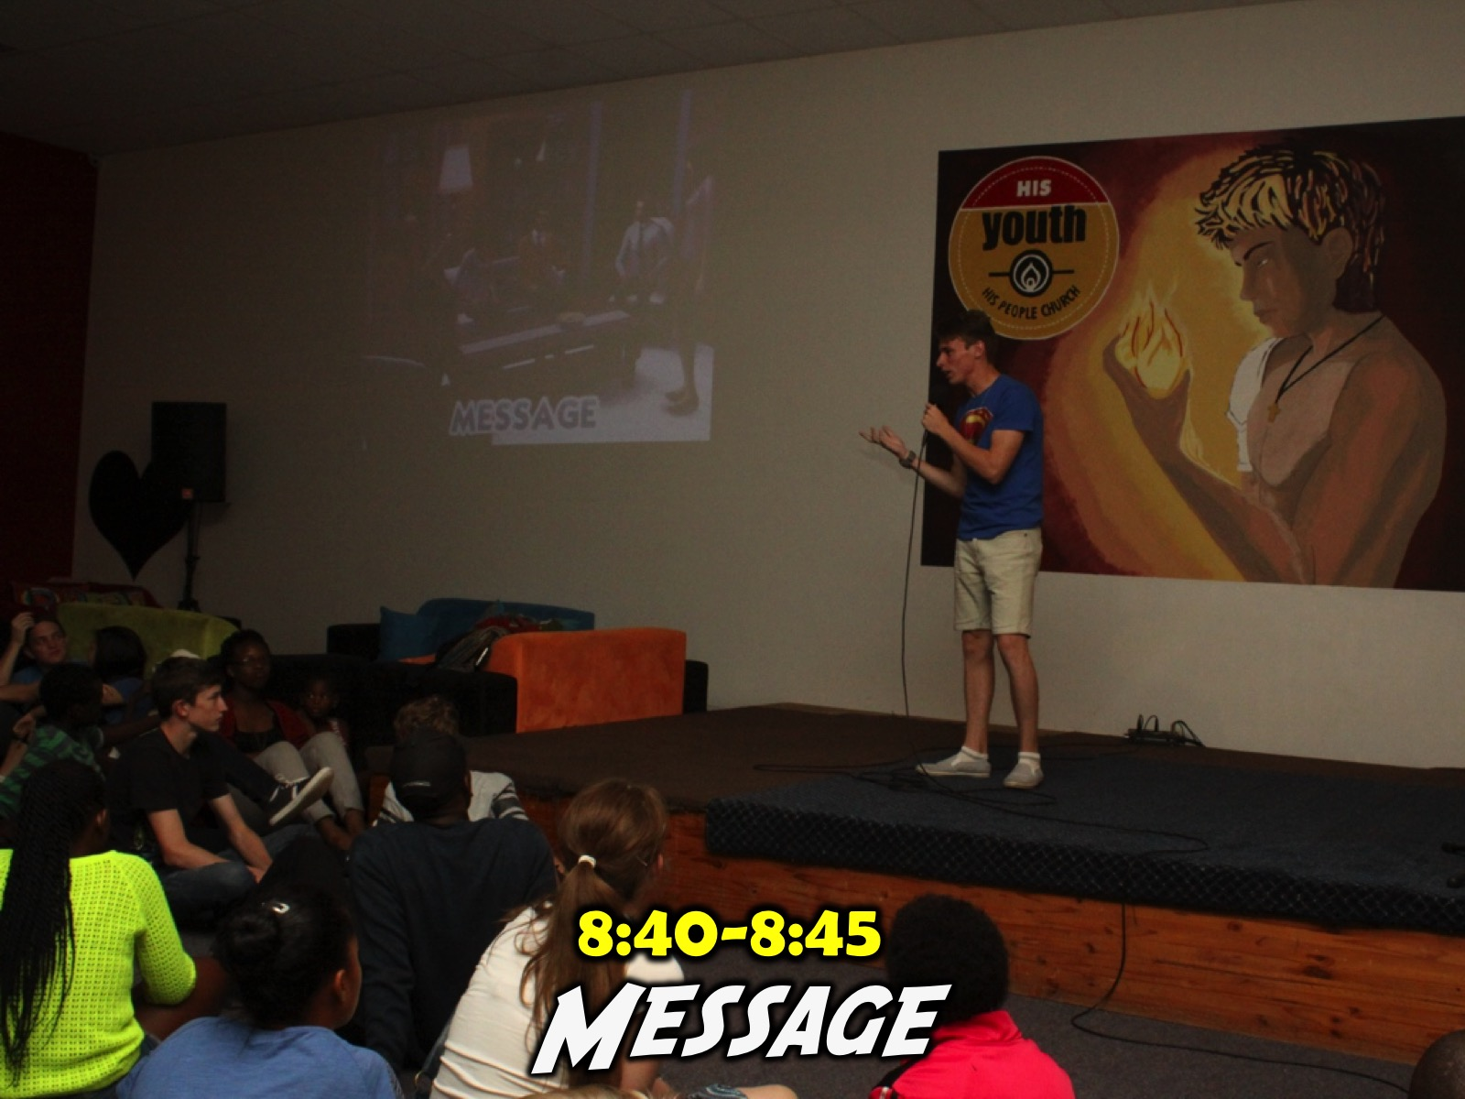
Notes:
Optional: A short devotional message or gospel presentation before teens go into small groups.

Slide 24
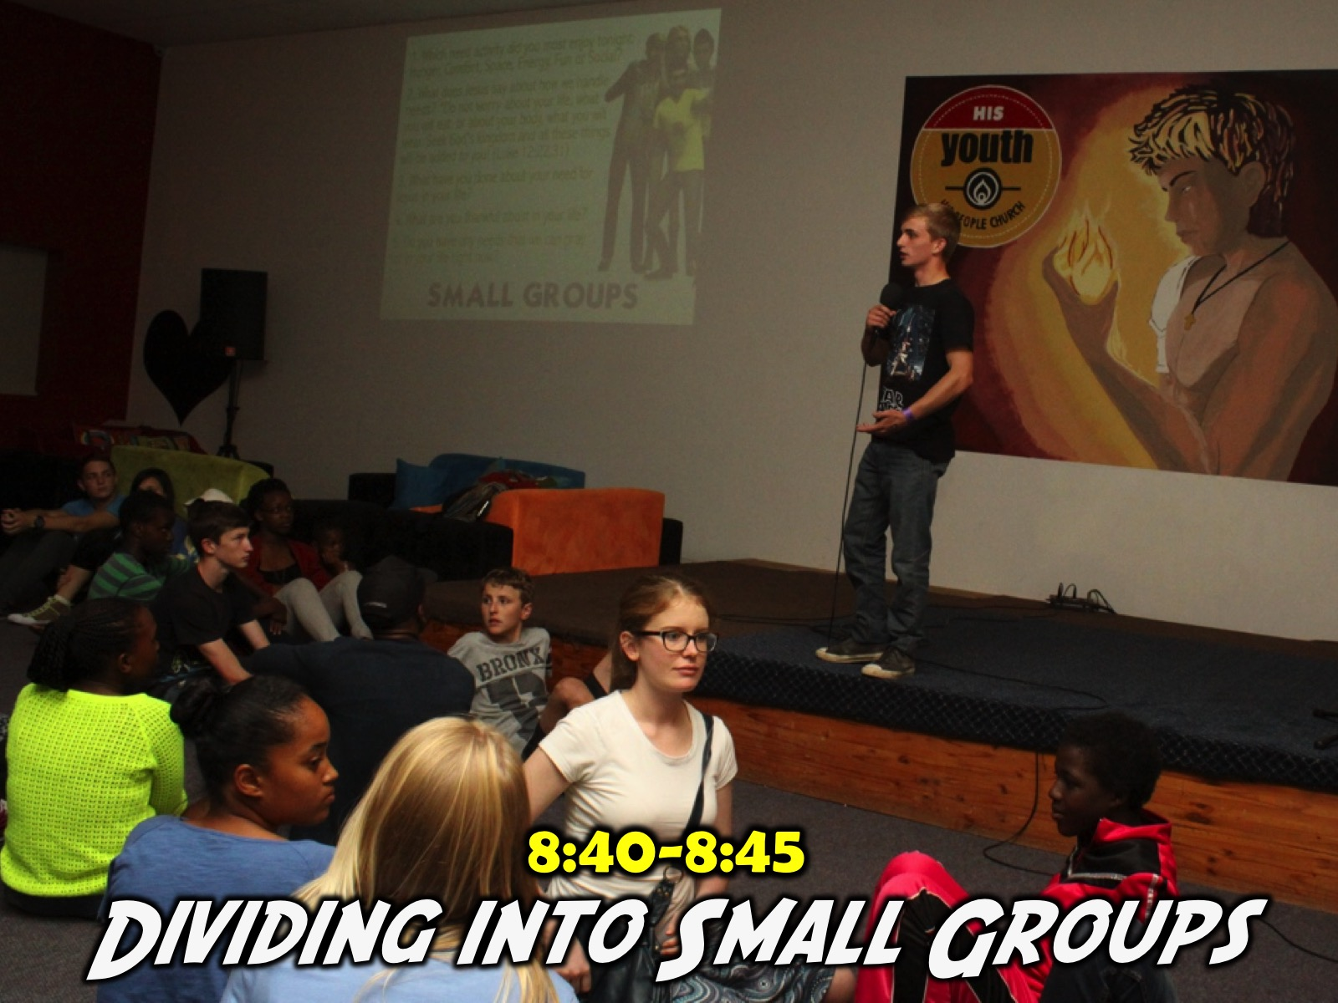
Notes:
8:40-8:45 Dividing into Small Groups
It takes about 5 minutes to get teens to find their small group leaders and settle down into their groups - we have a teen leader who comes to stage and says it is Small Group Time and has all the Teen Leaders stand up (we have about 20 at present) and those leaders go and find a place on chairs or the group or couches so their regular group members can go and sit with them. The leader mentions that anyone who is new should come forward and we will put them into either an existing group that is low in numbers on the night or into a new group with a new teen leader.

Slide 25
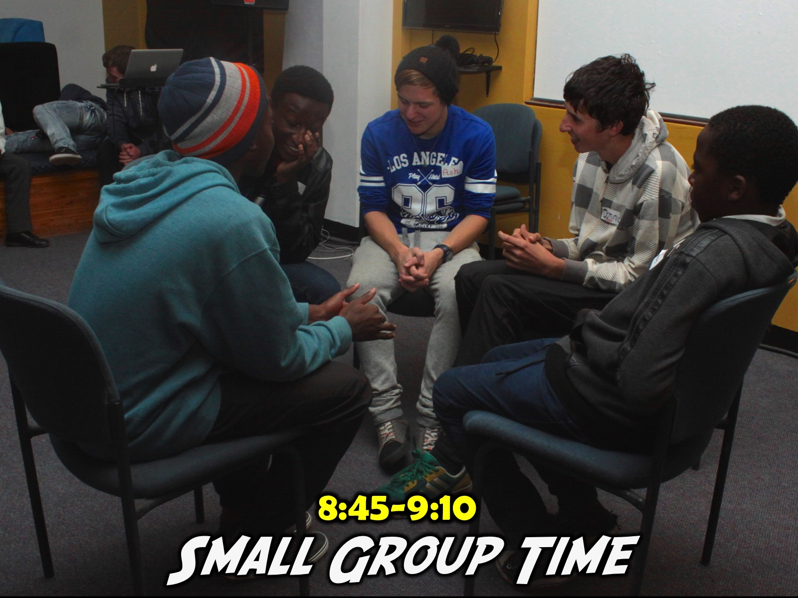
Notes:
8:45-9:10 Small Group Time. We currently use 4 to 5 small group question for this time - the first one refers back to what we explored last week and gets them to talk about how they implemented what they learnt and the next two to three questions focus on implementing the new learning for this week (based on the night's theme) and then the final question is a pray item on the topic.

Slide 26

Notes:
Small Groups: Here are the questions: (1) What did you most enjoy doing tonight? (2) What does it mean to be healthy? (3) What is your current physical and spiritual health status? (4) How can you improve your physical and spiritual health? (5) Pray for God to help you as you work on your health.

Slide 27
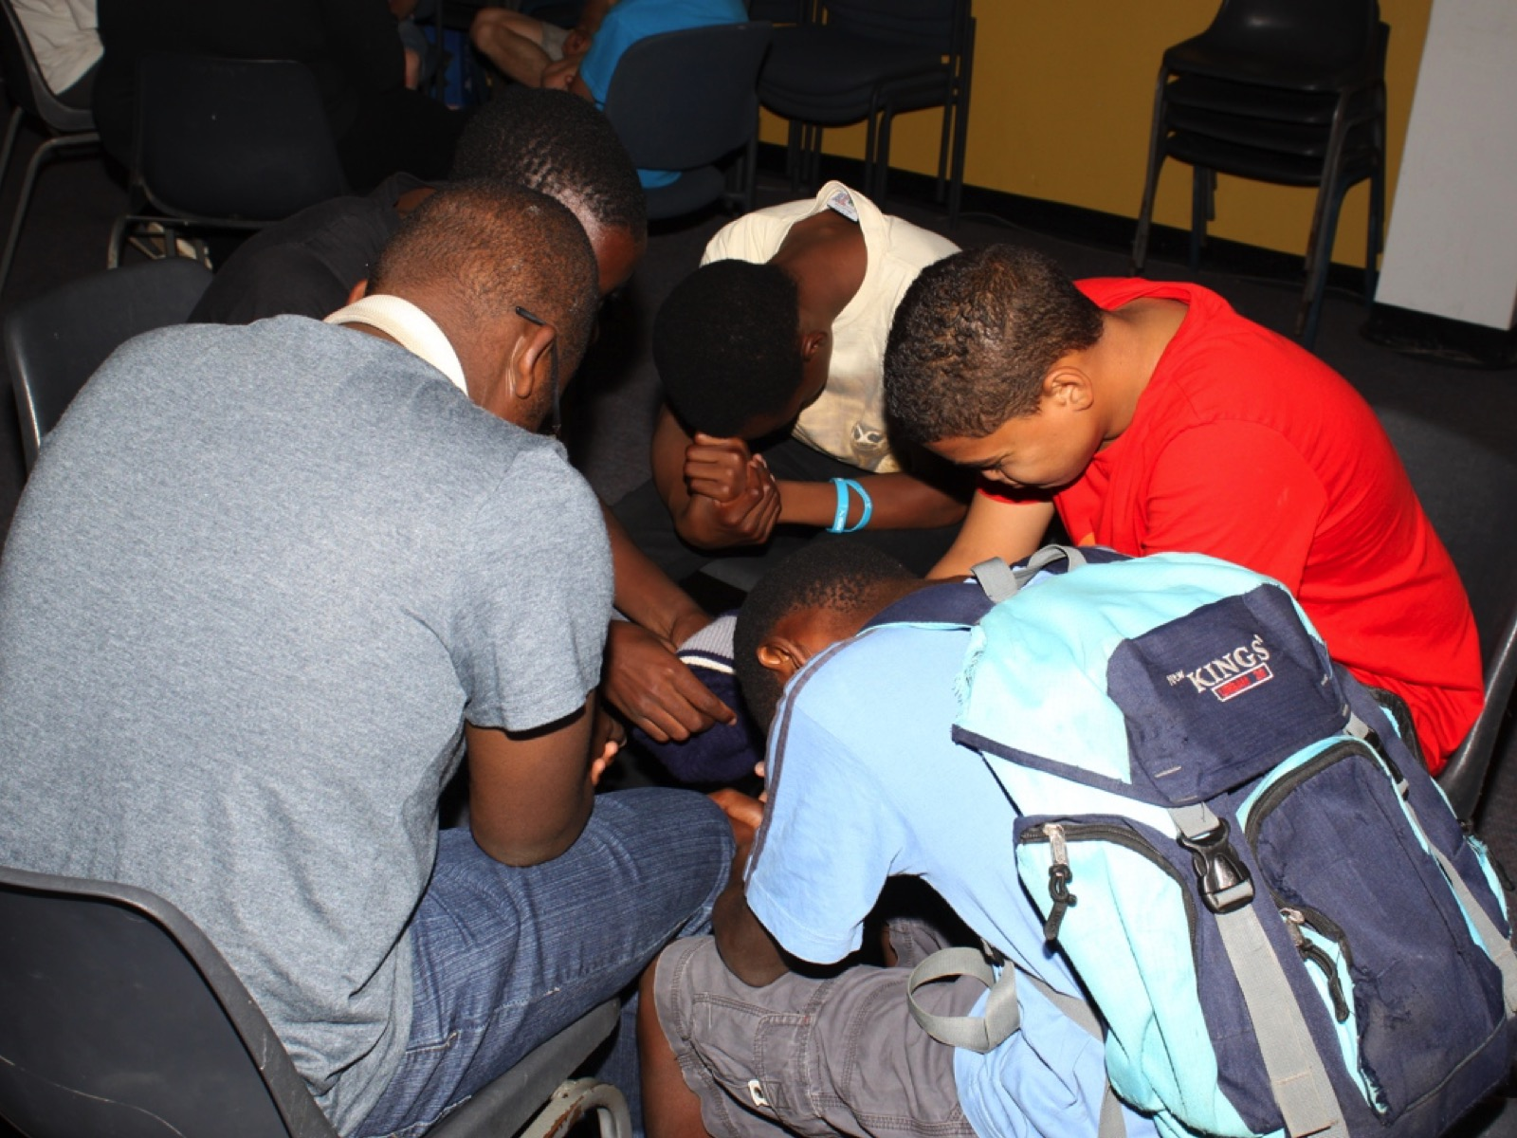
Notes:
Small groups always end with teens praying for each other.

Slide 28
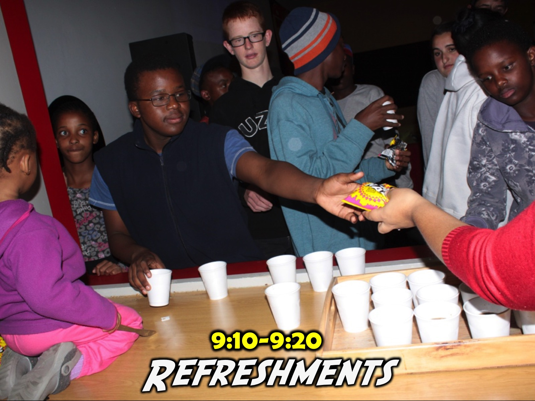
Notes:
9:10-9:15 Refreshments. We serve juice and biscuits in summer and Hot Chocolate and biscuits in winter. Some nights the main program includes some food - like this week where Coke and Fruit Loops are available throughout the gaming experience but we generally still end with a drink at the end. If the night is a meal then we often build the drinks into the main program.

Slide 29
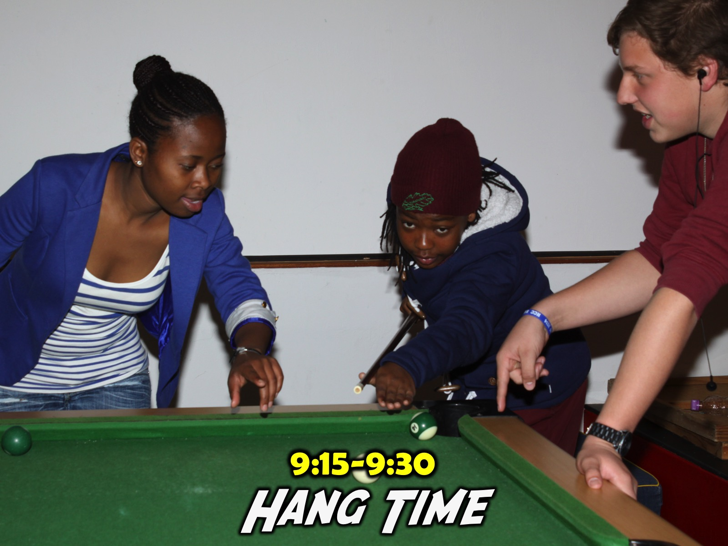
Notes:
9:15-9:30 Hang Time. We allow more time for the teens to hang, play games in the room (Darts, Fooseball, Pool, Table Tennis, Free-style Dancing, One Bounce, etc) from when small groups end and refreshments start to 9:30 but we have a hard close at 9:30 - when we start to flash the lights in the youth room and teens know that it is home time.

Slide 30
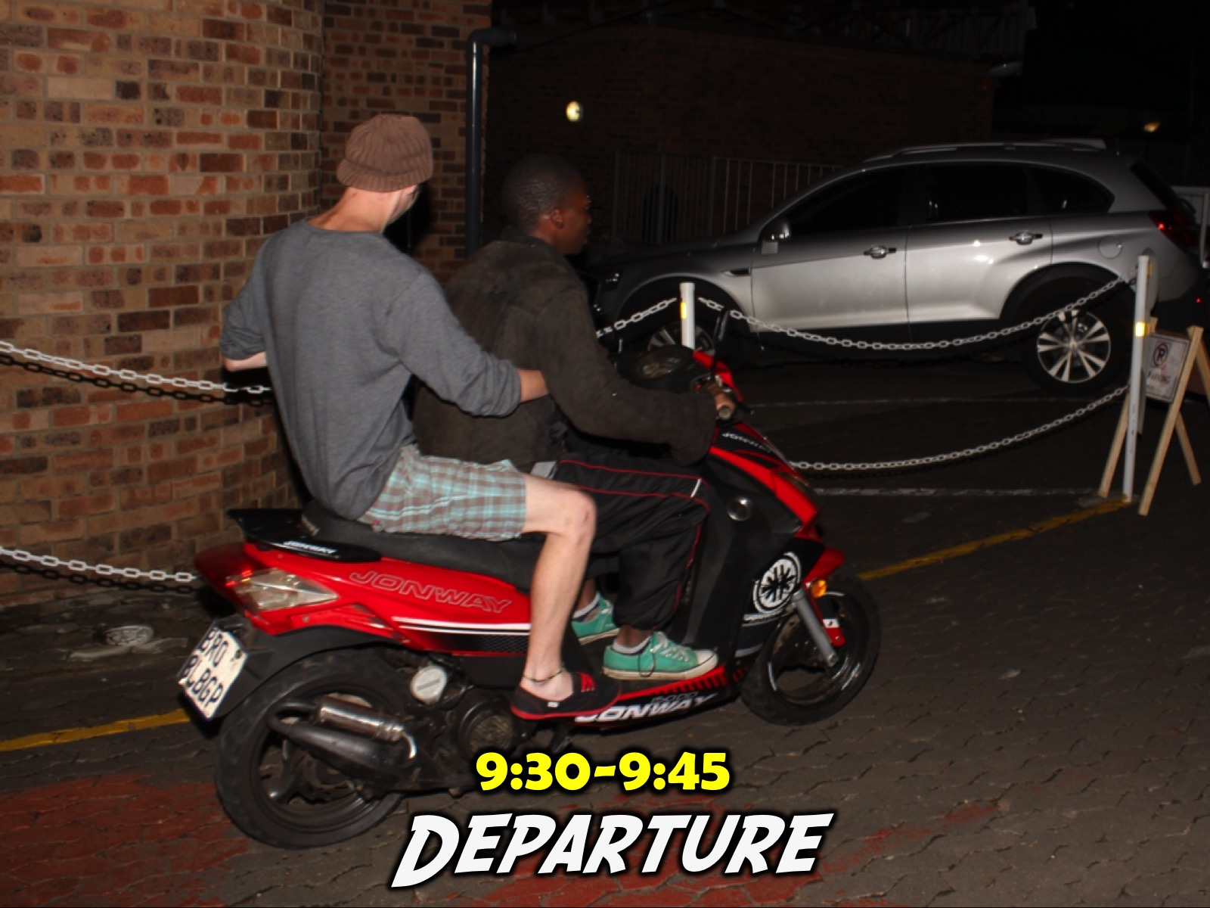
Notes:
9:30-9:45 Departure. We spend some time in the parking lot making sure everyone has a lift home (and also have adult leaders do some dropping off which is a great way to engage with teens).

Slide 31
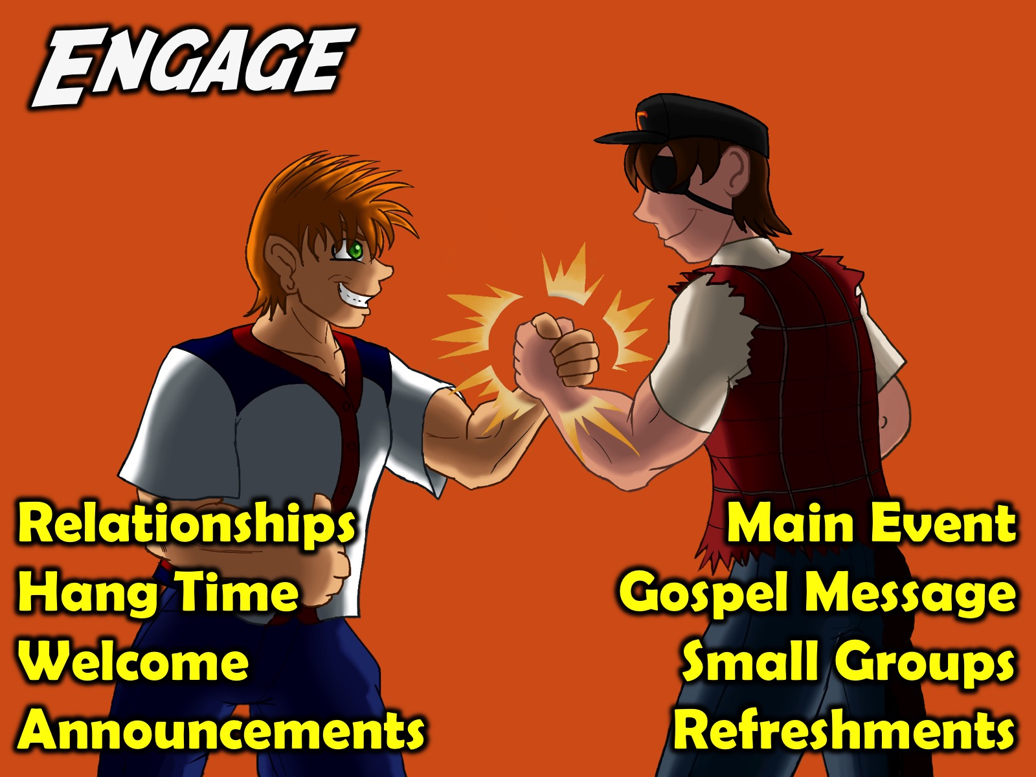
Notes:
So, in summary, here are some of the key components of our Engage event that takes place on a Friday night: Relationships. Hang Time, Welcome, Announcements, The Main Event, a Gospel Presentation, Small Groups and Refreshments.

Slide 32

Notes:
We create a theme for each Term (there are about 10 Friday night events each term) – this ensures that the 10 Friday Nights in the term are connected to one another and not just random events.

Slide 33
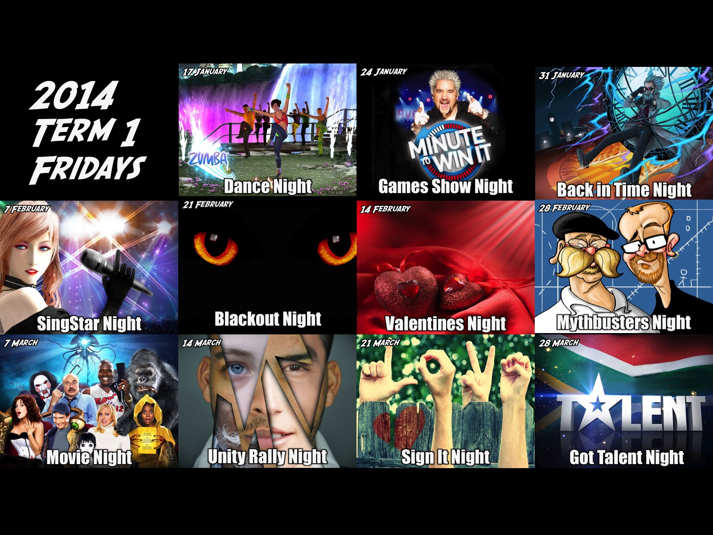
Notes:
At the start of 2014 and before that our Friday nights were basically a random selection of fun events that did not really have anything that held them all together.

Slide 34
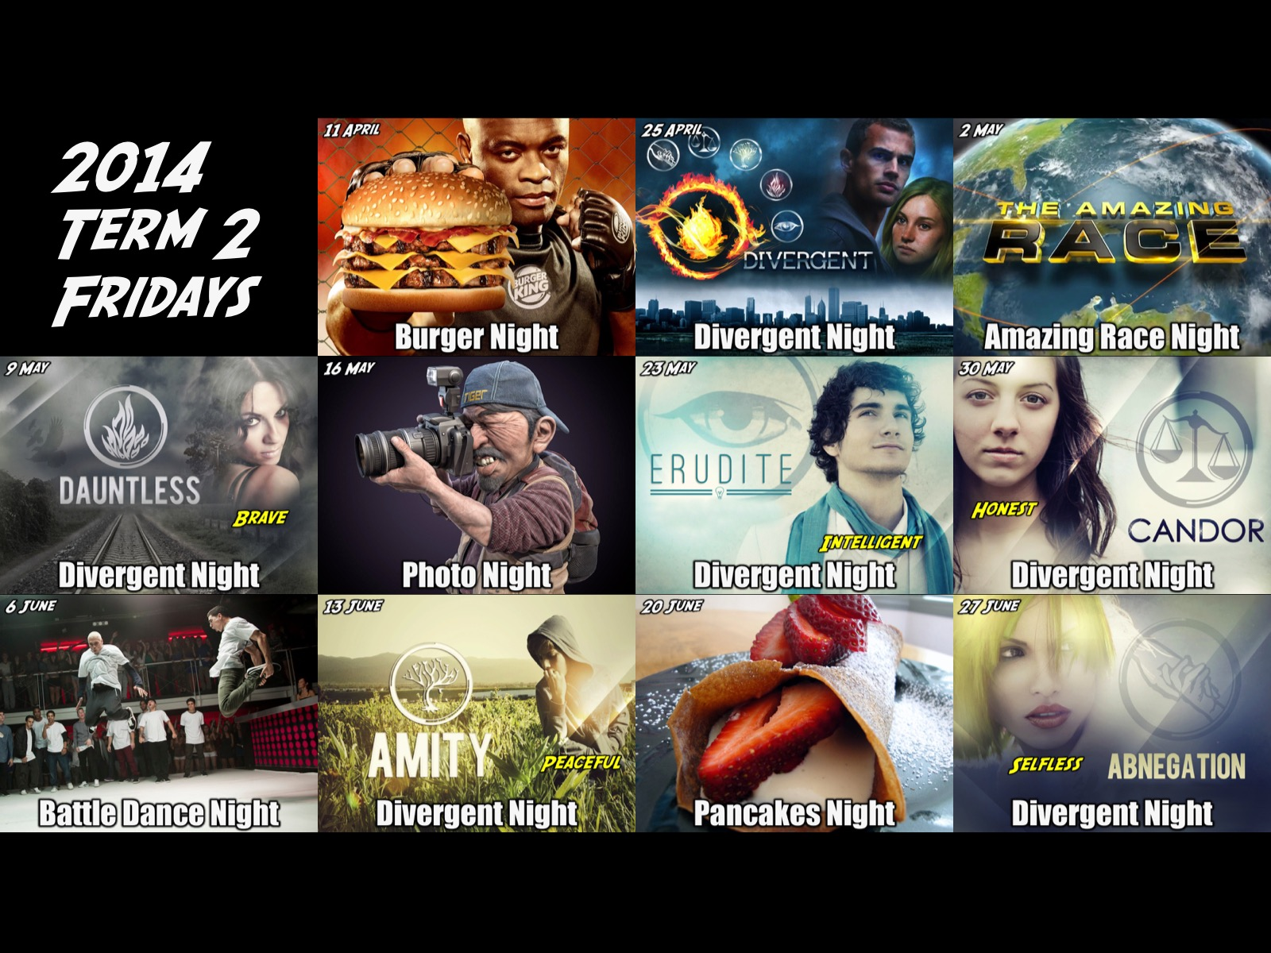
Notes:
In the second term of 2014 we stumbled across the Divergent film series and it set us on a new direction. For 6 Friday nights of that term we focussed on a different faction (Dauntless, Erudite, Candour, Amity and Abnegation) and taught teens that as believers we are called to live out the values of each faction (ie Brave, Wise, Honest, Peaceful and Selfless). From them on we have themed each term as follows:

Slide 35


Slide 36

Notes:
The Online Friday Series – each week we focused on a different media platform (Whatsapp, iTunes, Snapchat, Google, Steam, Twitter, YouTube, Facebook, Instagram and Netflix) to give teens a chance to connect with each other and explored ways to get online with God.

Slide 37

Notes:
The Live Friday Series – each week we took a game (such as Sims, GTA, Assassins Creed, Destiny, Tomb Raider, Watch_Dogs, COD) and built an event to bring the game to life in the real world.

Slide 38

Notes:
The Reality Friday Series – each each week we used a different reality TV series (Survivor, Utopia, Star School, The Mole, Project Runway, Amazing Race, Hunger Games, Come Dine With Me) – to teach teens to be real with themselves, each other and with God.

Slide 39

Notes:
The My Life Friday Series – each week we focused on a different area of a teen’s life (their Hobbies, Music, Movies, Passion, Health, Mind, School and Friends) to explore how to bring God into that part of their world)

Slide 40

Notes:
Cash Friday - Here is an overview slide of the Friday night events that we have just planned for the third term of 2015.

Slide 41
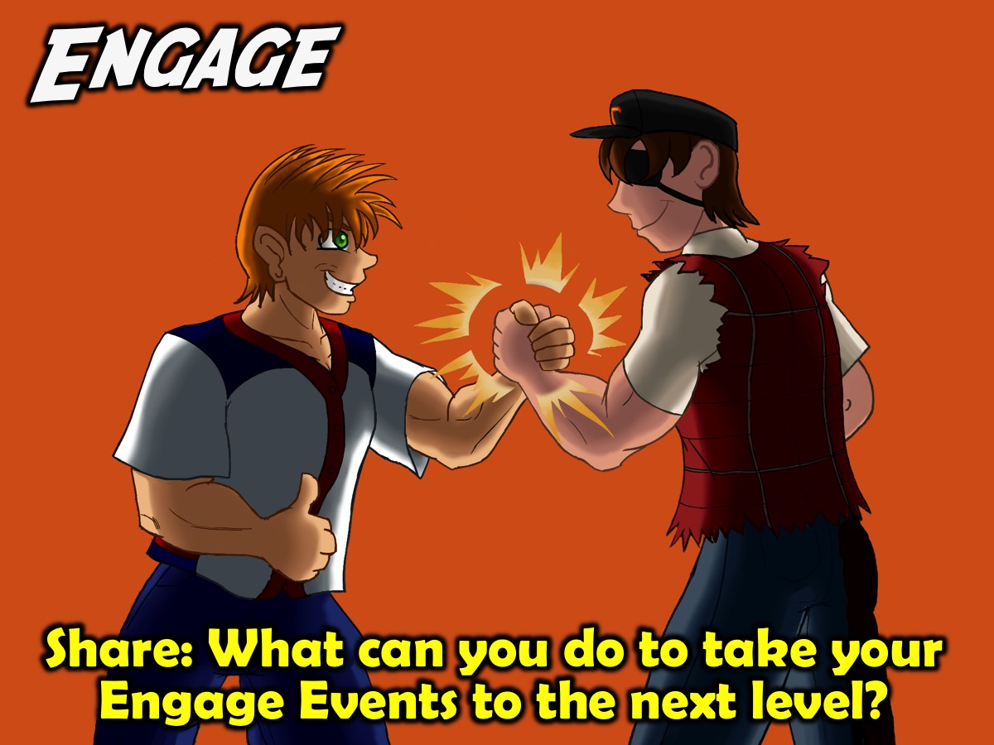
Notes:
Share: What can you do to take your Engage Events to the next level?

Slide 42

Notes:
Establish. The second phase in our disciplemaking strategy is to Establish teens in the faith. Our Sunday morning weekly ministry focuses on this phase. Here is a detailed outline of our current Sunday morning approach and strategy for youth ministry.

Slide 43
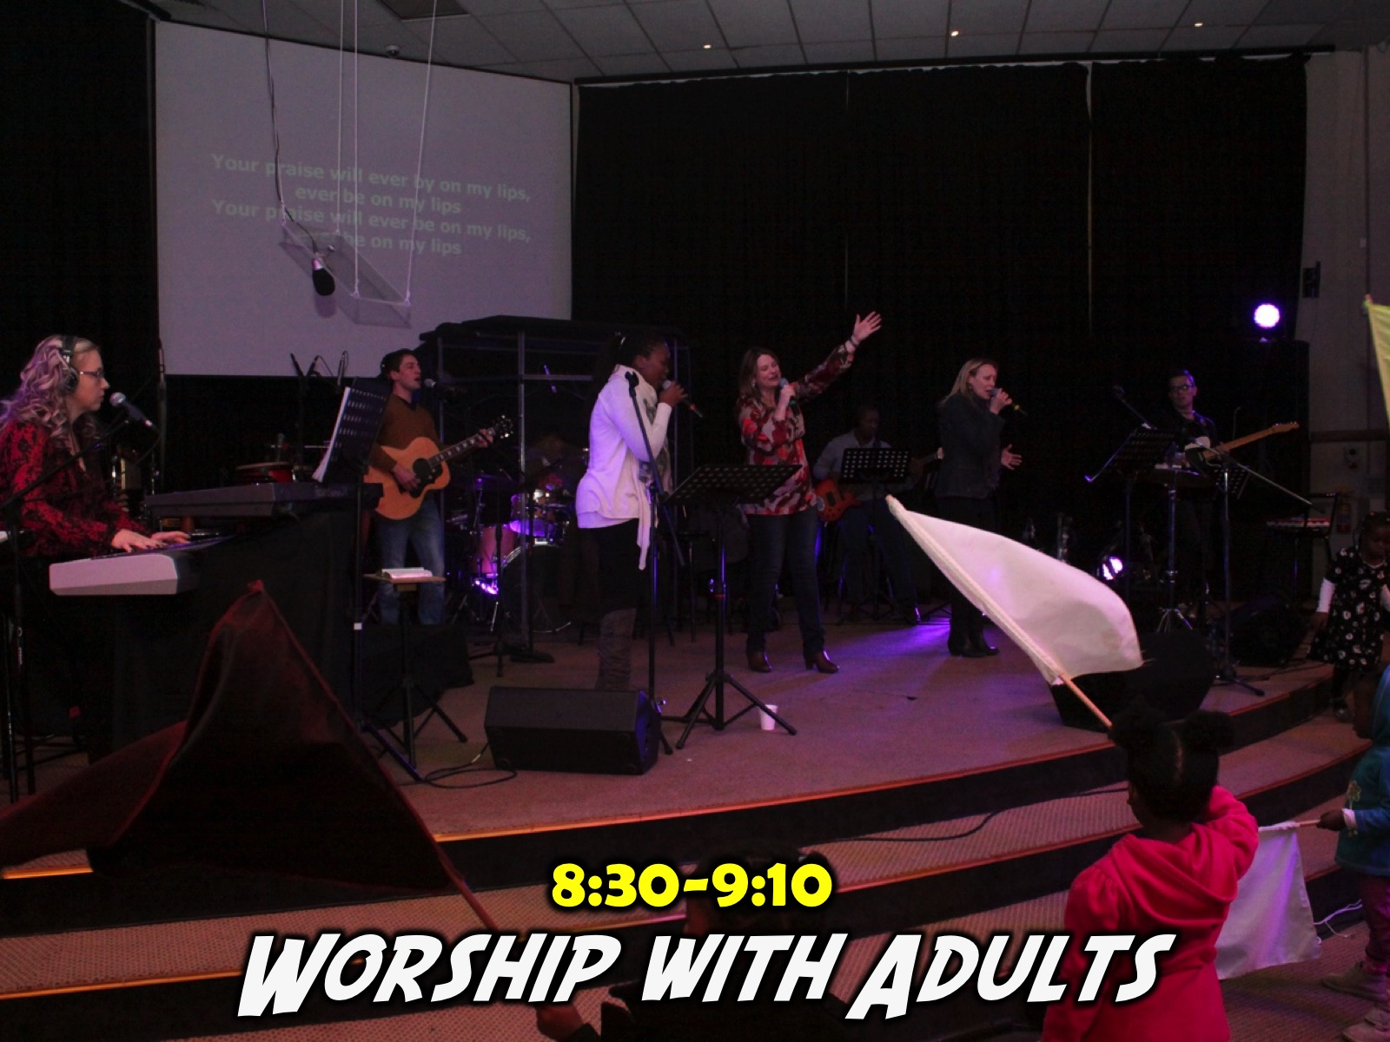
Notes:
The Sunday morning event is our Establish event - where we start by worshipping together with the adult congregation and we exit the sanctuary when worship ends - usually after around 40 minutes of 90 minute service. Our church is very contemporary and young given that Campus ministry is a key value in our church - so teens actually enjoy the worship experience with the adults and don't really need their own worship experience although for many years we went that route on a Sunday morning but we felt that we became a para-church youth ministry that happened to meet on the premises of His People Church. Now there are better connections in the church and in the school holidays when we don't have a Sunday morning youth service, the teens are much happier to attend "big" church rather than just stay at home.

Slide 44

Notes:
So after worship is finished there is a slide that goes up in the Sanctuary advertising our series (with the topic or character we are focusing on for that particular week) and it has our logo and it says: "High Schoolers to the youth room now!" This helps us catch new teens who are attending church with their parents and who don't yet know about our youth service.

Slide 45
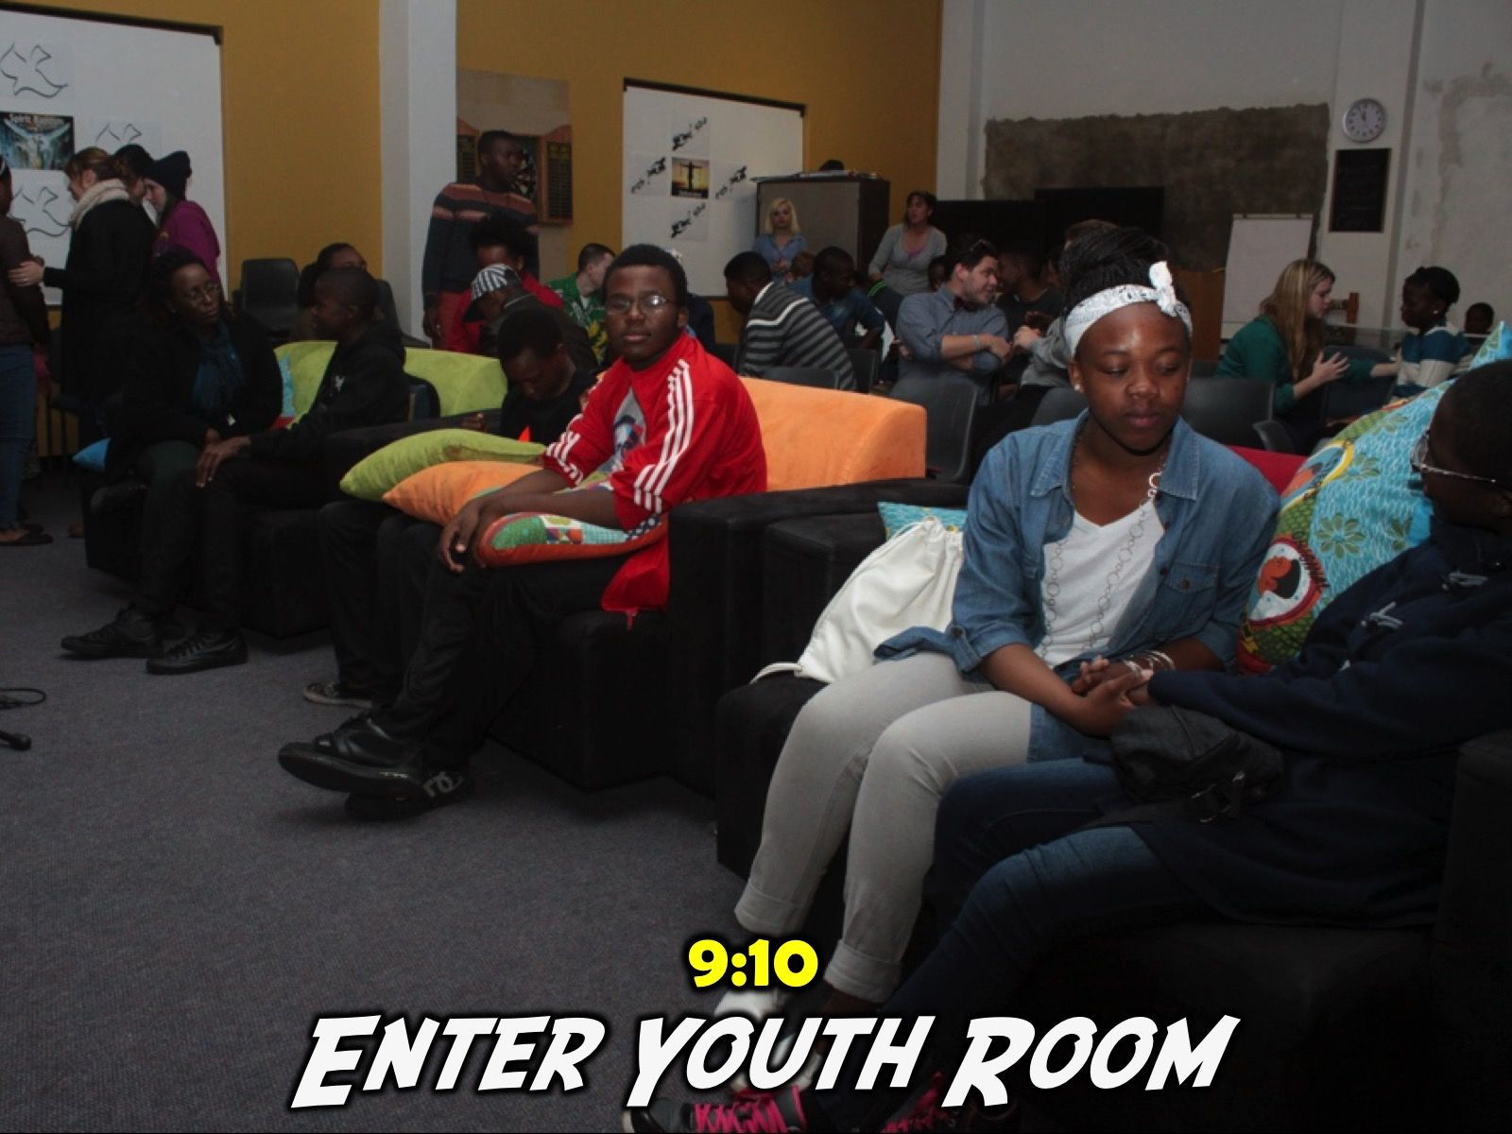
Notes:
Once we get into the youth room we wait up to 3 to 5 minutes for the teens to connect with their friends and also grab a chair to sit on. As they enter the room there is music playing and also a PowerPoint presentation is looping with photos that have been chosen from the Friday night event – this helps to get the Sunday congregation to be aware of what we do on Friday nights and also teens enjoy seeing themselves on the big screen.

Slide 46
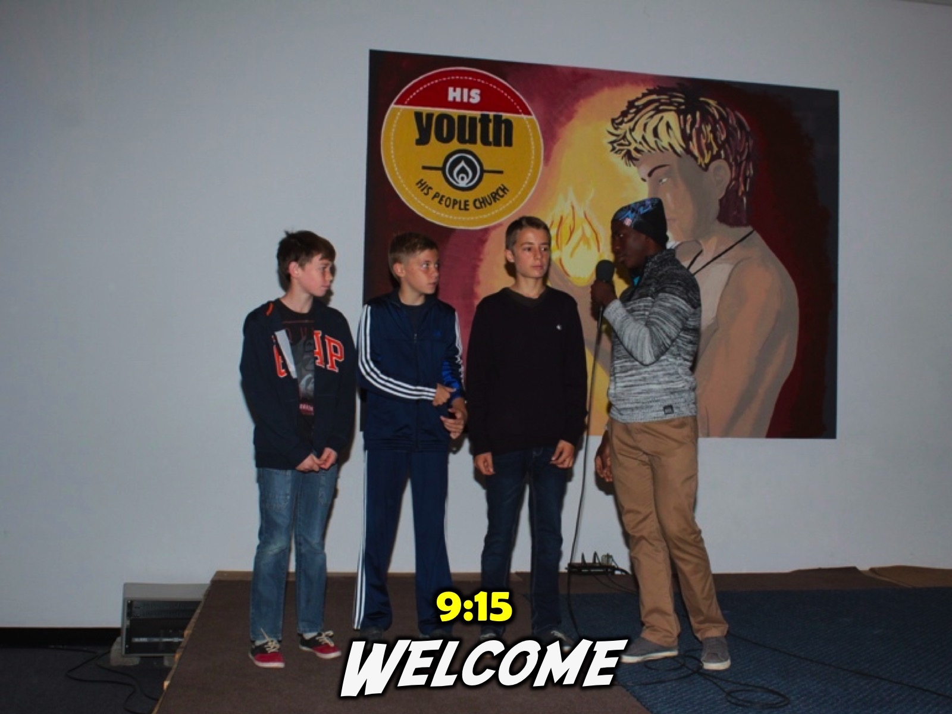
Notes:
A teen leader will then welcome people to His Youth and also ask any newcomers to come up to the stage. They are then asked to share their name, the school they attend (sometimes their grade) and usually one stilly bit of information about themselves – like their favourite colour or the colour of their toothbrush. Once they have shared this information about themselves, the person welcoming them will interact with the audience and ask: “What is their name?” and “What school do they go to?” And everyone has to repeat it back. We are then asked: “And what are they?” To which we answer: “Family!” The next question is: “And what must we do to them?” To which we answer: “Love them”. And finally the person says: “And what else?” To which we answer: “Care for them.” The person is then allowed to take their seat and the next person is welcomed if there is more than one visitor on the day.

Slide 47
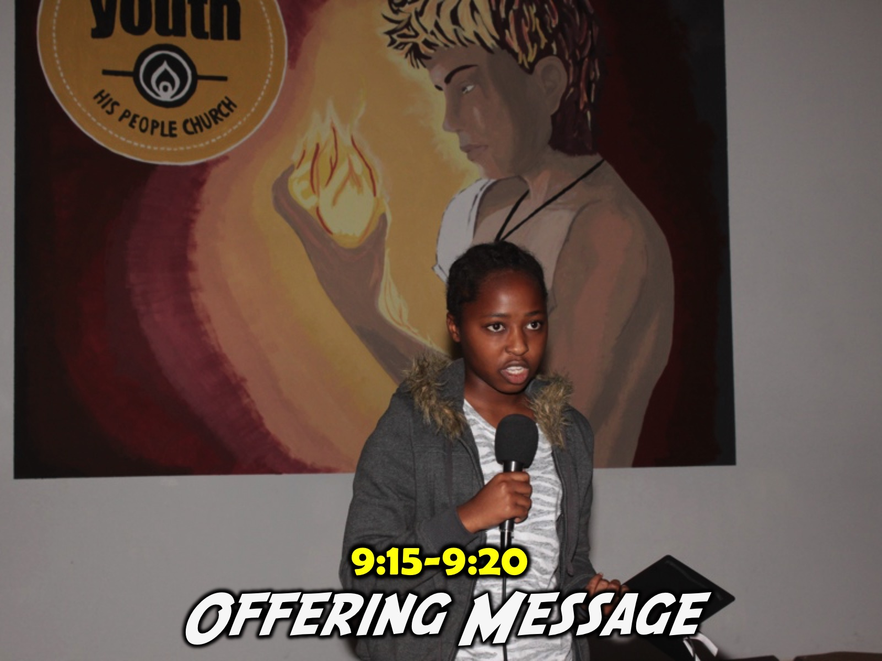
Notes:
The welcome person then hands over to the next teen who does the offering message. They share a brief word of encouragement that will motivate teens to give of their tithes and offerings and then the box is sent around. For some reason we do not follow this up with a prayer as this point which is very common in most church services. Maybe it is something we need to look into. When their message is over they make sure that the offering box is given to the first person in the front row and the box makes it way through the teens (without the help of ushers) until it gets to the back where it is passed to an adult leader at the sound desk who counts the offering.

Slide 48
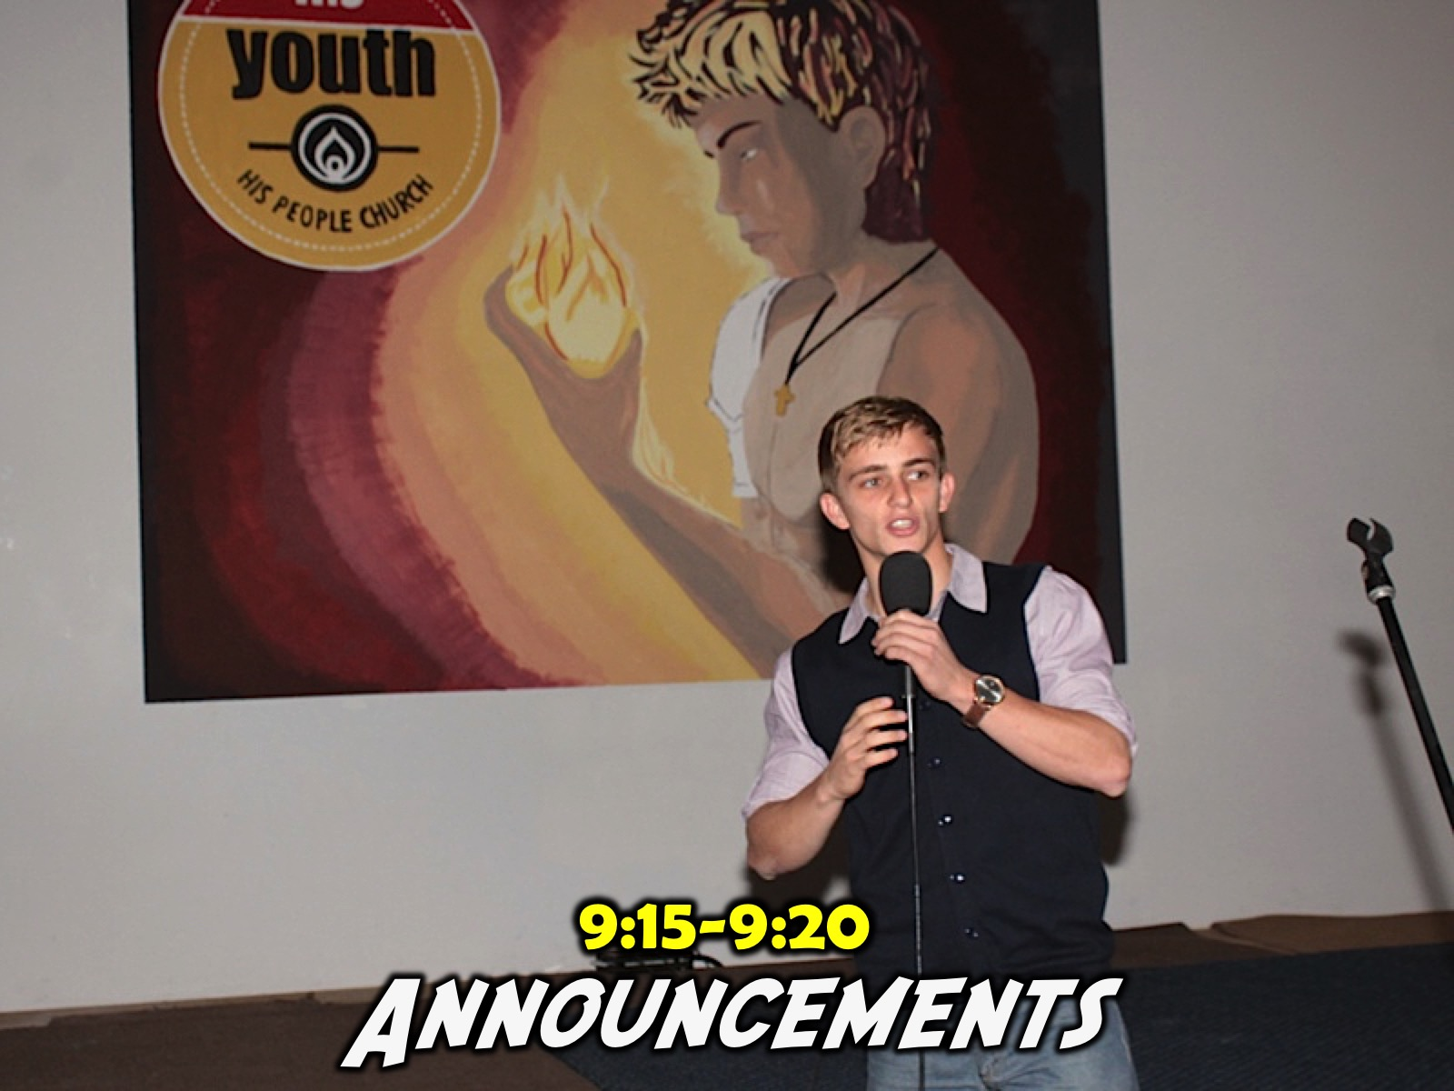
Notes:
The offering person then hands over to the announcements person (there are overheads slides for each of these parts of the service to help keep things moving and prevent us forgetting about one of the key elements in the service). Generally the first item to be mentioned is our Facebook page and the teens are encouraged to Like the page and visit it each week to view photos and download sermons they missed or want to listen to again or the PowerPoint presentations to visit or share with their friends. We spend a lot of time tagging teens from our Friday night events and are having teens tell us that they are part of our ministry because they found us on Facebook – probably through teens they are friends with from their school. The announcer then mentions the event that was held the past Friday night (and we show just 5 slides that capture the highlights of the event) and then they mention the next Friday night event and encourage the teens to be there. Any other special announcement, like praying for teens going on a mission trip, are also made at this point. The last announcement is about the message that is about to be presented and the announcer will mention the series that we are currently in (not what we are going to focus on that day – as that is left to the preacher to do) and also they call up the preacher to the stage.

Slide 49
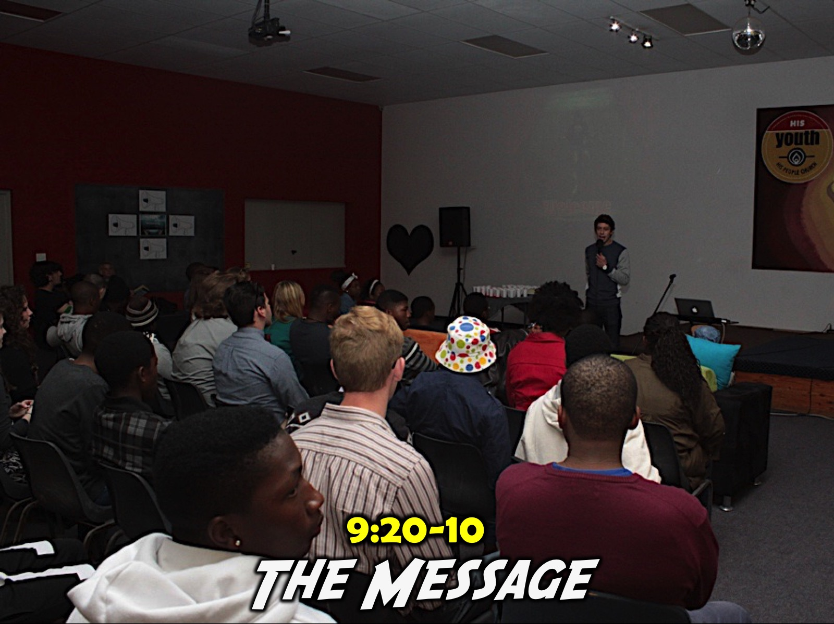
Notes:
Usually the Welcome, Offering and Announcements takes around 10 minutes in total which leaves us around 35 to 40 minutes for the ministry of the Word. A recent series was entitled Heroes where we have spent eight Sunday mornings focusing on different Bible characters (Joseph, Rebekah, Daniel, Hannah, Jonah, Ruth, Peter and Esther – we alternated between male and female characters and also had the appropriate gender present that hero for the week). A key focus of the term was to get the teens to get into the Word for themselves, to Connect with the life of that Bible character and discover for themselves keys to growing in their relationship with Jesus. Some Sundays included lots of Video, images printed and placed on walls, drama, reflective reading, narrated readings, small group discussion and report back, etc. Some weeks involved a contemplative journey through the life of the character – as was done for the Jonah week. Teens were generally given a handout or worksheet to use during the service and we also made use of the chalkboard to capture insights that the teens learnt and reported back on from their small groups.

Slide 50

Notes:
Term 1 Sundays

Slide 51

Notes:
Term 3 Sundays

Slide 52
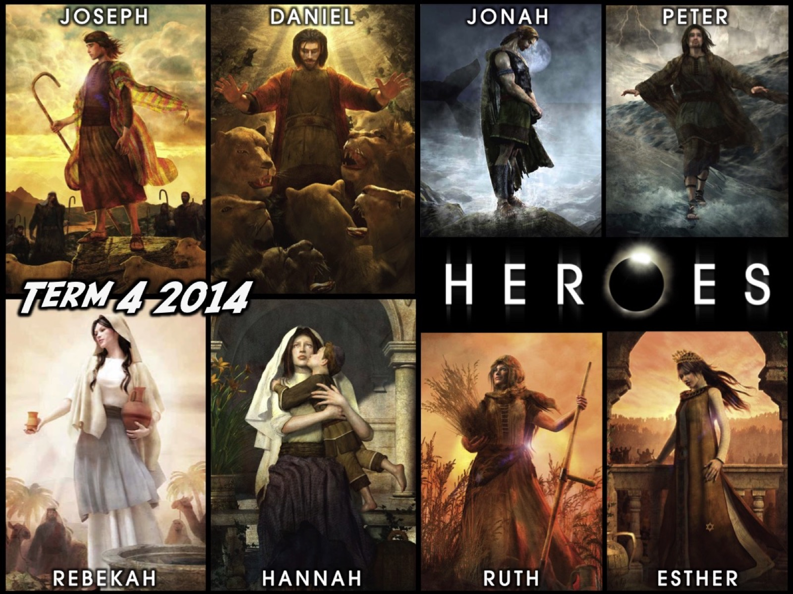
Notes:
Term 4 Sundays

Slide 53


Slide 54
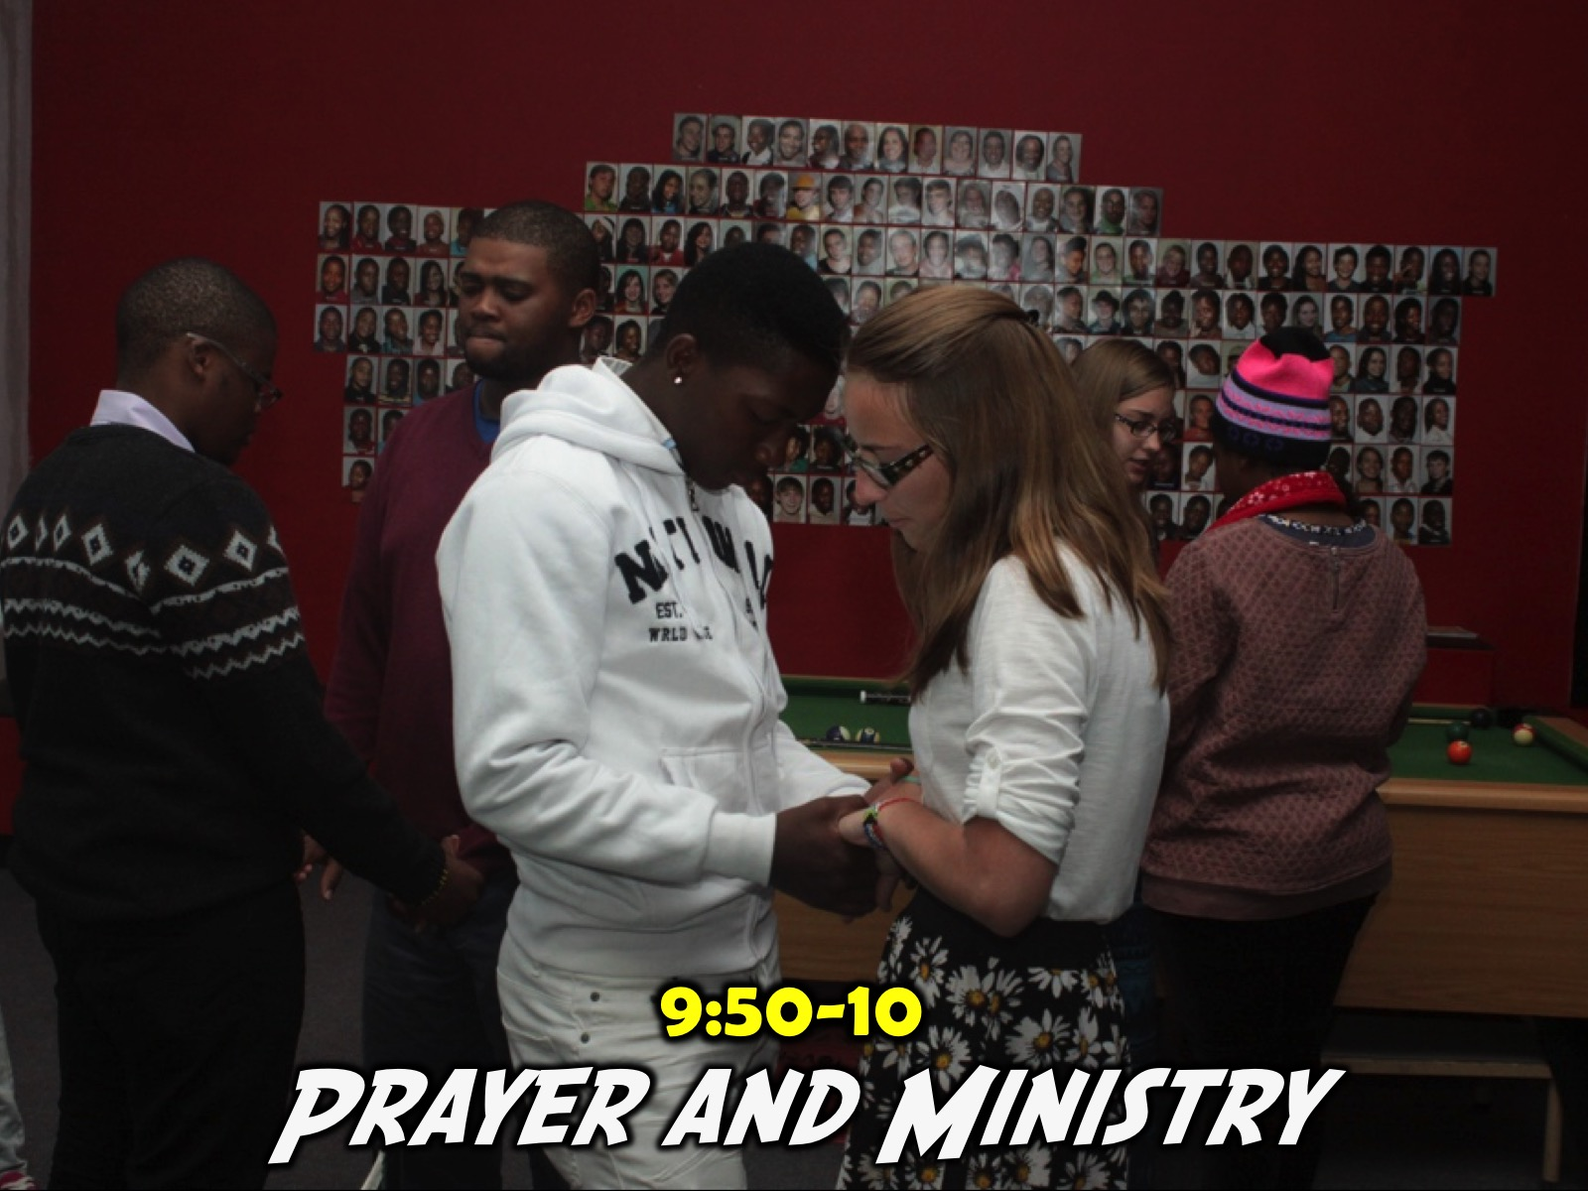
Notes:
The service ends with prayer and often a time of response and ministry before music is played as teens either hang around playing pool or foosball or table tennis or just chat with their friends or adult leaders.

Slide 55
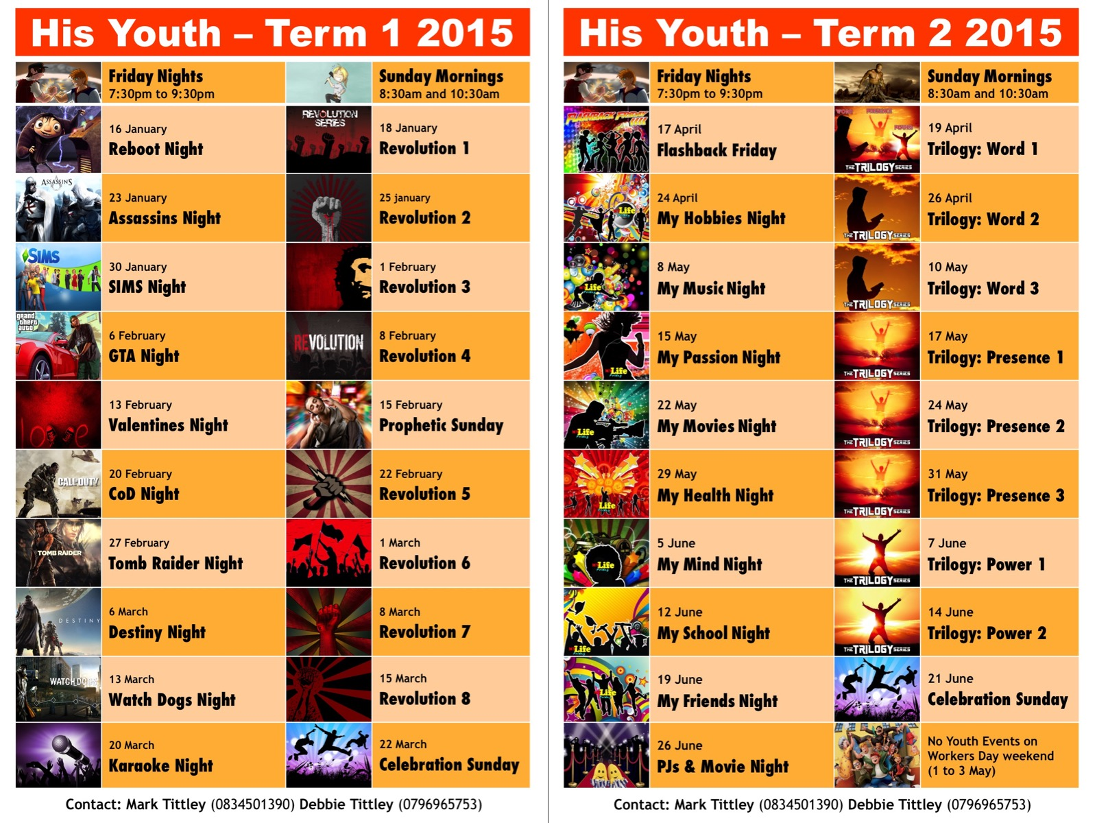
Notes:
We hand out a term planner each term that includes all our Engage and Establish events and contact details for key leaders.

Slide 56
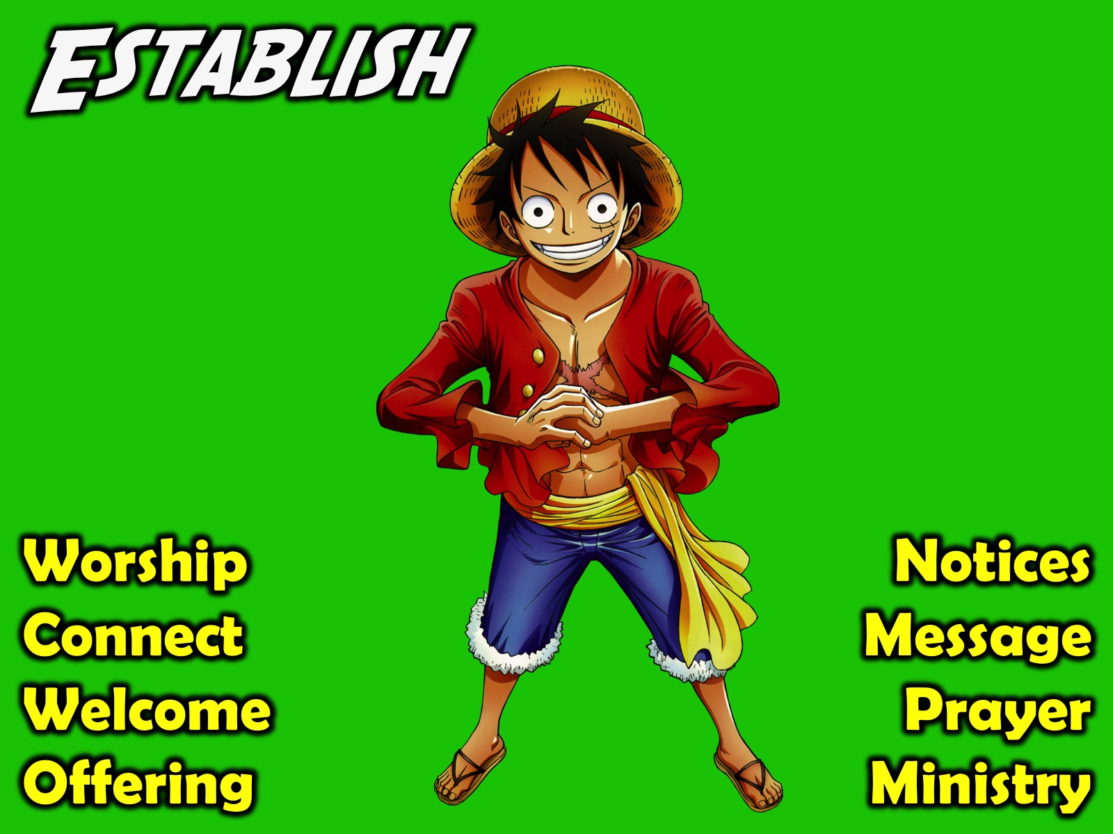
Notes:
Here are some of the key components of our weekly Establish event:

Slide 57
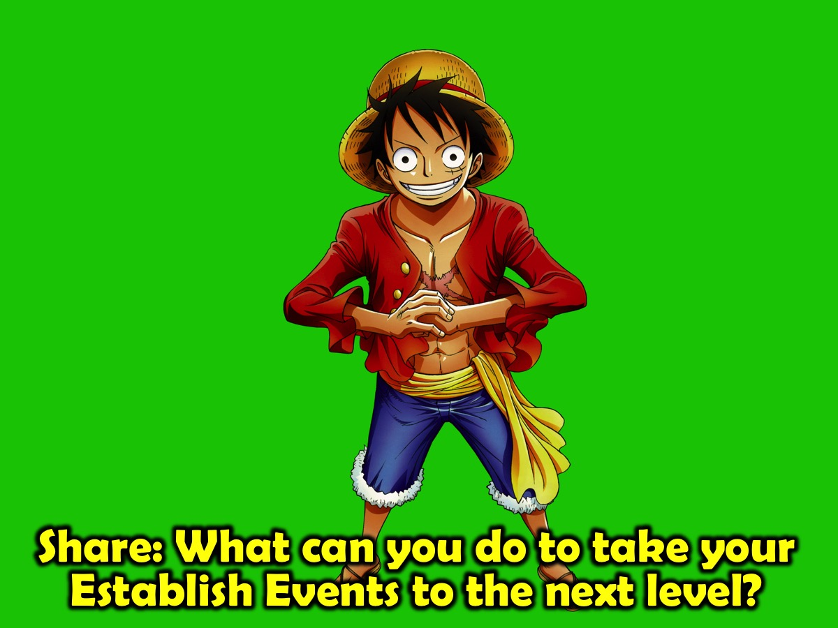
Notes:
Share: What can you do to take your Establish Events to the next level?

Slide 58

Notes:
Equip. At His Youth we equip teens so they are able to be involved in ministering. Here are some of the ways in which we do that:

Slide 59

Notes:
Some Sunday series at His Youth are actually Equipping Events rather than Establish event, although there is an overlap of course.

Slide 60


Slide 61
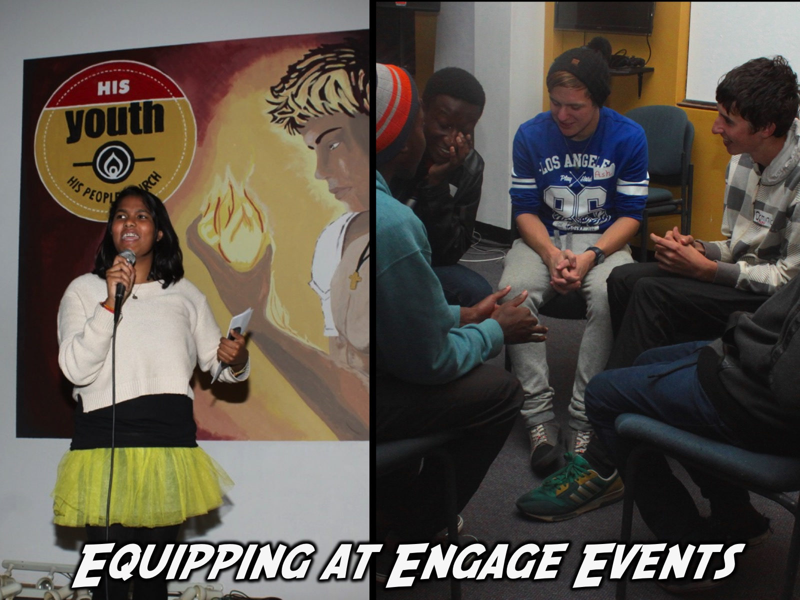
Notes:
We use the Engage Event on Friday nights to equip teens for ministry - by having them take responsibility for an event in the term, planning and involving other teens in running the event and also serving as small group leaders on the night.

Slide 62
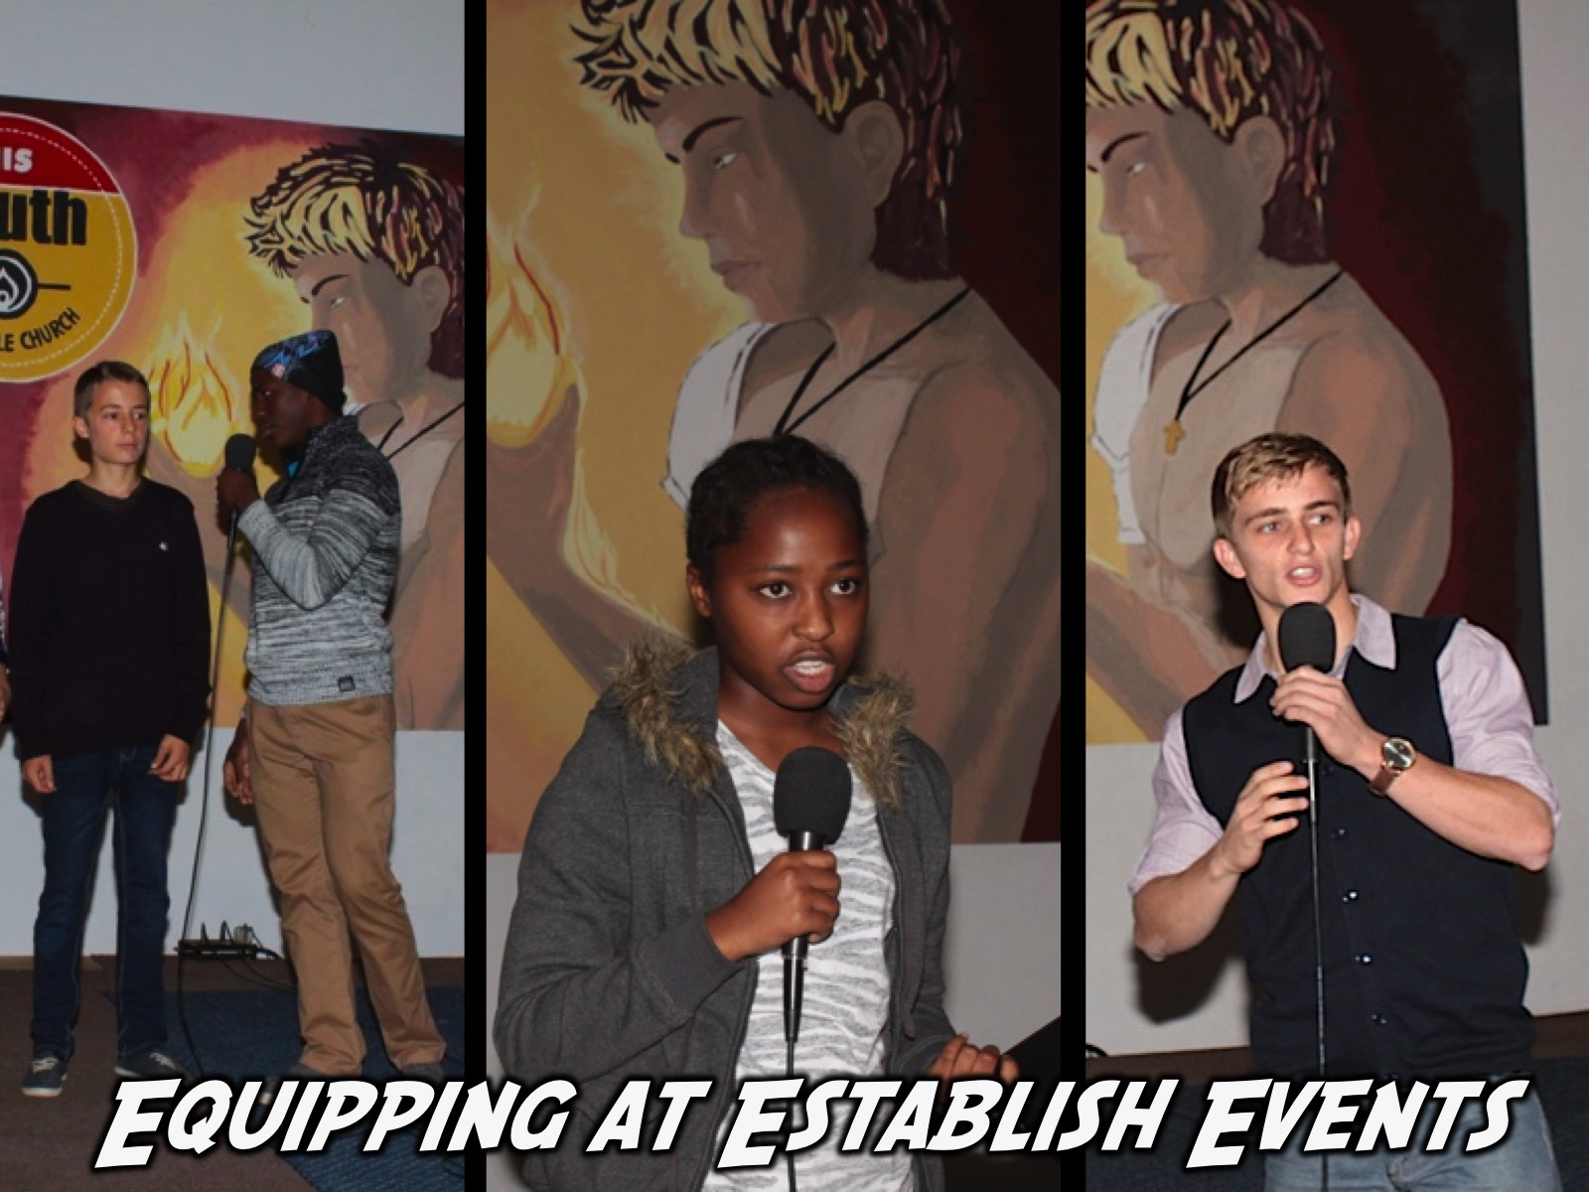
Notes:
We use the Establish Event on Sunday mornings to equip teens for ministry - by having them do the Welcome, Offering, Announcements and give Testimonies - and even preaching.

Slide 63
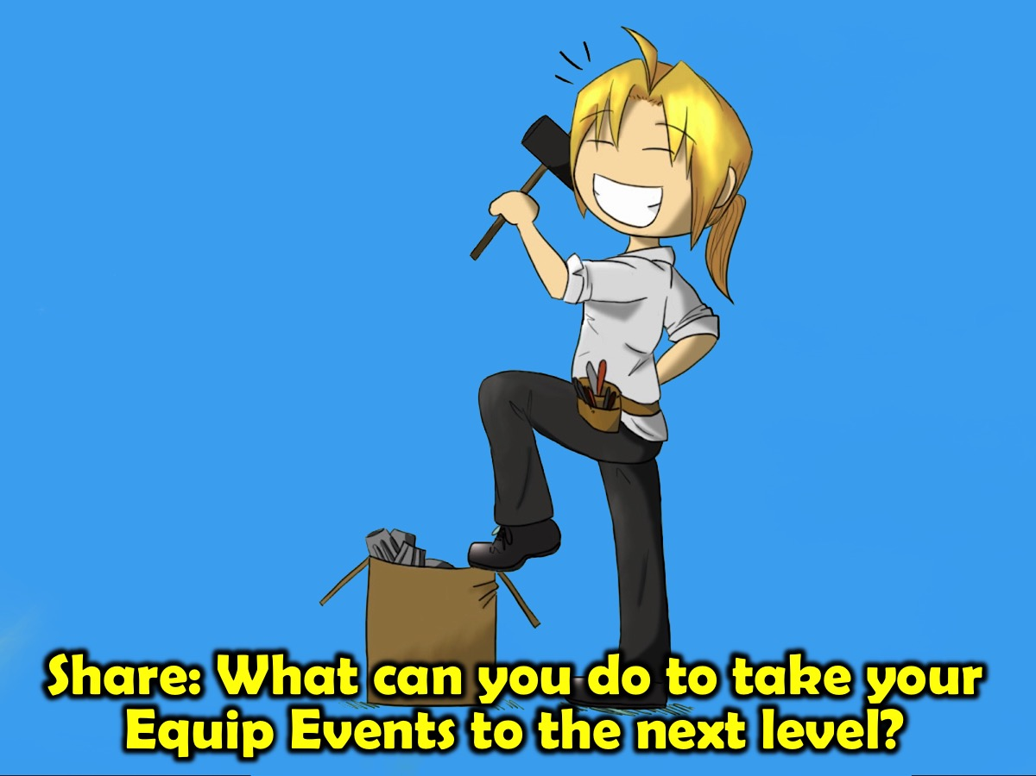
Notes:
Share: What can you do to take your Equip Events to the next level?

Slide 64

Notes:
4. Empower Events. We also empower teens by releasing them to serve in various levels of ministry.

Slide 65
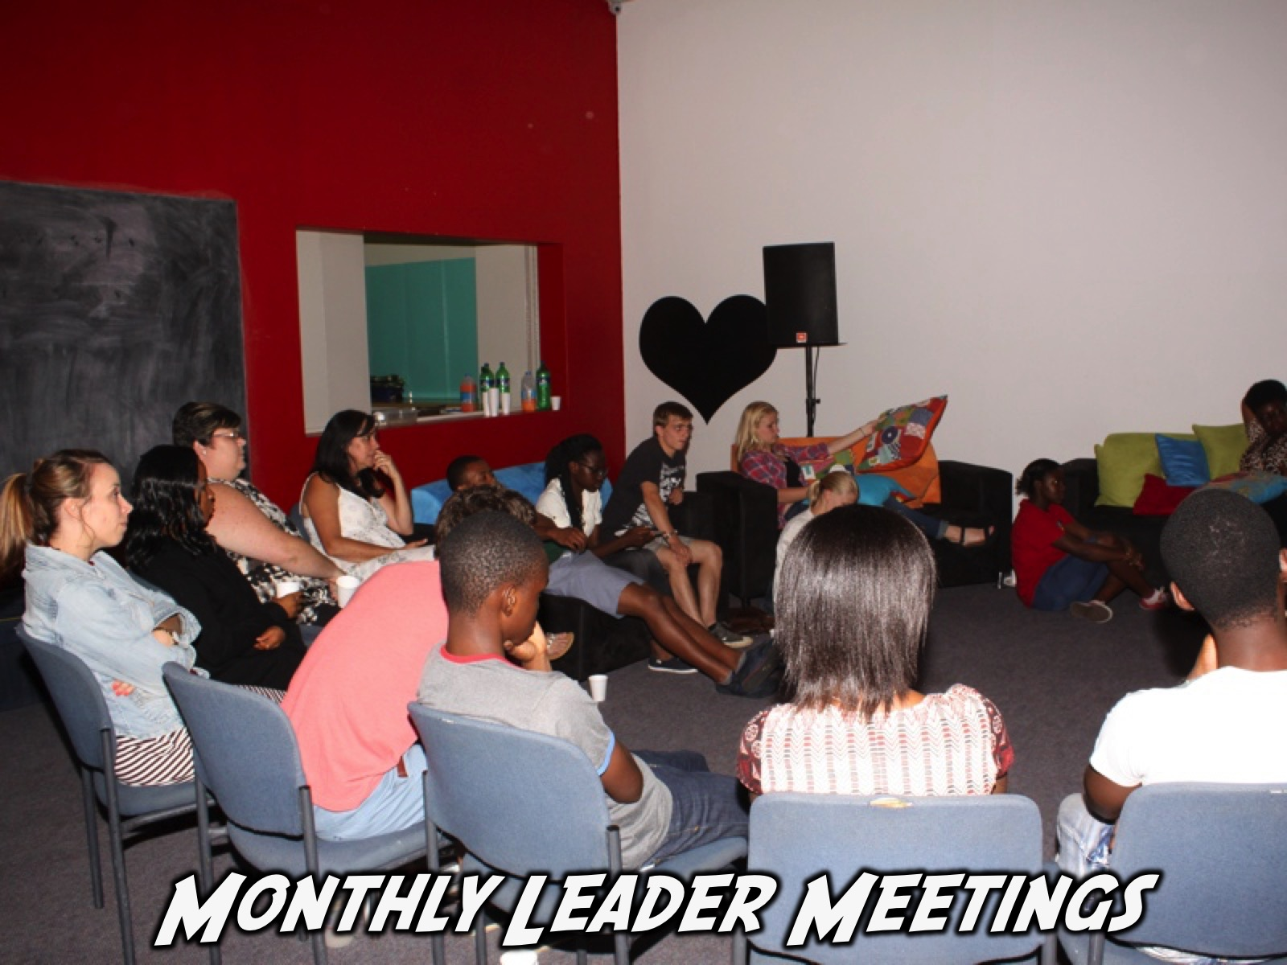
Notes:
A key event is our monthly leaders meeting and is aimed at our various levels of leadership at His Youth.

Slide 66
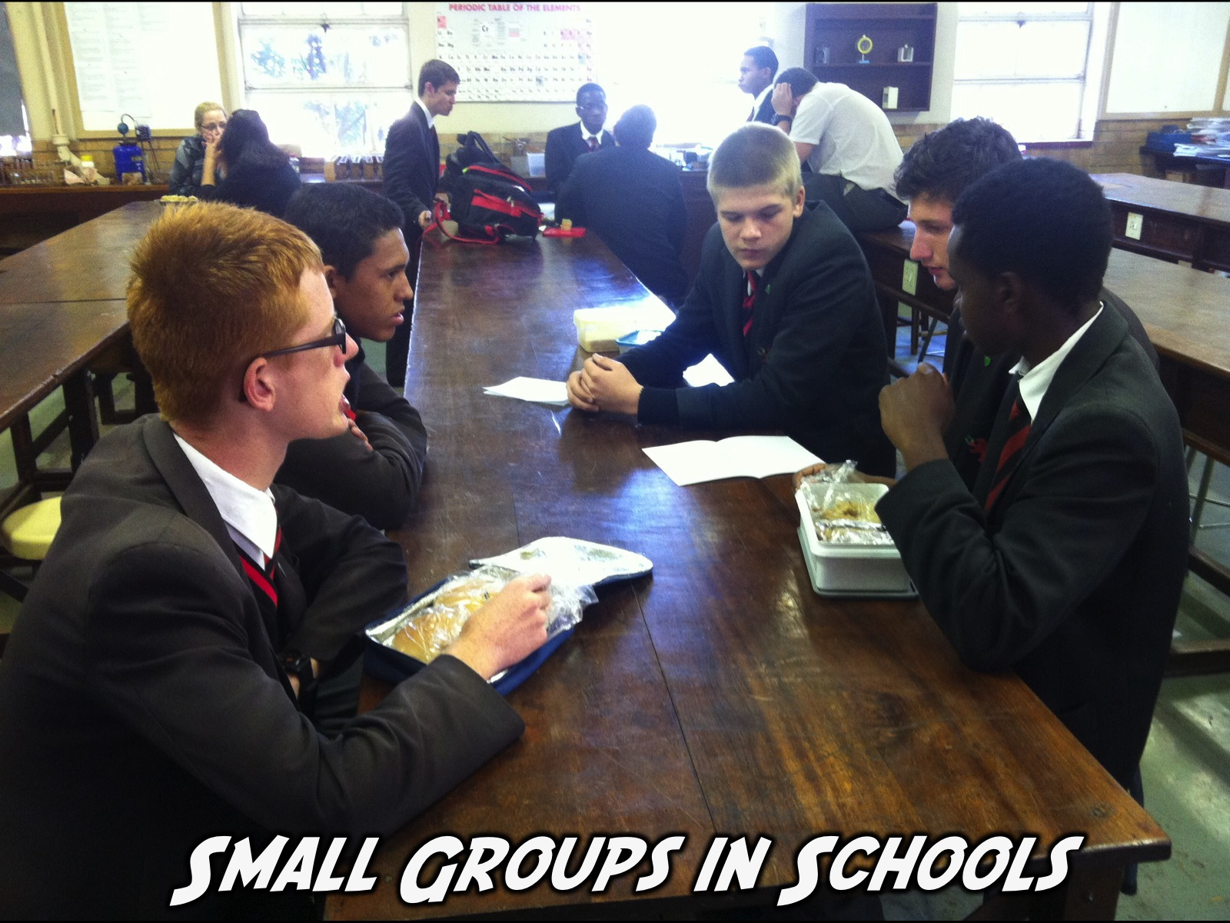
Notes:
Another aspect of ministry is to equip and empower teens to lead small groups within their high schools. We are currently developing and releasing leaders in 3 high schools and hope to add at least another school in 2016.

Slide 67

Notes:
Our Leadership Philosophy: Our ministry is adult-guided and youth-led. Adult leaders play a critical role in setting the vision of the ministry and through their presence, mentoring and coaching provide a safe environment in which teens can grow into leadership.

Slide 68
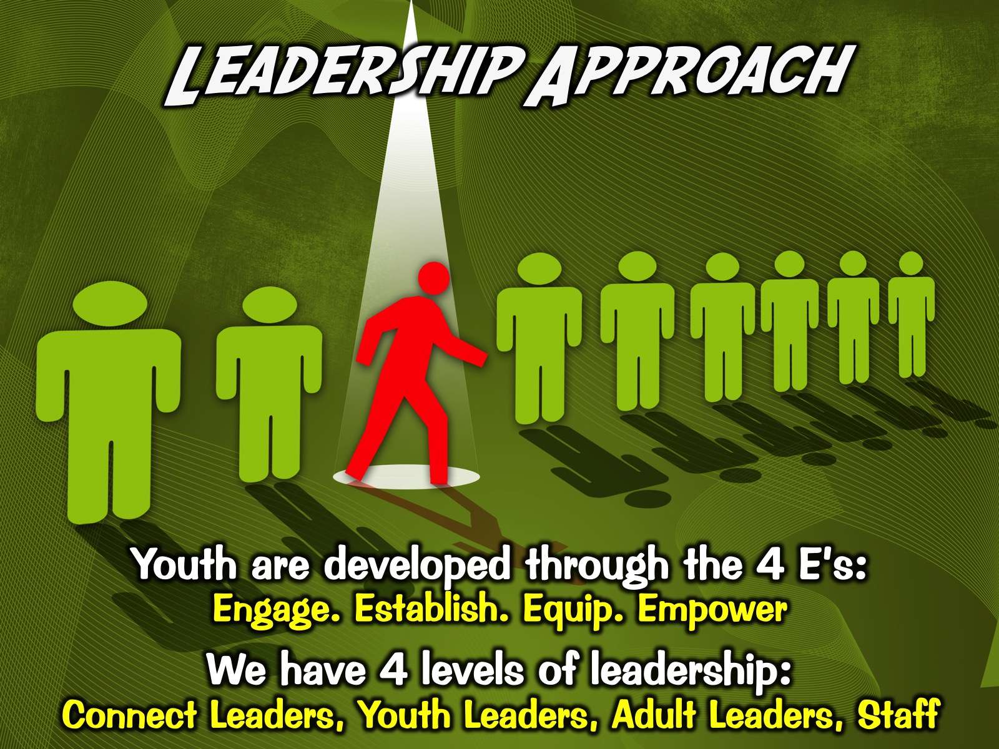
Notes:
Our Leadership Approach: Our youth are developed through the process of Encounter, Establish, Equip and Empower to lead among their peers. We have four levels of leadership that people can participate in at present:

Slide 69
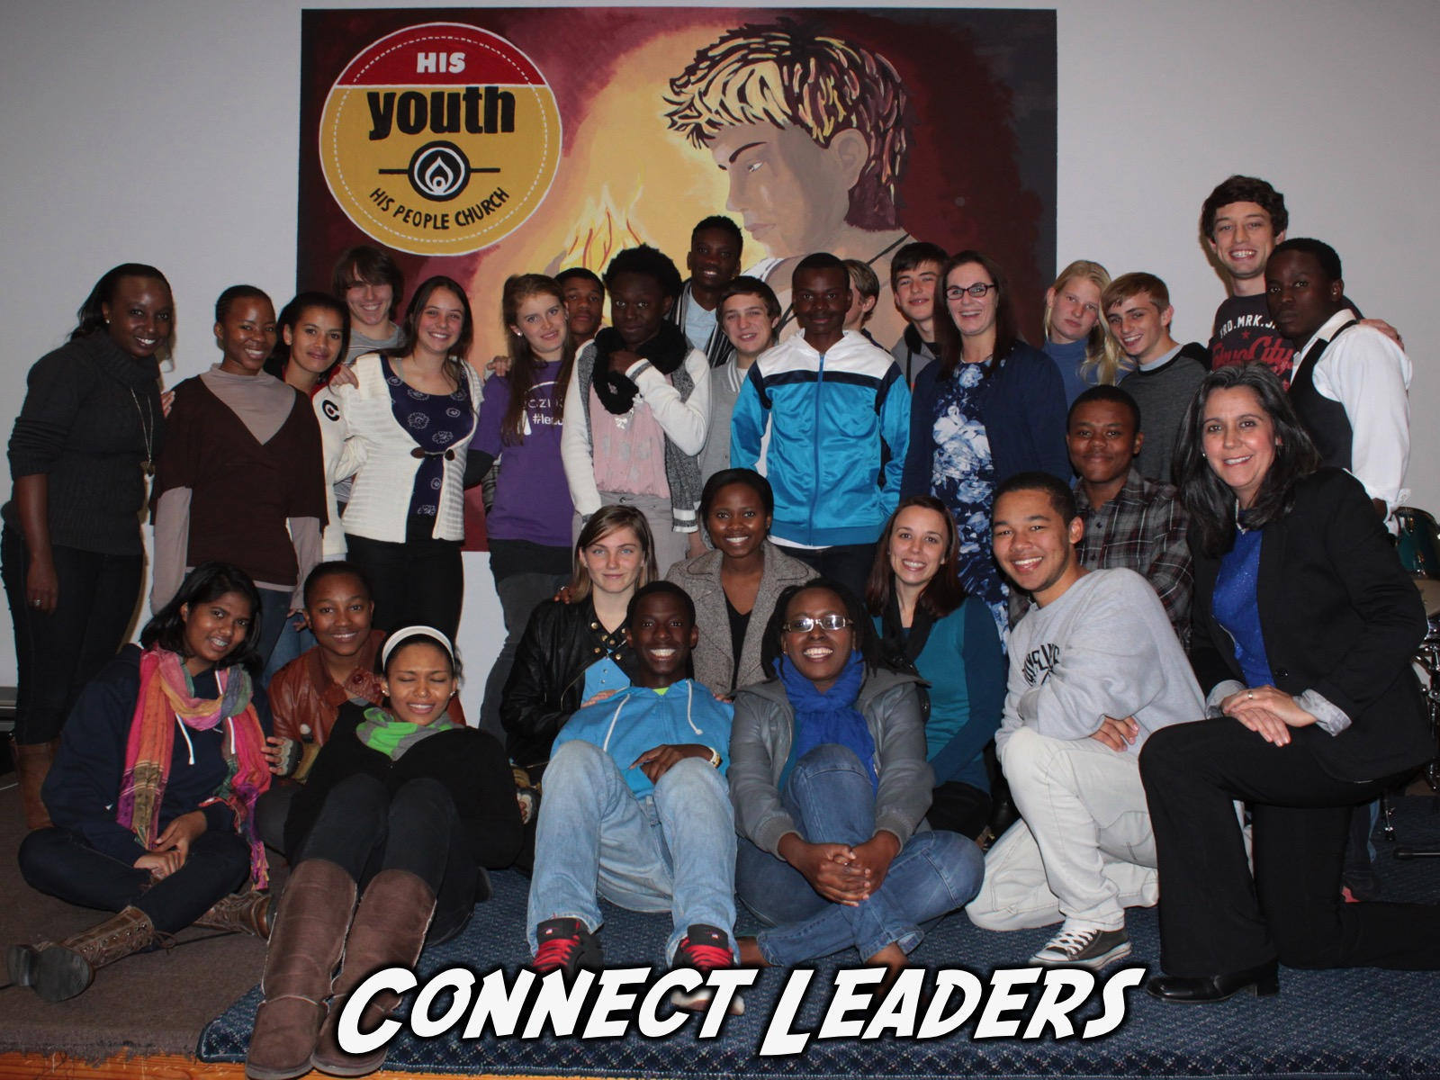
Notes:
(1) Connect Leaders. As youth have been established in the faith we call them into this level of leadership in which they serve on a weekly basis as small group leaders at our Friday night event. We provide equipping for them on how to lead a small group, lead teens to Christ and challenge them to take their role as small group leaders beyond the four walls of the church but connecting with their group during the week – meeting at school in small groups or continue disciplemaking through social media. This group is the larger leadership group at present in our ministry (during September 2014 we had 24 teens who were identified as Connect Group Leaders and who connected regularly on a WhatsApp group and who met once a term for two hours for impartation and planning and who meting once a week for prayer on a Friday night from 6:45 to 7:15). They also handle the welcome, notices and offering message on Sunday mornings in our Establish level event and serve as leaders in children’s ministry and take part in mission trips.

Slide 70
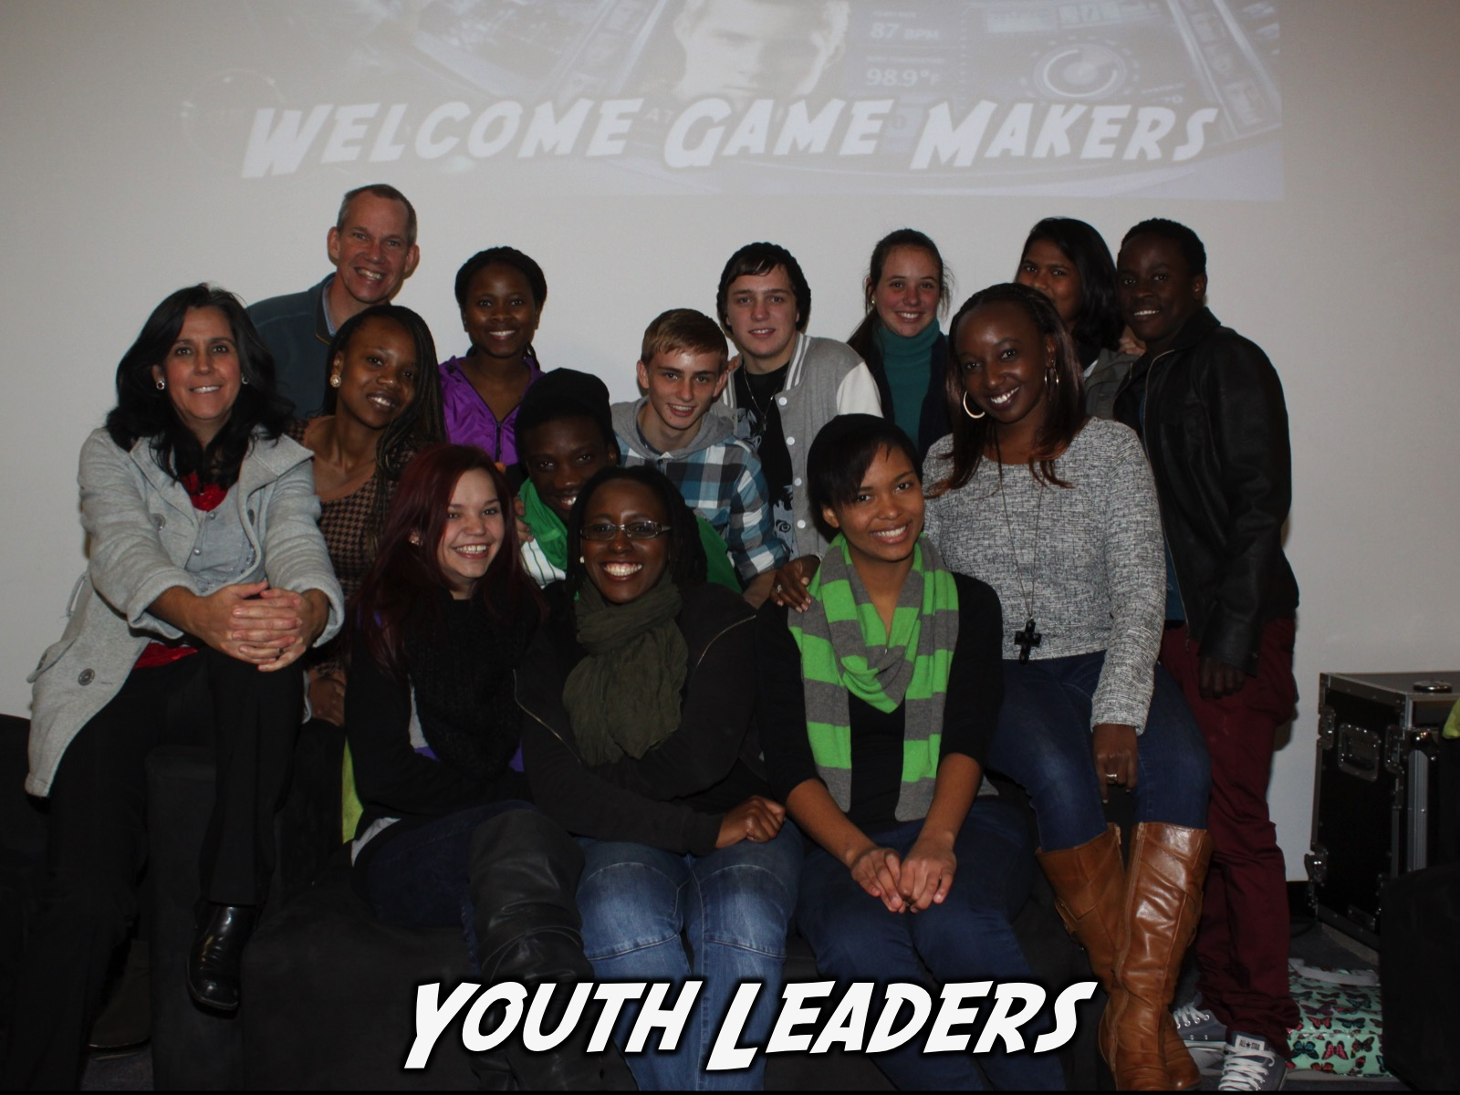
Notes:
(2) Youth Leaders. We have a second level for youth leadership that consists of a small group of teen leaders who These leaders meet once a month for 2 hours and together with the adult leaders plan each term’s ministry focus and programs. They are responsible for one Friday night a term and work with a small group of Connect Leaders to plan and present Friday night events. They are also small groups leaders at Friday night events. They also communicate with each other via a WhatsApp group.

Slide 71
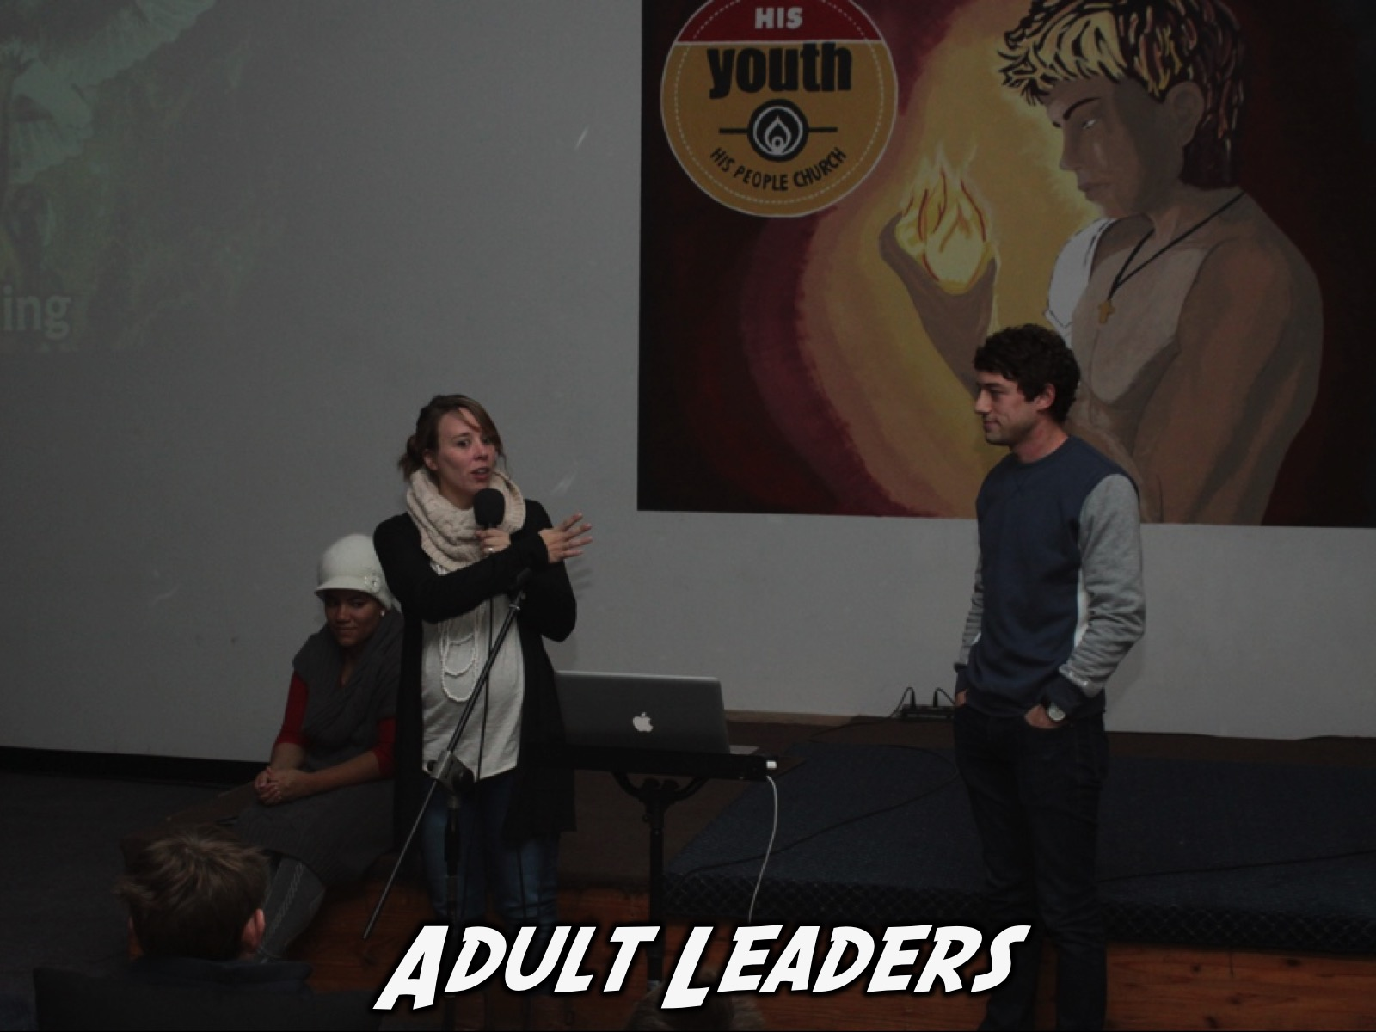
Notes:
(3) Adult Leaders. The adult leaders currently provide supervision and mentoring for the ministry and are encouraged to see their role in building into the lives of youth and young leaders rather than in running the actual ministry. They do take part in preaching on Sunday mornings and handling the behind the scenes set up and serving at youth events. Some teens who matriculate sense the call to serve in a leadership role at His Youth as adult leaders while the rest are encouraged to get involved in either campus ministry or the adult church.

Slide 72
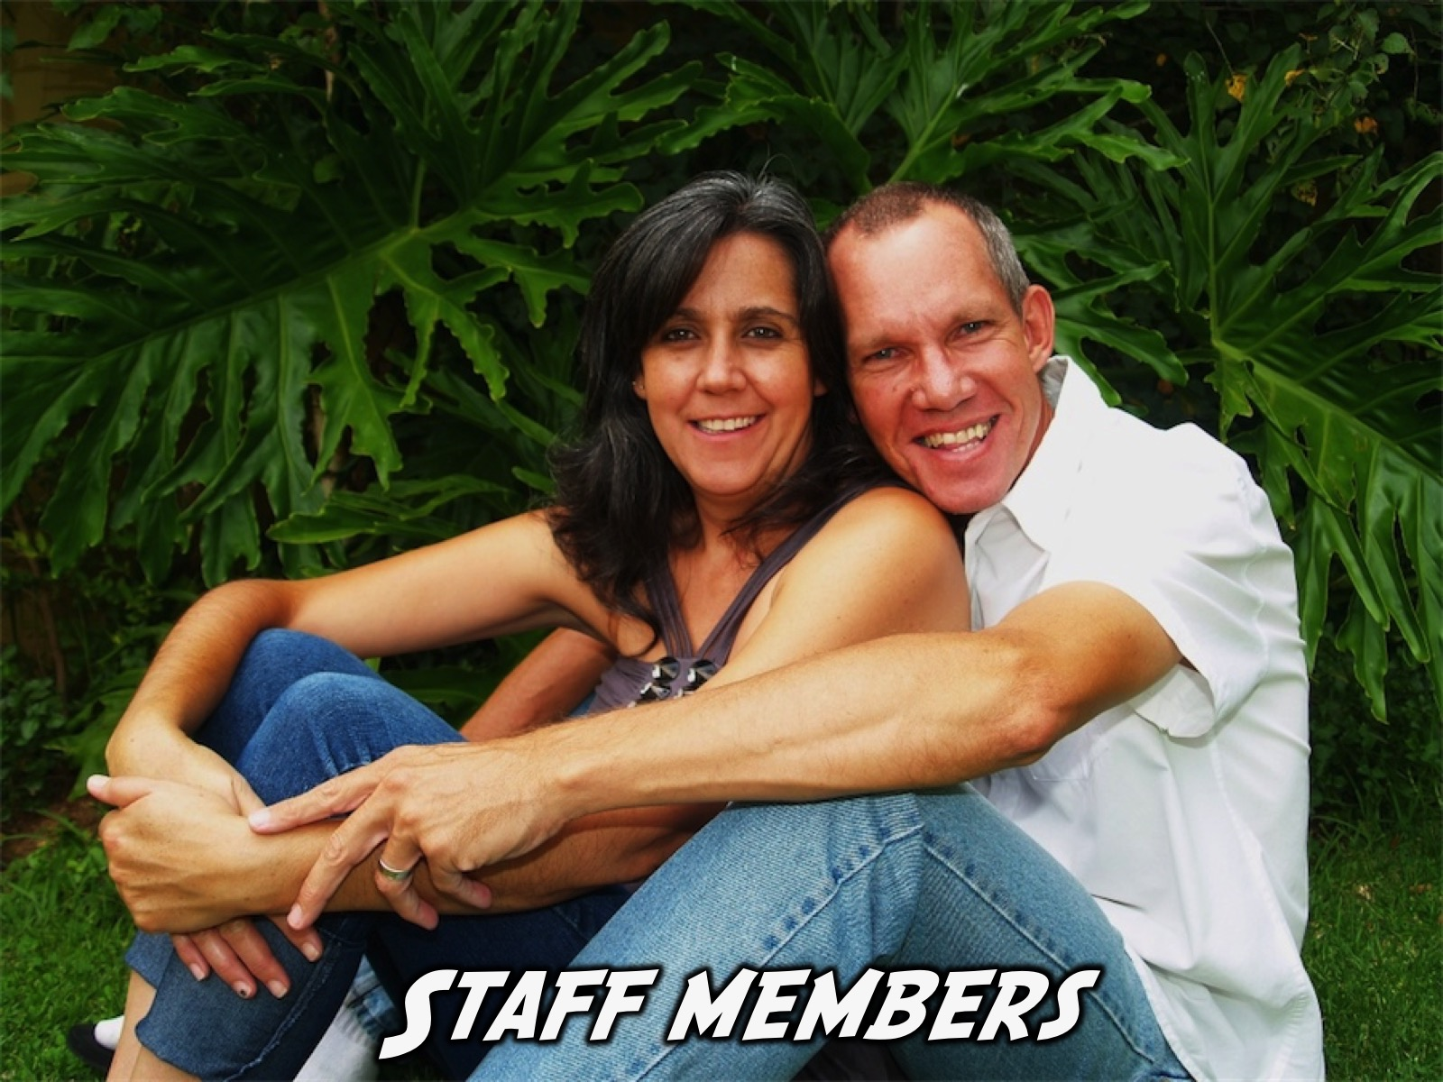
Notes:
(4) Staff Members. Our final level of leadership is that of staff members – currently two people are serving in a full-time capacity and their main responsibilities revolve around guiding the overall direction of the ministry, shaping the events, counseling youth and working in local high schools.

Slide 73
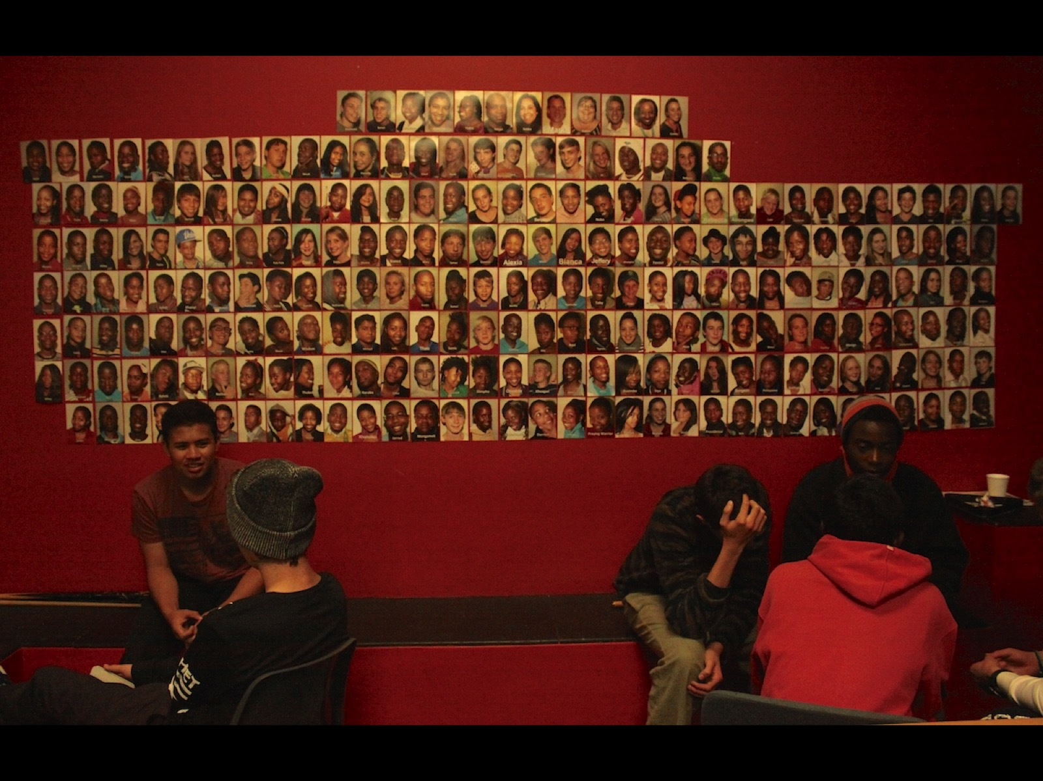
Notes:
A quick mention of our photo wall - the top row is our adult leaders (including staff members), the second row is our teen leaders (including connect group leaders) followed by the rest of the teens.

Slide 74


Slide 75
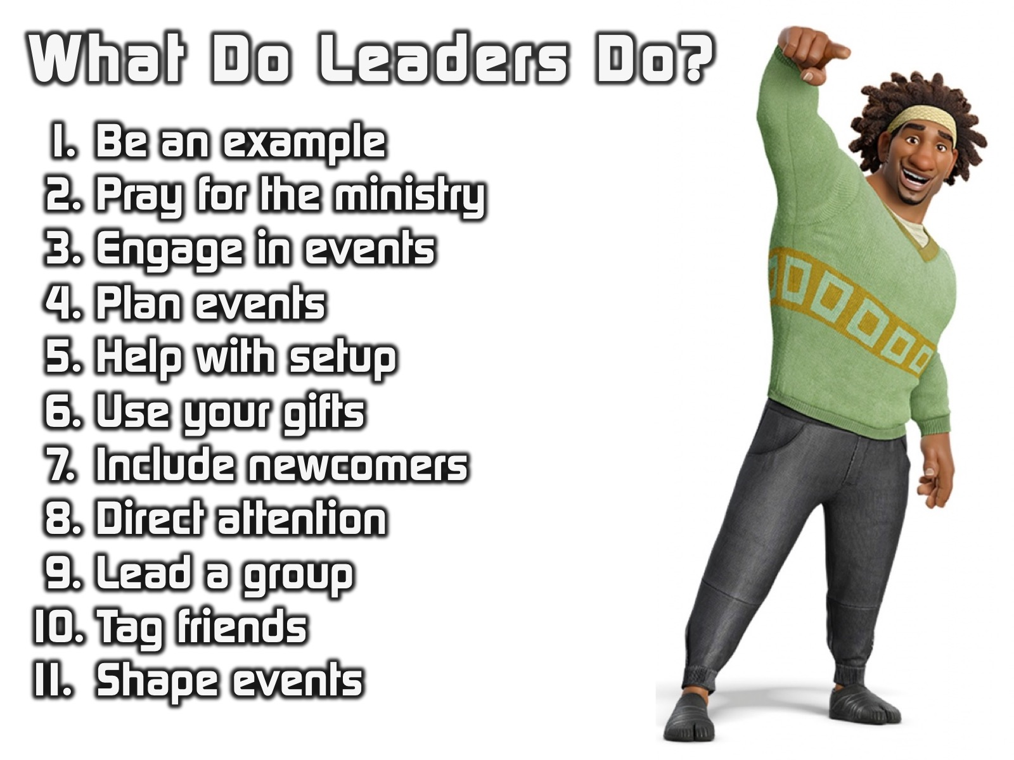
Notes:
Here are some guidelines we give to teen leaders in our ministry: Be an example. Pray for the ministry. Engage in events. Plan events. Help with setup. Use your gifts. Include newcomers. Direct attention during events. Lead a group. Tag friends on Facebook. Shape events.

Slide 76
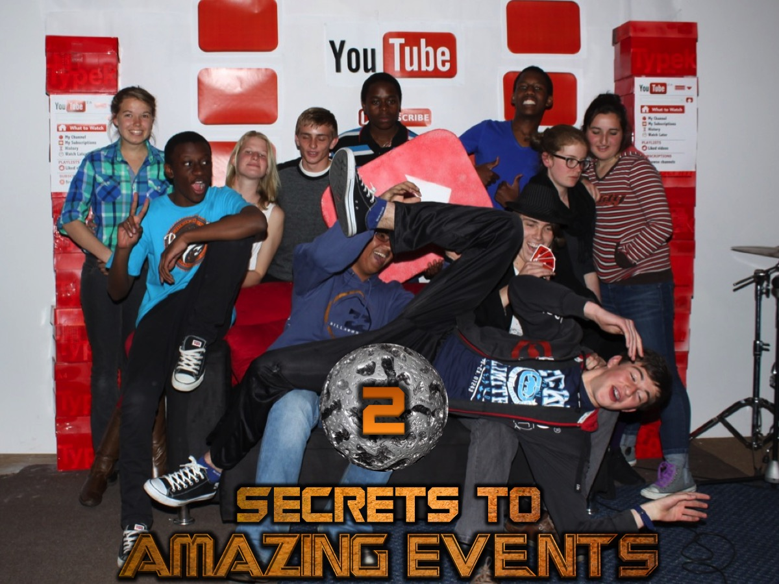
Notes:
2. Secrets to Amazing Events. Here are some general guidelines to running great events:

Slide 77
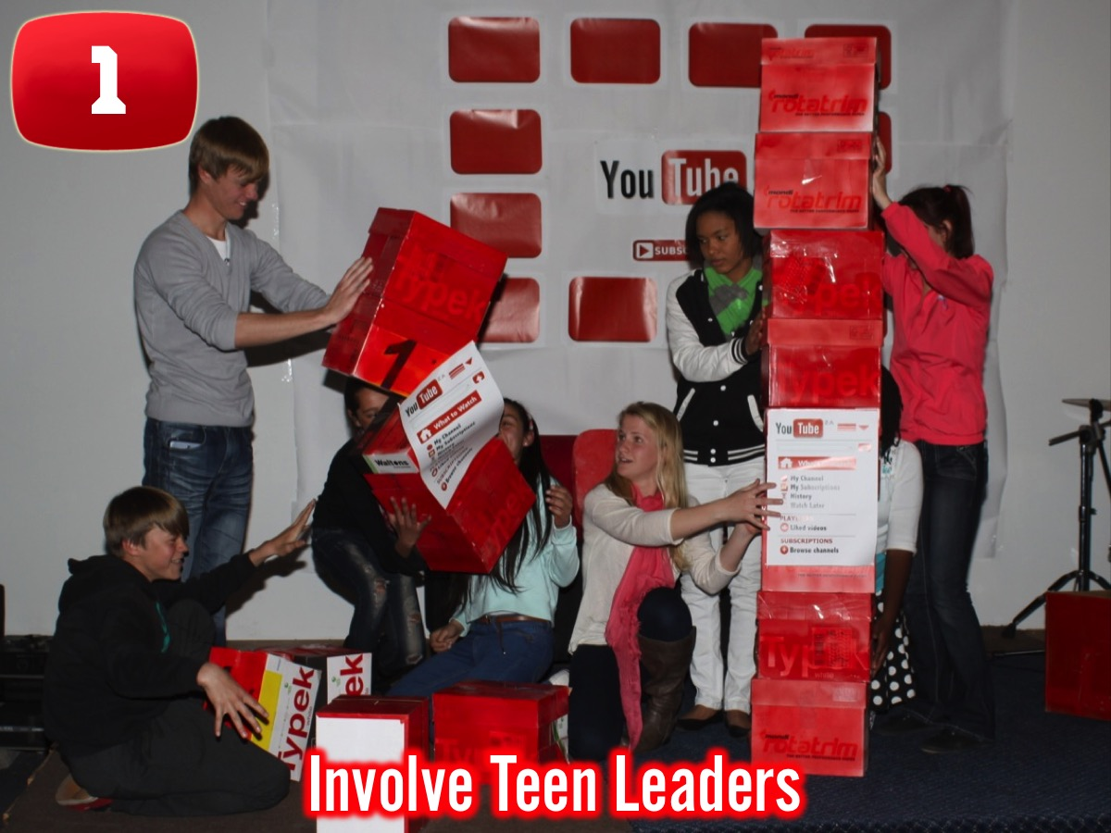
Notes:
(1) Involve Teen Leaders. It is best if teens (or at least adult volunteers) are the ones who do the planning and leading of the events. It takes a little more work to get there but is much more rewarding in the long run and will help create valuable skills in teens.

Slide 78

Notes:
(2) Design Promotional Material. We live in a visual world so spending a good amount of time in crafting striking promotional material for the event is well worth the effort. This involves posters that can be shared in Facebook or a youth website and also printed and displayed in the venue.

Slide 79

Notes:
(3) Prepare the Space. Make sure that every part of the venue is ready for the event – in fact, go out of your way to make the most of the space – even on a limited budget you will be amazing at what you can do with some creativity and effort. Think through every part of the event and decide where people will be at each point and whether chairs, carpets or tables will be needed.

Slide 80

Notes:
(4) Create Hang Time. It is tempting to get carried away in the design phase that on the night you run out of time or end up sacrificing relational or hang time. Set time aside when teens enter the venue and also after the event for teen leaders and adult leaders to engage with teenagers.

Slide 81

Notes:
(5) Design Amazing Visuals. Teens should walk into the venue and be visually know that the event is going to be awesome. The décor, posters, PowerPoint presentations, props, etc. should all communicate that effort has been put in and that they can expect a Wow event.

Slide 82

Notes:
(6) Involve Teens Throughout. We make it a priority that teens are not spectators in events. It takes a lot more work to design an event in which teens are active participants throughout but the results will be worth the extra effort. Dividing a bigger group into smaller groups that work together and at times compete against other teams is one way to maximize participation as is choosing activities where many people participate rather than having everyone watch one or two people taking part.

Slide 83

Notes:
(7) Use Small Groups. At His Youth the actual focus of our Friday night event is what takes place in small groups. The whole event culminates in that thirty minute experience in small groups, of no more than 5 teens who answer questions created around the activities of the event and the theme that is being fleshed out.

Slide 84

Notes:
(8) Pray Before Events. And finally, make sure that you gather as a leadership team once the setup has been done and things are ready to pray that God would prepare the hearts of the leaders to touch lives, that His power would be experienced and that every teen will be loved and drawn into the community of believers.

Slide 85

Notes:
3. How to Lead a Wow Event
Recently at a leadership team training event, I prepared the following guidelines on how to actually run one of our weekly events! This was aimed at the teenagers who are responsible once having prepared the event (in partnership with the youth pastor) to actually get up on stage and lead a Wow Event!

Slide 86

Notes:
(1) Do Your Homework. It takes a lot of work to pull off a Wow event so makes sure you put in the hours necessary to create the event. Start working long before the week of the event so you don’t end up in panic stations and last minute desperation.

Slide 87

Notes:
(2) Be Super Prepared. Think through every single detail of the program. Write or type everything out to ensure that nothing is left unprepared. This will help things go smoothly on the night and increase your confidence levels.

Slide 88

Notes:
(3) Brief Your Team. Before the prayer time, gather everyone who is helping you pull off the event and make sure everything knows exactly what they are responsible to do. If there are any question patiently answer them going over things more than once if necessary!

Slide 89

Notes:
(4) Look the Part. It will add to the event if you think through how you will present yourself on the night as a leader. This does not mean wearing a suit an a tie but there could be items of clothing or accessories that will help you look and play the part as MC on the night.

Slide 90

Notes:
(5) Come Out Blazing. When you start the event make sure you come out guns blazing – this means, confidently welcoming people and reflecting the level of excitement that you want the audience to reflect. This means knowing exactly what you are going to do at each moment of the event!

Slide 91

Notes:
(6) Own the Stage. Make the stage your own by moving around and standing in a central part of the stage.

Slide 92

Notes:
(7) Use Your Hands. The bigger your audience the bigger your gestures need to be – so be willing to exaggerate your movements to ensure people are drawn in to the event.

Slide 93

Notes:
(8) Be Gentle and Tough. Throughout the event there may be those moments when people will be tempted to check out or chat with their friends. Be sure to take a gentle approach in drawing them back into the group or you will alienate them. It is best if you brief your fellow teen and adult leaders to help with “crowd-control” so you don’t have to chastise people from the stage.

Slide 94

Notes:
(9) Watch the Clock. It is critical to keep a close eye on how long each part of the event is taking and make the necessary adjustments along the way so that you don’t run out of time and end up sacrificing important parts of the event due to a lack of control. Don’t be afraid to leave out an activity along the way if time is running short.

Slide 95

Notes:
(10) Always Be Flexible. If an activity is not working out or you sense that you need to move on from something that is dangerous then be willing to be flexible with the program.

Slide 96

Notes:
(11) Share the Credit. When the event is over and people thank you for an amazing event be sure to give credit to others who have helped you create and present the event.

Slide 97

Notes:
(12) Improve Each Time. Ask for feedback from peer and adult leaders and look for ways that you can prepare and lead a better event the next time round.

Slide 98

Notes:
Finally, I recently briefed our teen leaders about their involvement in planning and presenting Wow events at our Friday night youth event, and listed the following practical guidelines they needed to follow:

Slide 99

Notes:
1. Design the Event – it is their responsibility to design the event from start to finish – not just come up with a few games.

Slide 100

Notes:
2. Work With Others – some teens are tempted to plan and lead an event on their own – we are looking for teamwork!

Slide 101

Notes:
3. Think Everything Through – they need to consider every aspect of the event and ensure it works together.

Slide 102

Notes:
4. Figure Out the Details – there is a tendency to do surface level planning but they have to get specific with every detail!

Slide 103

Notes:
5. Type it Up – when people actually type out the whole event it forces them to be more thorough and tighter.

Slide 104

Notes:
6. Submit it for Review: Send it by Tuesday – we set a deadline in the week when the outline for the event must be submitted.

Slide 105

Notes:
7. Create Group Questions – they are responsible to create five questions for small groups based on the theme.

Slide 106

Notes:
8. Arrive Early to Setup – we challenge them to get to the veue at least an hour before it starts to set up properly!

Slide 107

Notes:
9. Set Things Up – this reminds them that it is their responsibility to ensure everything is ready for the event.

Slide 108

Notes:
10. Walk Through the Event – about 30 minutes before the event we walk through the Presentation to ensure all is clear.

Slide 109

Notes:
11. Present Well – they are challenged to be confident and lead the event well on the night.

Slide 110

Notes:
12. Ask for Feedback – after the event we expect they will get feedback about the event and how they led it.

Slide 111

Notes:
13. Improve Next Time – based on the feedback they reveive they are challenged to think of how they can improve.

Slide 112

Notes:
So here are the list of guidelines we want our teen leaders to fulfil as they design and present a Wow event:
* Work with others – some teens are tempted to plan and lead an event on their own – we are looking for teamwork!
* Design the event – it is their responsibility to design the event from start to finish – not just design a few games.
* Think everything through – they need to consider every aspect of the event and ensure it works together.
* Figure out details – there is a tendency to do surface level planning but they have to get specific with every detail!
* Type it all up – when people actually type out the whole event it forces them to be more thorough and tighter.
* Send it by Tuesday – we set a deadline in the week when the outline for the event must be submitted.
* Create group questions – they are responsible to create five questions for small groups based on the theme.
* Arrive early (6:30) – we challenge them to get to the veue at least an hour before it starts to set up properly!
* Set things up – this reminds them that it is their responsibility to ensure everything is ready for the event.
* Walk through event – about 30 minutes before the event we walk through the Presentation to ensure all is clear.
* Present well – they are challenged to be confident and lead the event well on the night.
* Ask for feedback – after the event we expect they will get feedback about the event and how they led it.
* Improve next time – based on the feedback they reveive they are challenged to think of how they can improve.

Slide 113

Notes:
Here are some relevant links to the sites I maintain directly connected to our youth ministry:
A. Our Facebook site is: https://www.facebook.com/pages/His-Youth/149262733386

Slide 114

Notes:
B. Our Youth Group Website is: http://youth.hispeoplejoburg.org (this site is updated each week with podcasts and other items like photo albums although that is mostly driven through Facebook).

Slide 115

Notes:
C. My Ministry Resource website where the program resource material and sermons get uploaded each week is at: http://www.ymresourcer.com (the Programs link on that page is where I upload what we do on Fridays and on Sundays).

Slide 116


