Slide 1
Notes:
SIMS Night

Slide 2
Notes:
Welcome to Live Friday.

Slide 3
Notes:
Tonight is SIMs Night

Slide 4
Notes:
Welcome to any newcomers.

Slide 5
Notes:
Video: The SIMS 4 Trailer. Get it on YouTube at: https://www.youtube.com/watch?v=VBQ6MFsJJsw

Slide 6
Notes:
Introduction: SIMS differs from most other games:

Slide 7
Notes:
(1) It is a free play game

Slide 8
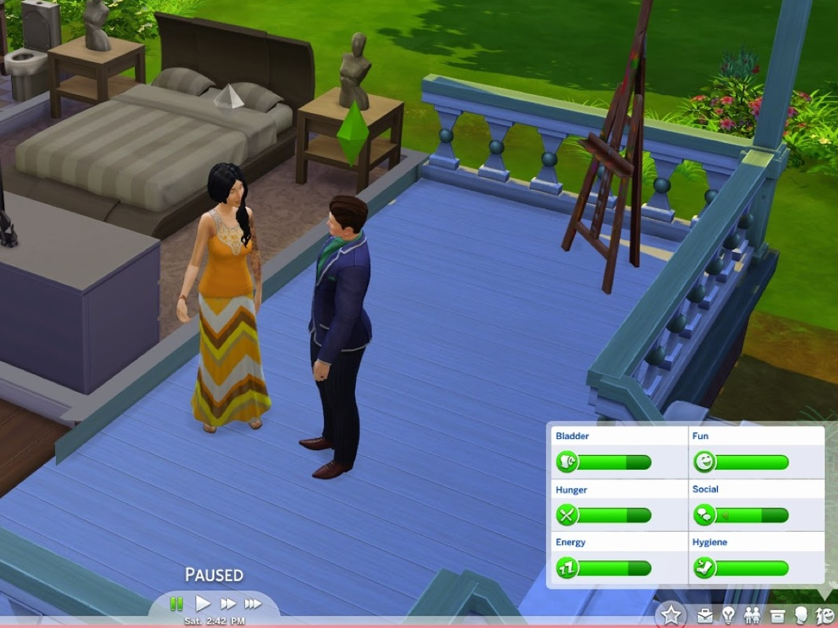
Notes:
(2) There is no point system – it is all about needs – meeting the needs of your characters.

Slide 9
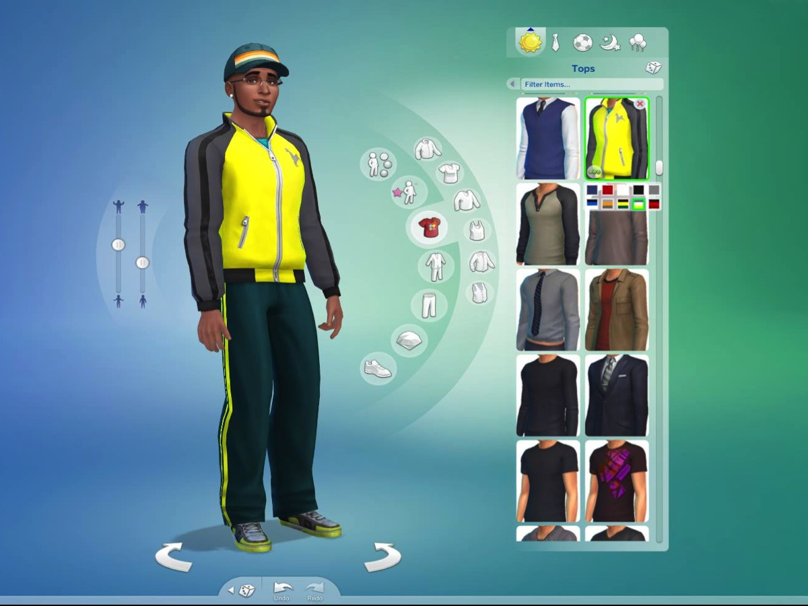
Notes:
(3) You choose the traits that your character will have.

Slide 10
Notes:
Teams: We are going to start by helping you identify your own character traits.

Slide 11
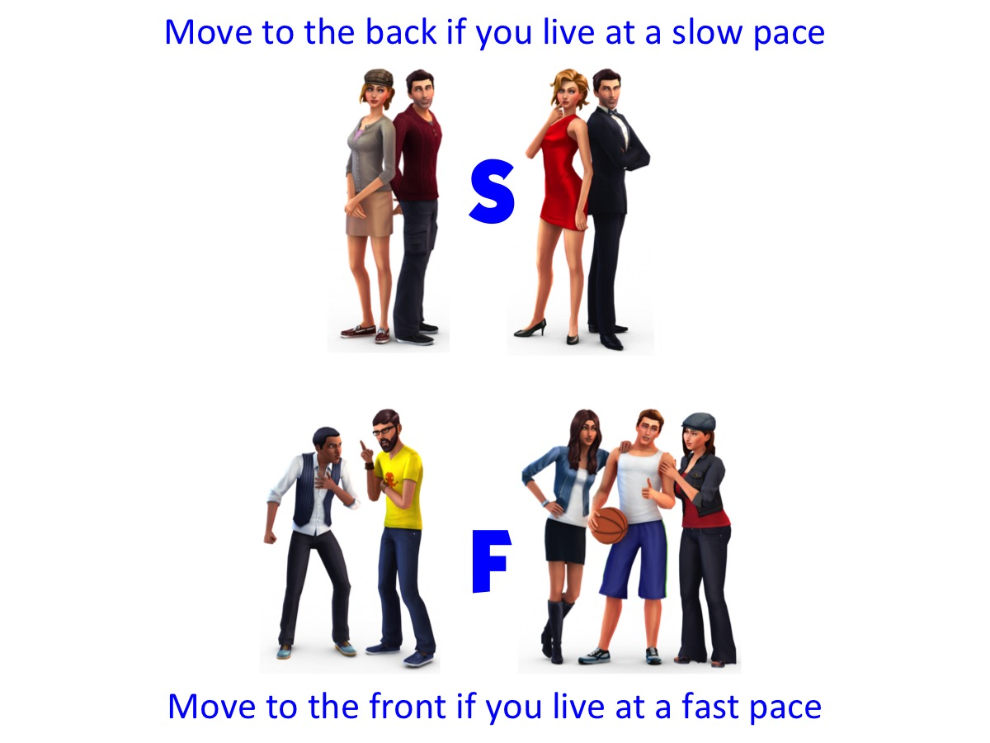
Notes:
Move to the back if you live at a slow pace and Move to the front if you live at a fast pace. (Leaders will marks hands with a S or a F.)

Slide 12
Notes:
Move to the left if people are most important to you and Move to the right if tasks are most important to you. (Leaders will add a P or a T to the markings on teens hands. Leaders will then divide the groups in half again if necessary but adding a 1 or a 2 to the hands)

Slide 13
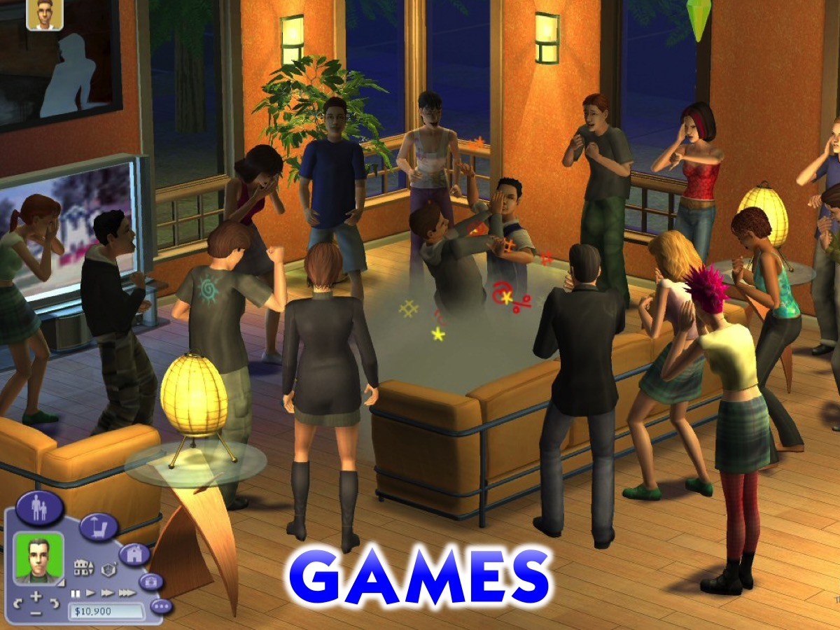
Notes:
Games – we are going play short, fun games, focussed on the needs of SIMS.

Slide 14
Notes:
Need #1 is Hunger: One person from each group is designated to run to the middle of the room where a box of apples is. They have to fetch enough apples for every member of their group. They can only take one at a time. Once all the apples are collected, the group needs to eat all their apples. The first group finished received a prize.

Slide 15
Notes:
Need #2 is Comfort – 10 boxes of the same size will be piled in the centre of the room. Each box contains a blanket of a different size – ranging from huge to tiny baby blankets. The team has to send another person forward to randomly select a box and carry it back to their group. On the count of three, all teams must take out their blanket and try and fit their entire group under the blanket.

Slide 16
Notes:
Need #3 is Space – The groups must fold their blankets in half (leaders will supervise) and will have to fit 20 body parts onto the blanket.

Slide 17
Notes:
Need #4 is Energy – a long song will play and each member of each team must do jumping jacks. When a person stops/loses momentum, they will be told to sit down. This will continue until 1) the song stops in which case the last people standing will get energy bars or 2) only one person is left in which case their entire team gets energy bars. The song used was the theme for the SIMS.

Slide 18
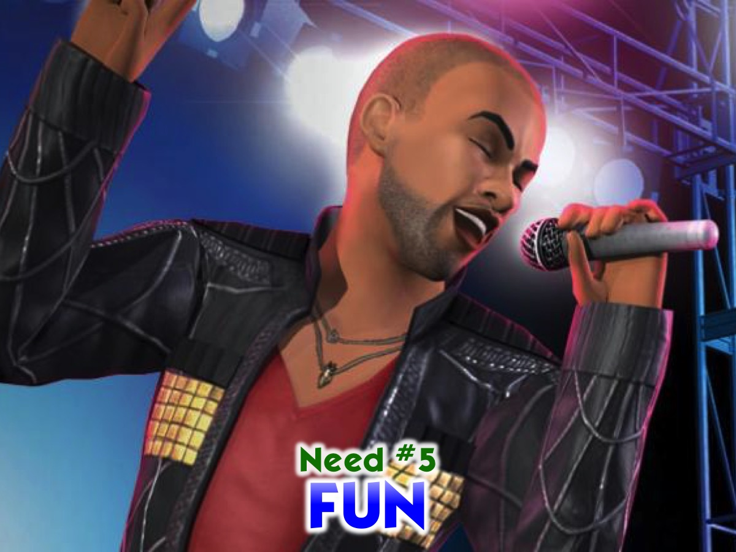
Notes:
Need #5 is Fun – one person from each group will be sent forward to lip synch to a song (probably All the Rowboats) they haven’t heard before. The most hilarious/most accurate/most entertaining wins a chocolate medal for their group
Video: Midnight Memories by One Direction. Get it on YouTube: https://www.youtube.com/watch?v=bcWWArLFgys

Slide 19
Notes:
Need #6 is Social – get the phone numbers, email addresses and embarrassing nicknames from all members of your group. Write them on a piece of paper. Send one representative from each group to write them all (minus the person’s full, real name) on the blackboard.

Slide 20
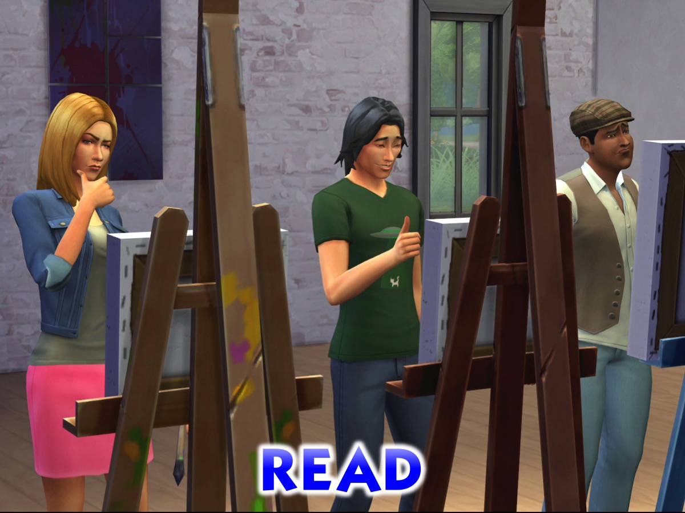
Notes:
You have 3 minutes to read what’s on blackboard while a clip is playing (depending on time)

Slide 21
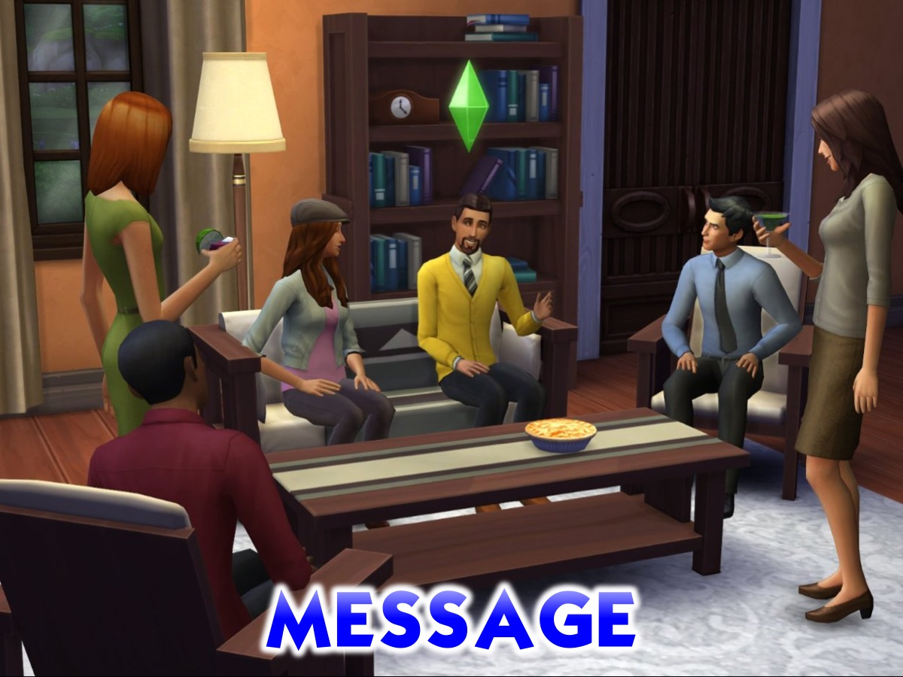
Notes:
Short message is shared.

Slide 22
Notes:
Small Group: Brief explanation of why we do small group; why guys/girls separate and why we keep them to a leader with 3 teens.

Slide 23
Notes:
Small Group Questions: (1) Which need did you most enjoy meeting tonight? (2) What does Jesus say about how we handle needs? “Do not worry about your life, what you will eat; or about your body, what you will wear. Seek God’s kingdom and all these things will be added to you! (Luke 12:22,31) (3) What have you done about your need for Jesus in your life? (4) What are you thankful about in your life? (5) Do you have any needs that we can pray for in your life right now?

Slide 24
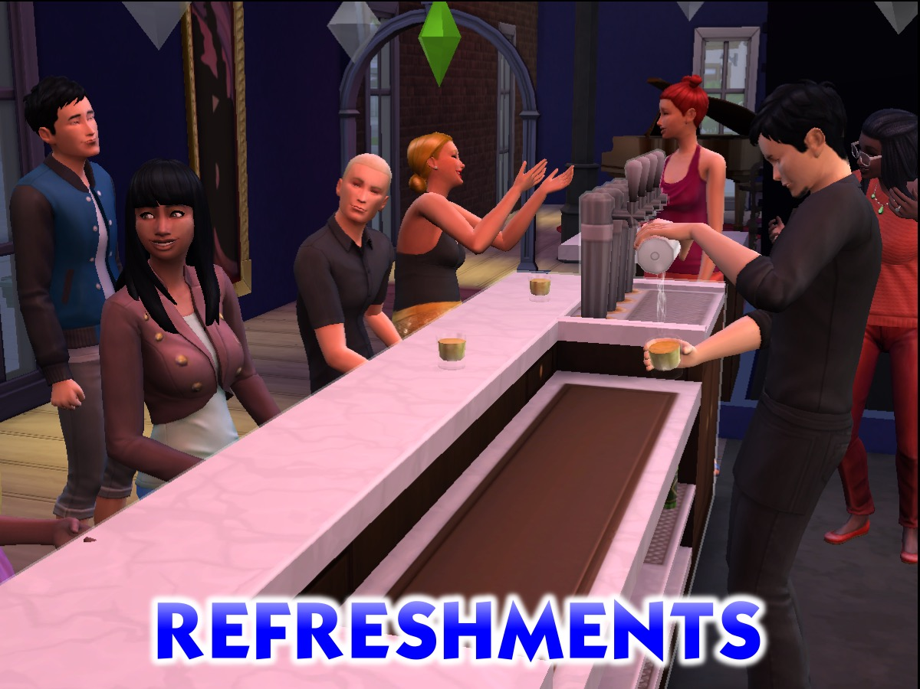
Notes:
Refreshments

Slide 25
Notes:
Announcements: On Sunday morning we continue with our new Revolution Series. And next Friday night it is GTA Night.

