Slide 1

Notes:
Here are guidelines on running an effective SWOT Analysis for your youth ministry or organization:

Slide 2

Notes:
In the book of Revelation, chapter 2 and 3 we find that Jesus took each of the 7 worshipping communities that had been established and he conducted a SWOT analysis for each of them.

Slide 3
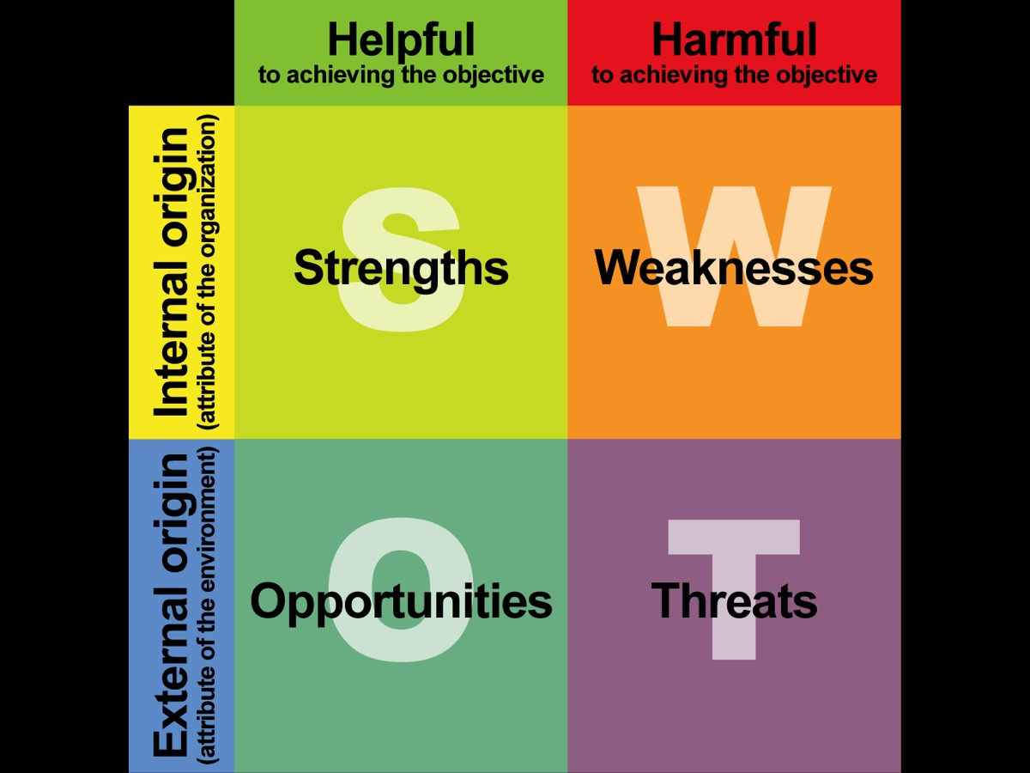
Notes:
Understanding the Four Aspects of the SWOT Analysis
(1) Strengths – areas where we are strong.
(2) Weaknesses – areas where we need to improve. (Strengths and Weakness deal with current realities)
(3) Opportunities – areas we can move into to develop.
(4) Threats – areas that will hinder our progress.
(Strengths and Weakness deal with current realities)
(Opportunities and Threats deal with future realities)
(Weaknesses are internal while Threats are external)

Slide 4

Notes:
Once you have looked at your strengths, weaknesses, opportunities and threats - you must do the next step which is to identify critical issues that are raised during the SWOT analysis. This step is seldom done in SWOT analysis exercises but is critical to translating the exercise to value and action.

Slide 5

Notes:
1. What are the Strengths?

Slide 6

Notes:
2. What are the Weaknesses?

Slide 7

Notes:
3. What are the Opportunities?

Slide 8

Notes:
4. What are the Threats?

Slide 9
Notes:
What are the Critical Issues?

Slide 10

Notes:
Here is an example of some critical issues identified in a youth group during this process.

Slide 11

Notes:
The final step is to Create an Action Plan. Take each of the critical issues that are identified and create an action plan for each area:
1. What do we need to do about it?
2. Who will take the action?
3. When will it be completed by?

