Slide 1
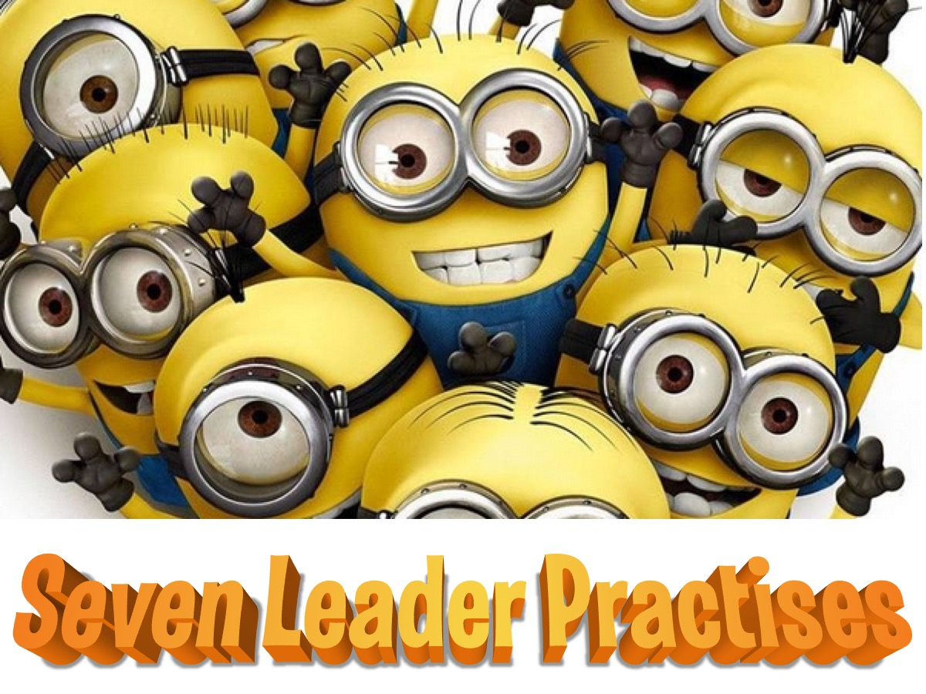
Notes:
In this session we are going to expose you to seven leader practises and challenge you to practise them in the coming weeks as you lead at His Youth:

Slide 2
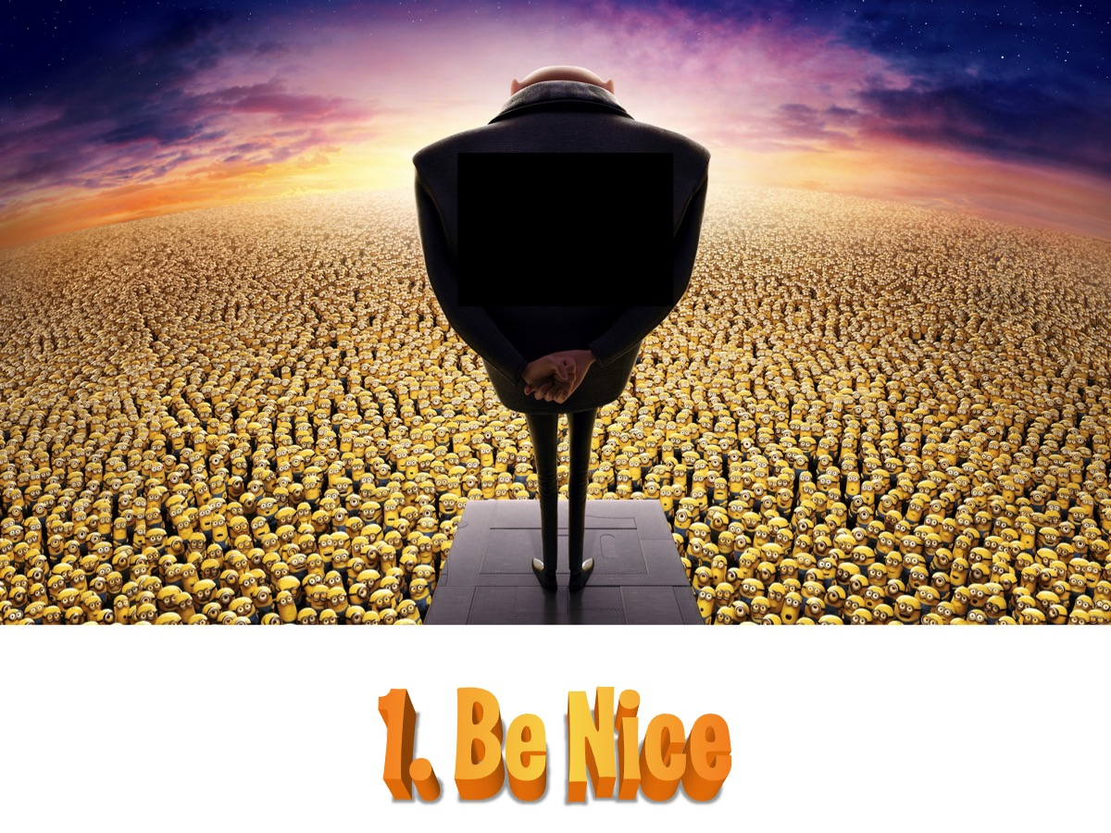
Notes:
1. Ne Nice – it is very easy for a leadership position to go to our heads and we start to become dictatorial and basically, just not nice! No one likes the evil villain, Gru, in the Minions movie – we don’t actually refer to or treat teens we lead as minions! So be nice!

Slide 3
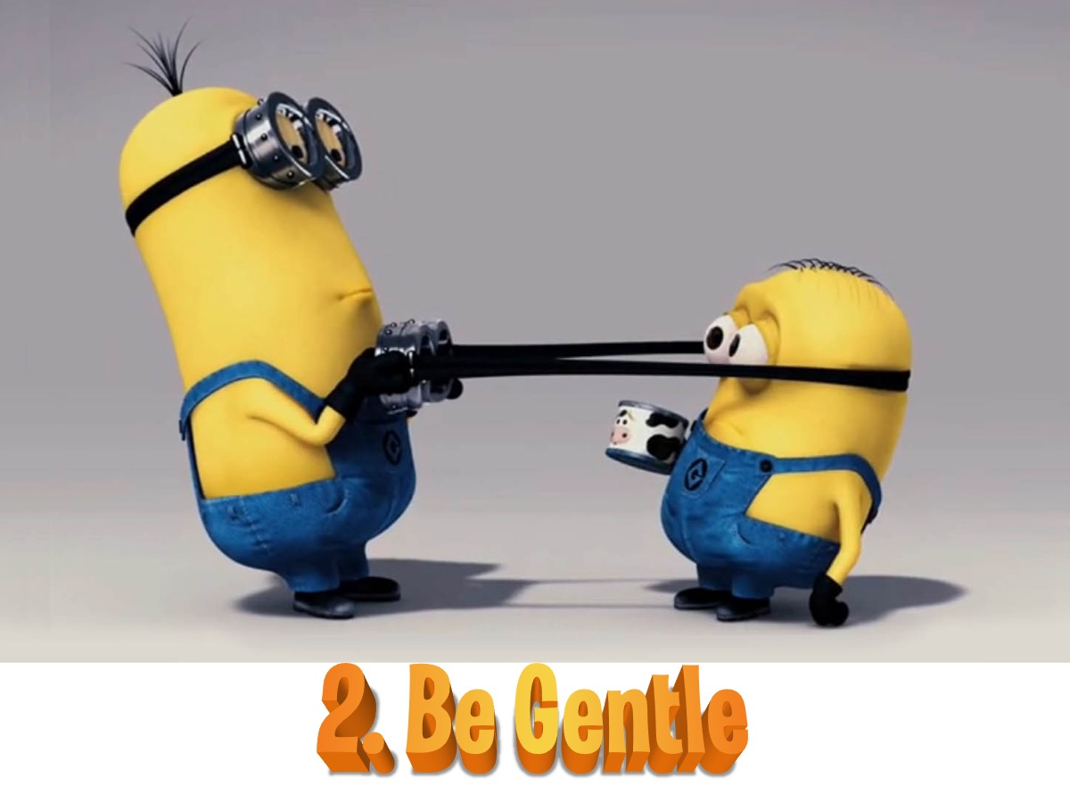
Notes:
2. Be Gentle - in fact, being gentle and kind will enable you to get a lot more done and have more fun along the way! Don’t hurt people physically or emotionally - that is just not cool leadership!

Slide 4

Notes:
3. Work Together. You are called to be a leader in the context of a team so it is essential that you learn how to work well with others as you lead. Let people help you - don’t try and do everything on your own. If you see someone needing some help - take the initiative and offer to help them even before they have to ask you!

Slide 5

Notes:
4. Participate - get involved in whatever is happening in our events. Don’t think that your leadership badge gives you a ticket to sit on the sidelines and watch the actions. They will be times when you are not in an activity because you are helping to lead it, but always make sure you are setting a good example by getting involved in whatever it is that the teens are doing!

Slide 6
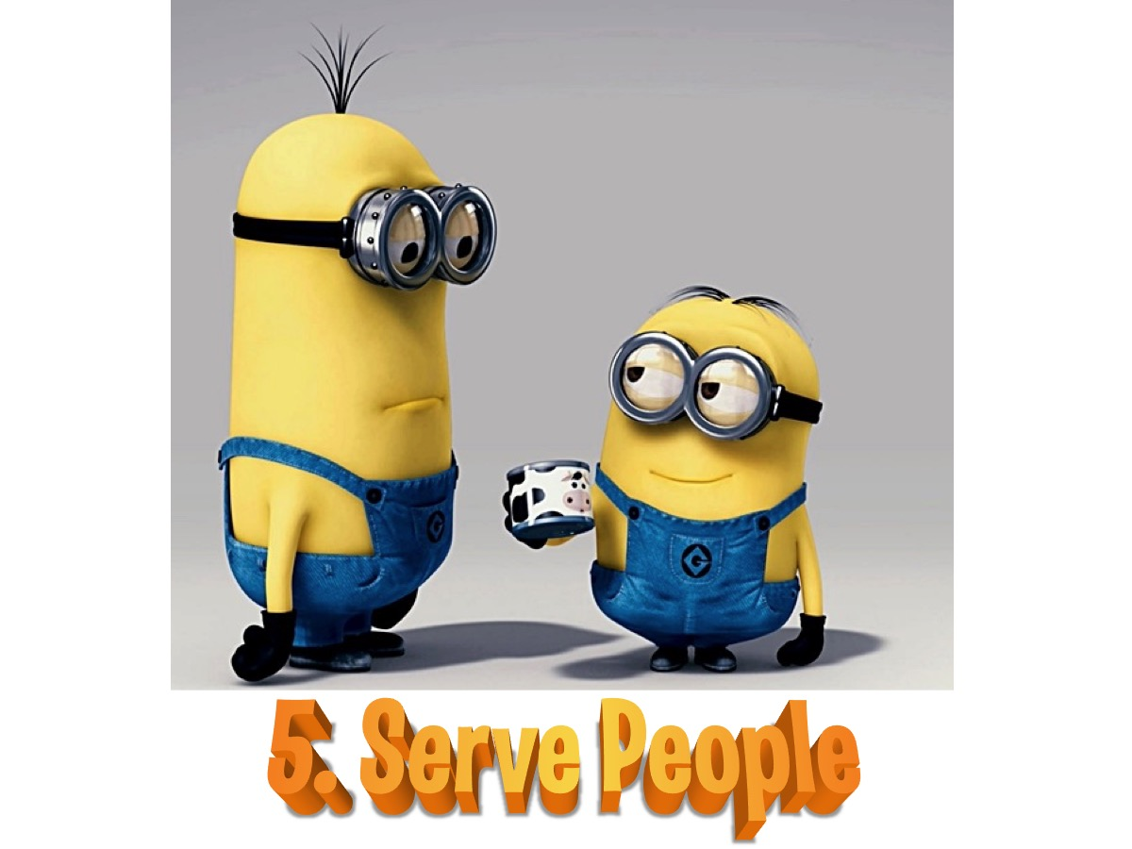
Notes:
5. Serve People - basically leadership is about serving people - so ALWAYS be on the lookout for ways to serve - whether it is helping to set up events, running events, cleaning up after events or helping people when they have needs along the way.

Slide 7

Notes:
6. Fix Things - be a problem solver and always look for ways to fix things that are broken - whether it is something that is physically broken or something that just a little bit of encouragement or tweaking to improve.

Slide 8

Notes:
7. Follow Up - as you see teens connecting with each other and with God look for ways to follow up so you end up helping them grow towards spiritual maturity!

