Slide 1

Notes:
Welcome to the Shine Series.

Slide 2

Notes:
Today we are going to preview our new series for Sunday mornings for Term 2.

Slide 3

Notes:
The video starts after this slide.

Slide 4
Notes:
Video: The Shine Series Promo Video. You can view a lower version of this video at: http://www.ymresourcer.com/Share/Shine_Promo_Small.mp4

Slide 5
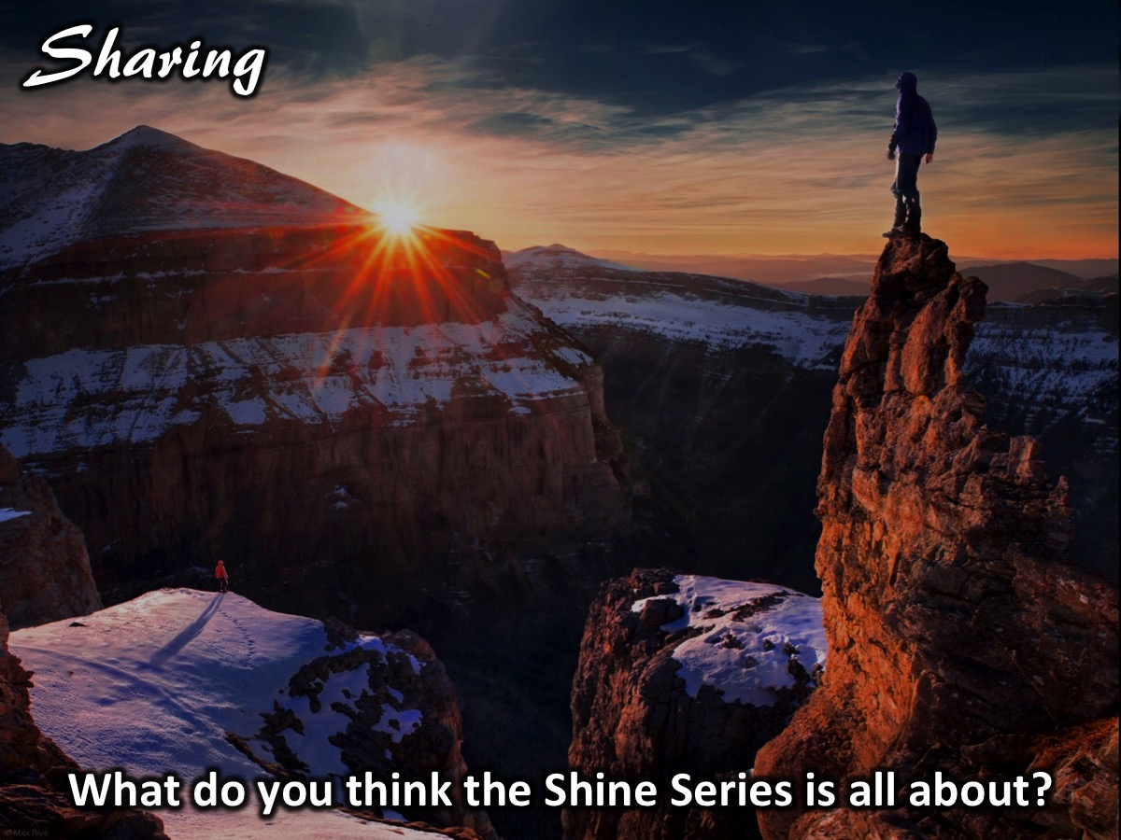
Notes:
Sharing: Turn to the person next to you and ask them: What do you think the Shine Series is all about?

Slide 6

Notes:
In week 2 of the Shine Series we will deal with facing our fears as we shine for Jesus.

Slide 7

Notes:
In week 3 of the Shine Series we will deal with finding our motivation as we shine for Jesus.

Slide 8

Notes:
In week 4 of the Shine Series we will deal with part 1 of mastering our message as we shine for Jesus.

Slide 9

Notes:
In week 5 of the Shine Series we will deal with part 2 of mastering our message as we shine for Jesus.

Slide 10

Notes:
In week 6 of the Shine Series we will deal with part 1 of sharing our story as we shine for Jesus.

Slide 11

Notes:
In week 7 of the Shine Series we will deal with part 2 of sharing our story as we shine for Jesus.

Slide 12
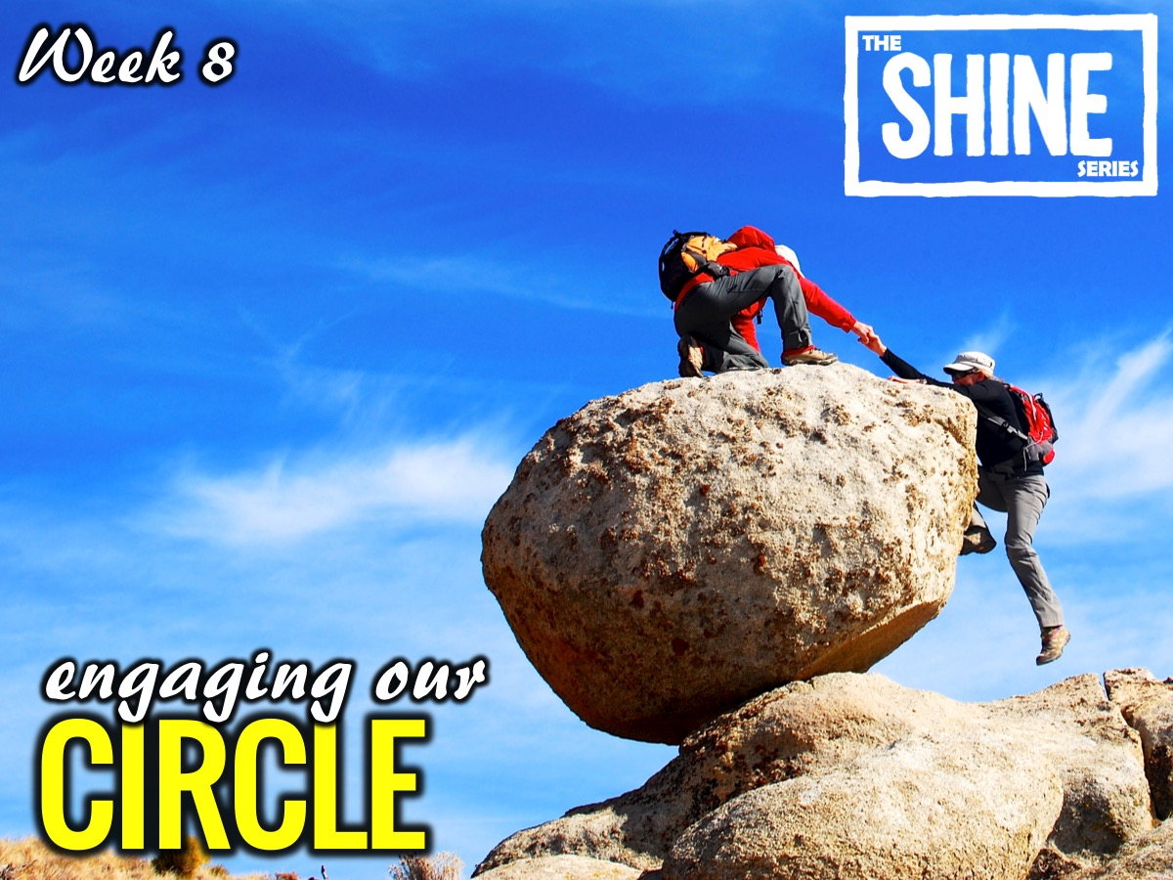
Notes:
In week 8 of the Shine Series we will deal with engaging our circle as we shine for Jesus.

Slide 13

Notes:
In week 9 of the Shine Series we will deal with continuing the conversation as we shine for Jesus.

Slide 14

Notes:
Today we are going to preview our new series for Sunday mornings for this term.

Slide 15
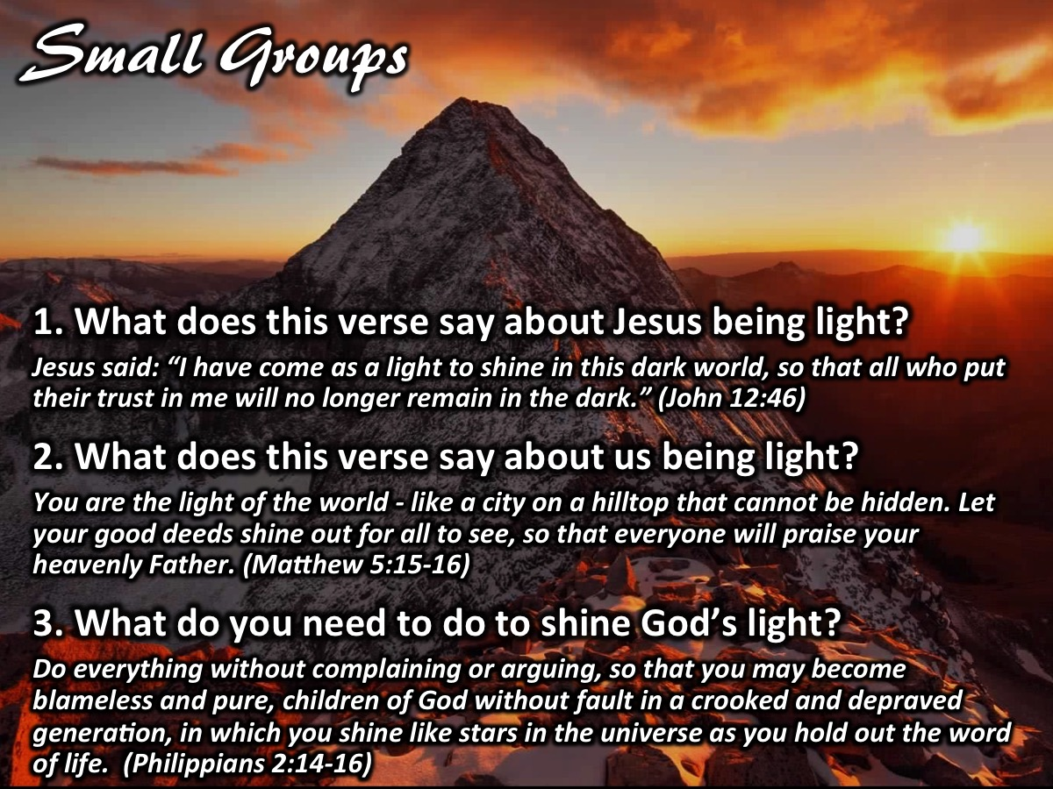
Notes:
Small Group Discussion: (1) What does this verse say about Jesus being light? Jesus said: “I have come as a light to shine in this dark world, so that all who put their trust in me will no longer remain in the dark.” (John 12:46). (2) What does this verse say about us being light? You are the light of the world - like a city on a hilltop that cannot be hidden. Let your good deeds shine out for all to see, so that everyone will praise your heavenly Father. (Matthew 5:15-16) (3) What do you need to do to shine God’s light? Do everything without complaining or arguing, so that you may become blameless and pure, children of God without fault in a crooked and depraved generation, in which you shine like stars in the universe as you hold out the word of life. (Philippians 2:14-16)

Slide 16

Notes:
Challenge: Live and Shine the Light of God - at home, at school, in society and among your friends and family.

Slide 17

Notes:
Let’s Pray

Slide 18

Notes:
Next Sunday is the Lead The Cause equipping event for those who have registered for the weekend. If you have not registered then you will stay in the sanctuary on Sunday morning.

