Slide 1
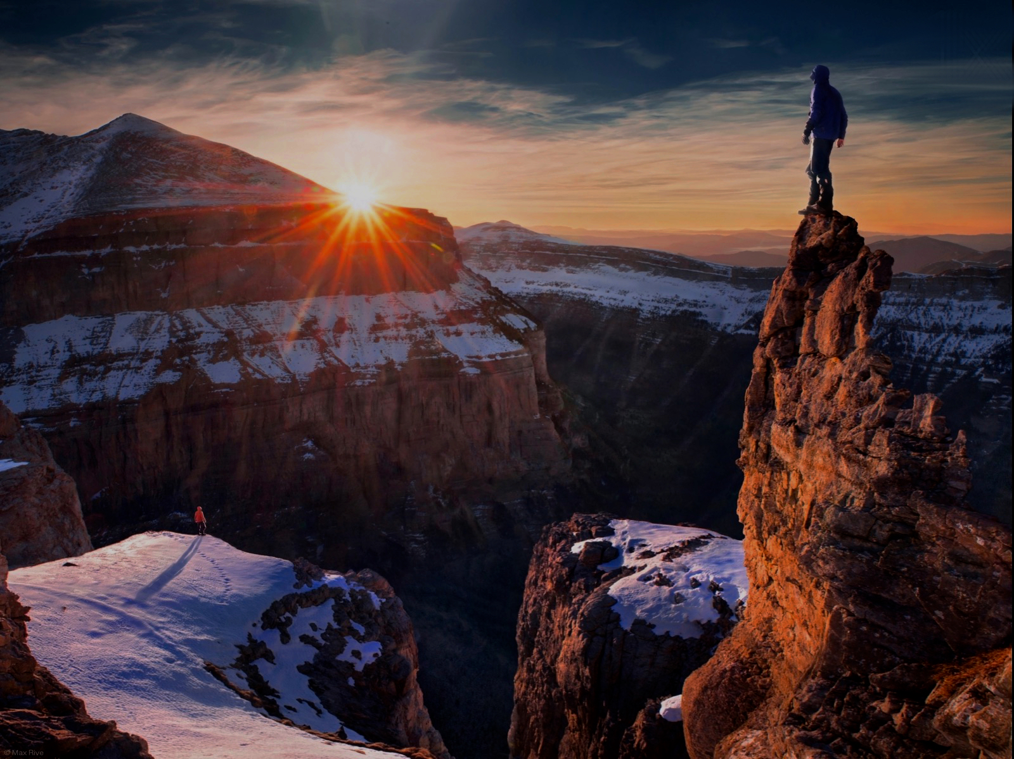

THE
SERIES
Notes:
Welcome to the Shine Series.

Slide 2
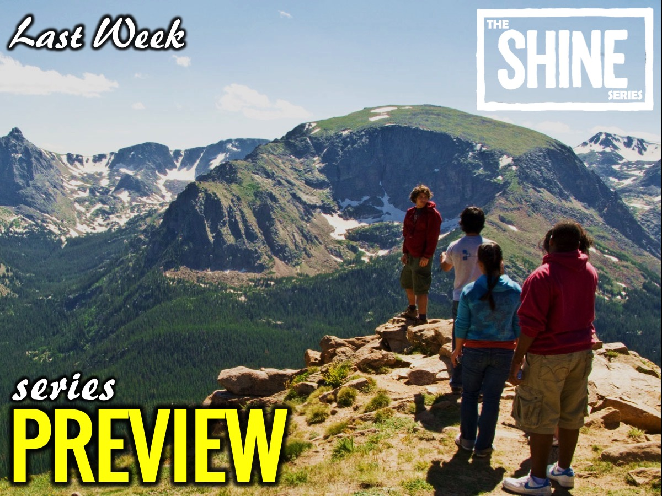
Notes:
Last week we launched our new series for Term 2 - the Shine Series!

Slide 3

Notes:
Today we are going to face our fears when it comes to shining our light for Jesus.

Slide 4

Notes:
Sharing: Turn to the person next to you and ask them: What is the scariest things you have ever done?

Slide 5

Notes:
The video starts after this slide.

Slide 6
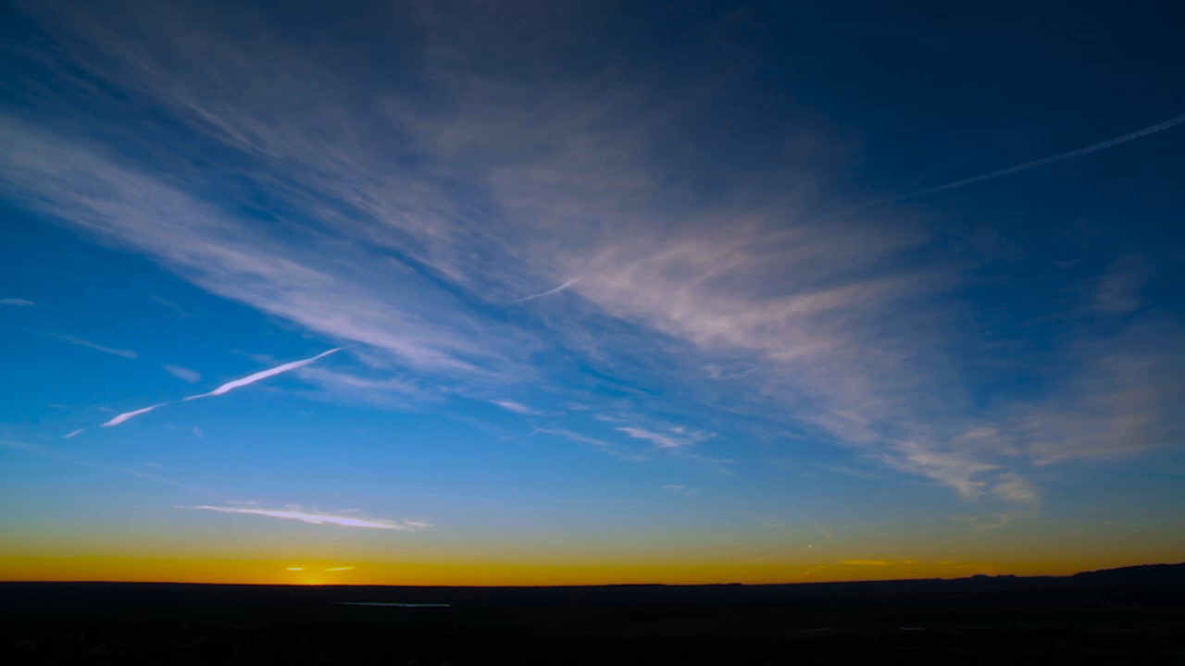
Notes:
Video: Shine Week 2. The video is 11 minutes in length.

Slide 7
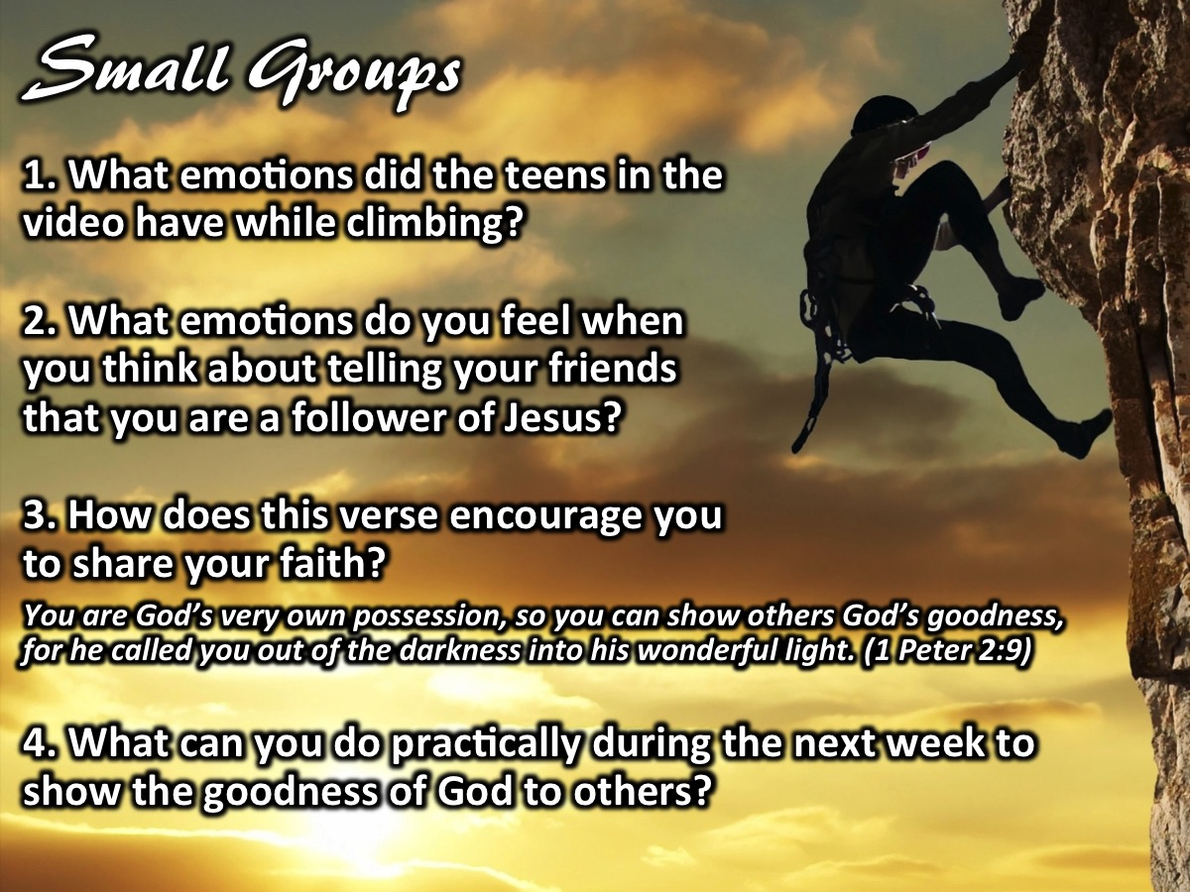
Notes:
Small Group Questions: (1) What emotions did the people in the video have when they were about to climb the sheer rock cliff? (2) What emotions do you have when you think about telling your friends that you are a follower of Jesus? (3) How does this verse encourage you to share your faith? “For you are God’s very own possession. As a result, you can show others the goodness of God, for he called you out of the darkness into his wonderful light.” (1 Peter 2:9). (4) What can you do practically during the next week to show the goodness of God to others?

Slide 8

Notes:
Challenge: God is calling us to overcome our fear of shining His light to people around us.

Slide 9
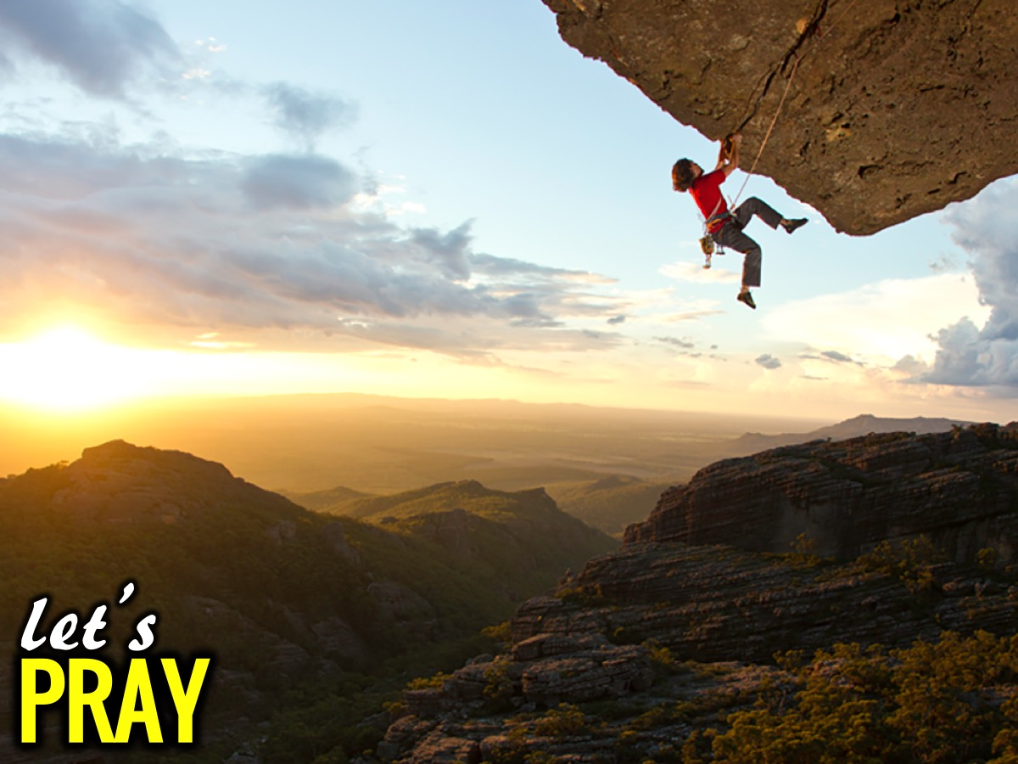
Notes:
Let’s Pray

Slide 10

Notes:
In week 3 of the Shine Series we will deal with finding our motivation as we shine for Jesus.

