Slide 1

Notes:
Welcome to the Shine Series.

Slide 2

Notes:
Last week we explored how to face our fears when we tell others about Jesus.

Slide 3

Notes:
Today we are going to find our motivation for shining our light for Jesus.

Slide 4

Notes:
Sharing: What keeps you moving forward in life?

Slide 5

Notes:
The video starts after this slide.

Slide 6
Notes:
Video: Shine Week 3. The video is 13 minutes in length.

Slide 7
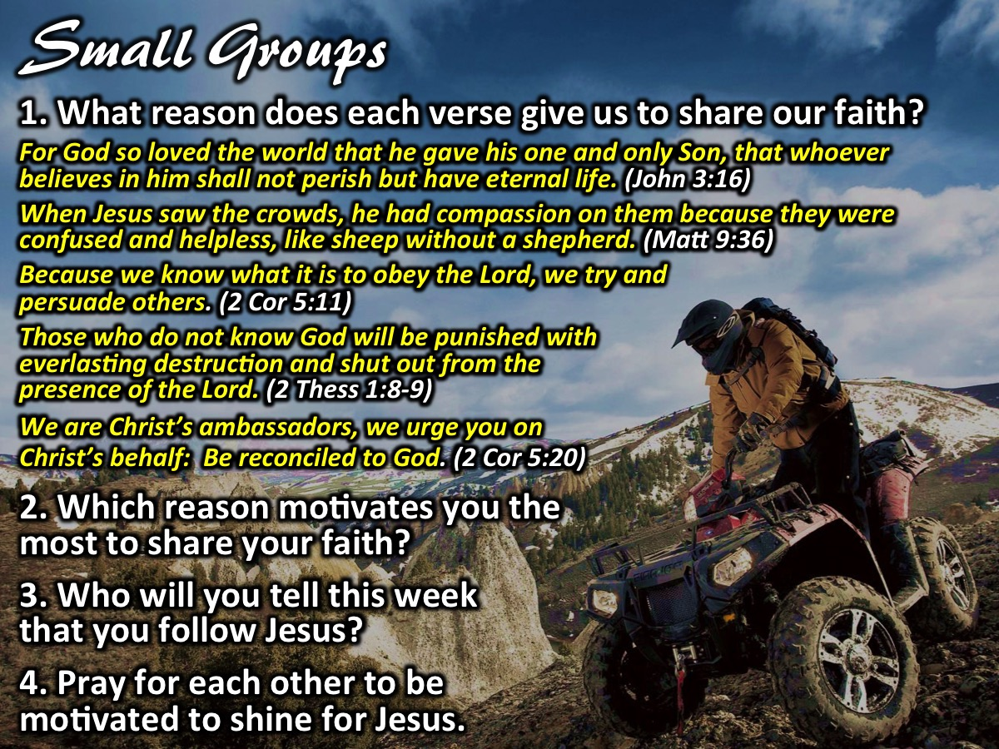
Notes:
Small Group Questions: (1) What reason does each Scripture give for us to share our faith? (a) For God so loved the world that he gave his one and only Son, that whoever believes in him shall not perish but have eternal life. (John 3:16) (God’s Love). (b) When Jesus saw the crowds, he had compassion on them because they were confused and helpless, like sheep without a shepherd. (Matthew 9:36) (Compassion). (c) Because we know what it is to obey the Lord, we try and persuade others. (2 Corinthians 5:11) (Obedience). (d) Those who do not know God will be punished with everlasting destruction and shut out from the presence of the Lord. (2 Thessalonians 1:8-9) (Hell). (e) We are Christ’s ambassadors, we urge you on Christ’s behalf: Be reconciled to God. (2 Corinthians 5:20) (Urgency). (2) Which reason motivates you the most to share your faith? (3) Who will you tell this week that you are a follower of Jesus? (4) Pray for each other to be motivated to shine for Jesus.

Slide 8

Notes:
Challenge: Be motivated to share your faith.

Slide 9

Notes:
Let’s Pray

Slide 10

Notes:
In week 4 of the Shine Series we will deal with part 1 of mastering our message as we shine for Jesus.

