Slide 1

Notes:
Welcome to the Shine Series.

Slide 2

Notes:
Last week we explored what should motivate us to tell others about Jesus: God’s love, Compassion, Obedience, Hell and Urgency.

Slide 3

Notes:
Today we are going to lean how to master our message (this is part 1 of 2) so we can shine our light for Jesus.

Slide 4
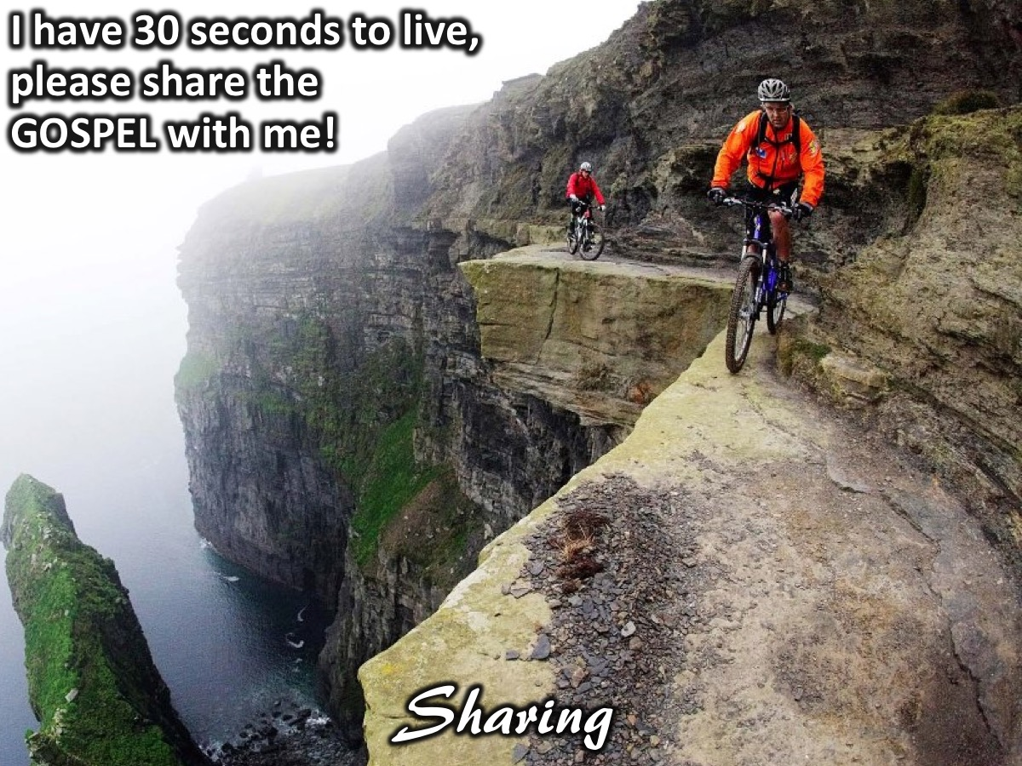
Notes:
Sharing: Imagine you are visiting me in hospital and I say to you: “I have 30 seconds to live, please share the GOSPEL with me!” What will you say to me?

Slide 5

Notes:
The video starts after this slide.

Slide 6
Notes:
Video: Shine Week 4. The video is 12 minutes in length.

Slide 7
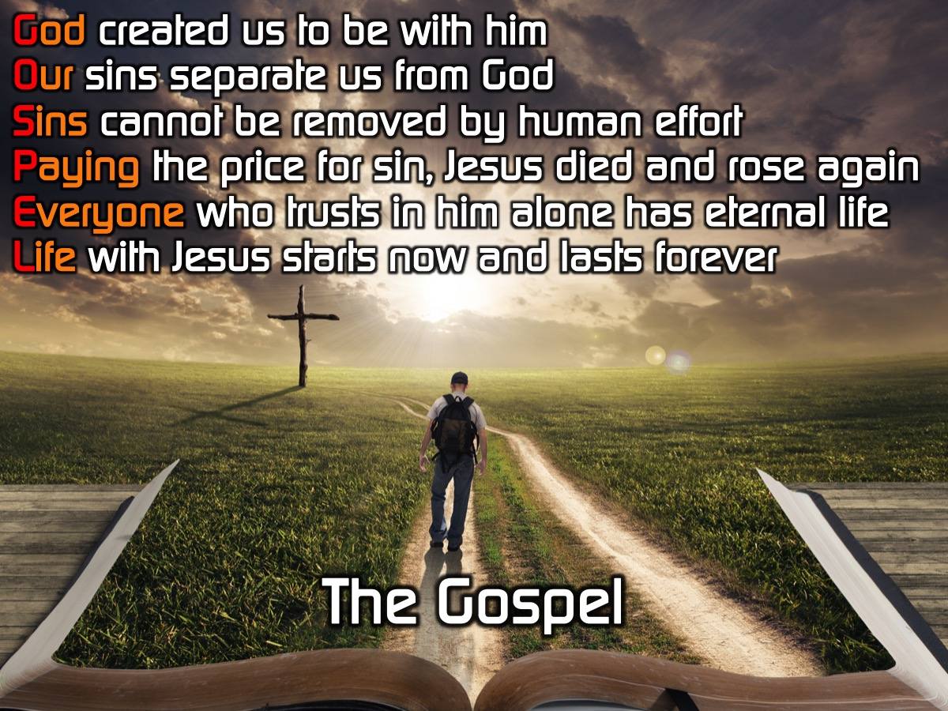
Notes:
These 6 sentences will help us master our message so we can present the GOSPEL to our friends. But how will we remember them?

Slide 8
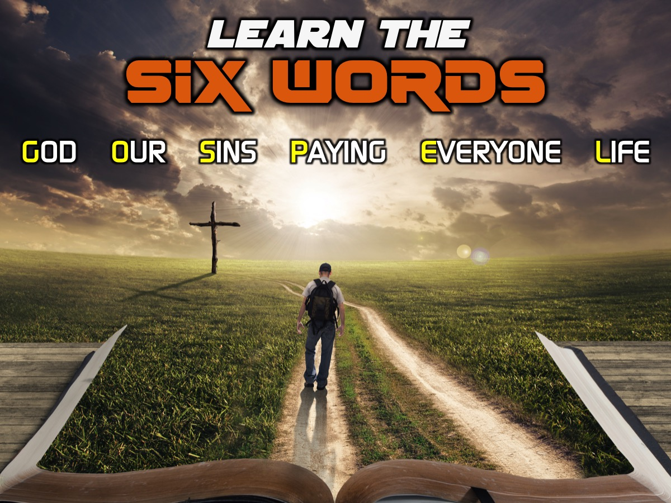
Notes:
Learn the Six Words: The first thing you need to do is actually learn the 6 words. Let’s go through them one at a time!

Slide 9
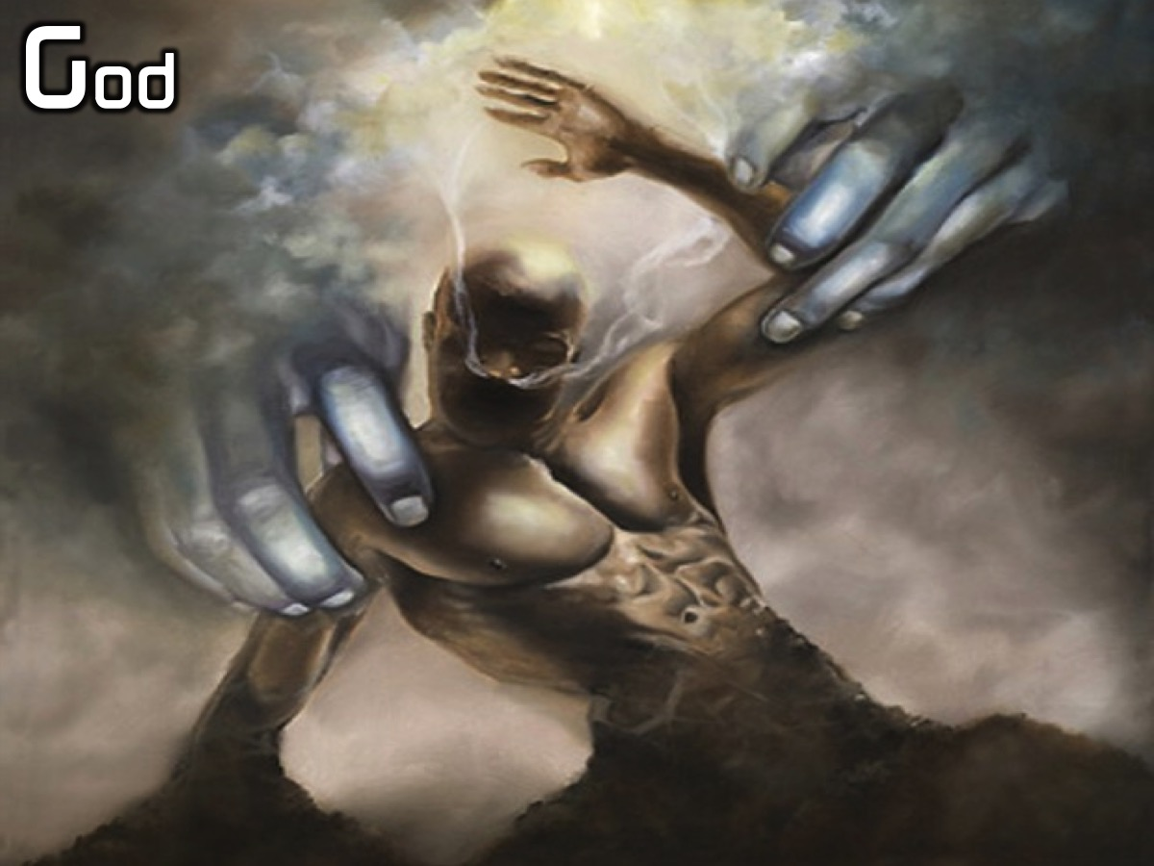
Notes:
God

Slide 10
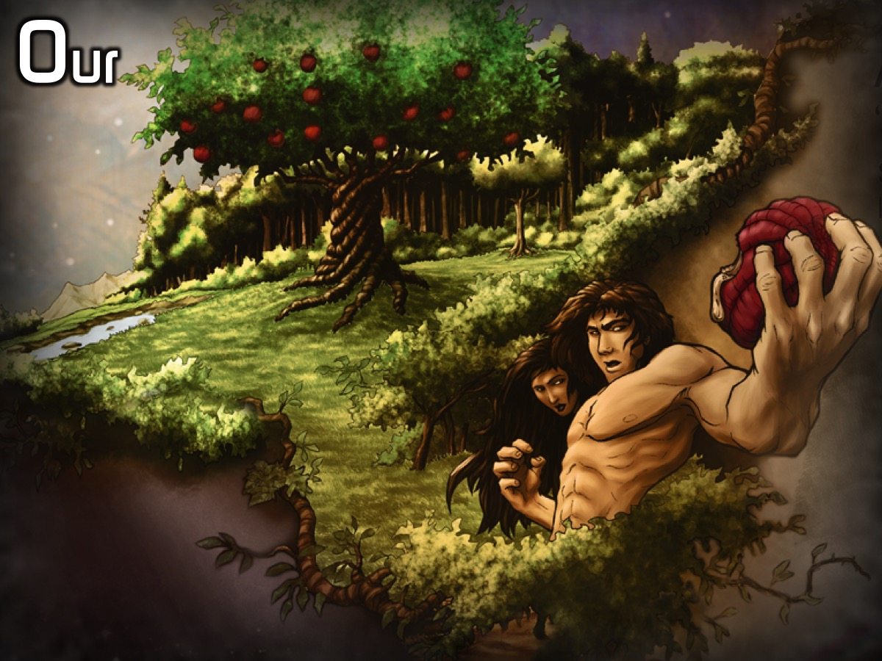
Notes:
Our

Slide 11
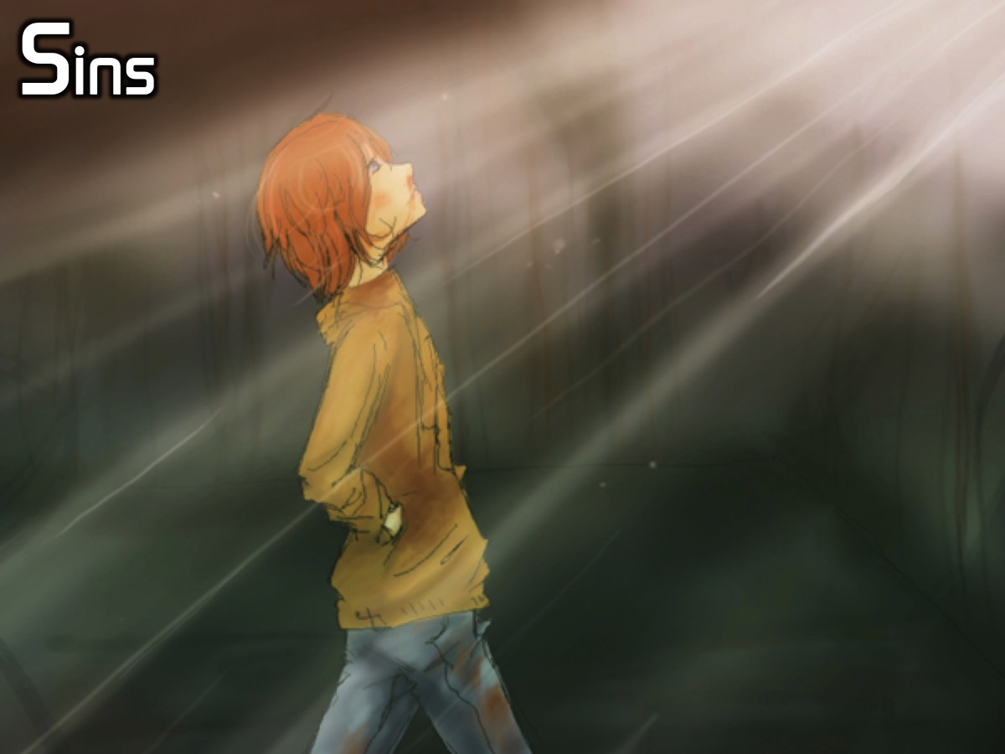
Notes:
Sins

Slide 12
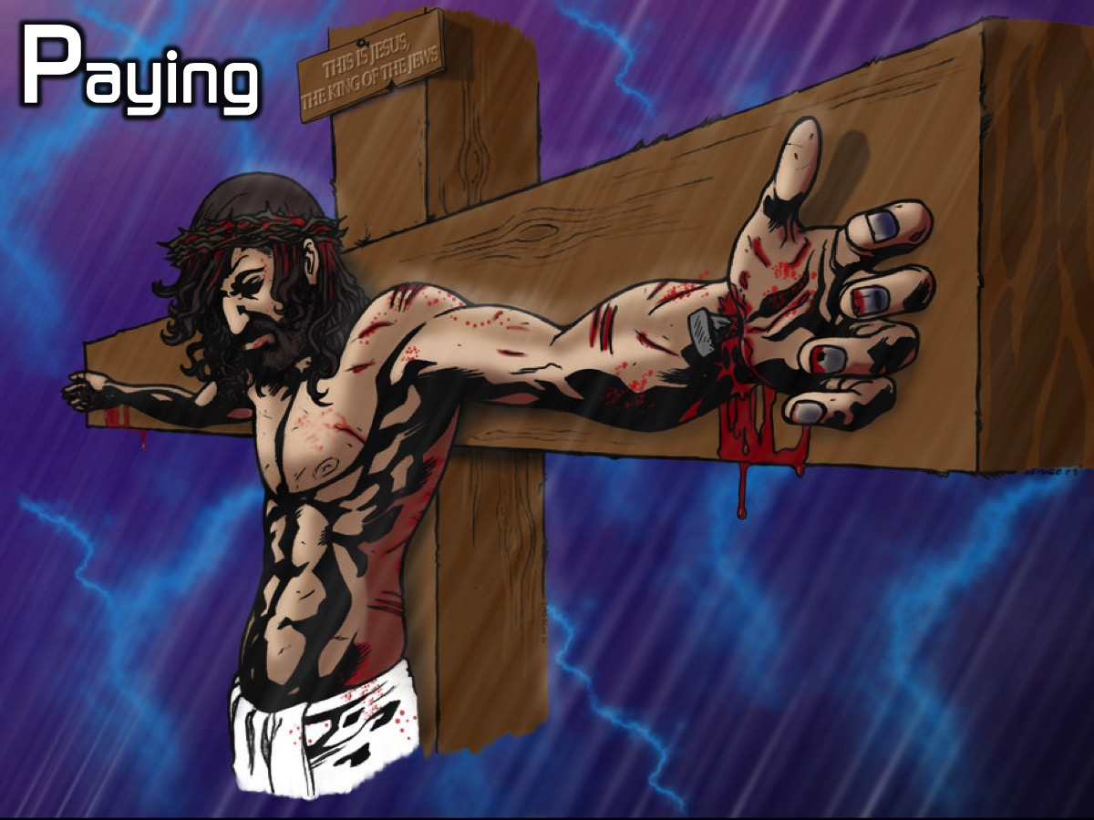
Notes:
Paying

Slide 13
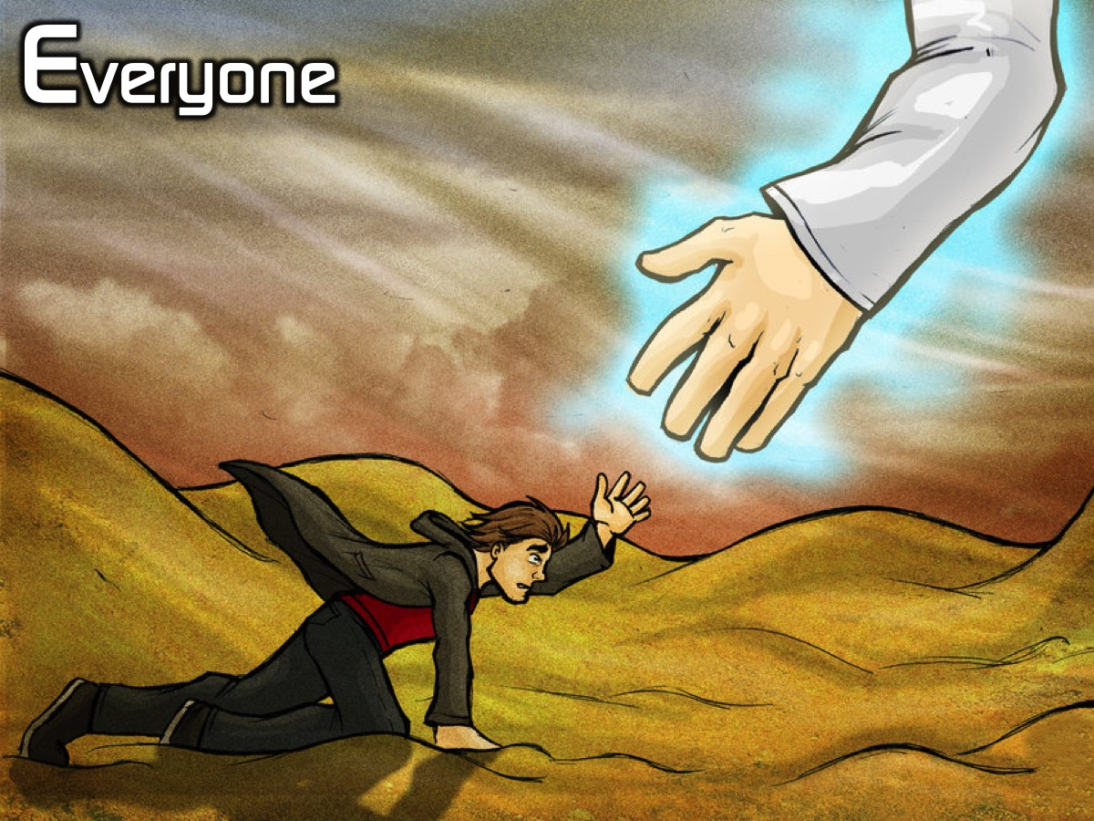
Notes:
Everyone

Slide 14
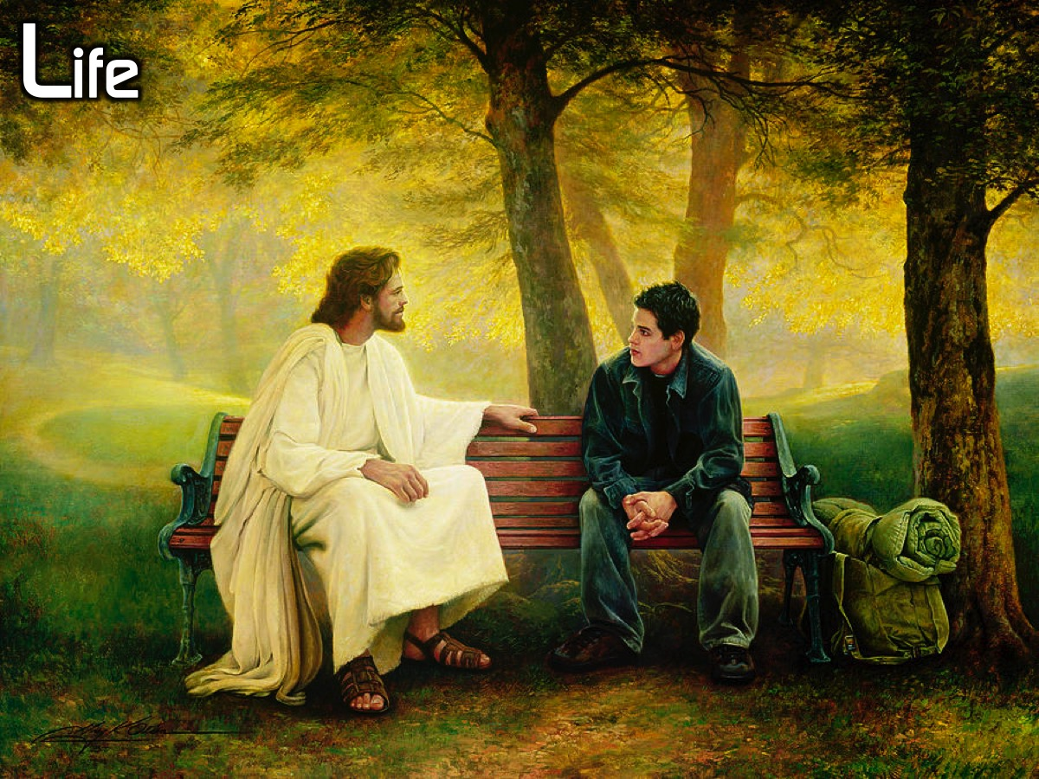
Notes:
Life

Slide 15
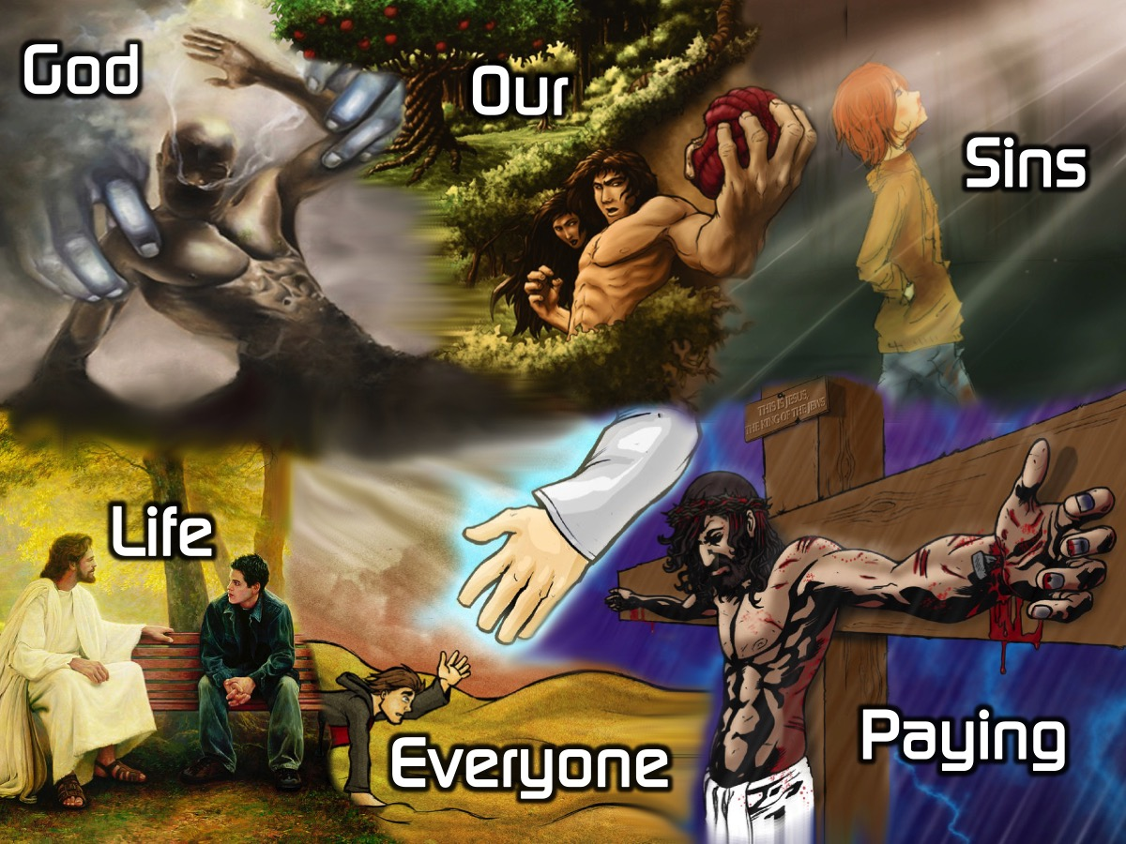
Notes:
Say them all at your own pace: God Our Sins Paying Everyone Life

Slide 16
Notes:
Say the words with me this time: God

Slide 17
Notes:
Our

Slide 18
Notes:
Sins

Slide 19
Notes:
Paying

Slide 20
Notes:
Everyone

Slide 21
Notes:
Life

Slide 22
Notes:
One more time, all together: God Our Sins Paying Everyone Life.

Slide 23
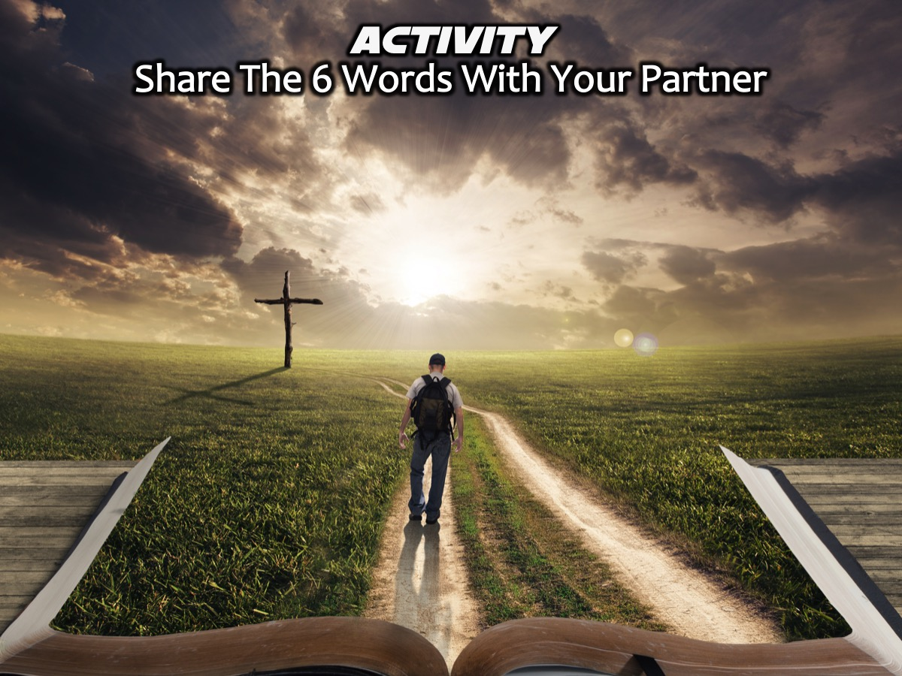
Notes:
Activity: Share The 6 Words With Your Partner and then let them share them with you.

Slide 24

Notes:
Learn the 6 Sentences: Each of the 6 words you have just learnt are the start of a sentence and we are now going to start learning the 6 sentences.

Slide 25
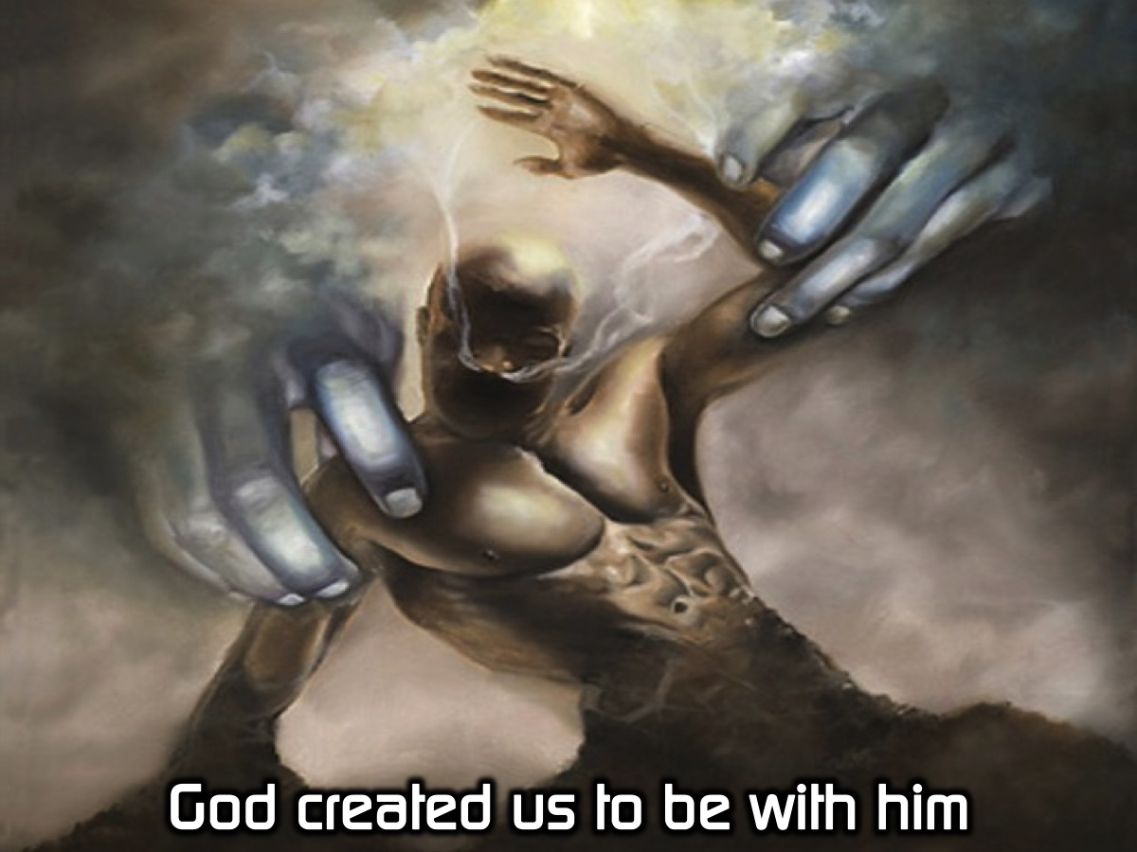
Notes:
God created us to be with him.

Slide 26
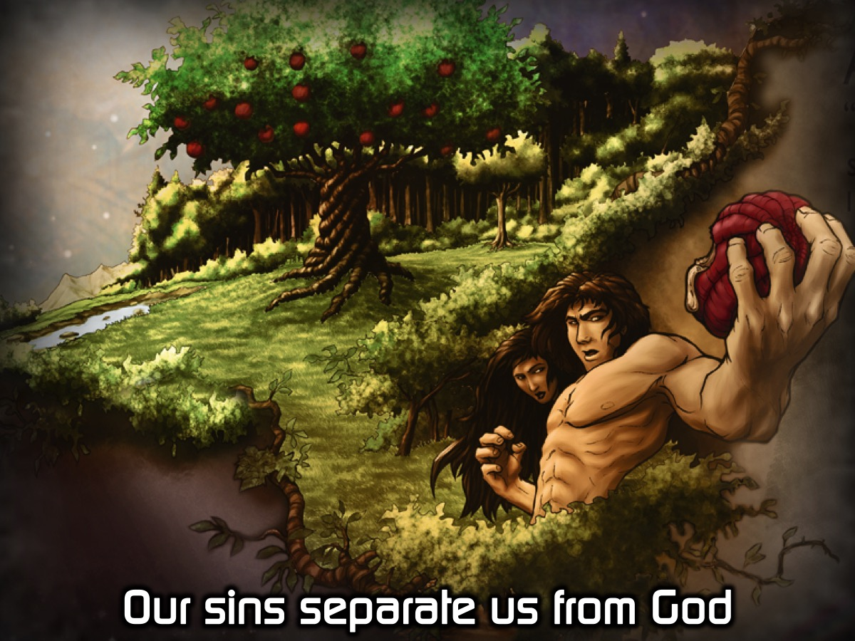
Notes:
Our sins separate us from God.

Slide 27
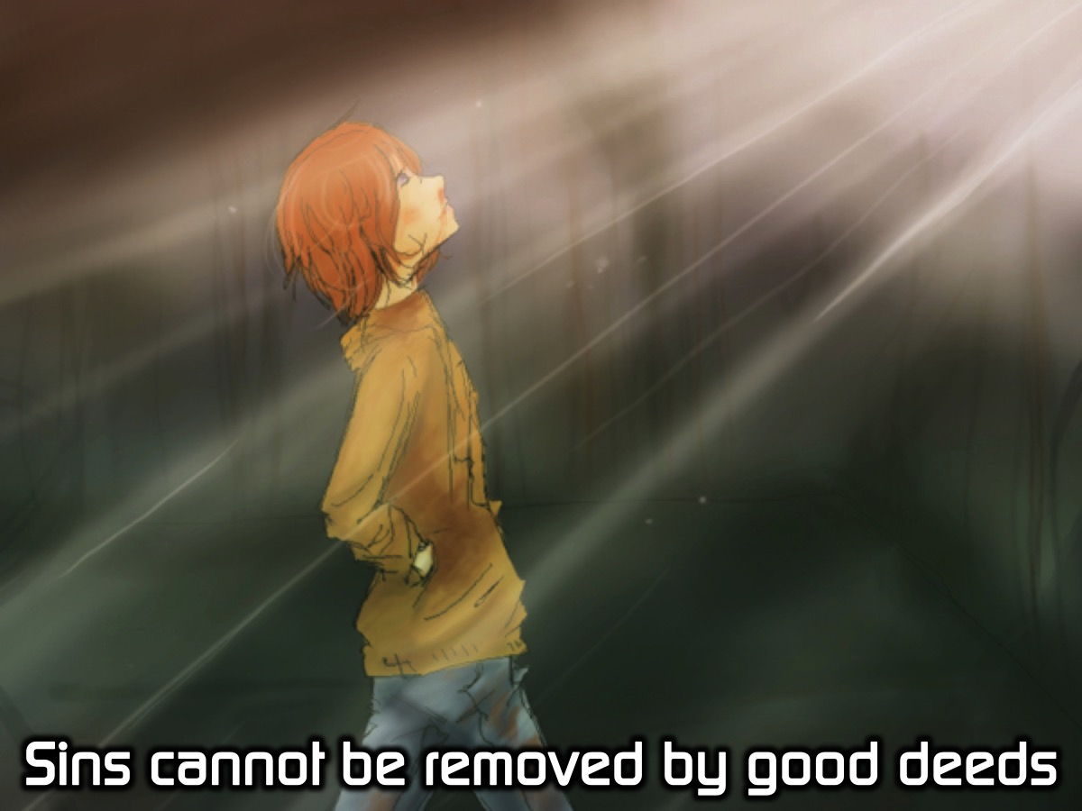
Notes:
Sins cannot be removed by good deeds.

Slide 28
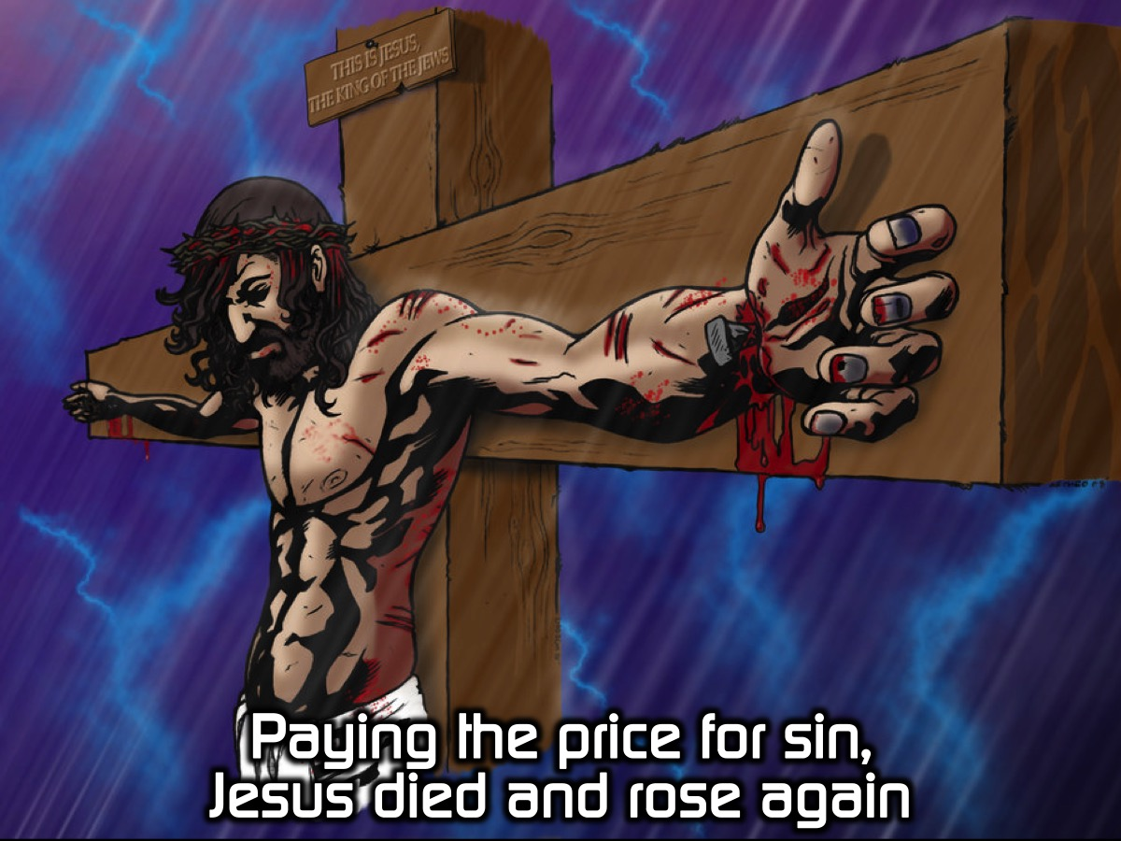
Notes:
Paying the price for sin, Jesus died and rose again.

Slide 29
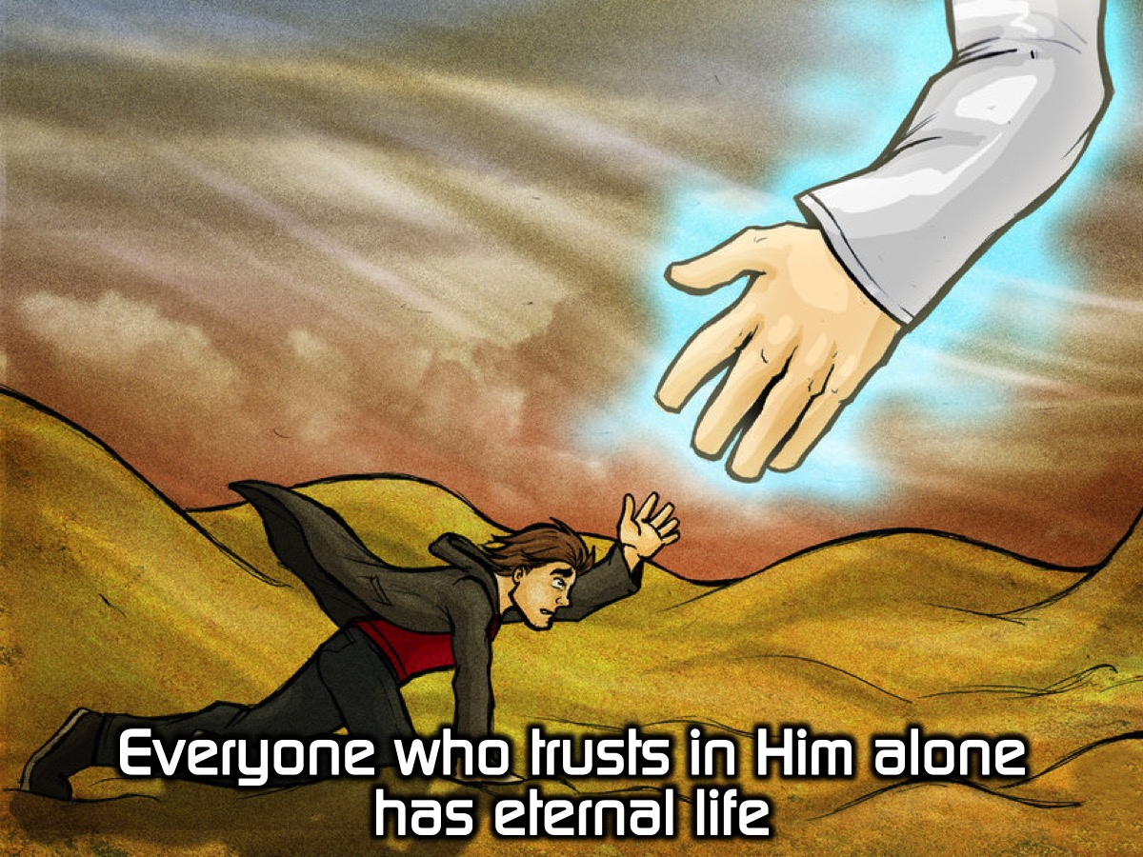
Notes:
Everyone who trusts in Him alone has eternal life.

Slide 30
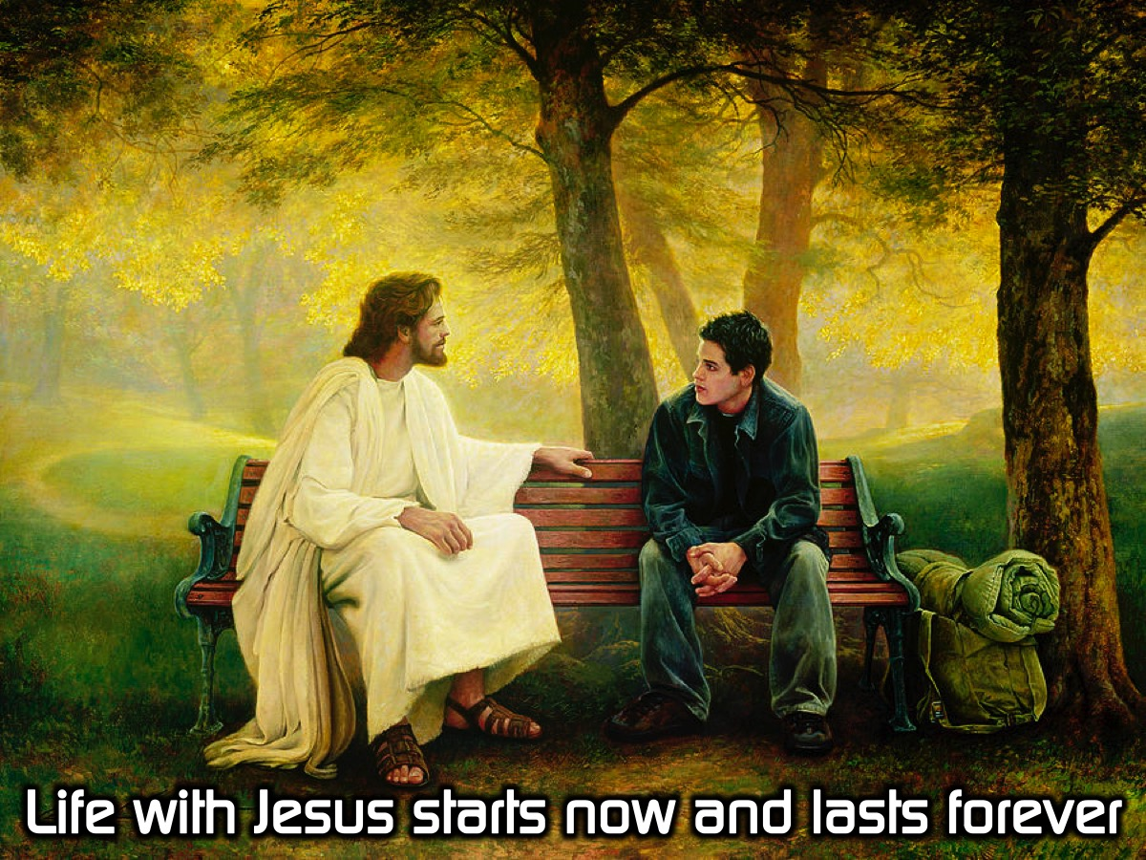
Notes:
Life with Jesus starts now and lasts forever.

Slide 31

Notes:
Activity: We are going to say the 6 sentences out loud as the slides come up.

Slide 32
Notes:
God created us to be with him.

Slide 33
Notes:
Our sins separate us from God.

Slide 34

Notes:
Sins cannot be removed by good deeds.

Slide 35
Notes:
Paying the price for sin, Jesus died and rose again.

Slide 36
Notes:
Everyone who trusts in Him alone has eternal life.

Slide 37

Notes:
Life with Jesus starts now and lasts forever.

Slide 38
Notes:
God created us to be with him.

Slide 39
Notes:
Our sins separate us from God.

Slide 40
Notes:
Sins cannot be removed by good deeds.

Slide 41
Notes:
Paying the price for sin, Jesus died and rose again.

Slide 42

Notes:
Everyone who trusts in Him alone has eternal life.

Slide 43
Notes:
Life with Jesus starts now and lasts forever.

Slide 44
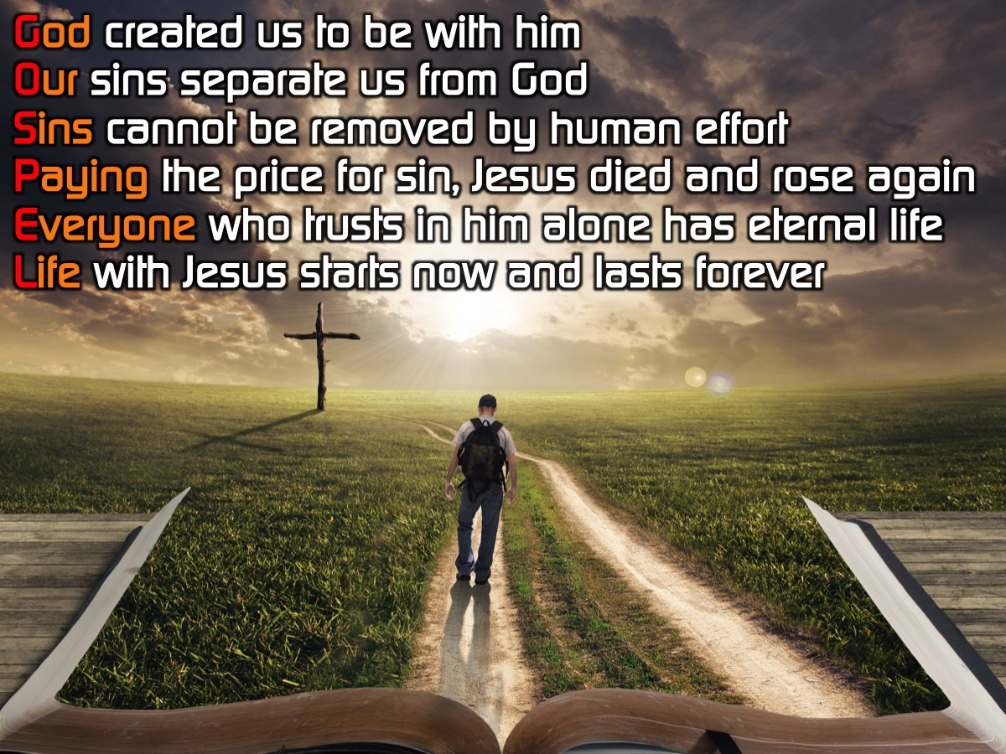
Notes:
Activity: Let’s say all the sentences together once more:
God created us to be with him.
Our sins separate us from God.
Sins cannot be removed by good deeds.
Paying the price for sin, Jesus died and rose again.
Everyone who trusts in Him alone has eternal life.
Life with Jesus starts now and lasts forever.

Slide 45
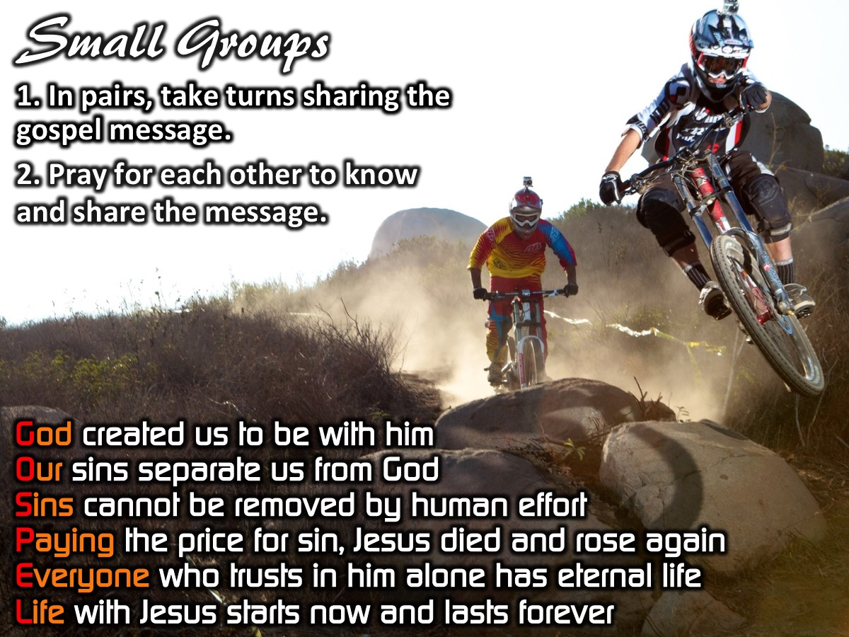
Notes:
Small Group Activity: (1) In pairs, take turns sharing the gospel message using the 6 sentences: God created us to be with him. Our sins separate us from God. Sins cannot be removed by human effort. Paying the price for sin, Jesus died and rose again. Everyone who trusts in him alone has eternal life. Life with Jesus starts now and lasts forever. (2) Pray for each other to know and share the message.

Slide 46

Notes:
Challenge: Master the message so you can share it with your friends.

Slide 47
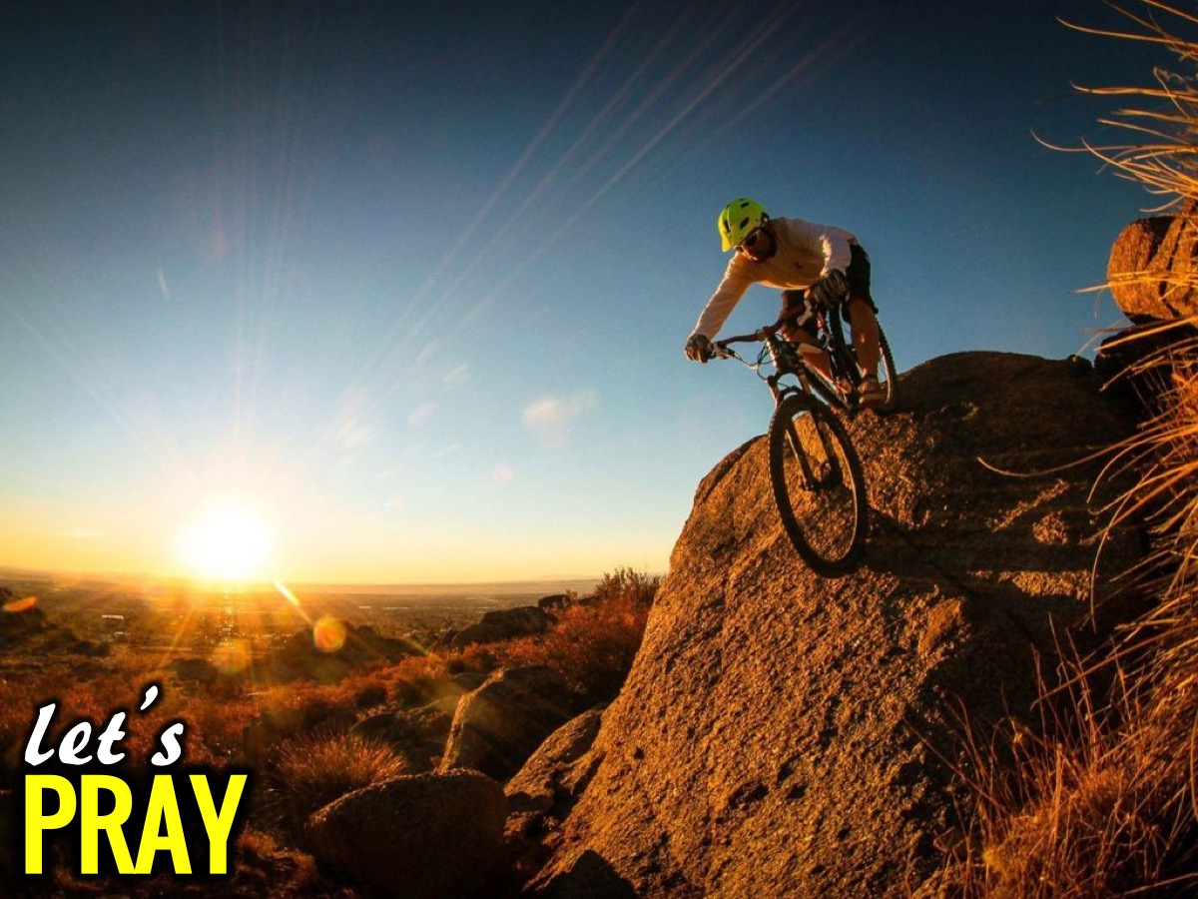
Notes:
Let’s Pray

Slide 48

Notes:
Next Week: In week 5 of the Shine Series we will deal with part 2 of mastering our message so we can share the Gospel with our friends.

