Slide 1
Notes:
Welcome to the Shine Series.

Slide 2
Notes:
Last week we explored how to master our message so we know how to share the gospel with our friends.

Slide 3
Notes:
Review the Six Words: Let’s review the 6 words that we learnt last week. Say them with me…

Slide 4
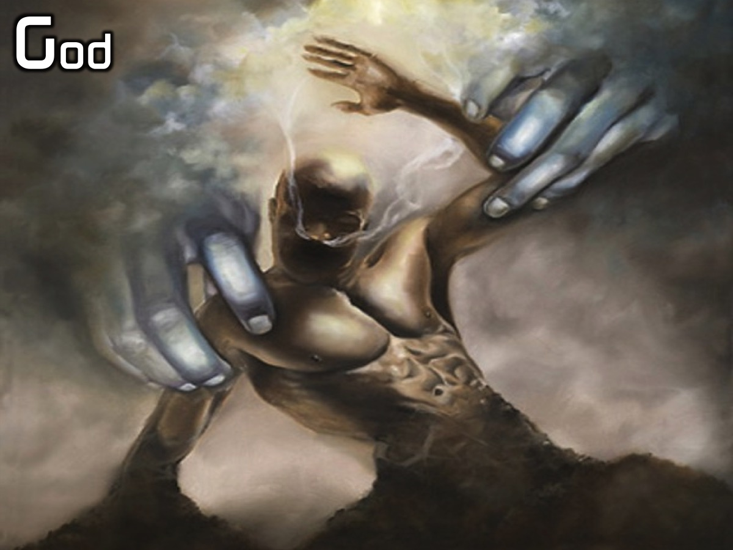
Notes:
God

Slide 5
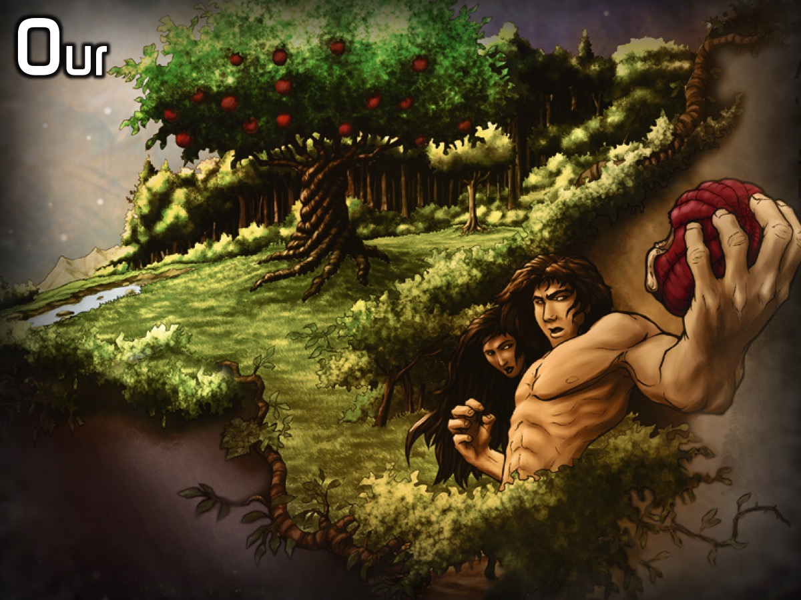
Notes:
Our

Slide 6
Notes:
Sins

Slide 7
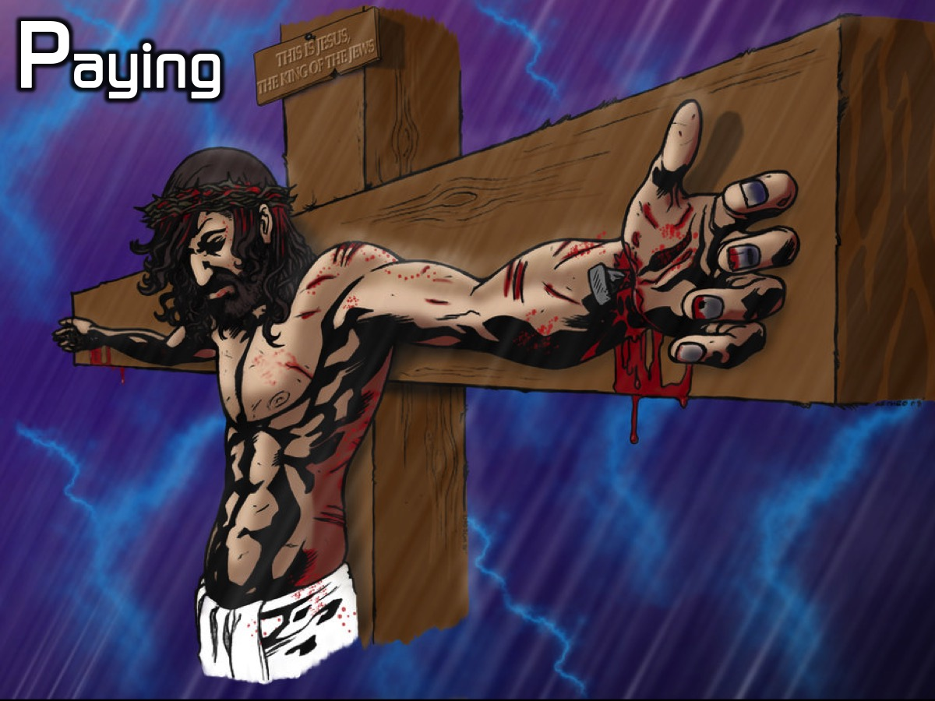
Notes:
Paying

Slide 8
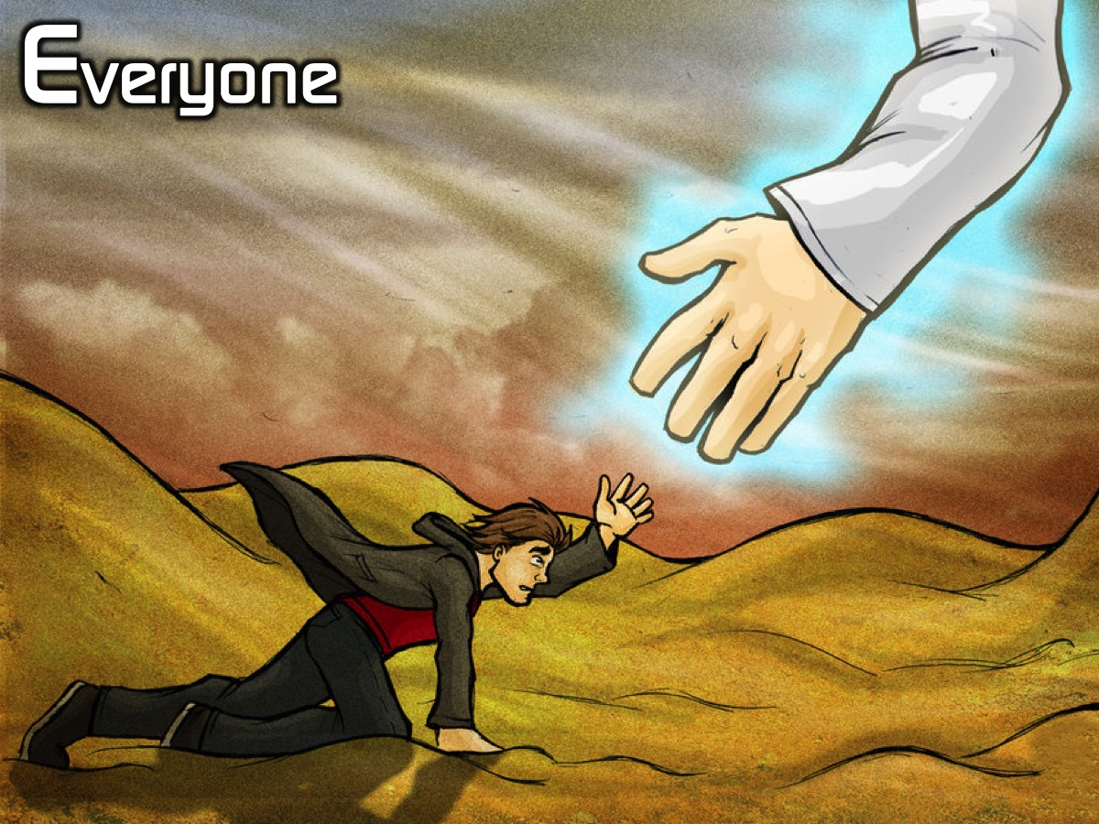
Notes:
Everyone

Slide 9
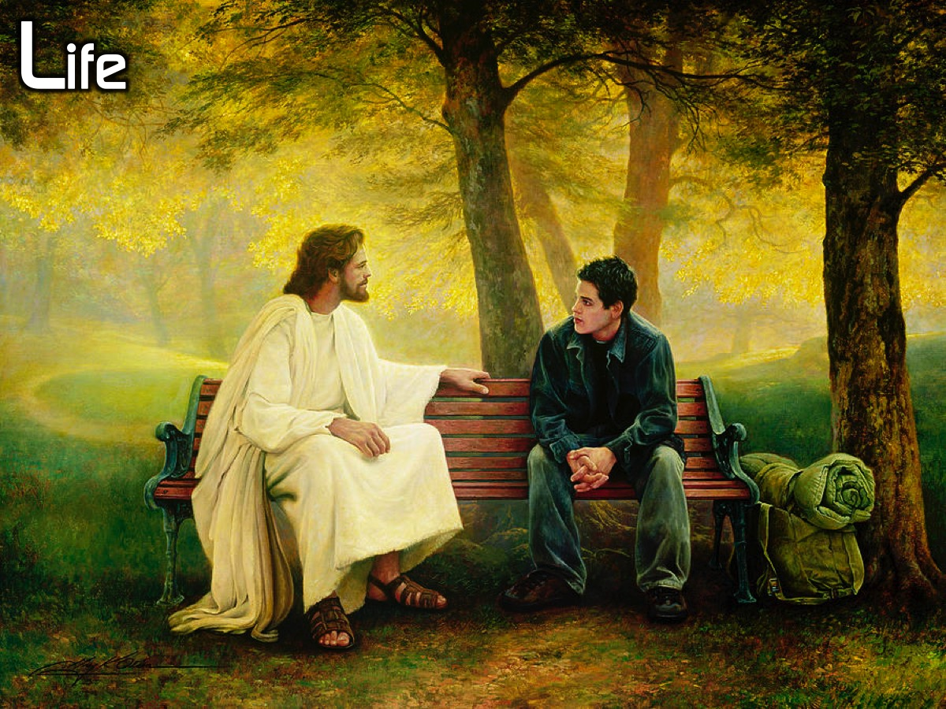
Notes:
Life

Slide 10
Notes:
God Our Sins Paying Everyone Life

Slide 11
Notes:
Review the 6 Sentences: Let’s review the 6 sentences that we learnt last week.

Slide 12
Notes:
God created us to be with him.

Slide 13
Notes:
Our sins separate us from God.

Slide 14
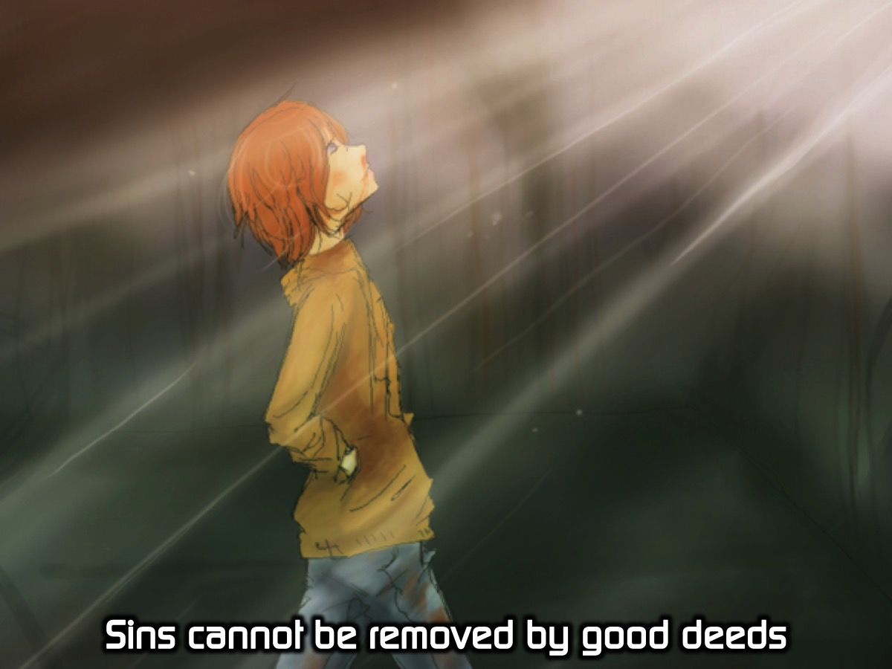
Notes:
Sins cannot be removed by good deeds.

Slide 15
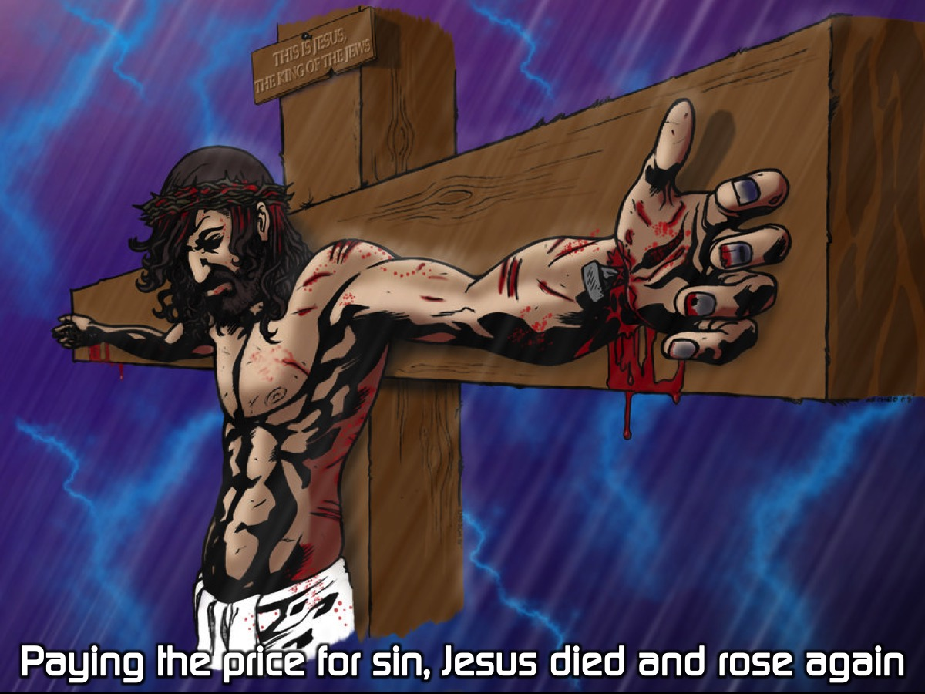
Notes:
Paying the price for sin, Jesus died and rose again.

Slide 16
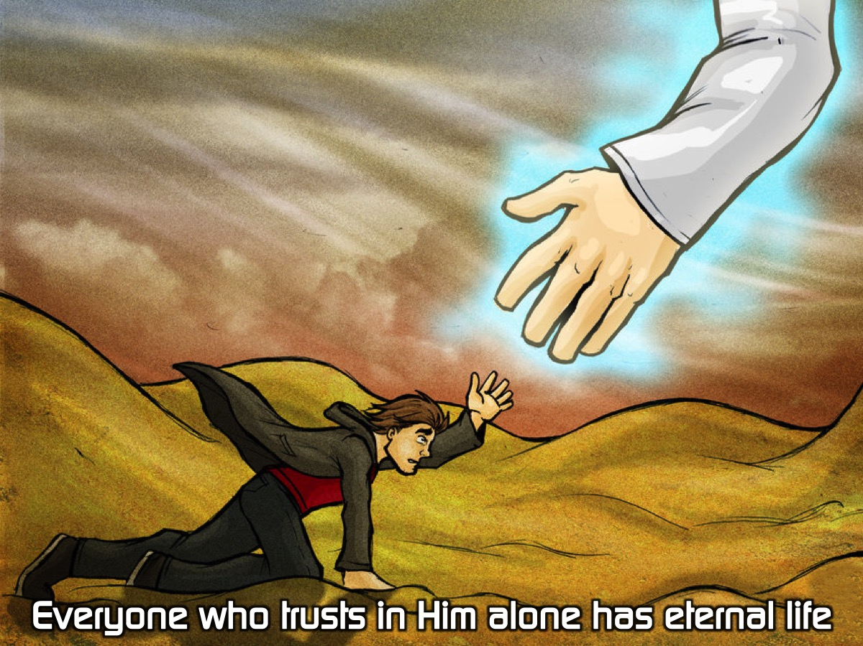
Notes:
Everyone who trusts in Him alone has eternal life.

Slide 17
Notes:
Life with Jesus starts now and lasts forever.

Slide 18
Notes:
Today we are going to continue leaning how to master our message so we can shine our light for Jesus.

Slide 19
Notes:
The video starts after this slide.

Slide 20
Notes:
Video: Shine Week 5. The video is 2 minutes in length.

Slide 21
Notes:
Sharing: What are some movies that contain a powerful love story?

Slide 22
Notes:
The GOSPEL is the ultimate love story!

Slide 23
Notes:
“But God demonstrates his own love for us in this: While we were still sinners, Christ died for us.” (Romans 5:8)

Slide 24
Notes:
God created us to be with him.

Slide 25
Notes:
We are a special creation of God handcrafted by God himself. “Then the Lord God formed a man from the dust of the ground and breathed into his nostrils the breath of life, and the man became a living being.” (Genesis 2:7)

Slide 26
Notes:
We were made in the image of God. “Then God said, ‘Let us make humans in our image, in our likeness.’” (Genesis 1:26)

Slide 27
Notes:
We were created to connect with God on the most intimate level.

Slide 28
Notes:
Our sins separate us from God.

Slide 29
Notes:
Satan tempted Eve and they sinned against God. “When the woman saw that the fruit of the tree was good for food and pleasing to the eye, and also desirable for gaining wisdom, she took some and ate it. She also gave some to her husband, who was with her, and he ate it.” (Genesis 3:6)

Slide 30
Notes:
Their sin separated them from God. “Then the man and his wife heard the sound of the Lord God as he was walking in the garden in the cool of the day, and they hid from the Lord God among the trees of the garden.” (Genesis 3:8)

Slide 31
Notes:
Sins cannot be removed by good deeds.

Slide 32
Notes:
We could never be good enough. “Be perfect, therefore, as your heavenly Father is perfect.” (Matthew 5:48)

Slide 33
Notes:
The Law is a mirror to show us our sin and not a ladder to get us to heaven. “Therefore no one will be declared righteous in God’s sight by the works of the law; rather, through the law we become conscious of our sin.” (Romans 3:20)

Slide 34
Notes:
Paying the price for sin, Jesus died and rose again.

Slide 35
Notes:
Jesus died in our place for our sins. “But he was pierced for our transgressions, he was crushed for our iniquities; the punishment that brought us peace was on him, and by his wounds we are healed. We all, like sheep, have gone astray, each of us has turned to our own way; and the Lord has laid on him the iniquity of us all.” (Isaiah 53:5-6)

Slide 36
Notes:
Jesus rose to prove he was the Son of God. “After his suffering, he presented himself to them and gave many convincing proofs that he was alive. He appeared to them over a period of forty days and spoke about the kingdom of God.” (Acts 1:3)

Slide 37
Notes:
Everyone who trusts in Him alone has eternal life.

Slide 38
Notes:
We are saved by grace through faith, not by good works. “For it is by grace you have been saved, through faith - and this is not from yourselves, it is the gift of God - not by works, so that no one can boast.” (Ephesians 2:8-9)

Slide 39
Notes:
When we trust in Jesus as our savior he exchanges our sin for his righteousness. “God made him who had no sin to be sin for us, so that in him we might become the righteousness of God.” (2 Corinthians 5:21)

Slide 40
Notes:
Life with Jesus starts now and lasts forever.

Slide 41
Notes:
Eternal life begins as soon as you believe in Jesus. “I tell you the truth, he who believes has everlasting life.” (John 6:47)

Slide 42
Notes:
Learn the Six Verses: It would be helpful if you learnt a verse for each of the 6 words or sentences.

Slide 43
Notes:
God: Know that the Lord is God. It is he who made us, and we are his (Psalm 100:3).

Slide 44
Notes:
Our: For all have sinned and fall short of the glory of God (Romans 3:23).

Slide 45
Notes:
Sins: All of us have become like one who is unclean, and all our righteous acts are like filthy rags. (Isaiah 64:6a)

Slide 46
Notes:
Paying: But God demonstrates his own love for us in this: While we were still sinners, Christ died for us (Romans 5:8).

Slide 47
Notes:
Everyone: For God so loved the world that he gave his one and only Son, that whoever believes in him shall not perish but have eternal life (John 3:16).

Slide 48
Notes:
Life: I give them eternal life, and they shall never perish; no one will snatch them out of my hand (John 10:28).

Slide 49
Notes:
Let’s say each of the verses together:
God: Know that the Lord is God. It is he who made us, and we are his (Psalm 100:3).

Slide 50
Notes:
Our: For all have sinned and fall short of the glory of God (Romans 3:23).

Slide 51
Notes:
Sins: All of us have become like one who is unclean, and all our righteous acts are like filthy rags. (Isaiah 64:6a)

Slide 52
Notes:
Paying: But God demonstrates his own love for us in this: While we were still sinners, Christ died for us (Romans 5:8).

Slide 53
Notes:
Everyone: For God so loved the world that he gave his one and only Son, that whoever believes in him shall not perish but have eternal life (John 3:16).

Slide 54
Notes:
Life: I give them eternal life, and they shall never perish; no one will snatch them out of my hand (John 10:28).

Slide 55
Notes:
Small Group Activity: (1) In pairs, take turns sharing the gospel with the verses: God: Know that the Lord is God. It is he who made us, and we are his. (Psalm 100:3). Our: For all have sinned and fall short of the glory of God. (Romans 3:23). Sins: All of us have become like one who is unclean, and all our righteous acts are like filthy rags. (Isaiah 64:6a). Paying: But God demonstrates his own love for us in this: While we were still sinners, Christ died for us. (Romans 5:8). Everyone: For God so loved the world that he gave his one and only Son, that whoever believes in him shall not perish but have eternal life. (John 3:16). Life: I give them eternal life, and they shall never perish; no one will snatch them out of my hand. (John 10:28). (2) Pray for each other to share the message.

Slide 56
Notes:
Challenge: Master the message so you can share it with your friends.

Slide 57
Notes:
Let’s Pray

Slide 58
Notes:
Next Week: In week 6 of the Shine Series we will deal will deal with part 1 of sharing our story as we shine for Jesus.

