Slide 1

Notes:
Welcome to the Shine Series.

Slide 2

Notes:
Last week we learnt 6 verses to go with the 6 sentences that we can use when we share the gospel with our friends. If you missed last week - then please pick up a handout with the verses so you can learn them.

Slide 3

Notes:
Today we are going to learn how to share our story as we shine our light for Jesus. This is part 1 or 2.

Slide 4

Notes:
Have you ever had something happen to you that was so significant that it divided your life into two parts - a before and an after? I have had an experience like that (or maybe more than one). My event was _______ (Share your story here) and when I look back on my life I can see that it divides my life into two parts - before the event and after the event. (The event could be a traumatic experience or a positive experience that happened to you).

Slide 5

Notes:
Sharing: What event divides your life into a Before & After?

Slide 6

Notes:
The video starts after this slide.

Slide 7
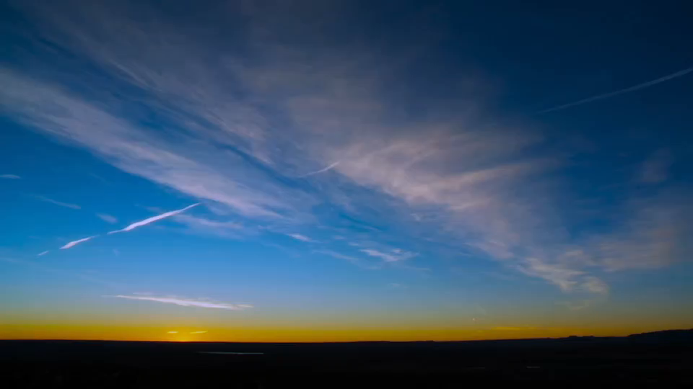
Notes:
Video: Shine Week 6. The video is 13 minutes in length.

Slide 8

Notes:
Small Groups: (1) Your faith story can be divided into three parts: (a) BEFORE: What your life was like before you trusted in Christ. What did you struggle with, what were you looking for? (b) THEN: How you became a believer. How did you hear and respond to the Gospel? (c) AFTER: What Jesus has been doing in your life since you put your trust in Him. What have you gained as a result of following Jesus? (2) Think about your story in this way and then pair up and take turns sharing it with each other in 2 minutes or less.

Slide 9

Notes:
Challenge: Share your story with your friends.

Slide 10

Notes:
Let’s Pray

Slide 11

Notes:
Next week we will deal with part 2 of sharing our story as we shine for Jesus.

