Slide 1

Notes:
Welcome to the Shine Series.

Slide 2

Notes:
Last week we learnt about the importance of using our story when we share the gospel to our lost friends. Our story is divided into 3 parts: Before, Then and After.

Slide 3

Notes:
Review the 6 Sentences: Let’s review the 6 sentences that we learnt in a previous week.

Slide 4
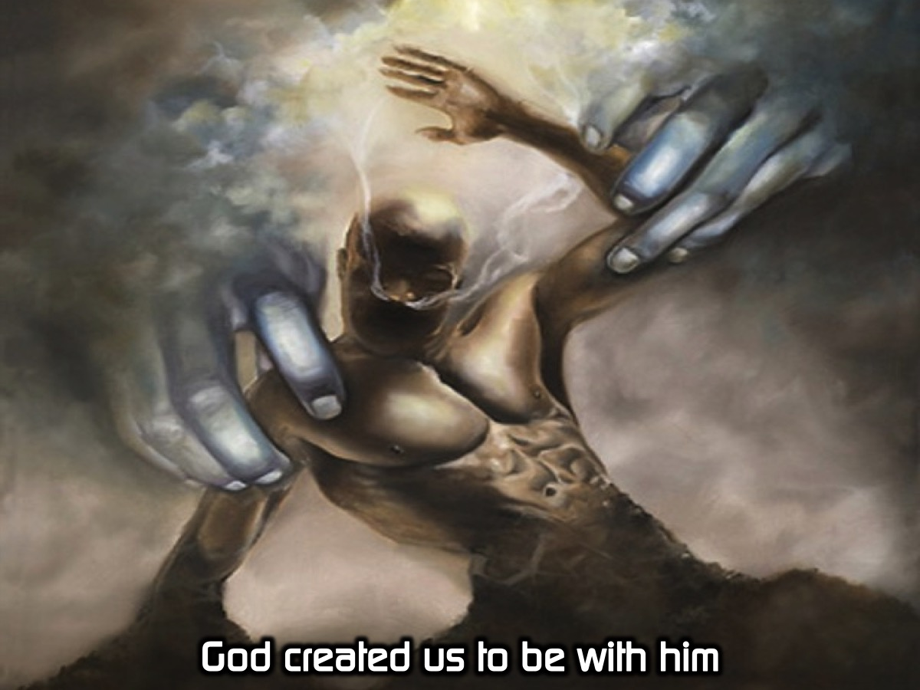
Notes:
God created us to be with him.

Slide 5
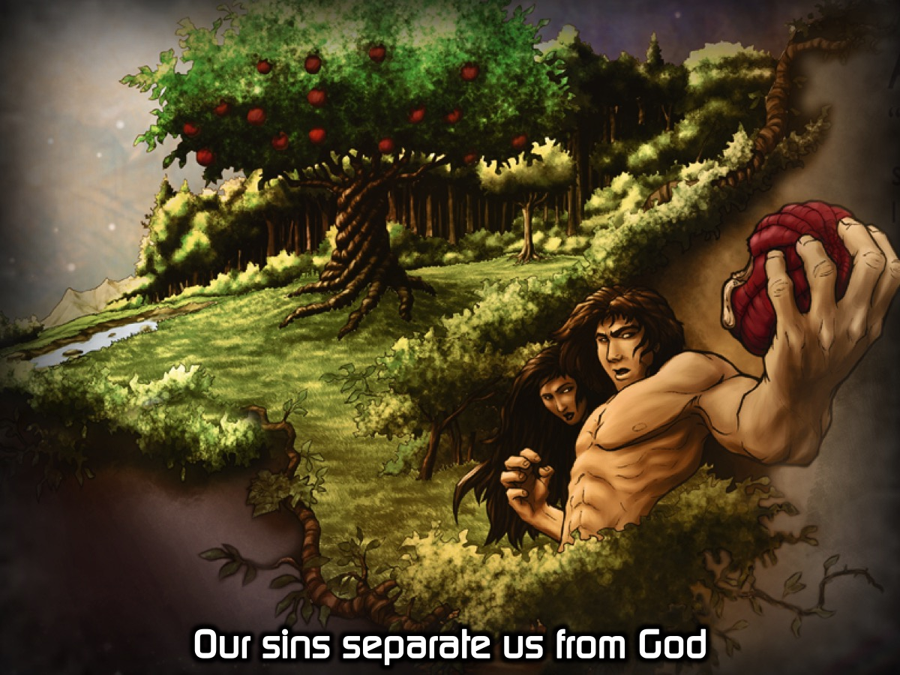
Notes:
Our sins separate us from God.

Slide 6
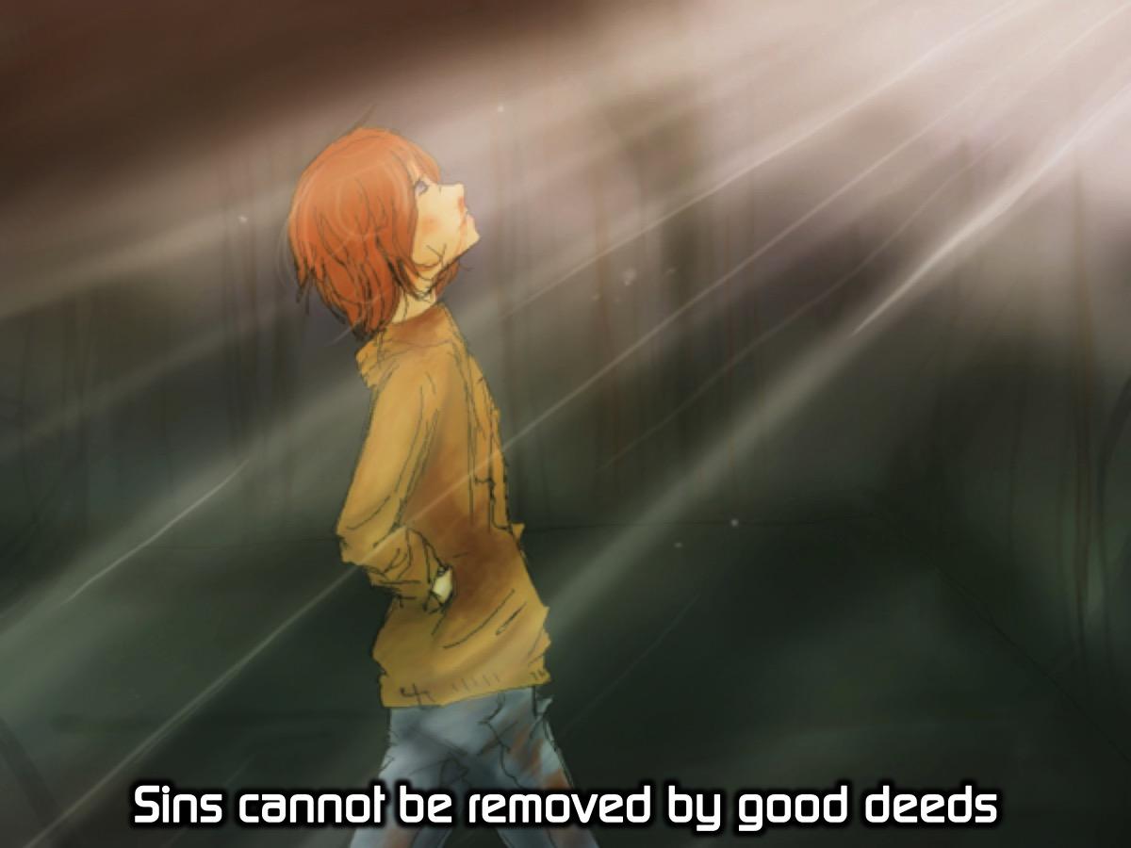
Notes:
Sins cannot be removed by good deeds.

Slide 7
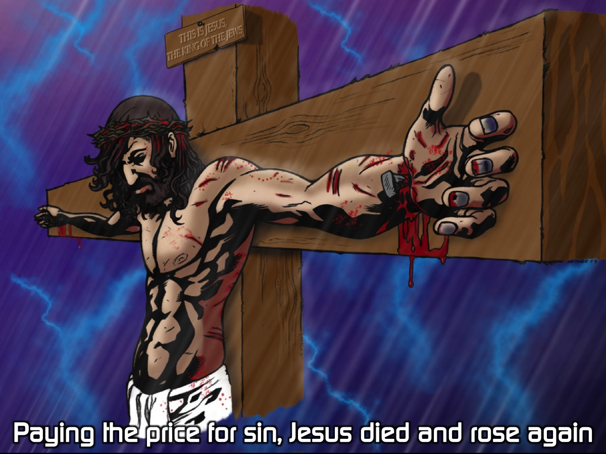
Notes:
Paying the price for sin, Jesus died and rose again.

Slide 8
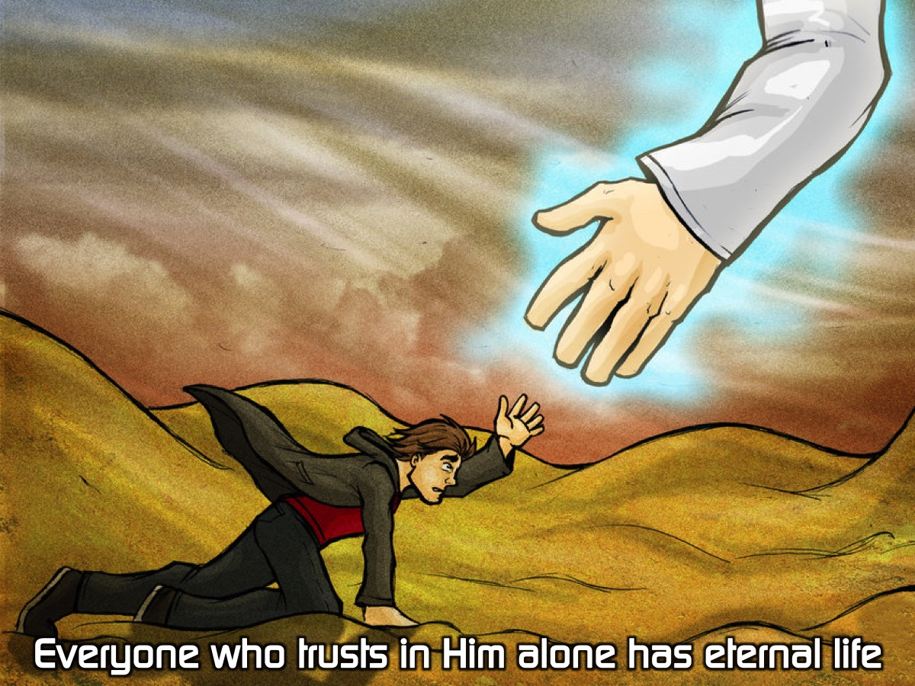
Notes:
Everyone who trusts in Him alone has eternal life.

Slide 9
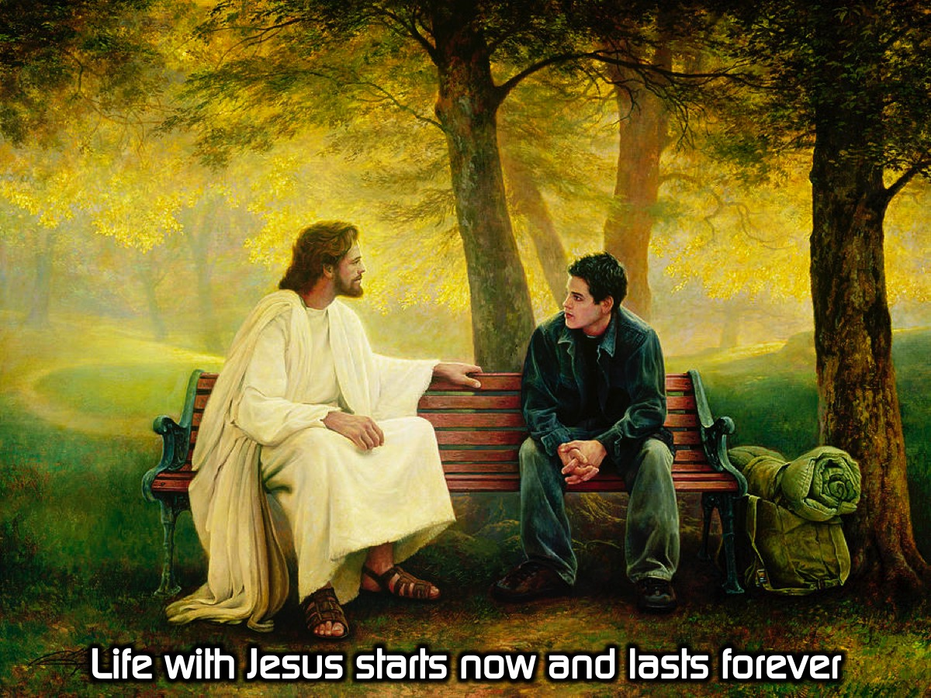
Notes:
Life with Jesus starts now and lasts forever.

Slide 10

Notes:
Today we are going to continue learning how to share our story as we shine our light for Jesus. This is part 2 or 2.

Slide 11

Notes:
The video starts after this slide.

Slide 12
Notes:
Video: Flame’s Testimony. Get it on YouTube at: https://www.youtube.com/watch?v=N9xc3qwOXEU. The video is 3 minutes long.

Slide 13

Notes:
Activity: Use the worksheet to write your BEFORE, THEN and AFTER Gospel story.

Slide 14

Notes:
Small Groups: (1) Share your faith story with the person sitting next to you. (2) Ask them to evaluate the content of your story and how you shared it. (3) Pray for each other to have the courage to share it with someone.

Slide 15

Notes:
Challenge: Share your story with your friends.

Slide 16

Notes:
Let’s Pray

Slide 17

Notes:
Next week we will deal with engaging our circle as we shine for Jesus.

