Slide 1

Notes:
Welcome to the Shine Series.

Slide 2

Notes:
Last week we learnt how to write our story in 3 parts: Before, Then and After and we were challenged to share it with someone during the week.

Slide 3

Notes:
Today we are going to talk about engaging our circle as we shine our light for Jesus.

Slide 4
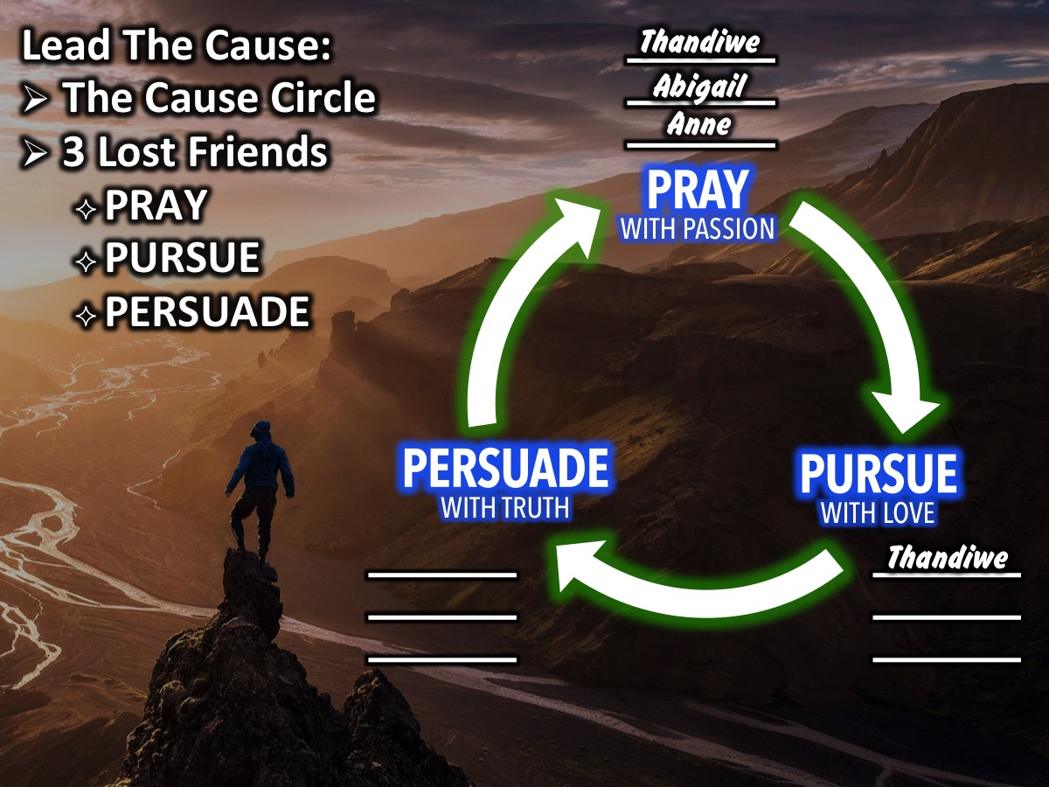
Notes:
A few weeks back some of us attended a training event called: Lead The Cause - where we were introduced to what is known as the Cause Circle - we write down the names of 3 lost friends above the Pray with Passion part of the circle and then we start to pray for them by name - asking God to reveal himself to them and help us get the chance to lead them to Jesus. We move to the next part of the Cause circle as we start to Pursue them with Love (when we start to do things that show them that we care about them we can move their name from the Pray section to the Pursue with Love section. Then at some point we start to Persuade them with Truth (maybe sharing our story or the Gospel story) and we can move their name to that part of the circle.

Slide 5
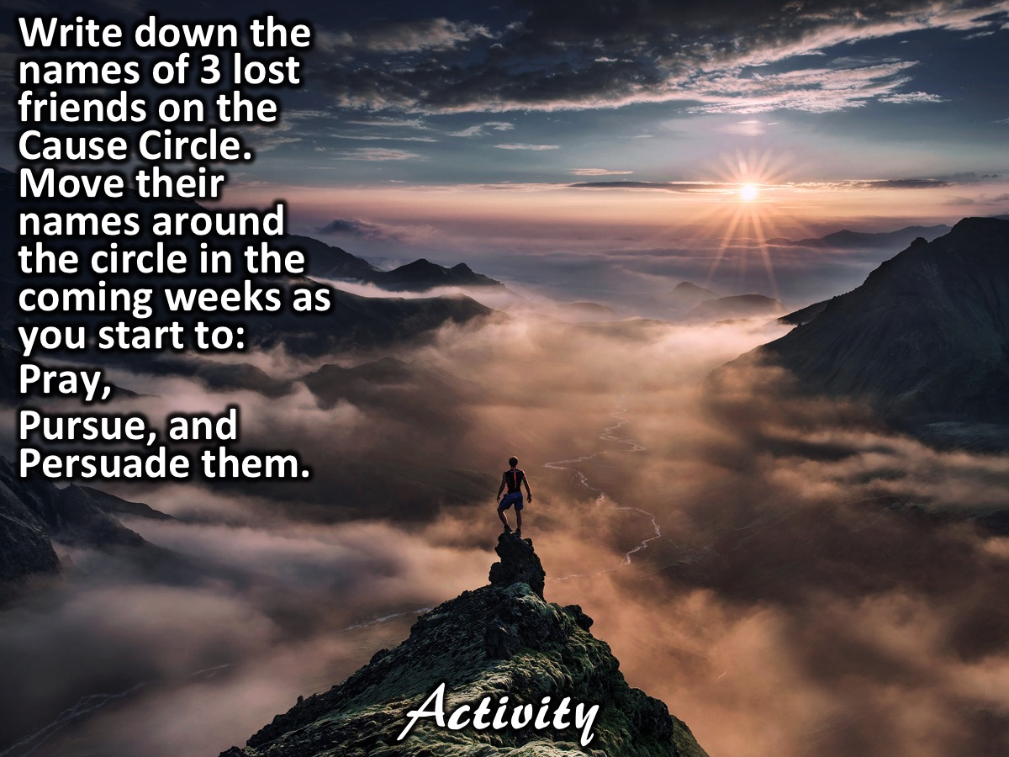
Notes:
Activity: Think of 3 people and write their names on your Cause Circle. If you are already Pursuing them with Love or Persuading them with Truth you can write their names on that part of the circle.

Slide 6

Notes:
The video starts after this slide.

Slide 7
Notes:
Video: Shine Week 8. The video is 13 minutes in length.

Slide 8
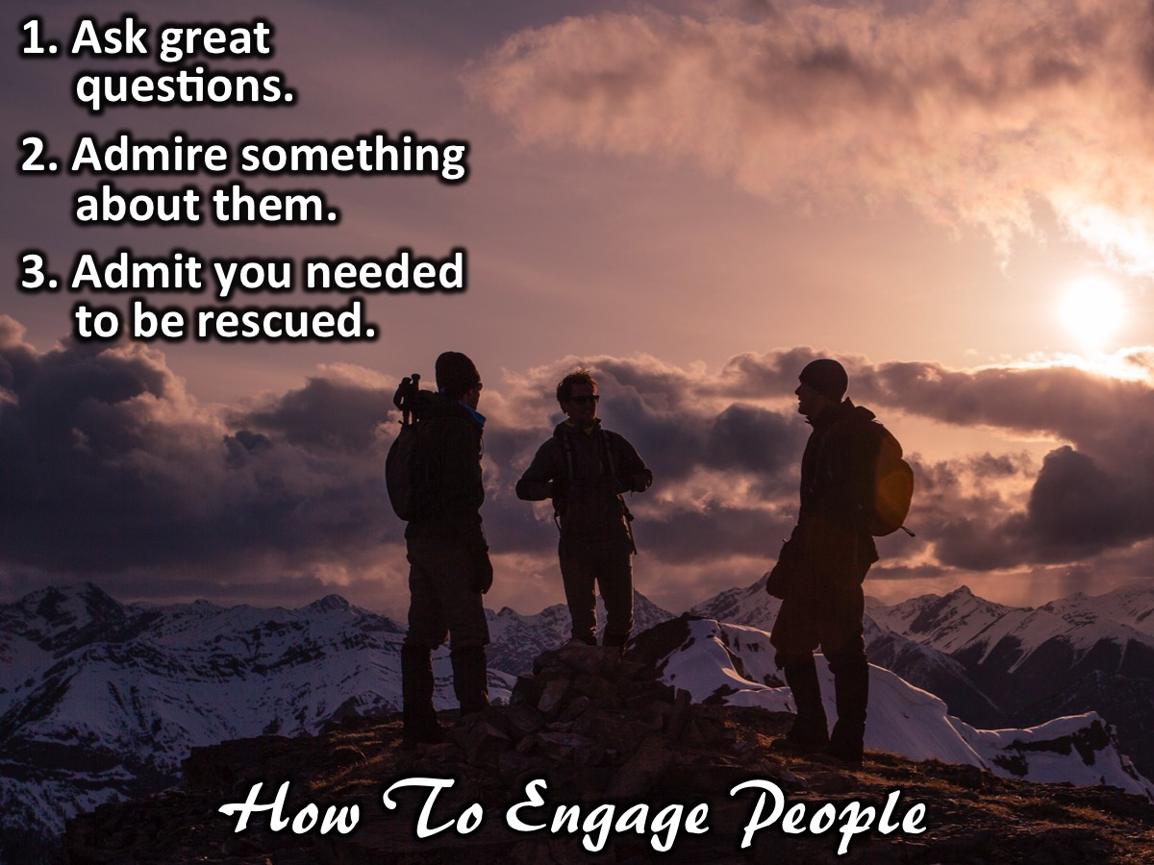
Notes:
In our Replicate series about a year ago we learnt how to engage people on our circle. There are 3 steps to follow: (1) Ask great questions. (2) Admire something about them. (3) Admit you needed to be rescued. These three steps will help us bring the gospel up more naturally.

Slide 9
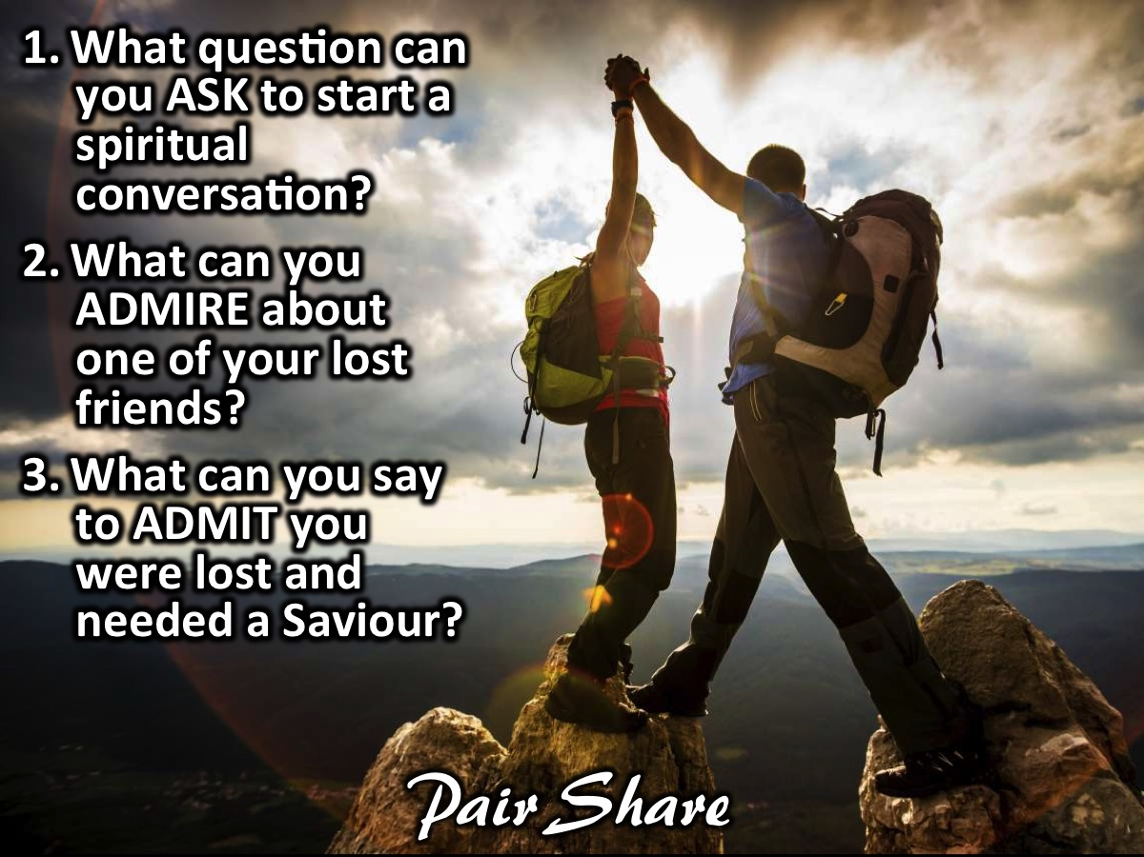
Notes:
Pair Share: In pairs, answer the following question to help you with the Ask, Admire and Admit strategy: (1) What question can you ASK to start a spiritual conversation? (2) What can you ADMIRE about one of your lost friends? (3) What can you say to ADMIT you were lost and needed a Saviour?

Slide 10

Notes:
Challenge: Engage your circle this coming week - start to Pray, Love or Pursue your lost friends and use the Ask, Admire and Admit strategy.

Slide 11

Notes:
Let’s Pray

Slide 12

Notes:
Next week as we wrap up the Shine Series we will deal with continuing the conversation as we shine for Jesus.

