Slide 1

Notes:
Welcome to the Shine Series.

Slide 2
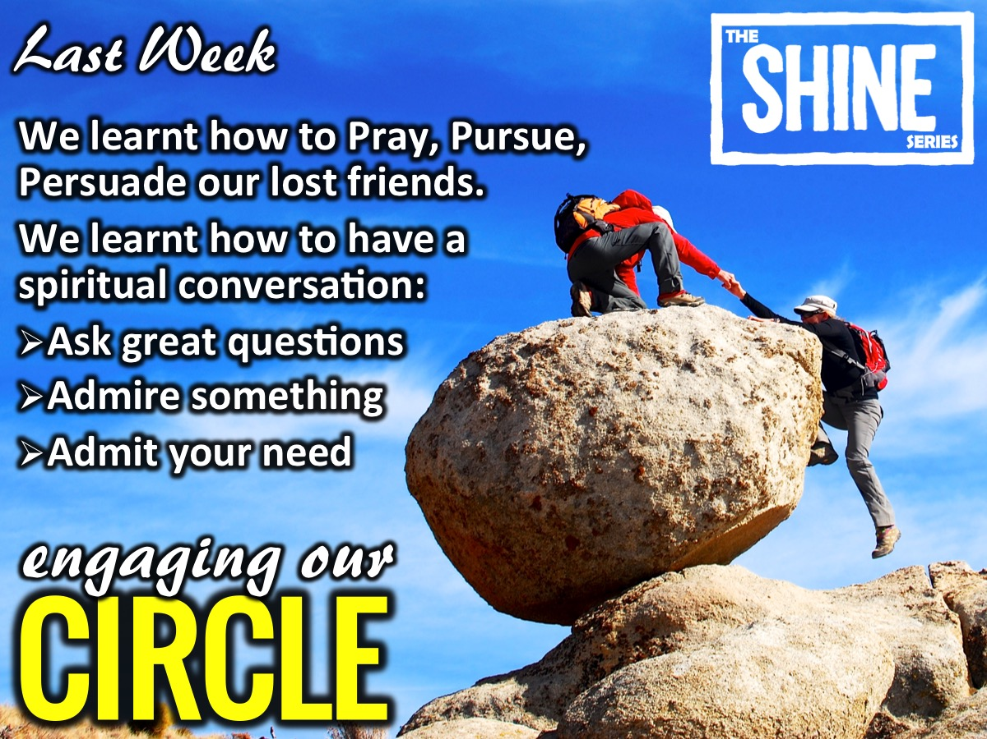
Notes:
Last week we learnt how to Pray, Pursue and Persuade our lost friends. We learnt how to have a spiritual conversation: Ask great questions, Admire something about them and Admit you needed a Saviour.

Slide 3
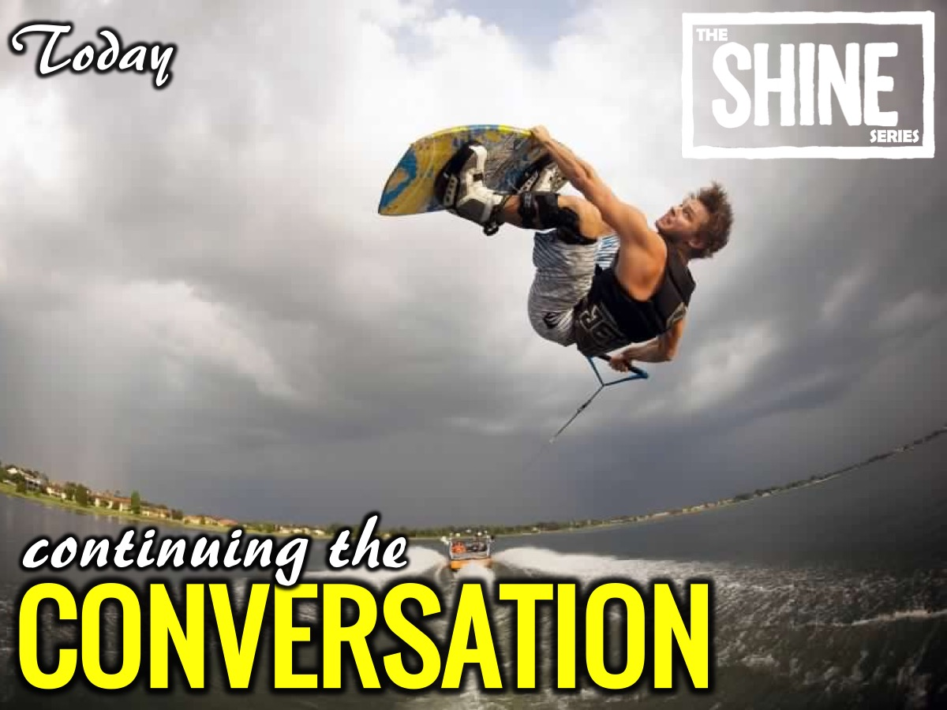
Notes:
Today we are going to talk about continuing the conversation.

Slide 4

Notes:
The video starts after this slide.

Slide 5
Notes:
Video: Shine Week 9. The video is 10 minutes in length.

Slide 6
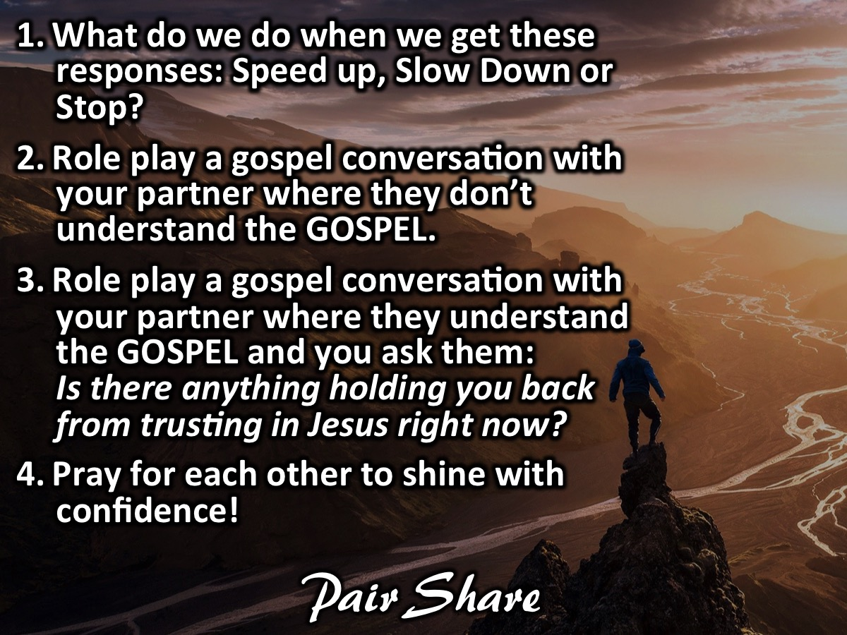
Notes:
Pair Share: In pairs, answer the following question: (1) What do we do when we get these responses: Speed up, Slow Down or Stop? (2) Role play a gospel conversation with your partner where they don’t understand the GOSPEL. (3) Role play a gospel conversation with your partner where they understand the GOSPEL and you ask them: Is there anything holding you back from trusting in Jesus right now? (4) Pray for each other to shine with confidence!

Slide 7
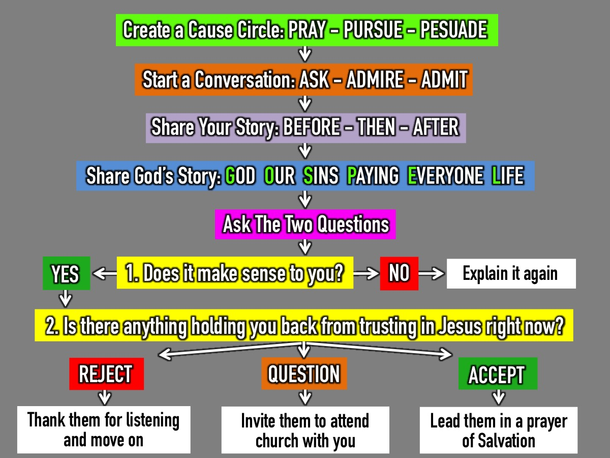
Notes:
Here is a summary of what we have learnt this term: (1) Create a Cause Circle so we can Pray with Passion, Pursue with Love and Persuade with Truth. (2) Start a Conversation with someone on our Cause Circle and Ask questions, Admire something about them and Admit we needed a Saviour. (3) Share your Story: Before - Then - After. (4) Share God’s Story with them: God Our Sins Paying Everyone Life. (5) Ask 2 Questions: The first question is: Does it make sense to you? If they say “No”: Explain the gospel again. If they say “Yes”: ask the second question: Is there anything holding you back from trusting in Jesus right now? (6) There are generally three responses to the gospel: (a) Some will Reject the Gospel - thank them for listening and move on to find someone else to share with. (b) Some will have more Questions - you could invite them to attend church on a Sunday morning to get answers to their questions. (c) Some will be ready to Accept Jesus right away - you can lead them in a prayer of salvation using the GOSPEL sentences as an outline.

Slide 8
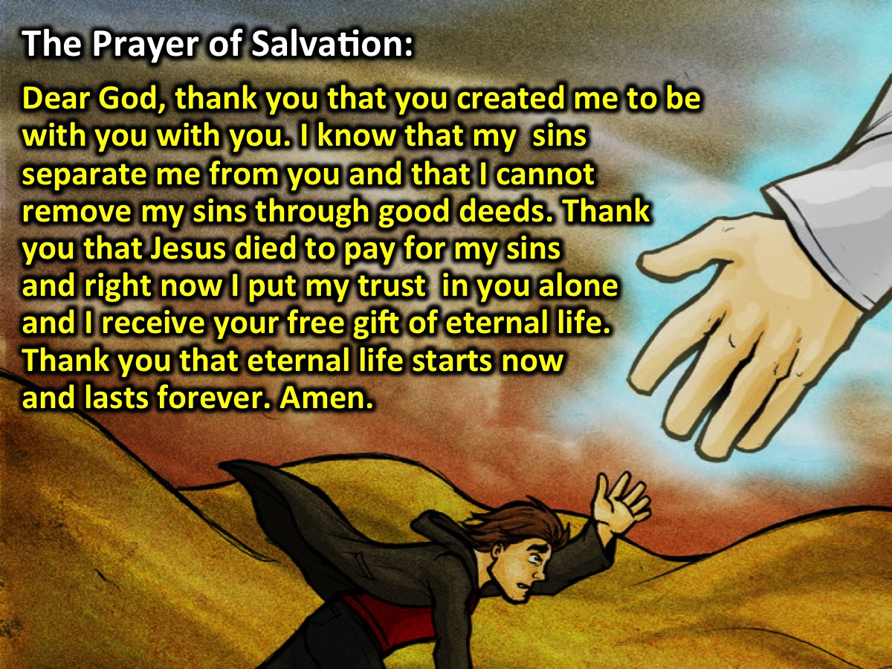
Notes:
The Prayer of Salvation: If your friends is ready to receive Jesus as their Saviour you can pray them through a prayer like this one based on the Six Sentences: Dear God, thank you that you created me to be with you with you. I know that my sins separate me from you and that I cannot remove my sins through good deeds. Thank you that Jesus died to pay for my sins and right now I put my trust in you alone and I receive your free gift of eternal life. Thank you that eternal life starts now and lasts forever. Amen.

Slide 9

Notes:
Challenge: Keep the conversations going with your lost friends.

Slide 10
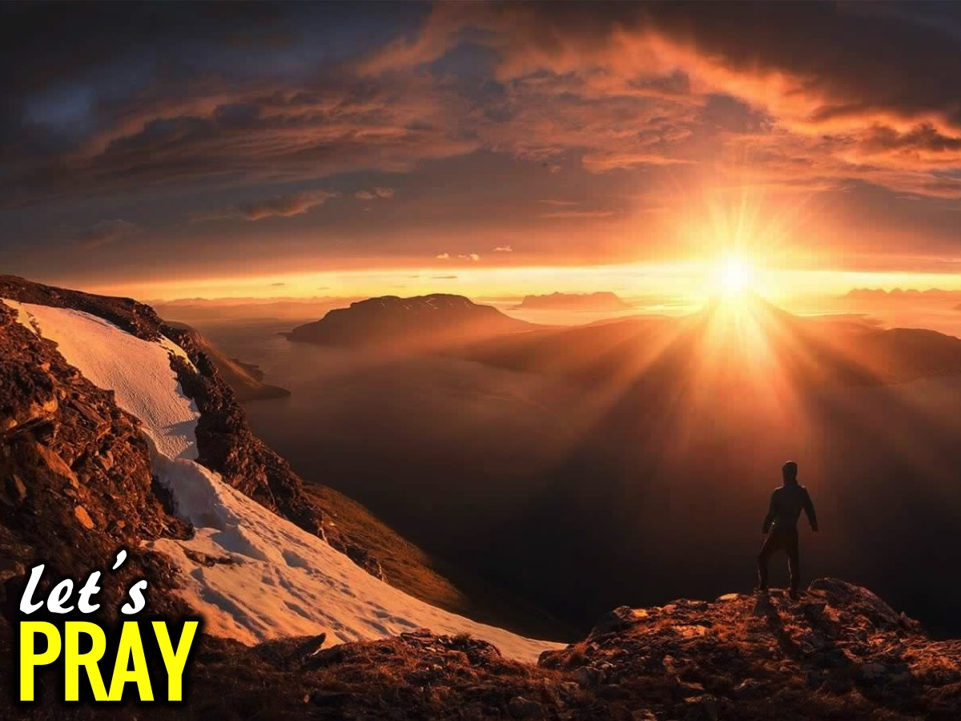
Notes:
Let’s Pray

Slide 11
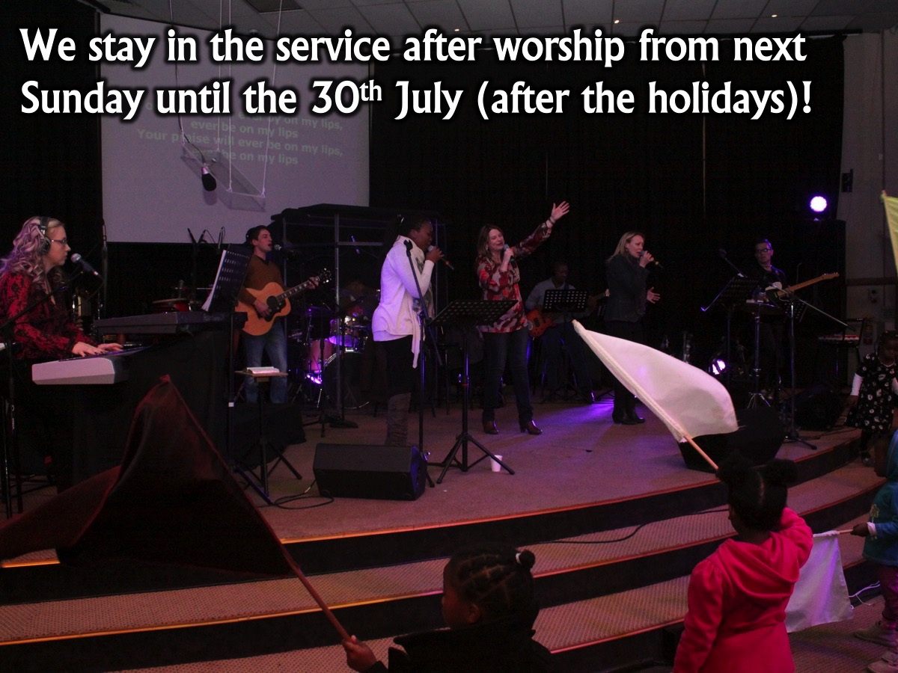
Notes:
Next Week: We stay in the service after worship from next Sunday until the 30th July (after the holidays)!

Slide 12

Notes:
Next Term: We will be presenting the Victory Series.

