Slide 1

Notes:
Tonight is the first of 4 Show Me The Money sessions.

Slide 2

Notes:
For the next four weeks we will be running the Heartlines’ “Show Me The Money” series. We will be looking at our values, attitudes and behaviour regarding money. We will cover three topics: Honesty, Thrift and Diligence.

Slide 3

Notes:
Welcome to newcomers and regulars.

Slide 4

Notes:
Tonight we are showing the movie: Nothing for Mahala. Popcorn and sweets will be served during the viewing of the movie. Sit back and enjoy the movie!

Slide 5
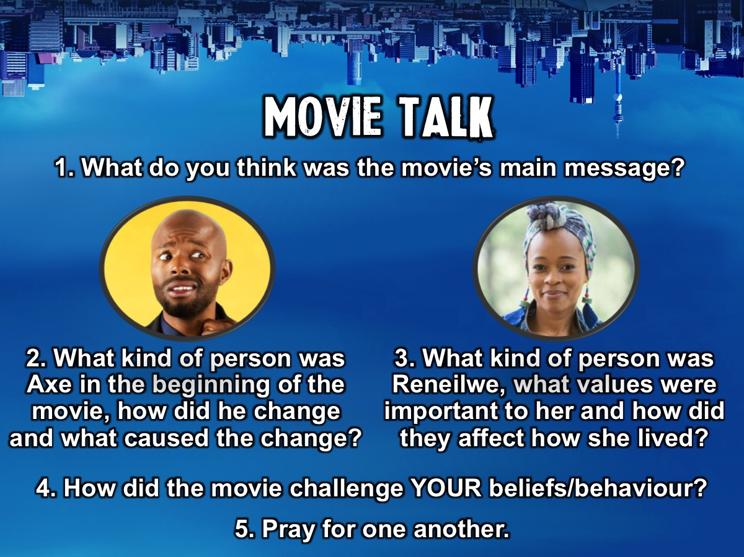
Notes:
Movie Talk: Here are some questions to discuss after viewing the movie: (1) What was the movie’s main message? (2) What kind of person was Axe in the beginning of the movie, how did he change and what caused him to change? (3) What kind of person was Reneilwe, what values were important to her and how did they affect how she lived? (4) How did the movie challenge your beliefs/behaviour? (5) Pray for one another.

Slide 6

Notes:
Next week we will be exploring Honesty!

