Slide 1
Notes:
Tonight is the second of four Show Me The Money sessions.

Slide 2
Notes:
Last week we showed the movie: Nothing for Mahala.

Slide 3
Notes:
Welcome to newcomers and regulars.

Slide 4
Notes:
Welcome to Session 2: tonight is all about Honesty.

Slide 5
Notes:
How many of you know the TV Show: Minute to Win It? Here is the trailer from the X-Box game based on the show.

Slide 6
Notes:
Video: Minute to Win It - Official Trailer (Xbox 360). Get it on YouTube: https://www.youtube.com/watch?v=QabKvdVZVZ0

Slide 7
Notes:
Icebreaker: 2 Minutes To Earn It (6-8 min). In your small groups, you have 2 minutes to come up with as many ways to make R1000 grow. Just one rule” - they have to be legal ways! When the two minutes are up, the group with the most creative, legal ideas is the winner and will receive a prize.

Slide 8
Notes:
Video: 2 Minute Countdown. Get it on YouTube at: https://www.youtube.com/watch?v=p82koOnk3nY

Slide 9
Notes:
Group Presentation: Each group has 20 seconds to present their most creative/legal idea to grow R1000.

Slide 10
Notes:
Prizes: And the winners are… (Reward the winning group).

Slide 11
Notes:
Introducing Honesty (3 min). Work is part of all our lives: we work at school, at home, in our communities, even playing sport and training is in some ways work. Some jobs earn us money while others earn us experience. What types of jobs come to mind when you hear the phrase, “making an honest day’s living”? Which person, people or company come to mind when you think of “honesty”? In this session we’ll look at the value of honesty in relation to how we do our work and earn our money. Today we’ll be challenged to consider: Am I proud of how I work and make my moolah?

Slide 12
Notes:
Honesty Defined: Honesty [noun]: Being free from deceit or fraud, to be open and above board in your transactions, and to be fair and just in how you treat others.

Slide 13
Notes:
Movie Clip: Before you show the clip read the following introduction: Axe is a young property agent who wants to make his mark in the world. Axe is willing to work hard and is driven by his desire to make as much money as possible. While Axe has been trying to make his mark, he has been living a lavish lifestyle and gets into trouble with loan sharks and the law. Axe is sentenced to community service at an old-age home where he soon discovers he can make a deal by selling the old-age home behind the backs of the elderly residents.

Slide 14
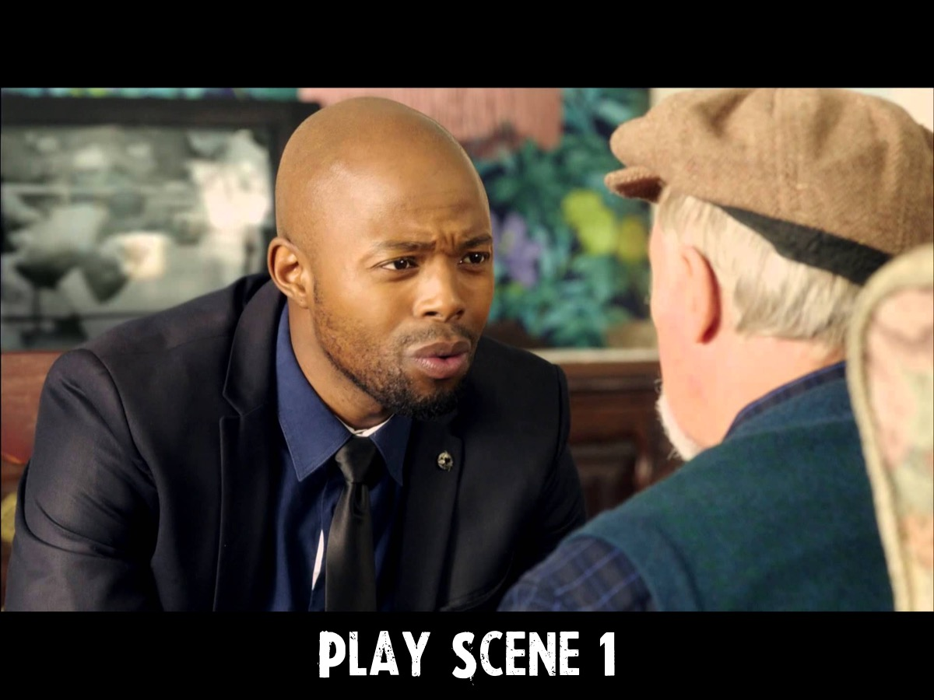
Notes:
(Ignore this slides if you play the video from the DVD)
Play Scene 1: The story of Axe and honesty on the DVD at the back of the book. (5 min). If you don’t have a DVD player or projector, you can read the scene synopsis out loud:
• Axe is a young property agent who wants to make his mark in the world. He believes, “If you’re poor, people think you’re nobody. But if people think you’re rich, you’re somebody ... I’m gonna make my mark. I’m gonna be somebody.”
• Axe is willing to work hard and is driven by his desire to make as much money as possible.
• His boss, Mike, challenges Axe and his work rival, Pule: “I’ll give a partnership position to whomever comes in with a deal. You’re my rainmakers – make it rain.”
• While Axe has been trying to make his mark, he has been living a lavish lifestyle and gets into trouble with loan sharks and the law. Axe is sentenced to community service at an old-age home where he soon discovers he can make a deal by selling the old-age home behind the backs of the elderly residents. After forming some relationships with the oldsters he tries to confess to Hendrik, one of the residents. “But,” says Axe, “business is business”.
• Axe’s boss finds out about his scheme to sell the old-age home and commends him: “You’re a liar, aren’t you? Outstanding!”
• Axe tries to come clean with the residents of the old-age home but they are disappointed and turn their backs on him. Hendrik tells Axe: “Well, you’ve done it. You’ve made your mark. Well done.”

Slide 15
Notes:
Video: The Story of Axe and Honesty. From the Show Me The Money/Nothing for Mahala DVD. (4 mins)

Slide 16
Notes:
Movie Talk (6-8 min)
1. What do you think Axe believes about honesty?
2. Axe says “business is business” and he has no choice about how to go about his business. Do you agree or disagree? Give a reason for your answer.
3. What are some of the things that may happen to Axe if he continues to make money this way?
4. Would you hire someone like Axe – why or why not?

Slide 17
Notes:
How many of you know the TV show - The Apprentice. Here is the opening scene:

Slide 18
Notes:
Video: The Opening of The Apprentice. Get it on YouTube at: https://www.youtube.com/watch?v=crpIuhB2x2s

Slide 19
Notes:
Activity - You’re Hired! (6-8 min): In your small groups, one person plays the role of Donald Trump who is looking to Hire someone for his company. Each person gets 30 seconds to put their case to Mr Trump to convince him to hire them. Once he has heard everyone he decides who he will hire and explain why he chose that person. If possible brief those who play the role of Donald Trump and tell them to look for someone who has a good work ethic, who is honest and who wants to give to the company and not just get from it.

Slide 20
Notes:
Honesty Discussion (6-8 min): We’re going to look at what the Bible has to say about honesty in how we do our work. Before we start keep in mind some of the ways that you are involved in work right now such as: school work; chores at home; a full-time or part-time job; volunteering somewhere etc.

Slide 21
Notes:
(1) “GOD cares about honesty in the workplace; your business is His business.” (Proverbs 16:11). What do you think this verse tells us about how Axe was working? (2) “Live clean, innocent lives as children of God, shining like bright lights in a world full of crooked and perverse people.” (Philippians 2:15). If Axe lived out this verse, what could he have done differently? (3) “One who is faithful in a very little is also faithful in much, and one who is dishonest in a very little is also dishonest in much.” (Luke 16:10). What situations in our world make it difficult for us to be totally honest in the way we work and earn our money?

Slide 22
Notes:
Bible Story: The Grim Tale of Ananias and Sapphira. Show the video or read Acts 5:1-11 or read the summary below.
• In the book of Acts, we read about how the early believers shared all of their possessions with each other. Some sold their property and would bring all the money to the apostles to share among anyone who had a need.
• Ananias and his wife Sapphira also sold a piece of property. They said they had given God’s people all the money, when in fact they had kept some of the money for themselves.
• The result of their actions? God put Ananias and Sapphira to death for lying!
• When the people saw this, they began to realise how highly God considered honesty.

Slide 23
Notes:
Video: The Grim Tale of Ananias and Sapphira. I purchased a HD legal copy of this video from: http://www.creationswap.com/media/12738. You can view the video on Vimeo: https://vimeo.com/16260944 or at the creators website: http://www.danstevers.com.

Slide 24
Notes:
Bible Discussion:
1. What do you think of what Ananias and Sapphira did?
2. What does this story tell us about what God thinks about honesty?
3. How can this story inspire you to be more honest in your homework, how you play sport, do chores, etc?
4. As you think of your future, how can this story inspire you in your work, or what you do with your money?

Slide 25
Notes:
Food For Thought: Working dishonestly often seems easier and has short-term rewards. But in the long run it can cost us – just like it did Axe. Think about the type of work you are doing, at school, at home, church or at your workplace. Working honestly in these situations might not always be easy but it certainly has better rewards both now and in the future.

Slide 26
Notes:
Reflect: Read through the following questions slowly and get your youth to quietly reflect on the answers.
• What changes do you need to make to become more honest in the work you do at school, home, or your community?
• What kind of worker or boss do you want to be in the future?
• What kind of work habits can you develop today that will help you become that person in the future?
• When it comes to how you work and earn your money, you have one question to answer: What mark will I make?

Slide 27
Notes:
Honesty Challenge (2min): Let’s challenge ourselves to make a mark of working honestly in the week ahead: (1) Find a story in the news or media that reflects honesty in making money. (2) Have a conversation with your parents and/or friends about honesty when it comes to working or earning.

Slide 28
Notes:
Closing Prayer (2min): Heavenly Father, thank you for your concern about how I work and earn my money – my business is your business. Help us to remember that there are rewards both here on earth and in eternity that come from being honest in how we do our work. Help us to earn our money in a way you will be proud of. In Jesus’ Name. Amen.

Slide 29
Notes:
Announcements: Next week we will be exploring Thrift!

