Slide 1

Notes:
Introduction and Welcome: Tonight is the last of 4 Show Me The Money sessions.

Slide 2

Notes:
In the first week we showed the movie: Nothing for Mahala.

Slide 3

Notes:
In week 2 we looked at Honesty.

Slide 4

Notes:
Last week we are looked at Thrift.

Slide 5

Notes:
Welcome to newcomers and regulars.

Slide 6

Notes:
This week we are going to look at Diligence.

Slide 7

Notes:
Diligence Boot Camp: We have setup different stations with activities with a mix of mental and physical challenges for you to experience. You will move around in your groups.

Slide 8

Notes:
1. Human Knot: The group forms a circle, everyone reaches into the center with their right hand, and grabs someone else’s hand. Next they use their left hands to grab another person’s hand. No one should be holding the same person’s hands. This is a human knot. Now they have to untangle themselves and reform the circle without letting go of their partner’s hand.

Slide 9

Notes:
2. Puzzle Build. The group has 2 minutes to build a jigsaw puzzle without using the picture.

Slide 10

Notes:
3. Coin Stack. The team has 2 minutes to stack all the coins that are provided into a free standing stack.

Slide 11

Notes:
4. Ball Rally. The group is given table tennis bats and a ball and they have to keep the ball in the air for at least 50 hits.

Slide 12

Notes:
5. Defy Gravity. The group is given 3 balloons and they have to keep them in the air for 2 minutes - without using their hands nor touching a balloon more than once at a time.

Slide 13

Notes:
6. Needle Thread. The group is given a piece of cotton and each person gets a needle. They have 2 minutes to thread the cotton through all the needles.

Slide 14

Notes:
Diligence Boot Camp: You have 10 minutes to tackle as many challenges as you can.

Slide 15
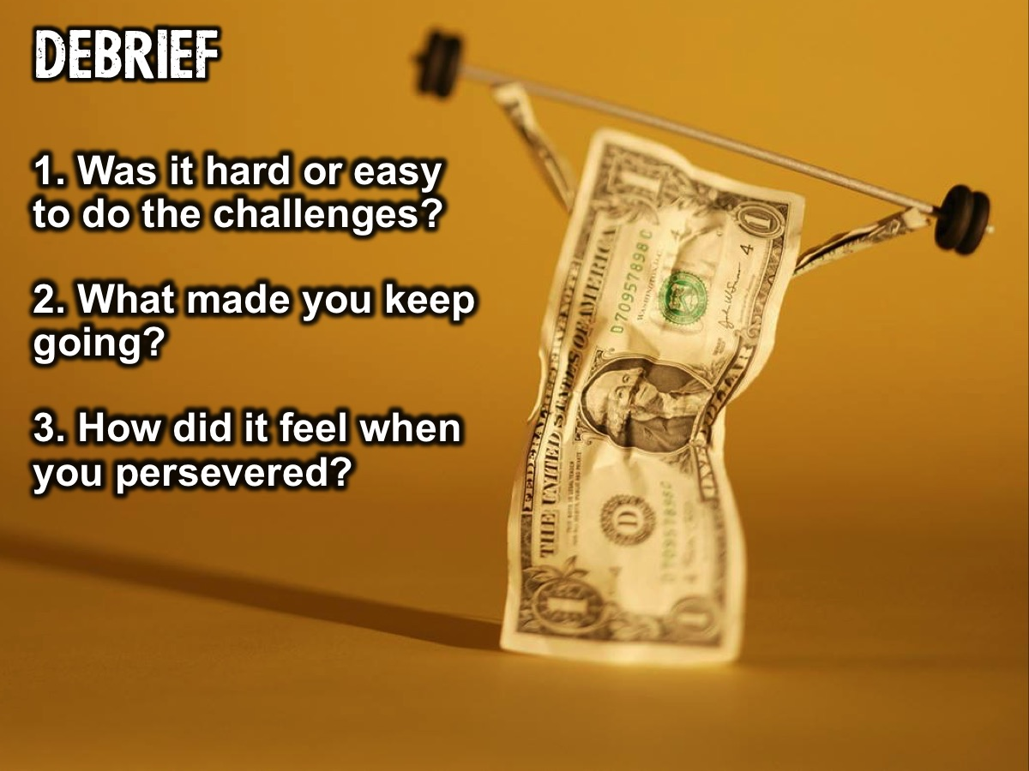
Notes:
Debrief: (1) Was it hard or easy to do the challenges? (2) What made you keep going? (3) How did it feel when you persevered?

Slide 16

Notes:
Introducing Diligence: (1) Working hard and doing your absolute best, with enthusiasm and excellence. (2) The value that drives one to earn one’s money in a way that is honourable. (3) Persevering to overcome obstacles; being responsible with money and future-minded when it comes to saving. (4) Being diligent about school work and taking pride in your work.

Slide 17
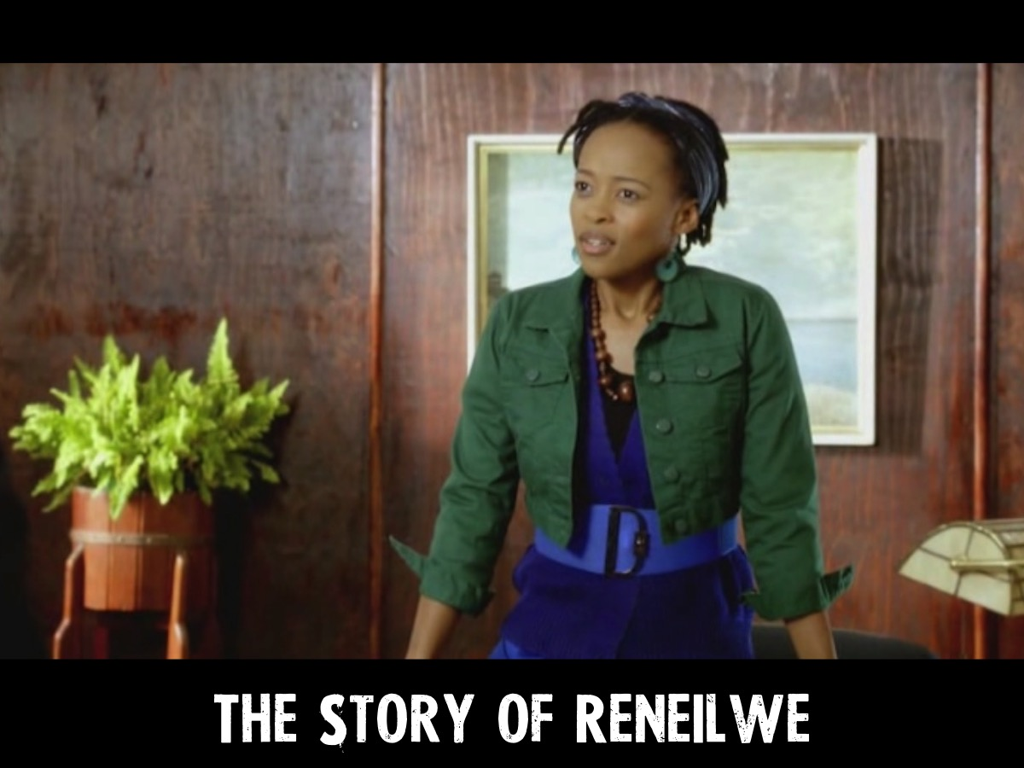
Notes:
Movie Clip: Before you show the clip read the following introduction: Reneilwe is the young, talented manager of an old-age home where Axe is sentenced for community service. She embodies the values of service, generosity and unselfish giving. She has chosen a modestly paid job over a wealthy lifestyle and is diligent in the way she executes her work and responds to the residents in the old-age home.

Slide 18
Notes:
Video: Diligence: The Story of Reneilwe and Diligence. From the Show Me The Money/Nothing for Mahala DVD.

Slide 19
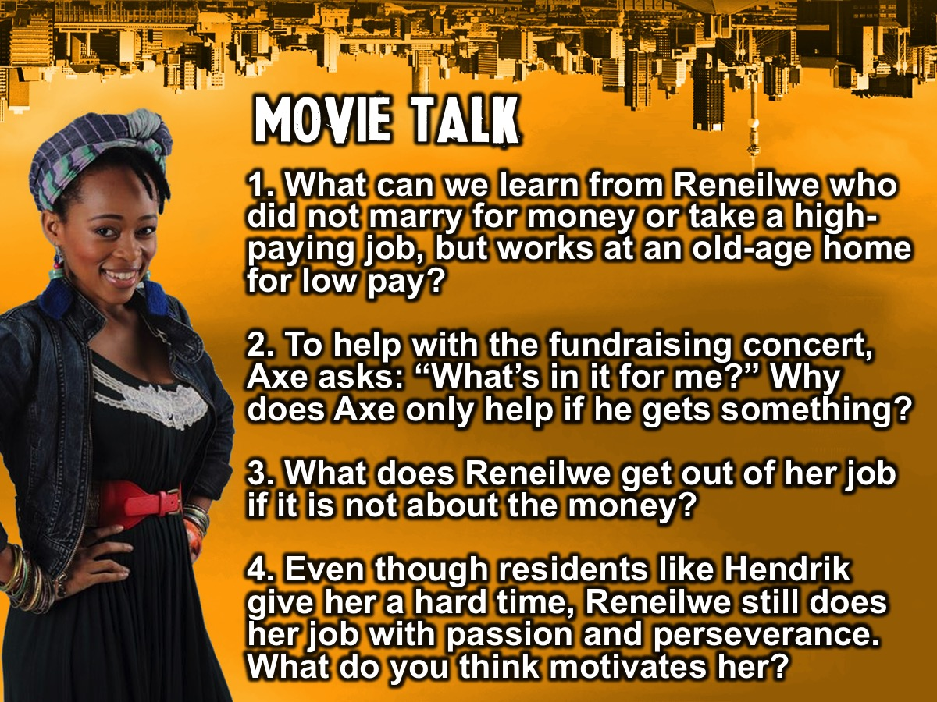
Notes:
Movie Talk: (1) What can we learn from Reneilwe who did not marry for money or take a high-paying job, but works at an old-age home for low pay? (2) To help with the fundraising concert, Axe asks: “What’s in it for me?” Why does Axe only help if he gets something? (3) What does Reneilwe get out of her job if it is not about the money? (4) Even though residents like Hendrik give her a hard time, Reneilwe still does her job with passion and perseverance. What do you think motivates her?

Slide 20

Notes:
Diligence Discussions: In small groups we are going to look at what the Bible says about diligence.

Slide 21
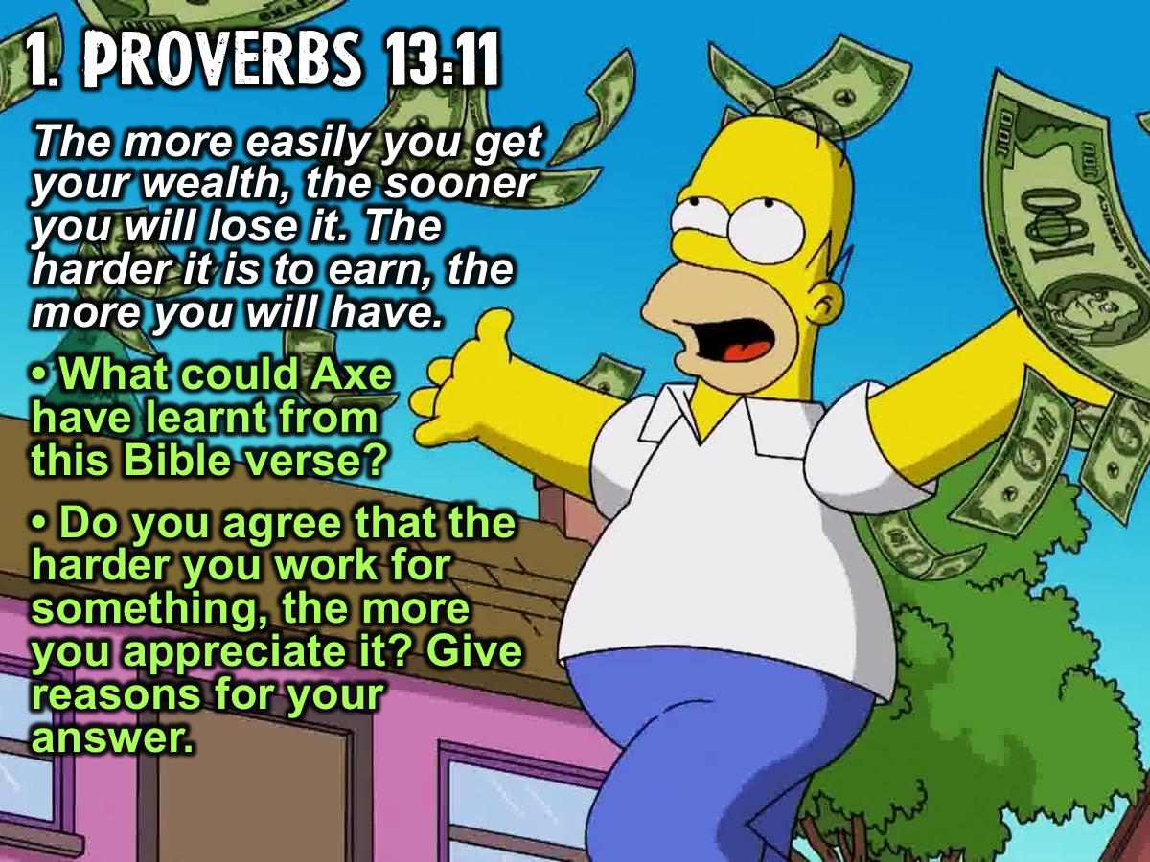
Notes:
1. Read Proverbs 13:11 (Good News Translation). “The more easily you get your wealth, the sooner you will lose it. The harder it is to earn, the more you will have.” (a) What do you think Axe could have learnt from this Bible verse? (b) Do you agree that the harder you work for something, the more you appreciate it? Give reasons for your answer.

Slide 22

Notes:
2. Read Proverbs 12:27. “A slothful (lazy) man will not catch his prey, but the diligent man will get precious wealth.” (1) Reneilwe might not be earning much but she works hard at her job. In which ways would this verse inspire her? (b) What does this verse tell us about working hard and achieving success?

Slide 23

Notes:
3. Read Proverbs 10:5 (TLB). “A wise youth makes hay while the sun shines, but what a shame to see a lad who sleeps away his hour of opportunity.” (a) What does this Bible verse tell us about being diligent? (b) In which ways could we live out this verse at school, place of study, and in how we earn our money?

Slide 24

Notes:
Diligence Challenge: (1) Take a photo of someone living out any of the values we explored: Honesty, Thrift or Diligence. (2) Post the photos on our Facebook page.

Slide 25

Notes:
Food For Thought: Today we looked at how Reneilwe was an example of a life of diligence and how the Bible urges us to work hard, be responsible and committed to what we do.

Slide 26

Notes:
Reflection: As I read through these questions (slowly) I want you to quietly reflect on your answers:
• Would your parents, teachers, sports coaches and friends describe you as a hard worker?
• When you face obstacles, do you give up easily or do you persevere?
• Have you started something (projects, savings, joined a club, etc.) and given up too easily? Why?
• How diligent and persevering do you want to be as a person in the future?
• What habits can you develop now to help you be hard working and diligent in the future?

Slide 27

Notes:
Closing Prayer: Almighty God, thank you that you want us to be successful and are willing to partner with us make it happen. Please help us to make wise choices that will result in us being hard working, diligent and persevering. In Jesus’ name. Amen

Slide 28

Notes:
Announcement: Next Friday night is our Matric Farewell.

