Slide 1

Notes:
Sadly this was the last of 4 nights where we presented the Heartline's Show Me The Money series.

Slide 2
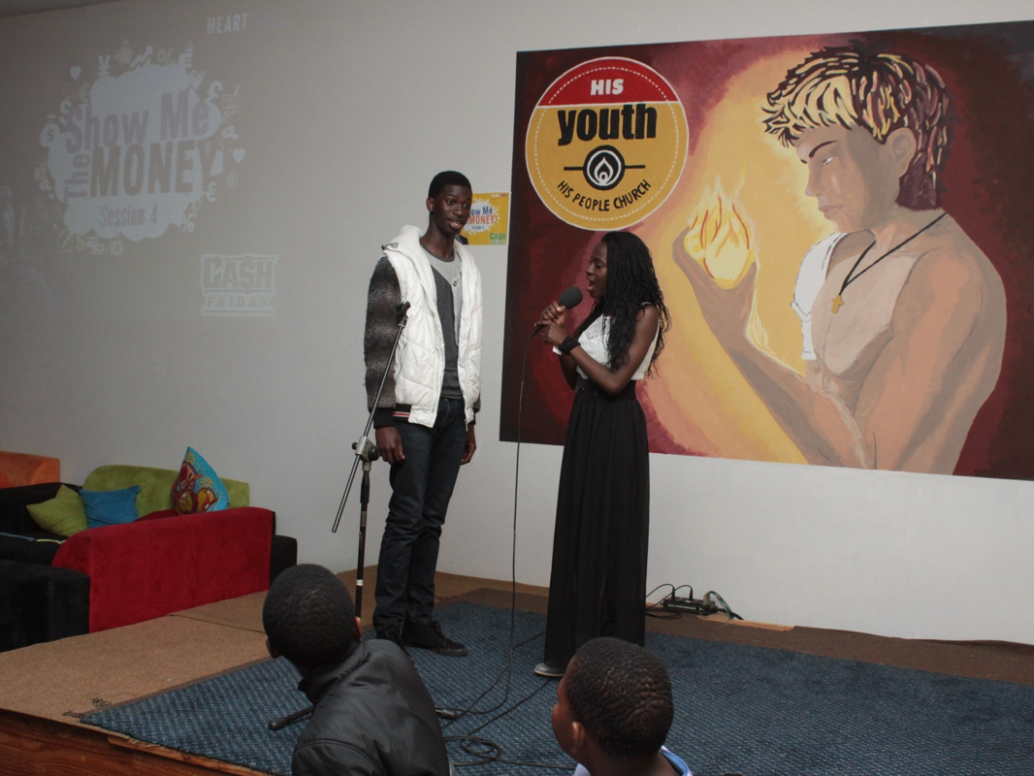
Notes:
Danielle welcoming a newcomers - Lao, a friend of Ryan.

Slide 3
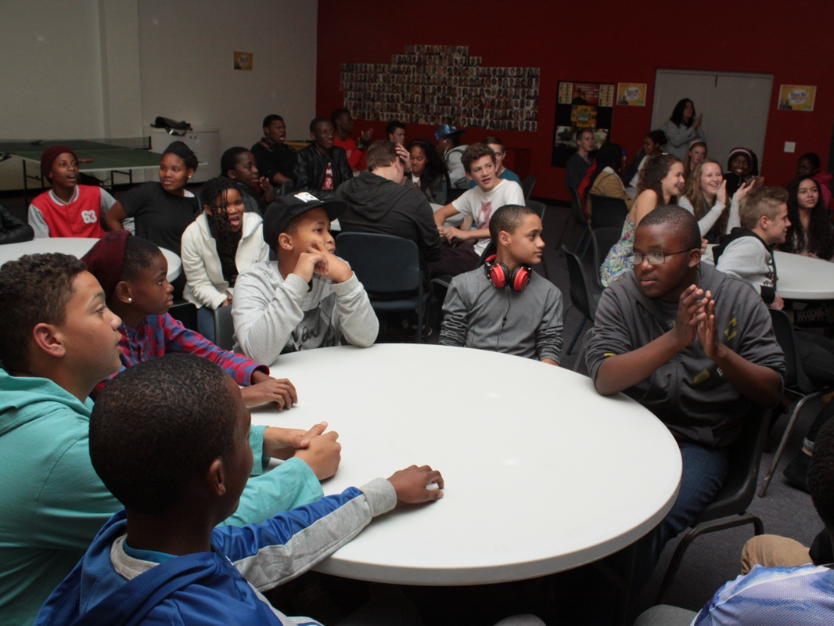
Notes:
Part of the enthusiastic audience.

Slide 4
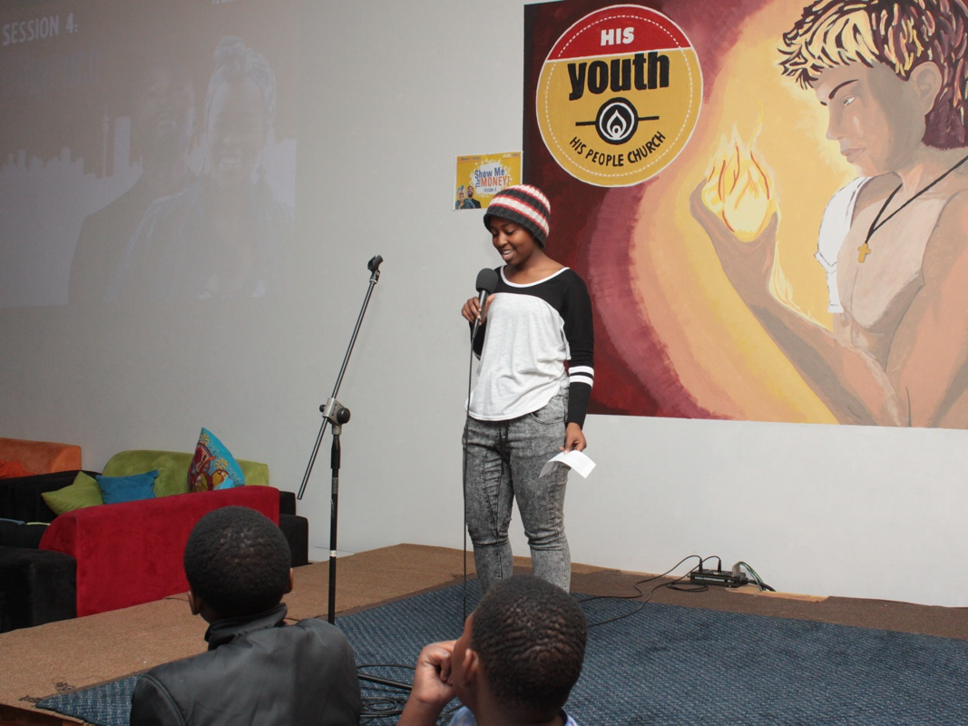
Notes:
CJ did a fantastic job introducing the Bookcamp part of the program where there were 6 mental/physical challenges that groups had to compete in 2 minutes.

Slide 5
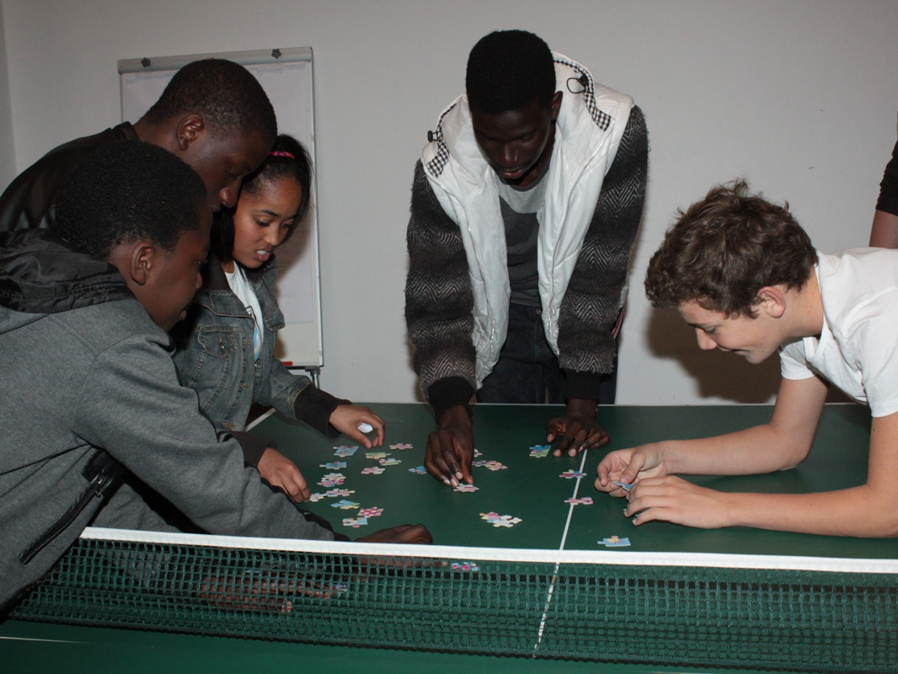
Notes:
Puzzle Build. The group has 2 minutes to build a jigsaw puzzle without using the picture.

Slide 6
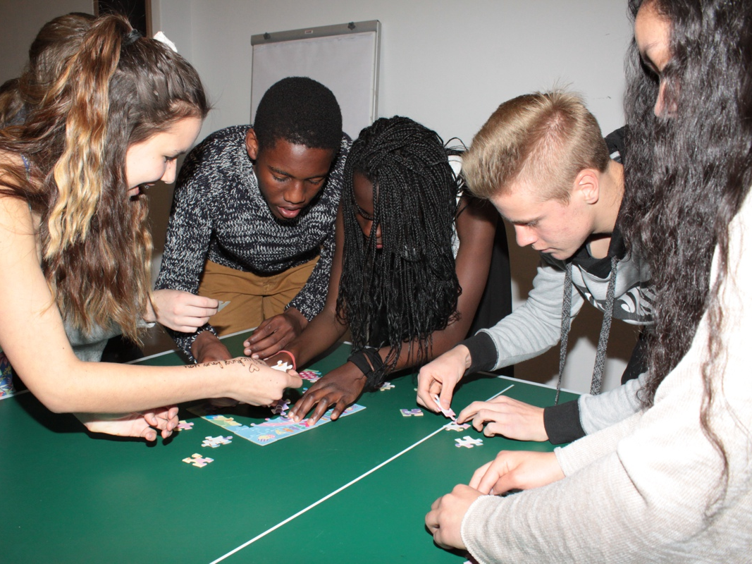
Notes:
Puzzle Build. The group has 2 minutes to build a jigsaw puzzle without using the picture.

Slide 7
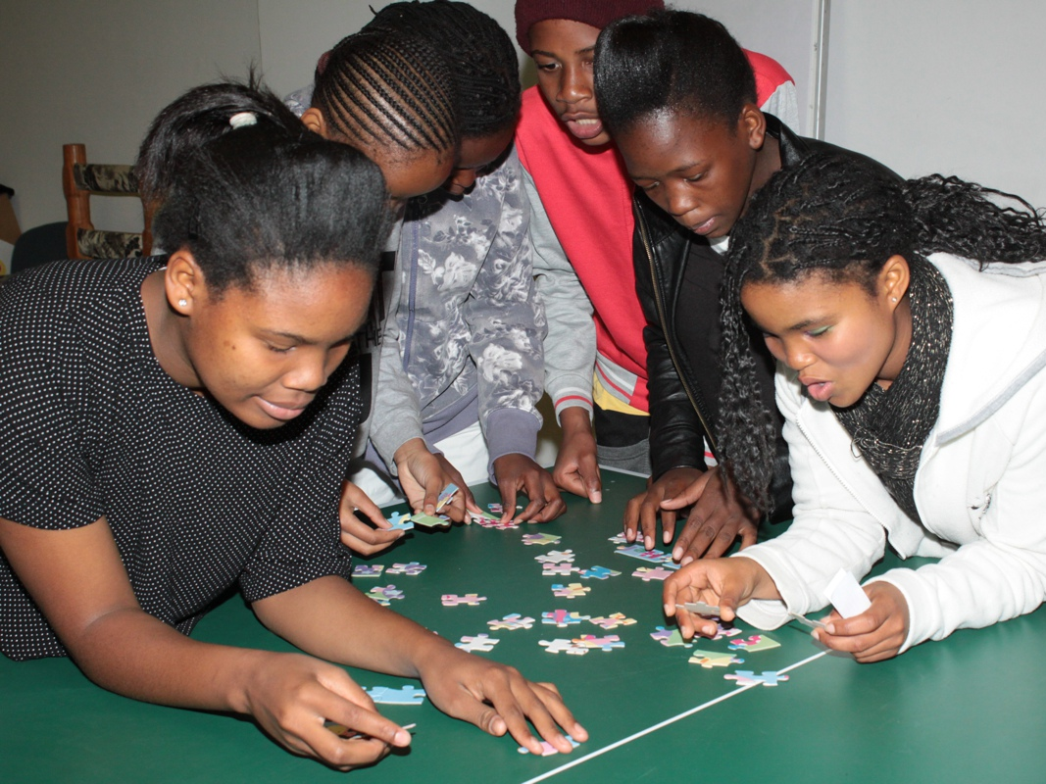
Notes:
Puzzle Build. The group has 2 minutes to build a jigsaw puzzle without using the picture.

Slide 8
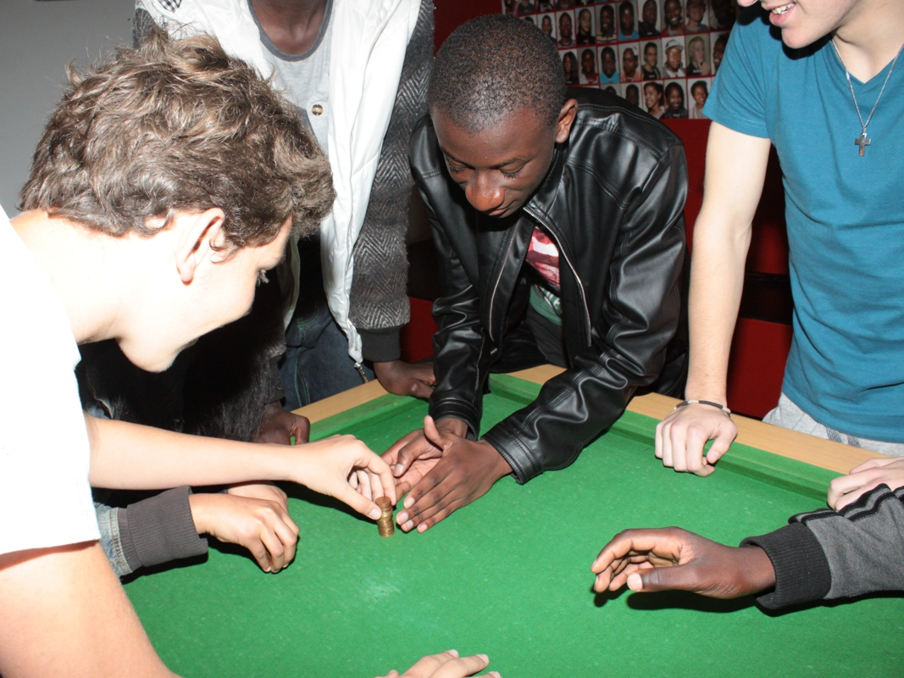
Notes:
Coin Stack. The team has 2 minutes to stack all the coins that are provided into a free standing stack.

Slide 9
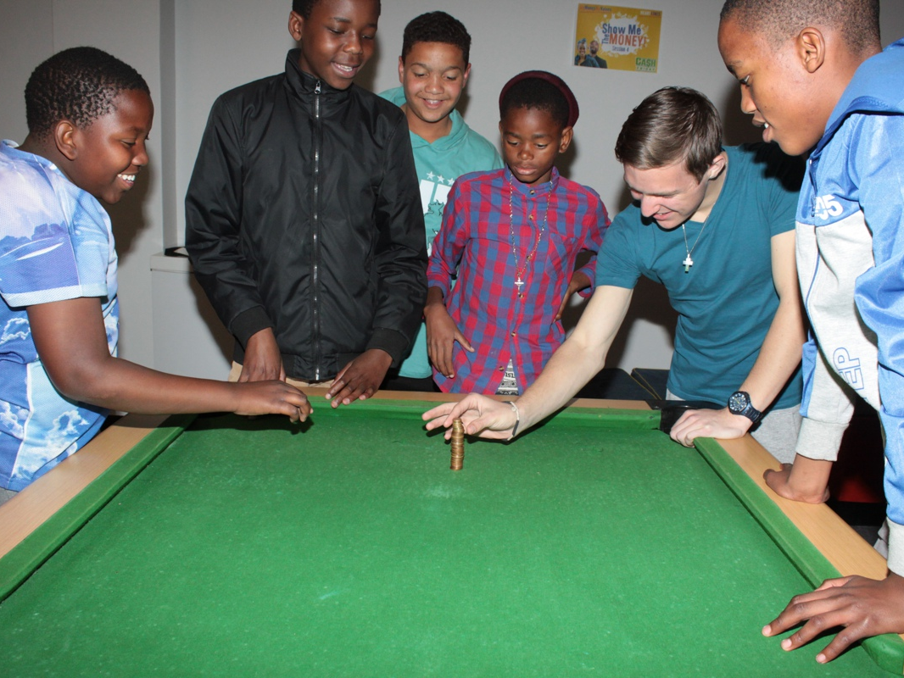
Notes:
Coin Stack. The team has 2 minutes to stack all the coins that are provided into a free standing stack.

Slide 10
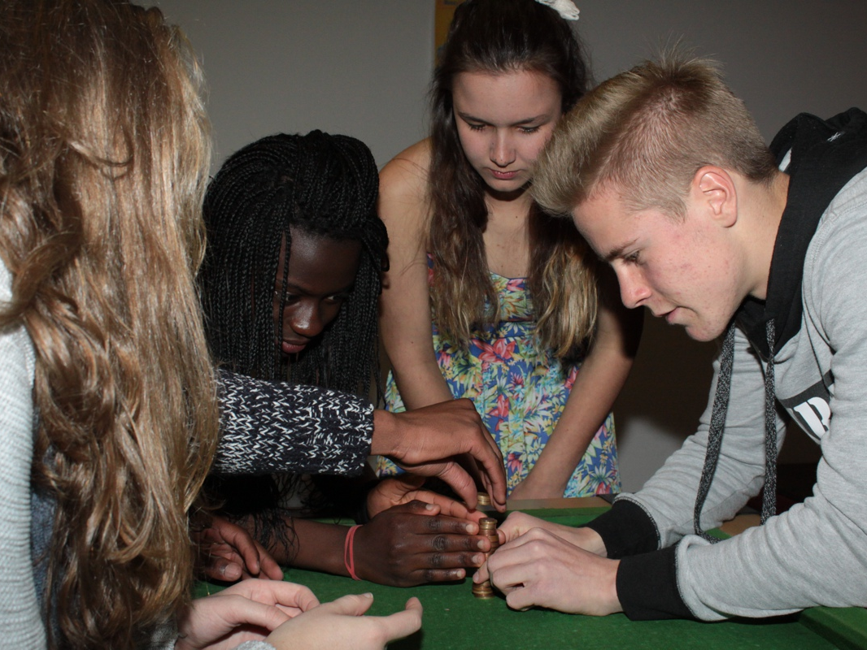
Notes:
Coin Stack. The team has 2 minutes to stack all the coins that are provided into a free standing stack.

Slide 11
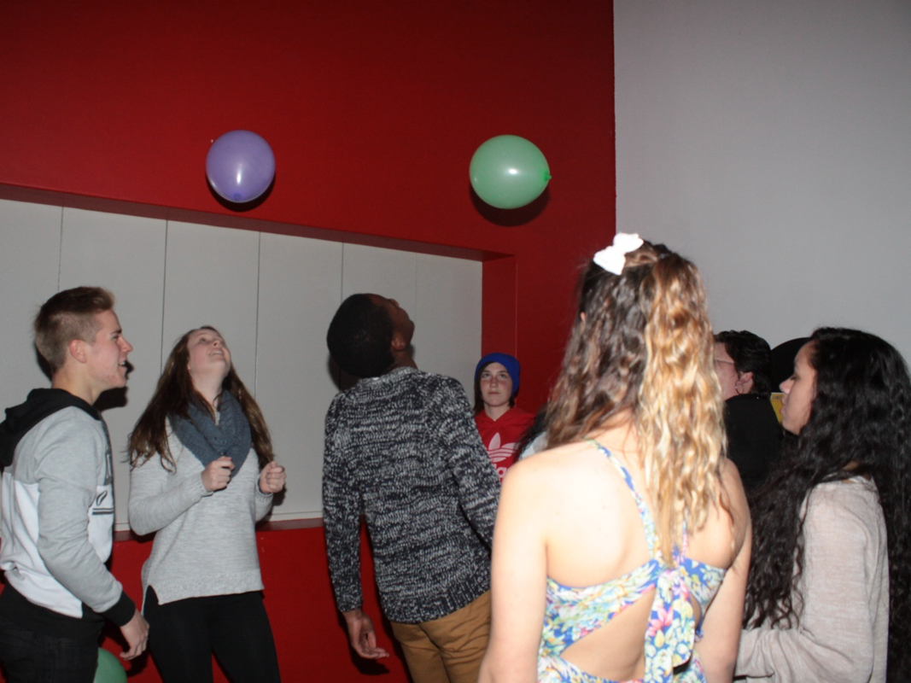
Notes:
Defy Gravity. The group is given 3 balloons and they have to keep them in the air for 2 minutes - without using their hands nor touching a balloon more than once at a time.

Slide 12
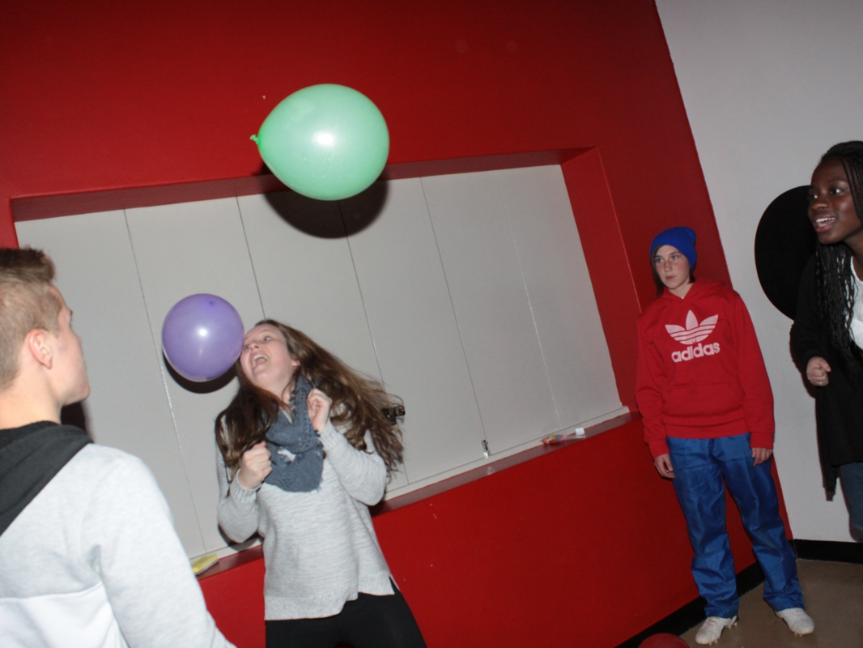
Notes:
Defy Gravity. The group is given 3 balloons and they have to keep them in the air for 2 minutes - without using their hands nor touching a balloon more than once at a time.

Slide 13
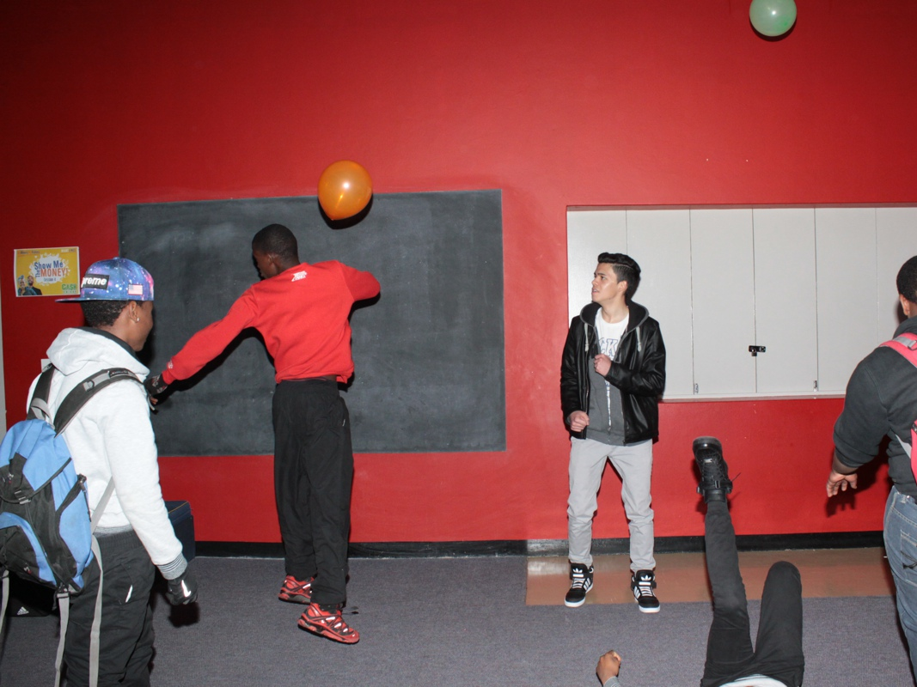
Notes:
Defy Gravity. The group is given 3 balloons and they have to keep them in the air for 2 minutes - without using their hands nor touching a balloon more than once at a time.

Slide 14
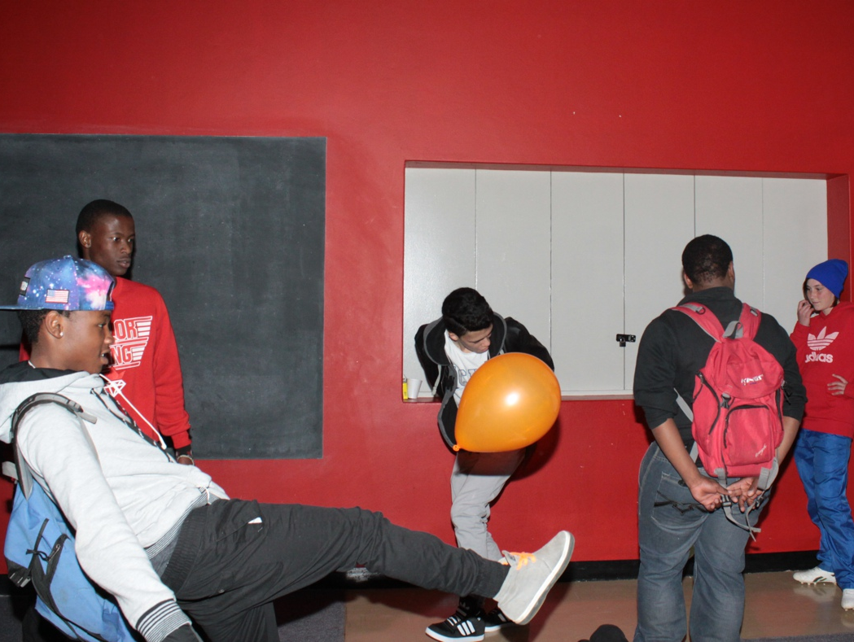
Notes:
Defy Gravity. The group is given 3 balloons and they have to keep them in the air for 2 minutes - without using their hands nor touching a balloon more than once at a time.

Slide 15
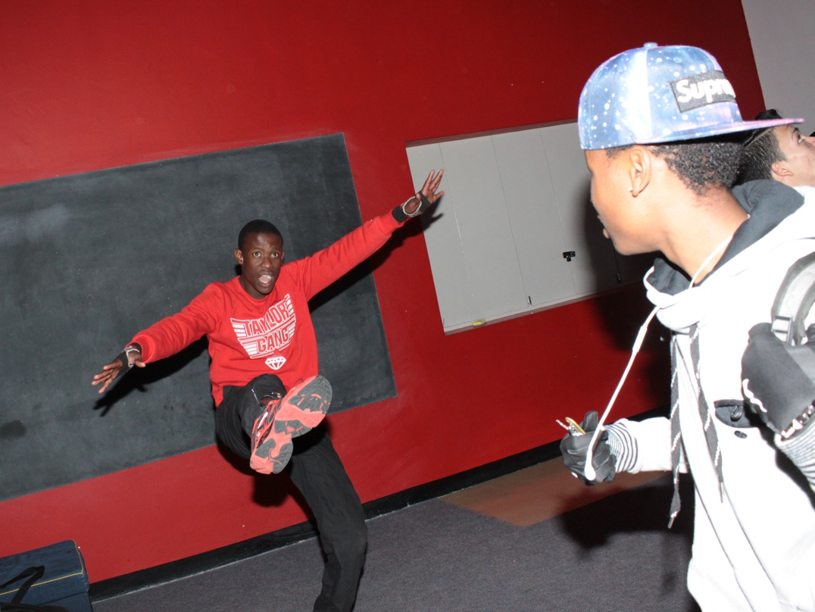
Notes:
Defy Gravity. The group is given 3 balloons and they have to keep them in the air for 2 minutes - without using their hands nor touching a balloon more than once at a time.

Slide 16
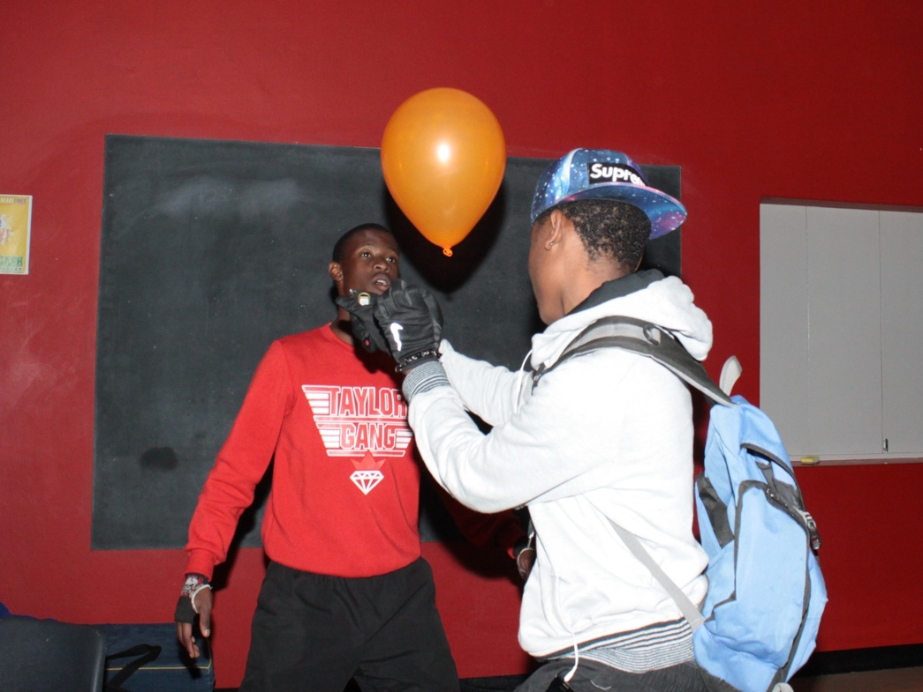
Notes:
Defy Gravity. The group is given 3 balloons and they have to keep them in the air for 2 minutes - without using their hands nor touching a balloon more than once at a time.

Slide 17
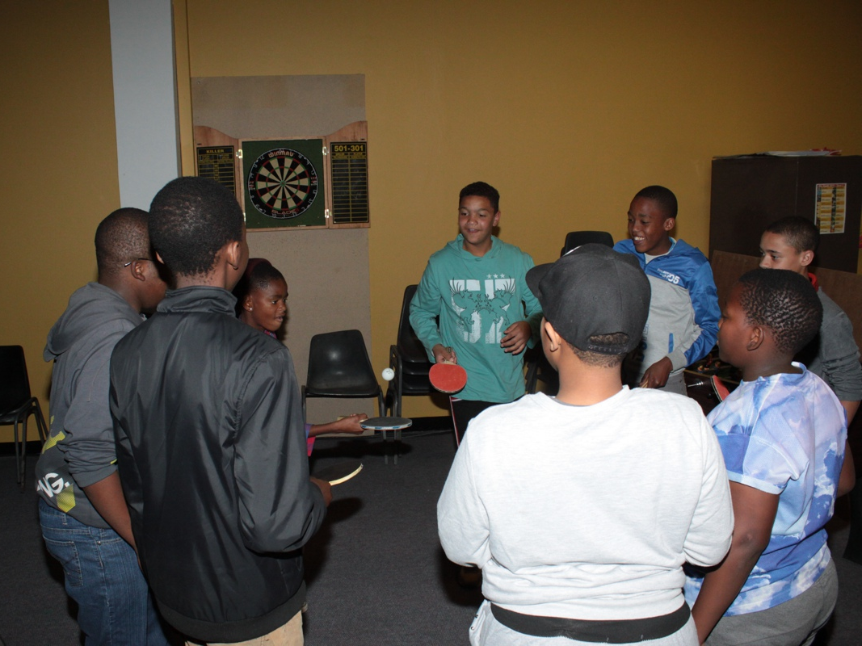
Notes:
Ball Rally. The group is given table tennis bats and a ball and they have to keep the ball in the air for at least 50 hits.

Slide 18
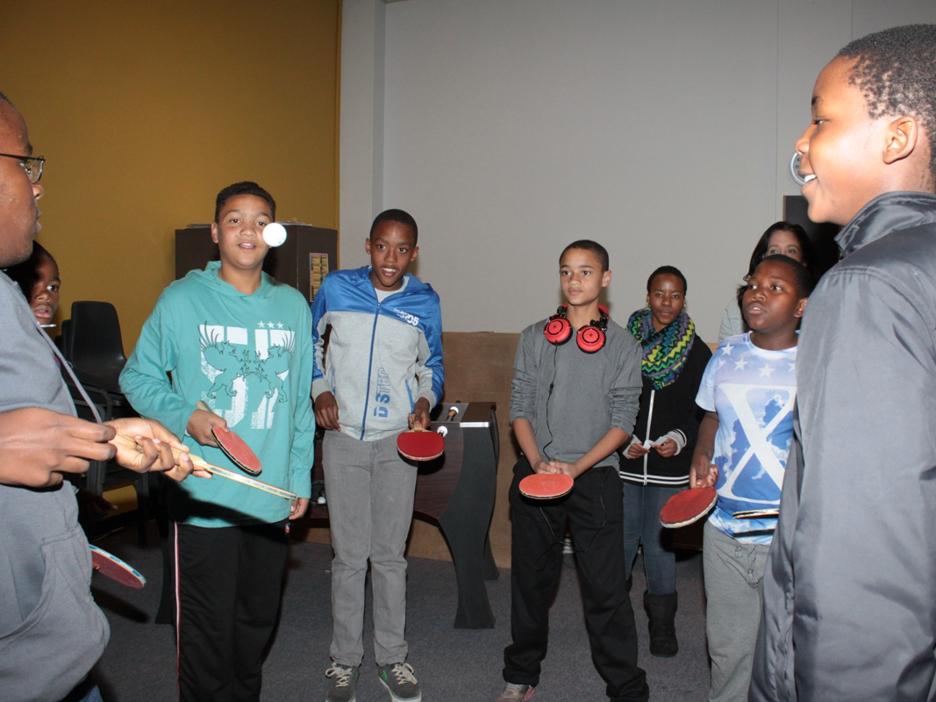
Notes:
Ball Rally. The group is given table tennis bats and a ball and they have to keep the ball in the air for at least 50 hits.

Slide 19
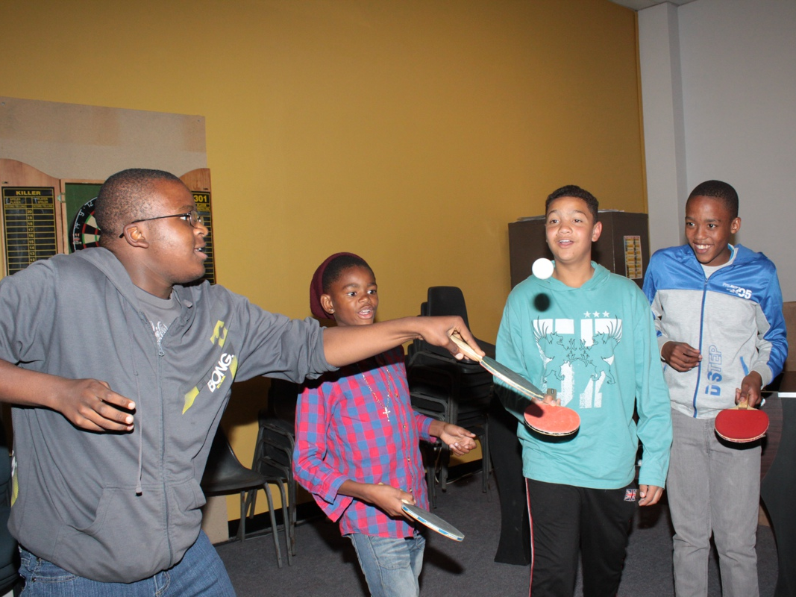
Notes:
Ball Rally. The group is given table tennis bats and a ball and they have to keep the ball in the air for at least 50 hits.

Slide 20
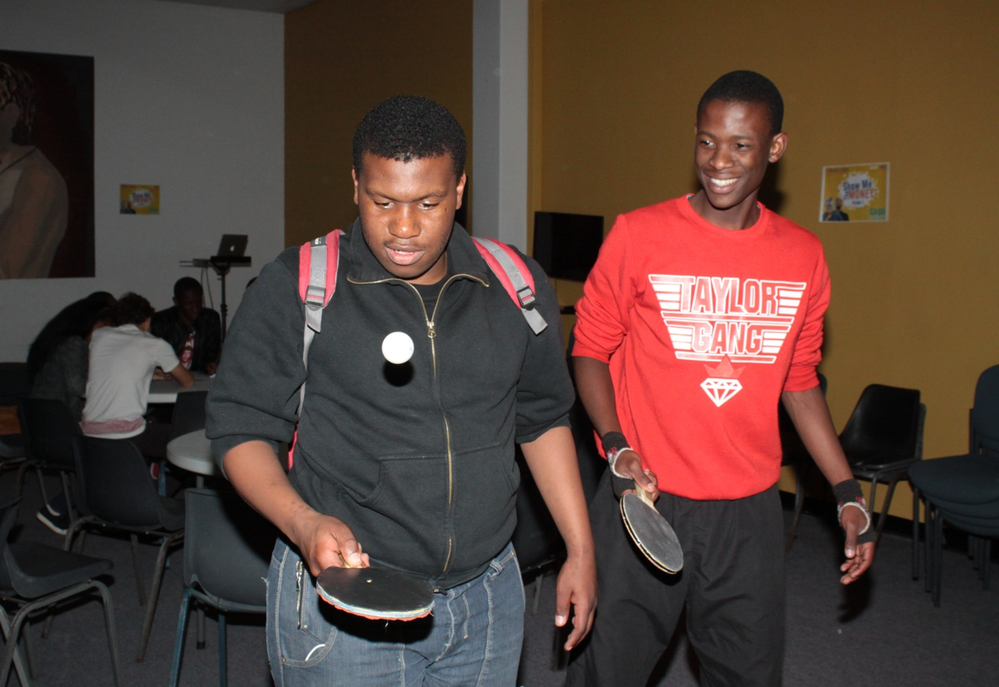
Notes:
Ball Rally. The group is given table tennis bats and a ball and they have to keep the ball in the air for at least 50 hits.

Slide 21
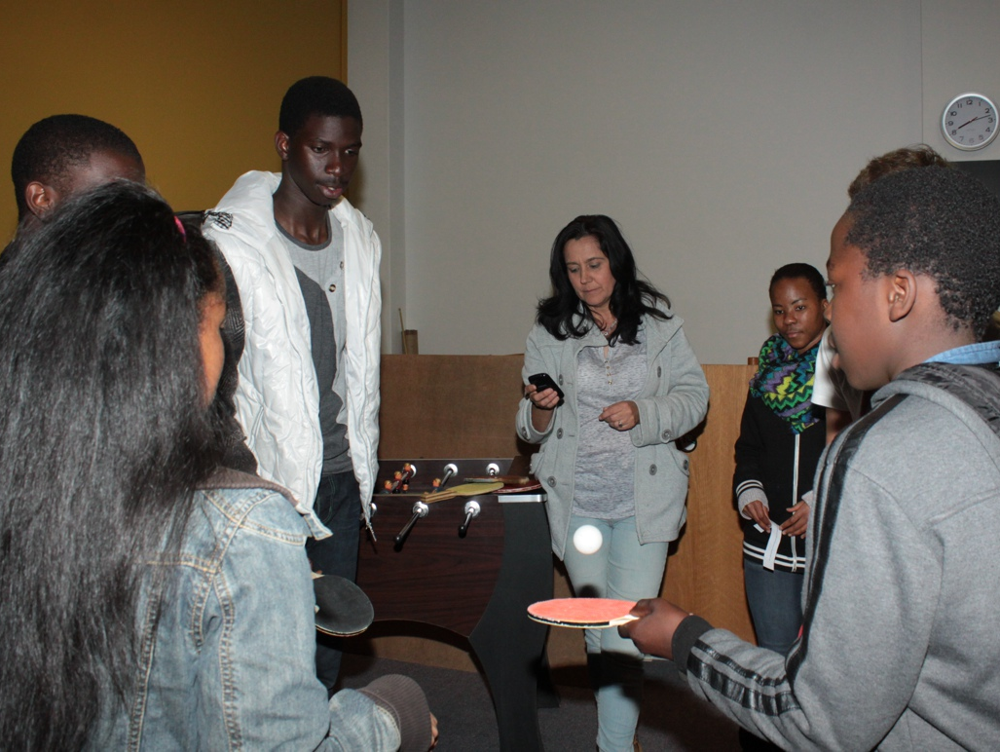
Notes:
Ball Rally. The group is given table tennis bats and a ball and they have to keep the ball in the air for at least 50 hits.

Slide 22
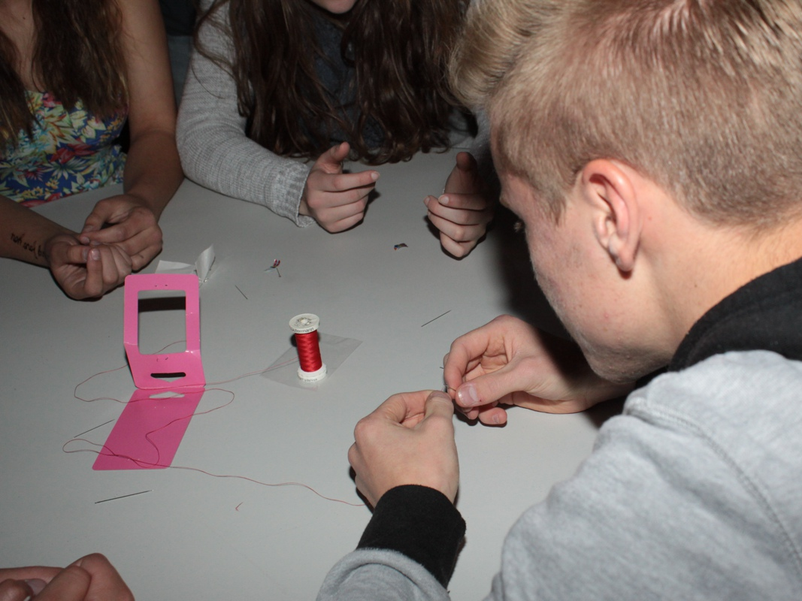
Notes:
Needle Thread. The group is given a piece of cotton and each person gets a needle. They have 2 minutes to thread the cotton through all the needles.

Slide 23
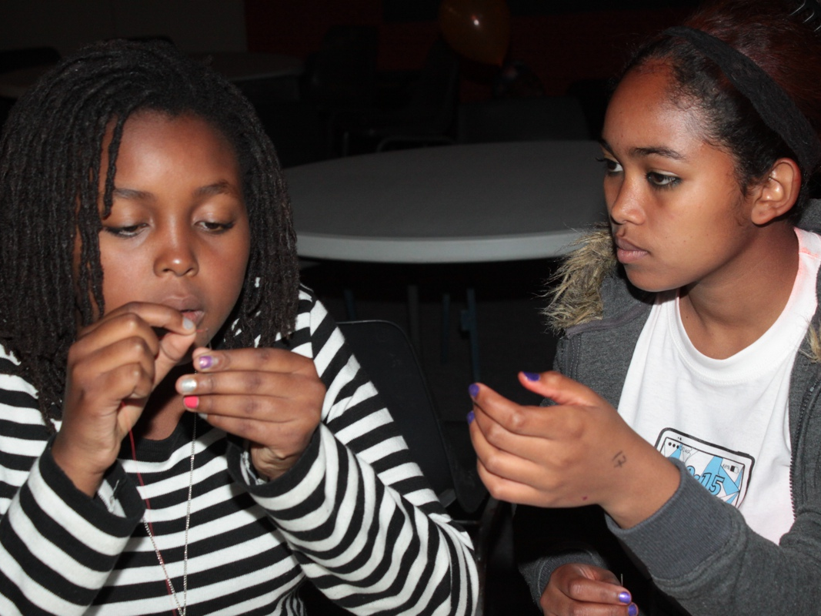
Notes:
Needle Thread. The group is given a piece of cotton and each person gets a needle. They have 2 minutes to thread the cotton through all the needles.

Slide 24
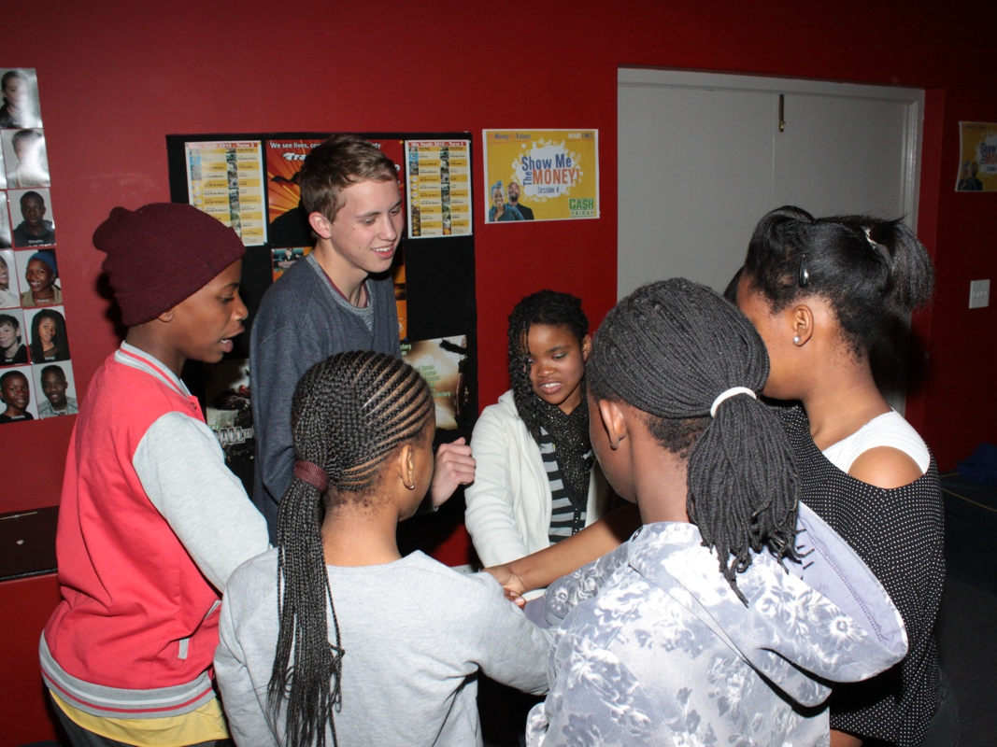
Notes:
Human Knot: The group forms a circle, everyone reaches into the center with their right hand, and grabs someone else’s hand. Next they use their left hands to grab another person’s hand. No one should be holding the same person’s hands. This is a human knot. Now they have to untangle themselves and reform the circle without letting go of their partner’s hand.

Slide 25
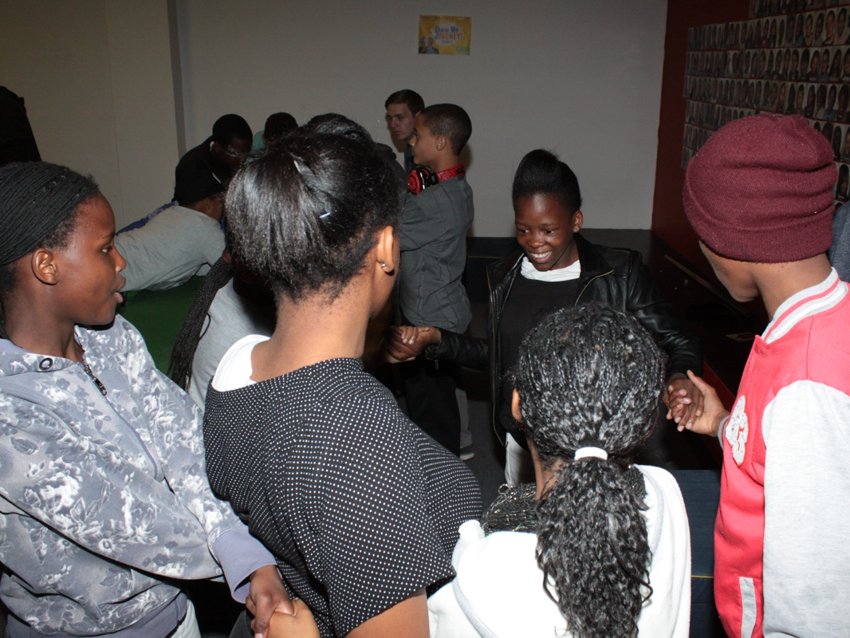
Notes:
Human Knot: The group forms a circle, everyone reaches into the center with their right hand, and grabs someone else’s hand. Next they use their left hands to grab another person’s hand. No one should be holding the same person’s hands. This is a human knot. Now they have to untangle themselves and reform the circle without letting go of their partner’s hand.

Slide 26
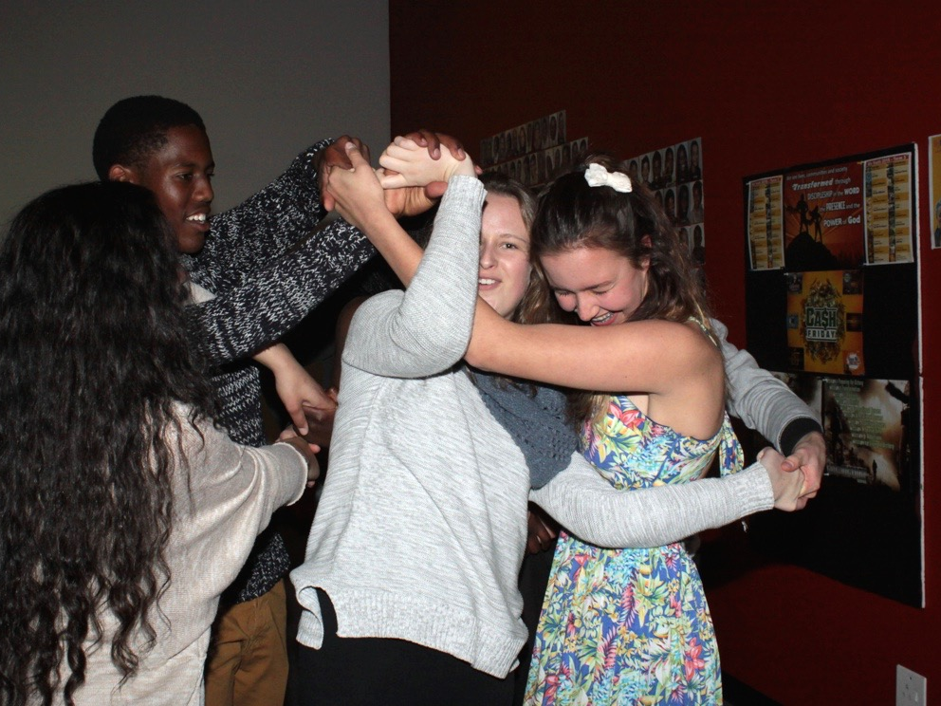
Notes:
Human Knot: The group forms a circle, everyone reaches into the center with their right hand, and grabs someone else’s hand. Next they use their left hands to grab another person’s hand. No one should be holding the same person’s hands. This is a human knot. Now they have to untangle themselves and reform the circle without letting go of their partner’s hand.

Slide 27
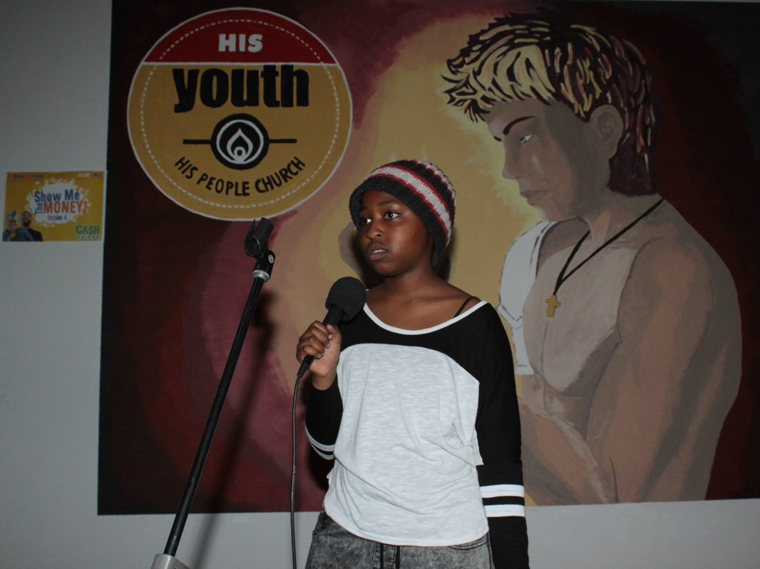
Notes:
CJ leading the debrief of the Boot Camp experience - with these question: (1) Was it hard or easy to do the challenges? (2) What made you keep going? (3) How did it feel when you persevered?

Slide 28
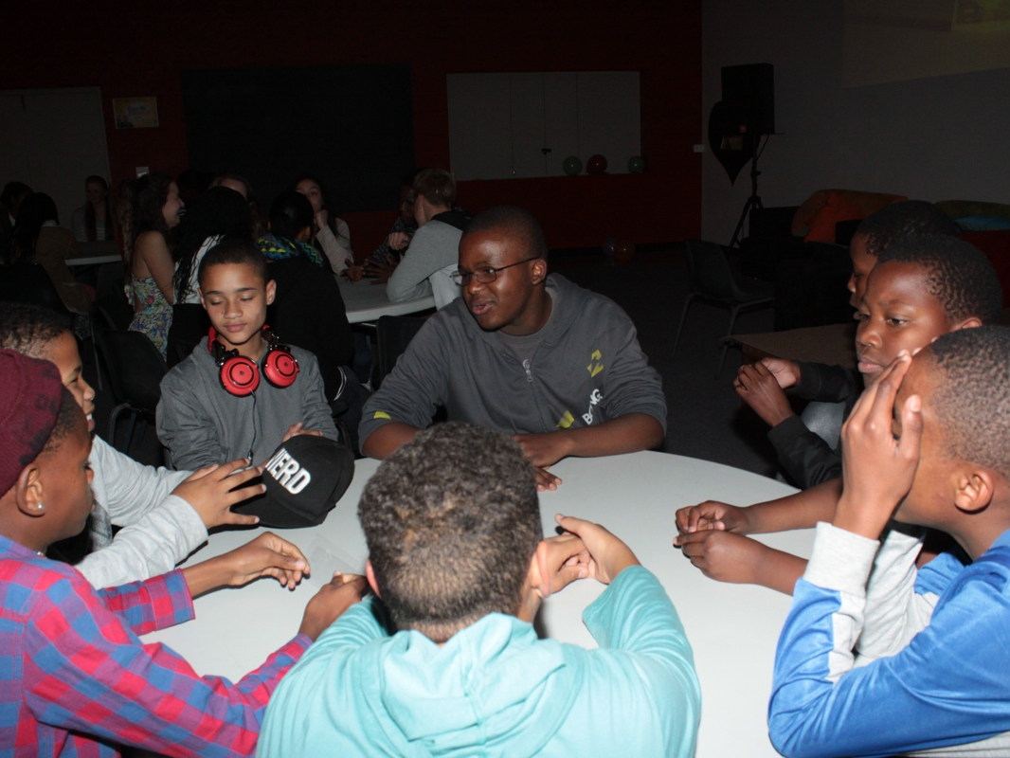
Notes:
Groups discussing the movie clip

Slide 29
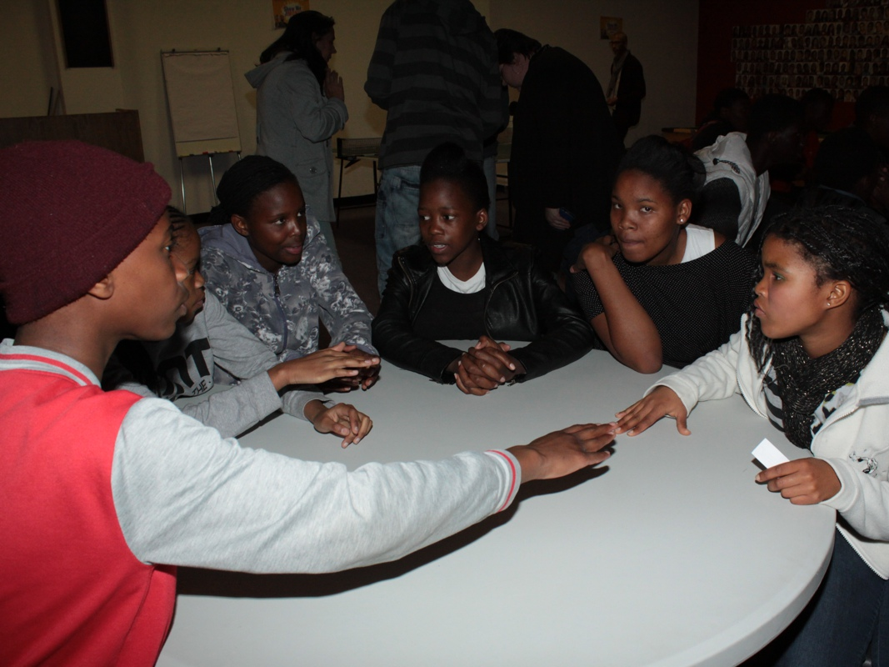
Notes:
Groups discussing the movie clip

Slide 30
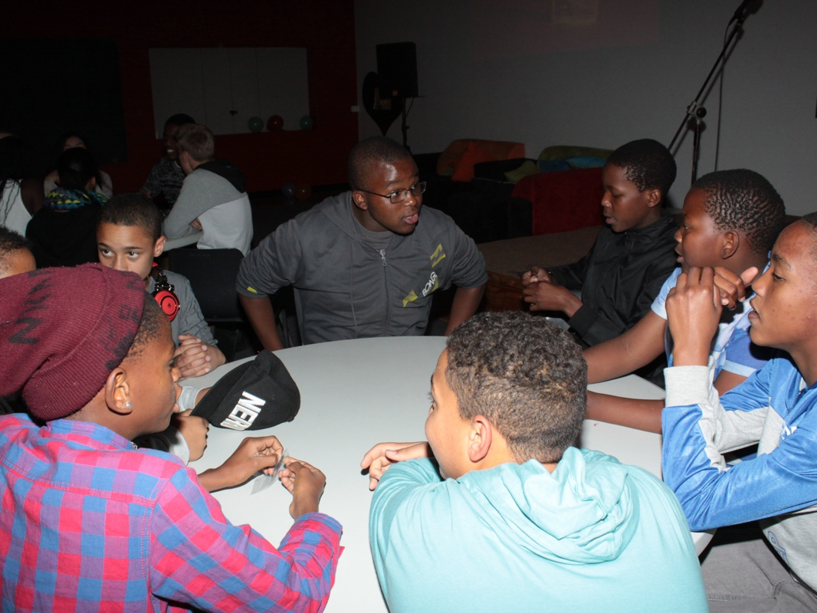
Notes:
Groups discussing the movie clip

Slide 31
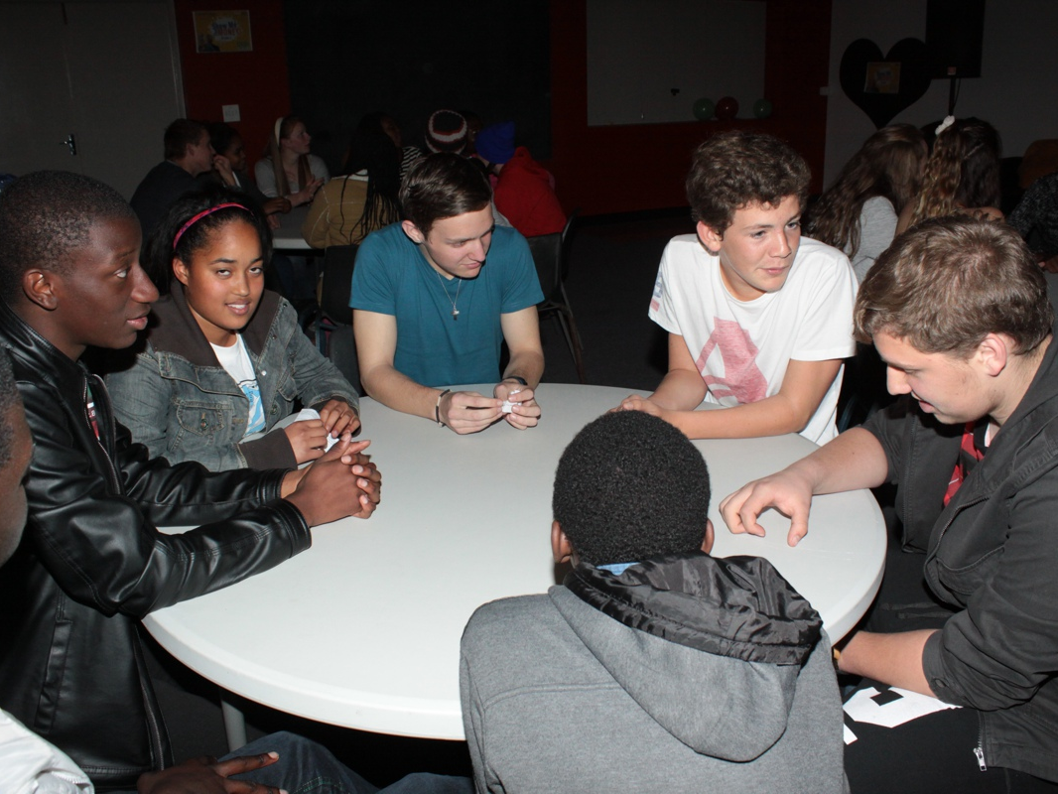
Notes:
Groups discussing the movie clip

Slide 32
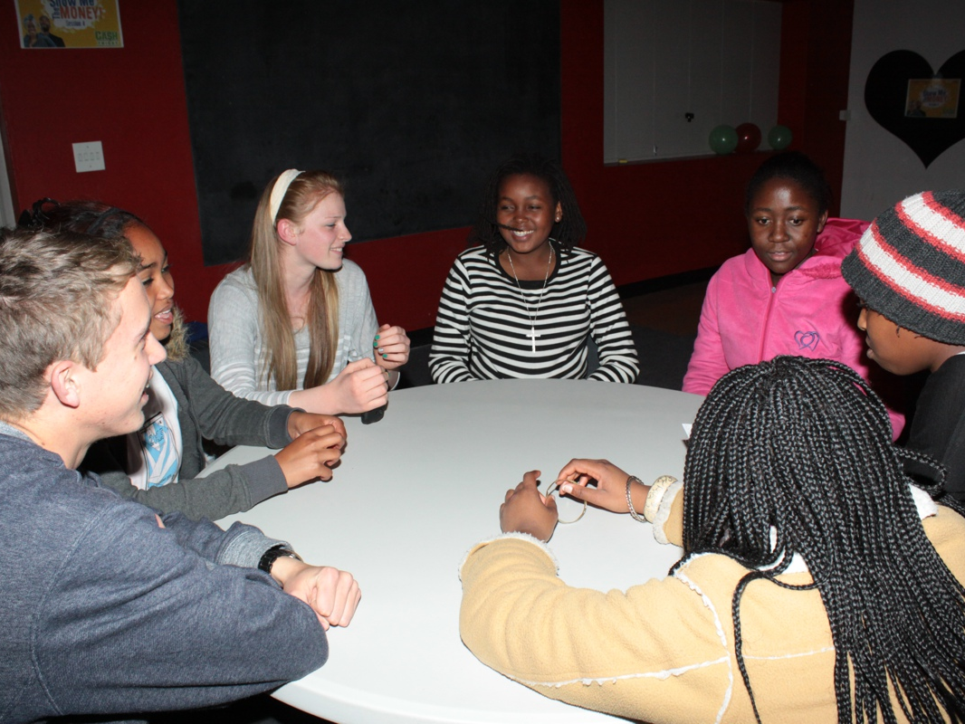
Notes:
Groups discussing the movie clip

Slide 33
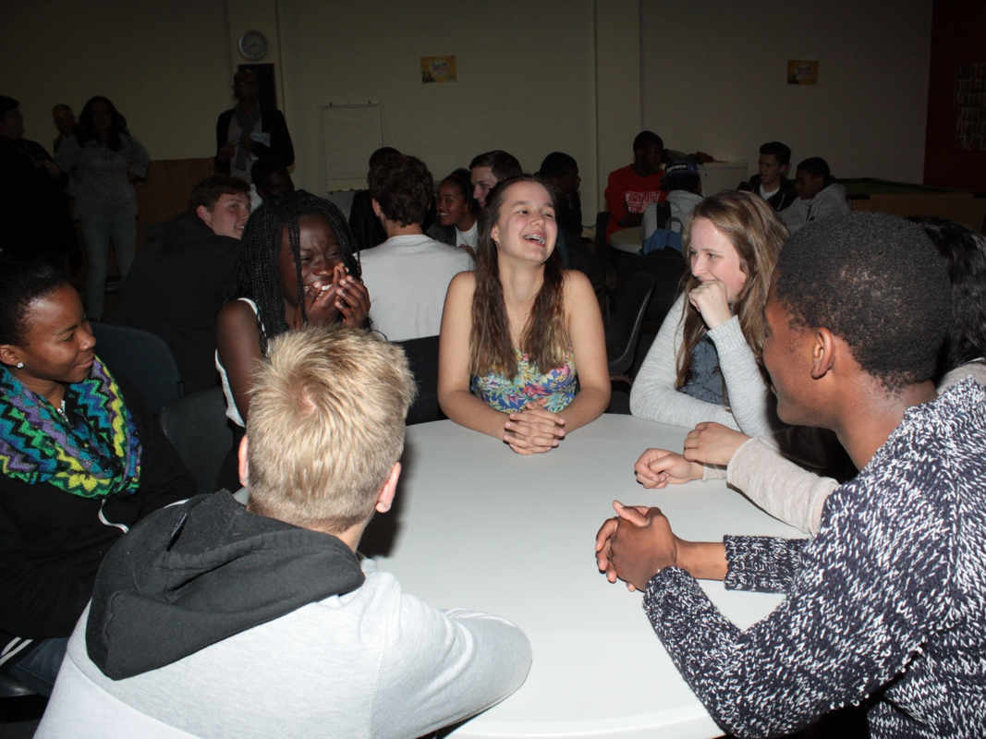
Notes:
Groups discussing the movie clip

Slide 34
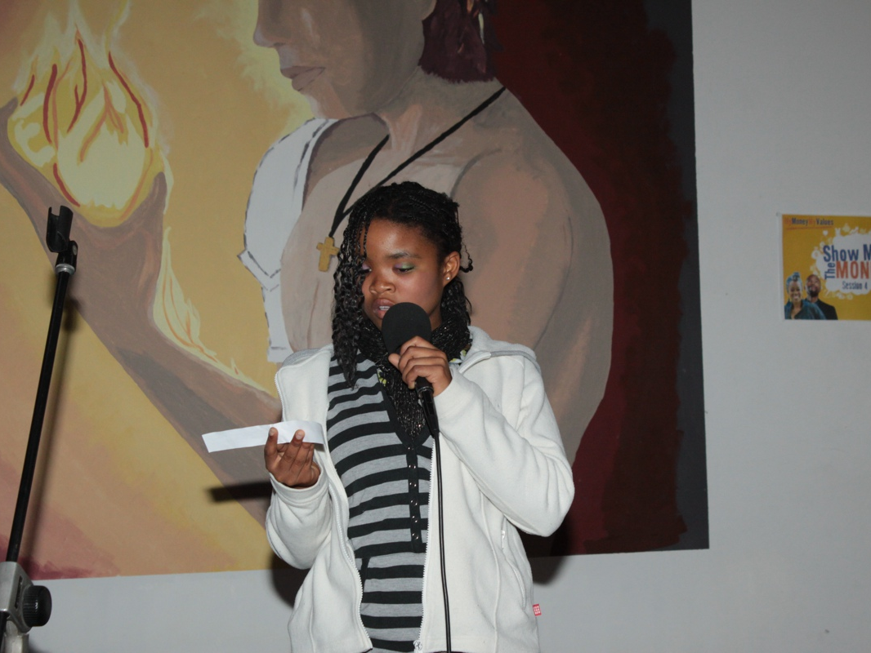
Notes:
Lorraine introducing the idea of diligence. (1) Working hard and doing your absolute best, with enthusiasm and excellence. (2) The value that drives one to earn one’s money in a way that is honourable. (3) Persevering to overcome obstacles; being responsible with money and future-minded when it comes to saving. (4) Being diligent about school work and taking pride in your work.

Slide 35
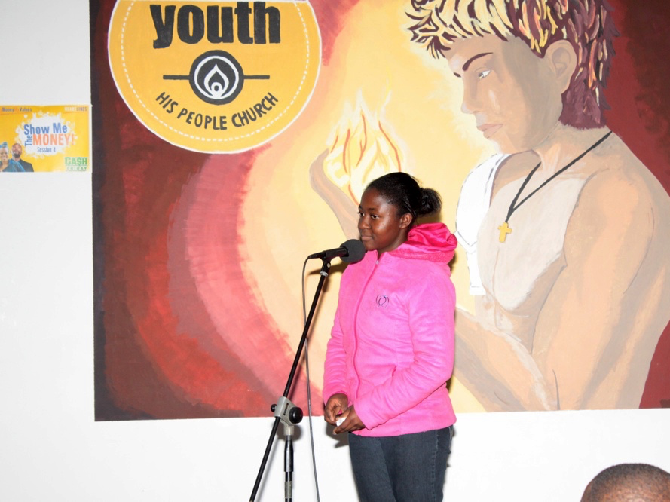
Notes:
Tama introducing the Bible discussion on diligence.
1. Read Proverbs 13:11 (Good News Translation). “The more easily you get your wealth, the sooner you will lose it. The harder it is to earn, the more you will have.” (a) What do you think Axe could have learnt from this Bible verse? (b) Do you agree that the harder you work for something, the more you appreciate it? Give reasons for your answer.
2. Read Proverbs 12:27. “A slothful (lazy) man will not catch his prey, but the diligent man will get precious wealth.” (1) Reneilwe might not be earning much but she works hard at her job. In which ways would this verse inspire her? (b) What does this verse tell us about working hard and achieving success?
3. Read Proverbs 10:5 (TLB). “A wise youth makes hay while the sun shines, but what a shame to see a lad who sleeps away his hour of opportunity.” (a) What does this Bible verse tell us about being diligent? (b) In which ways could we live out this verse at school, place of study, and in how we earn our money?

Slide 36
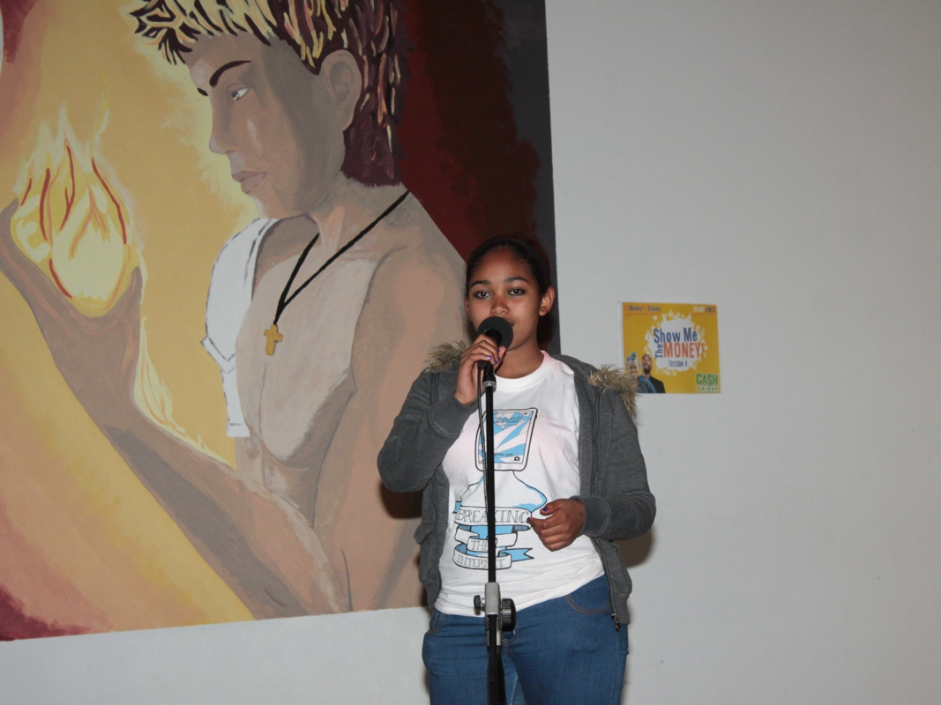
Notes:
Cristal challenged us to find examples of people acting out the three values we explored in this series (Honesty, Thrift and Diligence) and take a photo to post on Facebook.

Slide 37
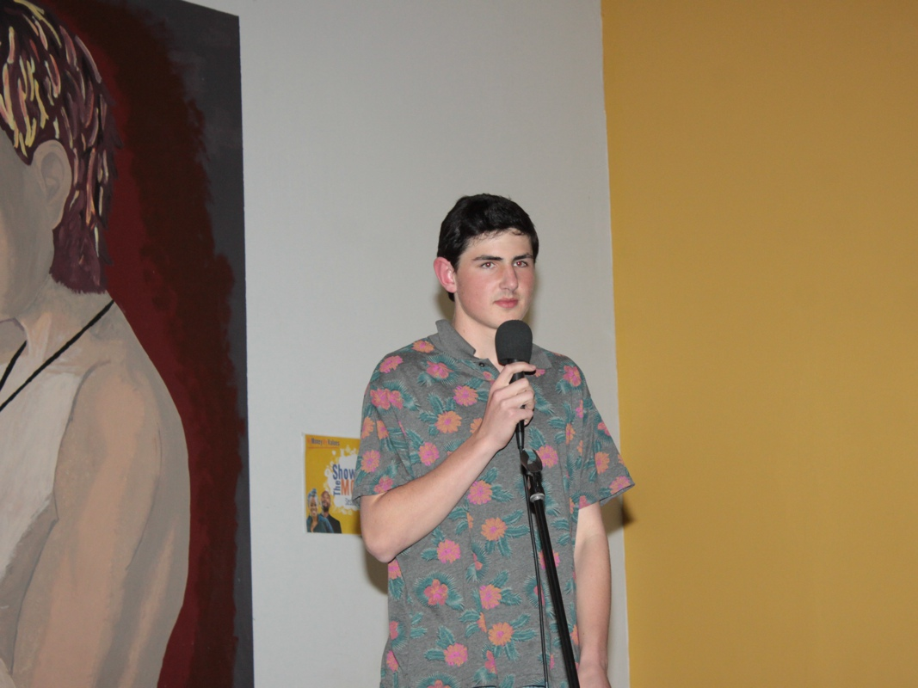
Notes:
Tiague leading us in reflection using the following questions:
• Would your parents, teachers, sports coaches and friends describe you as a hard worker?
• When you face obstacles, do you give up easily or do you persevere?
• Have you started something (projects, savings, joined a club, etc.) and given up too easily? Why?
• How diligent and persevering do you want to be as a person in the future?
• What habits can you develop now to help you be hard working and diligent in the future?

Slide 38
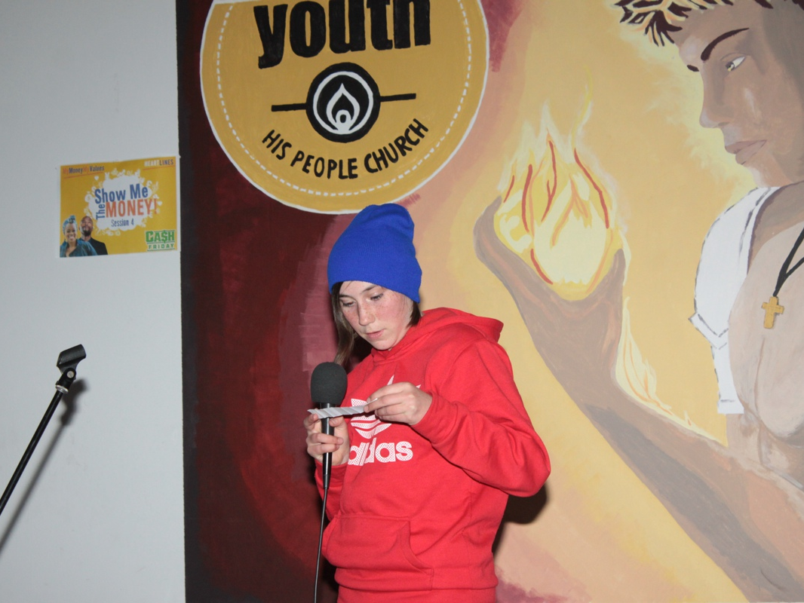
Notes:
Hannah closing the session in prayer: Almighty God, thank you that you want us to be successful and are willing to partner with us to make it happen. Please help us to make wise choices that will result in us being hard working, diligent and persevering. In Jesus’ name. Amen

