Slide 1

Notes:
Welcome to the launch of The Spirit Series at His Youth. Today is week 1 of a four week journey in getting to know and experience the Holy Spirit in our lives.

Slide 2
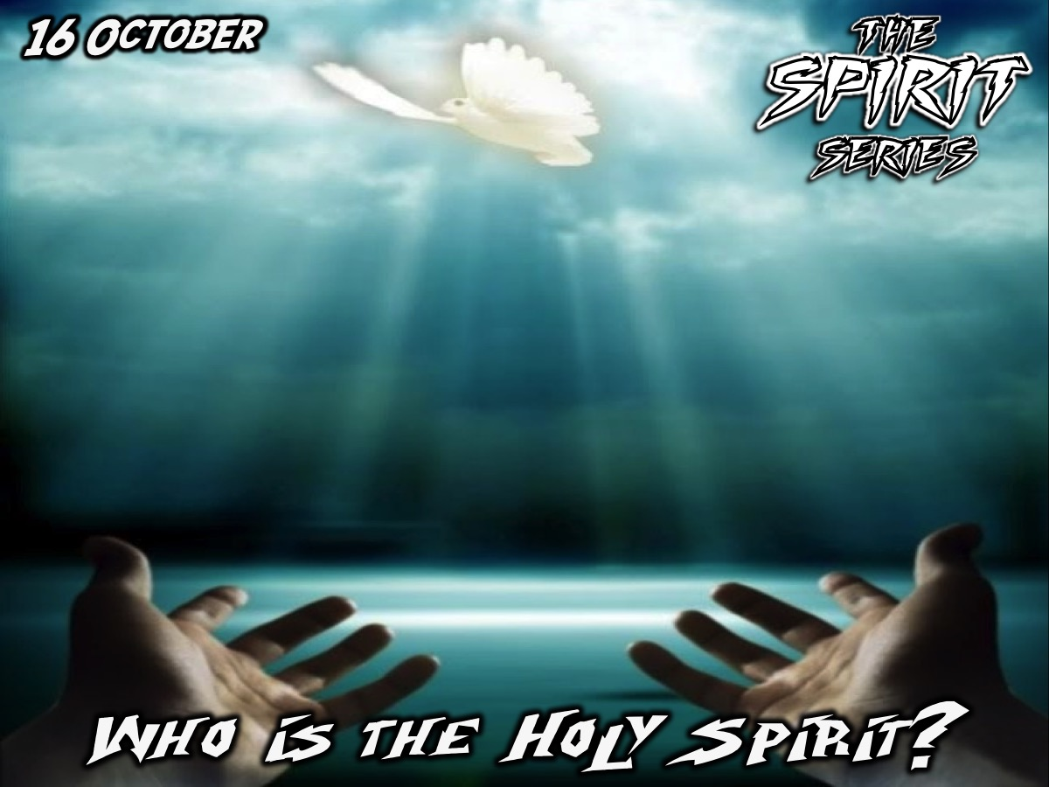
Notes:
In week 1 we are going to answer the question: Who is the Holy Spirit?

Slide 3
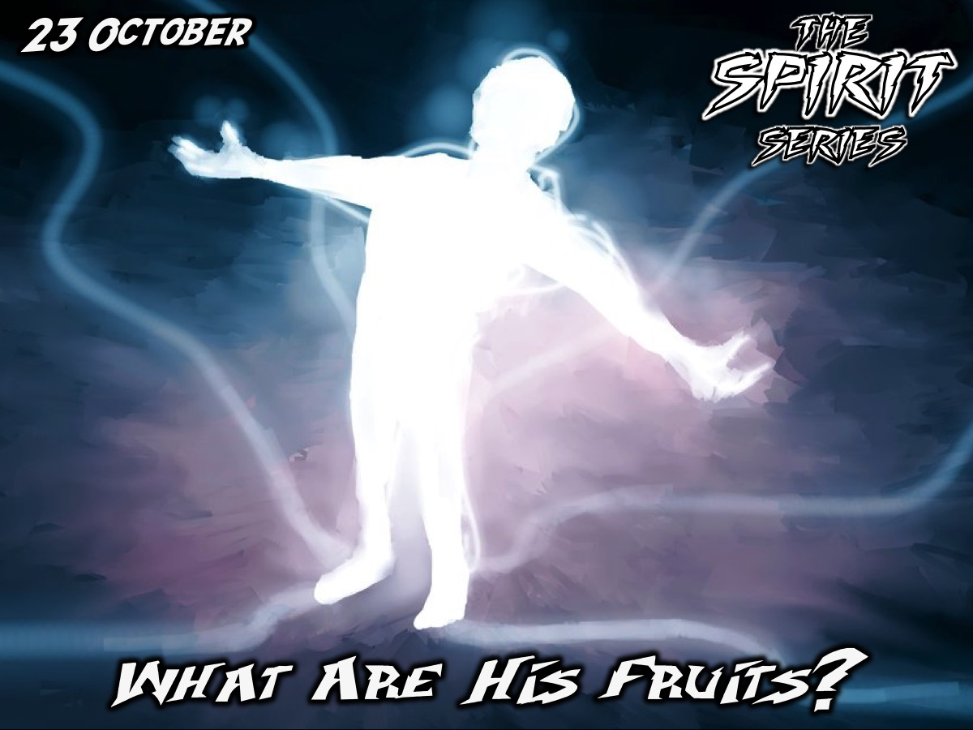
Notes:
In Week 2 we are going to answer the question: What are His Fruits?

Slide 4

Notes:
In Week 3 we are going to answer the question: What are His Gifts?

Slide 5
Notes:
In Week 4 we are going to answer the question: How can I be filled with the Holy Spirit?

Slide 6

Notes:
Today is all about getting to know who the Holy Spirit is.

Slide 7

Notes:
Many of you were a part of the Friday night Alpha series last term - well, there was a week that we did not include - the Holy Spirit week so we are going to experience it this morning. We are going to watch a video clip and then discuss a question around our tables.

Slide 8
Notes:
Video clip #1 (You can watch the full video on YouTube using this link: http://bit.ly/YouthAlpha8)

Slide 9
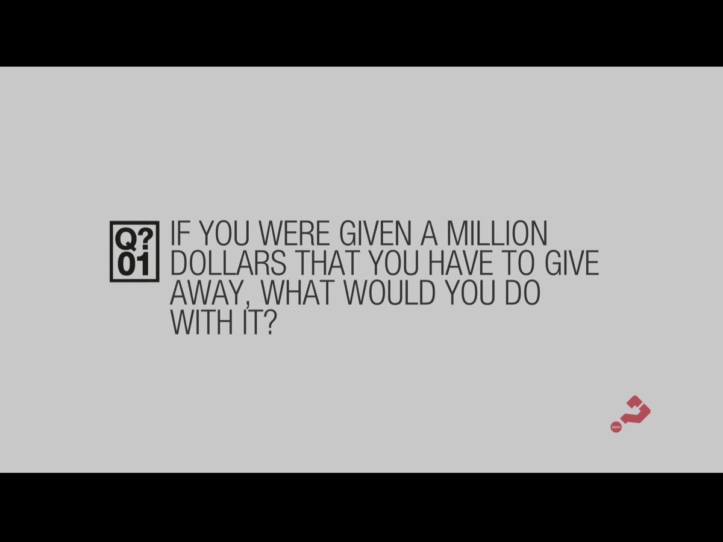
Notes:
Question #1: If you were given a million dollars that you have to give away, what would you do with it?

Slide 10
Notes:
Video clip #2

Slide 11

Notes:
Question #2: What questions come to mind when you hear about the Holy Spirit?

Slide 12
Notes:
Video clip #3

Slide 13
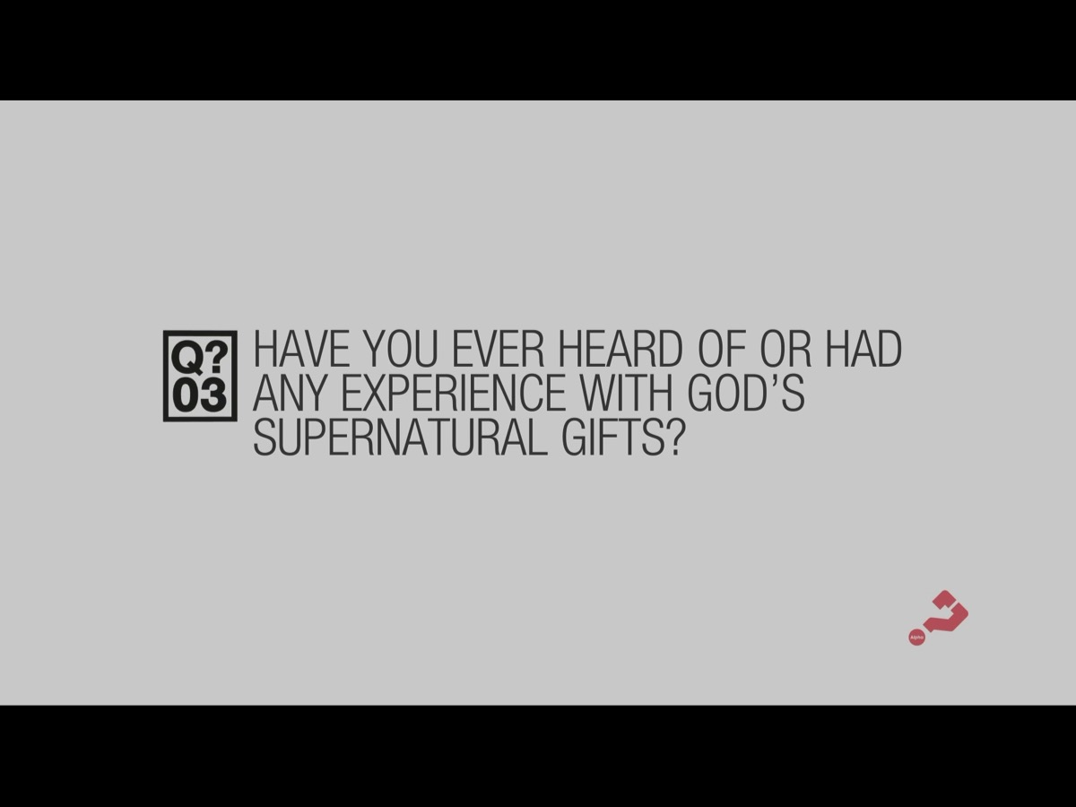
Notes:
Question #3: Have you ever heard of, or had any experience with God’s supernatural gifts?

Slide 14
Notes:
Video clip #4

Slide 15

Notes:
Challenge: This series has the potential to seriously change your life. We are going to ask you to commit to attending each of the next 3 session (as far as humanly possible) and open yourself up to what God wants to do in and through you as you learn about the Holy Spirit and encounter him personally. Let’s pray and ask God to impact us during this series.

Slide 16
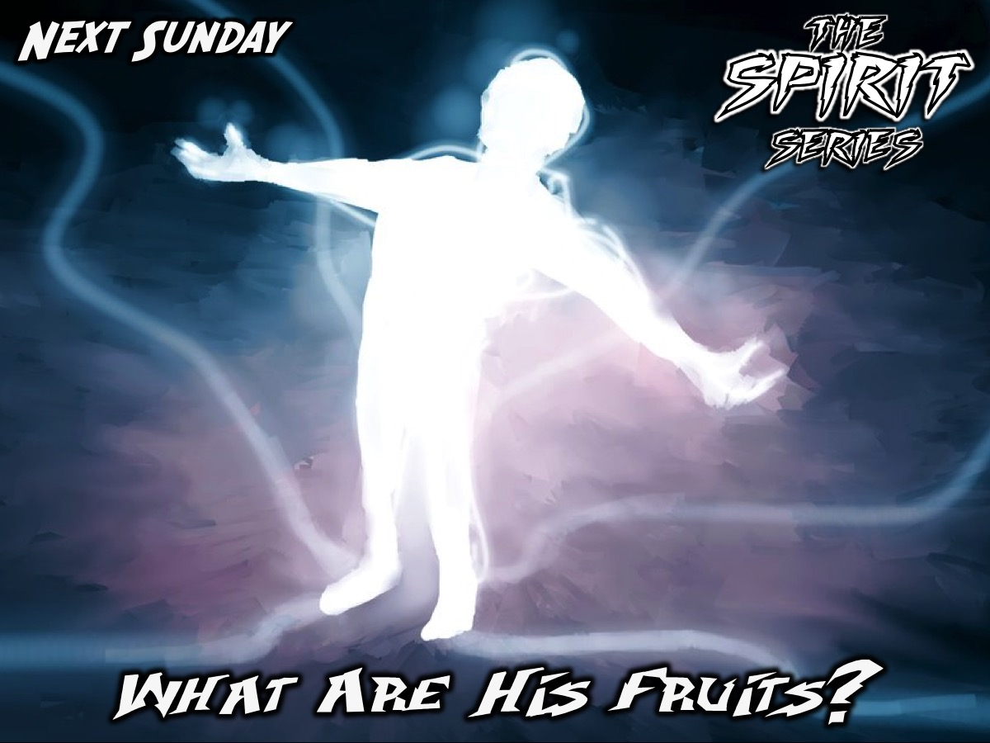
Notes:
Next Sunday morning we are going to learn about the fruit that the Holy Spirit wants to produce in our lives.

