Slide 1

Notes:
Welcome to week 2 of The Spirit Series at His Youth.

Slide 2
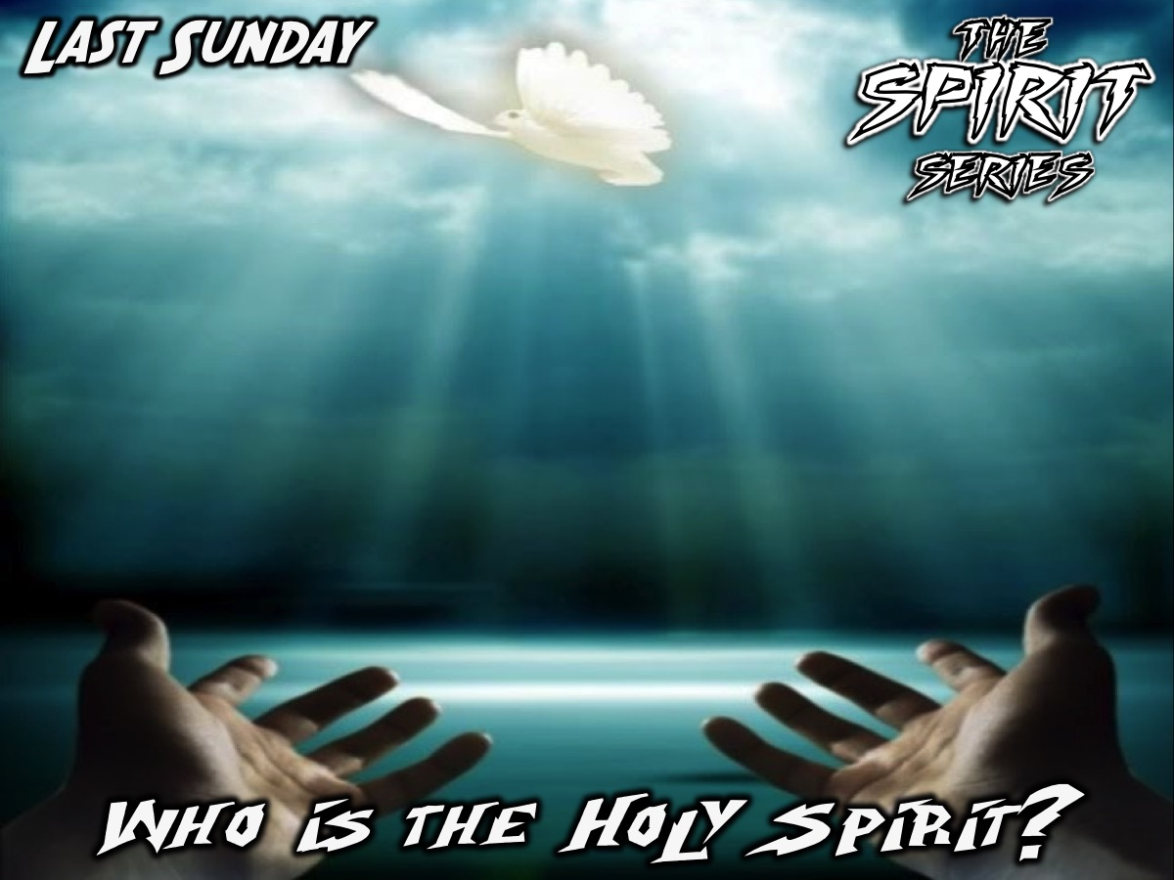
Notes:
Last week we looked at who the Holy Spirit is.

Slide 3
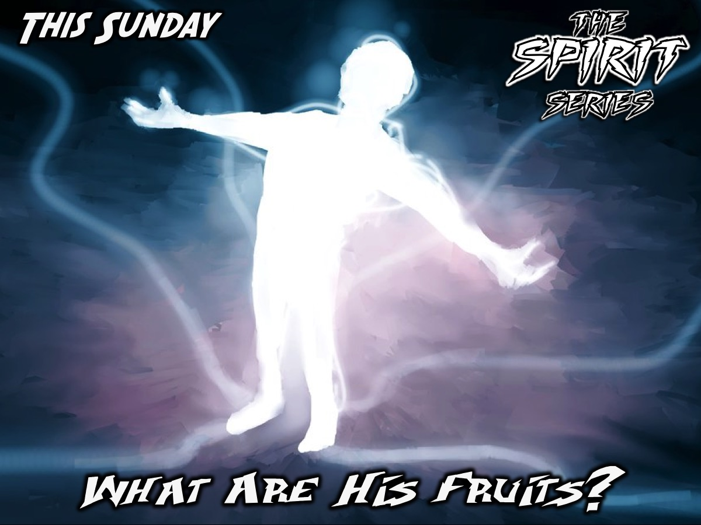
Notes:
This week we are going to answer the question: What are His Fruits?

Slide 4
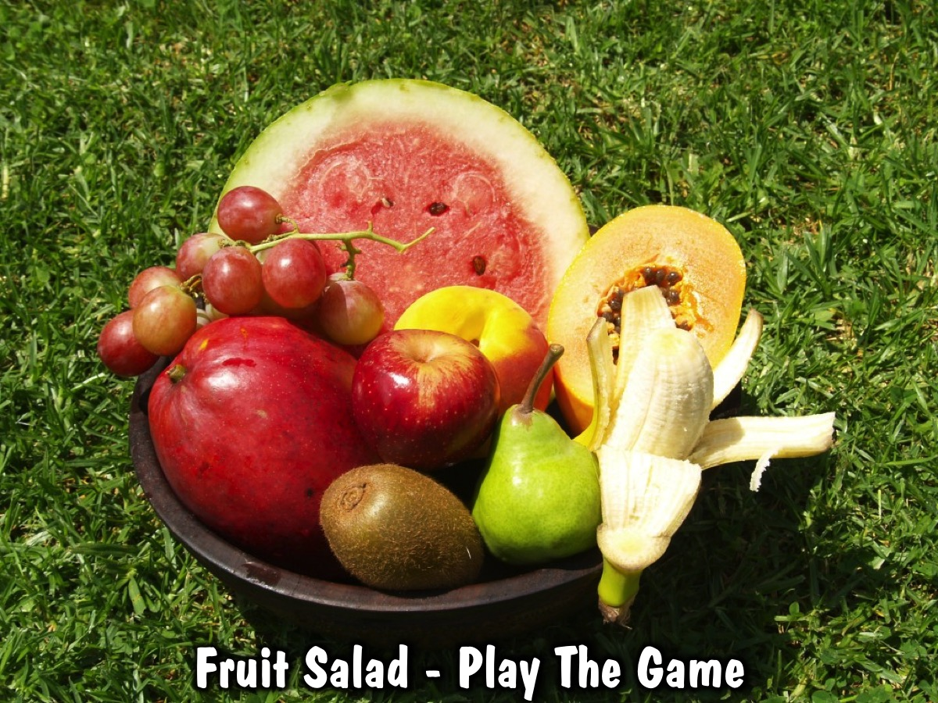
Notes:
Game: Fruit salad. Each people is given the name of a fruit and when you call out the name of their fruit they have to swop seats with another person with that fruit - they HAVE to move. And when you call fruit salad everyone has to move!
The Fruit are: Water Melon, Grape, Peach, Paw Paw, Apple, Pear, Banana, Kiwi, Mango

Slide 5
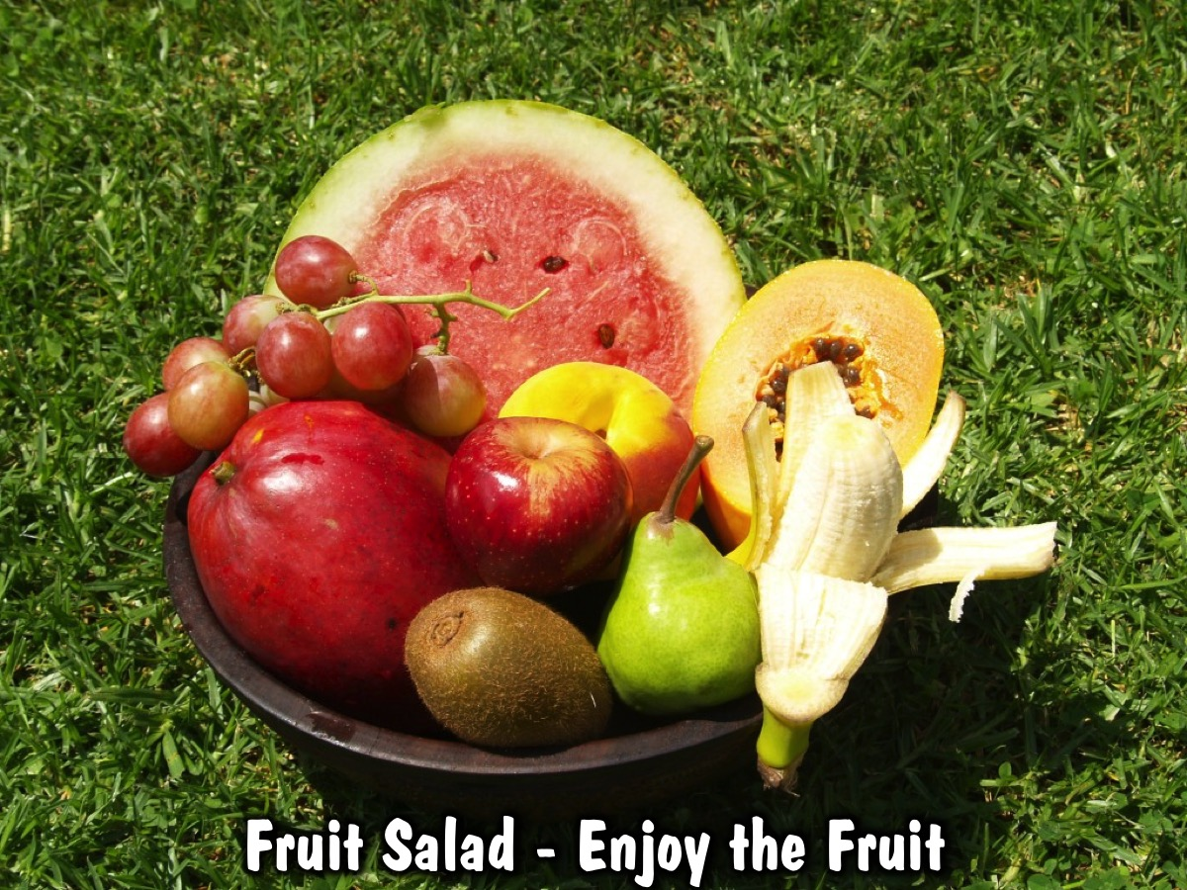
Notes:
We are going to serve everyone a cup of fruit salad to enjoy.

Slide 6
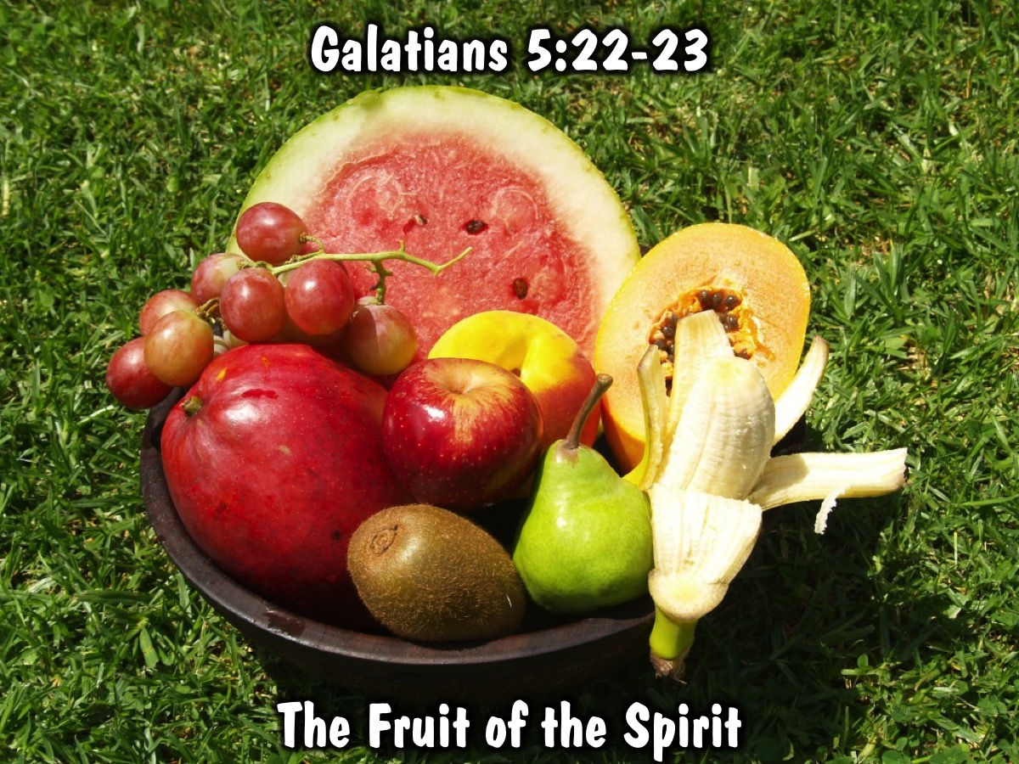
Notes:
I am sure you have heard of the fruit of the Spirit - it is found in Galatians 5:22-23. There are 9 fruit that the Holy Spirit wants to produce in our lives and they are: Love, Joy, Peace, Patience, Kindness, Goodness, Faithfulness, Gentleness, Self-control.

Slide 7
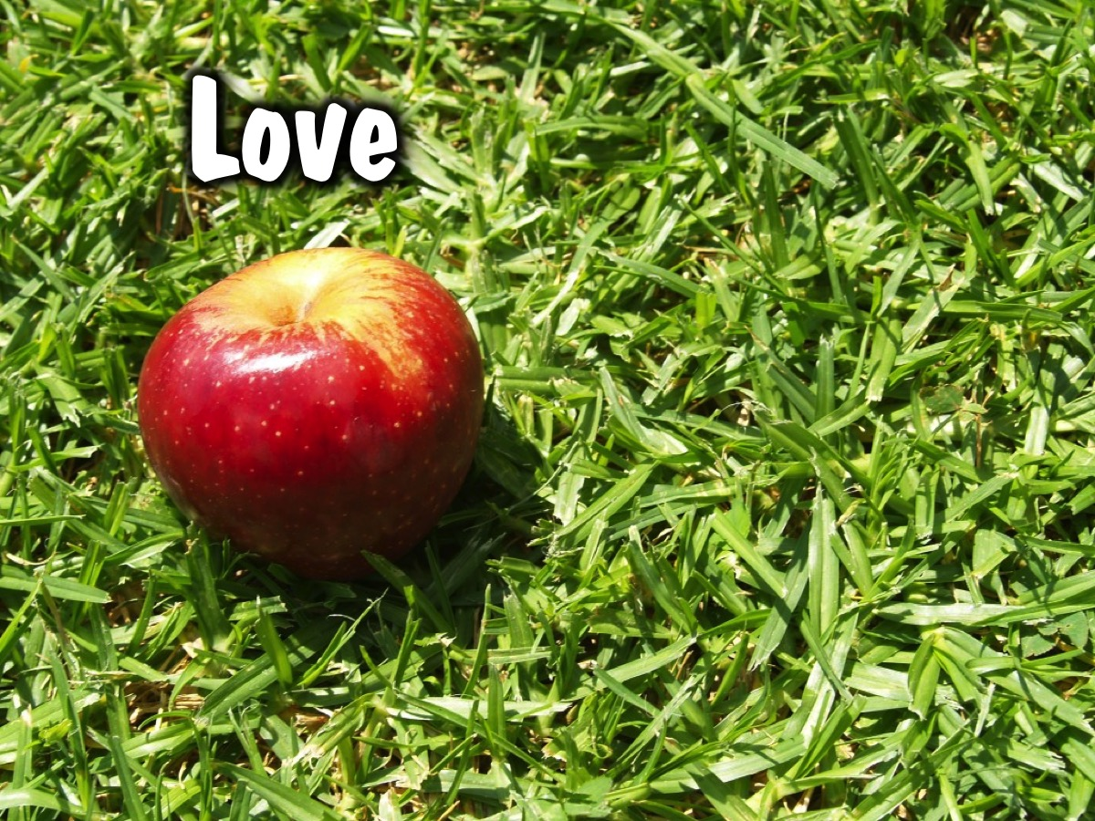
Notes:
Love

Slide 8
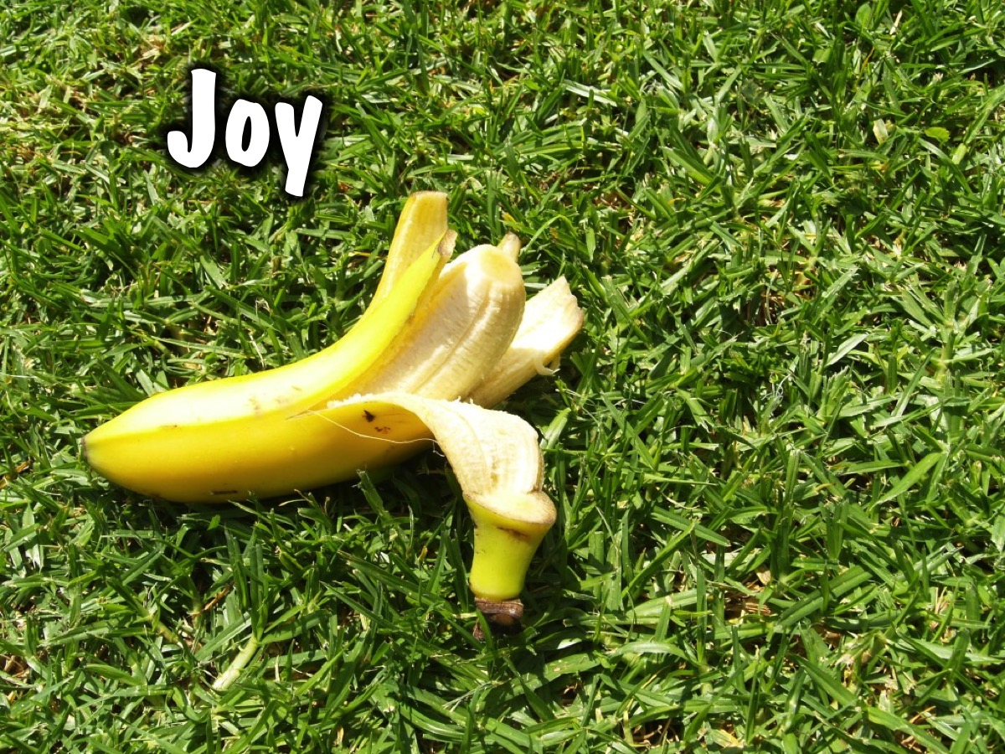
Notes:
Joy

Slide 9
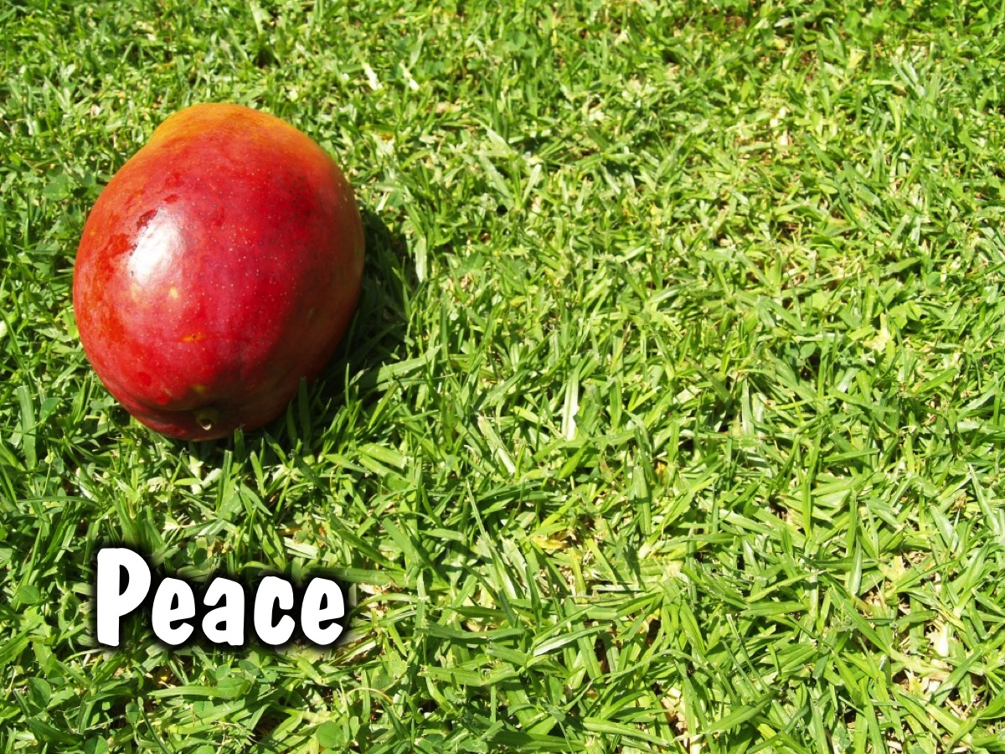
Notes:
Peace

Slide 10
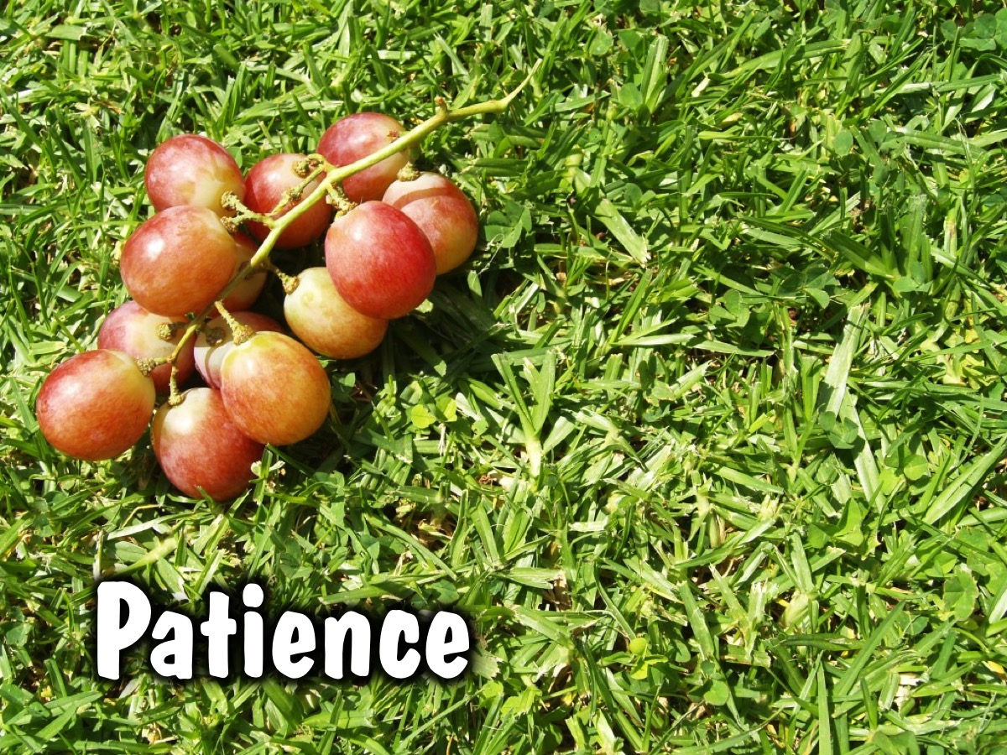
Notes:
Patience

Slide 11
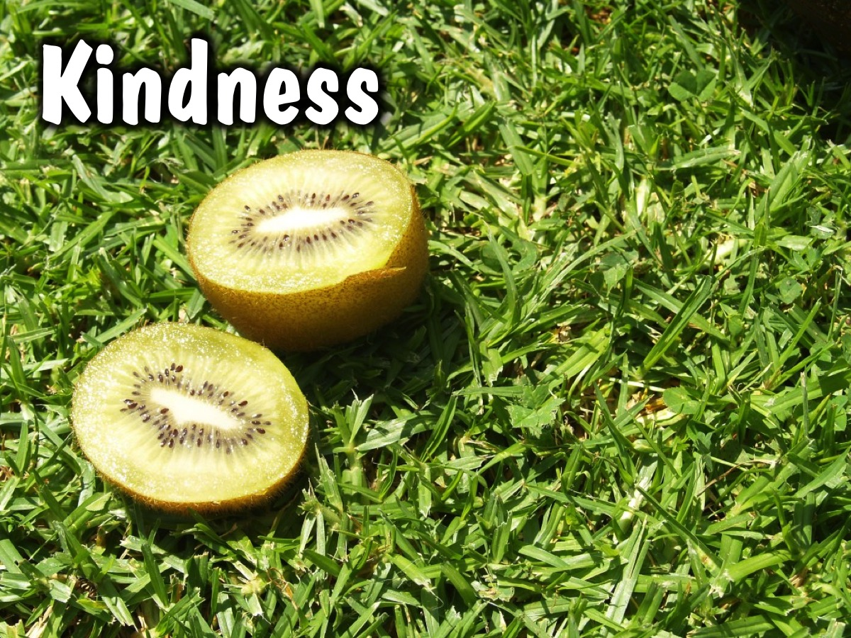
Notes:
Kindness

Slide 12
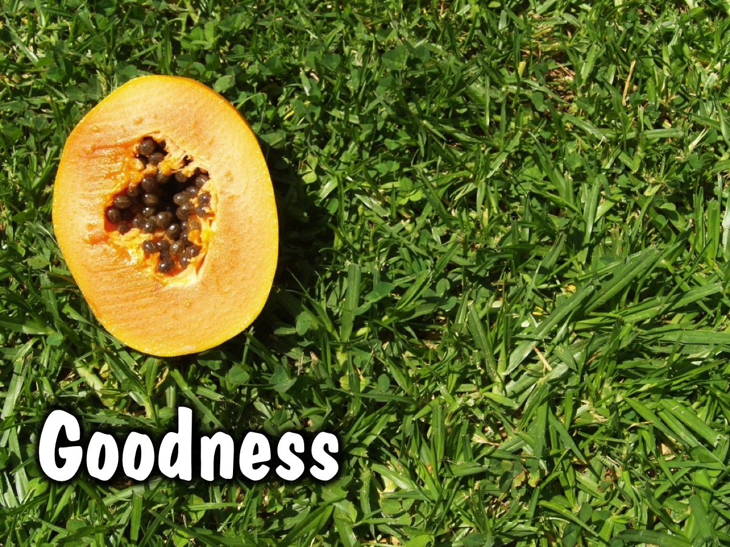
Notes:
Goodness

Slide 13
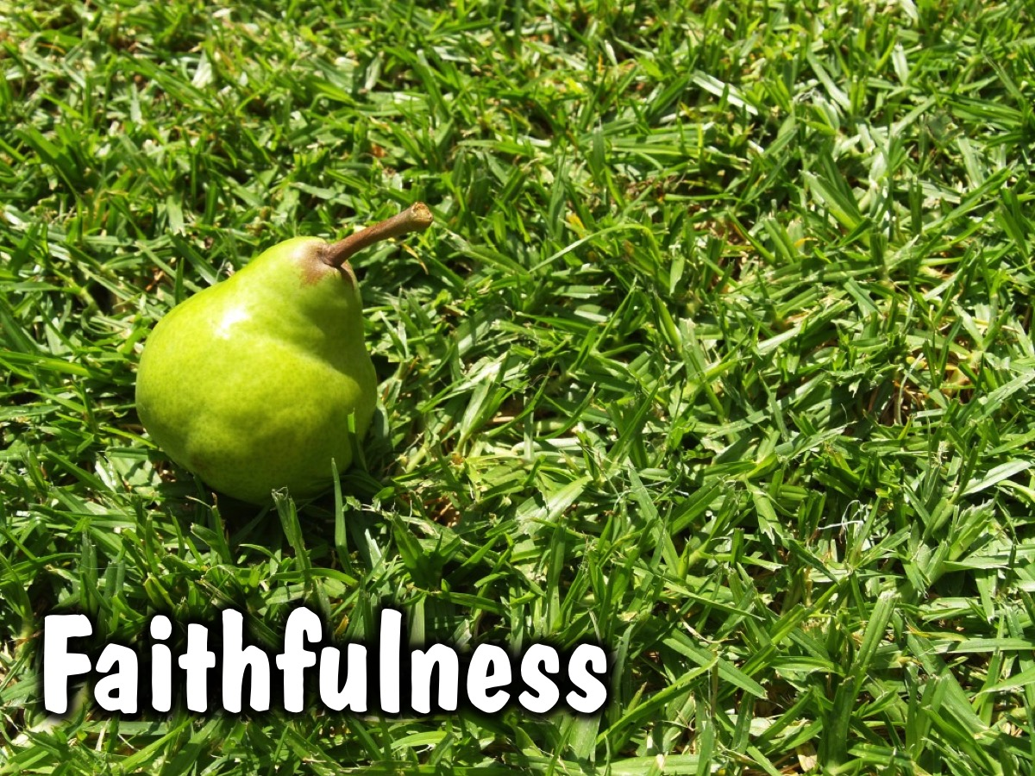
Notes:
Faithfulness

Slide 14
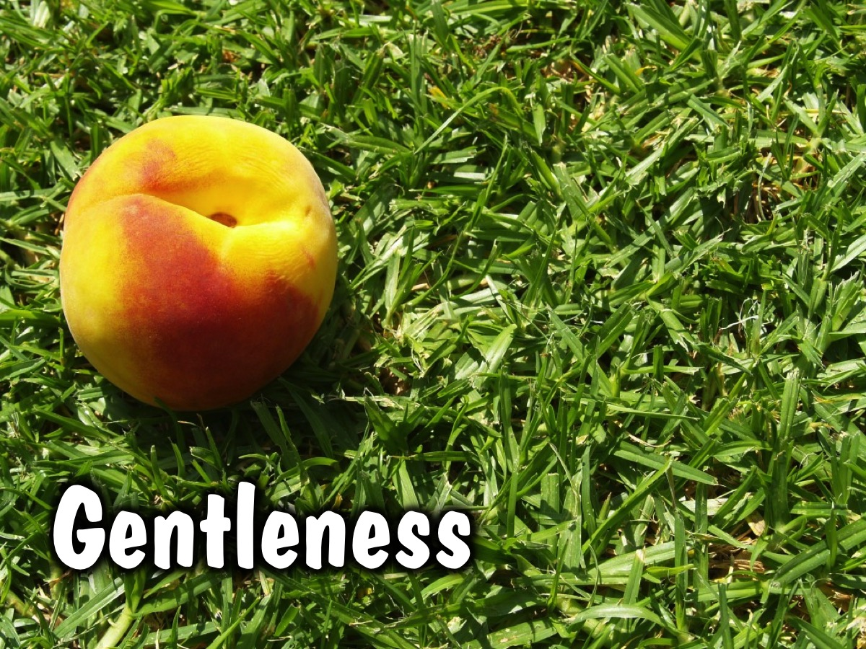
Notes:
Gentleness

Slide 15
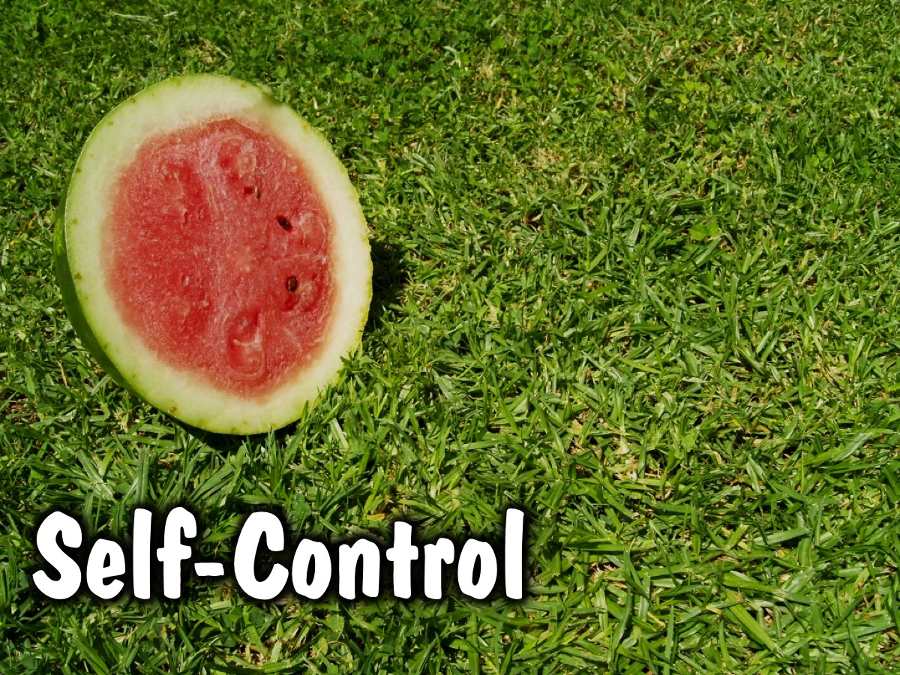
Notes:
Self-control

Slide 16
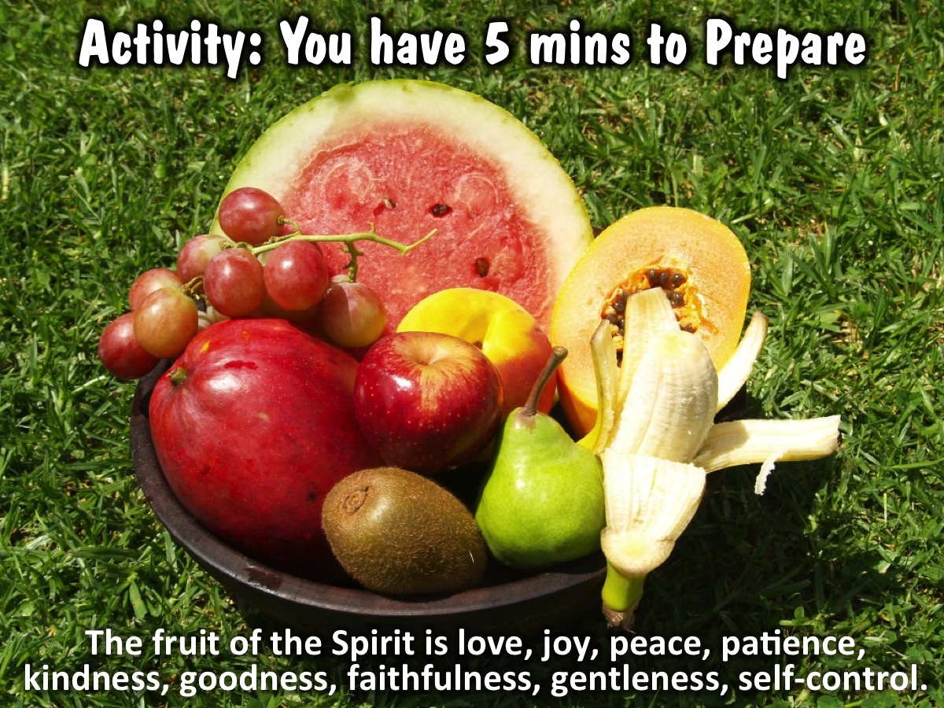
Notes:
Activity: Each of the 9 groups will be given 5 minutes to take a look at the fruit of the spirit that they are given, and the definition we provide and you have 1 minute to creatively introduce your fruit to the wider group on stage.

Slide 17

Notes:
Present: Each of the 9 groups have 1 minute to creatively introduce their fruit to the wider group

Slide 18
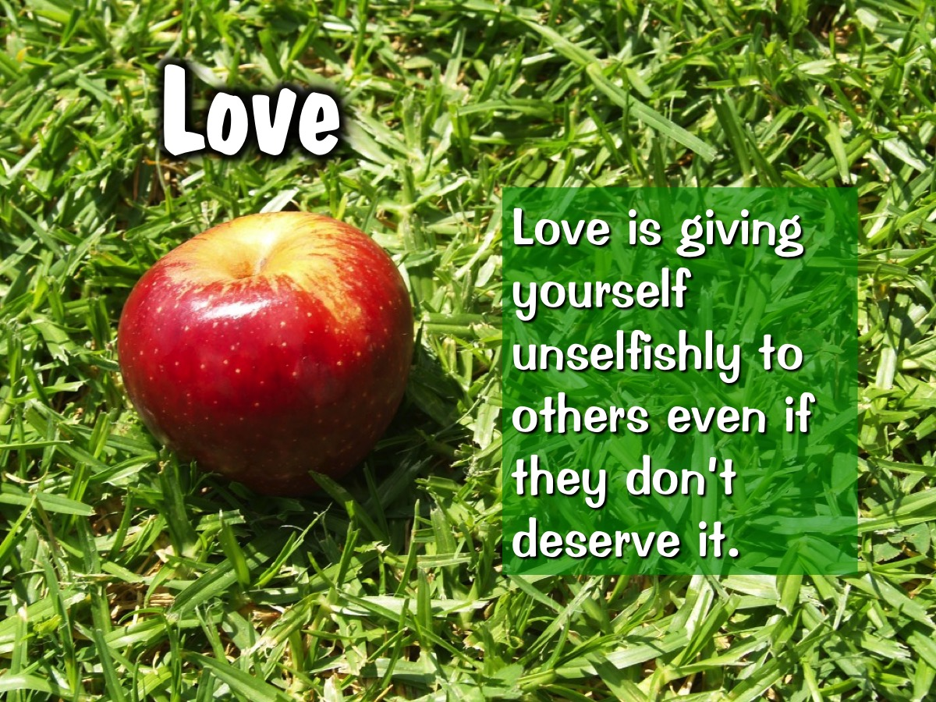
Notes:
Love: Love is giving yourself unselfishly to others even if they don’t deserve it.

Slide 19
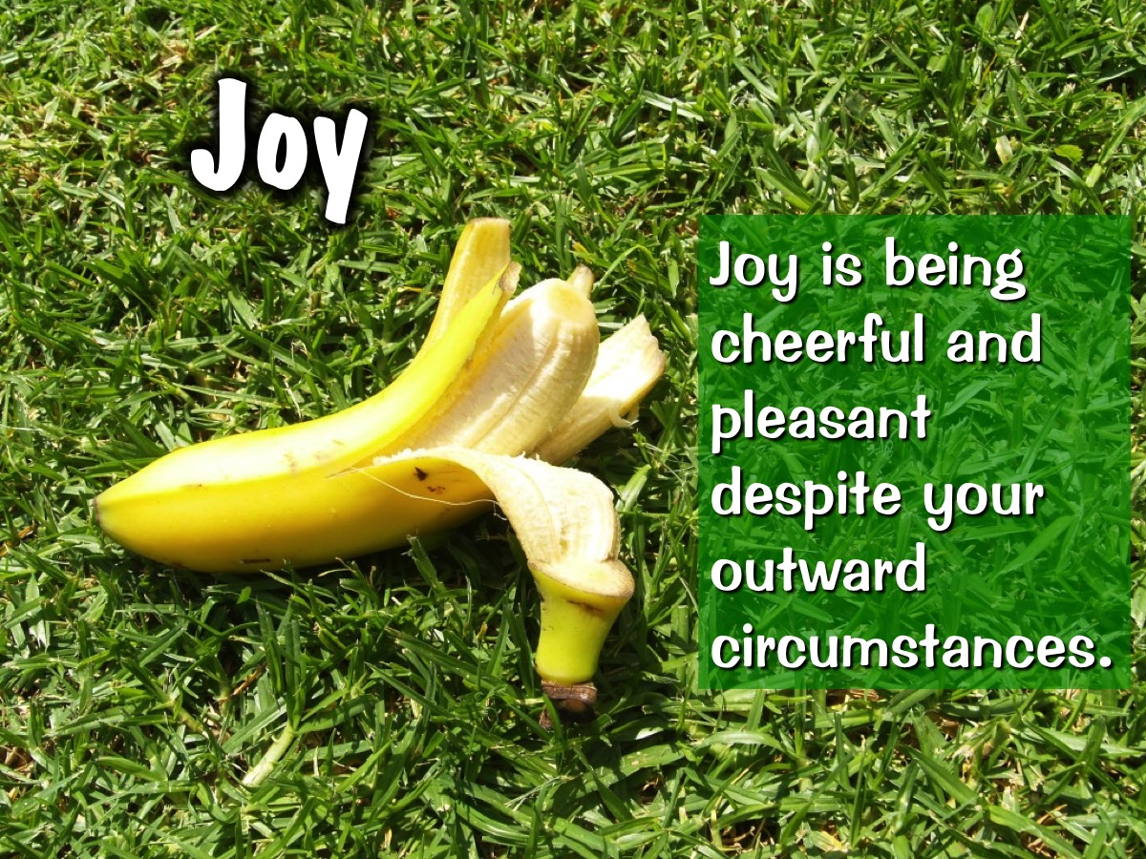
Notes:
Joy: Joy is being cheerful and pleasant despite your outward circumstances.

Slide 20
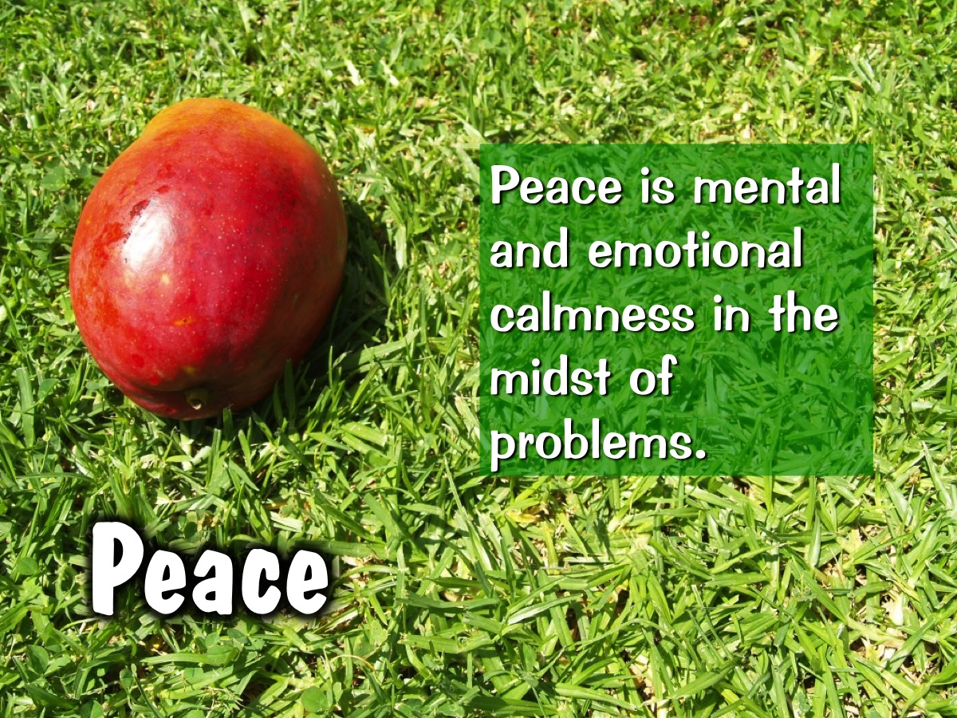
Notes:
Peace: Peace is mental and emotional calmness in the midst of problems.

Slide 21
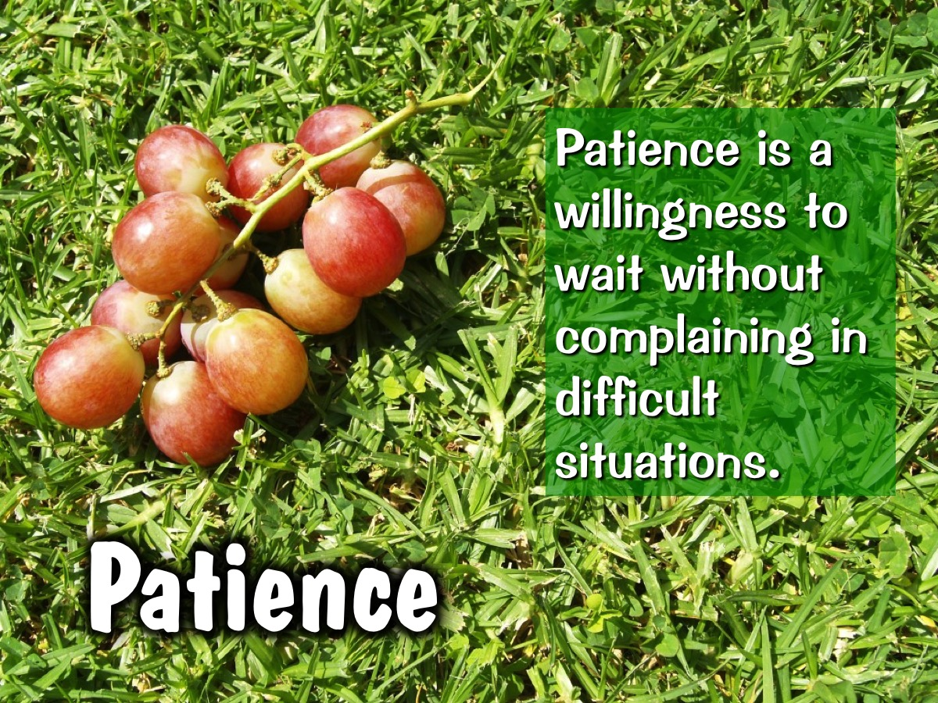
Notes:
Patience: Patience is a willingness to wait without complaining in difficult situations.

Slide 22
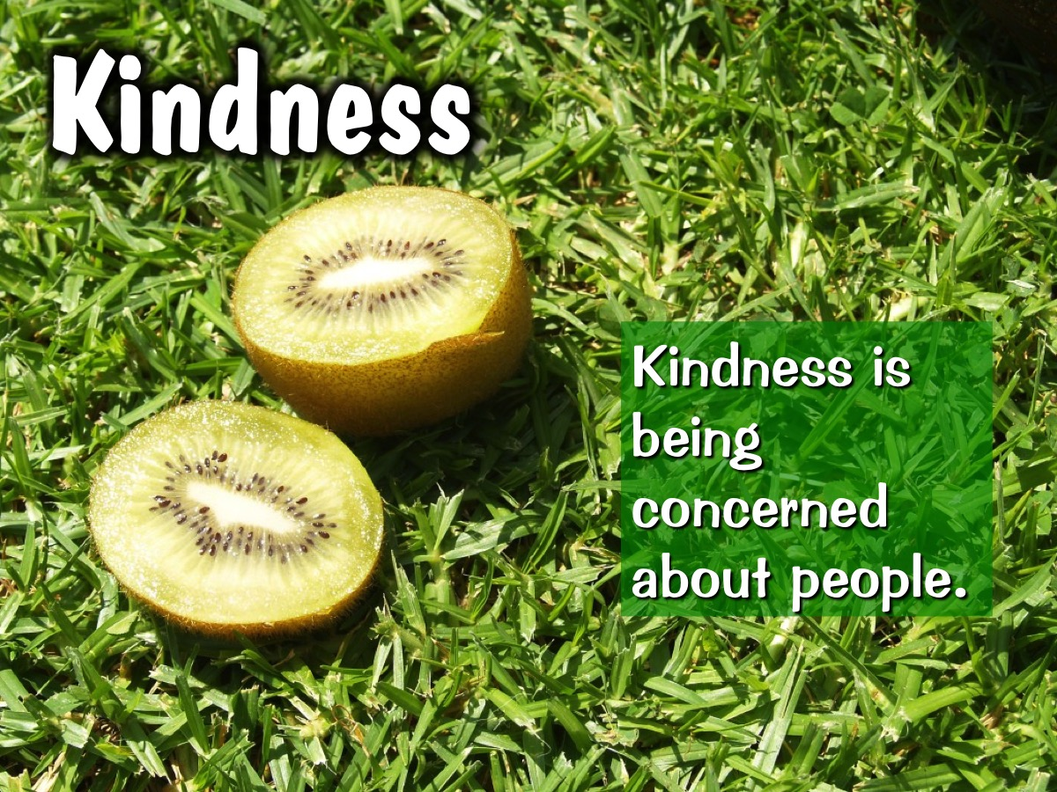
Notes:
Kindness: Kindness is being concerned about people.

Slide 23
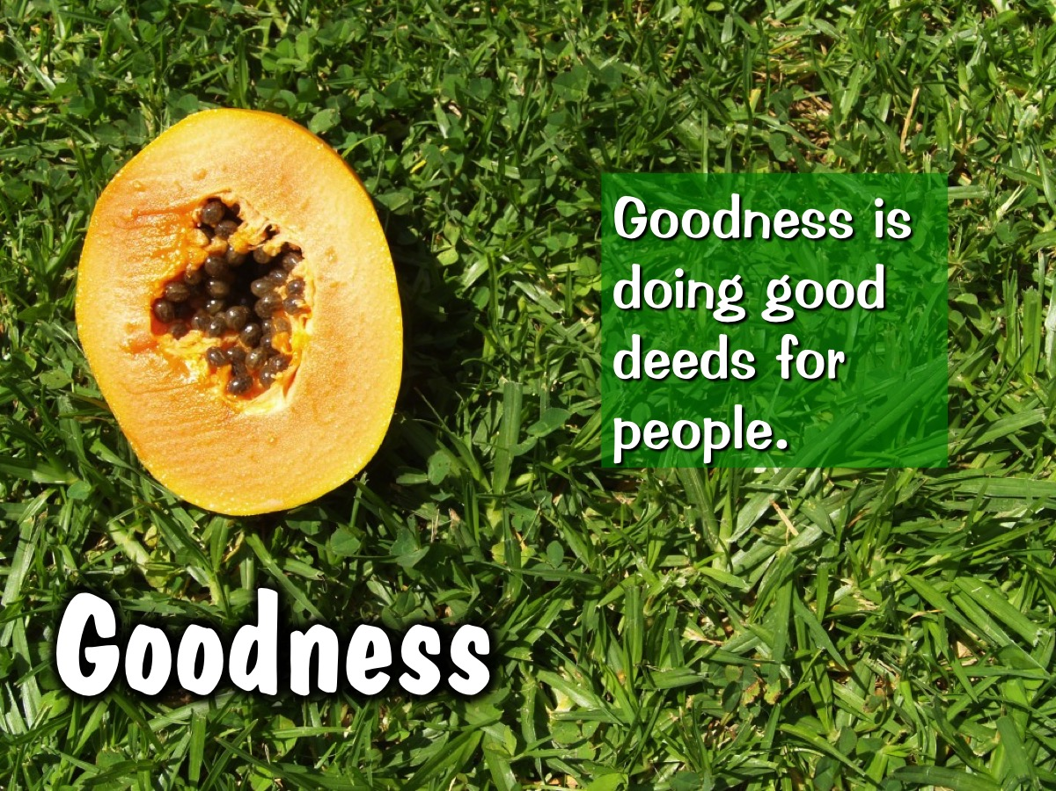
Notes:
Goodness: Goodness is doing good deeds for people.

Slide 24

Notes:
Faithfulness: Faithfulness is trustworthiness in all situations and with everything you have.

Slide 25
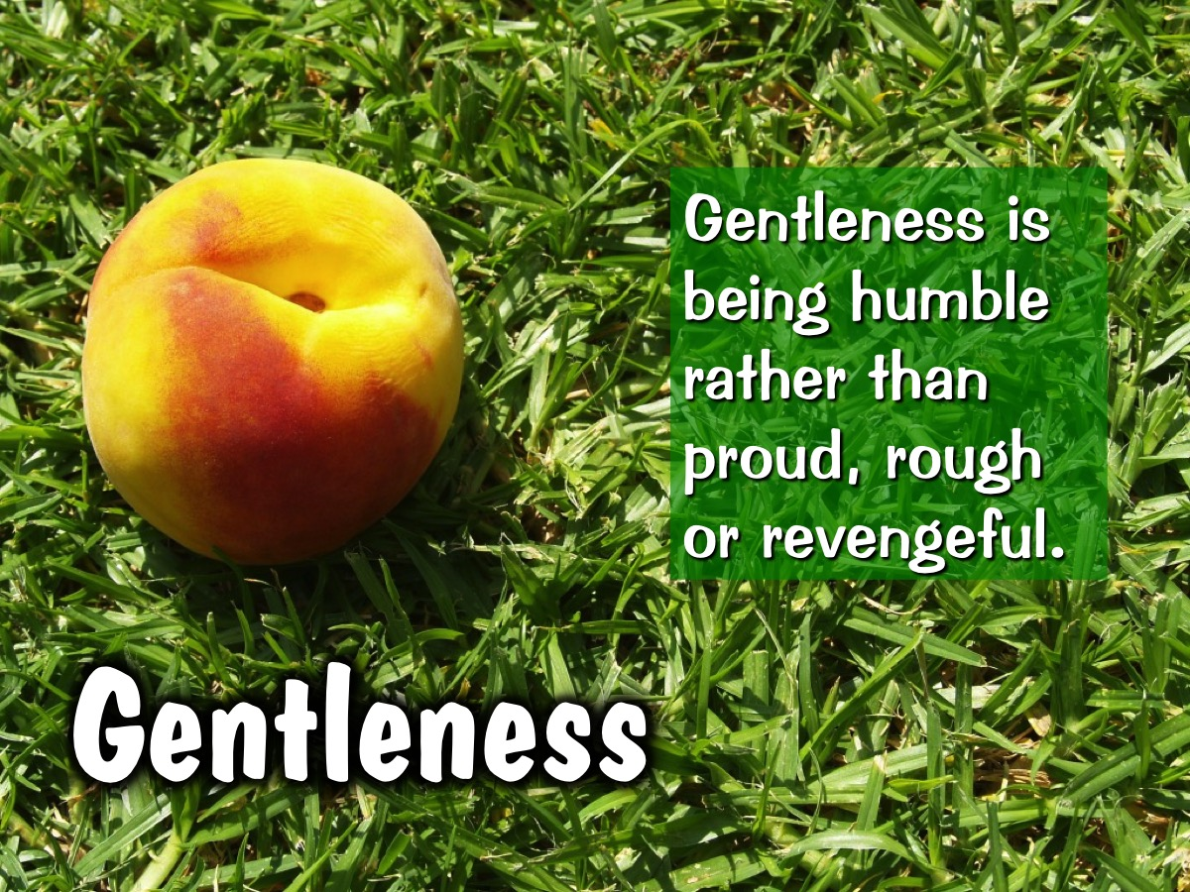
Notes:
Gentleness: Gentleness is being humble rather than proud, rough or revengeful.

Slide 26
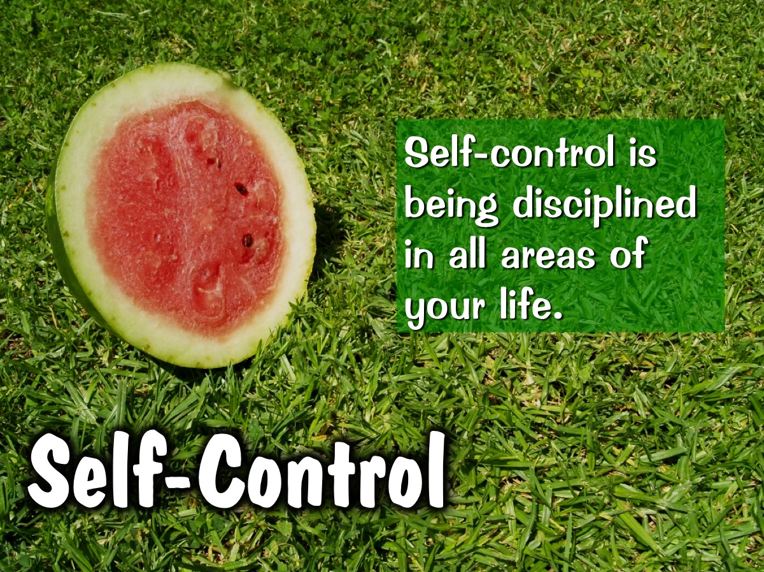
Notes:
Self-control: Self-control is being disciplined in all areas of your life.

Slide 27
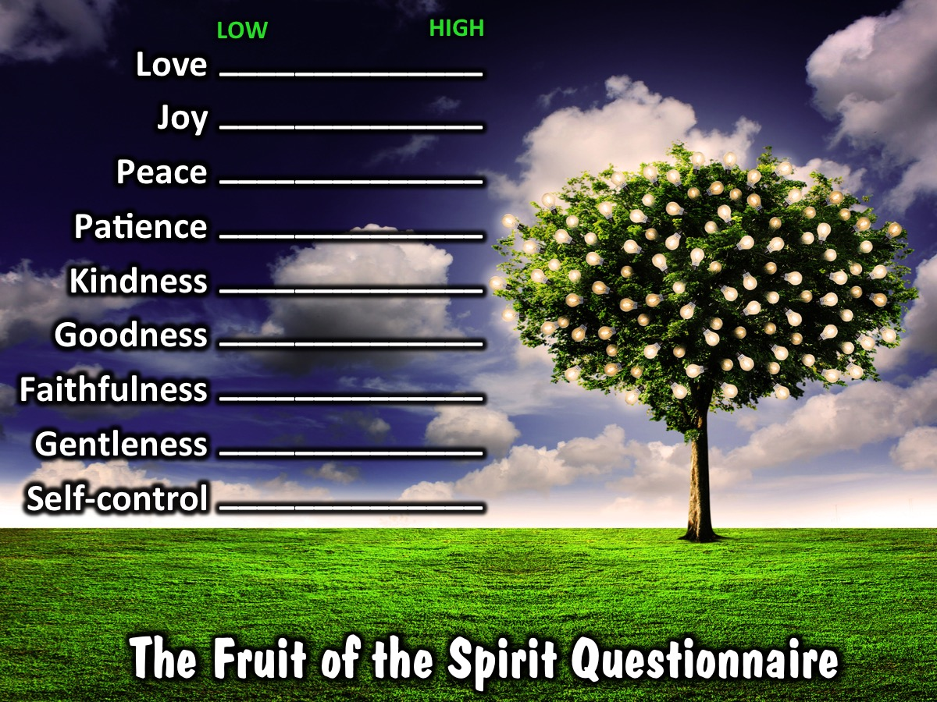
Notes:
Questionnaire: Here is a questionnaire to help you find out how much of the Holy Spirit’s fruit is ripe in your life. Rate yourself from 1 to 10 for each fruit and add the totals up for a score out and 90 and see how well you are doing.

Slide 28

Notes:
Challenge: So, now that you tested to see what the fruit in your life is like, how son-ripened are you? Is the Holy spirit producing His Fruit in you?

Slide 29
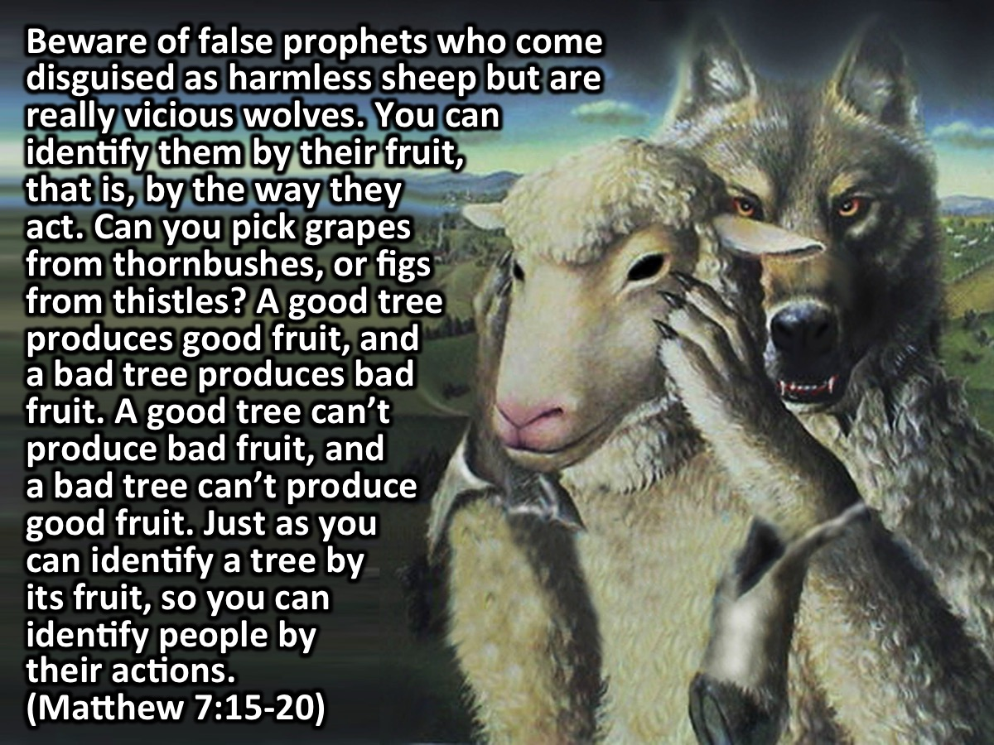
Notes:
Beware of false prophets who come disguised as harmless sheep but are really vicious wolves. You can identify them by their fruit, that is, by the way they act. Can you pick grapes from thornbushes, or figs from thistles? A good tree produces good fruit, and a bad tree produces bad fruit. A good tree can’t produce bad fruit, and a bad tree can’t produce good fruit. So every tree that does not produce good fruit is chopped down and thrown into the fire. Yes, just as you can identify a tree by its fruit, so you can identify people by their actions. (Matthew 7:15-20)

Slide 30
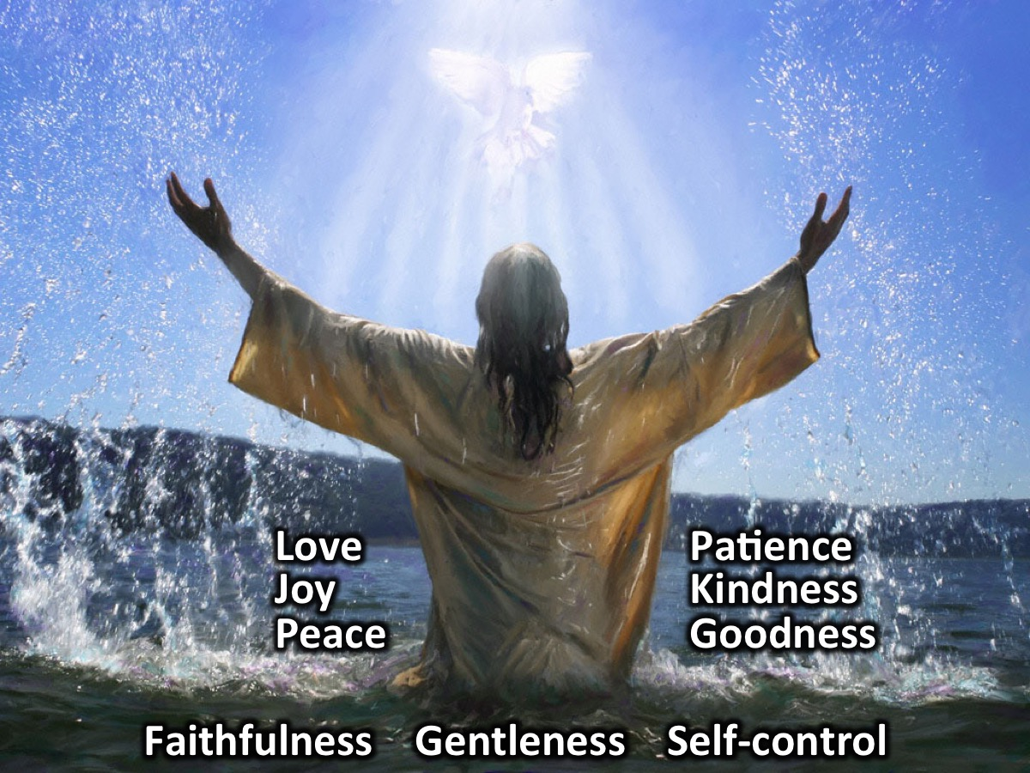
Notes:
Jesus is an excellent example of someone how showed all 9 of the fruit in his life fully!
[Have teens reflect on how Jesus showed the fruit of the Spirit]

Slide 31
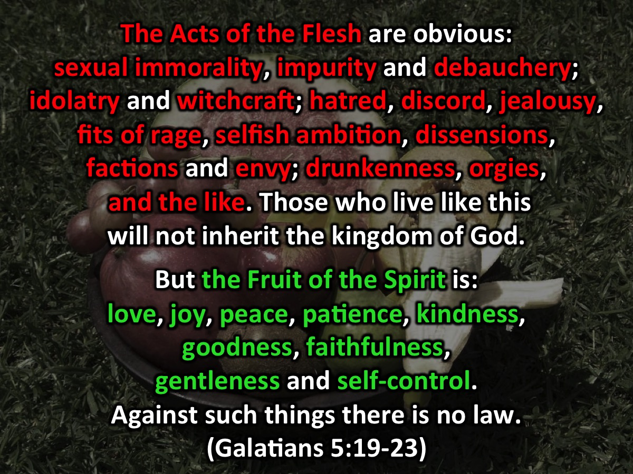
Notes:
The acts of the flesh are very different to the fruit of the spirit - lets go back to Galatians 5: “The Acts of the Flesh are obvious: sexual immorality, impurity and debauchery; idolatry and witchcraft; hatred, discord, jealousy, fits of rage, selfish ambition, dissensions, factions and envy; drunkenness, orgies, and the like. Those who live like this will not inherit the kingdom of God.”

Slide 32

Notes:
Here are some of the acts of the flesh from that passage in Galatians 5.

Slide 33
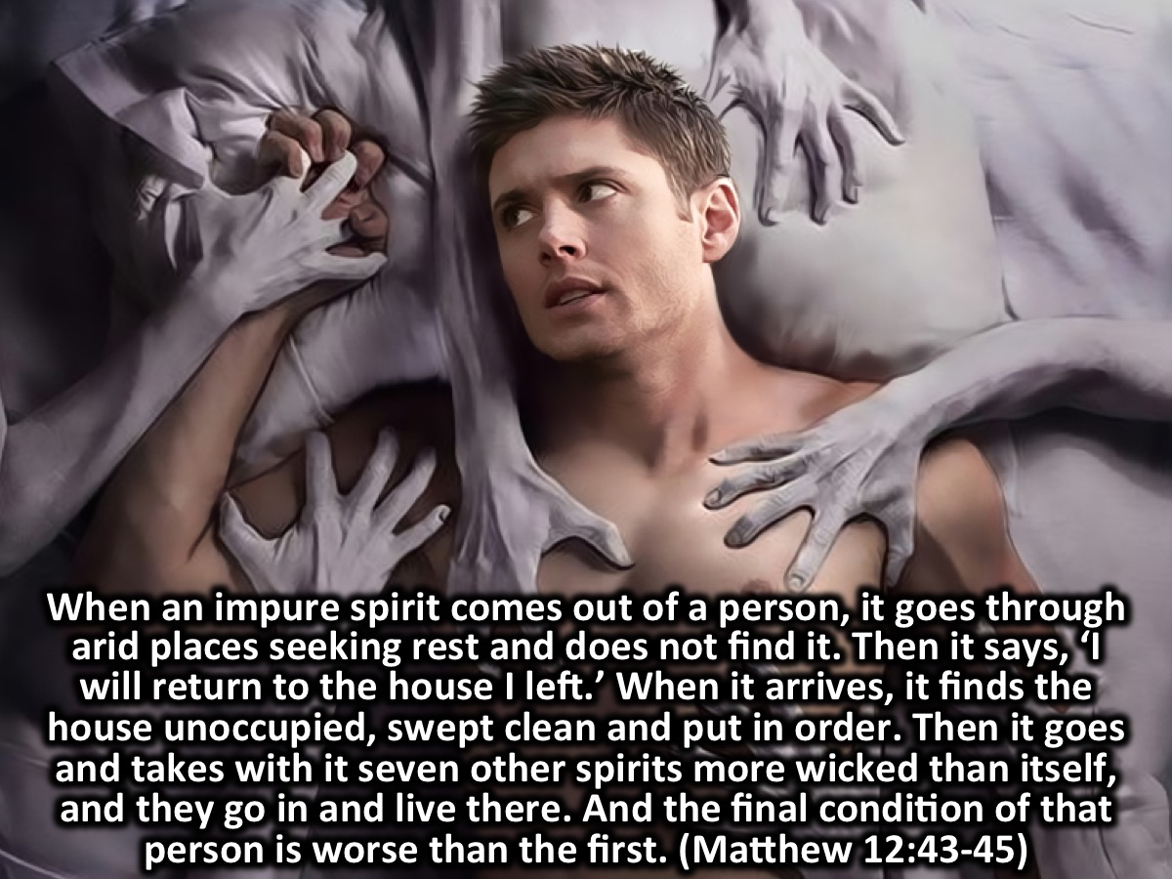
Notes:
We must keep the Holy Spirit in our lives: “When an impure spirit comes out of a person, it goes through arid places seeking rest and does not find it. Then it says, ‘I will return to the house I left.’ When it arrives, it finds the house unoccupied, swept clean and put in order. Then it goes and takes with it seven other spirits more wicked than itself, and they go in and live there. And the final condition of that person is worse than the first.” (Matthew 12:43-45)

Slide 34
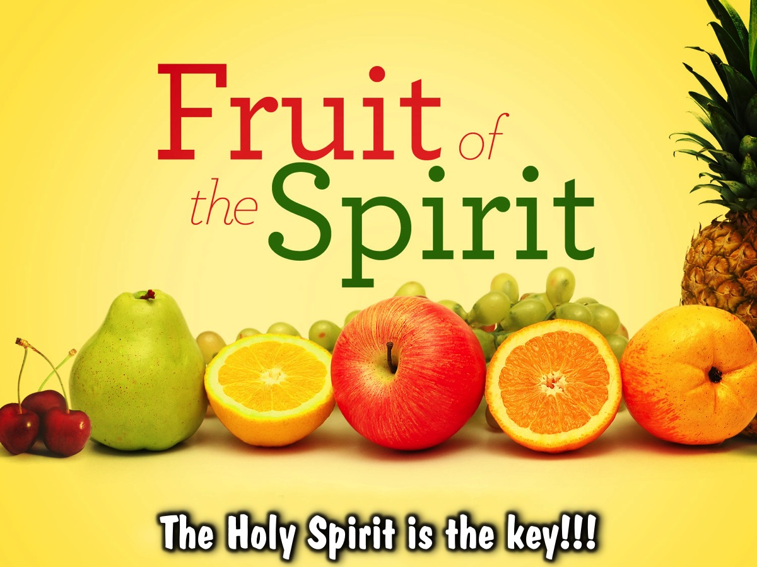
Notes:
We will avoid having the fruits of the flesh by having the Holy Spirit!

Slide 35
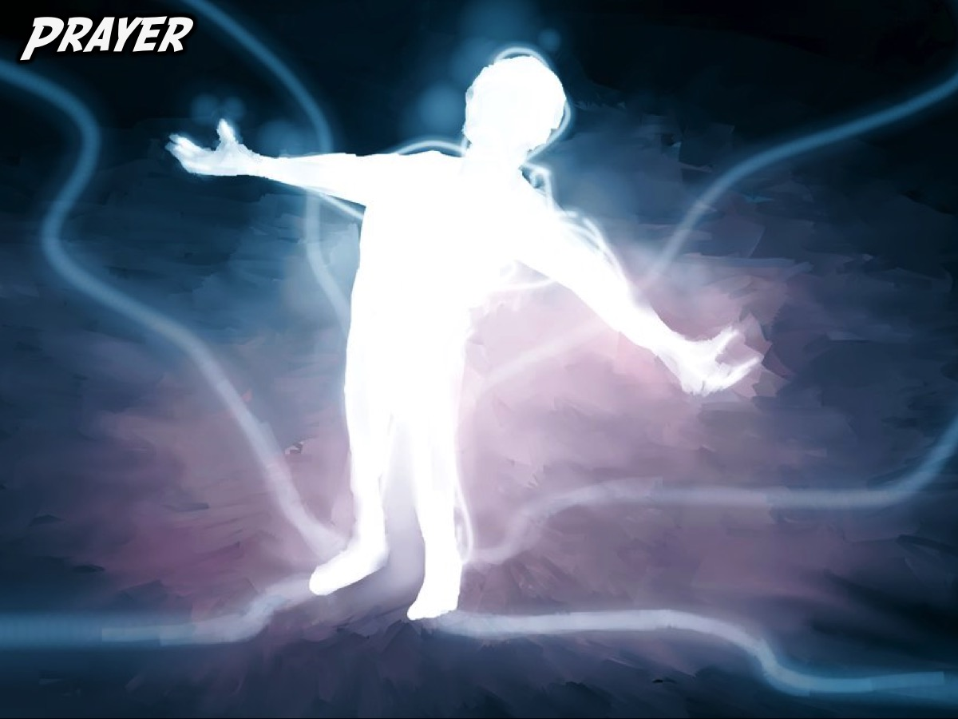
Notes:
Prayer: Let’s ask God by His Holy Spirit to produce the fruit of the Holy Spirit in our lives!

Slide 36

Notes:
Next week we are going to answer the question: What are His Gifts?

