Slide 1

Notes:
Welcome to week 3 of The Spirit Series at His Youth.

Slide 2

Notes:
In Week 1 we looked at who the Holy Spirit is.

Slide 3
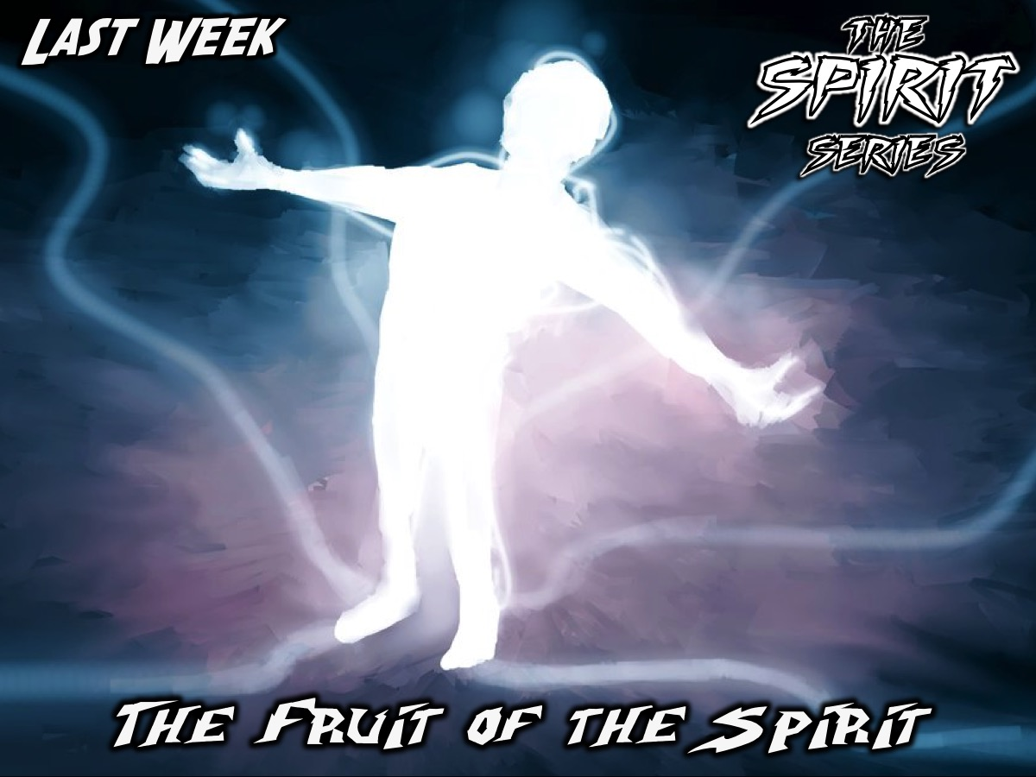
Notes:
Last week we looked at the fruit of the Spirit.

Slide 4

Notes:
This week we are going to explore the gifts of the Spirit.

Slide 5
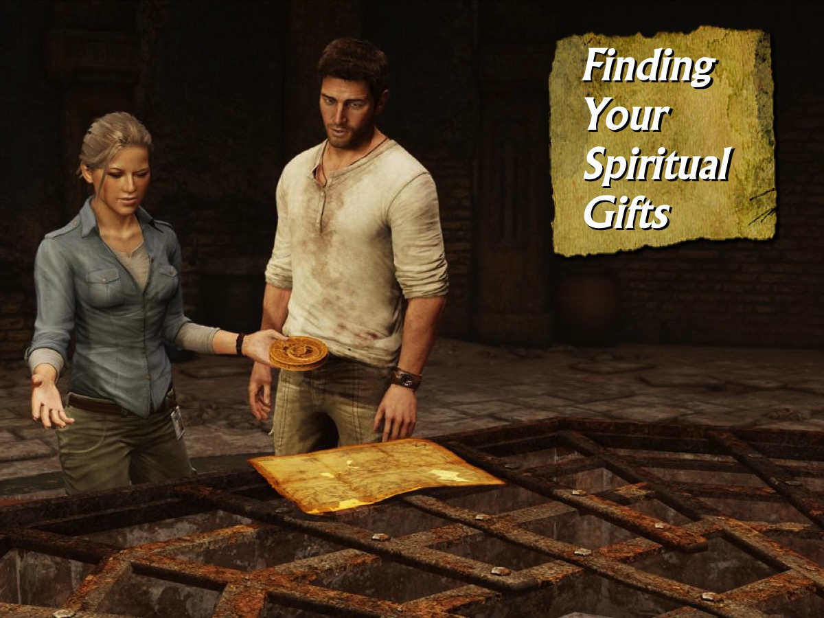
Notes:
Finding Your Gifts. How many of you actually know what your spiritual gifts are? Some of you may say: “What are spiritual gifts?” and some may even say, “I have spiritual gifts?” Yes you do!

Slide 6

Notes:
Blind-Fold Activity: One person in the group has to recreate a sequence of candy (liquorice allsorts) which they do not see before they are blind-folded. The other 7 members of the group help by each using just one of these abilities: Question, Answer, Encourage, Touch, Correct, Comfort or Strategize. They are not allowed to touch the candy or the person’s hands. Allow time for the groups to plan how they will individually and corporately guide the blind folded person to complete the task using their unique abilities and then give them time to do the activity.

Slide 7
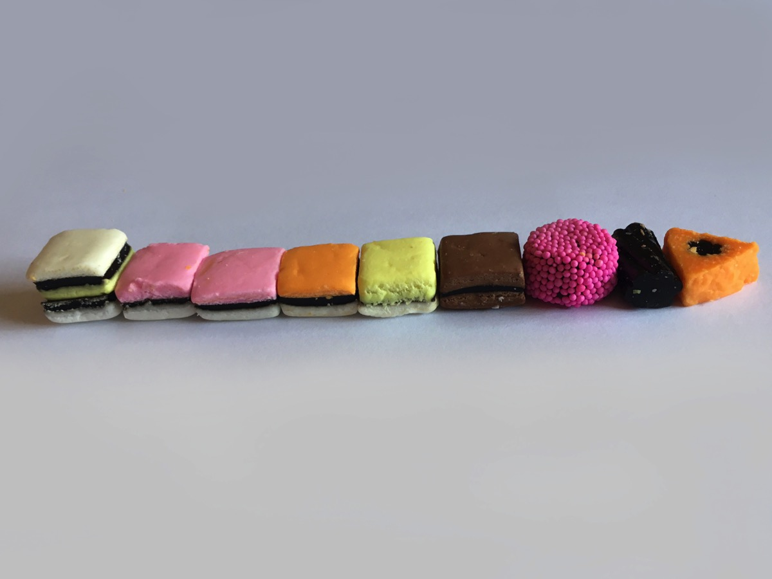
Notes:
Here is the sequence of liquorice they have to create.

Slide 8

Notes:
Allow time for the activity and then debrief with this question: What did you learn from the game about using your gifts and working together?

Slide 9
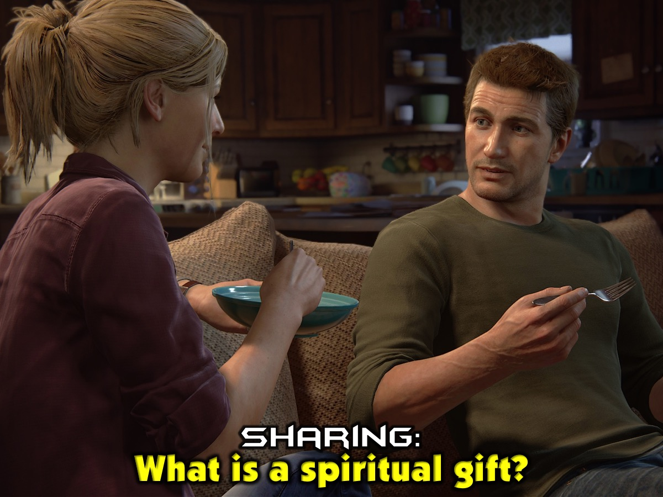
Notes:
Sharing: Turn to the person next to you and ask them: “What is a spiritual gift?

Slide 10
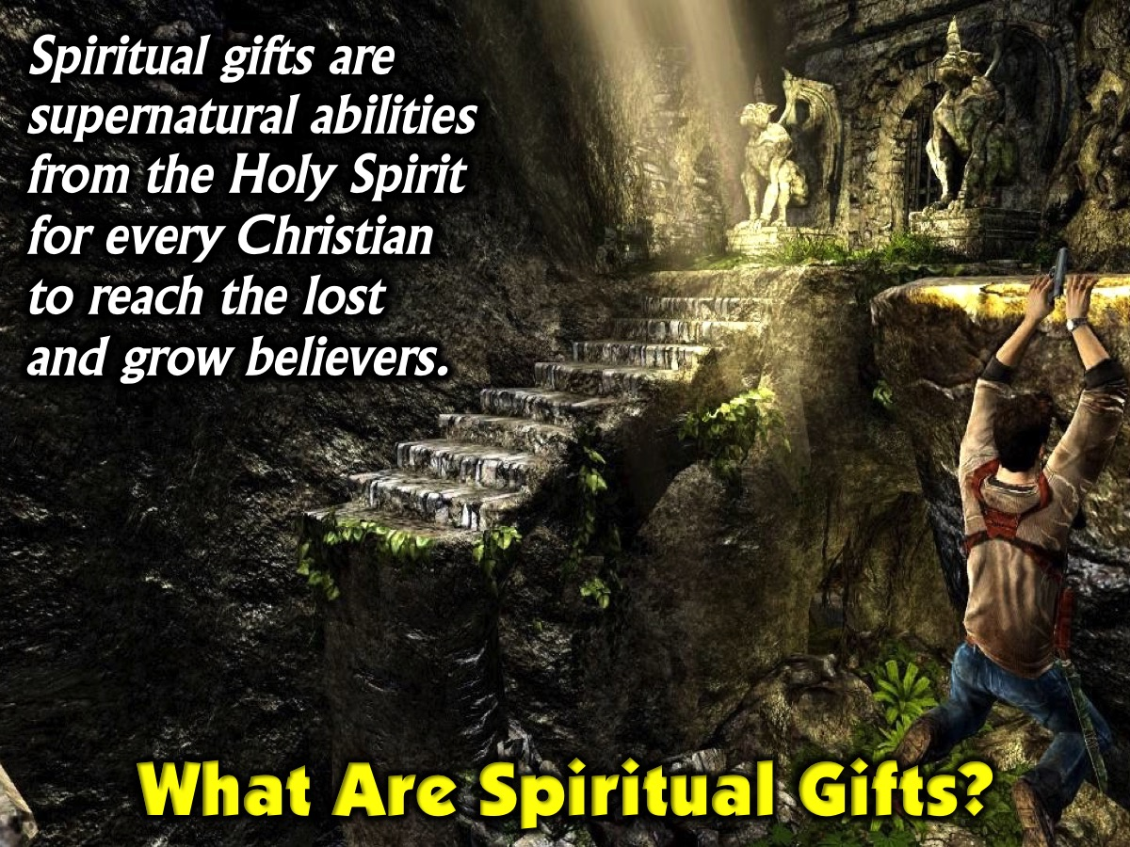
Notes:
Before we get really practical let’s answer some questions about spiritual gifts.
What are spiritual gifts? Spiritual gifts are supernatural abilities from the Holy Spirit for every Christian to reach the lost and grow believers.

Slide 11
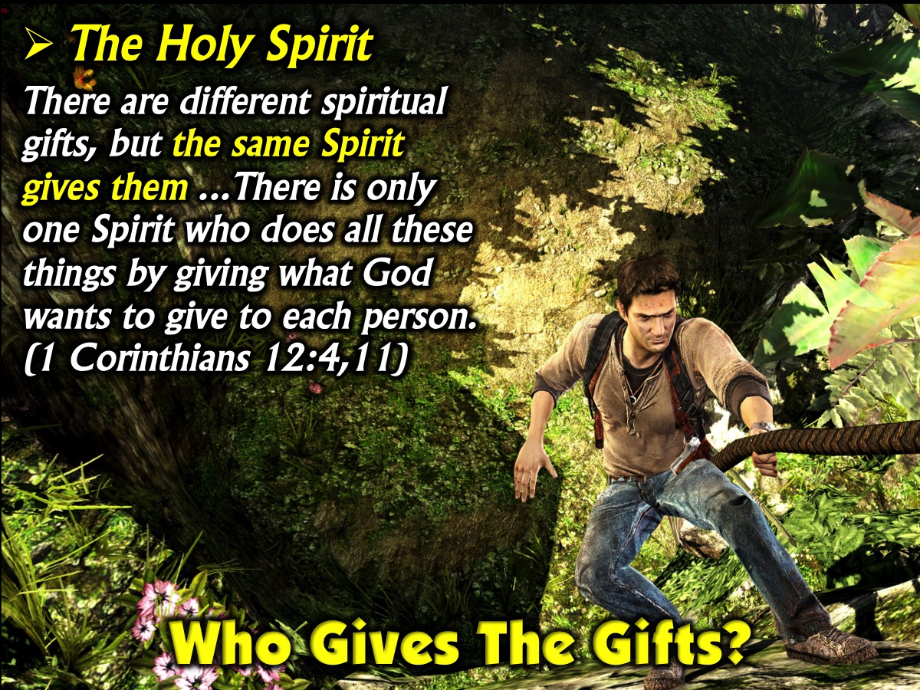
Notes:
Who Gives The Gifts? The Holy Spirit. “There are different spiritual gifts, but the same Spirit gives them...There is only one Spirit who does all these things by giving what God wants to give to each person.’ (1 Corinthians 12:4,11)

Slide 12
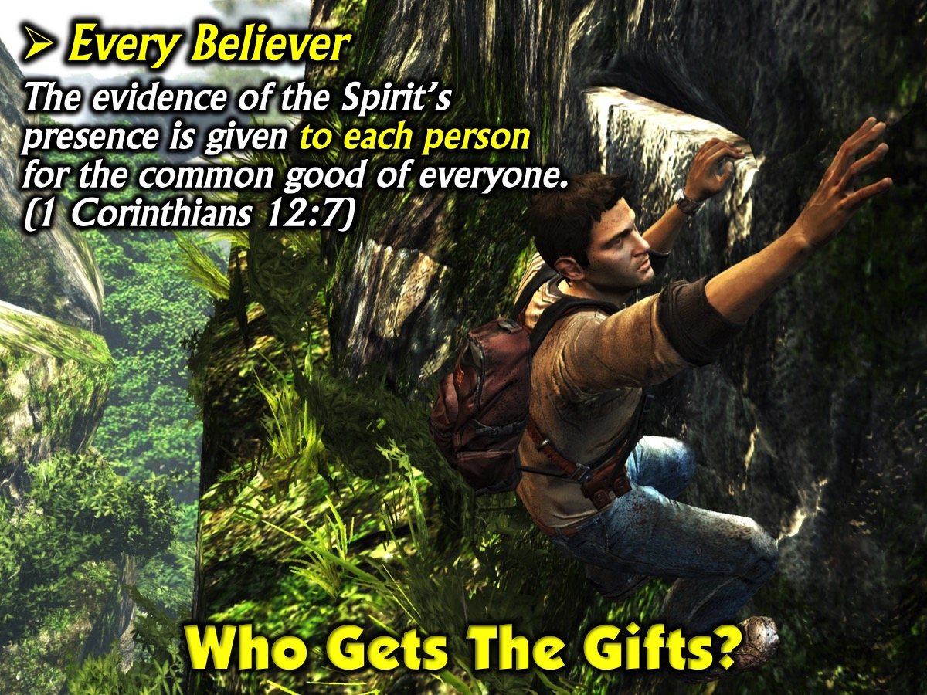
Notes:
Who Gets The Gifts? Every Believer is given gifts! “The evidence of the Spirit’s presence is given to each person for the common good of everyone”. (1 Corinthians 12:7)

Slide 13
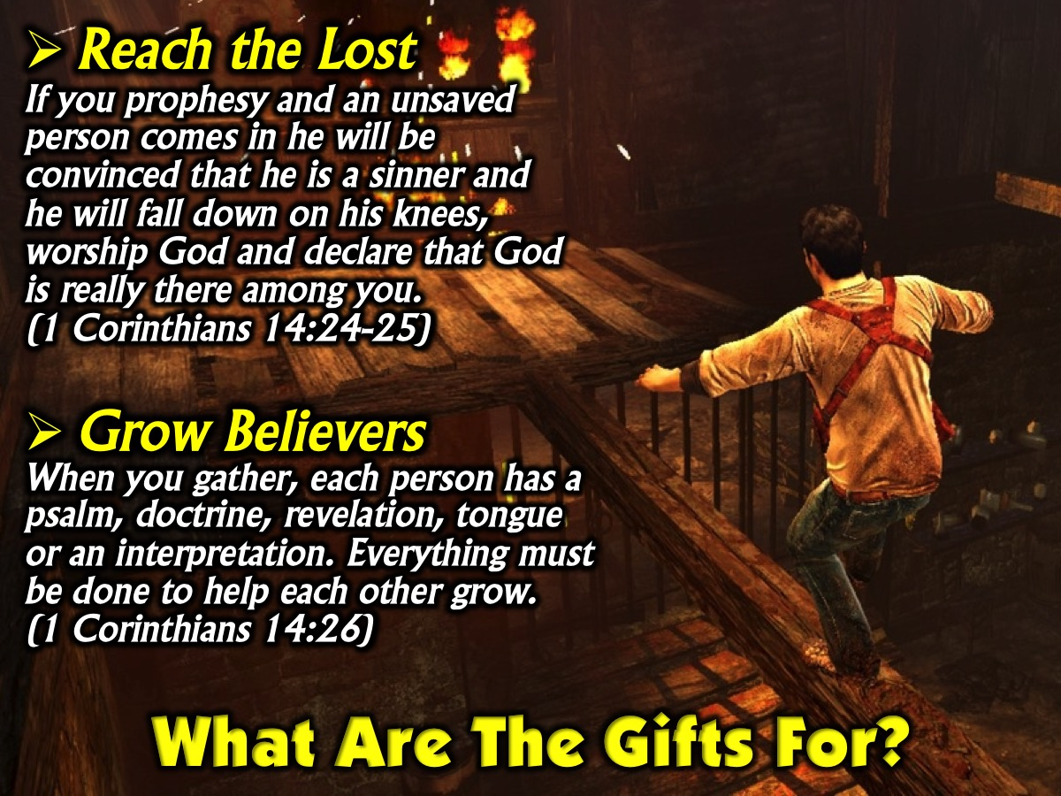
Notes:
What are the Gifts For? (1) Reach the Lost – “If you prophesy and an unsaved person comes in he will be convinced that he is a sinner and he will fall down on his knees, worship God and declare that God is really there among you.” (1 Corinthians 14:24-25). (2) Grow Believers – “When you gather, each person has a psalm, doctrine, revelation, tongue or an interpretation. Everything must be done to help each other grow.” (1 Corinthians 14:26)

Slide 14
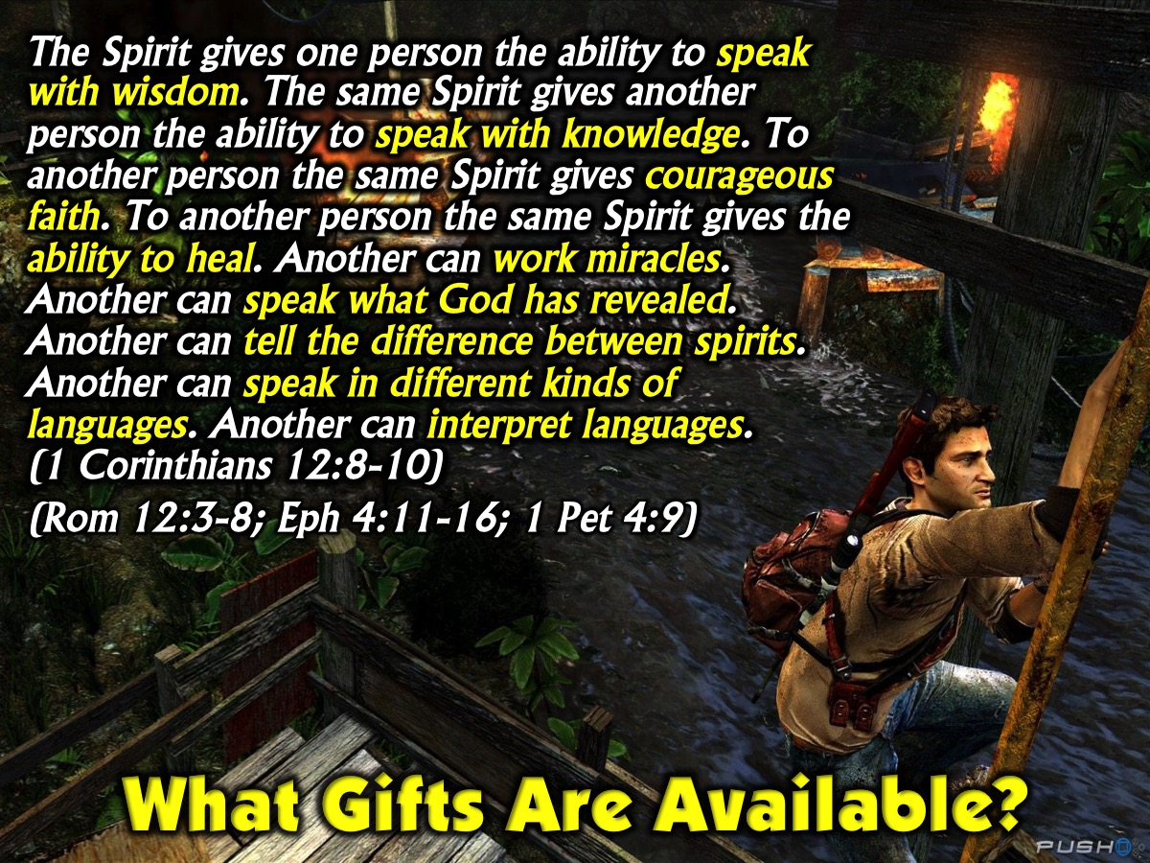
Notes:
What gifts are available? This passage in 1 Corinthians 12 mentions 9 different gifts: wisdom, knowledge, faith, healing, miracles, prophesying, discernment, tongues and interpreting tongues. There are other passages in the Bible that present lists of spiritual gifts (1 Corinthians 12:8-10 and 28-30; Romans 12:3-8; Ephesians 4:11-16 and 1 Peter 4:9).

Slide 15
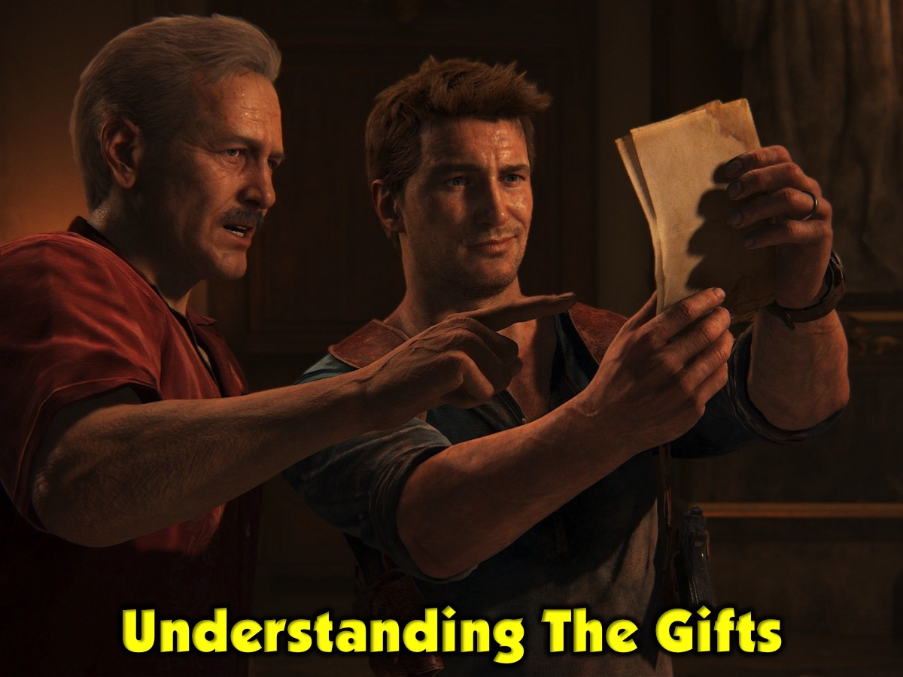
Notes:
Understanding the Gifts: Let me briefly define each of the gifts.

Slide 16

Notes:
1. Administration: To provide practical support to leaders or ministries. (1 Corinthians 12:28; Luke 14:28-30; Acts 6:1-7; 27:11; Titus 1:5)

Slide 17
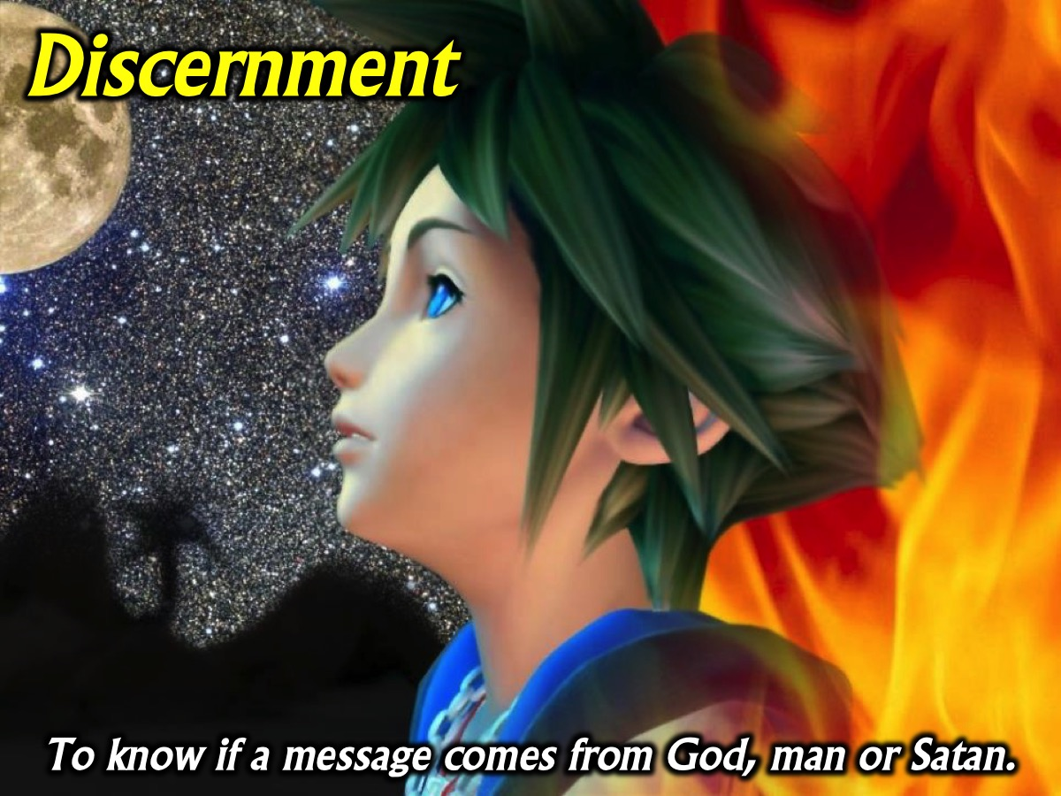
Notes:
2. Discernment: To know if a message comes from God, man or Satan. (1 Corinthians 12:10; Matthew 16:21-23; Acts 5:1-11; 16:16-18; 1 John 4:1-6)

Slide 18

Notes:
3. Encouragement: To share a word of encouragement with somebody. (Romans 12:8; Timothy 4:13; Hebrews 10:25; Acts 14:22)

Slide 19
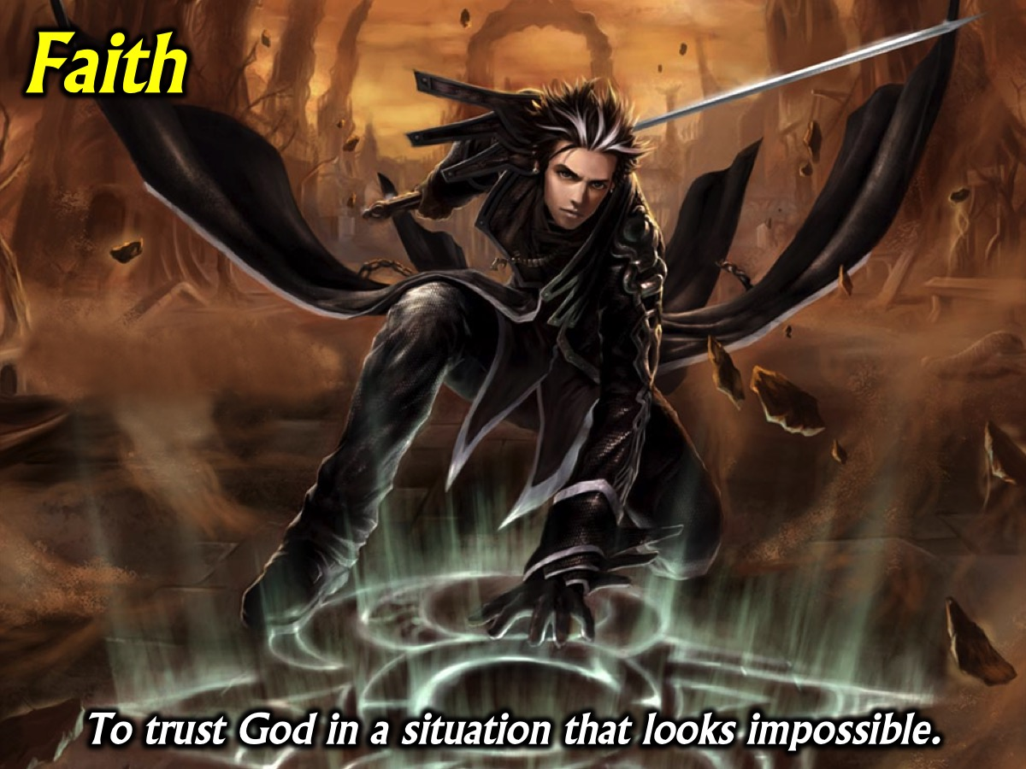
Notes:
4. Faith: To trust God in a situation that looks impossible. (1 Corinthians 12:9; Acts 11:22-24; 27:21-25; Hebrews 11; Romans 4:18-21)

Slide 20
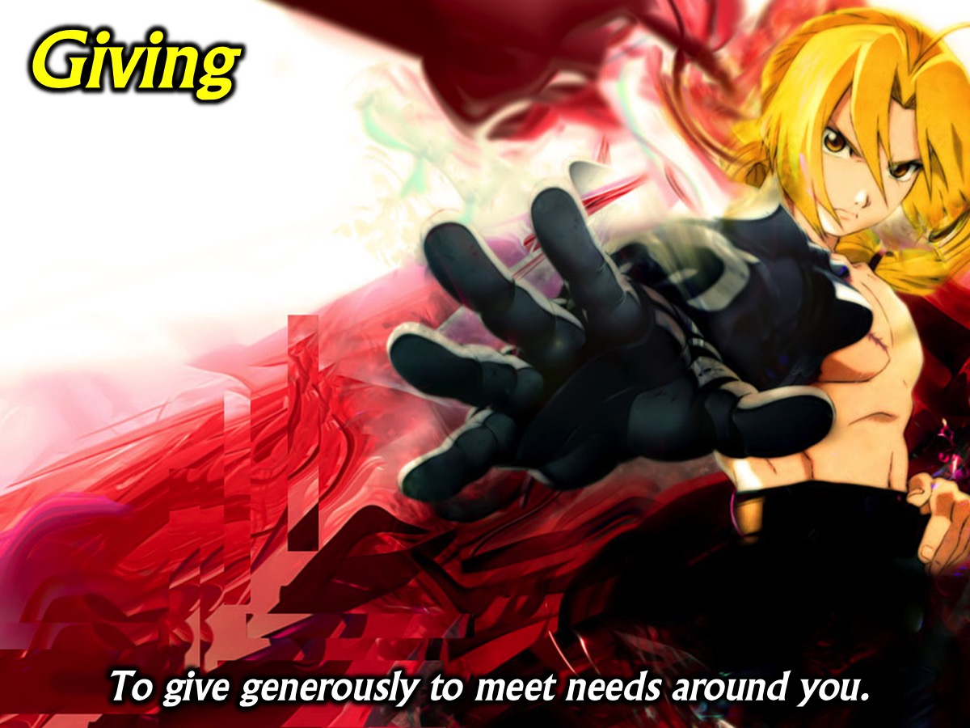
Notes:
5. Giving: To give generously to meet needs around you. (Romans 12:8; 2 Corinthians 8:1-7; 9:2-8; Mark 12:41-44)

Slide 21
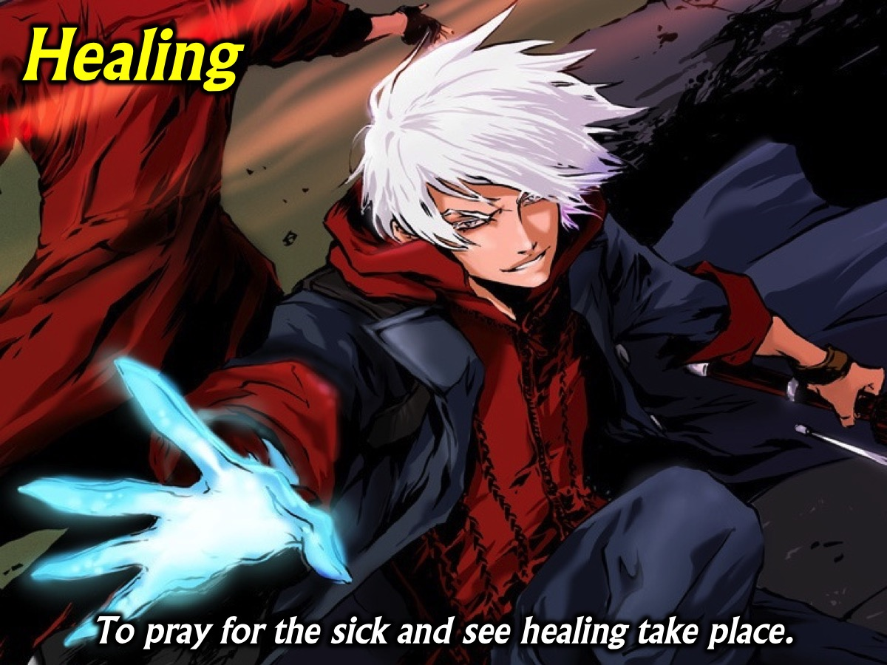
Notes:
6. Healing: To pray for the sick and see healing take place (1 Corinthians 12:9, 28; Acts 3:1-10; 5:12-16; Acts 9:32-35; 28:7-10)

Slide 22

Notes:
7. Helps: To help others reach their potential and achieve goals. (1 Corinthians 12:28; Romans 16:1-2; Acts 9:36; Luke 8:23; Mark 15:40-41)

Slide 23

Notes:
8. Leadership: To help people work together to do God’s work. (1 Timothy 5:17; Acts 7:10; 15:7-11; Romans 12:8; Hebrews 13: 17; Luke 9:51)

Slide 24
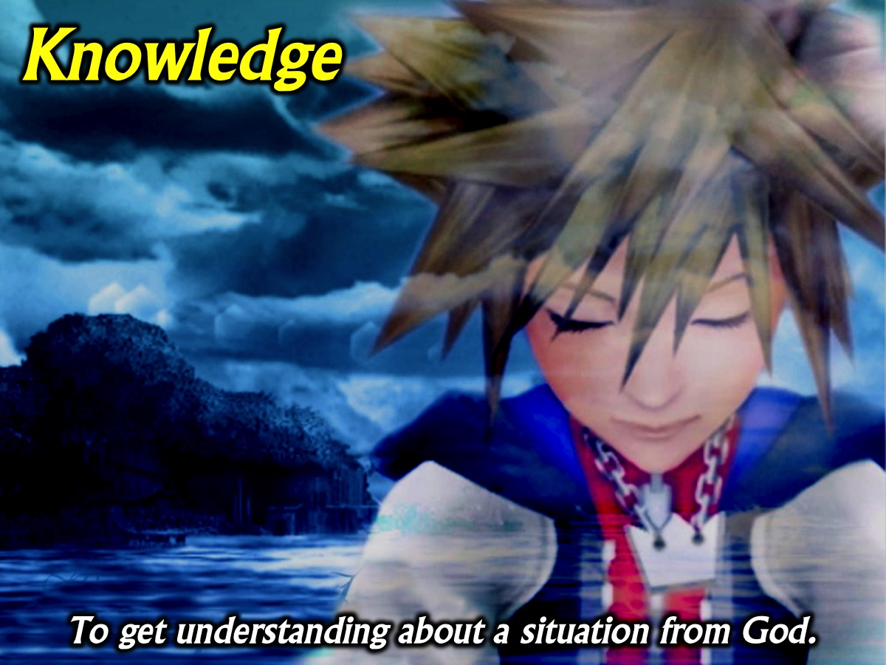
Notes:
9. Knowledge: To get understanding about a situation from God. (1 Corinthians 2:14; 12:8; Acts 5:1-11; Colossians 2:2-3; 2 Corinthians 11:6)

Slide 25
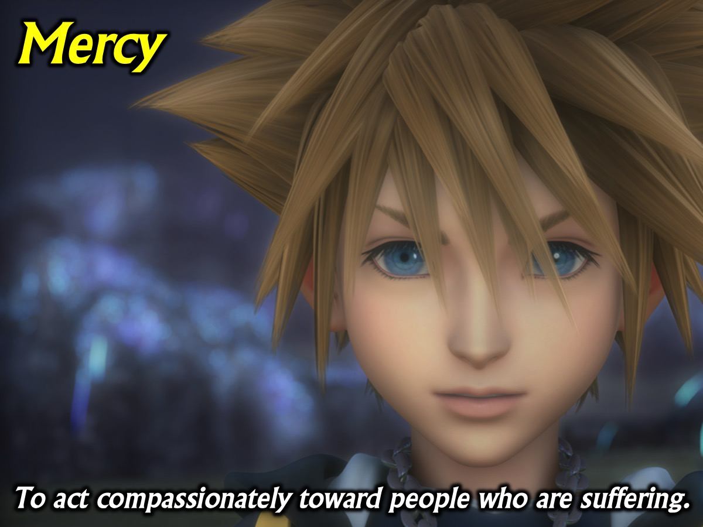
Notes:
10. Mercy: To act compassionately toward people who are suffering. (Romans 12:8; Mark 9:41; Acts 11:28-30; 16:33-34; Luke 10:33-35; Matthew 20:29-34; 25:34-40)

Slide 26
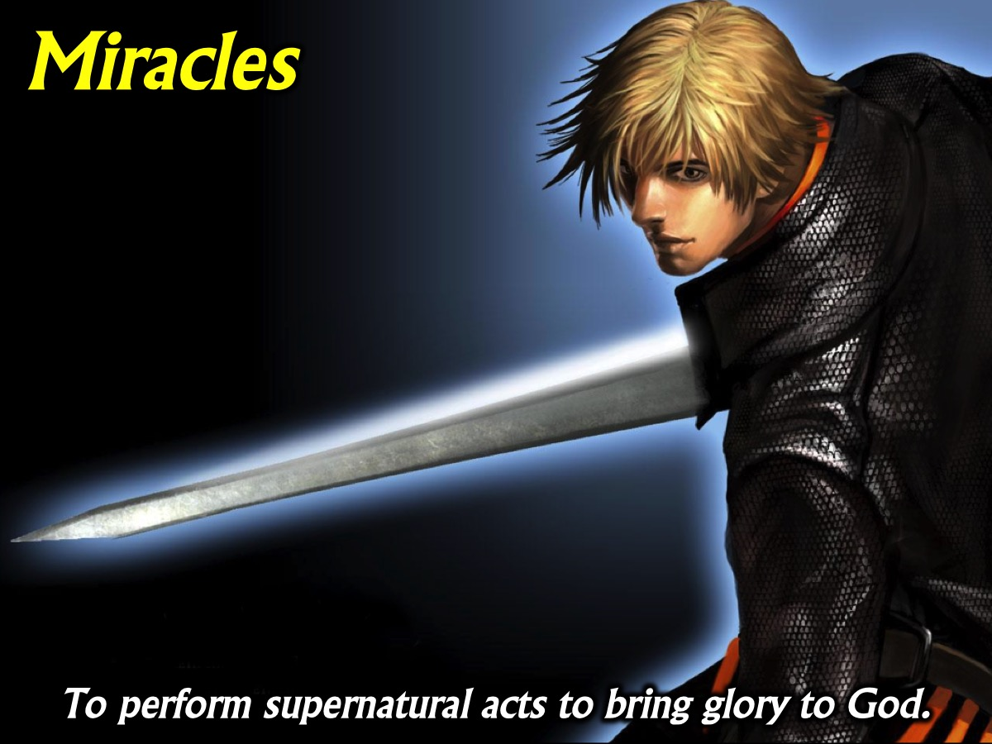
Notes:
11. Miracles: To perform supernatural acts to bring glory to God. (1 Corinthians 12:10, 28; Acts 9:36-42; 19:11-20; Acts 20:7-12; Romans 15:18-19; 2 Corinthians 12:12)

Slide 27
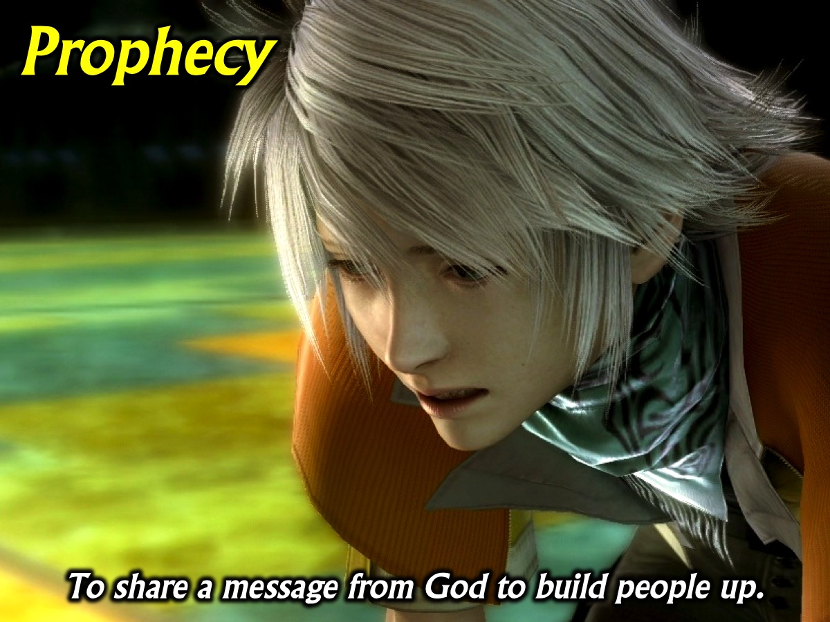
Notes:
12. Prophecy: To share a message from God to build people up. (1 Corinthians 12:10,28; Ephesians 4:11-14; Romans 12:6; Luke 7:26; Acts 15:32; 21:9-11)

Slide 28
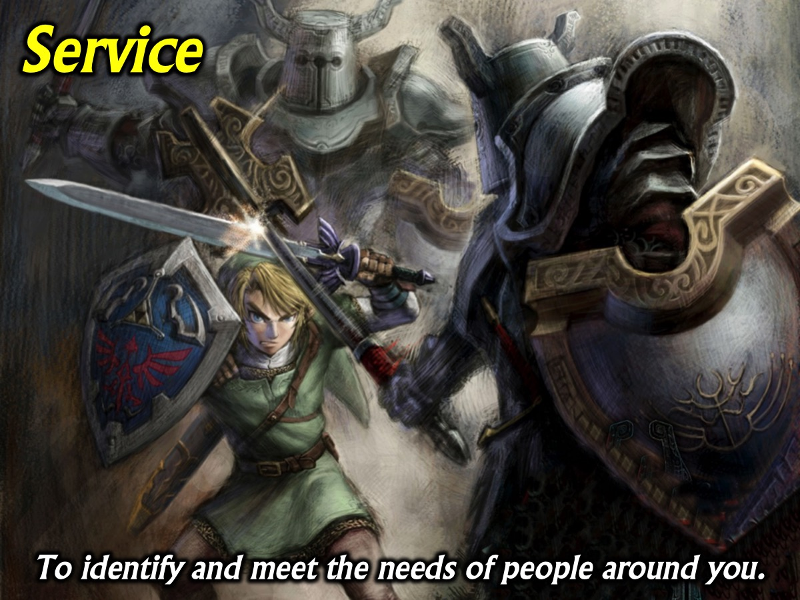
Notes:
13. Service: To identify and meet the needs of people around you. (2 Timothy 1:16-18; Romans 12:7; Acts 6:1-7; Titus 3:14; Galatians 6:2, 10)

Slide 29

Notes:
14. Teaching: To communicate Gods Word so others understand. (1 Corinthians 12:28; Ephesians 4:11-14; Romans 12:7; Acts 18:24-28; 20:20-21)

Slide 30

Notes:
15. Wisdom: To share wise insights so people know how to act. (1 Corinthians 2:1-3; 12:8; Acts 6:3,10; James 1:5-6; 2 Peter 3:15-16)

Slide 31

Notes:
How do you find your Spiritual Gifts?

Slide 32

Notes:
1. Through Experience. As we look for ways to be helpful in the body of Christ we will discover that there are certain gifts that we have been given and that we can practise and develop.

Slide 33
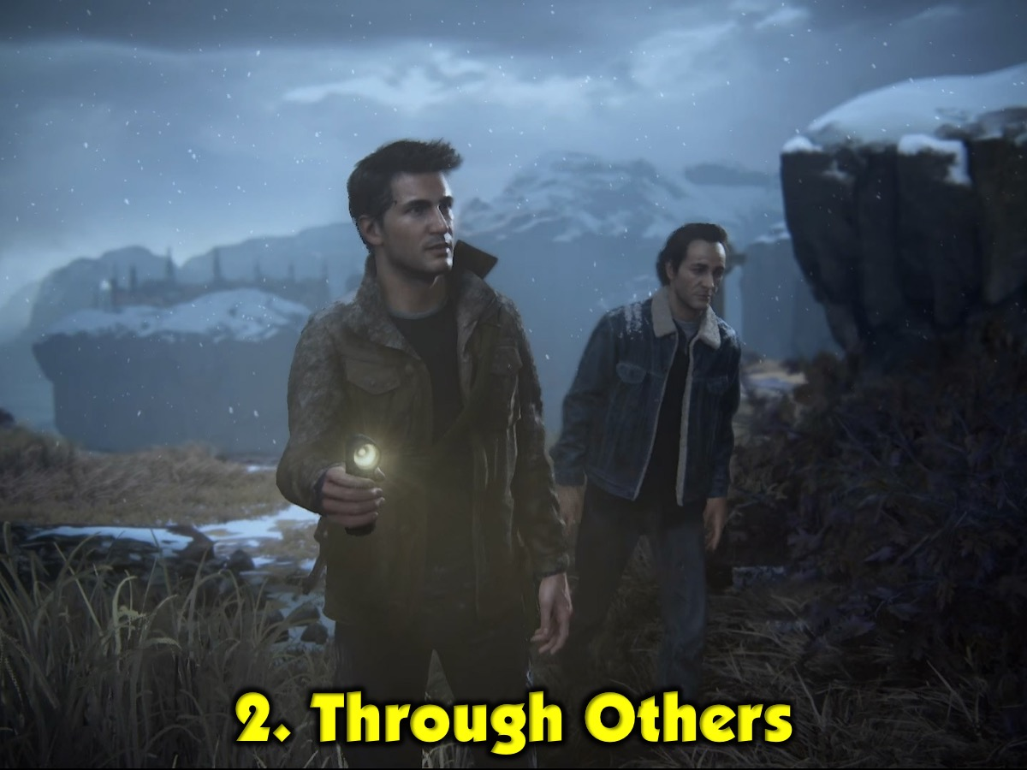
Notes:
2. Through Others. Often people can identify gifts in us that can be activated either through practise of the laying on of hands.

Slide 34

Notes:
Paper-Fold Activity: Each person is given a piece of paper and they write their name on the top – and pass it around the group. Each person writes on the paper (starting at the bottom of the page and not the top) how they believe that God has gifted the person and then folds the paper over what they have written before passing it on. When each person has written a sentence or some words on the paper the group members can reflect on what has been written.

Slide 35
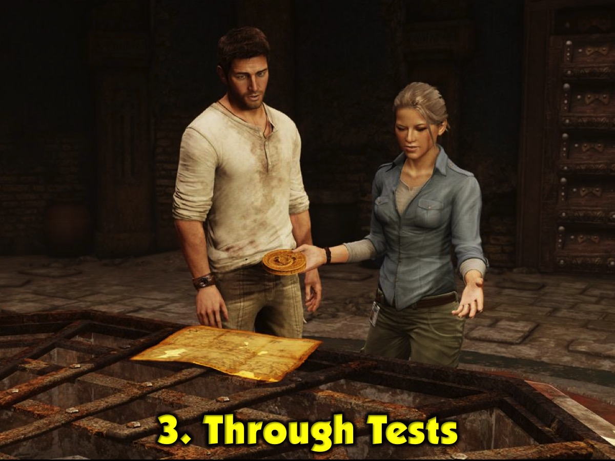
Notes:
3. Through Tests. One of the best ways to find your gifts is to take a gifts test. Take one of the handouts and work through the Gifts Test. First answer each question in the 5 categories with a score from 0 to 3 (where 0 is Never, 1 is Sometimes, 2 is Often and 3 is A Lot). You will see brackets at the end of each sentence – find the scores for each of the 15 different gifts and transfer them to the boxes on the second page and then add each line up to get a Total. On the bottom of the page write a list of your top three spiritual gifts.

Slide 36

Notes:
How do you Grow your Gifts? (1) Practise: People sometimes tell me that they think I am pretty good as a preacher. Do you know that I preached my first sermon when I was 15 and my knees were knocking and I think it was not a very good sermon. I had to practice, practice and practice some more, to develop my skills as a preacher. (2) Feedback: Ask people to evaluate your use of a gift and for ways in which they think you can improve. (3) Prayer: Ask God to increase the effectiveness of the gift that He is working through you.

Slide 37
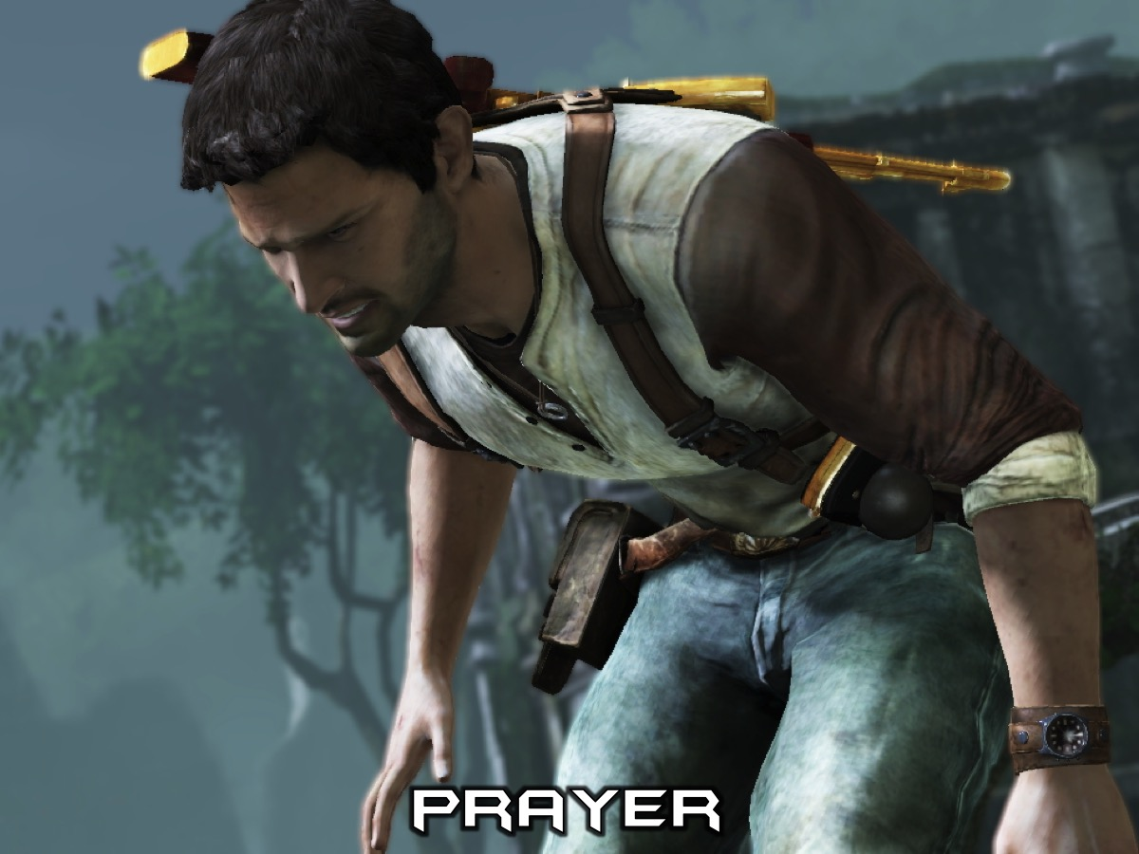
Notes:
Prayer

Slide 38

Notes:
Next Sunday we end the Spirit series with a special guest who is going to lead us into an experience of being filled with the Spirit.

