Slide 1

Notes:
Welcome to week 4 of The Spirit Series at His Youth.

Slide 2

Notes:
In week 1 we looked at who the Holy Spirit is.

Slide 3

Notes:
In Week 2 we looked at the fruit of the Spirit.

Slide 4

Notes:
Last week we looked at the gifts of the Spirit.

Slide 5

Notes:
This week we are going to look at the filling of the Spirit.
Nothing can fill the vacuum in our soul - only Jesus can do that! Philippians 1:6 - if God has started a work in us he is able to complete the work! God does not only want us to be converts - but disciples! He wants us to make disciples - so he has sent us his Holy Spirit. God wants us to be his witnesses - for our ministry to be filled with signs and wonders!

Slide 6
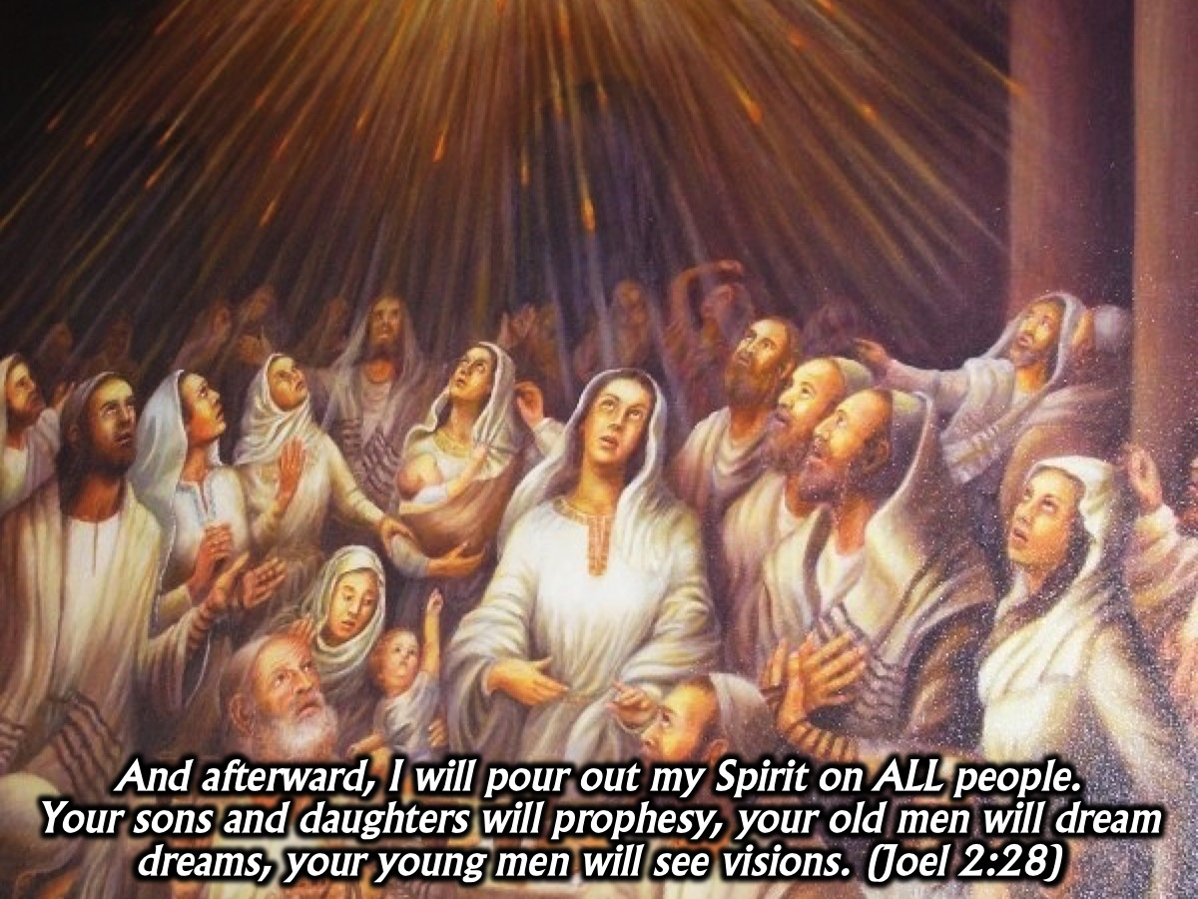
Notes:
Jesus said, Repent and be Baptised and be filled for Service. God’s love for us is the basis of our relationship with the Holy Spirit. When I love someone, I follow that love up with action - as we read in Joel 2:28: And afterward, I will pour out my Spirit on ALL people. Your sons and daughters will prophesy, your old men will dream dreams, your young men will see visions. (Joel 2:28). God is a God of promise. Peter said: This is that which was promised by the father. We all want to look sharp on the outside - have a six-pack - ladies want a good looking guys. Sometimes there is a promise that is made but it is not kept. We try and equate the promises of God with the promises of our loved ones which are not always kept. But God is different.

Slide 7

Notes:
It's God desire. How do we reconcile this with people who break their promise. But God is different! Sometimes we trust our parents will be together for ever and they let us down. We end up hiding what we are feeling inside. Min Shaw sang: “No one knows what a simile can conceal. Only God knows what a young heart can conceal.” God’s desire is to bless his children - to give us good gifts. God promises to never leave us or forsake us! Numbers 23:19 - God is not as a man that he should live. Our earthly fathers withhold gifts when we do wrong. God is not like that! We qualify for God’s gifts because of what Jesus did on the cross. All I have to do is A.S.K.

Slide 8

Notes:
It's the promise of the Father. No good thing will he withhold from them that walk uprightly. (Psalm 84:11). God wants us to do his business. He wants us to evangelise. One of his desires us to baptise us in the holy spirit with the evidence of speaking in tongues so that we can be witnesses. Acts 1:8. God is a good father. He keeps us from falling by baptising us in the Holy Spirit. In Luke 11 we read that earthly fathers are limited and subject to failures and yet if their children ask them for bread they will not give them a stone. So how much more will God give the Holy Spirit to those who ask for Him? Those of us who don’t have a good father experience think that God is unfaithful.

Slide 9
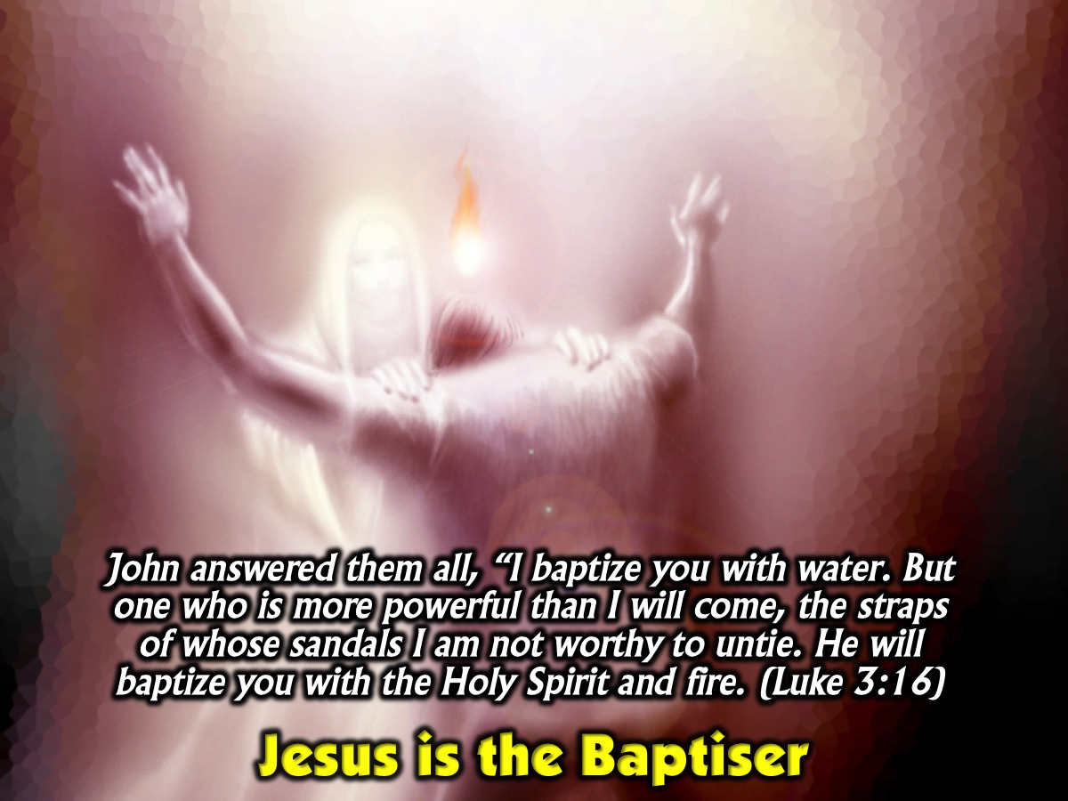
Notes:
Jesus is the Baptiser. John answered them all, “I baptize you with water. But one who is more powerful than I will come, the straps of whose sandals I am not worthy to untie. He will baptize you with the Holy Spirit and fire. (Luke 3:16). It is God’s pleasure to baptise us in the Holy Spirit. We don’t have to wait in an upper room anymore. It was like that in the book of Acts in the beginning but now all we need to do is ask God for the filling! Just surrender your heart to Jesus and he will empower you!

Slide 10

Notes:
The Holy Spirit is a down payment. He has also sealed us and given us the Spirit as a down payment in our hearts. (2 Corinthians 1:22)

Slide 11

Notes:
God wants to anoint the believer for acts of service

Slide 12

Notes:
He will lead and guide you into all truth. But when he, the Spirit of truth, comes, he will guide you into all the truth. He will not speak on his own; he will speak only what he hears, and he will tell you what is yet to come. (John 16:13)

Slide 13
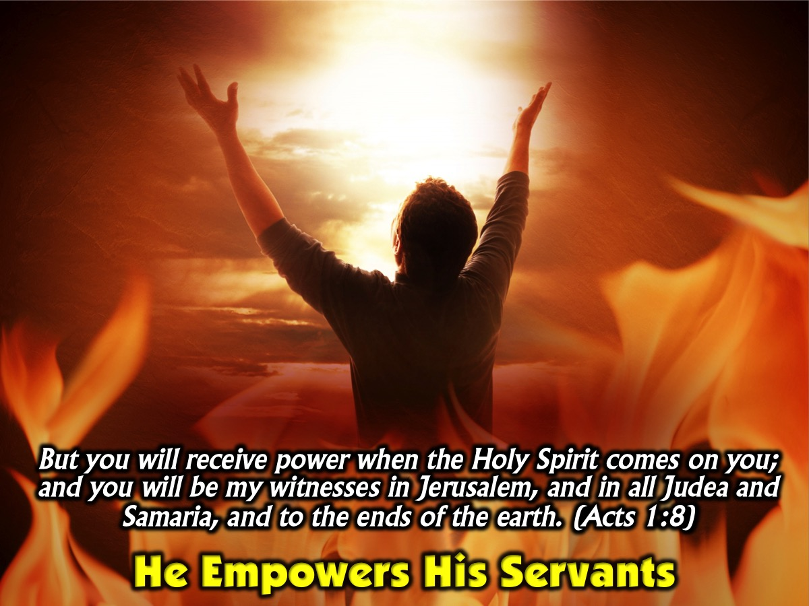
Notes:
He wants to empower all His servants. But you will receive power when the Holy Spirit comes on you; and you will be my witnesses in Jerusalem, and in all Judea and Samaria, and to the ends of the earth. (Acts 1:8)

Slide 14
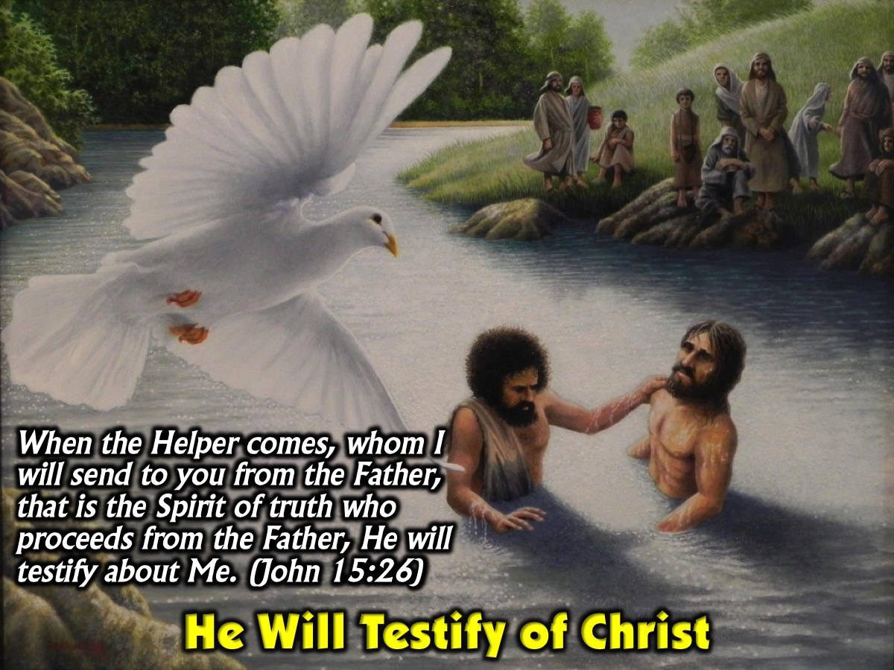
Notes:
He will testify of Christ. When the Helper comes, whom I will send to you from the Father, that is the Spirit of truth who proceeds from the Father, He will testify about Me. (John 15:26)

Slide 15
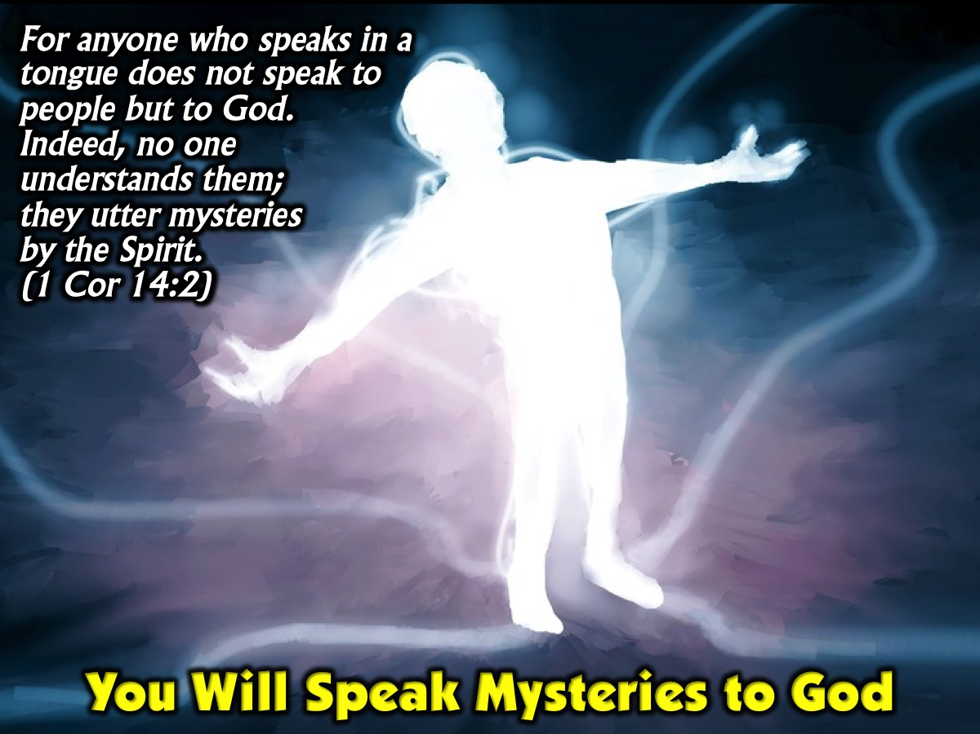
Notes:
You will be able to speak mysteries to God. For anyone who speaks in a tongue does not speak to people but to God. Indeed, no one understands them; they utter mysteries by the Spirit. (1 Corinthians 14:2)

Slide 16

Notes:
God is not a respecter of persons - It is His pleasure that all His children be filled!

Slide 17

Notes:
Prayer. As we stand let’s lift our hands and receive the filling of the Holy spirit. Come forward and we will pray that Jesus will baptise you with the Holy Spirit.

Slide 18

Notes:
Next Sunday we launch our brand new series: Hearing the Voice of God.

Slide 19

Notes:
Pastor Mark will kick off the series as he answers the question: Does God Speak Today?

