Slide 1

Notes:
Welcome to Sporty Friday.

Slide 2

Notes:
Tonight is Dodgeball Night!

Slide 3
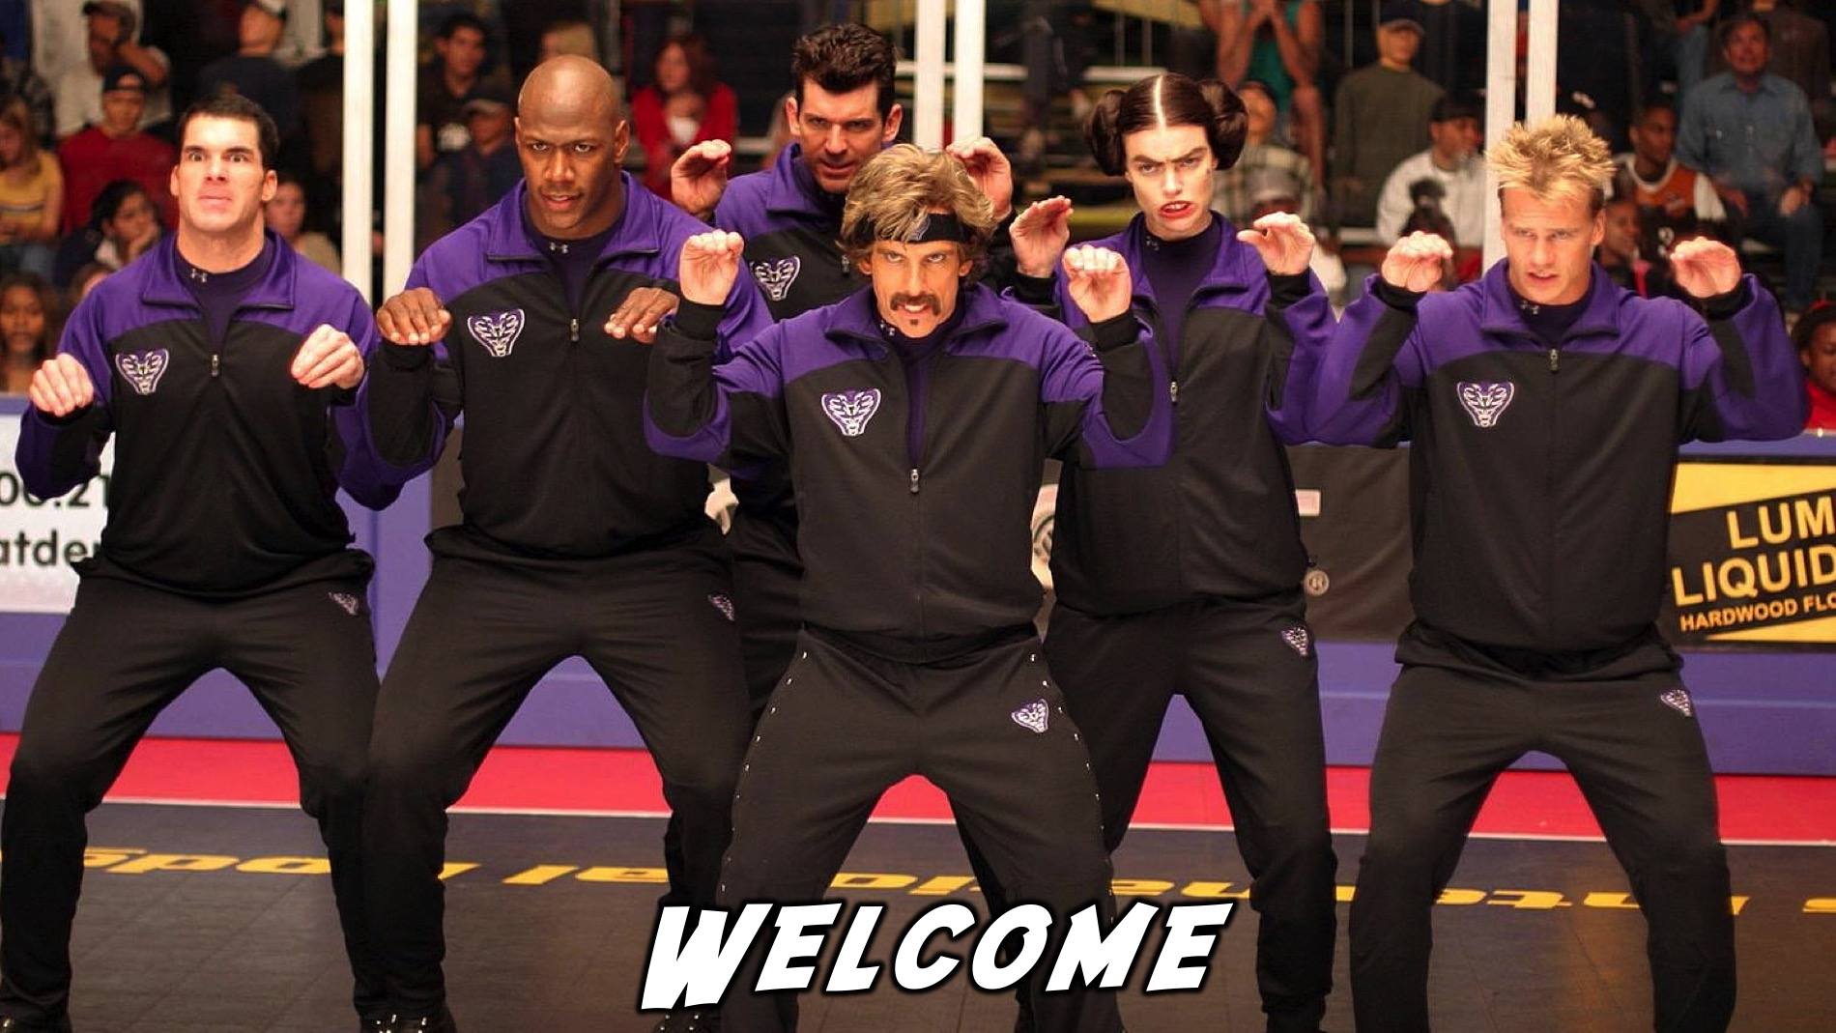
Notes:
Welcome to regulars and newcomers!

Slide 4
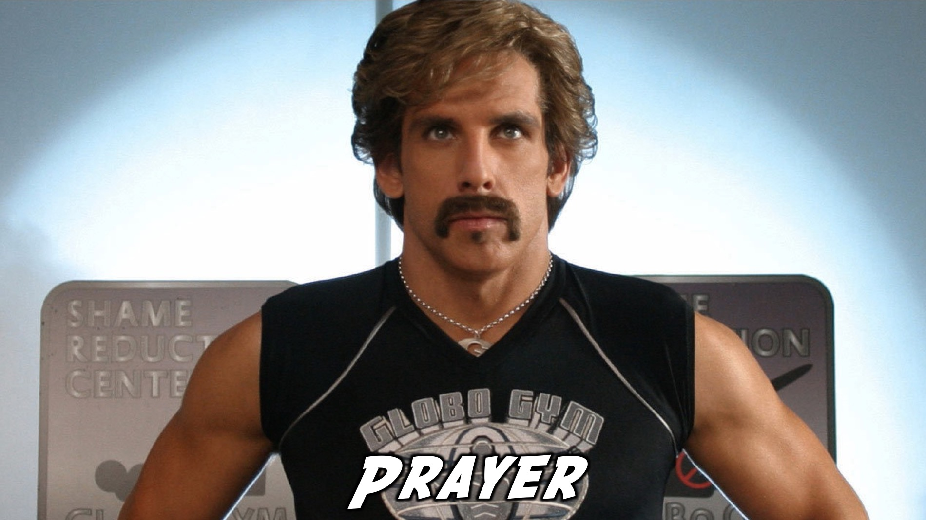
Notes:
Prayer: Let’s open our meeting in prayer.

Slide 5

Notes:
Please listen up for the following announcements!

Slide 6
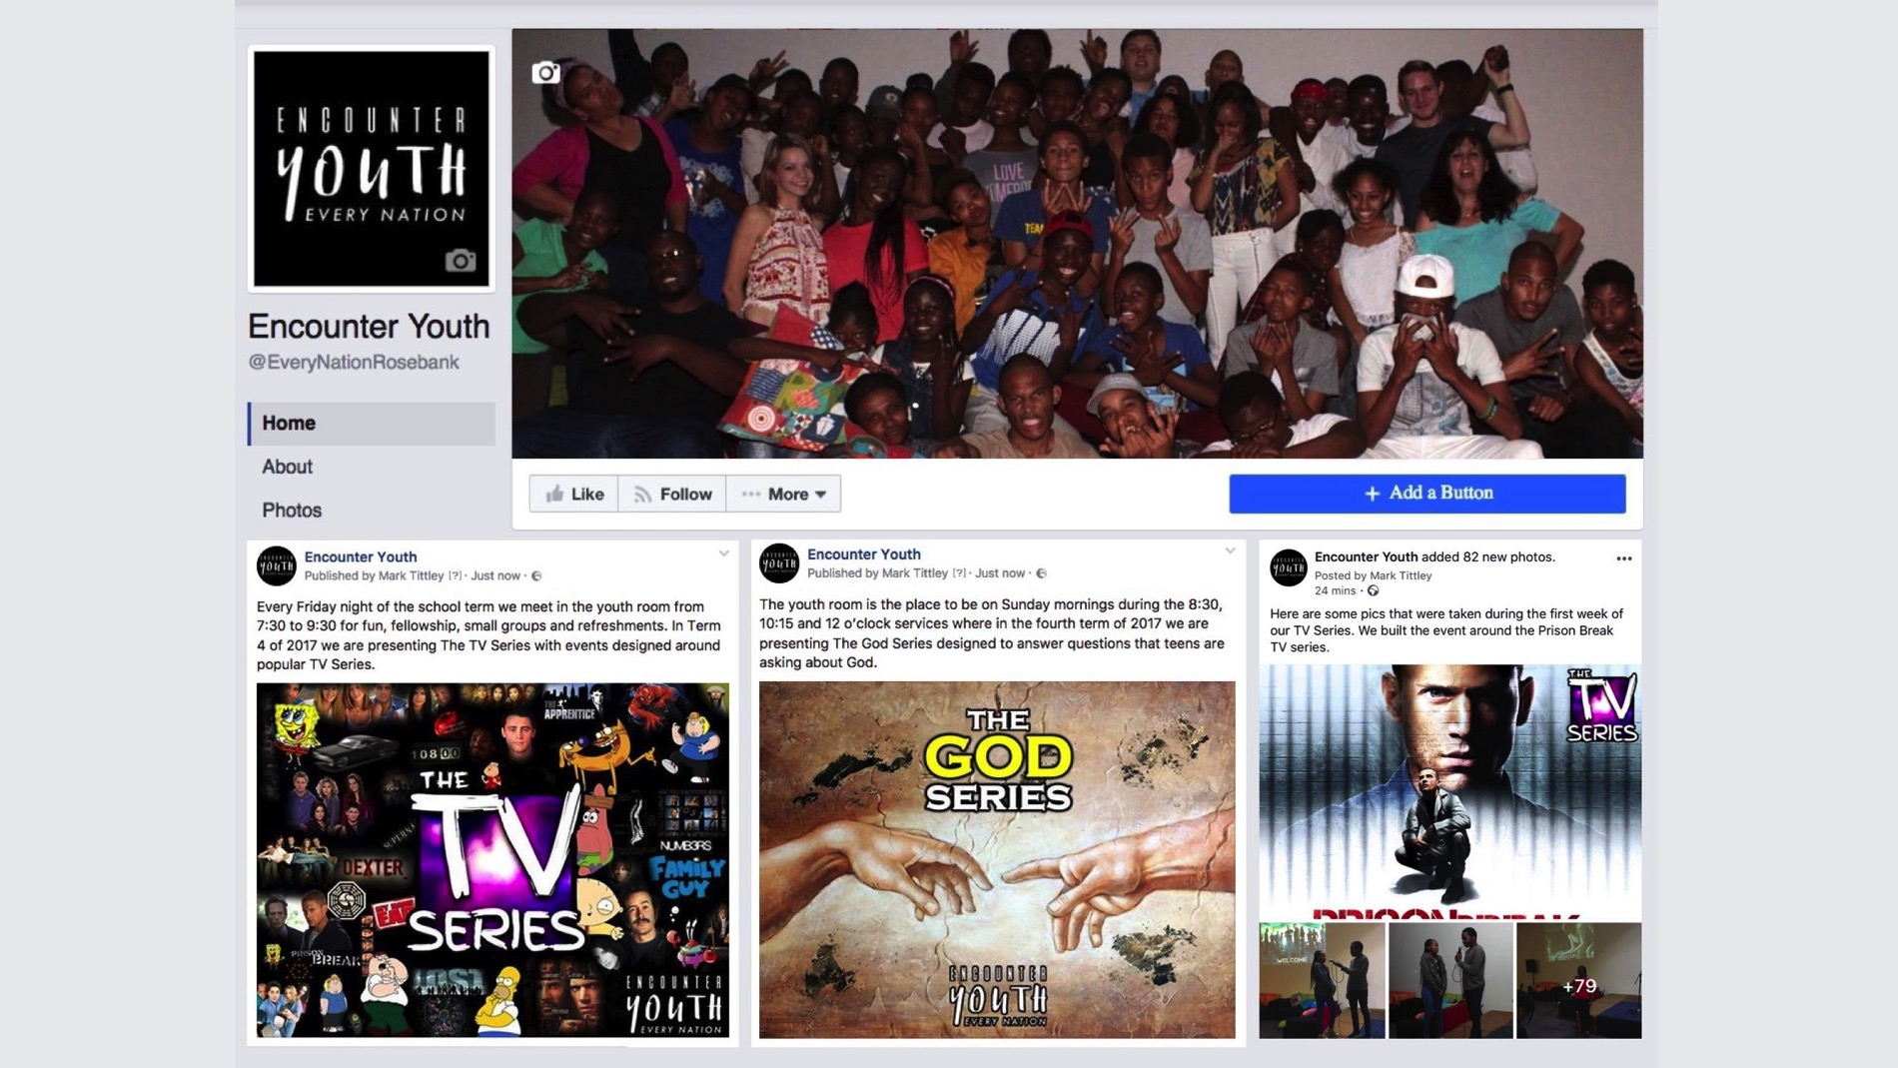
Notes:
Announcements: Like us on Facebook to keep up to date with the latest news.

Slide 7
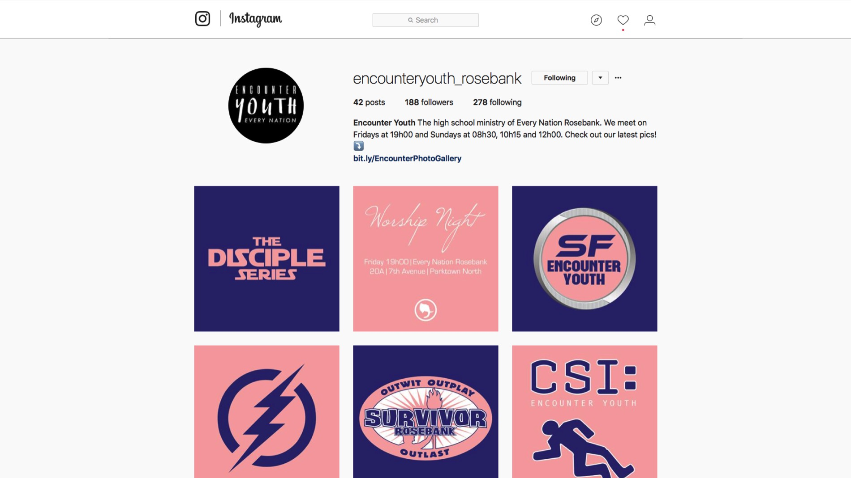
Notes:
Announcements: Follow us on Instagram! @EncounterYouth_Rosebank

Slide 8

Notes:
Announcements: Join our Friday Night WhatsApp group!

Slide 9

Notes:
Announcements: Join us this Sunday as we learn about being a disciple.

Slide 10
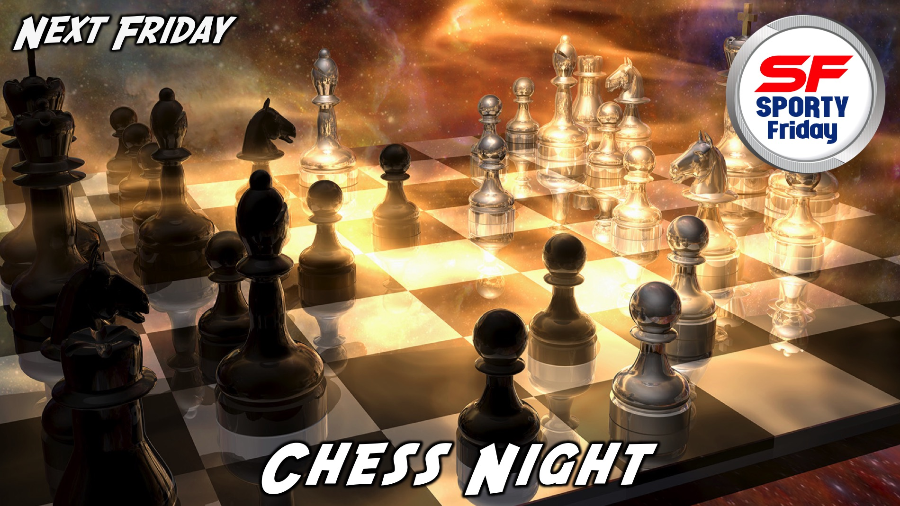
Notes:
Announcements: Join us next Friday for our Chess Night!

Slide 11

Notes:
Tonight is Dodgeball Night!

Slide 12
Notes:
Video Clip from the film Dodgeball. Find the clip on YouTube at: https://www.youtube.com/watch?v=-4QqksHXUCc

Slide 13
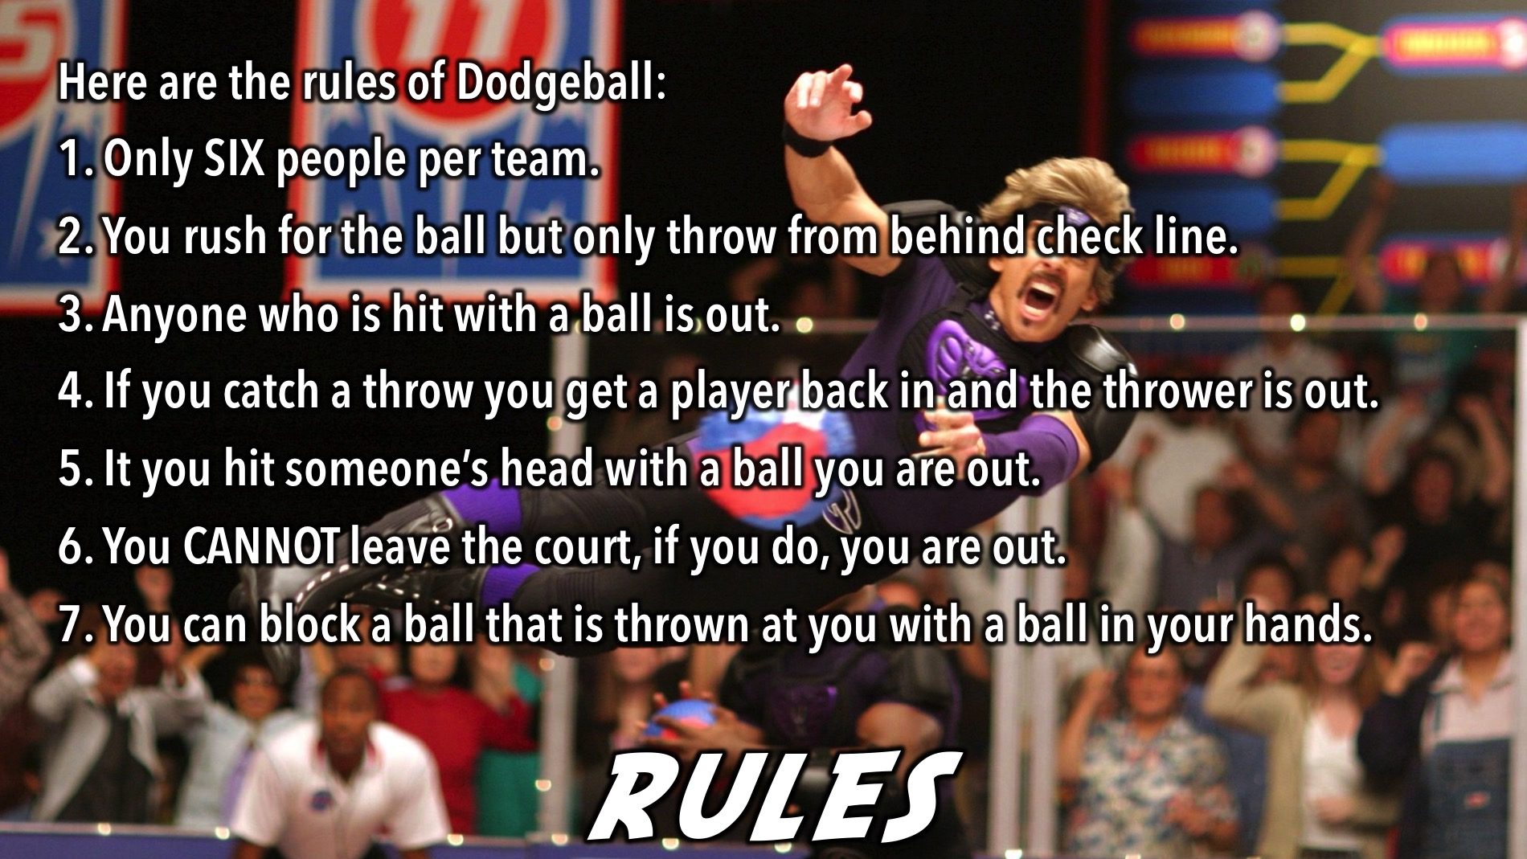
Notes:
Dodgeball Rules: Here are the rules of Dodgeball: (1) Only SIX people per team. (2) You rush for the ball but only throw from behind check line. (3) Anyone who is hit with a ball is out. (4) If you catch a throw you get a player back in and the thrower is out. (5) It you hit someone’s head with a ball you are out. (6) You CANNOT leave the court, if you do, you are out. (7) You can block a ball that is thrown at you with a ball in your hands.

Slide 14
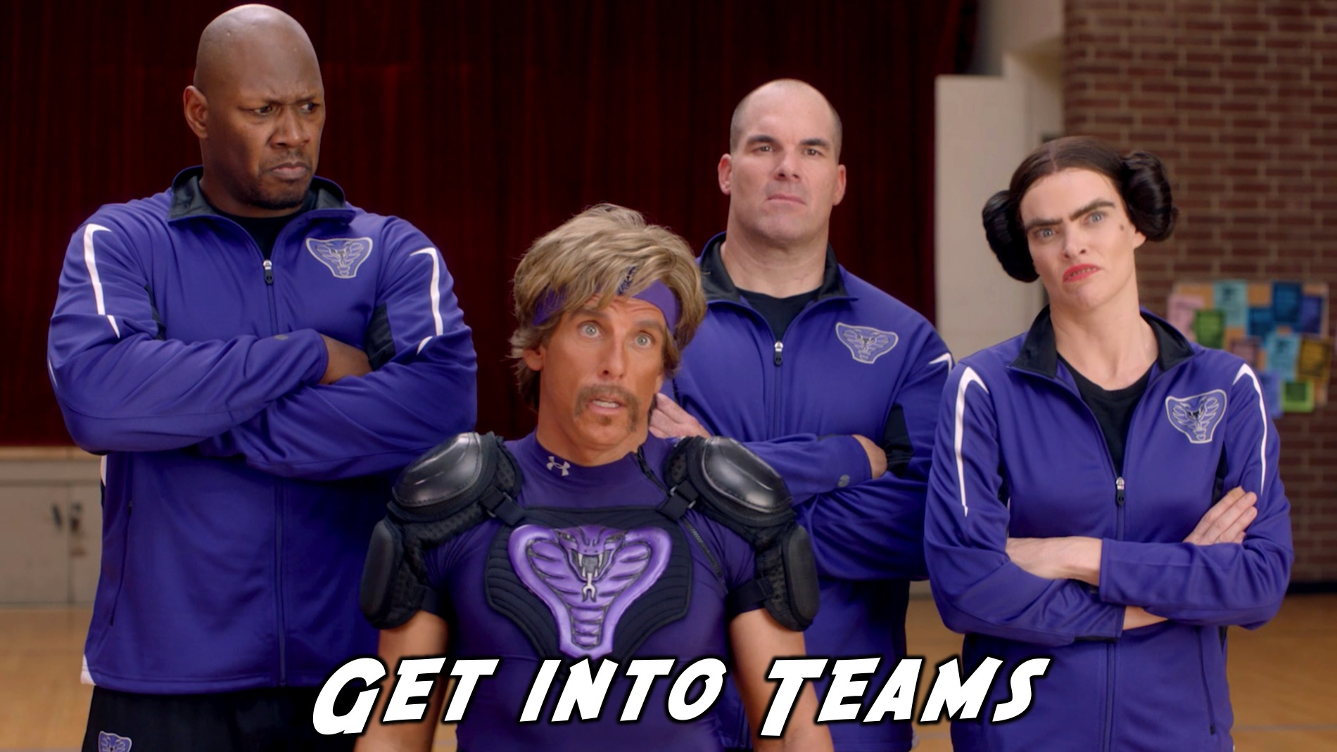
Notes:
Get into groups of Six and choose a team name.

Slide 15

Notes:
Team Dodgeball: We will divide into teams and start with a round of friendly games where teams play each other and then the other teams play each other etc. Then we will have a knockout competition and there will be a draw to see which two teams play each other and then the next two teams play each other followed by a final game to reward the ultimate winners.

Slide 16

Notes:
2-on-2 Dodgeball. Then each team will choose two players to compete in 2-on-2 Dodgeball - using the same knockout format as with the Team Dodgeball.

Slide 17

Notes:
And the winners are…

Slide 18
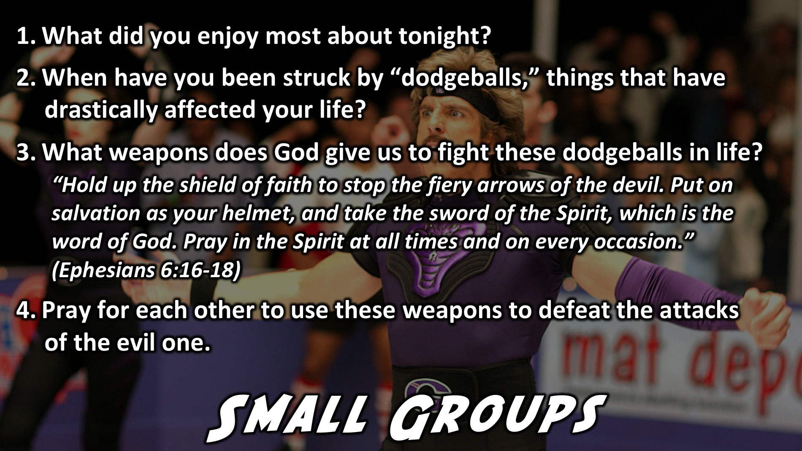
Notes:
Small Group Time: (1) What did you enjoy most about tonight? (2) When have you been struck by “dodgeballs,” things that have drastically affected your life? (3) What weapons does God give us to fight these dodgeballs in life? “Hold up the shield of faith to stop the fiery arrows of the devil. Put on salvation as your helmet, and take the sword of the Spirit, which is the word of God. Pray in the Spirit at all times and on every occasion.” (Ephesians 6:16-18) (4) Pray for each other to use these weapons to defeat the attacks of the evil one.

Slide 19

Notes:
Refreshments: It is time for refreshments.

Slide 20
Notes:
Don’t forget to join our WhatsApp group for regular updates!

