Slide 1

Notes:
Welcome to Sporty Friday.

Slide 2

Notes:
Tonight is Chess Night!

Slide 3
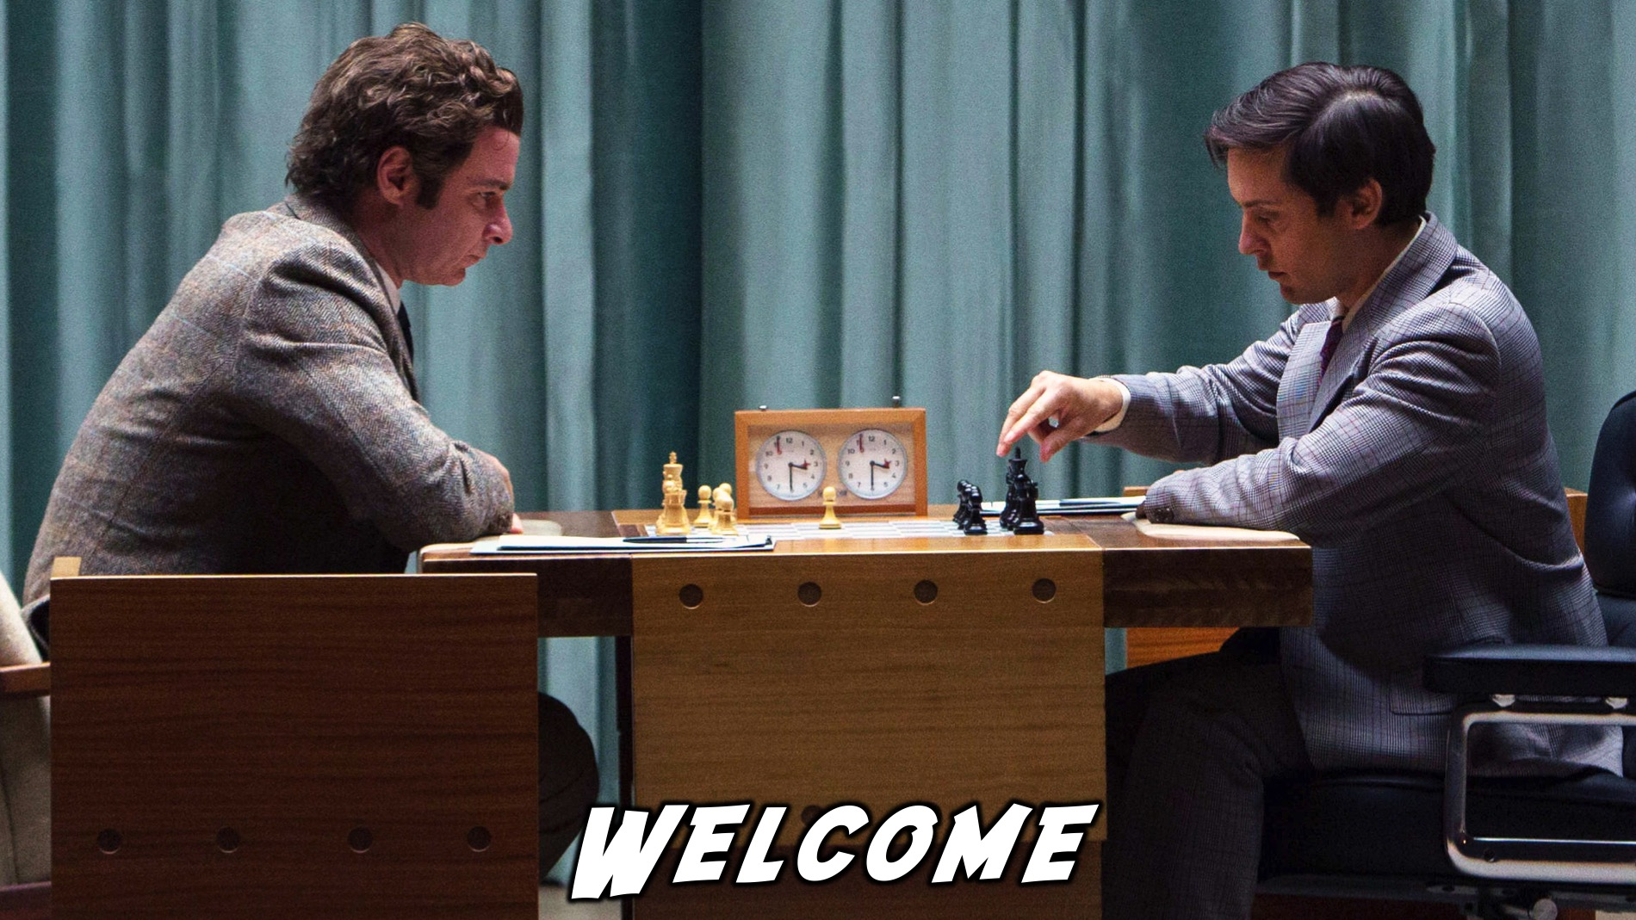
Notes:
Welcome to regulars and newcomers!

Slide 4
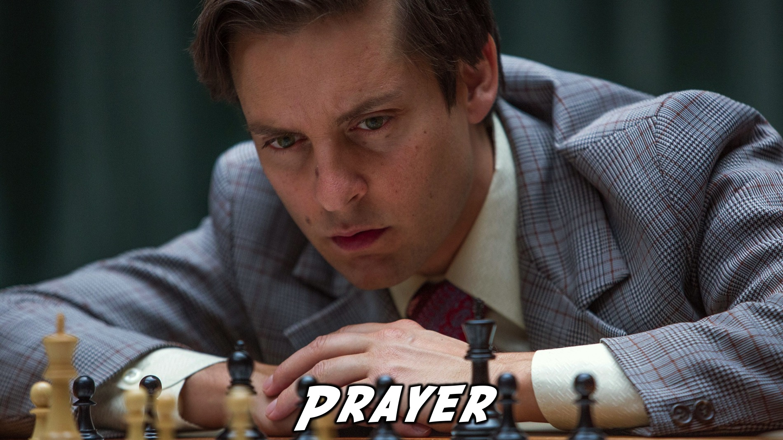
Notes:
Prayer: Let’s open our meeting in prayer.

Slide 5

Notes:
Please listen up for the following announcements!

Slide 6

Notes:
Announcements: Like us on Facebook to keep up to date with the latest news.

Slide 7
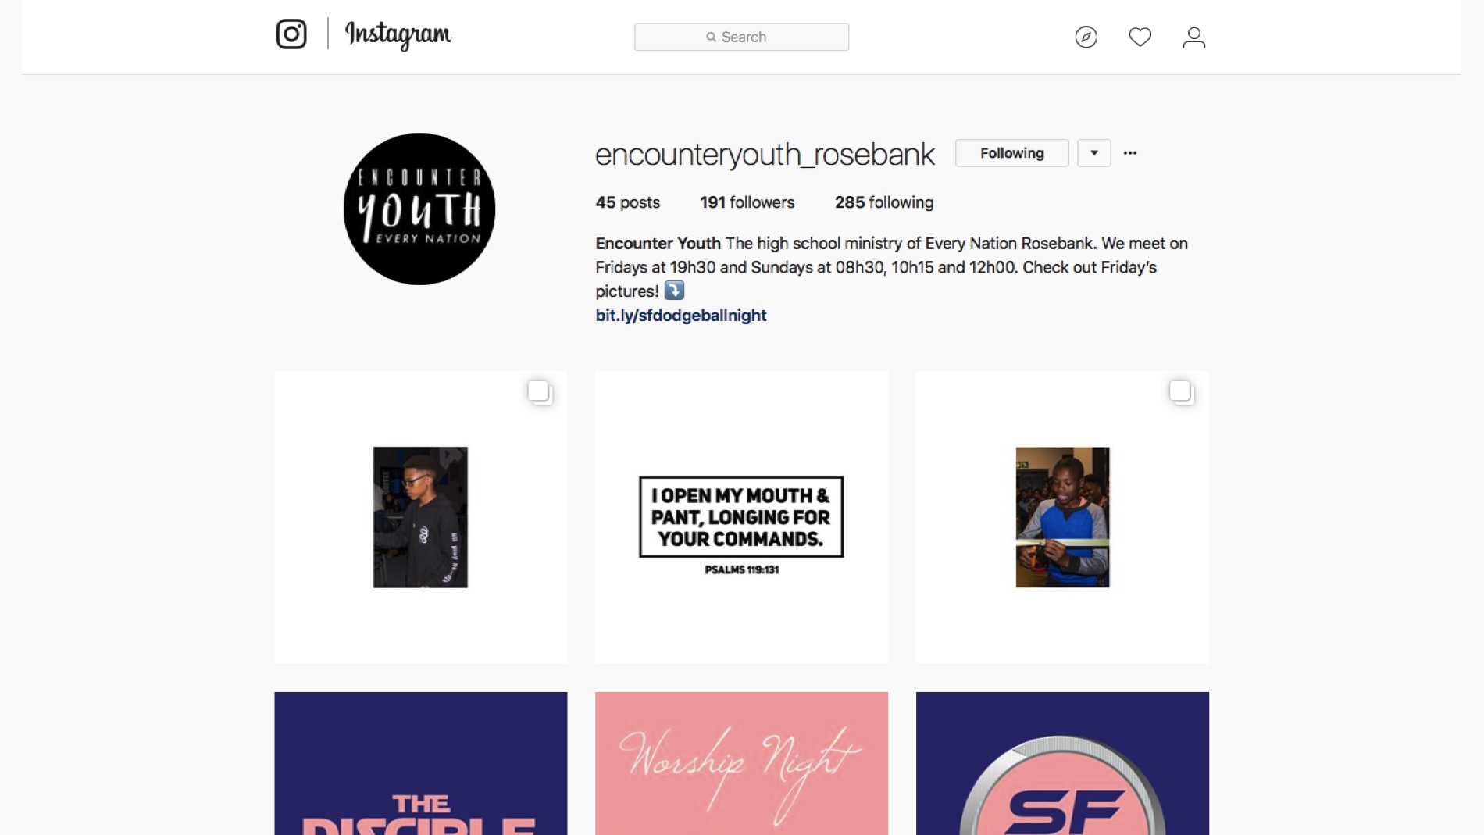
Notes:
Announcements: Follow us on Instagram! @EncounterYouth_Rosebank

Slide 8

Notes:
Announcements: Join our Friday Night WhatsApp group!

Slide 9

Notes:
Announcements: Join us this Sunday as we learn about being a disciple.

Slide 10

Notes:
Announcements: Join us next Friday for our Hockey Night!

Slide 11

Notes:
Tonight is Chess Night!

Slide 12
Notes:
Video Clip from the film “Pawn Sacrifice”. Find the clip on YouTube at: https://www.youtube.com/watch?v=SfxZvQEIU5U

Slide 13
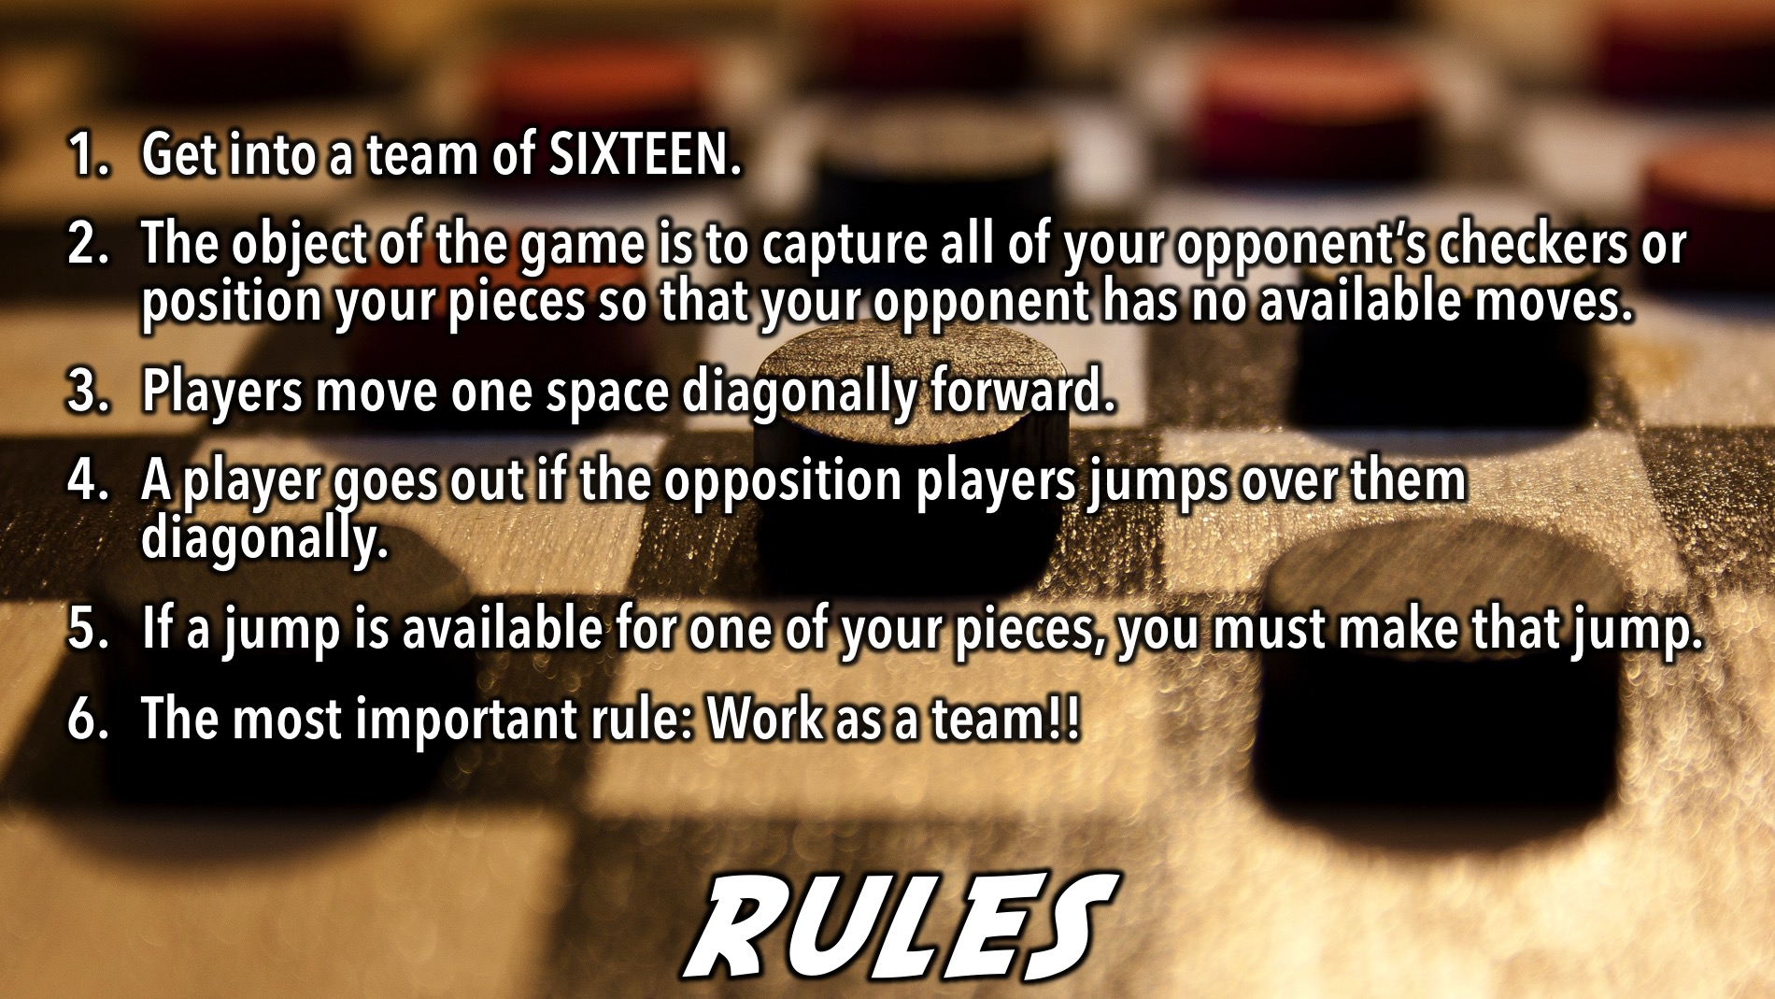
Notes:
Checkers Rules: (1) Get into a team of 16. (2) The object of the game is to capture all of your opponent’s checkers or position your pieces so that your opponent has no available moves. (3) Basic movement is to move a checker one space diagonally forward. (4) A player goes out if the opposition players jumps over them diagonally. (5) If a jump is available for one of your pieces, you must make that jump. (6) The most important rule: Work as a team!!
But first let’s watch an instructional video to help us learn how to play chess.

Slide 14
Notes:
Video: How to Play: Chess instructional video. Find the clip on YouTube at: https://www.youtube.com/watch?v=fKxG8KjH1Qg

Slide 15
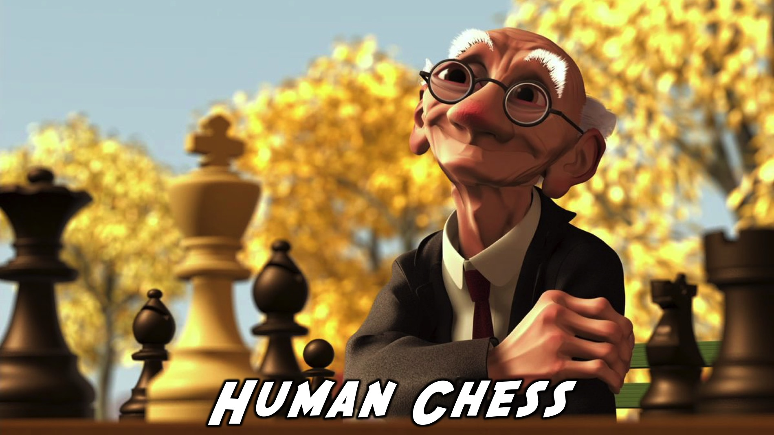
Notes:
Now we’re going to play Chess.

Slide 16
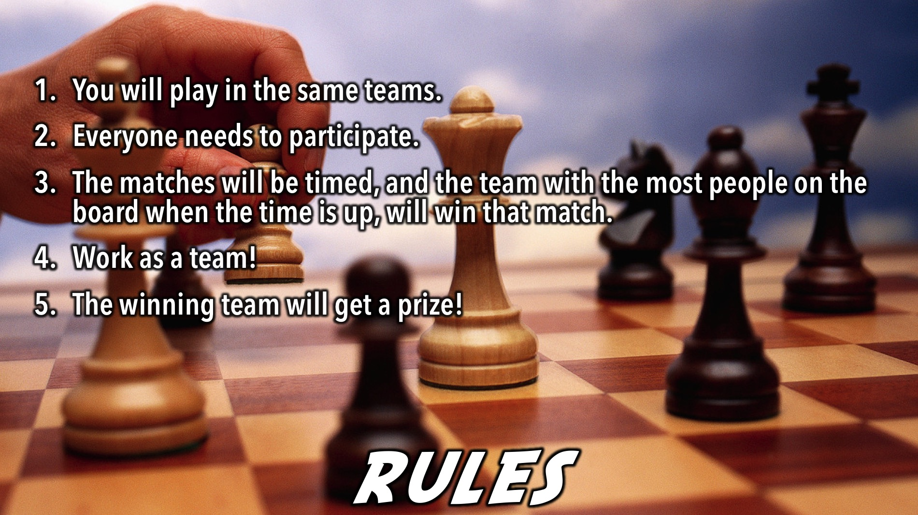
Notes:
Chess Rules: (1) You will play in the same teams. (2) Everyone needs to participate. (3) The matches will be timed, and the team with the most people on the board when the time is up, will win that match. (4) Work as a team! (5) The winning team will get a prize!

Slide 17

Notes:
And the winners are…

Slide 18
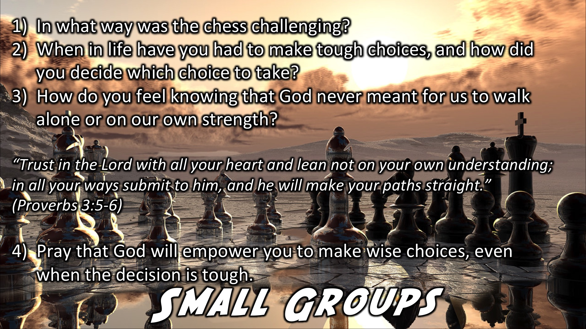
Notes:
Small Group Time: (1) In what ways was chess challenging? (2) When in life have you had to make tough choices, and how do you know what decisions to make? (3) Proverbs 3:5-6 says, "Trust in the Lord with all your heart and lean not on your own understanding; in all your ways submit to him, and he will make your paths straight.” How do you feel knowing that God never meant for us to walk alone or on our own strength?(4) Pray that God will empower you to make wise choices, even when the decision is tough.

Slide 19

Notes:
Refreshments: It is time for refreshments.

Slide 20
Notes:
Don’t forget to join our WhatsApp group for regular updates!

Slide 21

Notes:
An option and if time allows is to start off by playing Checkers.

