Slide 1

Notes:
Welcome to Sporty Friday.

Slide 2

Notes:
Tonight is Hockey Night!

Slide 3

Notes:
Welcome to regulars and newcomers!

Slide 4
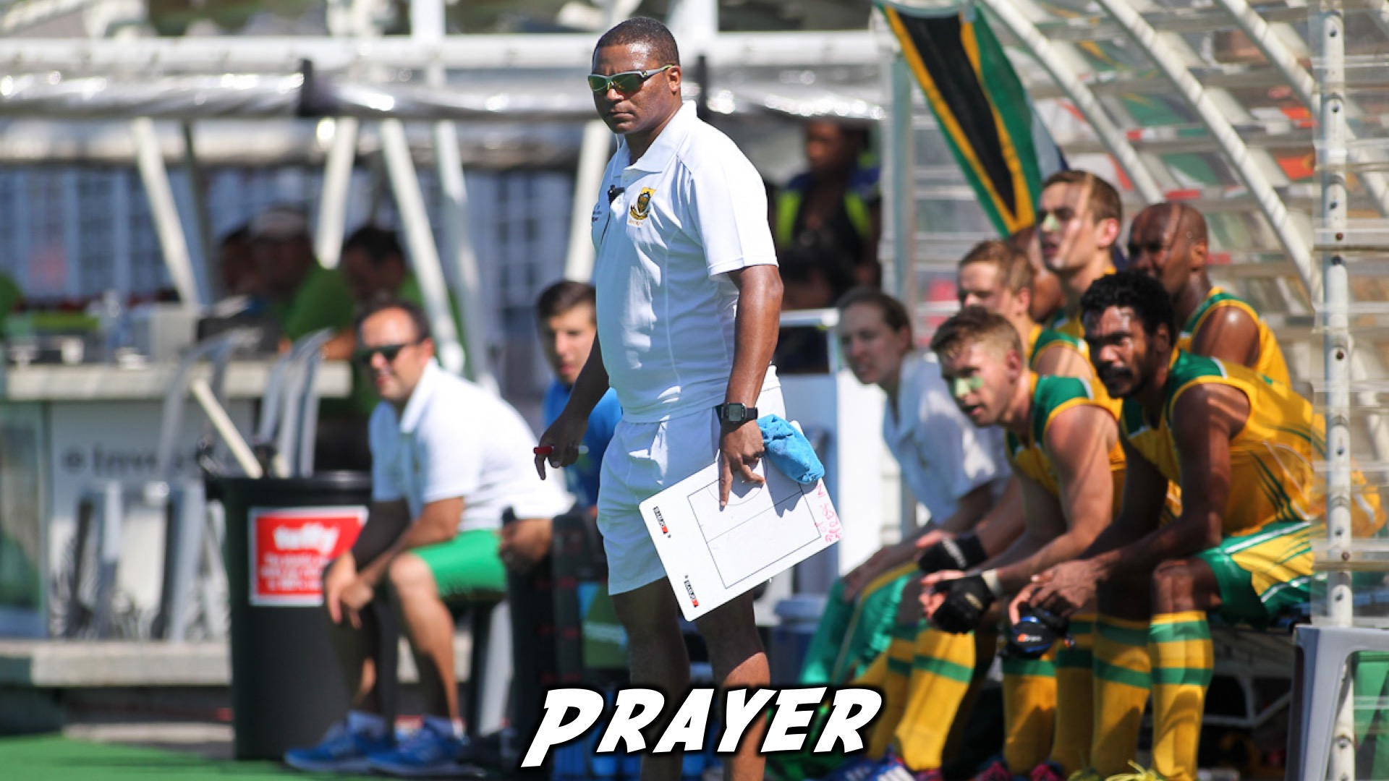
Notes:
Prayer: Let’s open our meeting in prayer.

Slide 5

Notes:
Please listen up for the following announcements!

Slide 6
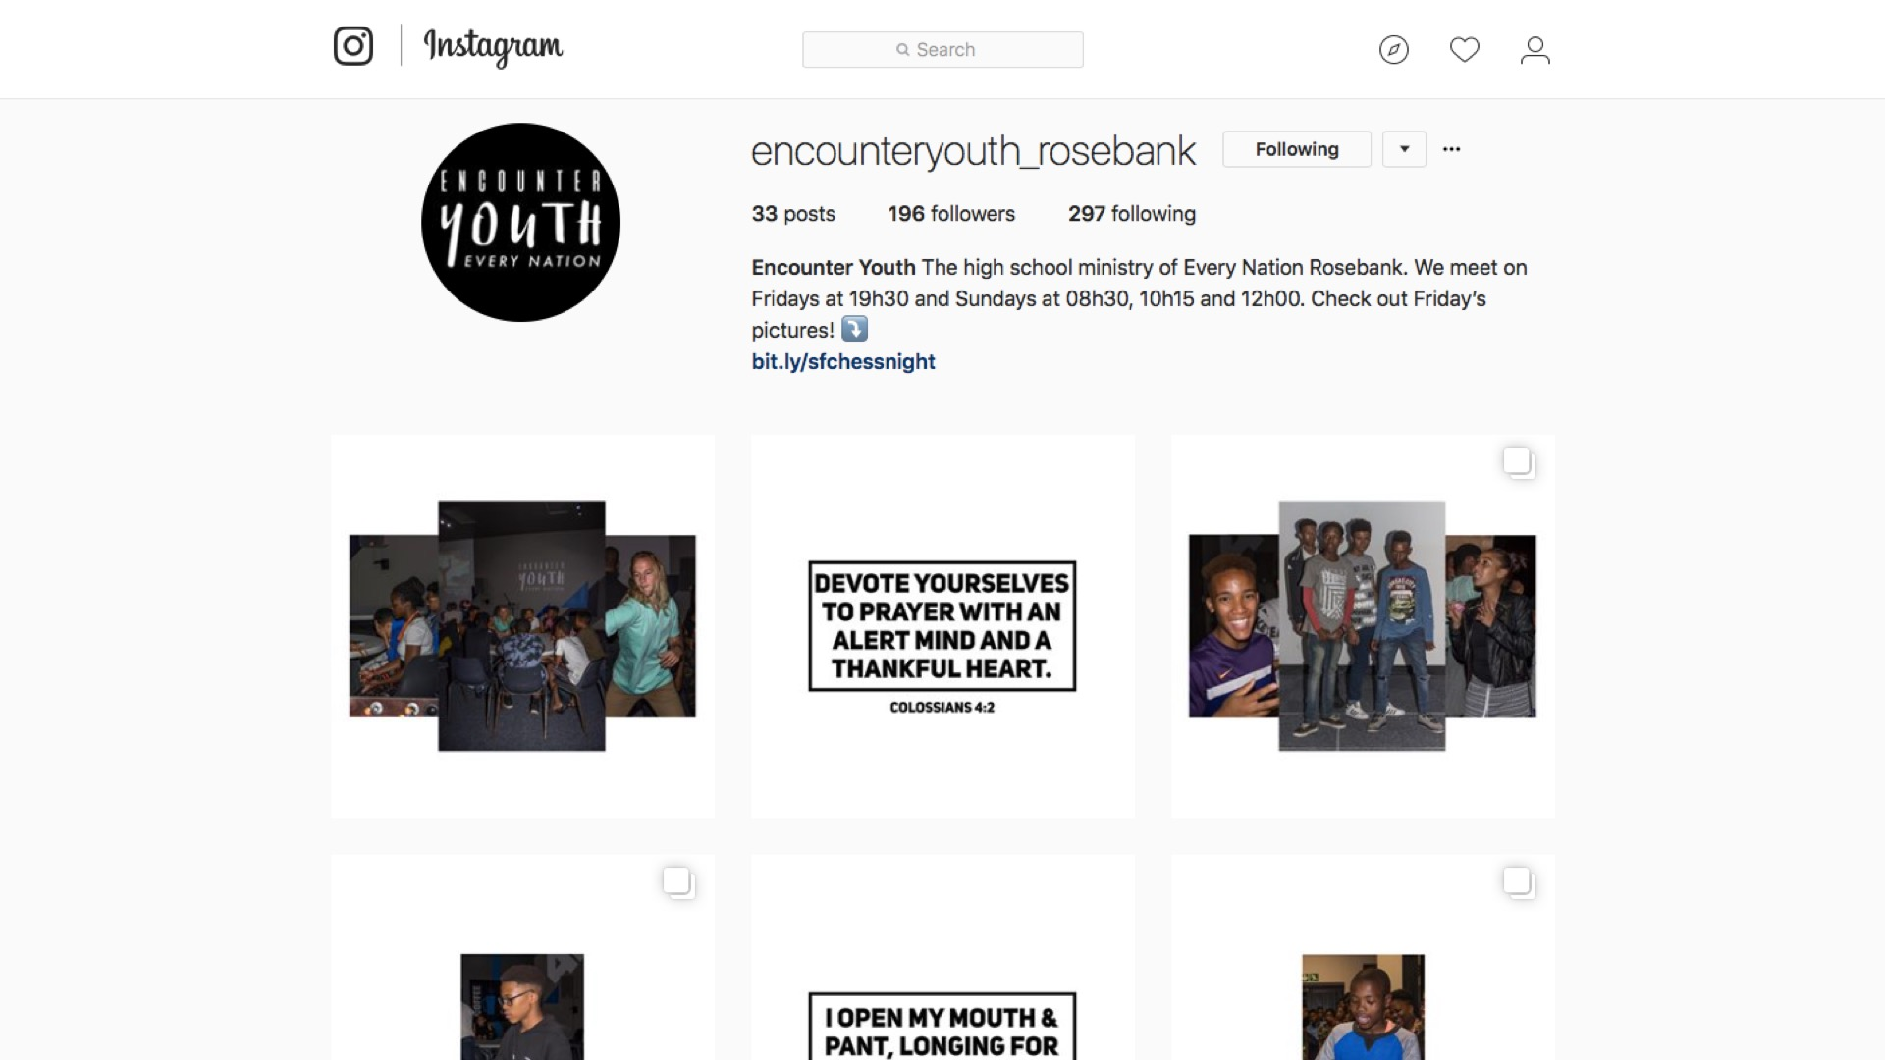
Notes:
Announcements: Follow us on Instagram! @EncounterYouth_Rosebank

Slide 7

Notes:
Announcements: Join our Friday Night WhatsApp group!

Slide 8

Notes:
Announcements: Join us this Sunday as we learn more about being a disciple.

Slide 9

Notes:
Announcements: Join us next Friday for our Athletics Night!

Slide 10

Notes:
Tonight is Hockey Night!

Slide 11

Notes:
Deleted scene from the film “Elf”. Find the clip on YouTube at: https://www.youtube.com/watch?v=0tX9qQvYCB0

Slide 12
Notes:
Deleted scene from the film “Elf”. Find the clip on YouTube at: https://www.youtube.com/watch?v=0tX9qQvYCB0

Slide 13

Notes:
We’re going to start off by playing Newspaper Hockey.

Slide 14
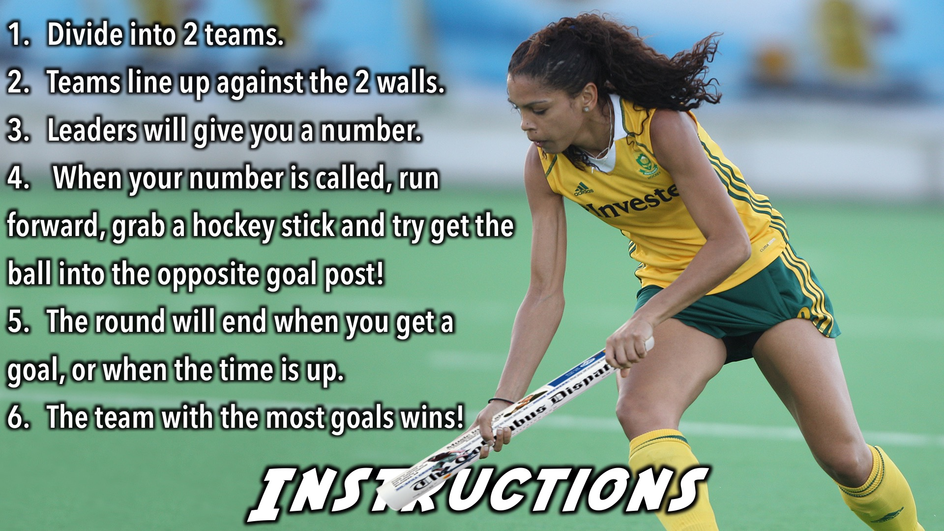
Notes:
Newspaper Hockey Instructions: (1) Divide into 2 teams. (2) Teams must line up on opposite sides of the room. (3) Leaders will allocate a number to each person. (4) When your number is called, run forward, grab a hockey stick and try get the ball into the opposite goal post! (5) The round will end when you get a goal, or when the time is up. (6) The team with the most goals wins!

Slide 15

Notes:
It’s time to play Balloon Hockey!

Slide 16
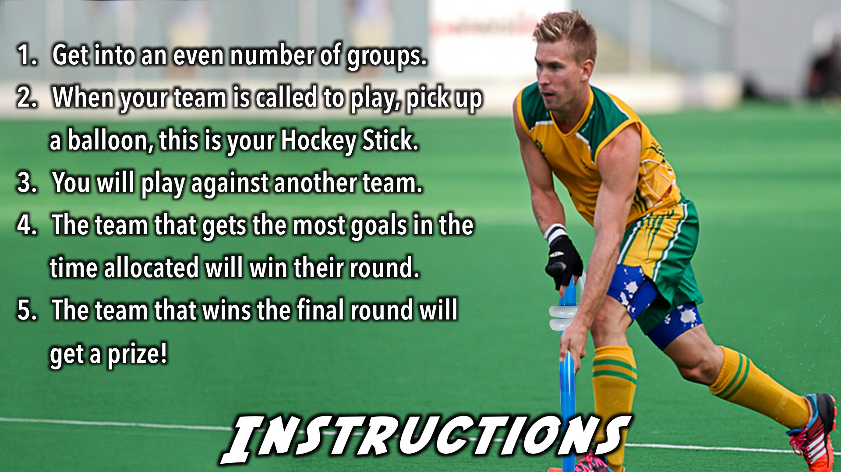
Notes:
Balloon Hockey Instructions: (1) Get into an even number of groups. (2) When your team is called to play, pick up a balloon, this is your Hockey Stick. (3) You will play against another team. (4) The team that gets the most goals in the time allocated will win their round. (5) The team that wins the final round will get a prize!

Slide 17

Notes:
And the winners are…

Slide 18
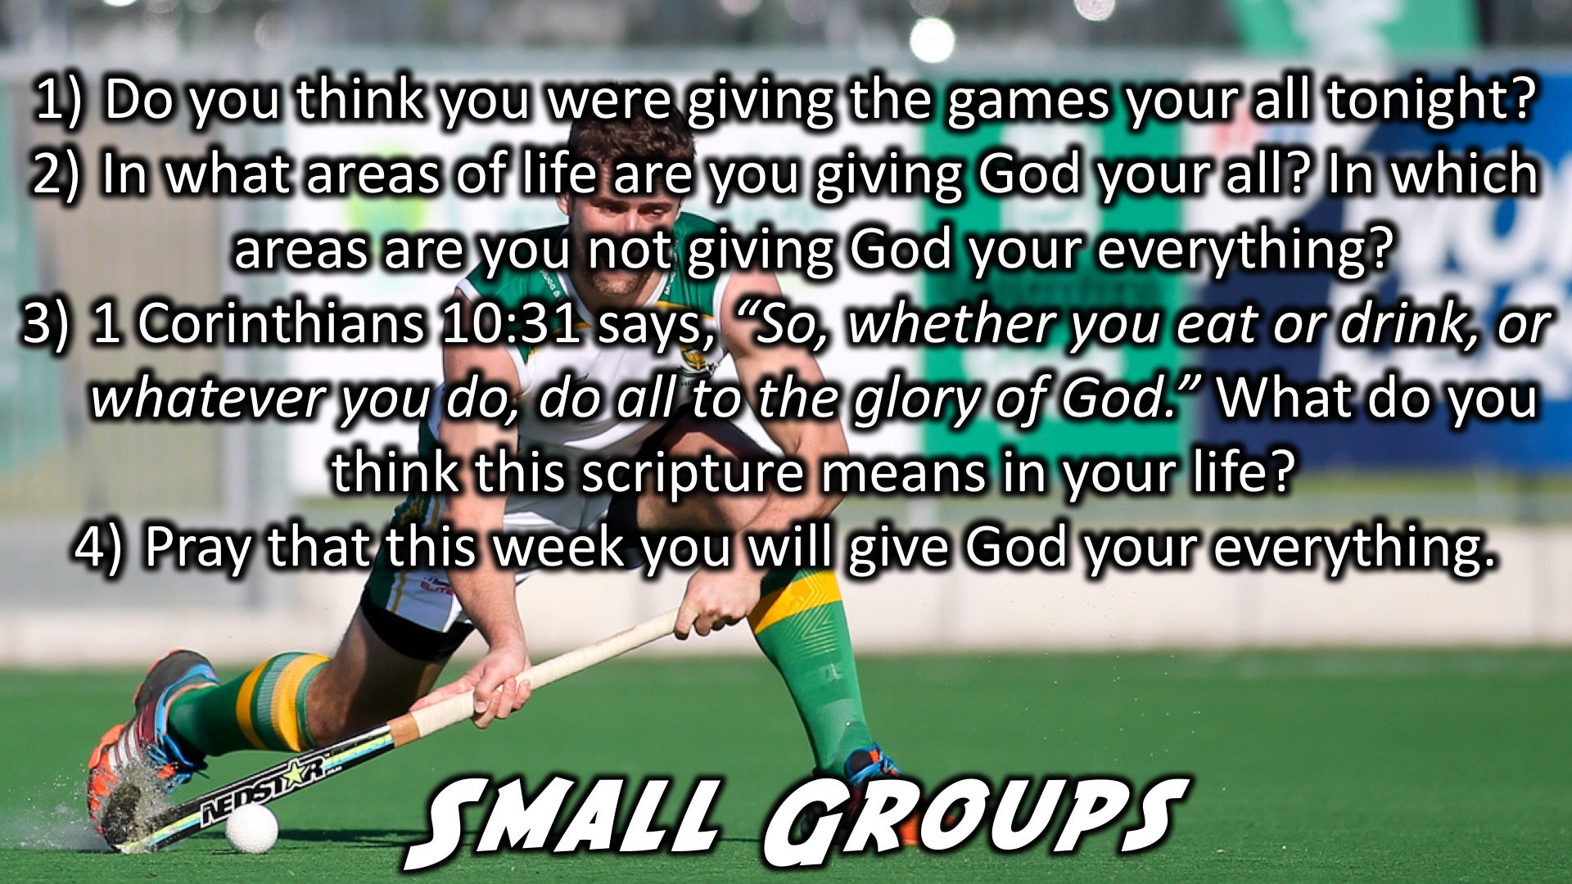
Notes:
Small Groups: (1) Do you think you were giving the games your all tonight? (2) In what areas of life are you giving God your all? In which areas are you not giving God your everything? (3) 1 Corinthians 10:31 says, “So, whether you eat or drink, or whatever you do, do all to the glory of God.” What do you think this scripture means in your life? (4) Pray that this week you will give God your everything.

Slide 19
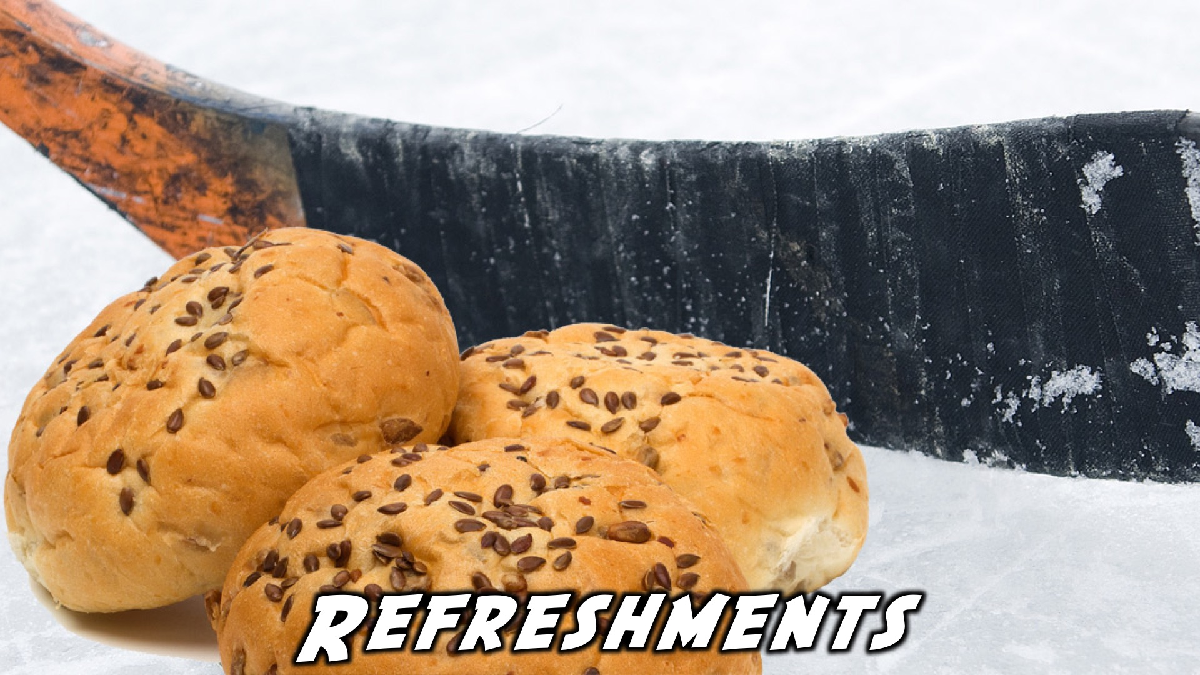
Notes:
Refreshments: It is time for refreshments.

Slide 20
Notes:
Don’t forget to join our WhatsApp group for regular updates!

