Slide 1

Notes:
Welcome to Sporty Friday.

Slide 2

Notes:
Tonight is Athletics Night!

Slide 3

Notes:
Welcome to regulars and newcomers!

Slide 4

Notes:
Prayer: Let’s open our meeting in prayer.

Slide 5

Notes:
Please listen up for the following announcements!

Slide 6

Notes:
Announcements: Follow us on Instagram! @EncounterYouth_Rosebank

Slide 7

Notes:
Announcements: Join our Friday Night WhatsApp group!

Slide 8
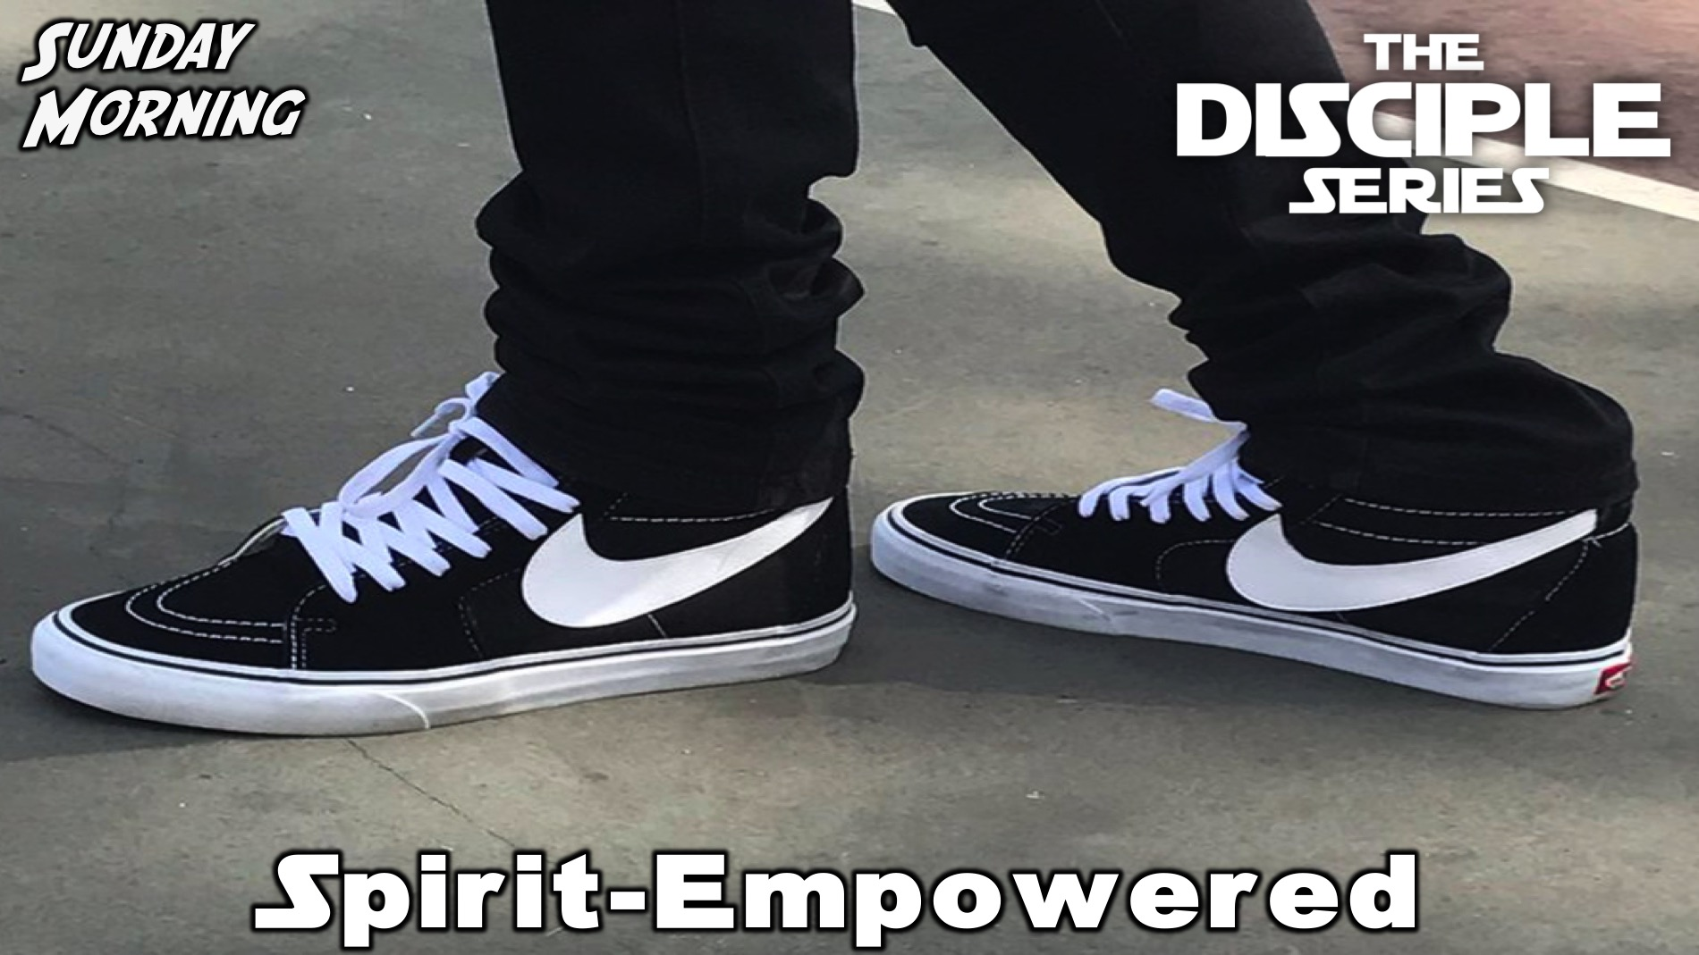
Notes:
Announcements: Join us this Sunday as we learn more about being a disciple.

Slide 9

Notes:
Announcements: Join us next Friday for our Cricket Night!

Slide 10

Notes:
Tonight is Athletics Night!

Slide 11
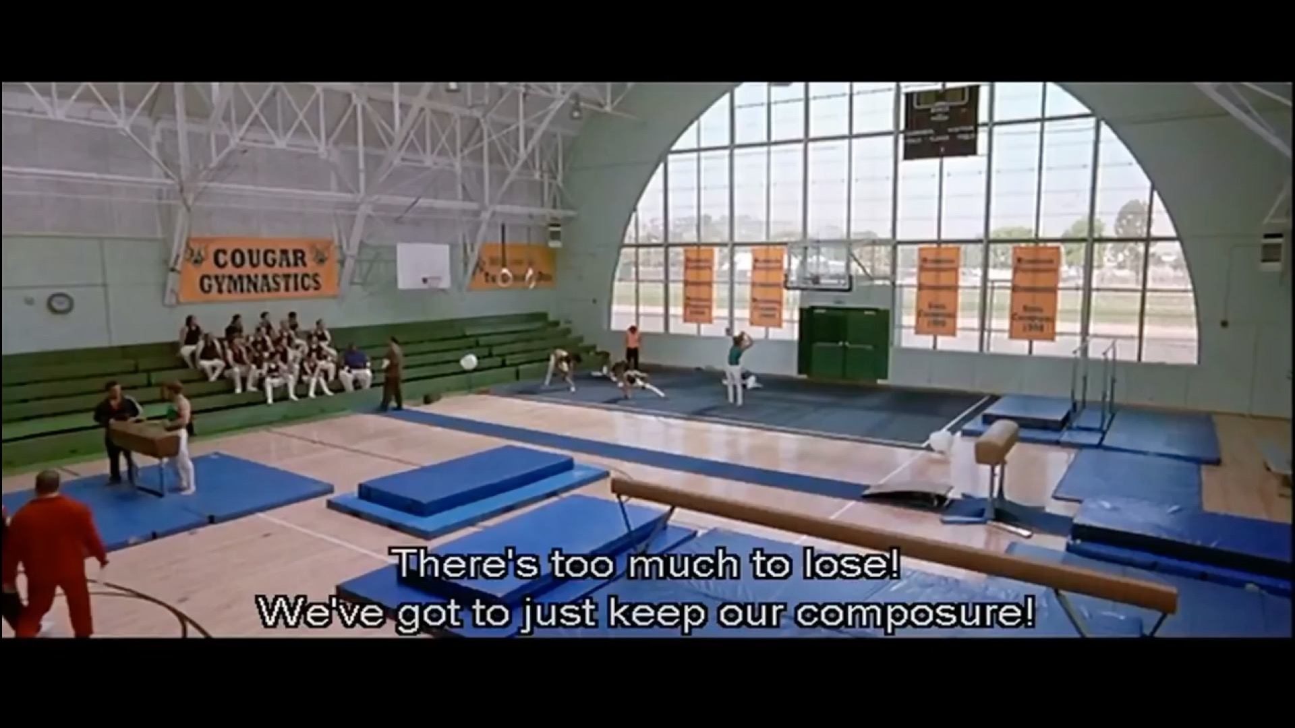
Notes:
Video Clip: Funny scene from the film, Old School. Find the video on Youtube: https://www.youtube.com/watch?v=cnSaugYLSW4

Slide 12
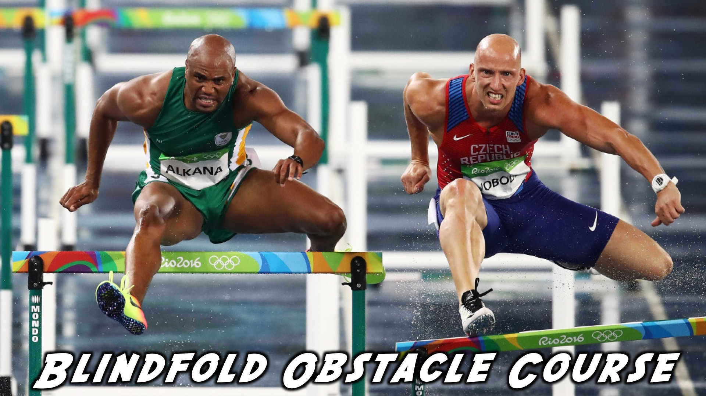
Notes:
Blindfold Obstacle Course

Slide 13
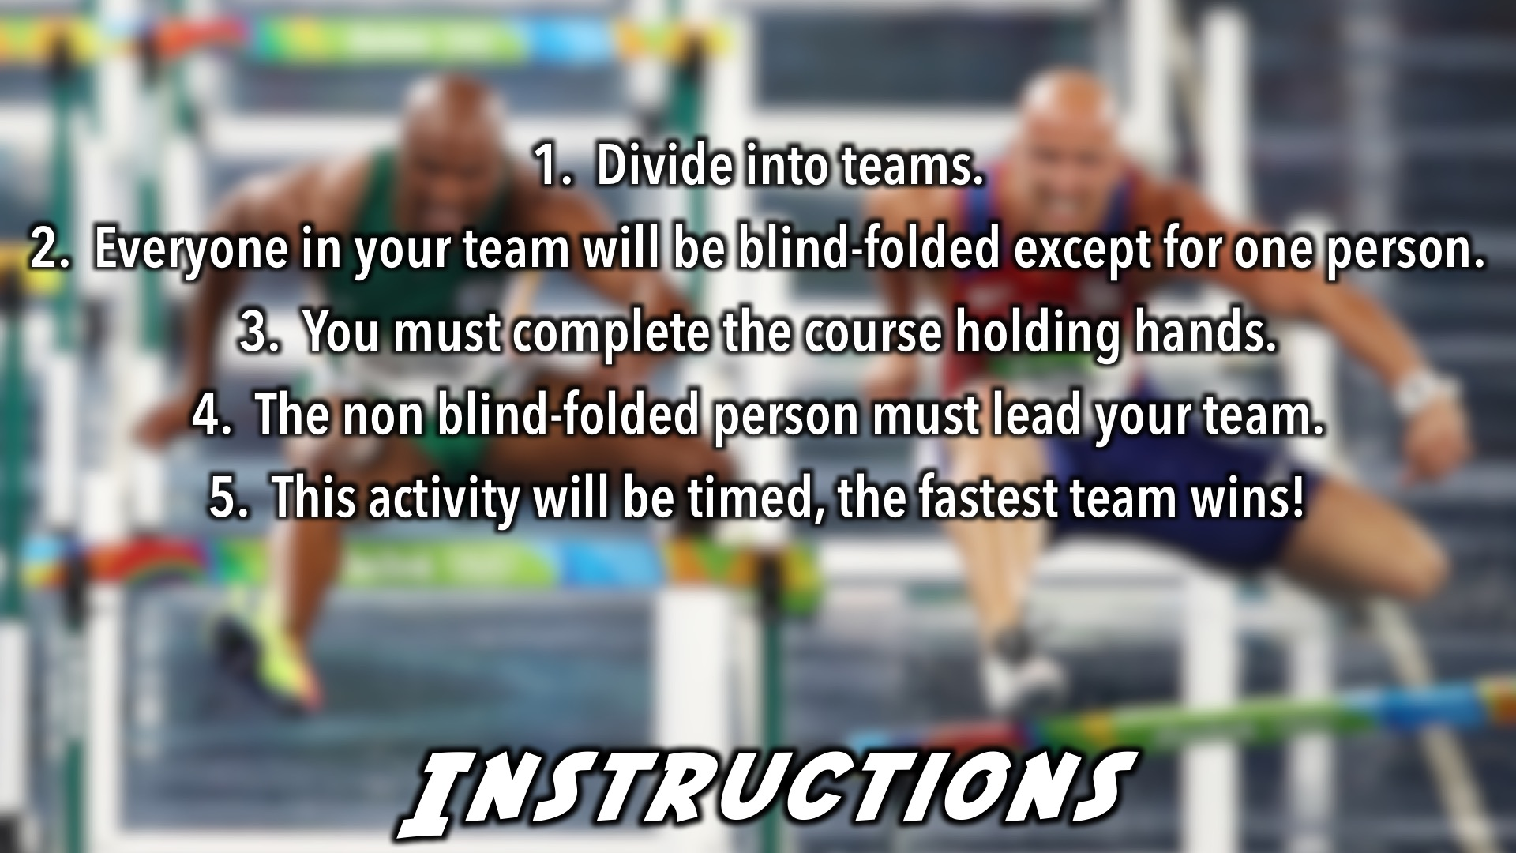
Notes:
Blind-fold Obstacle Course - We will set out an obstacle course in the youth room, with chairs, and any random things we can find. All the team members will be blindfolded except one. They will have to do the course holding hands. We will time each team, and the fastest team wins that game.

Slide 14

Notes:
Face the Ball

Slide 15
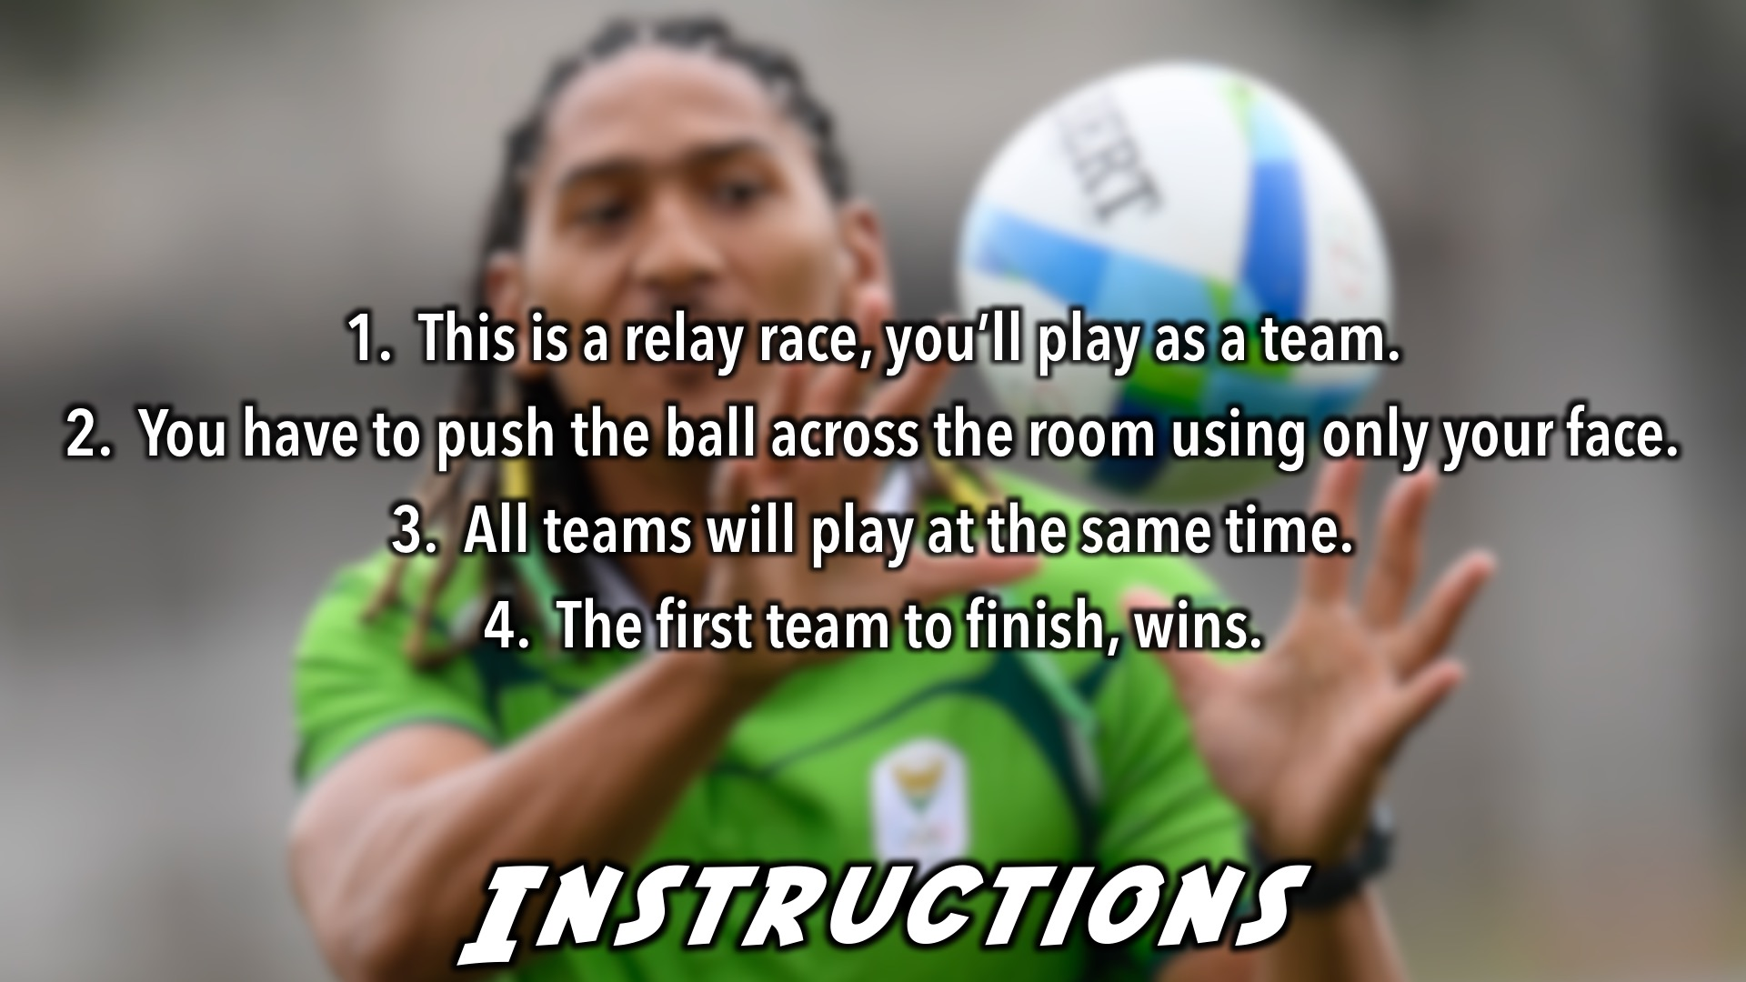
Notes:
Face the Ball - This is a relay race, teams have to push the ball across the room and back using only their faces. All the teams will compete at the same time, the team that finishes first, wins. We can use the dodgeball balls.

Slide 16

Notes:
Speed Skating

Slide 17
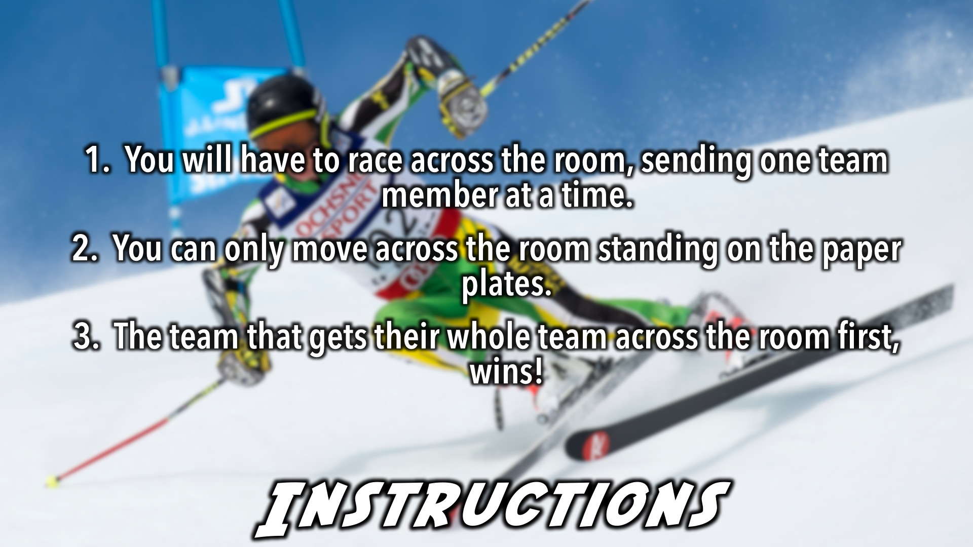
Notes:
Speed Skating - This is a game that will relate to the winter Olympics, it's also a relay game. Teams will have to race across the room, each team sending one person at a time. They can only get across the room by standing on paper plates, which are their ”skis." The team that gets across the room first, wins.

Slide 18

Notes:
Straw Javelin

Slide 19
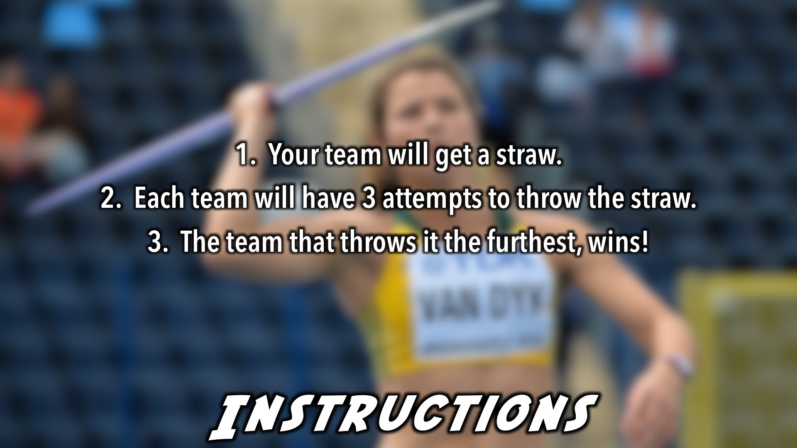
Notes:
Straw Javelin - Teams get a straw, and they have to see how far they can throw the staw, javelin style. The team that gets the furthest wins.

Slide 20
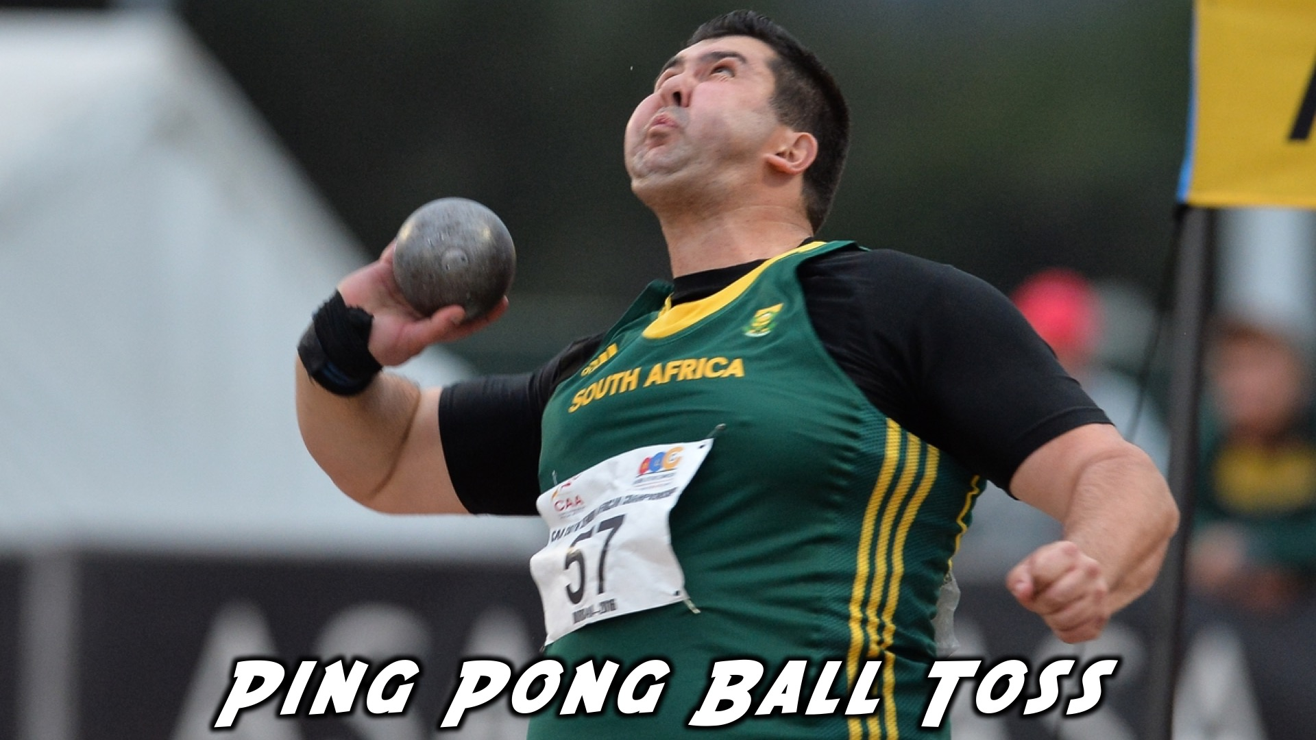
Notes:
Ping Pong Ball Toss

Slide 21
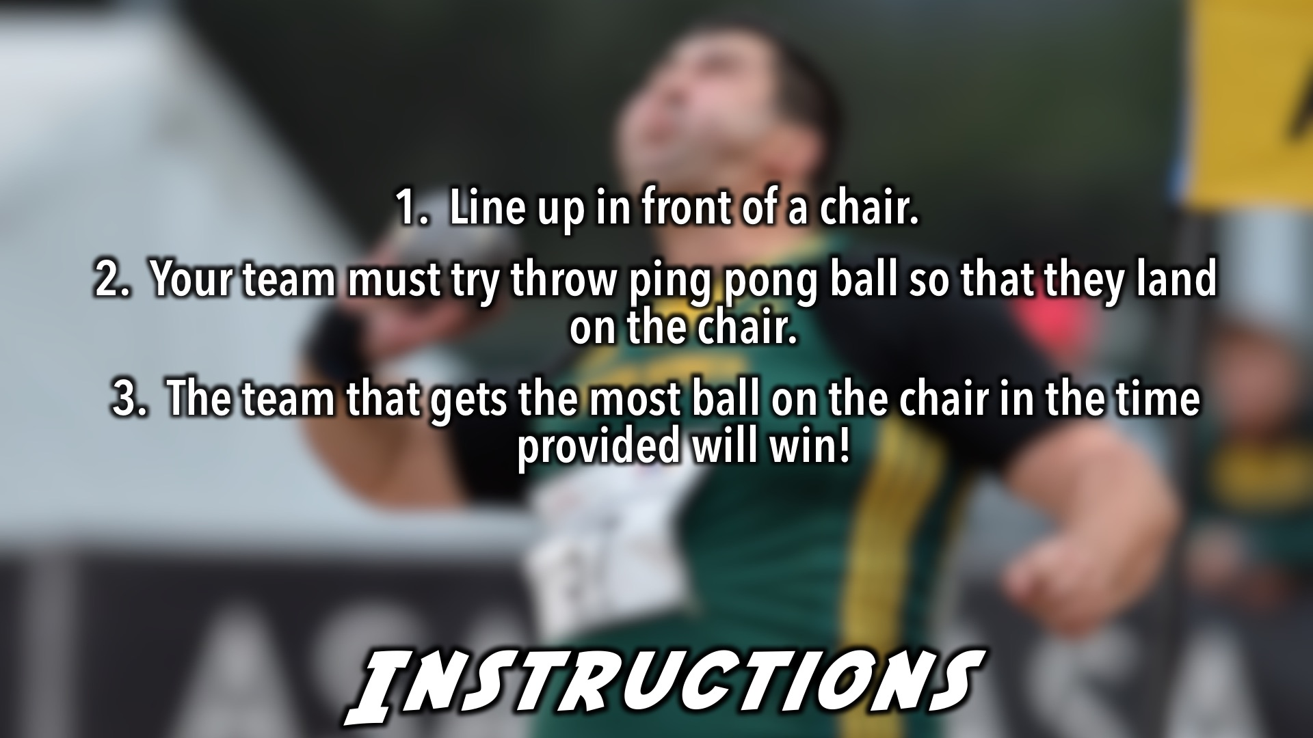
Notes:
Ping Pong Ball Toss (Shot put) - Teams will line up with a chair in front of each team. Teams have to see how many ping pong balls can land on their chair in the time given. We could have the chairs relatively far to make the challenge difficult. The team with the most balls on their chair wins.

Slide 22

Notes:
Long Jump

Slide 23
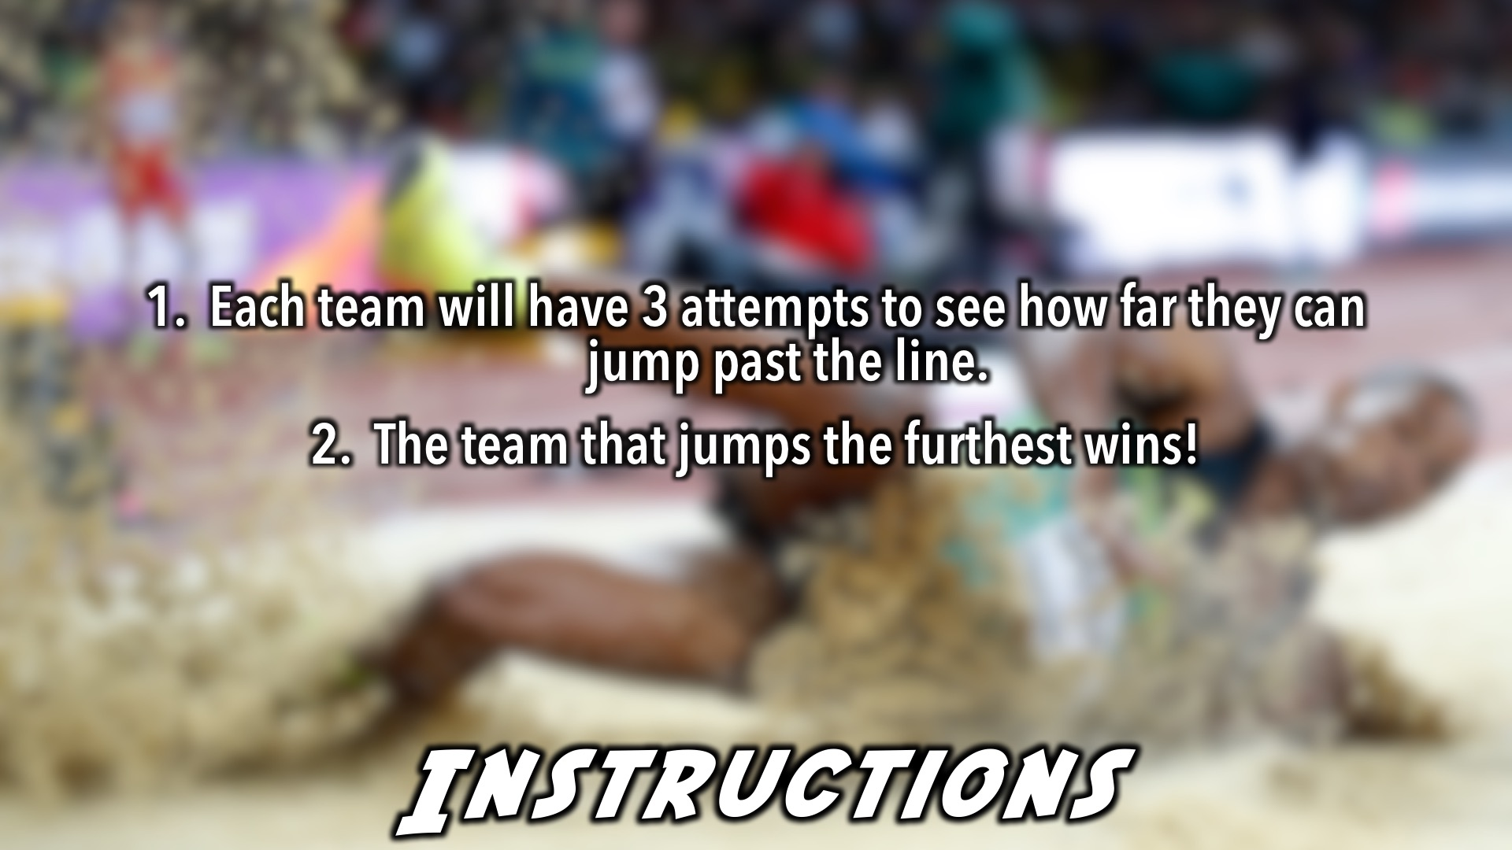
Notes:
Long Jump - We can make a line on the ground with masking tape. Each Team has 3 tries to see how far they can jump past the line. The team that jumps the furthest wins.

Slide 24

Notes:
And the winners are…

Slide 25

Notes:
Small Groups: (1) What made tonight challenging? (2) What are some of the challenges you’ve faced this week?(3) How do you know that God cares for you, and will help you overcome challenges? 1 Peter 5:7 says, "Cast all your anxiety on him because he cares for you.” (4) Pray that you’ll be able to overcome your challenges with God’s help.

Slide 26
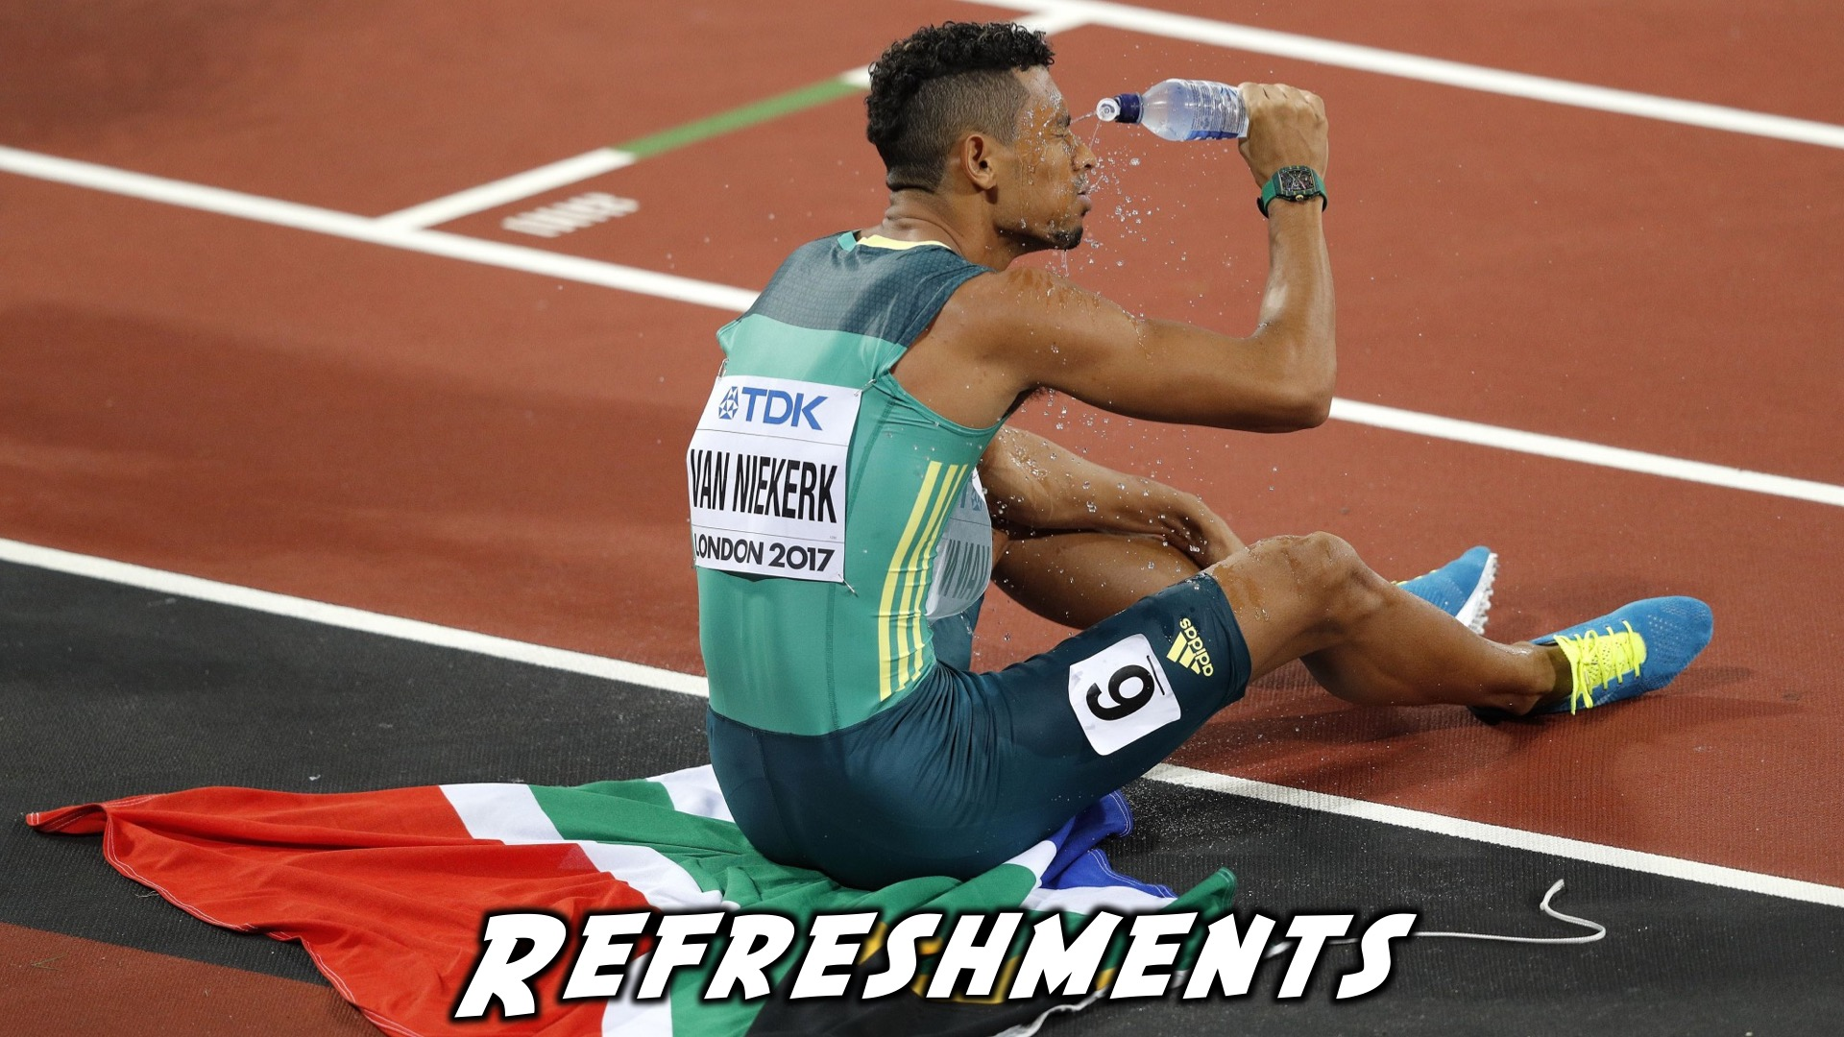
Notes:
Refreshments: It is time for refreshments.

Slide 27
Notes:
Don’t forget to join our WhatsApp group for regular updates!

