Slide 1

Notes:
Welcome to Sporty Friday.

Slide 2

Notes:
Tonight is Cricket Night!

Slide 3
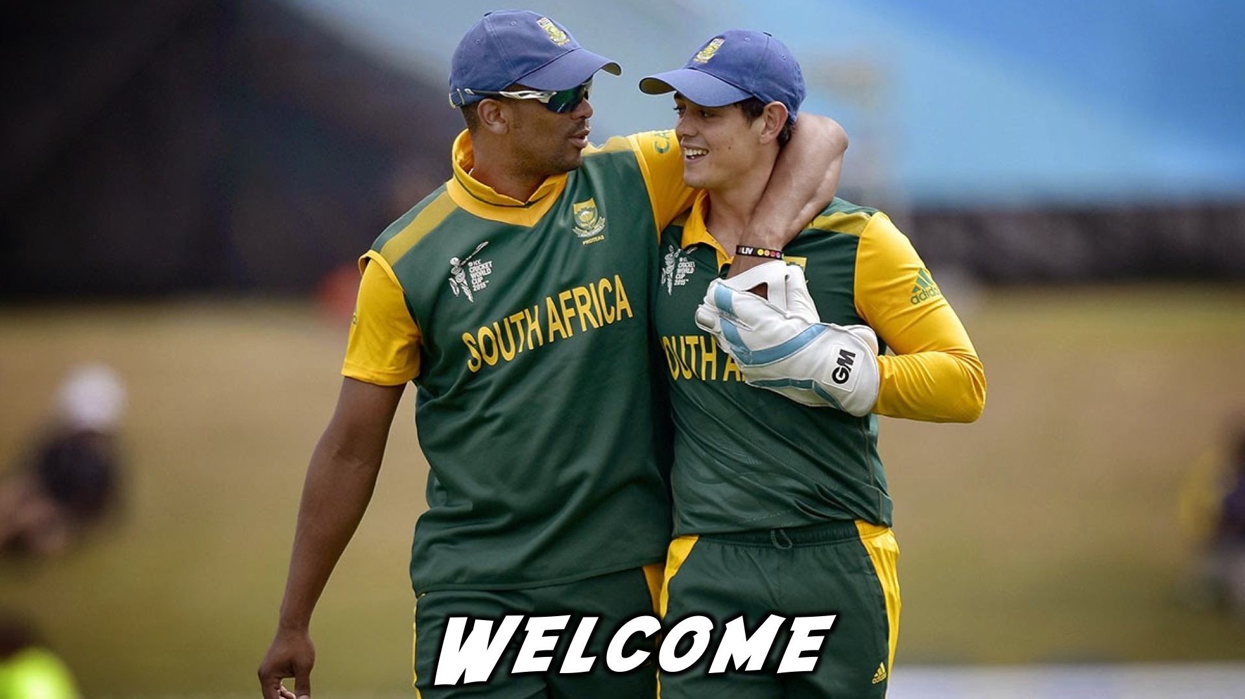
Notes:
Welcome to regulars and newcomers!

Slide 4
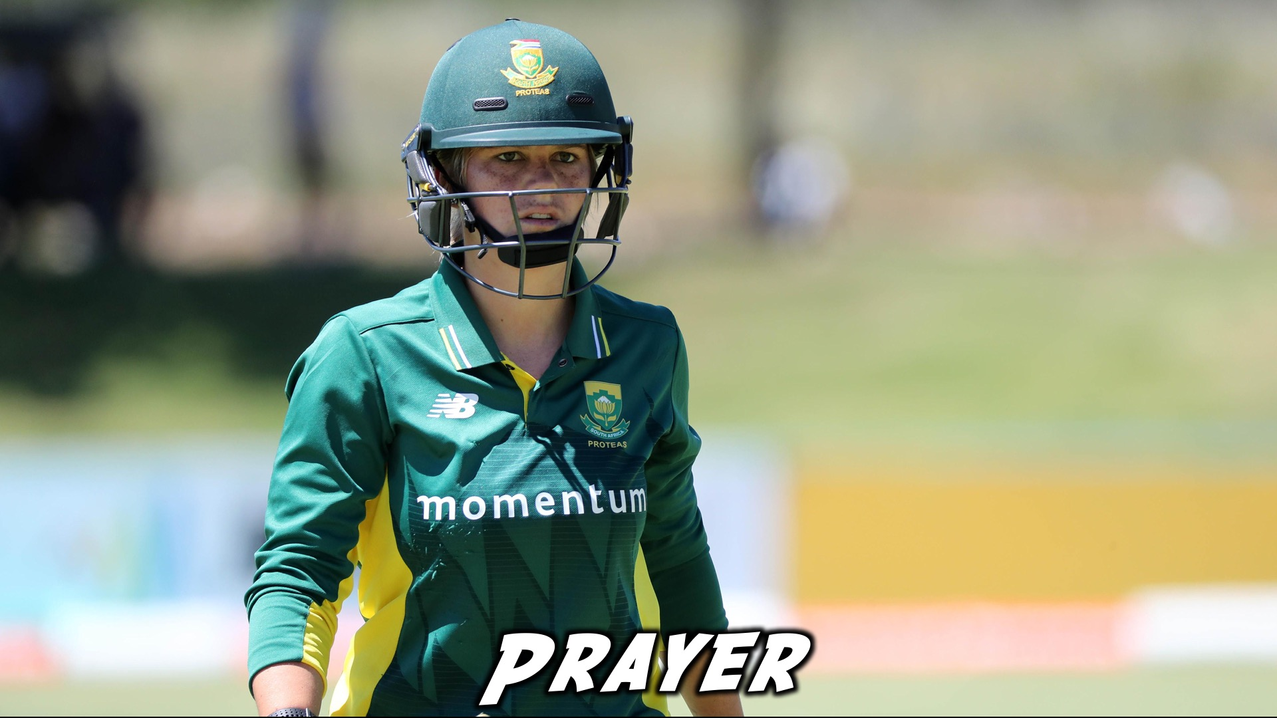
Notes:
Prayer: Let’s open our meeting in prayer.

Slide 5
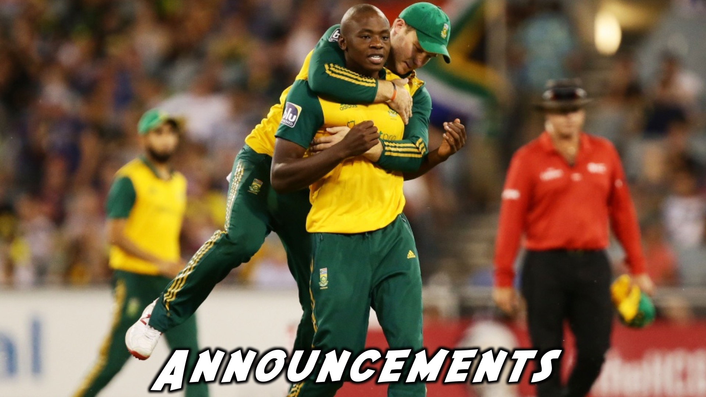
Notes:
Please listen up for the following announcements!

Slide 6

Notes:
Announcements: Follow us on Instagram! @EncounterYouth_Rosebank

Slide 7

Notes:
Announcements: Join our Friday Night WhatsApp group!

Slide 8

Notes:
Announcements: Join us this Sunday as we learn more about being a disciple.

Slide 9

Notes:
Announcements: Join us next Friday for our Basketball Night!

Slide 10

Notes:
Tonight is Athletics Night!

Slide 11

Notes:
Video Clip: Trailer for Hansie. Find the video on Youtube: https://www.youtube.com/watch?v=w3oNWQegbn8&feature=youtu.be

Slide 12
Notes:
Video Clip: Trailer for Hansie. Find the video on Youtube: https://www.youtube.com/watch?v=w3oNWQegbn8&feature=youtu.be

Slide 13
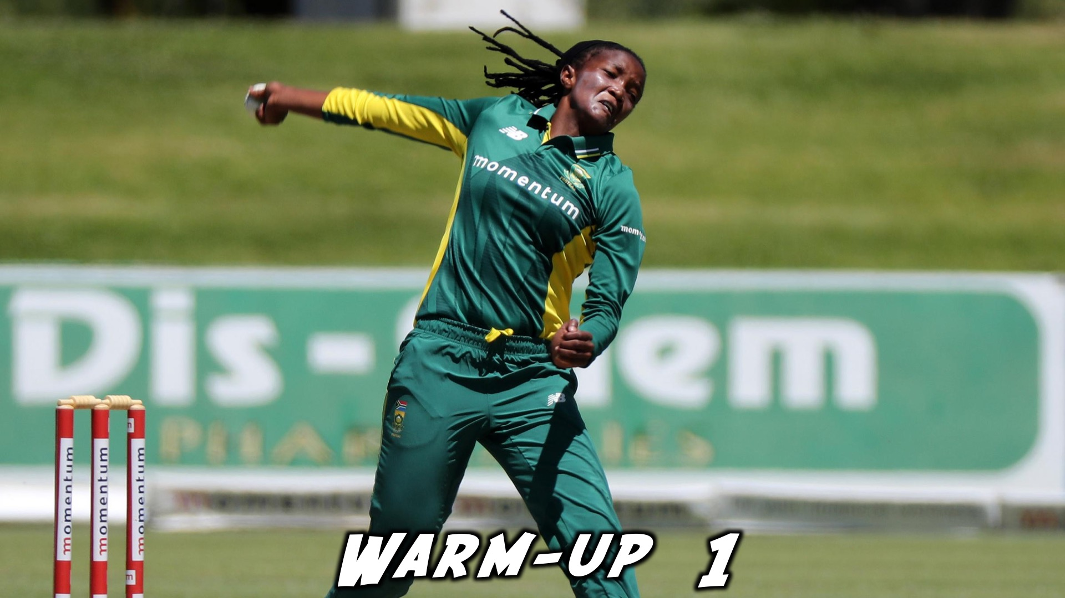
Notes:
Warm-up 1

Slide 14
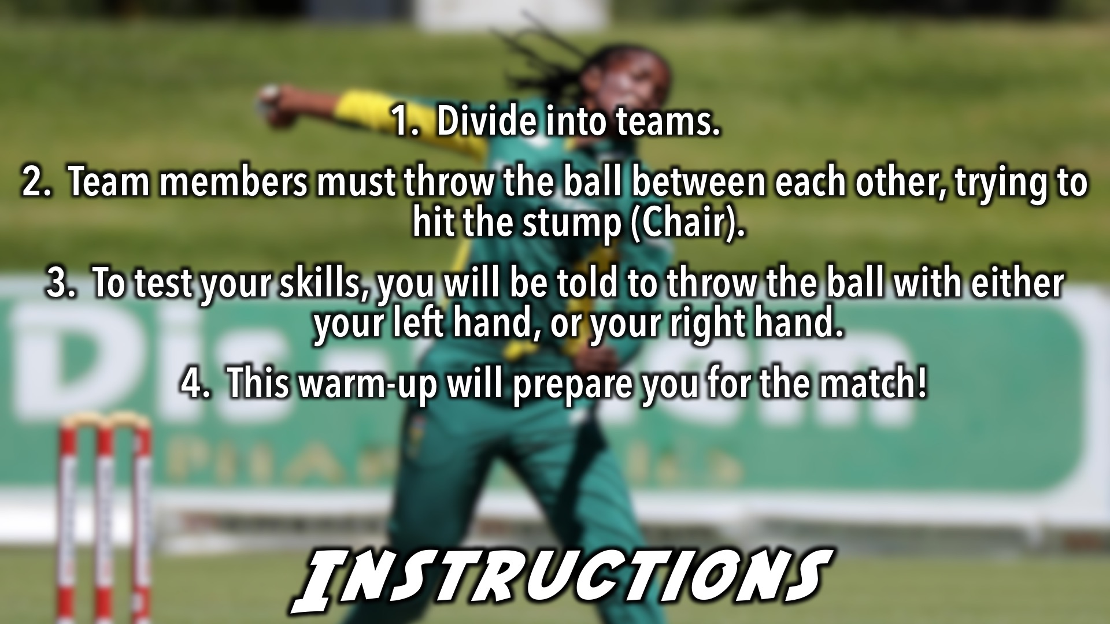
Notes:
Warm-up 1 Instructions: (1) Divide into teams. (2) Team members must throw the ball between each other, trying to hit the stump (Chair). (3) To test your skills, you will be told to throw the ball with either your left hand, or your right hand. (4) This warm-up will prepare you for the match!

Slide 15
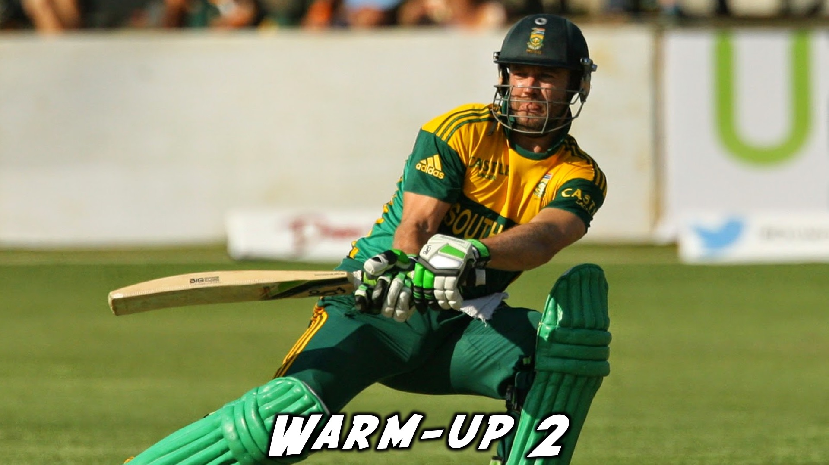
Notes:
Warm-up 2

Slide 16
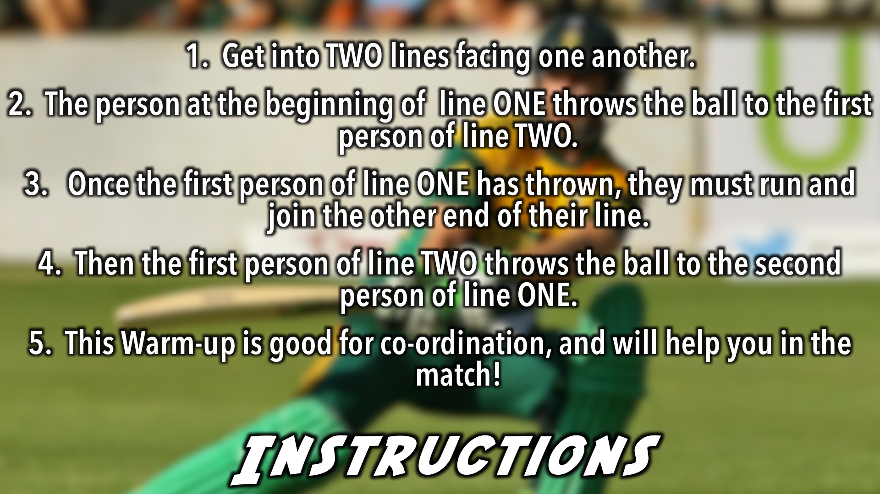
Notes:
Warm-up 2 Instructions: (1) Get into TWO lines facing one another. (2) The person at the beginning of line ONE throws the ball to the first person of line TWO. (3) Once the first person of line ONE has thrown, they must run and join the other end of their line. (4) Then the first person of line TWO throws the ball to the second person of line ONE. (5) This Warm-up is good for co-ordination and will help you in the match!

Slide 17
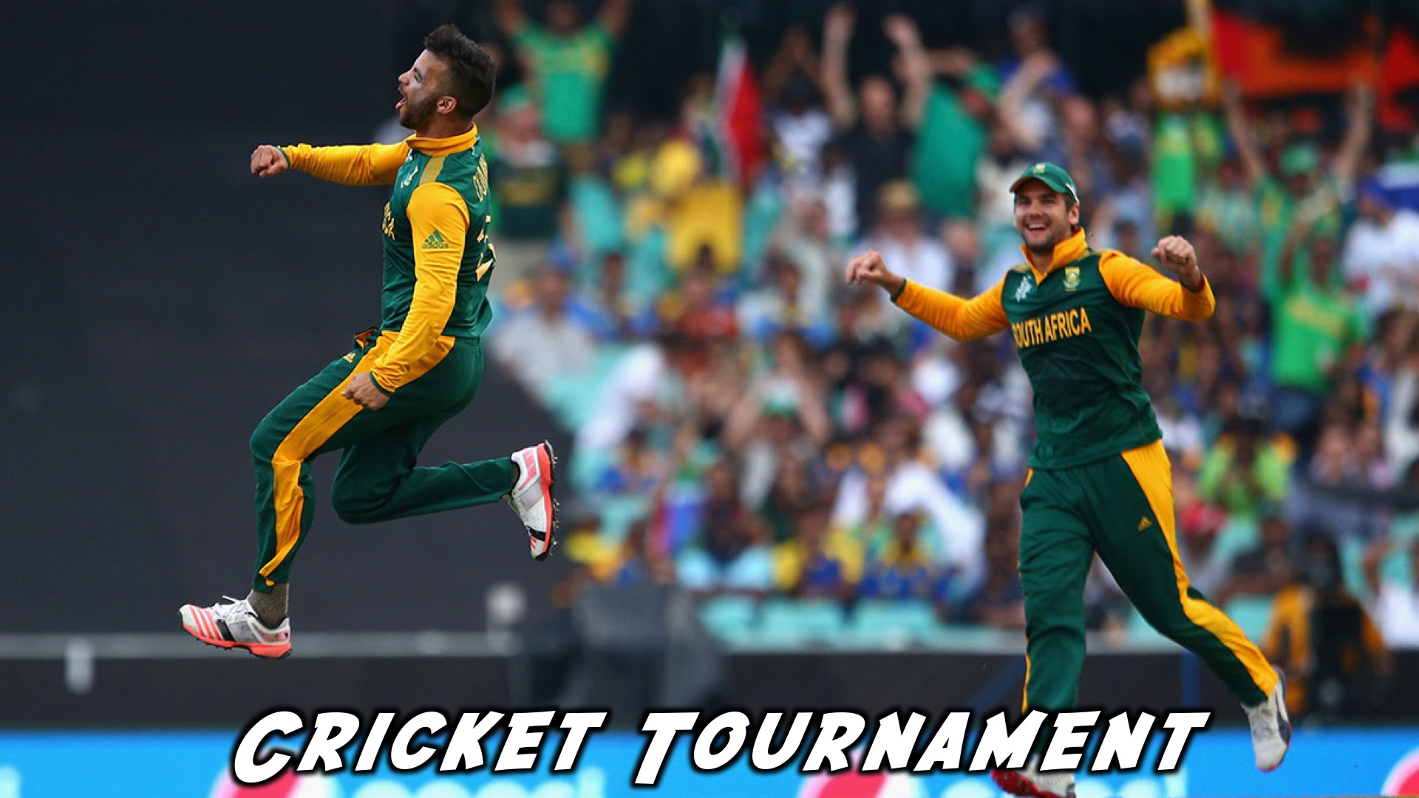
Notes:
Cricket Tournament

Slide 18
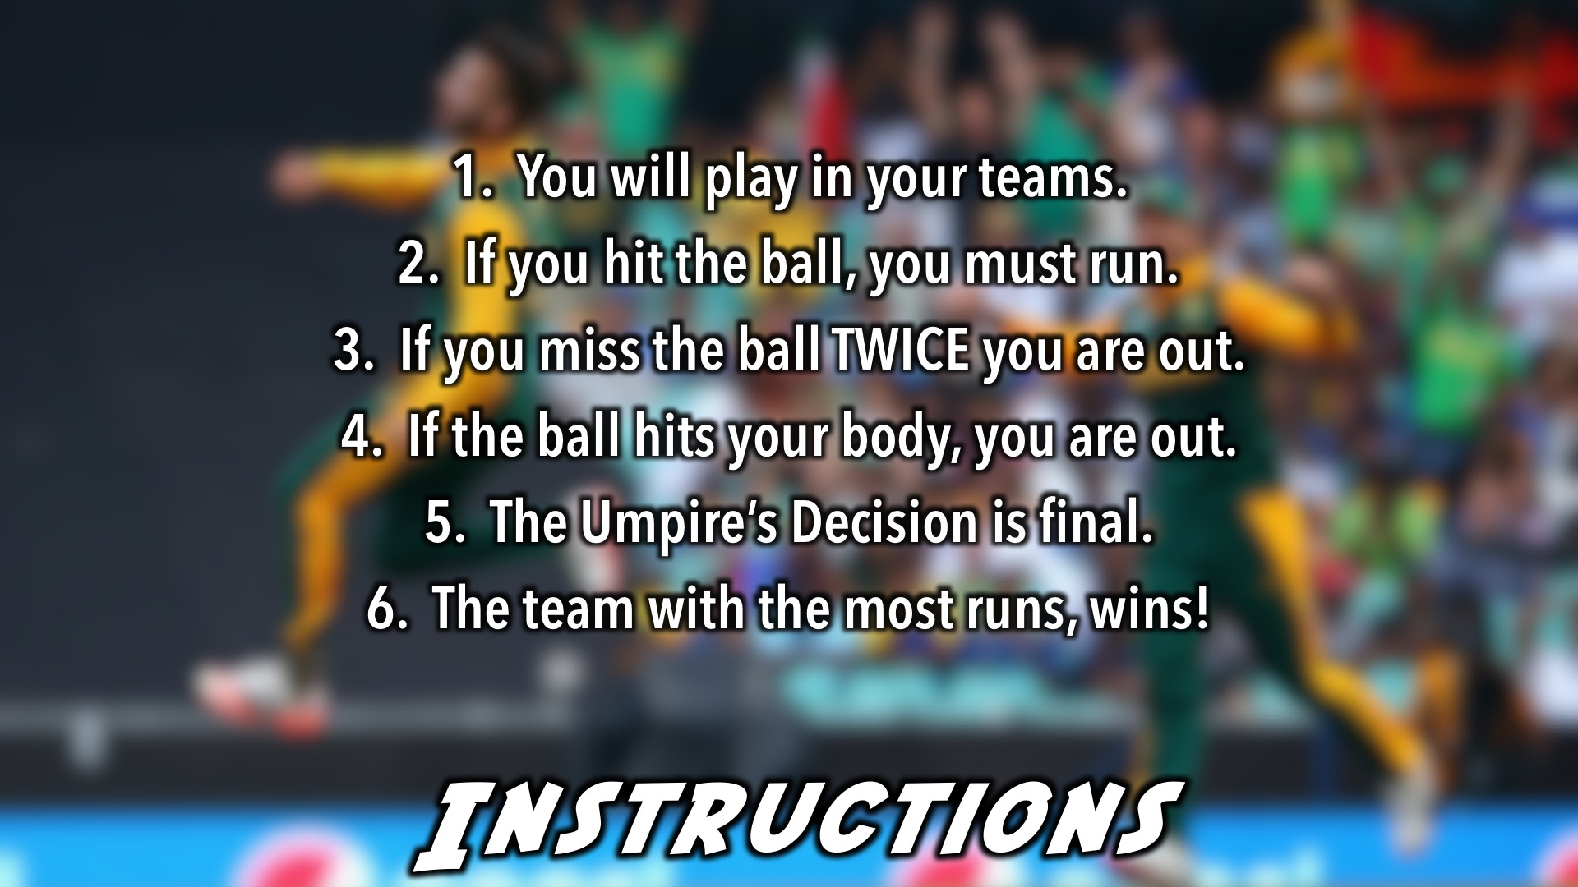
Notes:
Cricket Tournament Instructions: (1) You will play in your teams. If you hit the ball, you must run. (2) If you miss the ball TWICE you are out. (3) If the ball hits your body, you are out. (4) The Umpire’s Decision is final. (5) The team with the most runs, wins!

Slide 19

Notes:
And the winners are…

Slide 20
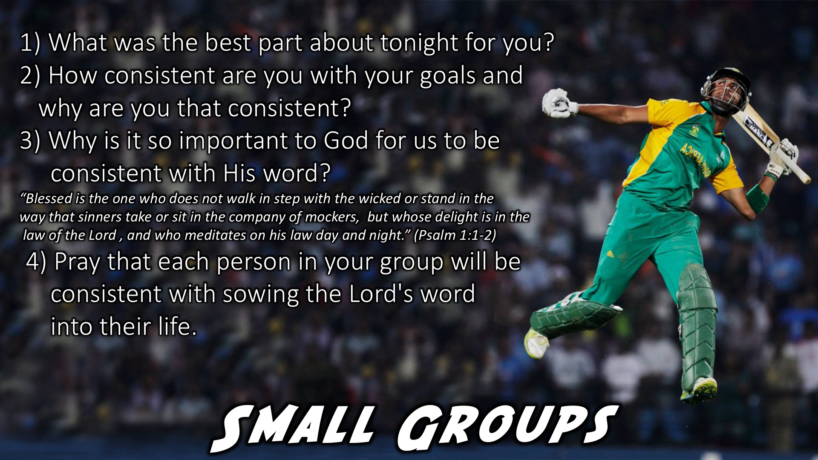
Notes:
Small Group Time: (1) What was the best part about tonight for you? (2) How consistent are you with your goals and why are you that consistent? (3) “Blessed is the one who does not walk in step with the wicked or stand in the way that sinners take or sit in the company of mockers, but whose delight is in the law of the Lord, and who meditates on his law day and night.” (Psalm 1:1-2) Why is it so important to God for us to be consistent with His word? (4) Pray that each person your group will be consistent with sowing the Lord's word into their life.

Slide 21
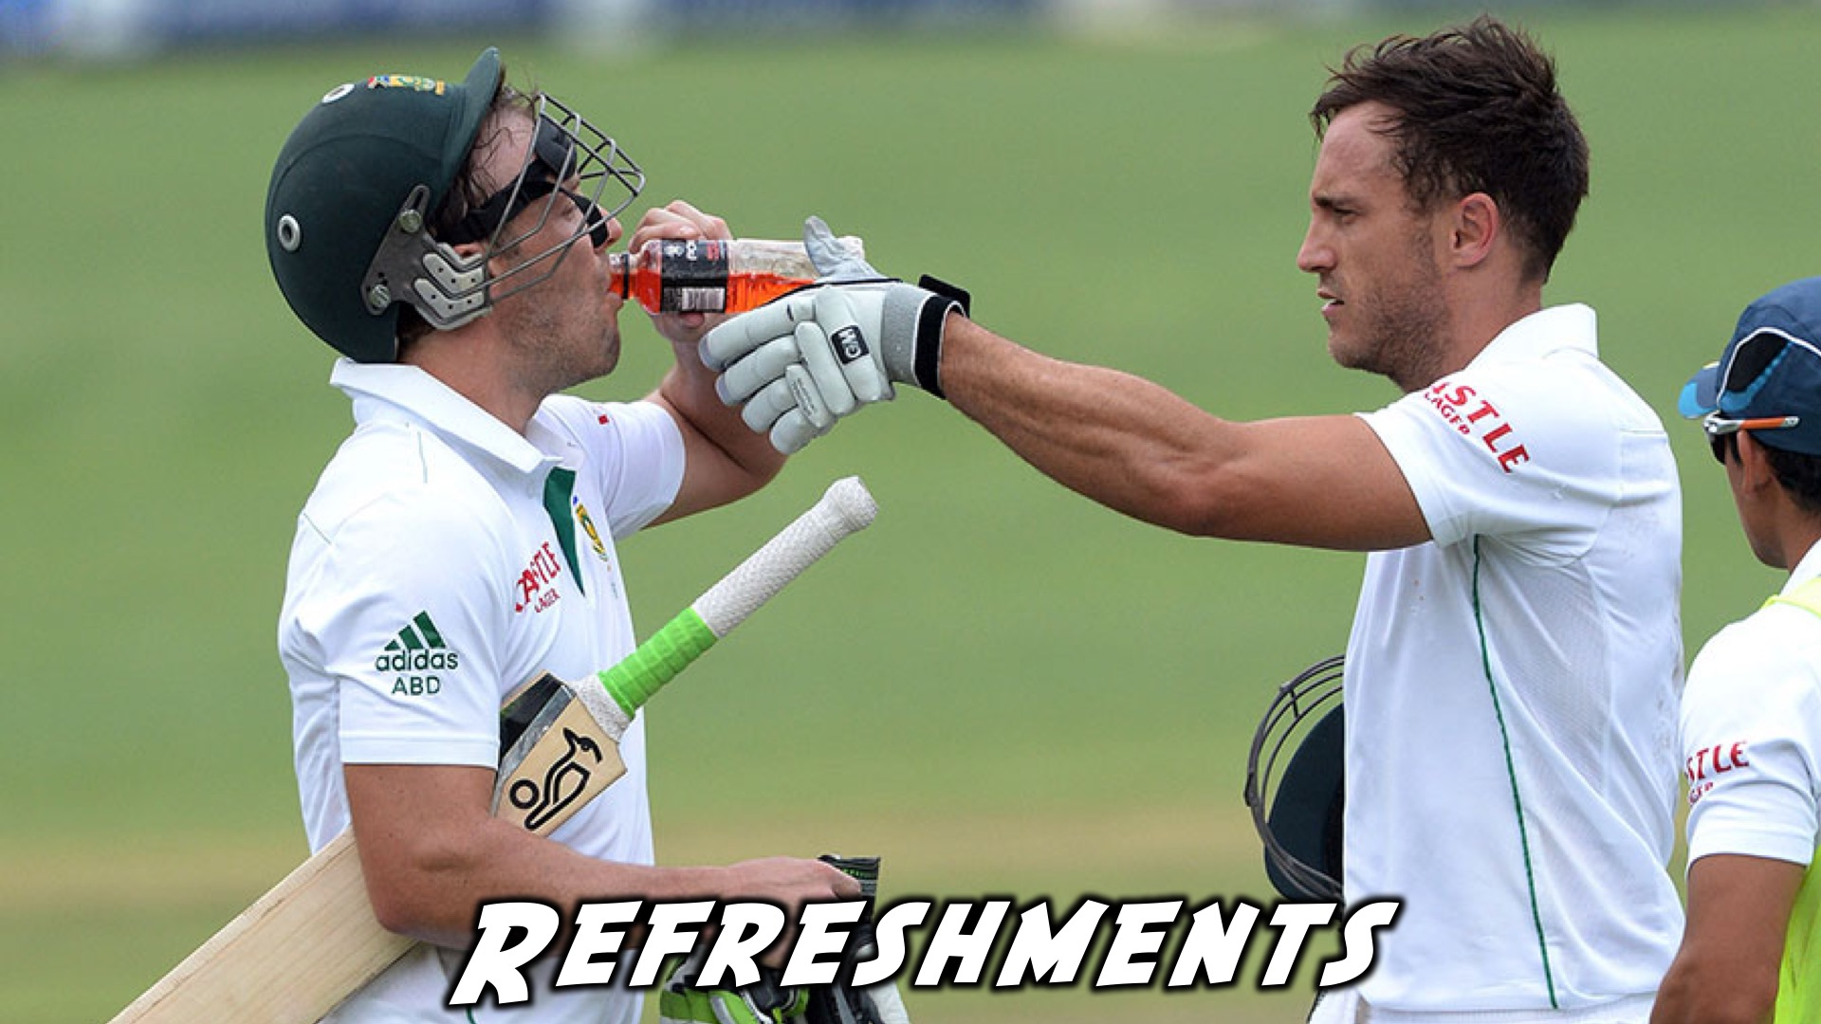
Notes:
Refreshments: It is time for refreshments.

Slide 22
Notes:
Don’t forget to join our WhatsApp group for regular updates!

