Slide 1

Notes:
Welcome to Sporty Friday.

Slide 2

Notes:
Tonight is Basketball Night!

Slide 3
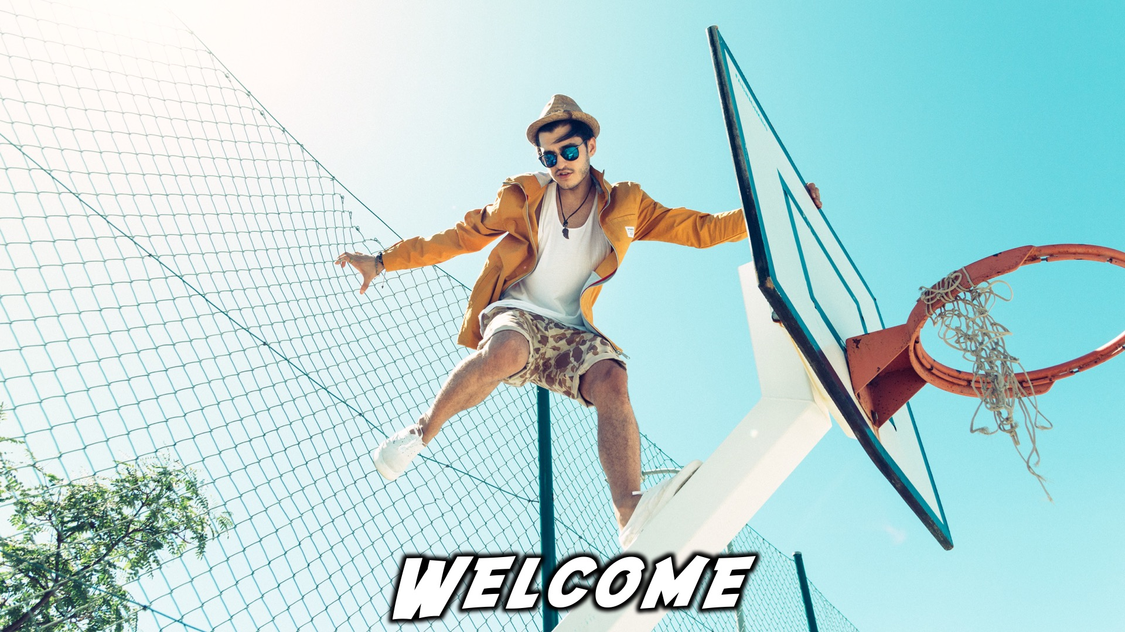
Notes:
Welcome to regulars and newcomers!

Slide 4
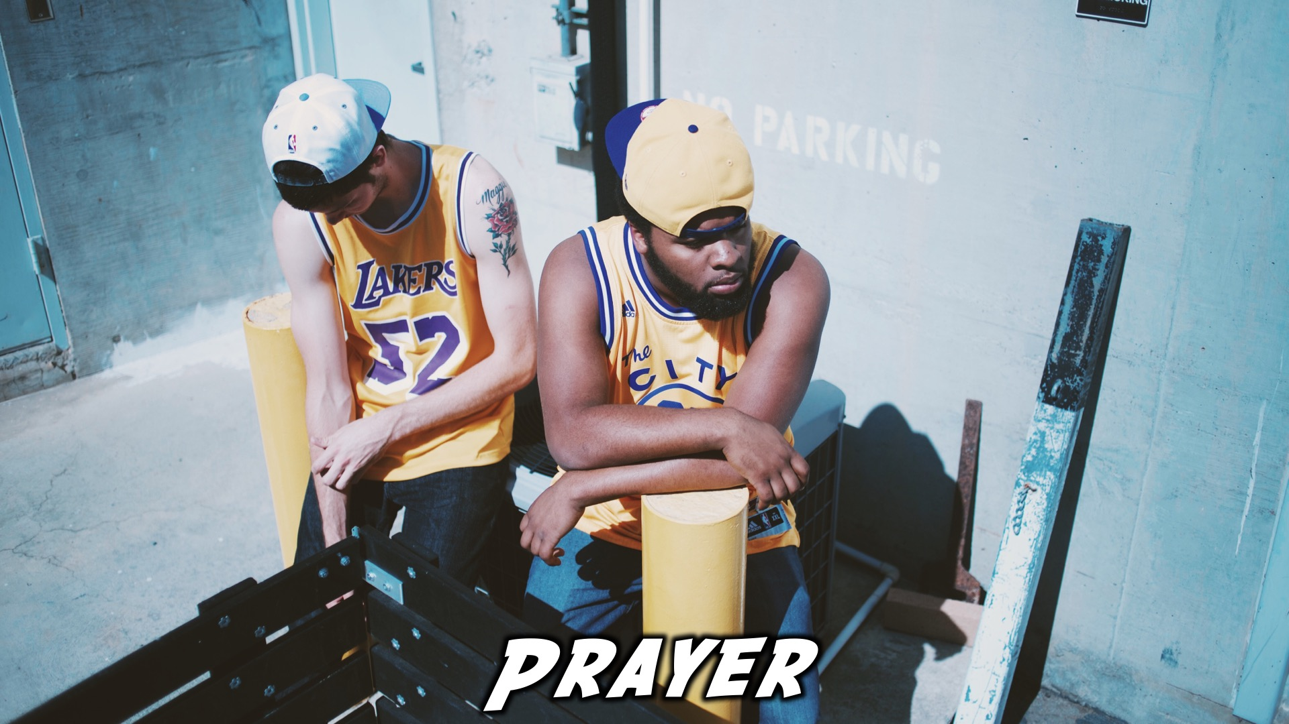
Notes:
Prayer: Let’s open our meeting in prayer.

Slide 5
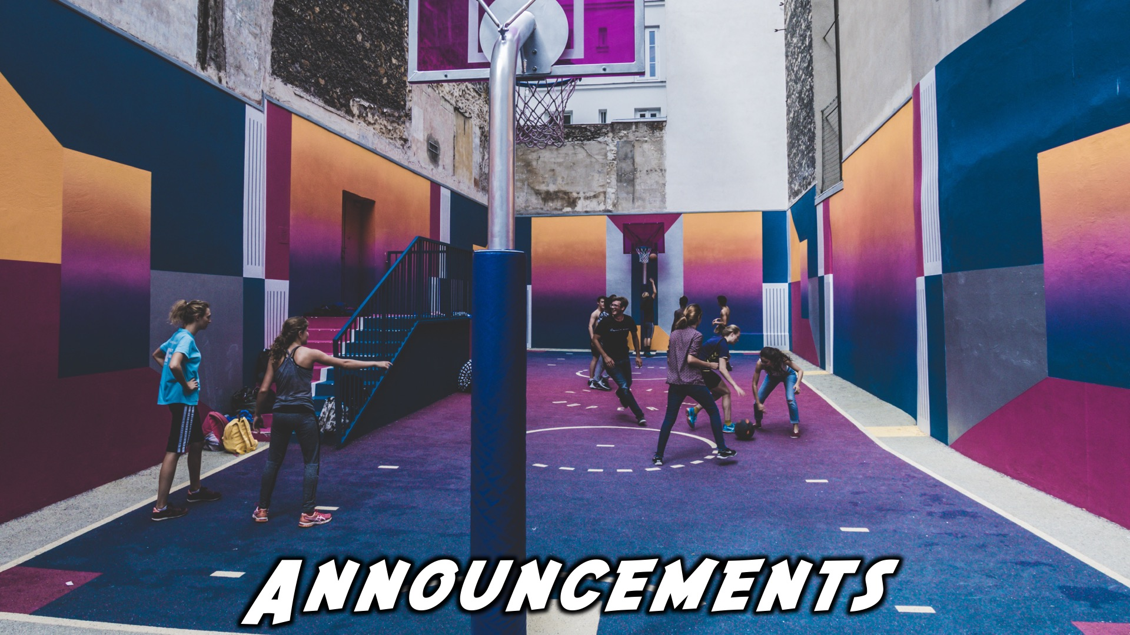
Notes:
Please listen up for the following announcements!

Slide 6
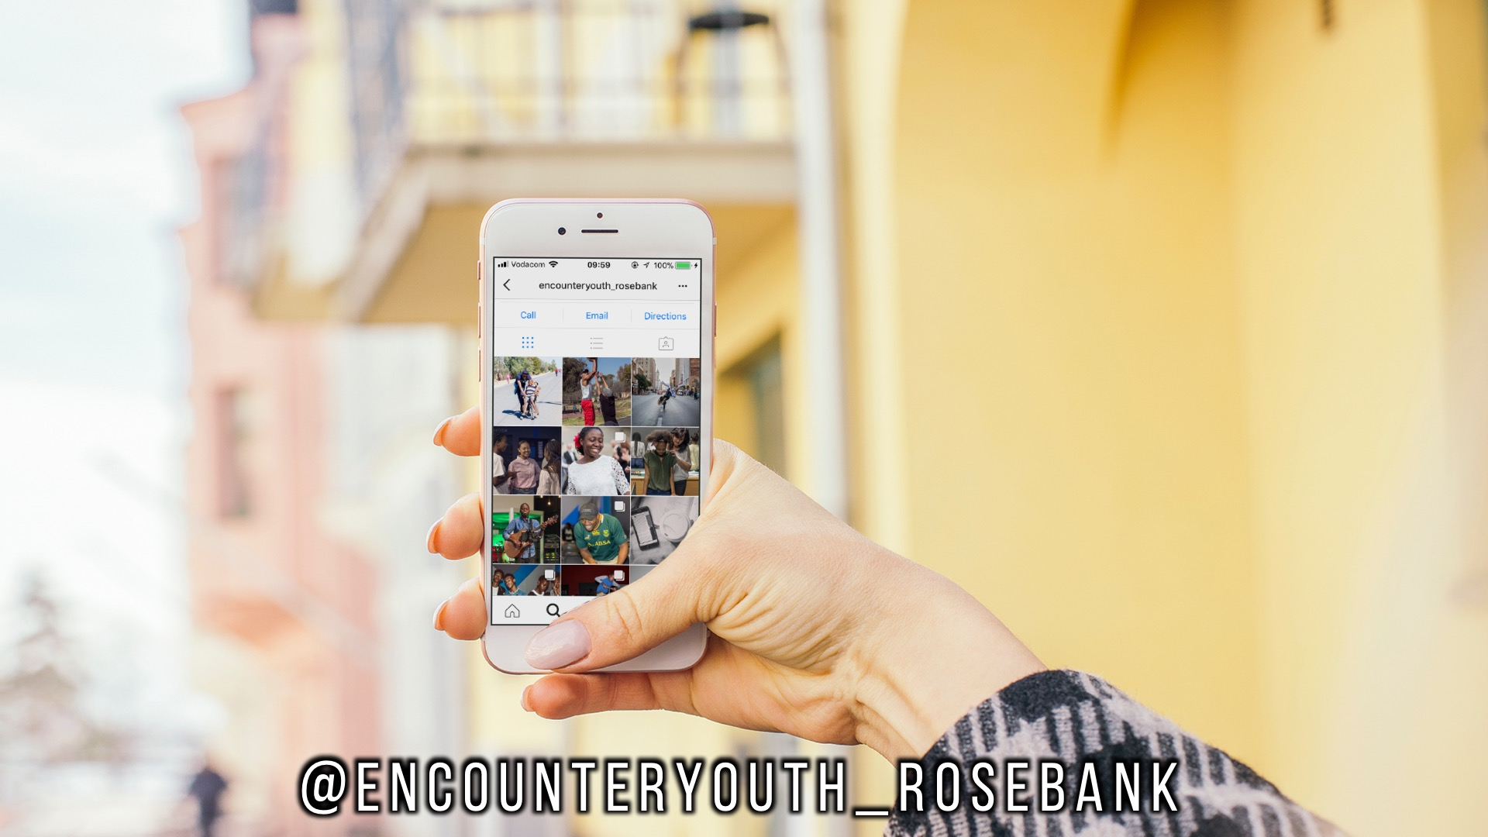
Notes:
Announcements: Follow us on Instagram! @EncounterYouth_Rosebank

Slide 7

Notes:
Announcements: Join our Friday Night WhatsApp group!

Slide 8

Notes:
Announcements: Join us this Sunday as we learn more about how a disciple is mission minded.

Slide 9
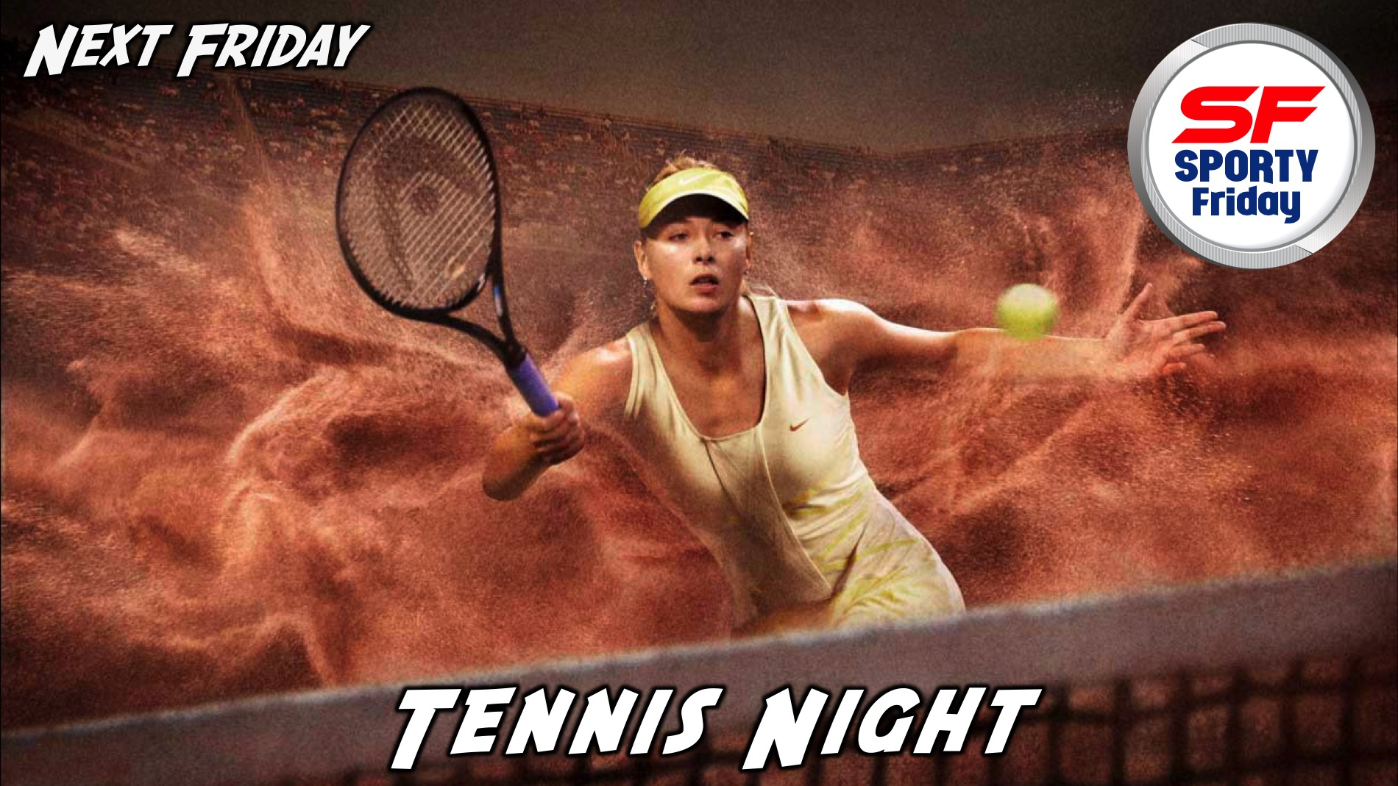
Notes:
Announcements: Join us next Friday for our Tennis Night!

Slide 10

Notes:
Tonight is Basketball Night!

Slide 11

Notes:
Video Clip: Trailer of the film Thunderstruck. Find the trailer on Youtube: https://www.youtube.com/watch?v=65qyPfZe9Eg

Slide 12

Notes:
Video Clip: Trailer of the film Thunderstruck. Find the trailer on Youtube: https://www.youtube.com/watch?v=65qyPfZe9Eg

Slide 13
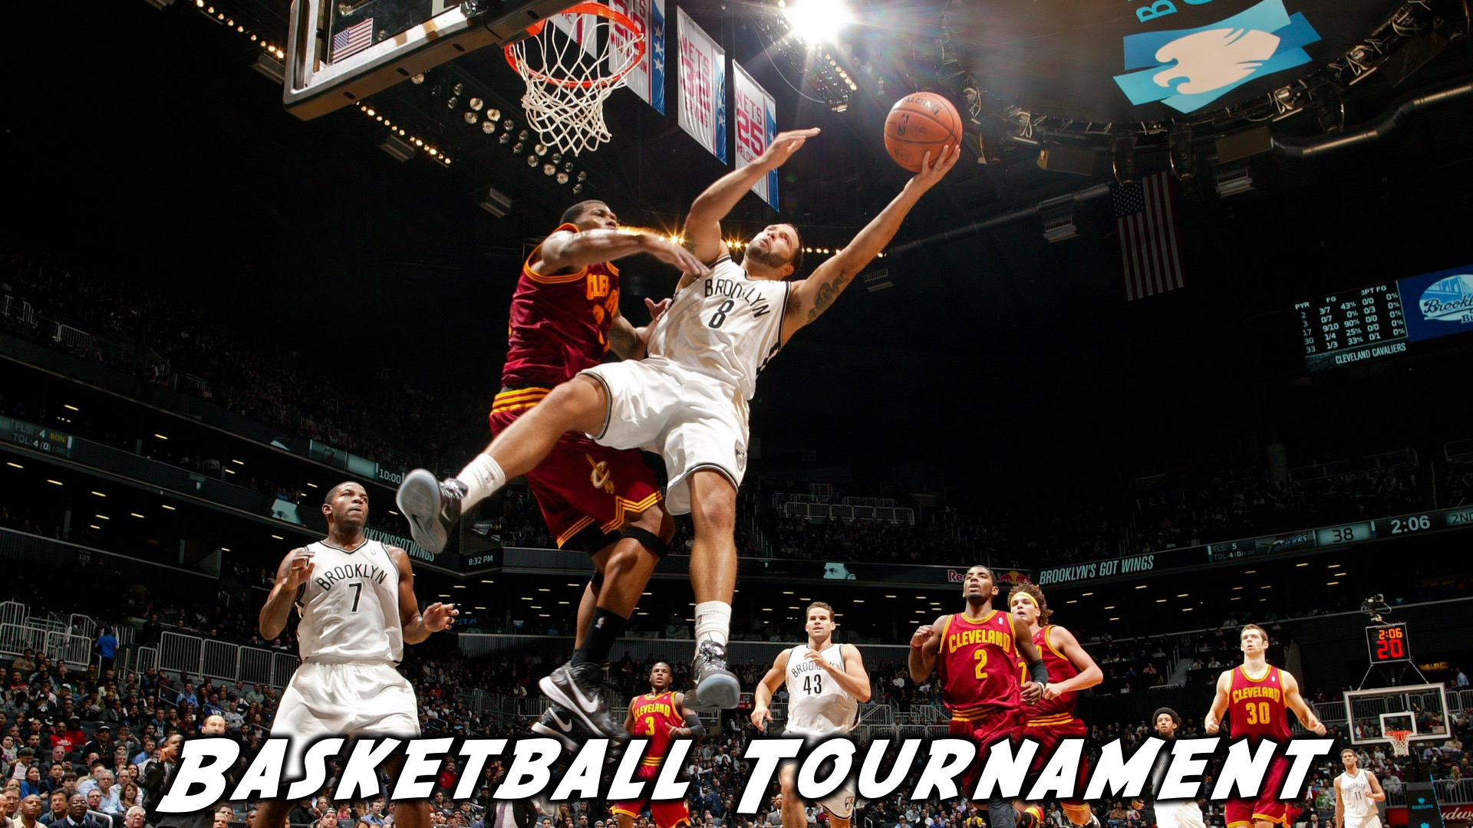
Notes:
It’s now time for our Basketball tournament

Slide 14
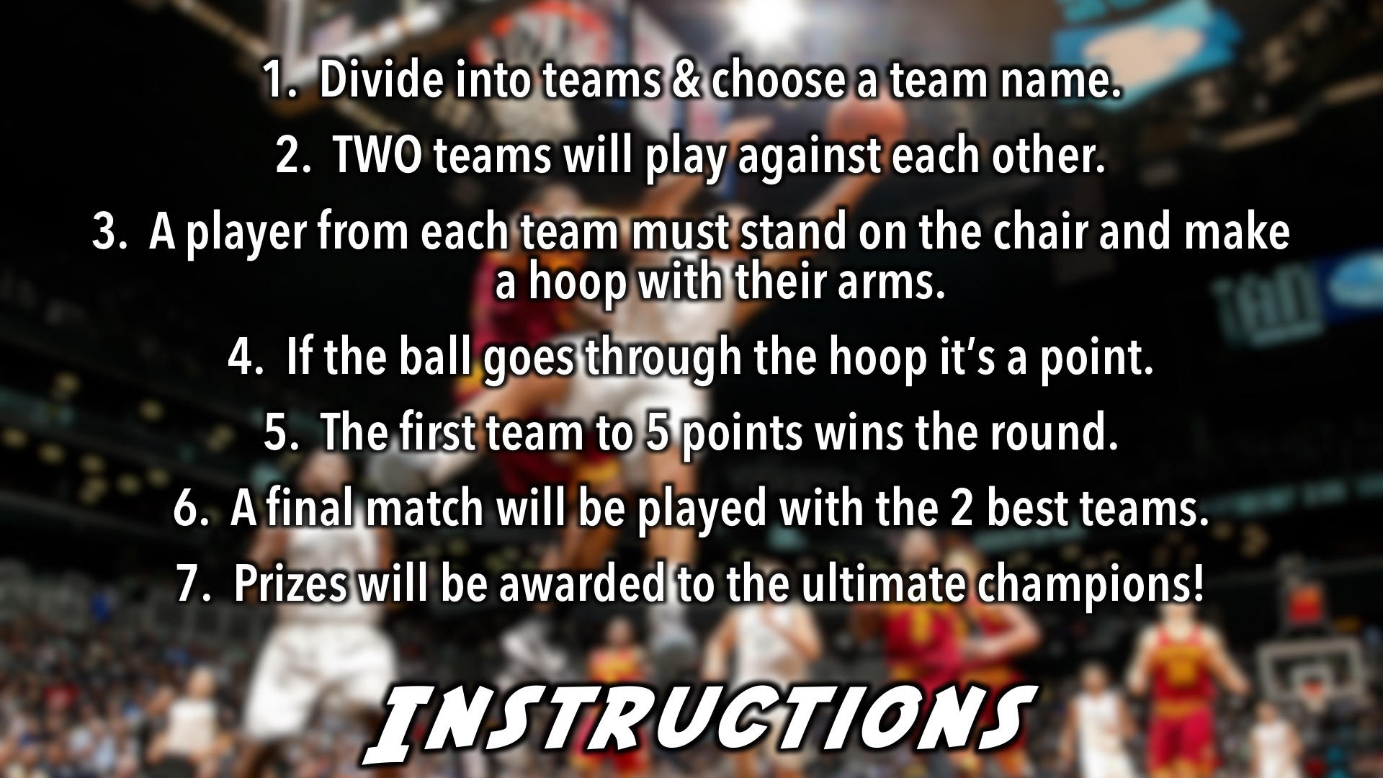
Notes:
Basketball Tournament Instructions - Listen Carefully! (1) Divide into teams & choose a team name. (2) TWO teams will play against each other. (3) A player from each team must stand on the chair and make a hoop with their arms. (4) If the ball goes through the hoop it’s a point. (5) The first team to 5 points wins the round. (6) A final match will be played with the 2 best teams. (7) Prizes will be awarded to the ultimate champions!

Slide 15

Notes:
And the winners are…

Slide 16
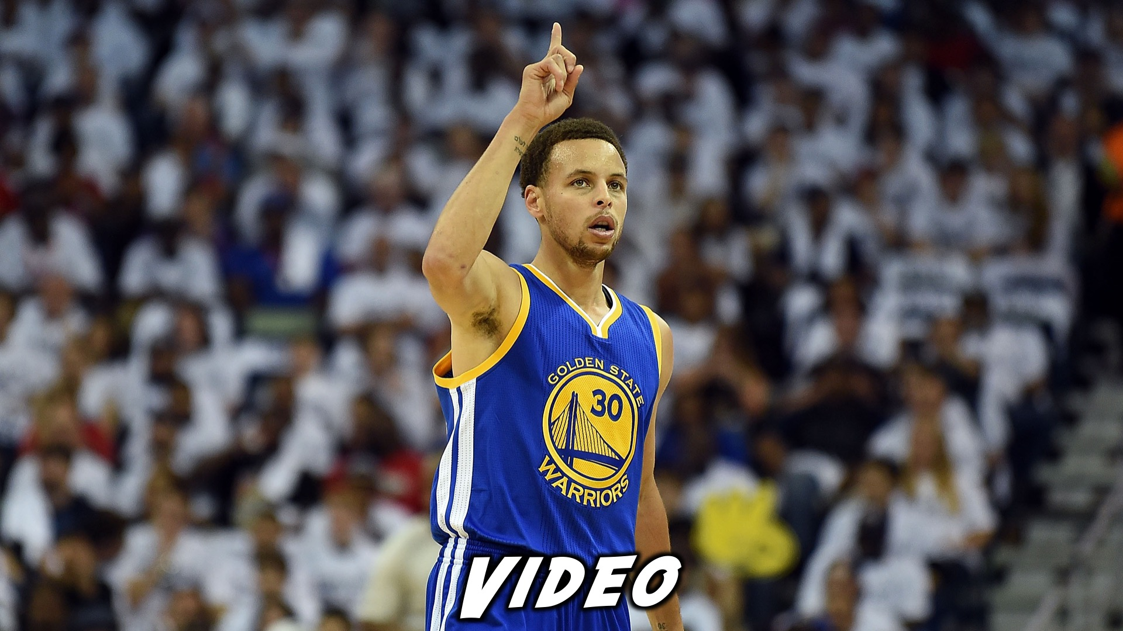
Notes:
Video of Stephen Curry. This will be played before small groups. Find this video on YouTube at: https://www.youtube.com/watch?v=ZCPyH52JCRw

Slide 17
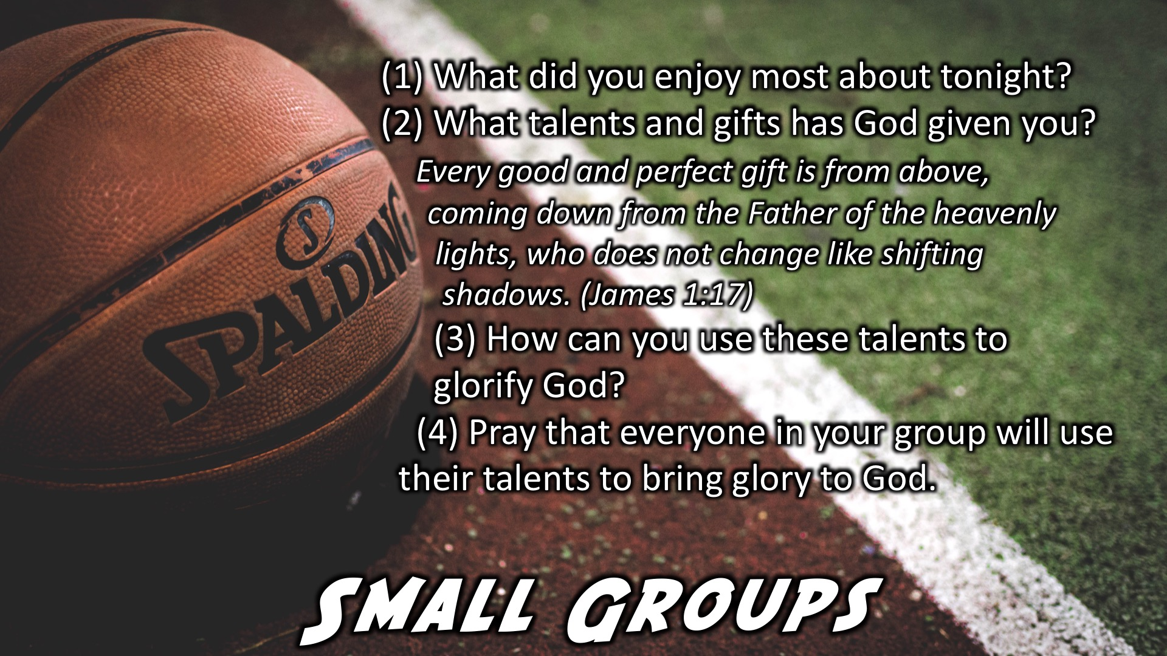
Notes:
Small Group Time: (1) What did you enjoy most about tonight? (2) What talents and gifts has God given you? Every good and perfect gift is from above, coming down from the Father of the heavenly lights, who does not change like shifting shadows. (James 1:17) (3) How can you use these talents to glorify God? (4) Pray that everyone in your group will use their talents to bring glory to God.

Slide 18

Notes:
Refreshments: It is time for refreshments.

Slide 19
Notes:
Don’t forget to join our WhatsApp group for regular updates!

Slide 20

Notes:
Find us on Instagram!!

