Slide 1

Notes:
Welcome to Sporty Friday.

Slide 2
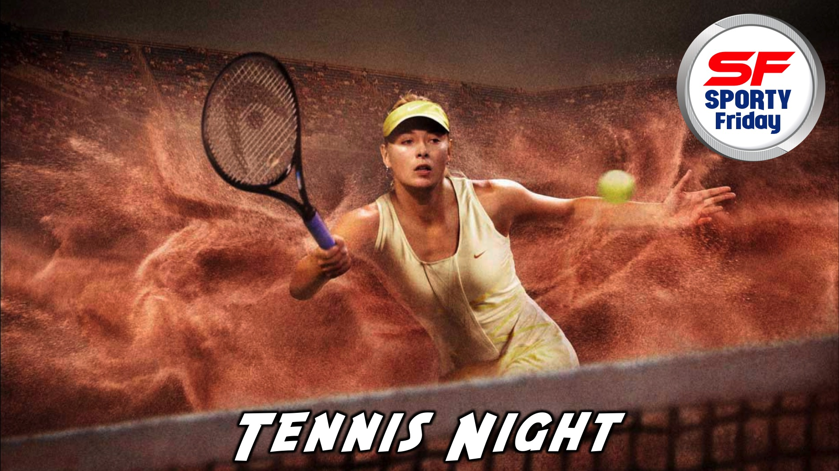
Notes:
Tonight is Tennis Night!

Slide 3

Notes:
Welcome to regulars and newcomers!

Slide 4
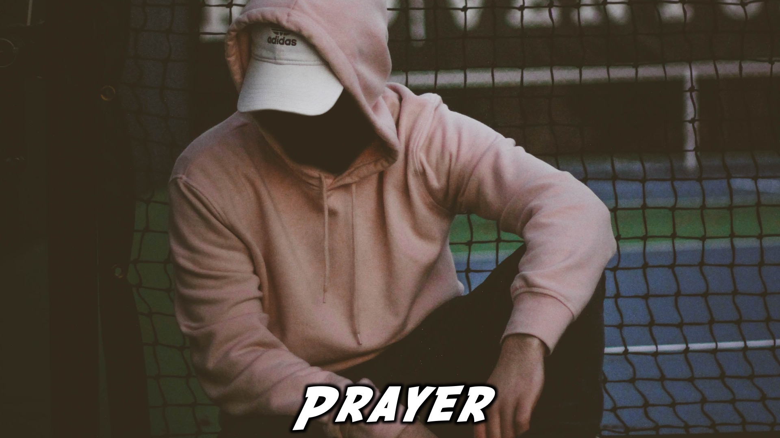
Notes:
Prayer: Let’s open our meeting in prayer.

Slide 5
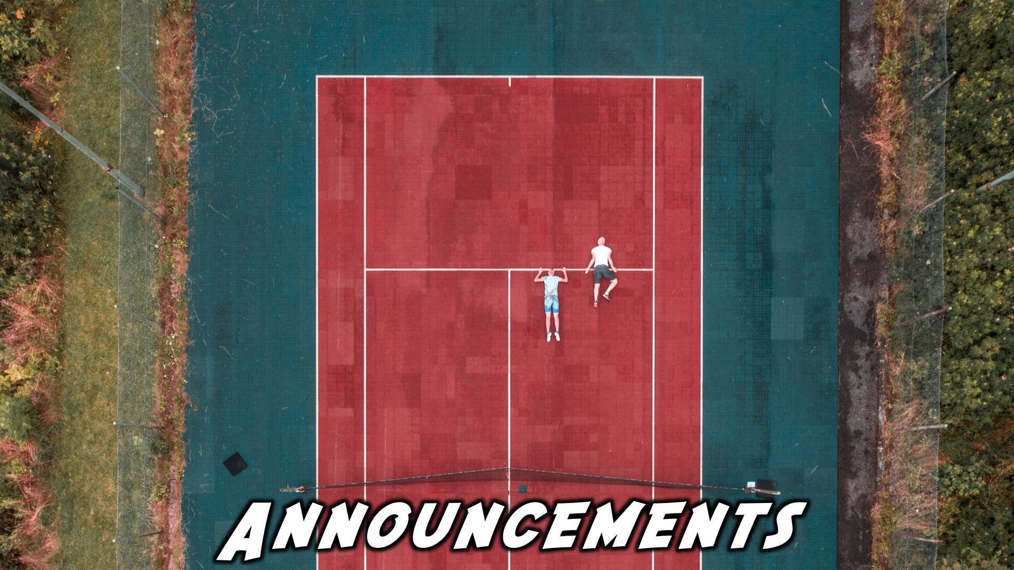
Notes:
Please listen up for the following announcements!

Slide 6
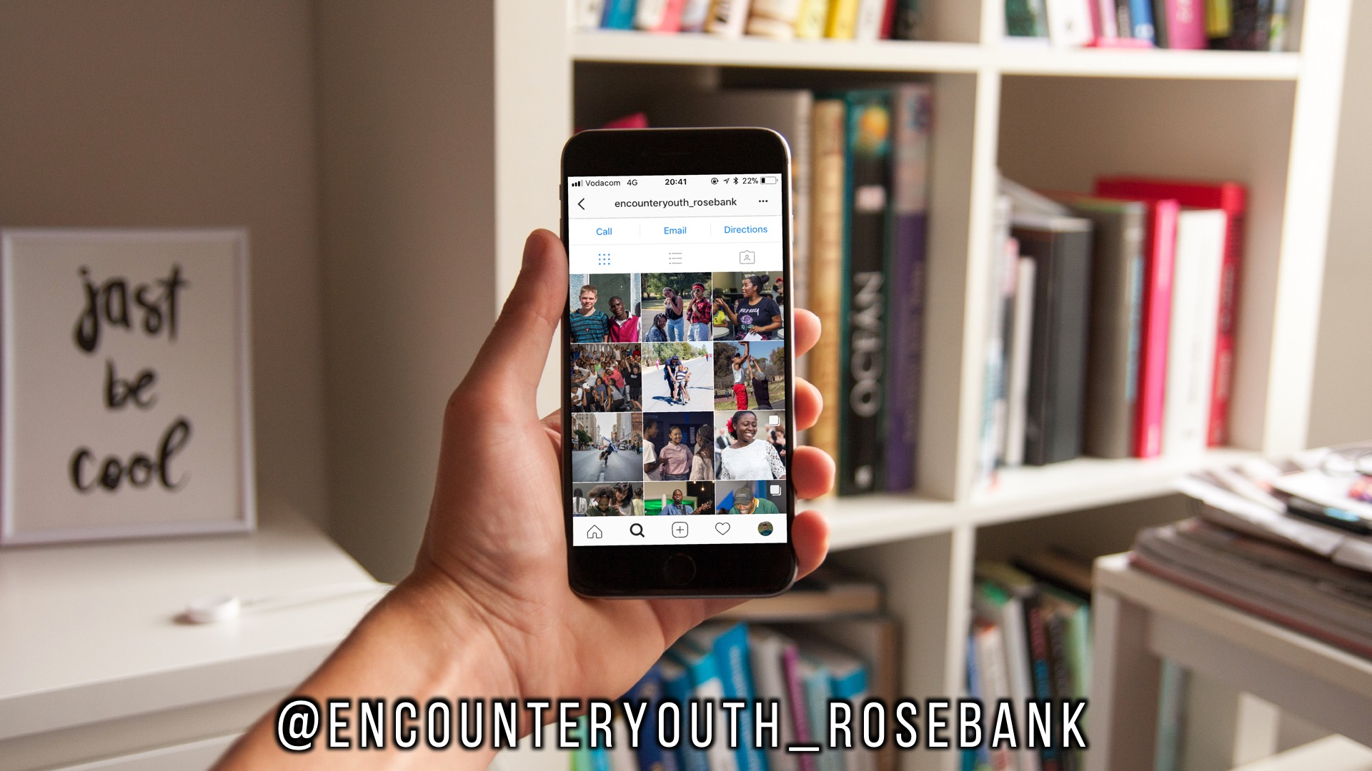
Notes:
Announcements: Follow us on Instagram! @EncounterYouth_Rosebank

Slide 7

Notes:
Announcements: Join our Friday Night WhatsApp group!

Slide 8

Notes:
Don’t forget about our Zoo Lake Youth Outing on Wednesday the 21st March from 9am to 12.

Slide 9

Notes:
Announcements: Join us this Sunday as we learn more about how a disciple is Leadership-Empowered.

Slide 10

Notes:
Announcements: Join us next Friday for our Football Night!

Slide 11
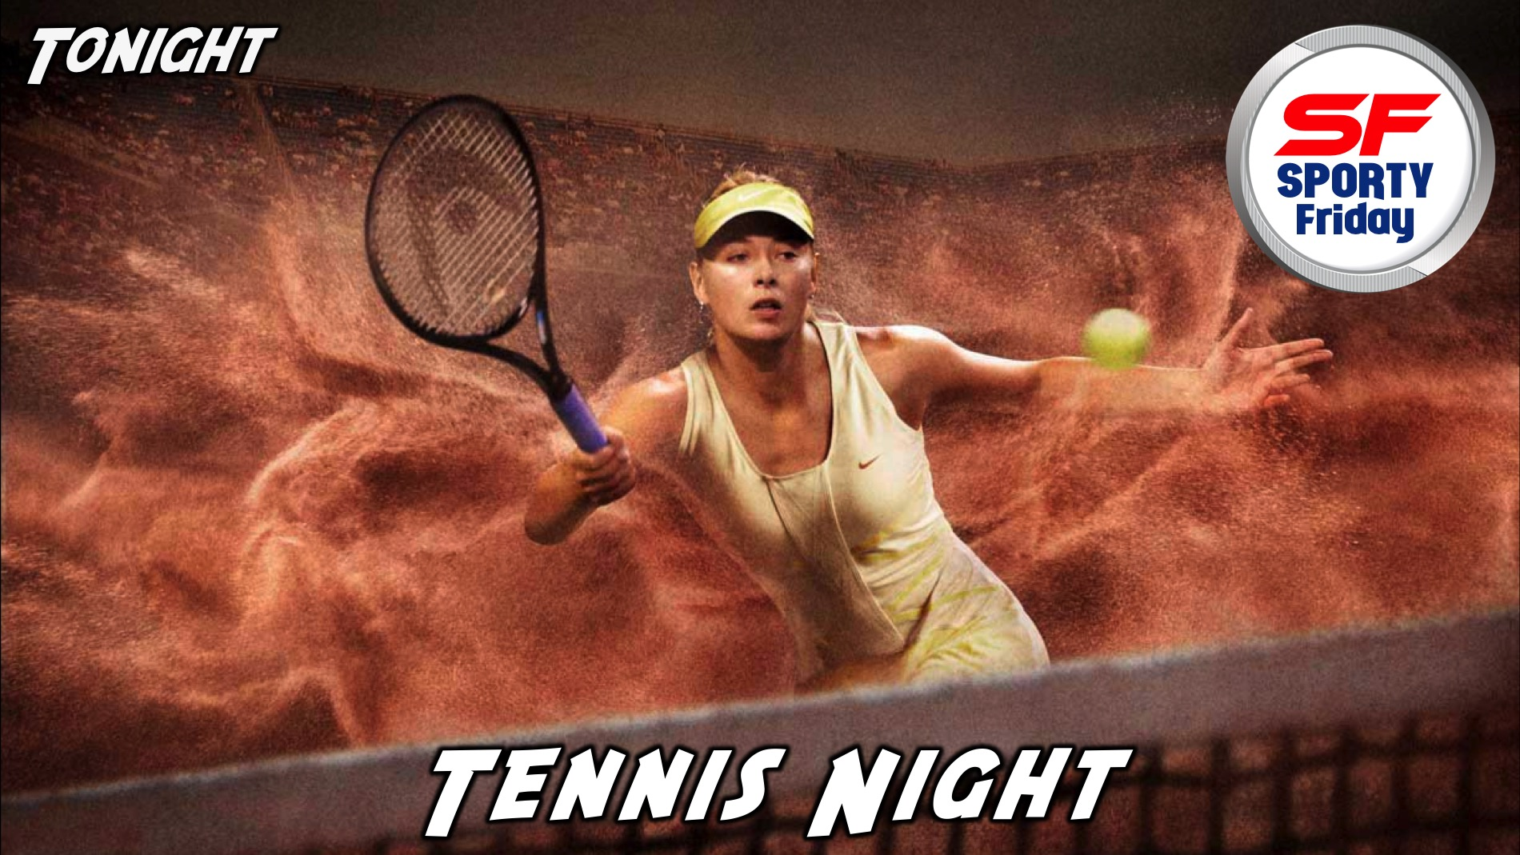
Notes:
Tonight is Tennis Night!

Slide 12

Notes:
Video Clip: Tennis Stereotypes.

Slide 13
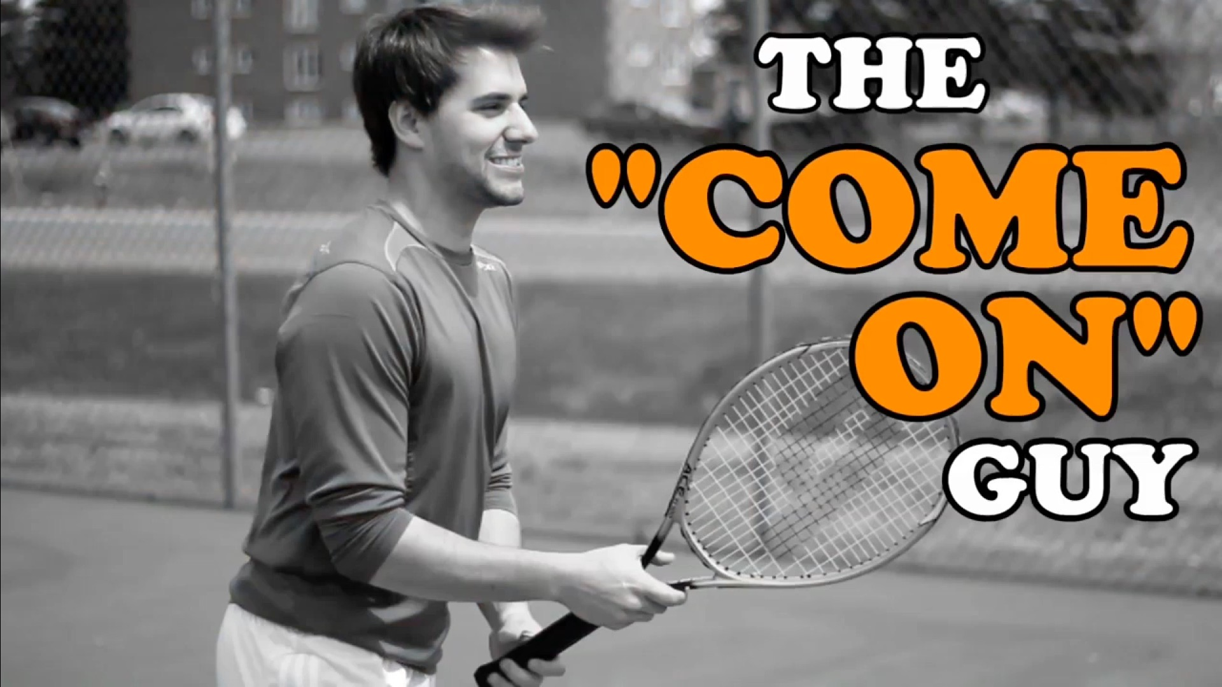
Notes:
Video Clip: Tennis Stereotypes. Find this video on Youtube: https://www.youtube.com/watch?v=gF8QGGHcYuw&t=137s

Slide 14
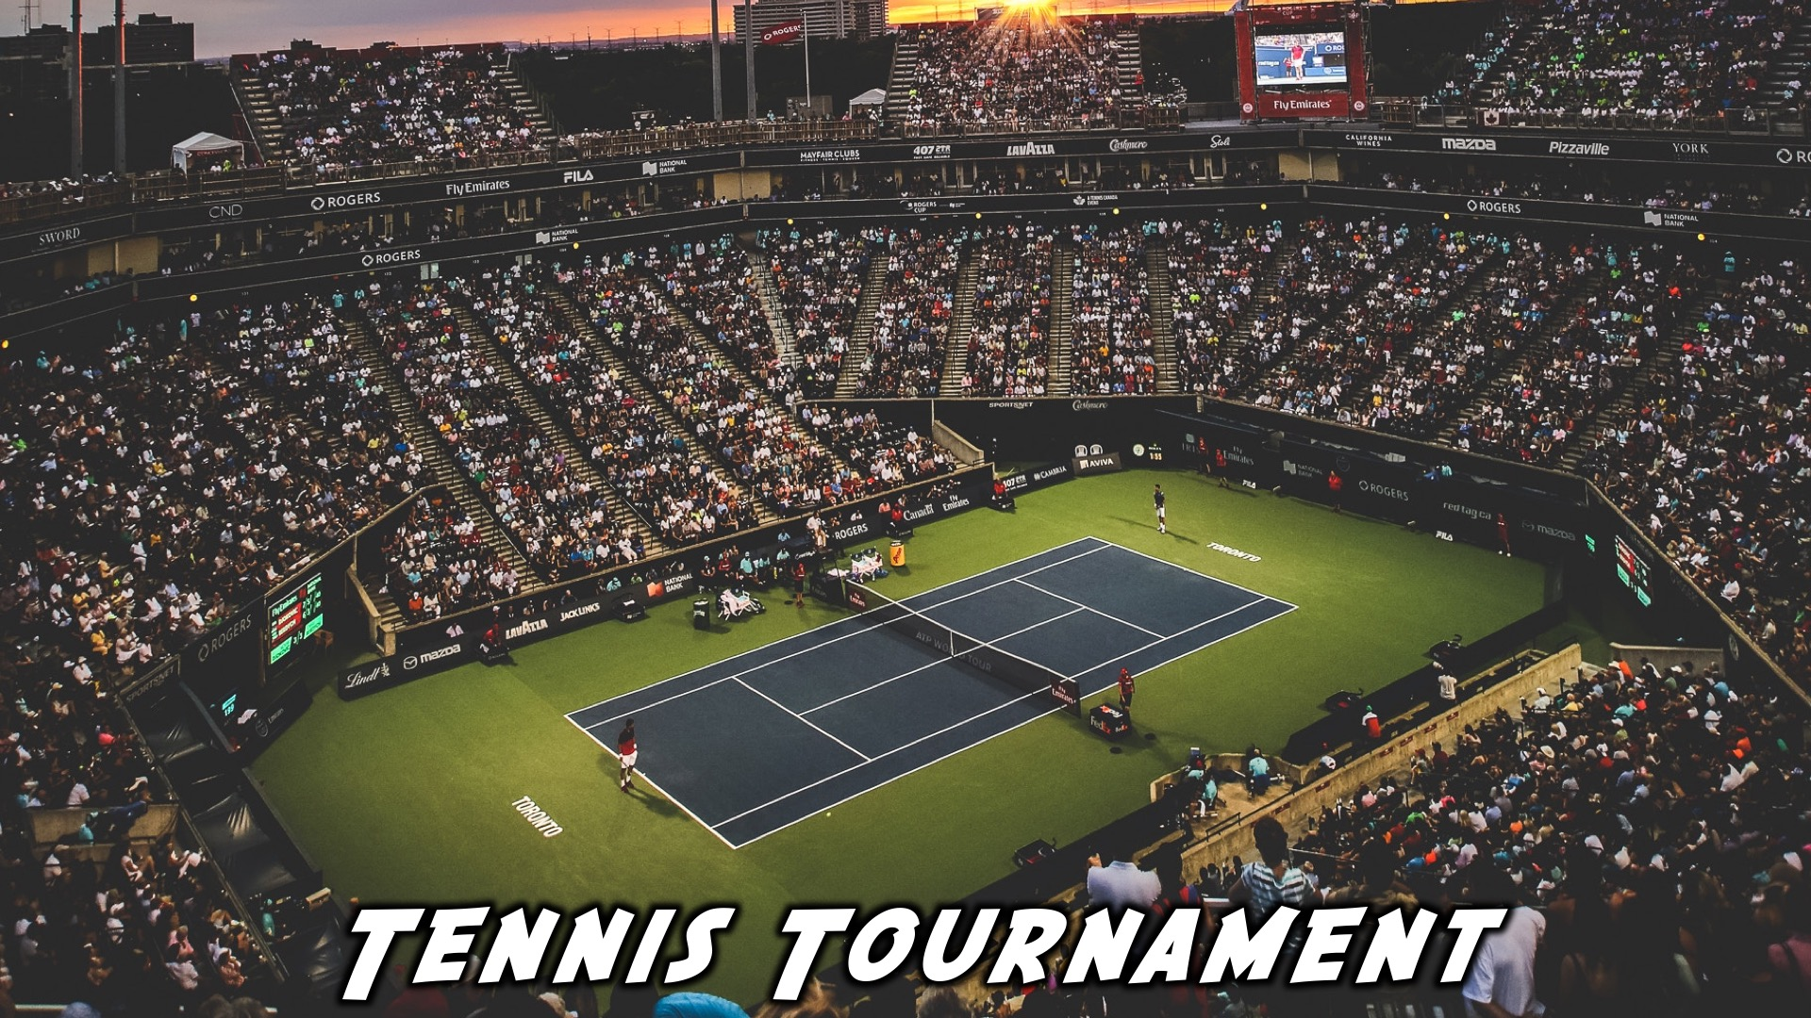
Notes:
It’s now time for our Tennis tournament

Slide 15
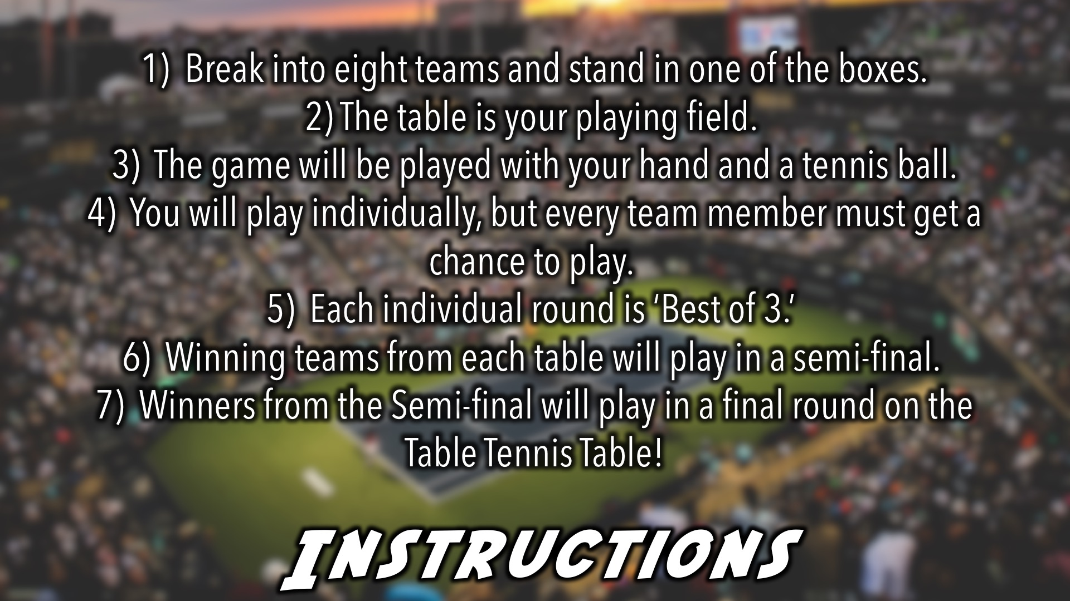
Notes:
Tennis Tournament Instructions: (1) Break into eight teams and stand in one of the boxes. (2) The table is your playing field. (3) The game will be played with your hand and a tennis ball. (4) You will play individually, but every team member must get a chance to play. (5) Each individual round is ‘Best of 3.’ (6) Winning teams from each table will play in a semi-final. (7) Winners from the Semi-final will play in a final round on the Table Tennis Table!

Slide 16
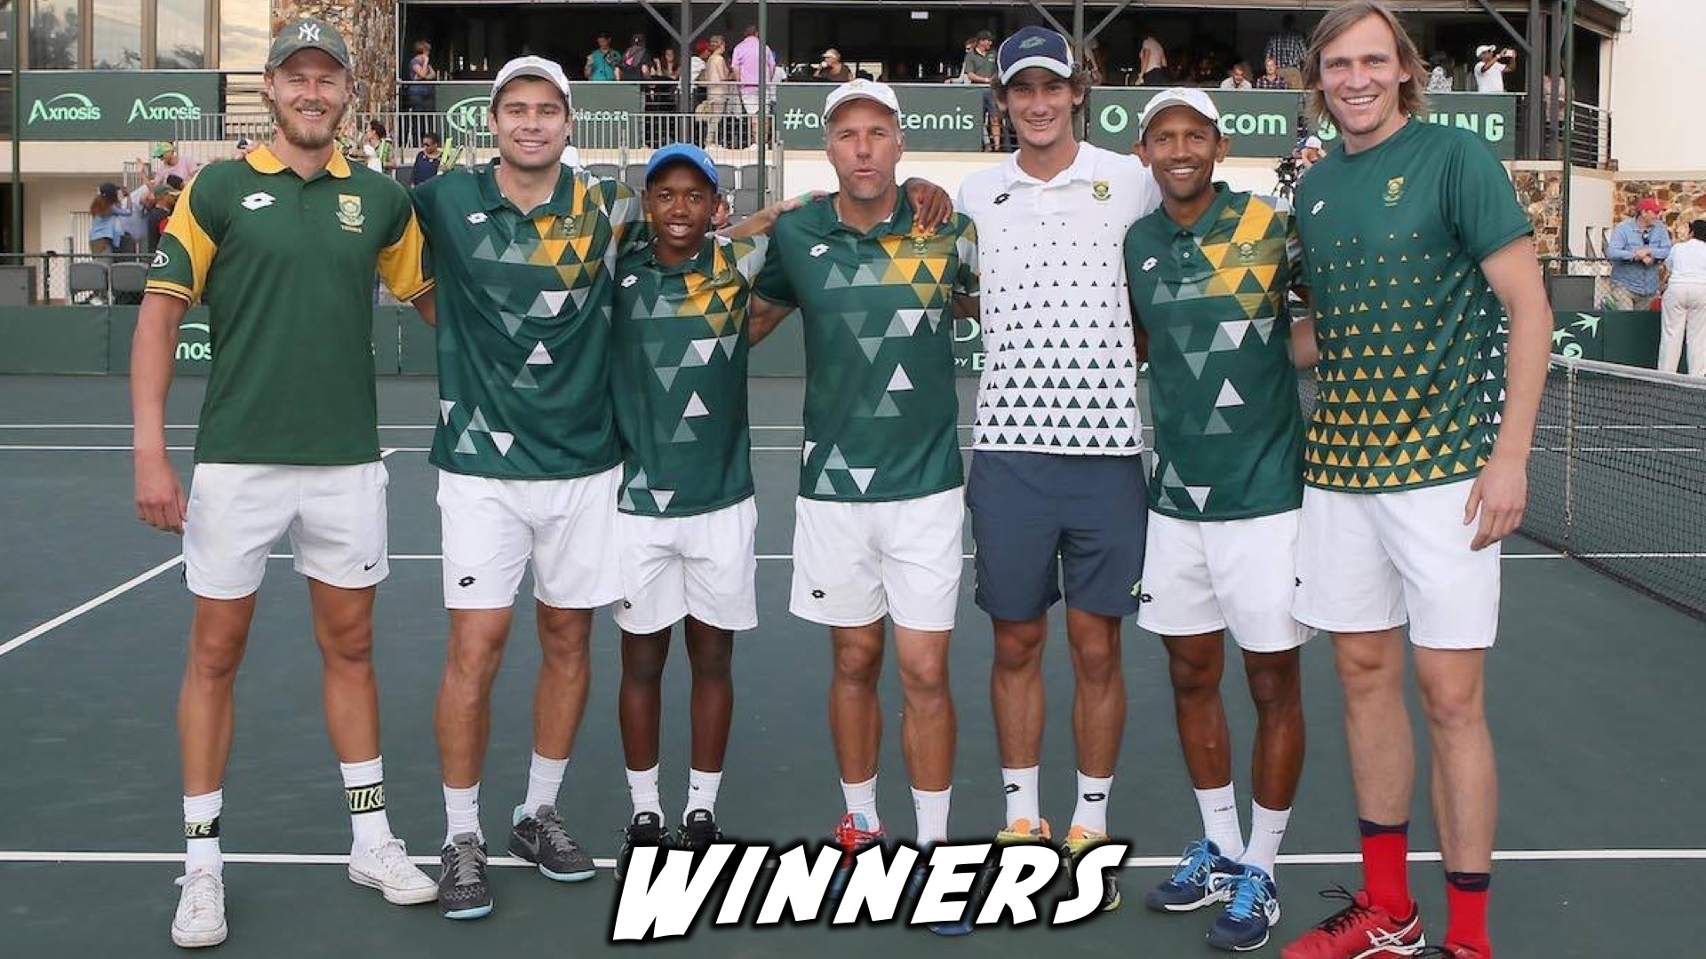
Notes:
And the winners are…

Slide 17
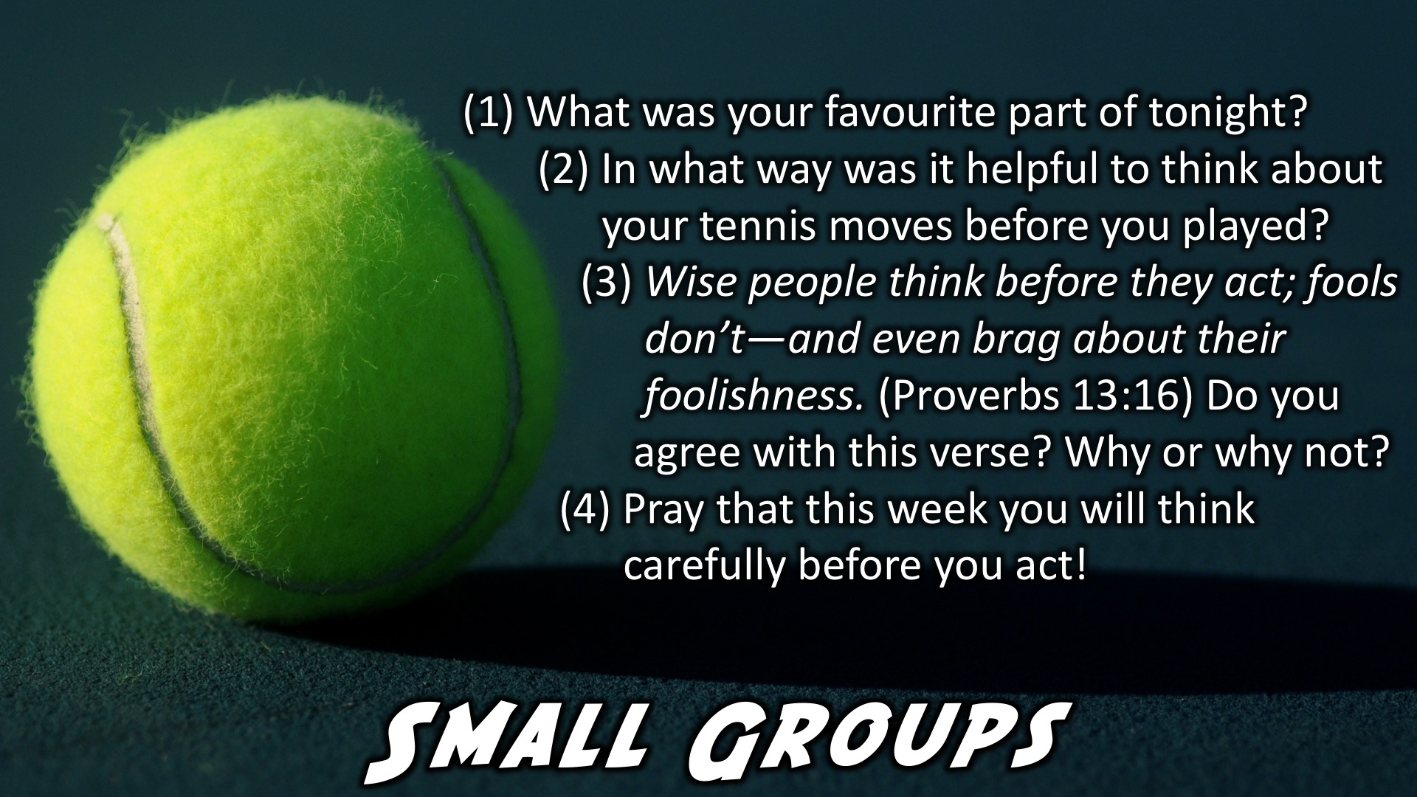
Notes:
Small Group Time: (1) What was your favourite part of tonight?(2) In what way was it helpful to think about your tennis moves before you played? (3) Wise people think before they act; fools don’t—and even brag about their foolishness. Proverbs 13:16. Do you agree with this verse? Why or why not? (4) Pray that this week you will think carefully before you act!

Slide 18
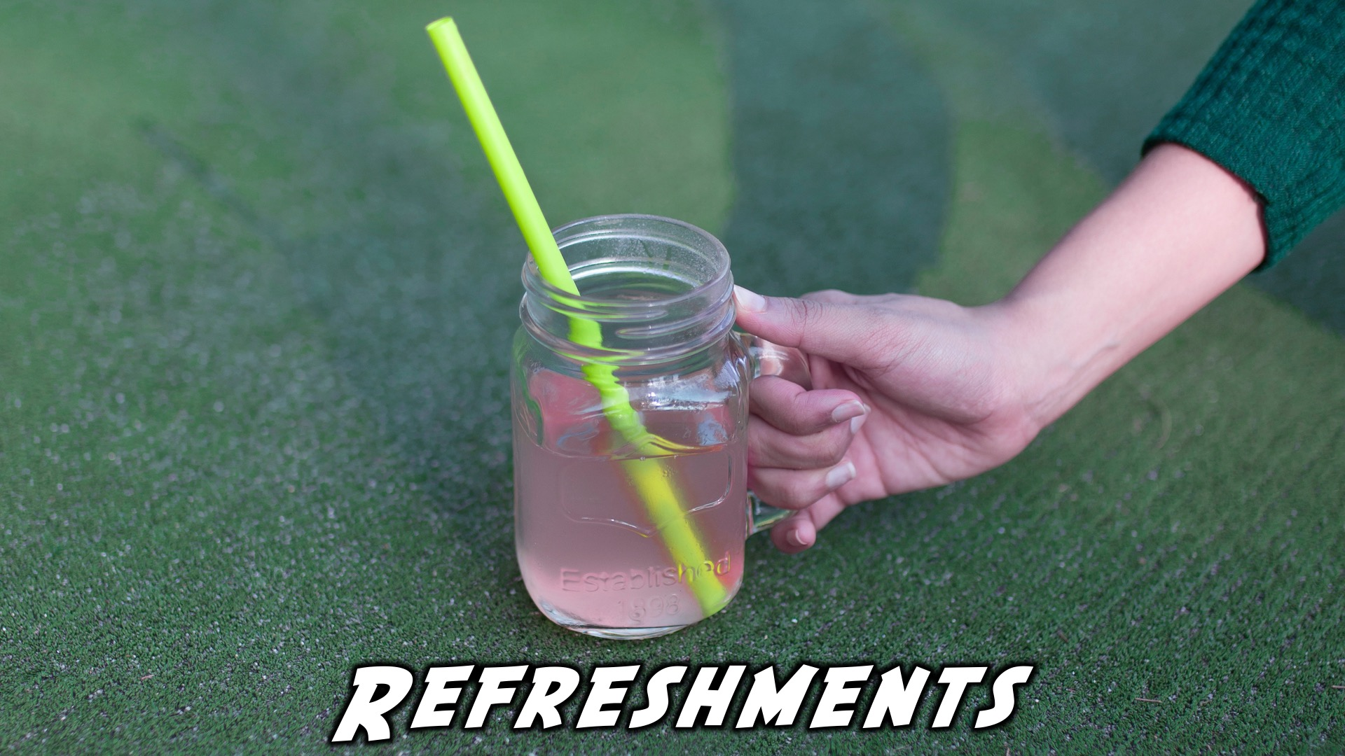
Notes:
Refreshments: It is time for refreshments.

Slide 19
Notes:
Don’t forget to join our WhatsApp group for regular updates!

Slide 20
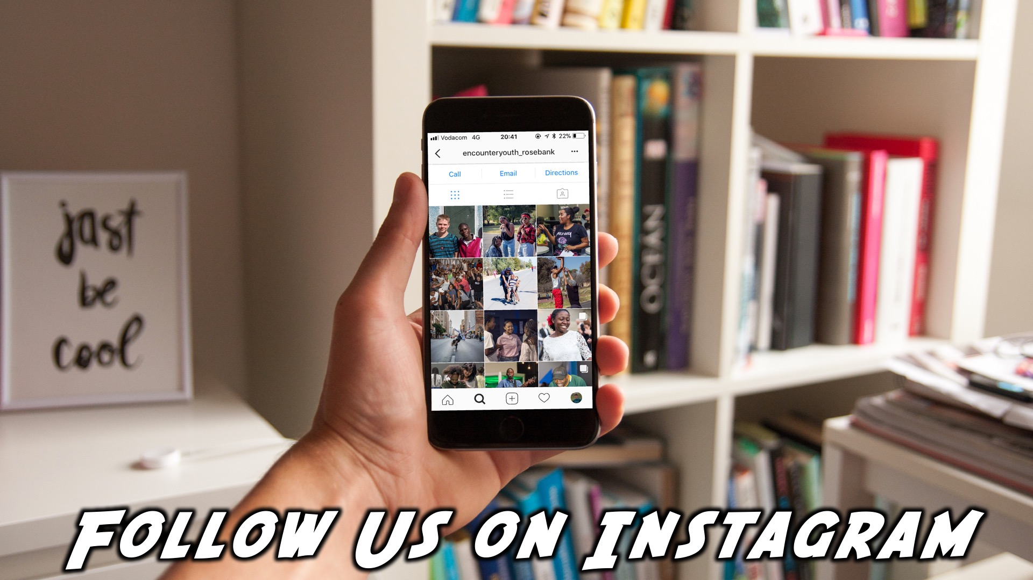
Notes:
Find us on instagram!!

