Slide 1
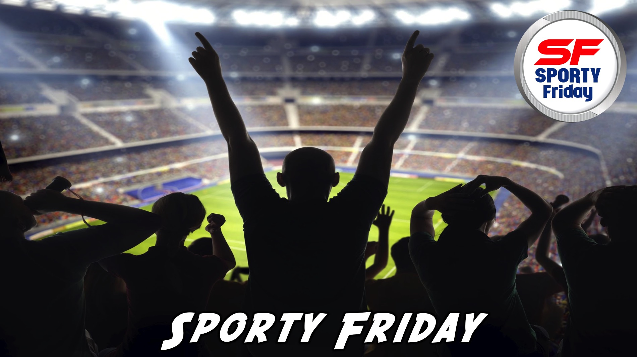
Notes:
Welcome to Sporty Friday.

Slide 2

Notes:
Tonight is Football Night!

Slide 3
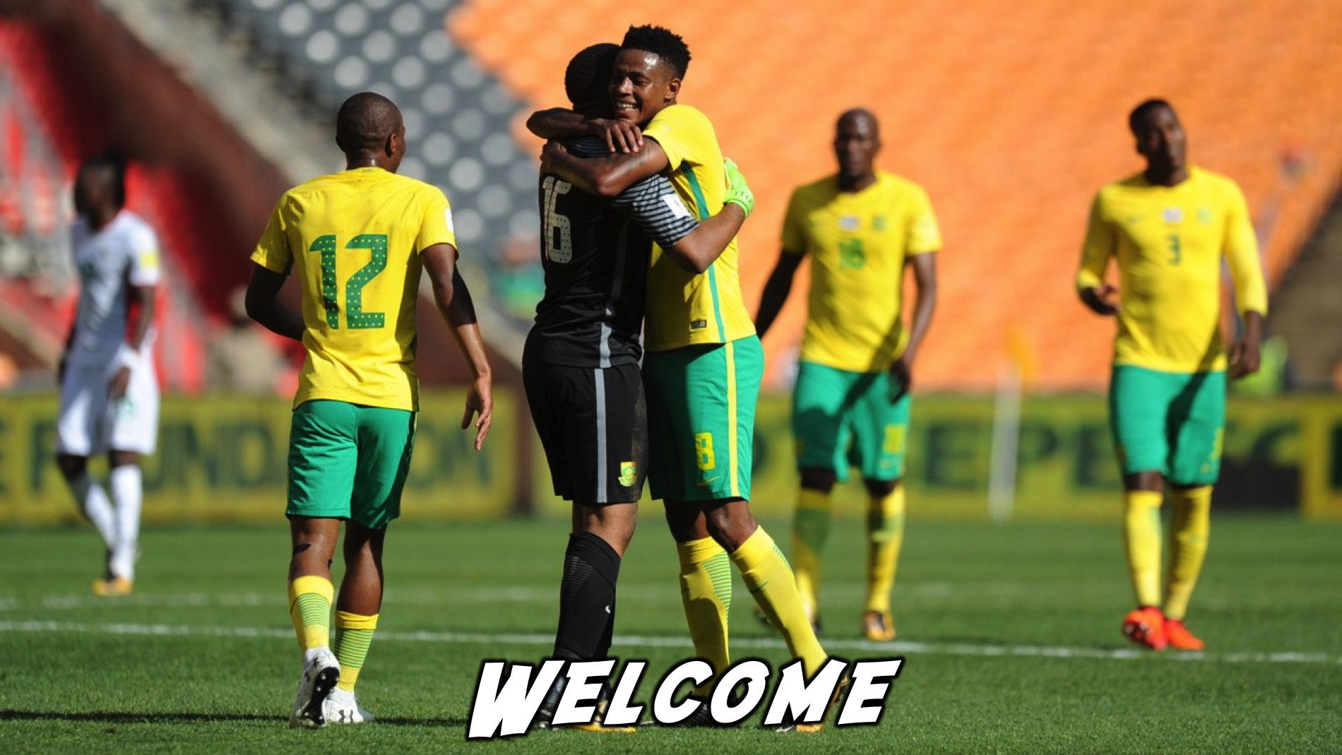
Notes:
Welcome to regulars and newcomers!

Slide 4
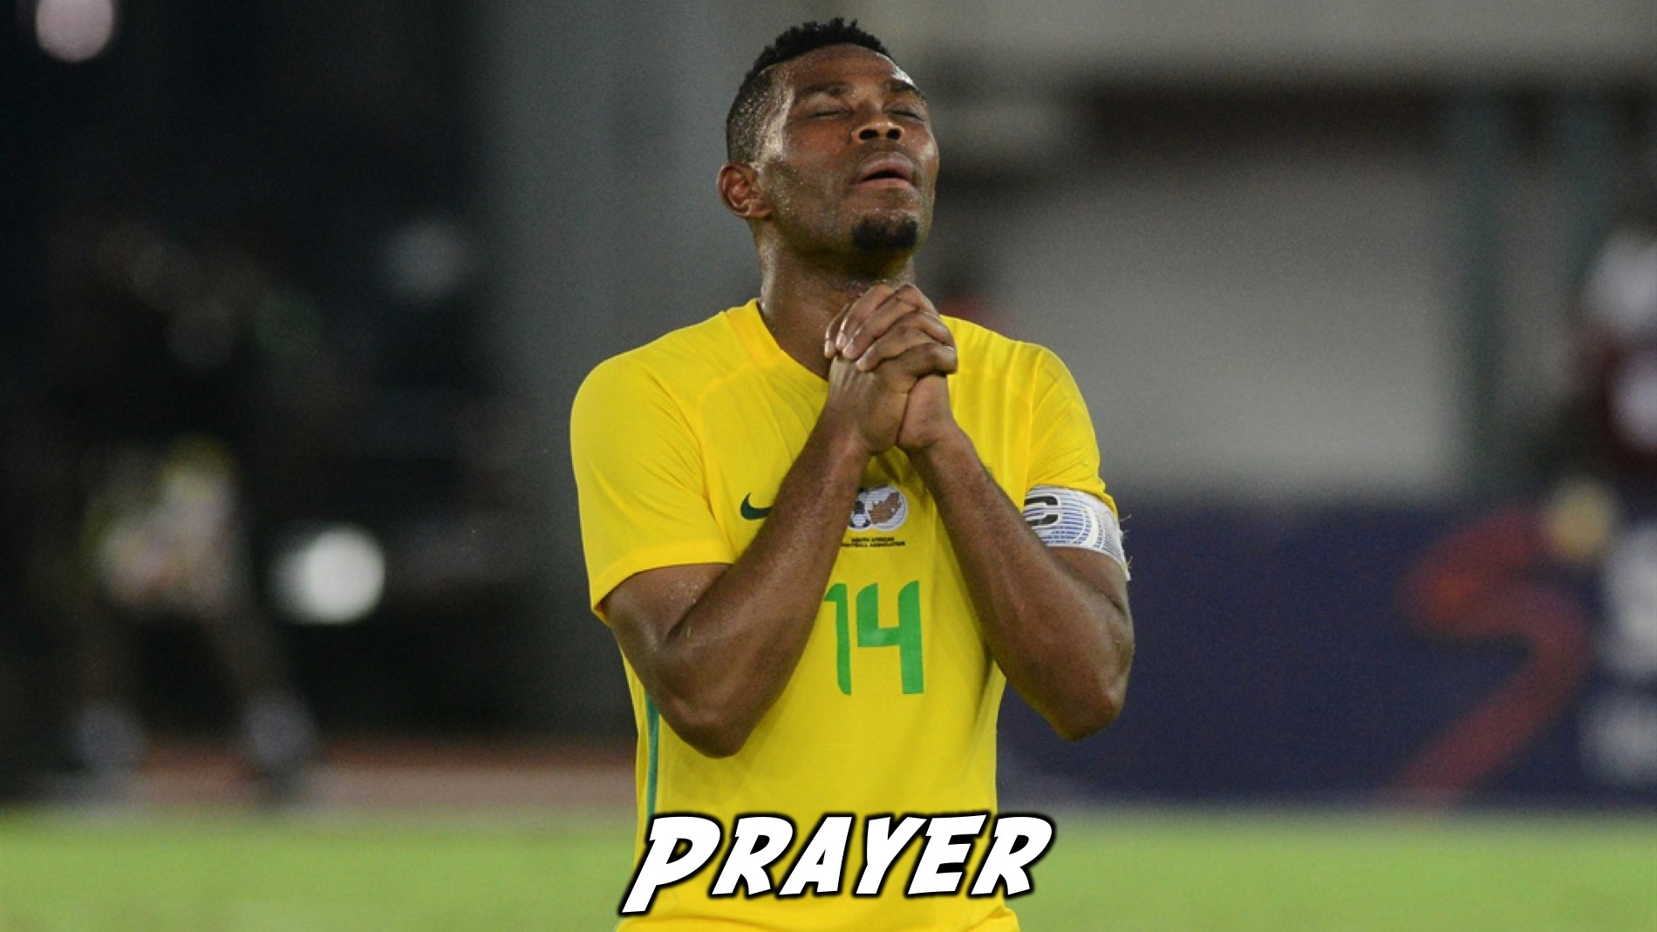
Notes:
Prayer: Let’s open our meeting in prayer.

Slide 5
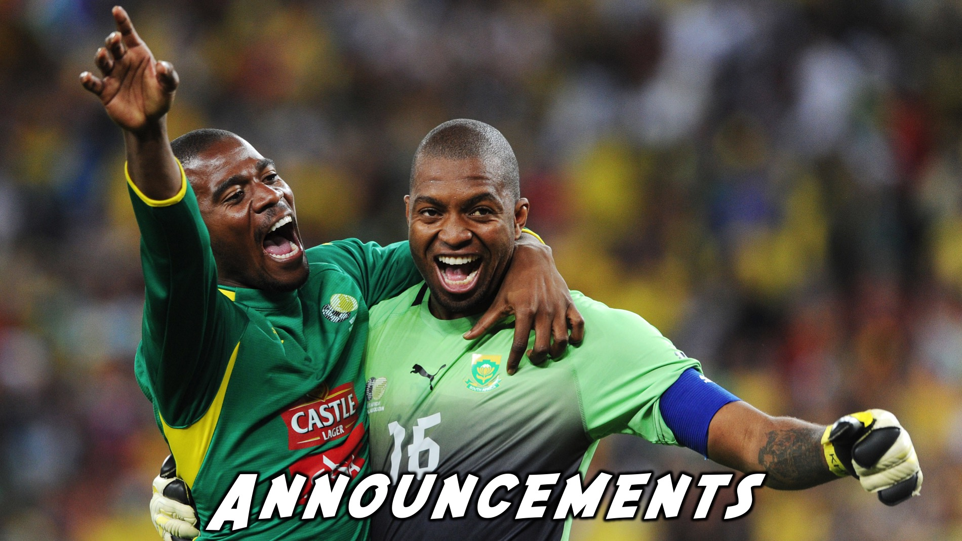
Notes:
Please listen up for the following announcements!

Slide 6
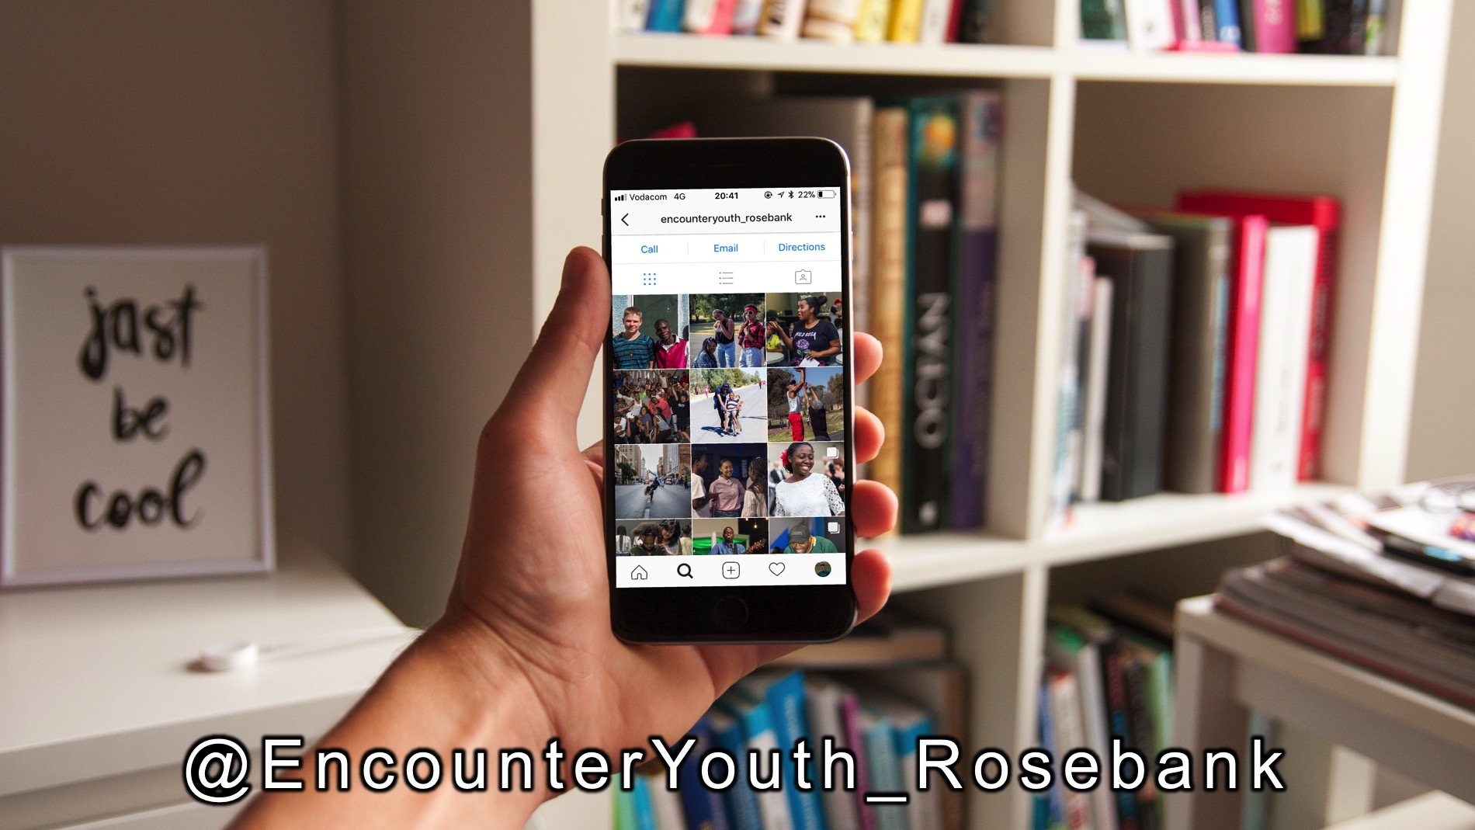
Notes:
Announcements: Follow us on Instagram! @EncounterYouth_Rosebank

Slide 7

Notes:
Announcements: Join our Friday Night WhatsApp group!

Slide 8

Notes:
Don’t forget about our Zoo Lake Youth Outing on Wednesday the 21st March from 9am to 12.

Slide 9
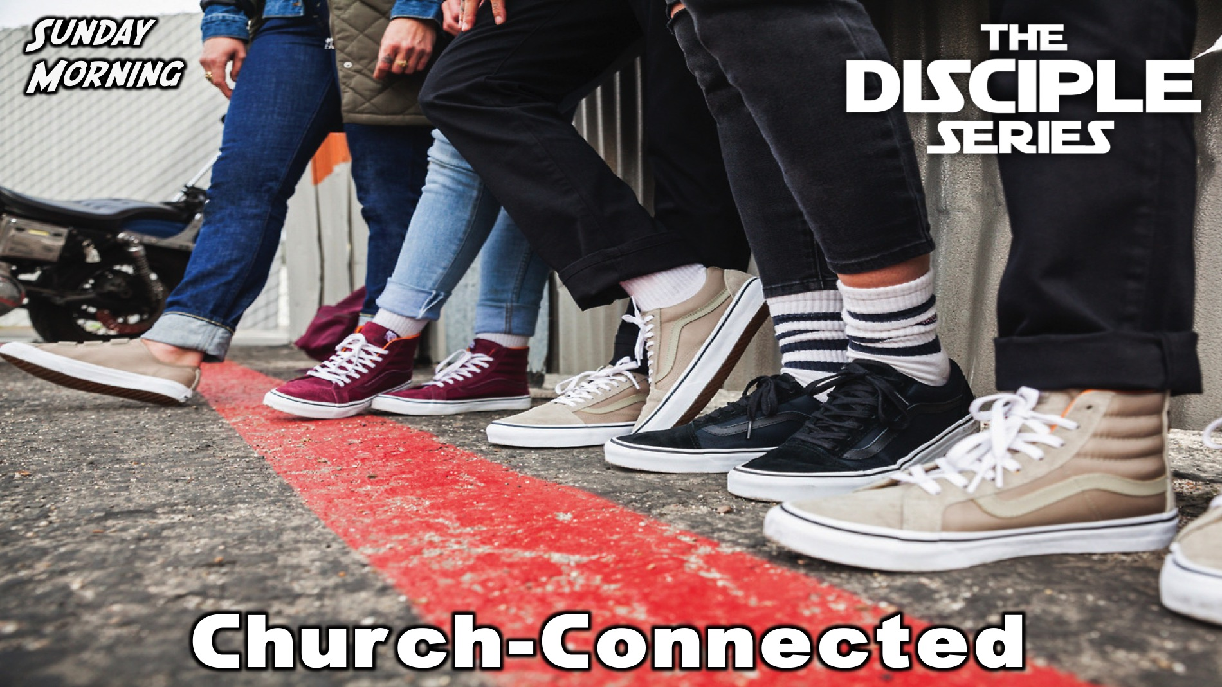
Notes:
Announcements: Join us this Sunday as we learn more about how a disciple is Church-Connected.

Slide 10
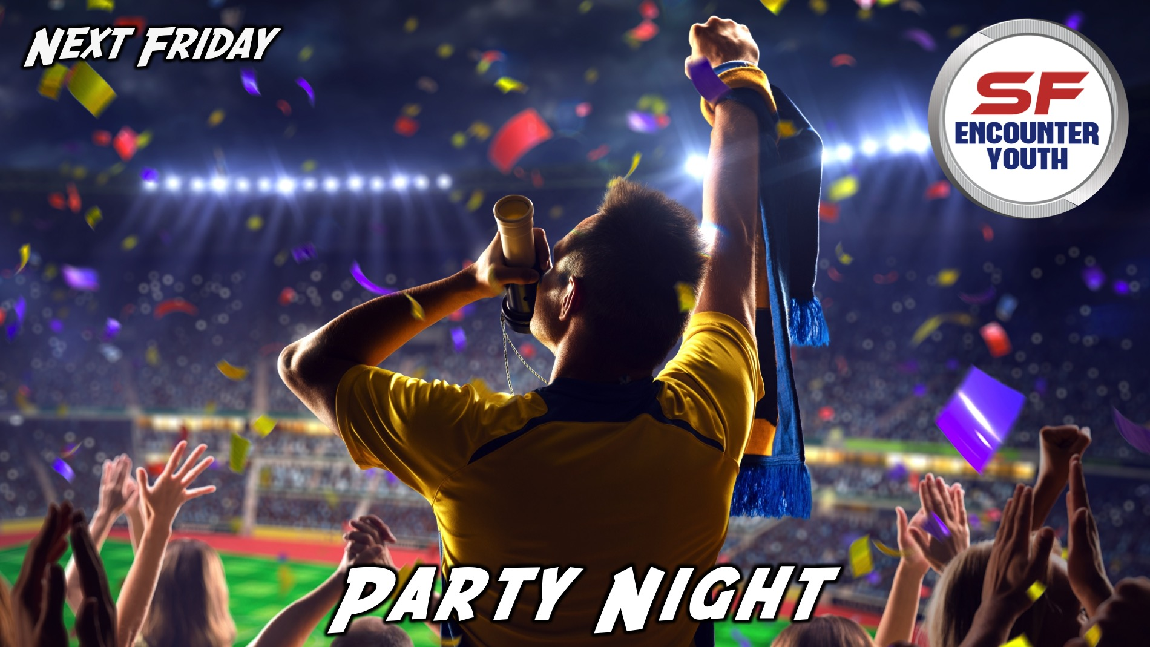
Notes:
Announcements: Join us next Friday for our Party Night!

Slide 11

Notes:
Tonight is Football Night!

Slide 12
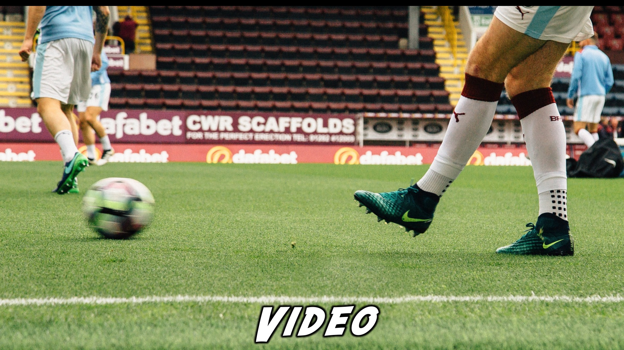
Notes:
Video Clip: Nike Advert. Find this video on Youtube: https://www.youtube.com/watch?v=b4XoQ5j5kAE

Slide 13
Notes:
Video Clip: Nike Advert. Find this video on Youtube: https://www.youtube.com/watch?v=b4XoQ5j5kAE

Slide 14
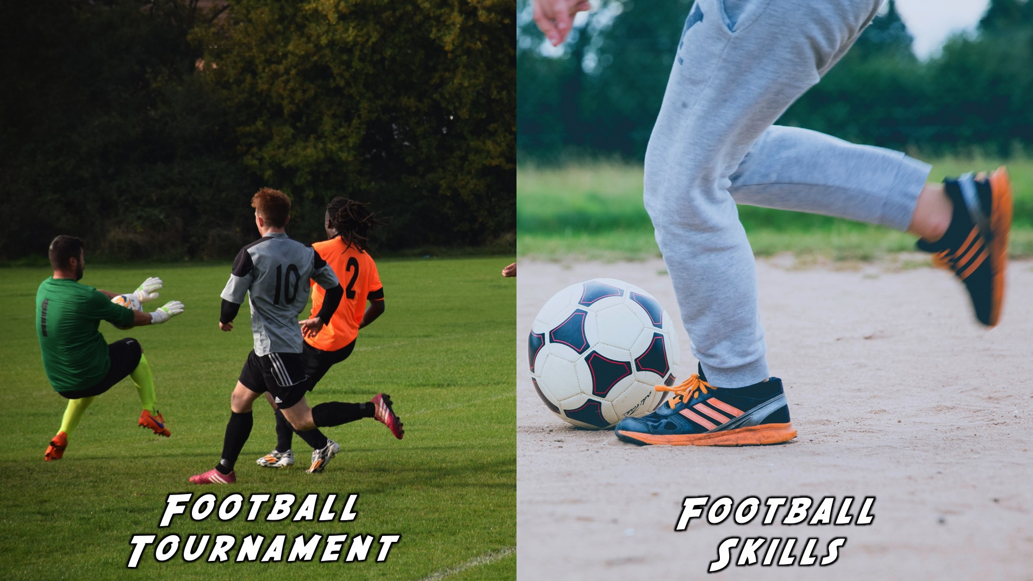
Notes:
It’s now time for our Football event. Tonight you to choose between two options: (1) Football Tournament or (2) Football Skills.

Slide 15
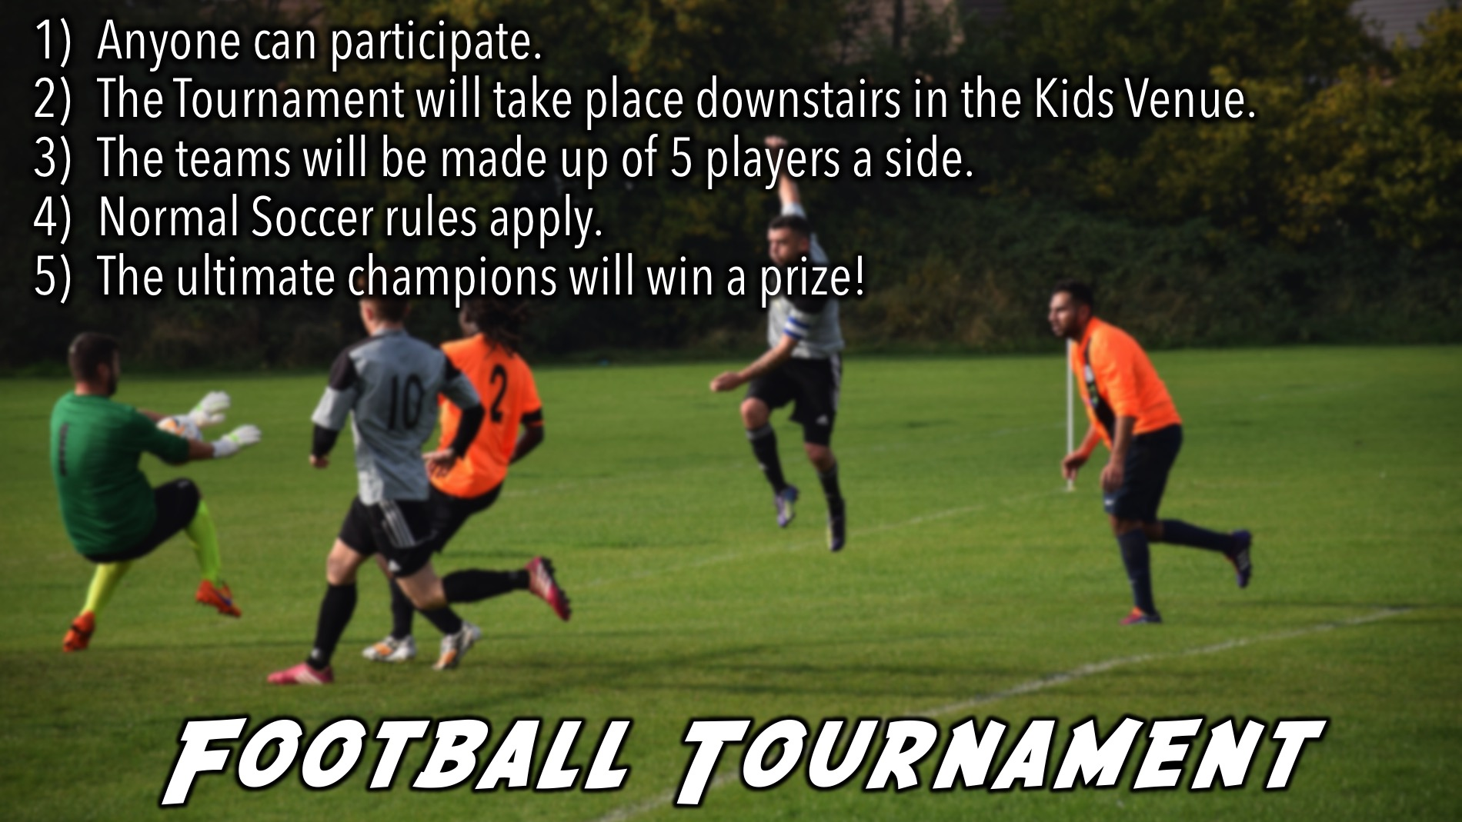
Notes:
Football Tournament Instructions: (1) Anyone can participate. (2) The Tournament will take place downstairs in the Kids Venue. (3) The teams will be made up of 5 players a side. (4) Normal Soccer rules apply. (5) The ultimate champions will win a prize!

Slide 16
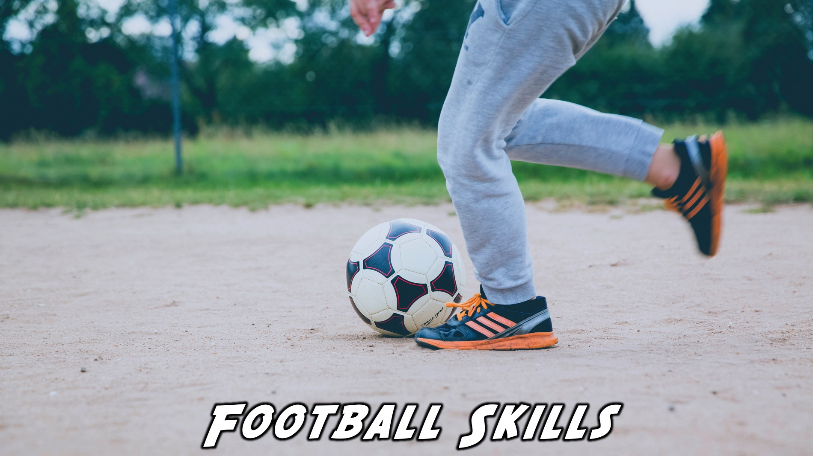
Notes:
Football Skills is taking place in the Youth Room and there are four stations to compete at:

Slide 17
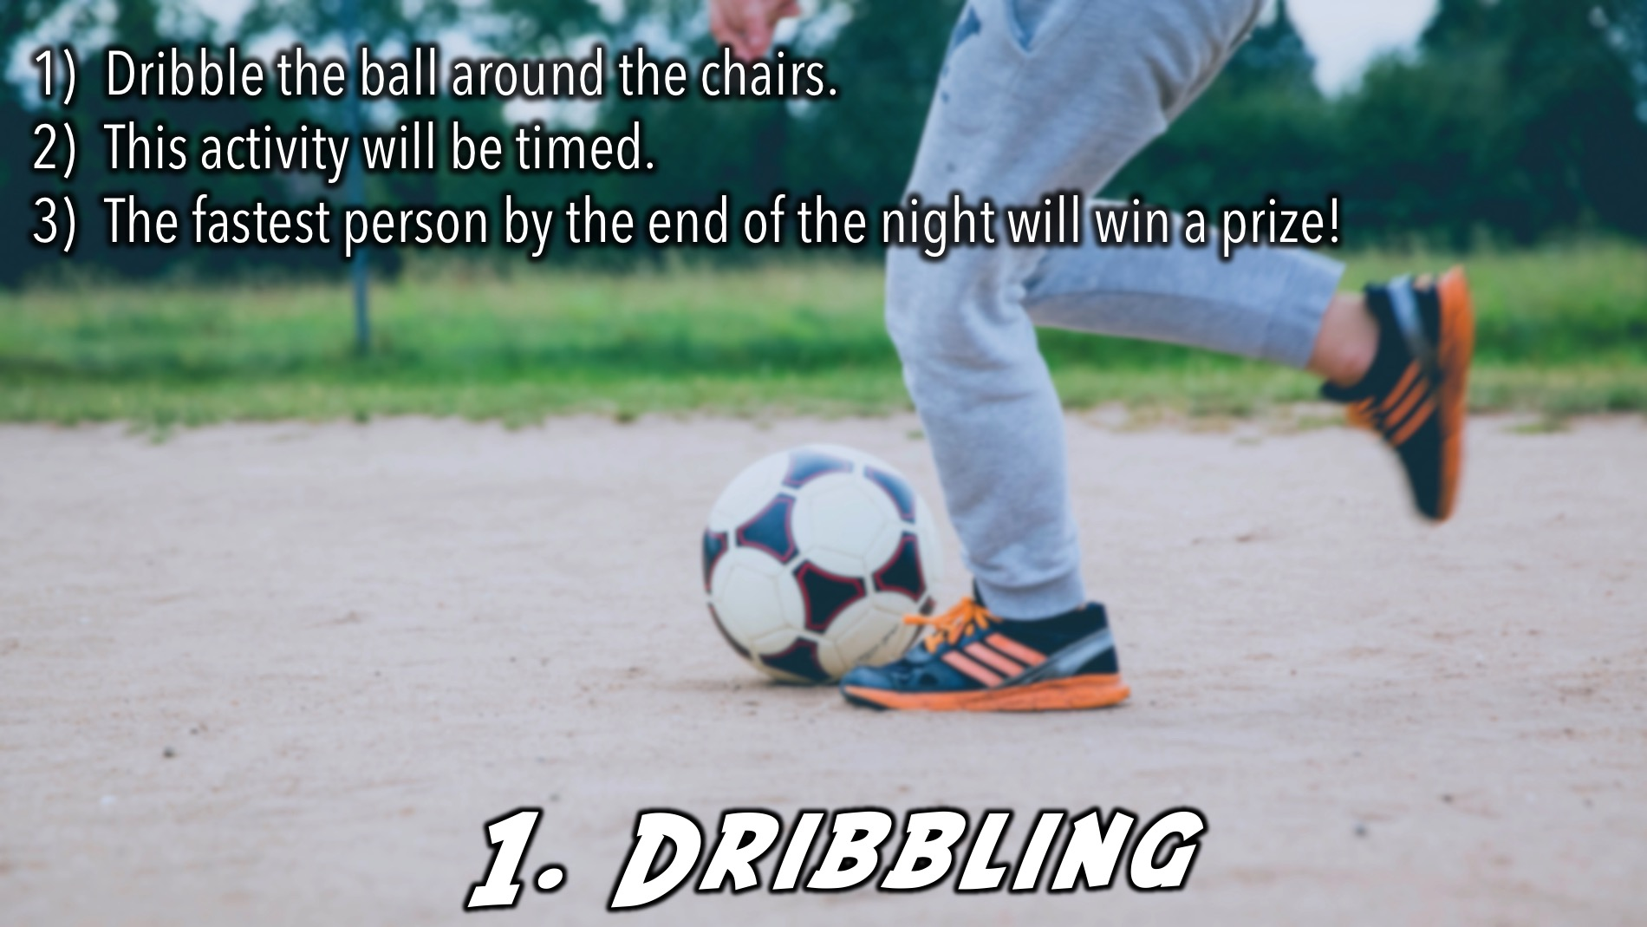
Notes:
1. Dribbling - The person has to dribble the soccer ball around chairs. This is timed, and the fastest person will win.

Slide 18
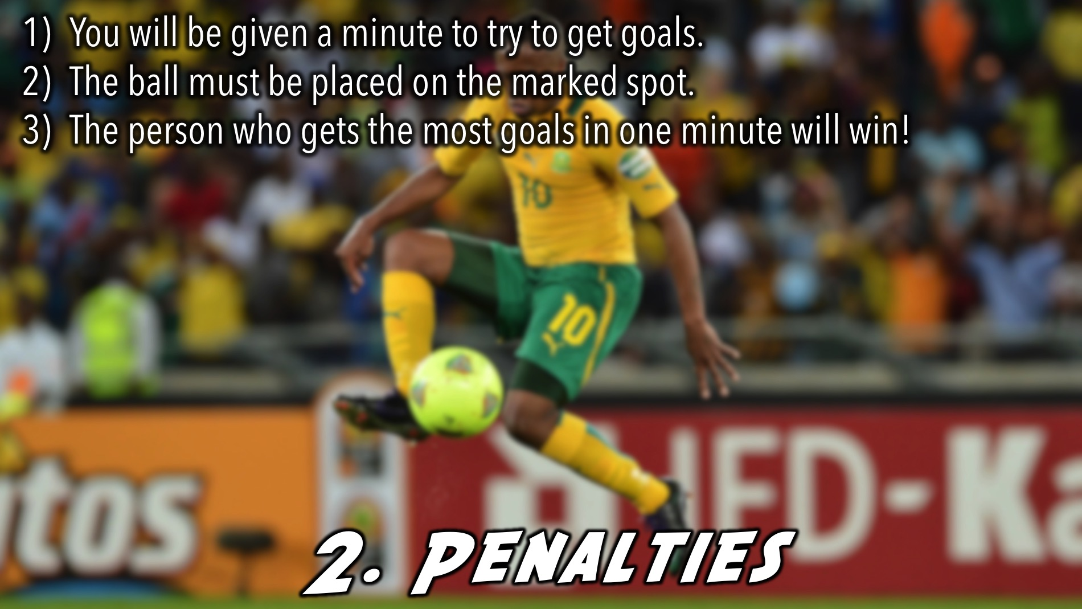
Notes:
2. Penalties. - There will be 2 goals made out of chairs. The ball will be placed on a market spot. Every player has a minute to see how many goals they can get.

Slide 19
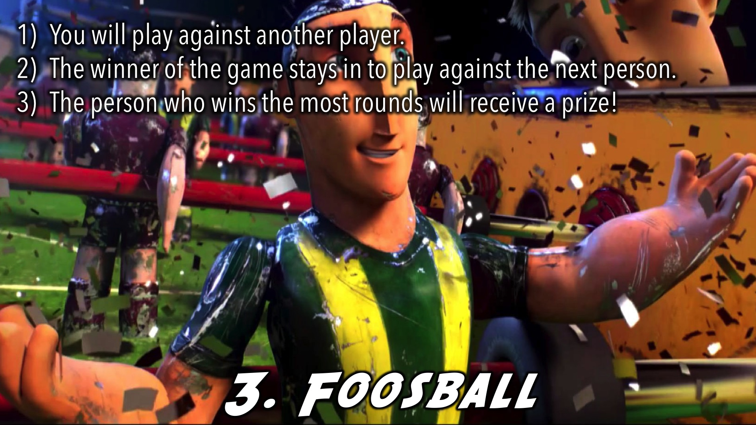
Notes:
3. Foosball - The foosball table will be set up as a station. The player who wins the foosball game stays to play against the next person. The player who wins the most rounds will win.

Slide 20
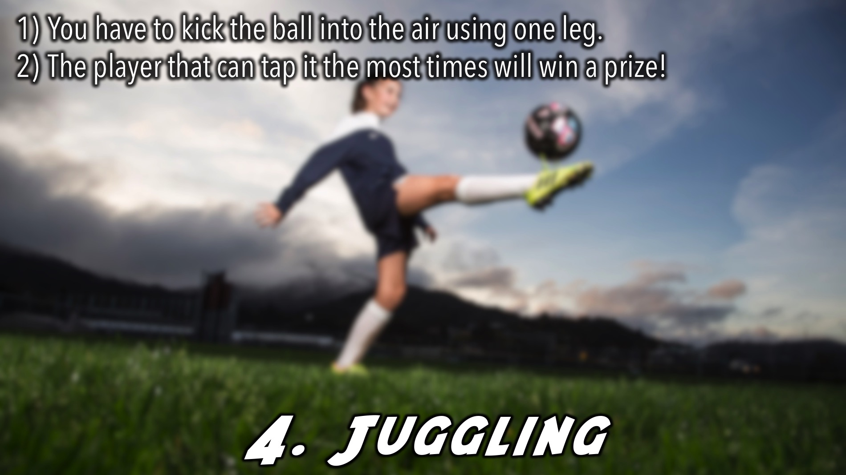
Notes:
4. Juggling - at this station, players will have to try and kick the ball up in the air using one leg. The player that can tap it the most times wins.

Slide 21
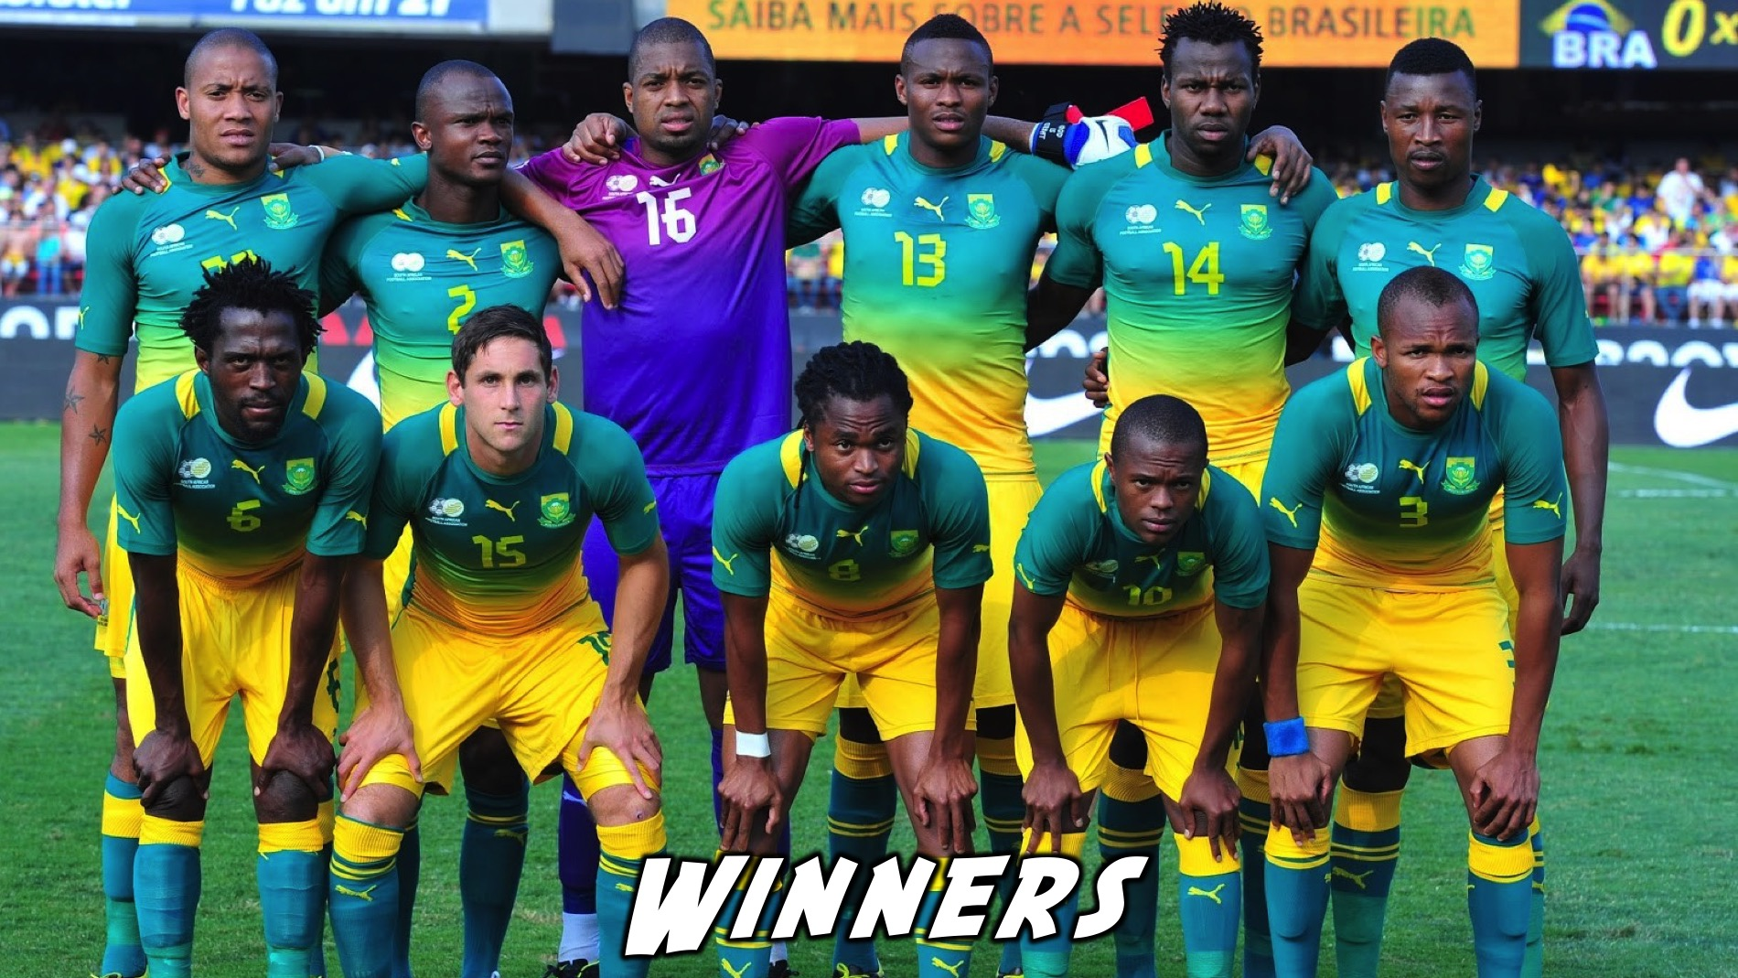
Notes:
And the winners are…

Slide 22
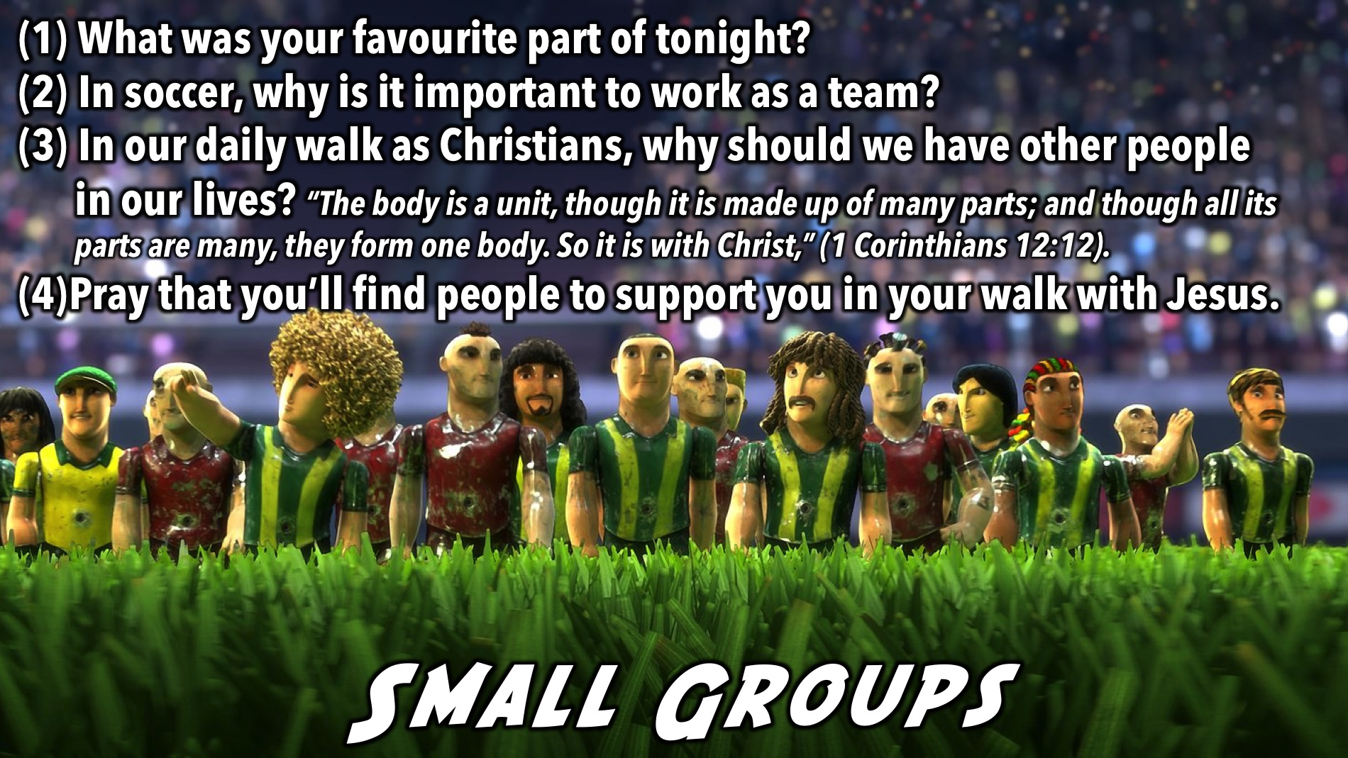
Notes:
Small Group Time: (1) What was your favourite part of tonight? (2) In soccer, why is it important to work as a team? (3) In our daily walk as Christians, why should we have other people in our lives? “The body is a unit, though it is made up of many parts; and though all its parts are many, they form one body. So it is with Christ,” (1 Corinthians 12:12). (4) Pray that you’ll find people who can support you in your walk with Jesus.

Slide 23
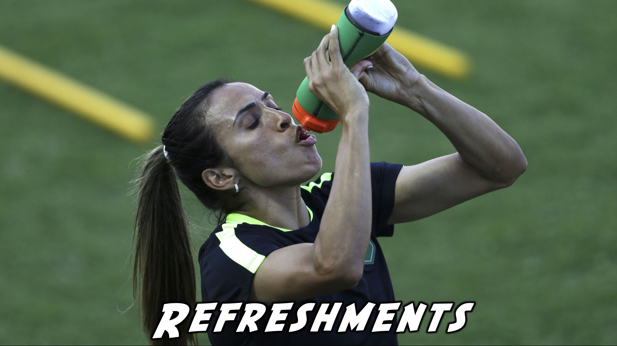
Notes:
Refreshments: It is time for refreshments.

Slide 24
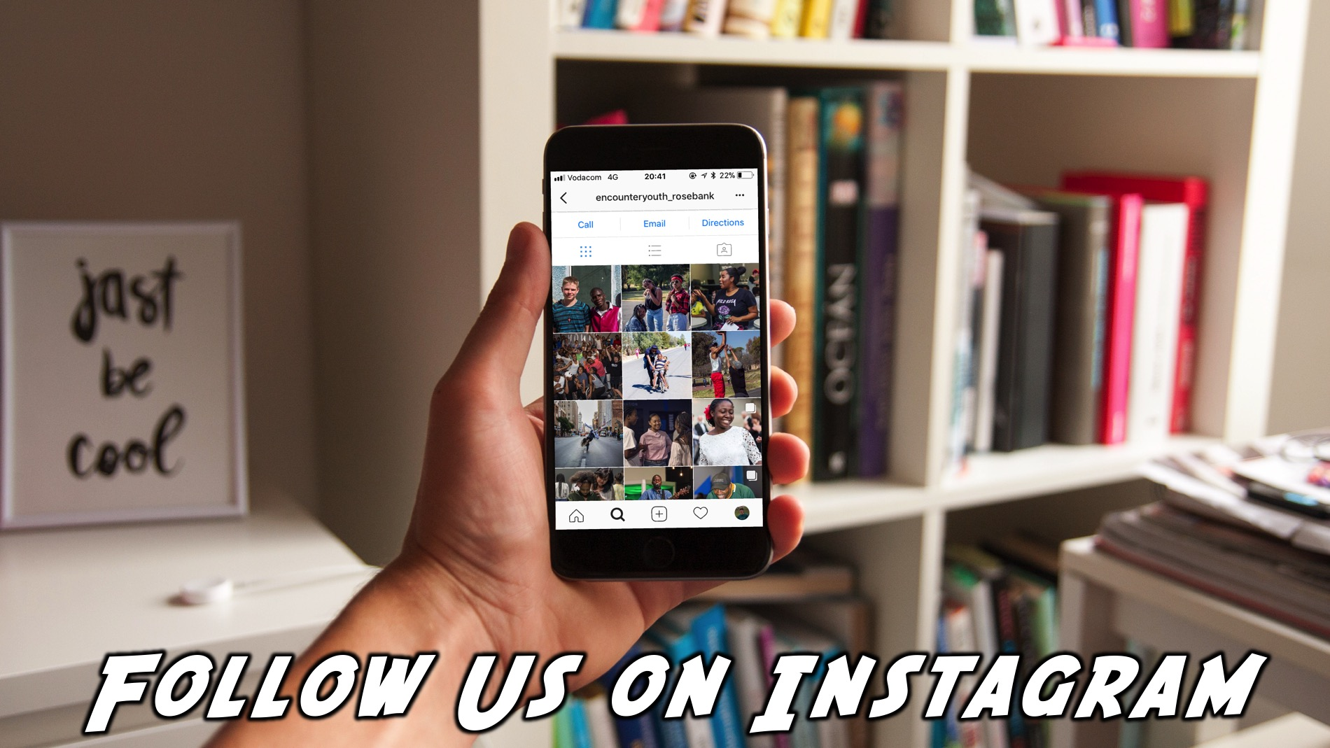
Notes:
Find us on Instagram!!

