Slide 1

Notes:
Welcome to Sporty Friday.

Slide 2

Notes:
Tonight is Party Night!

Slide 3

Notes:
Welcome to regulars and newcomers!

Slide 4
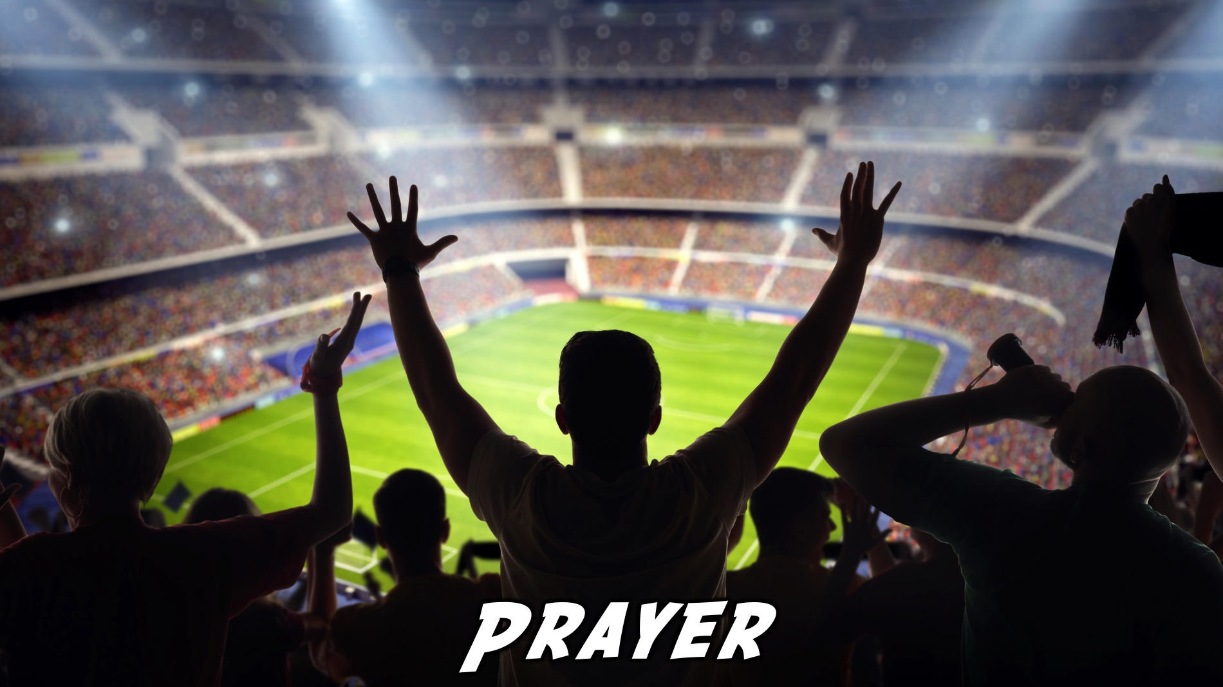
Notes:
Prayer: Let’s open our meeting in prayer.

Slide 5

Notes:
Please listen up for the following announcements!

Slide 6
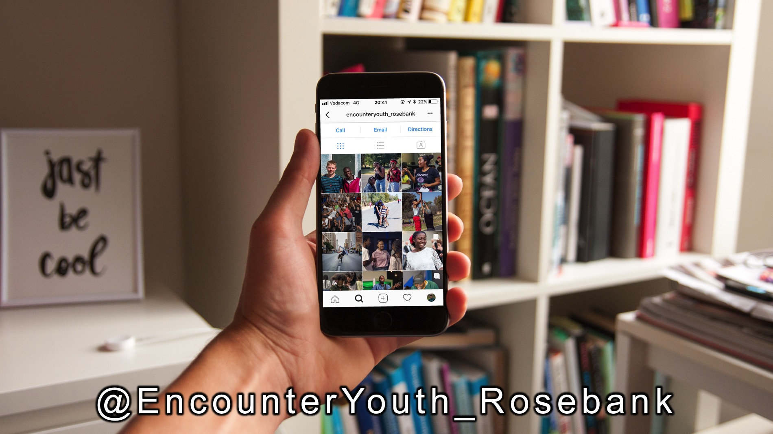
Notes:
Follow us on Instagram! @EncounterYouth_Rosebank

Slide 7

Notes:
Join our Friday Night WhatsApp group!

Slide 8

Notes:
Join us for an Easter Sunrise service on the top of Northcliff Hill on Easter Sunday morning next weekend.

Slide 9

Notes:
Join us this Sunday morning as we review all that we learnt this term about being a disciple and have a rap artist, Z_lus, performing for us.

Slide 10

Notes:
Join us next term when school starts again on Friday the 13th April. We are taking a 2 week break. Next term we will be presenting the Youth Alpha series on 6 of the nights and we will end the term with our Matric Farewell.

Slide 11

Notes:
Tonight is Party Night!

Slide 12

Notes:
Speed Relating: We are going to start with a round of speed relating. Divide into two equal circles (one facing in and one facing out) each person must be facing a partner and get ready for the first question that you will each answer before the outside circle rotates to their right.

Slide 13
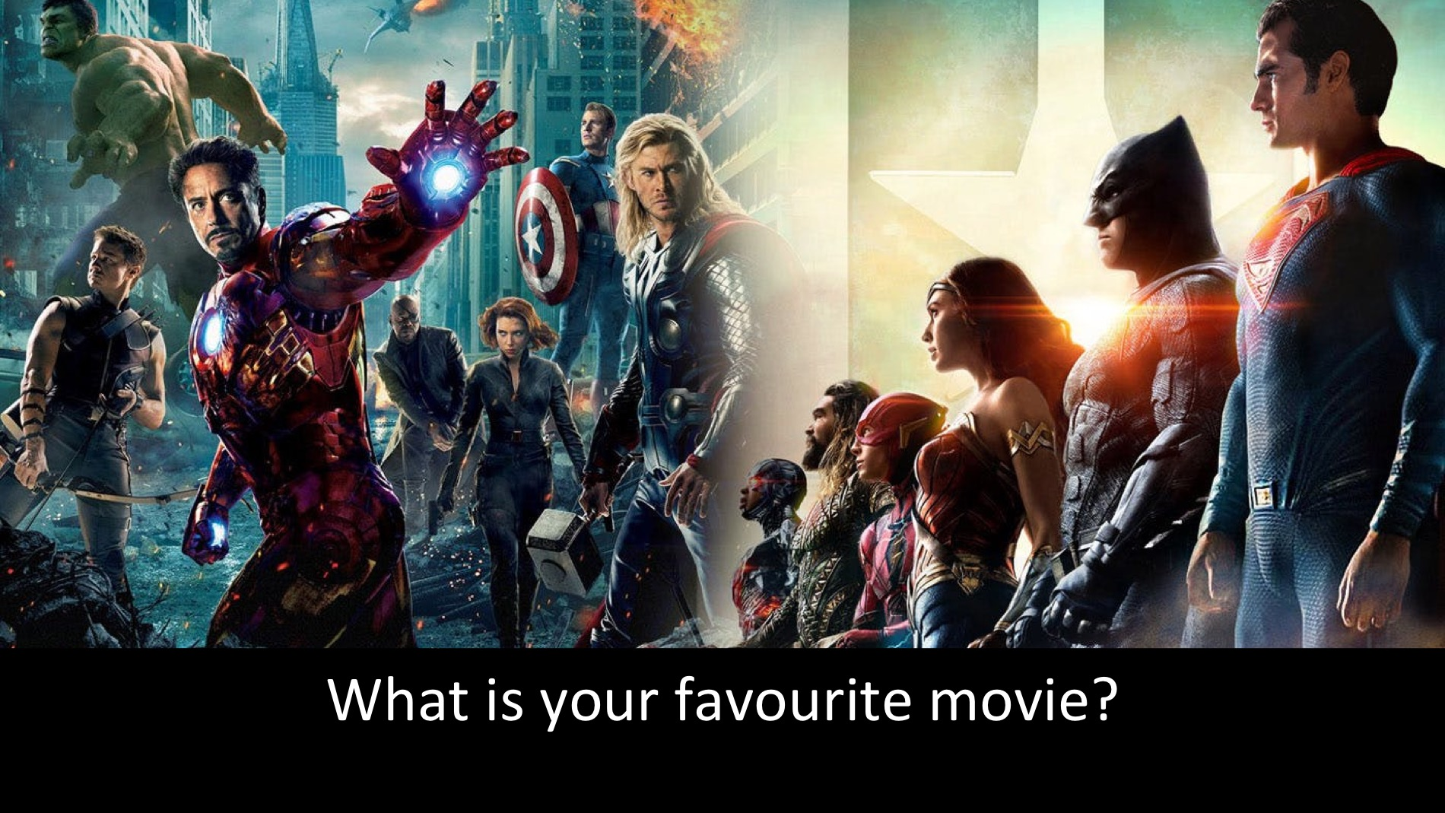
Notes:
What is your favourite movie?

Slide 14

Notes:
What car would you love to own?

Slide 15
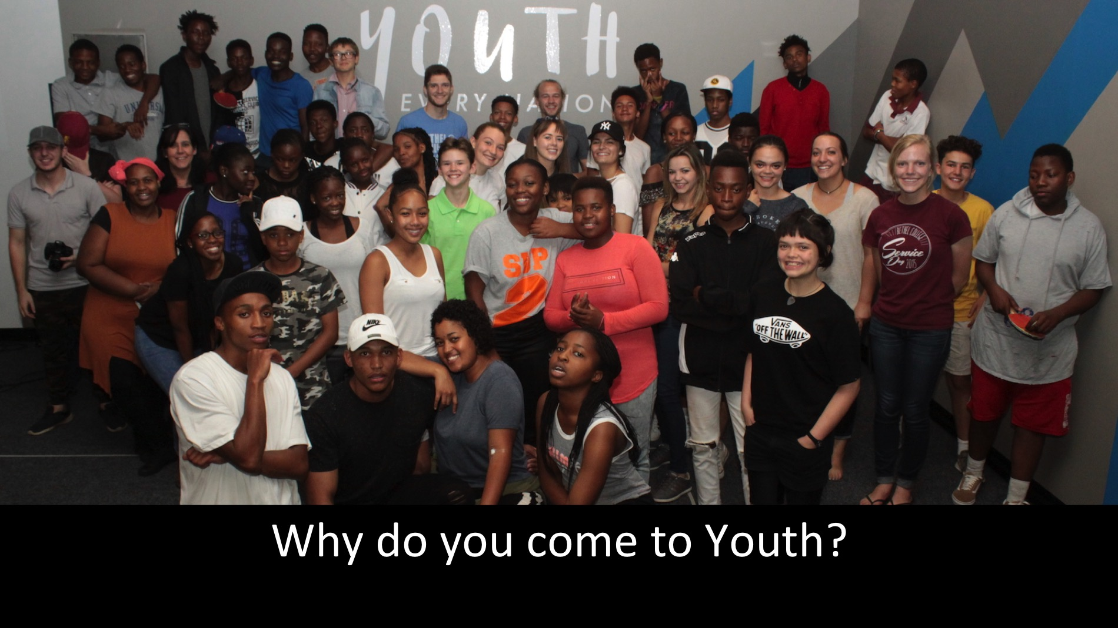
Notes:
Why do you come to Youth?

Slide 16
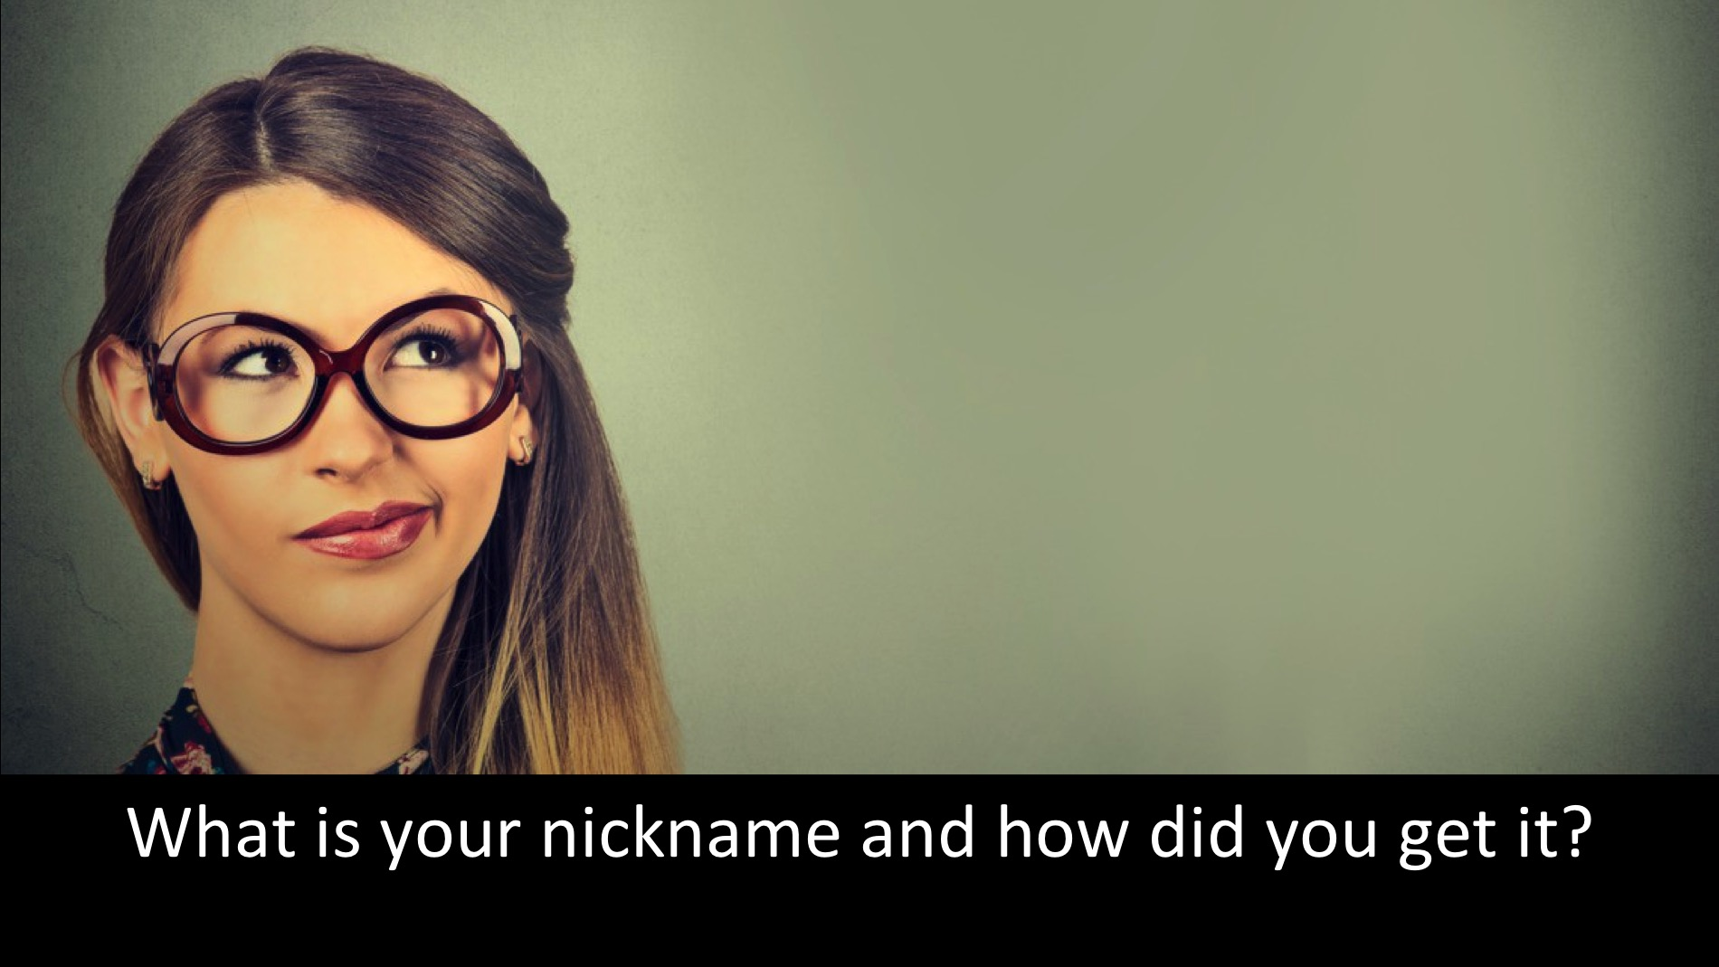
Notes:
What is your nickname and how did you get it?

Slide 17
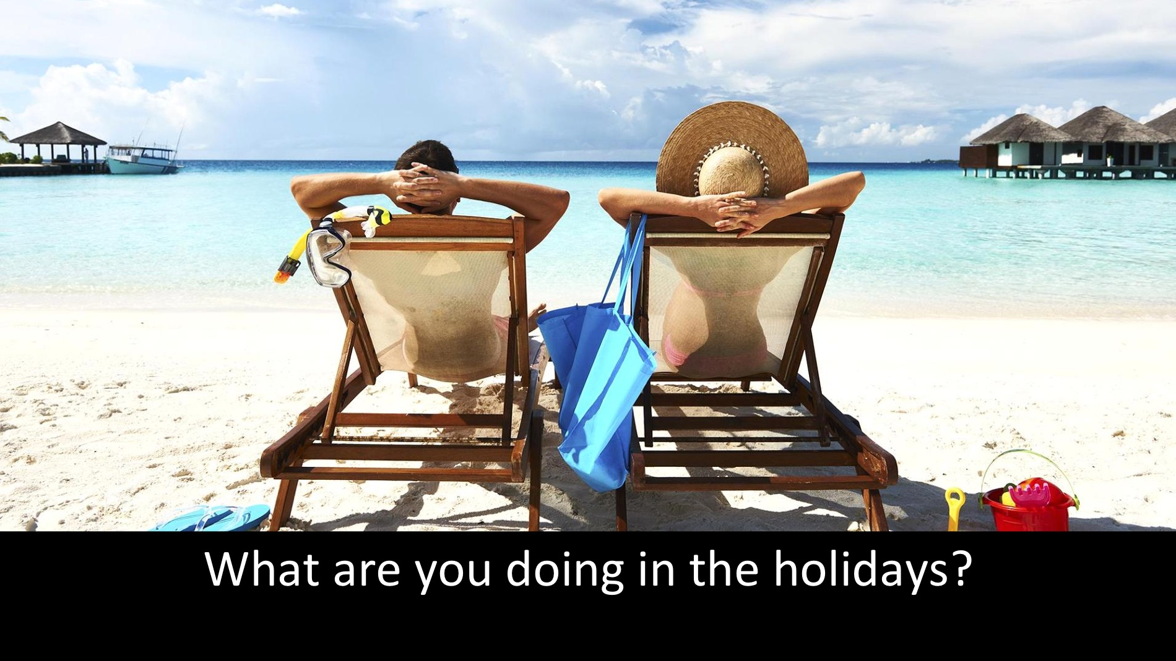
Notes:
What are you doing in the holidays?

Slide 18
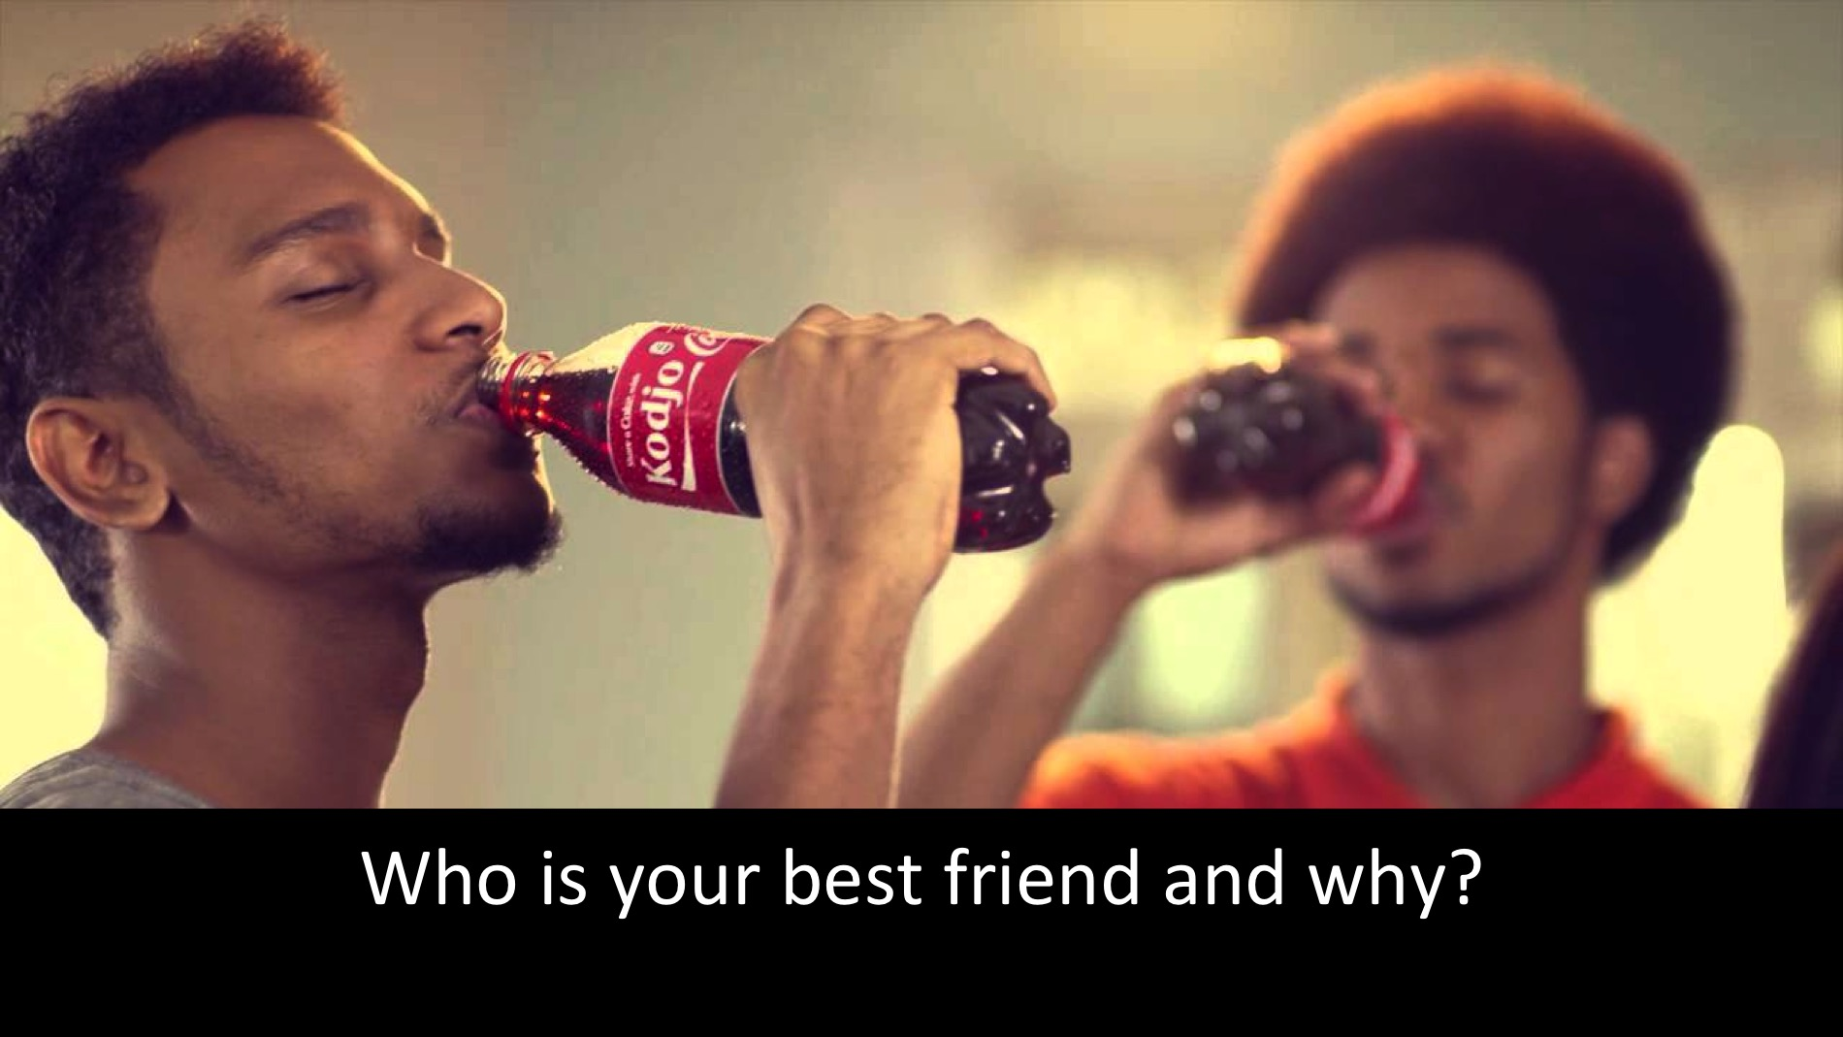
Notes:
Who is your best friend and why?

Slide 19

Notes:
What is your biggest fear?

Slide 20
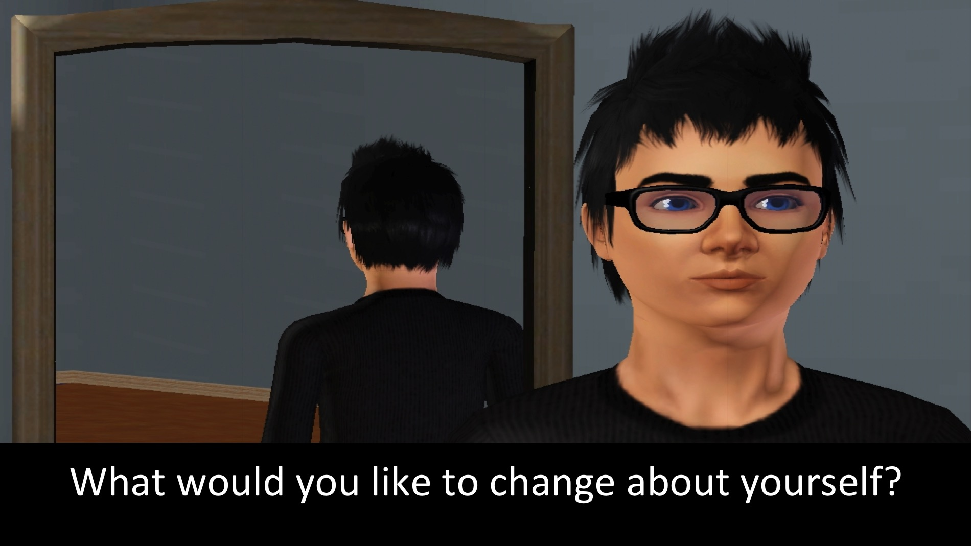
Notes:
What would you like to change about yourself?

Slide 21

Notes:
What was your last argument about? With who?

Slide 22

Notes:
What are you looking for in a life partner?

Slide 23

Notes:
What are you most passionate about in life?

Slide 24
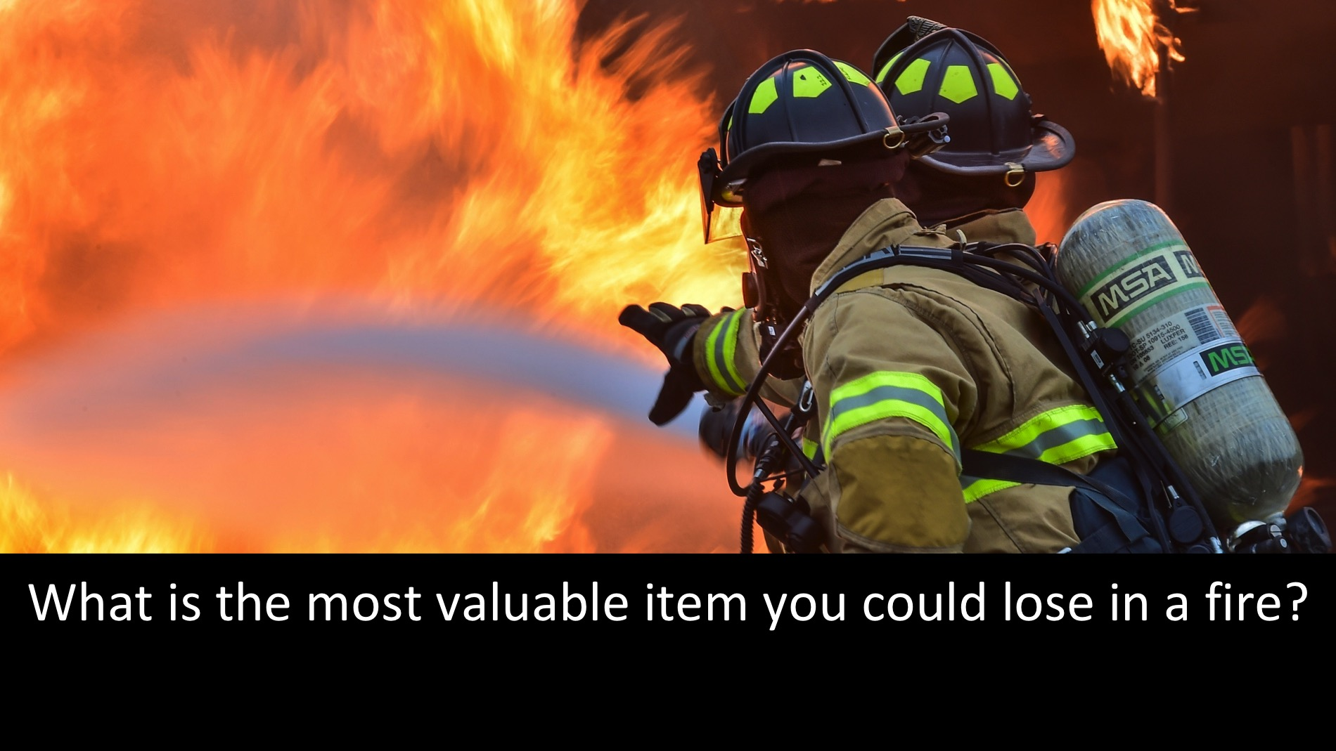
Notes:
What is the most valuable item you could lose in a fire?

Slide 25
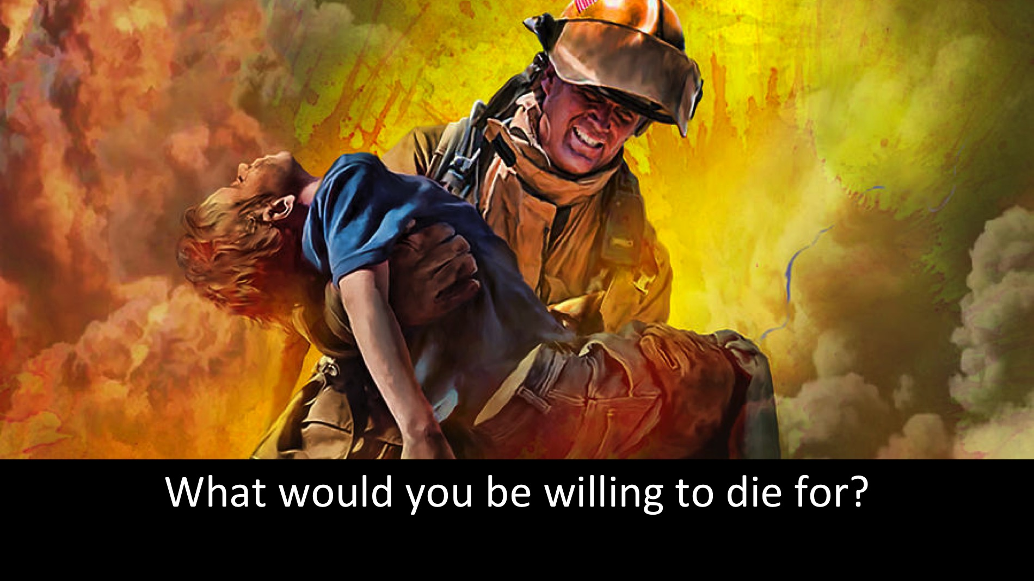
Notes:
What would you be willing to die for?

Slide 26

Notes:
If you could ask God one question, what would it be?

Slide 27

Notes:
Review: Here is a review of our term using photos taken on the 8 Sporty Friday nights.

Slide 28
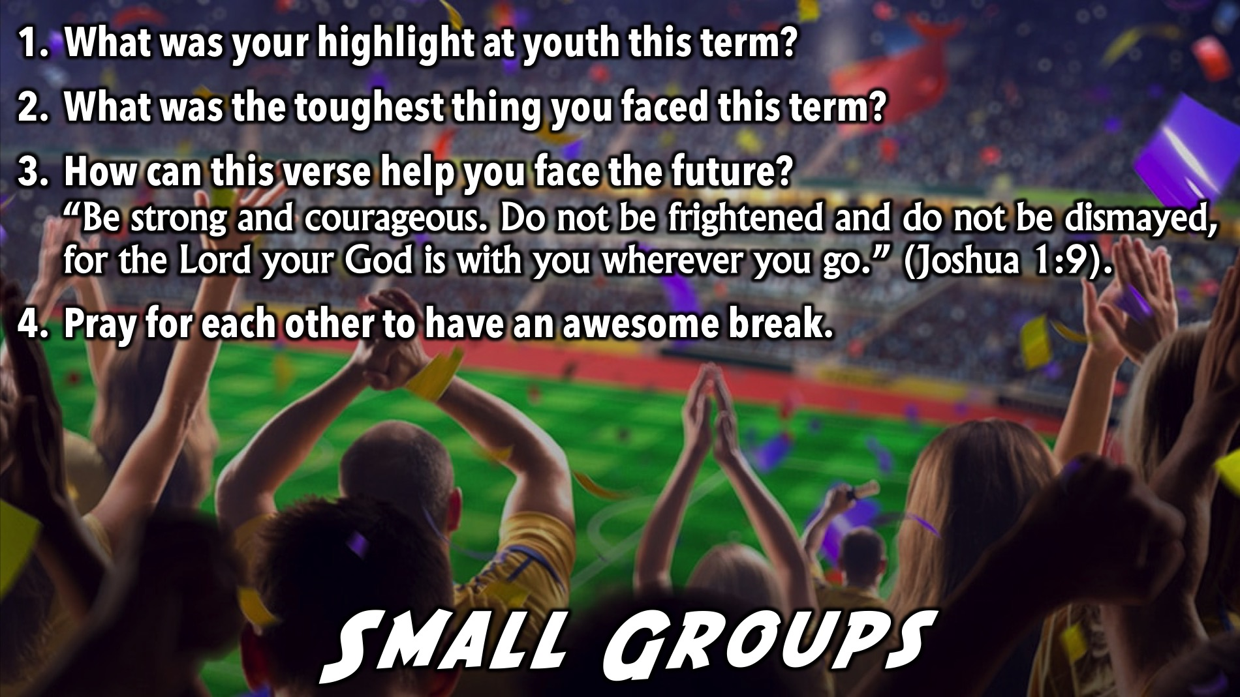
Notes:
Small Group Time: (1) What was your highlight at youth this term? (2) What was the toughest thing you faced this term? (3) How can this verse help you face the future? “Be strong and courageous. Do not be frightened, and do not be dismayed, for the Lord your God is with you wherever you go.” (Joshua 1:9). (4) Pray for each other to have an awesome break.

Slide 29

Notes:
Refreshments: It is time for refreshments.

Slide 30

Notes:
Find us on Instagram!!

