Slide 1
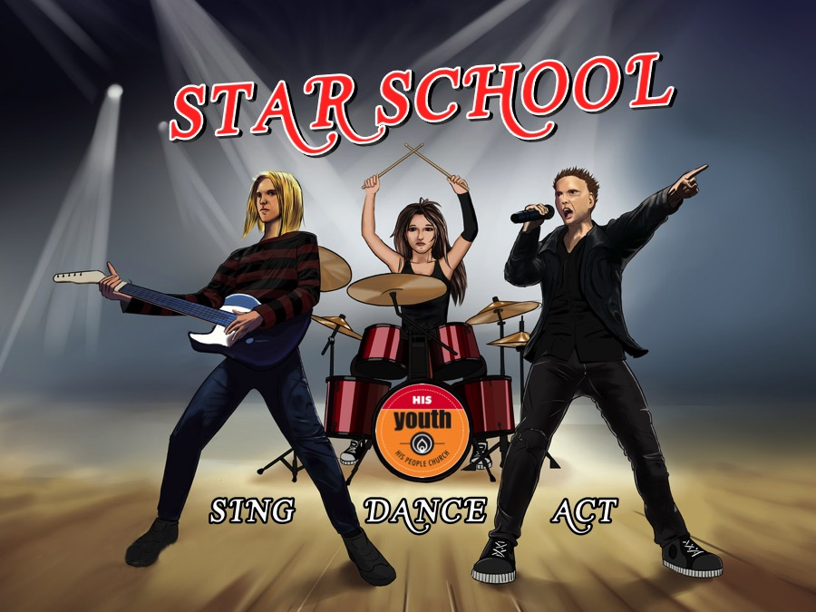
Notes:
Sing Star Night
Overview: There are 9 classes on the night. 3 classes will sing, 3 classes will dance and 3 classes will act.
Before the event starts our teen leaders will go around with black markers and mark teens’ hands with one of the following symbols: 1,2,3,A,B,C,#,@,$
When the night is ready to start the 9 leaders leaders will gather their class and sit around one of the 9 tables in the room (the tables are each marked with one of the group symbols).

Slide 2
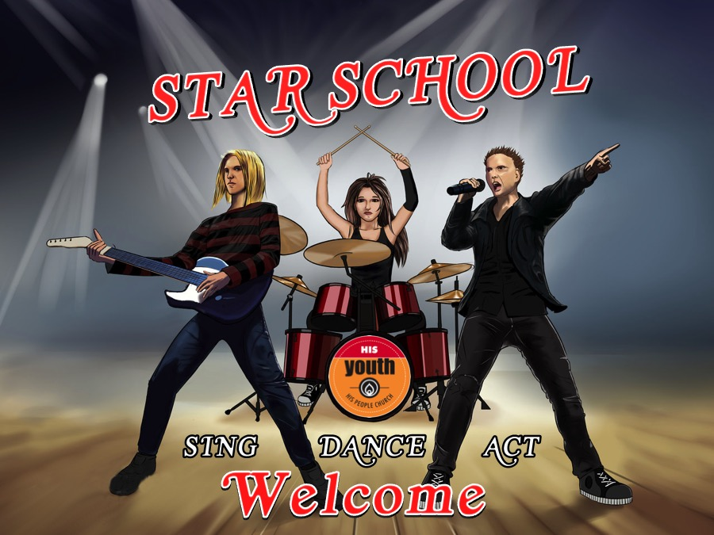
Notes:
Welcome to Star School – are there any newcomers?

Slide 3
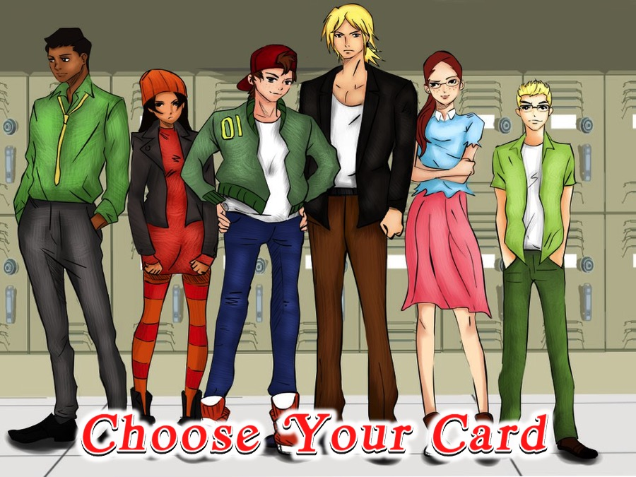
Notes:
Choose Your Card: Each group sends a leader to the front to choose a card from the bowl. The card will tell them which activity they will do.

Slide 4
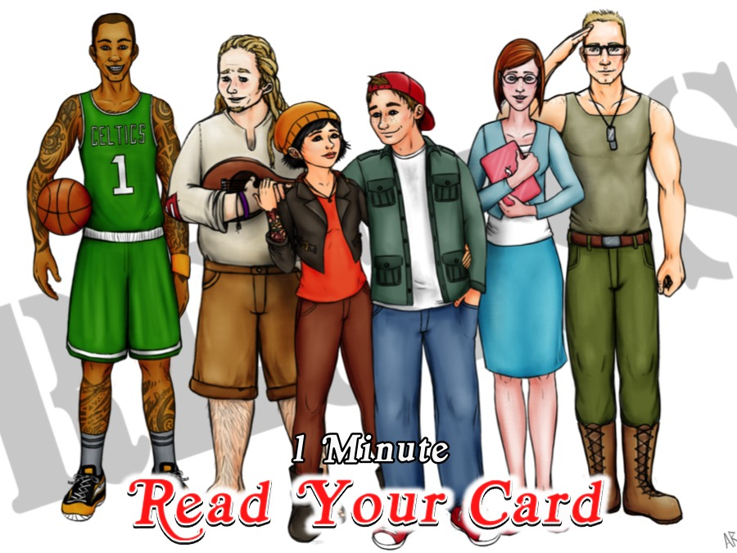
Notes:
Read Your Card: The groups have a minute to read about their activity.

Slide 5
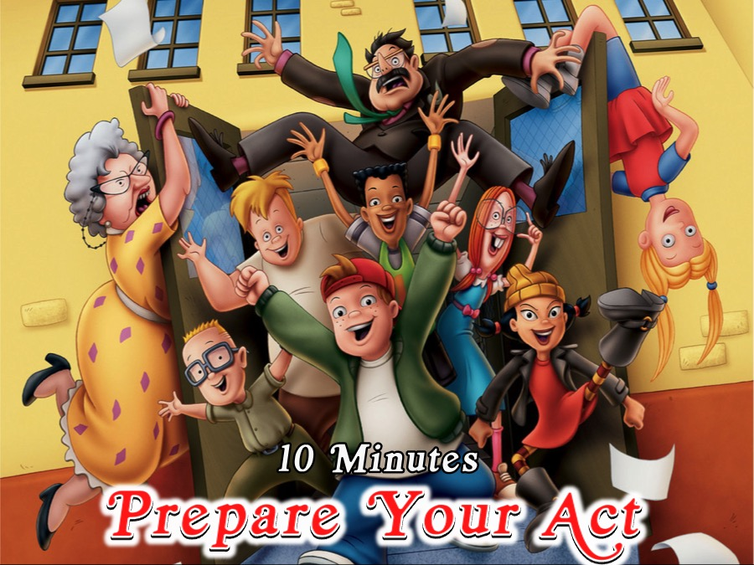
Notes:
Prepare Your Act: Classes will have 10 minutes to prepare their different acts.

Slide 6
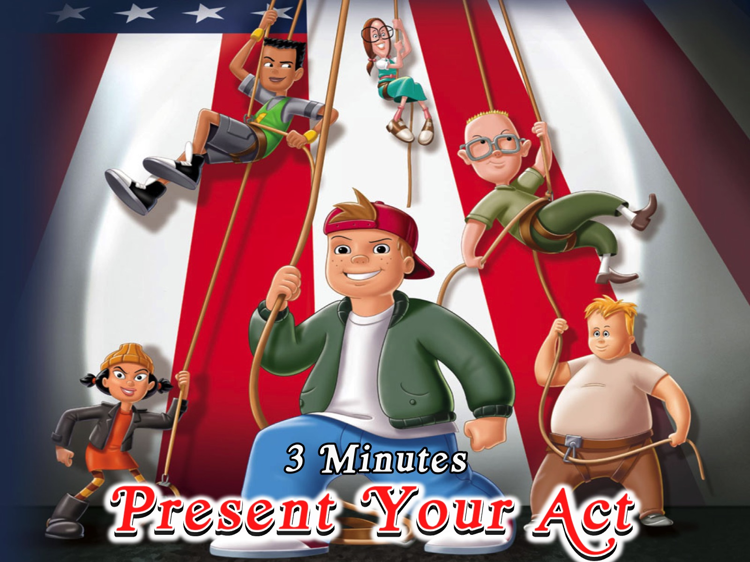
Notes:
Present Your Act: Classes will have around 3 minutes to present their acts.

Slide 7
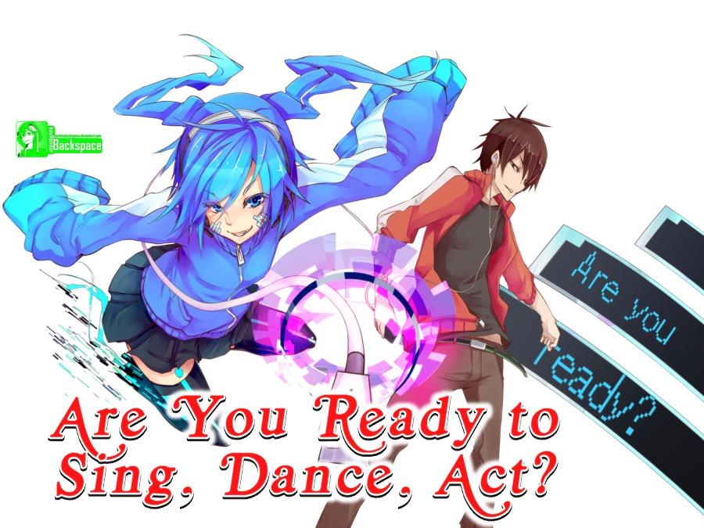
Notes:
Are you ready to Sing, Dance, Act?

Slide 8
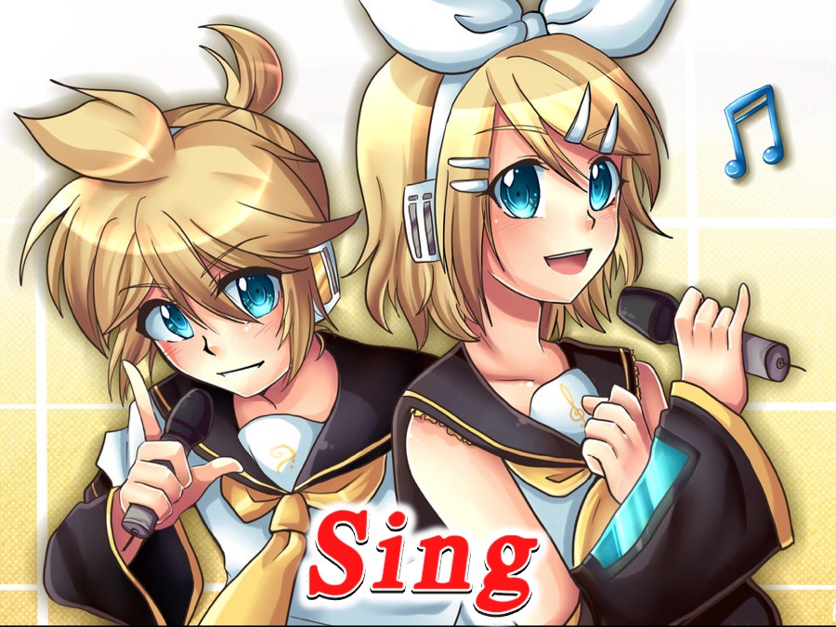
Notes:
Category 1: Sing – three classes will each do their singing performance. Each class has to perform the song: “Call Me Maybe” by Carly Rae Jepsen – but each class has to do it in a different style: Rap or Jazz or Reggae as assigned to them.

Slide 9
Notes:
Video: Video Sing Montage.mp4
The video montage was created from these videos:
Original: Carly Rae Jepsen Call Me Maybe
Rap: https://www.youtube.com/watch?v=RAEVunh9V7w - Call Me Maybe Bootleg Remix
Reggae: https://www.youtube.com/watch?v=7WBeEpx3iec - Call Me Maybe Reggae Ska
Jazz: https://www.youtube.com/watch?v=t8Ls4yLNlCA - Call Me Maybe Jazz Lounge Cover

Slide 10
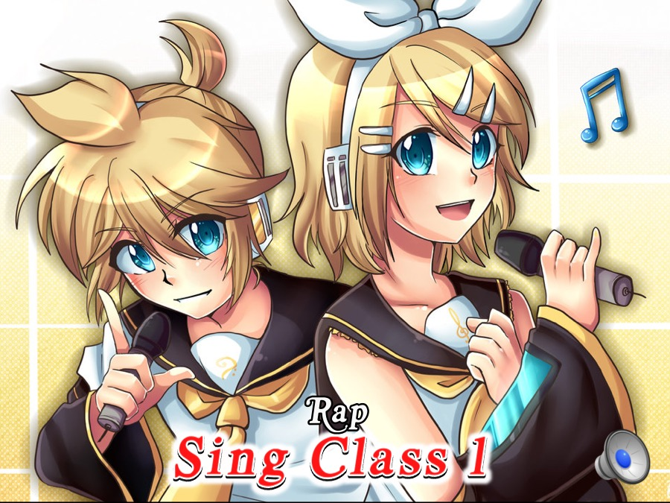
Notes:
Sing Class 1 does their singing performance: They sing “Call Me Maybe” by Carly Rae Jepsen in a Rap style.
Link for Rap backtrack: https://www.youtube.com/watch?v=lDKuNfsGN4s - Rap Beat Instrumental Backtrack for Rappers
Track: Sing 1 Track.mp3

Slide 11

Notes:
Sing Class 2 does their singing performance: They sing “Call Me Maybe” by Carly Rae Jepsen in a Jazz style.
Link for Jazz backtrack: https://www.youtube.com/watch?v=I7LmHILR9AQ - Sad Blues Ballad Backing Track in Em
Track: Sing 2 Track.mp3

Slide 12

Notes:
Sing Class 3 does their singing performance: They sing “Call Me Maybe” by Carly Rae Jepsen in Reggae style.
Link for Raggae backtrack: https://www.youtube.com/watch?v=GarPkcxbbgo - Reggae Guitar Backing Track in C major
Track: Sing 3 Track.mp3

Slide 13
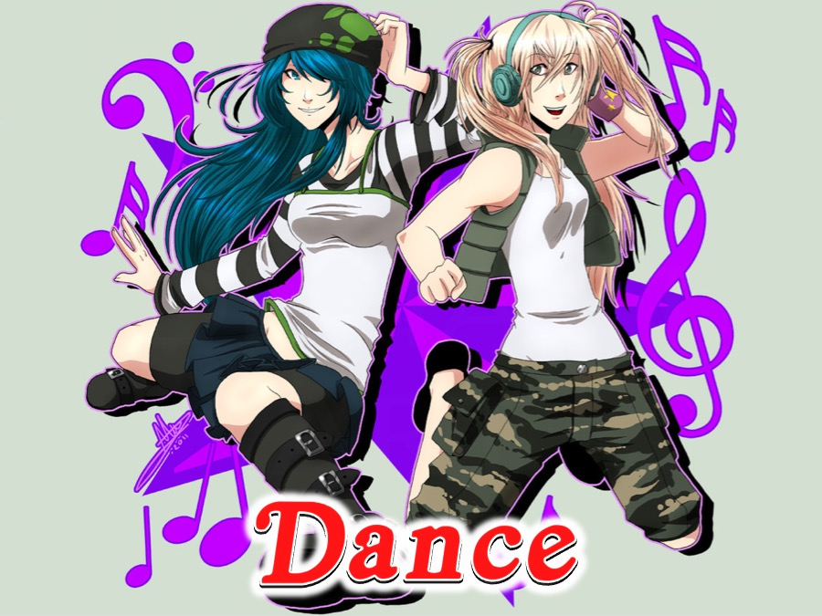
Notes:
Category 2: Dance – three classes will each do their dance performance. Each class has to do a Swan Lake routine – but each class has to do it in a different style: Krump, Modern or Hip Hop.

Slide 14
Notes:
Video: Video Dance Montage.mp4
The video montage was created from these videos:
Classic Swan Lake: https://www.youtube.com/watch?v=JG2NSUHPml0 - Swan Lake - English National Ballet
Swan Lake Reloaded: https://www.youtube.com/watch?v=0uwAm08iQJY - Swan Lake Reloaded
Modern: https://www.youtube.com/watch?v=4_EOiXgVGhs - Dance of the Little Swans
Hip-Hop Style: https://www.youtube.com/watch?v=G_3vh7BX2Bc - BeatCircuit - Swan Lake Remix

Slide 15
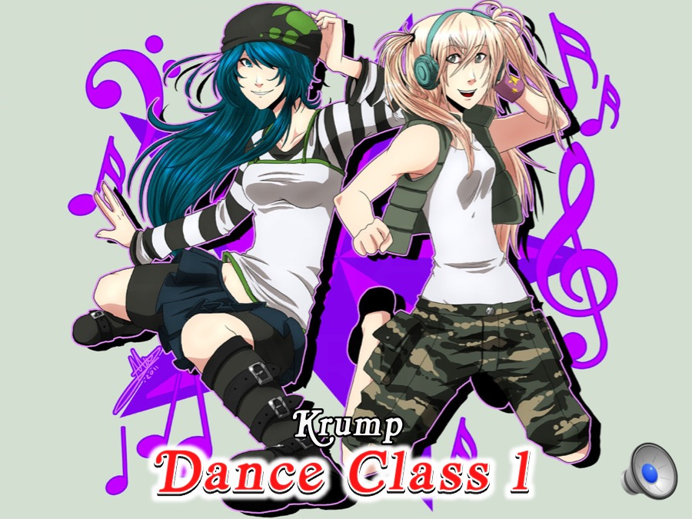
Notes:
Dance Class 1 does their dance performance: They dance a short Swan Lake routine in a Krump style.
Track: https://www.youtube.com/watch?v=2MDq_0PdPUw - Dance Track 1.mp3

Slide 16

Notes:
Dance Class 2 does their dance performance: They dance a short Swan Lake routine in a Modern style.
Track: https://www.youtube.com/watch?v=1BYzOPzF6DQ - Dance Track 2.mp3

Slide 17

Notes:
Dance Class 3 does their dance performance: They dance a short Swan Lake routine in a Hip Hop style.
Track: https://www.youtube.com/watch?v=7dImnGw4E64 - Dance Track 3.mp3

Slide 18
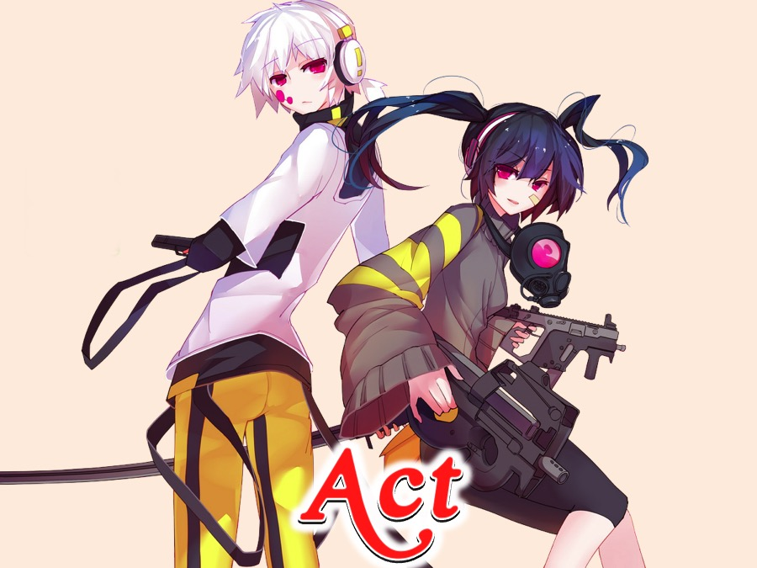
Notes:
Category 3: Act – three classes will each do their acting performance. Each class has to do act out the following scene in one of three accents: Cape Coloured, Nigerian or Shakespearean: You are seated in a train full of people and you see the train conductor walking along checking tickets. You reach into your pocket and realise you have lost your ticket. You know you will get kicked off the train if you don’t show him your ticket. He is slowly approaching, what do you do?

Slide 19
Notes:
Video: Video Act Montage. Get it on YouTube at: https://www.youtube.com/watch?v=nBRGx13UGMY

Slide 20
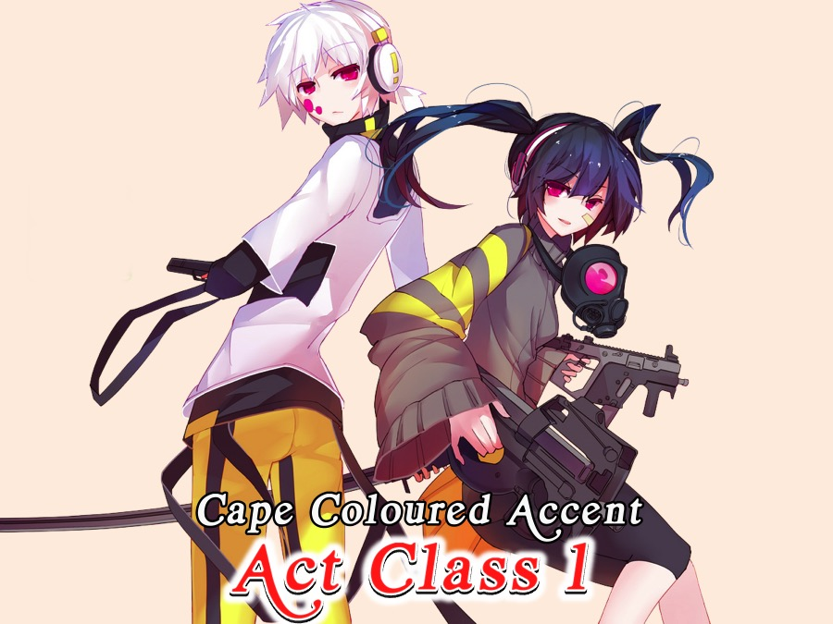
Notes:
Acting Class 1 does their acting performance: They act out the following scene in a Cape Coloured Accent: You are seated in a train full of people and you see the train conductor walking along checking tickets. You reach into your pocket and realise you have lost your ticket. You know you will get kicked off the train if you don’t show him your ticket. He is slowly approaching, what do you do?

Slide 21
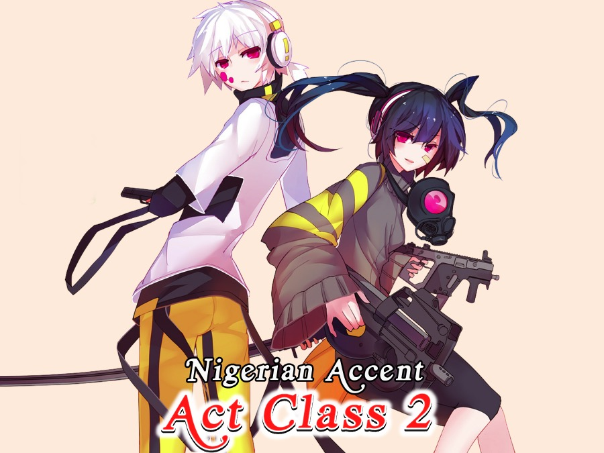
Notes:
Acting Class 2 does their acting performance: They act out the following scene in a Nigerian Accent: You are seated in a train full of people and you see the train conductor walking along checking tickets. You reach into your pocket and realise you have lost your ticket. You know you will get kicked off the train if you don’t show him your ticket. He is slowly approaching, what do you do?

Slide 22
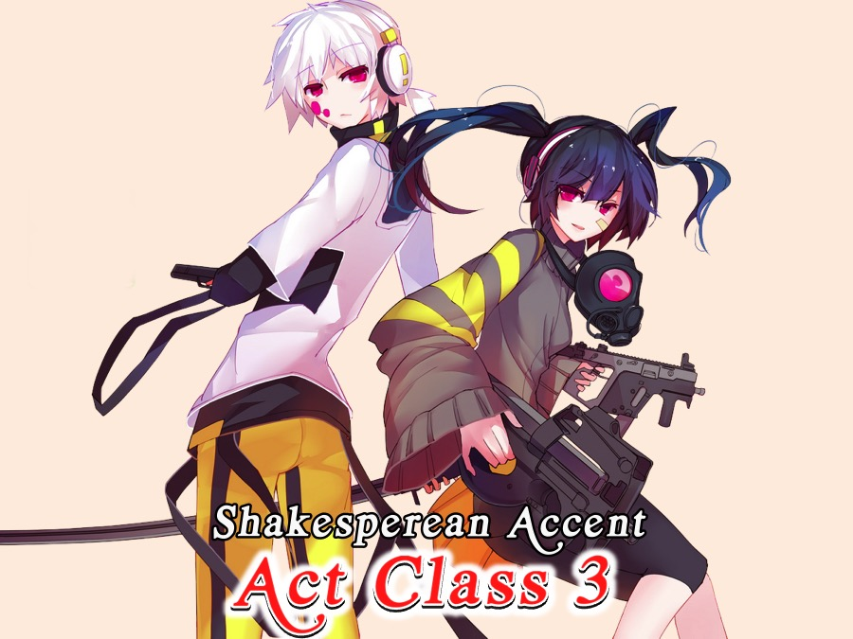
Notes:
Acting Class 3 does their acting performance: They act out the following scene in a Shakesperean Accent: You are seated in a train full of people and you see the train conductor walking along checking tickets. You reach into your pocket and realise you have lost your ticket. You know you will get kicked off the train if you don’t show him your ticket. He is slowly approaching, what do you do?

Slide 23
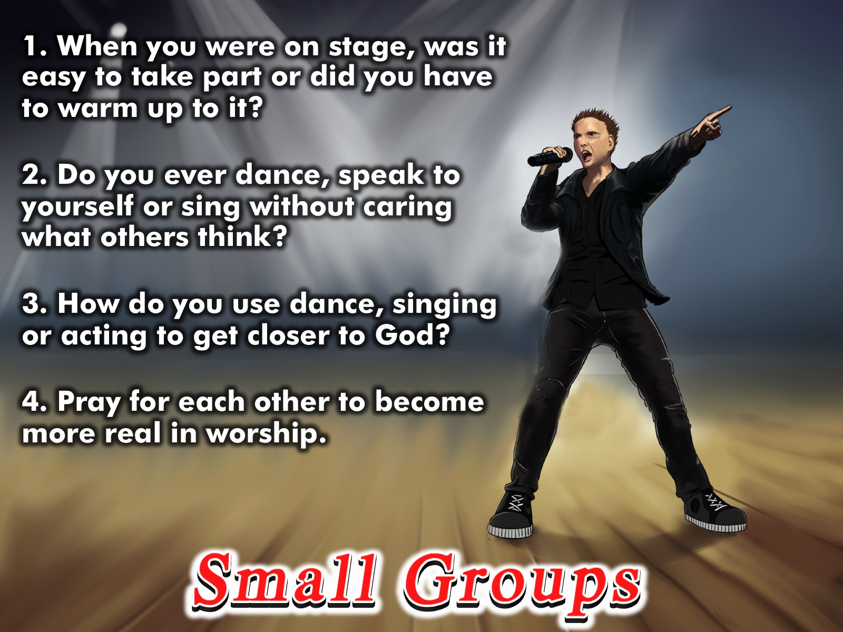
Notes:
Small Groups Questions:
1. When you were on stage, was it easy to take part or did you have to warm up to it?
2. Do you ever dance, speak to yourself or sing without caring what others think?
3. How do you use dance, singing or acting to get closer to God?
4. Pray for each other to become more real in worship.

Slide 24
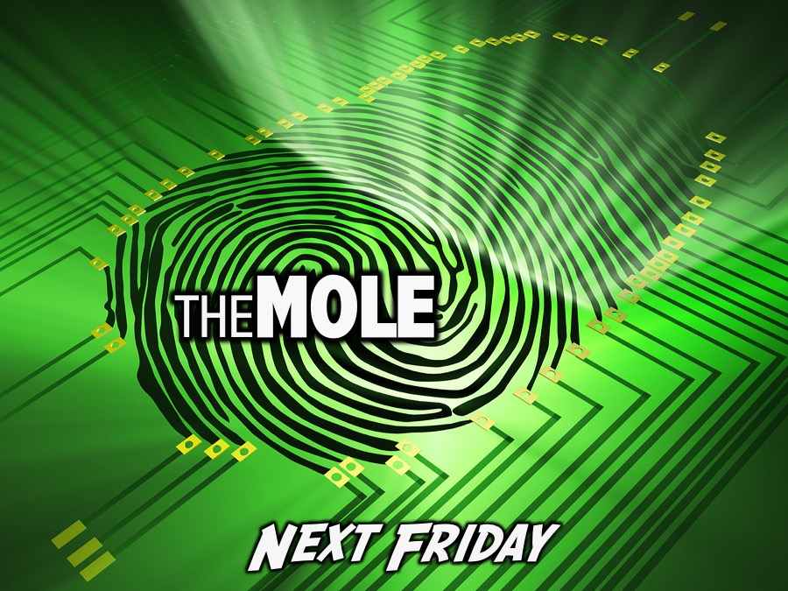
Notes:
Next Friday night is The Mole Night.

Slide 25
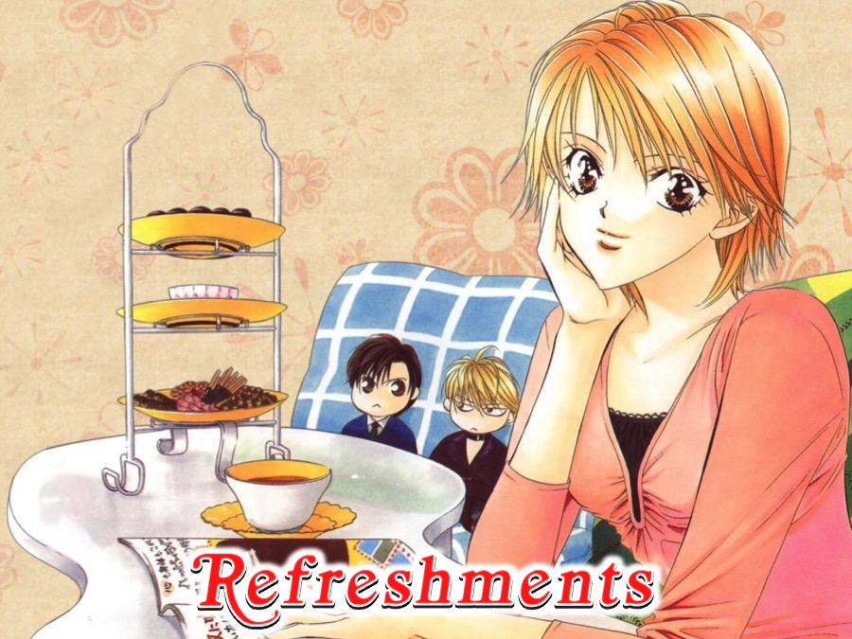
Notes:
Refreshments.

