Slide 1
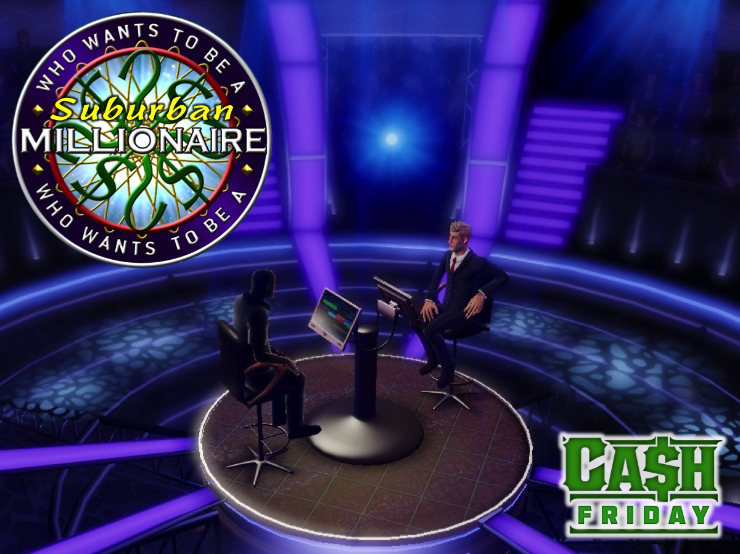
Notes:
Suburban Millionaire Night
Setup Instructions:
1. Place the presenters chair in the front of the room with four chairs facing the presenter
2. Place rows of chairs in four blocks for the team members to sit on (this will help with participation) - the team player seat is in front of the team.
3. Use masking tape to mark off where the teams are seated (around the chairs - to replicate the lighting used in the visuals in this presentation)
4. On the blackboard paste the 4 coloured sets of lifelines and below each, the corresponding posters with the money values.
5. Once a lifeline has been used it is crossed off with a marking pen. There are 3 Lifelines (each used once by each team on their way to a million):
* Ask Your Team – the person competing asks for a show of hands from their team members.
* Call a Leader – have a phone available and a leader in the room is called and they have 30s to answer.
* 50:50 – two answers are crossed off from the four possible answers - the presenter can call they out.
6. Prepare a Cell Phone with Leader Numbers for "Call a Leader”
7. Note for the Game Show host: There is a 20 second countdown from the original show for each question - once you read out the 4 possible answers and advance to the next slide it will start playing. It ends with a buzzer sound. At this point - you should first ask whether anyone is choosing to use a Lifeline. If they are - then do the lifelines first (the other teams not using a lifeline are not allowed to chance their answer to benefit from the team using a lifeline – their cards must be help face down in front of them until the lifeline is used and everyone is ready to reveal their answer); and if no one is using a lifeline, then instruct the four players to all hold up the card with the correct answer facing you. You then advance to the next slide with the answer on it and those with the correct answers will have their next value crossed off by the Scorer on the scoreboard (on their way towards the Million). Note: You must appoint a scorer on the night! 8. If you need to do the Sudden Death questions - you will see an arrow on the last Question 20 slide that will Hyperlink you to the first of the 2 possible elimination questions. When you are done with one or two of them - you will see an arrow on those slides to advance back to the Winners slide.
9. Get prizes for the winning team and the runner up teams.

Slide 2
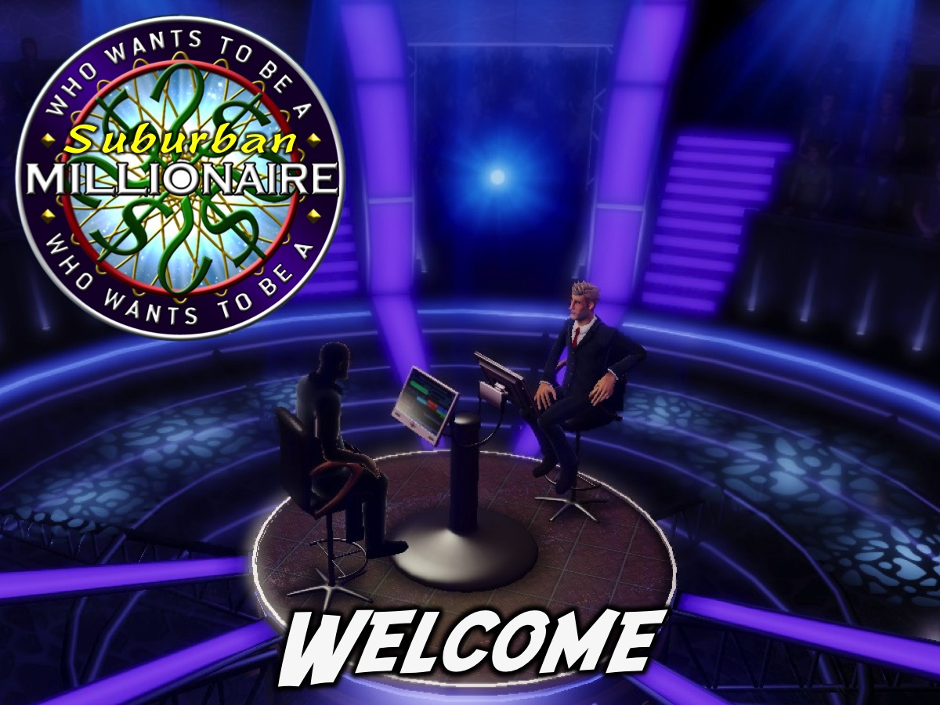
Notes:
Welcome: Welcome to all our regulars and if there are any newcomers – please come up onto stage so we can welcome you!

Slide 3
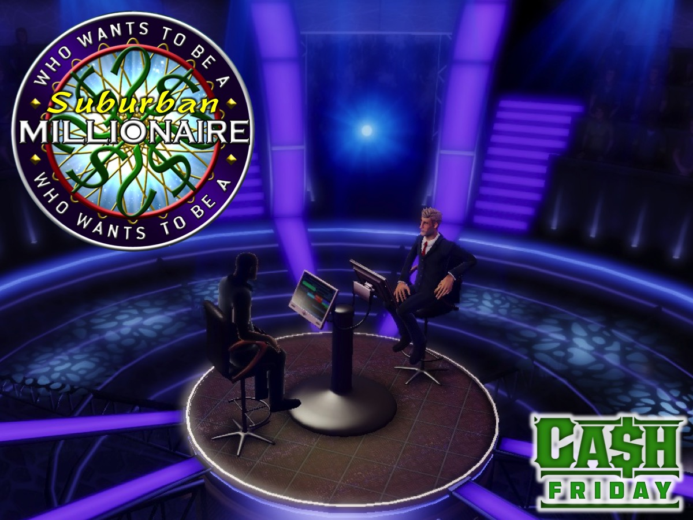
Notes:
So tonight is Suburban Millionaire Night
Sound to play: Theme Walk Down - Who Wants to Be a Millionaire. Get it on YouTube at: https://www.youtube.com/watch?v=IJlZS7BClK4

Slide 4
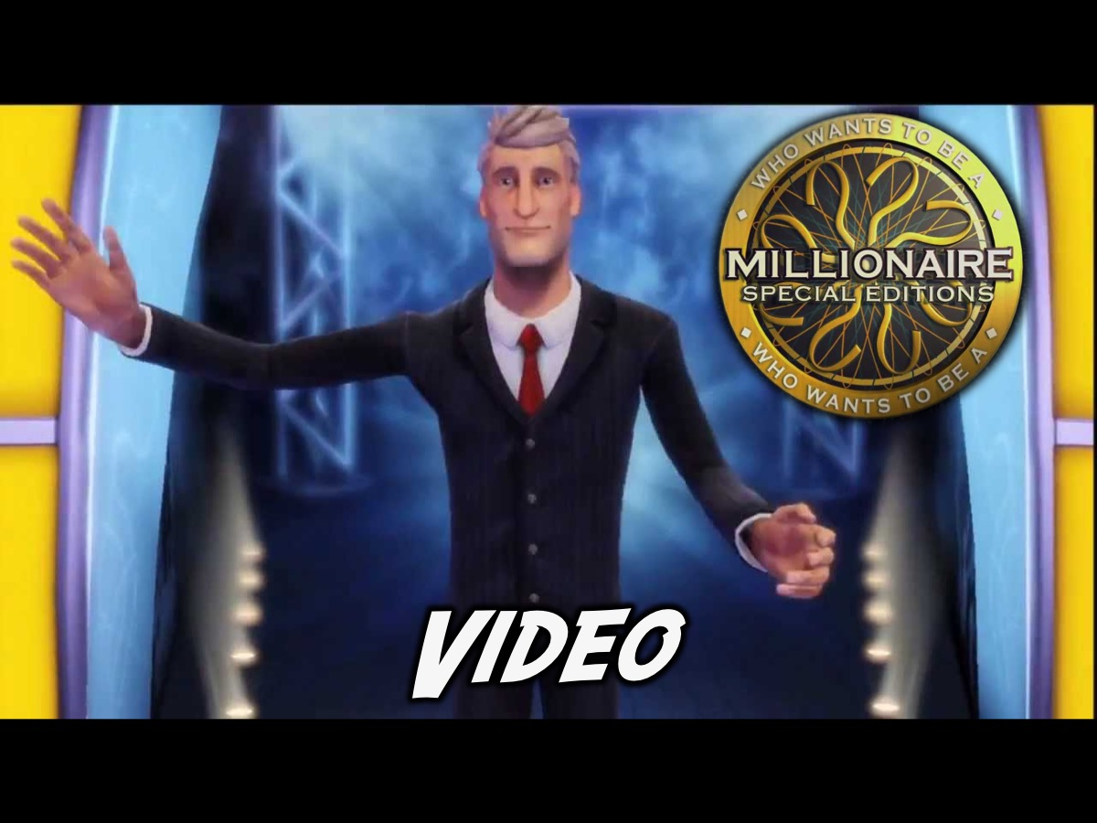
Notes:
But first a video from the launch of the PlayStation game!

Slide 5
Notes:
Video: Who Wants To Be A Millionaire Special Editions Trailer. Get it on YouTube at: https://www.youtube.com/watch?v=lq-ugdOYWJ0

Slide 6
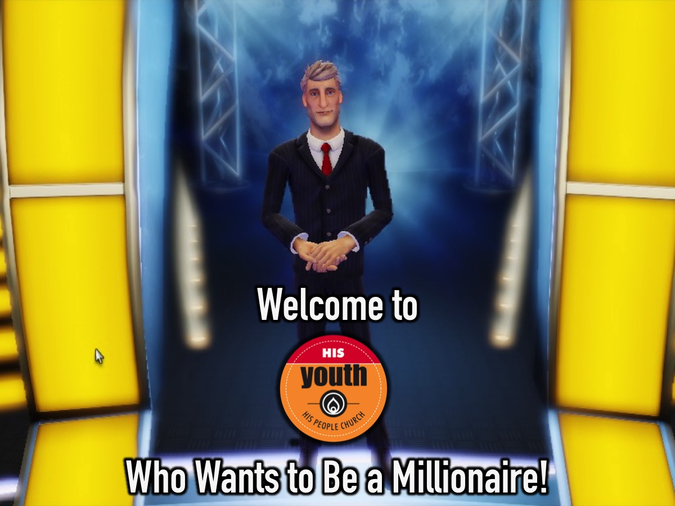
Notes:
So, welcome to His Youth’s Who Wants to Be A Millionaire!

Slide 7
Notes:
Teams: You are going to divide up into 4 teams and take your seats on the chairs in each of the four colours: Red, Green, Yellow and Blue.

Slide 8
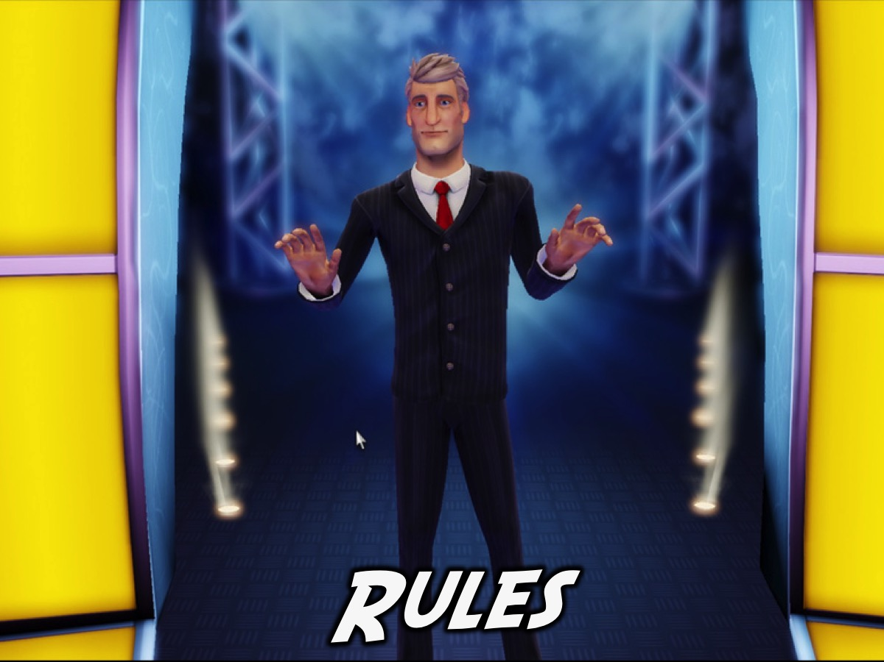
Notes:
Rules: Listen carefully to the following rules or you will have no chance of winning the Million!

Slide 9
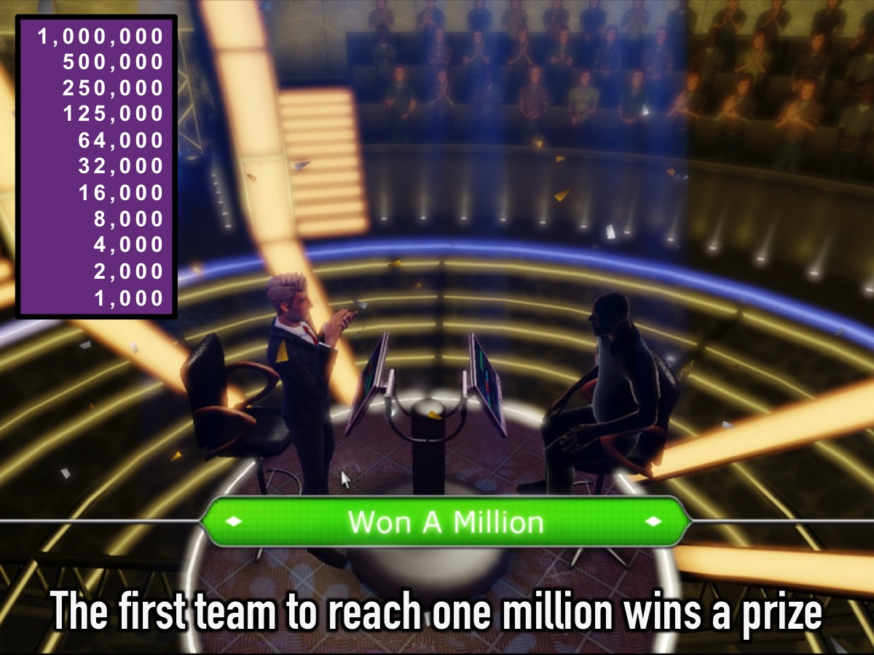
Notes:
The first team to reach one million will win a prize. Here are the levels you are playing for:
1,000,000
500,000
250,000
125,000
64,000
32,000
16,000
8,000
4,000
2,000
1,000

Slide 10
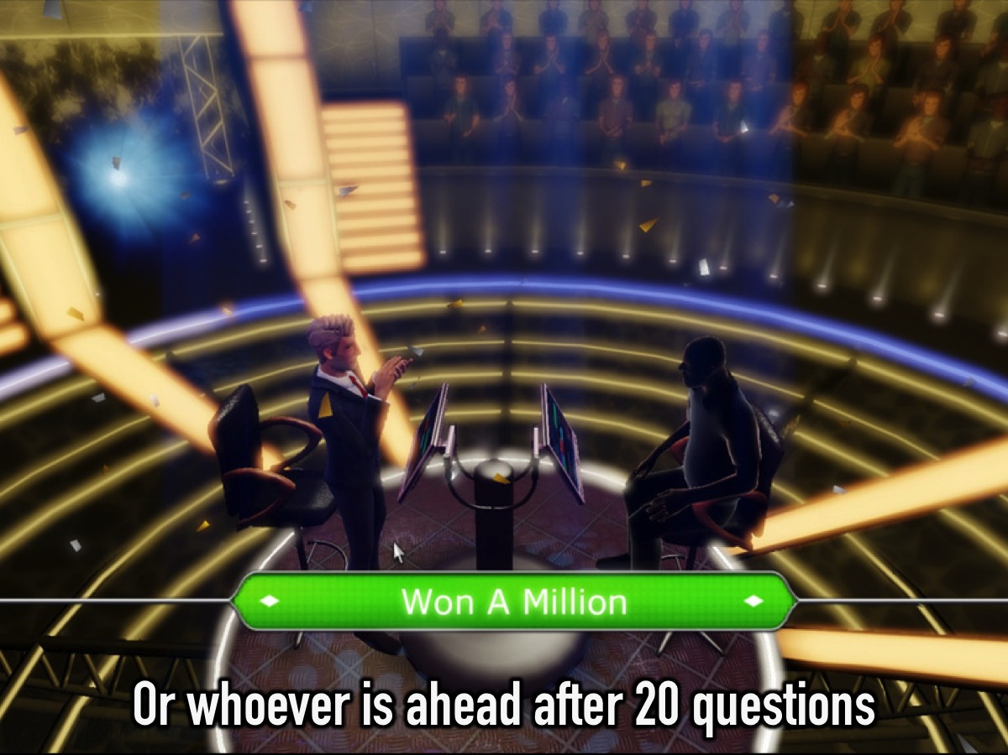
Notes:
Or the team that is ahead after 20 questions will be declared the winners.

Slide 11
Notes:
A different person from each team will step up to compete each round.

Slide 12
Notes:
You can answer the question or choose to use a lifeline:
* 50:50 – two answers are crossed off from the four possible answers - the presenter can call they out.
* Call a Leader – have a phone available and a leader in the room is called and they have 30s to answer.
* Ask Your Team – the person competing asks for a show of hands from their team members.

Slide 13
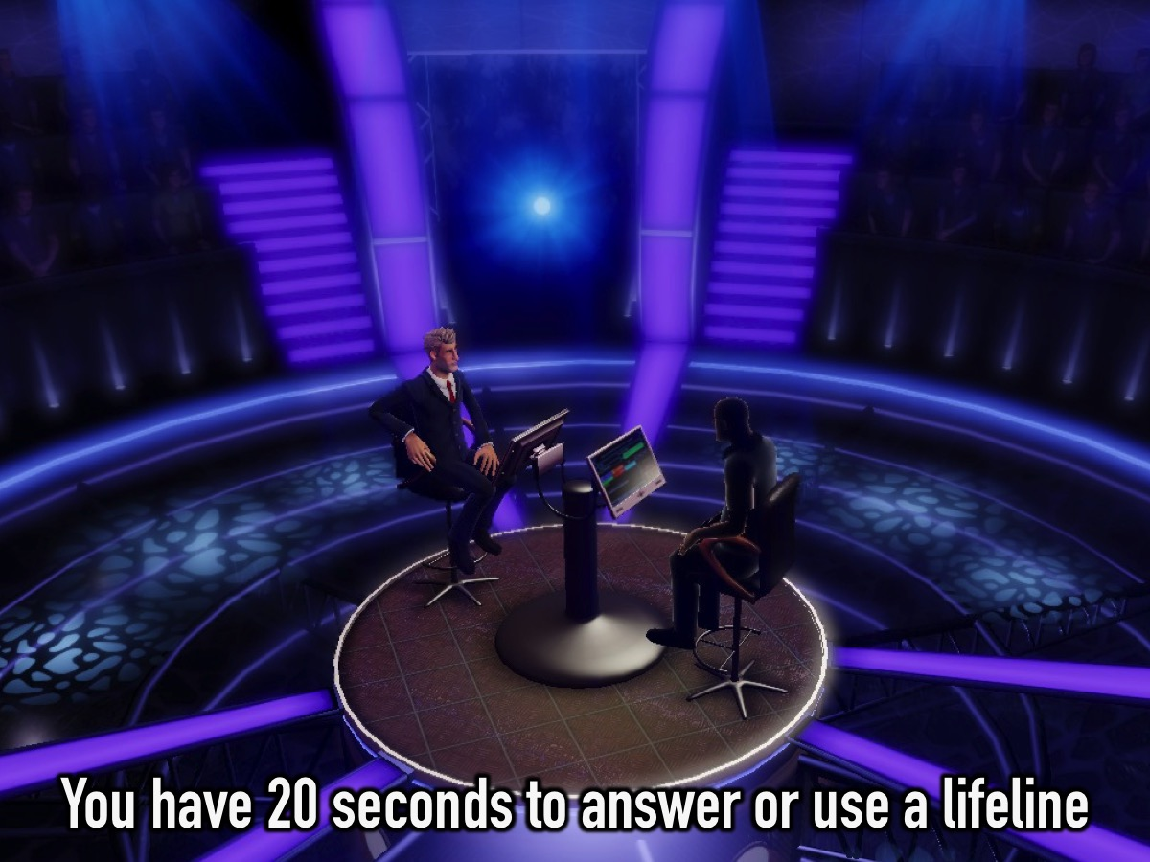
Notes:
You have just 20 seconds to think about your answer or whether to use a lifeline!

Slide 14
Notes:
The four players are asked a question at the same time and the person has to write an A B C or D on a piece of paper and show it when the clock has counted down. Maybe 15 seconds per question. If a person chooses to use a lifeline at the end of the countdown they may opt to do so.

Slide 15
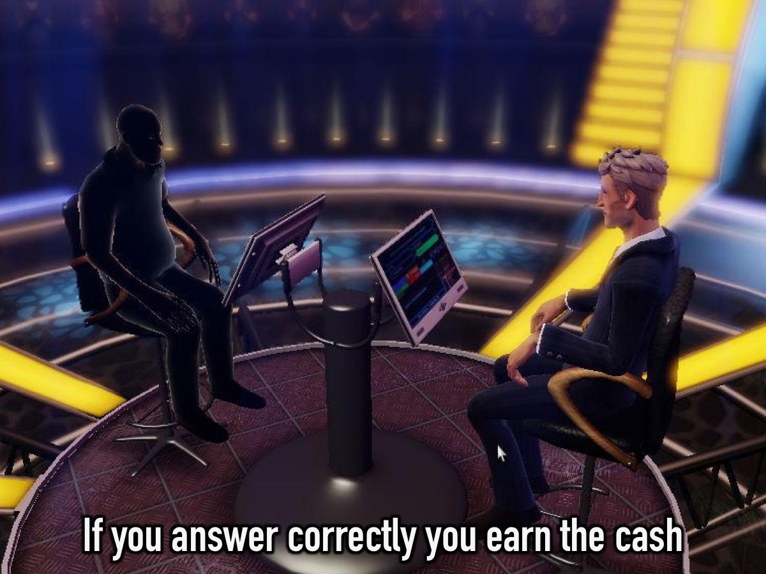
Notes:
If you answer a question correctly you earn the cash!

Slide 16
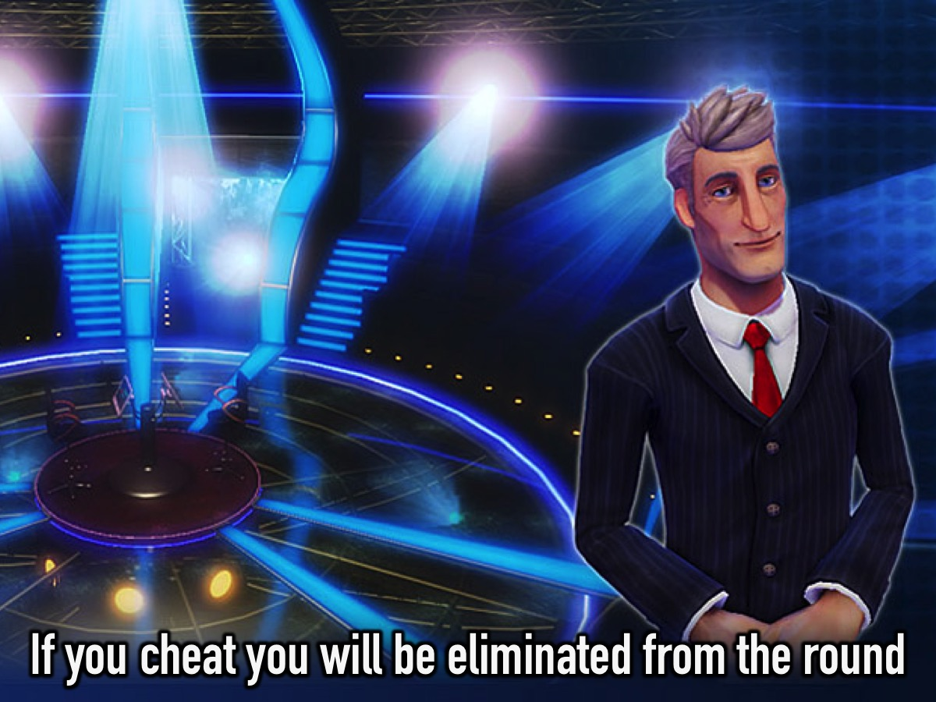
Notes:
If you cheat you will be eliminated from the round

Slide 17
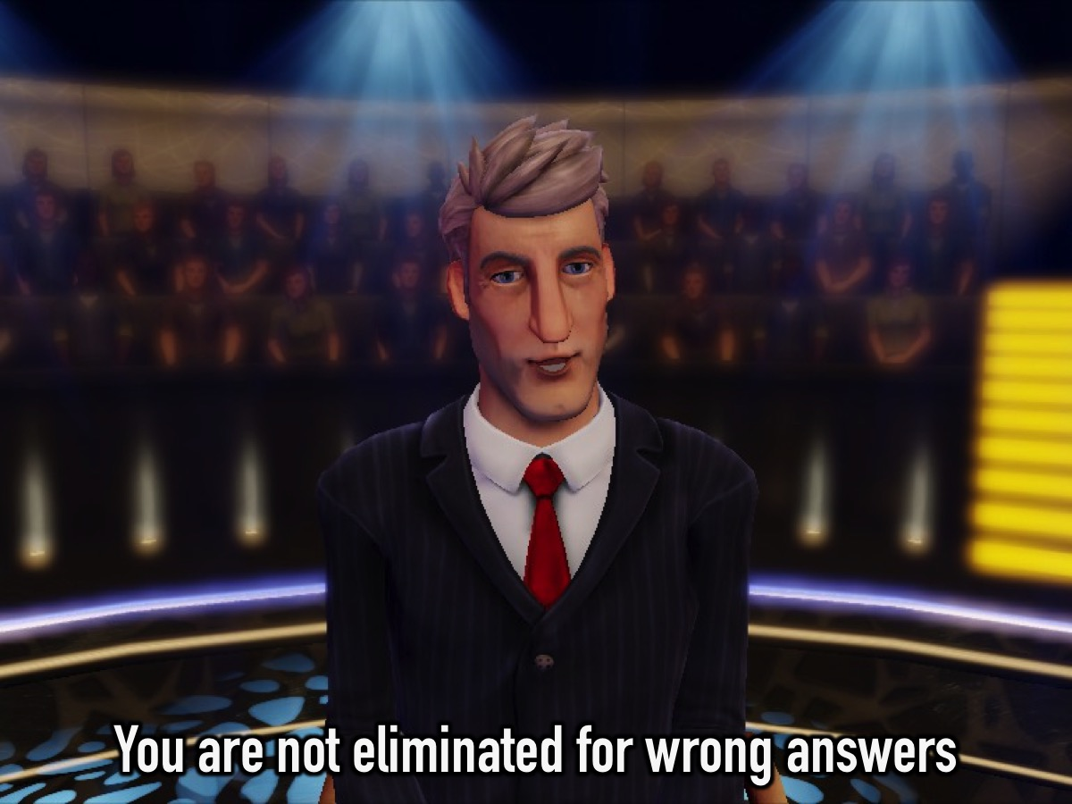
Notes:
You are not eliminated for wrong answers

Slide 18
Notes:
“Let’s play: Who Want to be a Suburban Millionaire?”
Sound clip: Edited from: “Who Wants To Be A Millionaire Music - Fastest Finger First”. Get it online at: https://www.youtube.com/watch?v=5fY7LOGJF2o

Slide 19
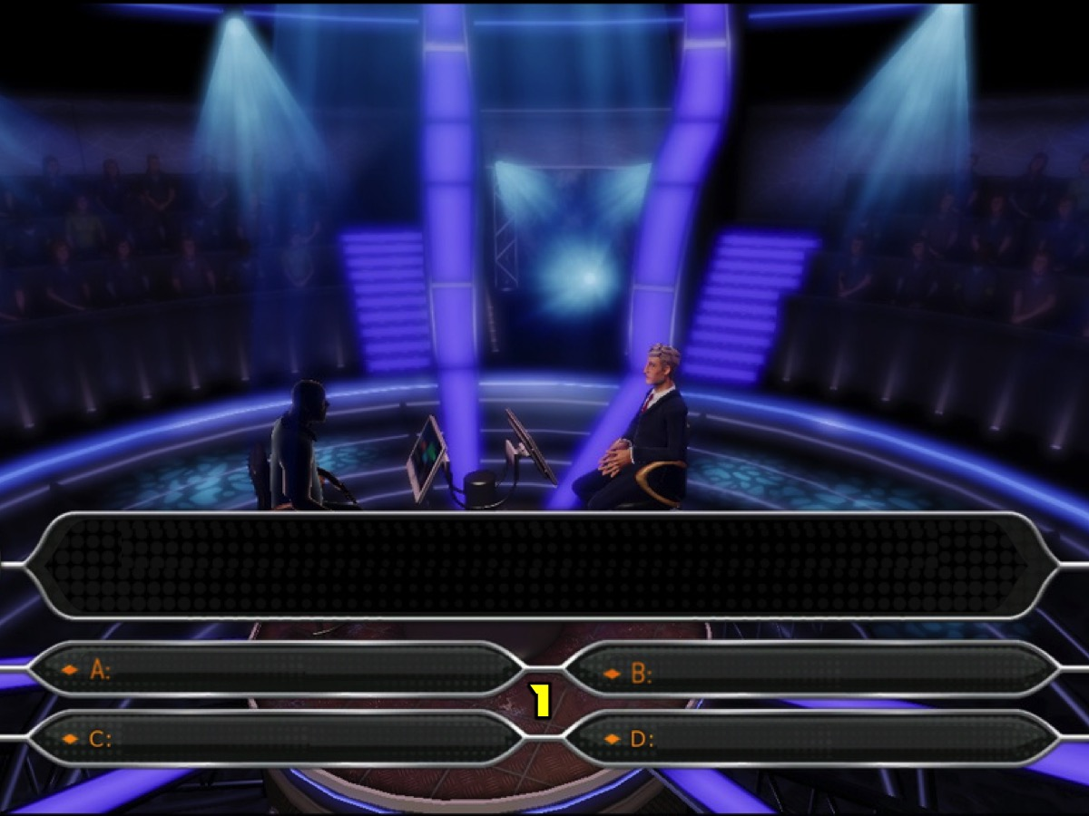
Notes:
Get ready for Question #1
Sound clip: Edited from: “Who Wants To Be A Millionaire Music - Fastest Finger First”. Get it online at: https://www.youtube.com/watch?v=5fY7LOGJF2o

Slide 20
Notes:
Question #1. What is South Africa’s national rugby team known as?

Slide 21
Notes:
Is it:
A. Banyana Banyana
B. Sprinkboks
C. Bafana Bafana
D. Proteas

Slide 22
Notes:
Your 20 seconds starts now!
Countdown Video: Get it on YouTube at: https://www.youtube.com/watch?v=8tAXbkGR_-c

Slide 23
Notes:
Is anyone using a lifeline? (If Yes, other teams hold their cards face down and can't change their answer while you deal with the lifeline for the one (or more) teams.

Slide 24
Notes:
The Correct Answer is B: Springboks.
Get the Scorer to strike off a value on the board for each team that has the correct answer.

Slide 25
Notes:
Get ready for Question #2

Slide 26
Notes:
Question #2. Who plays the lead female actress in “Divergent”?

Slide 27
Notes:
Is it:
A. Selena Gomez
B. Charlize Theron
C. Shailene Woodley
D. Demi Lovato

Slide 28
Notes:
Your 20 seconds starts now!
Countdown Video: Get it on YouTube at: https://www.youtube.com/watch?v=8tAXbkGR_-c

Slide 29
Notes:
Is anyone using a Lifeline?

Slide 30
Notes:
The Correct Answer is C. Shailene Woodley

Slide 31
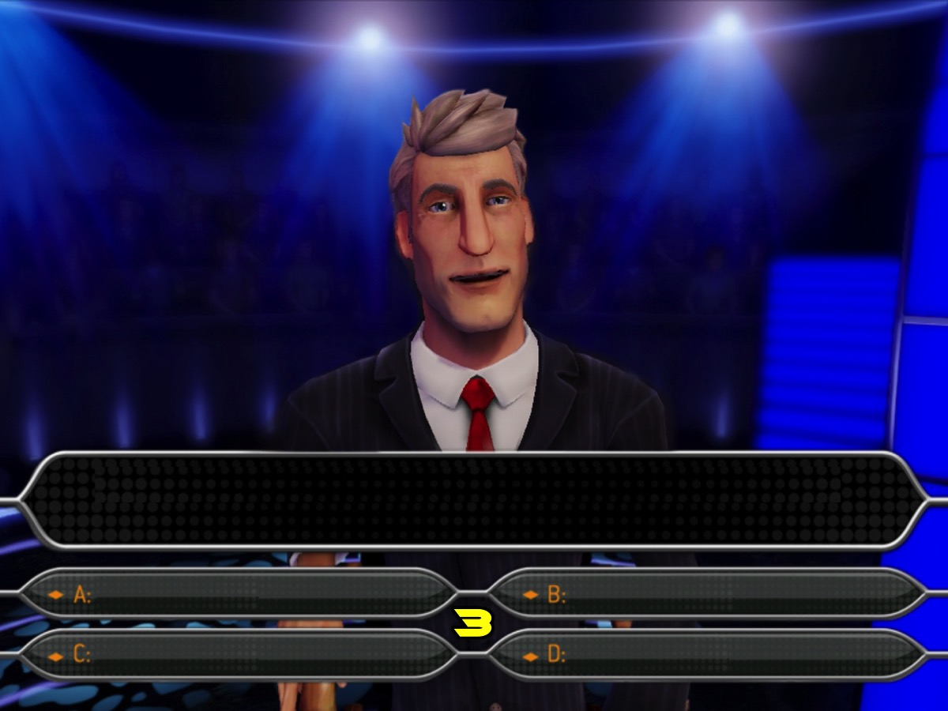
Notes:
Get ready for Question #3

Slide 32
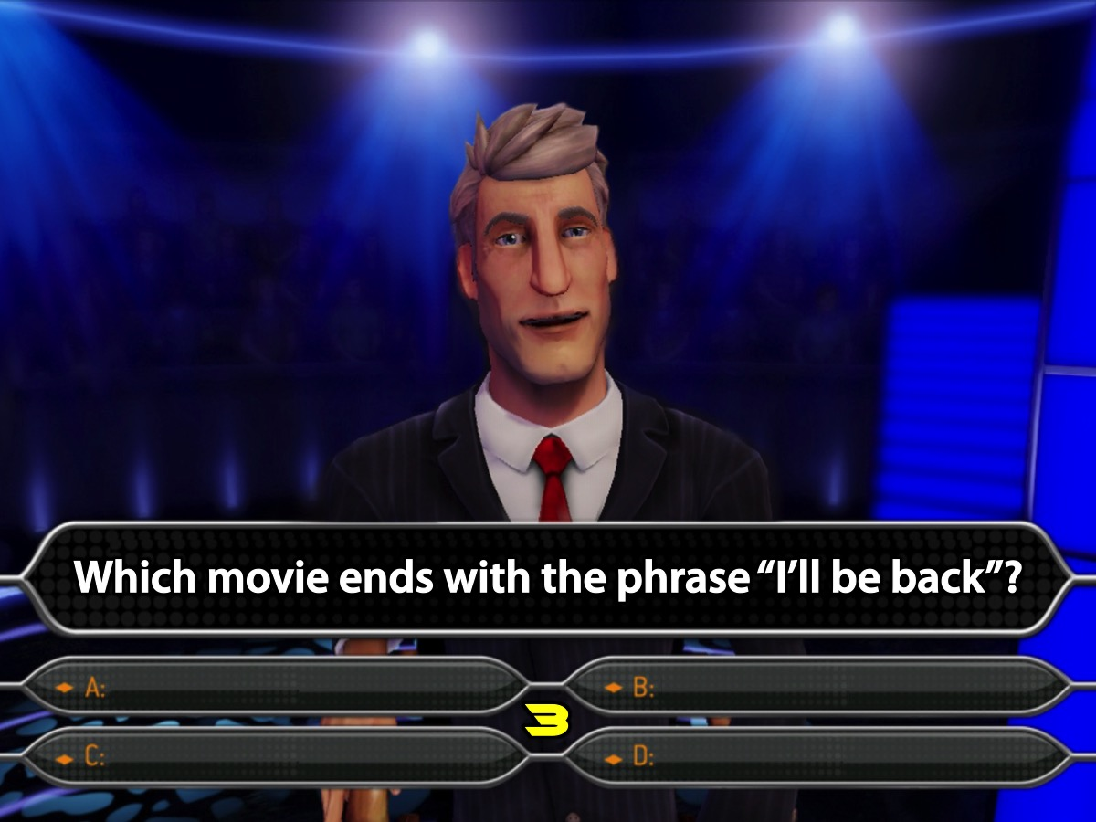
Notes:
Question #3. Which movie ends with the phrase “I’ll be back”?

Slide 33
Notes:
Is it:
A. A Walk To Remember
B. Insurgent
C. The Terminator
D. Rocky

Slide 34
Notes:
Your 20 seconds starts now!
Countdown Video: Get it on YouTube at: https://www.youtube.com/watch?v=8tAXbkGR_-c

Slide 35
Notes:
Is anyone using a Lifeline?

Slide 36
Notes:
The Correct Answer is C. The Terminator

Slide 37
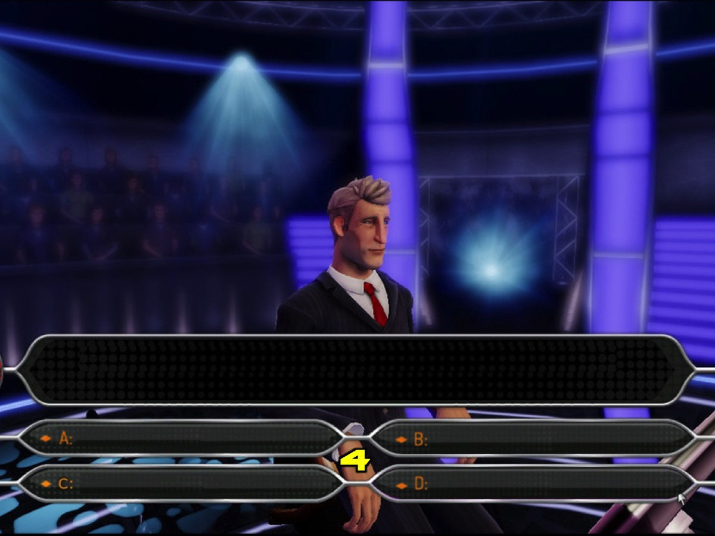
Notes:
Get ready for Question #4

Slide 38
Notes:
Question #4. In which city is the Eiffel Tower?

Slide 39
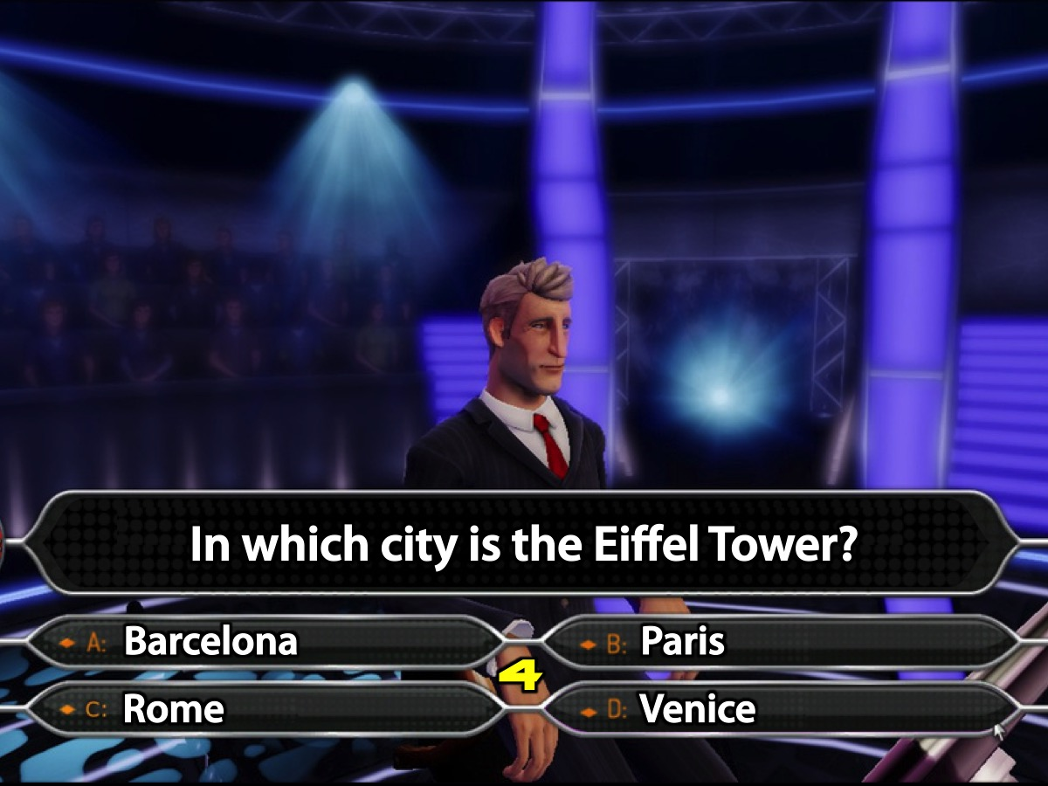
Notes:
Is it:
A. Barcelona
B. Paris
C. Rome
D. Venice

Slide 40
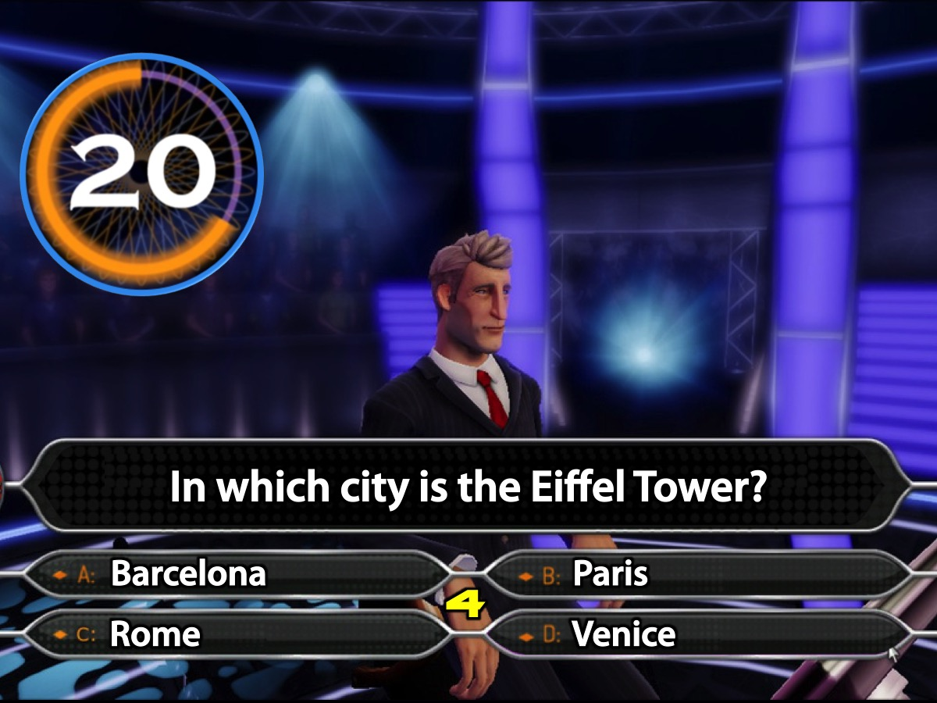
Notes:
Your 20 seconds starts now!
Countdown Video: Get it on YouTube at: https://www.youtube.com/watch?v=8tAXbkGR_-c

Slide 41
Notes:
Is anyone using a Lifeline?

Slide 42
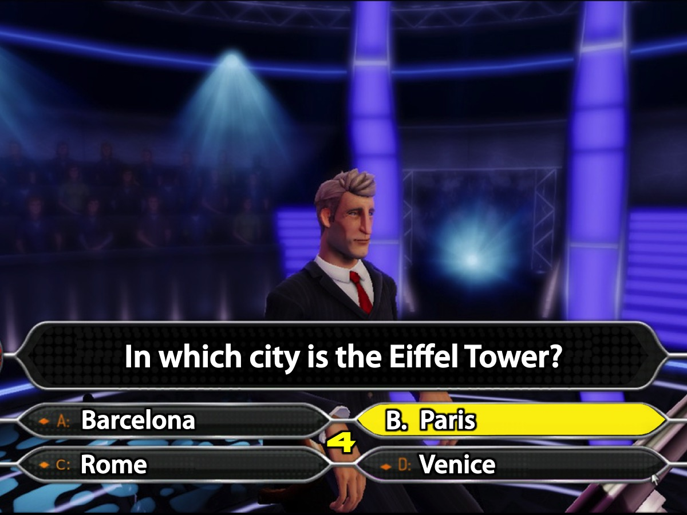
Notes:
The Correct Answer is B. Paris

Slide 43
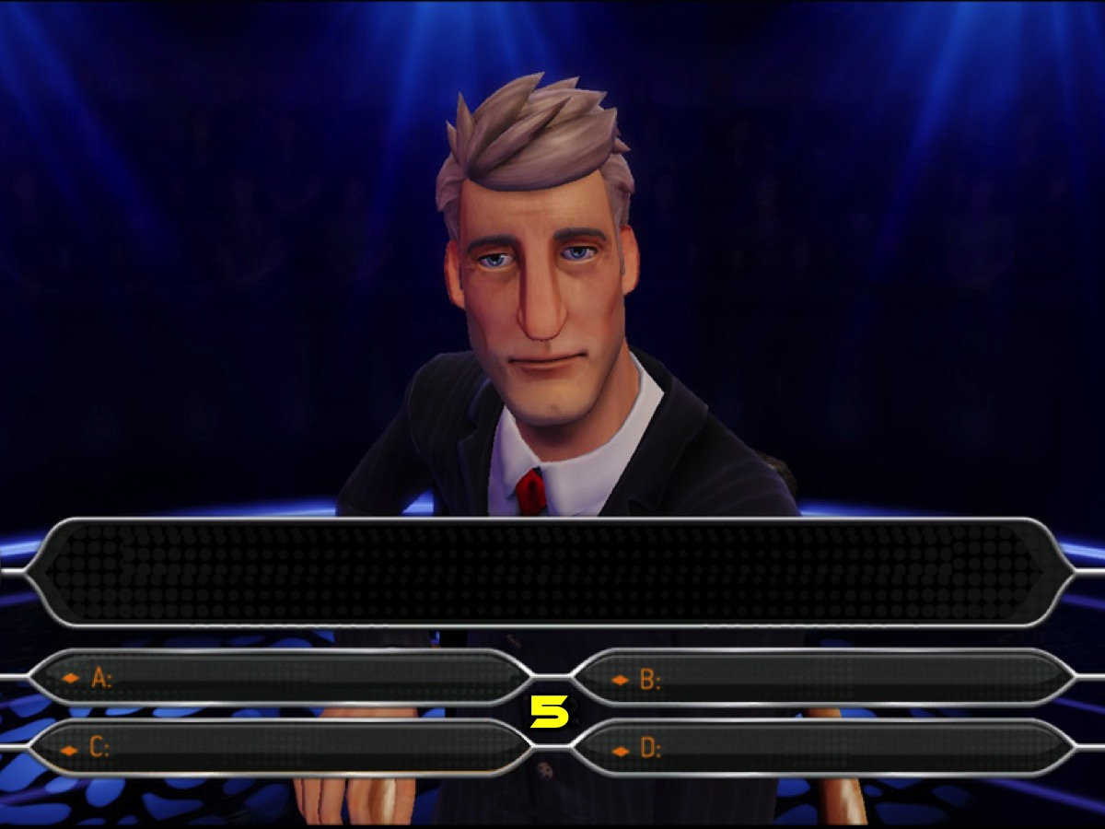
Notes:
Get ready for Question #5.

Slide 44
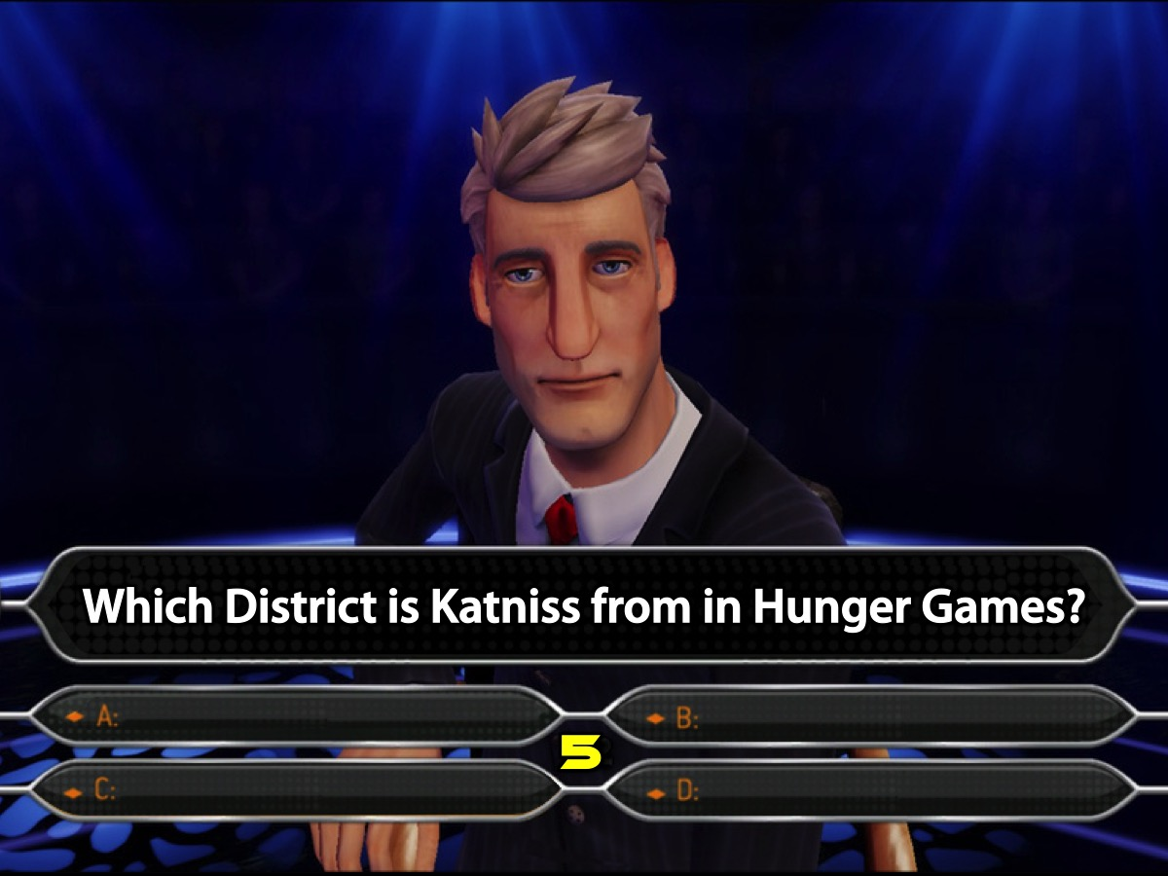
Notes:
Question #5. Which District is Katniss from in Hunger Games?

Slide 45
Notes:
Is it:
A. District 12
B. District 2
C. District 13
D. District 1

Slide 46
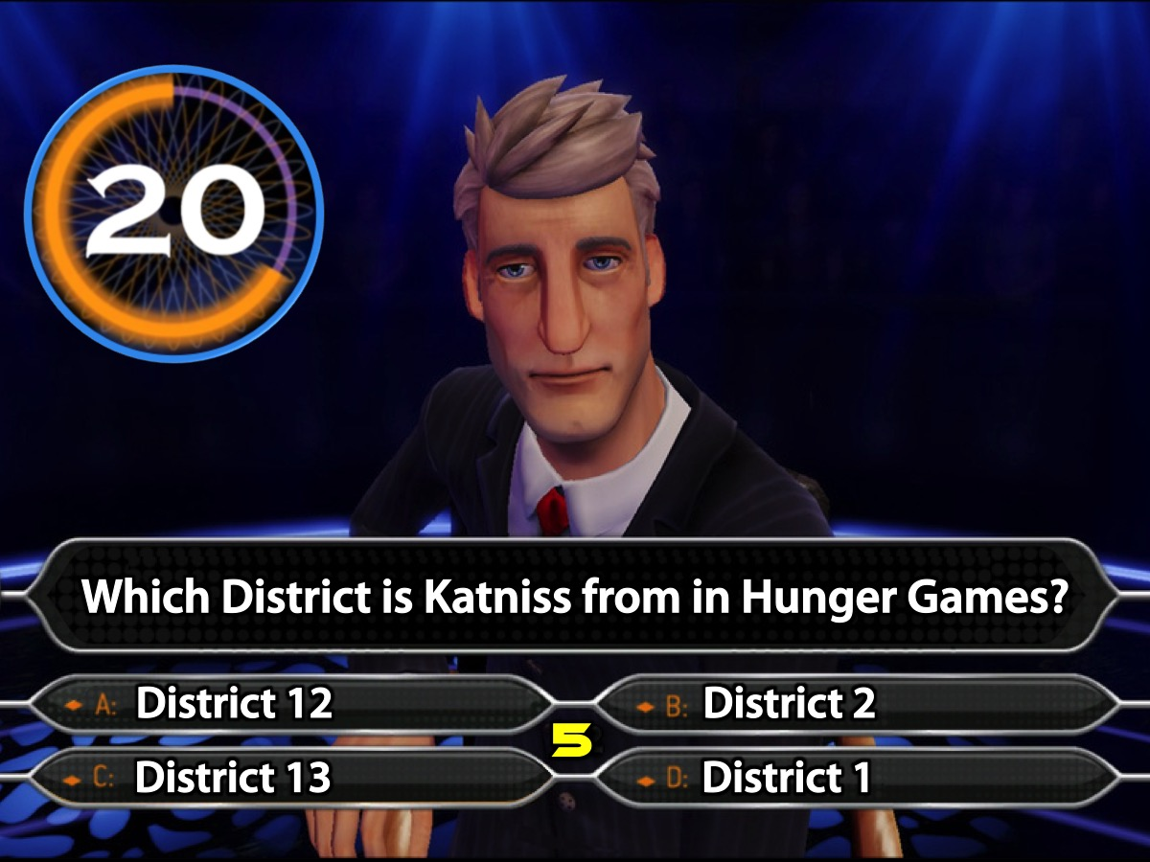
Notes:
Your 20 seconds starts now!
Countdown Video: Get it on YouTube at: https://www.youtube.com/watch?v=8tAXbkGR_-c

Slide 47
Notes:
Is anyone using a Lifeline?

Slide 48
Notes:
The Correct Answer is A. District 12.

Slide 49
Notes:
Get ready for Question #6

Slide 50
Notes:
Question #6. Who is the President of the African Union?

Slide 51
Notes:
Is it:
A. Thabo Mbeki
B. Robert Mugabe
C. Nkosazana Dlamini-Zuma
D. Muhammadu Buhari

Slide 52
Notes:
Your 20 seconds starts now!
Countdown Video: Get it on YouTube at: https://www.youtube.com/watch?v=8tAXbkGR_-c

Slide 53
Notes:
Is anyone using a Lifeline?

Slide 54
Notes:
The Correct Answer is B. Robert Mugabe

Slide 55
Notes:
Get ready for Question #7

Slide 56
Notes:
Question #7. How many Grand Slam Singles titles has Roger Federer won?

Slide 57
Notes:
Is it:
A. 17
B. 14
C. 16
D. 10

Slide 58
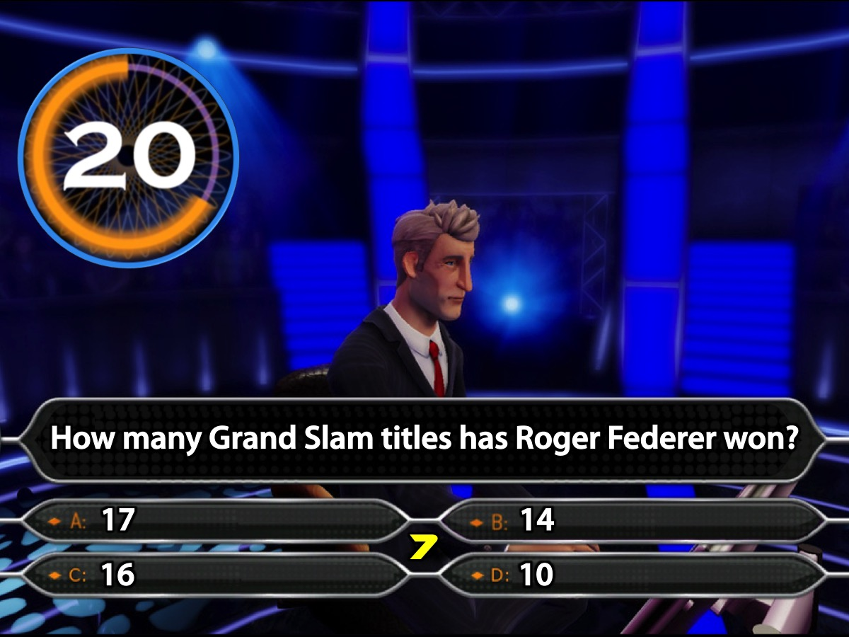
Notes:
Your 20 seconds starts now!
Countdown Video: Get it on YouTube at: https://www.youtube.com/watch?v=8tAXbkGR_-c

Slide 59
Notes:
Is anyone using a Lifeline?

Slide 60
Notes:
The Correct Answer is A. 17

Slide 61
Notes:
Get ready for Question #8

Slide 62
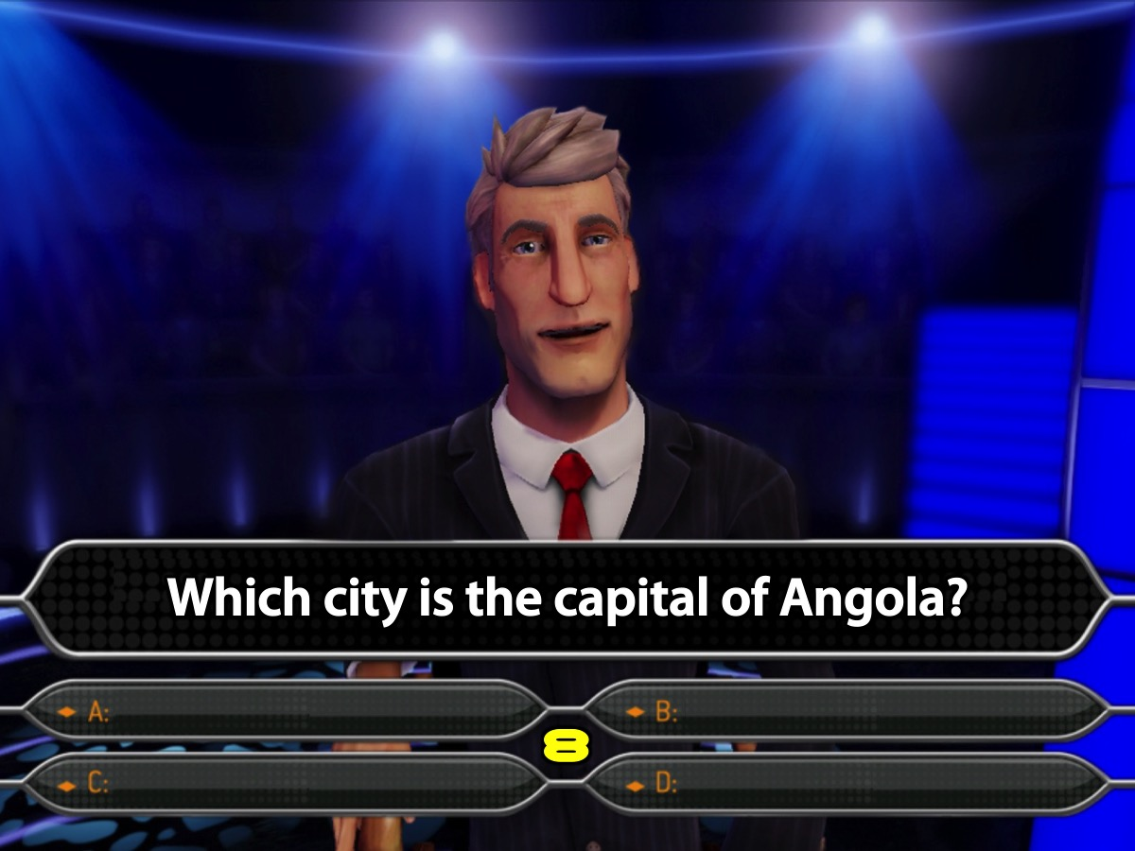
Notes:
Question #8. Which city is the capital of Angola?

Slide 63
Notes:
Is it:
A. Pretoria
B. Luanda
C. Lusaka
D. Dar Es Salaam

Slide 64
Notes:
Your 20 seconds starts now!
Countdown Video: Get it on YouTube at: https://www.youtube.com/watch?v=8tAXbkGR_-c

Slide 65
Notes:
Is anyone using a Lifeline?

Slide 66
Notes:
The Correct Answer is B. Luanda.

Slide 67
Notes:
Get ready for Question #9

Slide 68
Notes:
Question #9. Which of these are part of the Divergent series?

Slide 69
Notes:
Is it:
A. Convergent
B. Deviant
C. Emergent
D. Allegiant

Slide 70
Notes:
Your 20 seconds starts now!
Countdown Video: Get it on YouTube at: https://www.youtube.com/watch?v=8tAXbkGR_-c

Slide 71
Notes:
Is anyone using a Lifeline?

Slide 72
Notes:
The Correct Answer is D. Allegiant

Slide 73
Notes:
Get ready for Question #10

Slide 74
Notes:
Question #10. Which one of the following cricketers has taken the most wickets for South Africa in Test cricket?

Slide 75
Notes:
Is it:
A. Dale Steyn
B. Makhaya Ntini
C. Shaun Pollock
D. Julius Malema

Slide 76
Notes:
Your 20 seconds starts now!
Countdown Video: Get it on YouTube at: https://www.youtube.com/watch?v=8tAXbkGR_-c

Slide 77
Notes:
Is anyone using a Lifeline?

Slide 78
Notes:
The Correct Answer is C. Shaun Pollock

Slide 79
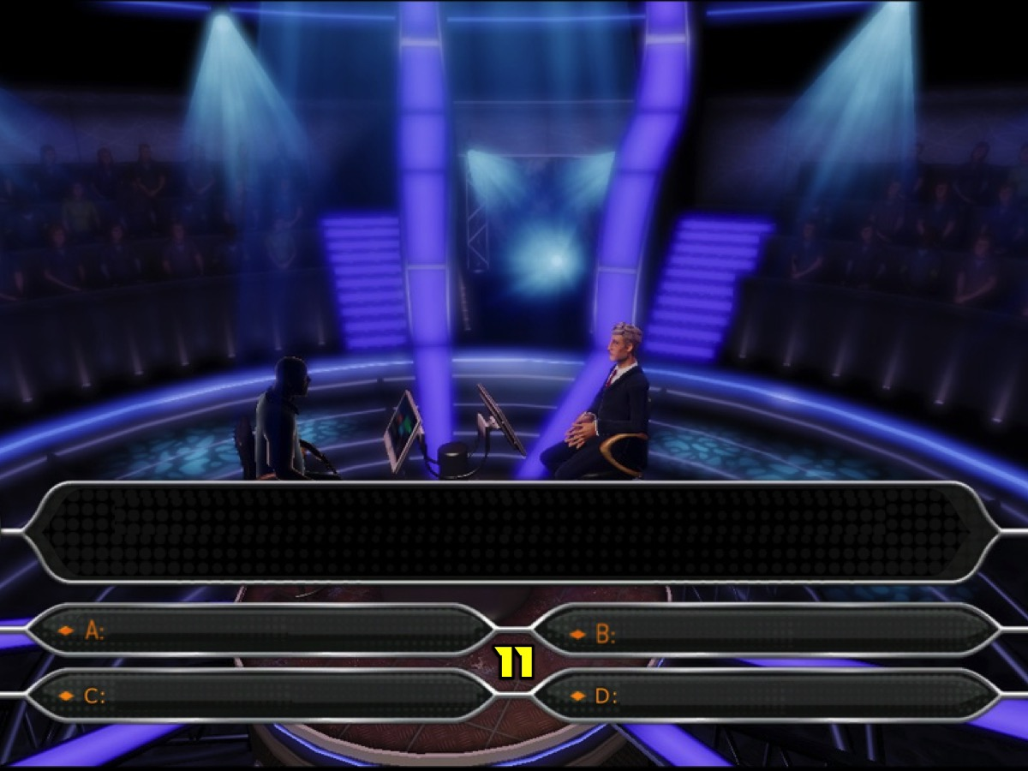
Notes:
Get ready for Question #11

Slide 80
Notes:
Question #11. Who is the author of the book “The Giver”?

Slide 81
Notes:
Is it:
A. Nancy Drew
B. Gabrielle Zevin
C. Cassandra Clare
D. Lois Lowry

Slide 82
Notes:
Your 20 seconds starts now!
Countdown Video: Get it on YouTube at: https://www.youtube.com/watch?v=8tAXbkGR_-c

Slide 83
Notes:
Is anyone using a Lifeline?

Slide 84
Notes:
The Correct Answer is D. Lois Lowry

Slide 85
Notes:
Get ready for Question #12

Slide 86
Notes:
Question #12. Which city is known as “The Big Apple”?

Slide 87
Notes:
Is it:
A. London
B. New York City
C. Munich
D. Cape Town

Slide 88
Notes:
Your 20 seconds starts now!
Countdown Video: Get it on YouTube at: https://www.youtube.com/watch?v=8tAXbkGR_-c

Slide 89
Notes:
Is anyone using a Lifeline?

Slide 90
Notes:
The Correct Answer is B. New York City

Slide 91
Notes:
Get ready for Question #13

Slide 92
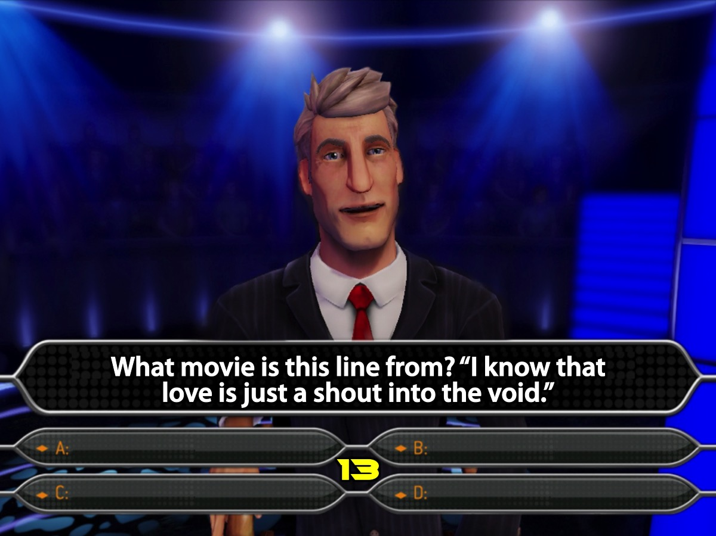
Notes:
Question #13. What movie is this line from: “I know that love is just a shout into the void.”

Slide 93
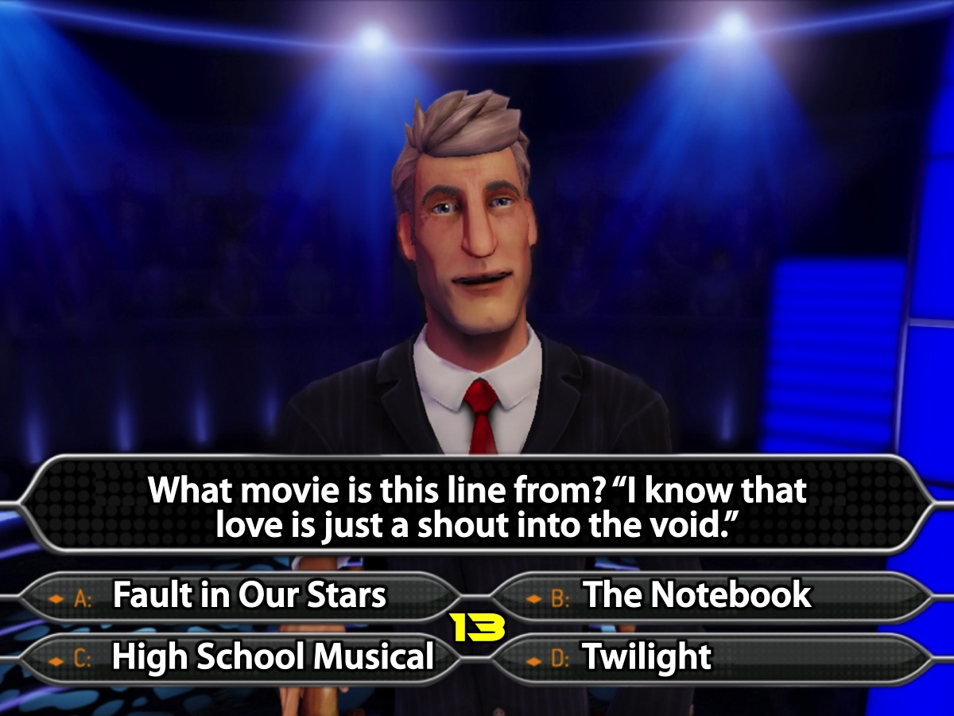
Notes:
Is it:
A. Fault in our Stars
B. The Notebook
C. High School Musical
D. Twilight

Slide 94
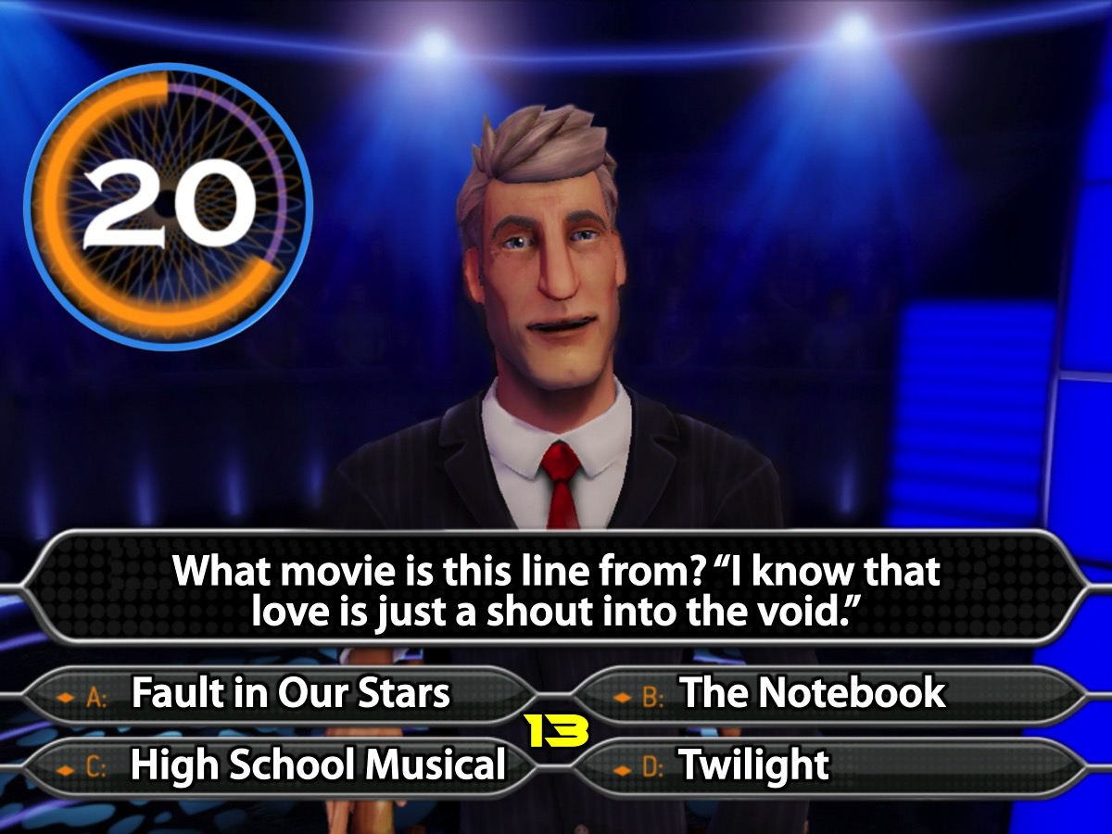
Notes:
Your 20 seconds starts now!
Countdown Video: Get it on YouTube at: https://www.youtube.com/watch?v=8tAXbkGR_-c

Slide 95
Notes:
Is anyone using a Lifeline?

Slide 96
Notes:
The Correct Answer is A. Fault in our Stars.

Slide 97
Notes:
Get ready for Question #14

Slide 98
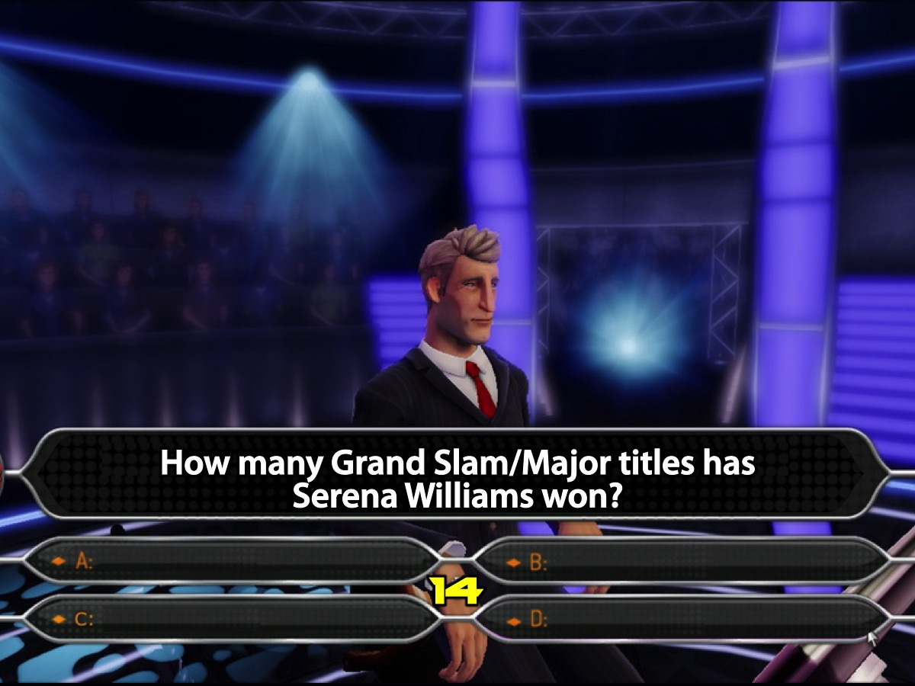
Notes:
Question #14. How many Grand Slam/Major titles has Serena Williams won?

Slide 99
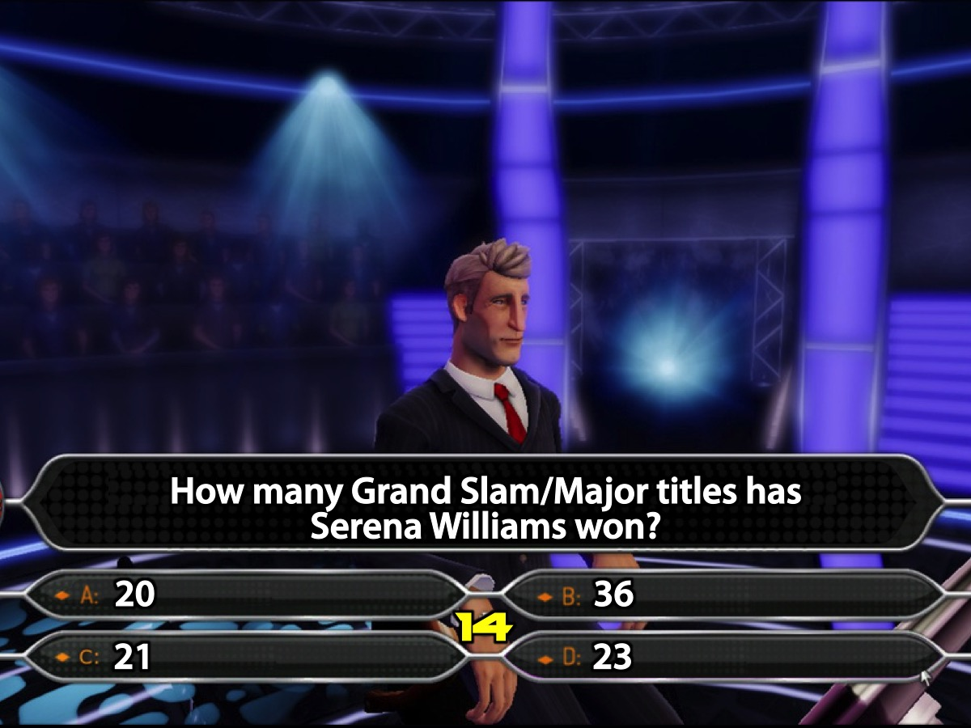
Notes:
Is it:
A. 20
B. 36
C. 21
D. 23

Slide 100
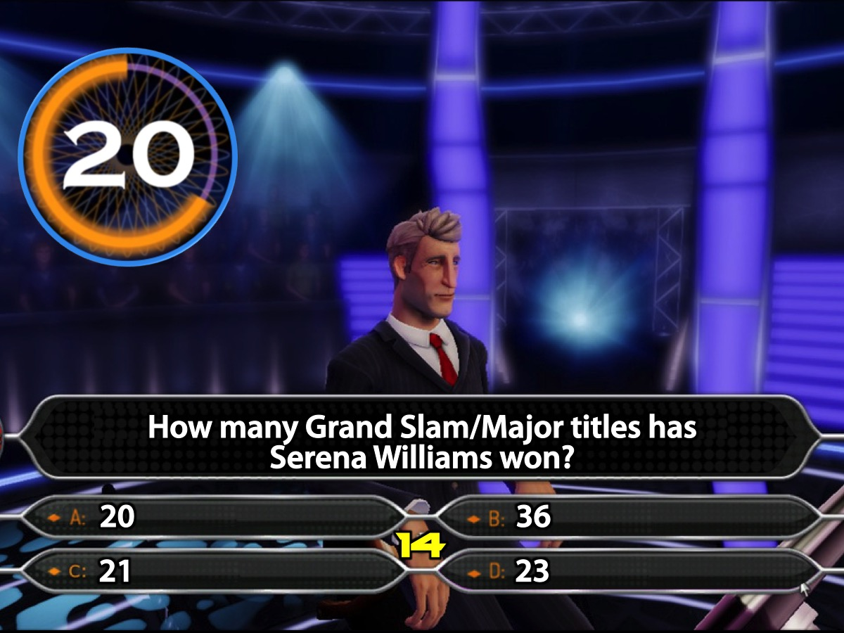
Notes:
Your 20 seconds starts now!
Countdown Video: Get it on YouTube at: https://www.youtube.com/watch?v=8tAXbkGR_-c

Slide 101
Notes:
Is anyone using a Lifeline?

Slide 102
Notes:
The Correct Answer is B. 36

Slide 103
Notes:
Get ready for Question #15

Slide 104
Notes:
Question #15. How many books are there in “The Mortal Instruments” Series?

Slide 105
Notes:
Is it:
A. 3
B. 5
C. 6
D. 7

Slide 106
Notes:
Your 20 seconds starts now!
Countdown Video: Get it on YouTube at: https://www.youtube.com/watch?v=8tAXbkGR_-c

Slide 107
Notes:
Is anyone using a Lifeline?

Slide 108
Notes:
The Correct Answer is C. 6.

Slide 109
Notes:
Get ready for Question #16

Slide 110
Notes:
Question #16. In which movie does Scarlett Johansson play the lead female actress?

Slide 111
Notes:
Is it:
A. Insurgent
B. Avengers
C. Hunger Games
D. Mad Max

Slide 112
Notes:
Your 20 seconds starts now!
Countdown Video: Get it on YouTube at: https://www.youtube.com/watch?v=8tAXbkGR_-c

Slide 113
Notes:
Is anyone using a Lifeline?

Slide 114
Notes:
The Correct Answer is B. Avengers

Slide 115
Notes:
Get ready for Question #17

Slide 116
Notes:
Question #17. In what sport does Katie Ledecky represent USA?

Slide 117
Notes:
Is it:
A. Swimming
B. Gymnastics
C. Tennis
D. Soccer

Slide 118
Notes:
Your 20 seconds starts now!
Countdown Video: Get it on YouTube at: https://www.youtube.com/watch?v=8tAXbkGR_-c

Slide 119
Notes:
Is anyone using a Lifeline?

Slide 120
Notes:
The Correct Answer is A. Swimming

Slide 121
Notes:
Get ready for Question #18

Slide 122
Notes:
Question #18. Which country borders South Africa?

Slide 123
Notes:
Is it:
A. Malawi
B. Angola
C. Zimbabwe
D. Zambia

Slide 124
Notes:
Your 20 seconds starts now!
Countdown Video: Get it on YouTube at: https://www.youtube.com/watch?v=8tAXbkGR_-c

Slide 125
Notes:
Is anyone using a Lifeline?

Slide 126
Notes:
The Correct Answer is C. Zimbabwe

Slide 127
Notes:
Get ready for Question #19

Slide 128
Notes:
Question #19. In what country was William Shakespeare born?

Slide 129
Notes:
Is it:
A. Scotland
B. England
C. Ireland
D. Wales

Slide 130
Notes:
Your 20 seconds starts now!
Countdown Video: Get it on YouTube at: https://www.youtube.com/watch?v=8tAXbkGR_-c

Slide 131
Notes:
Is anyone using a Lifeline?

Slide 132
Notes:
The Correct Answer is B. England

Slide 133
Notes:
Get ready for Question #20

Slide 134
Notes:
Question #20. In “The Hunger Games” who does Katniss marry?

Slide 135
Notes:
Is it:
A. Finnick
B. Gale
C. No One
D. Peeta

Slide 136
Notes:
Your 20 seconds starts now!
Countdown Video: Get it on YouTube at: https://www.youtube.com/watch?v=8tAXbkGR_-c

Slide 137
Notes:
Is anyone using a Lifeline?

Slide 138
Notes:
The correct answer is D.Peeta

Slide 139
Notes:
Prizes: And the winning team is…
Sound Clip: “Theme Walk Down - Who Wants to Be a Millionaire”. This sound clip will start automatically as this slide is shown: Get it on YouTube at: https://www.youtube.com/watch?v=IJlZS7BClK4

Slide 140
Notes:
Small Groups. Here are the questions for our small group time: (1) What did you like most about tonight? (2) If you won a million, how would you use it? (3) What does the Bible teach about wealth? No one can serve two masters, for either he will hate the one and love the other, or he will be devoted to the one and despise the other. You cannot serve God and money. (Matthew 6:24). Sell your possessions and give to the poor. Provide purses for yourselves that will not wear out, a treasure in heaven that will never fail, where no thief comes near and no moth destroys. (Luke 12:33). Those who want to get rich fall into temptation and a trap and into many foolish and harmful desires that plunge people into ruin and destruction. (1 Timothy 6:9). Command those who are rich in this present world not to be arrogant nor to put their hope in wealth, which is so uncertain, but to put their hope in God, who richly provides us with everything for our enjoyment. (1 Timothy 6:17). (4) Pray for each other to handle wealth wisely!

Slide 141
Notes:
Refreshments: It is time for Hot Chocolate and biscuits.

Slide 142
Notes:
Next Week is the first of our Show Me The Money Nights

Slide 143
Notes:
Sudden Death Question #1: Which Tom is married to actress Katie Holmes?
A. Tom Hanks
B. Tom Cruise
C. Tom Selleck
D. Tom Courtenay

Slide 144
Notes:
The correct answer is B. Tom Cruise.

Slide 145
Notes:
Sudden Death Question #2: Which blossom does the Japanese annual hanami festival celebrate?
A. Jasmine
B. Orange
C. Cherry
D. Frangipani

Slide 146
Notes:
The correct answer is C. Cherry

