Slide 1
Notes:
We start with a welcome of regulars and newcomers who are invited to the stage and introduced to the group.

Slide 2
Notes:
A teen leaders shares an offering message to motivate teens to give and the offering box is passed around while the announcements are given.

Slide 3
Notes:
A teen leader shares the announcements - the following items are generally included:

Slide 4
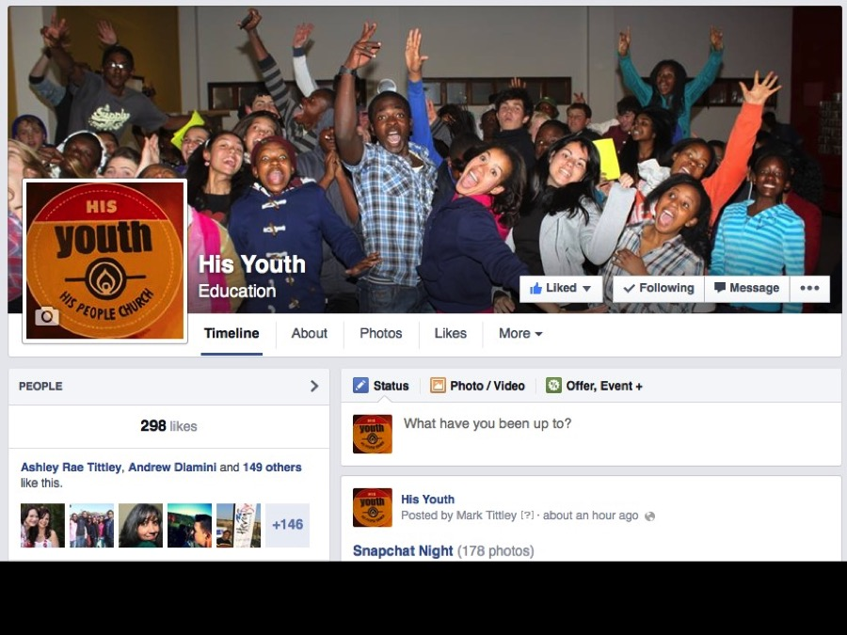
Notes:
A challenge to visit our Facebook page.

Slide 5
Notes:
A look back at the previous Friday night’s event - followed by a few photos taken from the event.

Slide 6
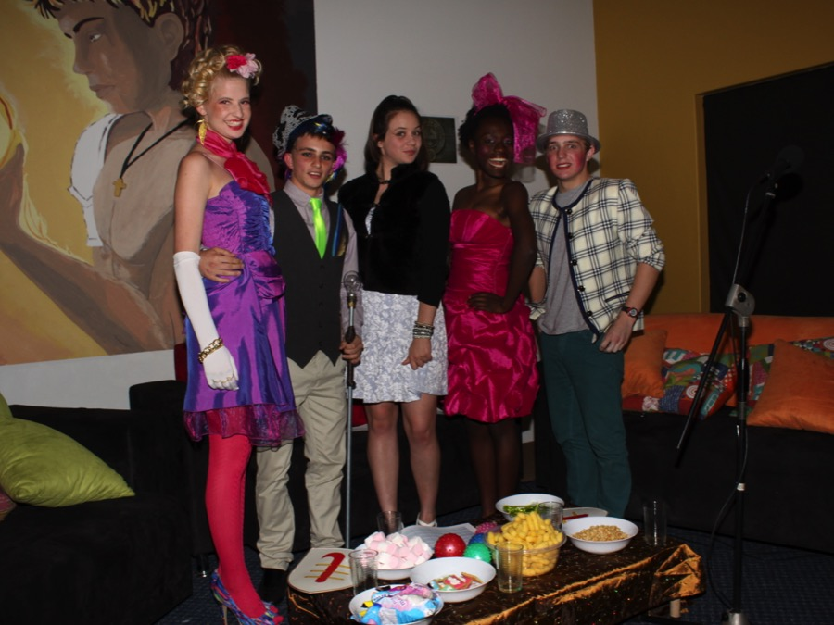

Slide 7
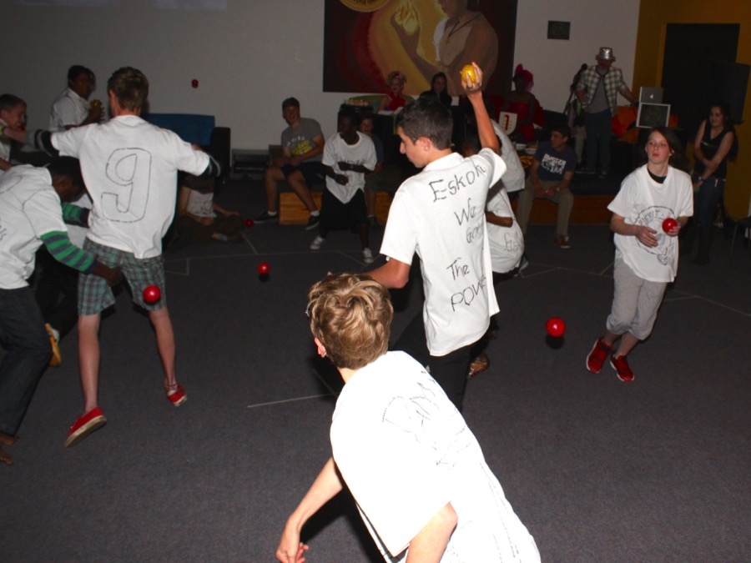

Slide 8
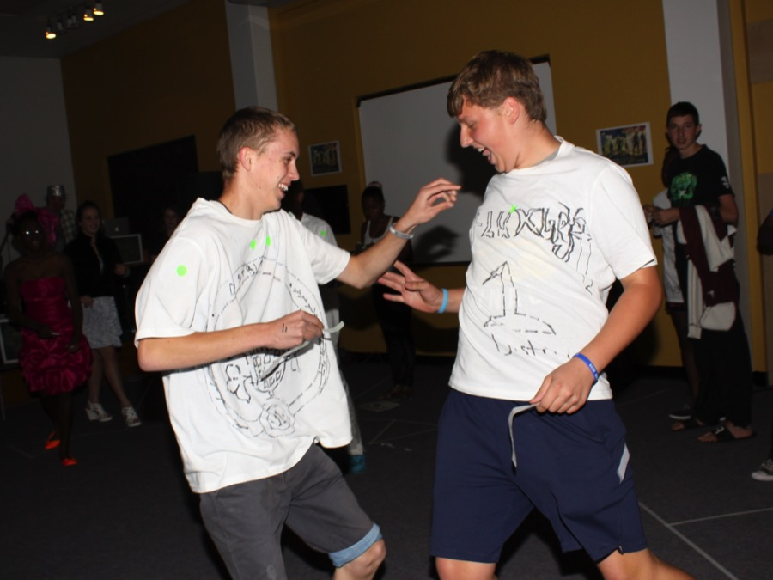

Slide 9
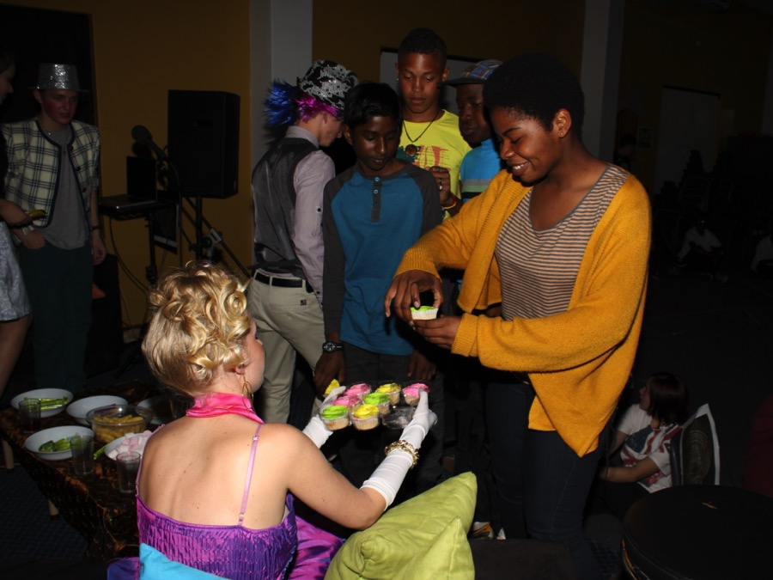

Slide 10
Notes:
An announcement about the upcoming Friday night’s event.

Slide 11
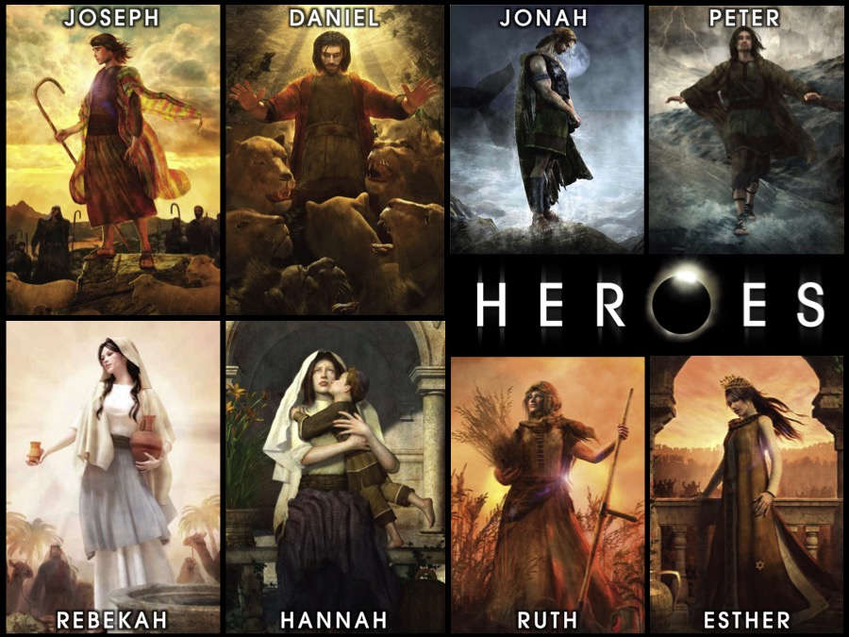
Notes:
A brief word about the message that is about to be delivered by the preacher for the day.

