Slide 1

Notes:
Welcome to Reality Friday – welcome to any newcomers.

Slide 2
Notes:
Pre-Event Video: All Survivor Intros: Seasons 1-27. Get it on YouTube at: https://www.youtube.com/watch?v=dU9W8XhrMYo
Video Length: 29 minutes

Slide 3
Notes:
Pre-Event Video: The top ten survivors of all time. Get it on YouTube at: https://www.youtube.com/watch?v=hmFdtRVFkRY
Video Length: 3:30 minutes

Slide 4
Notes:
Welcome to Reality Friday – welcome to any newcomers.

Slide 5

Notes:
Tonight is Survivor Night

Slide 6
Notes:
Video: Survivor: Redemption Island Opening Credits. Get it on YouTube at: https://www.youtube.com/watch?v=3sJ-HppLx2U

Slide 7
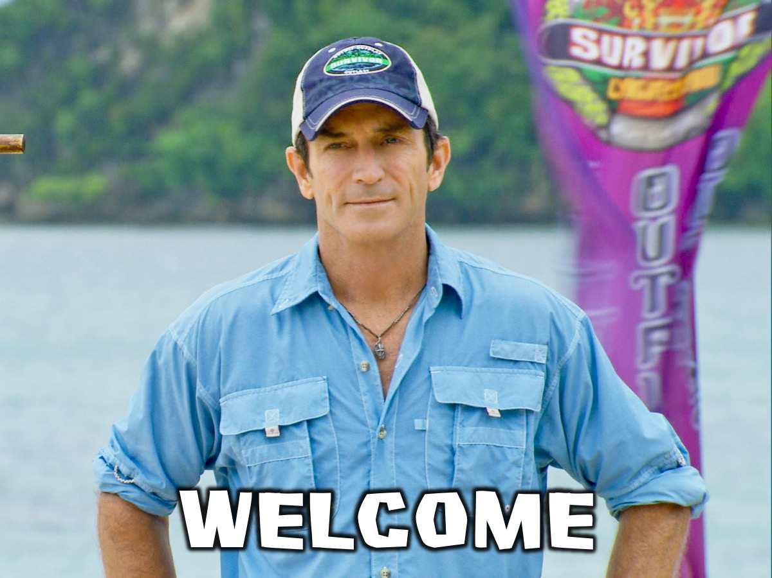
Notes:
Welcome by “Jeff”

Slide 8
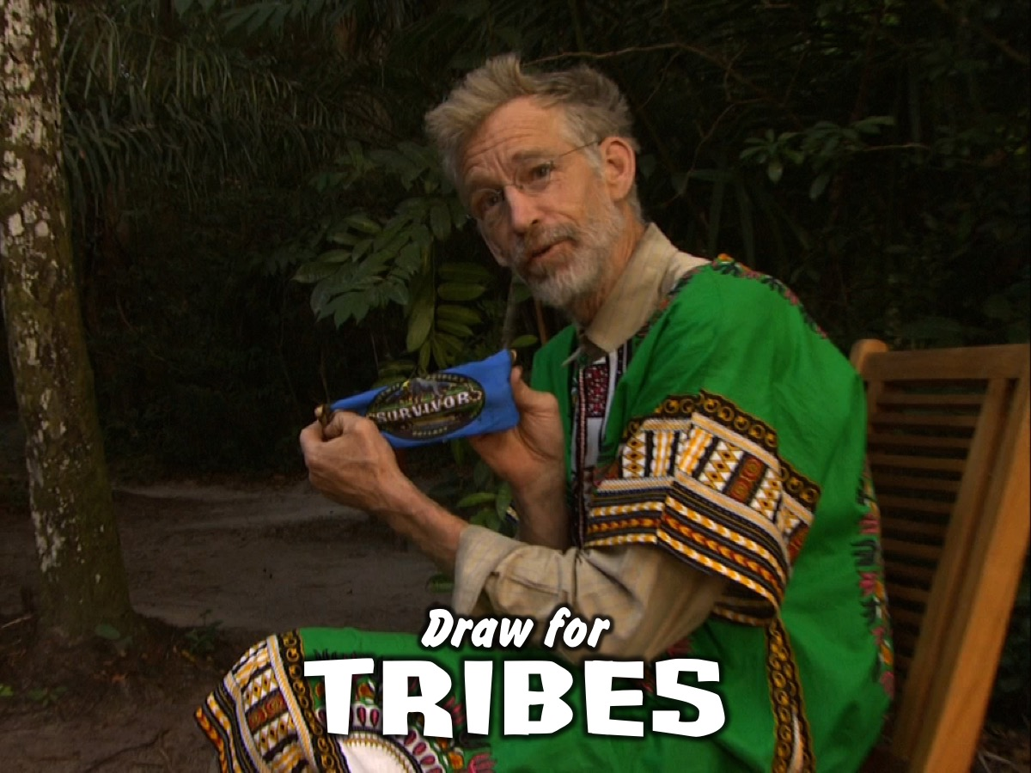
Notes:
Draw for Tribes – each person chooses a piece of coloured cloth from a container and that is their team for the night.

Slide 9
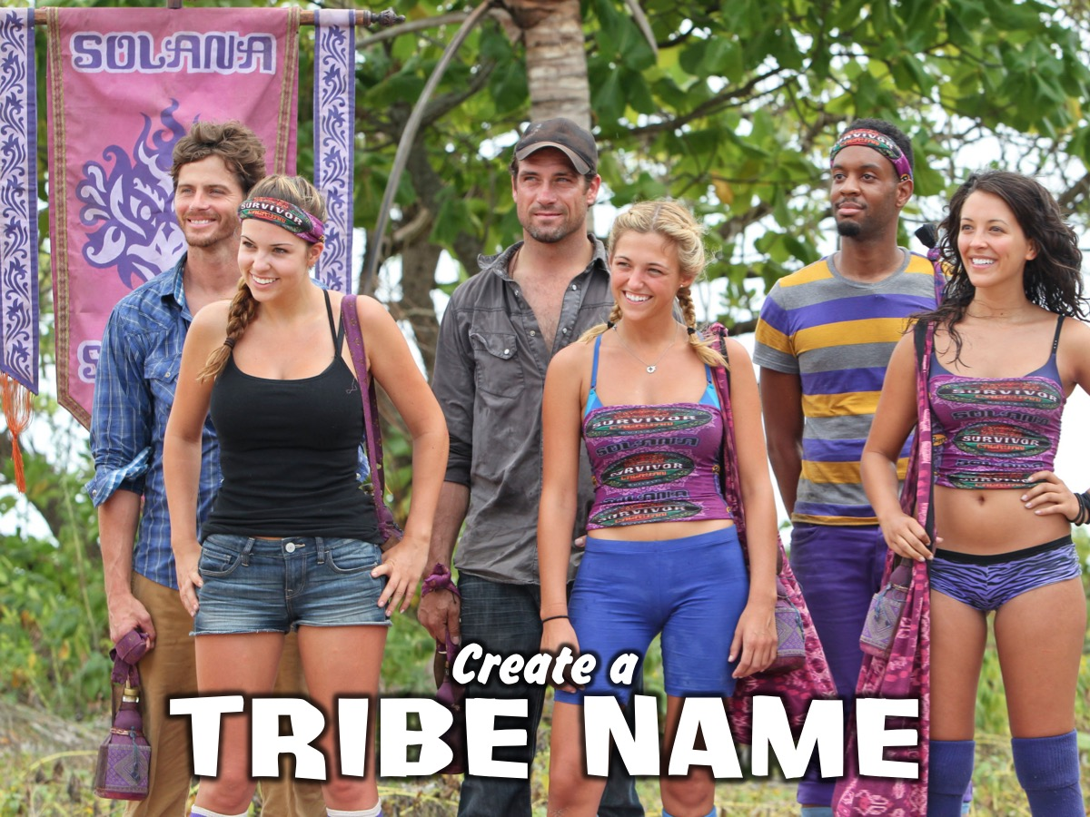
Notes:
Create a Tribe Name (and maybe a war cry) and write it on your tribe flag. (During this activity – leaders will set up the obstacle course)

Slide 10
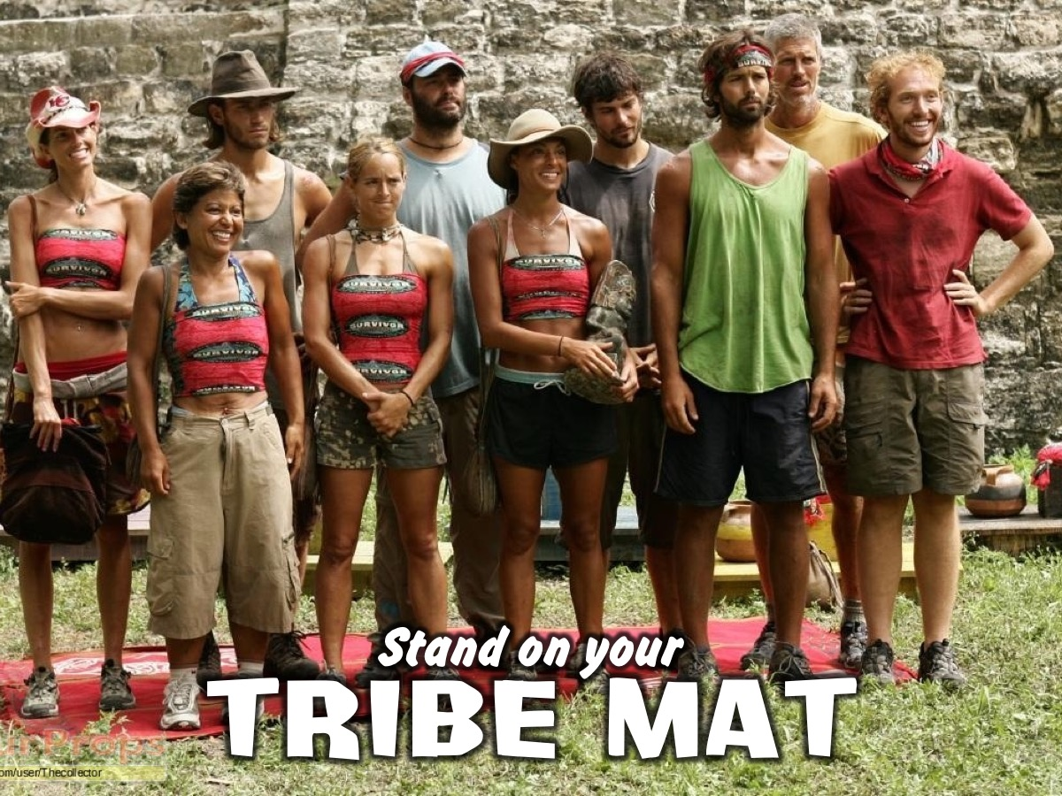
Notes:
Stand on Your Team Mat – teens go and stand on the colour mat they have chosen.

Slide 11
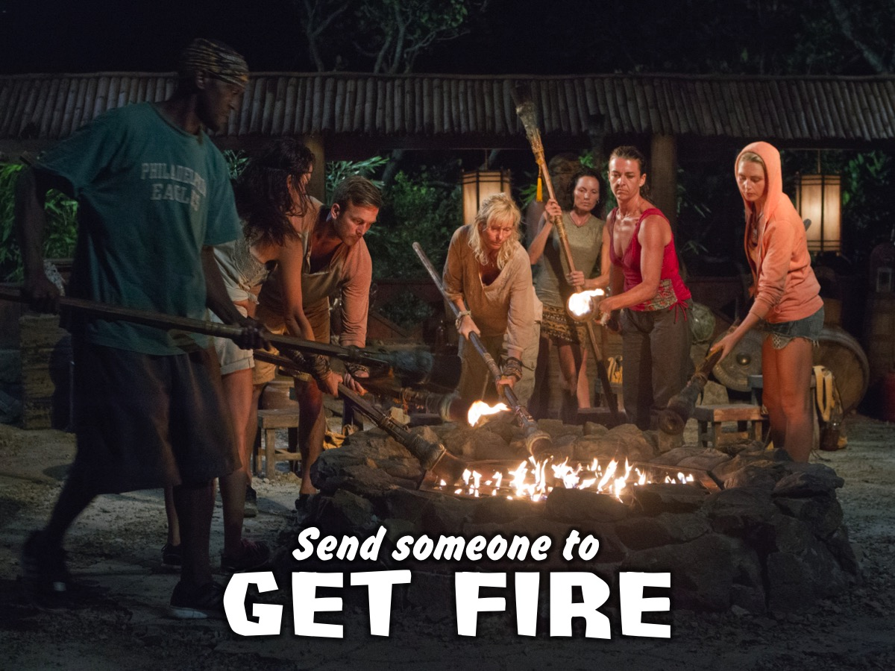
Notes:
Send someone to get fire – each group sends a representative to the stage where they light their fire (ie. Turn on the electric light placed on colored material)

Slide 12
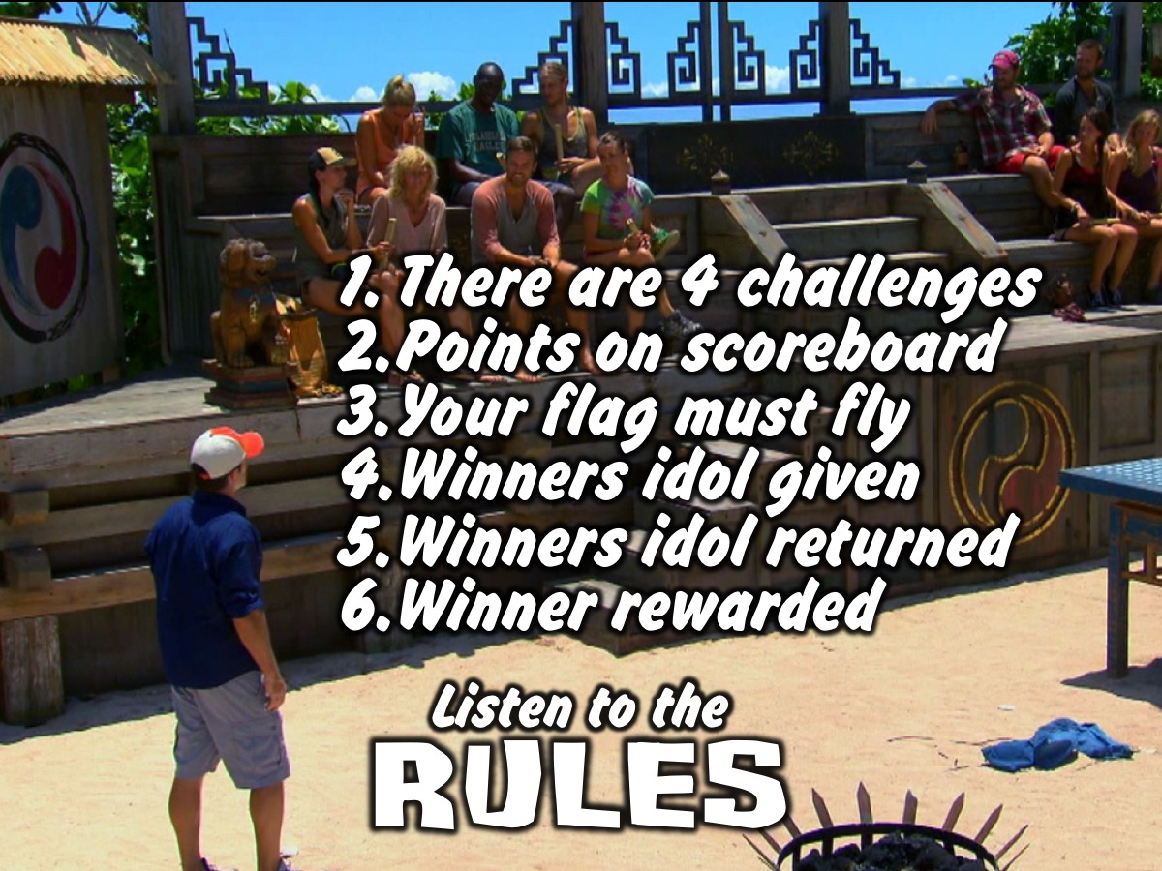
Notes:
Jeff Explains the Rules:
There will be four challenges where you will compete against each other.
Your team points will be recorded on the blackboard.
The team flag must always be flown by a team members.
The Winners Idol is give to the group that wins each challenge.
The Winners Idol is returned to Jeff at the start of each new challenge.
The Winner at the end of the night will be rewarded.

Slide 13
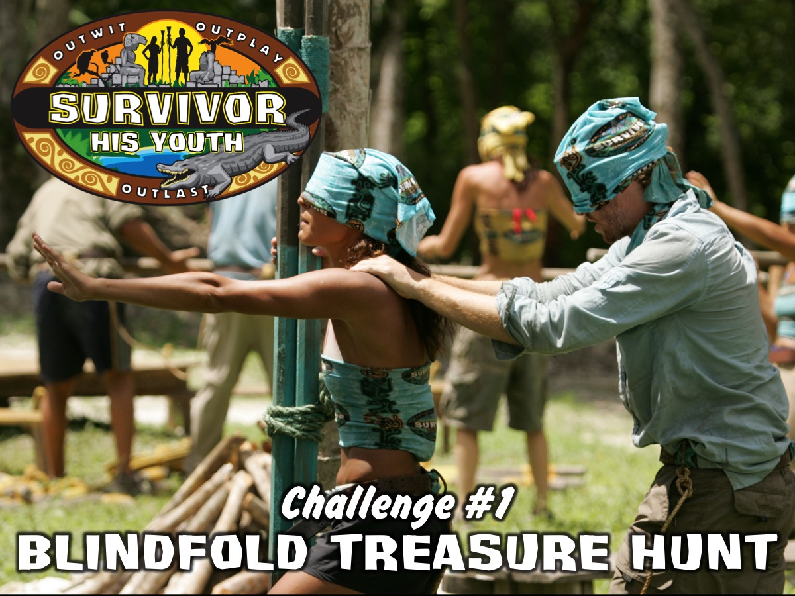
Notes:
Challenge #1: Blindfold Treasure Hunt. Two members of the tribe are tied to each other at the waist and blindfolded and the rest of the tribe has to direct them to find four items (placed in groups around the room): Polystyrene Cups, Snooker Balls, Empty Milk Bottles, Apples. Tribes are awarded points based on the order in which they finish the event – up to a maximum of 5 minutes (or a minute or two after the first tribe finishes). At end of activity – all obstacle course stuff must be removed for the next challenge.

Slide 14
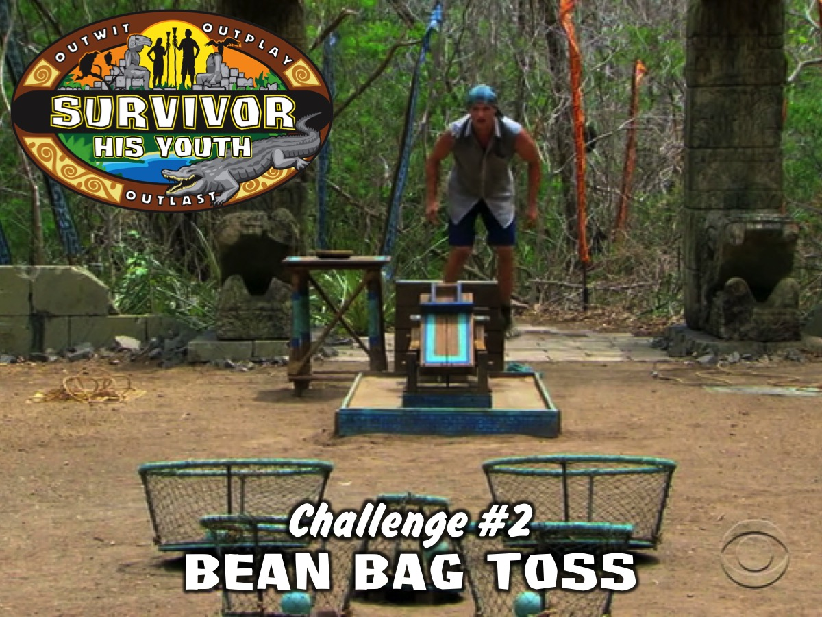
Notes:
Challenge #2: Bean Bag Toss. Members of the tribe take turns to thrown (and retrieve) their bean bag onto a chair positioned 10 meters away from them. It is a timed event where leaders will count how many bags land on the chair in the 5 minutes allowed. Tribe Contestant wears the blindfold as a scarf!

Slide 15
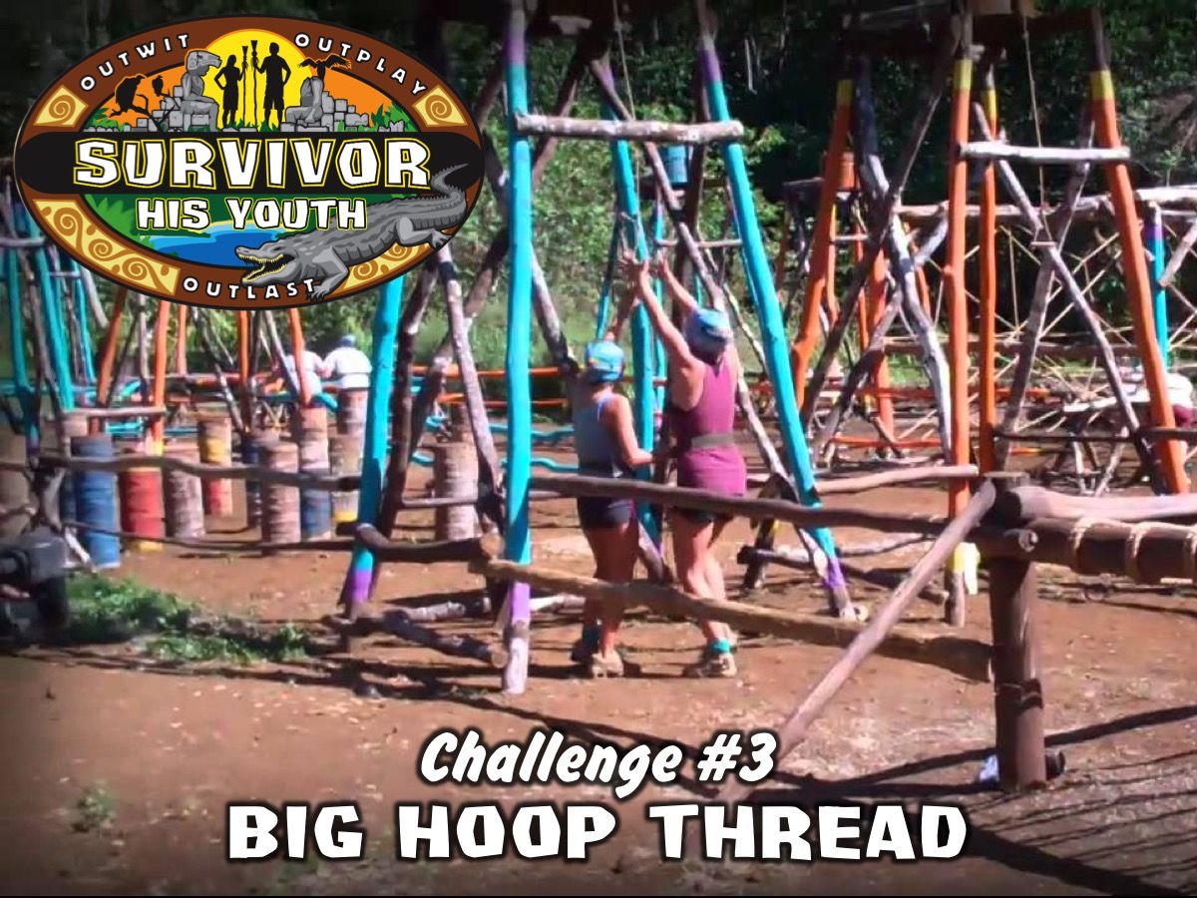
Notes:
Challenge #3: Big Hoop Thread. Members of the tribe have to join hands and climb through a hula hoop without letting go of their hands. The tribe has to start again if anyone lets go.

Slide 16

Notes:
Challenge #4: Cup Smack Down. Each tribe sends one members to compete. They are given a plastic plate and a polystyrene cup to place on top of the plate. They have to hold the plate (not touching the cup at all) and protect their cup from hitting the ground while trying to knock all the other group members cups to the ground. The top 3 tribes will be given points – 3, 5 and 10 points respectively. Tribe Contestant wears the blindfold as a scarf!

Slide 17
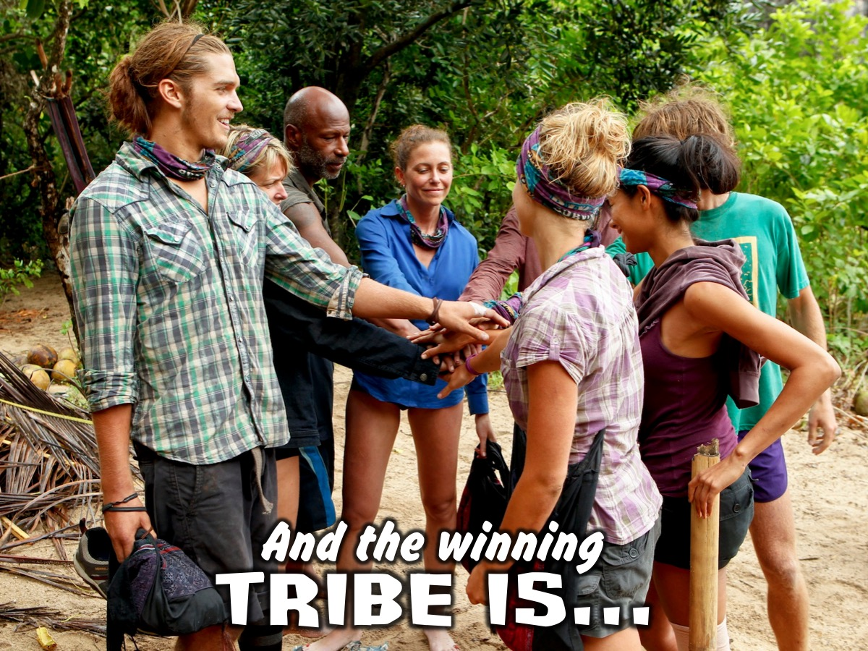
Notes:
The winning tribe is announced

Slide 18
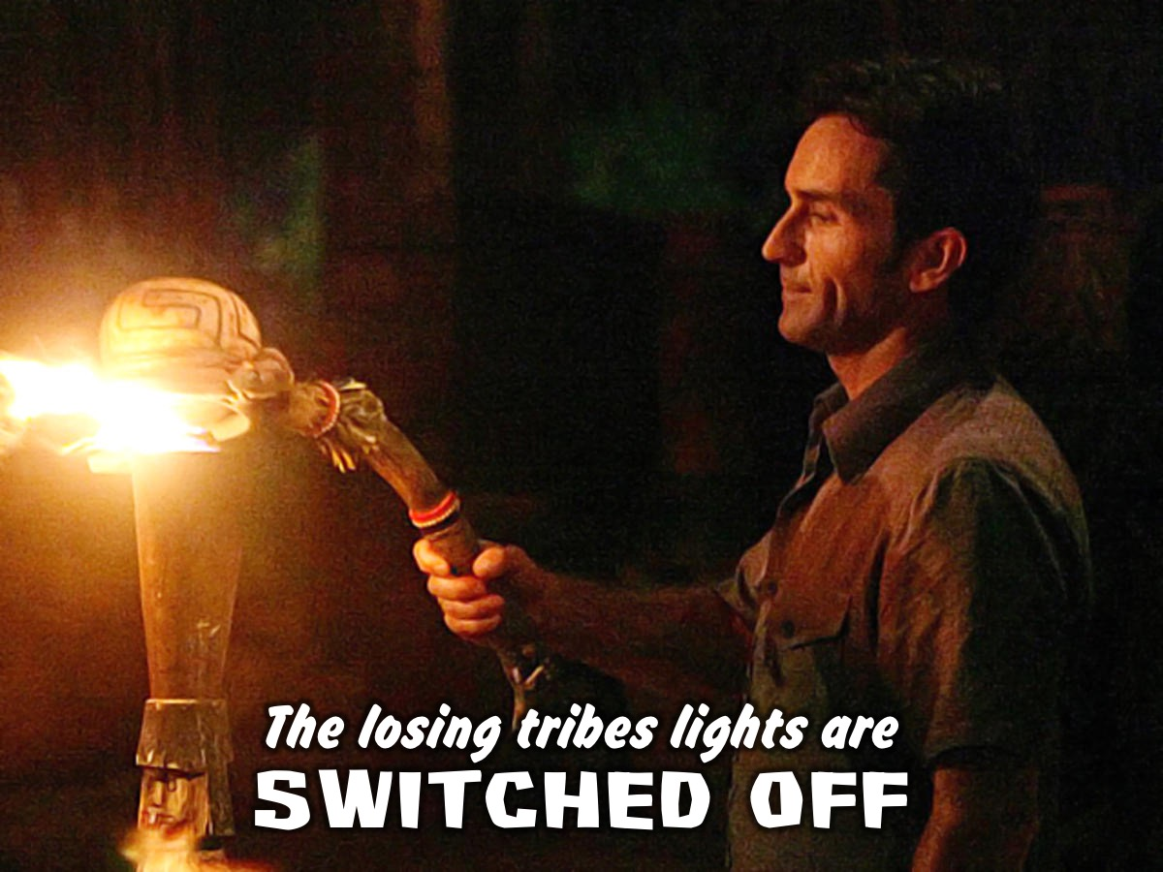
Notes:
The losing tribes lights are switched off – the MC does the switch off!

Slide 19
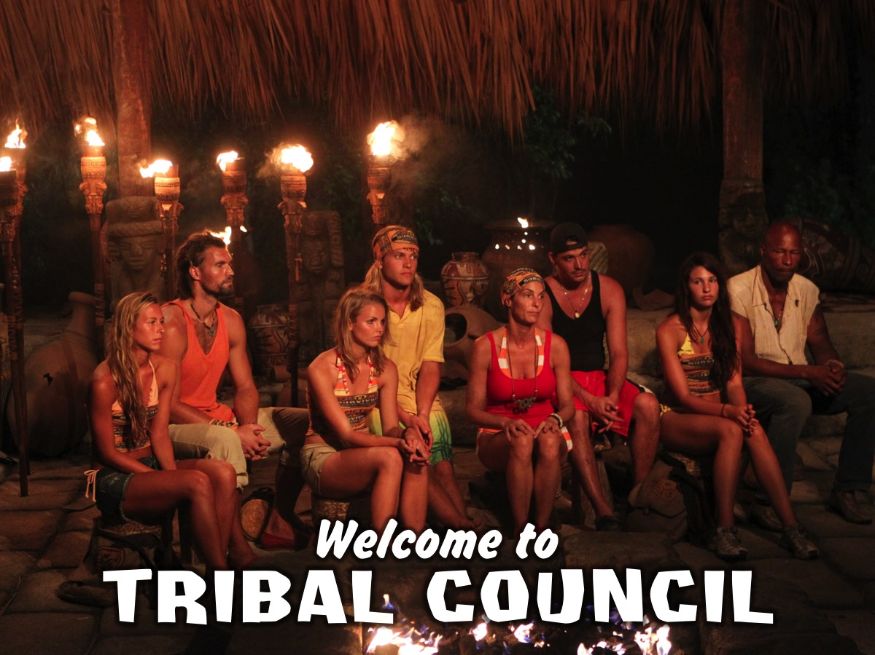
Notes:
The winning tribe is invited to Tribal Council set up on Stage. Jeff congratulates the winning tribe – but says it is time to vote to decide who in the winning team is the Ultimate Survivor. You are each going to get a piece of paper and you must write down the name of the person from your tribe you feel is most deserving of the title of Ultimate Survivor!

Slide 20
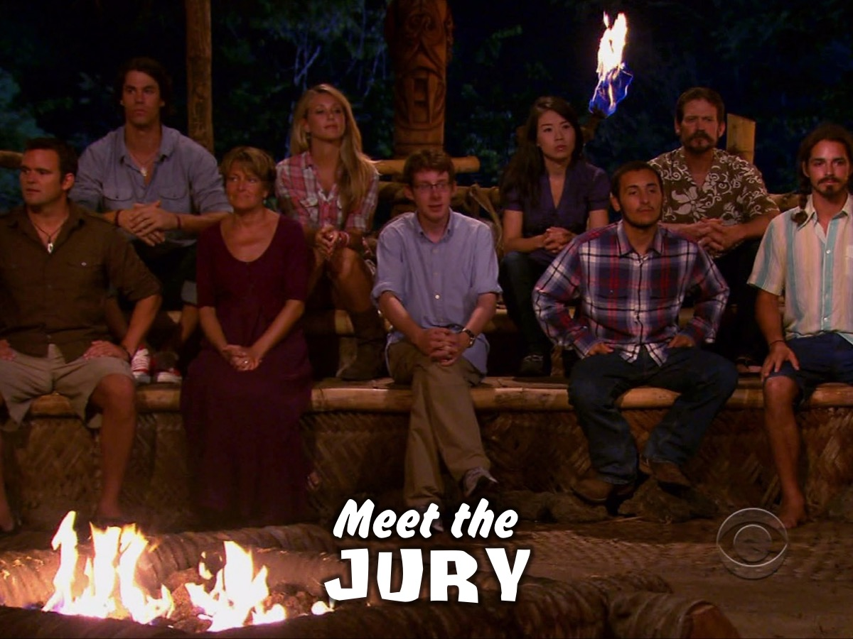
Notes:
But first, let me introduce you to the members of our Jury – who will each also be voting tonight – can one members from each of the losing tribes come forward and take a seat on the jury bench.

Slide 21
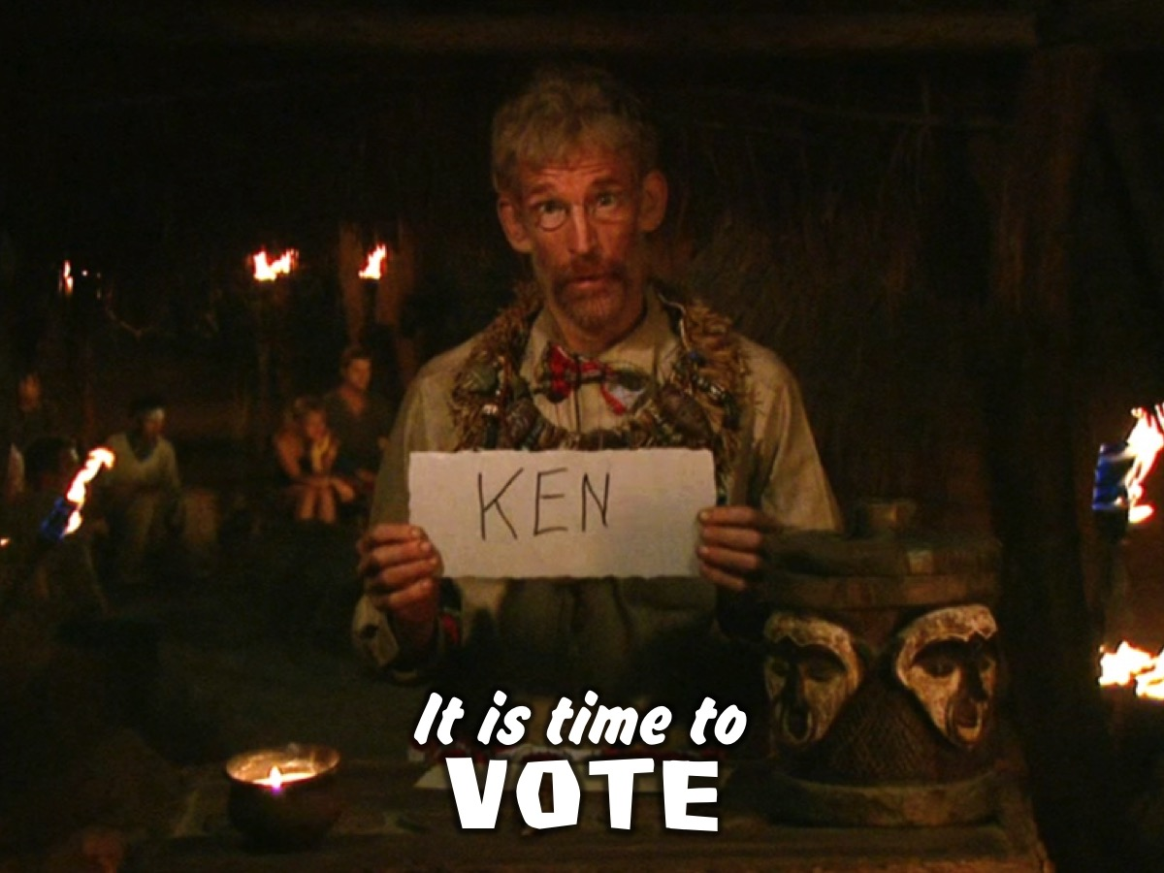
Notes:
Jeff says: “It is…Time to Vote!”
The Offering Box is placed on a stand in the middle of the room and each person has to walk to it and cast their vote.
Jeff says: “I am going to count the votes”

Slide 22
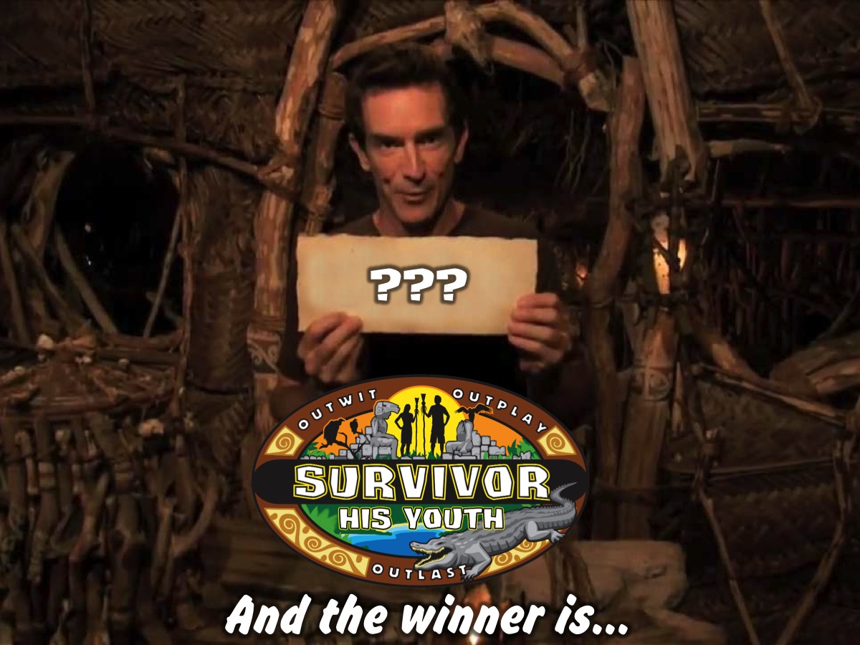
Notes:
The Ultimate Survivor is announced and rewarded.

Slide 23
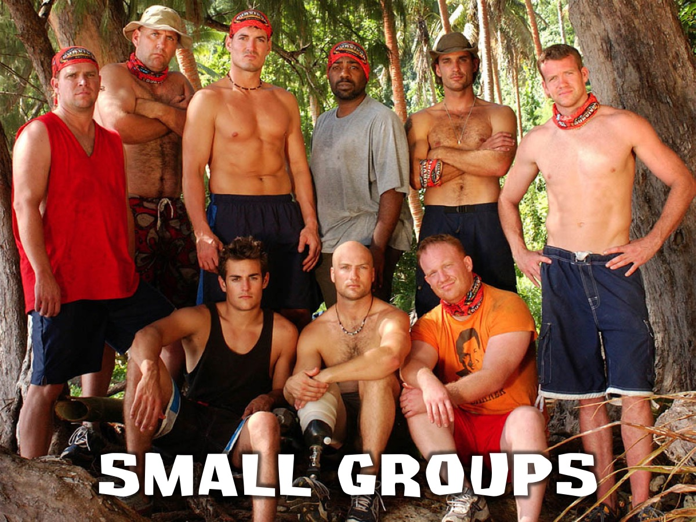
Notes:
Small Group Time

Slide 24
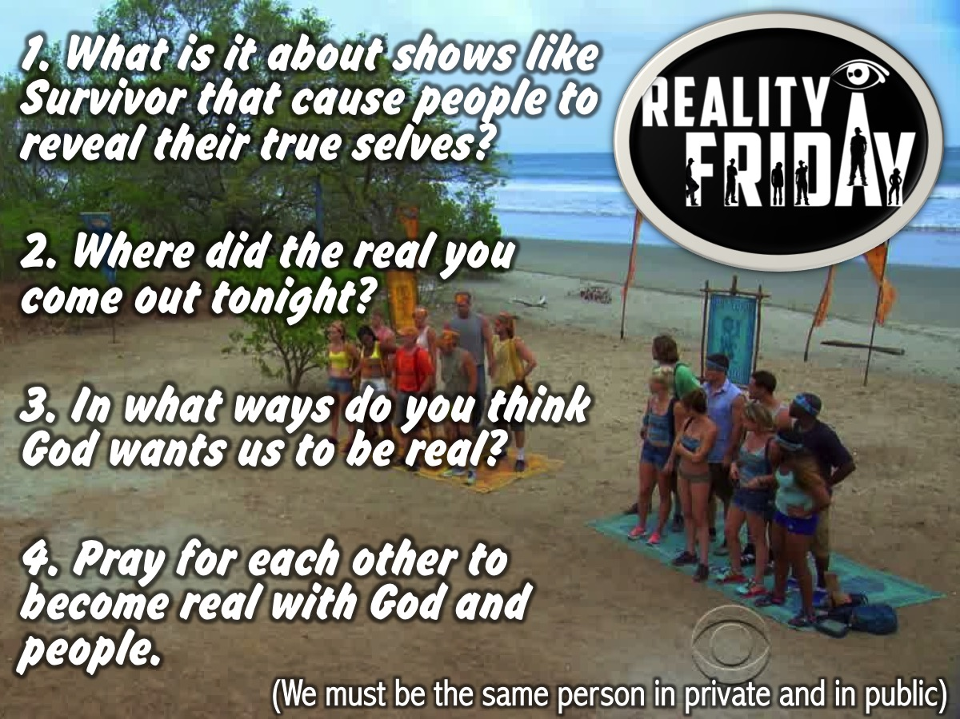
Notes:
Small Group Questions:
1. What is it about shows like Survivor that cause people to show their true selves?
2. Where did the real you come out tonight?
3. In what ways do you think God wants us to be real?
4. Pray for each other to become transparent with people and God.

Slide 25

Notes:
Next Friday night is Utopia Night!

Slide 26
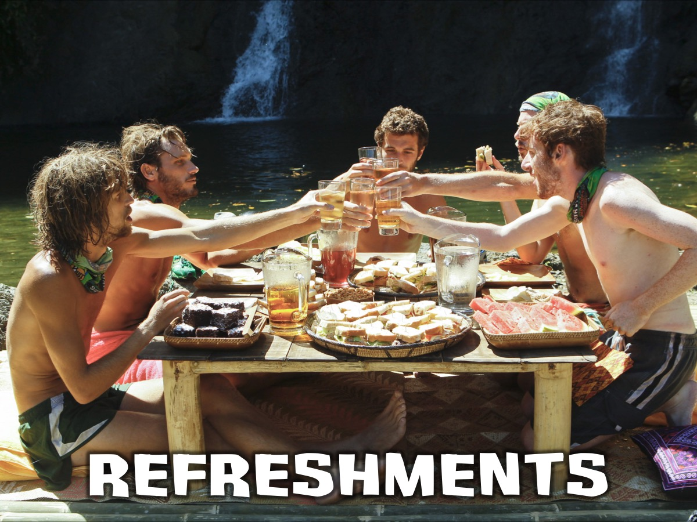
Notes:
Refreshments

