Slide 1


Notes:
Tonight is Survivor Night

Slide 2
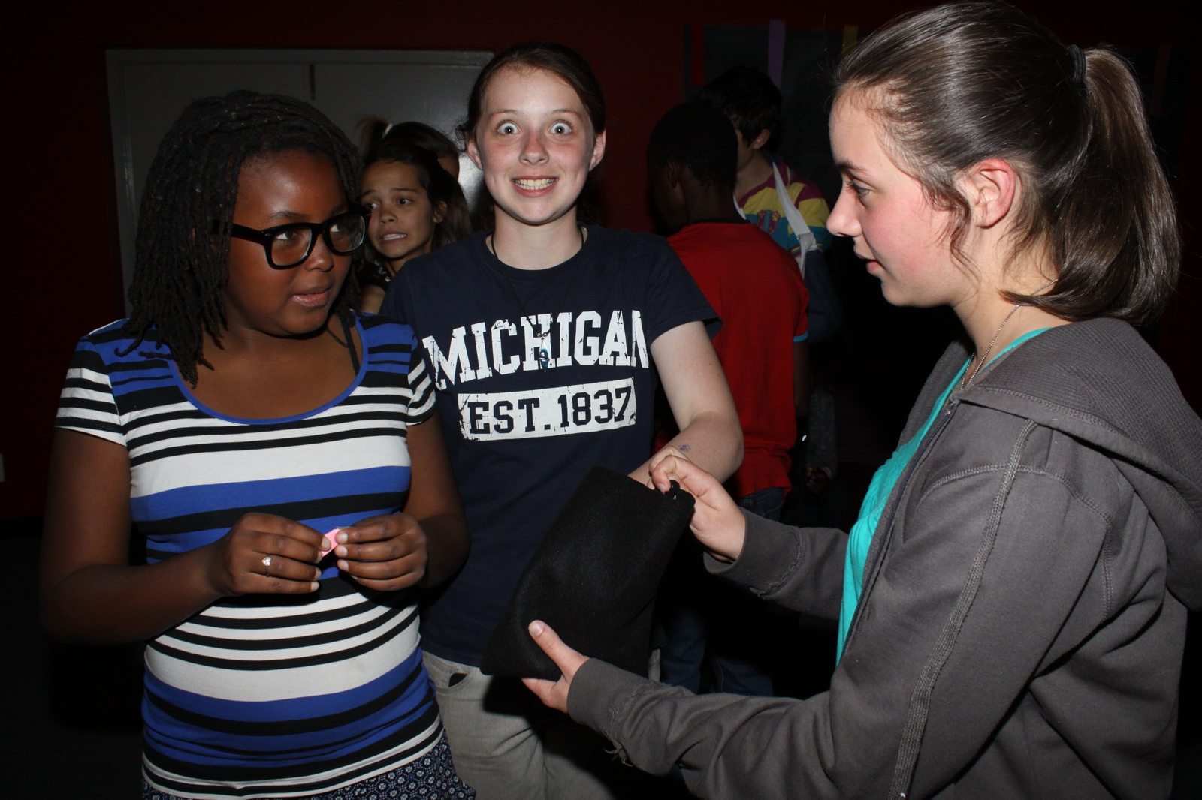
Notes:
Teens choosing teams

Slide 3
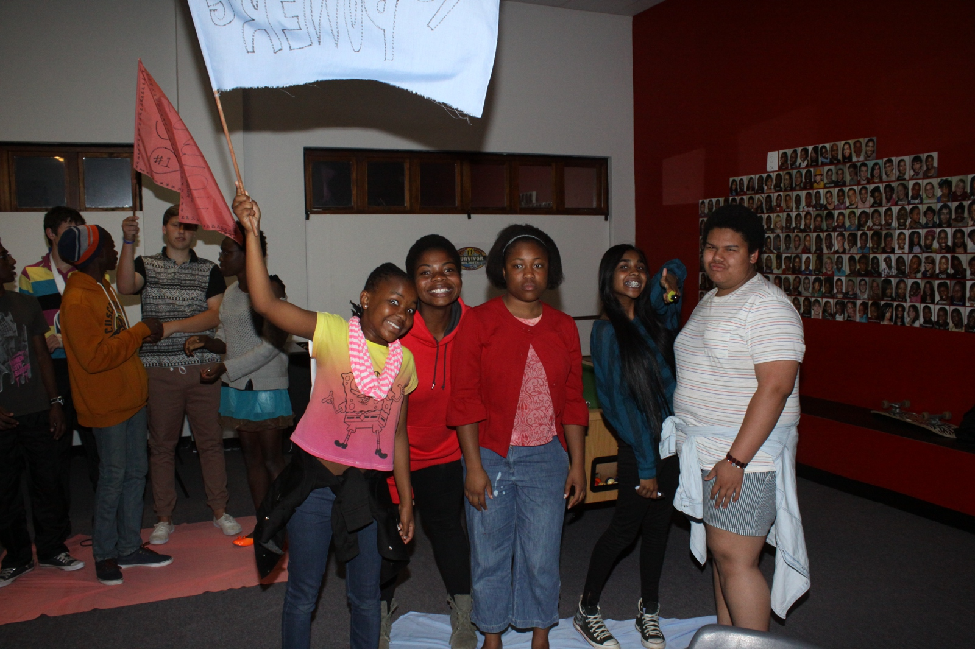
Notes:
Teens standing on their tribe mat

Slide 4
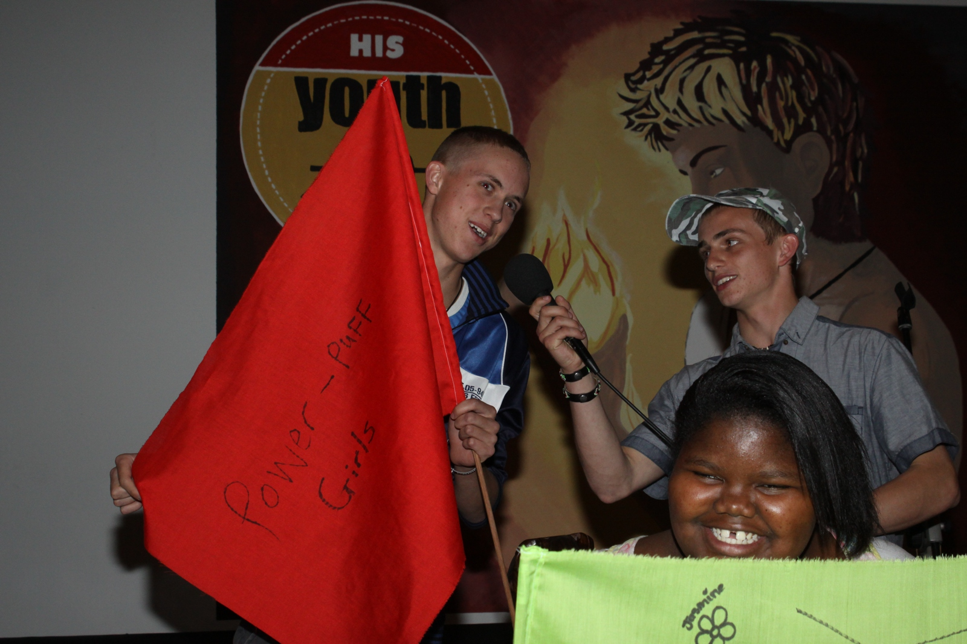
Notes:
Teens introducing their tribes to the big group

Slide 5
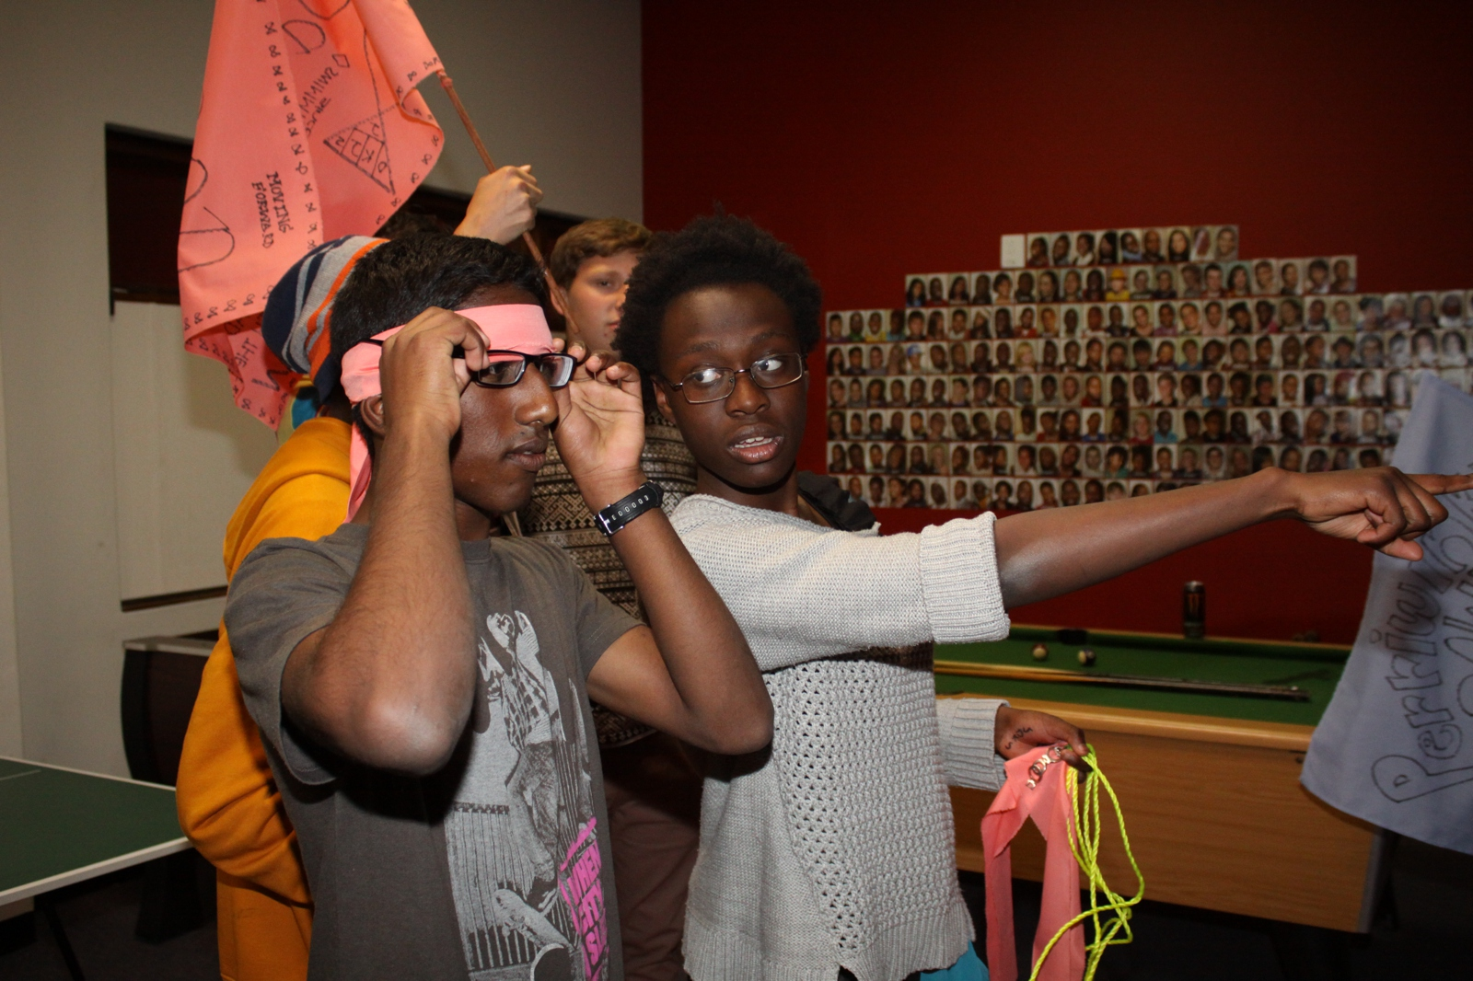
Notes:
Teens being blindfolded for the first challenge.

Slide 6
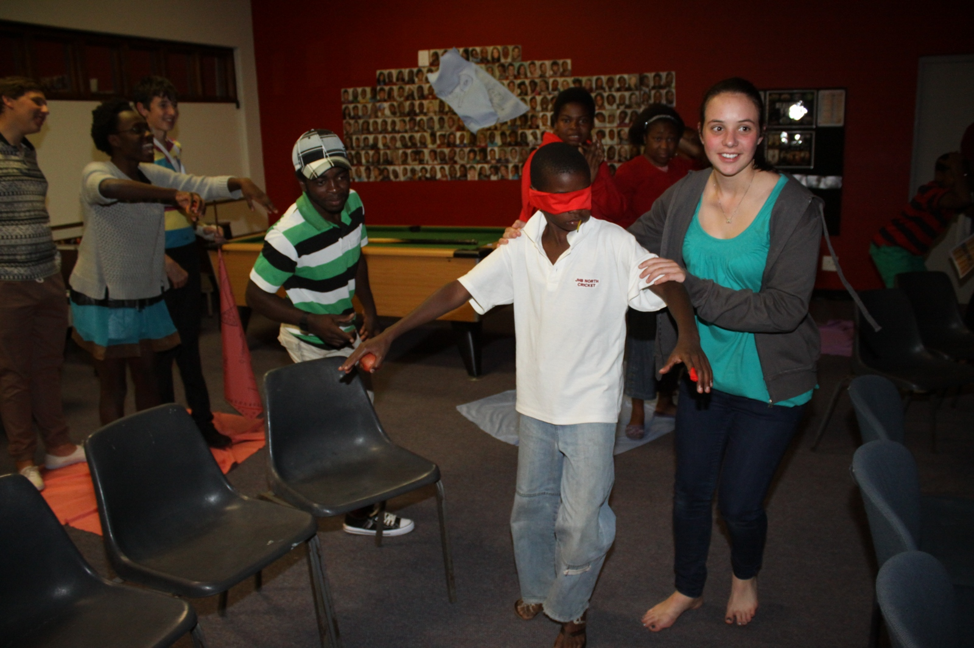
Notes:
Teens competing in the Blindfold treasure hunt.

Slide 7
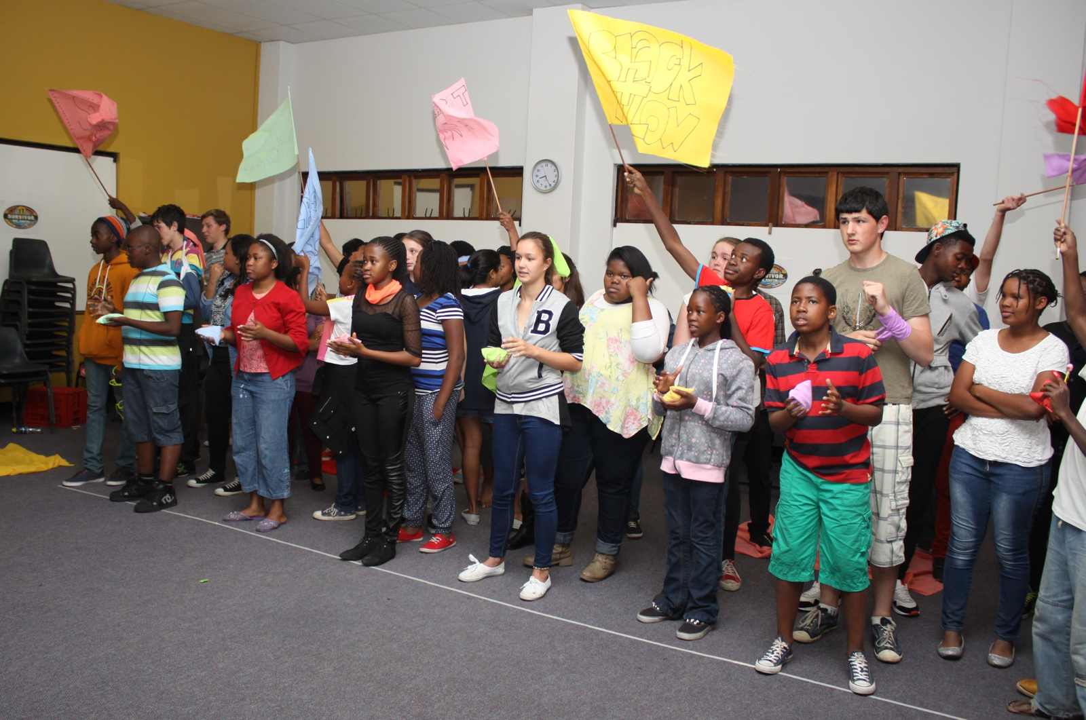
Notes:
Teens competing in the Bean Bag Toss

Slide 8
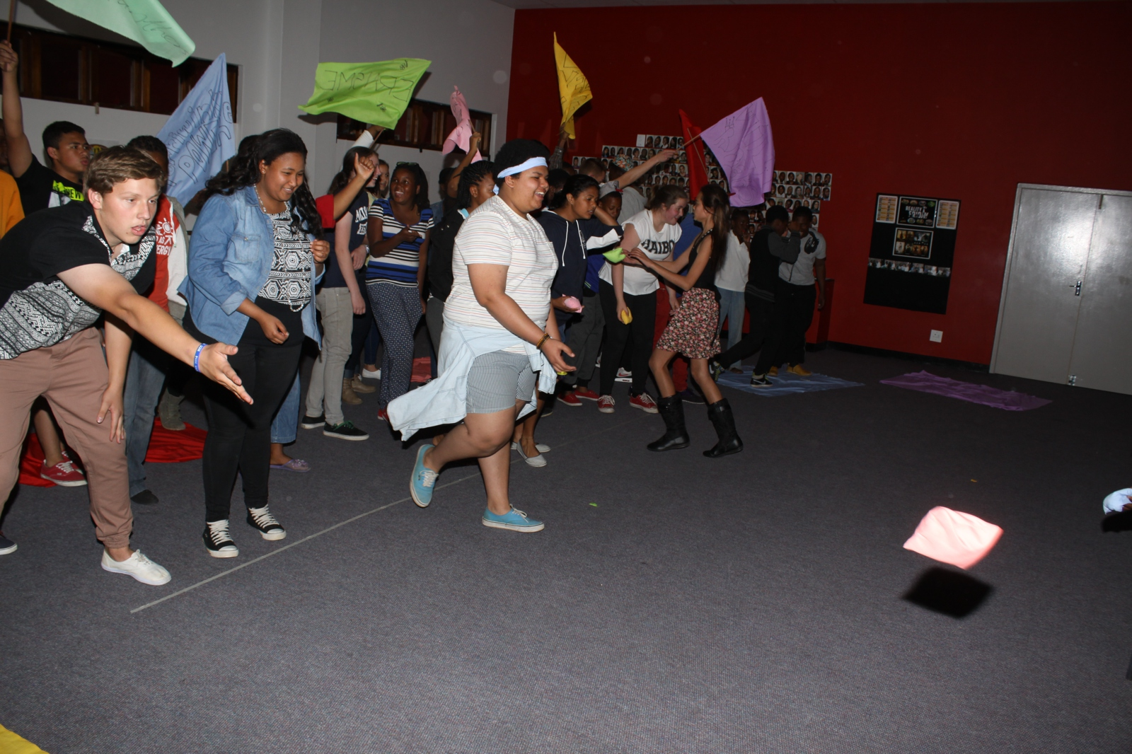
Notes:
Teens competing in the Bean Bag Toss

Slide 9
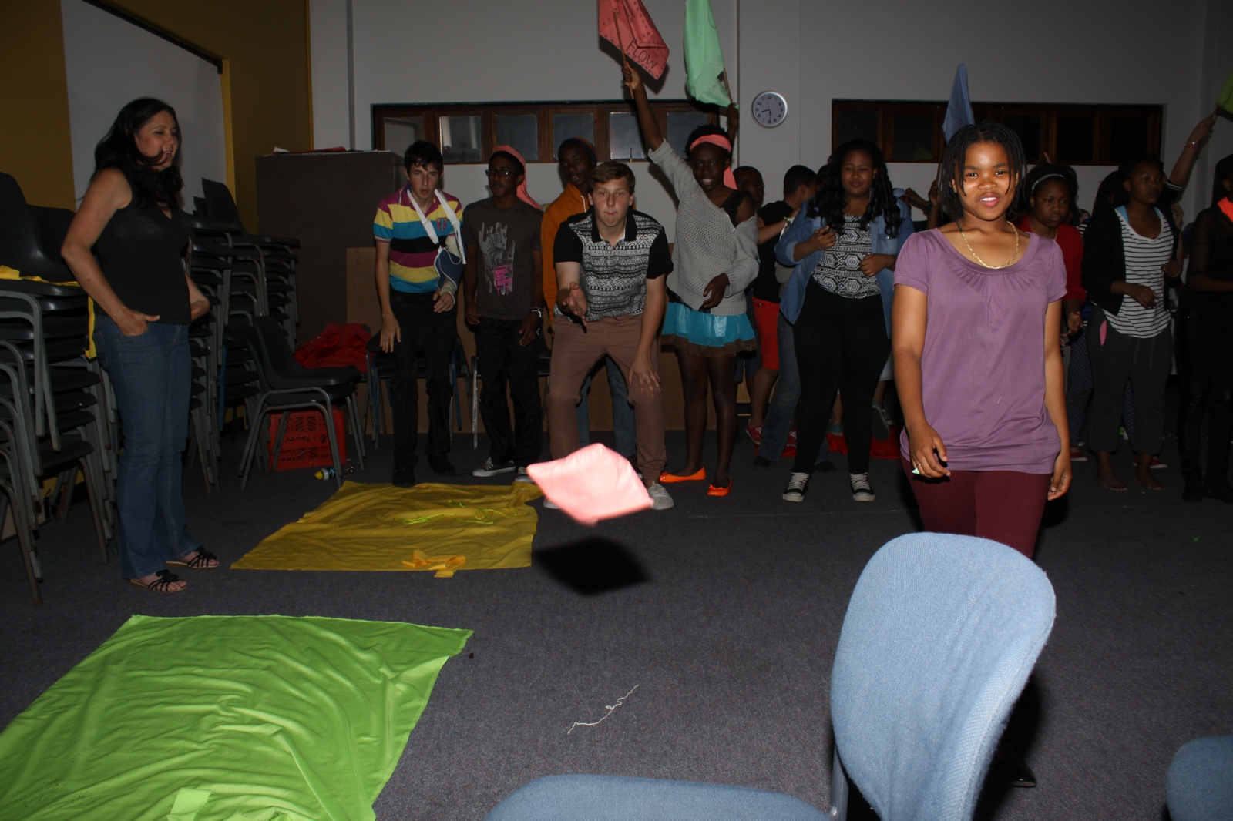
Notes:
Teens competing in the Bean Bag Toss

Slide 10
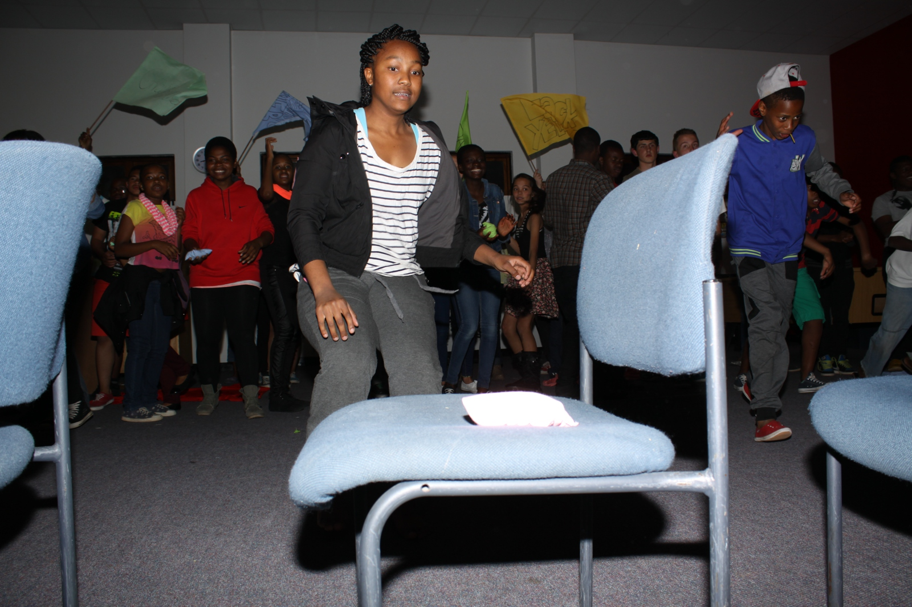
Notes:
Teens competing in the Bean Bag Toss challenge

Slide 11
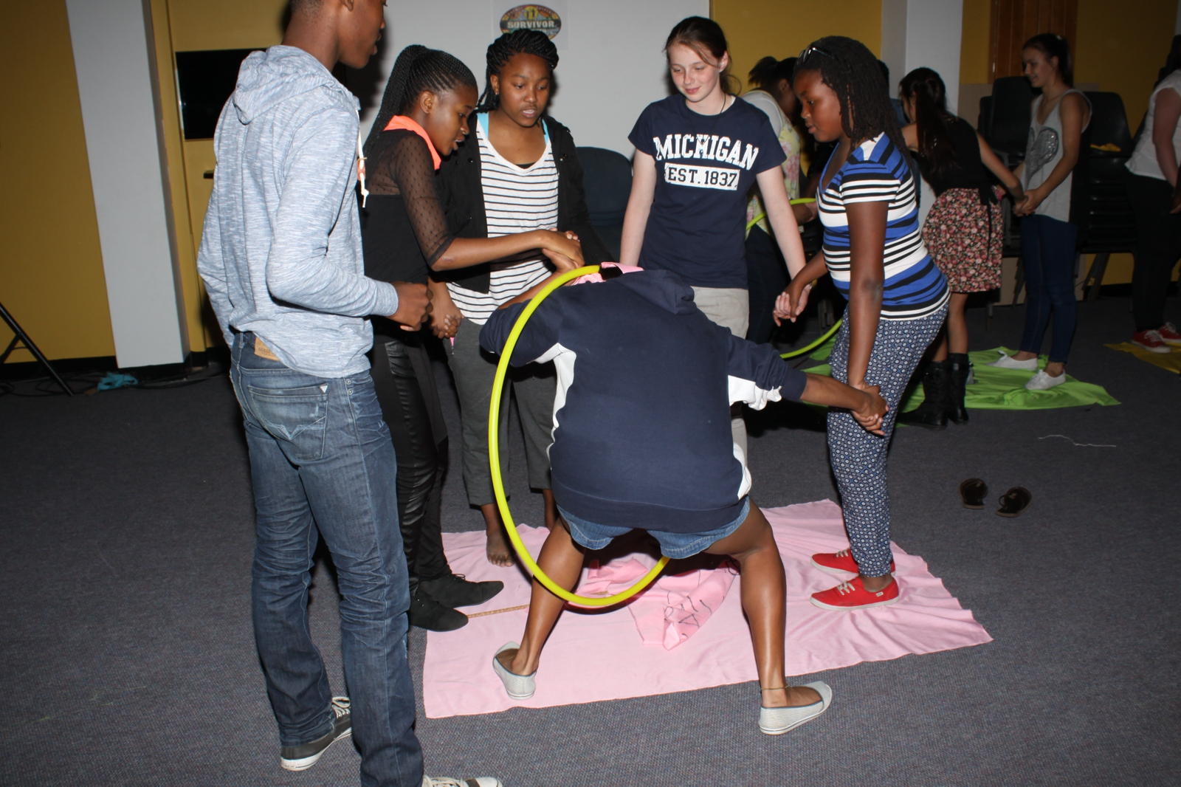
Notes:
Teens competing in the Big Hoop Thread challenge

Slide 12
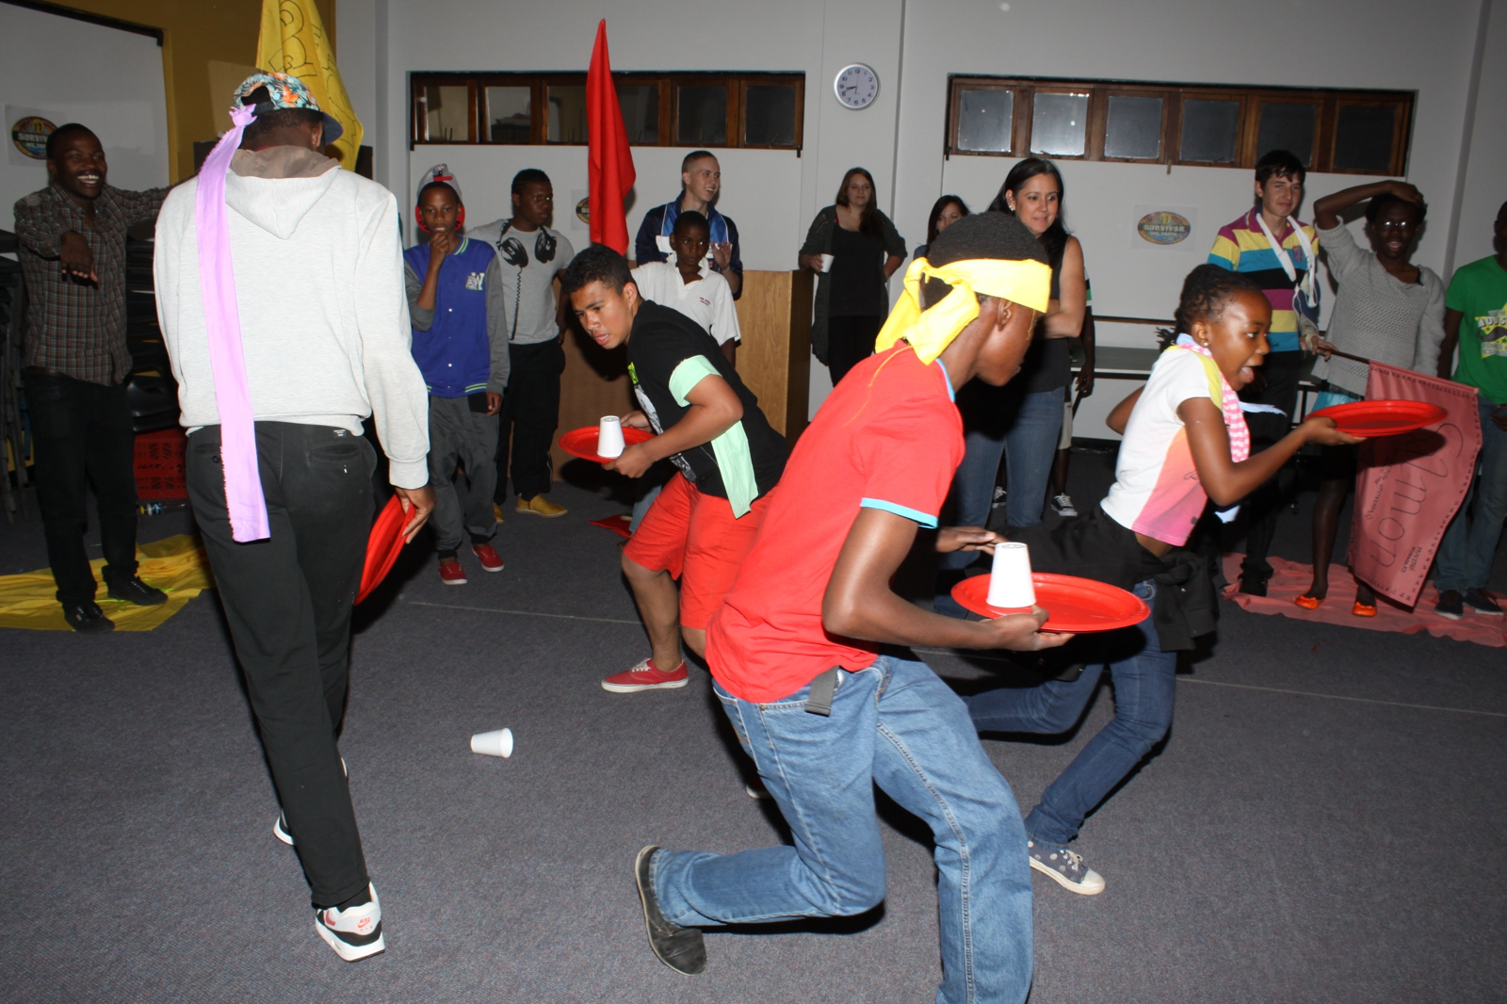
Notes:
Teens competing in the Cup Smack Down Challenge

Slide 13
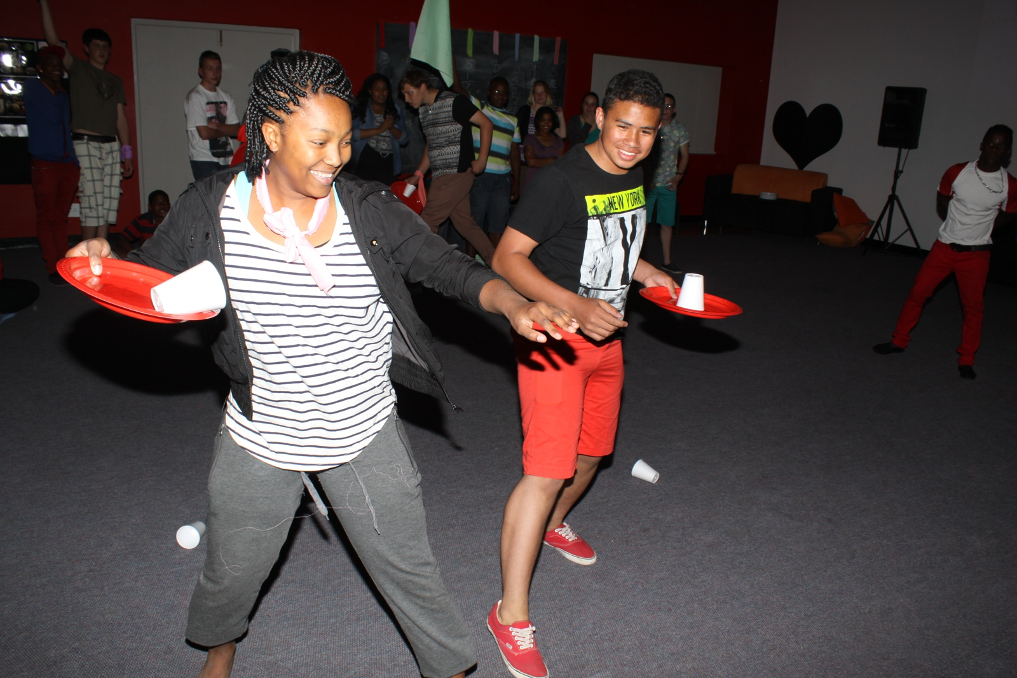
Notes:
Teens competing in the Cup Smack Down Challenge

Slide 14
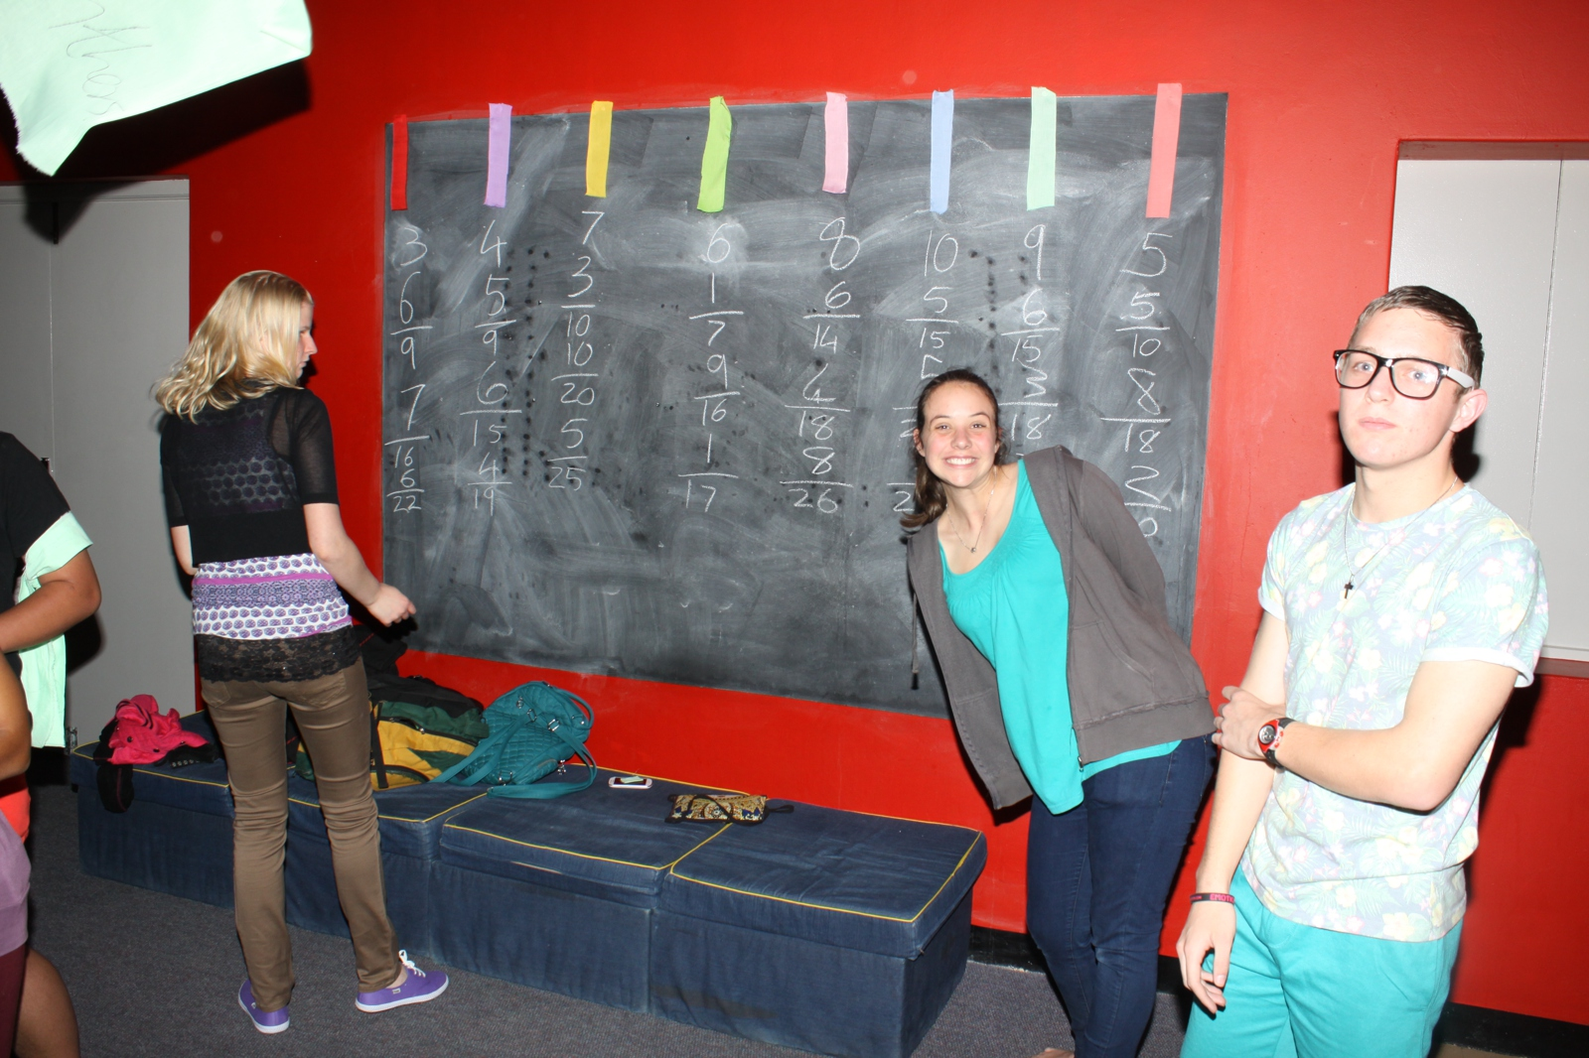
Notes:
The scoreboard and scorers.

Slide 15
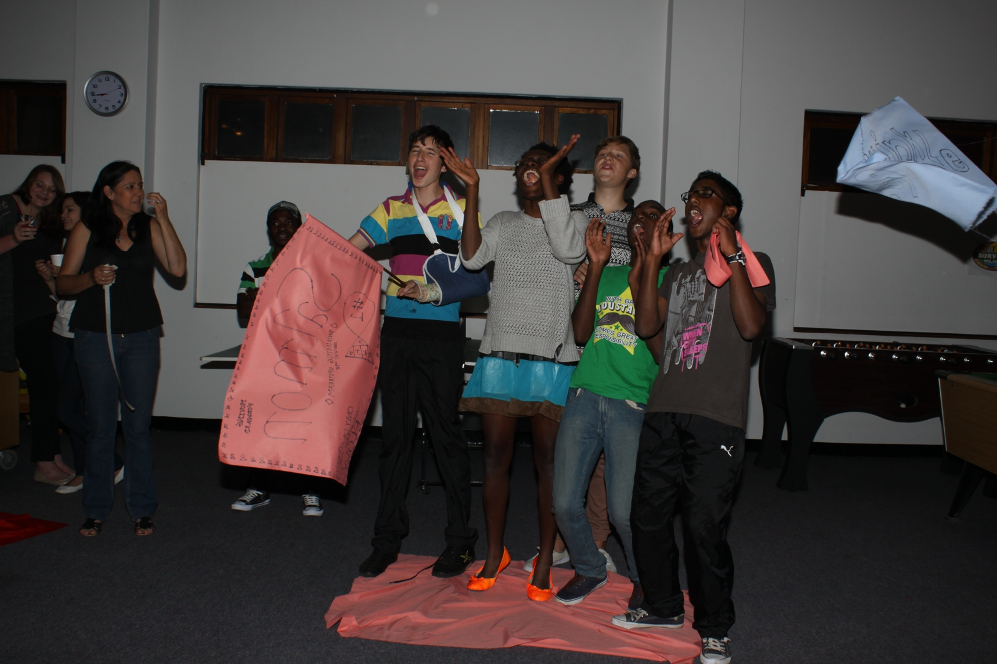
Notes:
A tribe showing team spirit

Slide 16
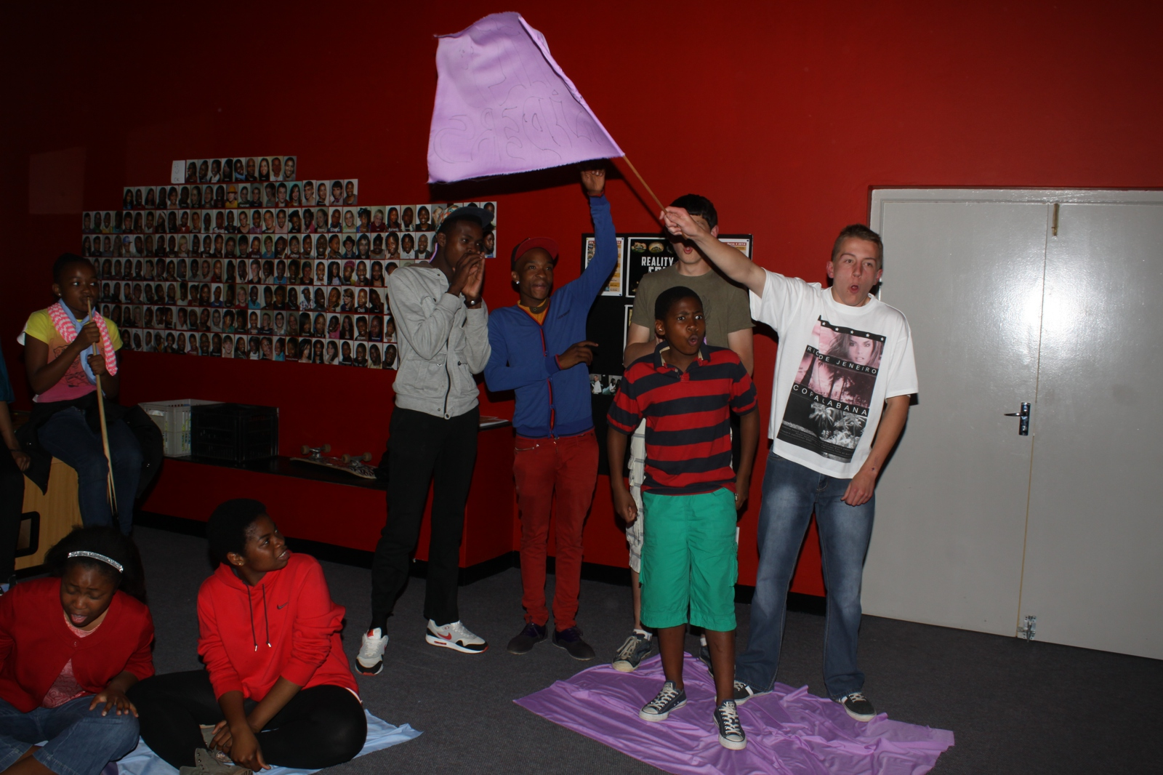
Notes:
A tribe showing team spirit

Slide 17
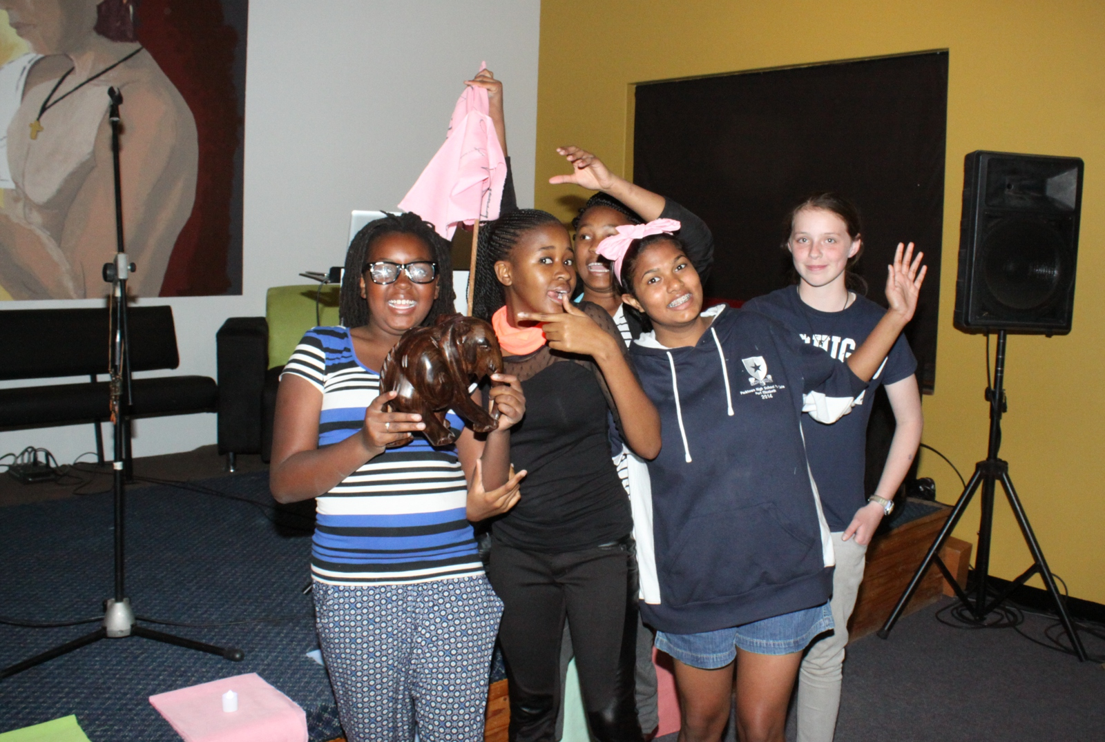
Notes:
The winning tribe

Slide 18
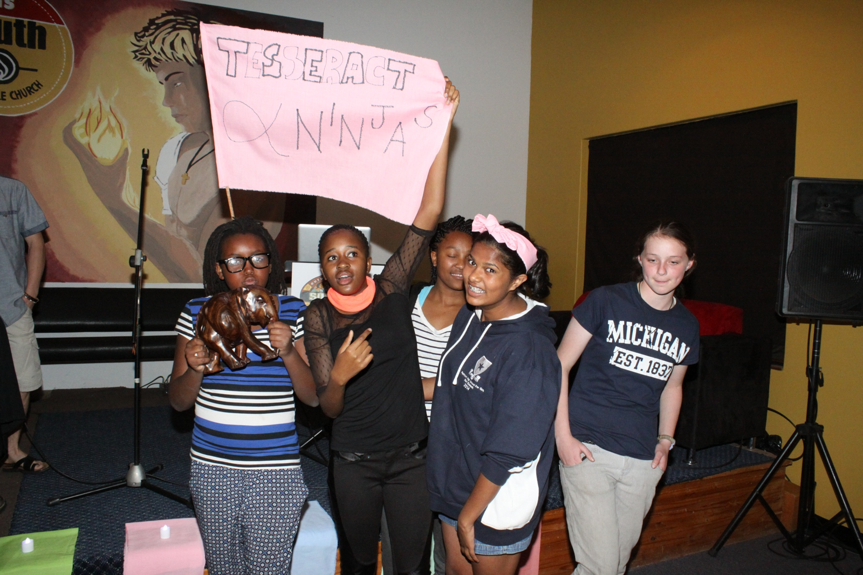
Notes:
The winning tribe

Slide 19
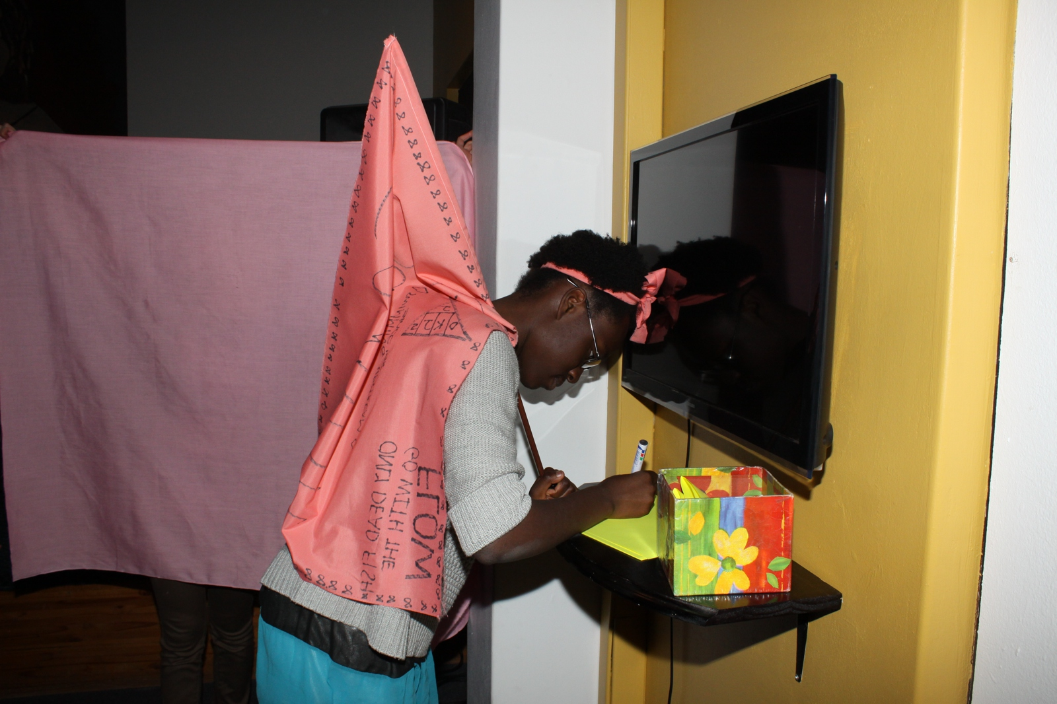
Notes:
Voting for the ultimate survivor

Slide 20
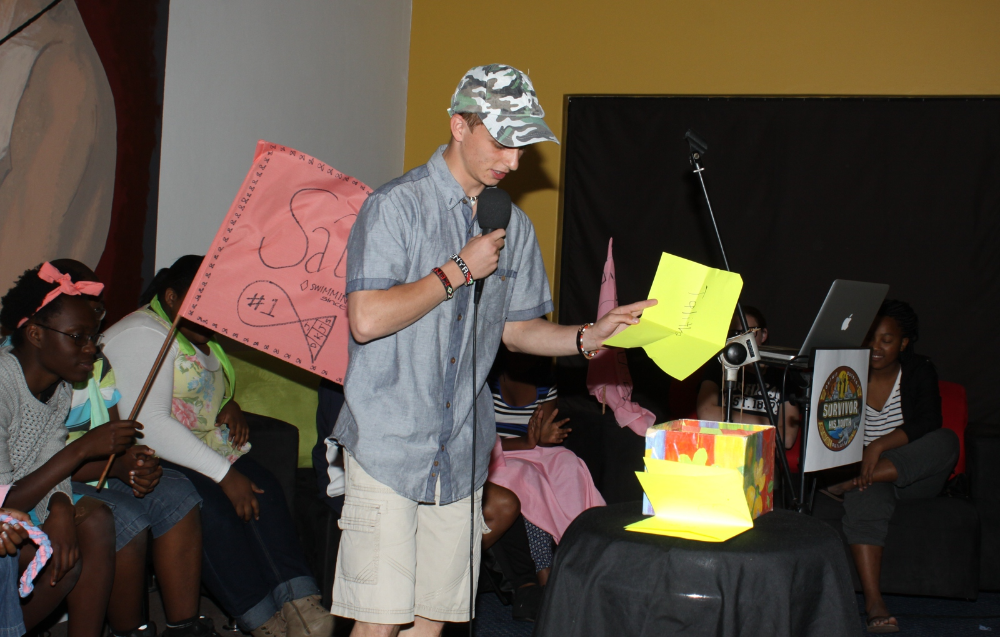
Notes:
Jeff reading the votes

Slide 21
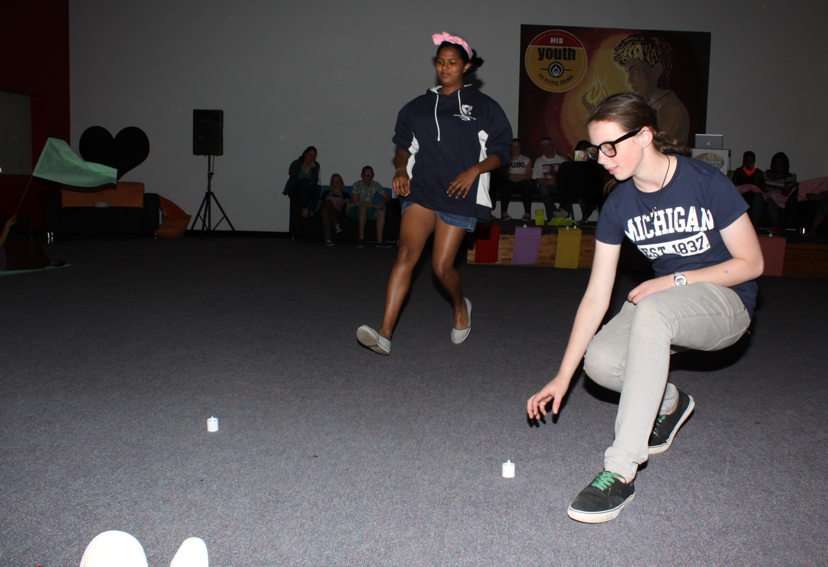
Notes:
Due to a tie – a fire challenge was created.

Slide 22
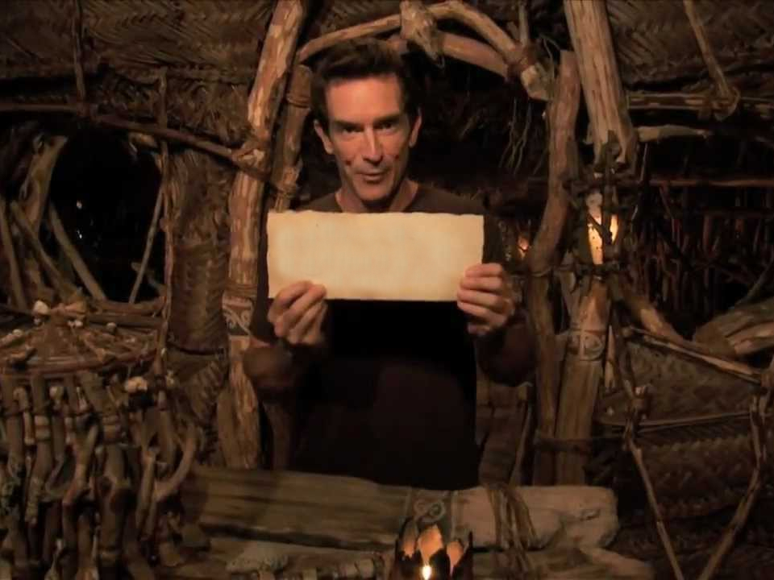

???
Winner
And the winner is…
Notes:
The Ultimate Survivor is announced and rewarded.

Slide 23
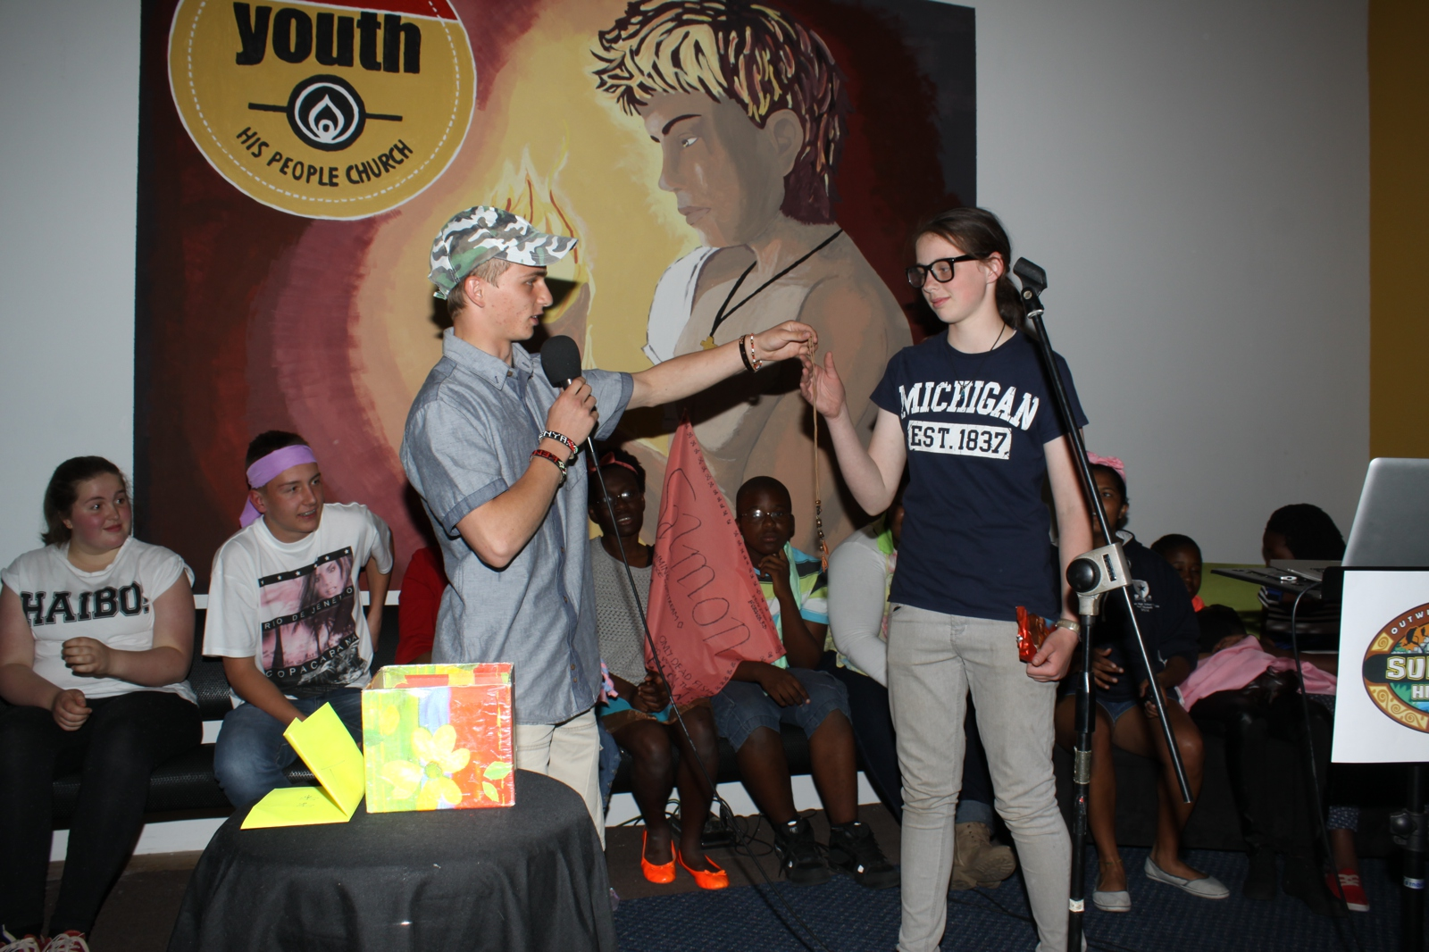
Notes:
Well done to our Ultimate Survivor, Talitha Neville. She received her prize (a huge slab of chocolate) and a necklace.

Slide 24
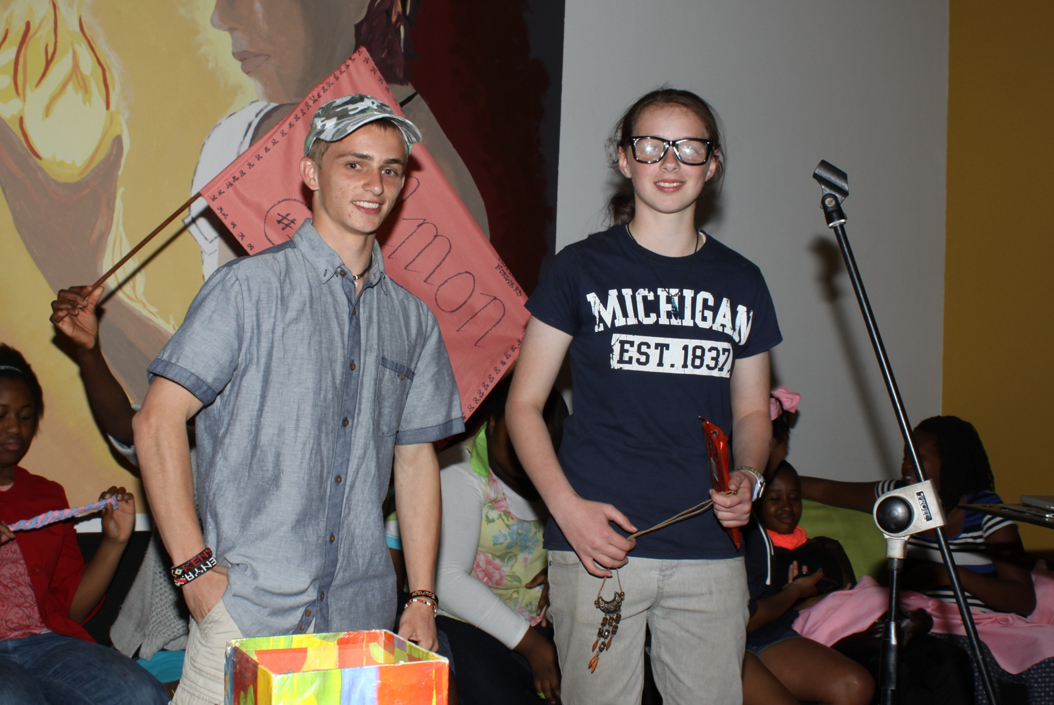
Notes:
Well done to our Ultimate Survivor, Talitha Neville. She received her prize (a huge slab of chocolate) and a necklace.

Slide 25
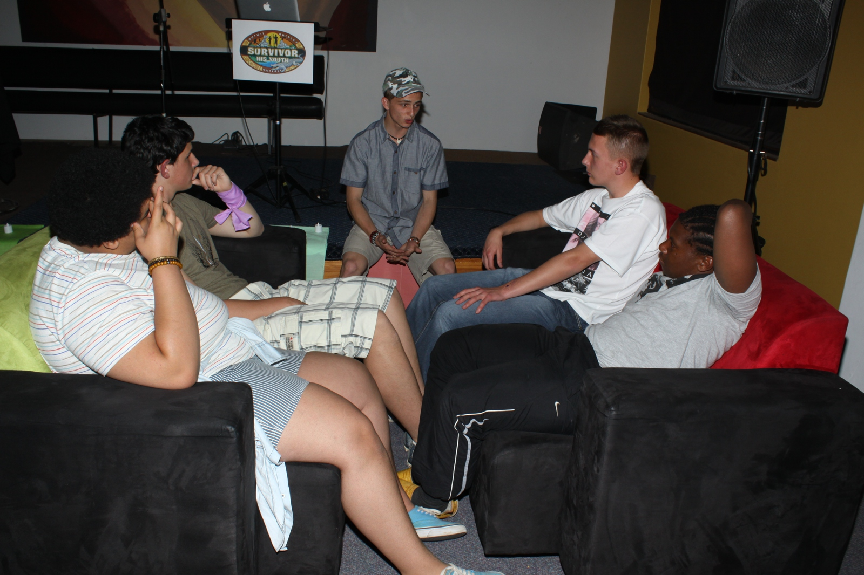
Notes:
Small group time

Slide 26
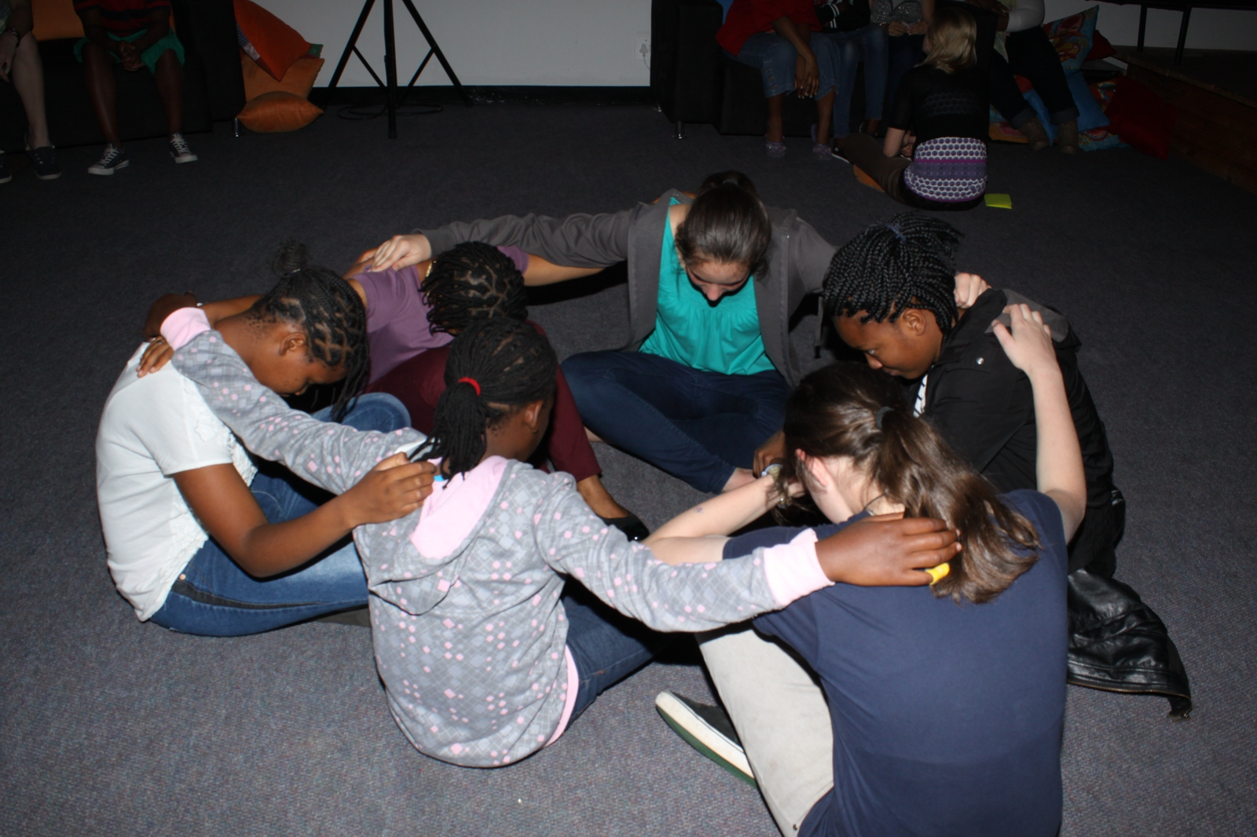
Notes:
Small group time – teens praying for each other.

