Slide 1


Slide 2

Notes:
Reading: The Parable of the Sower (Matthew 13:1-9)

Slide 3
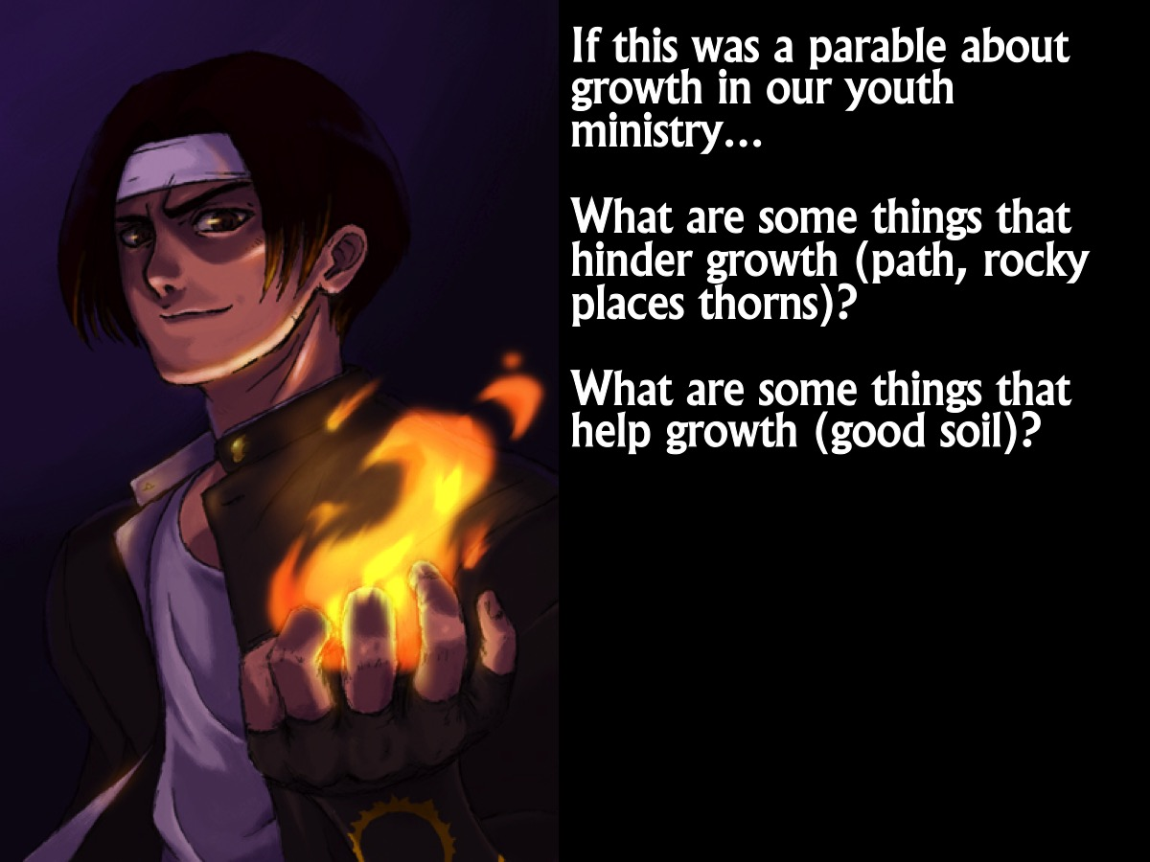
Notes:
Discuss: If this was a parable about growth in our youth ministry, what are some things that hinder growth (like the path, the rocky places or the thorns)? What would be some things that help growth (like the good soil)?

Slide 4

Notes:
Hurdles to Growth. There are many things that can hinder teens from growing in their relationship with Jesus:

Slide 5

Notes:
1. Factors in our Ministry: Theoretical or shallow teaching, lacking of involvement, etc.

Slide 6

Notes:
2. Issues in their Lives: Sin, habits, addictions, depression, wrong thinking, etc.

Slide 7

Notes:
3. Challenges in their Homes: Family conflict, divorce, abuse, etc.

Slide 8

Notes:
Springboards to Growth: Fortunately, there are many things that we can do to to help teens grow spiritually:

Slide 9
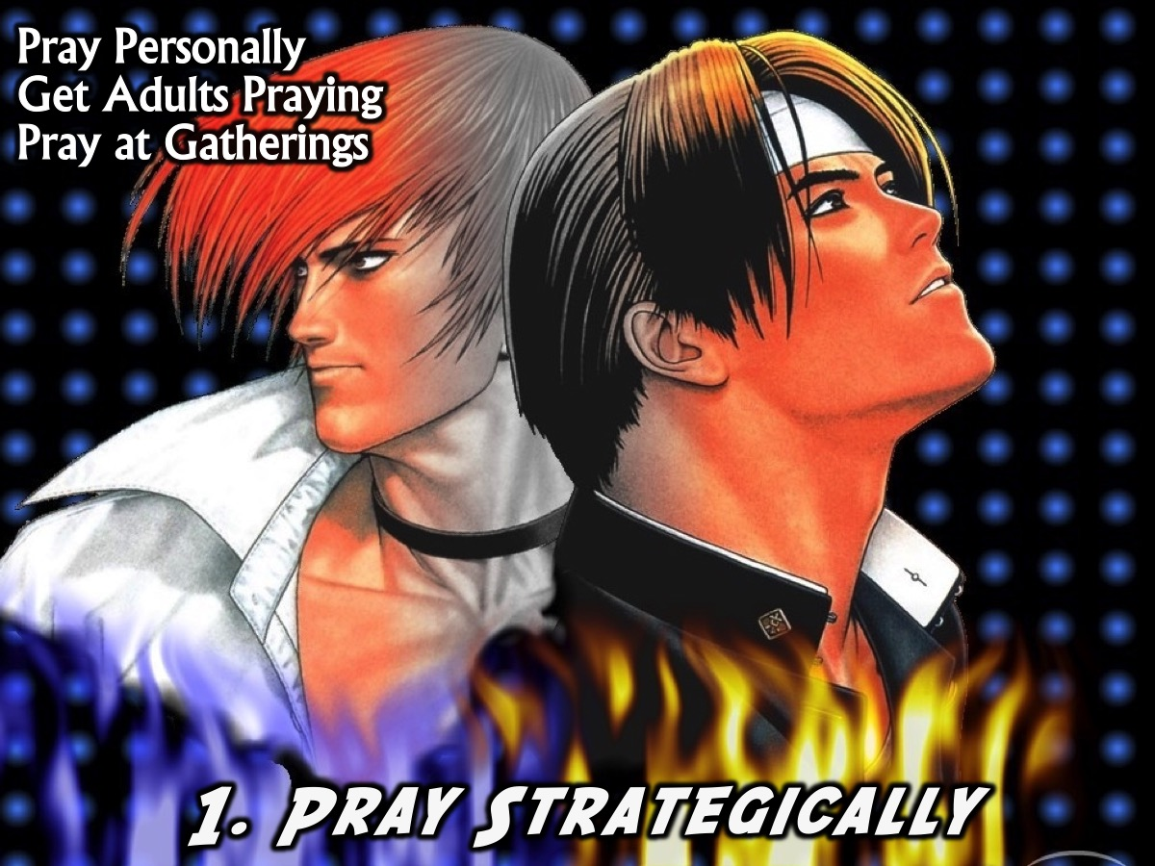
Notes:
1. Pray Strategically: Pray personally for spiritual growth within your ministry and within teens. Get adults in the church praying, build prayer into all your gatherings – pray personally and corporately.

Slide 10
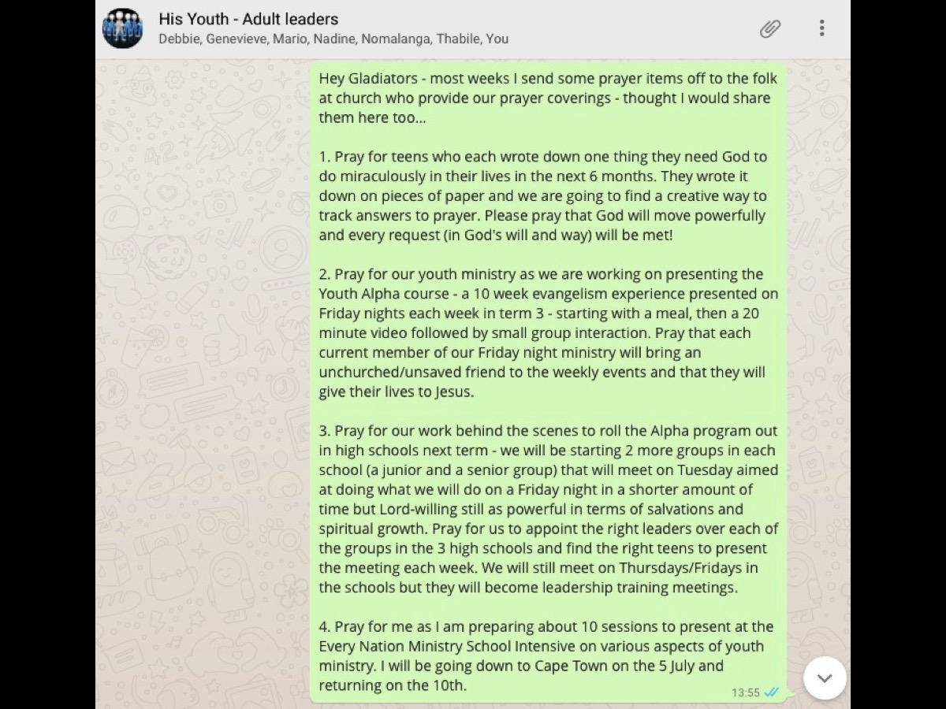
Notes:
Here is an example of how I share prayer needs with our adult leaders…

Slide 11
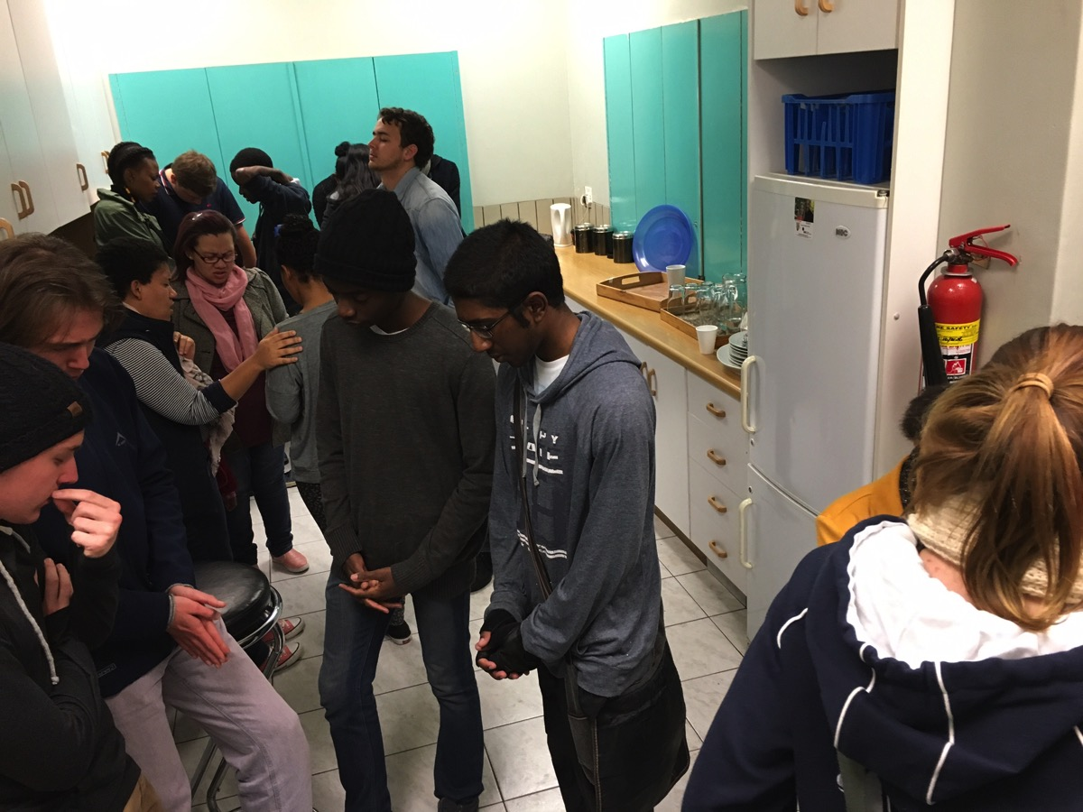
Notes:
Teens praying before a Friday night event.

Slide 12

Notes:
2. Shape Curriculum: Watch curriculum over the year(s) to ensure each intervention (series) builds on the previous and is wholistic. Create sermon series that over the course of a year cover a wide range of topics to ensure teens are given the knowledge and tools to grow.

Slide 13

Notes:
3. Align Events: Design ministry events to facilitate growth – each element of our ministry should connect to another and lead teens somewhere. For example, a Friday night event may have as it’s focus Engaging teens and leading them into a relationship with Jesus, while Sunday mornings may focus on Establishing teens and growing them in the faith, and you meet bi-weekly or monthly with the aim of Equipping teens for leadership in the group but then make sure that they are Empowered to serve using their spiritual gifts on Friday night (maybe by running small groups) or on Sunday mornings (maybe by doing the welcome, announcements, offering messages or even preaching occasionally).

Slide 14

Notes:
4. Track Growth: Focus on each level of spiritual commitment and move people through the levels: Lost, Believer, Worker, Disciplemaker.

Slide 15
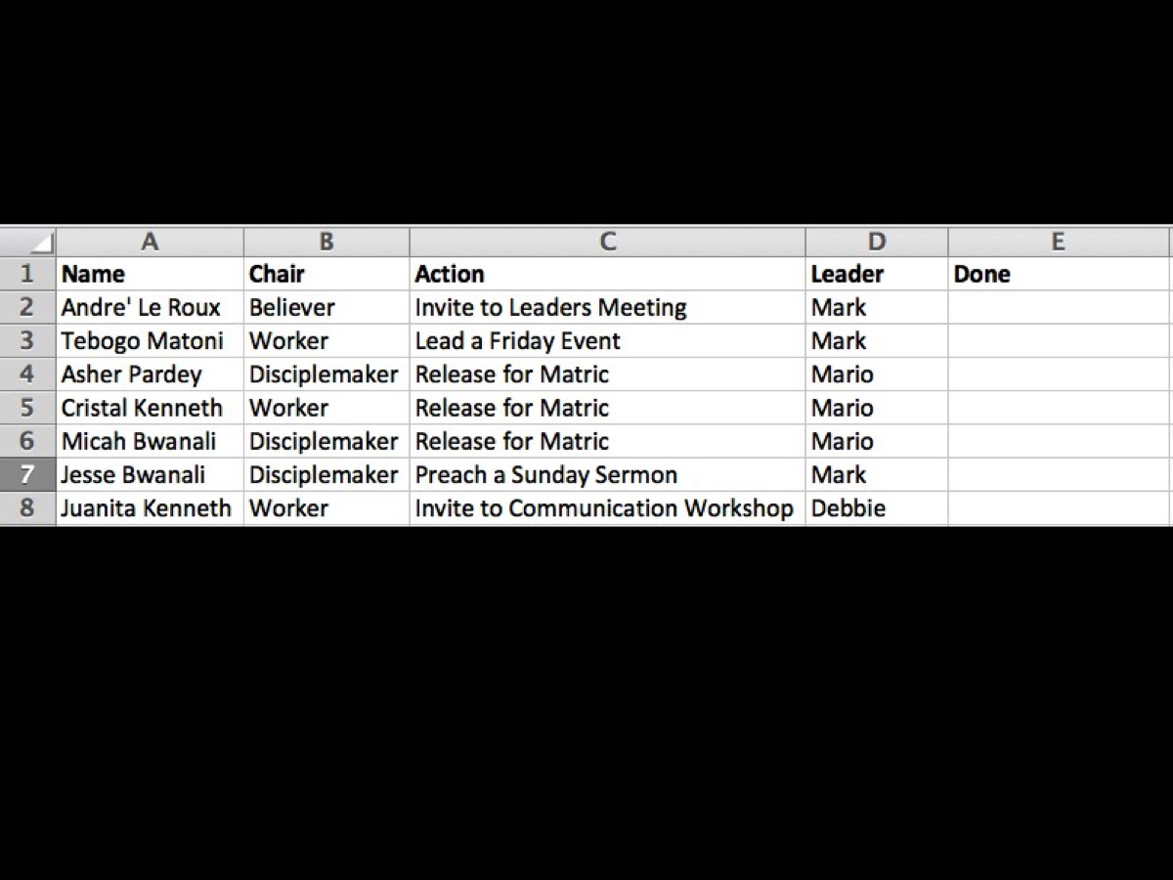
Notes:
Tool: Consider using a Spreadsheet to track their growth through the levels of spiritual commitment.

Slide 16
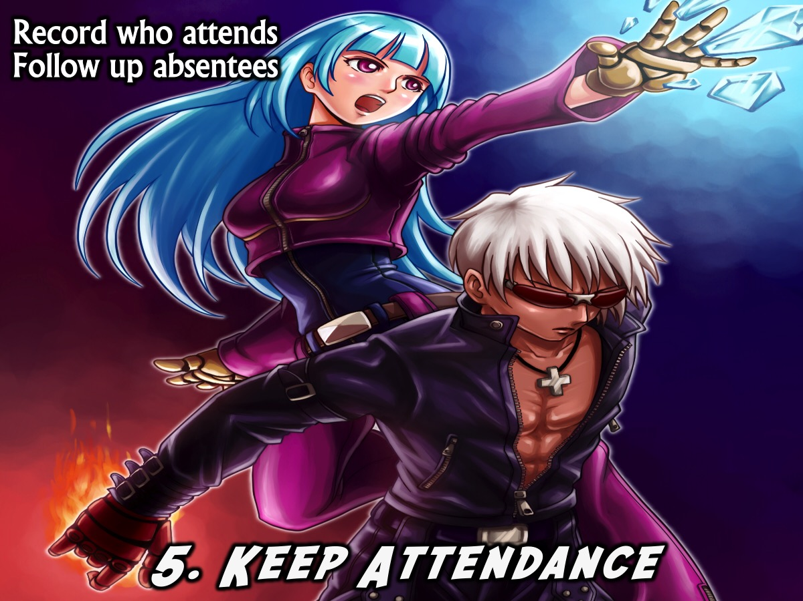
Notes:
5. Keep Attendance: Keep a record of attendance at events – maybe even record where individual teens are attending – this will help you follow up with teens who don’t attend and be sure to take quick action when someone misses a week or two to find out what is going on in their lives.

Slide 17
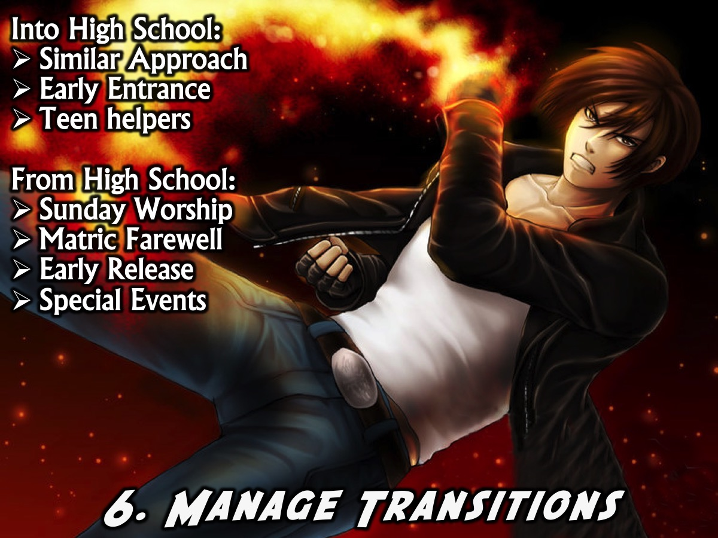
Notes:
6. Manage Transitions: Watch entrance into and out of high school ministry – ensure that pre-teens move up before they finish primary school (ie. In the third or fourth terms of their final year at primary school) and then have a matric farewell to honour the teens who are finishing their school career and connect them to campus leaders or ensure they are plugged into the wider congregation before transition from the youth ministry.
Manage Transitions. How do we manage transitions into high school ministry from kids ministry and from high school ministry into the wider church or campus and careers? There are all sorts of dangers lurking around this two times of transition!
For the transition into High School ministry we do the following: (1) Similar Approach - we ensure that we work closely with the kids ministry to ensure that the approach to disciplemaking we both use has common elements so that the kids coming into the group have a sense of familiarity even though it is a transition. Even our choice of branding ourselves as His Youth has helped with the transition from His Tots to His Kids to His Diz to His Youth. (2) Early Entrance - we have moved the entrance to high school ministry earlier so pre-teens in their final year at primary school have already made the transition before they have the added challenge of going to a new school - High School. We have two intakes in the year: June and November - and we let the kids, their families and the leaders in the Kids ministry make the decision about when they are ready to transition. The welcome service includes an official handing over of the kids who are incoming by the children’s pastor and a receiving by the youth pastor. They are introduced by name to the high school group and their photos are taken at the end of the service and displayed on the wall with all the others teens by the following Sunday. (3) Teen Helpers - another factor ensuring a smooth transition is the number of teens who volunteer as workers in the children’s ministry - this ensures that there are people in the group that the kids known when they get there!
For the transition from High School ministry we do the following: (1) Sunday Worship - our current approach of choosing to worship together with the adult congregation in church on Sunday mornings is helping teens to identify with the wider church family and this is a part of smoothing the way for them to make the transition. We look for ways to have senior teens involved in the church service - like opening the service in prayer of doing the offering message, or serving as door greeters, ushers or offering takers. (2) Matric Farewell - in the third term we have a farewell event for our Matrics which helps them with the realisation that within a few months they will have exited our ministry. Having church leaders or campus ministry leaders at this event is also a key to the transition. Last year we had our senior pastoral couple, Roger and Nicola Pearce at the dinner. (3) Early Release - we also ensure that in the first term the leaders on our teams who are in matric are aware that they are in a transition year. They continue as leaders in the first term, and in the second term are paired up with a young teen they help to mentor into a leadership position and then in the third term they are released from all program responsibility and removed from our social media lists so they can focus on their studies and exams. (4) Special Events - A further help with the transition was a paintball event planned in 2015 just for Matriculants to attend - it was run by our Sunday night congregation which is one of the places where Matriculants transition to.

Slide 18

Notes:
There are all sorts of dangers lurking around this two times of transition!

Slide 19
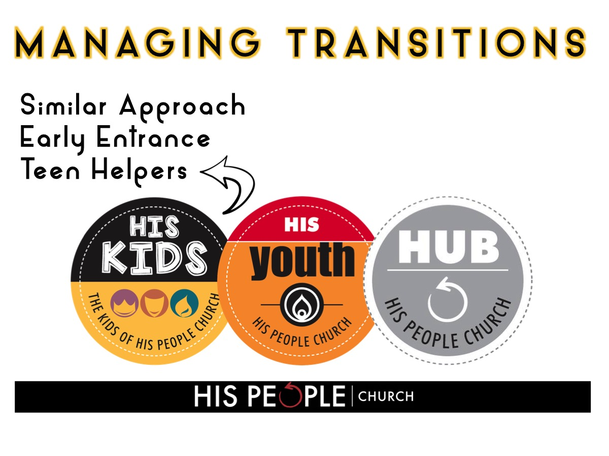
Notes:
For the transition into High School ministry we do the following: (1) Similar Approach - we ensure that we work closely with the kids ministry to ensure that the approach to disciplemaking we both use has common elements so that the kids coming into the group have a sense of familiarity even though it is a transition. Even our choice of branding ourselves as His Youth has helped with the transition from His Tots to His Kids to His Diz to His Youth. (2) Early Entrance - we have moved the entrance to high school ministry earlier so pre-teens in their final year at primary school have already made the transition before they have the added challenge of going to a new school - High School. We have two intakes in the year: June and November - and we let the kids, their families and the leaders in the Kids ministry make the decision about when they are ready to transition. The welcome service includes an official handing over of the kids who are incoming by the children’s pastor and a receiving by the youth pastor. They are introduced by name to the high school group and their photos are taken at the end of the service and displayed on the wall with all the others teens by the following Sunday. (3) Teen Helpers - another factor ensuring a smooth transition is the number of teens who volunteer as workers in the children’s ministry - this ensures that there are people in the group that the kids known when they get there!

Slide 20
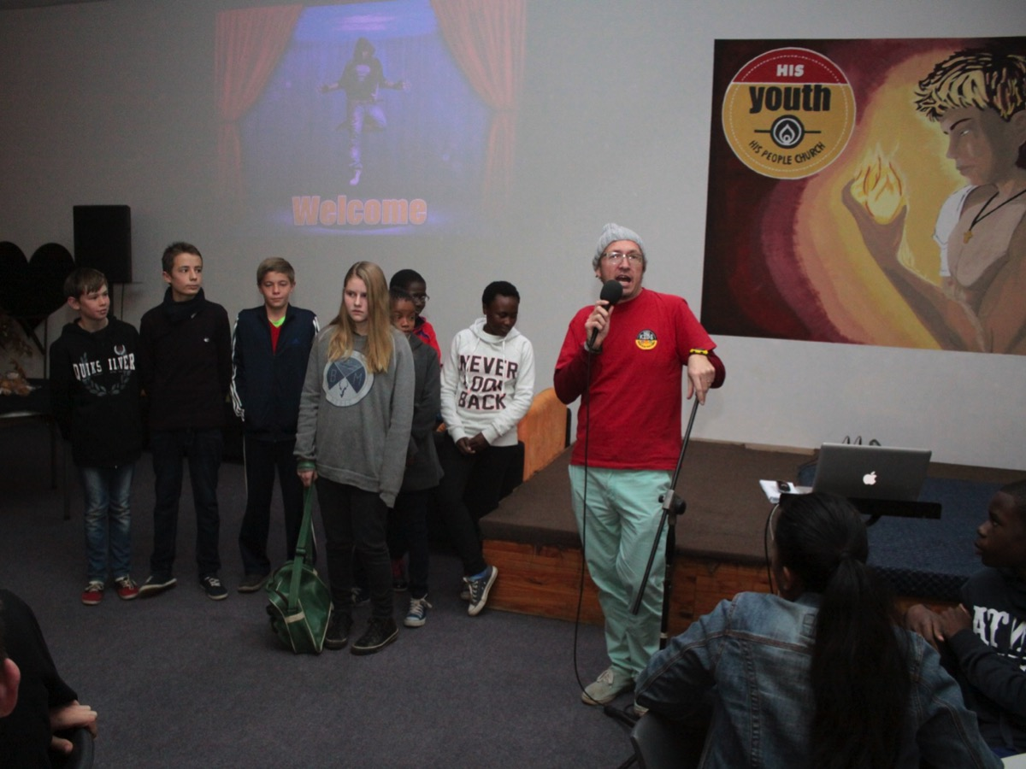
Notes:
Welcome Sunday - the first service kids making the transition into His Youth

Slide 21
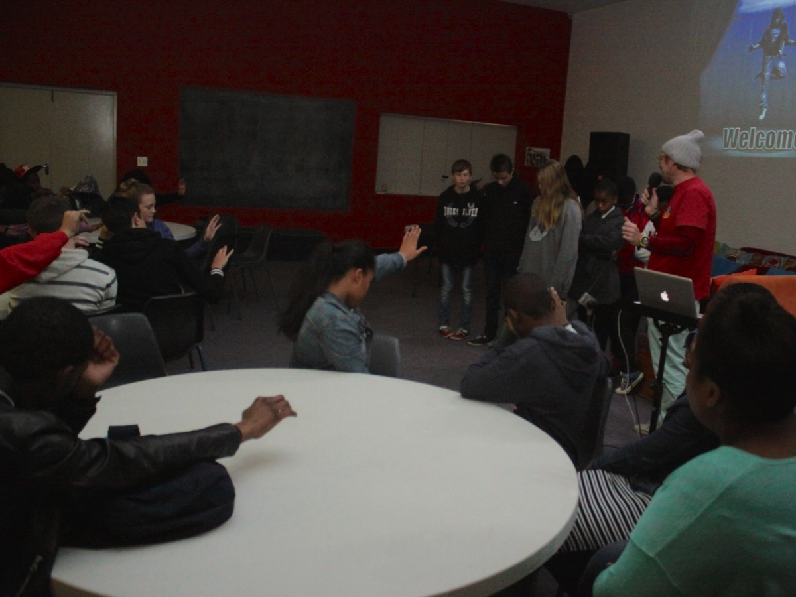
Notes:
Our teens praying for the incoming Kids.

Slide 22
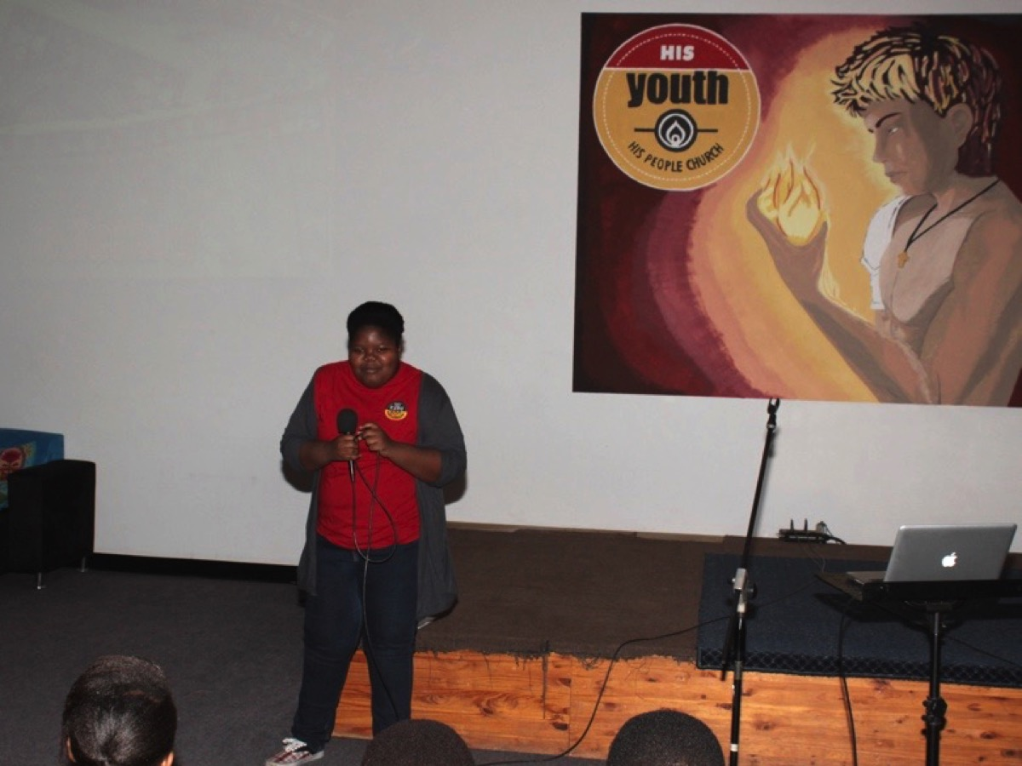
Notes:
One of our teens who serves at His Kids in her worker T-Shirt.

Slide 23
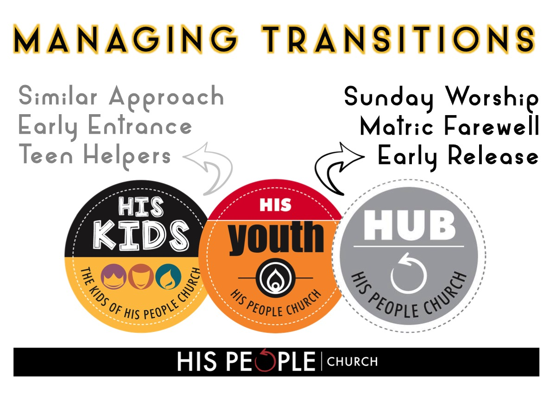
Notes:
For the transition from High School ministry we do the following: (1) Sunday Worship - our current approach of choosing to worship together with the adult congregation in church on Sunday mornings is helping teens to identify with the wider church family and this is a part of smoothing the way for them to make the transition. We look for ways to have senior teens involved in the church service - like opening the service in prayer of doing the offering message, or serving as door greeters, ushers or offering takers. (2) Matric Farewell - in the third term we have a farewell event for our Matrics which helps them with the realisation that within a few months they will have exited our ministry. Having church leaders or campus ministry leaders at this event is also a key to the transition. Last year we had our senior pastoral couple, Roger and Nicola Pearce at the dinner. (3) Early Release - we also ensure that in the first term the leaders on our teams who are in matric are aware that they are in a transition year. They continue as leaders in the first term, and in the second term are paired up with a young teen they help to mentor into a leadership position and then in the third term they are released from all program responsibility and removed from our social media lists so they can focus on their studies and exams. (4) Special Event - A further help with the transition was a paintball event planned in 2015 just for Matriculants to attend - it was run by our Sunday night congregation which would be one option for Matriculants to transition into.

Slide 24
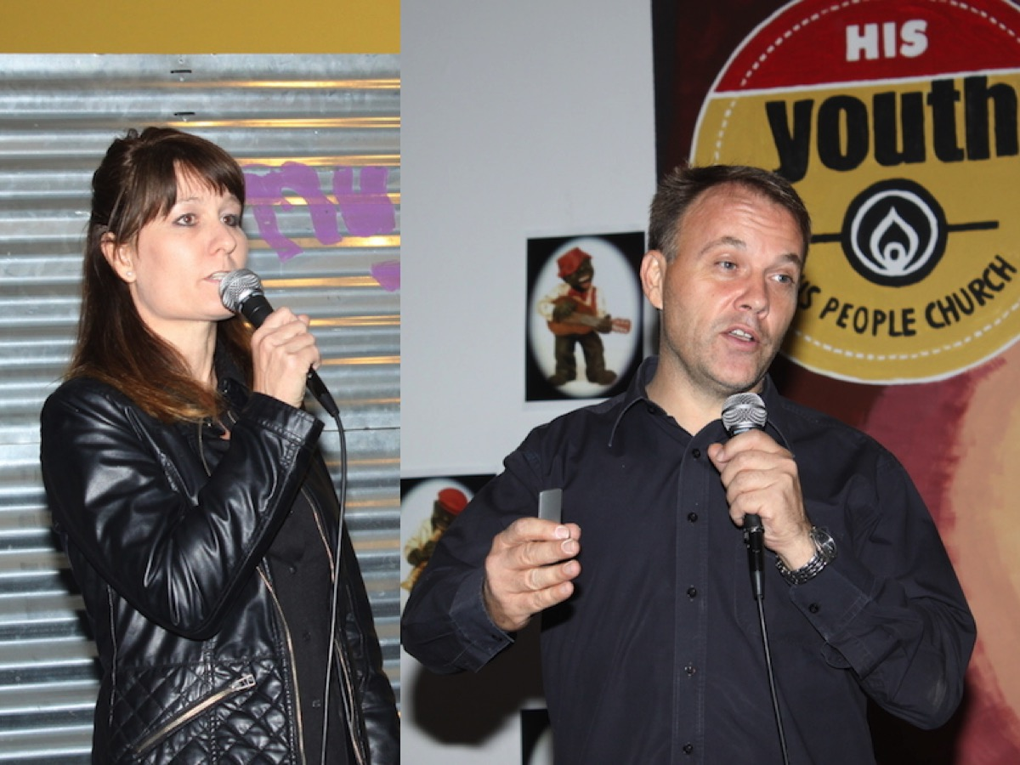
Notes:
Our senior leaders, Nicola and Roger Pearce, participated at our farewell dinner to welcome the Matrics into the life of the church.

Slide 25
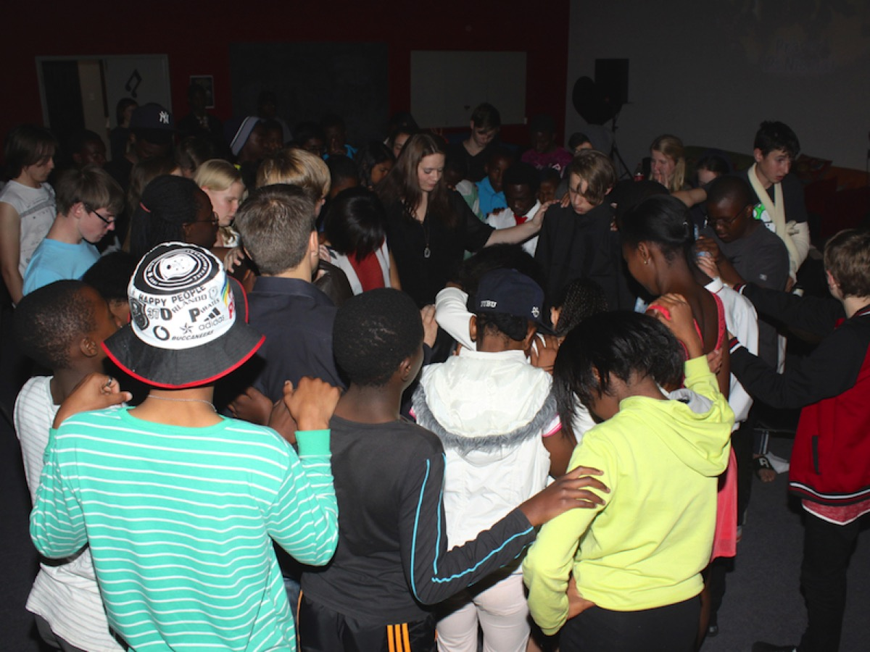
Notes:
Teens praying for the Matriculants.

Slide 26

Notes:
The Matriculants of 2014.

Slide 27
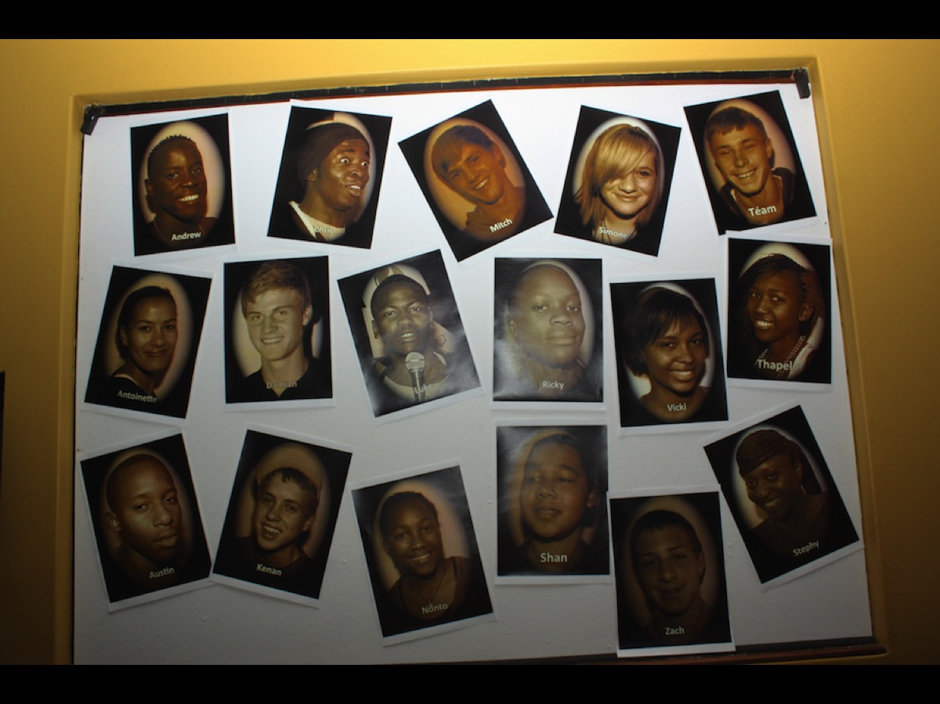
Notes:
A photo wall we created of our Matriculants in 2014.

Slide 28

Notes:
A Paintball event help in 2015 to integrate Matriculants into our Sunday evening service.

Slide 29
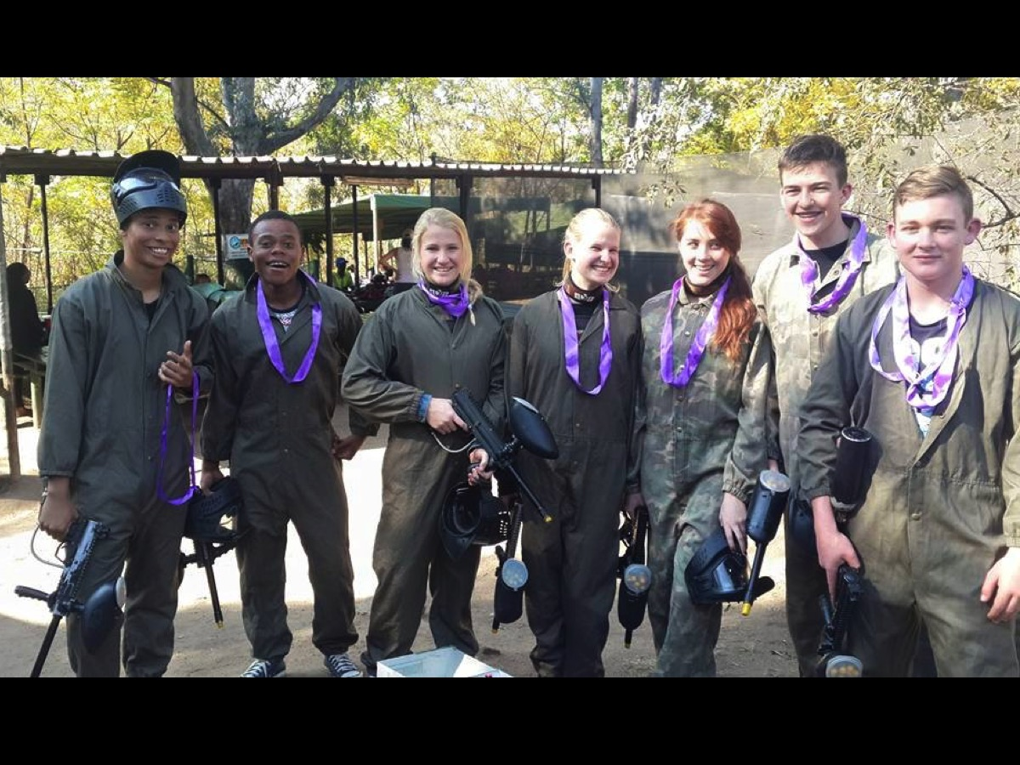
Notes:
The teens who participated in the Paintball experience in 2015.

Slide 30
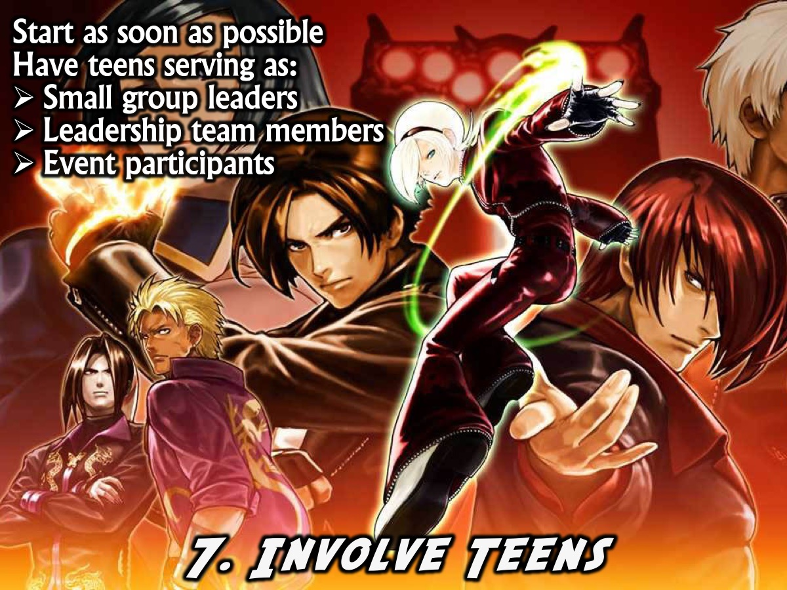
Notes:
7. Involve Teens: Continually look to pull teens into service (as soon as someone accepts Christ and they are being followed up we should work on moving them into some areas of service within the youth ministry and in time they can serve as small group leaders, leadership team members, event participants, etc.

Slide 31
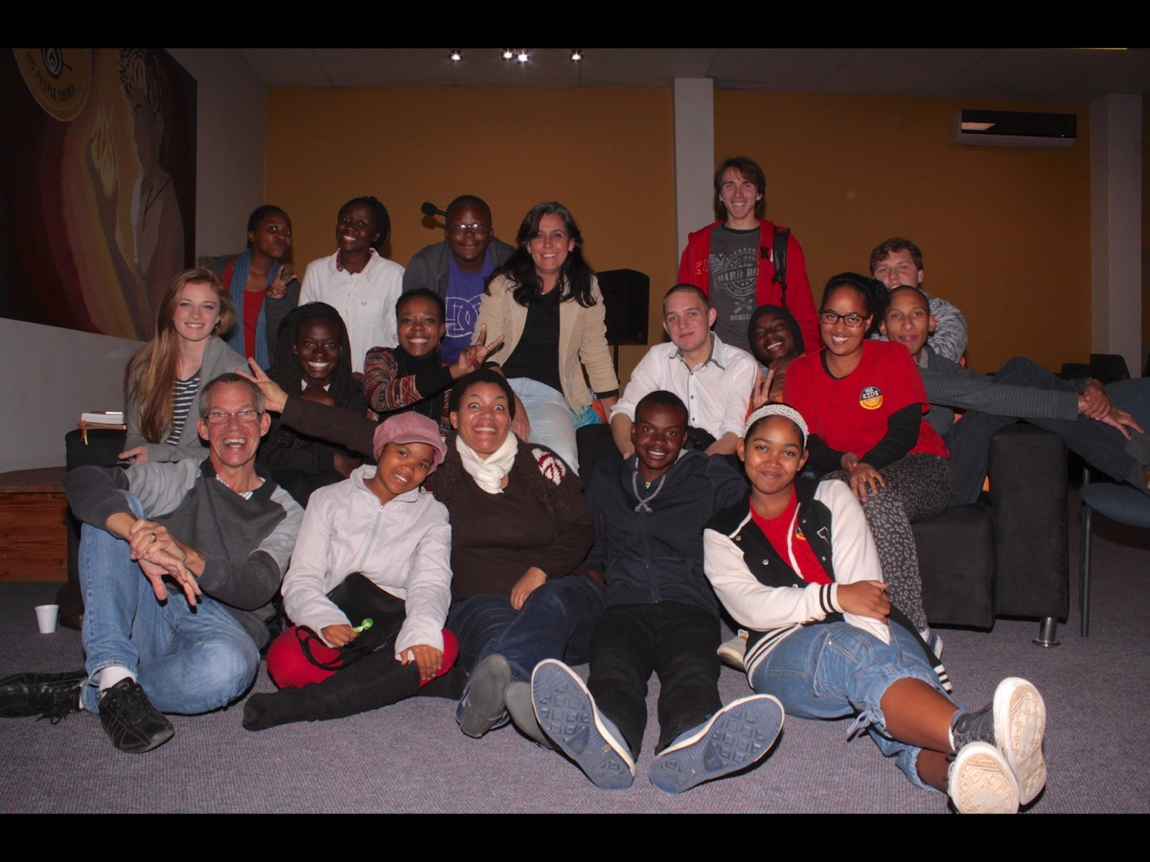
Notes:
Our teen leaders who meet once a month to plan the upcoming events and who run our events each week.

Slide 32
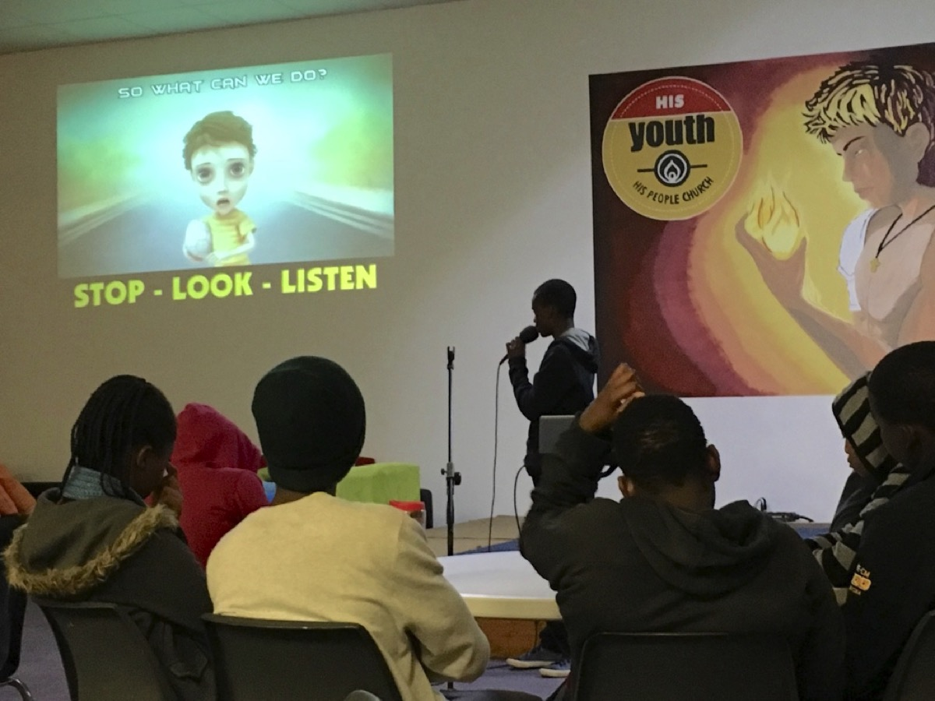
Notes:
One of our matriculants actually preached a few Sundays ago.

Slide 33

Notes:
8. Church Involvement: Involve teens in adult worship and other initiatives to ensure they feel a sense of belonging and grow spiritually in those contexts.

Slide 34
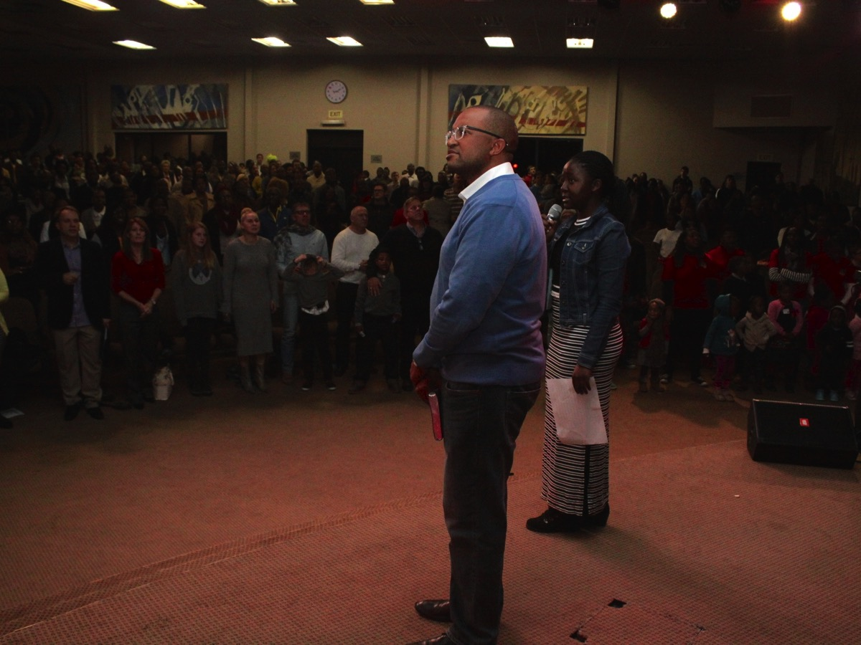
Notes:
Here is one of our teens presenting an offering message and leading the congregation in the offering declaration on a Sunday morning.

Slide 35
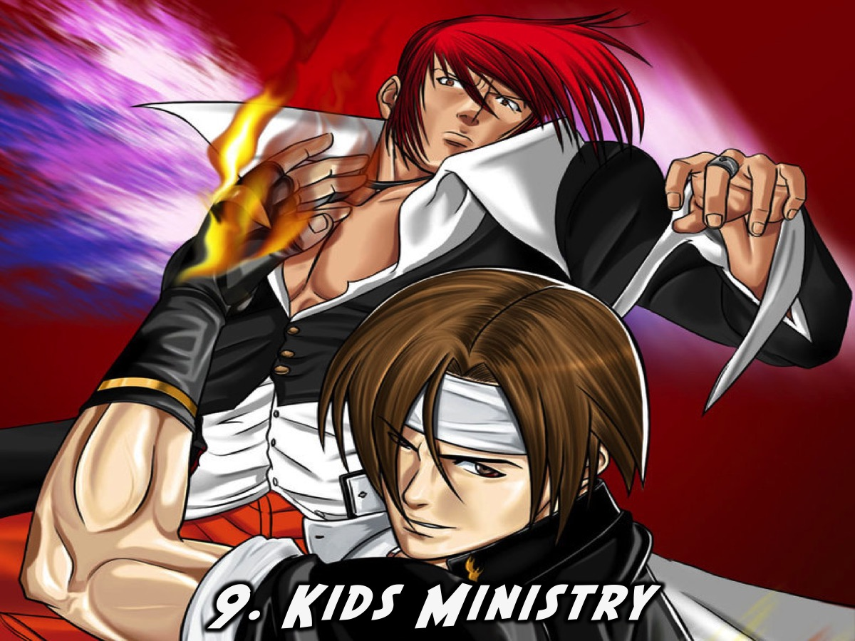
Notes:
9. Kids Ministry: Encourage teens to serve in the children’s ministry department as is a great way to ensure ongoing growth takes place in their lives.

Slide 36

Notes:
10. Facilitate Growth: Teach and program in a way that facilitates growth. Here are some ways to do that: Preach so that life-change takes place and not just the transfer of information; Create booklets that teens can work through to help them grow spiritually, Have teens sit around tables during sermons so they are forced to engage with each other, learn from each other and feedback during the sessions; Always ask: What do we want teens to know, do and be as a result of this session/sermon/event, etc.

Slide 37
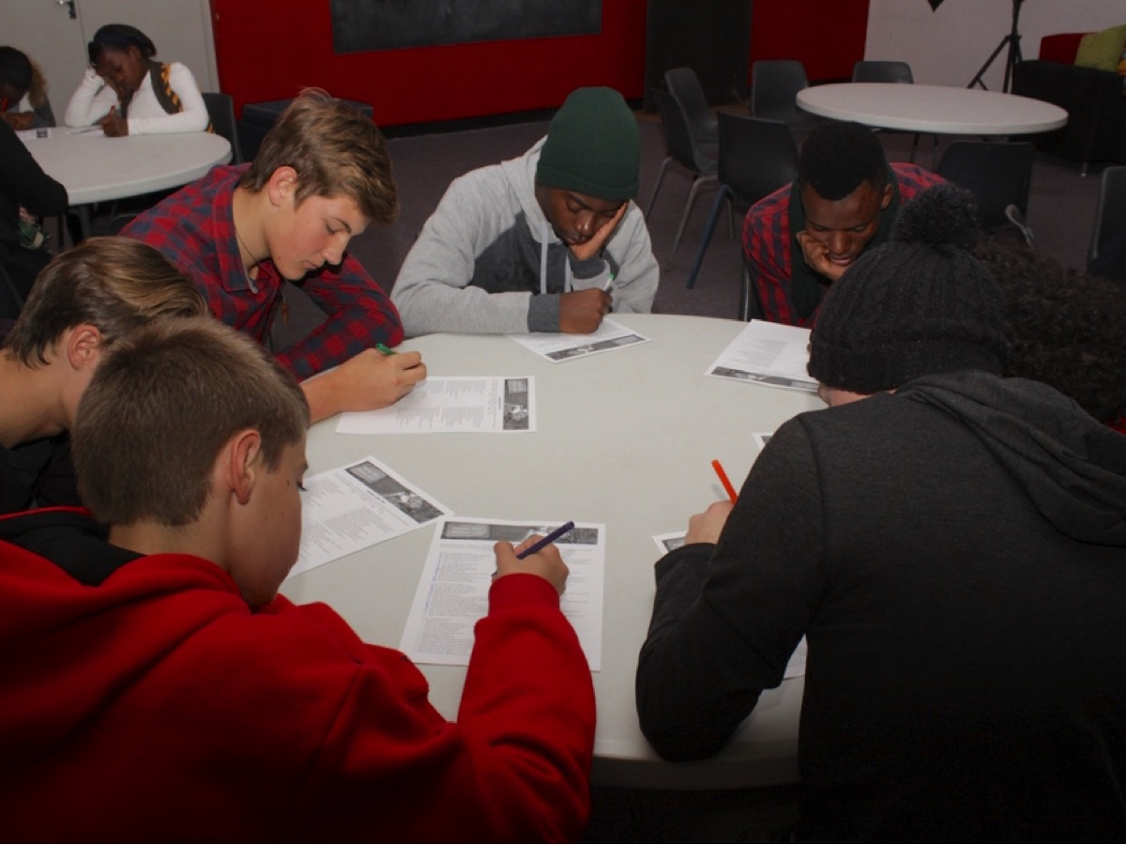
Notes:
We currently seat teens around tables so they can interact with each other and also do “stuff” during the sermons.

Slide 38

Notes:
11. Reward Growth: Do things that celebrate growth in teens – this can be through words of affirmation, through gifts/gift vouchers when certain milestones are reached and through public praise of growth that is evidenced.

Slide 39

Notes:
Reflect: What do you need to do in your ministry context to sustain growth?

Slide 40
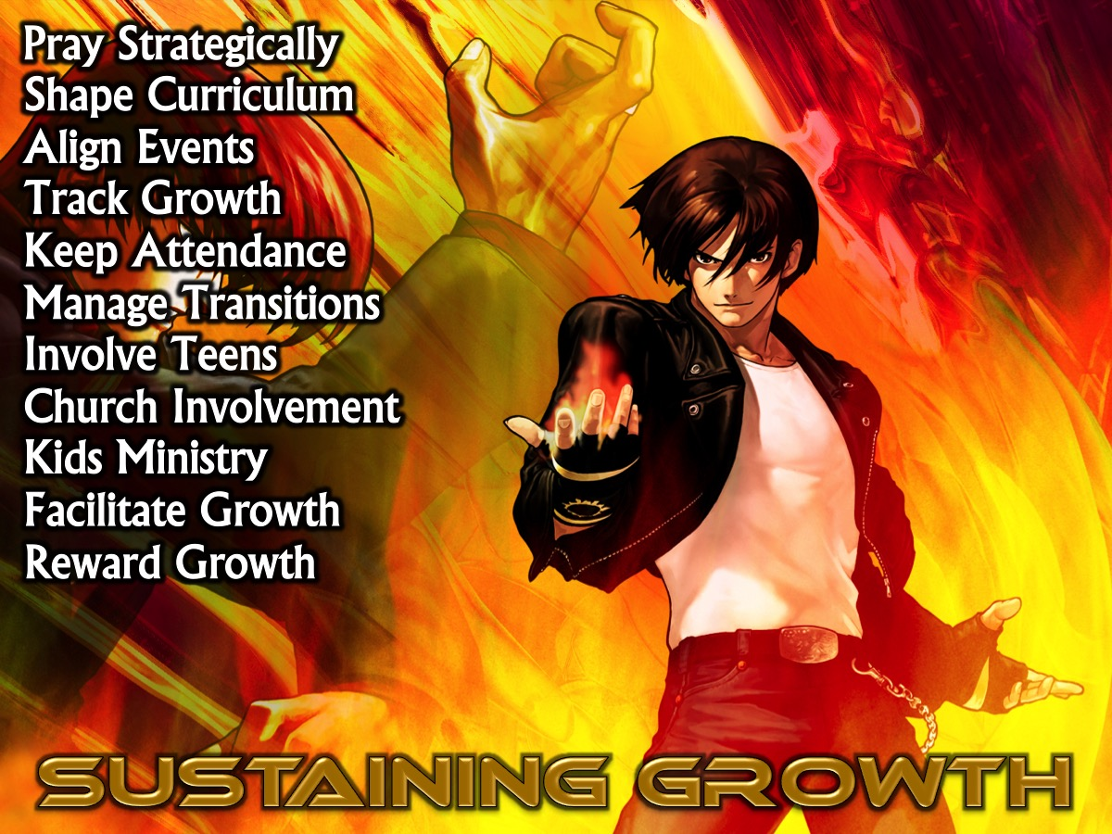
Notes:
Summary: How are you doing in these areas that will help to sustain growth in the lives of the teens that you are discipling?

