Slide 1

Notes:
Tonight is our Prison Break Night!

Slide 2

Notes:
Welcome to regulars and newcomers!

Slide 3
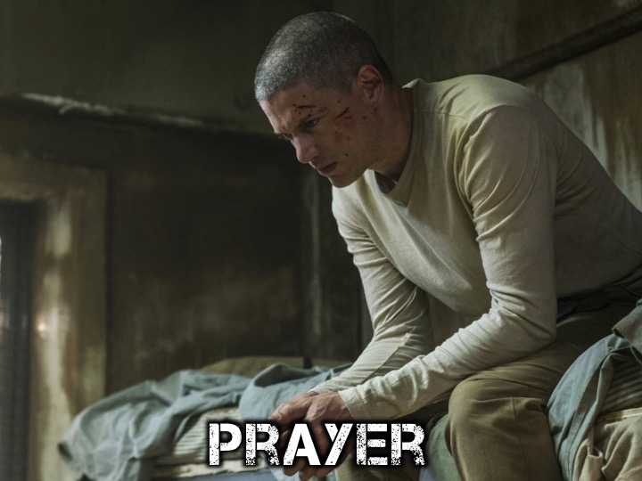
Notes:
Prayer: Let’s open our meeting in prayer.

Slide 4

Notes:
Please listen up for the following announcements!

Slide 5

Notes:
Announcements: Like us on Facebook to keep up to date with the latest news.

Slide 6
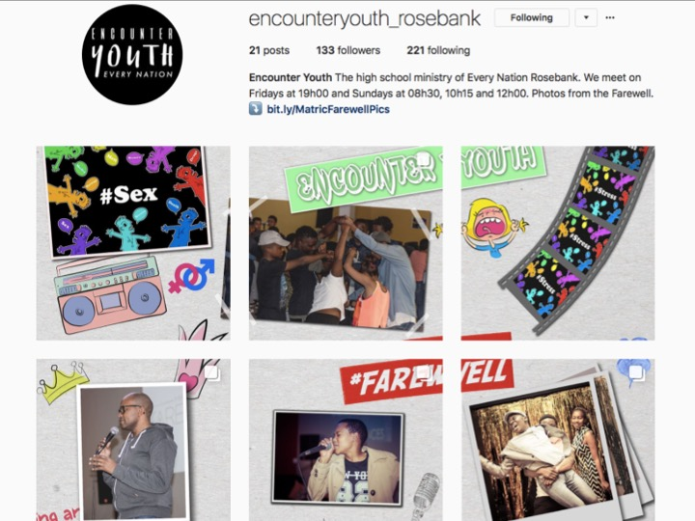
Notes:
Announcements: Follow us on Instagram! @EncounterYouth_Rosebank

Slide 7

Notes:
Announcements: Please put your praise and requests in the box!

Slide 8

Notes:
Announcements: We have Youth at schools, If we’re not at your school, check if your school already has an SCA group!

Slide 9

Notes:
Announcements: Join our Friday Night WhatsApp group!

Slide 10

Notes:
Announcements: Join us this Sunday as we discuss the question, “Does God Exist?”

Slide 11

Notes:
Announcements: Join us next Friday for our Amazing Race event!

Slide 12

Notes:
Video: Prison Break Season 5 Trailer (2017). Get it on YouTube at: https://www.youtube.com/watch?v=iABCLLOrzZA

Slide 13
Notes:
Video: Prison Break Season 5 Trailer (2017). Get it on YouTube at: https://www.youtube.com/watch?v=iABCLLOrzZA

Slide 14
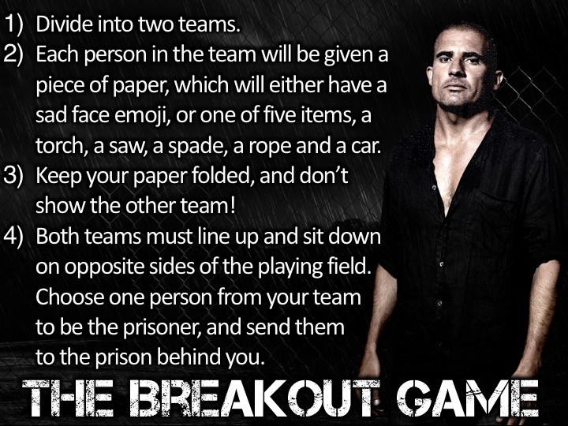
Notes:
The Breakout Game : (1) Divide into two teams. (2) Each person in the team will be given a piece of paper, which will either have a sad face emoji, or one of five items, a torch, a saw, a spade, a rope and a car. (3) Keep your paper folded, and don’t show the other team! (4) Both teams must line up and sit down on opposite sides of the playing field. Choose one person from your team to be the prisoner, and send them to the prison behind you. (5) The first team calls out the name of a person on the opposite side. That person must reveal their card, and the team should make a note of what the page contains. Once the item is revealed, the page is folded again. (6) Items must be remembered in this order (Torch, saw, spade, rope, and car), so teams must remember where items are located. (7) When an item is found in the correct order, the prisoner can cross off the item with a big red ‘X’ in the prison. (8) The team who is first to find the last item wins, the losing team will be punished by doing 20 push-ups each!

Slide 15
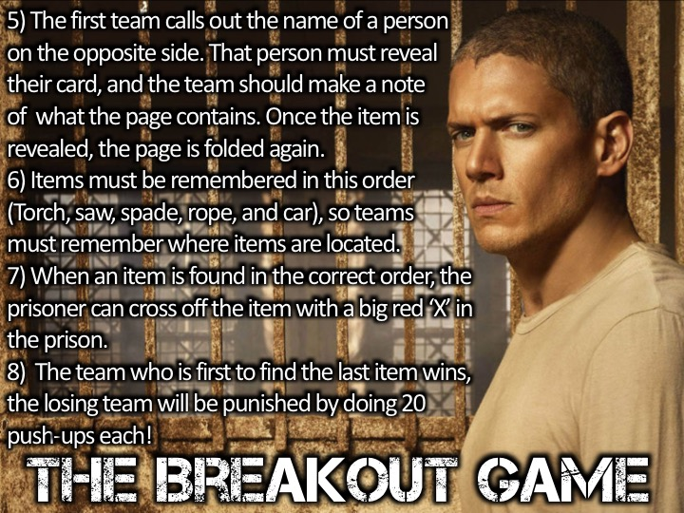
Notes:
The Breakout Game : (1) Divide into two teams. (2) Each person in the team will be given a piece of paper, which will either have a sad face emoji, or one of five items, a torch, a saw, a spade, a rope and a car. (3) Keep your paper folded, and don’t show the other team! (4) Both teams must line up and sit down on opposite sides of the playing field. Choose one person from your team to be the prisoner, and send them to the prison behind you. (5) The first team calls out the name of a person on the opposite side. That person must reveal their card, and the team should make a note of what the page contains. Once the item is revealed, the page is folded again. (6) Items must be remembered in this order (Torch, saw, spade, rope, and car), so teams must remember where items are located. (7) When an item is found in the correct order, the prisoner can cross off the item with a big red ‘X’ in the prison. (8) The team who is first to find the last item wins, the losing team will be punished by doing 20 push-ups each!

Slide 16
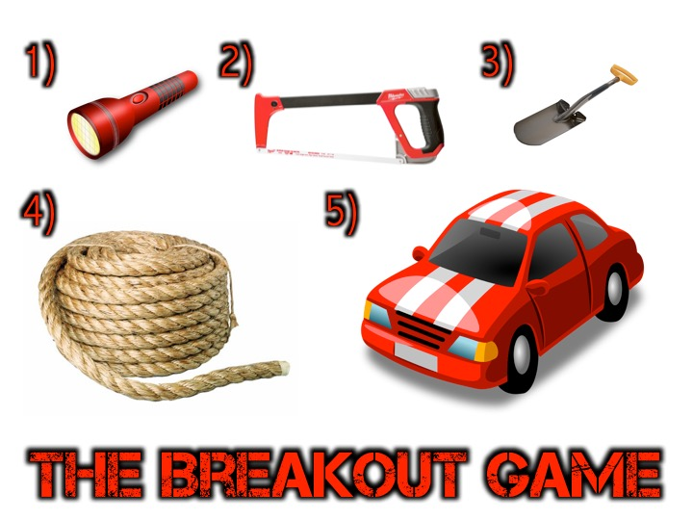
Notes:
The Breakout Game : (1) Divide into two teams. (2) Each person in the team will be given a piece of paper, which will either have a sad face emoji, or one of five items, a torch, a saw, a spade, a rope and a car. (3) Keep your paper folded, and don’t show the other team! (4) Both teams must line up and sit down on opposite sides of the playing field. Choose one person from your team to be the prisoner, and send them to the prison behind you. (5) The first team calls out the name of a person on the opposite side. That person must reveal their card, and the team should make a note of what the page contains. Once the item is revealed, the page is folded again. (6) Items must be remembered in this order (Torch, saw, spade, rope, and car), so teams must remember where items are located. (7) When an item is found in the correct order, the prisoner can cross off the item with a big red ‘X’ in the prison. (8) The team who is first to find the last item wins, the losing team will be punished by doing 20 push-ups each!

Slide 17
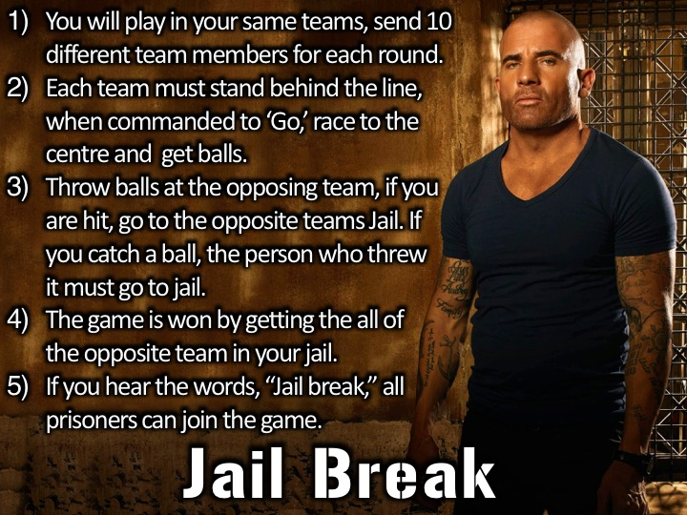
Notes:
Jail Break: (1) You will play in your same teams, send 10 different team members for each round. (2) Each team must stand behind the line, when commanded to ‘Go,’ race to the centre and get balls. (3) Throw balls at the opposing team, if you are hit, go to the opposite teams Jail. If you catch a ball, the person who threw it must go to jail. (4) The game is won by getting the all of the opposite team in your jail. (5) If you hear the words, “Jail break,” all prisoners can join the game.

Slide 18
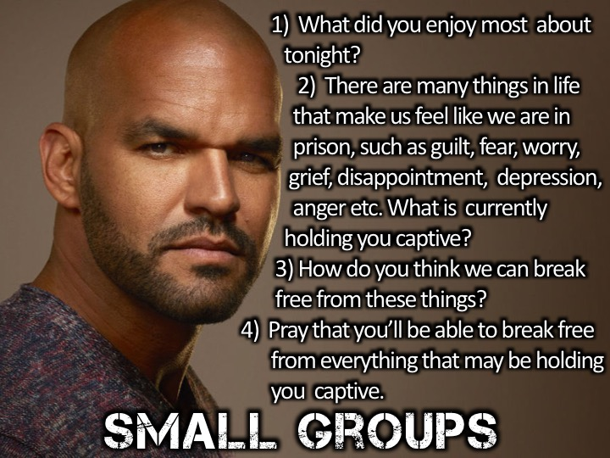
Notes:
Small Group Interaction: (1) What did you enjoy most about tonight? (2) There are many things in life that make us feel like we are in prison, such as guilt, fear, worry, grief, disappointment, depression, anger etc. What is currently holding you captive? (3) How do you think we can break free from these things? (4) Pray that you’ll be able to break free from everything that may be holding you captive.

Slide 19
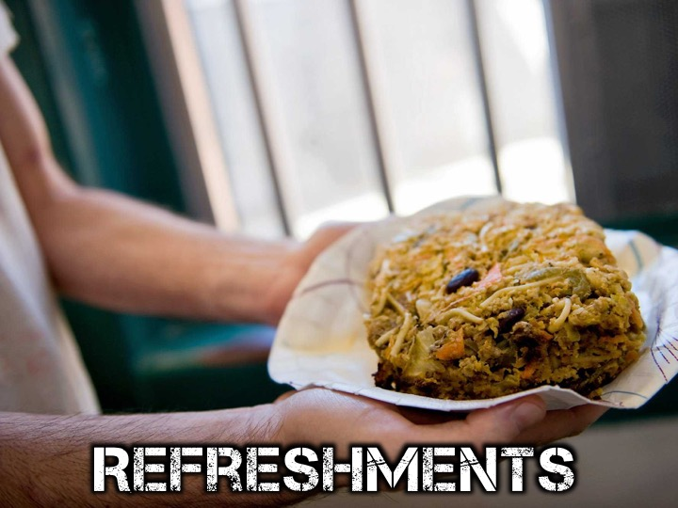
Notes:
Refreshments: It is time for refreshments.

Slide 20
Notes:
Thanks for coming!

Slide 21
Notes:
Don’t forget to join our WhatsApp group for regular updates!

