Slide 1

Notes:
Welcome to the TV Series.

Slide 2

Notes:
Tonight is our Amazing Race Night!

Slide 3

Notes:
Welcome to regulars and newcomers!

Slide 4
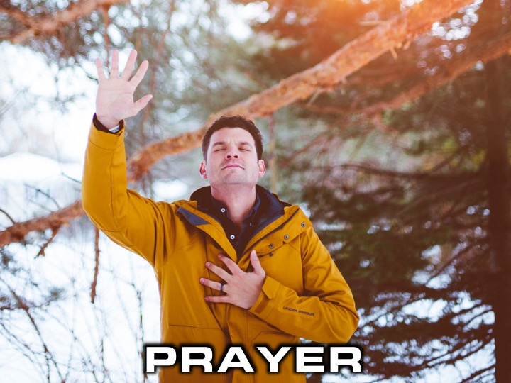
Notes:
Prayer: Let’s open our meeting in prayer.

Slide 5

Notes:
Please listen up for the following announcements!

Slide 6
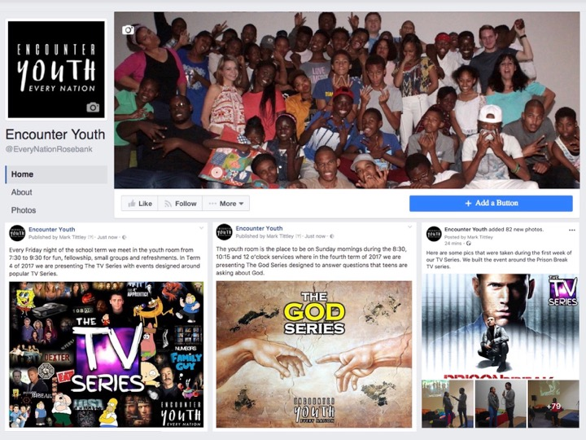
Notes:
Announcements: Like us on Facebook to keep up to date with the latest news.

Slide 7
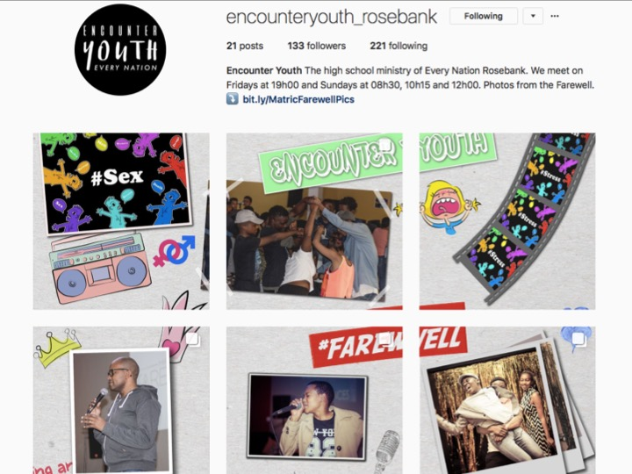
Notes:
Announcements: Follow us on Instagram! @EncounterYouth_Rosebank

Slide 8

Notes:
Announcements: Please put your praise and requests in the box!

Slide 9

Notes:
Announcements: We have Youth at schools, If we’re not at your school, check if your school already has an SCA group!

Slide 10

Notes:
Announcements: Join our Friday Night WhatsApp group!

Slide 11

Notes:
Announcements: Join us this Sunday as we discuss the question, “Does God Hear?”

Slide 12

Notes:
Announcements: Join us next Friday for our Suits Night!

Slide 13
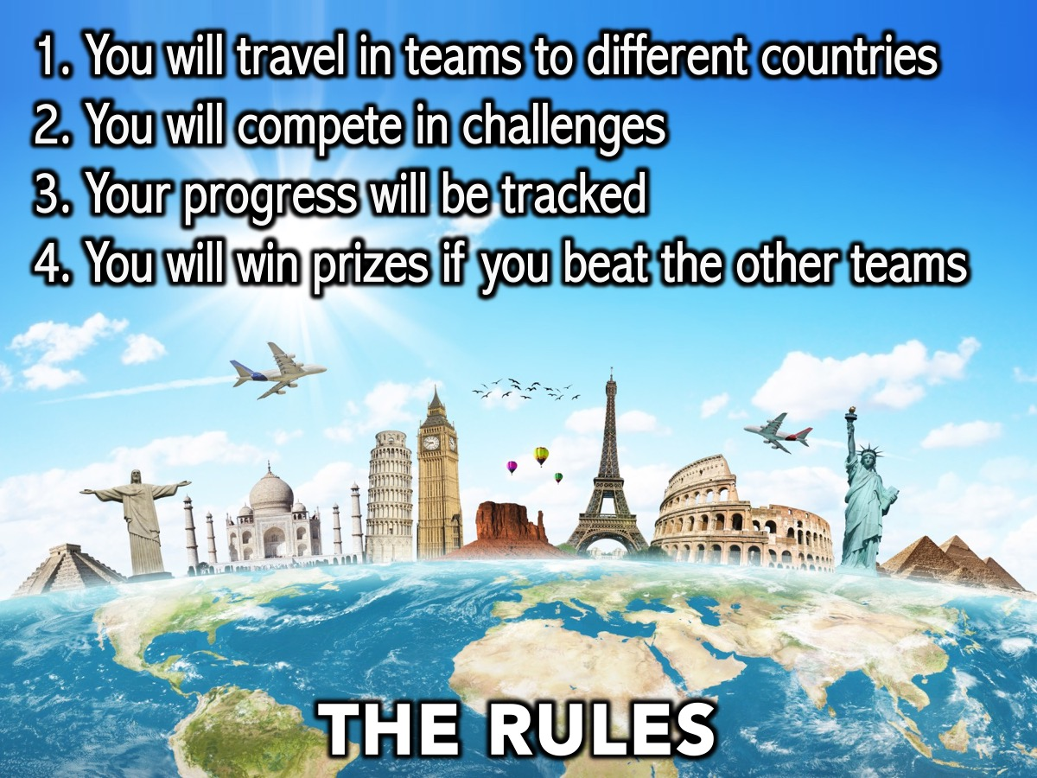
Notes:
The Rules: (1) You will travel in teams to different countries. (2) You will compete in challenges. (3) Your progress will be tracked. (4) You will win prizes if you beat the other teams.

Slide 14

Notes:
1. France

Slide 15
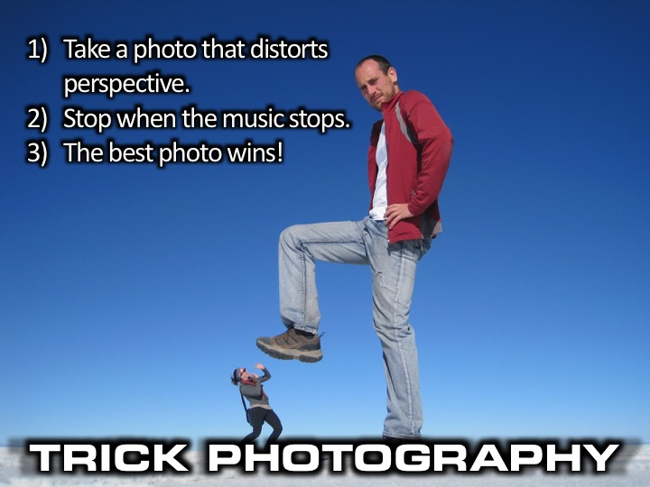
Notes:
Trick Photography: In teams take a photo that distorts perspective in some way.
Stop when the music stops.
The best photo wins!

Slide 16

Notes:
2. EGYPT

Slide 17
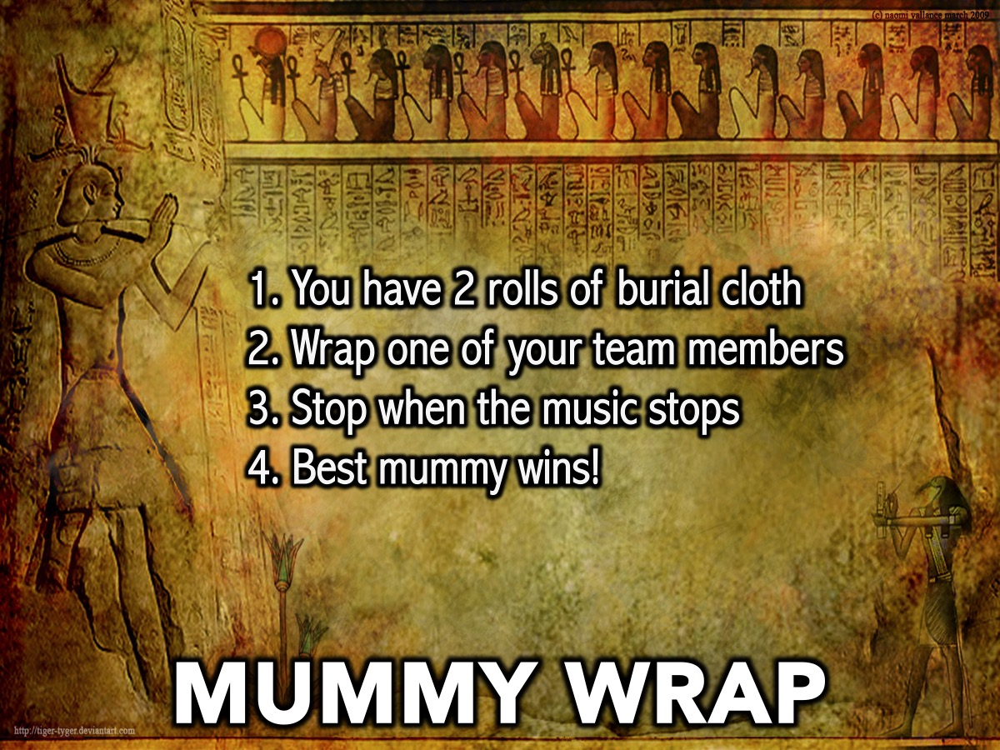
Notes:
Mummy Wrap: You have to wrap one of your team members with 3 rolls of toilet paper wins. When the music stops we will judge which team member is the best mummy!
Supplies: 3 rolls of toilet paper for each team

Slide 18

Notes:
3. JAPAN

Slide 19
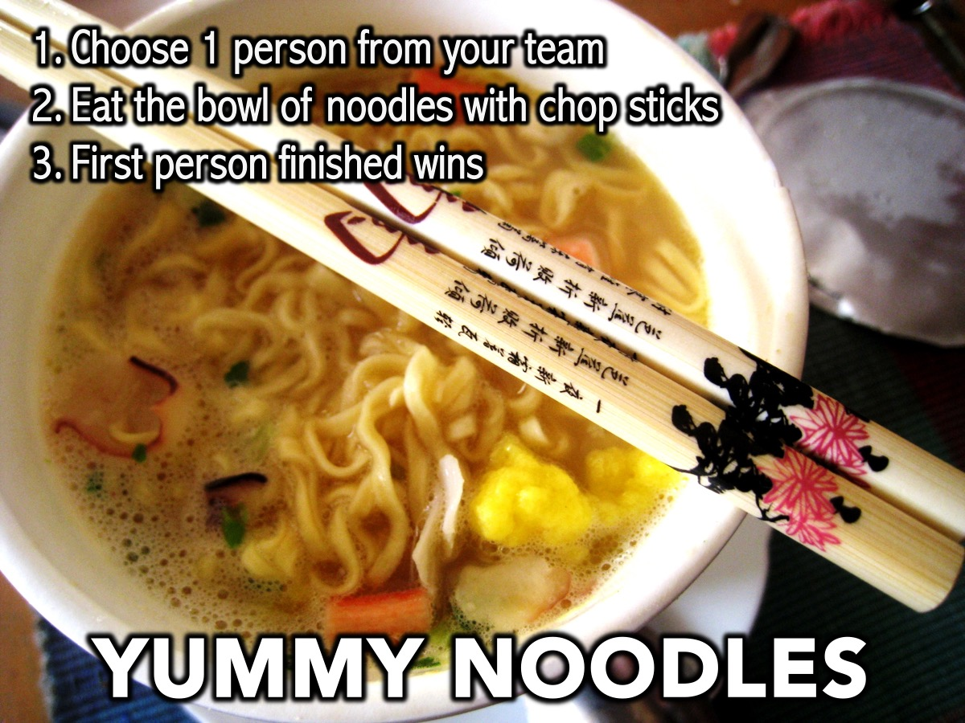
Notes:
3. JAPAN
Yummy Noodles: Each team is given a bowl of noodles to be eaten with chop sticks.
Supplies: 10 packets of 2-Minute Noodles. 10 sets of chop sticks.

Slide 20
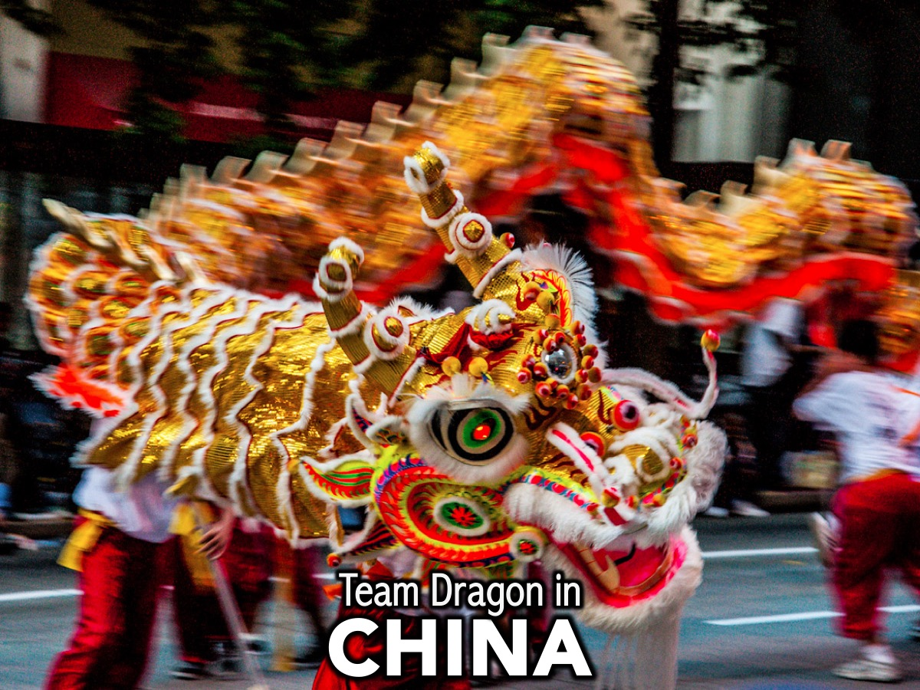
Notes:
4. CHINA

Slide 21
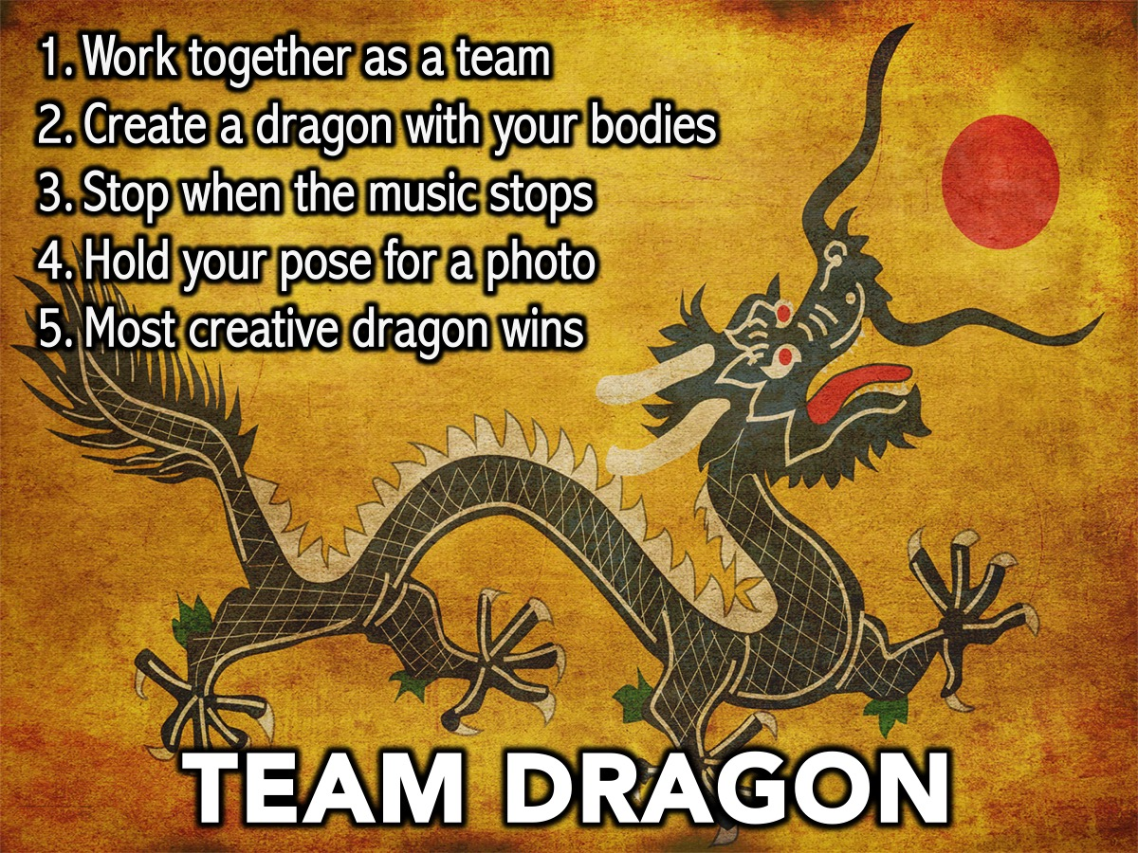
Notes:
4. CHINA
Team Dragon: Every member in the team has to work together to form a Chinese Dragon with their bodies – most creative team dragon wins. When the music stops you will be judged!
Supplies: None!

Slide 22

Notes:
ROAD BLOCK: The team currently in first place has to answer this question in 1 minute, otherwise they lose points. “Name 7 countries in Africa that start with the Letter M”
1. Madagascar
2. Malawi
3. Mali
4. Mauritania
5. Mauritius
6. Morocco
7. Mozambique

Slide 23
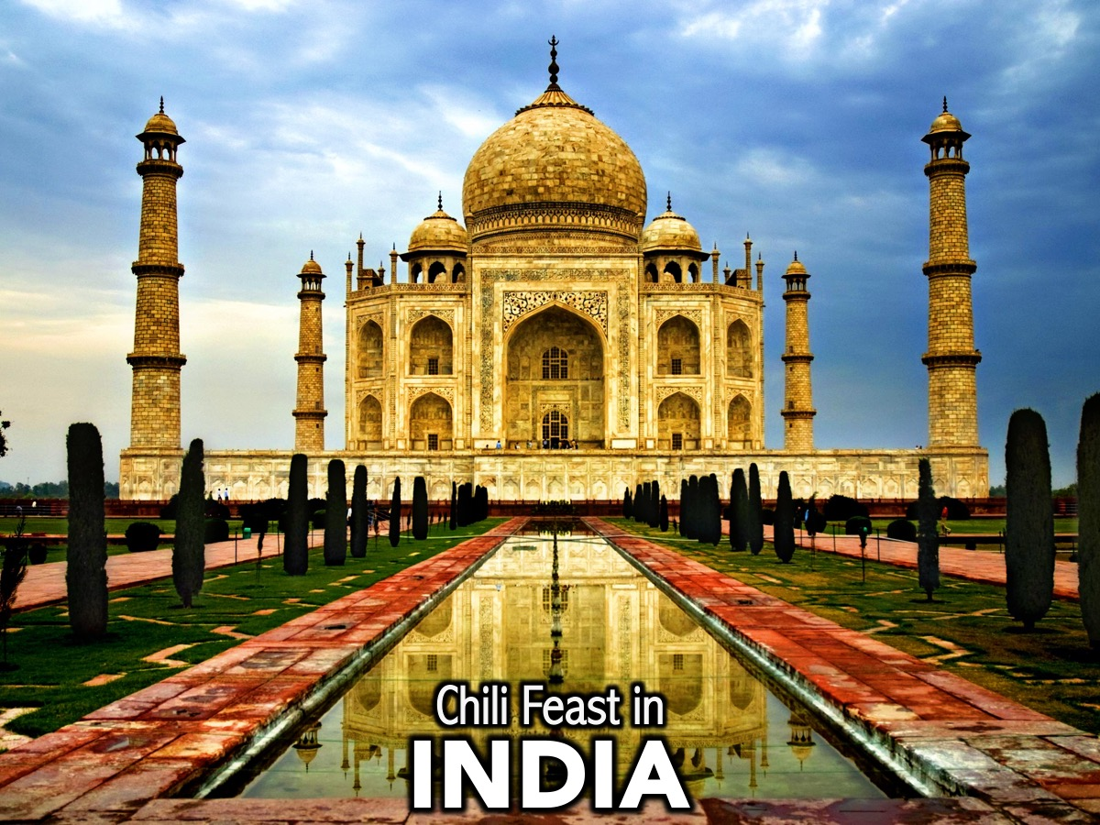
Notes:
5. INDIA

Slide 24
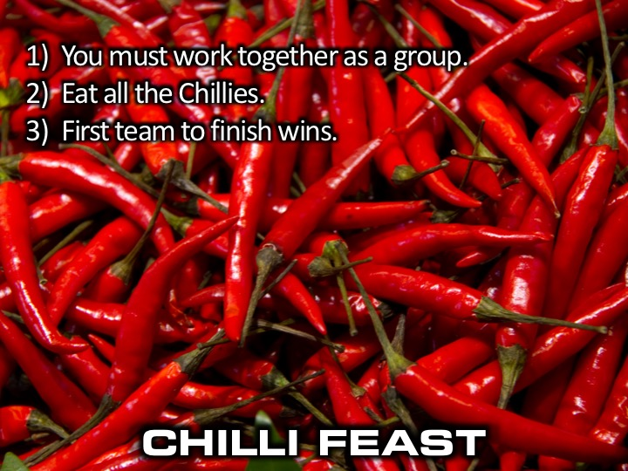
Notes:
5. INDIA
Chili Feast: The first team to eat a whole red pepper wins or the team with the most finished by the time the music stops wins the challenge.
Supplies: 10 red peppers.

Slide 25
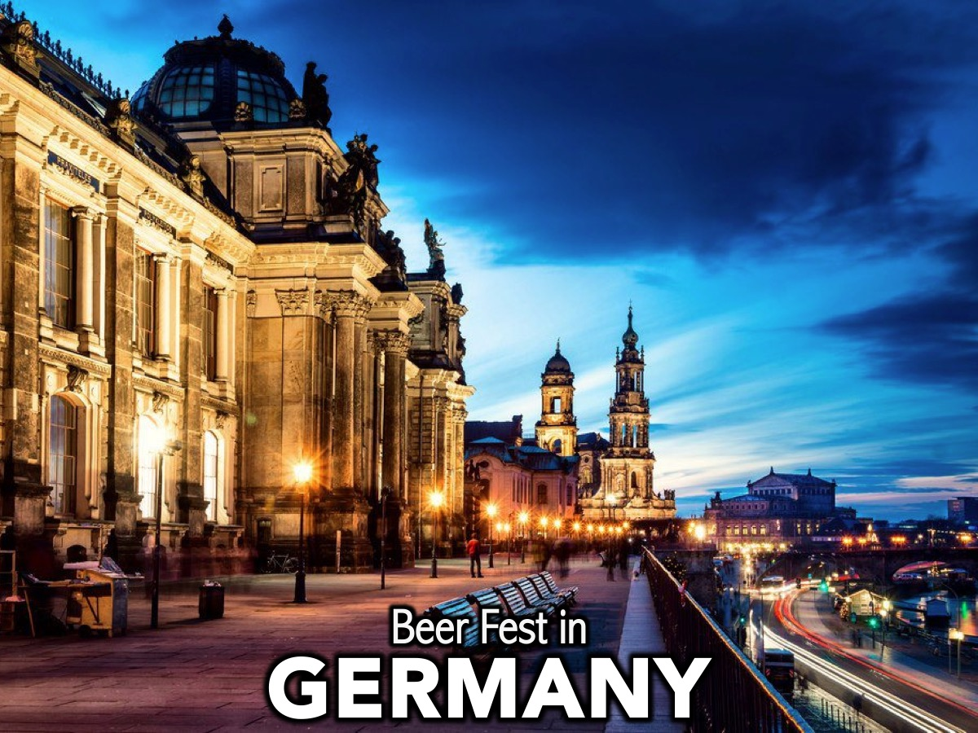
Notes:
6. GERMANY

Slide 26
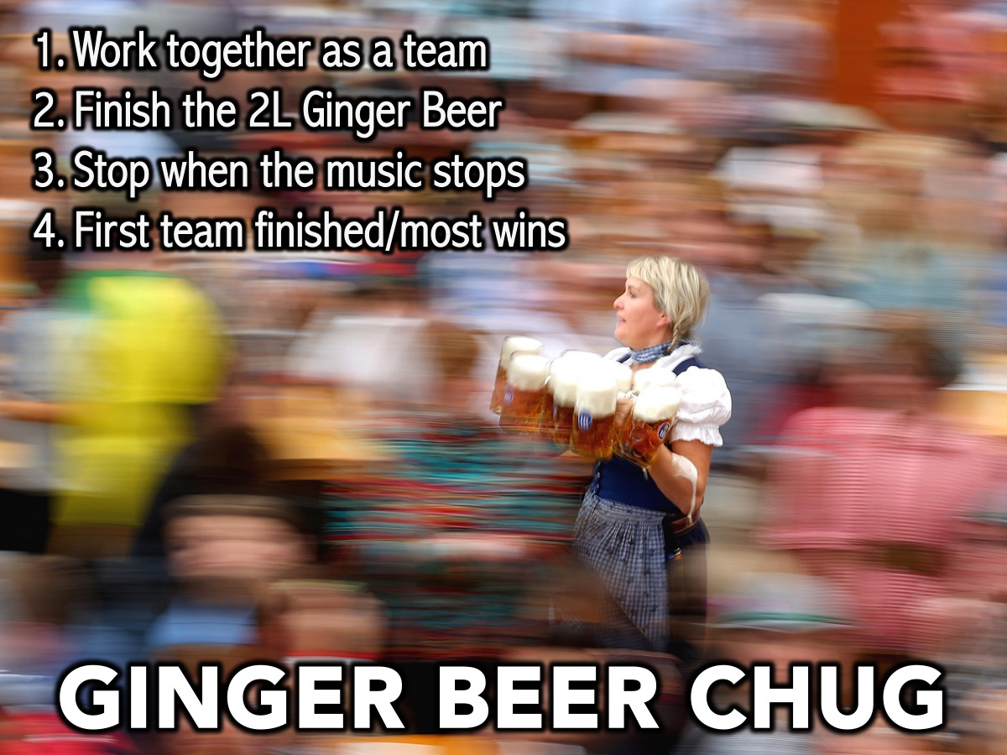
Notes:
6. GERMANY
Ginger Beer Chug: First team to finish a 2-liter bottle of ginger beer wins - or the team with the most finished when the music stops wins.
Supplies: 2L bottle of ginger beer

Slide 27

Notes:
7. THE USA

Slide 28
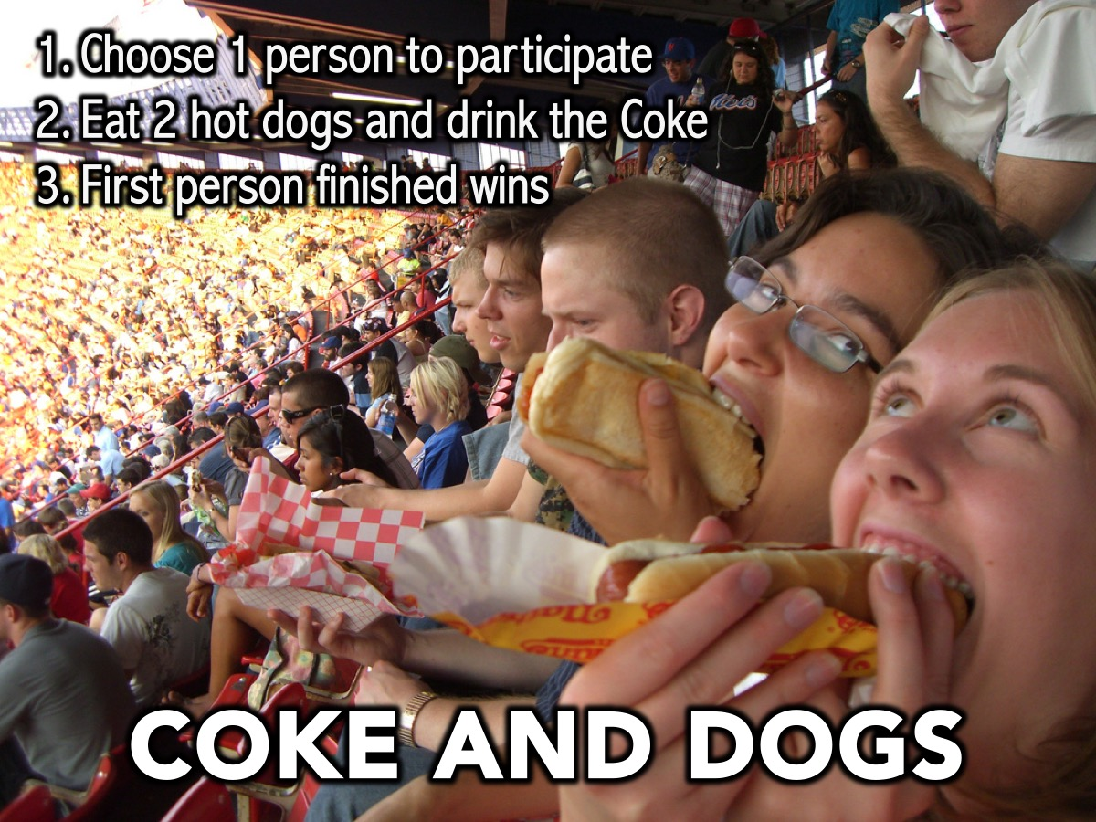
Notes:
7. THE USA
Hot Dog and Coke Feast: One person has to eat 2 hot dogs and finish a can of coke.
Supplies: 20 Hot Dogs, 10 cans of coke

Slide 29
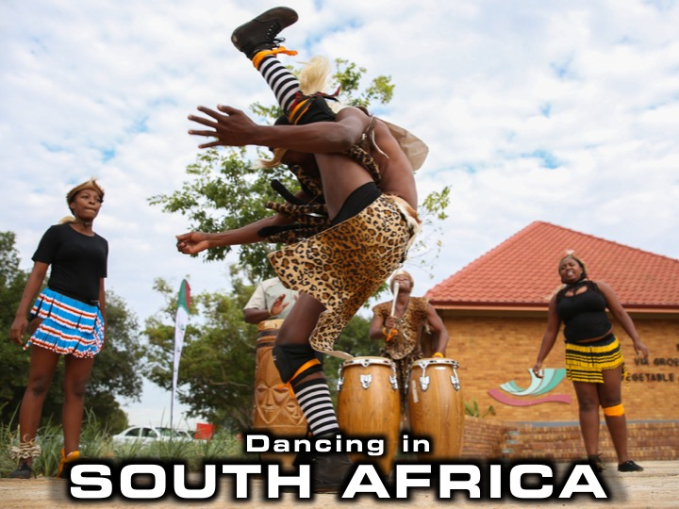
Notes:
8. South Africa

Slide 30
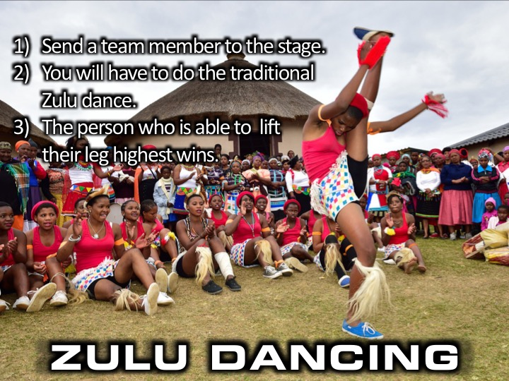
Notes:
8. Zulu Traditional Dancing: Send a participant to the stage. They will have to try lift their leg as high as possible. The person who is able to lift their leg highest wins.

Slide 31
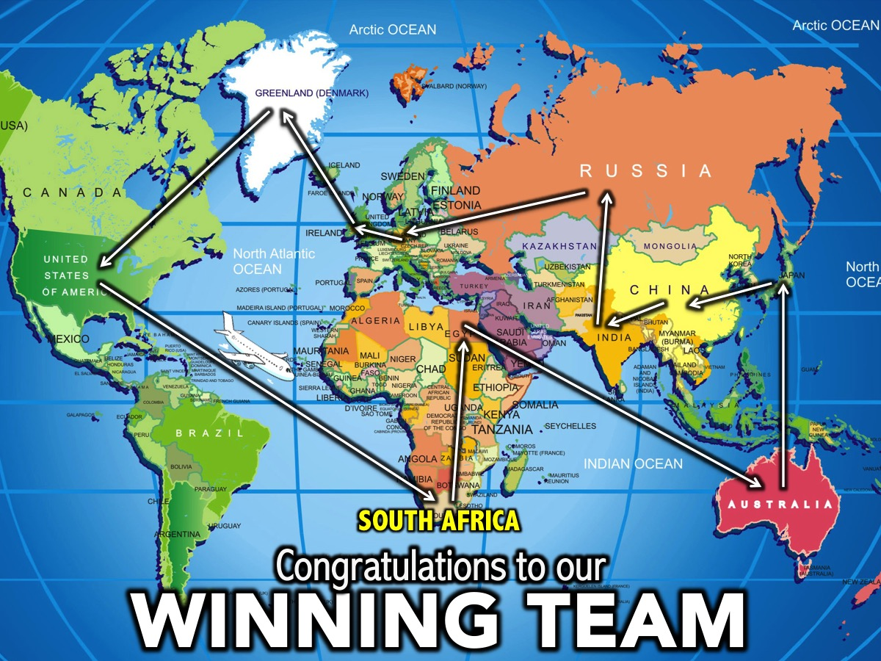
Notes:
Congratulations to our winning team! Come up to the stage for your prizes and a team photo!

Slide 32

Notes:
The Small Groups: Here are the questions for our small group time: (1) What lessons for life did you learn from tonight? (2) What is Amazing about the Race that is your life? (3) Which country could God use you to touch one day? (4) How can I pray for you as we close tonight?

Slide 33
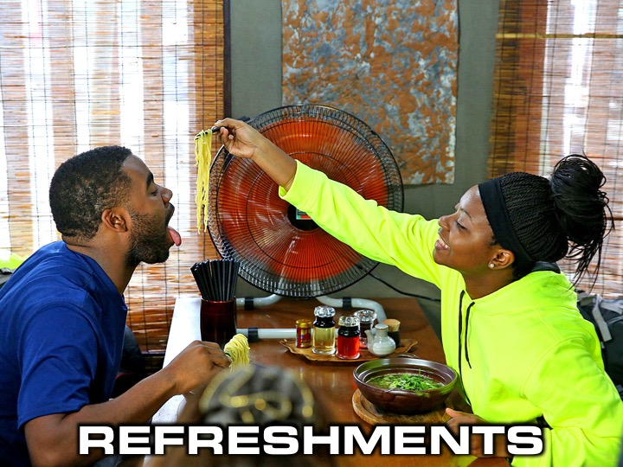
Notes:
Refreshments: It is time for refreshments.

Slide 34
Notes:
Thanks for coming!

Slide 35
Notes:
Don’t forget to join our WhatsApp group for regular updates!

