Slide 1

Notes:
Welcome to the TV Series.

Slide 2

Notes:
Tonight is our Suits Night!

Slide 3

Notes:
Welcome to regulars and newcomers!

Slide 4
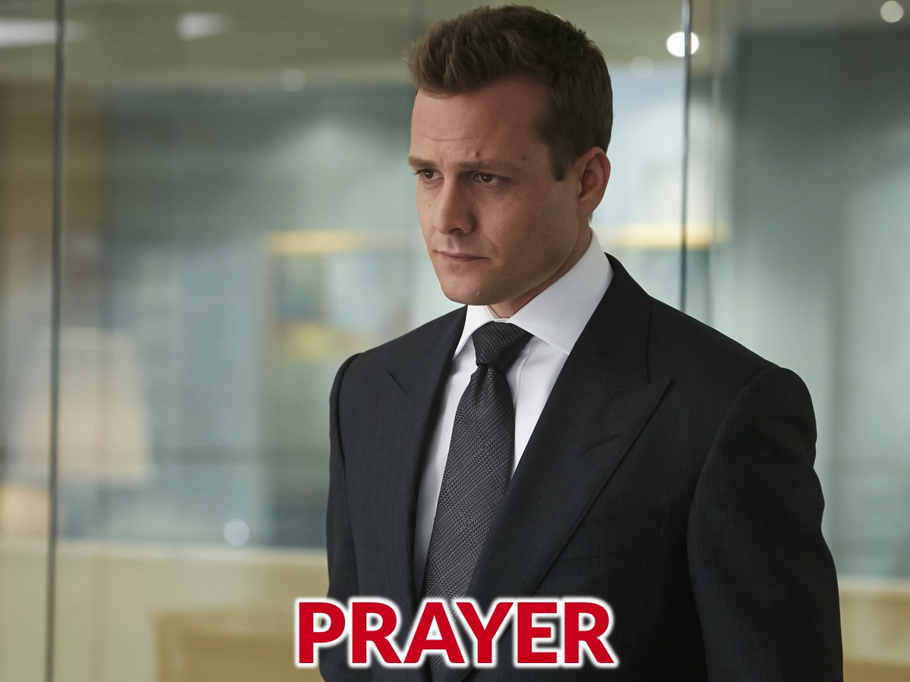
Notes:
Prayer: Let’s open our meeting in prayer.

Slide 5

Notes:
Please listen up for the following announcements!

Slide 6
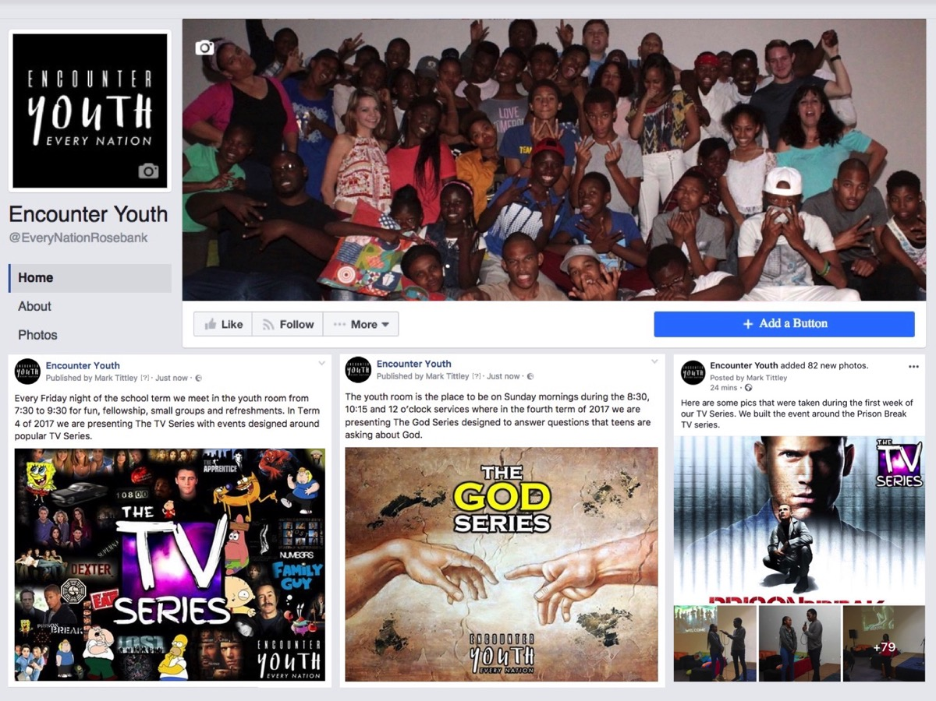
Notes:
Announcements: Like us on Facebook to keep up to date with the latest news.

Slide 7
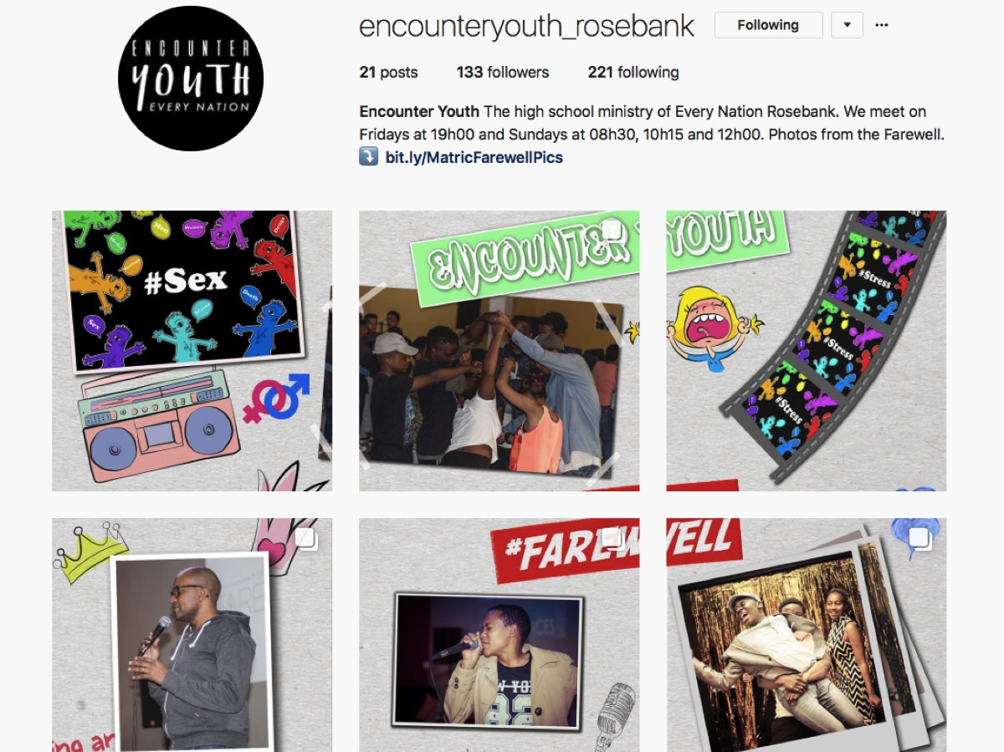
Notes:
Announcements: Follow us on Instagram! @EncounterYouth_Rosebank

Slide 8

Notes:
Announcements: Please put your praise and requests in the box!

Slide 9

Notes:
Announcements: We have Youth at schools, If we’re not at your school, check if your school already has an SCA group!

Slide 10

Notes:
Announcements: Join our Friday Night WhatsApp group!

Slide 11

Notes:
Announcements: Join us this Sunday as we discuss the question, “Does God Care?”

Slide 12

Notes:
Announcements: Join us next Friday for our Got Talent Night!

Slide 13

Notes:
Tonight is our Suits Night!
Here are some Suits soundtrack songs to use as background music during the program if needed:
https://www.youtube.com/watch?v=bv8xg57ZFLo
https://www.youtube.com/watch?v=iSAcahRvfAo
https://www.youtube.com/watch?v=was2VYDZstE

Slide 14
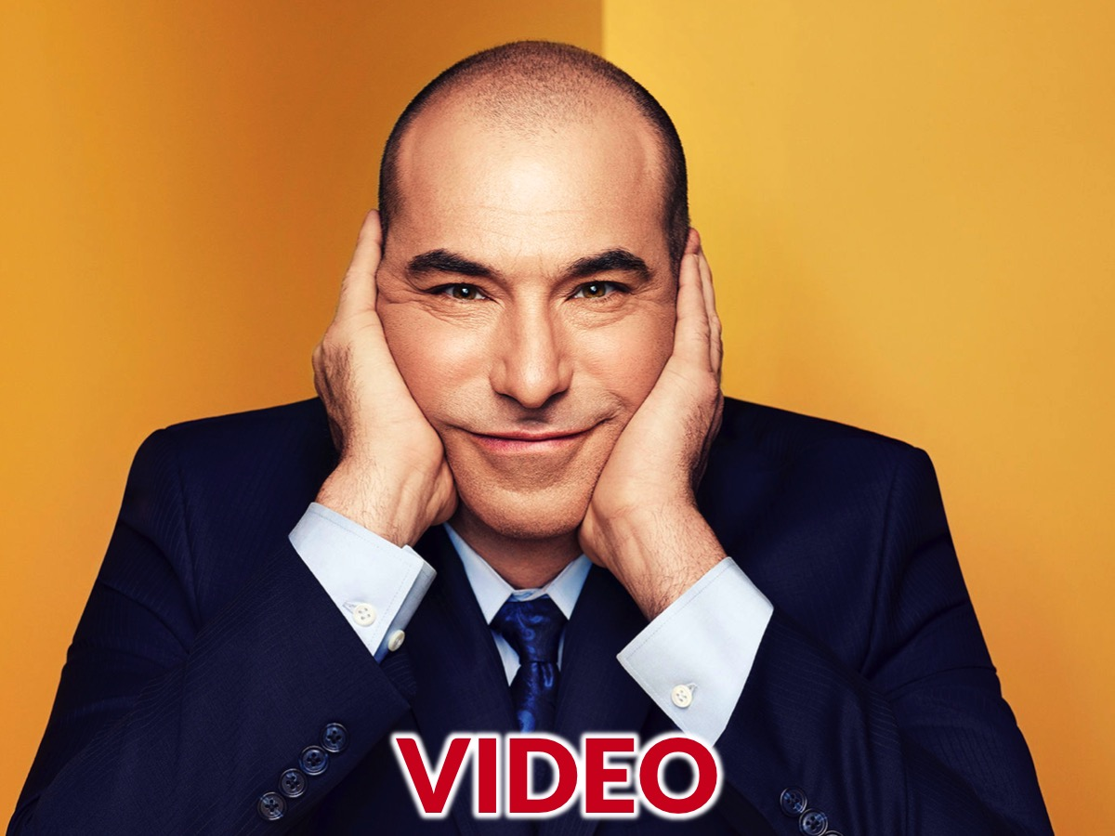
Notes:
Let’s watch a Suits video before we get going.

Slide 15
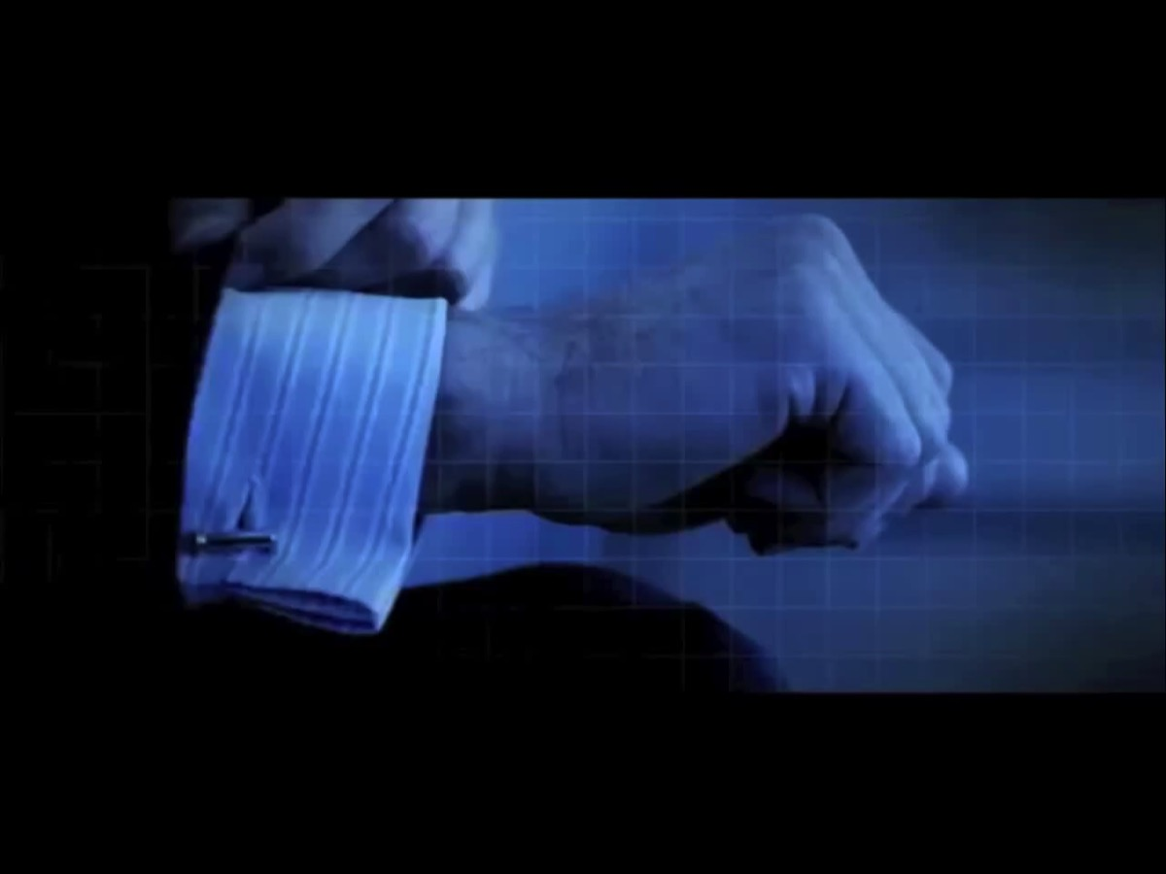
Notes:
Video: Suits Opening Theme Song. Get it on YouTube at: https://www.youtube.com/watch?v=R_dU54HXd_U

Slide 16
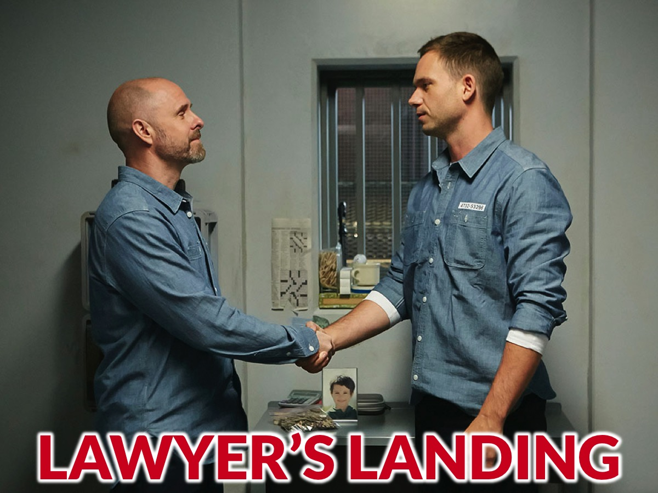
Notes:
We are now going to play ‘Lawyers Landing,’ a Murder Mystery Game.

Slide 17
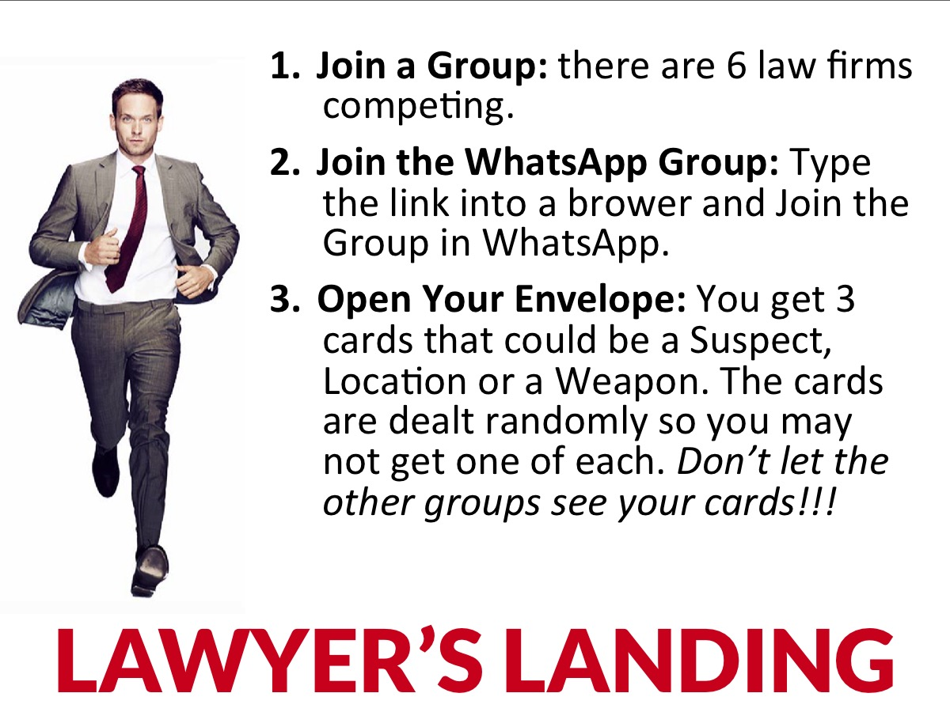
Notes:
(1) Join a Law Firm: Teens are seated at one of 6 tables and each table has the name of a Law Firm on it. Each team is given a pencil or a pen. (2) Join the WhatsApp Group: Make sure at least 1 member of your Firm is on the WhatsApp Group – the poster on each table has a link that you enter into a browser that will open WhatsApp on your phone so you can join your group. (3) Open Your Envelope: Your Law Firm will receive 3 cards. You could get a Suspect, a Crime Location or a Murder Weapon. The cards are dealt randomly so you may not get one of each but you will get 3 cards. Note: Don’t let the other groups see your cards!!!

Slide 18
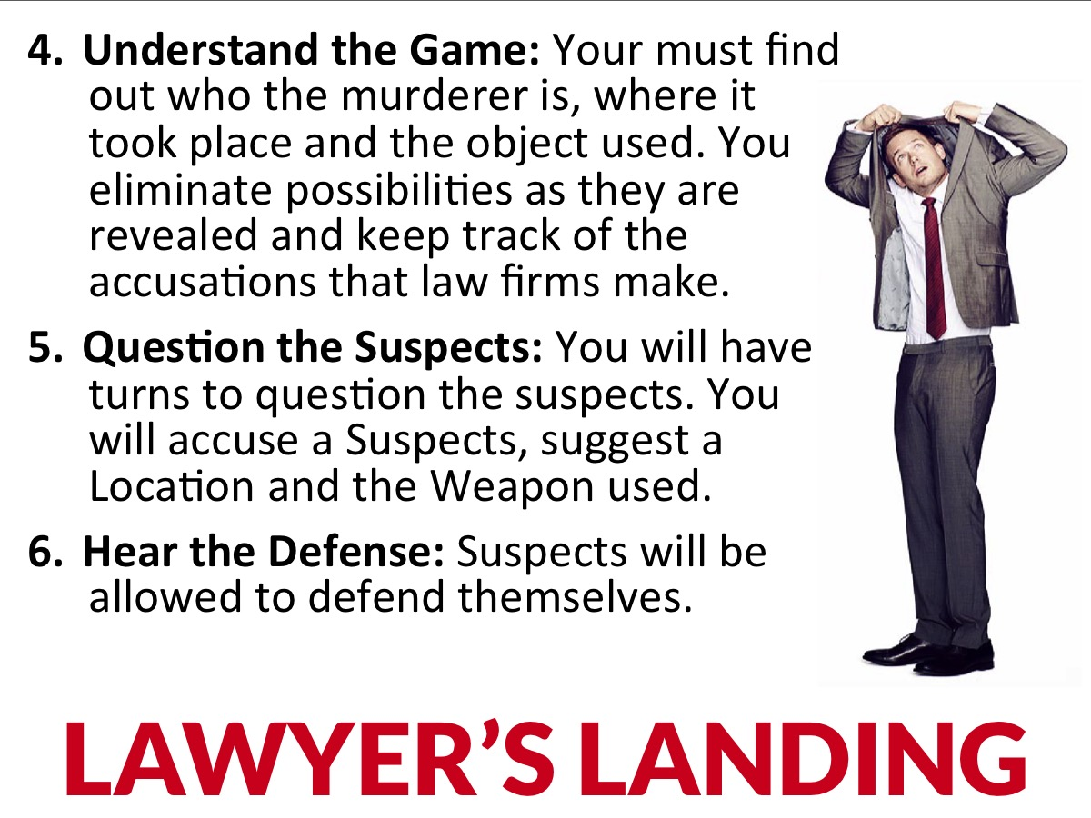
Notes:
(4) Understand the Game: Your aim is to figure out who the murderer is, where the murder took place, and what object was used to commit the murder. You will do this by eliminating possibilities as they are revealed and keeping track of the accusations that each law firm makes during the rounds. (5) Question the Suspects: Each Law Firm will have a turn in each round to question the suspects. They do this by addressing one of the Suspects, suggesting a Location were the murder took place and the Weapon that was used. (6) Hear the Defense: Suspects will be allowed to defend themselves, however, their defense is more to add drama and fun as their comments do not actually reveal anything as they do not know how the murderer is nor what weapon was used nor where it took place. Leaders can help on the night by engaging with the suspects to challenge their defense to add drama.

Slide 19
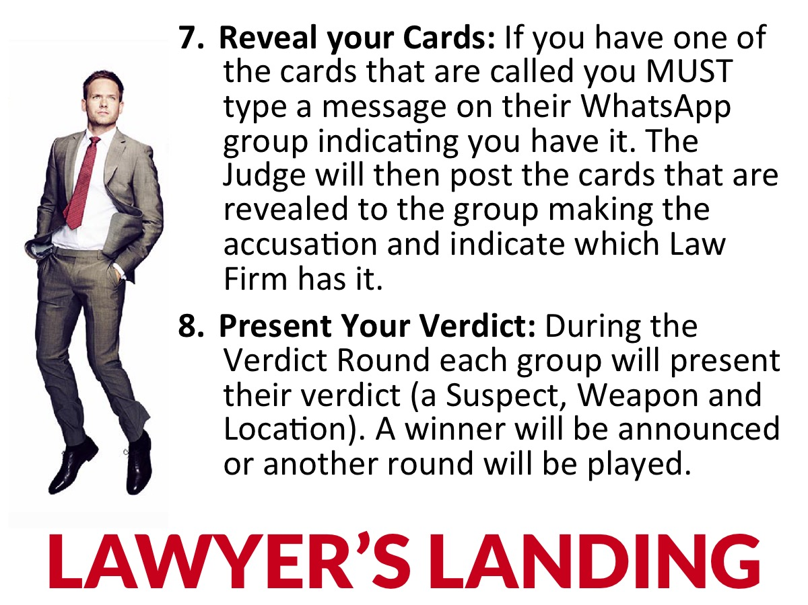
Notes:
(7) Reveal your Cards: The Game Master will remind the groups of the Suspect, Weapon and Location that has been called out in each round and each Firm must check their cards and if have one those cards in their envelope that MUST type a message on their WhatsApp group indicating they have that card. The Judge will then post the cards that are revealed to the group making the accusation and indicate which Law Firm has the card (if any).
(8) Present Your Verdict: During the Verdict Round each group will present their verdict (a Suspect, Weapon and Location). Once all the Verdicts are received the game master can reveal whether any group was right and also how many each group got right (but don’t reveal which were correct). If there is a winner then the game is over if not, then have another round of questing Subjects and then repeat the Verdict round.

Slide 20
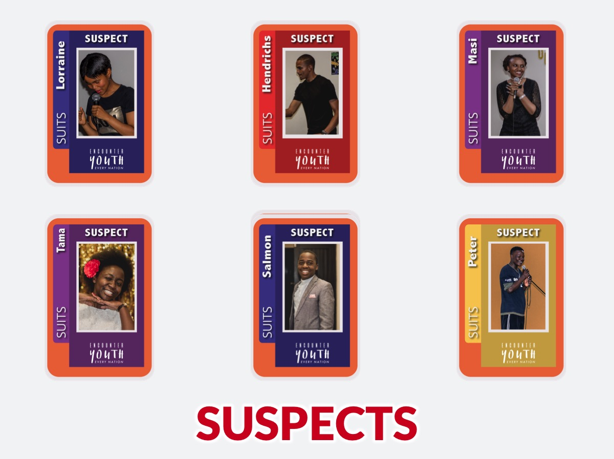
Notes:
Suspects: There are six suspects: based on 6 characters in the youth group.

Slide 21
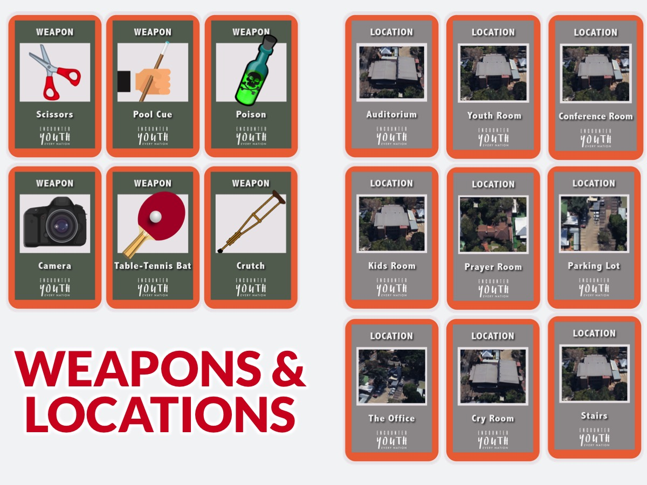
Notes:
Weapons: There are 6 Weapons. We used items somewhat linked to our youth space, namely, Table Tennis Bat, Pool Cue, Camera, Scissors, Crutch and Poison (the only one not connected).
Locations: There are 9 Locations. We used 9 locations on our church property, namely, Youth Room, Auditorium, Conference Room, Kid’s Room, Prayer Room, Parking Lot, The Office, Cry Room and Stairs.

Slide 22

Notes:
Prize Giving: Congratulations to the winning team!

Slide 23
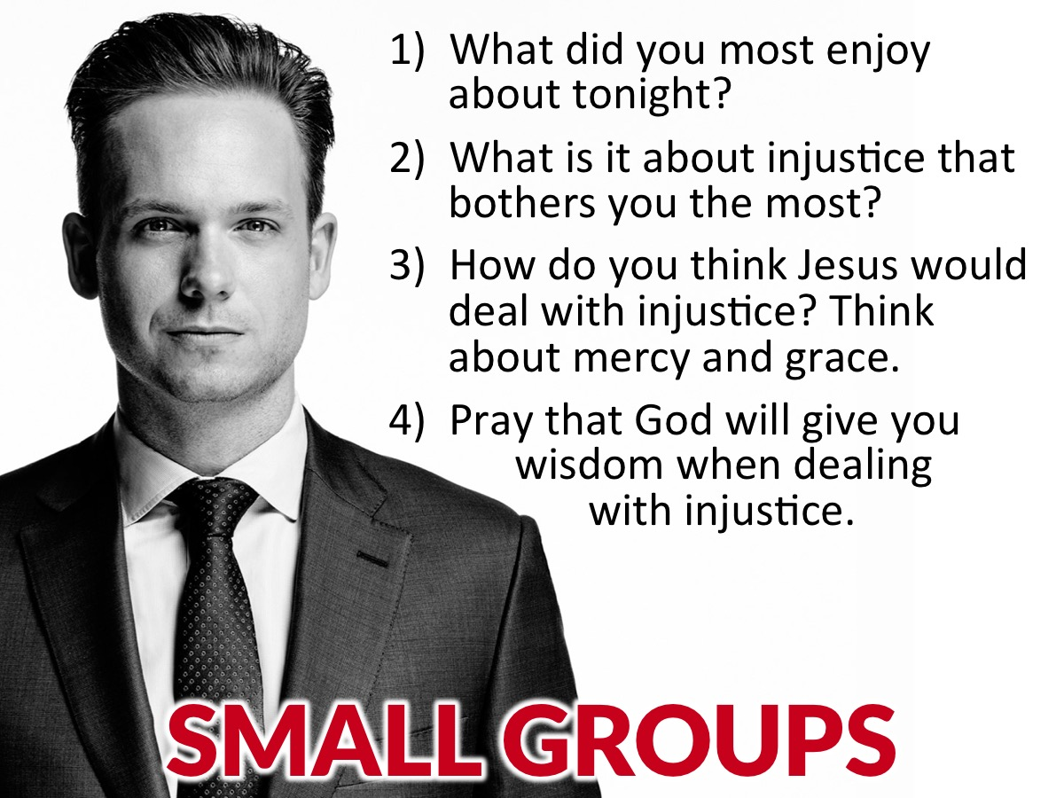
Notes:
Small Group Questions: (1) What did you most enjoy about tonight? (2) What is it about injustice that bothers you most? (3) How do you think Jesus would deal with injustice? Think about mercy and grace. (4) Pray that God will give you wisdom when dealing with injustice.

Slide 24
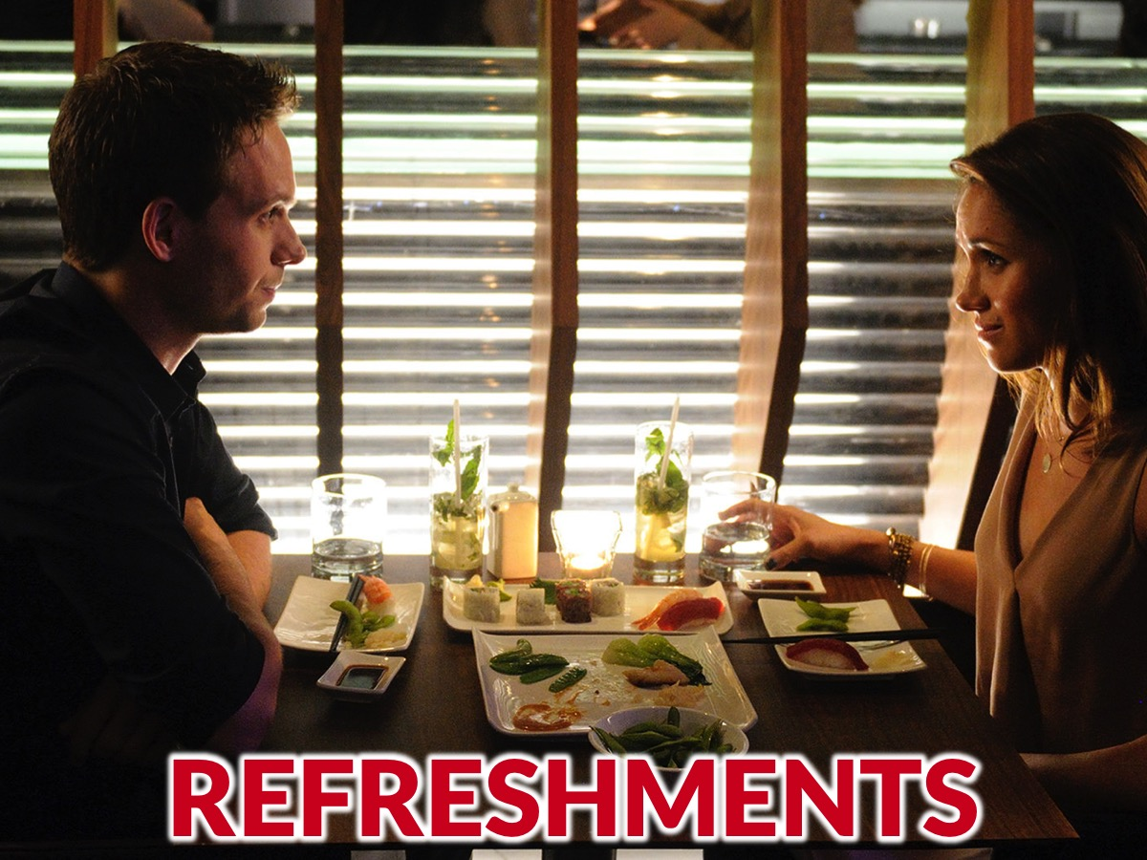
Notes:
Refreshments: It is time for refreshments.

Slide 25

Notes:
Thanks for coming!

Slide 26
Notes:
Don’t forget to join our WhatsApp group for regular updates!

