Slide 1

Notes:
Welcome to the TV Series.

Slide 2

Notes:
Tonight is our Got Talent Night!

Slide 3
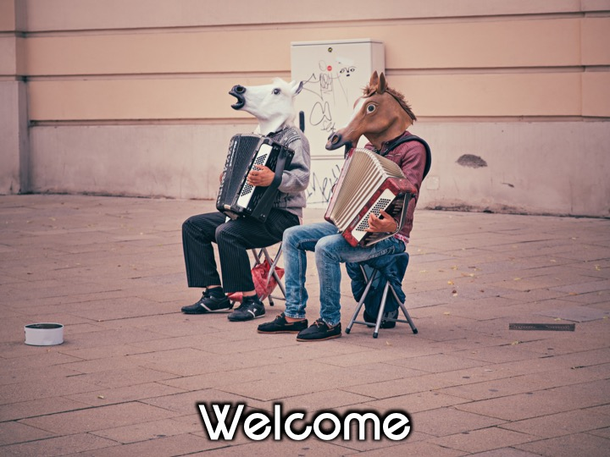
Notes:
Welcome to regulars and newcomers!

Slide 4
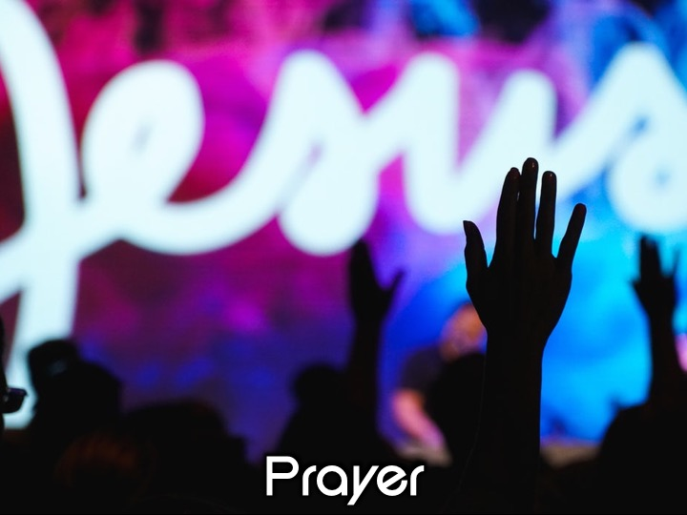
Notes:
Prayer: Let’s open our meeting in prayer.

Slide 5

Notes:
Please listen up for the following announcements!

Slide 6
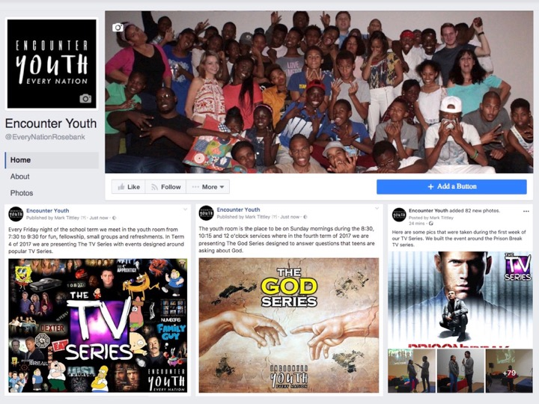
Notes:
Announcements: Like us on Facebook to keep up to date with the latest news.

Slide 7
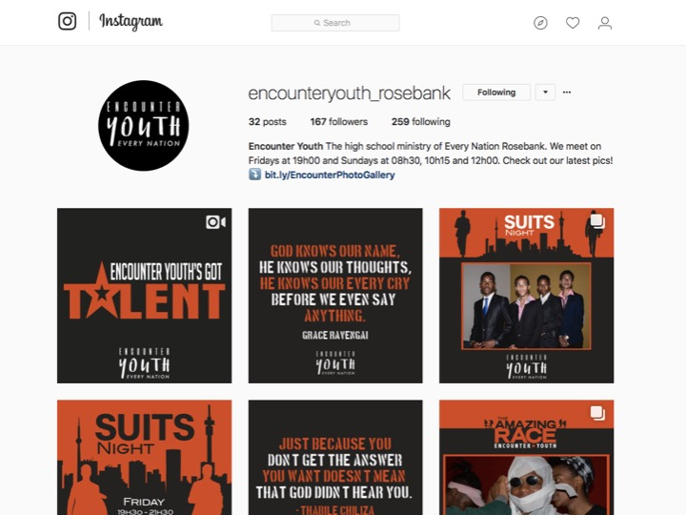
Notes:
Announcements: Follow us on Instagram! @EncounterYouth_Rosebank

Slide 8

Notes:
Announcements: Please put your praise and requests in the box!

Slide 9

Notes:
Announcements: Join our Friday Night WhatsApp group!

Slide 10
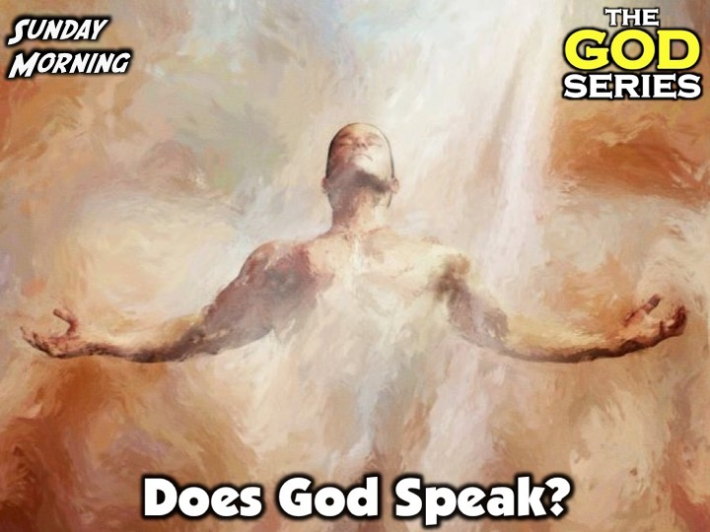
Notes:
Announcements: Join us this Sunday as we discuss the question, “Does God Speak?”

Slide 11

Notes:
Announcements: Join us next Friday for our Friends Night!

Slide 12

Notes:
Tonight is our Got Talent Night!

Slide 13
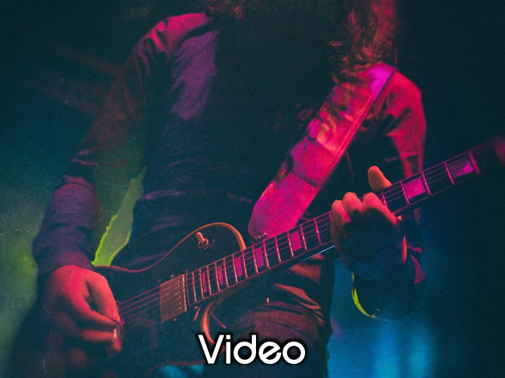
Notes:
Videos: There are 3 videos below, but you can choose one.

Slide 14

Notes:
Video: SA’s Got Talent 2017, ActionArte (Semi Final) – Watch it on Youtube at https://www.youtube.com/watch?v=fthCZ8F83so

Slide 15

Notes:
Video: SA’s Got Talent 2017, Anecnote (Audition) – Watch it on Youtube at https://www.youtube.com/watch?v=RgGsLWCQFKs

Slide 16
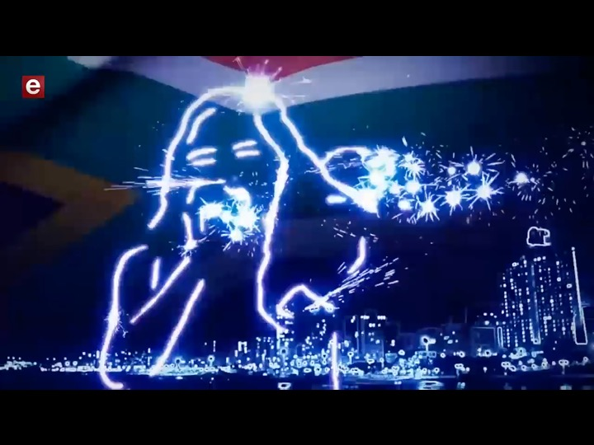
Notes:
Video: SA’s Got Talent 2016, Kryptonite Dance Academy (Final) – Watch it on Youtube at https://www.youtube.com/watch?v=eiCoxrHWPSc

Slide 17
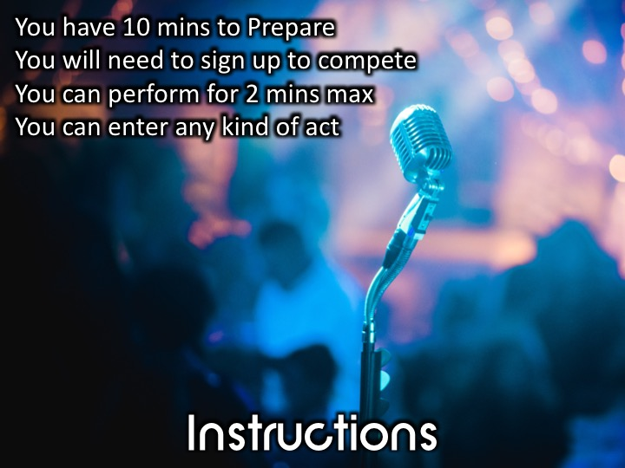
Notes:
Instructions: (1) You have 10 minsutes to prepare. (2) You will need to sign up to compete. (3) You can perform for 2 minutes max. (4) You can enter any kind of act: such as…

Slide 18
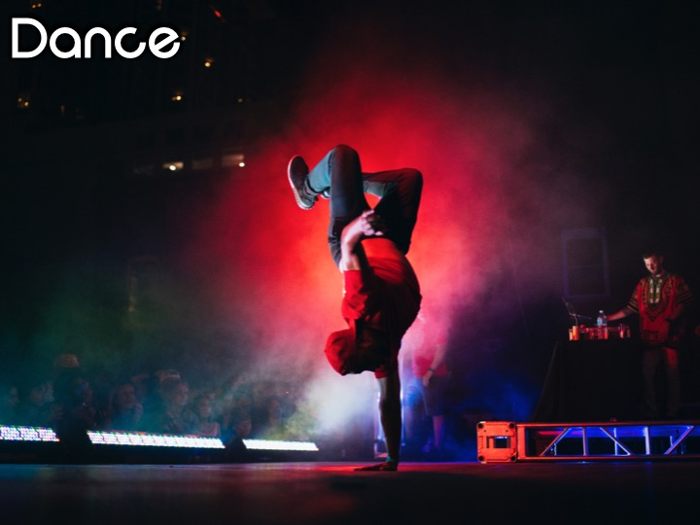
Notes:
Dance

Slide 19
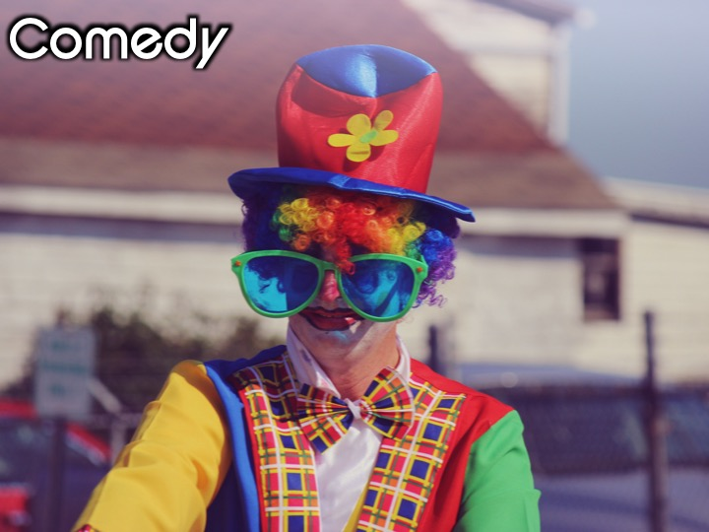
Notes:
Comedy

Slide 20
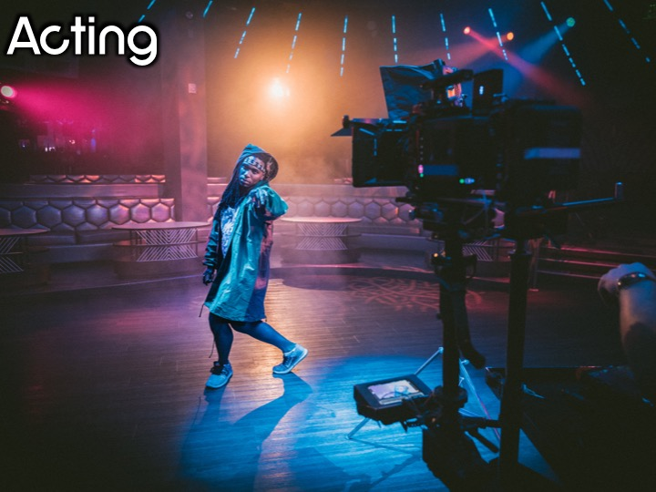
Notes:
Acting

Slide 21

Notes:
Singing

Slide 22
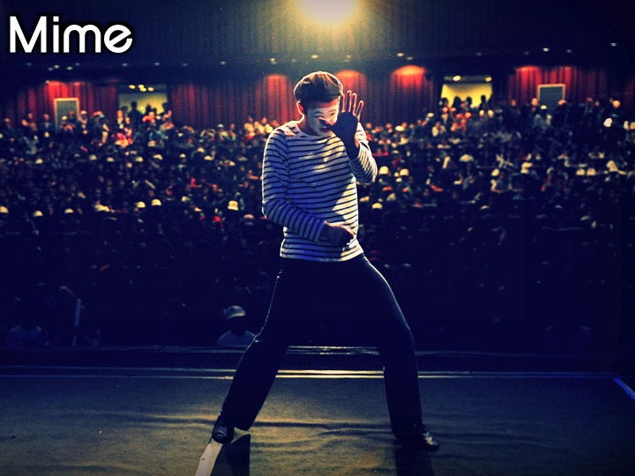
Notes:
Mime

Slide 23
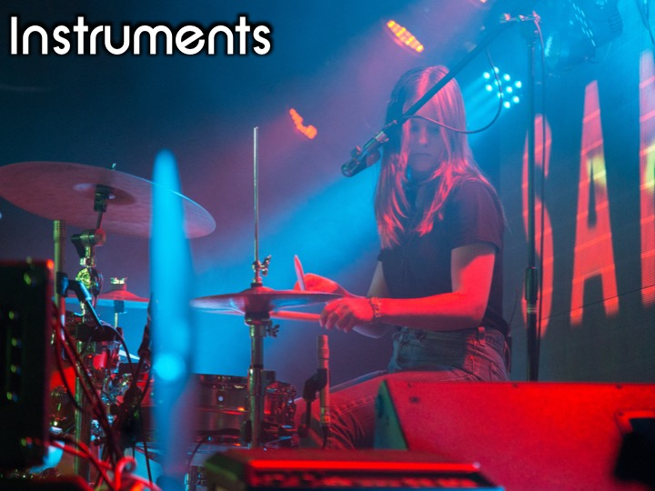
Notes:
Musical Instruments

Slide 24
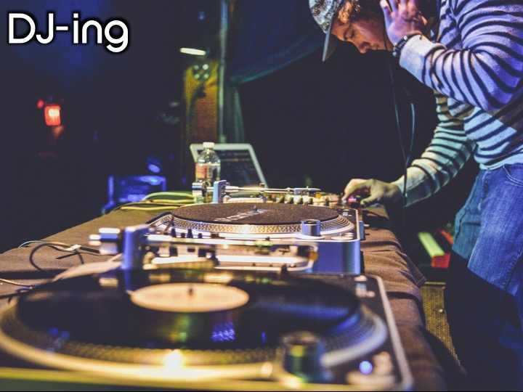
Notes:
DJ-ing

Slide 25
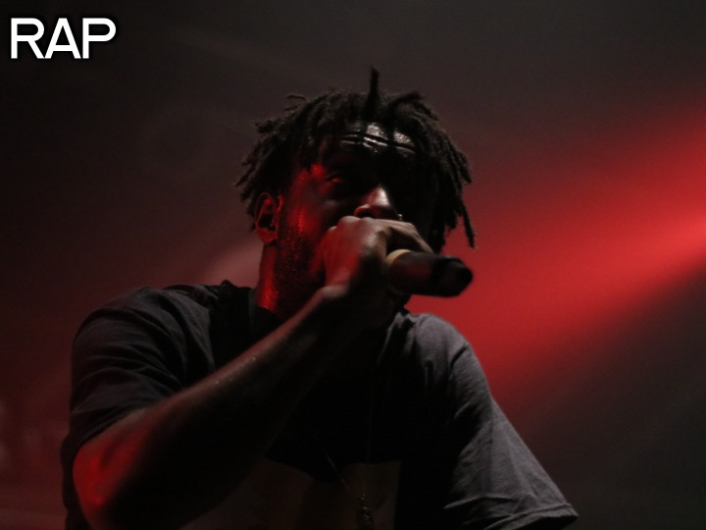
Notes:
Rap

Slide 26
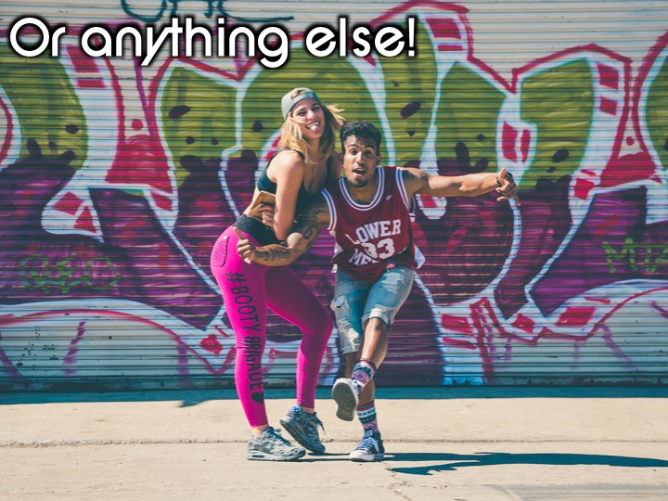
Notes:
Or anything else!

Slide 27

Notes:
Meet the judges, Tebogo, Pastor Debbie and Hendrichs.

Slide 28

Notes:
Let’s Begin!

Slide 29
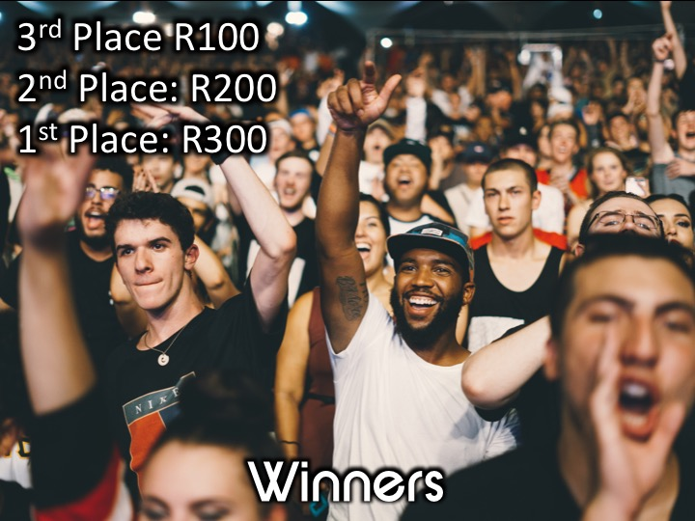
Notes:
The winners will receive prizes!

Slide 30
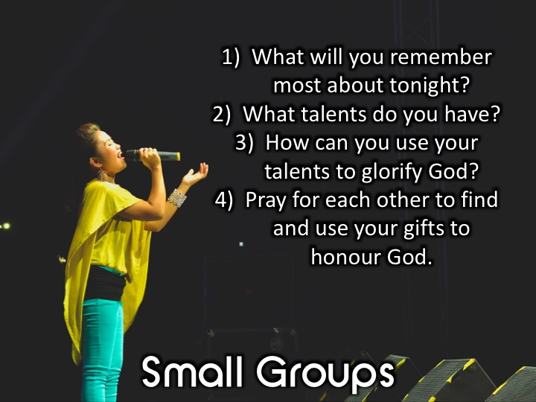
Notes:
Small Group Time: (1) What will you remember most about tonight? (2) What talents do you have? (3) How can you use your talents to glorify God? (4) Pray for each other to find and use your gifts to honour God.

Slide 31

Notes:
Refreshments: It is time for refreshments.

Slide 32
Notes:
Thanks for coming to Encounter youth, see you next week for Friends Night!

Slide 33
Notes:
Don’t forget to join our WhatsApp group for regular updates!

