Slide 1

Notes:
Welcome to the TV Series.

Slide 2
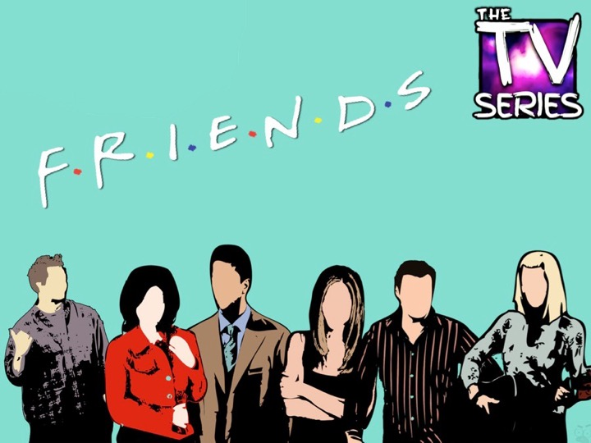
Notes:
Tonight is Friends Night!

Slide 3
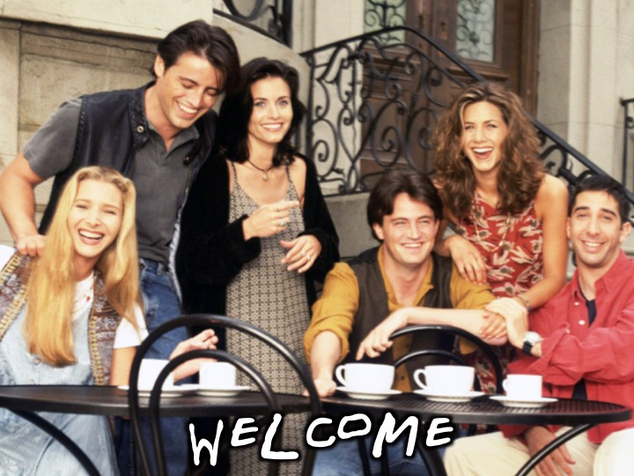
Notes:
Welcome to regulars and newcomers!

Slide 4

Notes:
Prayer: Let’s open our meeting in prayer.

Slide 5
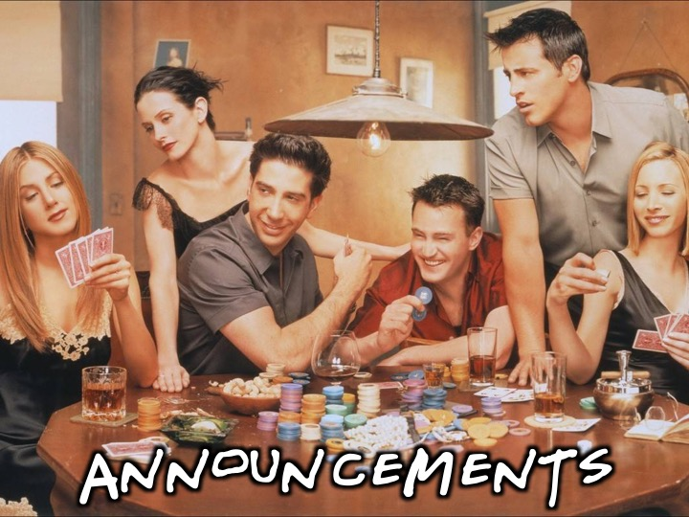
Notes:
Please listen up for the following announcements!

Slide 6
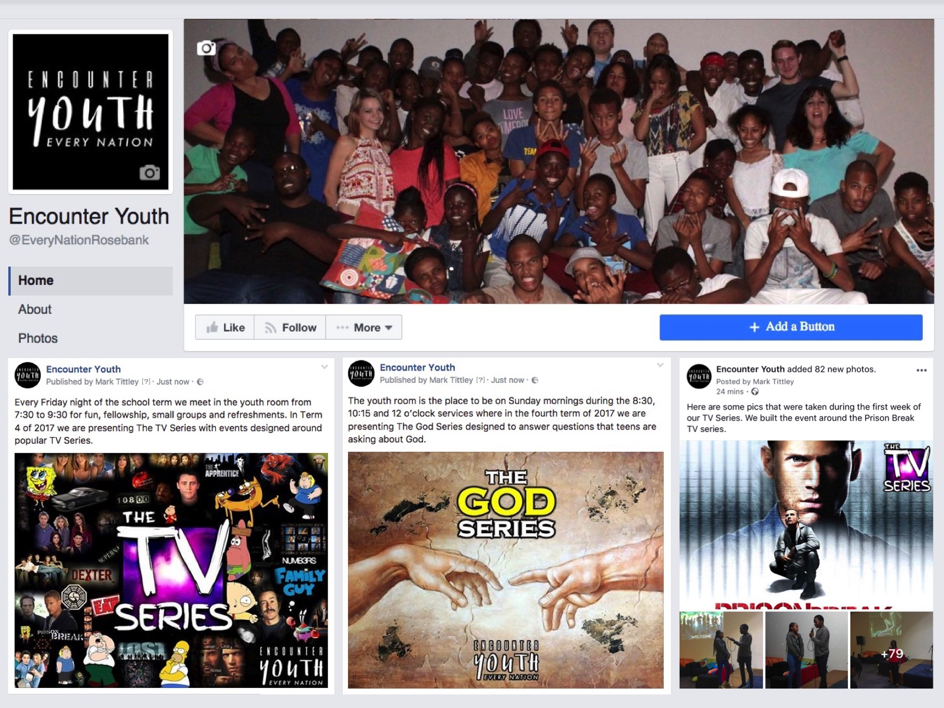
Notes:
Announcements: Like us on Facebook to keep up to date with the latest news.

Slide 7
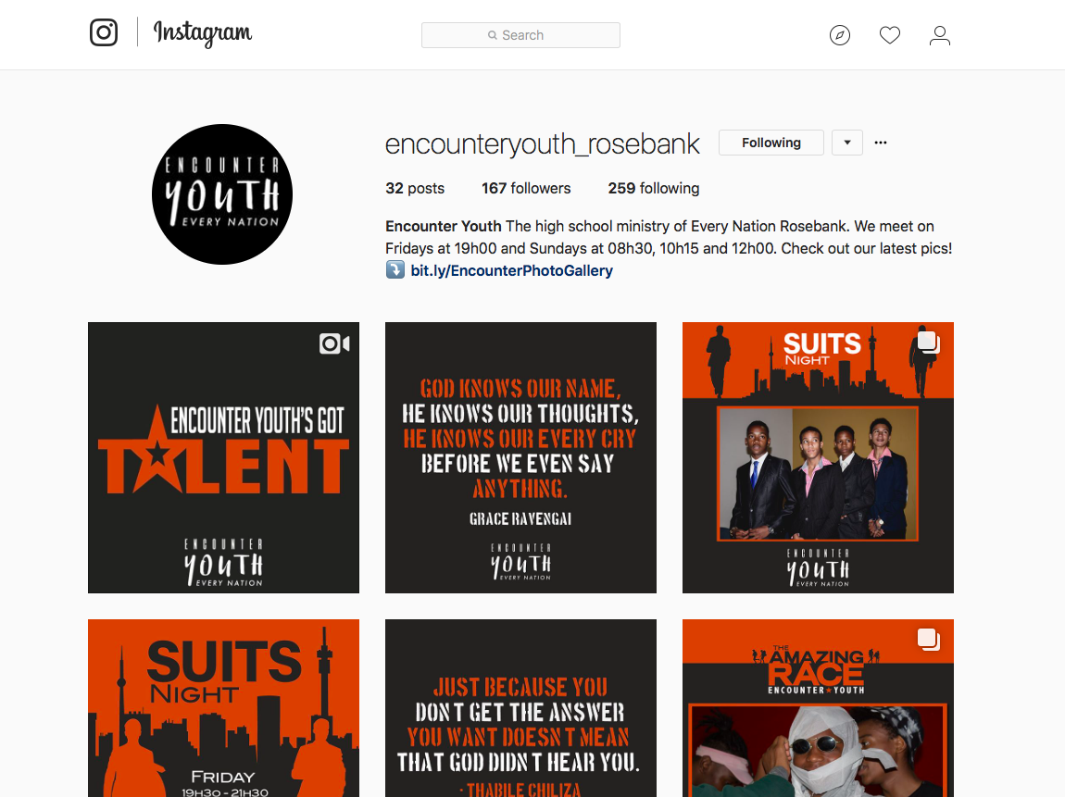
Notes:
Announcements: Follow us on Instagram! @EncounterYouth_Rosebank

Slide 8

Notes:
Announcements: Please put your praise and requests in the box!

Slide 9

Notes:
Announcements: Join our Friday Night WhatsApp group!

Slide 10

Notes:
Announcements: Join us this Sunday for a Family Service - we will be staying in the sanctuary for the whole service.

Slide 11

Notes:
Announcements: Join us next Friday for CSI Night!

Slide 12

Notes:
Welcome, tonight is Friends Night!

Slide 13
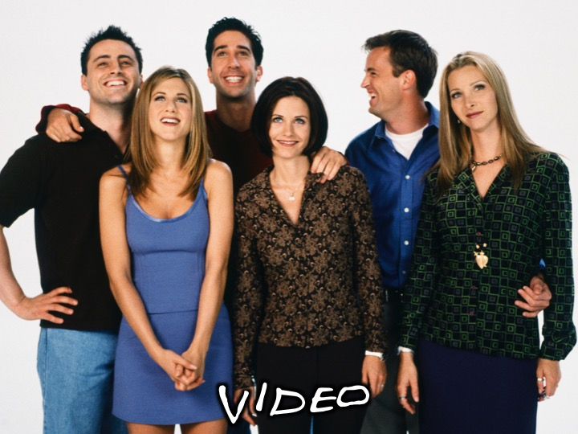
Notes:
Video: Friends Intro song. Find it on Youtube at: https://www.youtube.com/watch?v=ReIEiiEJ53M

Slide 14

Notes:
Video: Friends Intro song. Find it on Youtube at: https://www.youtube.com/watch?v=ReIEiiEJ53M

Slide 15
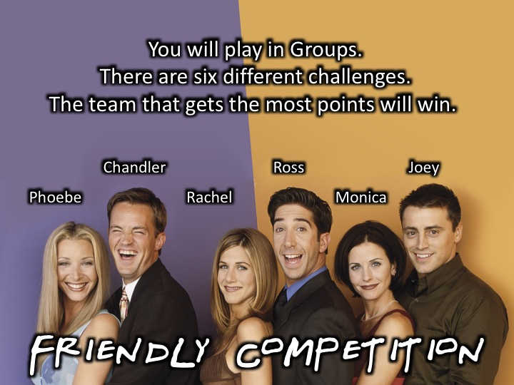
Notes:
Game time: There are 6 main ensemble characters in the series. There will be 6 different challenges, with one challenge per character.

Slide 16
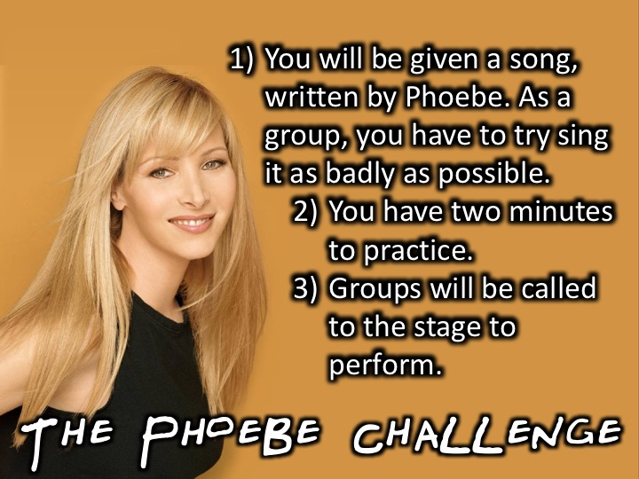
Notes:
The Phoebe Challenge: Phoebe believes she can sing, but is actually terrible. Groups will be given a song written by Phoebe, and will have to perform it on-stage. The group who sings worst wins.

Slide 17
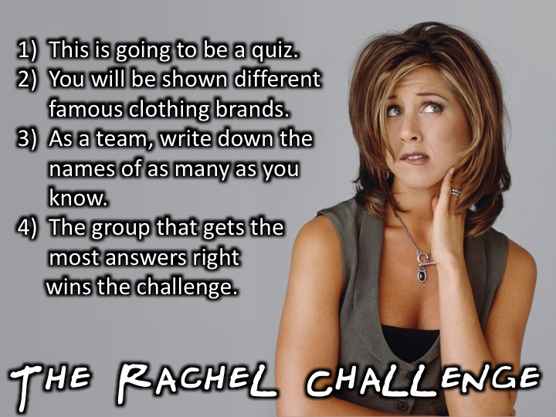
Notes:
The Rachel Challenge: Rachel loves fashion. There will be a fashion quiz, pictures will appear on screen, and groups will have to identify the famous brands. The team which gets the most answers right, will win that challenge.

Slide 18

Notes:
The Rachel Challenge: Rachel loves fashion. There will be a fashion quiz, pictures will appear on screen, and groups will have to identify the famous brands. The team which gets the most answers right, will win that challenge.

Slide 19

Notes:
The Rachel Challenge: Rachel loves fashion. There will be a fashion quiz, pictures will appear on screen, and groups will have to identify the famous brands. The team which gets the most answers right, will win that challenge.

Slide 20

Notes:
The Rachel Challenge: Rachel loves fashion. There will be a fashion quiz, pictures will appear on screen, and groups will have to identify the famous brands. The team which gets the most answers right, will win that challenge.

Slide 21

Notes:
The Rachel Challenge: Rachel loves fashion. There will be a fashion quiz, pictures will appear on screen, and groups will have to identify the famous brands. The team which gets the most answers right, will win that challenge.

Slide 22

Notes:
The Rachel Challenge: Rachel loves fashion. There will be a fashion quiz, pictures will appear on screen, and groups will have to identify the famous brands. The team which gets the most answers right, will win that challenge.

Slide 23

Notes:
The Rachel Challenge: Rachel loves fashion. There will be a fashion quiz, pictures will appear on screen, and groups will have to identify the famous brands. The team which gets the most answers right, will win that challenge.

Slide 24

Notes:
The Rachel Challenge: Rachel loves fashion. There will be a fashion quiz, pictures will appear on screen, and groups will have to identify the famous brands. The team which gets the most answers right, will win that challenge.

Slide 25

Notes:
The Rachel Challenge: Rachel loves fashion. There will be a fashion quiz, pictures will appear on screen, and groups will have to identify the famous brands. The team which gets the most answers right, will win that challenge.

Slide 26

Notes:
The Rachel Challenge: Rachel loves fashion. There will be a fashion quiz, pictures will appear on screen, and groups will have to identify the famous brands. The team which gets the most answers right, will win that challenge.

Slide 27

Notes:
The Rachel Challenge: Rachel loves fashion. There will be a fashion quiz, pictures will appear on screen, and groups will have to identify the famous brands. The team which gets the most answers right, will win that challenge.

Slide 28

Notes:
The Rachel Challenge: Rachel loves fashion. There will be a fashion quiz, pictures will appear on screen, and groups will have to identify the famous brands. The team which gets the most answers right, will win that challenge.

Slide 29

Notes:
The Rachel Challenge: Rachel loves fashion. There will be a fashion quiz, pictures will appear on screen, and groups will have to identify the famous brands. The team which gets the most answers right, will win that challenge.

Slide 30

Notes:
The Rachel Challenge: Rachel loves fashion. There will be a fashion quiz, pictures will appear on screen, and groups will have to identify the famous brands. The team which gets the most answers right, will win that challenge.

Slide 31

Notes:
The Rachel Challenge: Rachel loves fashion. There will be a fashion quiz, pictures will appear on screen, and groups will have to identify the famous brands. The team which gets the most answers right, will win that challenge.

Slide 32

Notes:
The Rachel Challenge: Here are the brands
Reebok
Fendi
Giorgio Armani
Vans
Channel
Louis Vouiton
Dolce and Gabanna
Gap
Zara
Dc Shoes
Levi
Converse
Adidas
Swatch
Rolex

Slide 33
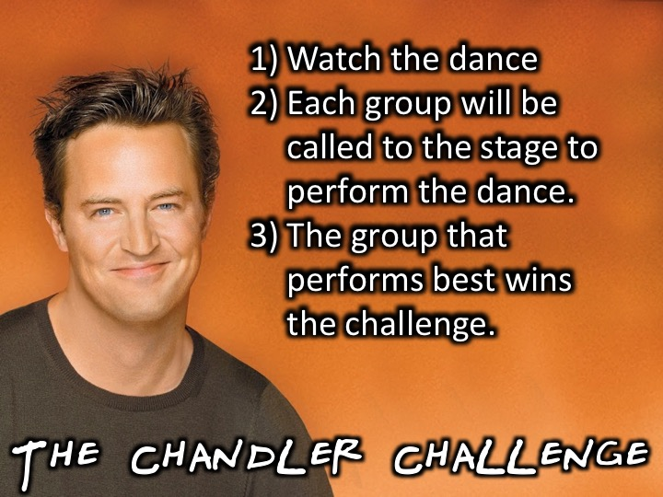
Notes:
The Chandler Challenge: Chandler dances a lot on the show. Each group will have a chance to perform a Chandler dance on-stage. The group which dances best, wins.

Slide 34

Notes:
The Chandler Challenge: Chandler dances a lot on the show. Each group will have a chance to perform like Chandler on-stage. The group which dances best, wins. This clip can be found on Youtube at: https://www.youtube.com/watch?v=_rQjMw1DApU (The music has been changed from the original clip).

Slide 35
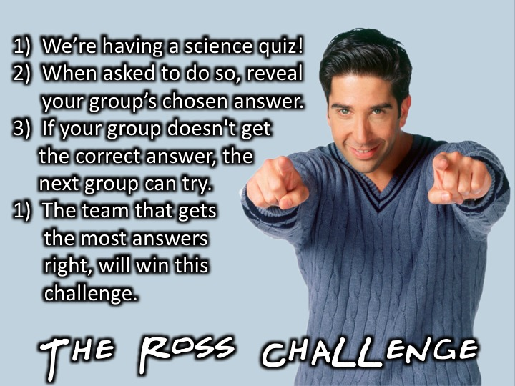
Notes:
The Ross Challenge: Ross is a palaeontologist by profession, and loves science. Groups will take part in a fun science quiz, testing their general knowledge. The group that has the most points will win.

Slide 36

Notes:
The Ross Challenge: Ross is a palaeontologist by profession, and loves science. Groups will take part in a fun science quiz, testing their general knowledge. The group that has the most points will win.

Slide 37

Notes:
The Ross Challenge: Ross is a palaeontologist by profession, and loves science. Groups will take part in a fun science quiz, testing their general knowledge. The group that has the most points will win.

Slide 38
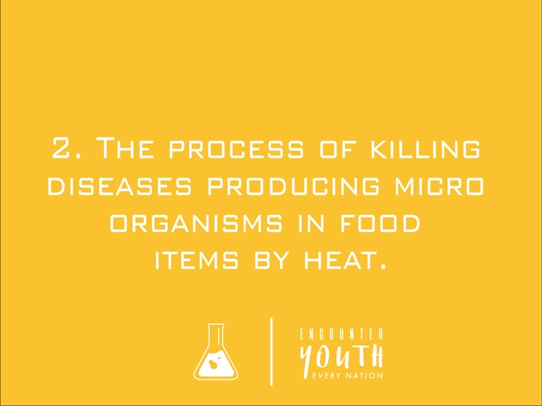
Notes:
The Ross Challenge: Ross is a palaeontologist by profession, and loves science. Groups will take part in a fun science quiz, testing their general knowledge. The group that has the most points will win.

Slide 39

Notes:
The Ross Challenge: Ross is a palaeontologist by profession, and loves science. Groups will take part in a fun science quiz, testing their general knowledge. The group that has the most points will win.

Slide 40

Notes:
The Ross Challenge: Ross is a palaeontologist by profession, and loves science. Groups will take part in a fun science quiz, testing their general knowledge. The group that has the most points will win.

Slide 41

Notes:
The Ross Challenge: Ross is a palaeontologist by profession, and loves science. Groups will take part in a fun science quiz, testing their general knowledge. The group that has the most points will win.

Slide 42
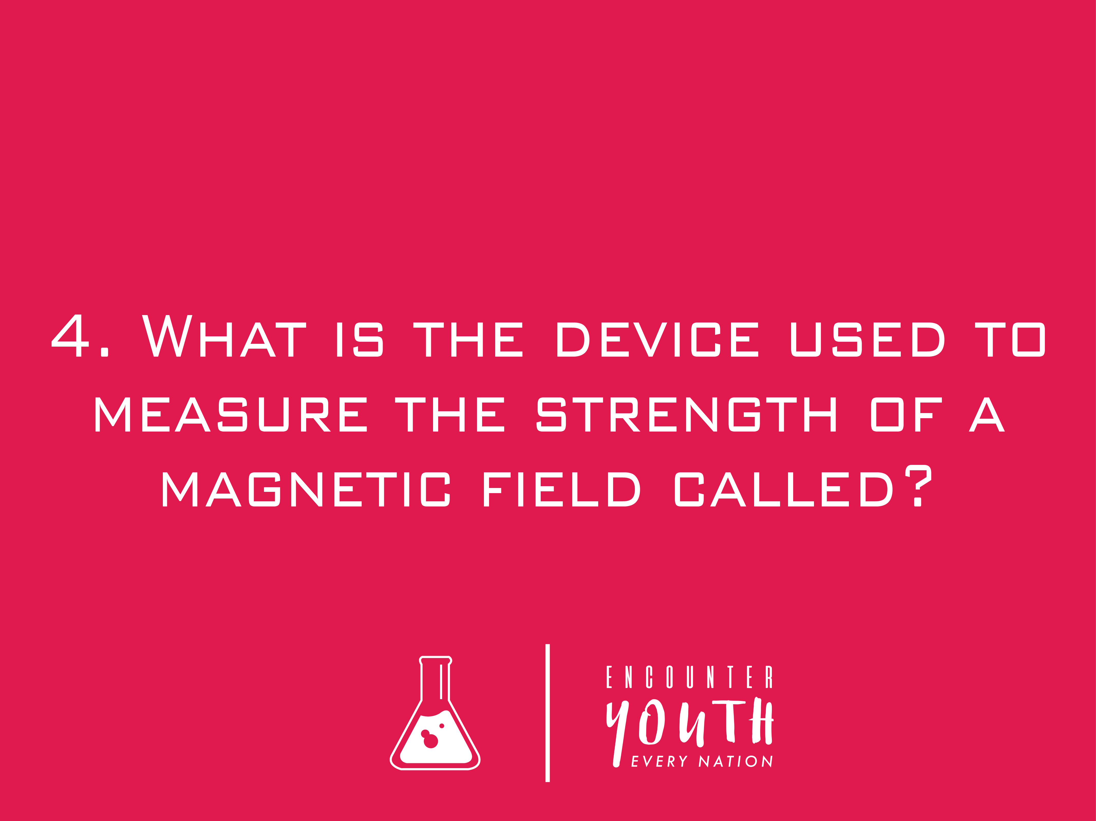
Notes:
The Ross Challenge: Ross is a palaeontologist by profession, and loves science. Groups will take part in a fun science quiz, testing their general knowledge. The group that has the most points will win.

Slide 43

Notes:
The Ross Challenge: Ross is a palaeontologist by profession, and loves science. Groups will take part in a fun science quiz, testing their general knowledge. The group that has the most points will win.

Slide 44

Notes:
The Ross Challenge: Ross is a palaeontologist by profession, and loves science. Groups will take part in a fun science quiz, testing their general knowledge. The group that has the most points will win.

Slide 45

Notes:
The Ross Challenge: Ross is a palaeontologist by profession, and loves science. Groups will take part in a fun science quiz, testing their general knowledge. The group that has the most points will win.

Slide 46
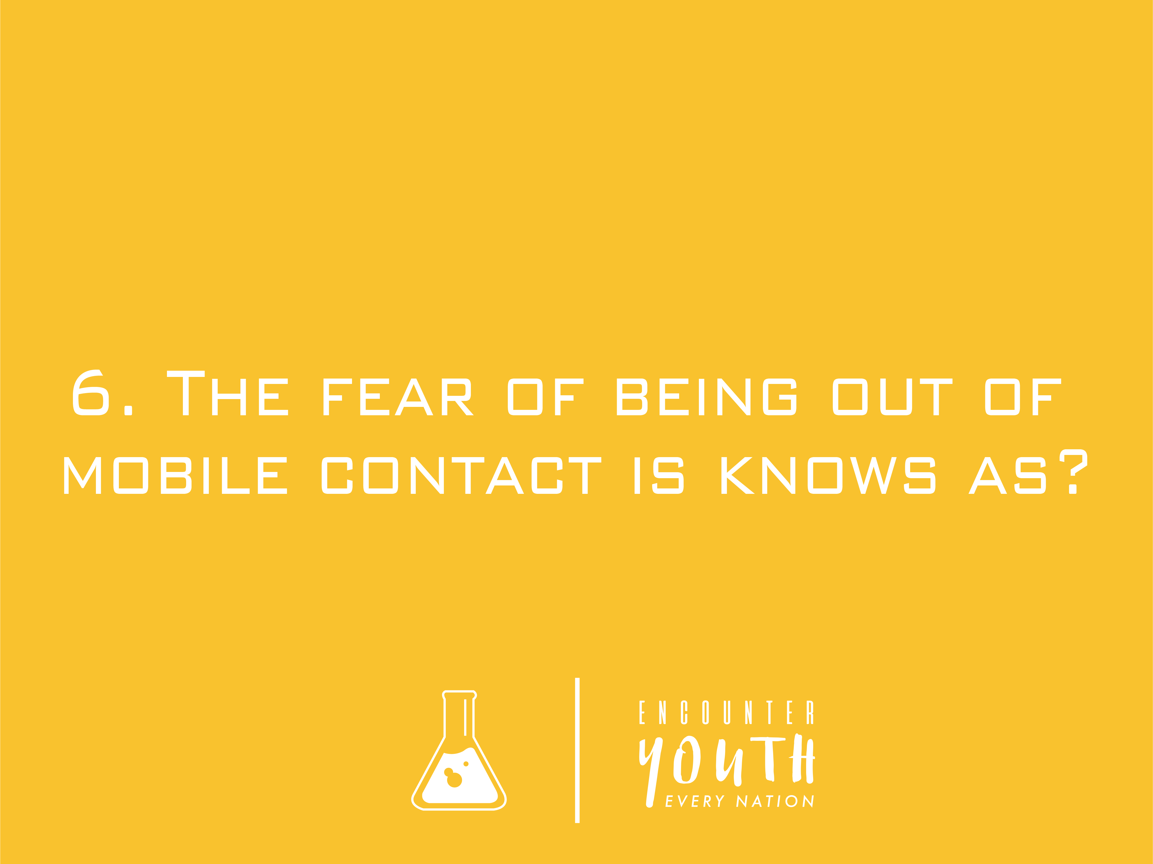
Notes:
The Ross Challenge: Ross is a palaeontologist by profession, and loves science. Groups will take part in a fun science quiz, testing their general knowledge. The group that has the most points will win.

Slide 47

Notes:
The Ross Challenge: Ross is a palaeontologist by profession, and loves science. Groups will take part in a fun science quiz, testing their general knowledge. The group that has the most points will win.

Slide 48
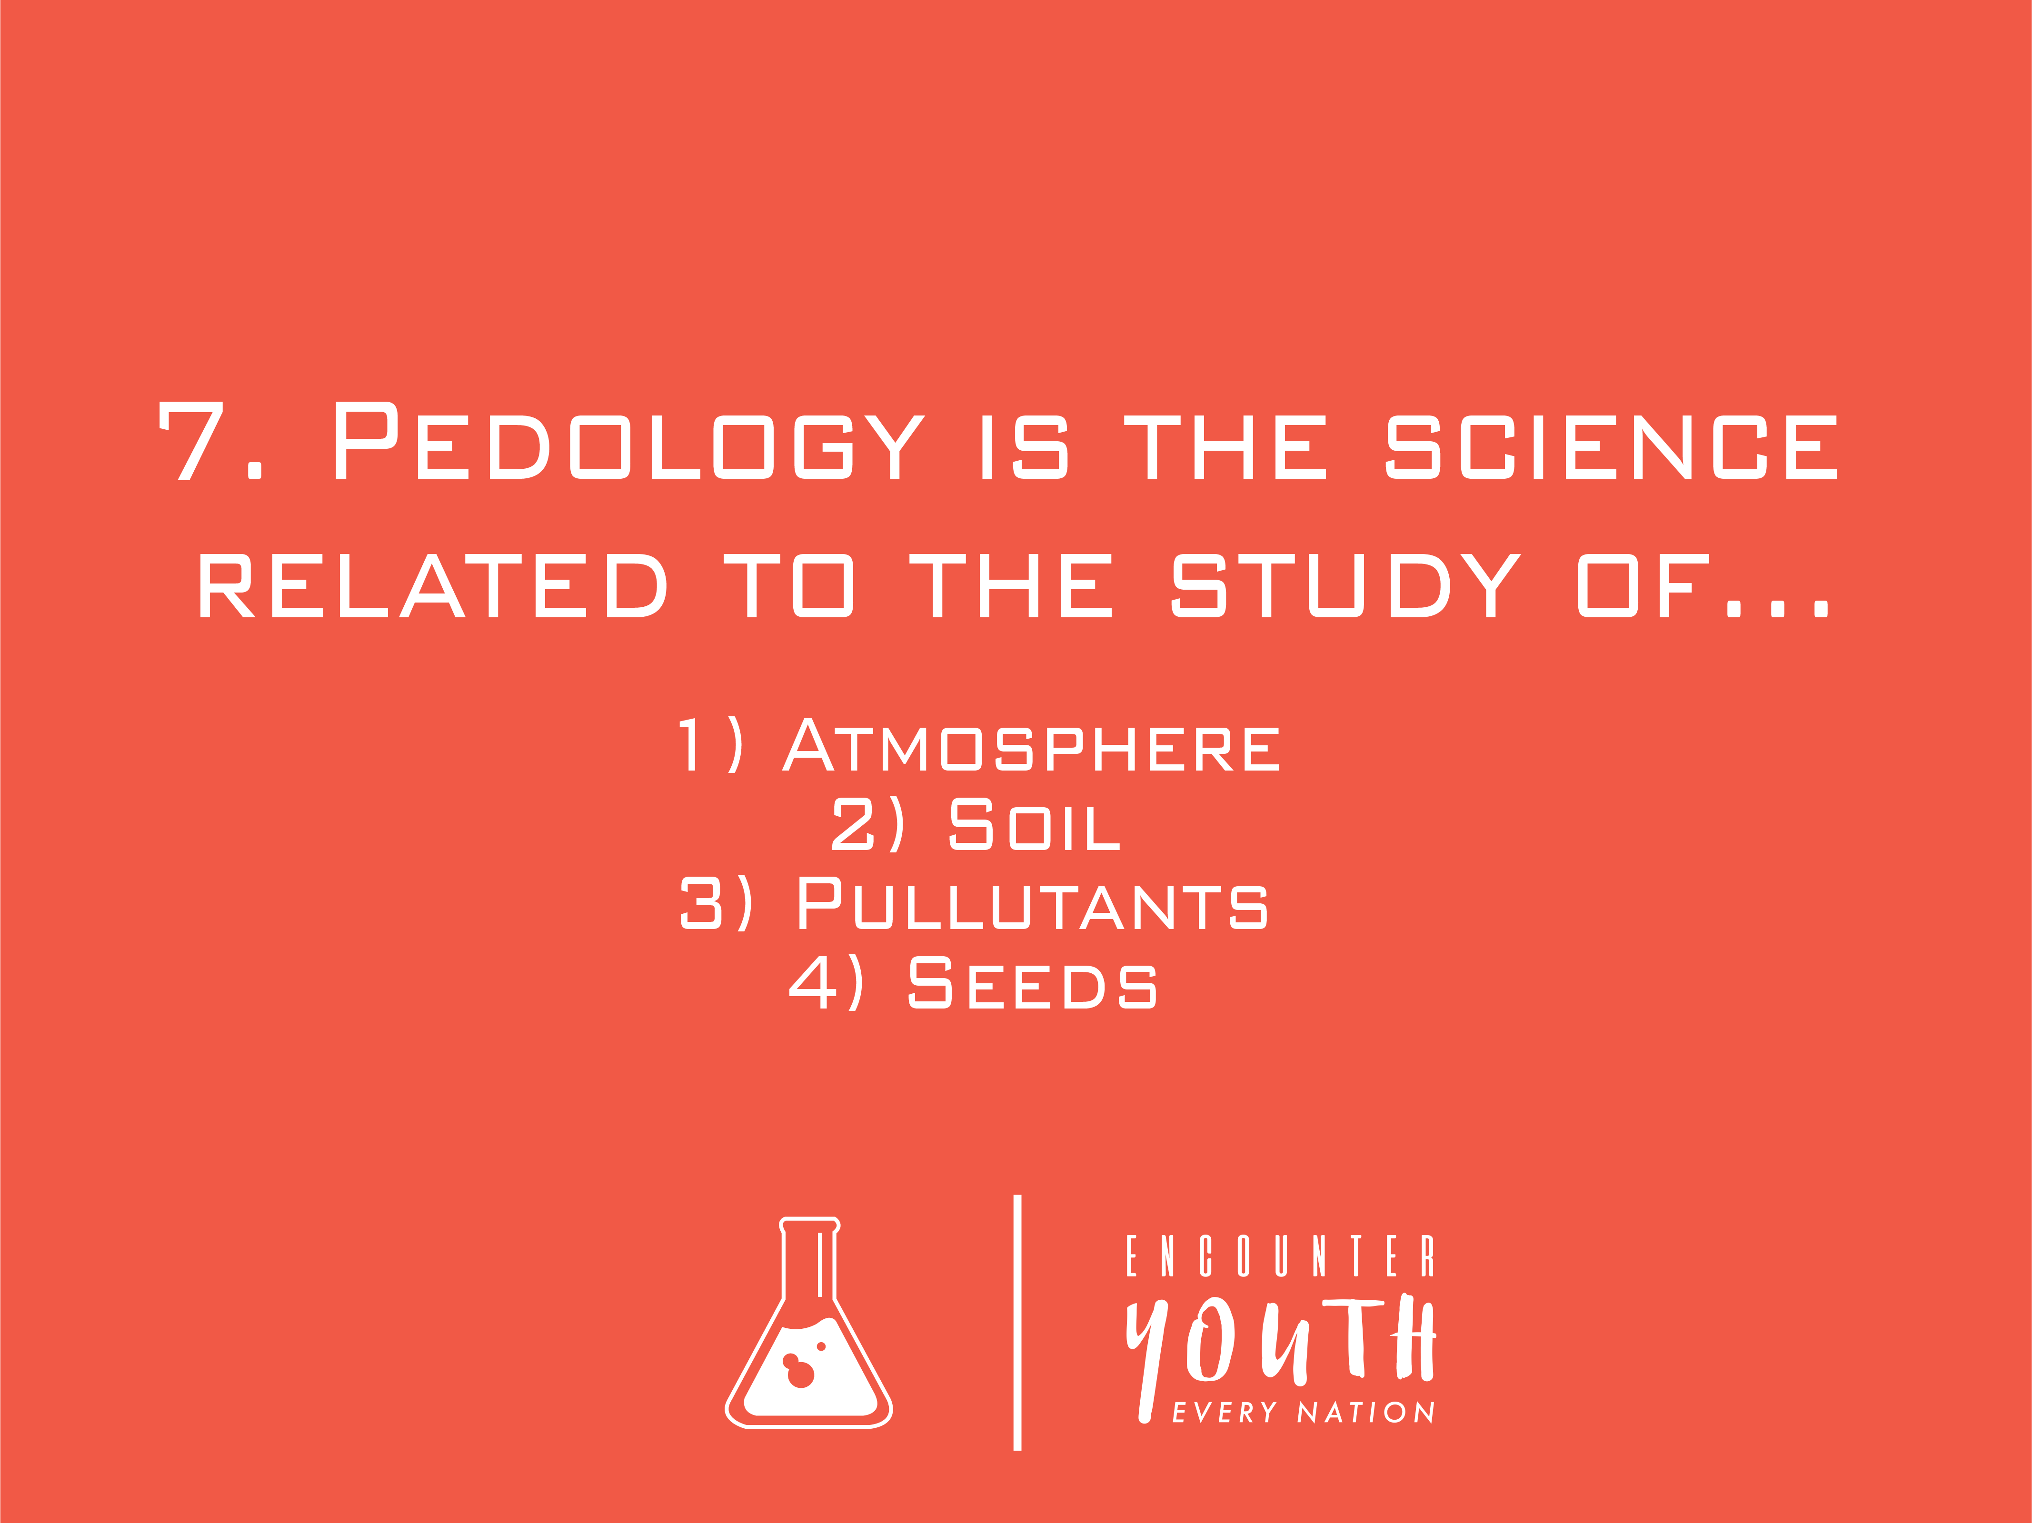
Notes:
The Ross Challenge: Ross is a palaeontologist by profession, and loves science. Groups will take part in a fun science quiz, testing their general knowledge. The group that has the most points will win.

Slide 49

Notes:
The Ross Challenge: Ross is a palaeontologist by profession, and loves science. Groups will take part in a fun science quiz, testing their general knowledge. The group that has the most points will win.

Slide 50
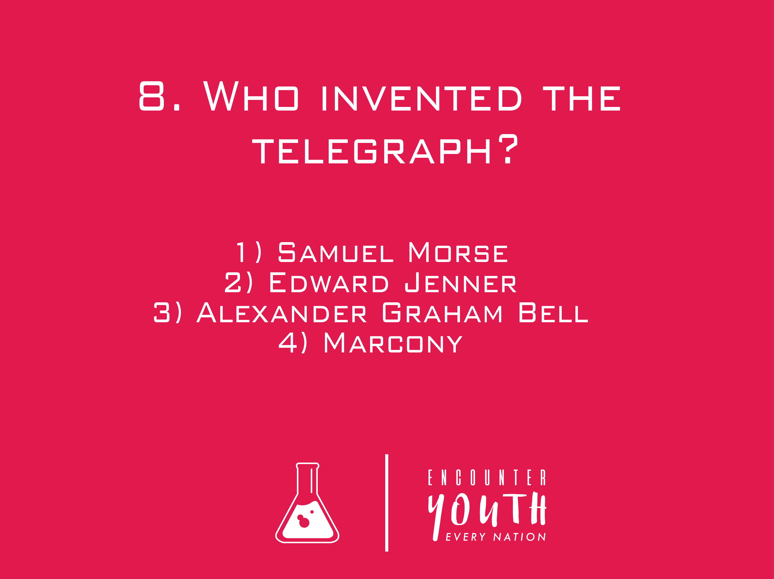
Notes:
The Ross Challenge: Ross is a palaeontologist by profession, and loves science. Groups will take part in a fun science quiz, testing their general knowledge. The group that has the most points will win.

Slide 51

Notes:
The Ross Challenge: Ross is a palaeontologist by profession, and loves science. Groups will take part in a fun science quiz, testing their general knowledge. The group that has the most points will win.

Slide 52
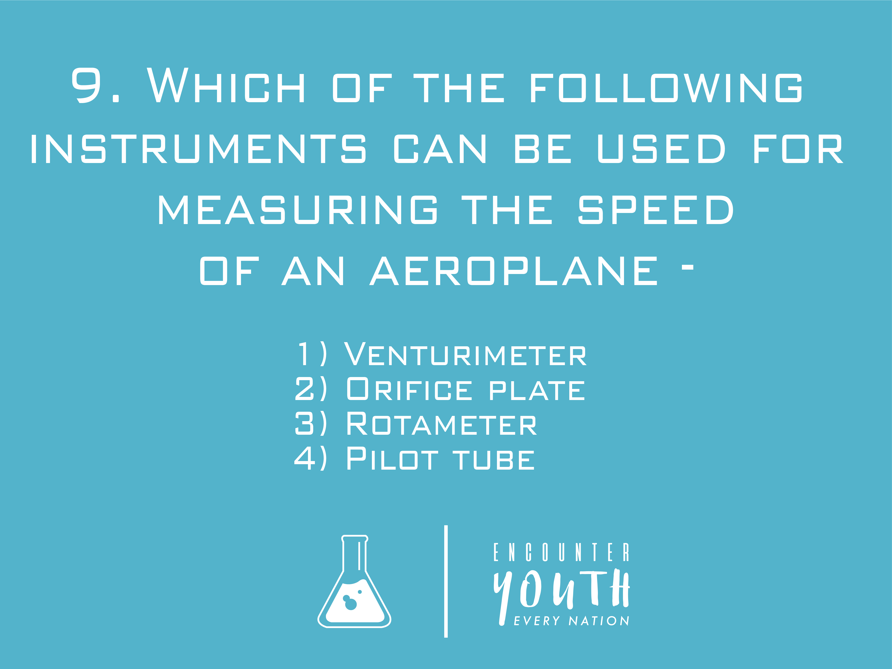
Notes:
The Ross Challenge: Ross is a palaeontologist by profession, and loves science. Groups will take part in a fun science quiz, testing their general knowledge. The group that has the most points will win.

Slide 53

Notes:
The Ross Challenge: Ross is a palaeontologist by profession, and loves science. Groups will take part in a fun science quiz, testing their general knowledge. The group that has the most points will win.

Slide 54
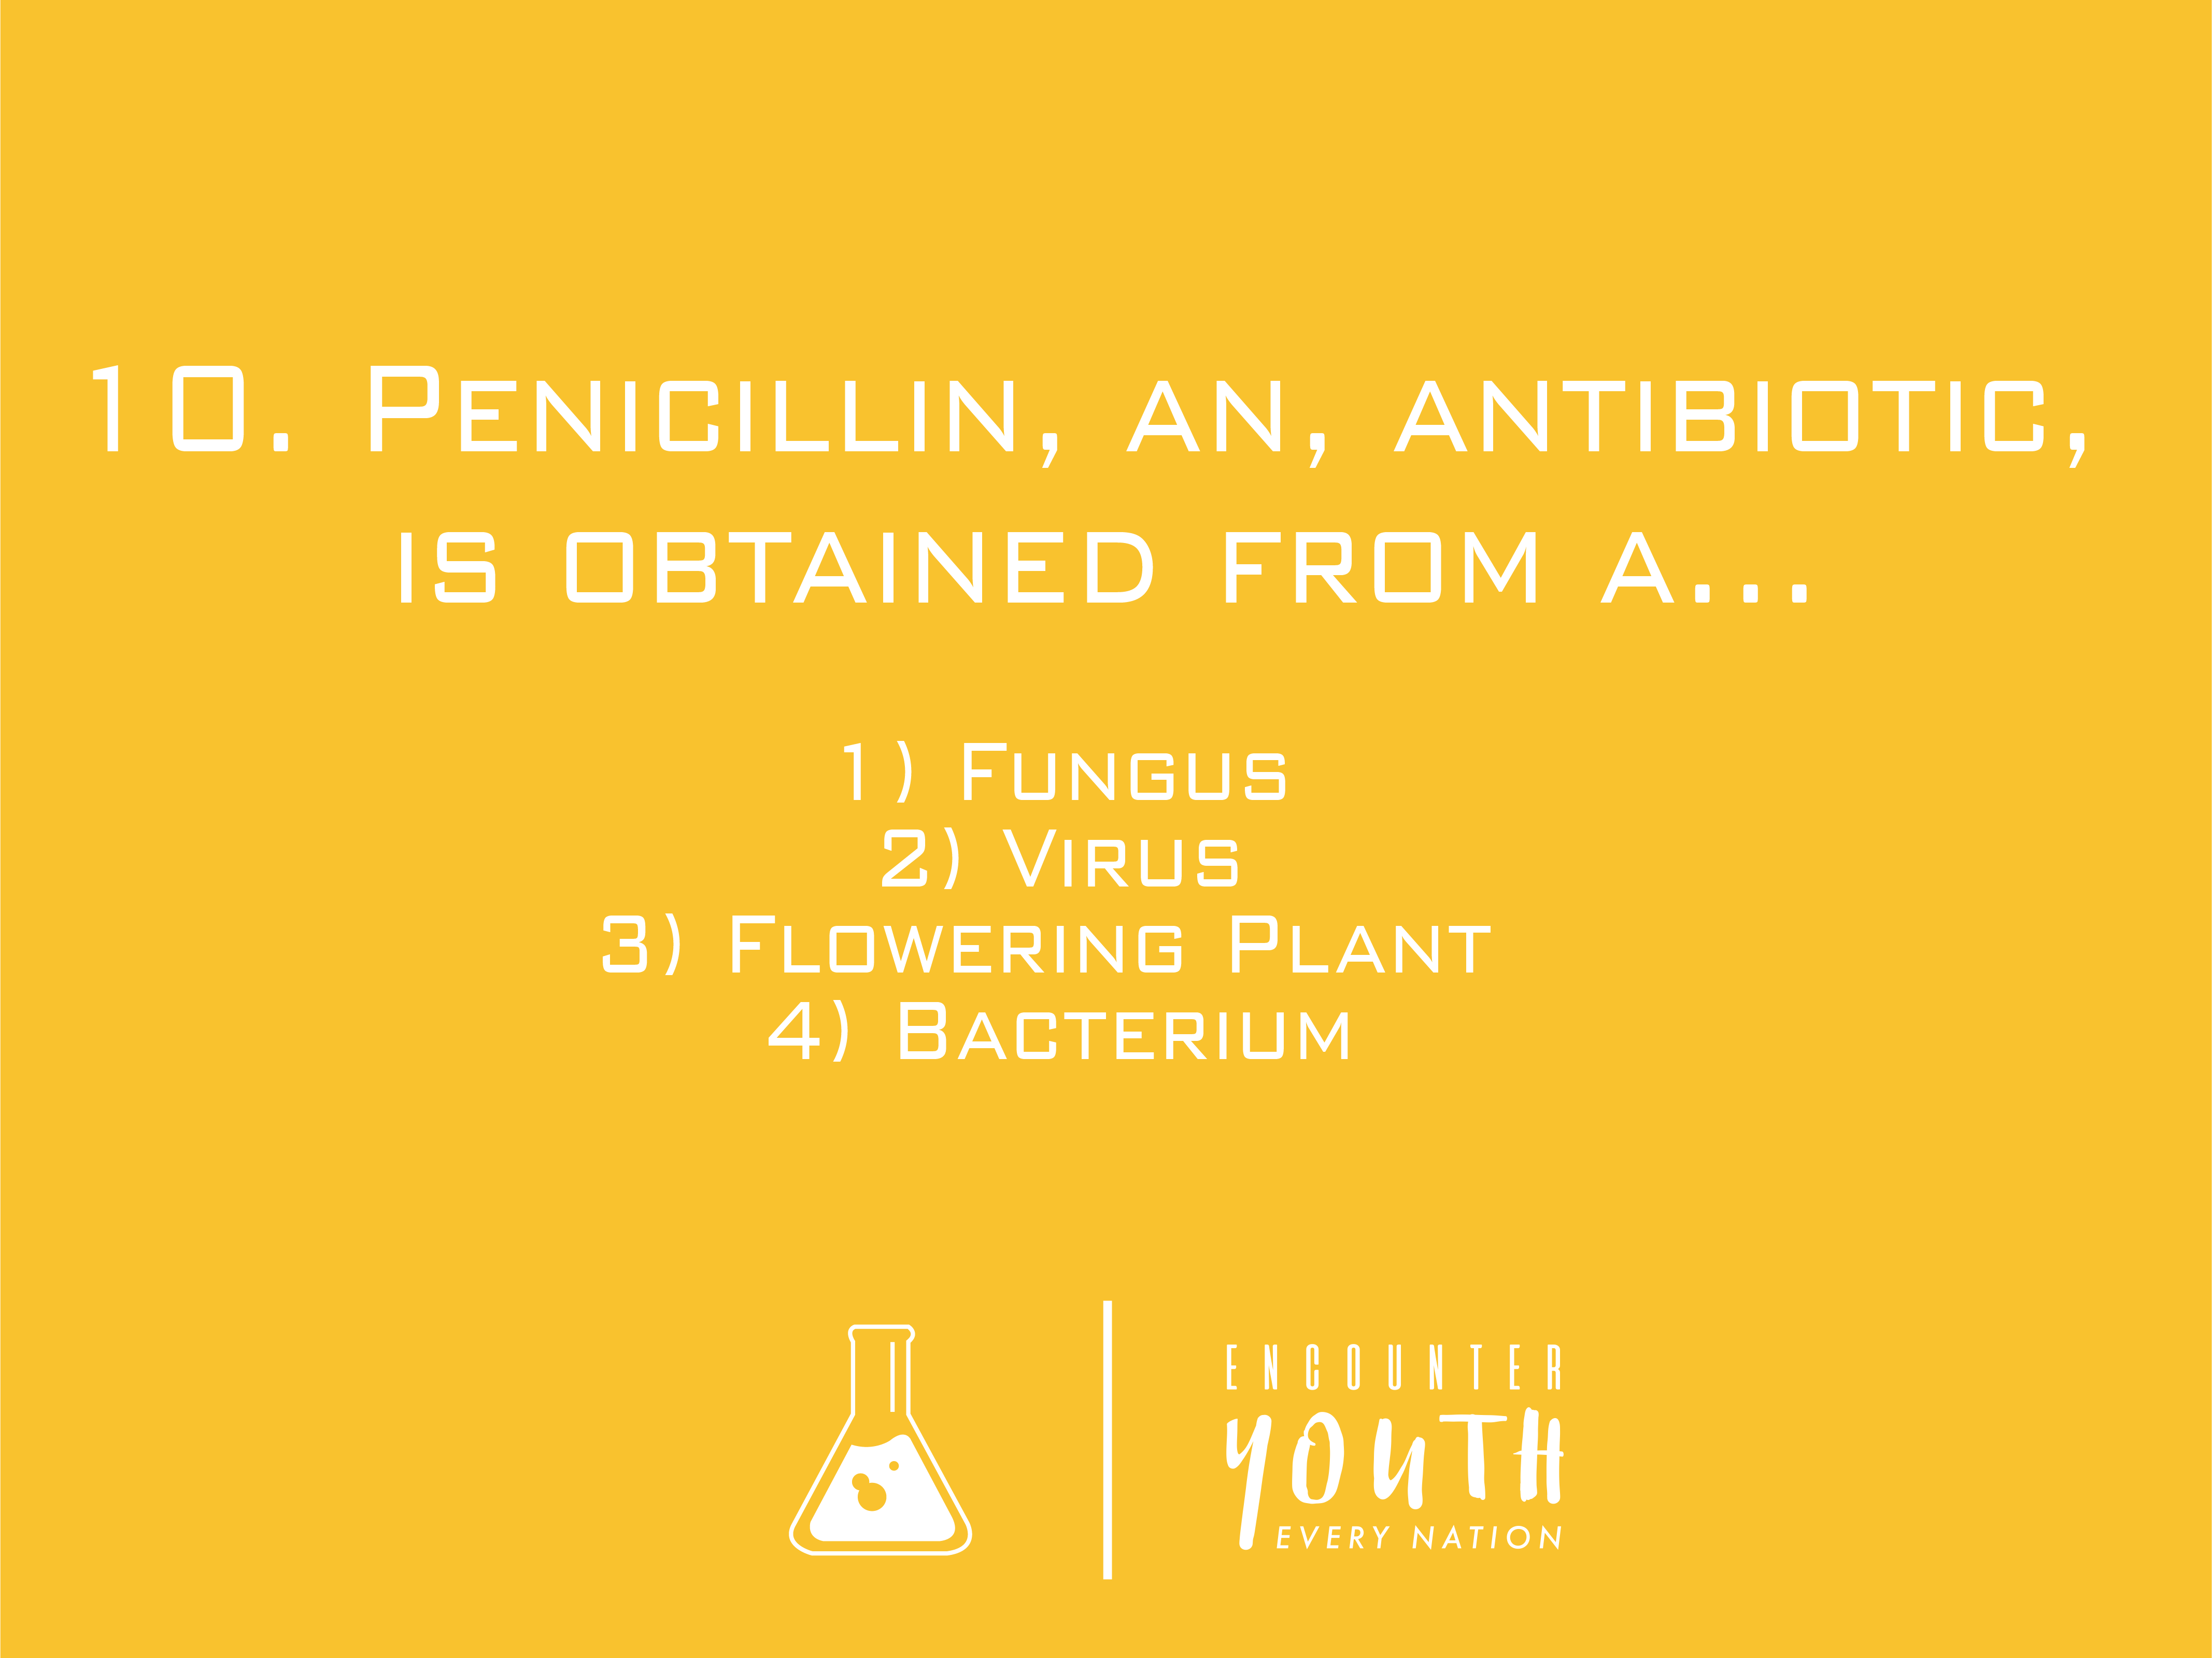
Notes:
The Ross Challenge: Ross is a palaeontologist by profession, and loves science. Groups will take part in a fun science quiz, testing their general knowledge. The group that has the most points will win.

Slide 55

Notes:
The Ross Challenge: Ross is a palaeontologist by profession, and loves science. Groups will take part in a fun science quiz, testing their general knowledge. The group that has the most points will win.

Slide 56
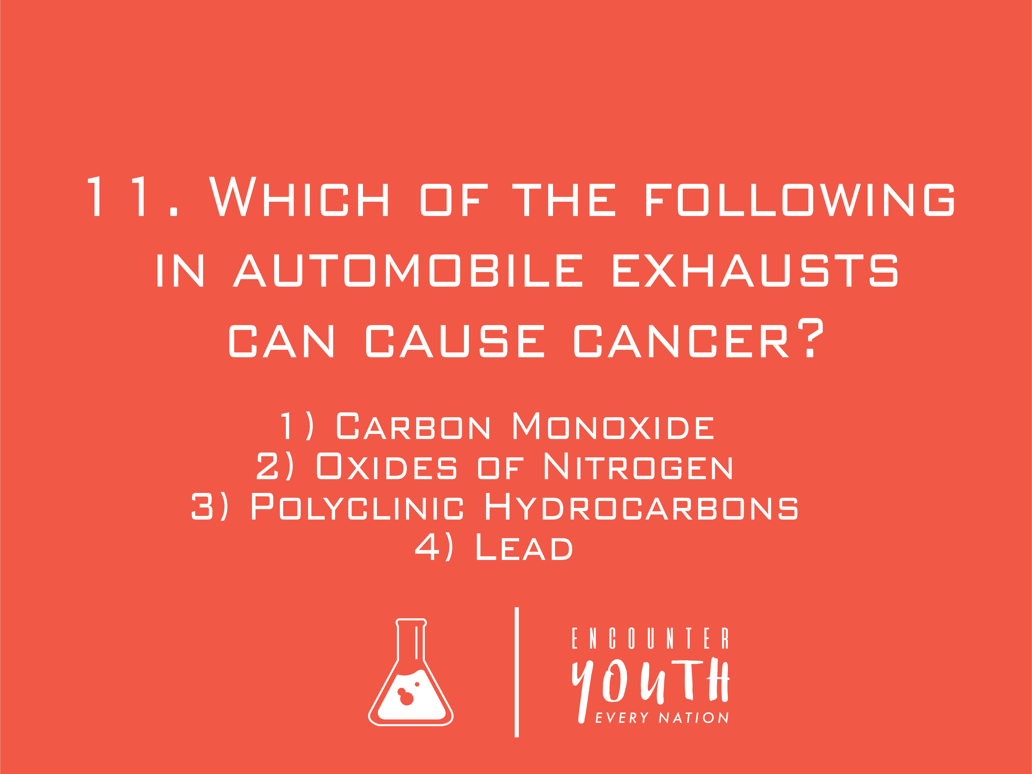
Notes:
The Ross Challenge: Ross is a palaeontologist by profession, and loves science. Groups will take part in a fun science quiz, testing their general knowledge. The group that has the most points will win.

Slide 57

Notes:
The Ross Challenge: Ross is a palaeontologist by profession, and loves science. Groups will take part in a fun science quiz, testing their general knowledge. The group that has the most points will win.

Slide 58

Notes:
The Ross Challenge: Ross is a palaeontologist by profession, and loves science. Groups will take part in a fun science quiz, testing their general knowledge. The group that has the most points will win.

Slide 59

Notes:
The Ross Challenge: Ross is a palaeontologist by profession, and loves science. Groups will take part in a fun science quiz, testing their general knowledge. The group that has the most points will win.

Slide 60
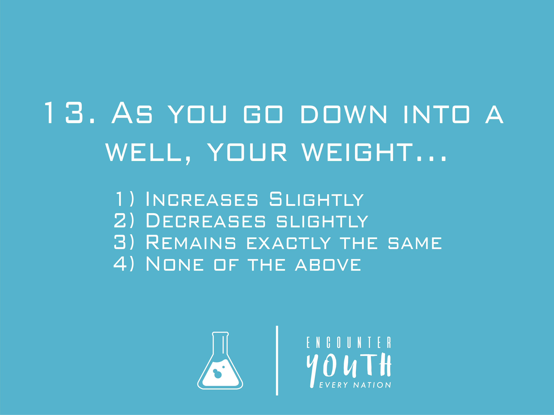
Notes:
The Ross Challenge: Ross is a palaeontologist by profession, and loves science. Groups will take part in a fun science quiz, testing their general knowledge. The group that has the most points will win.

Slide 61

Notes:
The Ross Challenge: Ross is a palaeontologist by profession, and loves science. Groups will take part in a fun science quiz, testing their general knowledge. The group that has the most points will win.

Slide 62
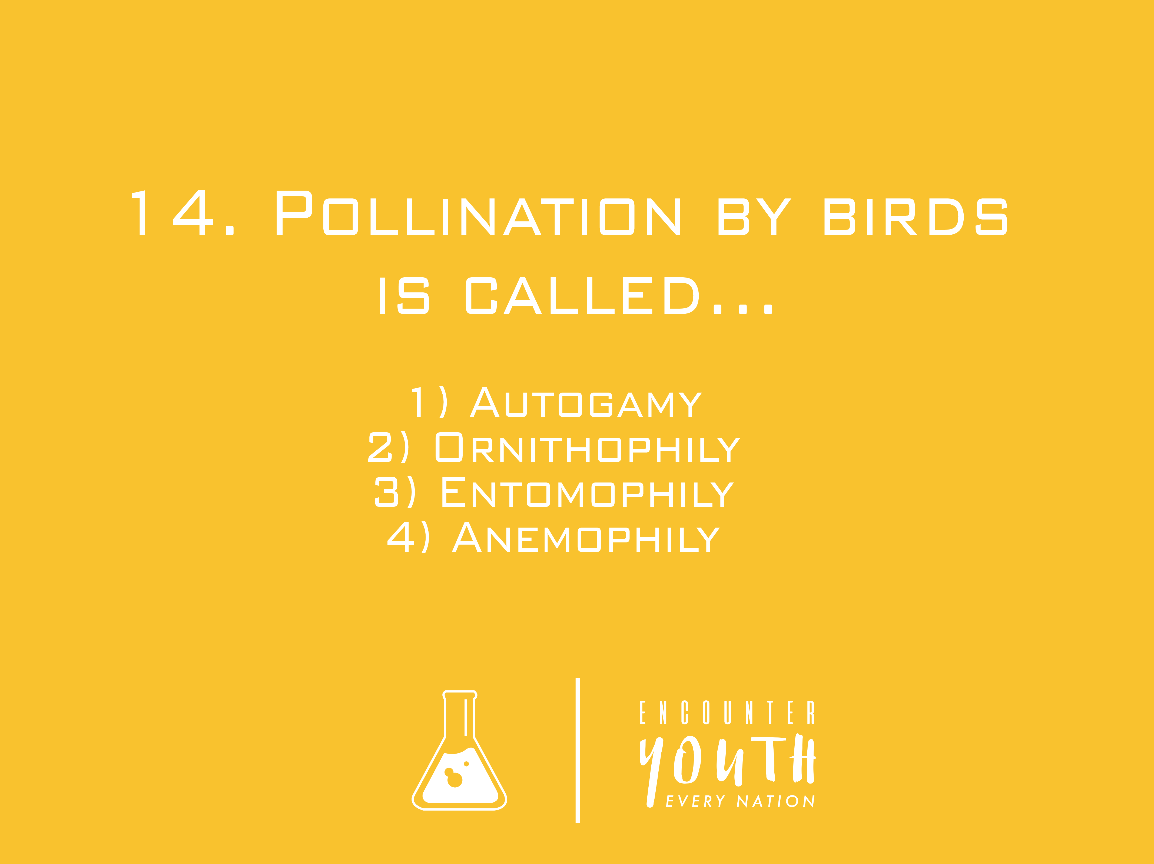
Notes:
The Ross Challenge: Ross is a palaeontologist by profession, and loves science. Groups will take part in a fun science quiz, testing their general knowledge. The group that has the most points will win.

Slide 63

Notes:
The Ross Challenge: Ross is a palaeontologist by profession, and loves science. Groups will take part in a fun science quiz, testing their general knowledge. The group that has the most points will win.

Slide 64
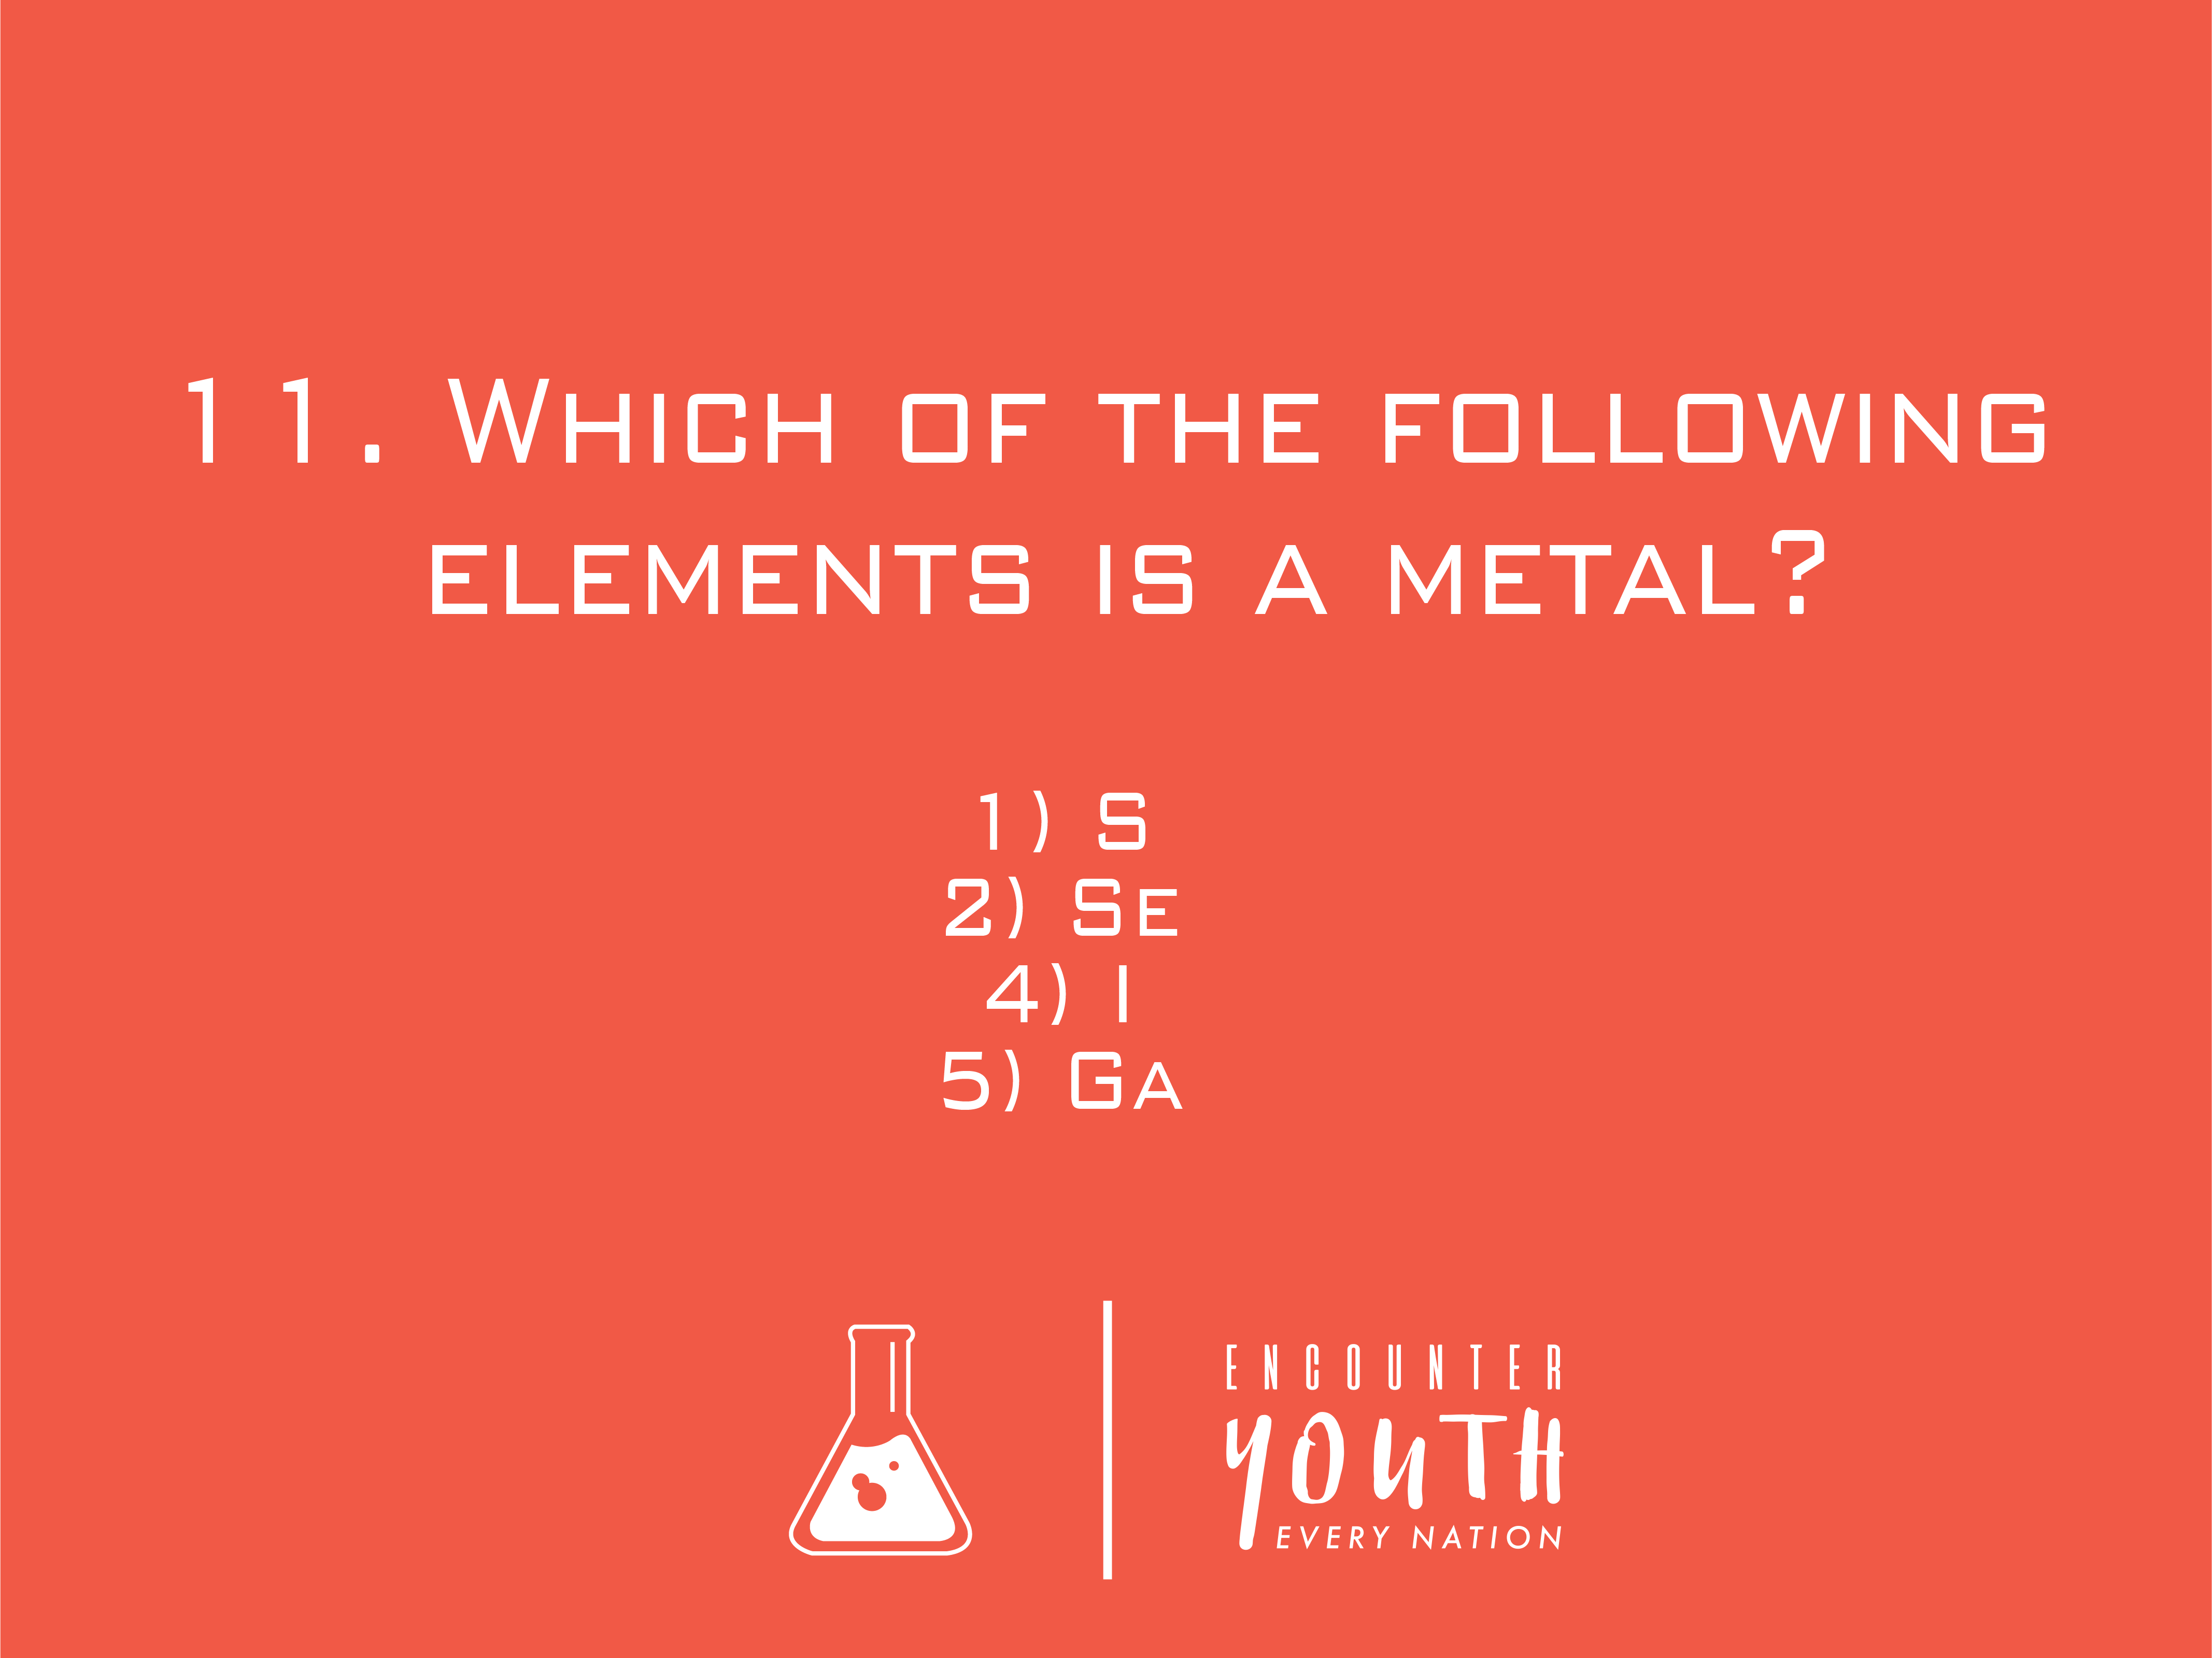
Notes:
The Ross Challenge: Ross is a palaeontologist by profession, and loves science. Groups will take part in a fun science quiz, testing their general knowledge. The group that has the most points will win.

Slide 65

Notes:
The Ross Challenge: Ross is a palaeontologist by profession, and loves science. Groups will take part in a fun science quiz, testing their general knowledge. The group that has the most points will win.

Slide 66
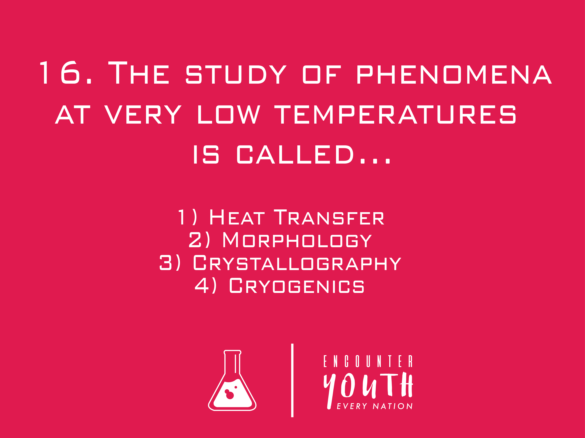
Notes:
The Ross Challenge: Ross is a palaeontologist by profession, and loves science. Groups will take part in a fun science quiz, testing their general knowledge. The group that has the most points will win.

Slide 67

Notes:
The Ross Challenge: Ross is a palaeontologist by profession, and loves science. Groups will take part in a fun science quiz, testing their general knowledge. The group that has the most points will win.

Slide 68

Notes:
The Ross Challenge: Ross is a palaeontologist by profession, and loves science. Groups will take part in a fun science quiz, testing their general knowledge. The group that has the most points will win.

Slide 69

Notes:
The Ross Challenge: Ross is a palaeontologist by profession, and loves science. Groups will take part in a fun science quiz, testing their general knowledge. The group that has the most points will win.

Slide 70
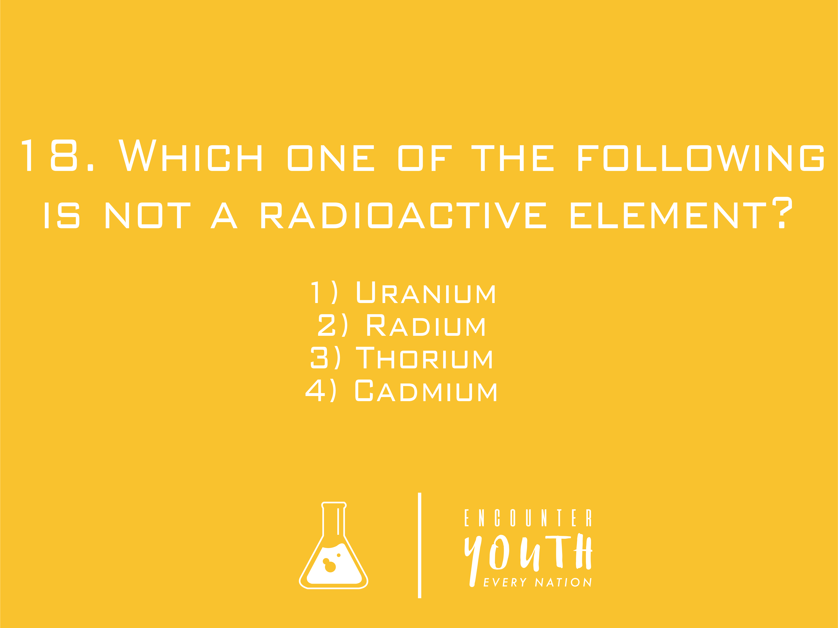
Notes:
The Ross Challenge: Ross is a palaeontologist by profession, and loves science. Groups will take part in a fun science quiz, testing their general knowledge. The group that has the most points will win.

Slide 71

Notes:
The Ross Challenge: Ross is a paleontologist by profession, and loves science. Groups will take part in a fun science quiz, testing their general knowledge. The group that has the most points will win.
The answers:
Ultra Sound Machine
Pasteurization
Bacteria
Magnetometer
Hydroelectricity
Nomophobia
Soil
Samuel Morse
Pilot Tube
Fungus
Carbon Monoxide
Nuclear Fusion
Decreases slightly
Ornithophily
Ga
Cryogenics
Dispersion of Light
Cadmium

Slide 72
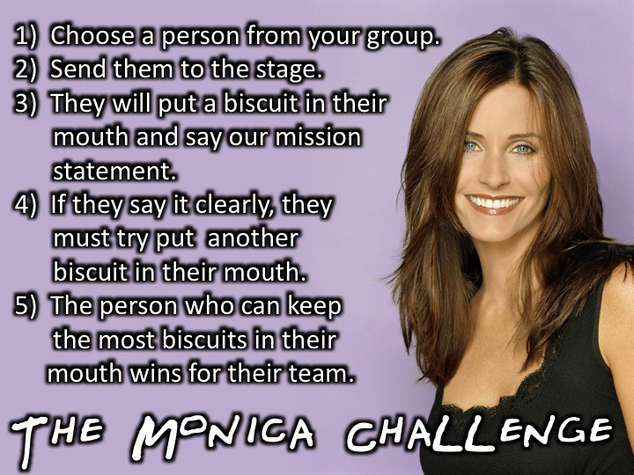
Notes:
The Monica Challenge: Monica is a chef and loves making silly comments. (1) Choose a person from your group. (2) Send them to the stage. (3) They will put a biscuit in their mouth and say the joke. (4) If they say the joke clearly, they must try put another biscuit in their mouth. (5) The person who can keep the most biscuits in their mouth wins for their team.

Slide 73

Notes:
Our Mission Statement

Slide 74
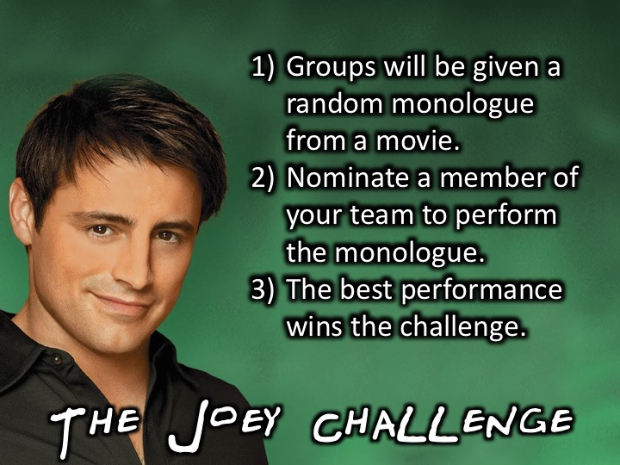
Notes:
The Joey Challenge: Joey may not be the greatest actor, but he loves acting. Groups will be given a random monologue from a movie. Each group will nominate a member of their team to perform the monologue on-stage. The best monologue will win the Joey Challenge.

Slide 75
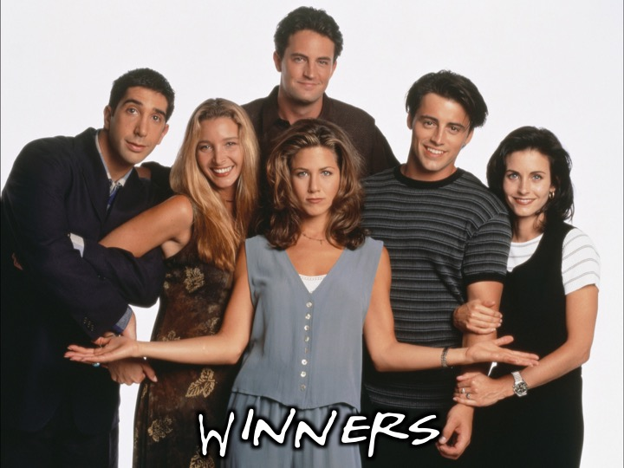
Notes:
The winners will receive prizes!

Slide 76
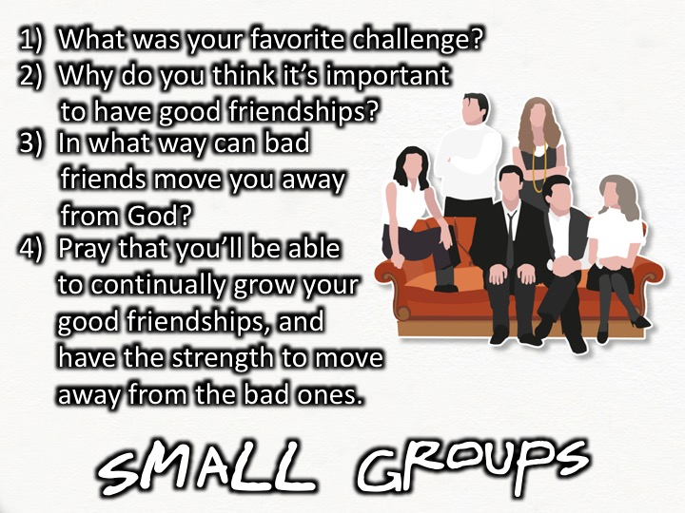
Notes:
Small Group Time: (1) What was your favorite challenge tonight? (2) Why do you think it’s important to have good friendships? (3) In what way can bad friendships move you away from God? (4) Pray that you’ll be able to continually grow your good friendships, and have the strength to move away from the negative ones.

Slide 77
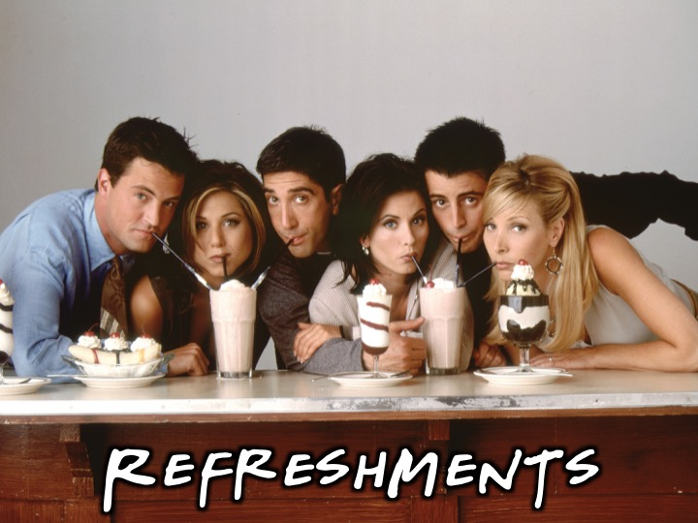
Notes:
Refreshments: It is time for refreshments.

Slide 78
Notes:
Thanks for coming to Encounter youth, see you next week for CSI Night!

Slide 79
Notes:
Don’t forget to join our WhatsApp group for regular updates!

