Slide 1
Notes:
Welcome to the TV Series.

Slide 2
Notes:
Tonight is CSI Night!

Slide 3
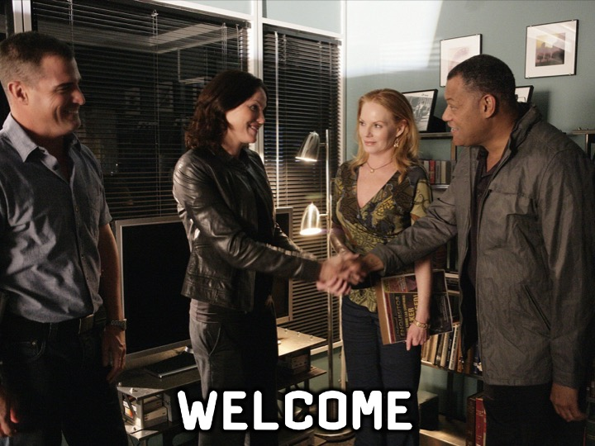
Notes:
Welcome to regulars and newcomers!

Slide 4
Notes:
Prayer: Let’s open our meeting in prayer.

Slide 5
Notes:
Please listen up for the following announcements!

Slide 6
Notes:
Announcements: Like us on Facebook to keep up to date with the latest news.

Slide 7
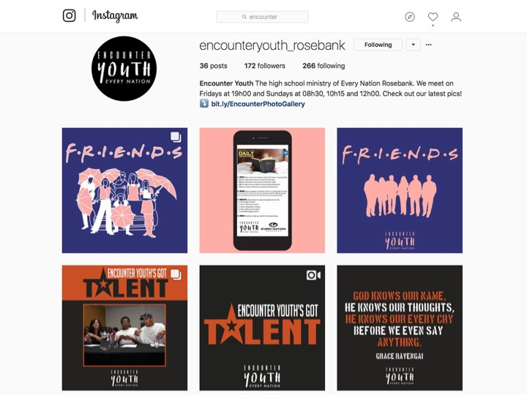
Notes:
Announcements: Follow us on Instagram! @EncounterYouth_Rosebank

Slide 8
Notes:
Announcements: Please put your praise and requests in the box!

Slide 9
Notes:
Announcements: Join our Friday Night WhatsApp group!

Slide 10
Notes:
Announcements: Join us this Sunday as we discuss the question, “Does God Relate?”

Slide 11
Notes:
Announcements: Join us next Friday for Survivor Rosebank!

Slide 12
Notes:
Welcome, tonight is CSI Night!

Slide 13
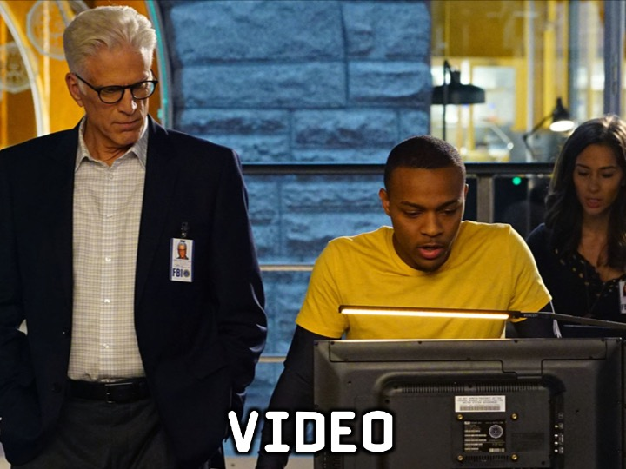
Notes:
Video: A clip from CSI Miami. Find it on Youtube at: https://www.youtube.com/watch?v=x2n-h9E8_ck

Slide 14
Notes:
Video: A clip from CSI Miami. Find it on Youtube at: https://www.youtube.com/watch?v=x2n-h9E8_ck

Slide 15
Notes:
Mafia: (1) There will be TWO groups playing. (2) You will be given a piece of paper with an assigned role written on it. (3) Do not tell anyone who you are! (4) The game Narrators will lead you through the game. Listen to them carefully! (5) The mafia have to try kill the innocents, and the innocents have to find out who the mafia are.

Slide 16
Notes:
The characters in the game: The Mafia

Slide 17
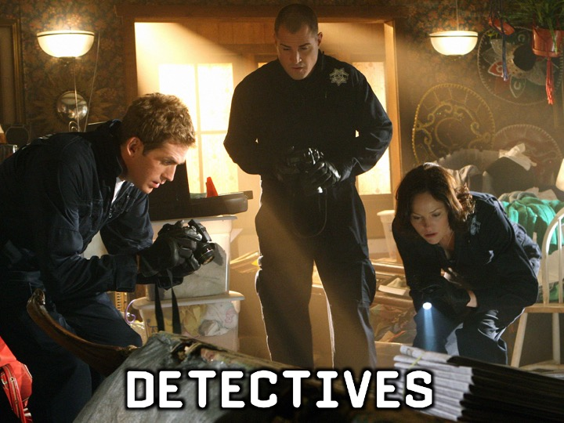
Notes:
The characters in the game: The Detectives

Slide 18
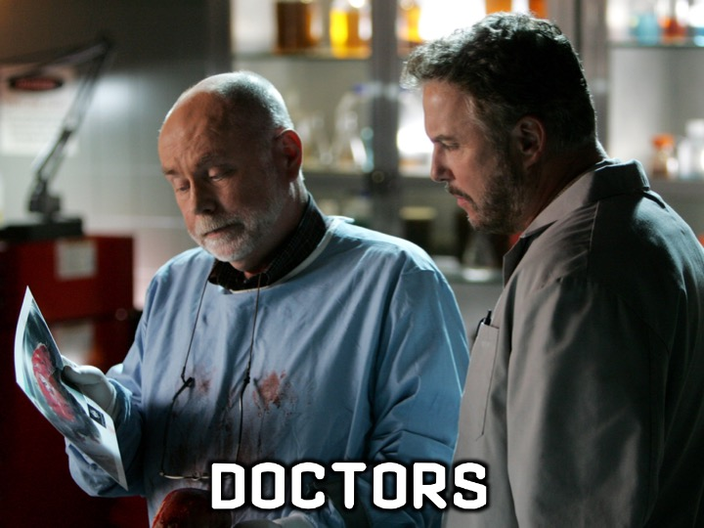
Notes:
The characters in the game: The Doctors

Slide 19
Notes:
Let’s start playing!

Slide 20
Notes:
Small Group Time: (1) How did you lie or get lied to during the game? (2) Is lying a bad thing? Why or why not? (3) What does the Bible mean when it says, “Put off falsehood and speak truthfully to your neighbor, for we are all members of one body?” (Ephesians 4:25) (4) Pray for forgiveness for all the lies you’ve spoken, and pray that God will help you live truthful lives going forward.

Slide 21
Notes:
Refreshments: It is time for refreshments.

Slide 22
Notes:
Don’t forget to join our WhatsApp group for regular updates!

