Slide 1

Notes:
Welcome to the TV Series.

Slide 2
Notes:
Pre-Event Video: The top ten survivors of all time. Get it on YouTube at: https://www.youtube.com/watch?v=hmFdtRVFkRY
Video Length: 3:30 minutes

Slide 3

Notes:
Tonight is Survivor Night!

Slide 4
Notes:
Video: Survivor: Redemption Island Opening Credits. Get it on YouTube at: https://www.youtube.com/watch?v=3sJ-HppLx2U

Slide 5
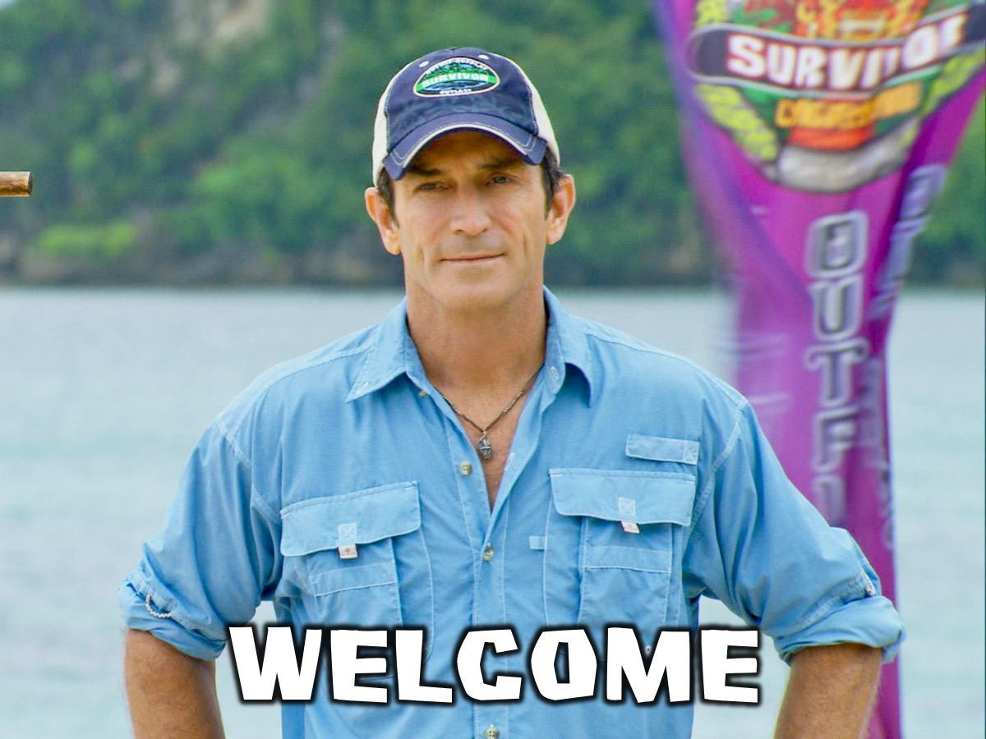
Notes:
Welcome by “Jeff”

Slide 6

Notes:
Prayer

Slide 7

Notes:
Prayer

Slide 8
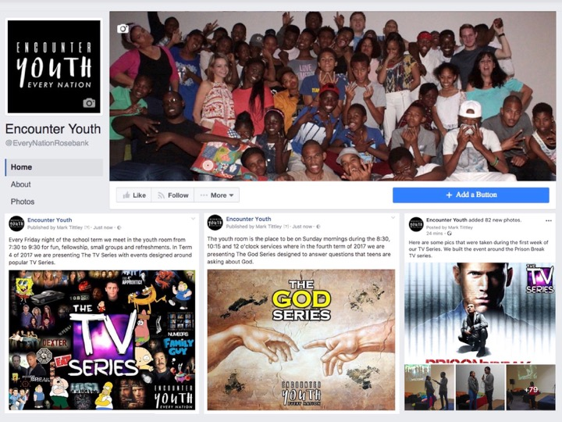
Notes:
Announcements: Like us on Facebook to keep up to date with the latest news.

Slide 9
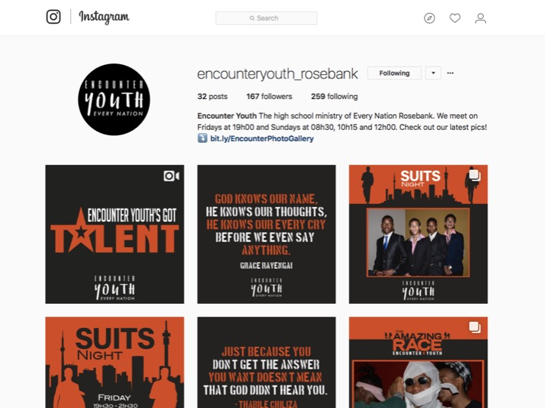
Notes:
Announcements: Follow us on Instagram! @EncounterYouth_Rosebank

Slide 10
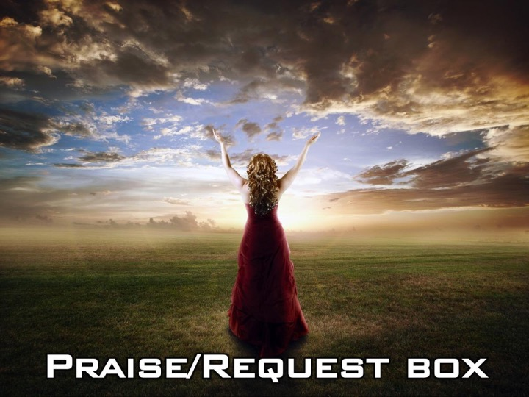
Notes:
Announcements: Please put your praise and requests in the box!

Slide 11

Notes:
Announcements: Join our Friday Night WhatsApp group!

Slide 12
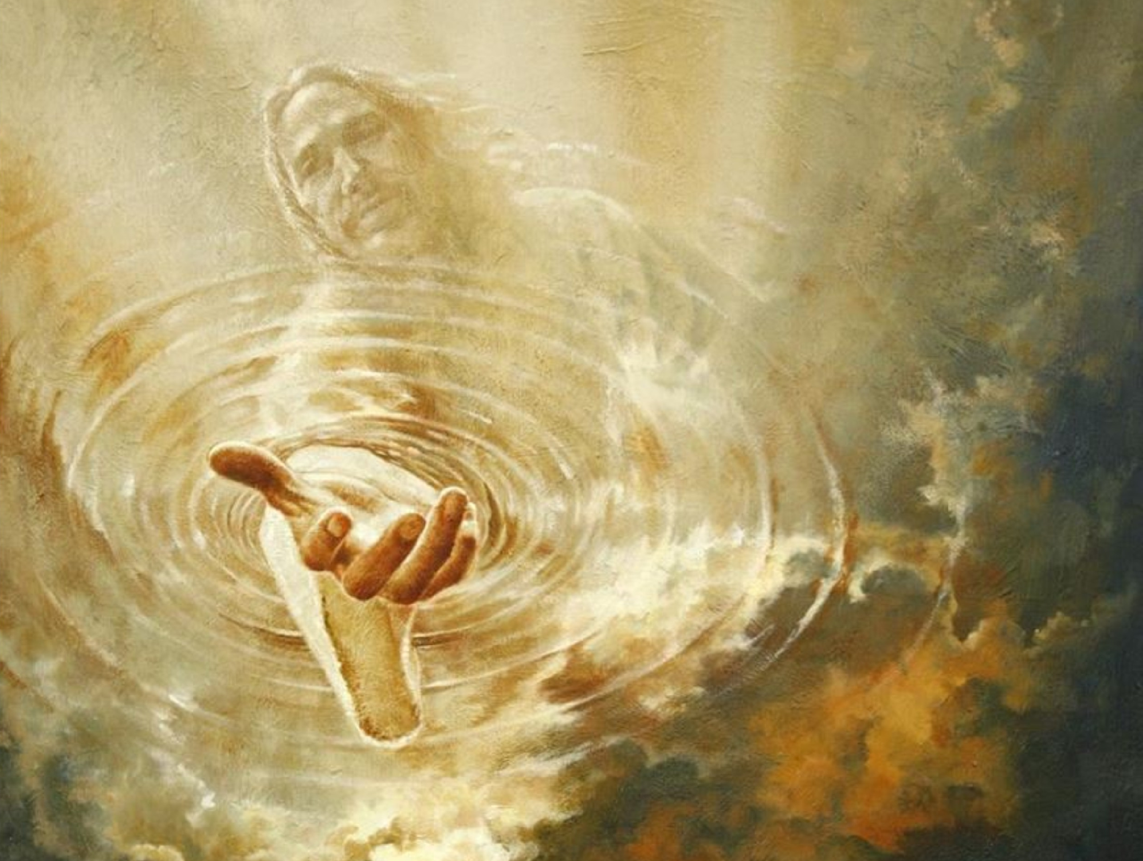
Sunday Morning
the
GOD
series
Does God Help?
Notes:
Announcements: Join us this Sunday as we discuss the question, “Does God Help?”

Slide 13

Notes:
Next Friday night is Flash Night!

Slide 14

Notes:
Tonight is Survivor Night

Slide 15
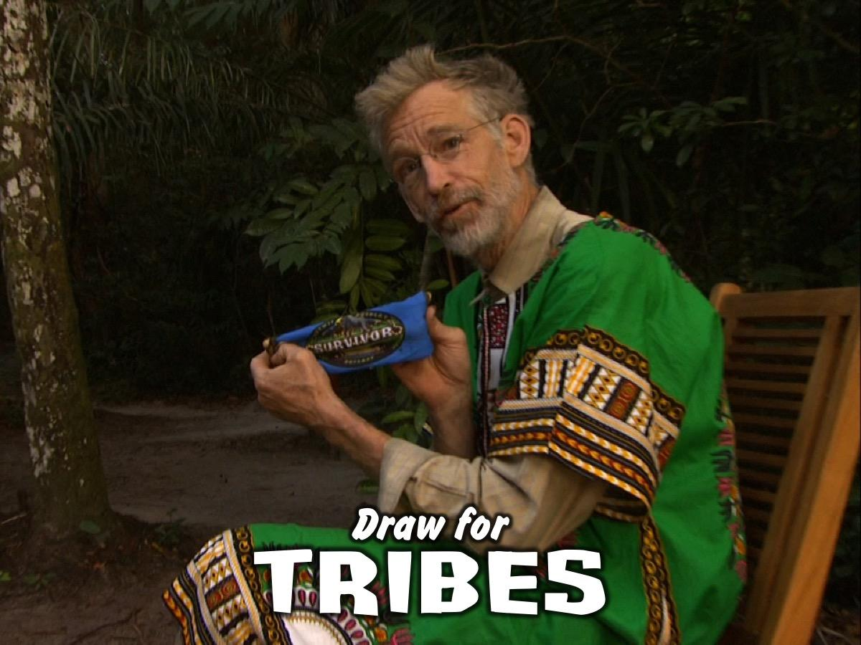
Notes:
Draw for Tribes – each person chooses a piece of coloured cloth from a container and that is their team for the night.

Slide 16
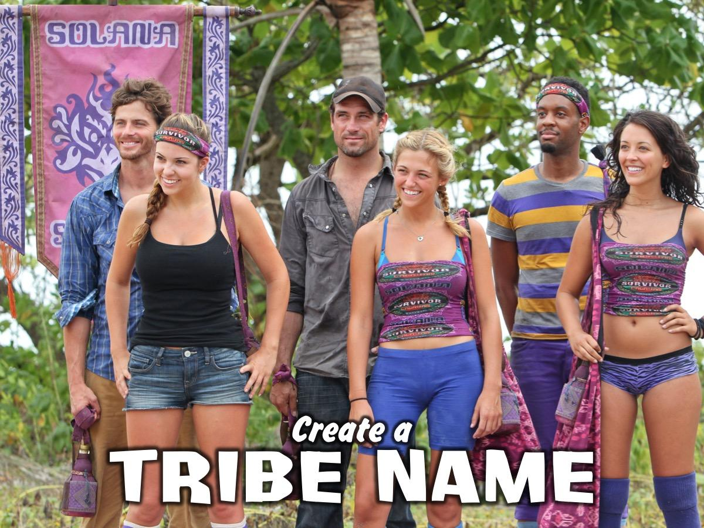
Notes:
Create a Tribe Name (and maybe a war cry) and write it on your tribe flag. (During this activity – leaders will set up the obstacle course)

Slide 17
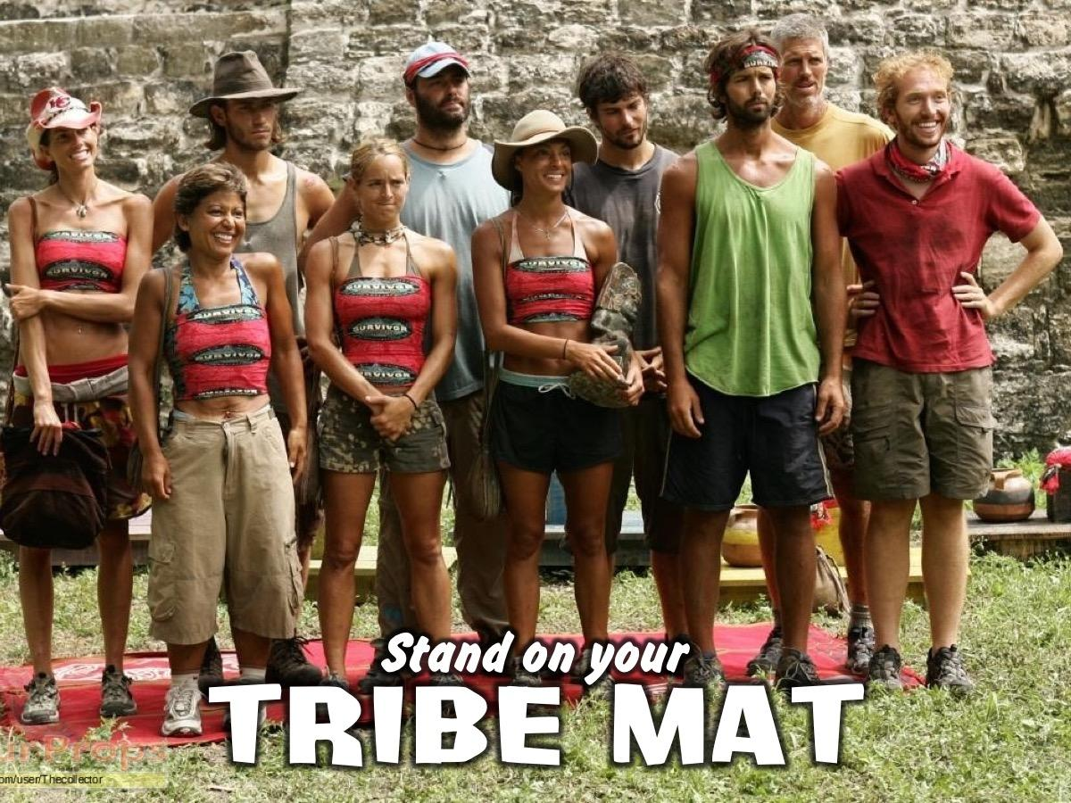
Notes:
Stand on Your Team Mat – teens go and stand on the colour mat they have chosen.

Slide 18
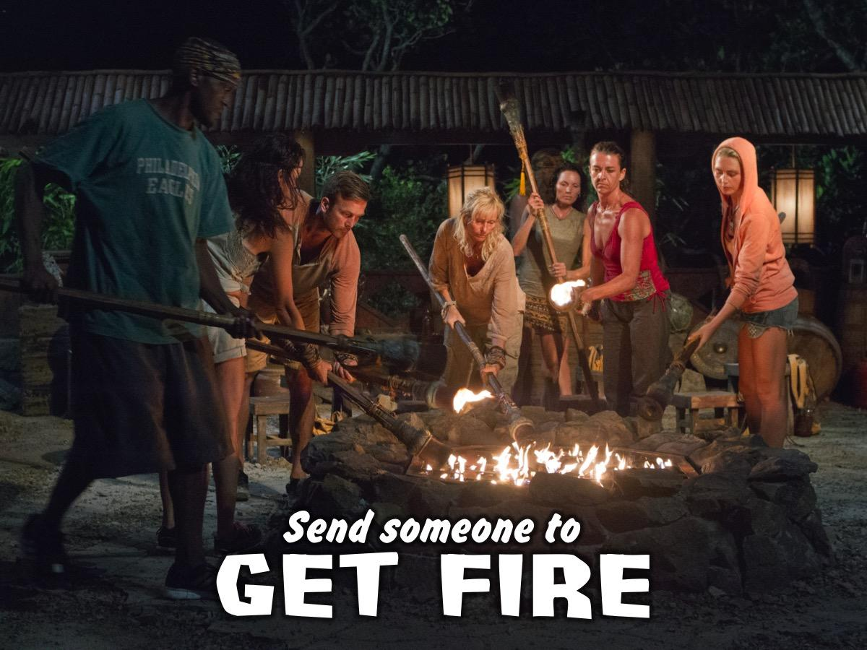
Notes:
Send someone to get fire – each group sends a representative to the stage where they light their fire (ie. Turn on the electric light placed on colored material)

Slide 19
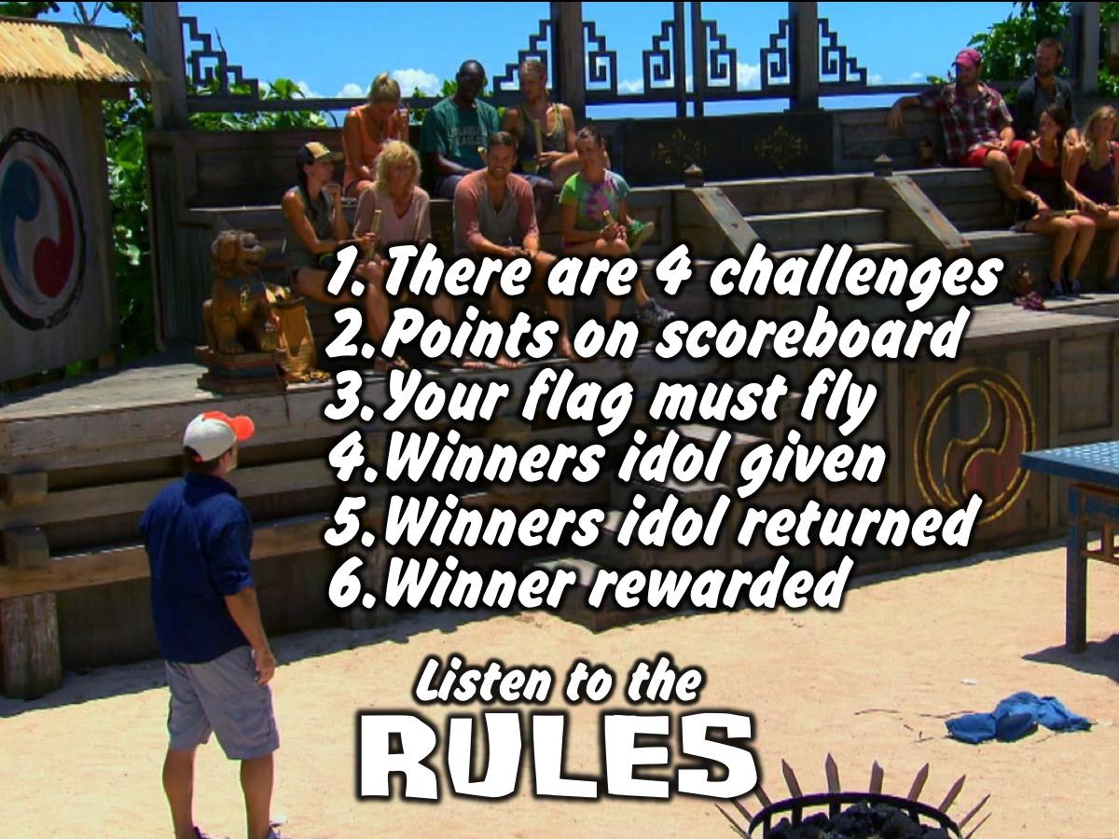
Notes:
Jeff Explains the Rules:
There will be four challenges where you will compete against each other.
Your team points will be recorded on the blackboard.
The team flag must always be flown by a team members.
The Winners Idol is give to the group that wins each challenge.
The Winners Idol is returned to Jeff at the start of each new challenge.
The Winner at the end of the night will be rewarded.

Slide 20
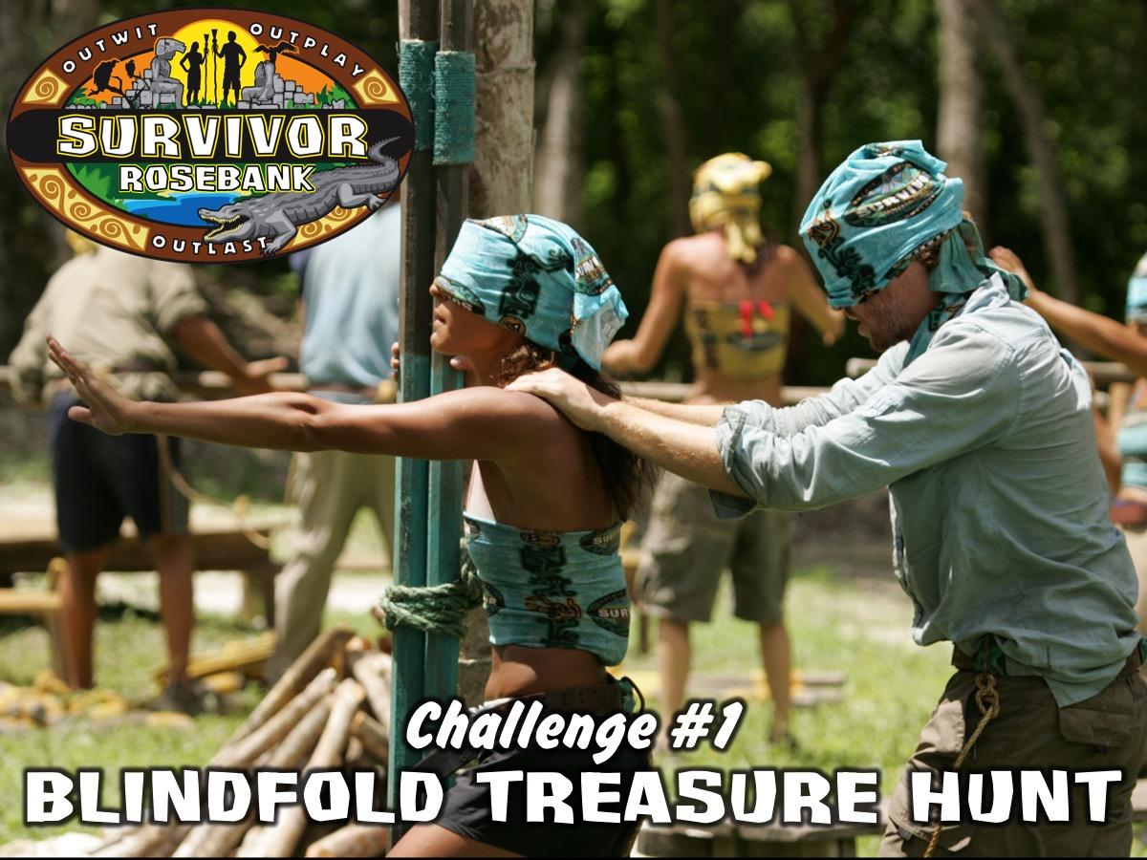
Notes:
Challenge #1: Blindfold Treasure Hunt. Two members of the tribe are tied to each other at the waist and blindfolded and the rest of the tribe has to direct them to find four items (placed in groups around the room): Polystyrene Cups, Snooker Balls, Empty Milk Bottles, Apples. Tribes are awarded points based on the order in which they finish the event – up to a maximum of 5 minutes (or a minute or two after the first tribe finishes). At end of activity – all obstacle course stuff must be removed for the next challenge.

Slide 21
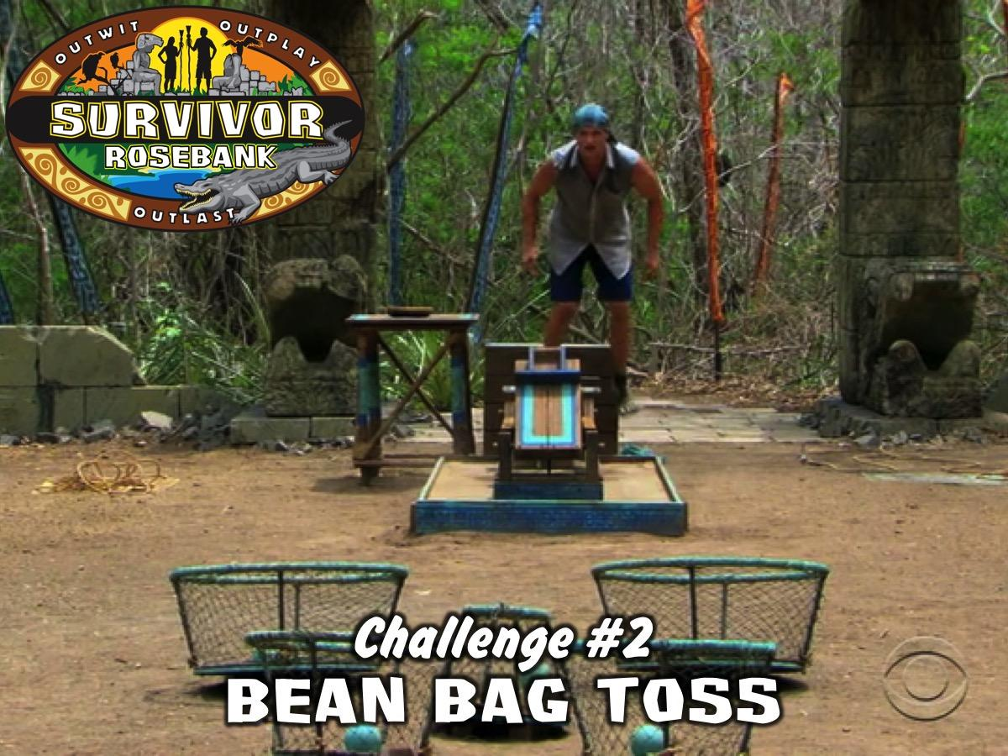
Notes:
Challenge #2: Bean Bag Toss. Members of the tribe take turns to thrown (and retrieve) their bean bag onto a chair positioned 10 meters away from them. It is a timed event where leaders will count how many bags land on the chair in the 5 minutes allowed. Tribe Contestant wears the blindfold as a scarf!

Slide 22
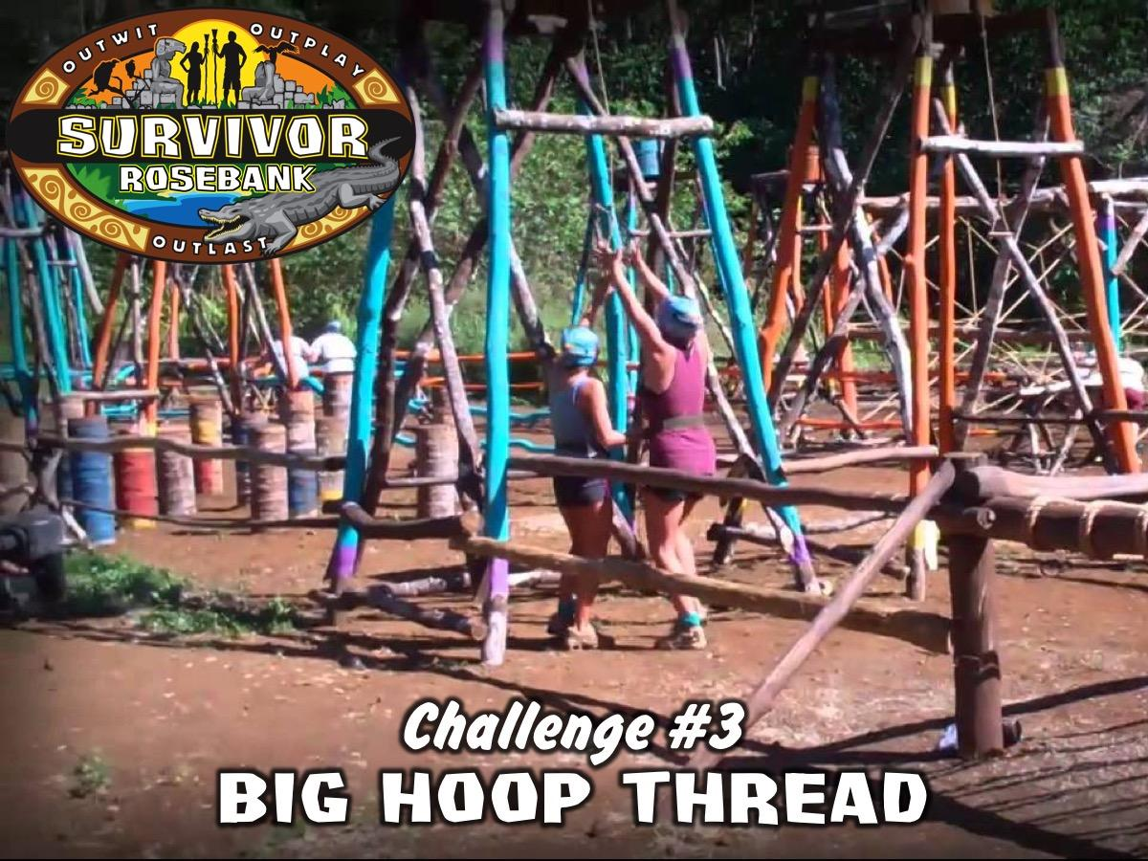
Notes:
Challenge #3: Big Hoop Thread. Members of the tribe have to join hands and climb through a hula hoop without letting go of their hands. The tribe has to start again if anyone lets go.

Slide 23

Notes:
Challenge #4: Cup Smack Down. Each tribe sends one members to compete. They are given a plastic plate and a polystyrene cup to place on top of the plate. They have to hold the plate (not touching the cup at all) and protect their cup from hitting the ground while trying to knock all the other group members cups to the ground. The top 3 tribes will be given points – 3, 5 and 10 points respectively. Tribe Contestant wears the blindfold as a scarf!

Slide 24
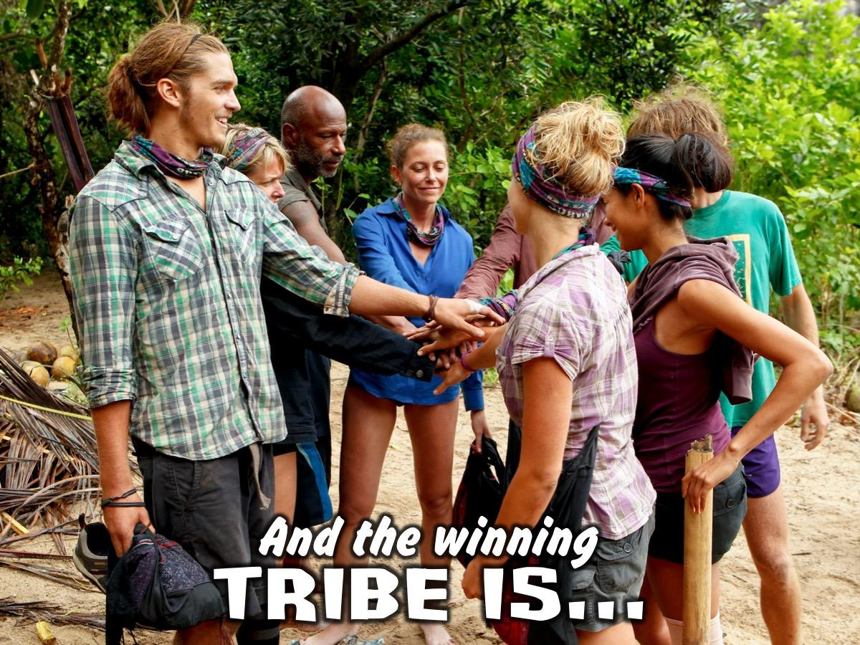
Notes:
The winning tribe is announced

Slide 25
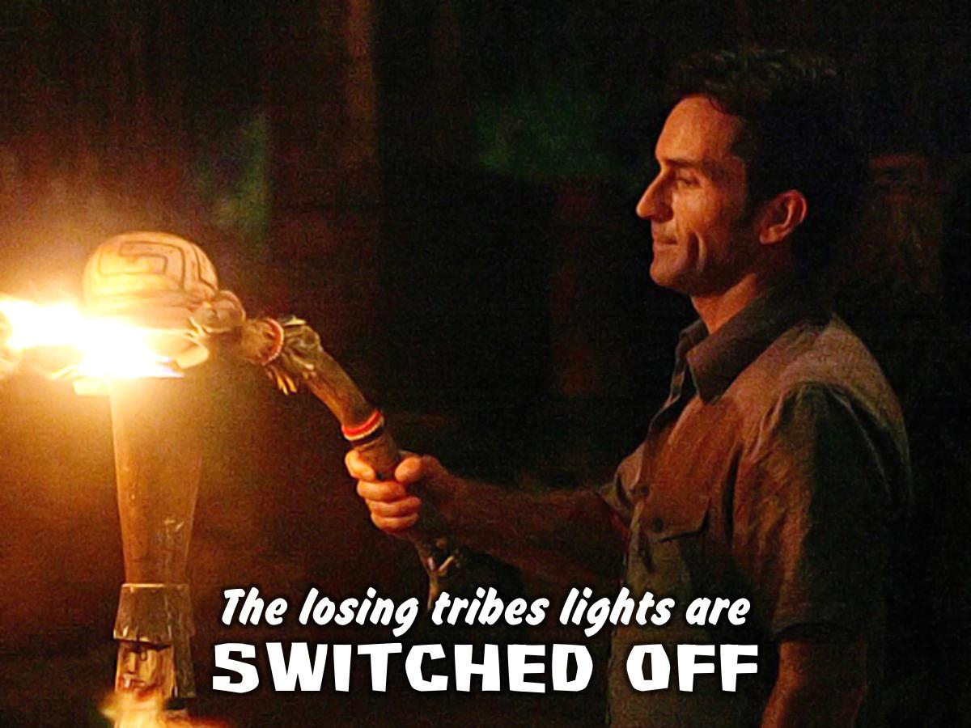
Notes:
The losing tribes lights are switched off – the MC does the switch off!

Slide 26
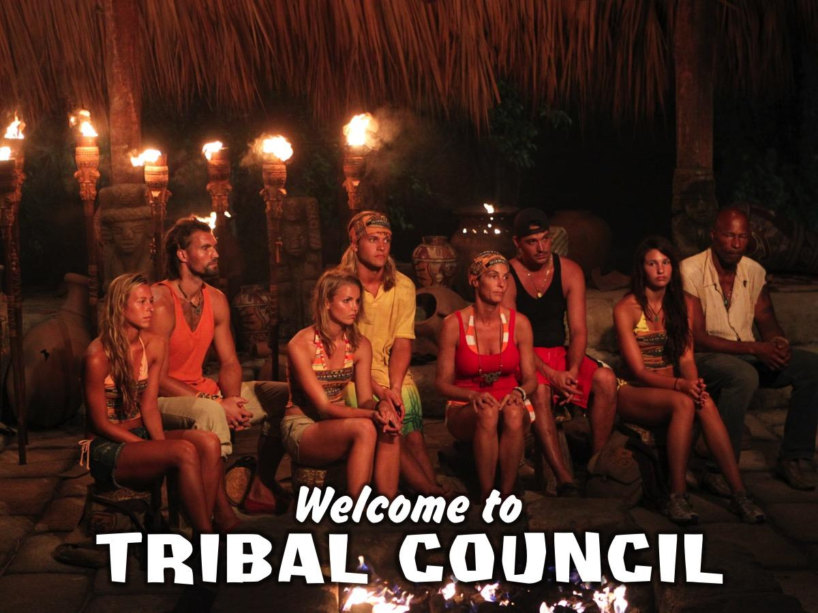
Notes:
The winning tribe is invited to Tribal Council set up on Stage. Jeff congratulates the winning tribe – but says it is time to vote to decide who in the winning team is the Ultimate Survivor. You are each going to get a piece of paper and you must write down the name of the person from your tribe you feel is most deserving of the title of Ultimate Survivor!

Slide 27
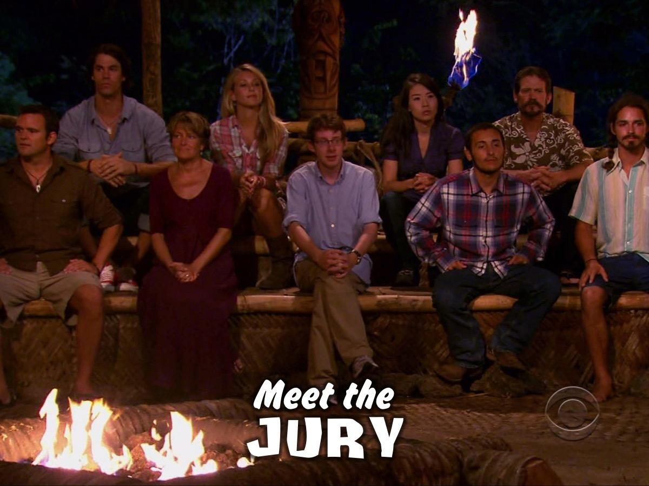
Notes:
But first, let me introduce you to the members of our Jury – who will each also be voting tonight – can one members from each of the losing tribes come forward and take a seat on the jury bench.

Slide 28
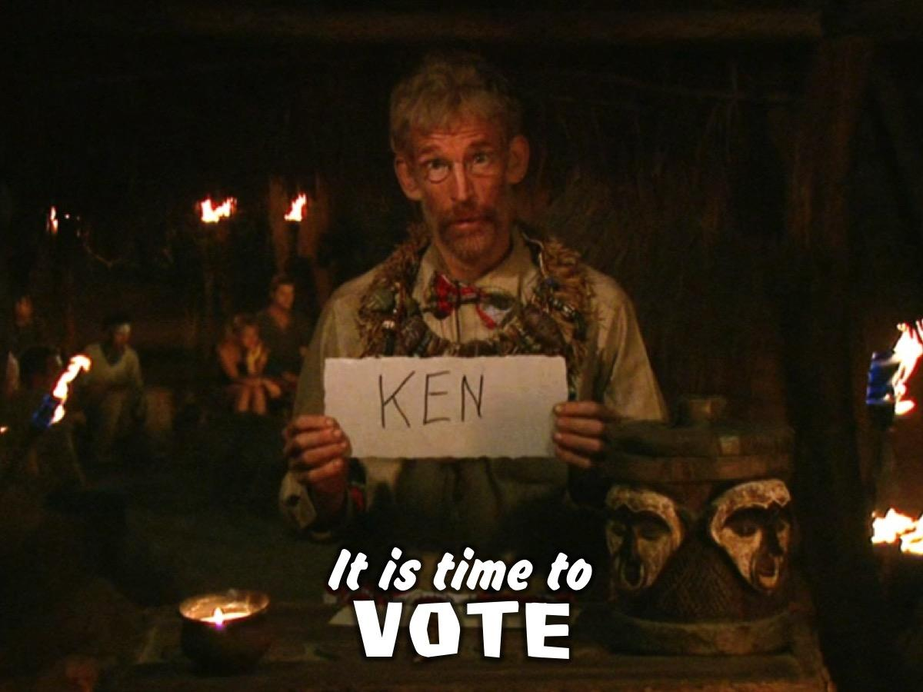
Notes:
Jeff says: “It is…Time to Vote!”
The Offering Box is placed on a stand in the middle of the room and each person has to walk to it and cast their vote.
Jeff says: “I am going to count the votes”

Slide 29
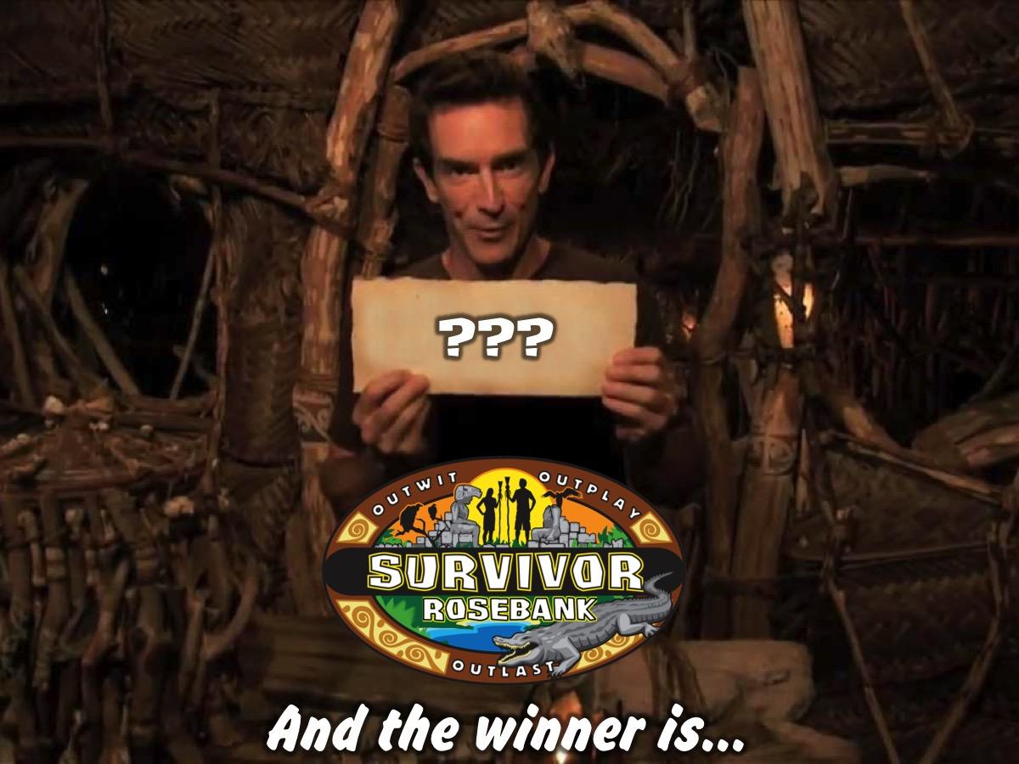
Notes:
The Ultimate Survivor is announced and rewarded.

Slide 30

Notes:
Small Group Time

Slide 31
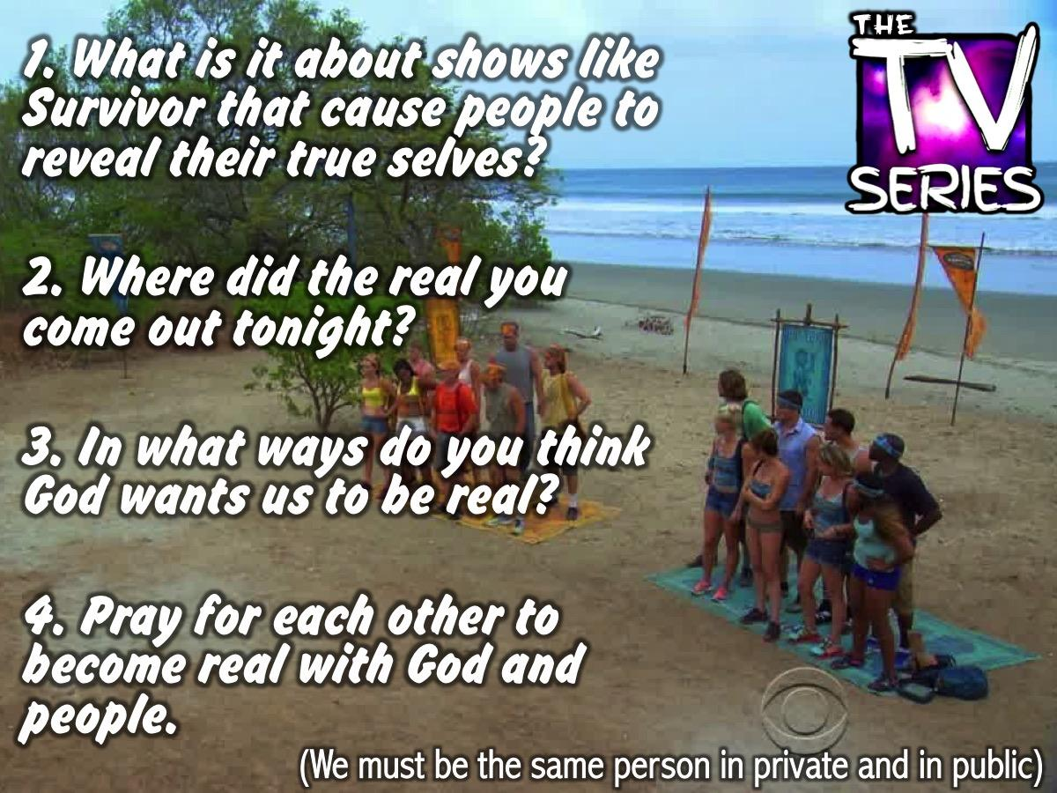
Notes:
Small Group Questions:
1. What is it about shows like Survivor that cause people to show their true selves?
2. Where did the real you come out tonight?
3. In what ways do you think God wants us to be real?
4. Pray for each other to become transparent with people and God.

Slide 32
Notes:
Next Friday night is Flash Night!

Slide 33
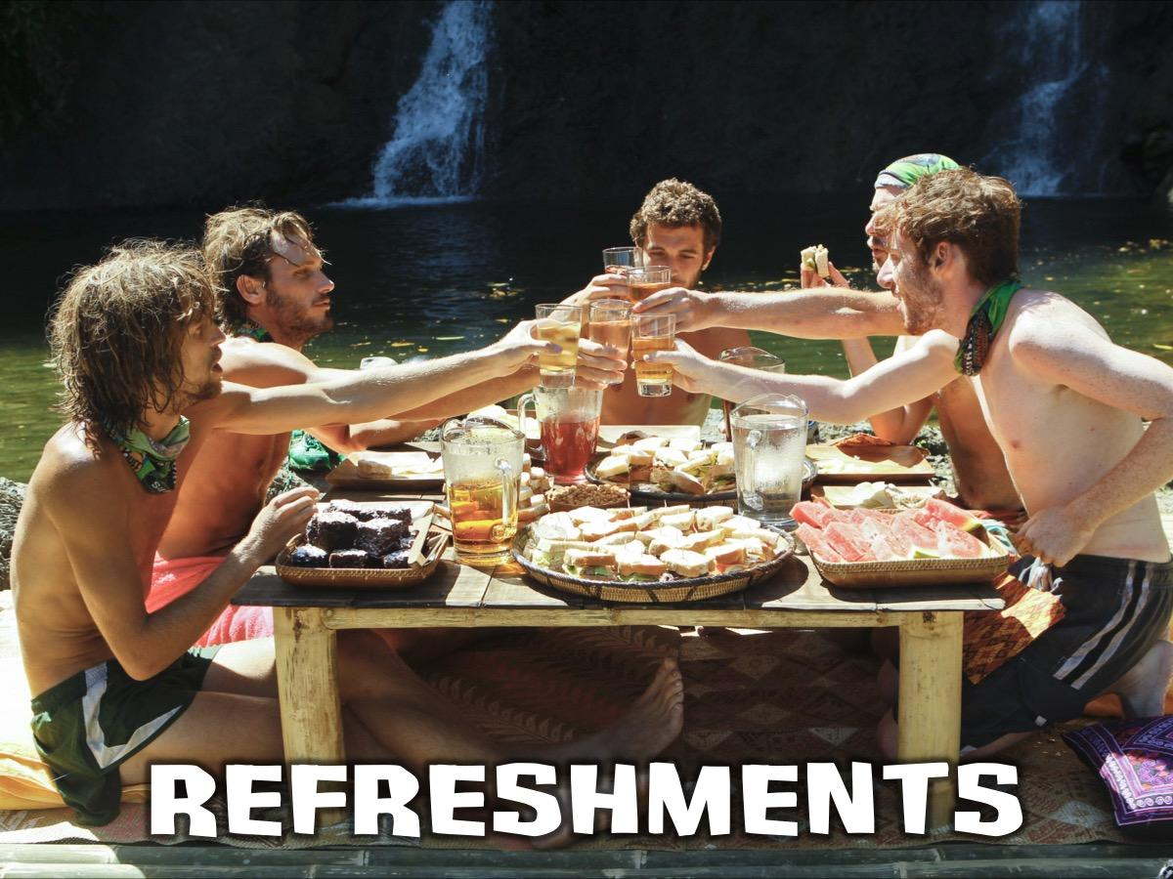
Notes:
Refreshments

