Slide 1

Notes:
Program Overview: Divide the big group into 10 equal sized groups and “visit” different countries (all in the same venue) where the team has to complete a challenge which will help them move on towards the finish line on the giant scoreboard.

Slide 2
Notes:
Pre-Event Video: Top 10 Amazing Race Moments. Get it on YouTube at: https://www.youtube.com/watch?v=m6Sd_atA5jI
Length: 3:45

Slide 3
Notes:
Welcome to The Amazing Race

Slide 4

Notes:
Welcome to our regulars and any newcomers.
So in case you don’t know what the reality show called The Amazing Race is – here is a premier for a new season.

Slide 5
Notes:
Video: The Amazing Race Season Premiere Preview. Get it on YouTube at: https://www.youtube.com/watch?v=SxZ8CpThq8g

Slide 6
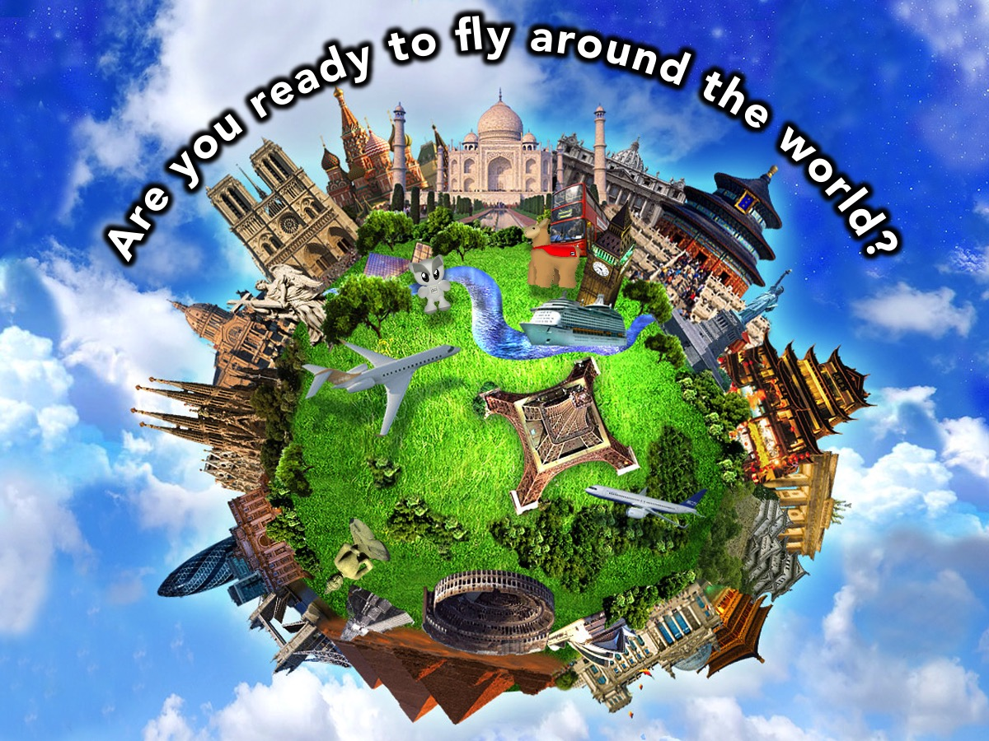
Notes:
Are you ready to fly around the world?

Slide 7
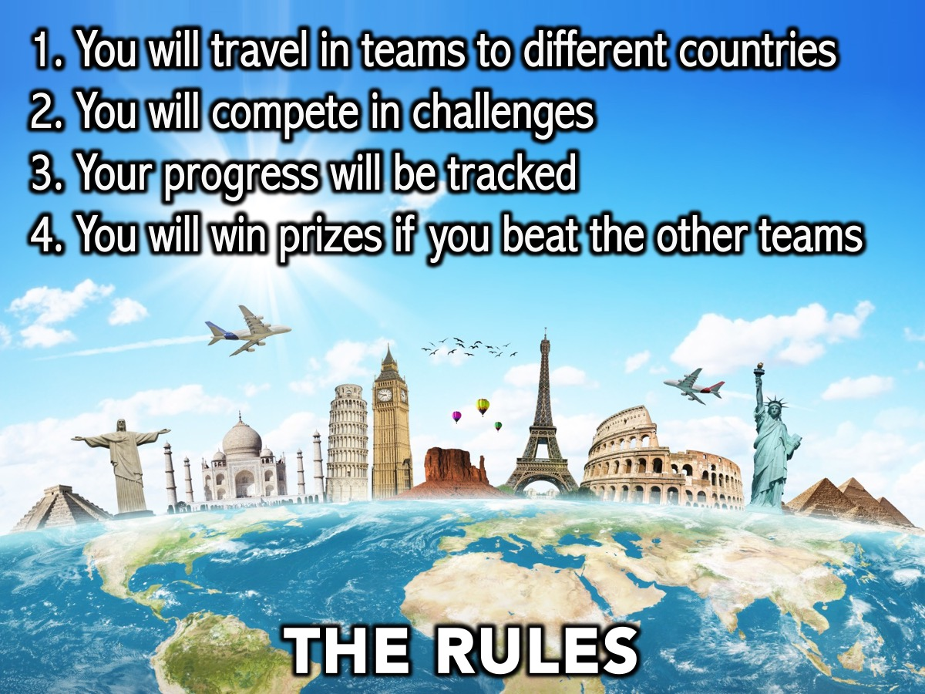
Notes:
The Rules: (1) You will travel in teams to different countries. (2) You will compete in challenges. (3) Your progress will be tracked. (4) You will win prizes if you beat the other teams.

Slide 8
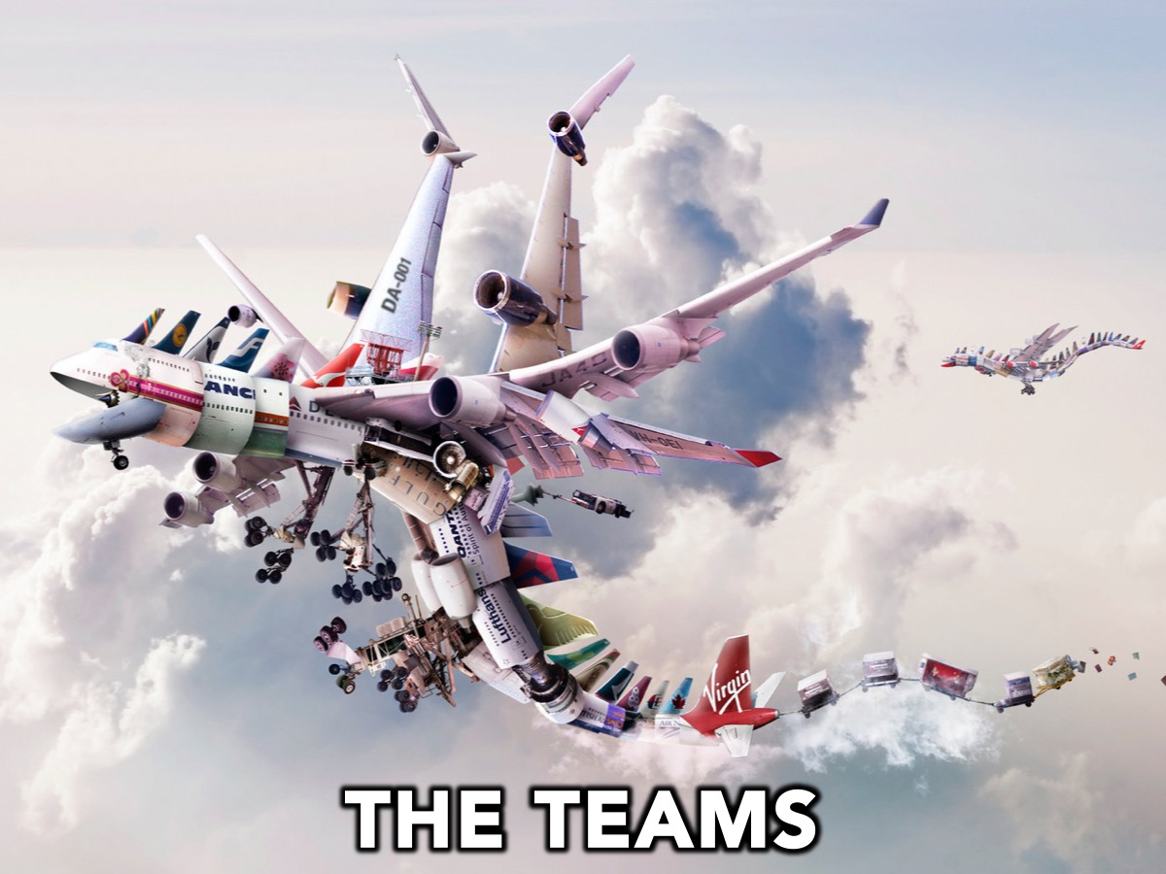
Notes:
The Teams: We are going to divide you up into 10 teams. Each person is given a card with the tail of one of the 10 airlines printed on it. They have to find their team by matching it up with the airplane photo on the wall by one of the 10 teams.

Slide 9
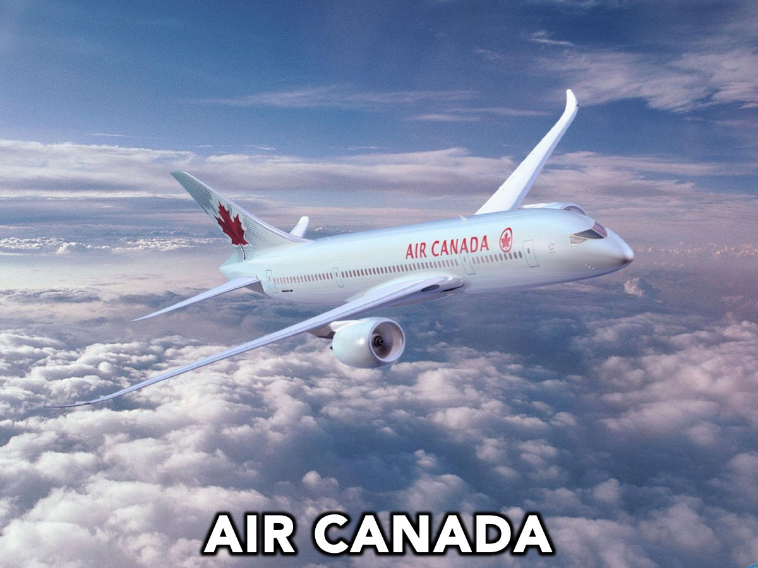
Notes:
Team #1 is Air Canada

Slide 10
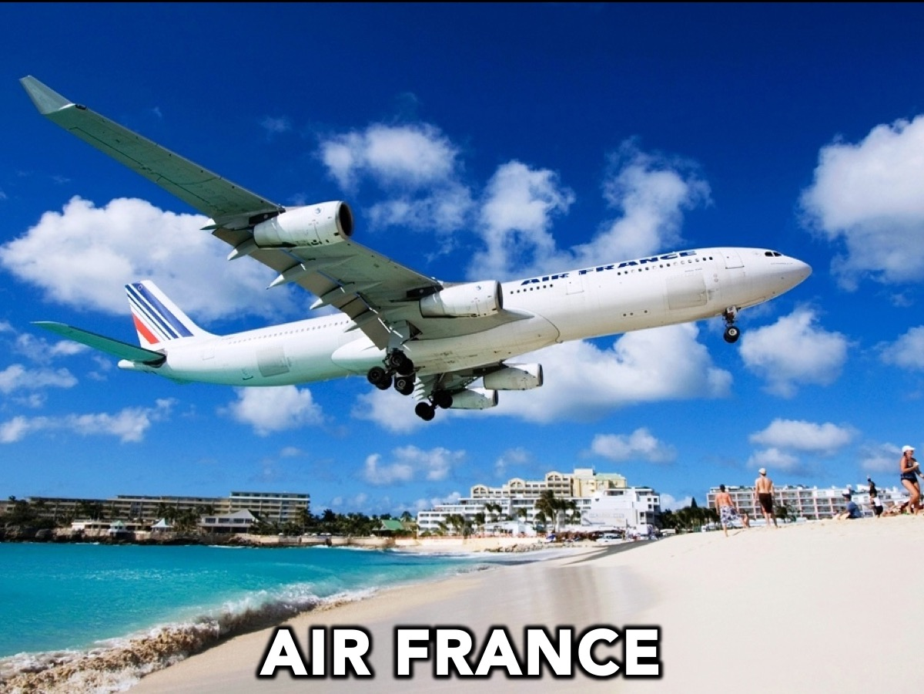
Notes:
Team #2 is Air France

Slide 11
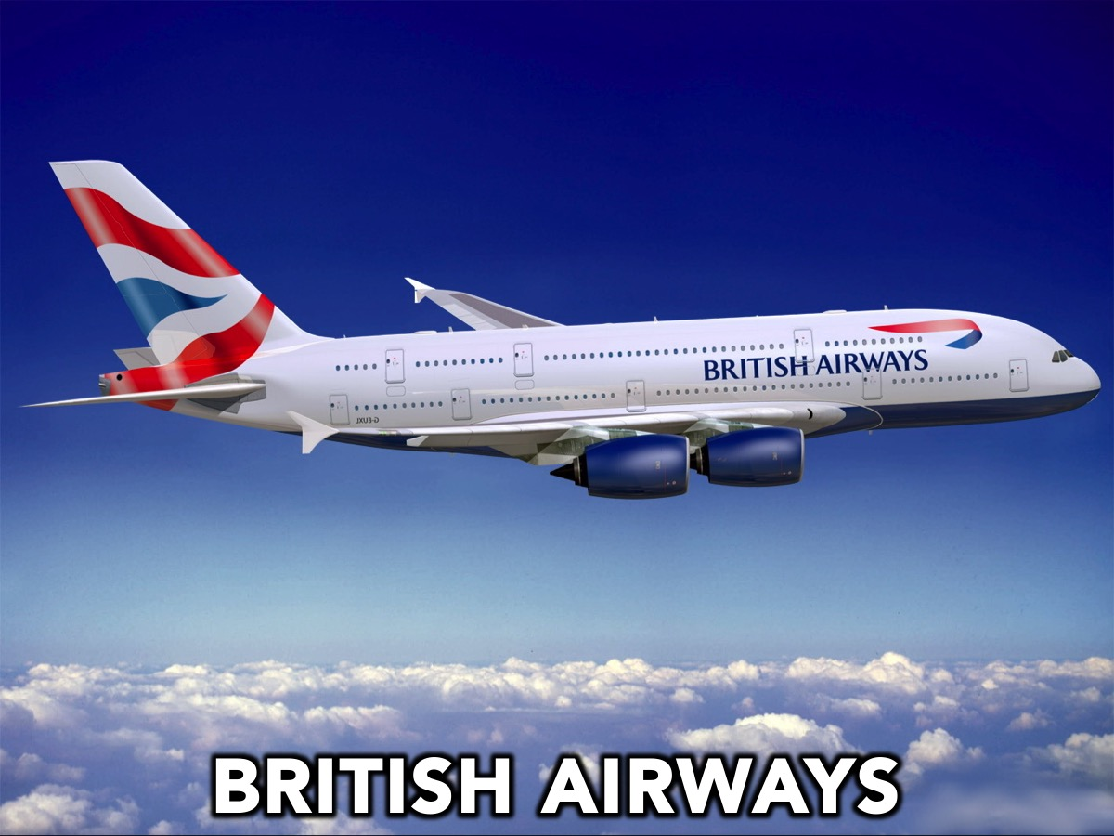
Notes:
Team #3 is British Airways

Slide 12
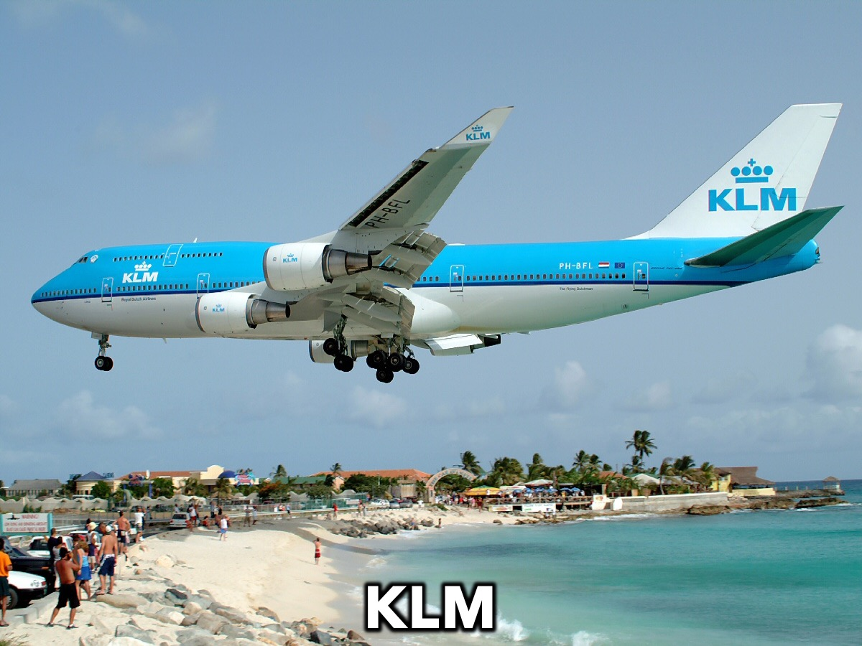
Notes:
Team #4 is KLM

Slide 13
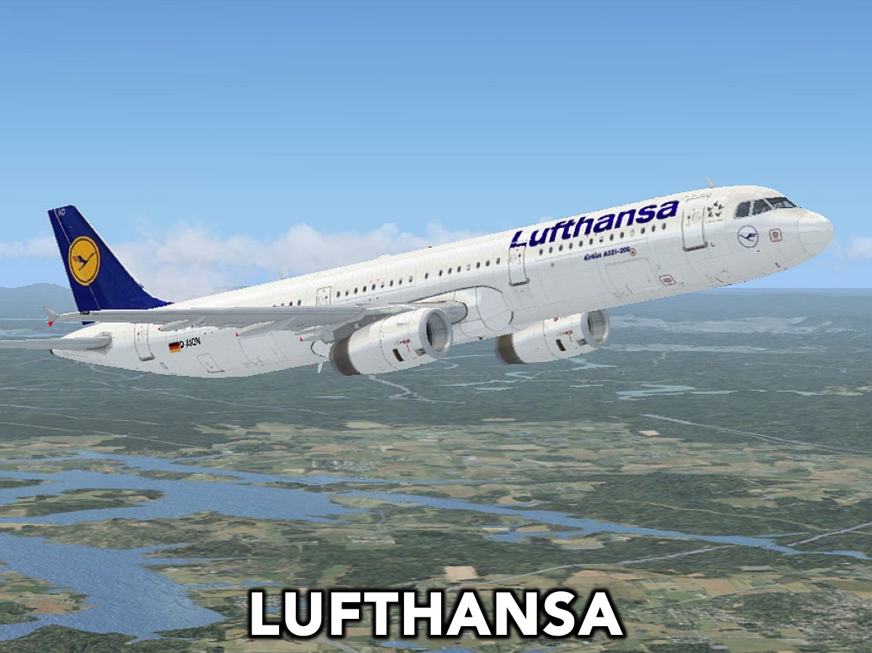
Notes:
Team #5 is Lufthansa

Slide 14
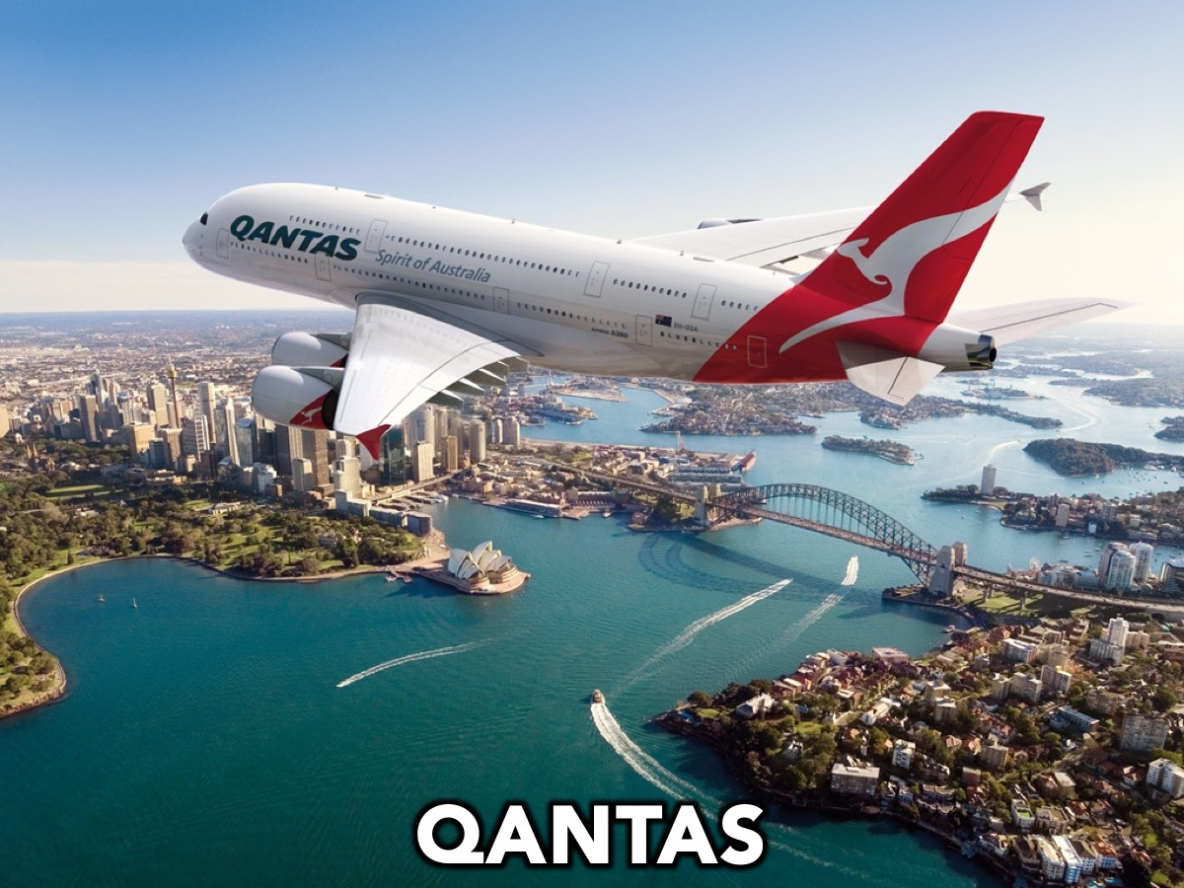
Notes:
Team #6 is Qantas (pronounced Kwantas)

Slide 15
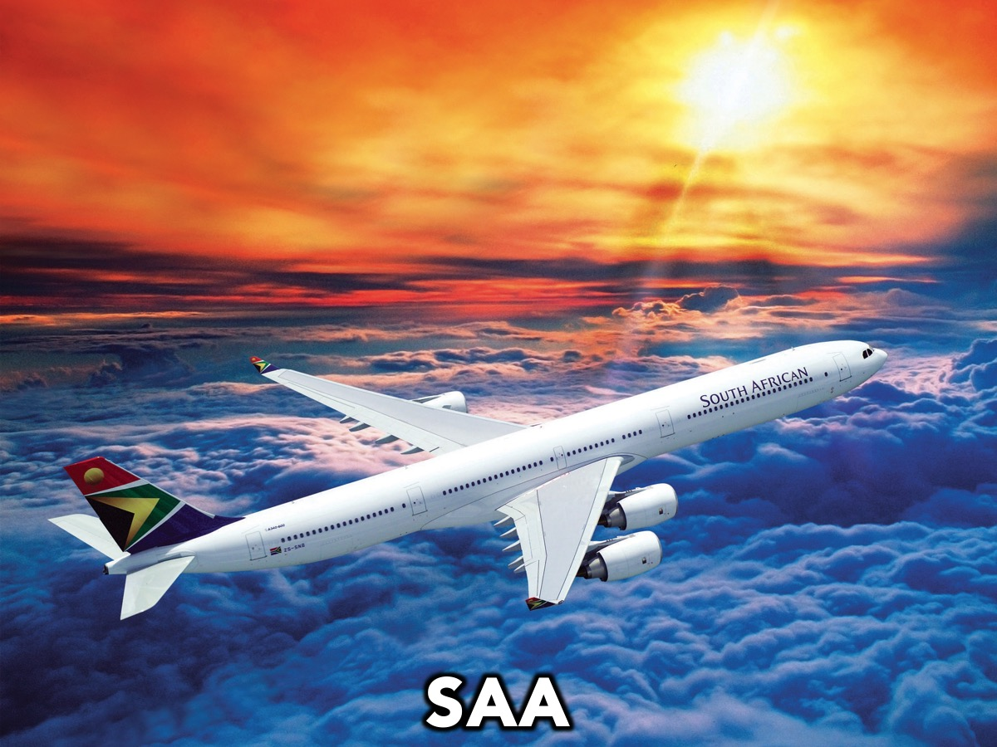
Notes:
Team #7 is SAA

Slide 16
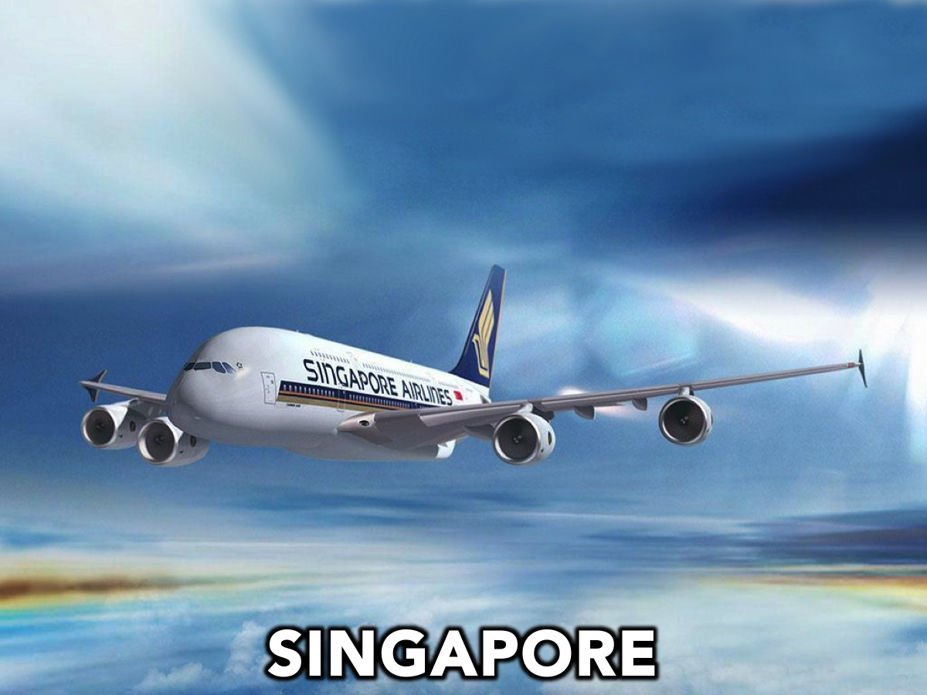
Notes:
Team #8 is Singapore

Slide 17
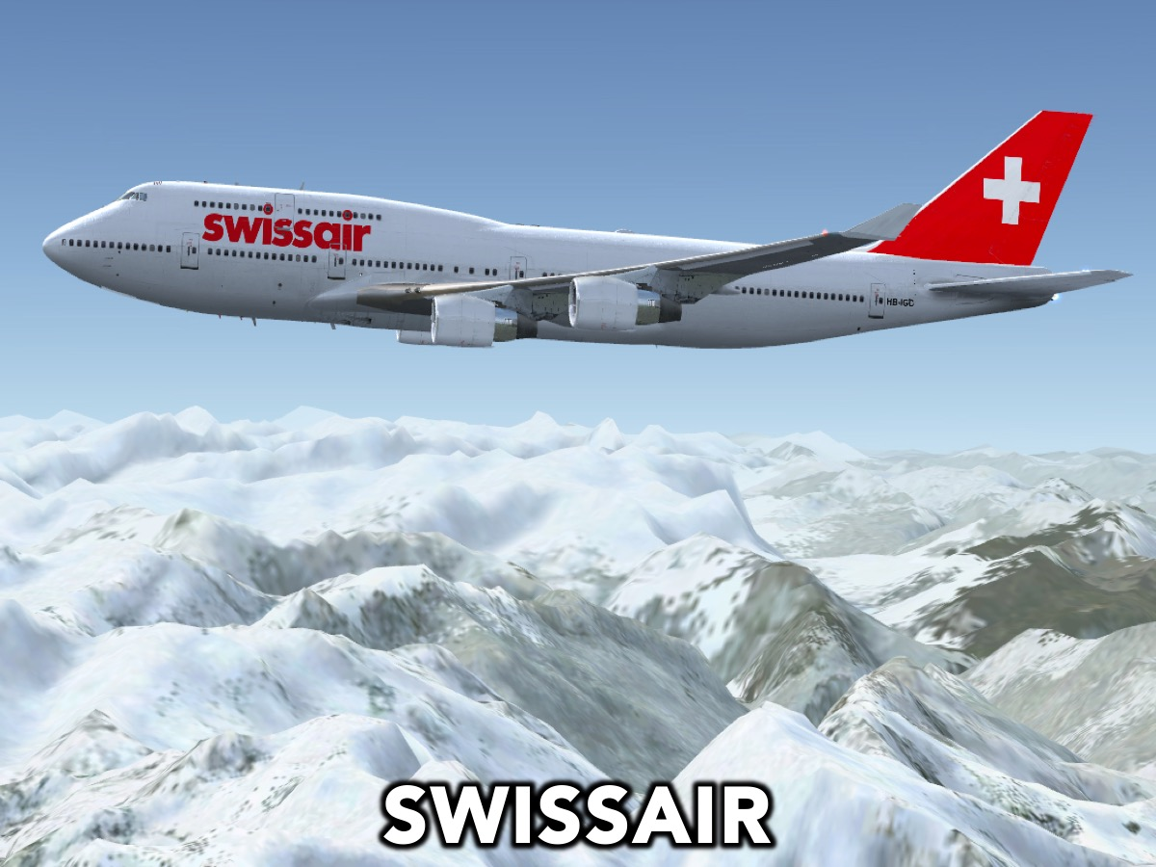
Notes:
Team #9 is Swiss Air

Slide 18

Notes:
Team #10 is Virgin Atlantic

Slide 19
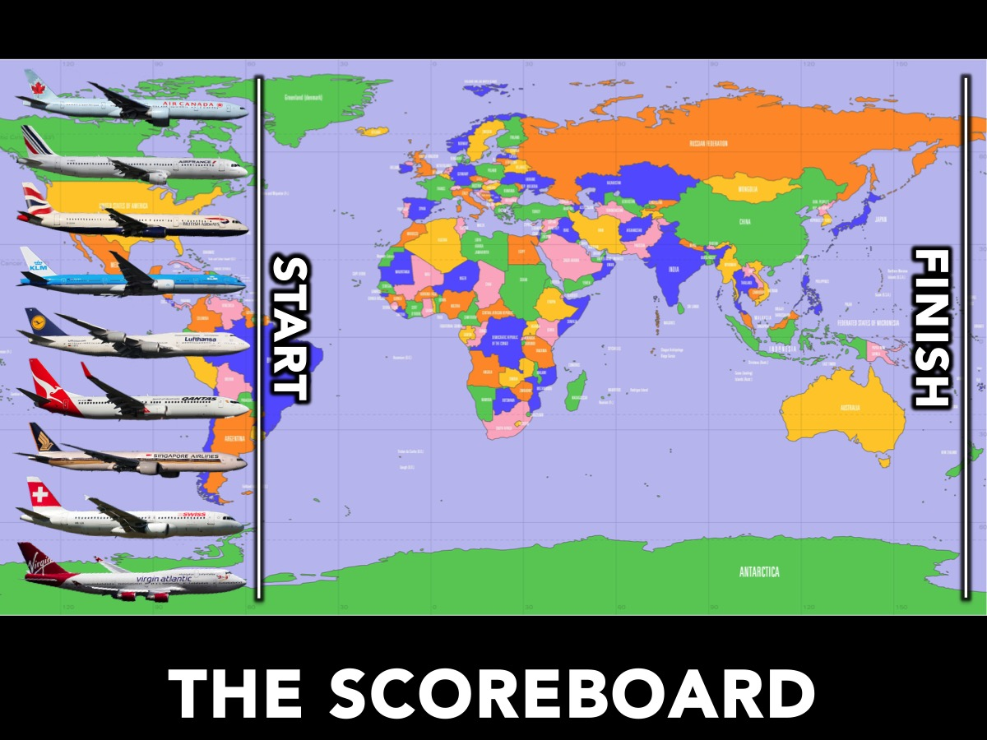
Notes:
Scoreboard – each team has a cardboard cutout of their airplane that is moved along the printed map of the world as teams earn point for each leg of the race.

Slide 20
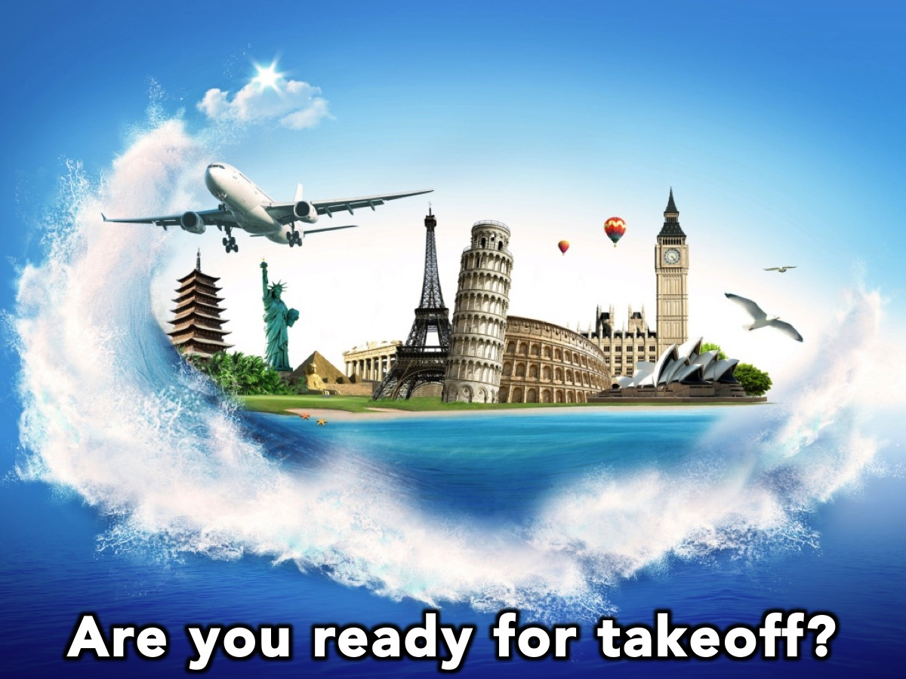
Notes:
Are you ready for takeoff?

Slide 21
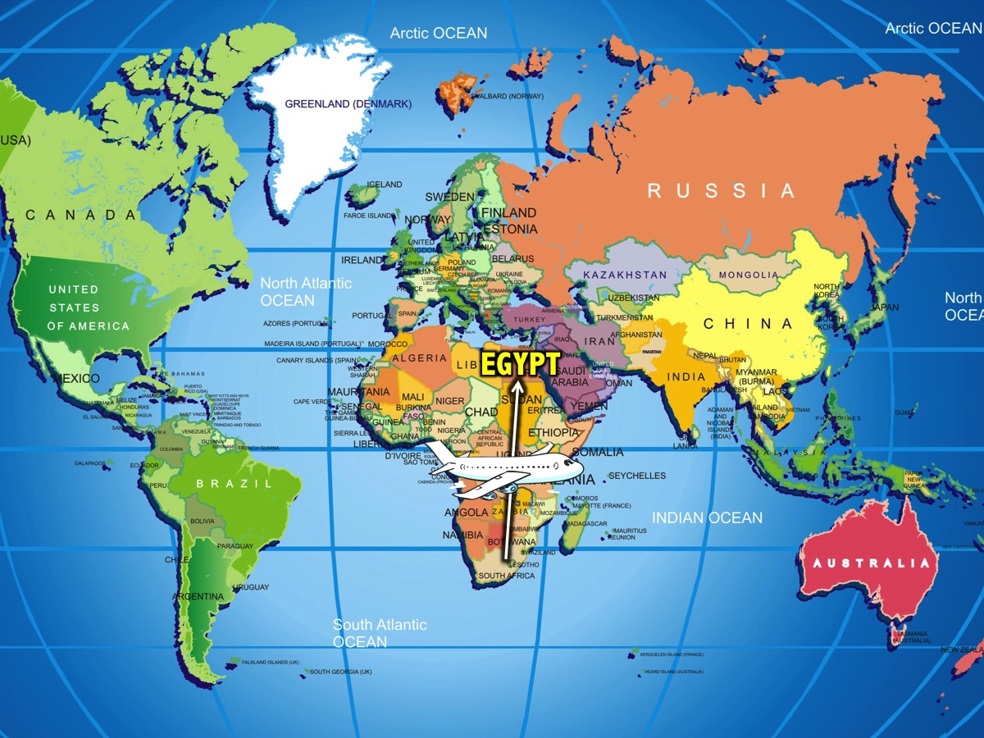
Notes:
Our first destination is Egypt!

Slide 22

Notes:
1. EGYPT

Slide 23
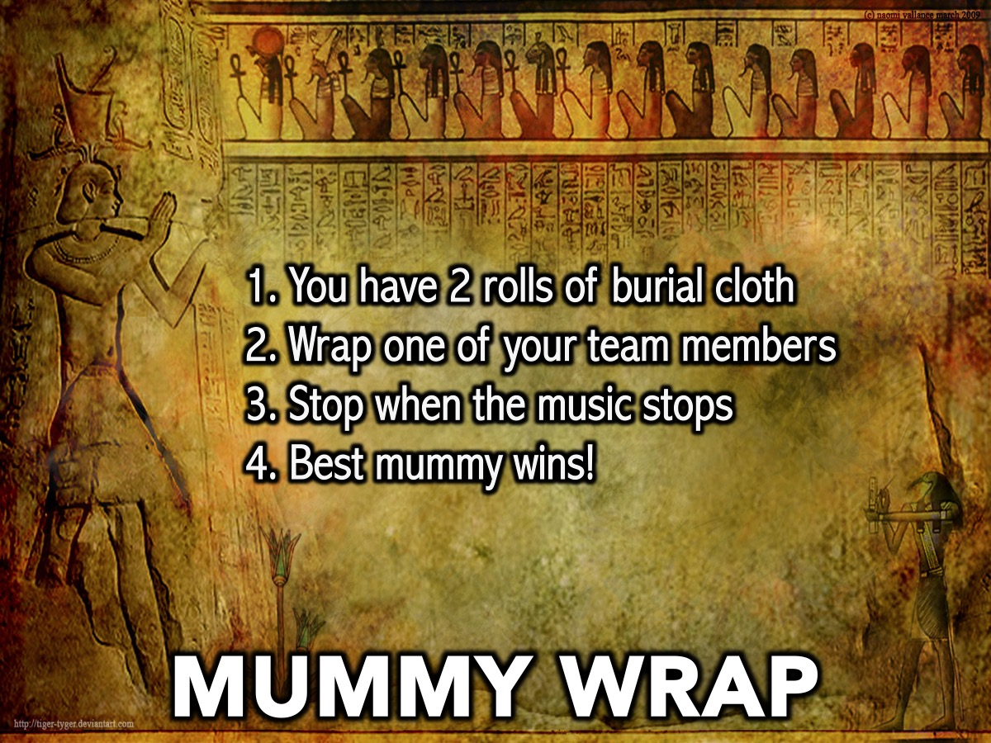
Notes:
Mummy Wrap: You have to wrap one of your team members with 3 rolls of toilet paper wins. When the music stops we will judge which team member is the best mummy!
Supplies: 3 rolls of toilet paper for each team

Slide 24
Notes:
1. EGYPT
Mummy Wrap: You have to wrap one of your team members with 3 rolls of toilet paper wins. When the music stops we will judge which team member is the best mummy!
Supplies: 3 rolls of toilet paper for each team.

Slide 25
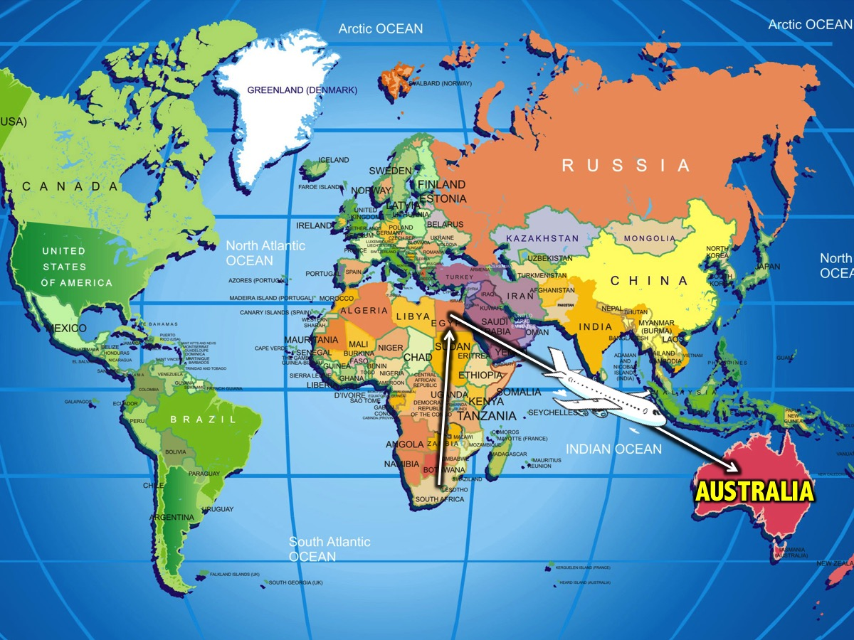
Notes:
Our next destination is Australia!

Slide 26

Notes:
2. AUSTRALIA

Slide 27
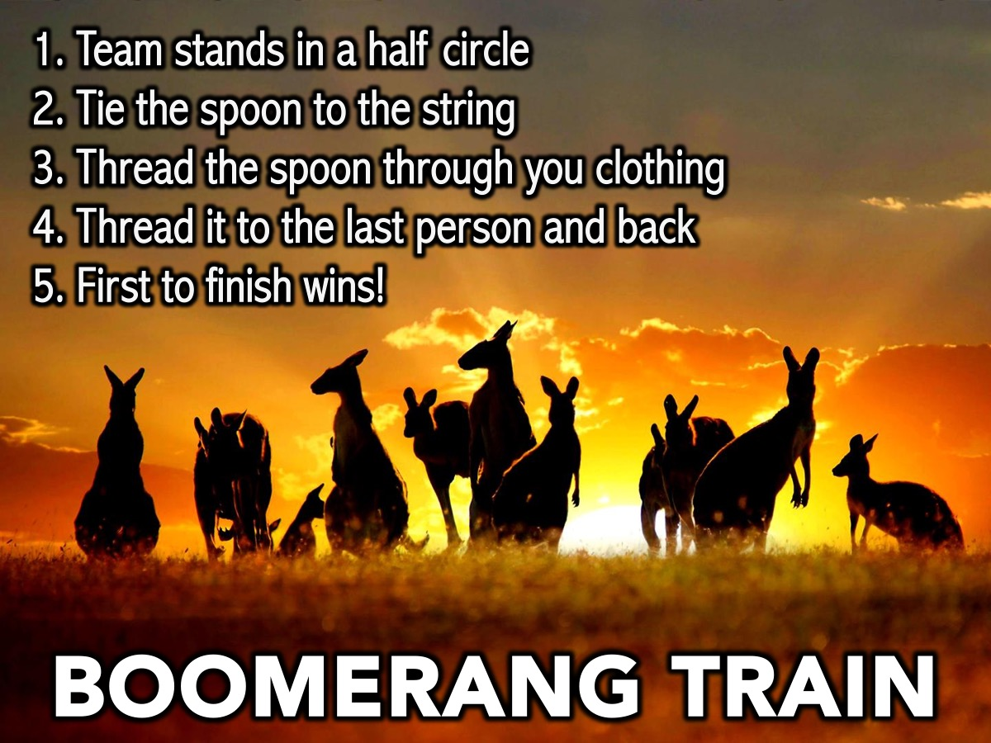
Notes:
Boomerang Train: Teams stand in a half circle. Each team has a large spoon with a ball of string tied to it. The first team to weave the spoon through each team member and back again to the start wins.
Supplies: 10 Spoons. Ball of string for each team .

Slide 28
Notes:
2. AUSTRALIA
Boomerang Train: Teams stand in a half circle. Each team has a large spoon with a ball of string tied to it. The first team to weave the spoon through each team member and back again to the start wins.
Supplies: 10 Spoons. Ball of string for each team .

Slide 29
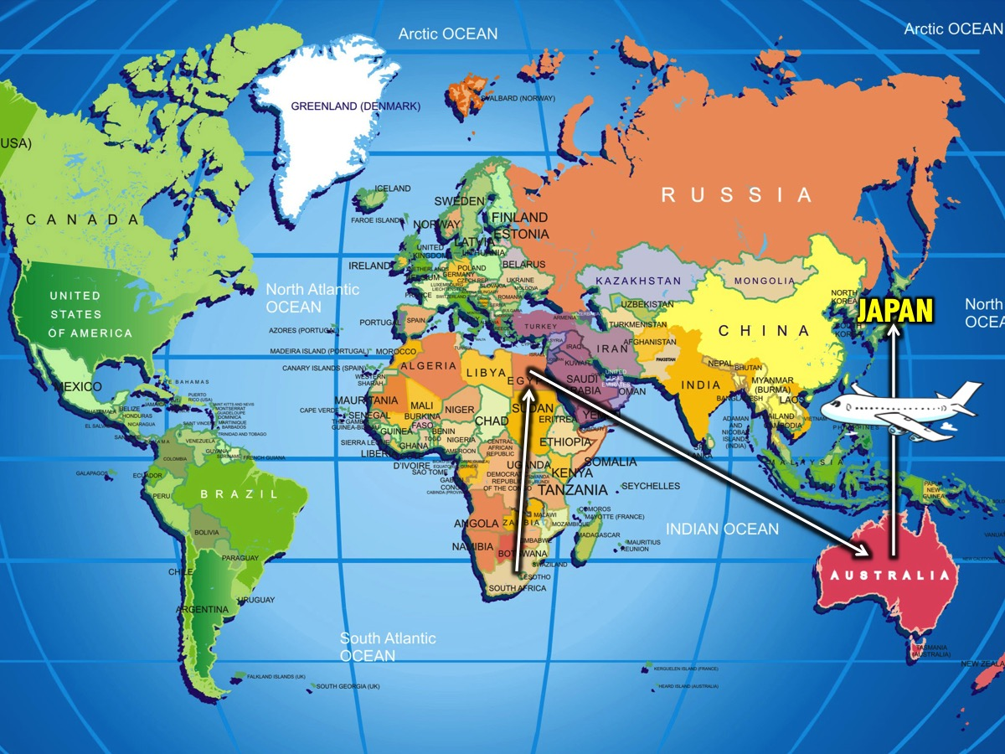
Notes:
Our next destination is Japan!

Slide 30

Notes:
3. JAPAN

Slide 31
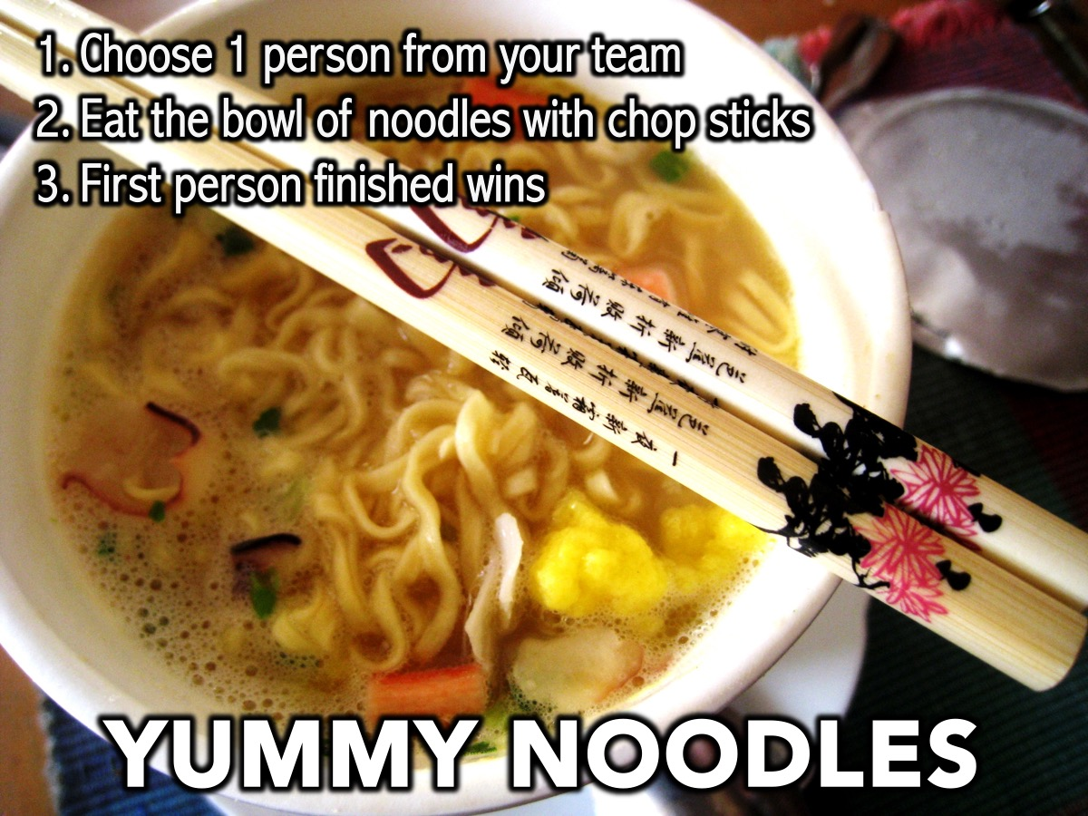
Notes:
3. JAPAN
Yummy Noodles: Each team is given a bowl of noodles to be eaten with chop sticks.
Supplies: 10 packets of 2-Minute Noodles. 10 sets of chop sticks.

Slide 32
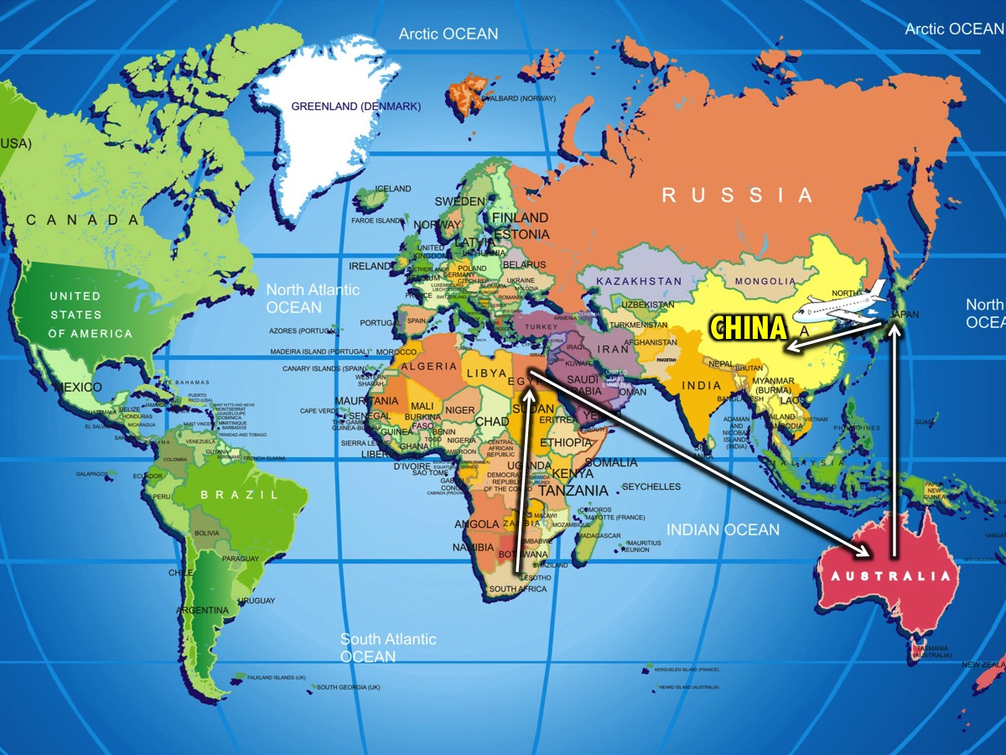
Notes:
Our next destination is China!

Slide 33
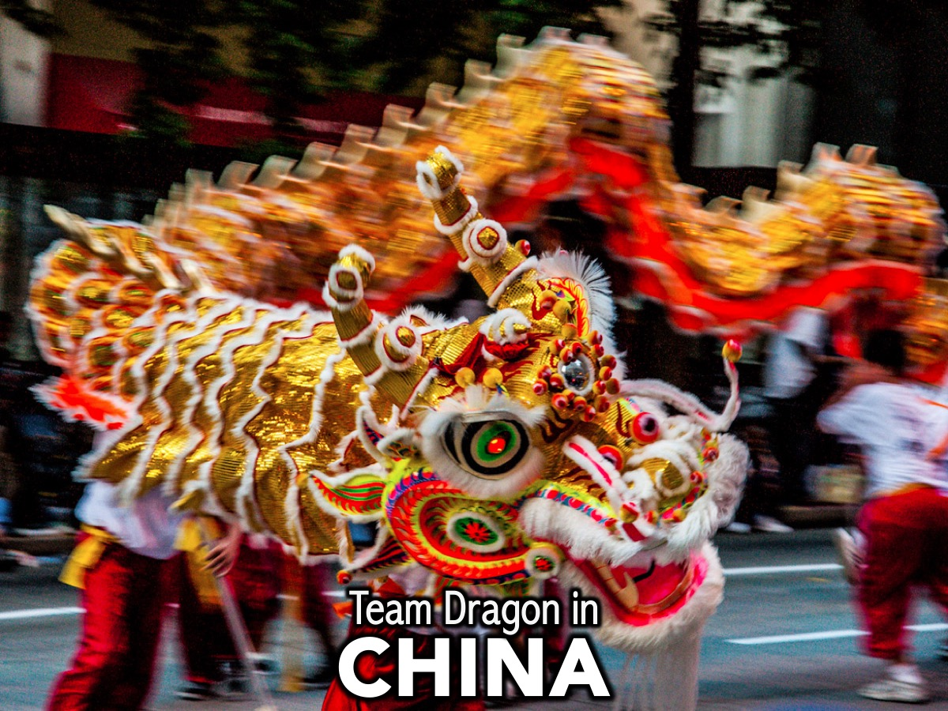
Notes:
4. CHINA

Slide 34
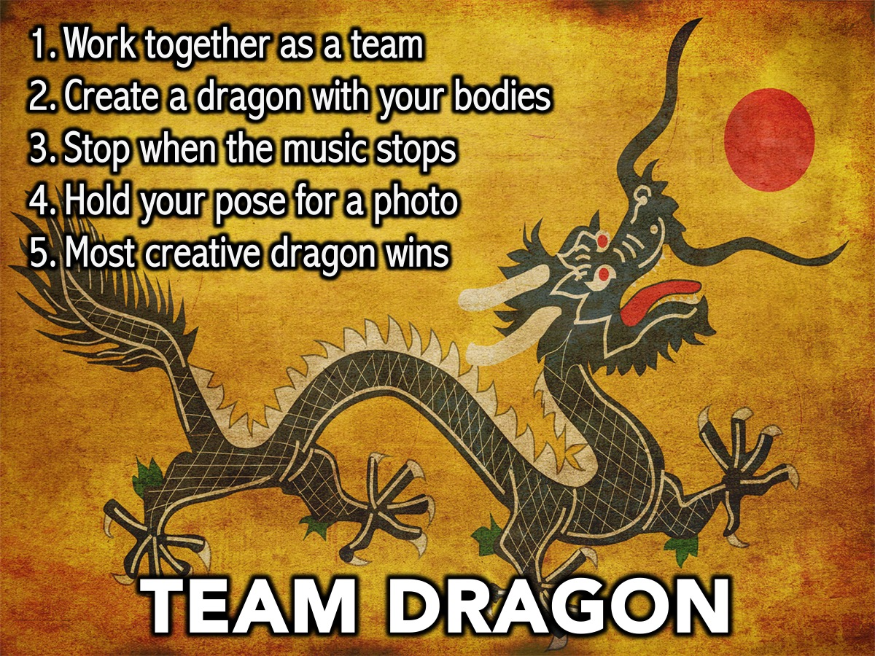
Notes:
4. CHINA
Team Dragon: Every member in the team has to work together to form a Chinese Dragon with their bodies – most creative team dragon wins. When the music stops you will be judged!
Supplies: None!

Slide 35
Notes:
4. CHINA
Team Dragon: Every member in the team has to work together to form a Chinese Dragon with their bodies – most creative team dragon wins. When the music stops you will be judged!
Supplies: None!

Slide 36

Notes:
Our next destination is India!

Slide 37
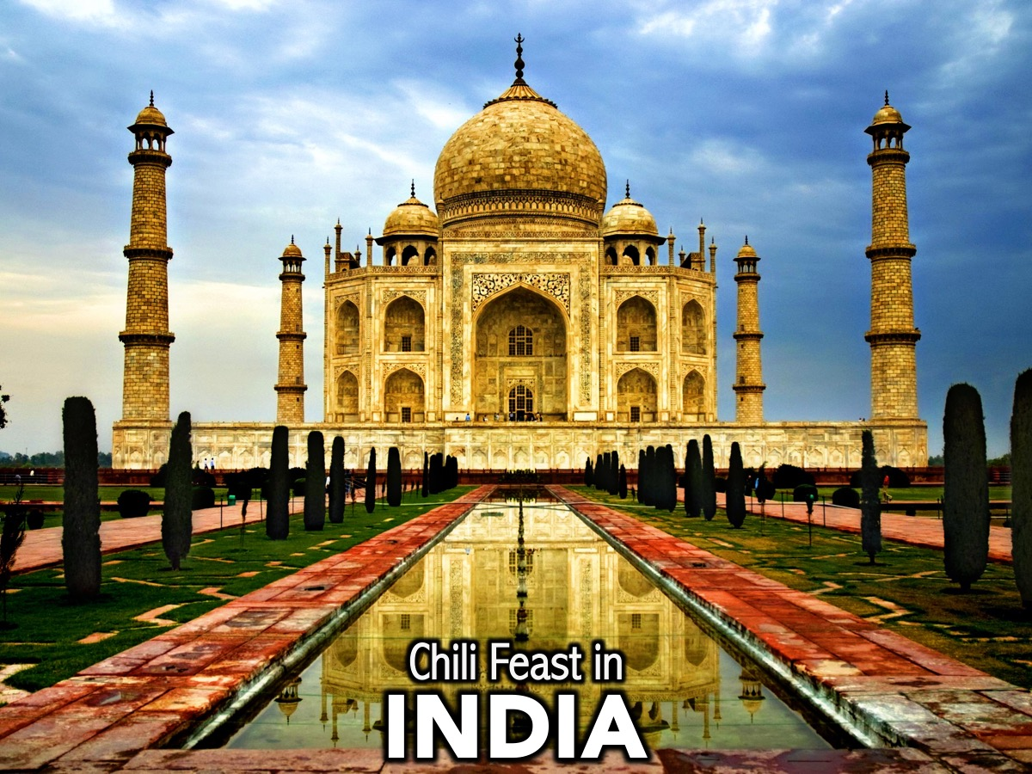
Notes:
5. INDIA

Slide 38
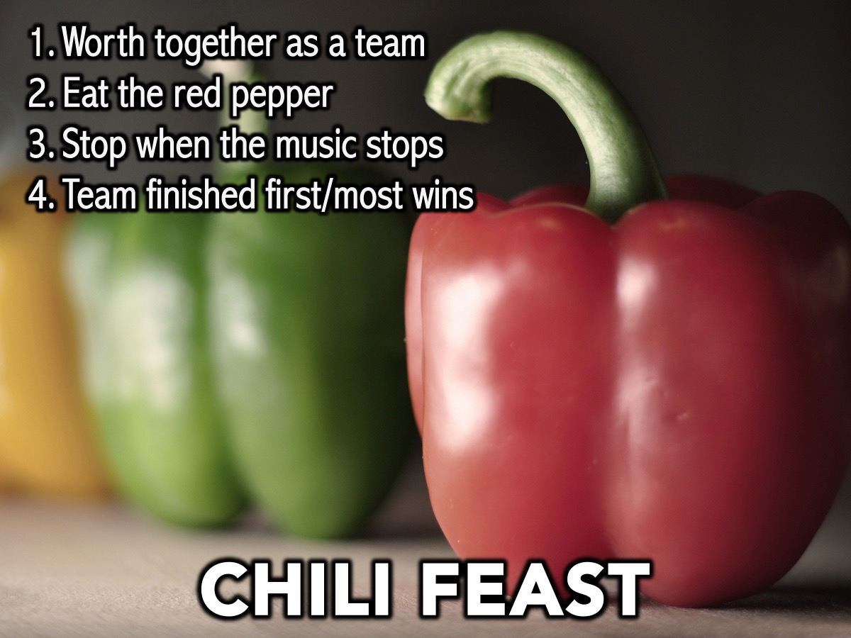
Notes:
5. INDIA
Chili Feast: The first team to eat a whole red pepper wins or the team with the most finished by the time the music stops wins the challenge.
Supplies: 10 red peppers.

Slide 39
Notes:
5. INDIA
Chili Feast: The first team to eat a whole red pepper wins or the team with the most finished by the time the music stops wins the challenge.
Supplies: 10 red peppers.

Slide 40
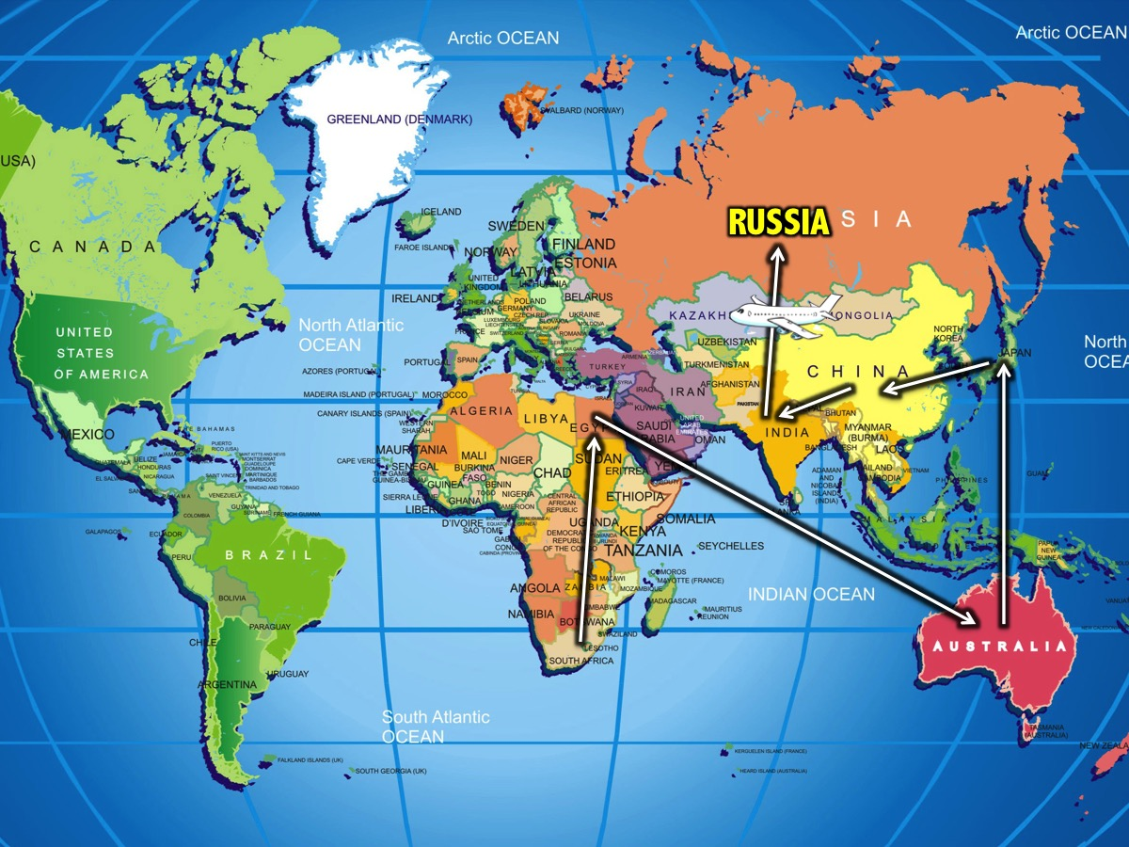
Notes:
Our next destination is Russia!

Slide 41

Notes:
6. RUSSIA

Slide 42
Notes:
Video: Jumpstyle Demo. Get it on YouTube at: https://www.youtube.com/watch?v=EzxmIFuAA7k

Slide 43
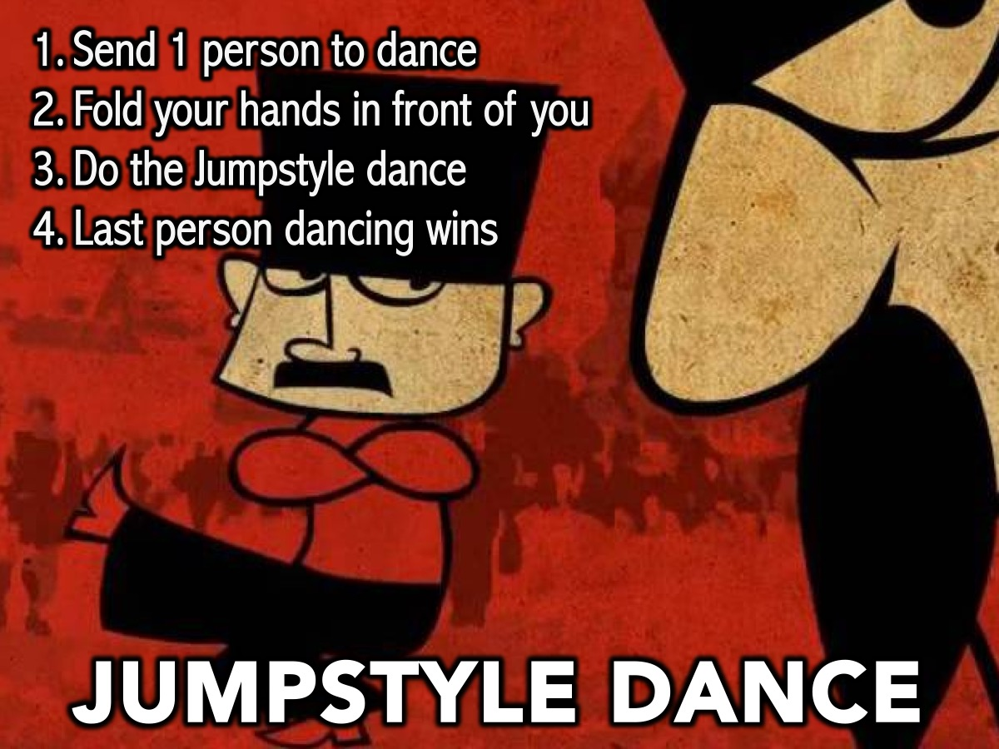
Notes:
6. RUSSIA
Jumpstyle Dance: Each team sends 1 person to the stage to compete in the Russian Jumpstyle dance where they fold their hands in front of them and alternatively kick their feet out in front of them – the last person standing wins. Play video in background.
Supplies: Video of Russian soldiers doing the Jumpstart.

Slide 44
Notes:
Video: Jumpstyle Video. Get it on YouTube at: https://www.youtube.com/watch?v=I90Y3XQ_guc

Slide 45

Notes:
Our next destination is Germany!

Slide 46

Notes:
7. GERMANY

Slide 47
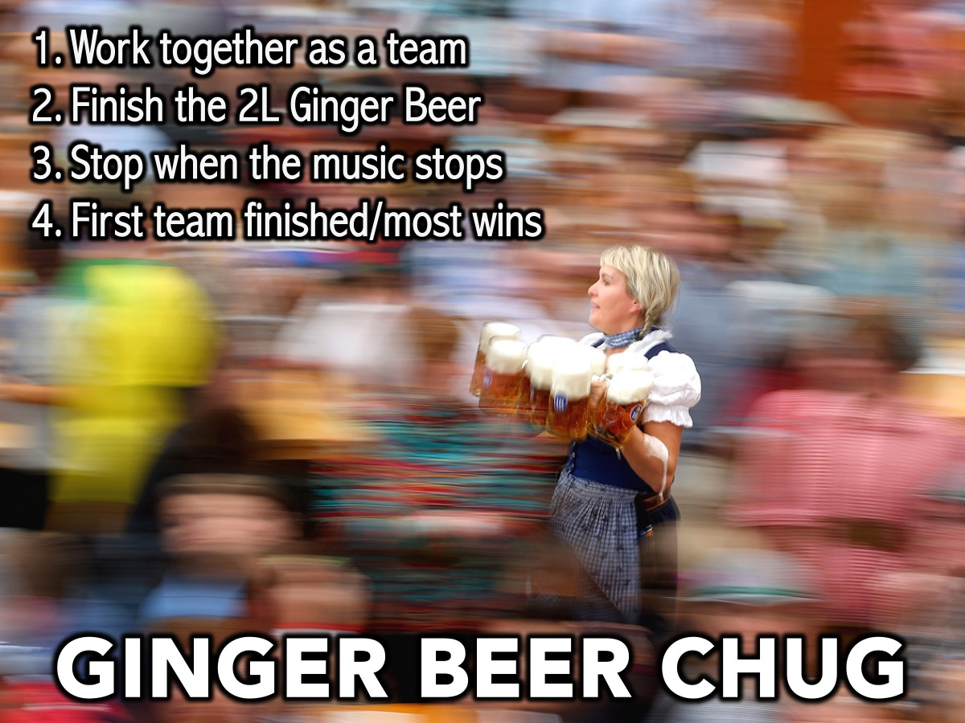
Notes:
7. GERMANY
Ginger Beer Chug: First team to finish a 2-liter bottle of ginger beer wins - or the team with the most finished when the music stops wins.
Supplies: 2L bottle of ginger beer

Slide 48
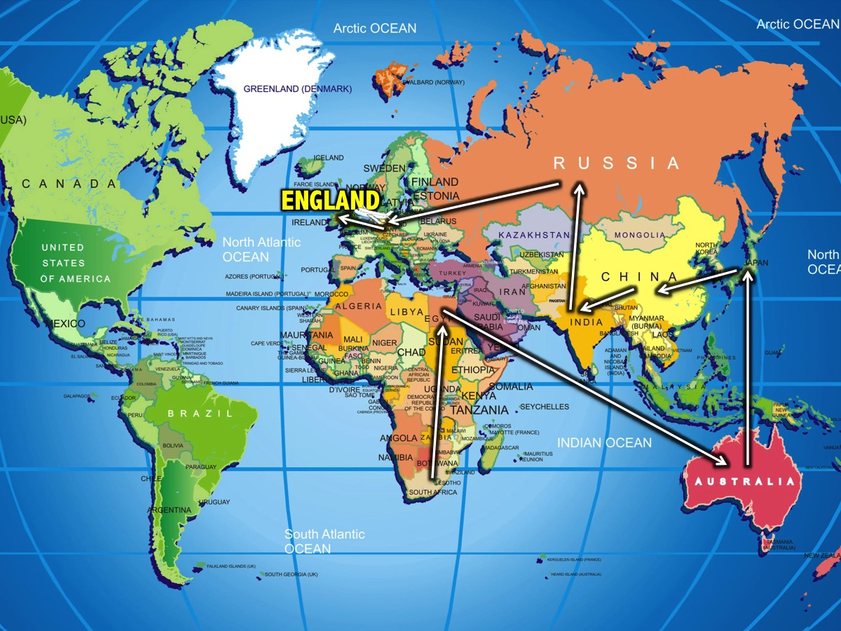
Notes:
Our next destination is England!

Slide 49

Notes:
8. ENGLAND

Slide 50
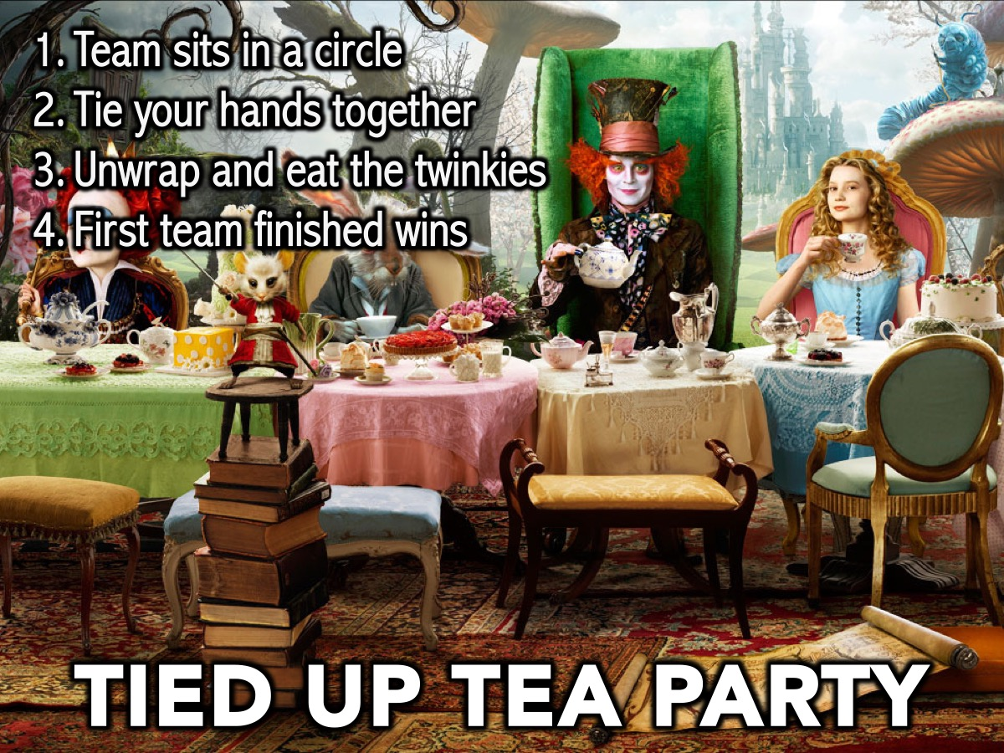
Notes:
8. ENGLAND
Tied Up Tea Party: Teams sit in a circle, with hands tied together and the first team to unwrap and eat their cakes wins.
Supplies: Ties for wrists, 5 Twinkies per group.

Slide 51
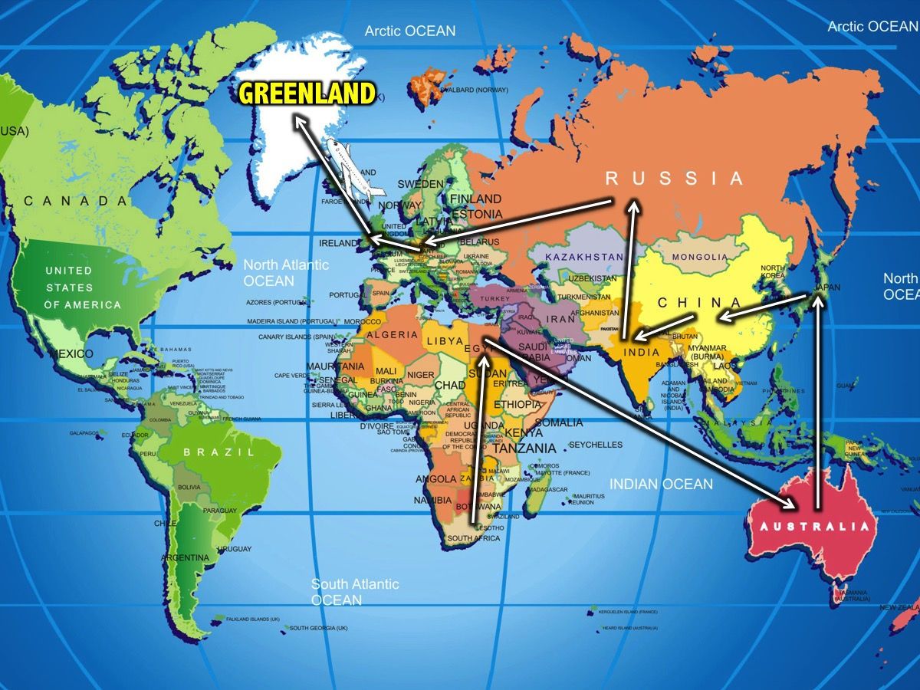
Notes:
Our next destination is Greenland!

Slide 52

Notes:
9. GREENLAND

Slide 53
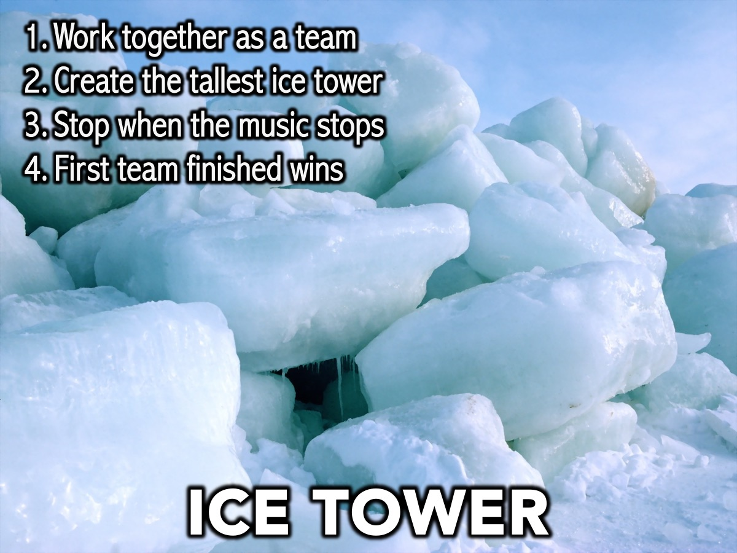
Notes:
9. GREENLAND
Ice Tower: Using Ice Cubes each team must build the tallest ice tower out of the cubes they are given. When the music stops you must stop building.
Supplies: Ice Cubes for each team

Slide 54
Notes:
9. GREENLAND
Ice Tower: Using Ice Cubes each team must build the tallest ice tower out of the cubes they are given. When the music stops you must stop building.
Supplies: Ice Cubes for each team

Slide 55
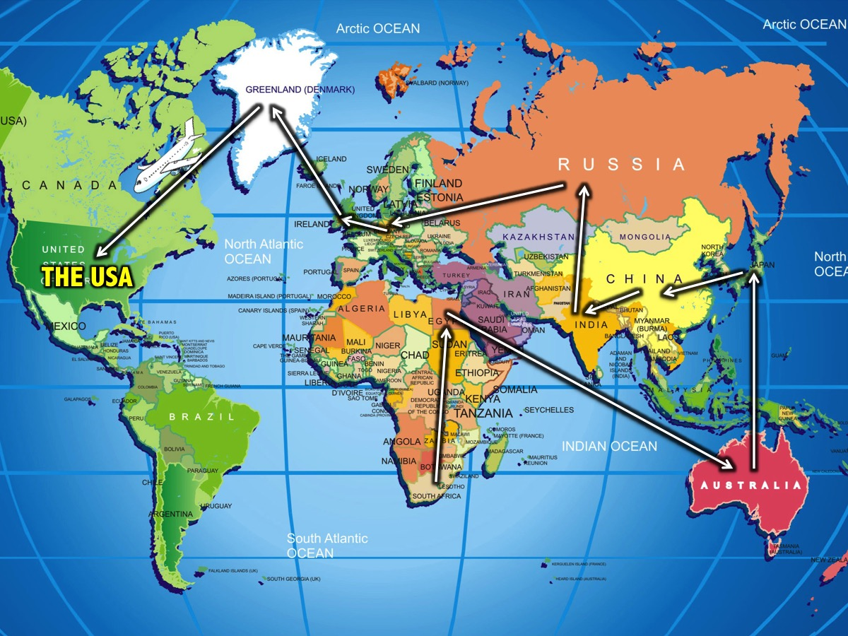
Notes:
Our final destination is The USA!

Slide 56

Notes:
10. THE USA

Slide 57
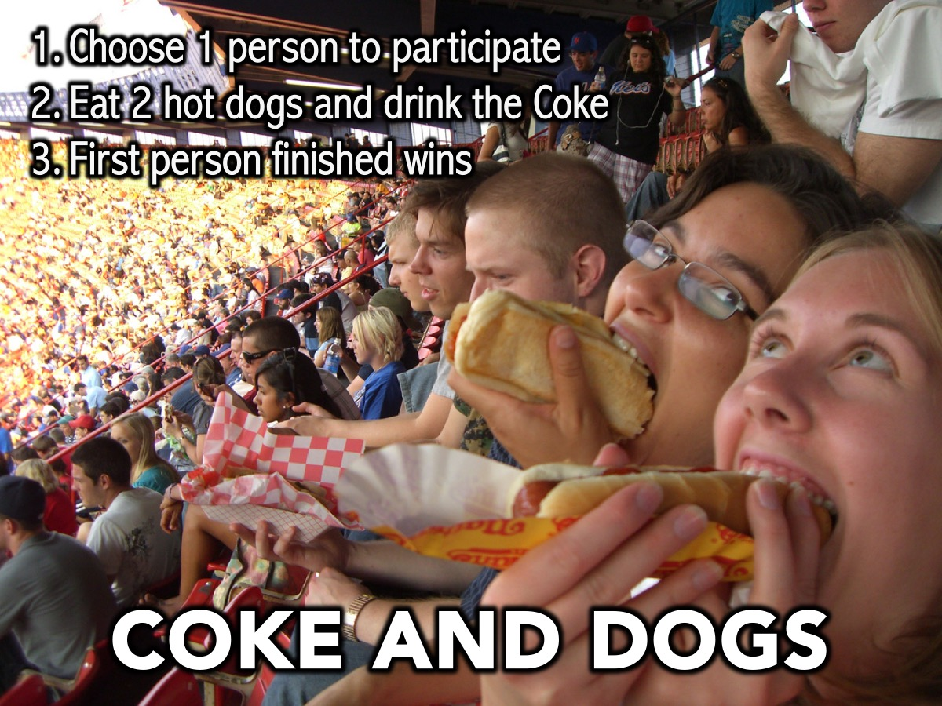
Notes:
10. THE USA
Hot Dog and Coke Feast: One person has to eat 2 hot dogs and finish a can of coke.
Supplies: 20 Hot Dogs, 10 cans of coke

Slide 58
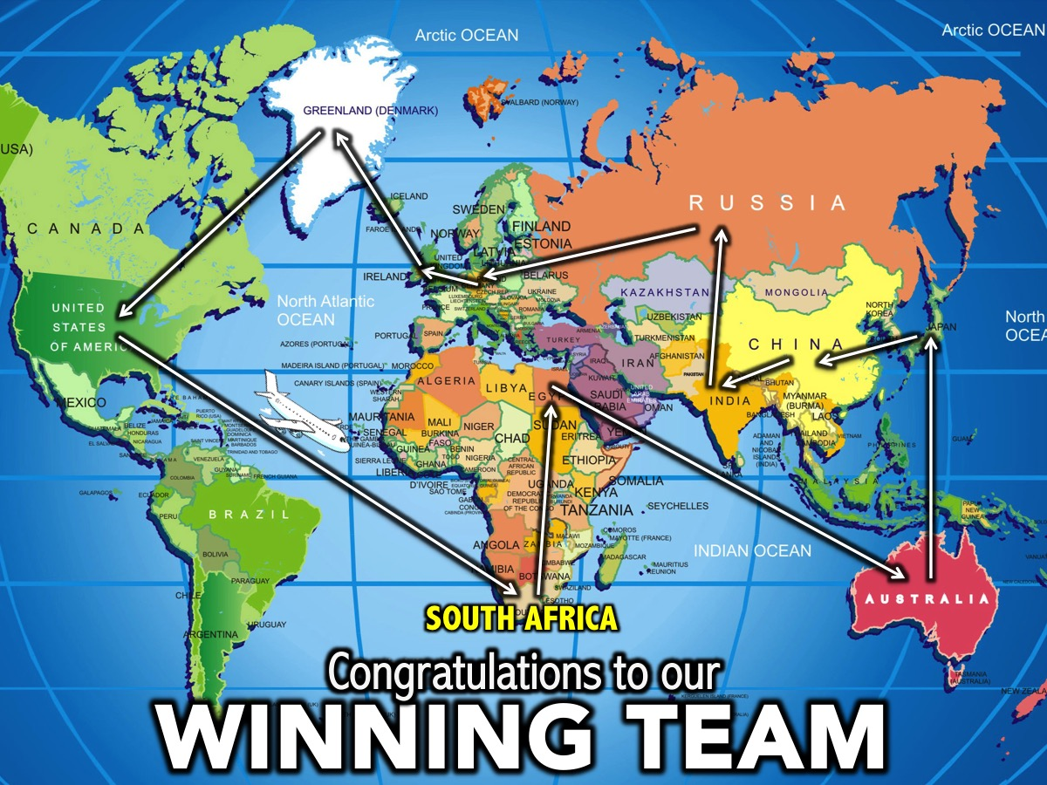
Notes:
Congratulations to our winning team! Come up to the stage for your prizes and a team photo!

Slide 59

Notes:
The Small Groups: Here are the questions for our small group time: (1) What lessons for life did you learn from tonight? (2) What is Amazing about the Race that is your life? (3) Which country could God use you to touch one day? (4) How can I pray for you as we close tonight?

Slide 60

Notes:
Refreshments

