Slide 1

Notes:
Tomb Raider Night

Slide 2

Notes:
Welcome to Live Friday

Slide 3

Notes:
Welcome to our regulars and any newcomers.

Slide 4

Notes:
Announcements: On Sunday morning we continue with our Revolution Series. And next Friday night it is our Watch_Dogs Night.

Slide 5
Notes:
Tonight is Tomb Raider Night.

Slide 6

Notes:
Here is the trailer from the Lara Croft Tomb Raider Reborn game.
Video: Tomb Raider Official Reborn Trailer. Get it on YouTube at: https://www.youtube.com/watch?v=twjNaXJvZfk

Slide 7
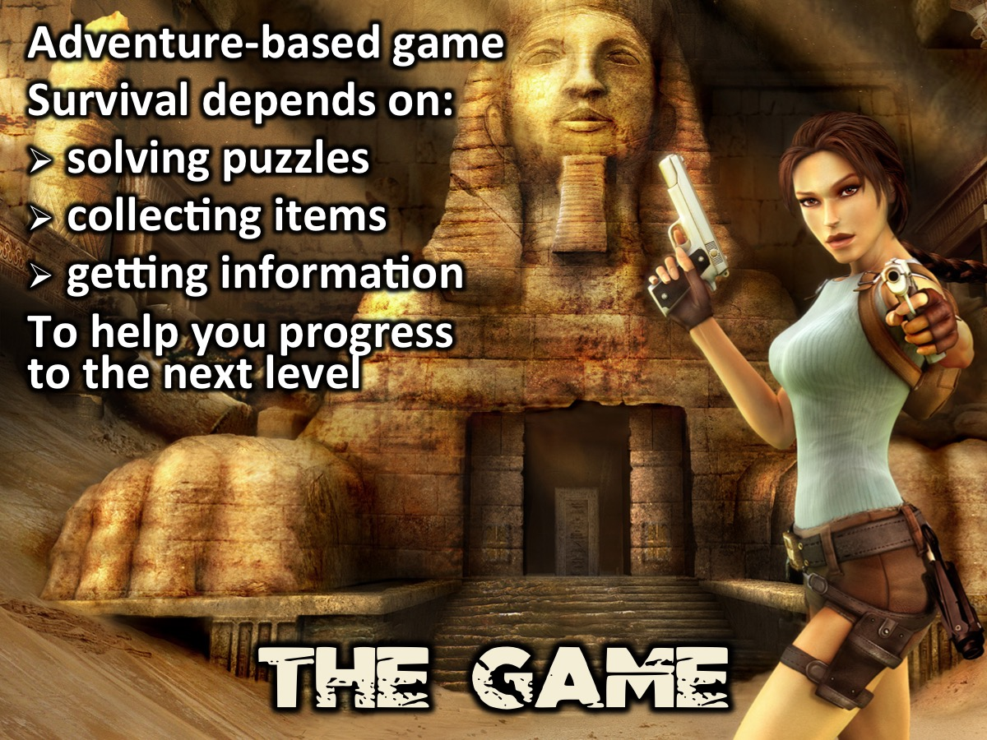
Notes:
Tomb Raider: The Game: If you have ever played Tomb Raider you will know that it is an adventure-based game where your survival depends on solving puzzles, collecting items and getting information that will help you progress to the next level.

Slide 8
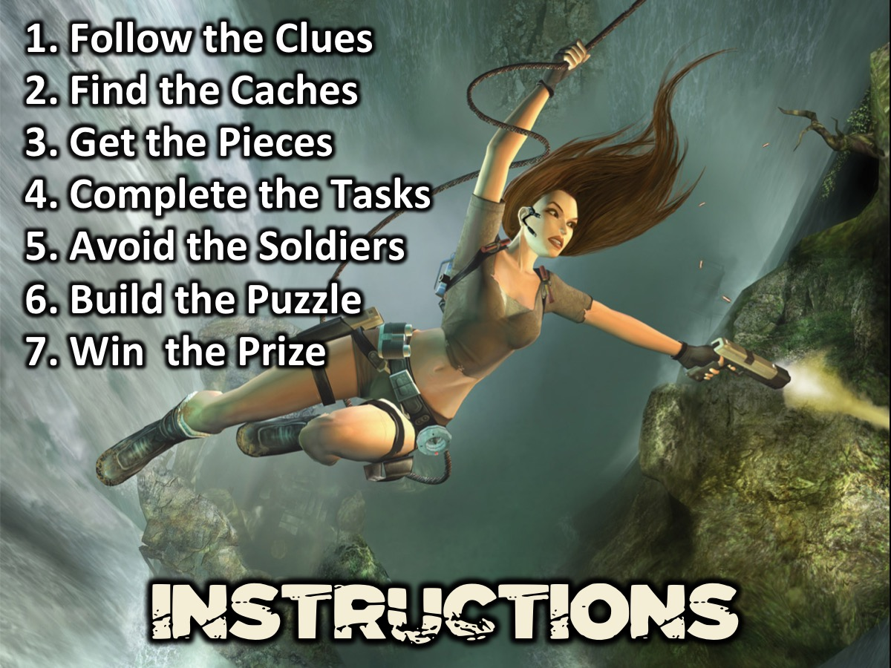
Notes:
Instructions: (1) Follow the clues on the paper you will be given. (2) Find the hidden caches. (3) Get the puzzle pieces. (4) Complete the 4 tasks on your sheet along the way. (5) Avoid the Soldiers (if they hear you they will shoot you!). (6) Build your puzzle when you get back to the youth room. (7) Win the Prize - First team back with all their tasks completed and with their puzzle built will win a prize.

Slide 9

Notes:
Teams: You are going to divide into 6 teams.

Slide 10

Notes:
Team Angel

Slide 11

Notes:
Team Chronicles

Slide 12

Notes:
Team Legend

Slide 13

Notes:
Team Osiris

Slide 14

Notes:
Team Guardian

Slide 15

Notes:
Team Underworld

Slide 16

Notes:
Here is a reminder of your mission: (1) Follow the clues on the paper you have been given. (2) Find the hidden caches. (3) Get the puzzle pieces (marked with your team sticker). (4) Complete the 4 tasks on your sheet along the way. (5) Avoid the Soldiers (if they hear you they will shoot you!). (6) Build your puzzle when you get back to the youth room. First team back with all their tasks completed and with their puzzle build will win a prize.

Slide 17

Notes:
Go!

Slide 18

Notes:
And the Winner is…

Slide 19
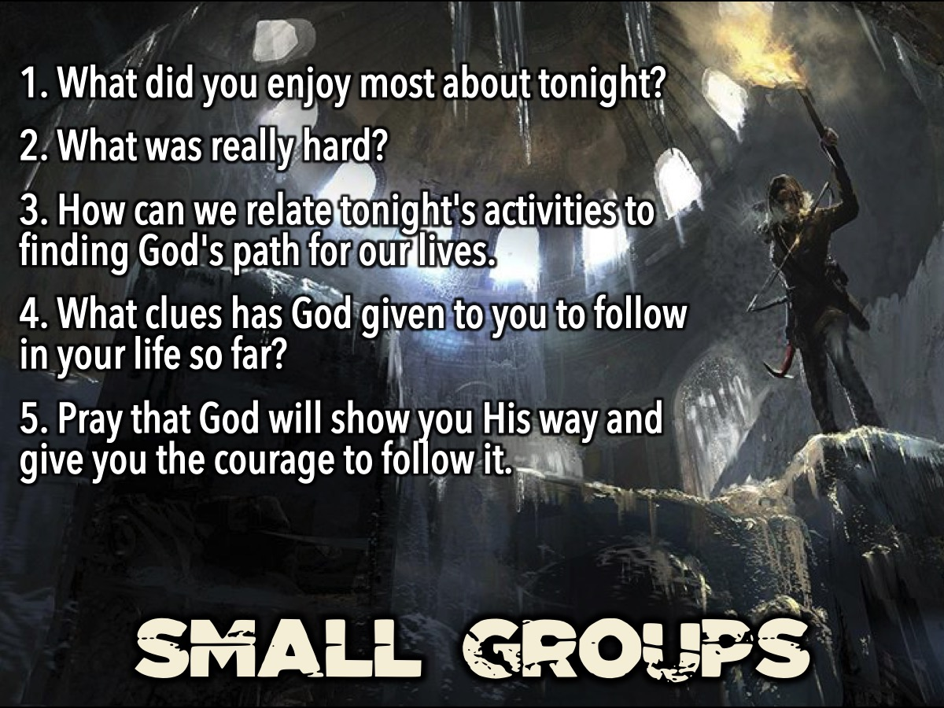
Notes:
Small Groups: Here are the questions for the small group time: (1) What did you enjoy most about tonight? (2) What was really hard? (3) How can we relate tonight's activities to finding God's path for our lives. (4) What clues has God given to you to follow in your life so far? The Bible says: "seek and you will find”. (5) Pray that God will show you his way and give you the courage to follow it.

Slide 20

Notes:
Refreshments: It is time for refreshments!

