Slide 1

Notes:
Sharing: Turn to the person next to you and ask them if they have ever read a trilogy? And if they have, what was it?

Slide 2

Notes:
Maybe it was the Divergent Trilogy…

Slide 3

Notes:
Or The Hunger Games trilogy…

Slide 4
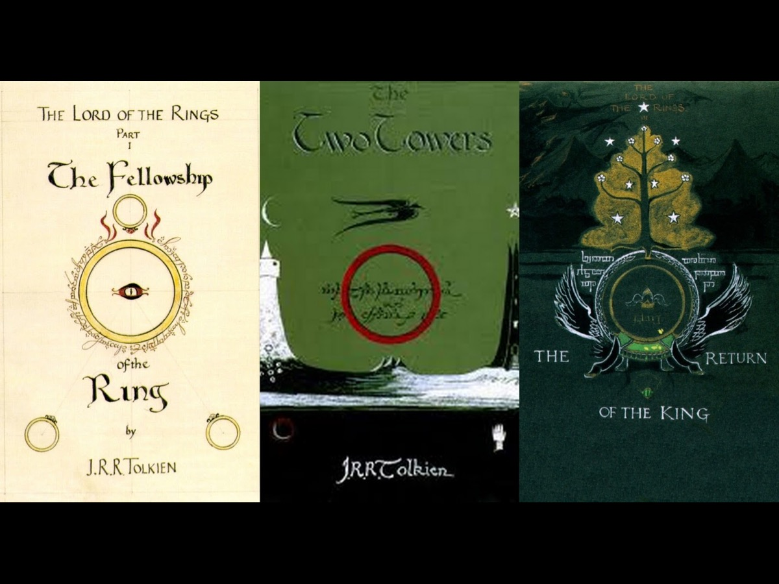
Notes:
Or The Lord of the Rings trilogy…

Slide 5

Notes:
Or The Maze Runner Trilogy – oops – there are 4 books in that series.

Slide 6

Notes:
Or The Twilight trilogy – oops – there were 5 books in that series.

Slide 7
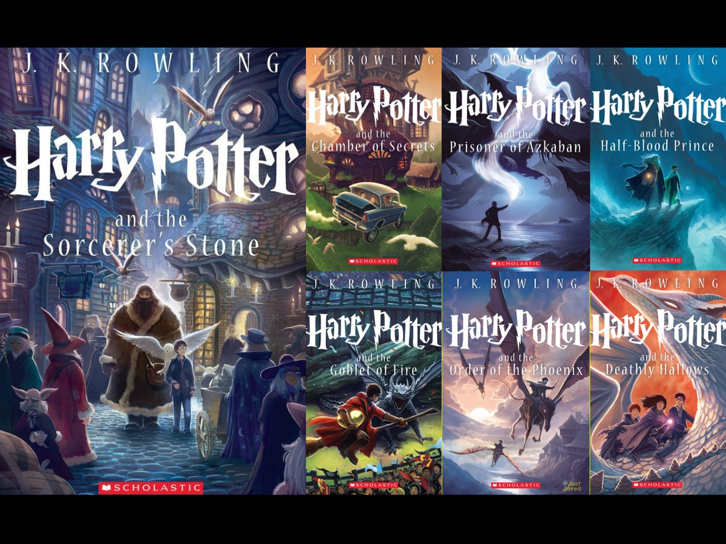
Notes:
Or The Harry Potter trilogy – oops – there were 7 books in that series.

Slide 8
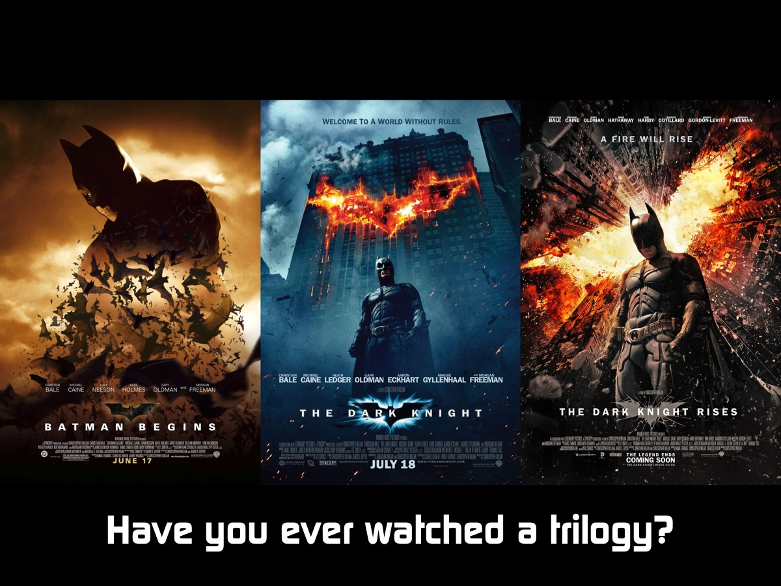
Notes:
Sharing: For those not so much into reading, maybe you have watched a trilogy on the big screen – like Batman. Turn to the person next to you and ask them whether they have ever watched a movie trilogy? And if so, what was it? And has anyone watched all 3 movies in 1 day?

Slide 9
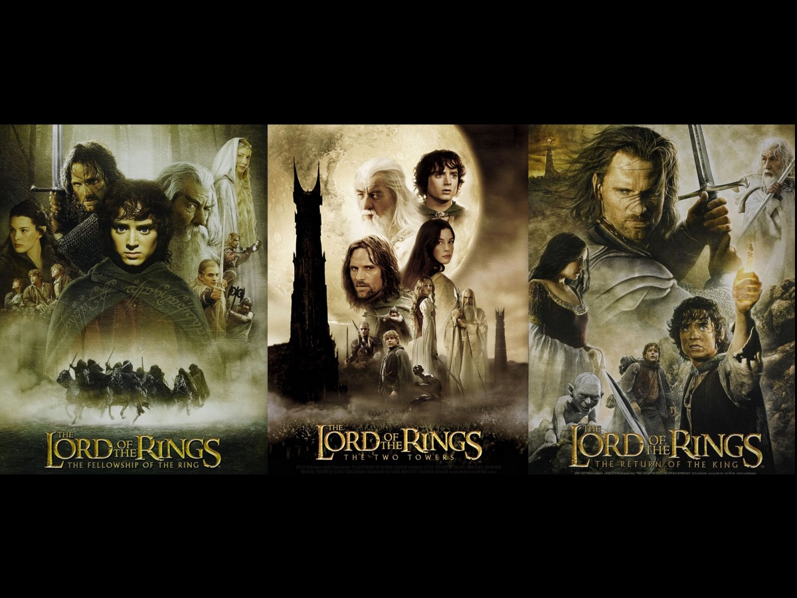
Notes:
Maybe it was The Lord of the Rings…

Slide 10
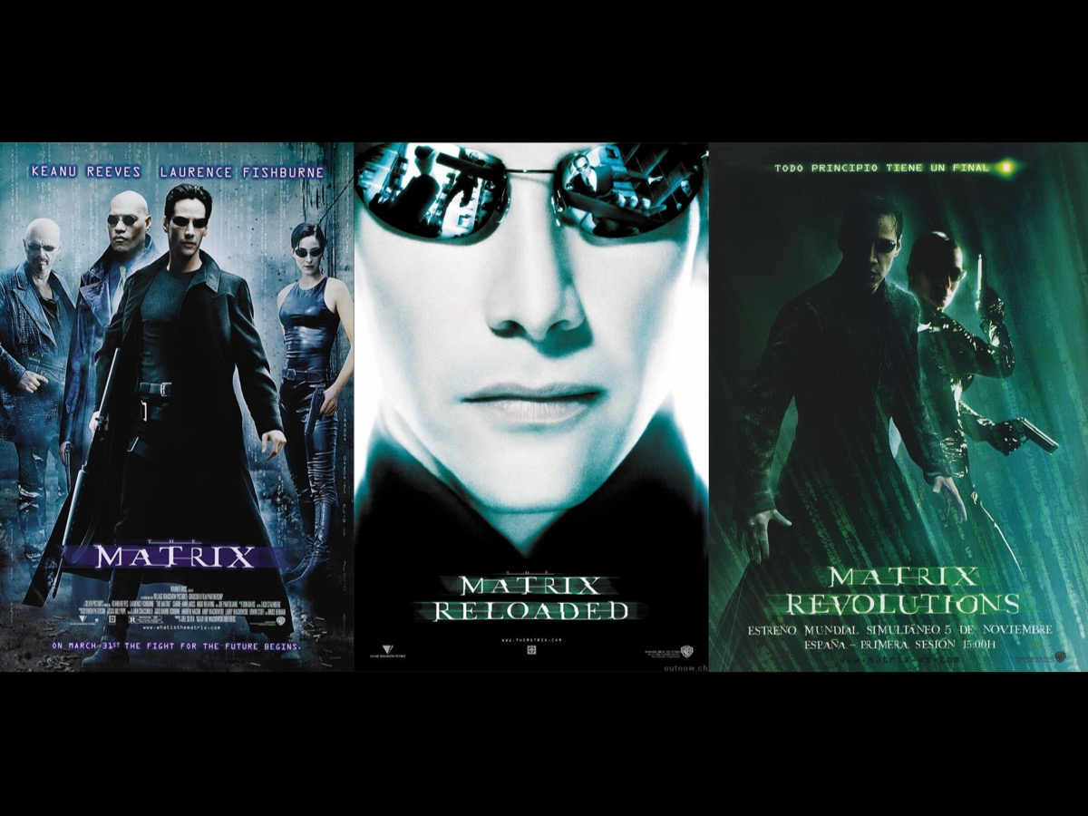
Notes:
Or the Matrix…

Slide 11
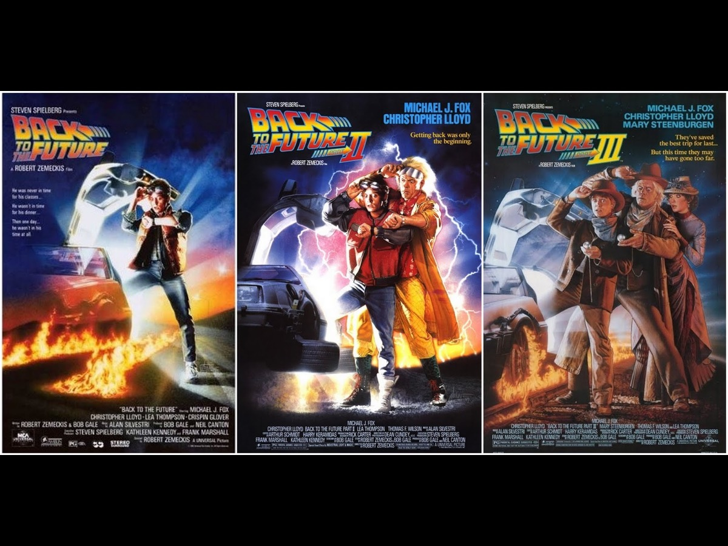
Notes:
Or Back to the Future…

Slide 12
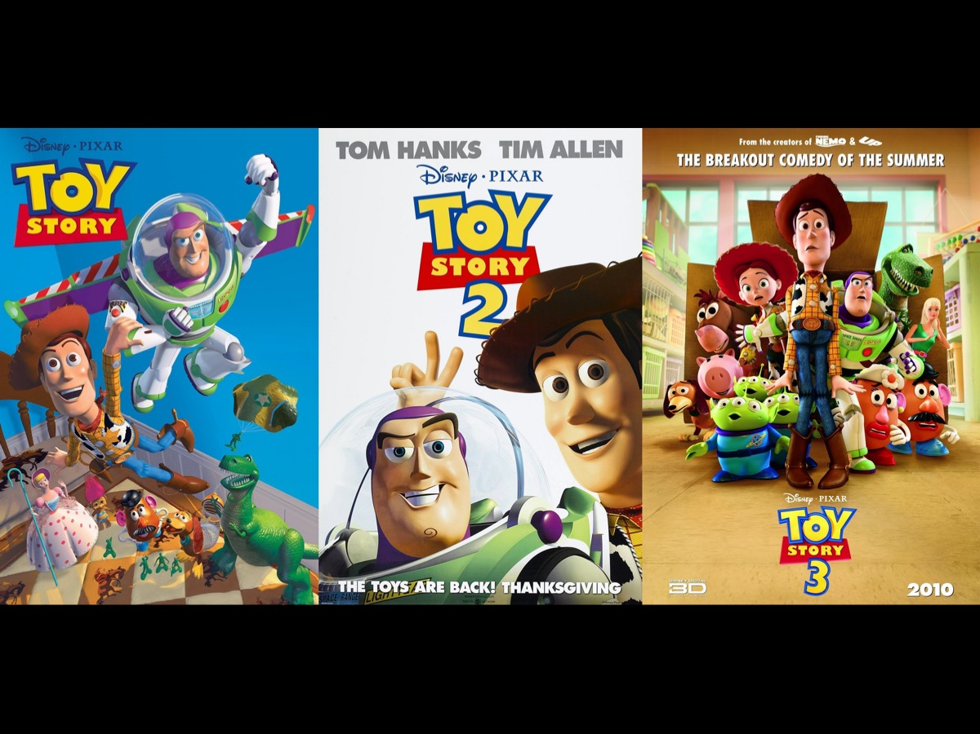
Notes:
Or Toy Story…

Slide 13

Notes:
So welcome to the Trilogy Series at His Youth on Sunday mornings.

Slide 14

Notes:
The church has this mission statement: We see lives, communities and society transformed through discipleship in the Word, the presence and power of God.

Slide 15
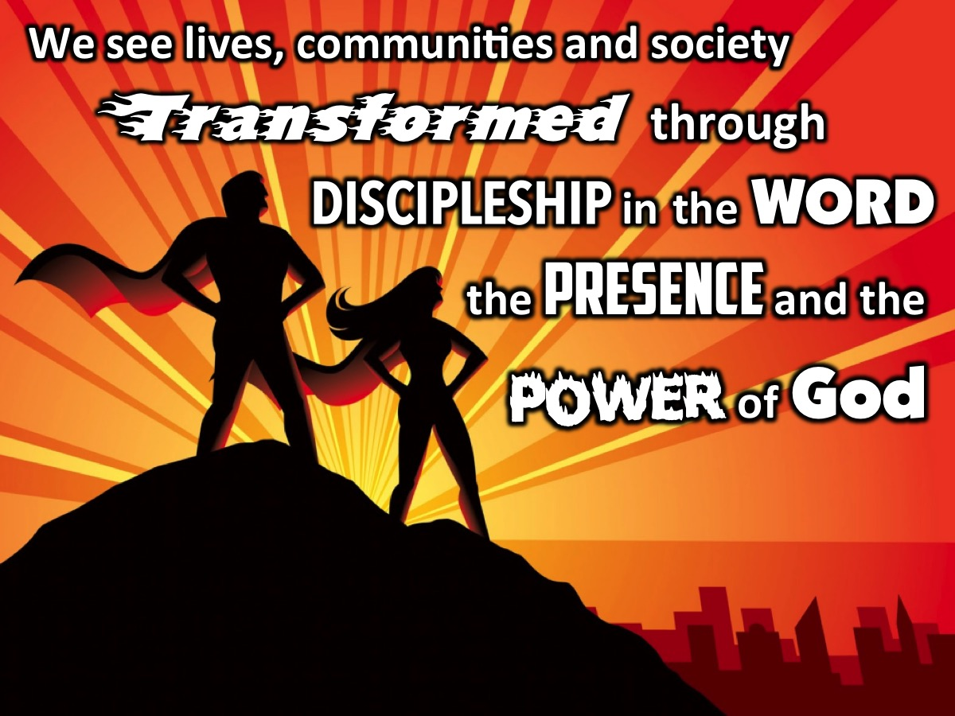
Notes:
Here is our mission statement at His People Church: We see lives, communities and society transformed through discipleship in the Word, the presence and the power of God.

Slide 16
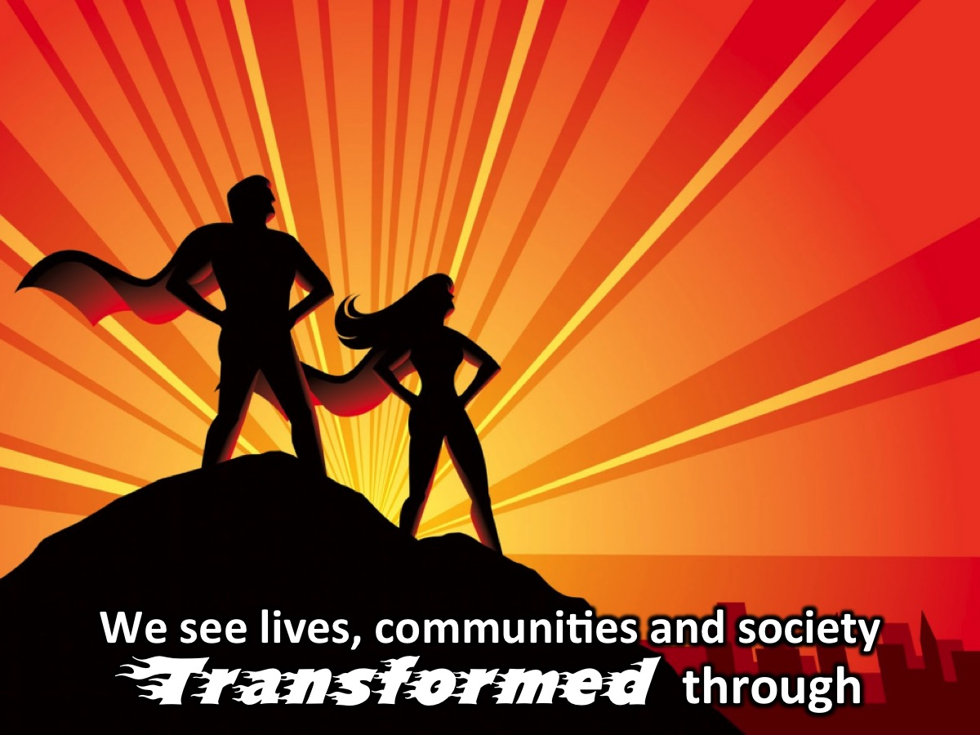
Notes:
Let’s say it together: We see lives, communities and society transformed through

Slide 17
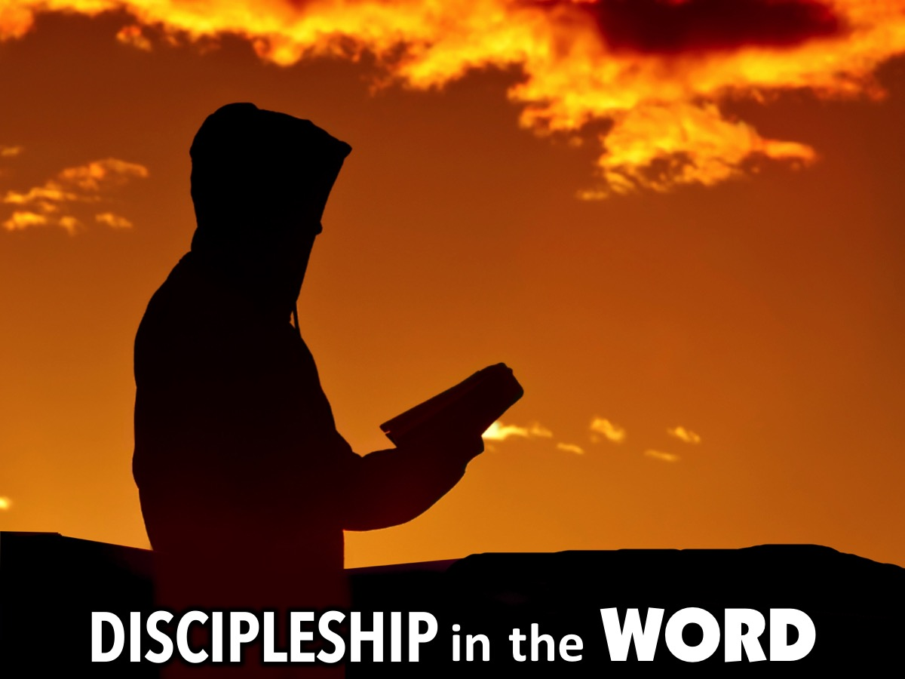
Notes:
discipleship in the Word

Slide 18
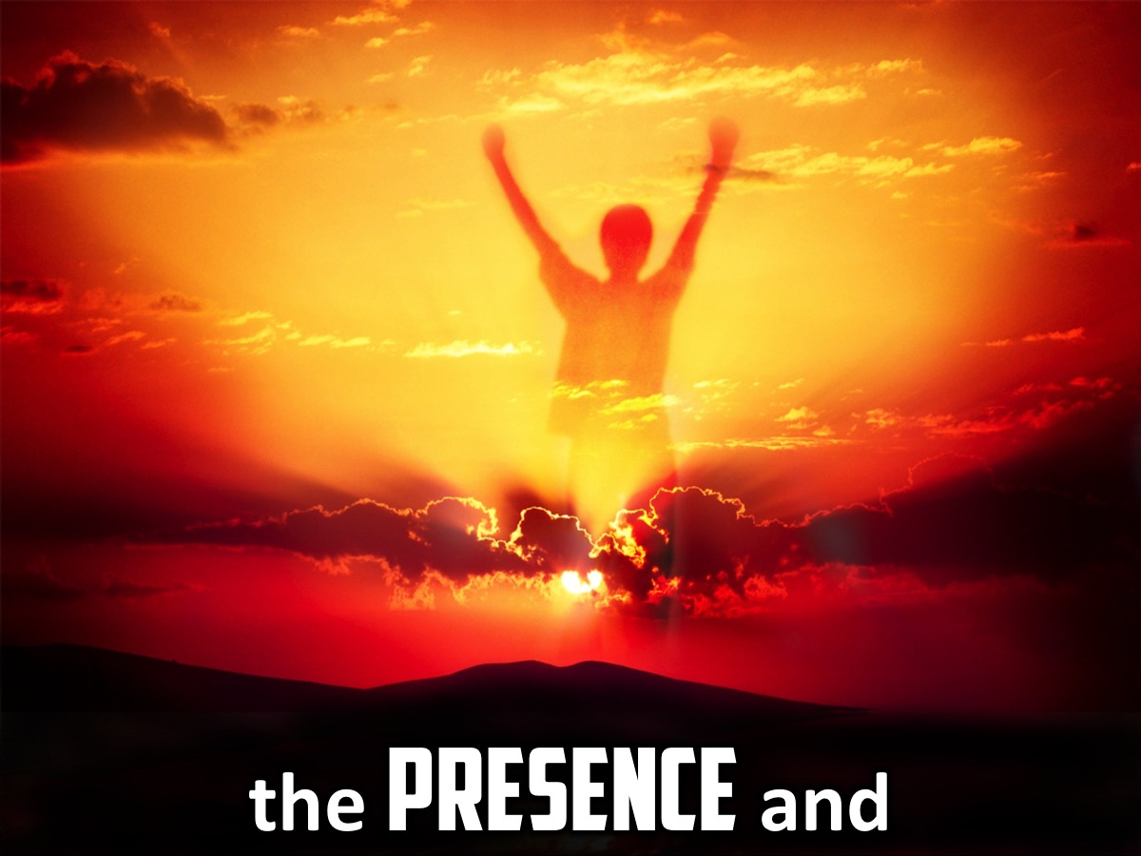
Notes:
the presence and

Slide 19
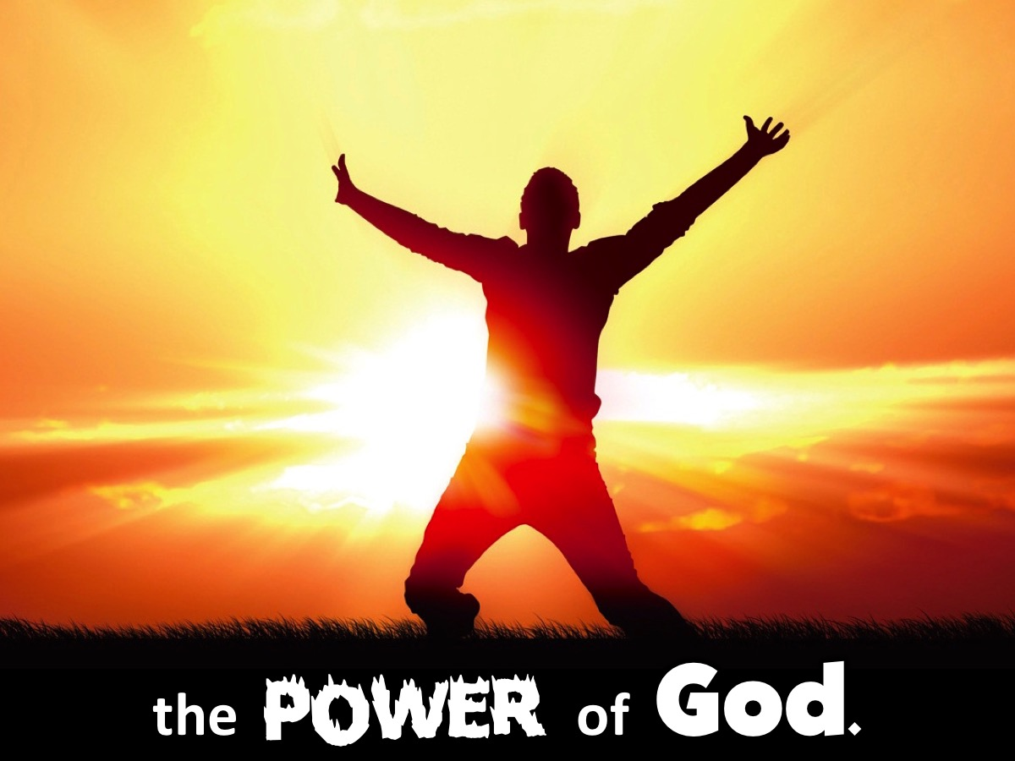
Notes:
and the power of God.

Slide 20
Notes:
Let’s say it again: We see lives, communities and society transformed...

Slide 21
Notes:
discipleship in the Word…

Slide 22
Notes:
the presence and

Slide 23

Notes:
the power of God.

Slide 24
Notes:
Can you spot the Trilogy?

Slide 25
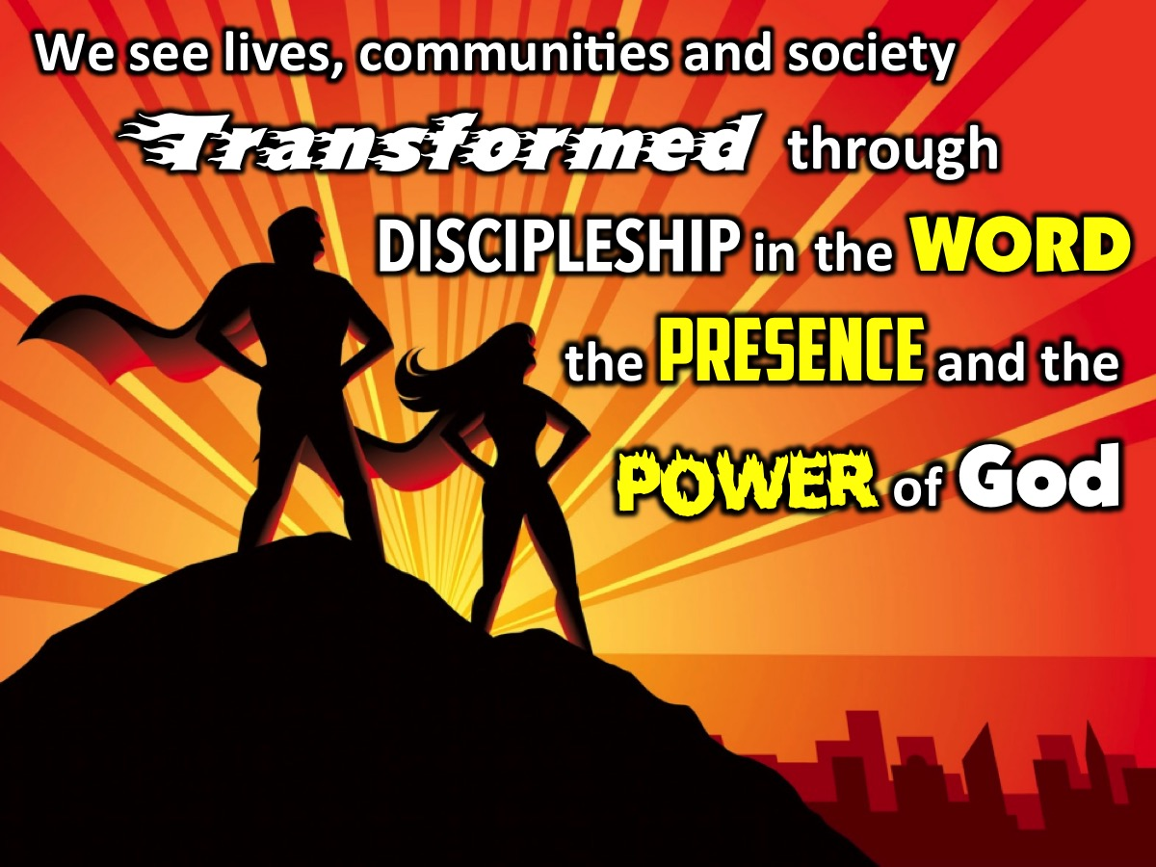
Notes:
There is the trilogy for our series: Word, Presence and Power.

Slide 26
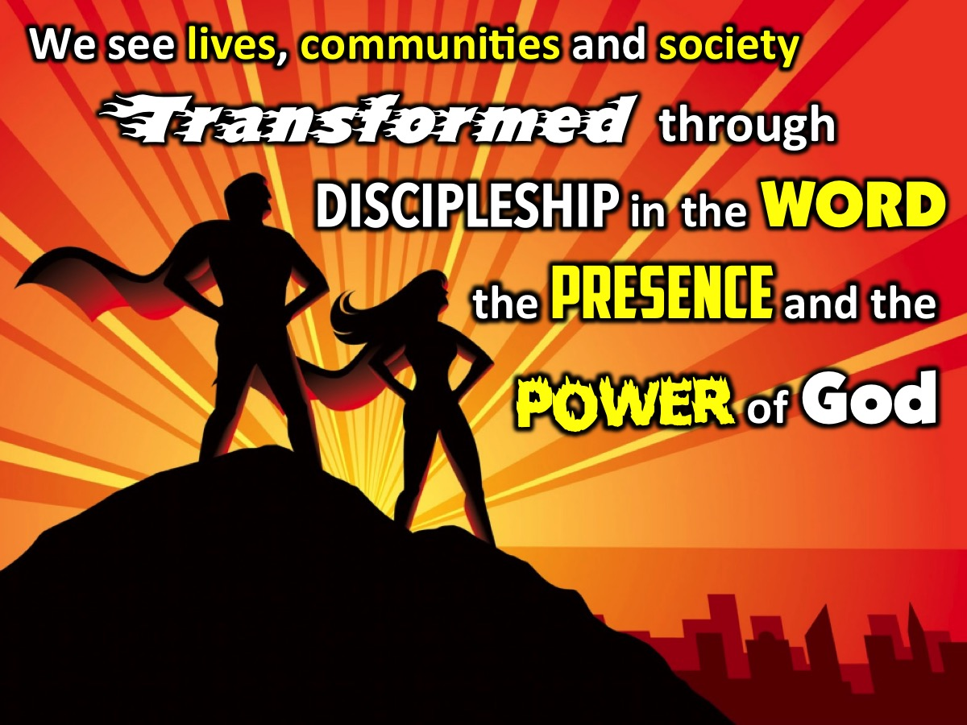
Notes:
Actually there is a second triligy too: Lives, Communities and Society – but that is not our main focus this term.

Slide 27
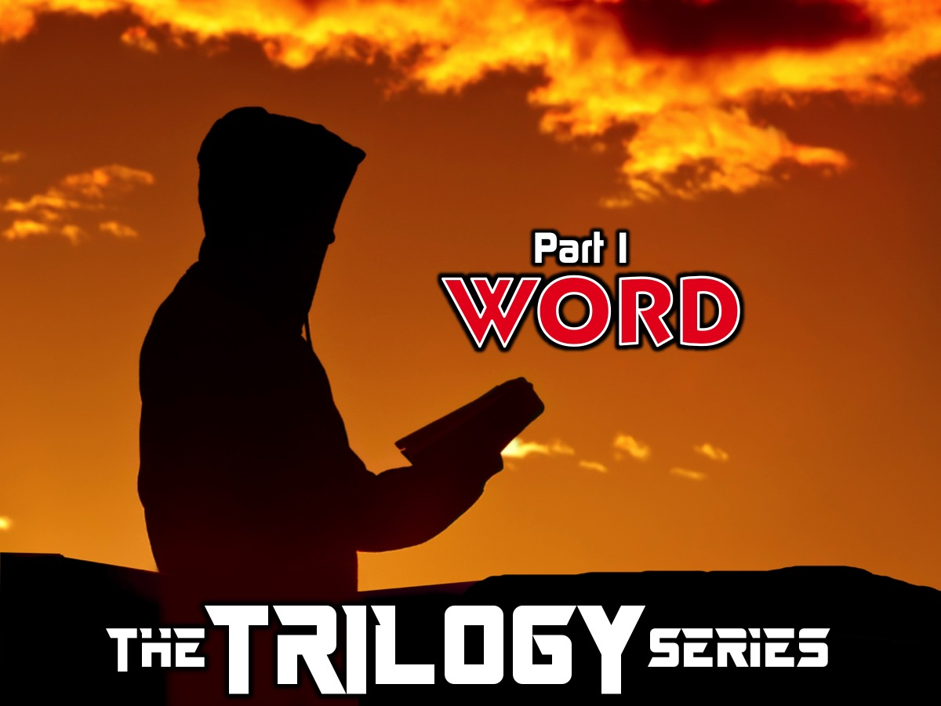
Notes:
Part 1 is all about the Word. The Trilogy Series: We start with 3 weeks focusing on the Word - where we will learn how to get into God's word (daily reading/devotions/skills for devotional reading and studying the Word). The preachers are: Week 1: Mark. Week 2: Mateam. Week 3: Shaun.

Slide 28
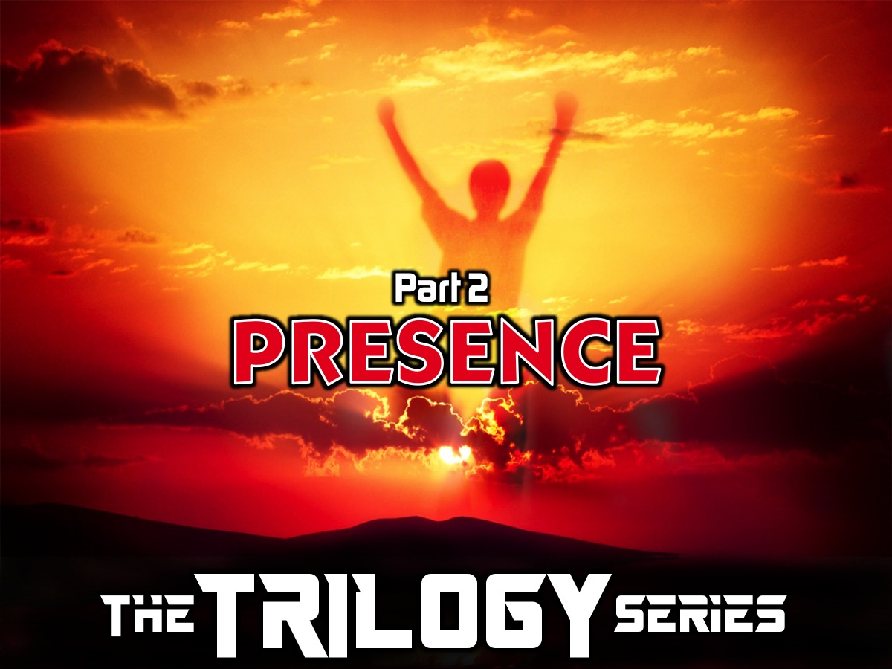
Notes:
Part 2 is all about the presence of God where over 3 weeks we will explore how to experience the Presence of God in your daily life and when we worship God on Sunday mornings in the sanctuary. Week 1: Mark. Week 2: Thabile. Week 3: Hannes

Slide 29

Notes:
Part 3 is Power: We will end with weeks focusing on the Power of God which will all be about relating to the Holy Spirit and experience his Baptism, Filling and power to witness. Week 1: Genevieve. Week 2: ?

Slide 30

Notes:
So let’s open up Book 1: The Word and introduce the first part of our trilogy!

Slide 31
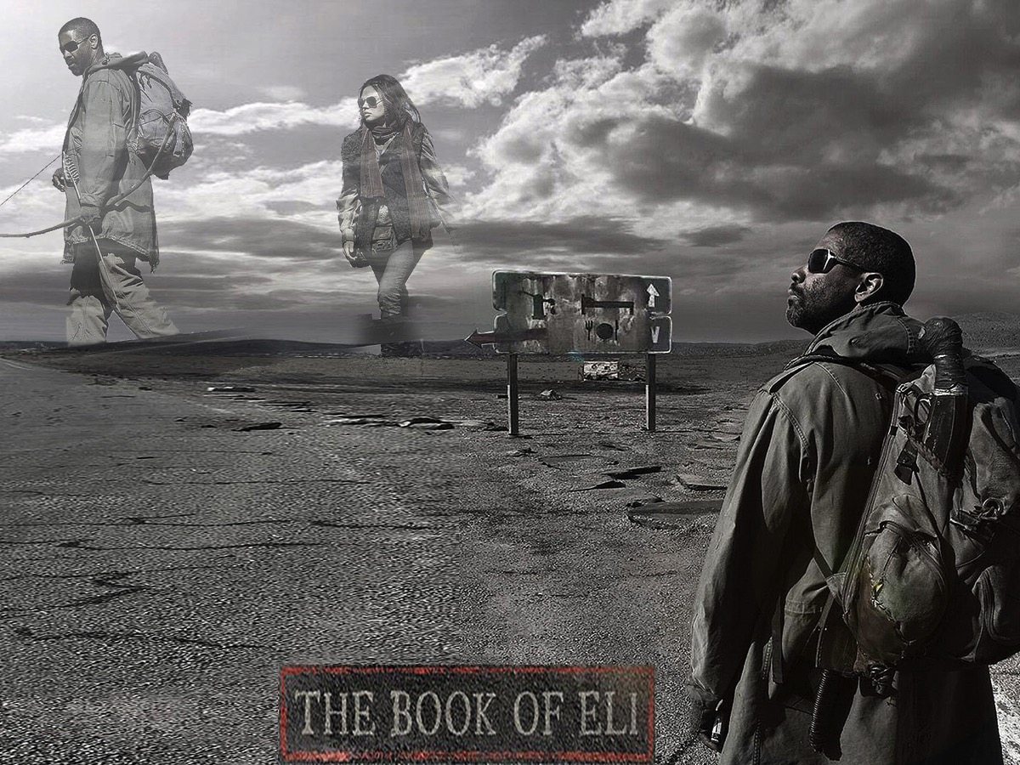
Notes:
Have any of you seen this movie? The Book of Eli

Slide 32
Notes:
Video: The Book of Eli Trailer. Get it on YouTube at: https://www.youtube.com/watch?v=kAMUv22y1og

Slide 33
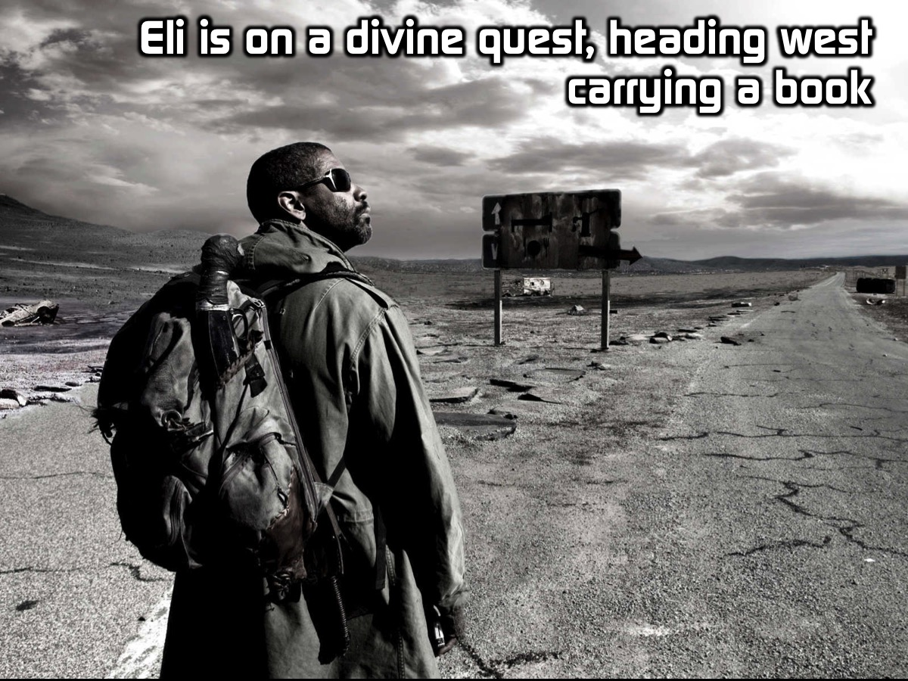
Notes:
The movie is set in an American west covered in the hot, dirty wind due to an apocalypse, Eli is on a journey to the west on a quest from God. Somehow religion was blamed for the apocalypse and all the holy books in the world were burned. Eli is an old man now and is carry a “mysterious” book west, as the voice is guiding him to do.

Slide 34
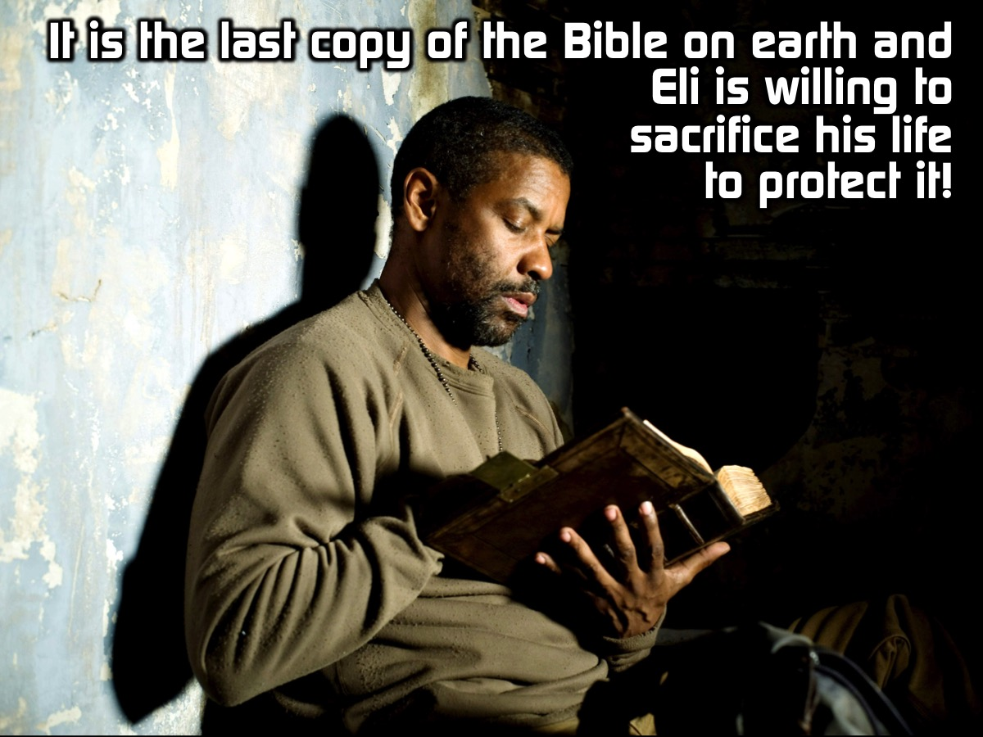
Notes:
Believed to be the last Bible on Earth, Eli is willing to sacrifice his life to protect it…

Slide 35
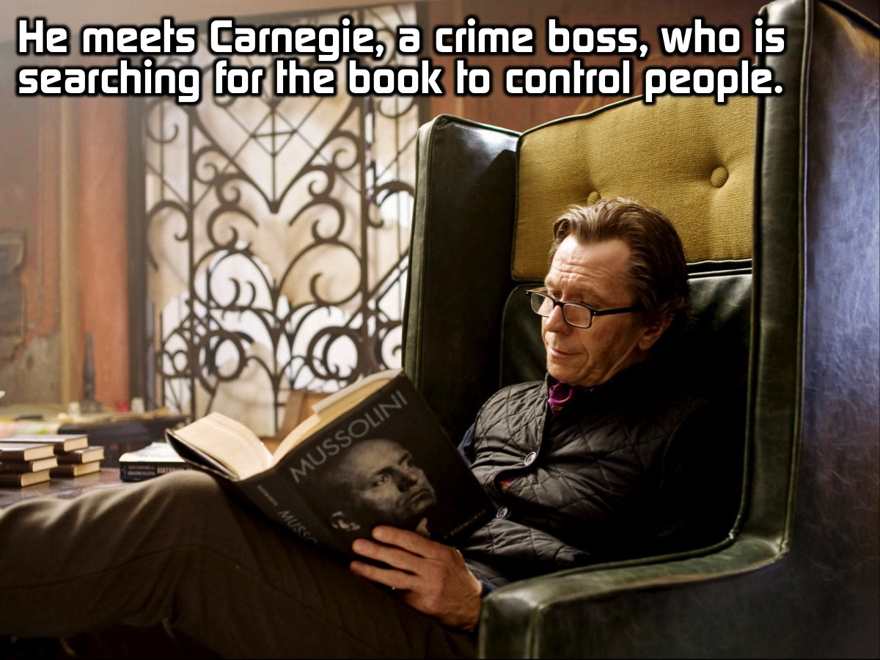
Notes:
Elis meets Carnegie, a crime boss, who is searching for the book so he can use it to control people

Slide 36
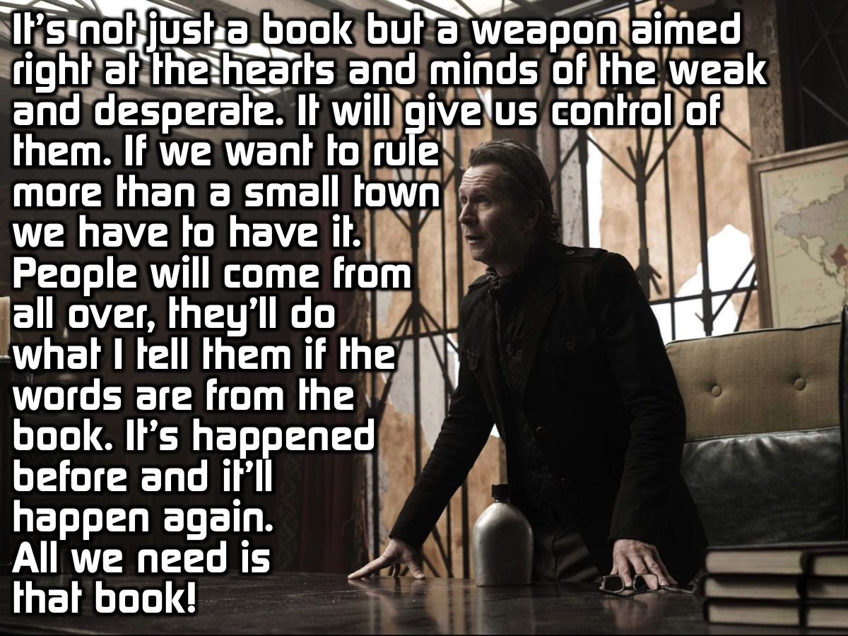
Notes:
It’s not just a book. It’s a weapon. A weapon aimed right at the hearts and minds of the weak and the desperate. It will give us control of them. If we want to rule more than one small town, we have to have it. People will come from all over, they’ll do exactly what I tell them if the words are from the book. It’s happened before and it’ll happen again. All we need is that book! (Carnegie)

Slide 37
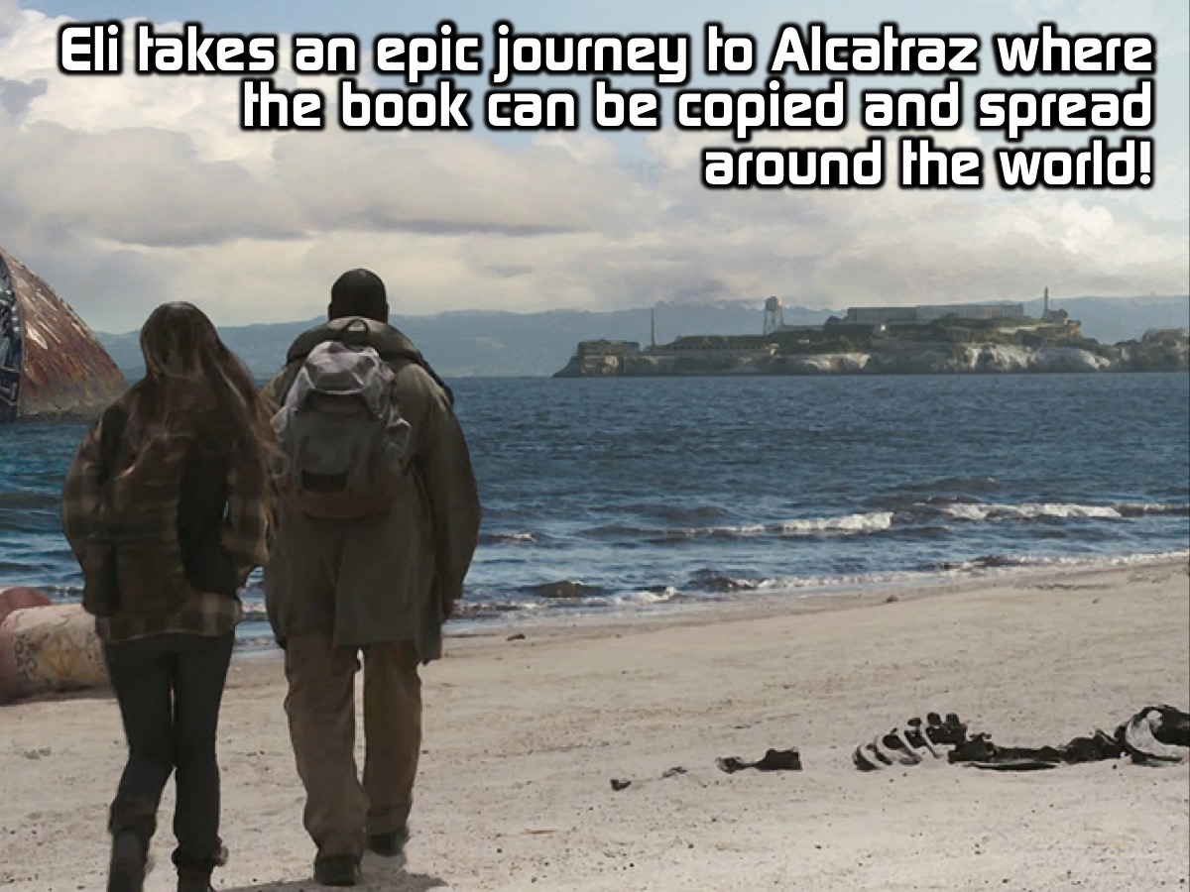
Notes:
Eli was willing to embark on an epic journey to get it delivered to a place – the prizon of Alcatraz on an island – where it could be copied and distributed to the world.

Slide 38
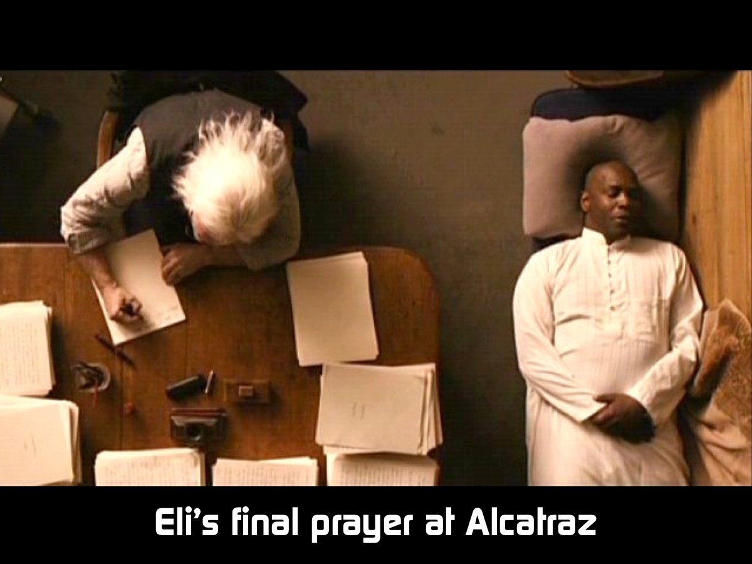
Notes:
Here is a clip from the end of the movie where the book has been successfully copied and preserved…

Slide 39
Notes:
Video: The Book of Eli Final Prayer. Get it on YouTube at: https://www.youtube.com/watch?v=OHuyd-n_7KE

Slide 40
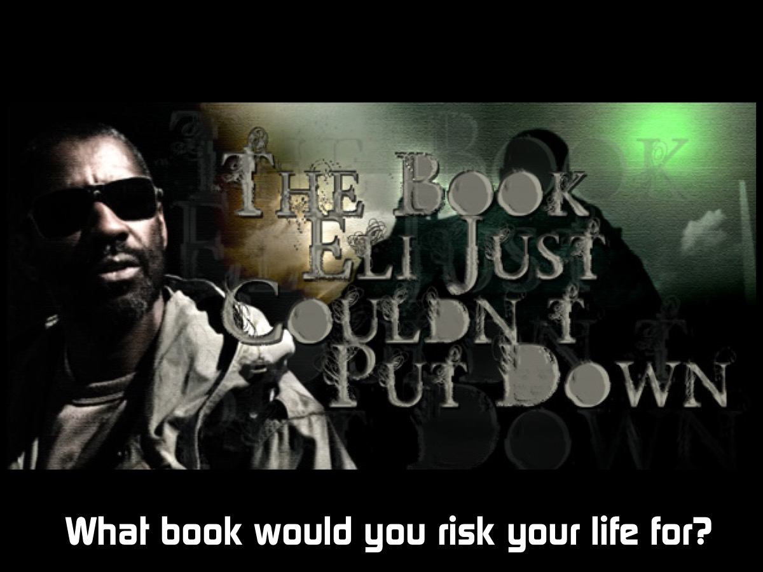
Notes:
What book would you be willing to risk your life for if you had the last copy on planet earth?

Slide 41
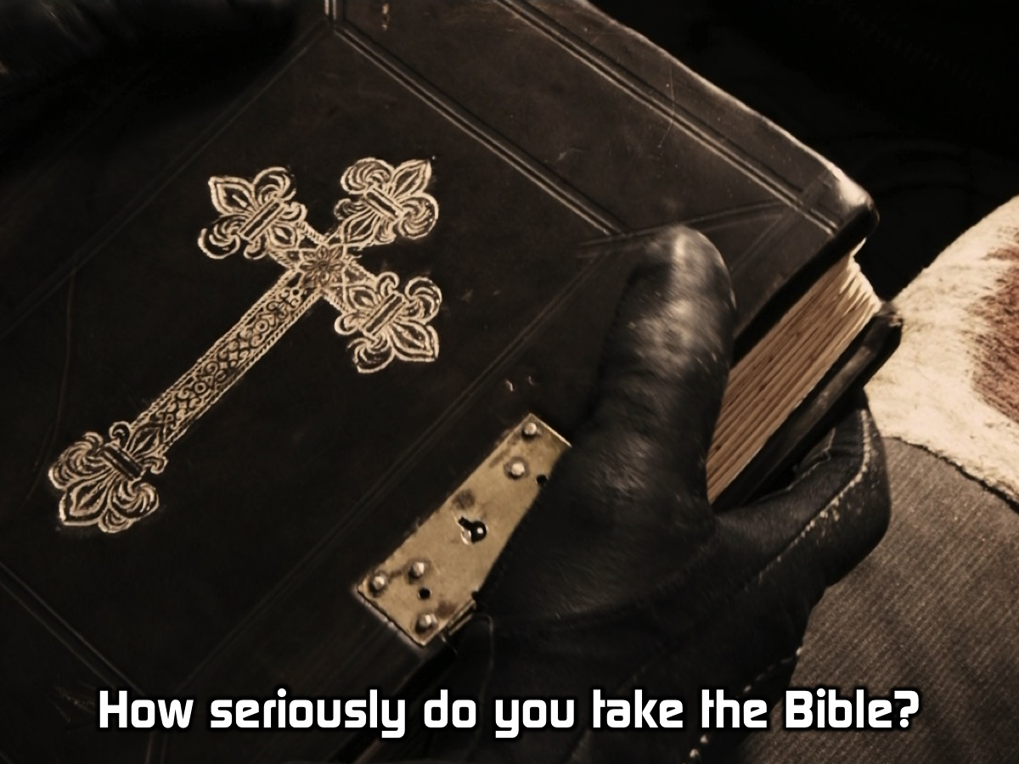
Notes:
How seriously do you take the Bible? As you watch the movie you are deeply challenged about how lightly we take the Bible – for Eli it was something that he was willing to give his life to protect.

Slide 42
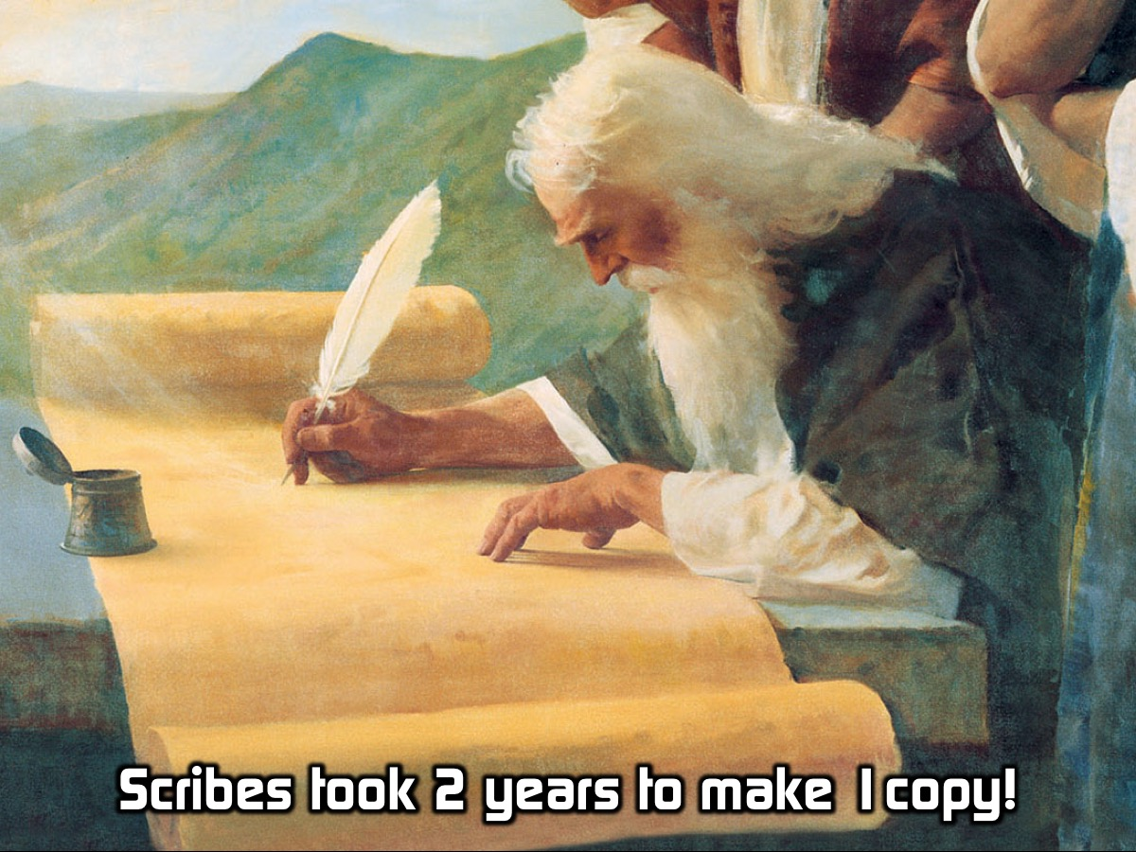
Notes:
In ancient times, scribes spent up to 2 years hand copying the Bible on parchment or scrolls so that it could be shared with others…

Slide 43
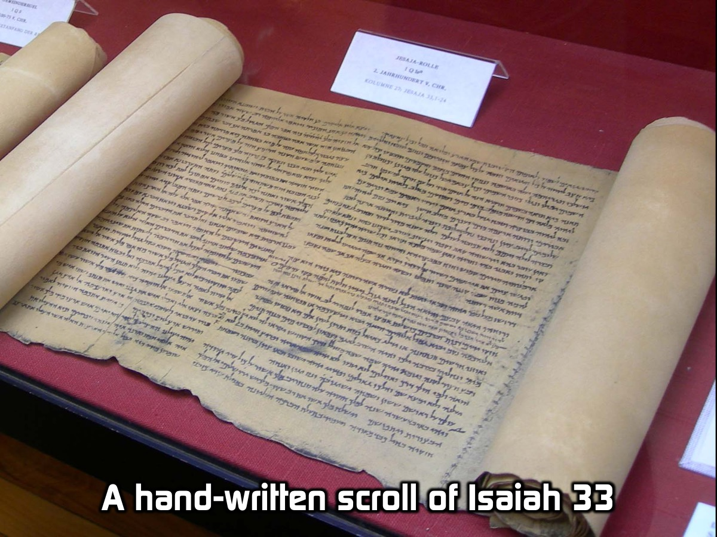
Notes:
Here is a hand-written Papyrus scroll of Isiah 33,1-24 in the Biblical Museum in Münster. Just image how long it took to make this copy!

Slide 44
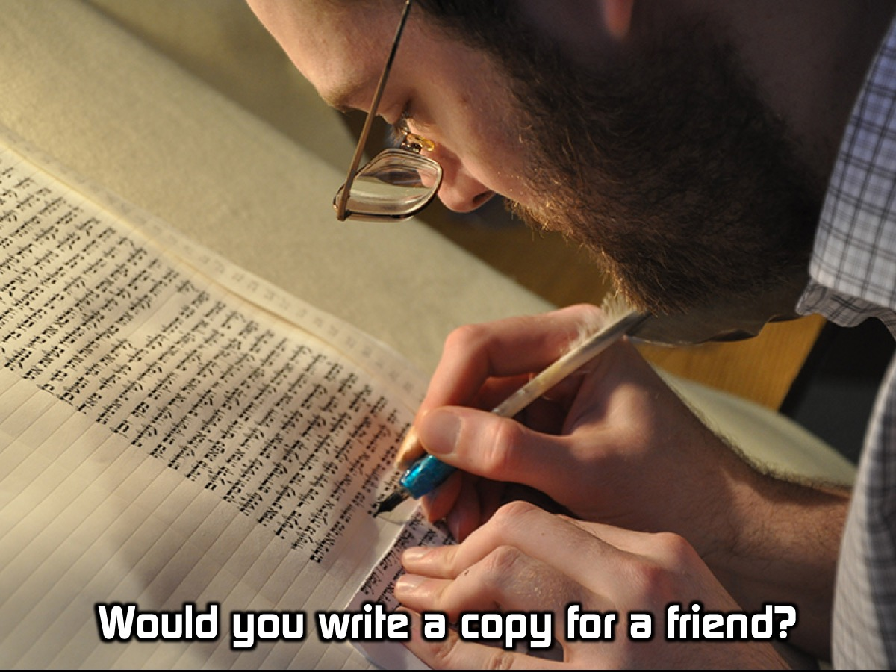
Notes:
Would you write out a copy for someone else to read if you had the last copy on earth?

Slide 45

Notes:
Some years back there was a chap, Brother Andrew, who used to smuggle Bibles into countries like China – and he knew that he could be jailed or even executed for doing so – but he believed that the Bible was so special that people had to get a copy even if it meant that he could lose his life!

Slide 46
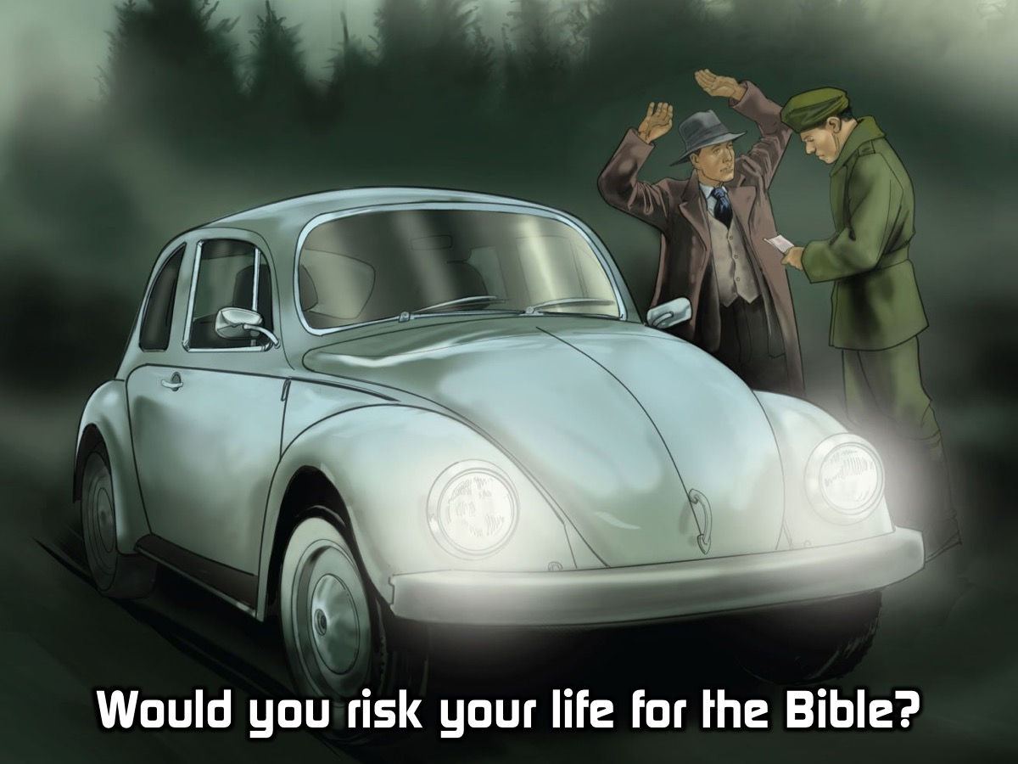
Notes:
Would you be willing to risk your life to get a copy of the Bible into someone’s hands?

Slide 47
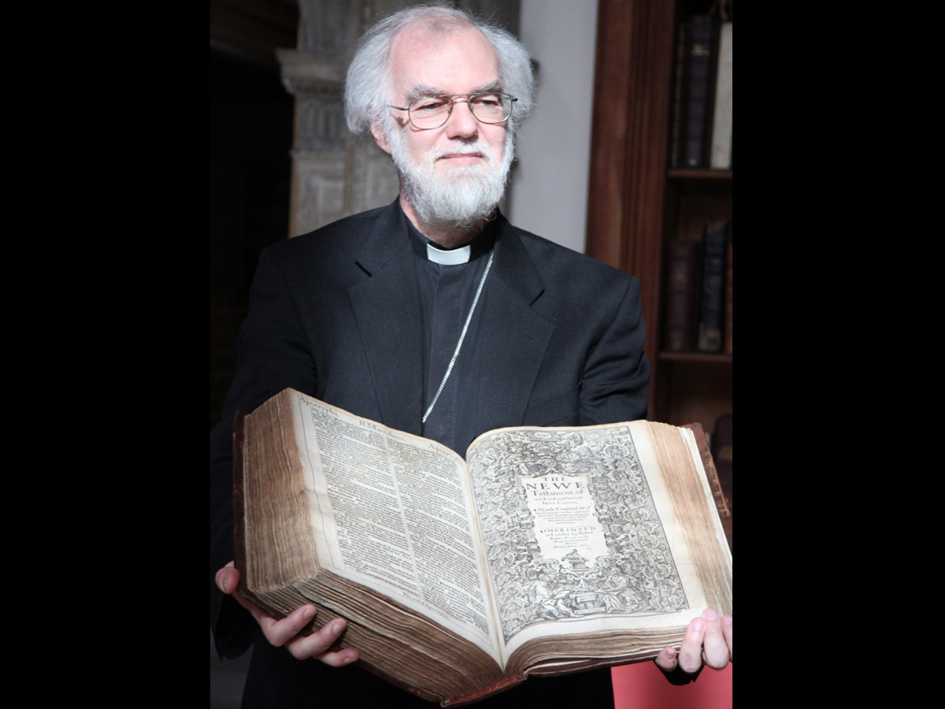
Notes:
In days gone by people had to carry around huge big bibles…

Slide 48
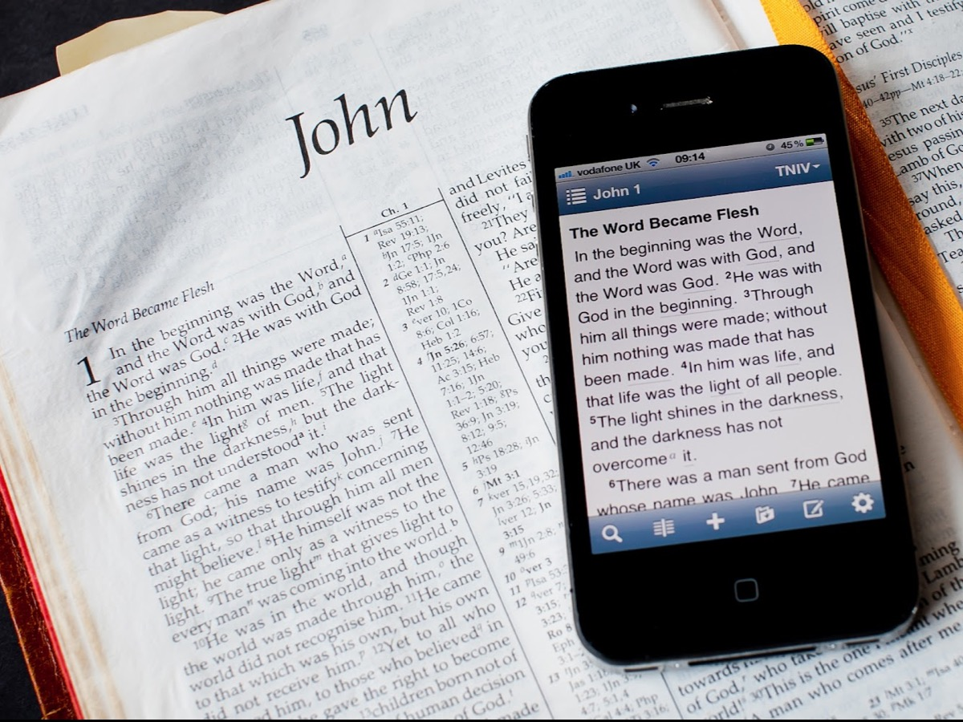
Notes:
Today you don’t have to carry a giant copy of the Bible around with you – you can just download the app for your phone…

Slide 49

Notes:
Like the YouVersion Bible!

Slide 50
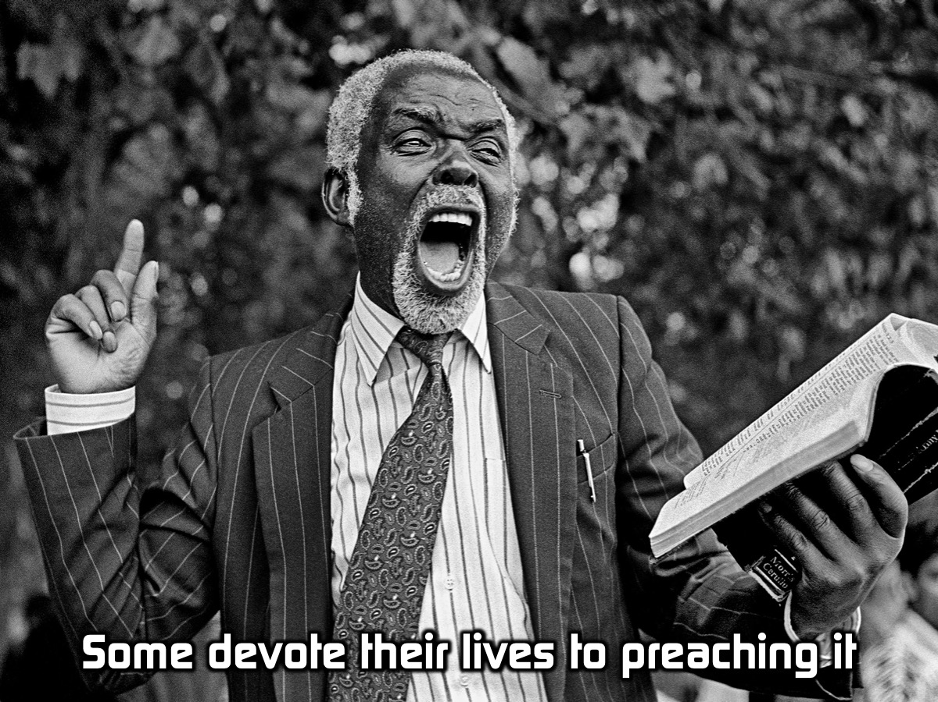
Notes:
Some people devote their whole lives to preaching the Bible!

Slide 51
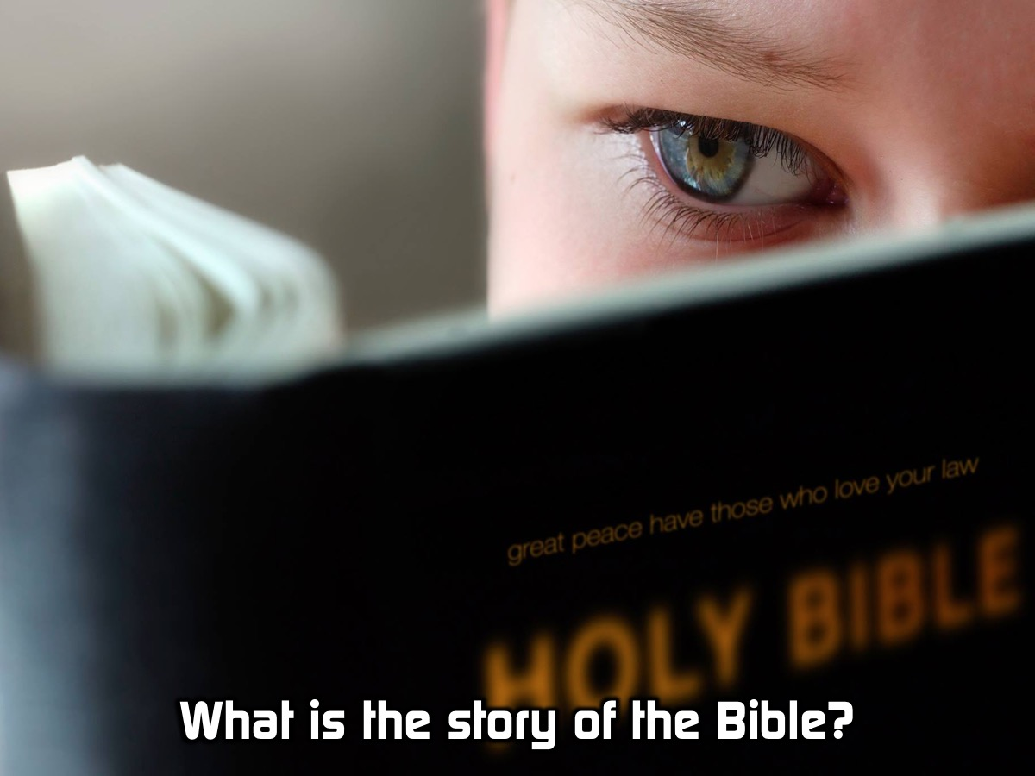
Notes:
So what is the story of the Bible?

Slide 52
Notes:
Video: What is the Story of the Bible? Get it on YouTube at: https://www.youtube.com/watch?v=LBmxzvqsz-8

Slide 53
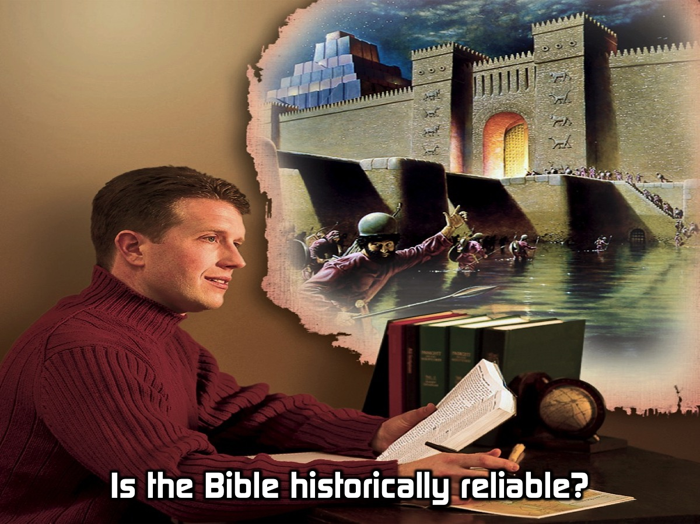
Notes:
Is the Bible historically reliable?

Slide 54
Notes:
Video: What is the Story of the Bible? Get it on YouTube at: https://www.youtube.com/watch?v=LBmxzvqsz-8

Slide 55
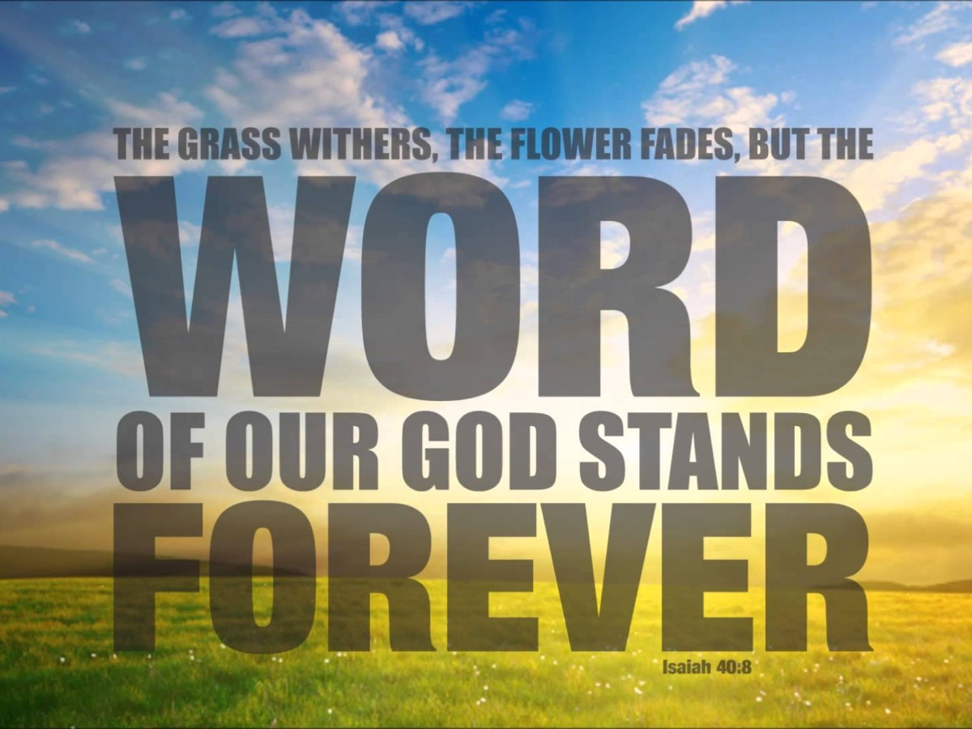
Notes:
Isaiah 40:8 says: “The grass withers, the flower fades, but the Word of our God stands Forever.”

Slide 56
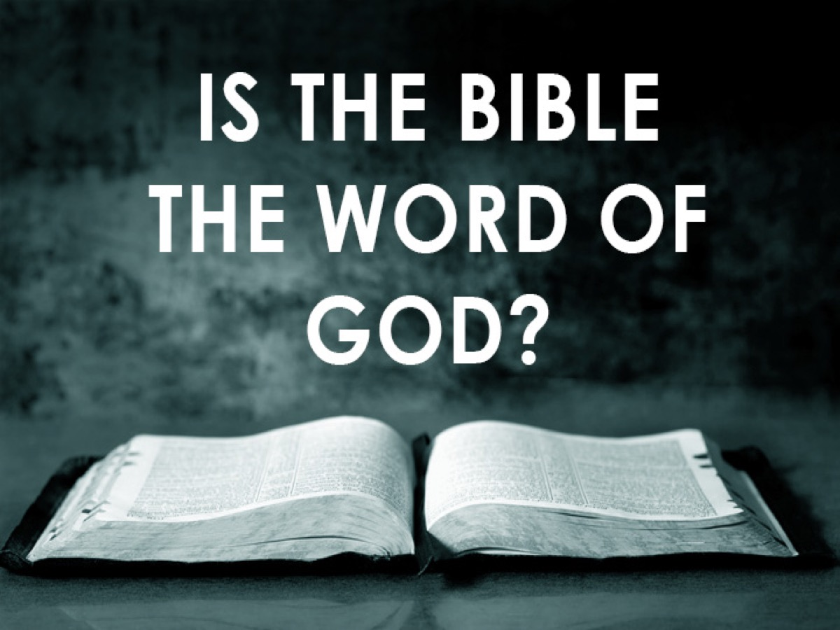
Notes:
But is the Bible the Word of God? Here is a short video clip about the trustworthiness of the Bible.

Slide 57
Notes:
Video: How Do We Show Someone The Bible Is Trustworthy? Get it on YouTube at: https://www.youtube.com/watch?v=AYDxyiCBGI4

Slide 58
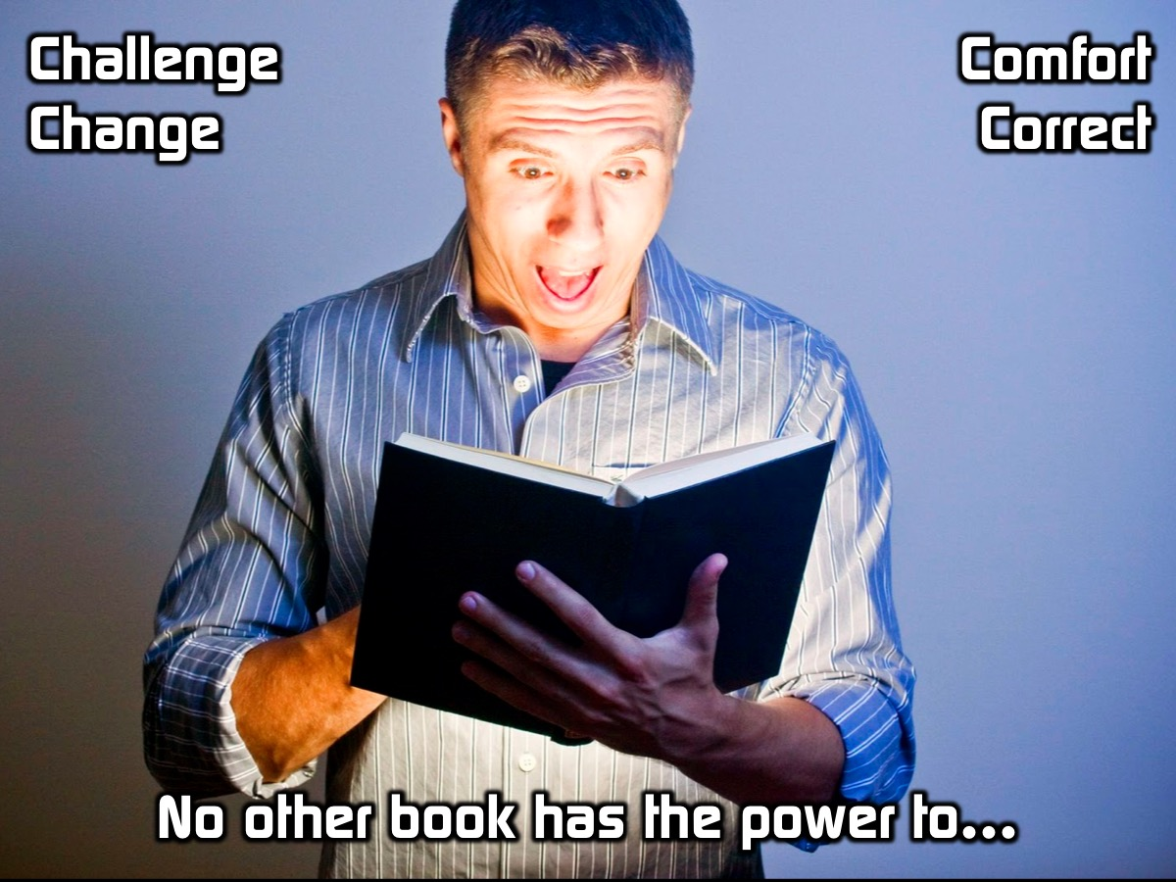
Notes:
No other book has the power to challenge, change, comfort or correct us like the Bible!

Slide 59
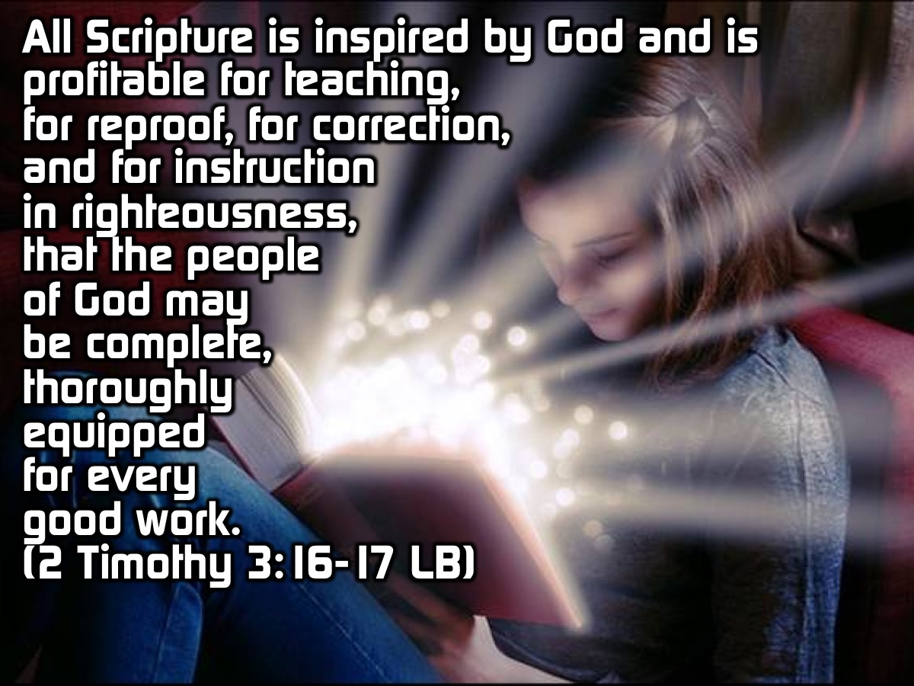
Notes:
2 Timothy 3:16-17 has this to say about the Bible: “All Scripture is inspired by God and is profitable for teaching, for reproof, for correction, and for instruction in righteousness, that the man of God may be complete, thoroughly equipped for every good work”. (The Living Bible)

Slide 60
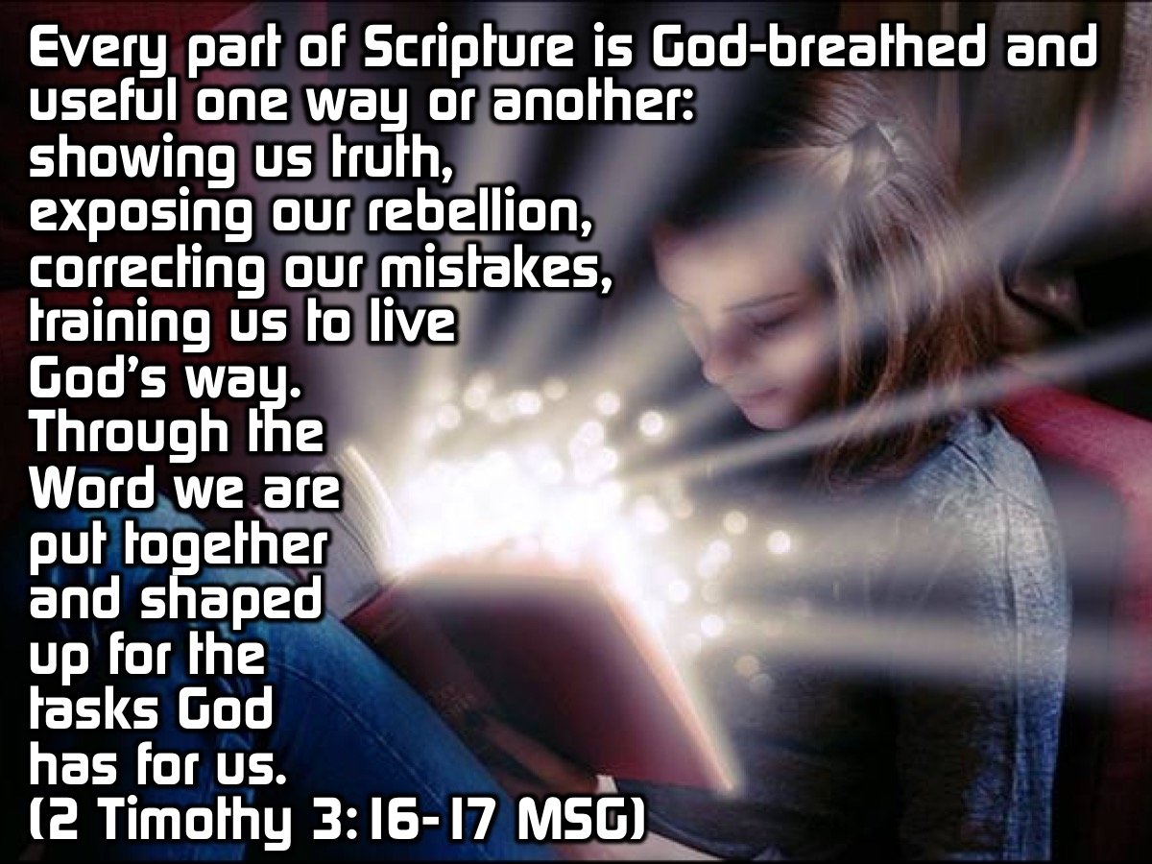
Notes:
2 Timothy 3:16-17 in the Message translation says: “Every part of Scripture is God-breathed and useful one way or another—showing us truth, exposing our rebellion, correcting our mistakes, training us to live God’s way. Through the Word we are put together and shaped up for the tasks God has for us”. (The Message)

Slide 61
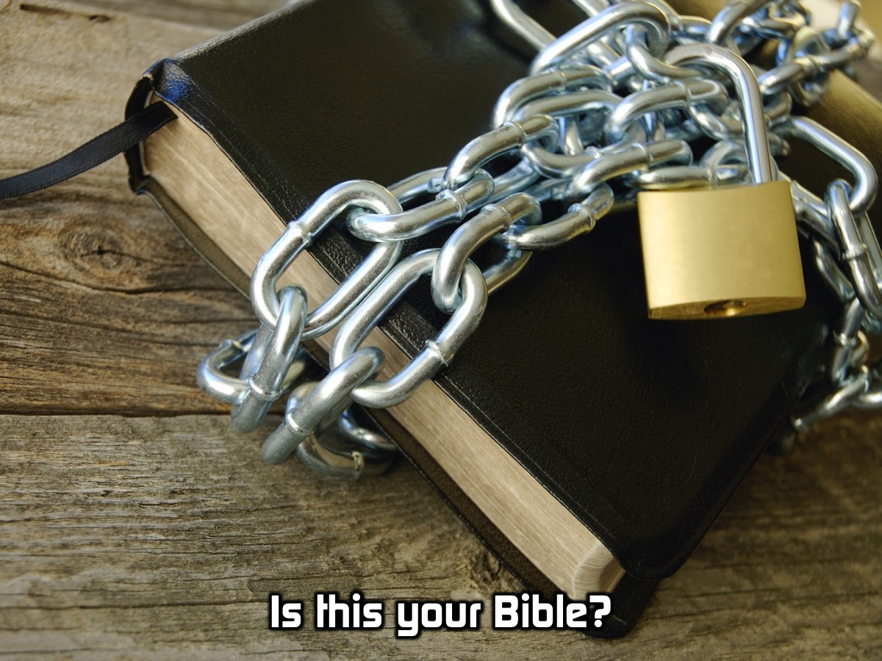
Notes:
Is your Bible in chains?

Slide 62
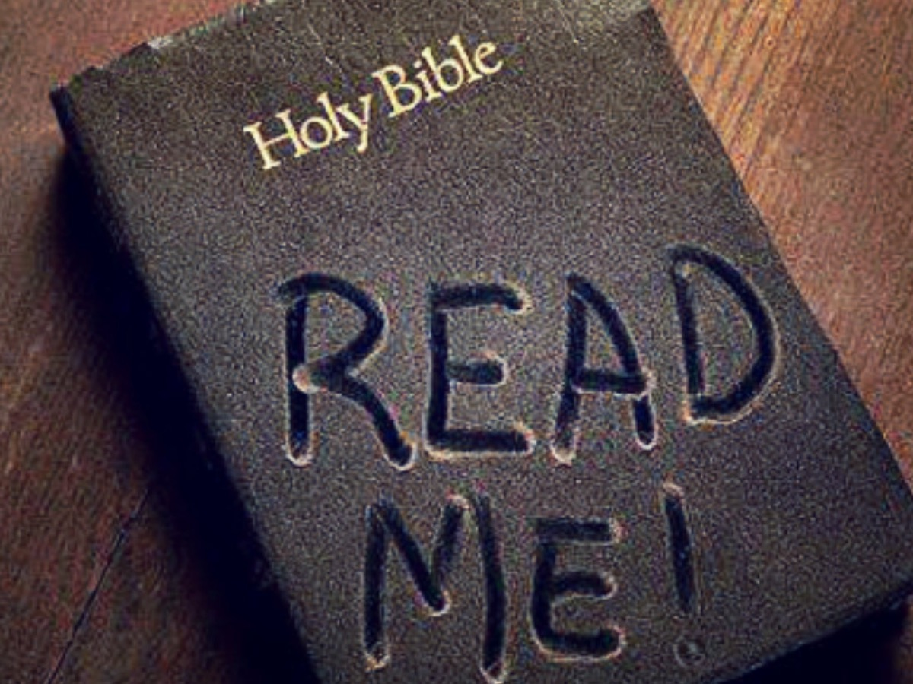
Notes:
Is it pleading with you to wipe the dust off and read it?

Slide 63
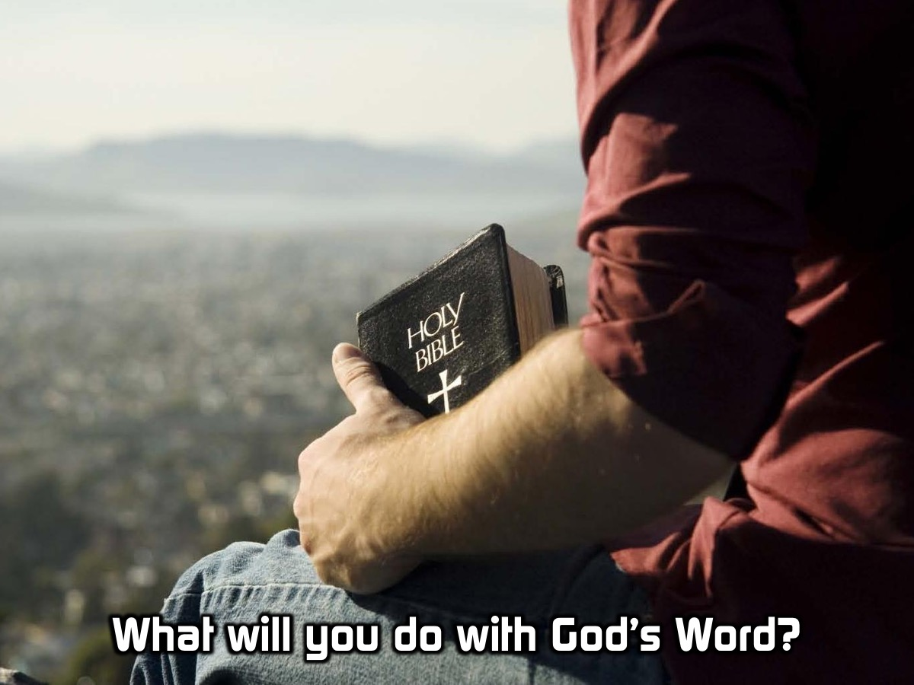
Notes:
What will you do with the Word of God?

Slide 64

Notes:
This series will inspire you to get in God’s Word

Slide 65
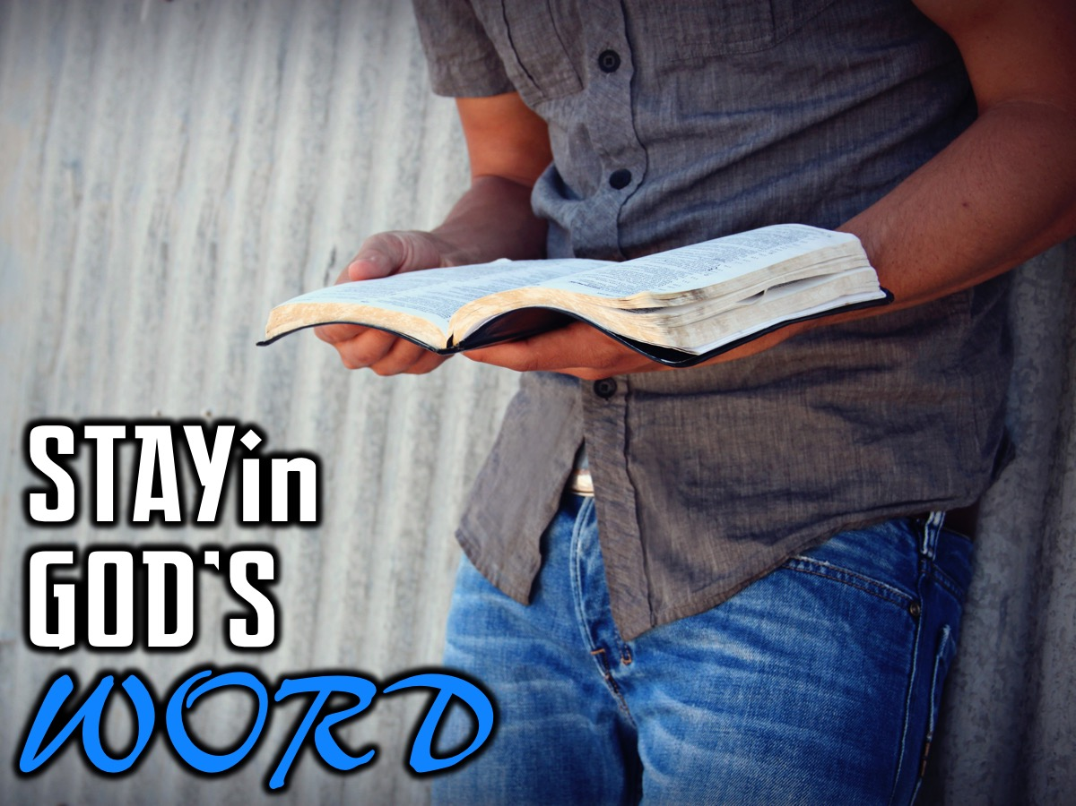
Notes:
and stay in God’s Word!

Slide 66
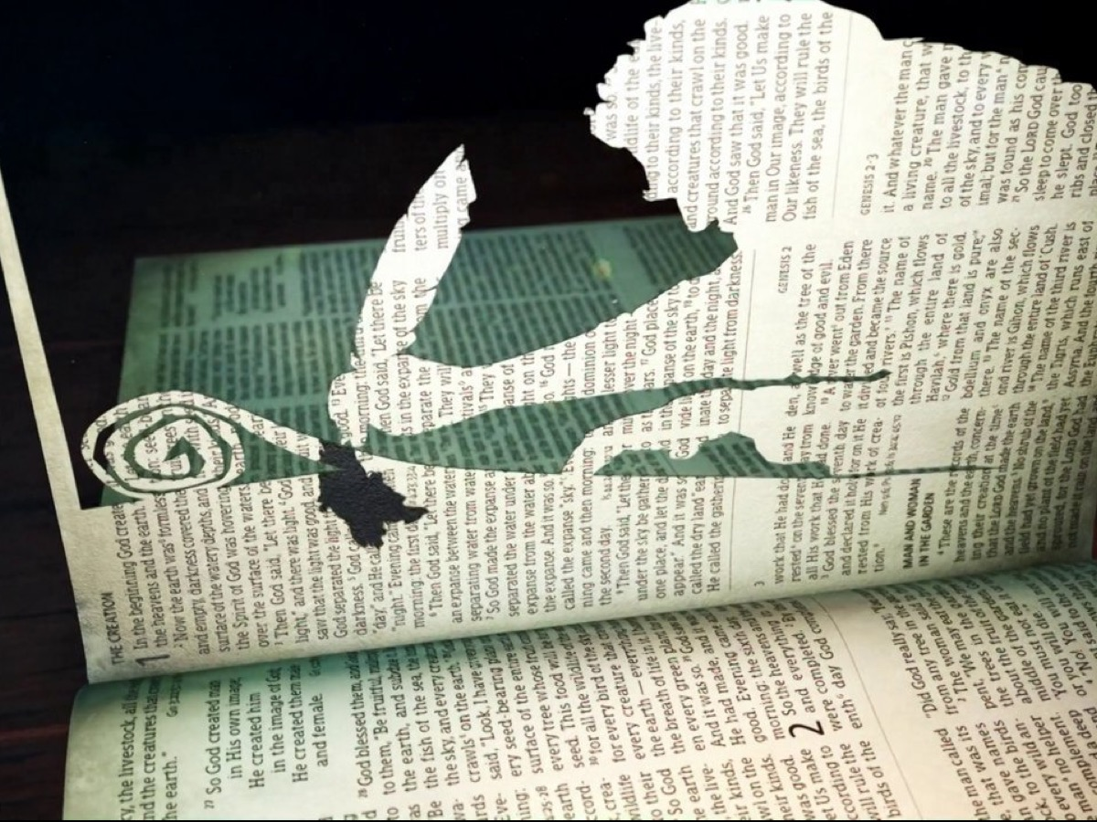
Notes:
We have time for one last video to inspire you about the Word!

Slide 67
Notes:
Video: The Gospel Story Chronological. Get it on YouTube at: https://www.youtube.com/watch?v=zkOJV95Uq-M

Slide 68
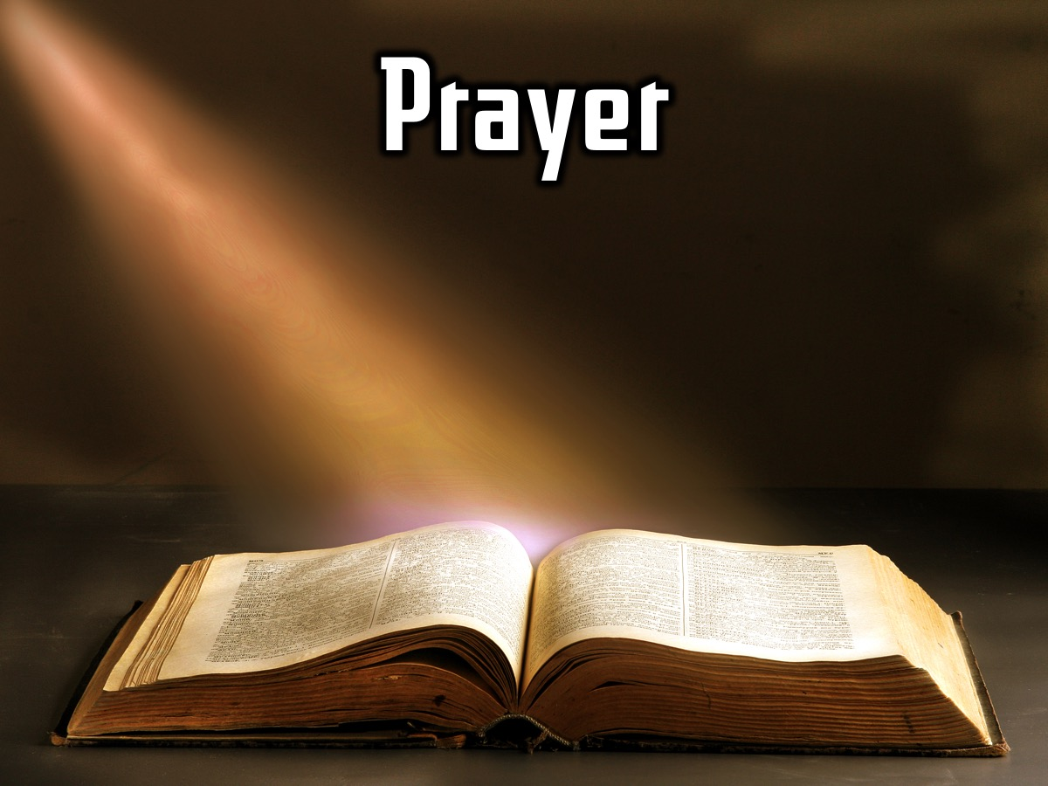
Notes:
Prayer

Slide 69

Notes:
Next week will we continue our journey in the Word with Mateam who will be preaching on how to get into the Word and get stuff out of it!

