Slide 1

Notes:
Welcome to the Trilogy Series at His Youth on Sunday mornings.

Slide 2

Notes:
Last week we introduced our mission statement: We see lives, communities and society transformed through discipleship in the Word, the presence and the power of God.

Slide 3

Notes:
Let’s say it together: We see lives, communities and society transformed through

Slide 4

Notes:
discipleship in the Word

Slide 5

Notes:
the presence and

Slide 6

Notes:
and the power of God.

Slide 7
Notes:
Let’s say it again: We see lives, communities and society transformed...

Slide 8
Notes:
discipleship in the Word…

Slide 9
Notes:
the presence and

Slide 10

Notes:
the power of God.

Slide 11

Notes:
In this series we are looking at the trilogy in our mission statement: Disciplemaking in the WORD, the PRESENCE and the POWER of God.

Slide 12

Notes:
Last week, Pastor Mark introduced the first part of the trilogy which is all about the Word.

Slide 13

Notes:
We learnt that no other book has the power to challenge, change, comfort or correct us like the Bible!

Slide 14

Notes:
We learnt that we need to get into God’s Word

Slide 15

Notes:
and stay in God’s Word!

Slide 16

Notes:
This week we continue our journey in the Word...

Slide 17
Notes:
Video: Did you know that God speaks to us through the Bible? Get it at: https://vimeo.com/68748218

Slide 18
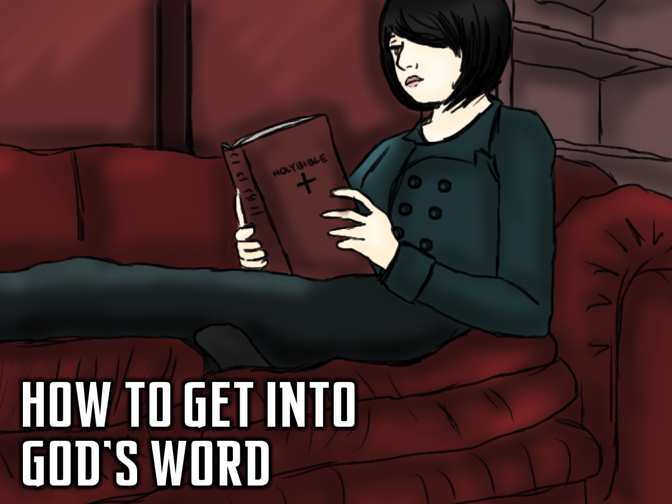
Notes:
How to Get Into God’s Word: Today I am going to show you a way you can use to help you get into God’s Word. This is a way of getting into the word so that reading the Bible is not like trying to do math.

Slide 19
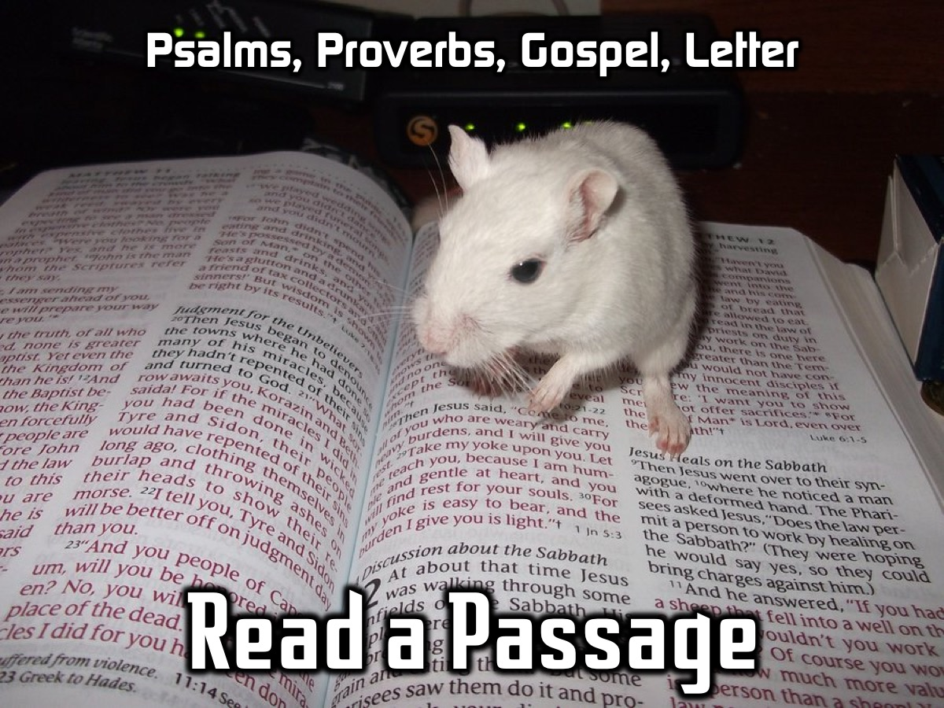
Notes:
Read a Bible Passage. We suggest that you consider starting with a book of the Bible and each day move on to the next section. Some options: Psalms; Proverbs, one of the Gospels; or a Letter.

Slide 20
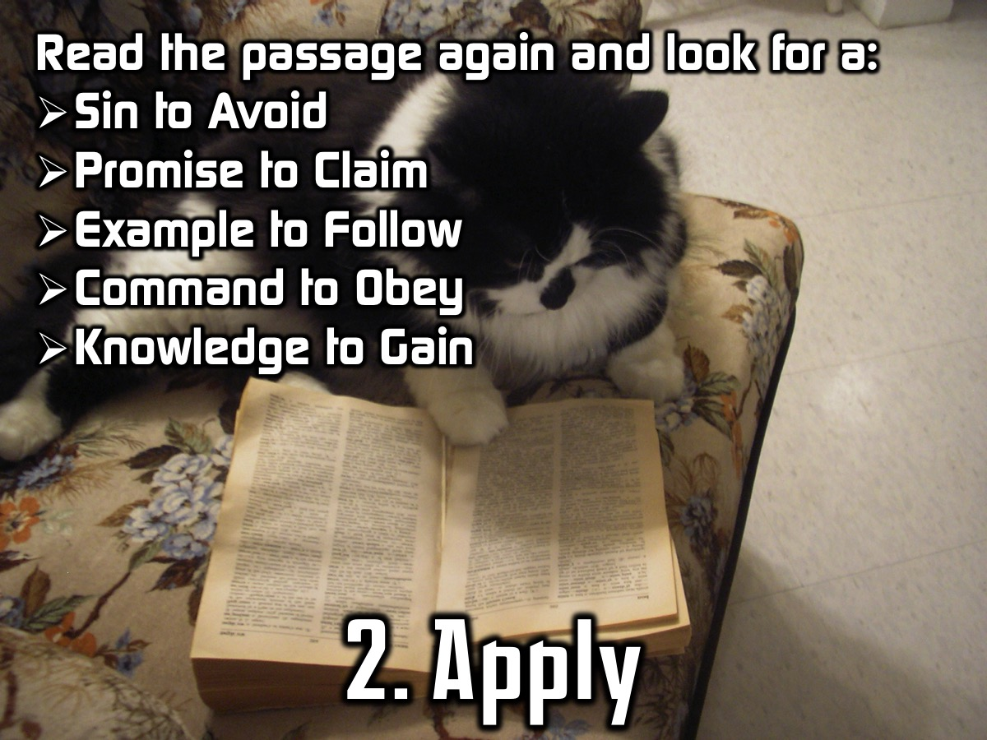
Notes:
1. Reflect. Write or summarise the passage in your own words:

Slide 21
Notes:
2. Apply. Read the passage again and look for:
S = A Sin to Avoid?
P = A Promise to Claim?
E = An Example to Follow?
C = A Command to Obey?
K = A Knowledge to Gain?

Slide 22
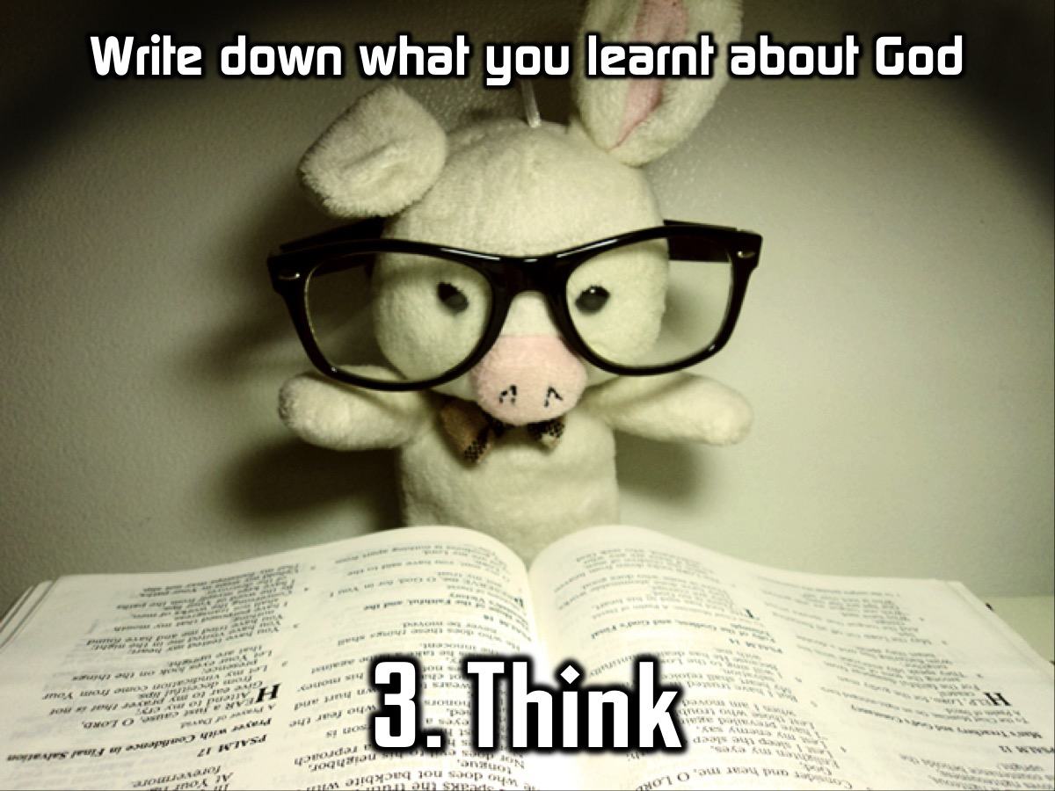
Notes:
3. Think. Write down what you have learnt about God.

Slide 23
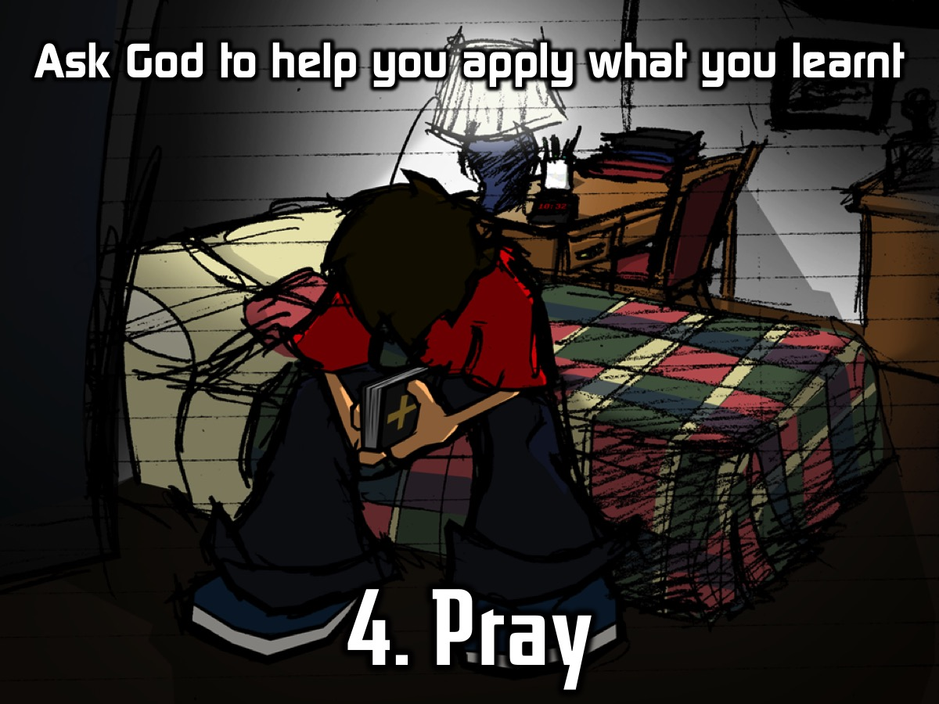
Notes:
4. Pray. Ask God to help you apply what you have learnt.

Slide 24
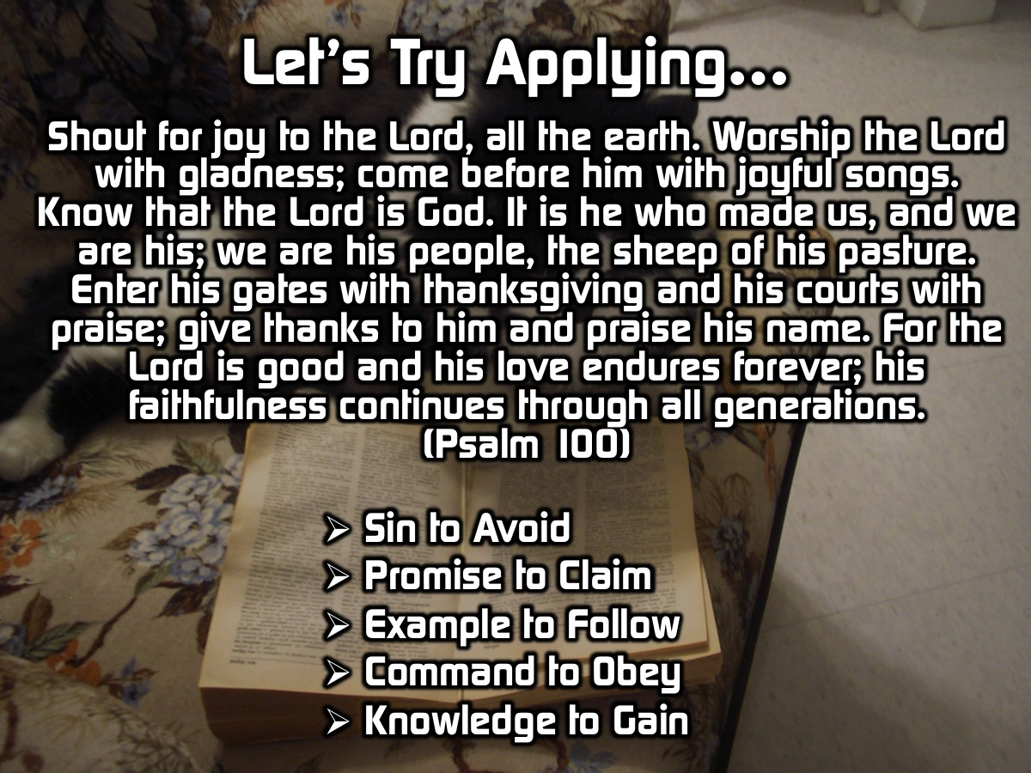
Notes:
Let’s try appying what we read to our lives using the five questions we learnt to ask about what we read: Is there a Sin to Avoid, a Promise to Claim, an Example to Follow, a Command to Obey, and Knowledge to Gain?

Slide 25
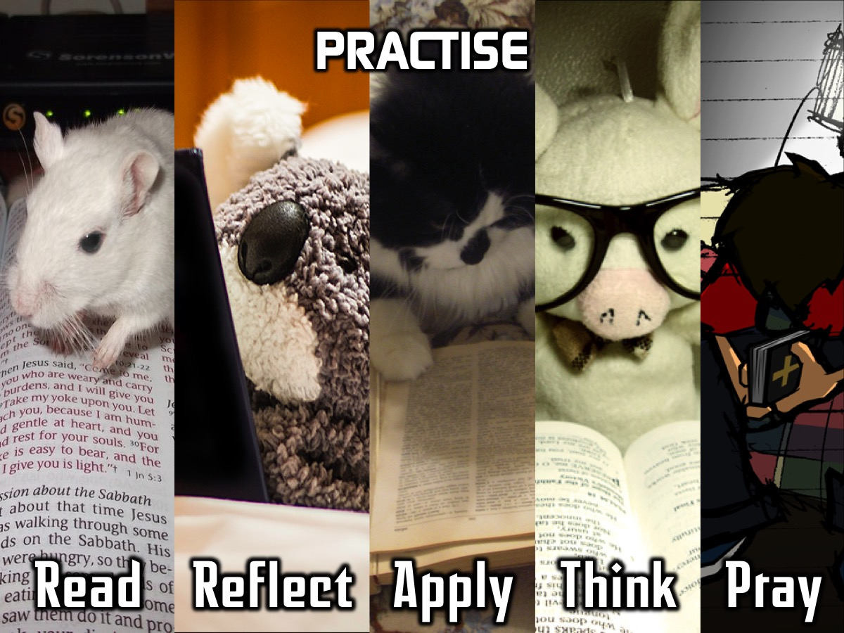
Notes:
Practise: It is time for you to Get Into God’s Word. We are going to give you each a copy of a handout to work through – using Psalm 1.

Slide 26
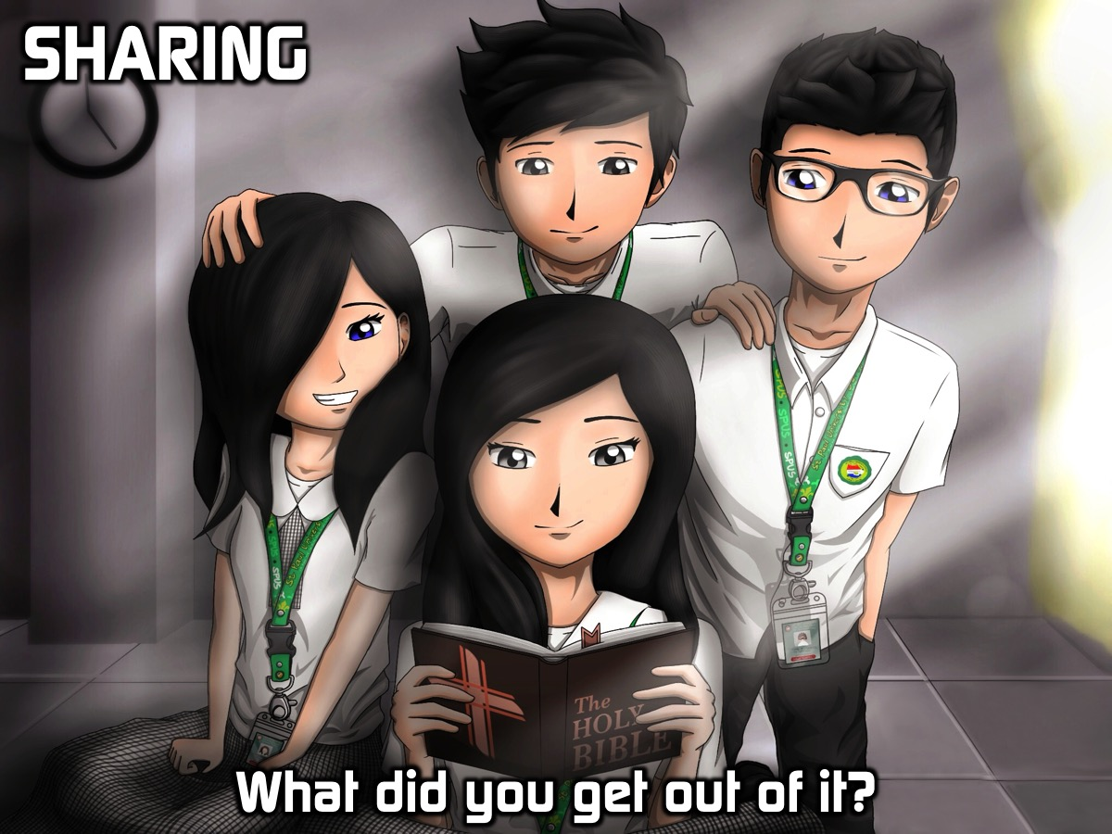
Notes:
Sharing: This is your chance to come to the microphone and share what you got out of your time in the Word and with God.

Slide 27
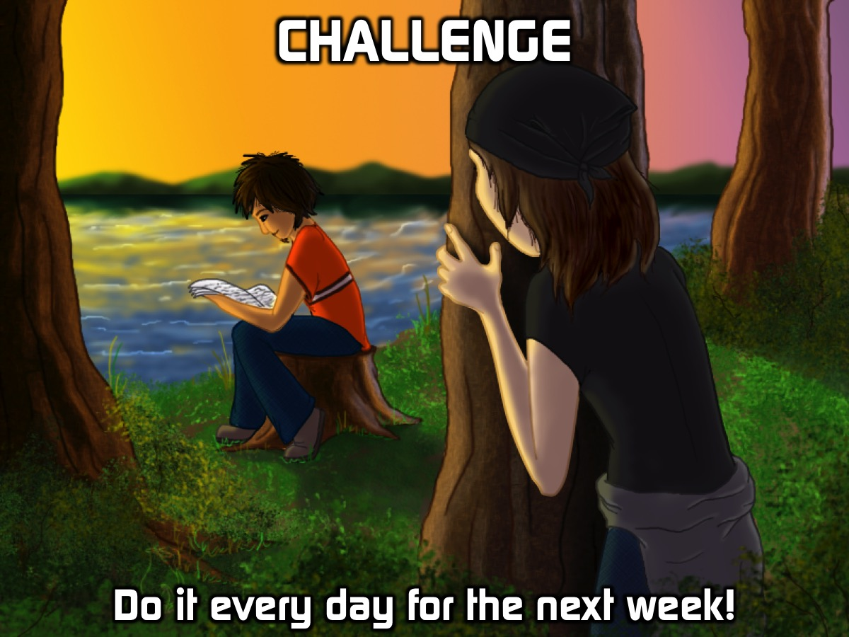
Notes:
Challenge: Do it every day for the next week! And then for the rest of your life!

Slide 28
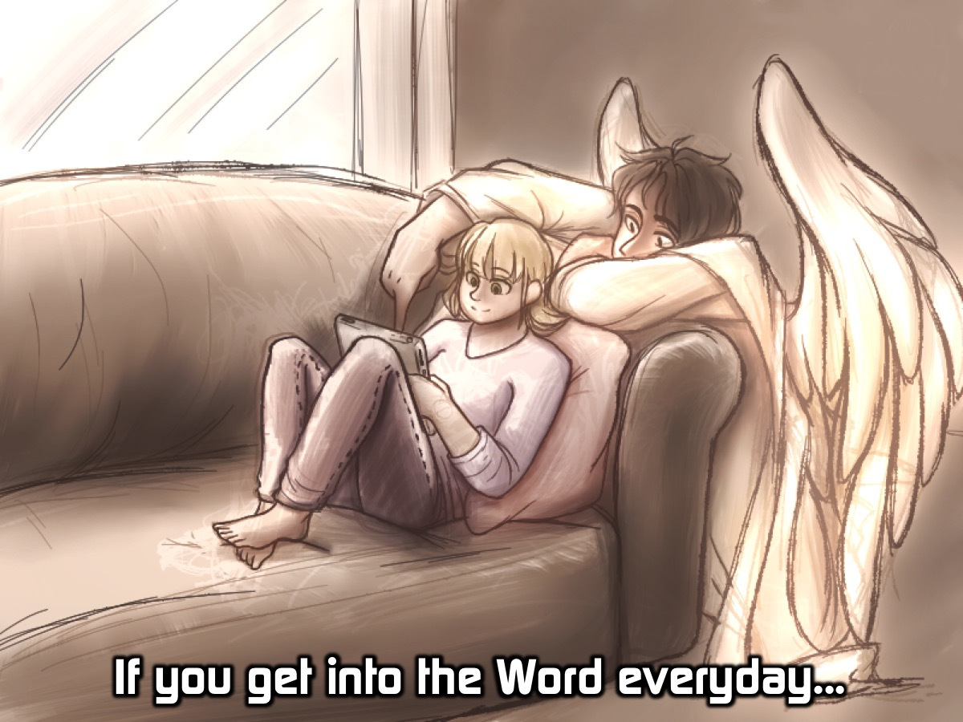
Notes:
If you get into the Word everyday…

Slide 29
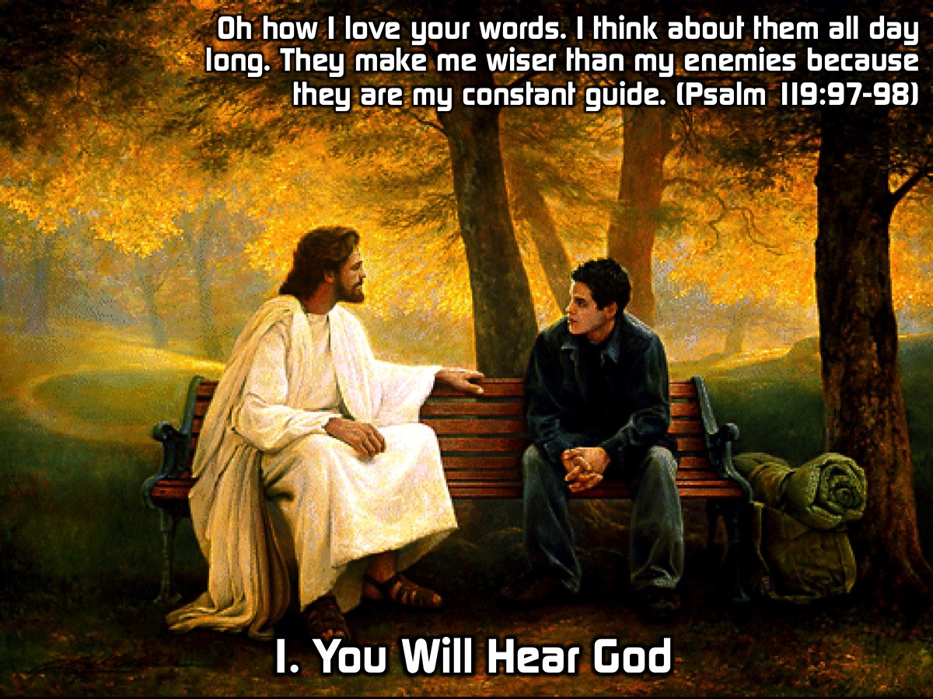
Notes:
(1) You Will Hear God (and he will speak through you). “Oh how I love your words. I think about them all day long. They make me wiser than my enemies because they are my constant guide.” (Psalm 119:97-98)

Slide 30
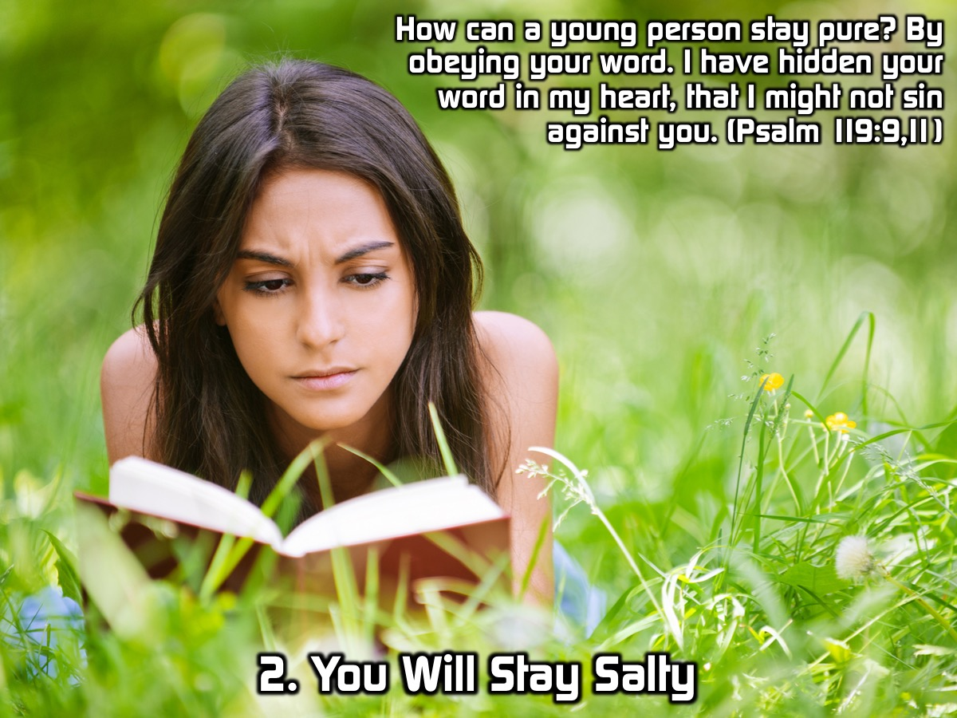
Notes:
(2) You Will Stay Salty. “How can a young person stay pure? By obeying your word. I have hidden your word in my heart, that I might not sin against you.” (Psalm 119:9,11)

Slide 31
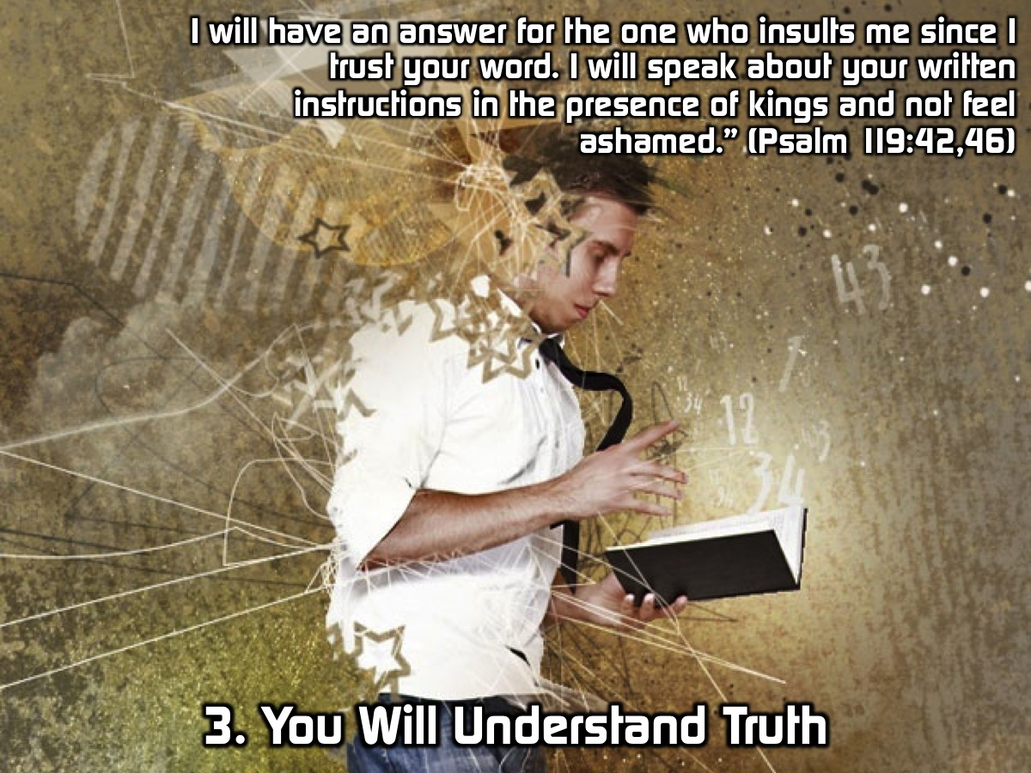
Notes:
(3) You Will Understand Truth. “I will have an answer for the one who insults me since I trust your word. I will speak about your written instructions in the presence of kings and not feel ashamed.” (Psalm 119:42,46)

Slide 32
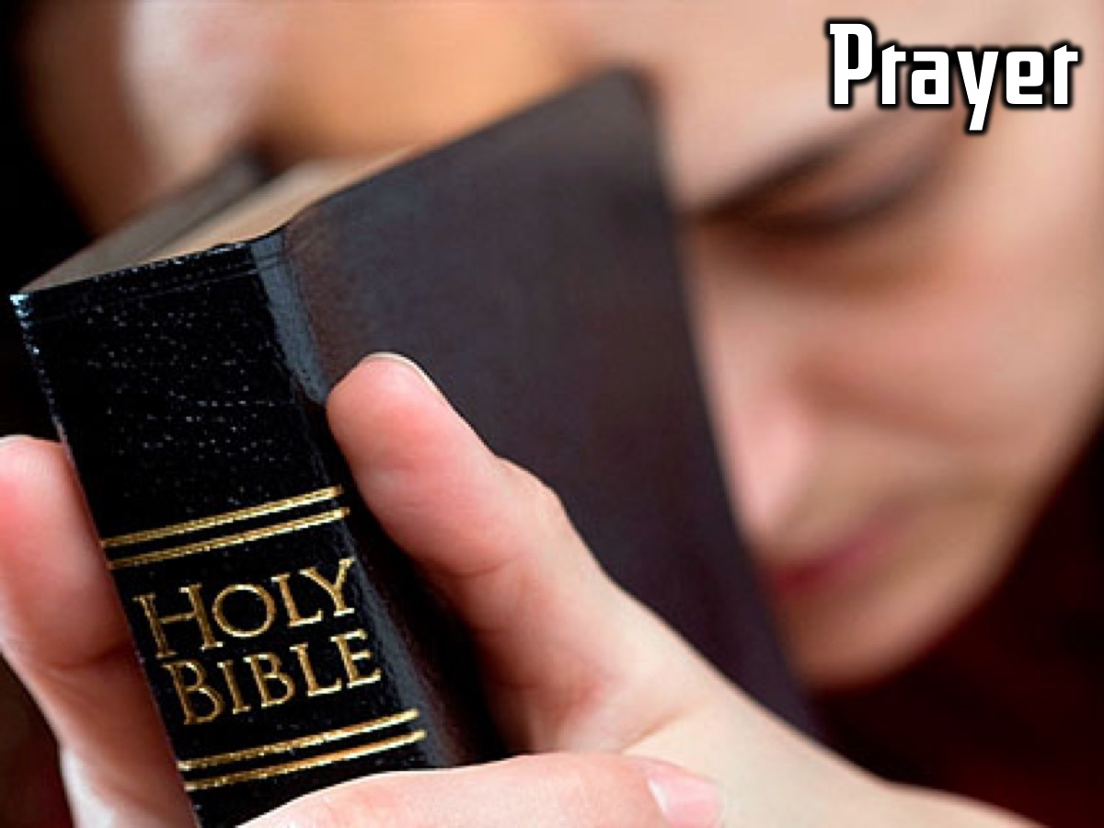
Notes:
Prayer

Slide 33

Notes:
Next week will we continue our journey in the Word with Shaun who will be preaching on how to get into the Word and get stuff out of it!

