Slide 1
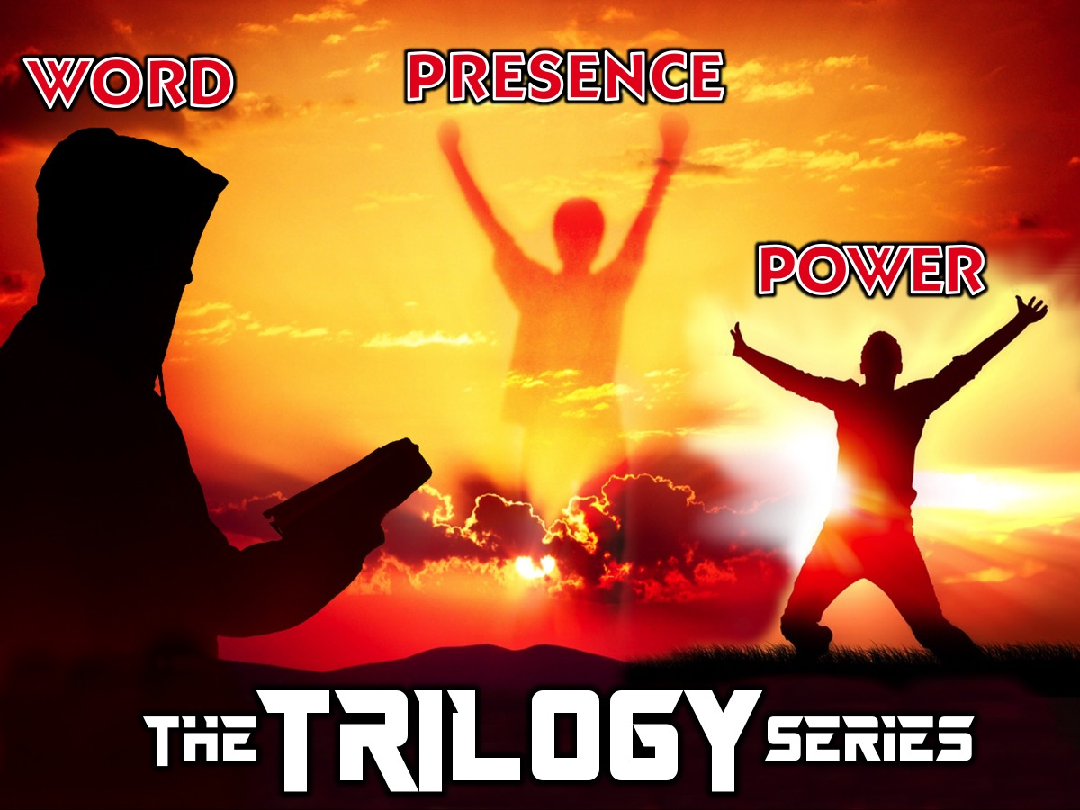
Notes:
Welcome to the Trilogy Series.

Slide 2
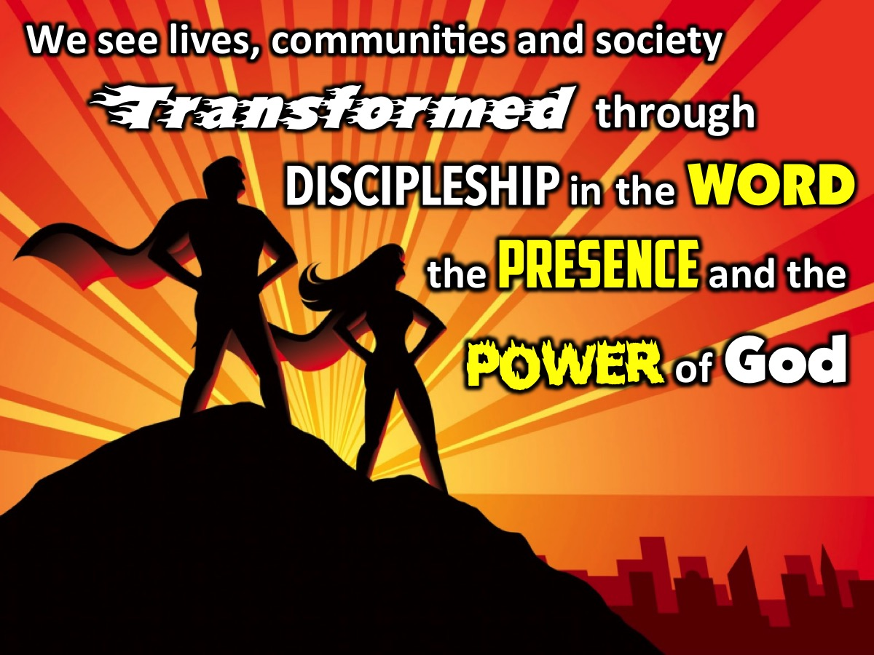
Notes:
In this series we are looking at the trilogy in our mission statement: Disciplemaking in the WORD, the PRESENCE and the POWER of God.

Slide 3
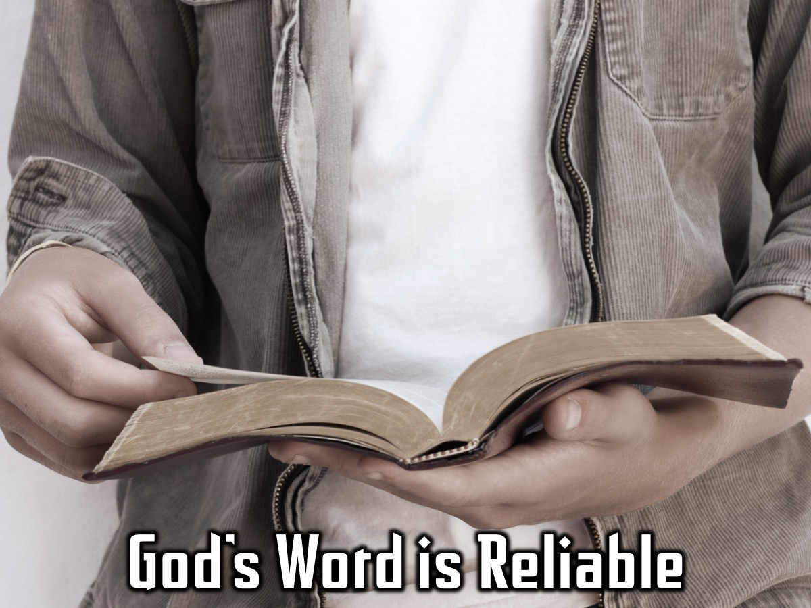
Notes:
We have looked at the reliability of God’s word. Ps Mark spoke to us about how the Bible really is God’s word that has been faithfully and accurately handed down for us to read.

Slide 4
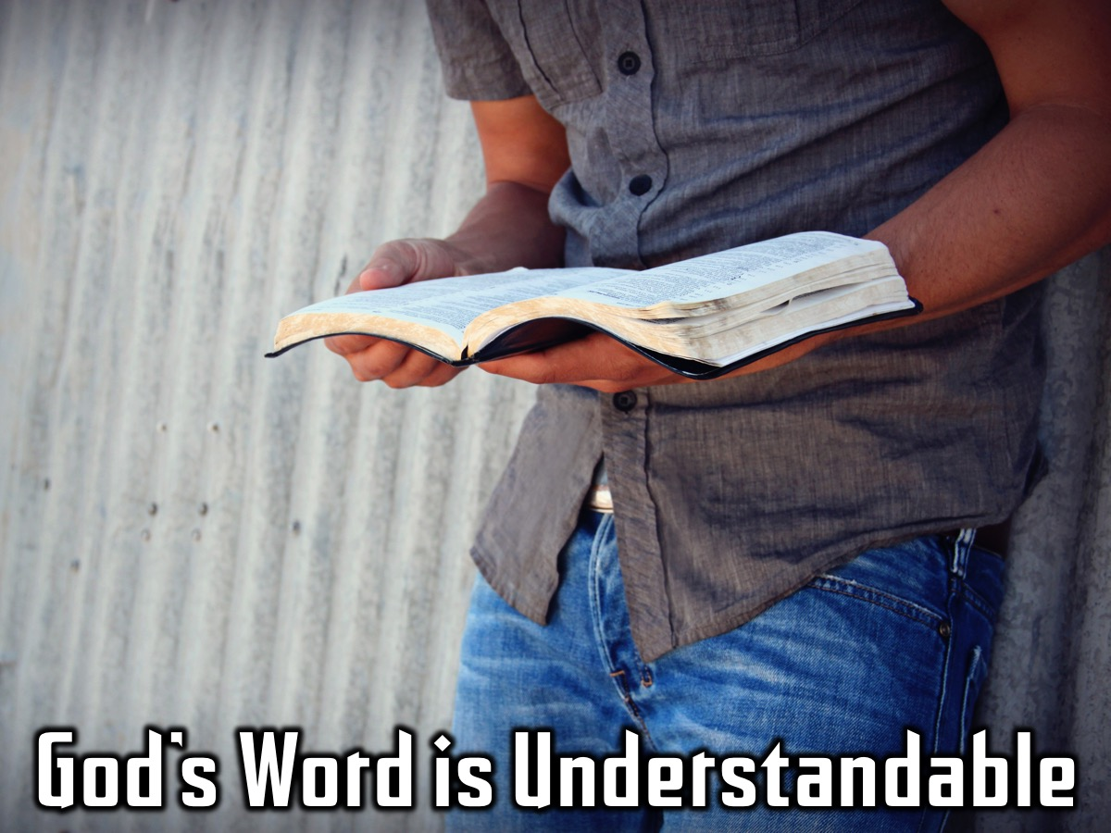
Notes:
Mateam taught us to to read and apply God’s word in our lives. The Bible does not have to be confusing and lifeless, if we apply it to our lives in a practical way using simple methods.

Slide 5
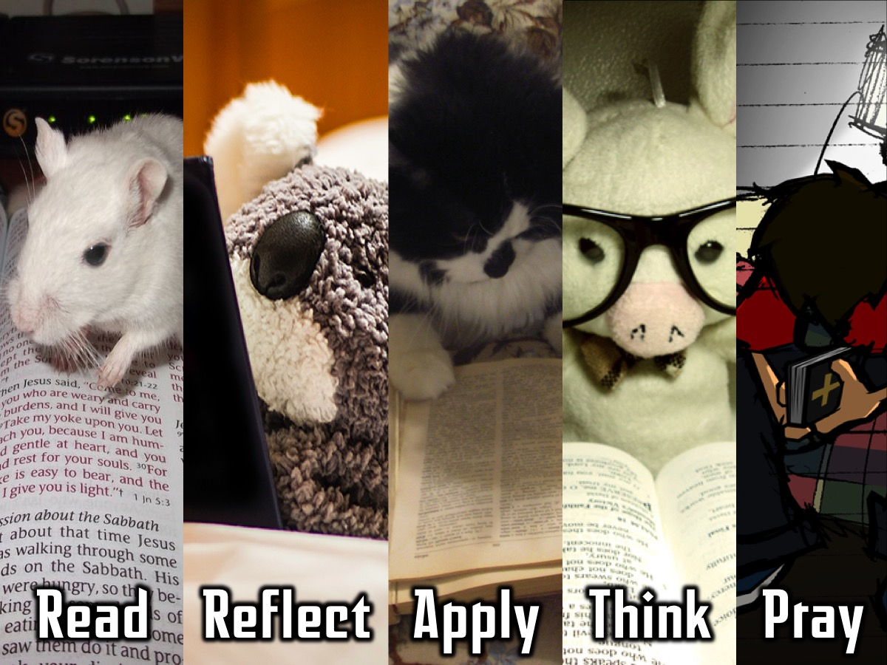
Notes:
We learnt how to get into God’s Word with a method where we read the word, reflect on it, apply what we read to our life, think about what we have learnt about God and then end with prayer.

Slide 6
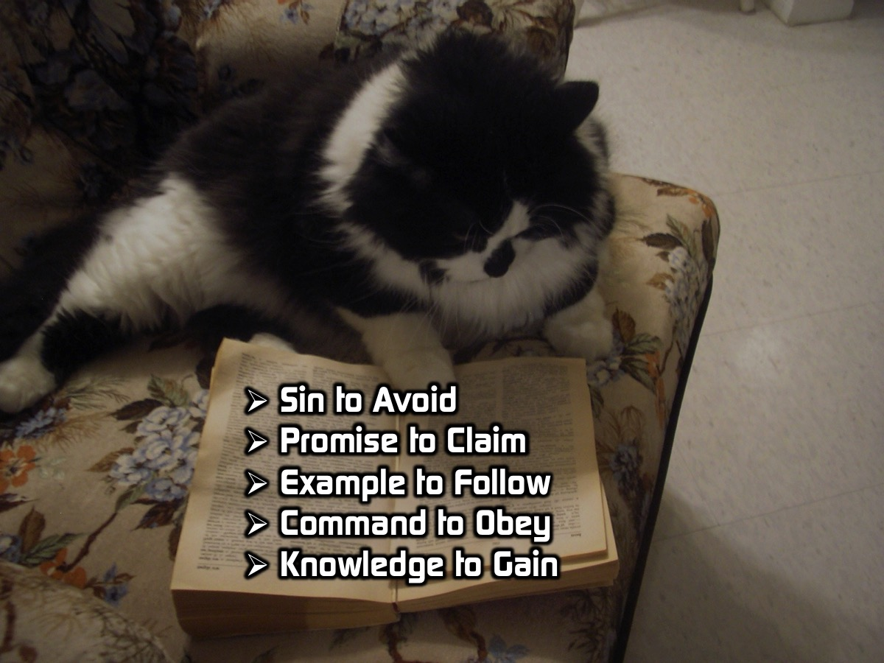
Notes:
We learnt how to use five questions to apply what we read to our lives: Is there a Sin to Avoid, a Promise to Claim, an Example to Follow, a Command to Obey, and Knowledge to Gain?

Slide 7
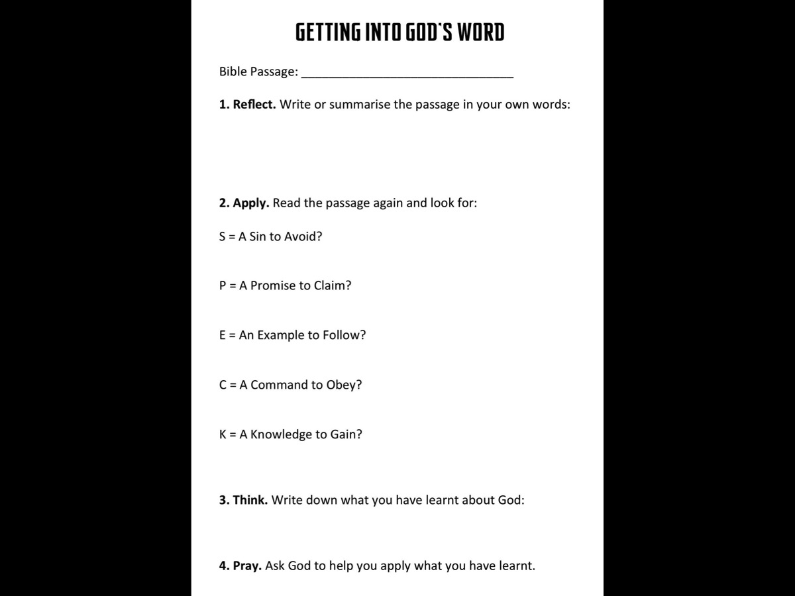
Notes:
If you missed it – pick up a handout at the back before you leave this morning!

Slide 8
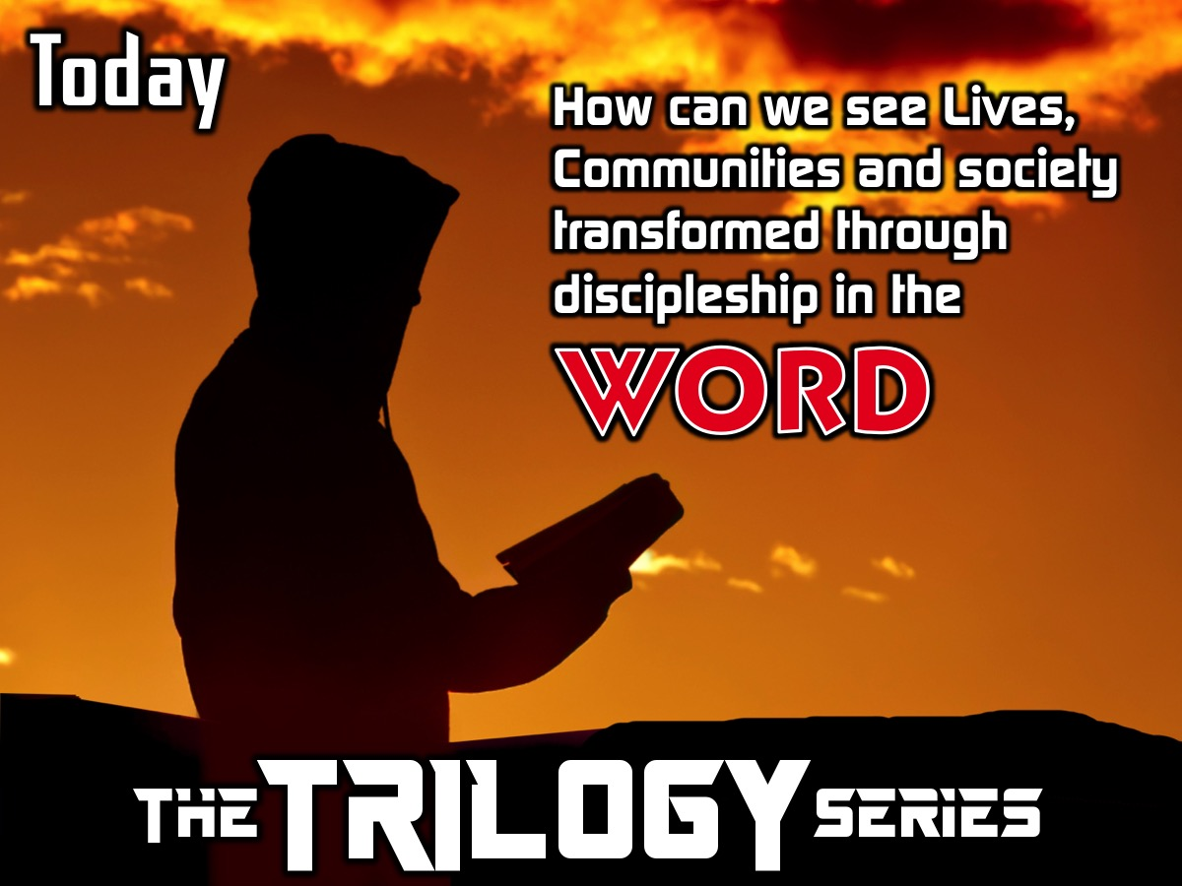
Notes:
The Question now is: How can we see Lives, Communities and society transformed through discipleship in the word of God? How is God’s word able to change our lives?

Slide 9

Notes:
Illustration: You can’t prepare for your exams by putting your text book under your pillow and hoping to know it all by the morning. You actually have to read and study the material.

Slide 10

Notes:
In the same way, God’s Word won’t change us if it is left unopened on our shelf!

Slide 11
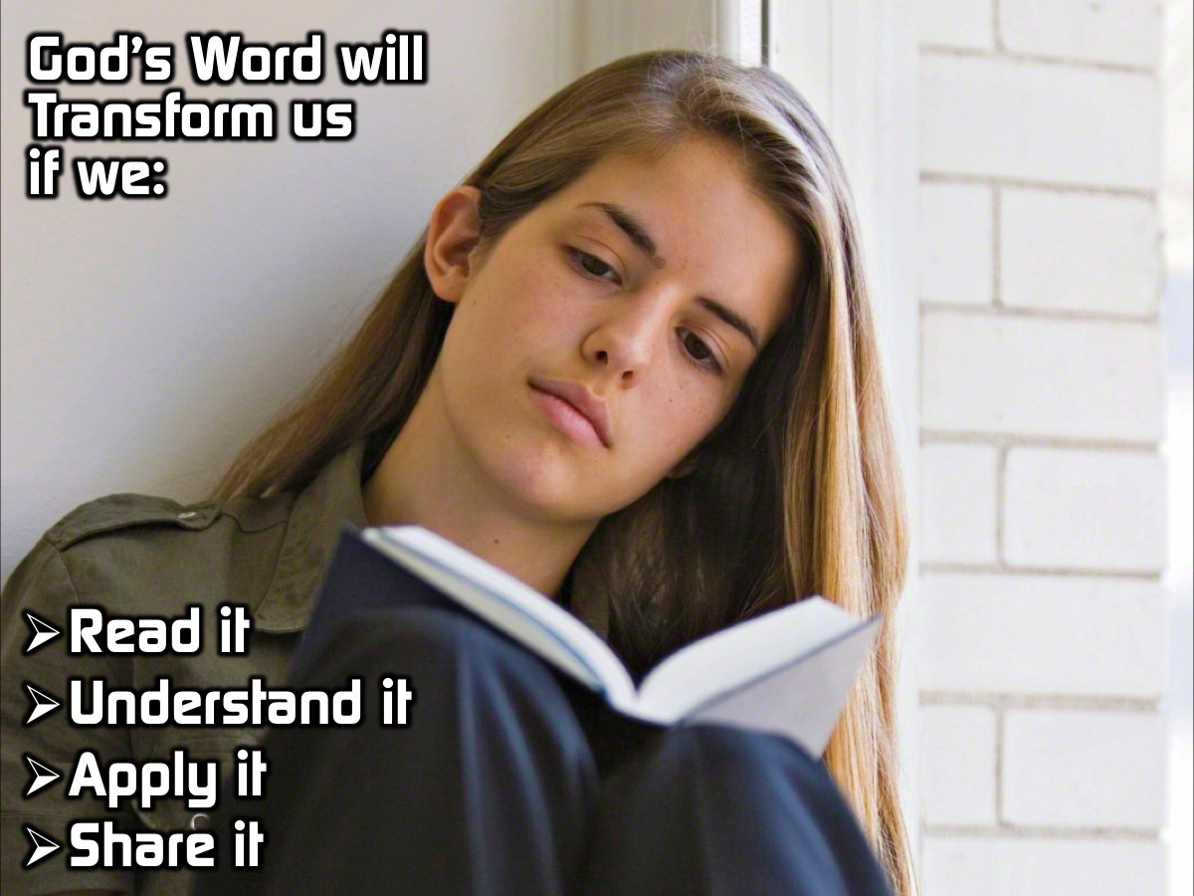
Notes:
God’s Word Will Transform Us If We:
1. Read It
2. Understand It
3. Apply It
4. Share It

Slide 12
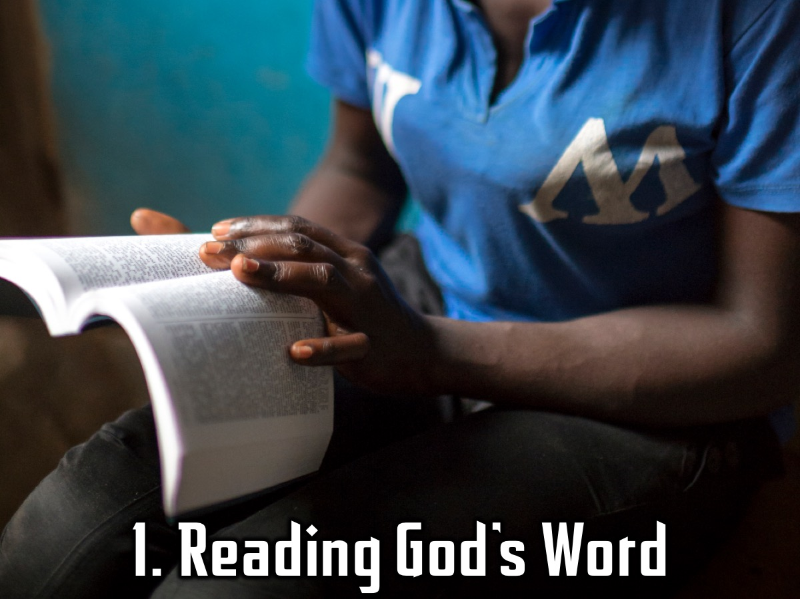
Notes:
Stage 1: Reading God’s Word

Slide 13
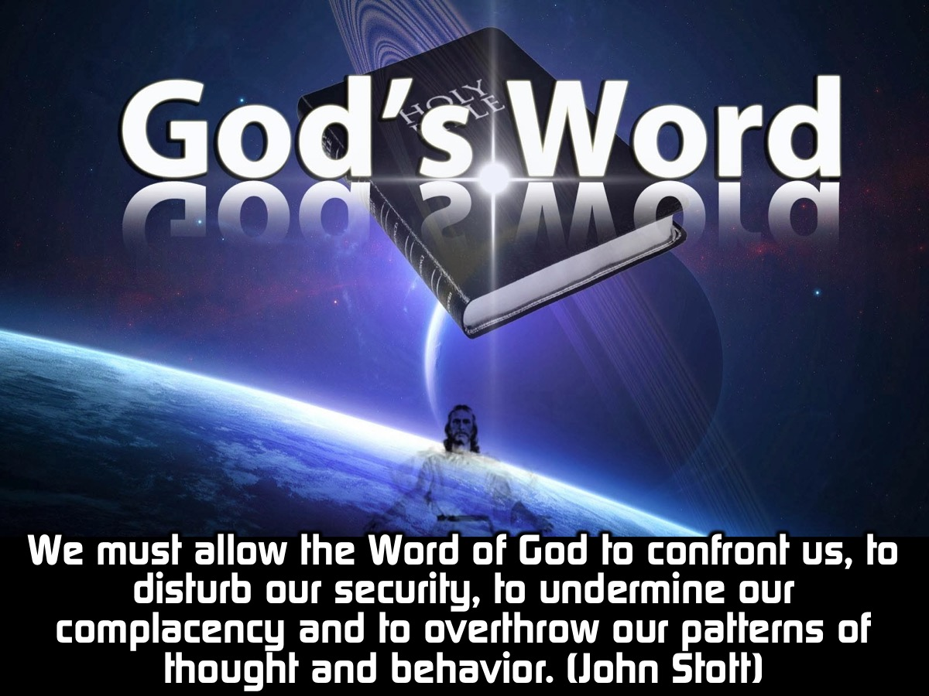
Notes:
“We must allow the Word of God to confront us, to disturb our security, to undermine our complacency and to overthrow our patterns of thought and behavior.” (John Stott)

Slide 14
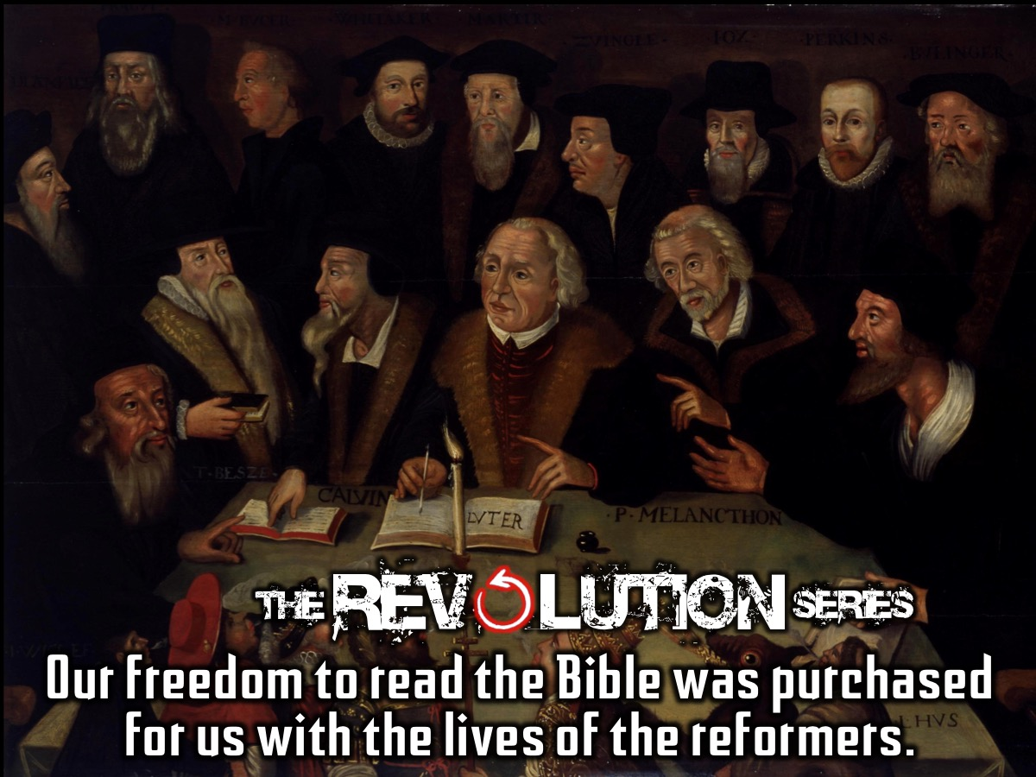
Notes:
In our revolution series we saw how The freedom of being able to read the Bible was purchased for us with the lives of the reformers. We need to understand the importance of the words in this great book.

Slide 15
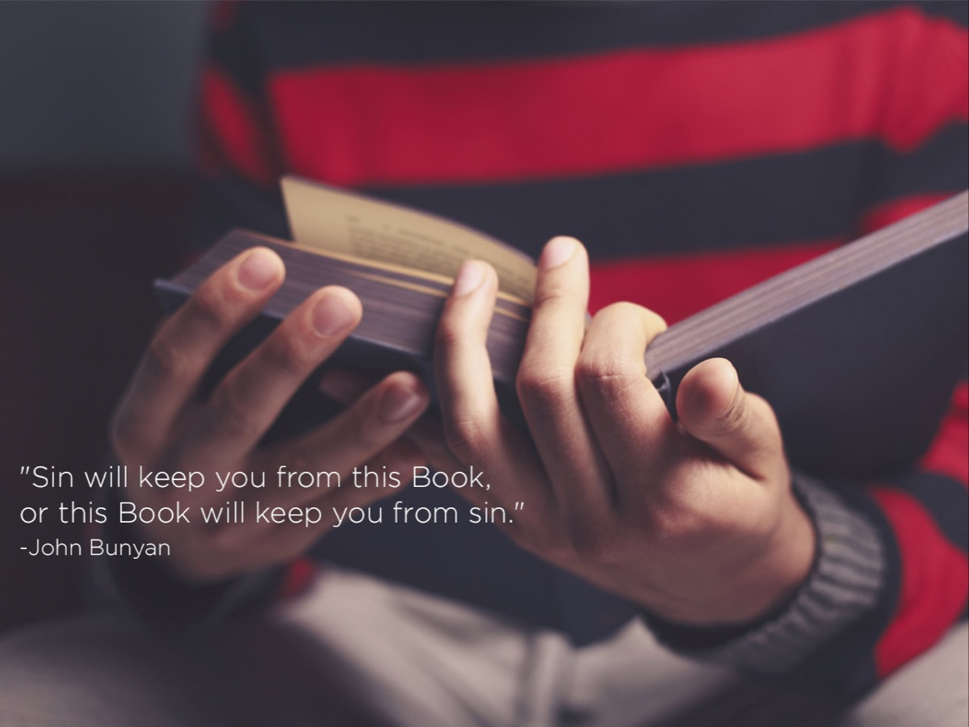
Notes:
Pastor Mark shared in week 1 something that he wrote in the front of his Bible 30 years ago: “This book will keep you from sin, but sin will keep you from this book.”

Slide 16
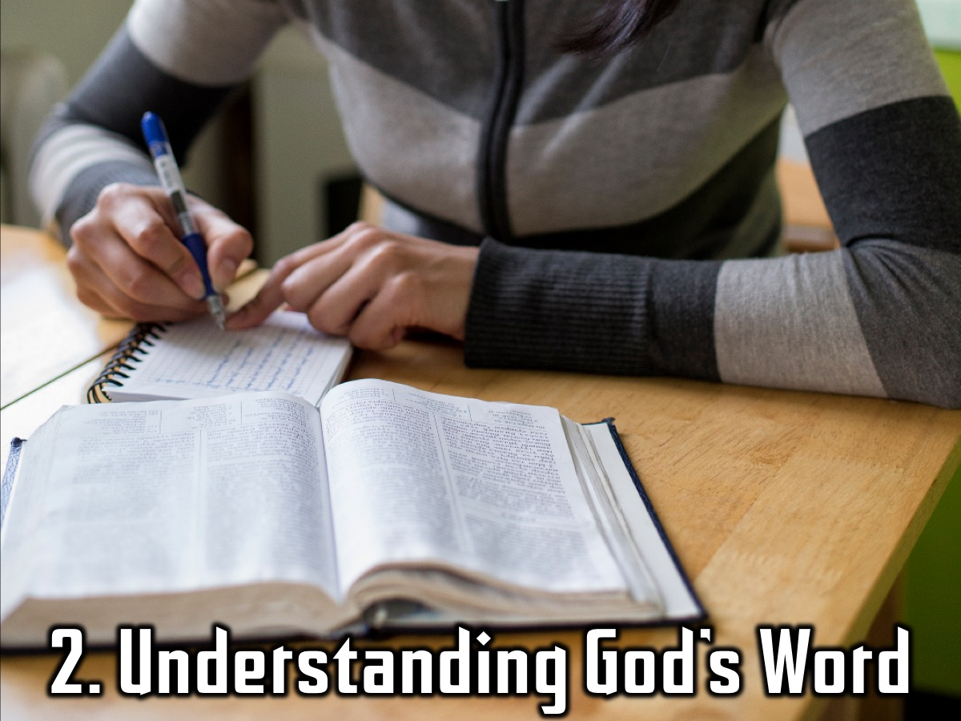
Notes:
Stage 2: Understanding God’s Word

Slide 17
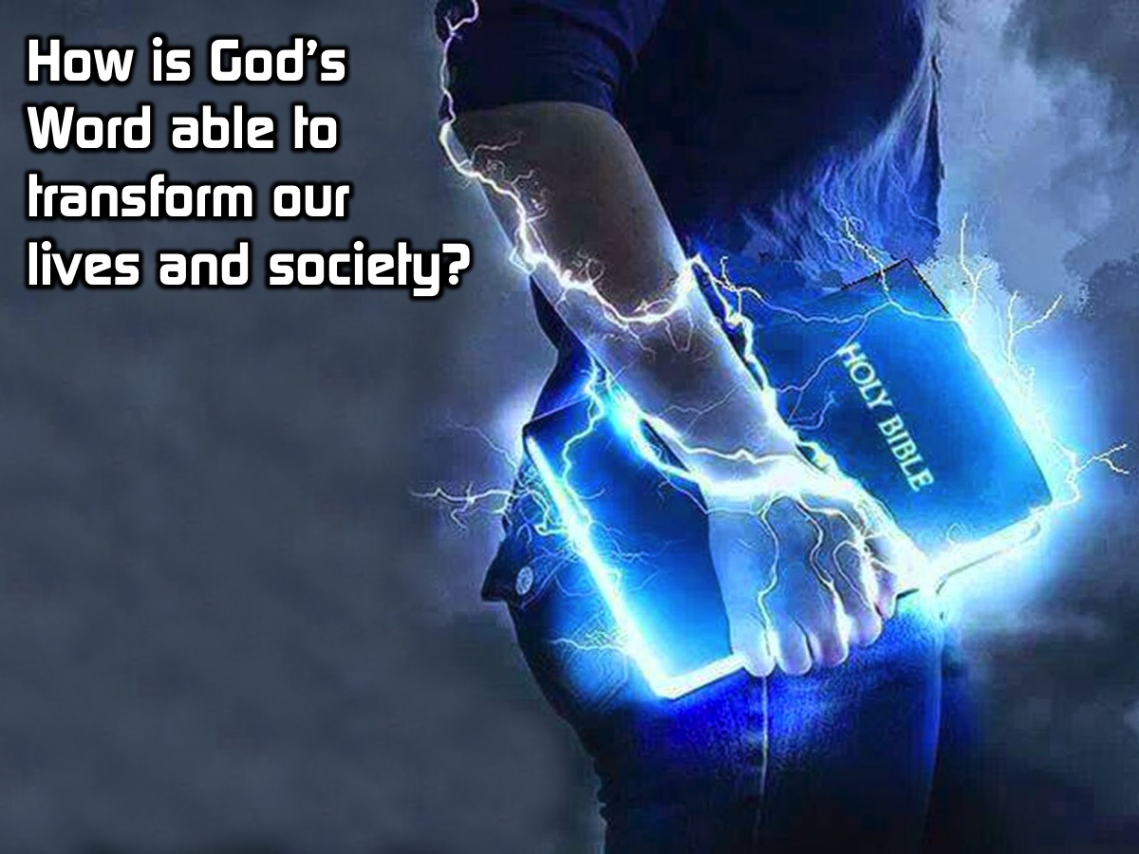
Notes:
So how is God’s word is able to transform our lives and every culture and society? What does God’s word do? How does it benefit us? How can it transform our lives and in what way?

Slide 18
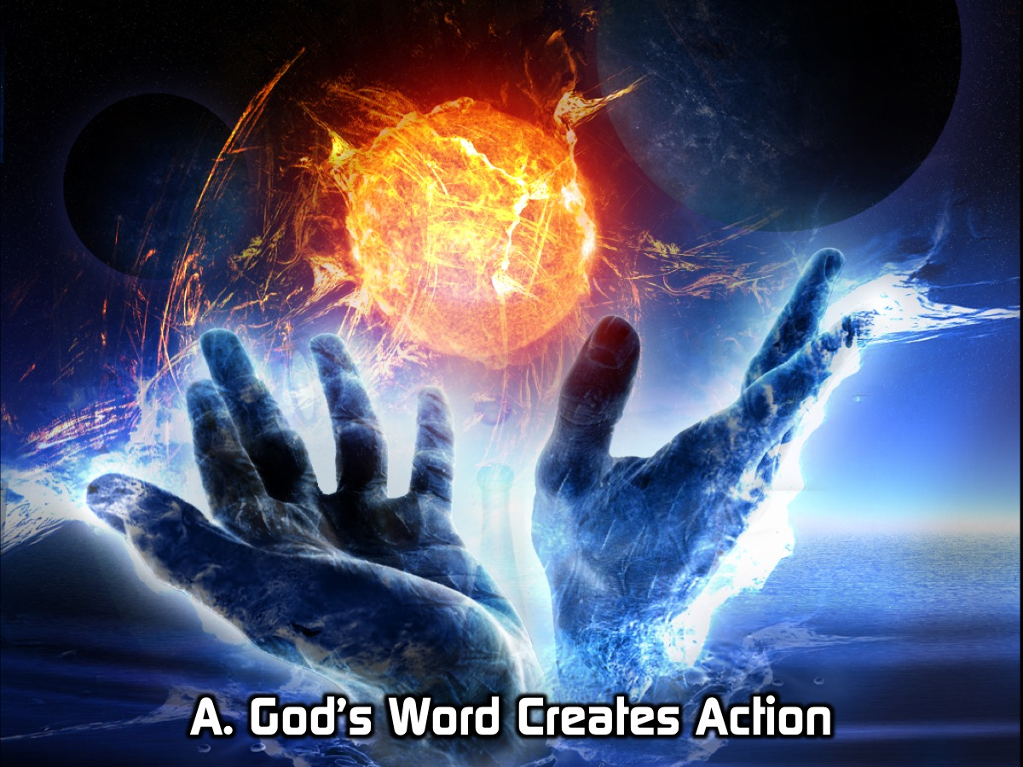
Notes:
A. God’s Word Creates Action

Slide 19
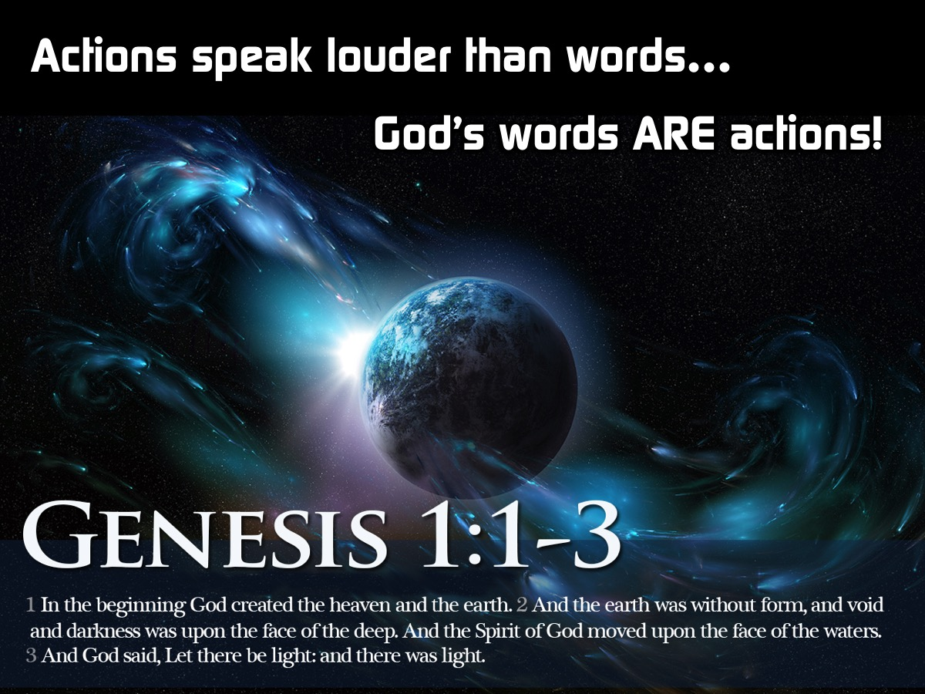
Notes:
Everyone has heard the saying that actions speak louder than words. When it comes to God, his words ARE action! In Genesis it is God’s word that causes the universe to come into being. “And God said, ‘Let there be light,’ and there was light.” (Genesis 1:3)

Slide 20
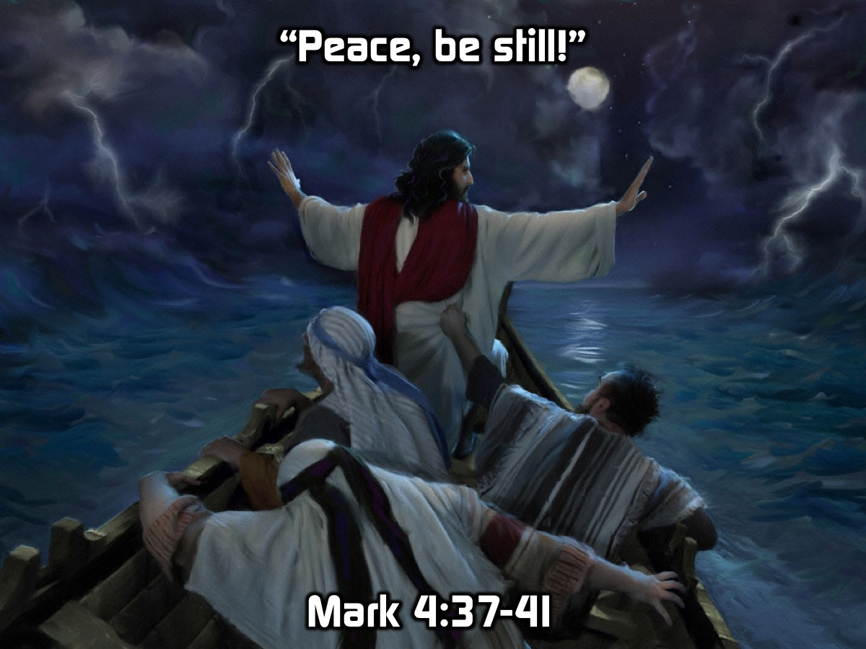
Notes:
When Jesus was in a boat with the disciples and there was a huge storm that threatened to sink their boat, Jesus calmed the storm with three words. And a great windstorm arose, and the waves were breaking into the boat, so that the boat was already filling. But he was in the stern, asleep on the cushion. And they woke him and said to him, “Teacher, do you not care that we are perishing?” And he awoke and rebuked the wind and said to the sea, “Peace! Be still!” And the wind ceased, and there was a great calm. He said to them, “Why are you so afraid? Have you still no faith?” And they were filled with great fear and said to one another, “Who then is this, that even the wind and the sea obey him?” (Mark 4: 37-41)
(In the original text Jesus used a 2 word phrase (siwpa pefimwso □ siopao phimoo - "Quiet! Be still!" The Greek words are siopao, "keep silent, say nothing, make no sound, stop speaking, become quiet," and phimoo, " 'tie shut,' specifically, 'muzzle.' Figuratively it means to put to silence.'”)

Slide 21
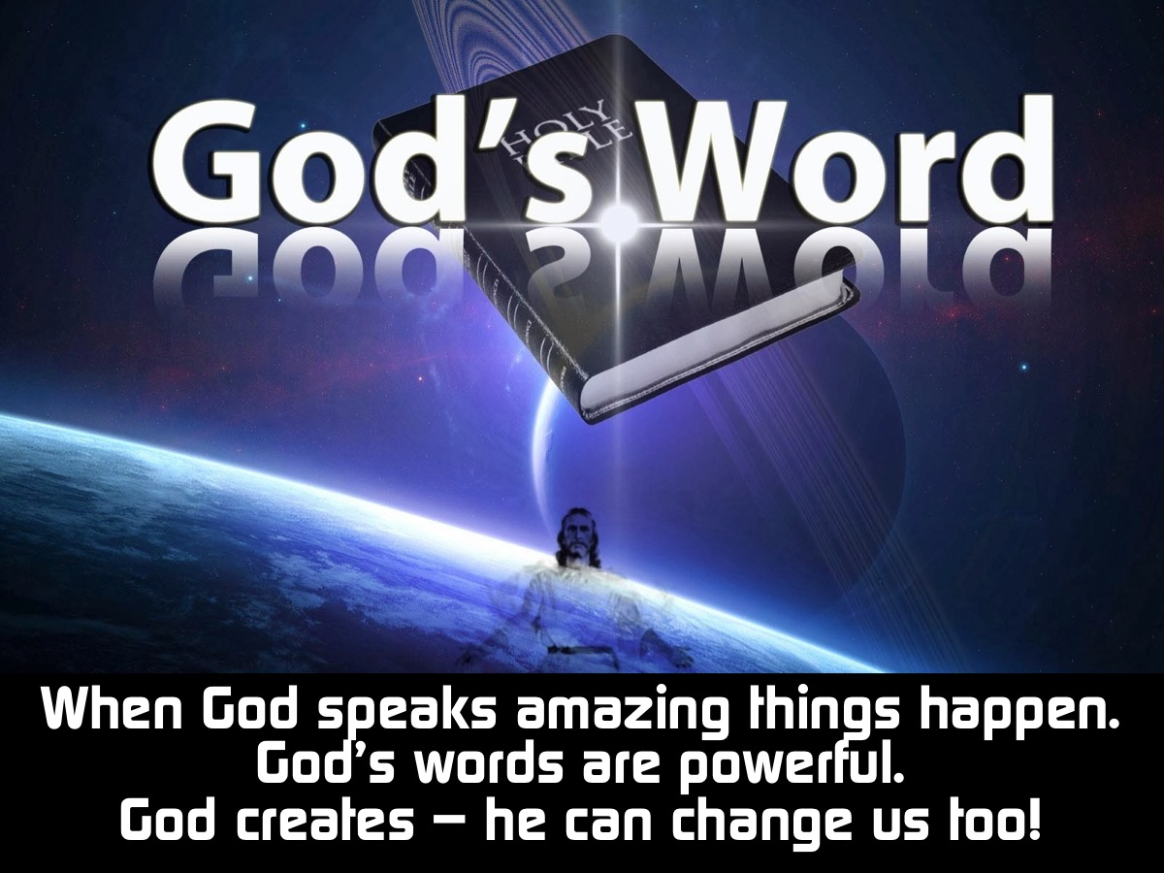
Notes:
Here is what we have learnt so far: (1) When God speaks – amazing things happen. (2) God’s words are powerful. (3) If God can create the universe in a single breath then I am 100% certain he can change our lives too.

Slide 22
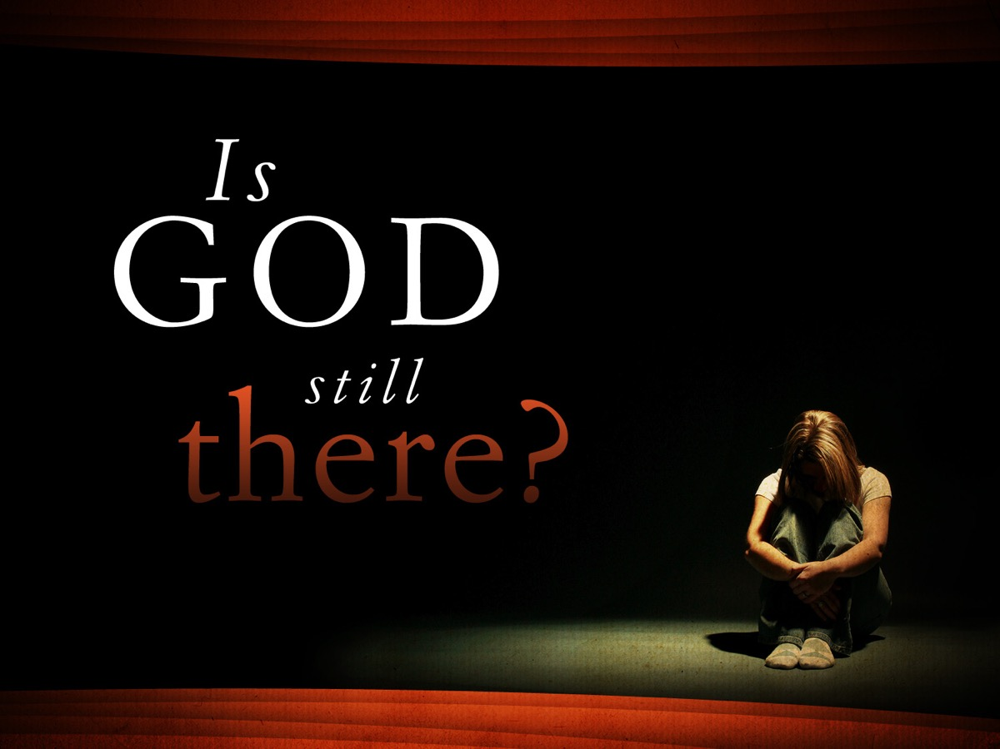
Notes:
We often say that God is not there to help us when we need Him or that he feels far away. Or we often feel that God never speaks to us.

Slide 23
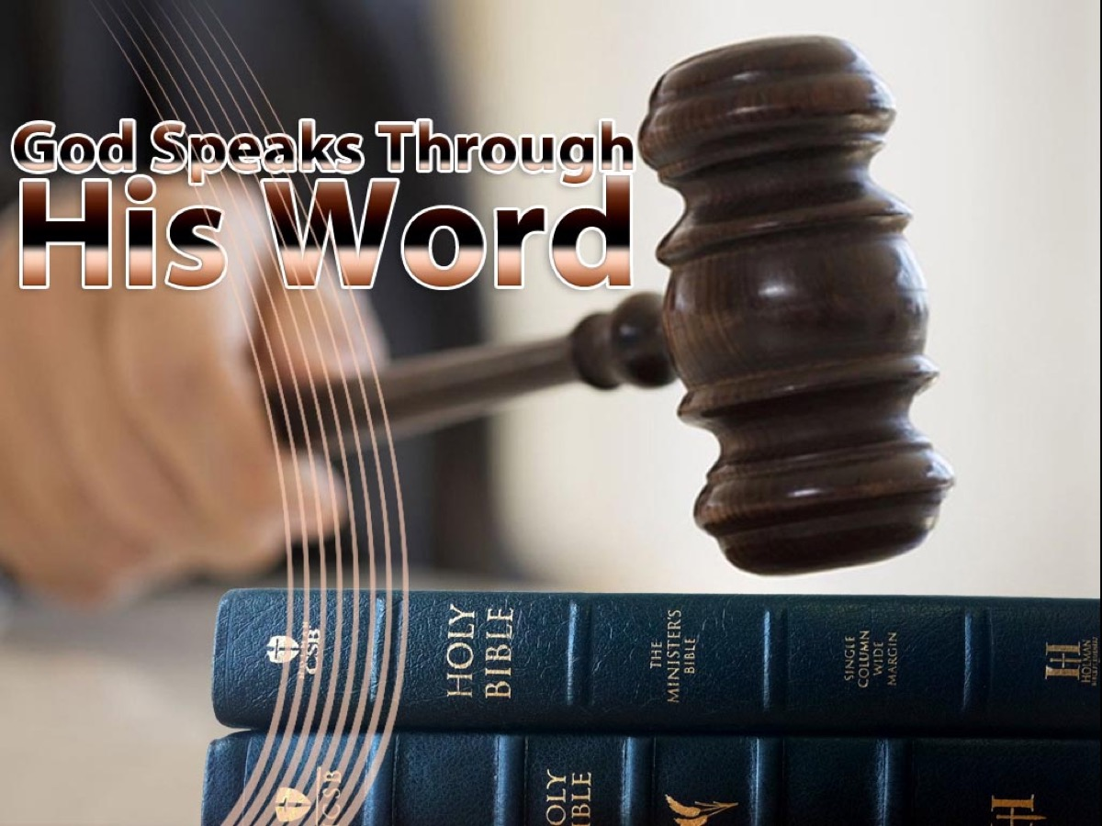
Notes:
The sad reality is that there is a whole book filled with Gods word that he wants us to hear but we hardly take the time to listen. When was the last time you took some time to spend with God and listen to his words? To hear what he wants to say about you, to hear his advice, to be comforted and strengthened by his words? God has the power to help you, if you would only listen to his voice. When God speaks, things happen because his words are that powerful.

Slide 24
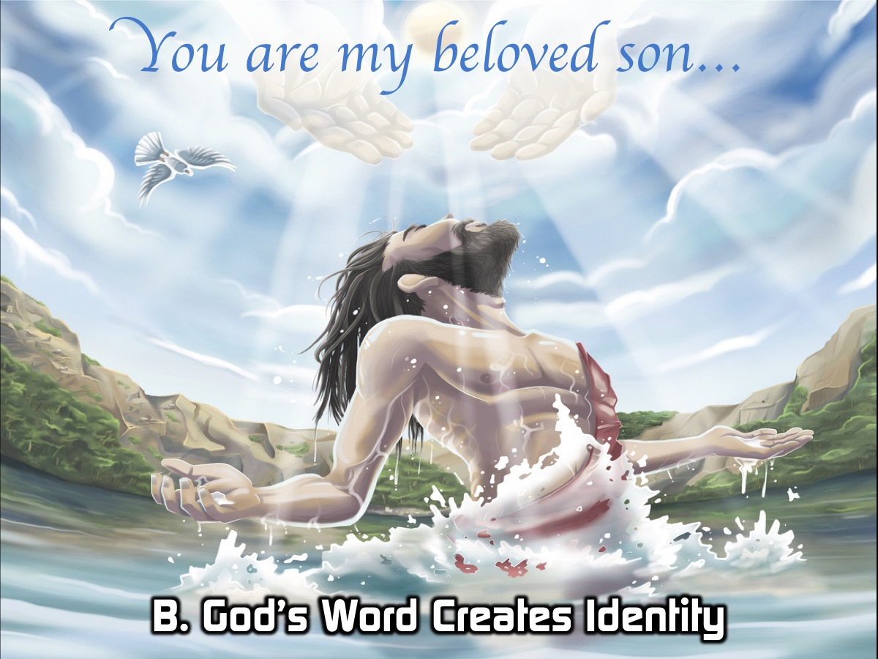
Notes:
B. God’s Word Creates Identity

Slide 25
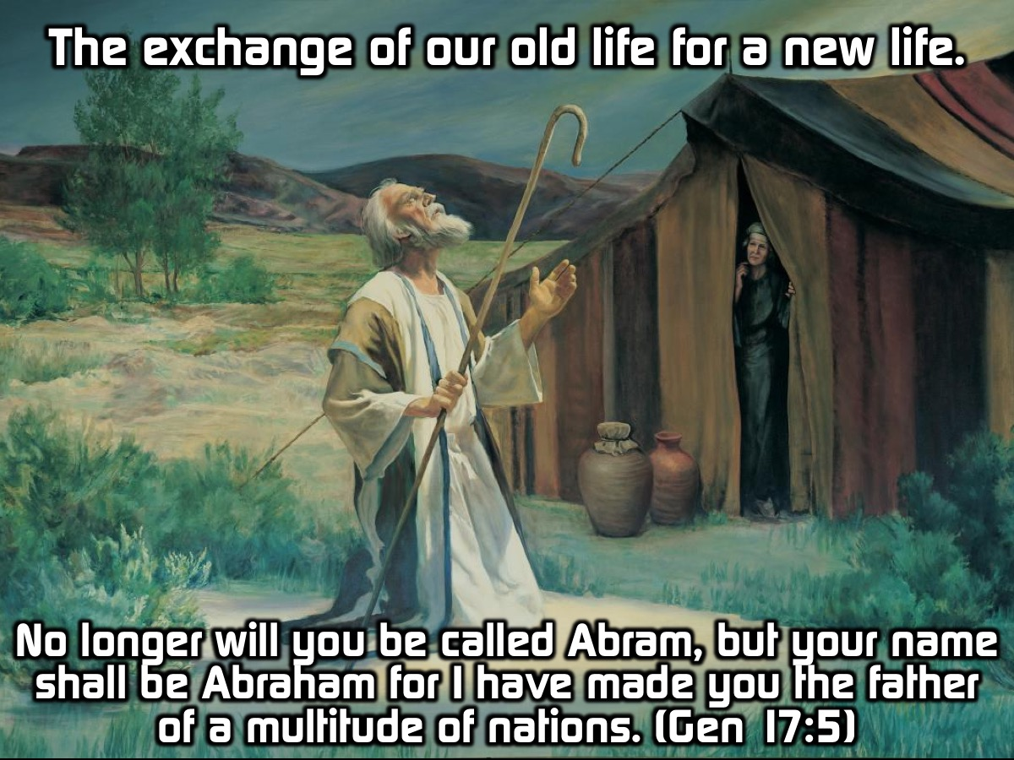
Notes:
Through the Word we experience the instantaneous exchange of our old life for a new life. “No longer will you be called Abram, but your name shall be Abraham for I have made you the father of a multitude of nations.” (Genesis 17:5)

Slide 26
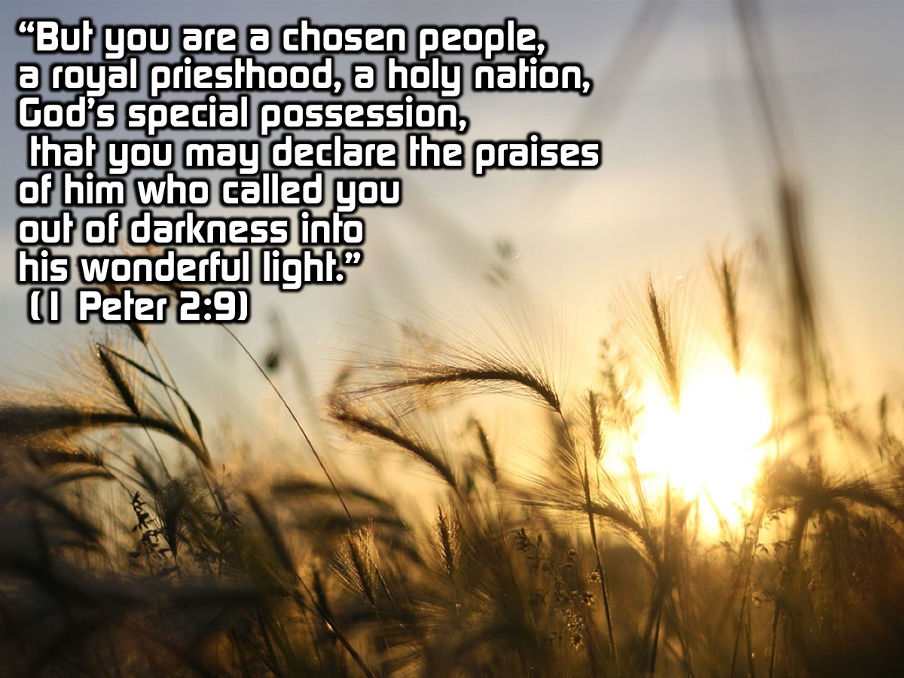
Notes:
“But you are a chosen people, a royal priesthood, a holy nation, God's special possession, that you may declare the praises of him who called you out of darkness into his wonderful light.” (1 Peter 2:9)

Slide 27
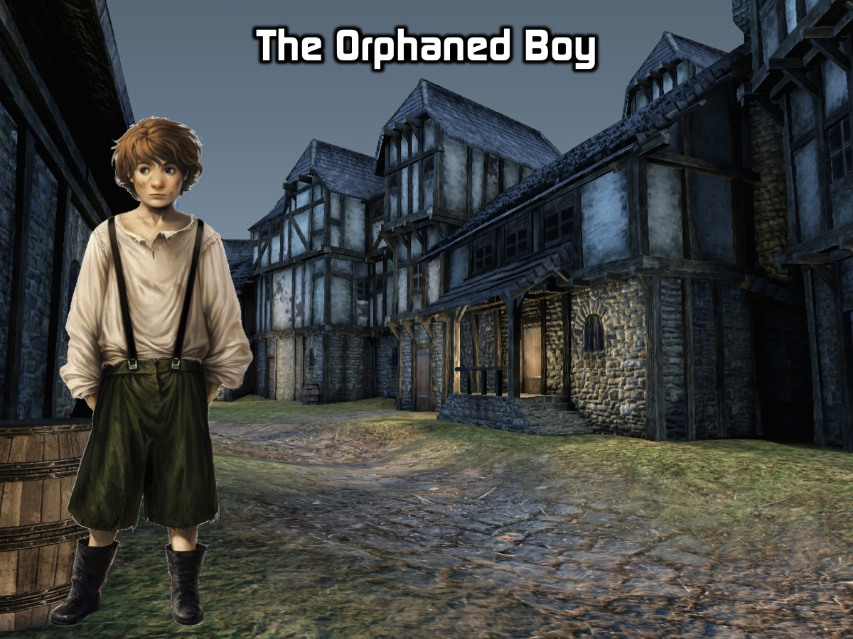
Notes:
There is a story about an orphaned boy who lived in a great city. Everyday this young boy would crawl out of his thin tattered blanket which was his only possession as the sun began to rise, he would stand up from his place on the side of the street which he called home and go off in search of food. He was thin and pale and often went for days without eating anything. When it got bad, especially in winter he would steal from people in the marketplace or creep into people’s homes to steal and sell whatever he could find. He was dirty, and he had never taken a bath in his entire life. He didn’t have a single friend. He didn’t even have a name.

Slide 28
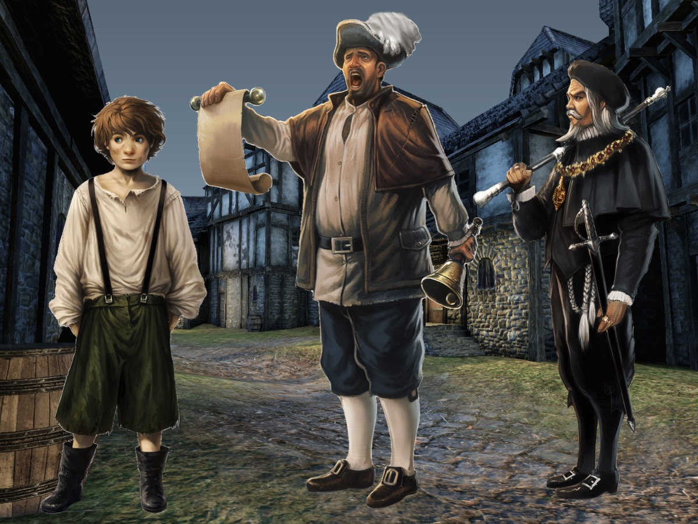
Notes:
One day he was caught for stealing from a wealthy merchant in the city and in accordance with the law he was sentenced to be put to death. The executioner came forward and was about to kill him…

Slide 29
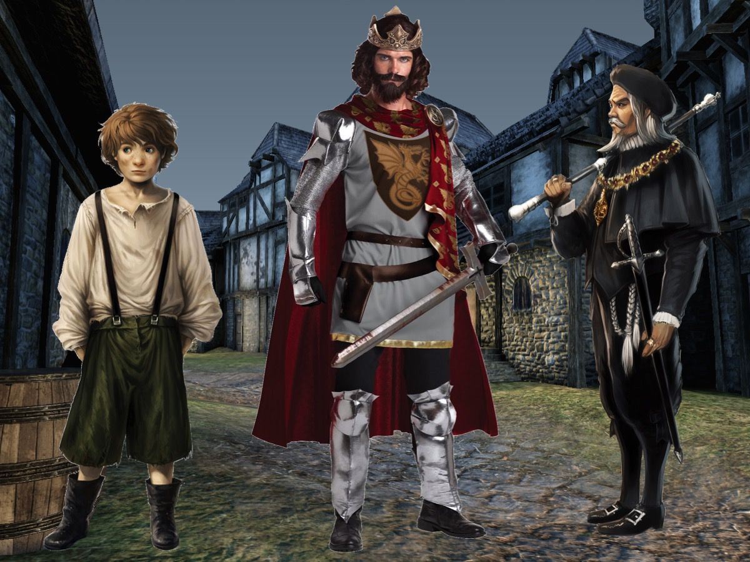
Notes:
…when the King suddenly stepped into the scene. He declared that the orphan boy with no name was his own son and that no harm should come to him. And with those few words the boy was set free and was suddenly a prince with the kings own name.

Slide 30
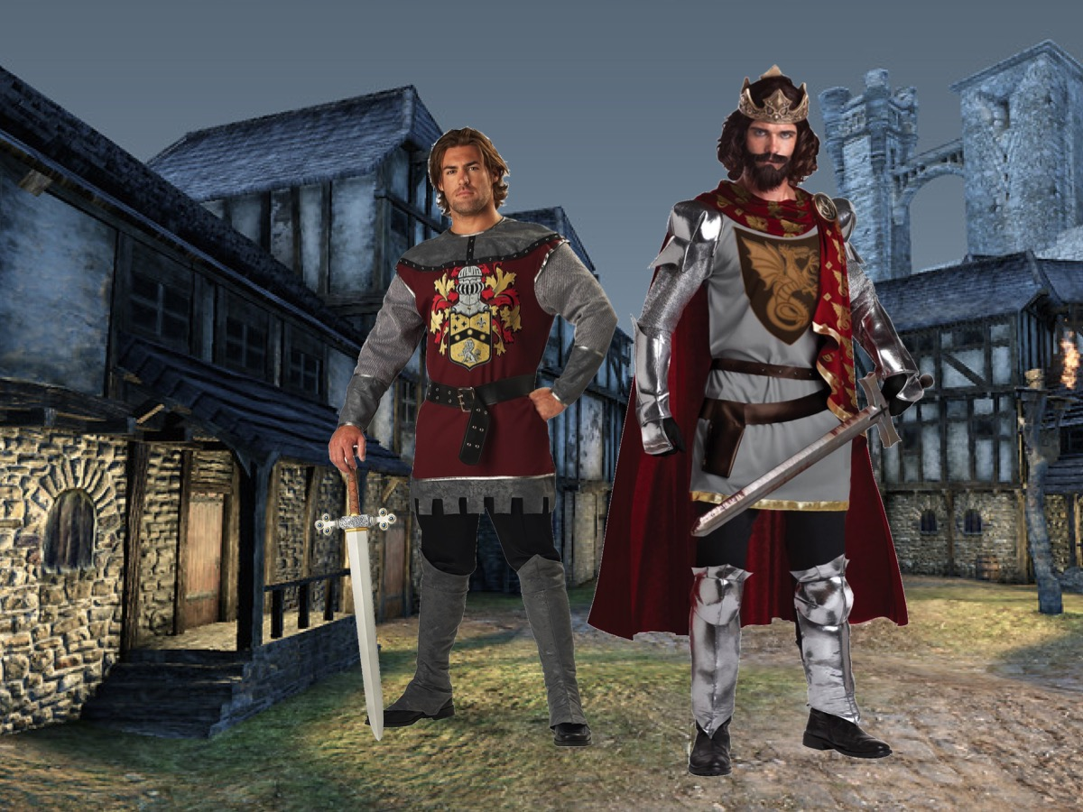
Notes:
The boy never had to beg or steal again, never had to go hungry or suffer in winter as he slept outside. The King changed the boy’s life and did all of this with a few words.

Slide 31
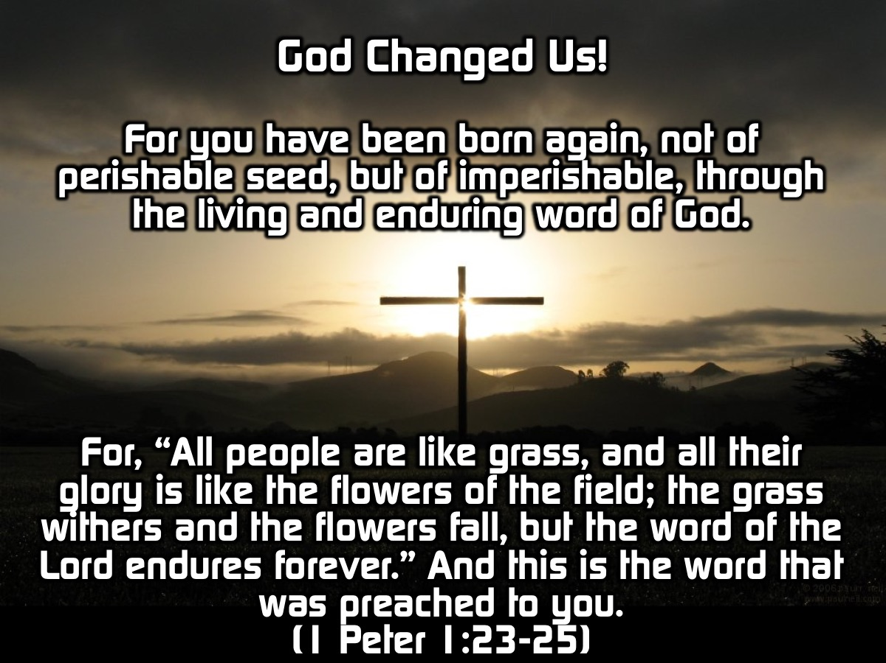
Notes:
In the same way God calls us by a new name, he redeems us and makes us a new person, and we are adopted into his family. When we accept this invitation to be a part of God’s family our lives are changed. It means that we no longer live in our old ways, situations and habits but rather those that God shows us. For you have been born again, not of perishable seed, but of imperishable, through the living and enduring word of God. For, “All people are like grass, and all their glory is like the flowers of the field; the grass withers and the flowers fall, but the word of the Lord endures forever.” And this is the word that was preached to you. (1 Peter 1:22-25)

Slide 32
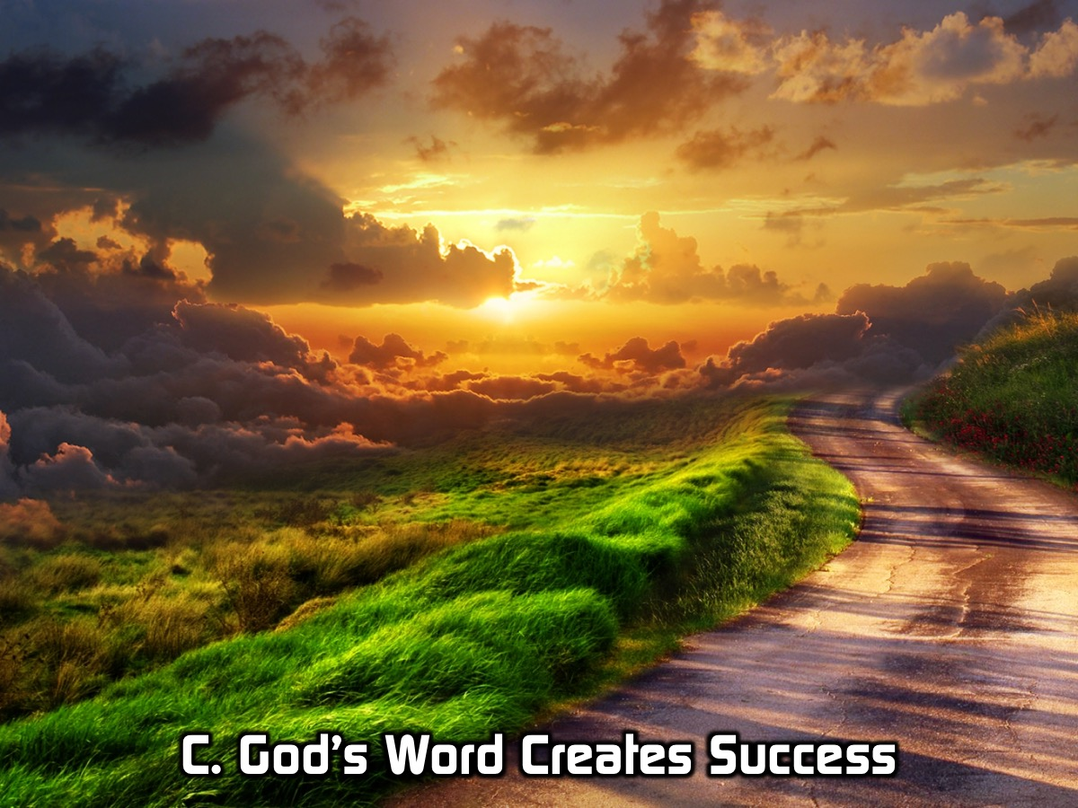
Notes:
C. God’s Word Creates Success

Slide 33

Notes:
Have you ever felt discouraged or let down because your friend promised something and they didn’t follow through with it? Or you had great plans and spoke about them but they never happened?

Slide 34
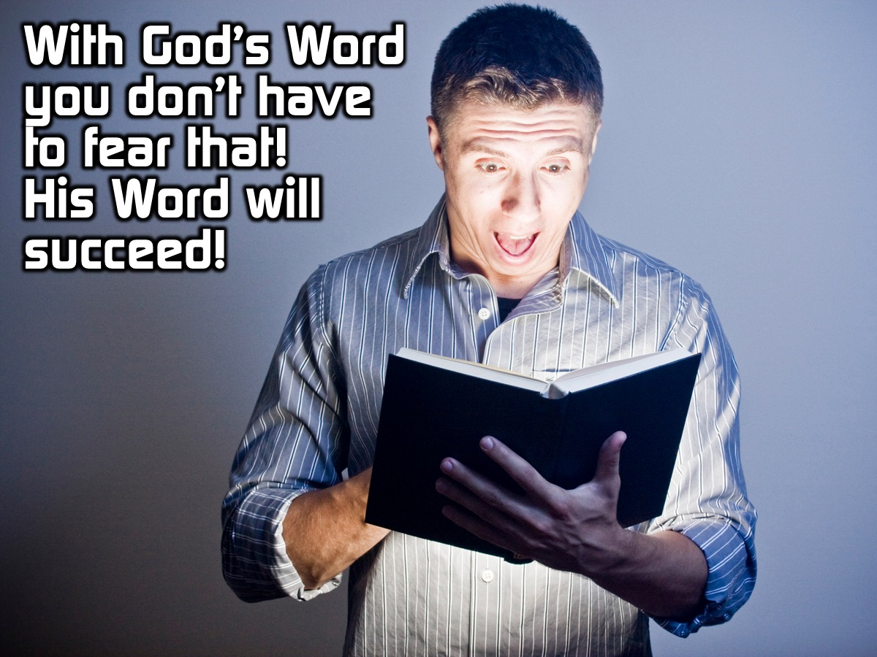
Notes:
When it comes to God’s Word we don’t have to fear that. He says that his word shall succeed:

Slide 35
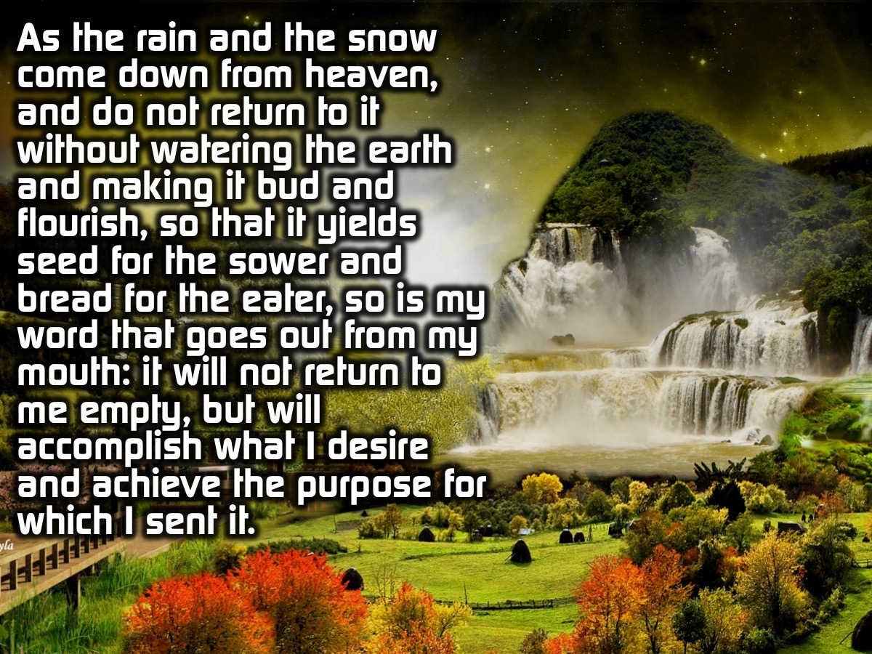
Notes:
As the rain and the snow come down from heaven, and do not return to it without watering the earth and making it bud and flourish, so that it yields seed for the sower and bread for the eater, so is my word that goes out from my mouth: it will not return to me empty, but will accomplish what I desire and achieve the purpose for which I sent it.

Slide 36
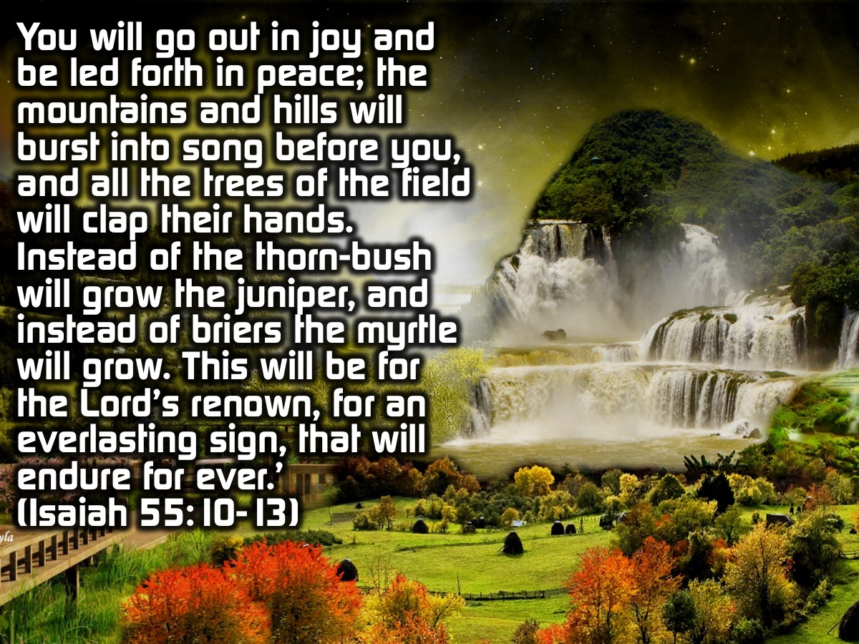
Notes:
…You will go out in joy and be led forth in peace; the mountains and hills will burst into song before you, and all the trees of the field will clap their hands. Instead of the thorn-bush will grow the juniper, and instead of briers the myrtle will grow. This will be for the Lord’s renown, for an everlasting sign, that will endure for ever.’ (Isaiah 55:10-13)

Slide 37
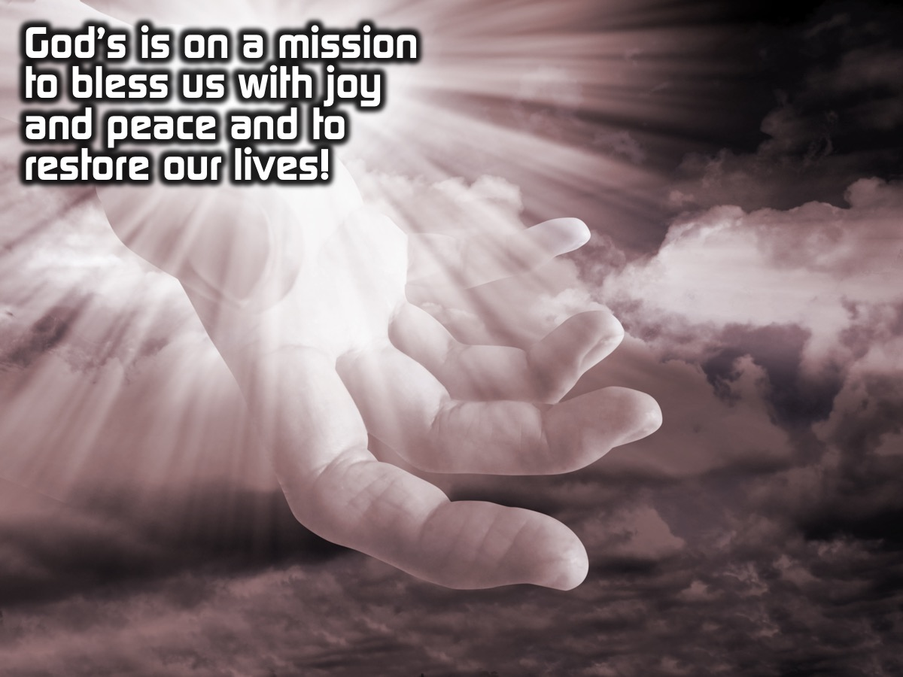
Notes:
It doesn’t depend on what man does but what God does. God is on a mission and he will succeed, for those of us who respond to his word which has gone out to us we will have His blessing (See verses 12 and 13) This is a blessing of Joy, Peace and Restoration of life before the fall of man.

Slide 38
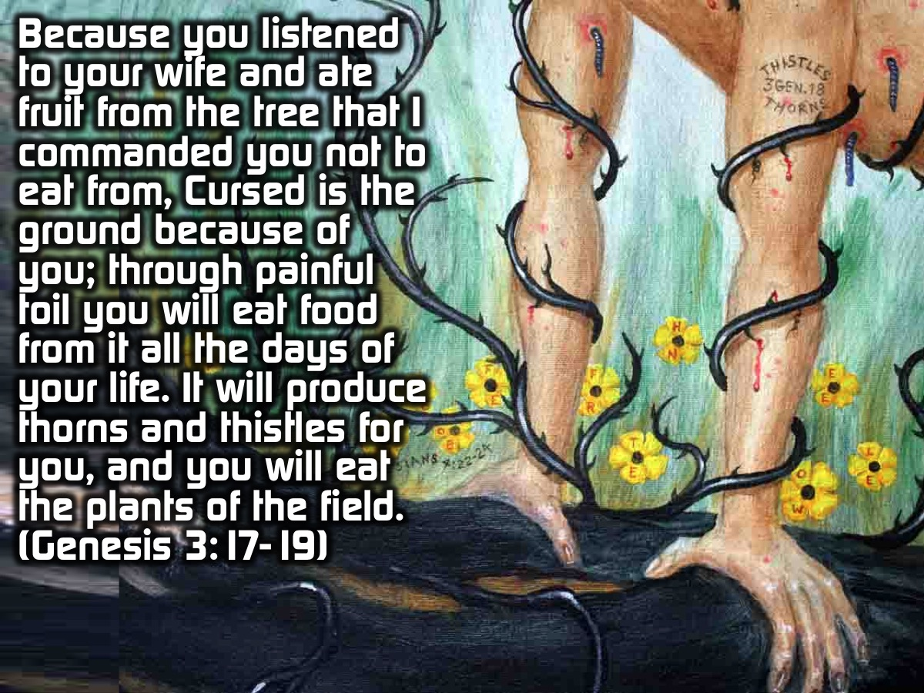
Notes:
Do you remember what God said to Adam after he had sinned in the Garden of Eden: “Because you listened to your wife and ate fruit from the tree that I commanded you not to eat from, Cursed is the ground because of you; through painful toil you will eat food from it all the days of your life. It will produce thorns and thistles for you, and you will eat the plants of the field. (Genesis 3:17-19)

Slide 39
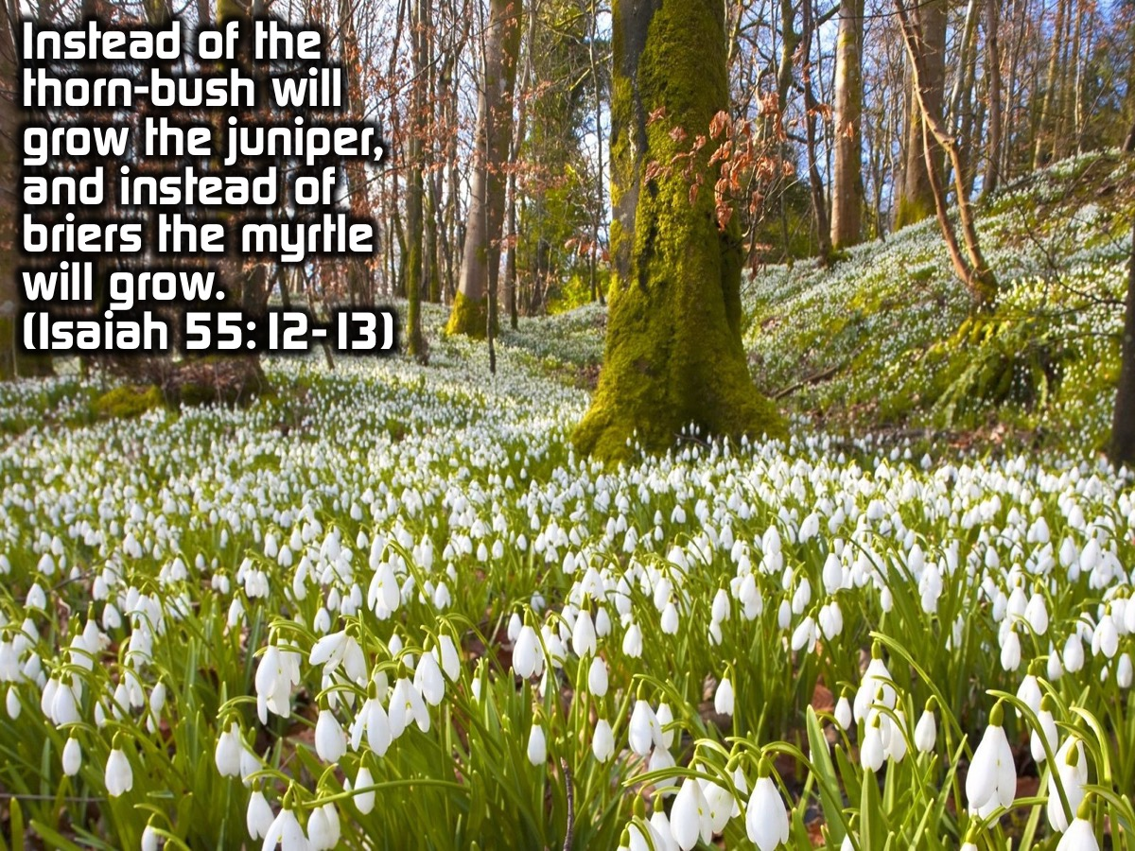
Notes:
Now God says: “Instead of the thorn-bush will grow the juniper, and instead of briers the myrtle will grow.” (Isaiah 55:12-13)

Slide 40
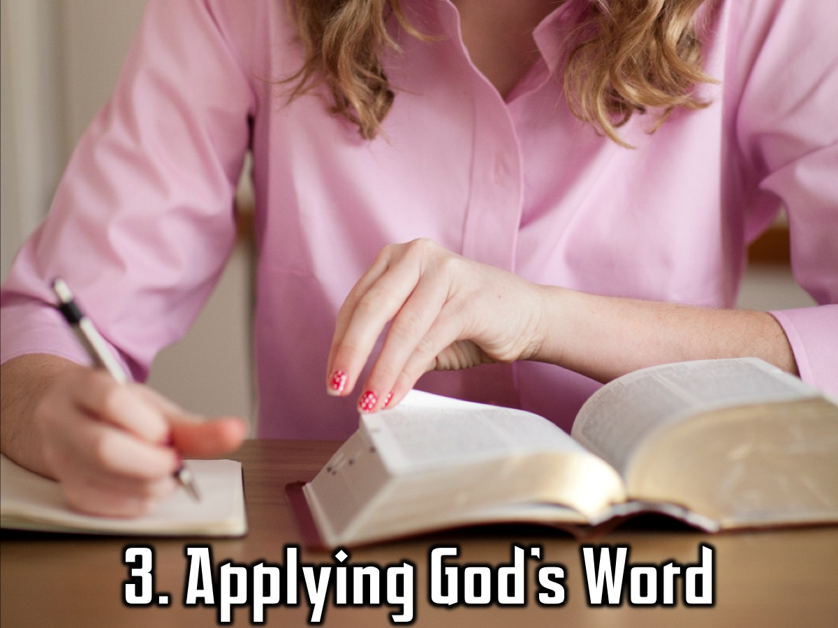
Notes:
Stage 3: Applying God’s Word

Slide 41
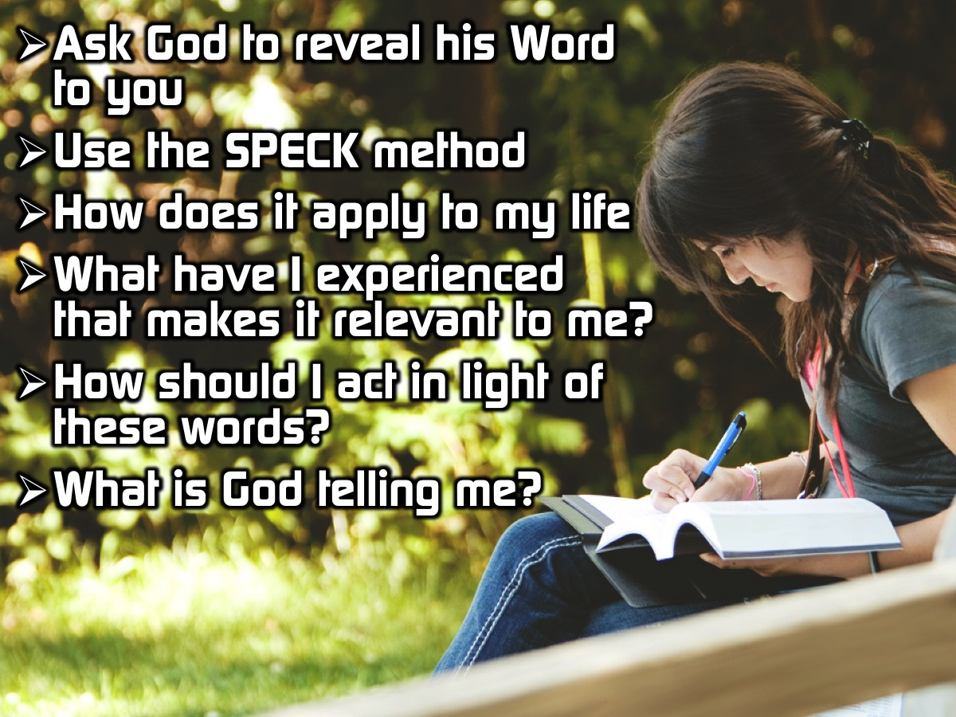
Notes:
When reading the Bible it is important to pray and ask God to reveal his word to you, often we feel that God is not telling us anything but we need to ask and believe! Then start by (Using SPECK) asking how does this apply to my own life? What have I experienced recently that makes this scripture relevant? How should I act on a day to day basis in light of these words? What is God trying to tell me?

Slide 42
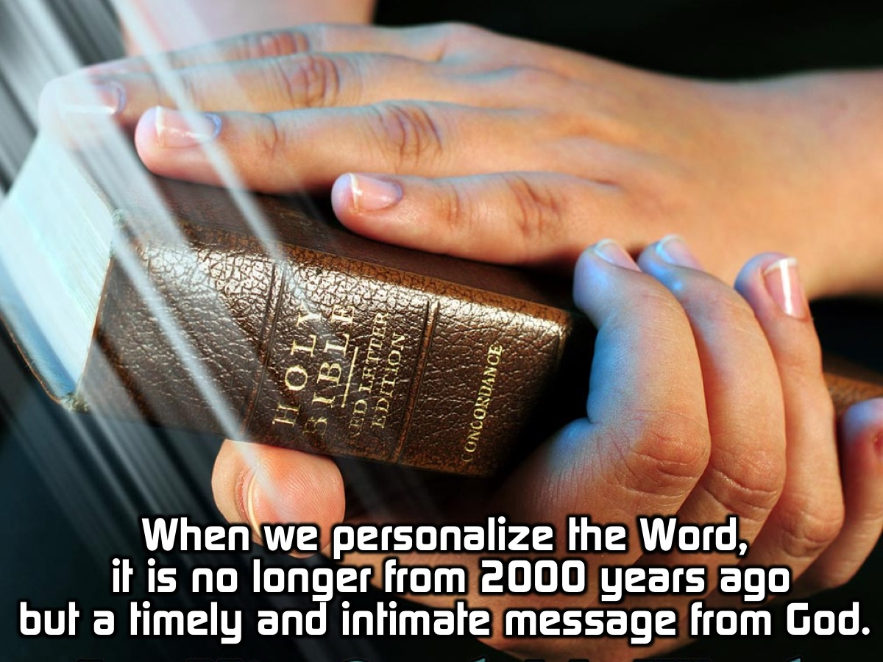
Notes:
When we personalize the Word, it is no longer something from 2000 years ago but a timely and intimate message from God to you.

Slide 43
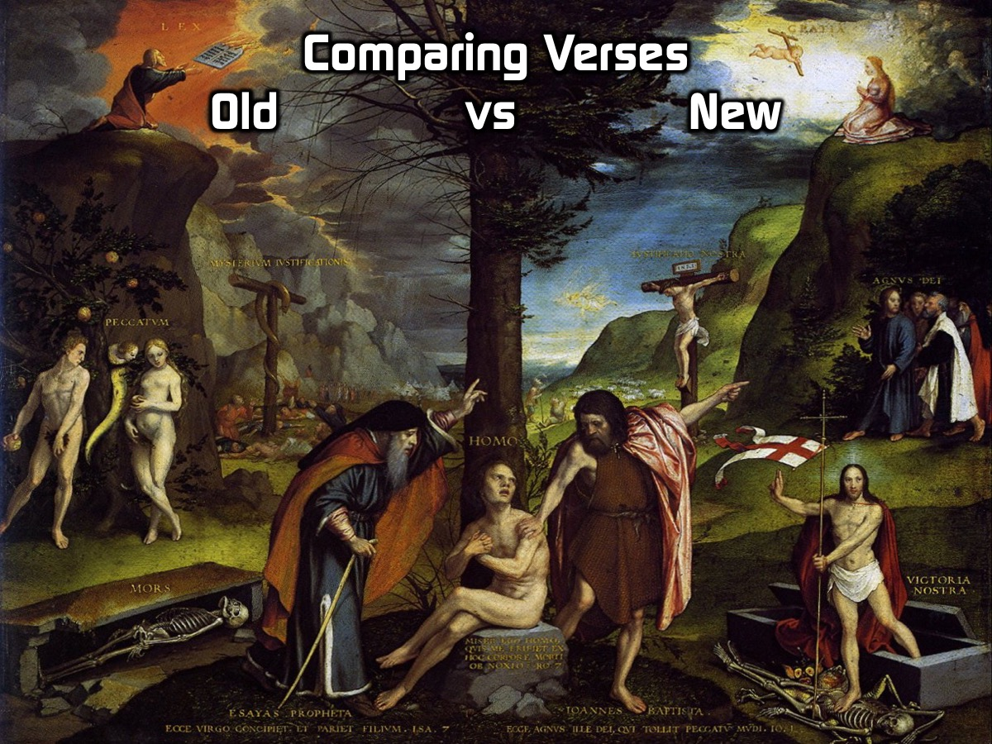
Notes:
Comparing verses in the Bible even across the new and old testament gives context and unifies God’s word showing us how to act on it.

Slide 44
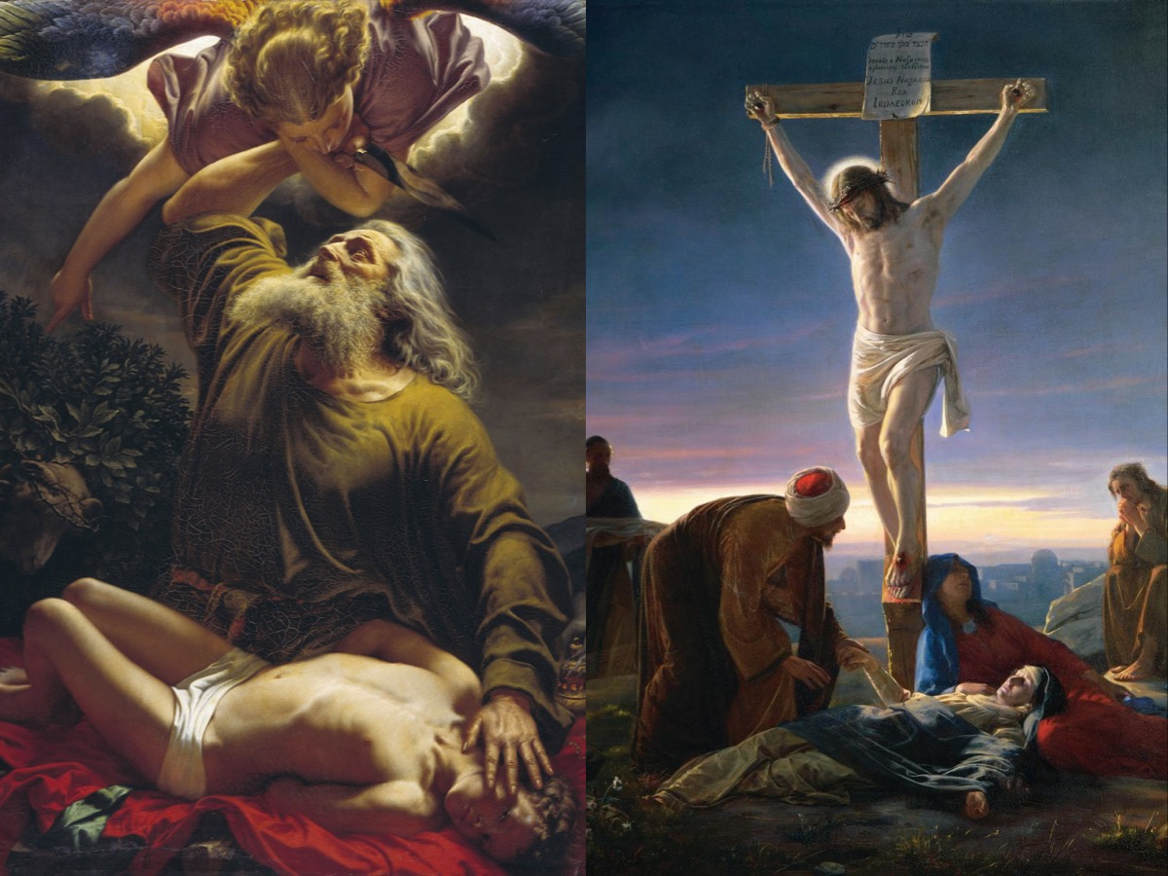
Notes:
When God told Abraham to sacrifice his son Isaac it was a foreshadowing of Jesus – God’s son, being sacrificed. In the same way that Jesus is the sacrifice for our sins that rose from the dead…

Slide 45
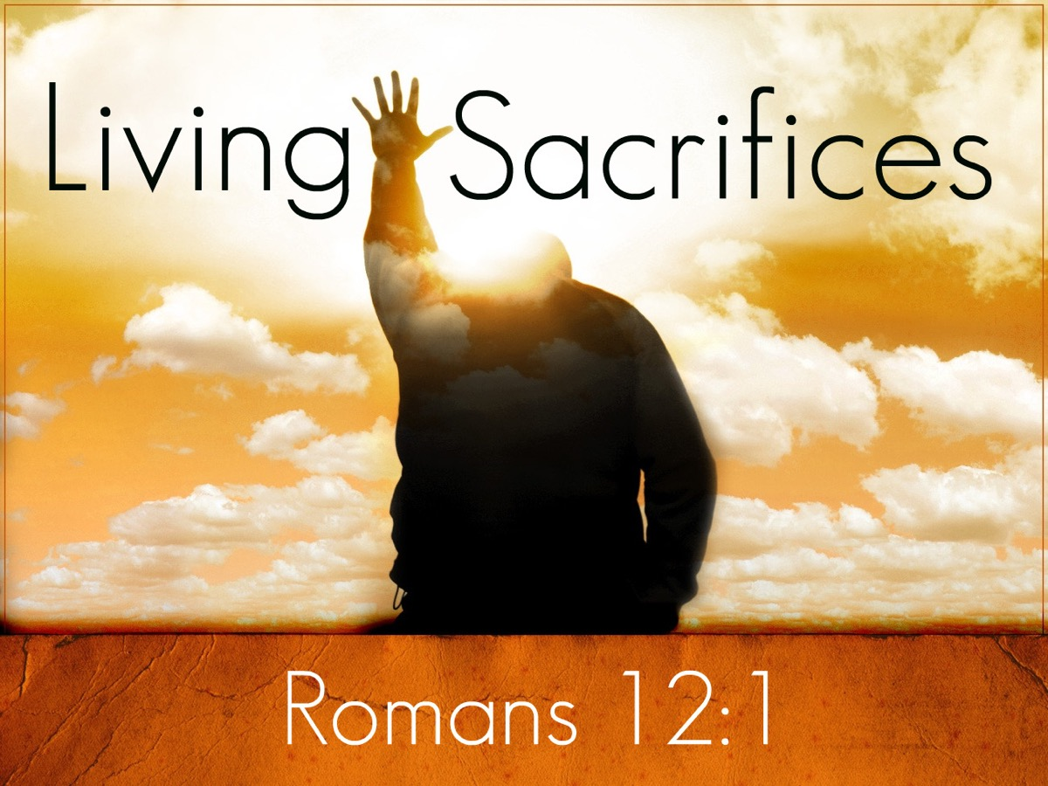
Notes:
…we too must be living sacrifices who daily push aside our own desires in order to do God’s will.

Slide 46
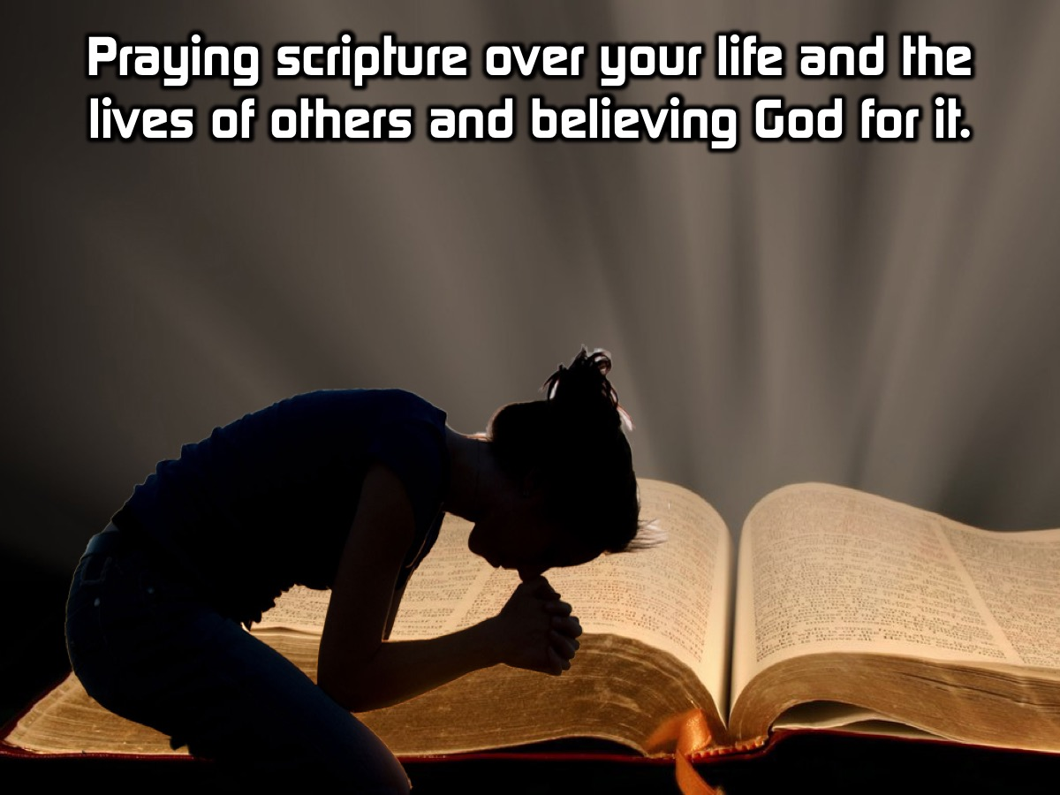
Notes:
Praying scripture that you read over your own life and the lives of others and believing God for it.

Slide 47
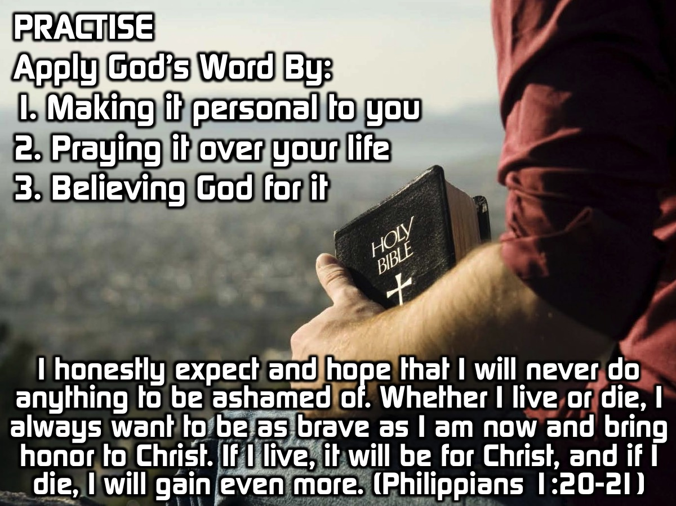
Notes:
Practise: Use the following verses to practice applying God’s Word by: (1) Making the verse personal to you, (2) Praying it over your life and (3) Believing God for it:
I honestly expect and hope that I will never do anything to be ashamed of. Whether I live or die, I always want to be as brave as I am now and bring honor to Christ. If I live, it will be for Christ, and if I die, I will gain even more. (Philippians 1:20-21 CEV)

Slide 48
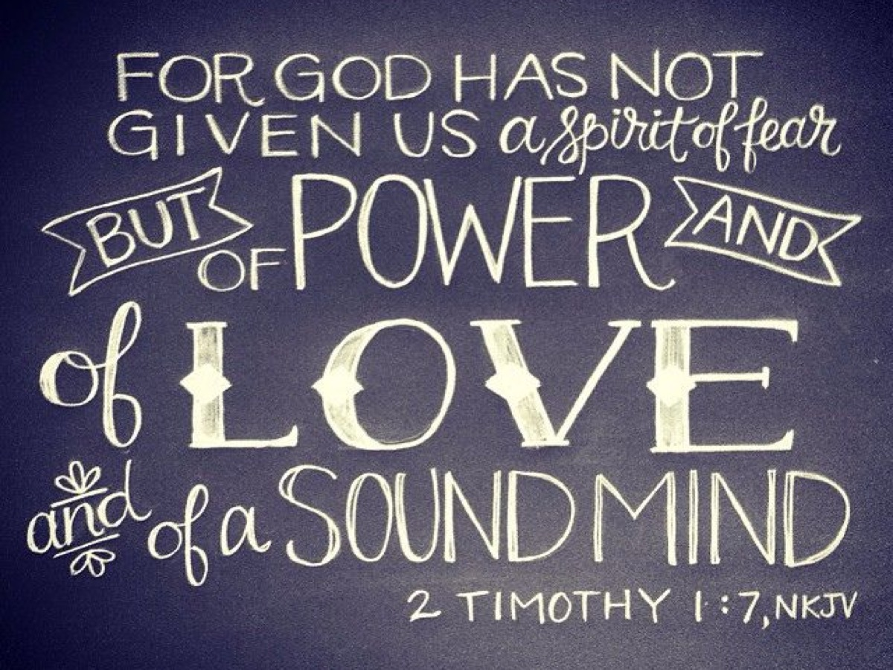
Notes:
Illustration: Testimony of being afraid of going upstairs in our new house when James and I were small. Our parents stuck 2 Timothy 1:7 on our doors to read every time we went upstairs.
For God gave us a spirit not of fear but of power and love and self-control. (2 Timothy 1:7)
Every time that I was afraid I repeated that verse. I read it over and over until I memorized it. I understood that what it said was true and took comfort in that. Then I applied God’s word by acting as if I was not afraid until it became a reality. I have shared this with my friends who have needed this Word from God and I am telling you guys about it now.

Slide 49
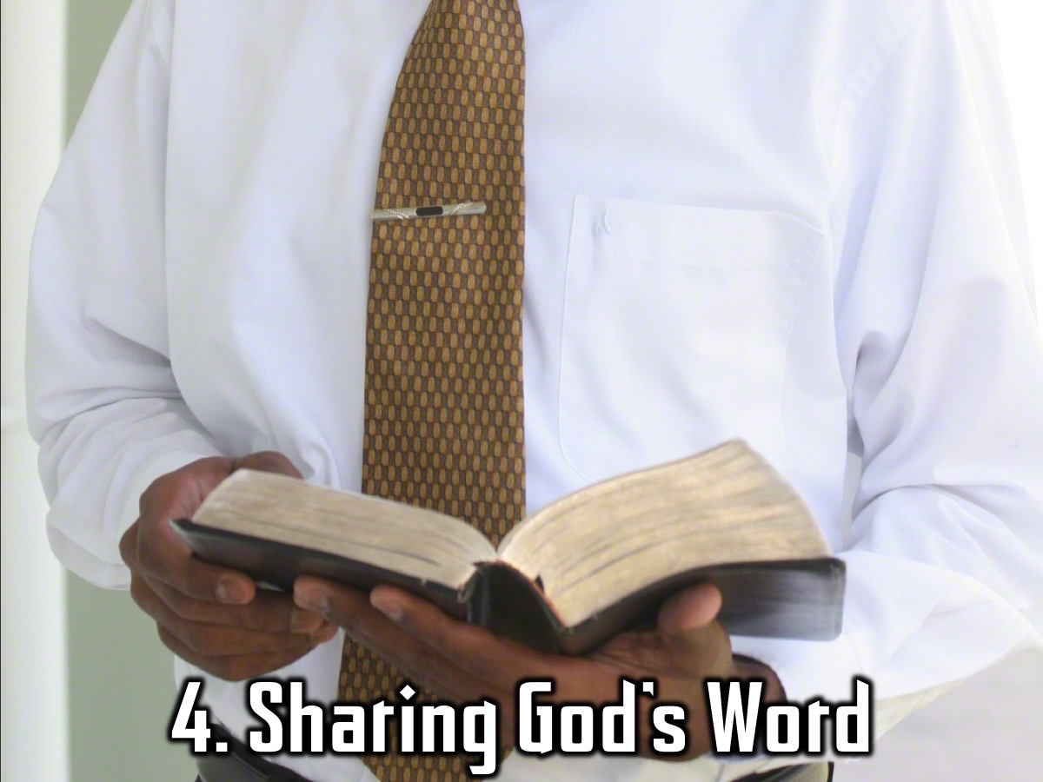
Notes:
Stage 4: Sharing God’s Word

Slide 50
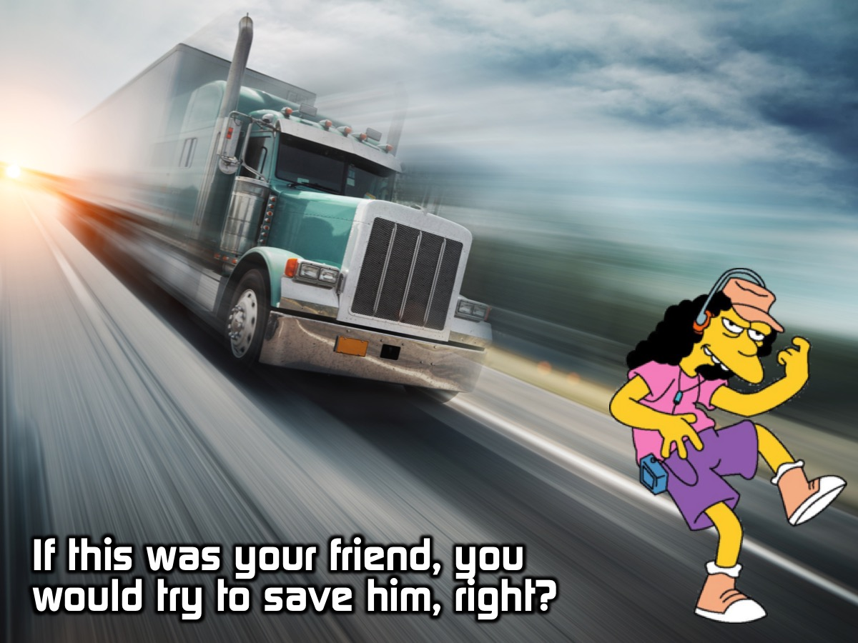
Notes:
If your friend was standing in the middle of a road with a truck bearing down on them you would save them, right?

Slide 51
Notes:
Video: The Drowning Friend

Slide 52
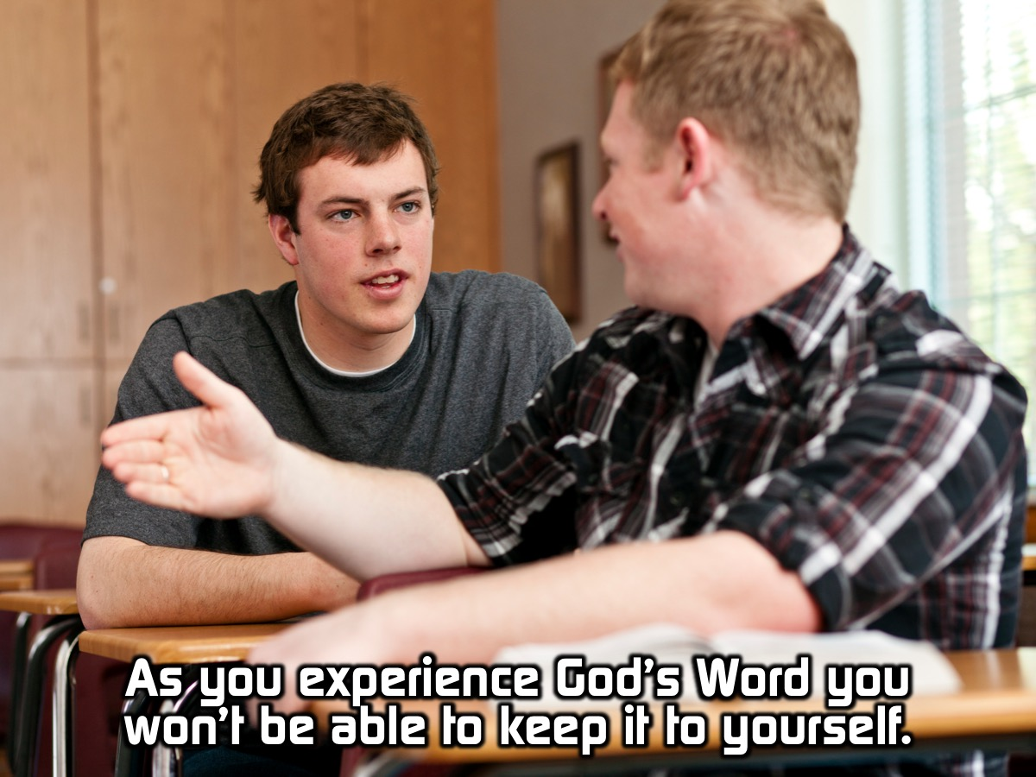
Notes:
As you seek God’s word and discover how amazing it is for yourself you will not be able to keep it to yourself.

Slide 53
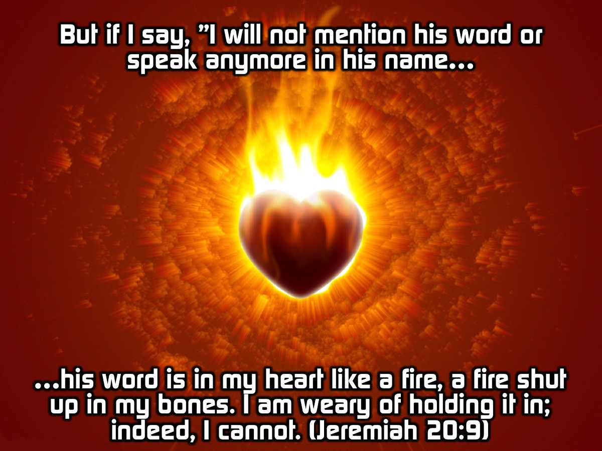
Notes:
But if I say, "I will not mention his word or speak anymore in his name," his word is in my heart like a fire, a fire shut up in my bones. I am weary of holding it in; indeed, I cannot.” (Jeremiah 20:9)

Slide 54
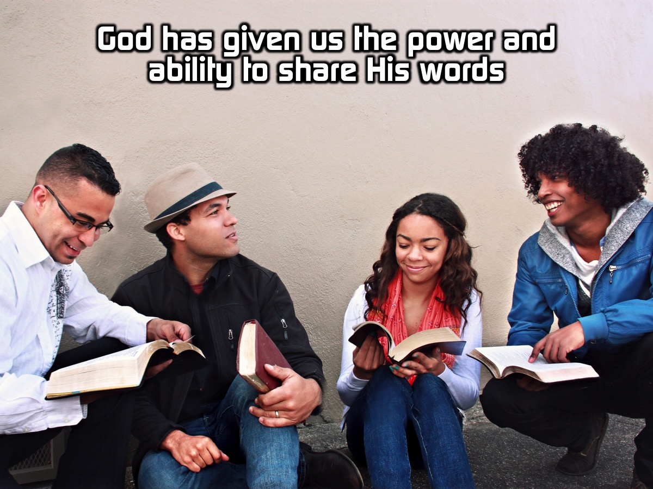
Notes:
God has given us the power and ability to share His words. Importance of our words, life and death, tongue is a small rudder that drives a great ship. Let us not waste our breath but glorify God.

Slide 55

Notes:
The tongue is like a small rudder that drives a great ship. Let us not waste our breath but glorify God.

Slide 56

Notes:
Do not let any unwholesome talk come out of your mouths, but only what is helpful for building others up according to their needs, that it may benefit those who listen. (Ephesians 4:29)

Slide 57

file:///.file/id=6571367.30243004
file:///.file/id=6571367.30243004
Notes:
We are not made to be Lone Rangers.

Slide 58

Notes:
The more we meet together and share what God has said to us the more we will be amazed by God’s word.

Slide 59

Notes:
Illustration: Times when James got revelations but I didn’t and felt jealous or useless but now actually value and have benefitted from what I learnt because ultimately it is not about me but about God and his Word.

Slide 60

Notes:
Wrap up: Today we learnt that God’s Word will transform our lives and our society as we: (1) Read It. (2) Understand It. (3) Apply It. (4) Share It.

Slide 61

Notes:
Prayer

Slide 62

Notes:
Next week will start the second part of our Trilogy Series exploring the presence of God.

