Slide 1
Notes:
Welcome to the Trilogy Series.

Slide 2
Notes:
Who can recite our vision statement from memory? I have some chocolates to give to those who can do it.

Slide 3
Notes:
Here is our mission statement - let's say it together: We see lives, communities and society transformed through discipleship in the Word, the presence and the power of God.

Slide 4
Notes:
Let’s take a look back at the last two weeks in this series…

Slide 5
Notes:
We looked at what the Bible have to say about God’s Presence? We learnt from the Old Testament that God’s Presence was found in Creation, in God’s Name, in Specific Places (like the tabernacle, Jerusalem and the Temple), and it is Everywhere and especially with us when we go through Tough Times.

Slide 6
Notes:
From the New Testament we learnt that God’s Presence was found in Jesus, in individuals believers, in the church (or when we gather to worship) and in eternity.

Slide 7
Notes:
Last week we learnt how to create reminders so we remember that God is with us.

Slide 8
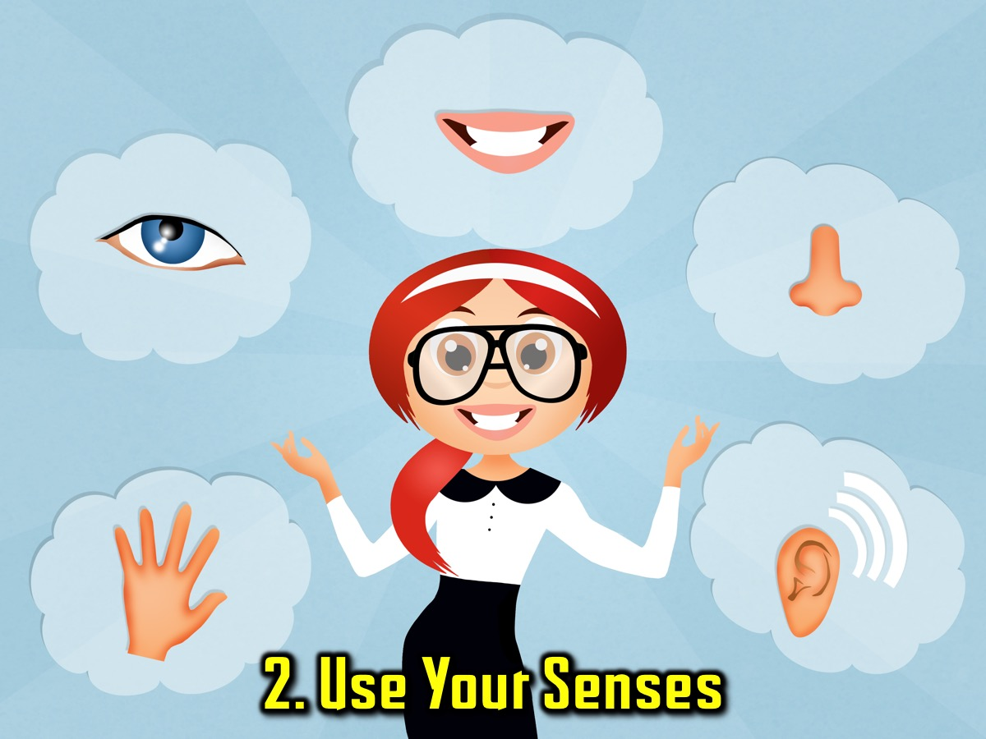
Notes:
And we learnt how to use our senses to they turn our attention towards God.

Slide 9
Notes:
Today we are looking at experincing the presence of God in worship. We are going to look at the 3 elements of this topic today: (1) What is worship. (2) God’s presence. (3) Practical things that can help us experience God’s presence.

Slide 10
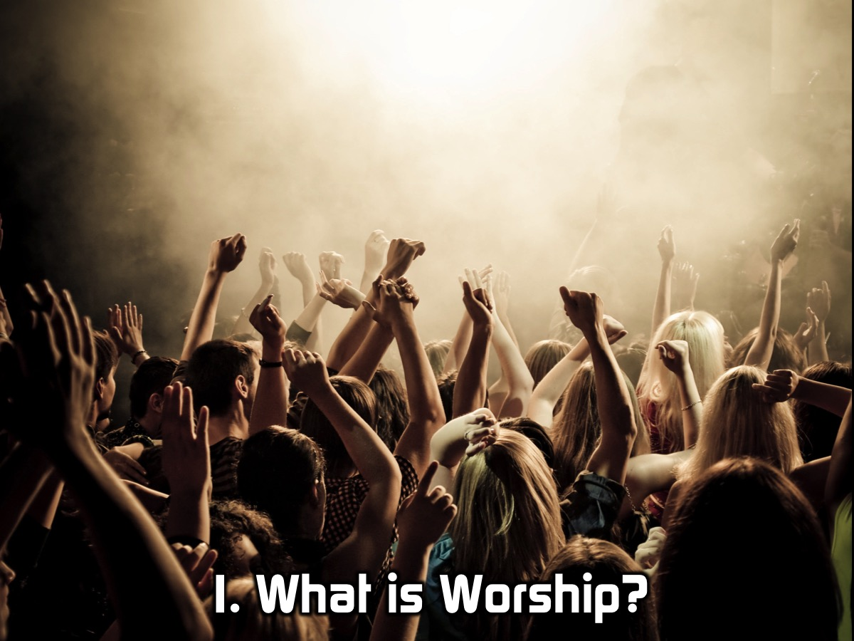
Notes:
1. What is worship?

Slide 11
Notes:
Share: Turn to the person next to you and ask them this question: What do you think worship is?

Slide 12
Notes:
Worship is becoming aware of God’s presence and responding to His presence with verbal or active expressions of love and devotion.

Slide 13
Notes:
(1) We become AWARE of God’s presence – “Reminders” from last week. (2) We RESPOND to His presence.

Slide 14
Notes:
What are different ways to express love and devotion to God?

Slide 15
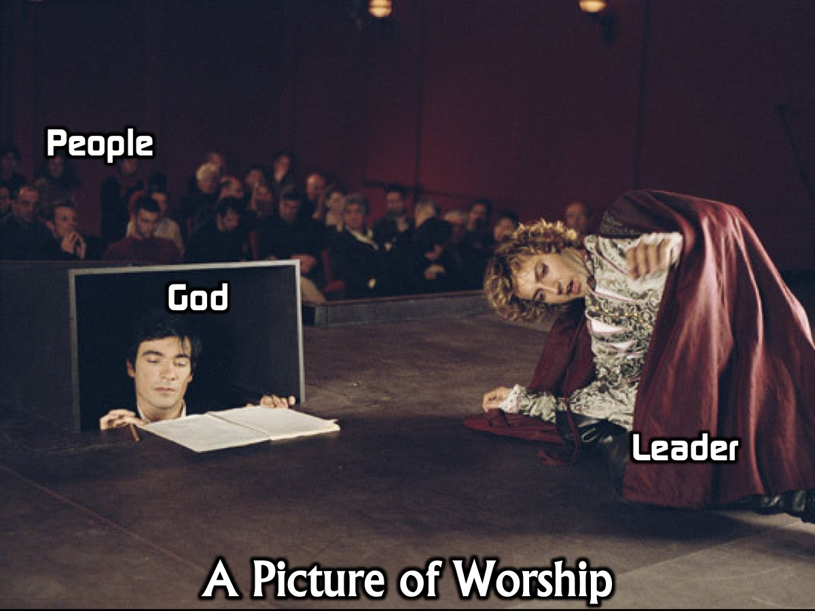
Notes:
Danish philosopher Kiekegaard’s picture of Worship. The Danish philosopher, Kiekegaard, compared worship to a dramatic production. In worship, it often seems as though the worship leader is the actor and God is the prompter, whispering in his ear, telling him what to do next. The congregation listens and, at the end, they applaud if they like the way he's led worship, or throw things, ie. grumble or complain if they don't.

Slide 16
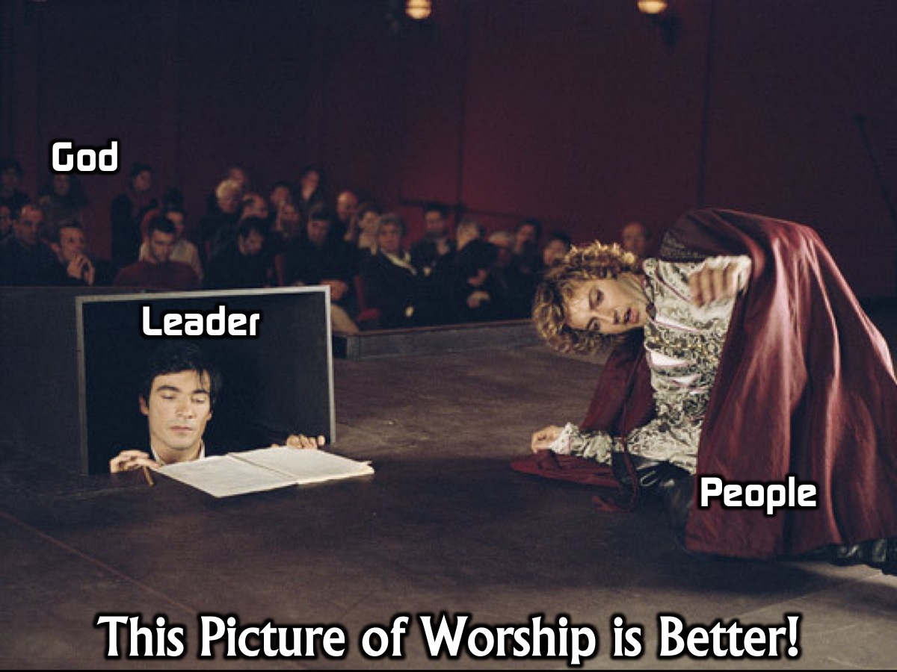
Notes:
But Kiekegaard said that's all back to front. For in reality, God is the audience, the congregation are the actors and the person leading worship is the prompter, simply keeping the production going. So when we come together to worship, we come wanting to please God alone, offering to him the very best.

Slide 17
Notes:
Maybe in worship all of us should get onto the stage…

Slide 18
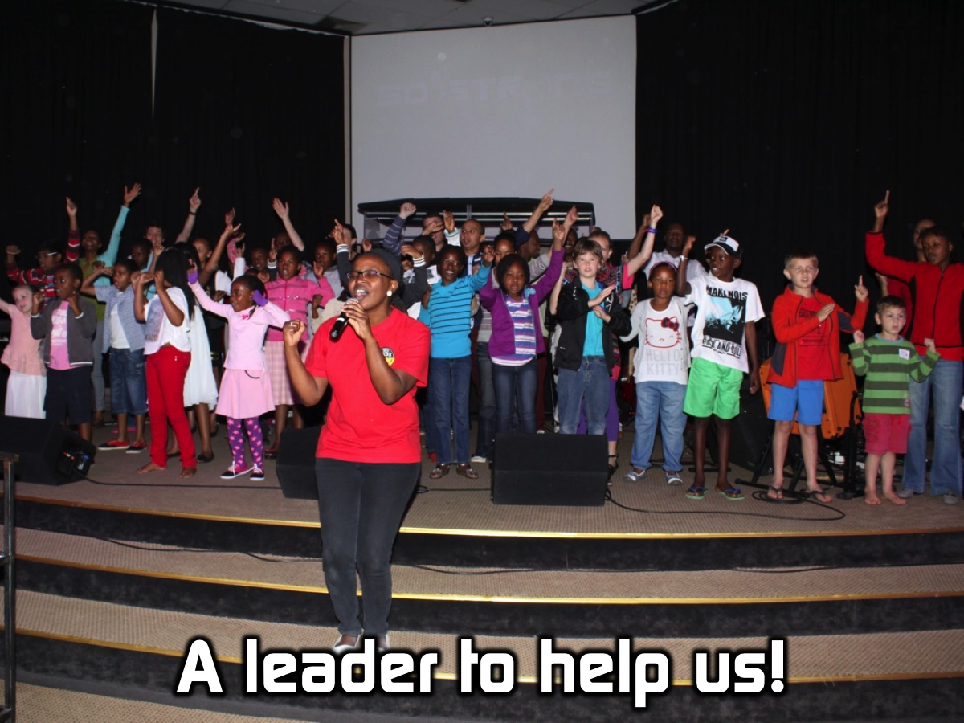
Notes:
The worship leader can help us along the way - but we are the performers…

Slide 19
Notes:
And in the audience - no one by God!

Slide 20
Notes:
Worship is all about the audience of one!

Slide 21
Notes:
2. What is God’s manifest Presence?

Slide 22
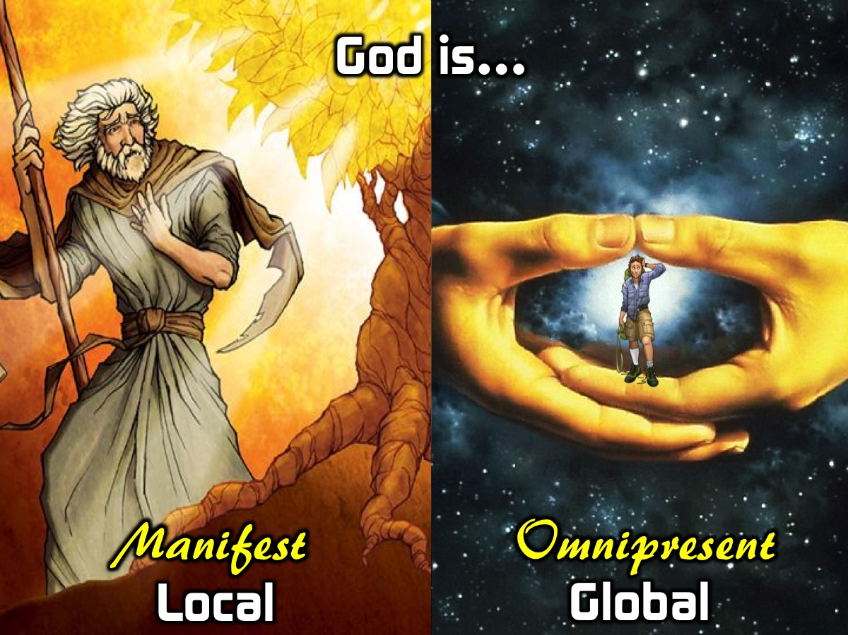
Notes:
We learnt two weeks ago that God is everywhere present all the time (like David describes in Psalm 139) but we also have experiences where we sense or feel God’s presence and know that he is with us experientially. Just like Moses the experience that Moses had at the burning bush or like we have in an amazing worship service. (Note: If you want to read more about God’s manifest presence check out this link: http://www.gotquestions.org/manifest-presence.html)

Slide 23
Notes:
Who has ever experienced God’s manifest presence during worship or during a Sunday morning service?

Slide 24
Notes:
Why should we care about experiencing God’s presence? What happens in God’s presence?

Slide 25
Notes:
We were made to be in God’s presence in relationship with Him – we come alive!

Slide 26
Notes:
We are changed in the presence of God:
* God reveals who He is in our lives
* We see things from His perspective - He shows us how he sees us and situations
* We are encouraged and strengthened
* We experience God’s Power

Slide 27
Notes:
3. What can I do to experience God’s presence during Sunday morning Worship?

Slide 28
Notes:
1. Prepare: You are coming to meet with God together with other believers so take some time out early that morning to mentally and spiritually prepare to experience God. Read bible, Pray, Worship music, acknowledge God

Slide 29
Notes:
2. Focus. As you enter the service you will need to make a conscious effort to enter into worship. The Psalmist often spoke to himself to encourage himself to worship God: “Why, my soul, are you downcast? (Feeling Depressed? Sunday Blues?). Why so disturbed within me? Put your hope in God, for I will yet praise him, my Savior and my God.” (Psalm 42:5) See also: Psalm 103:1-2; 116:7; 146:1-2. Then acknowledge who God is: Praise the Lord, my soul. Lord my God, you are very great; you are clothed with splendor and majesty. (Psalm 104:1)

Slide 30
Notes:
Then acknowledge who God is: Praise the Lord, my soul. Lord my God, you are very great; you are clothed with splendor and majesty. (Psalm 104:1)

Slide 31
Notes:
3. Deal with Sin. Confess sins and choose to turn back to God else you will spend the whole time feeling guilty and ashamed. Start thanking and praising God for his forgiveness and mercy.

Slide 32
Notes:
4. Eliminate Distractions. There are many things around you that can easily distract you from experiencing God’s presence during worship: Other people; Friends; Phone; Band/Music. Keep pulling yourself back to worship when you feel your mind is wandering.

Slide 33
Notes:
5. Enter In. Turn things said by the worship leader or the words of songs into prayers that you can speak to God. What do I do when the worship leader starts singing words that are not on the screen? Don’t just sing mindlessly – Turn words into prayers to God.

Slide 34
Notes:
6. Picture. Use your mind to create mental images to help you worship God. You can practise it by closing your eyes and seeing what image is created in your mind when you hear phrases like this: God is Great, Mighty, Exalted, Holy, “I love you Lord”.

Slide 35
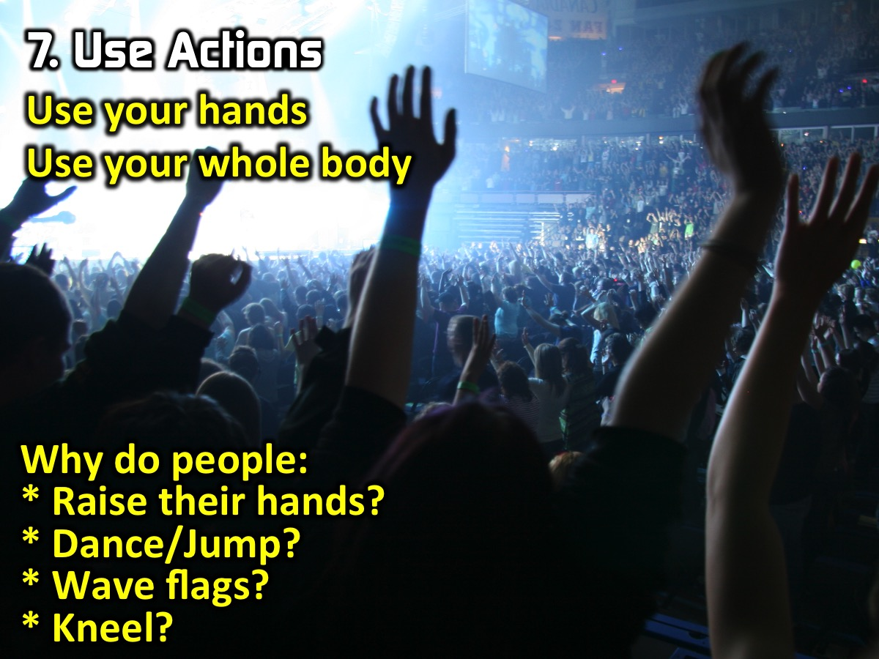
Notes:
7. Use Actions. Using your hands or your whole body can be really helpful to you experiencing God. You could raise your hands, dance or jump, wave flags, kneel, etc.

Slide 36
Notes:
Challenge: Next week when we gather to worship we are going to practise what we have learnt this morning – there will be cue cards flashed during the time of worship in the sanctuary to prompt us to really experience God in worship.

Slide 37
Notes:
Prayer

Slide 38
Notes:
Next Sunday we start the final part of our Trilogy series where we will be looking at the Power of God!

